Slide 1
Introduction
Dr. X. Zhang,
Fordham Univ.
1

Slide 2
What’s discrete mathematics ?
Discrete mathematics: dealing with objects that can assume only distinct, separated values
Sequence, set
Logic
Relations, functions
Counting, probability
Graphs
Useful for modeling real world objects
Especially useful for computer problem solving
2

Slide 3
Discrete mathematics is concrete, i.e., very practical …
3

Slide 4
We start with set …
Set is everywhere …
the group of all students in our class is a set
the group of all freshmen in our class is a set
Some set are subset of another set
Some sets are disjoint, i.e., have no common elements
e.g., the set of freshmen and the set of sophomore
Operations on sets makes sense too
union, intersection, complement, …
4

Slide 5
With set, we define relations
Among the set of all students in our class, some pairs are special …
The pairs have same birthday
The pairs are from same states
The first is older than the second
All are binary relation defined on a set of students
5

Slide 6
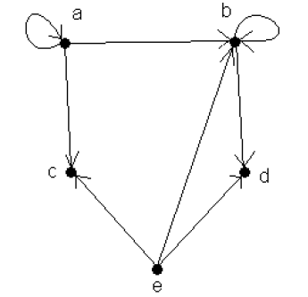
Graph representation of relations
6

Slide 7
Graph is a way to visualize relations
A graph for “having same birthday” relation among class members
An airline graph represents “having direct flight” relation
A network graph connects two nodes if they are connected (via a wire or a wireless radio).
…
7

Slide 8
Graph problems
Can you draw the following picture without lifting the pencil or retracing any part of the figure ?
8

Slide 9
Graph: many real world applications
Computer network: how to send data (URL request you type in browser) from your PC to a web server ?
Engineering: how to connect five cities with highway with minimum cost ?
Scheduling: how to assign classes to classrooms so that minimal # of classrooms are used?
…
9

Slide 10
Functions as a special type of relations…
Where one element in a set is related (mapped) to one and only one element in another set
“birthday of” can be viewed as a function defined on our set
Any student is mapped to the date when he/she was born
10

Slide 11
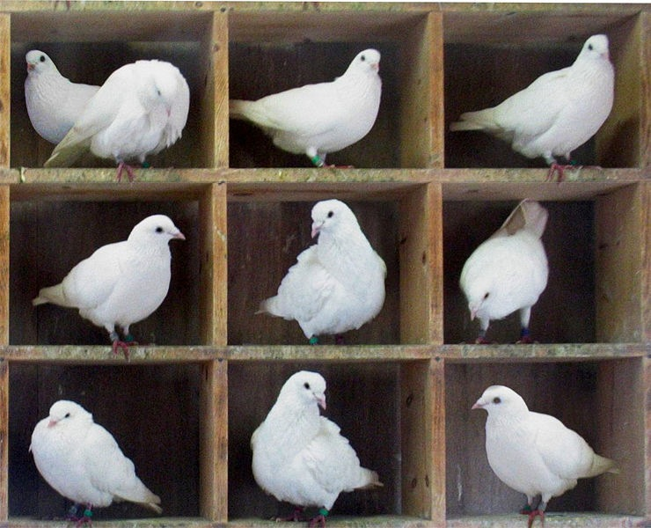
Our class: birthday remark
Some says, “there are at least two students in the class that are born in the same month (not necessarily same year).”
Do you agree ?
Pigeonhole theorem
If put n pigeons into
m holes, where n>m,
there is at least a hole
that has more than one
pigeons.
11

Slide 12
Still too obvious ?
Suppose I randomly pick some students from class, how many students do I need to pick to guarantee that there are at least two students of same gender among those I picked ?
Students: pigeons (x)
Gender: holes (2)
If x>2, then there are at least one gender that has more than one student
Note: the tricky part is
Recognize the theorem/formula that applies
Map entities/functions in your problem to those in the theorem/formula
12

Slide 13
With set defined, one is naturally interested in its size, a.k.a. counting the number of elements in a set
13

Slide 14
Our class: counting problem
Simple ones:
How many students are there in the class, i.e. the cardinality of the set ?
How many ways can we elect a representative ?
How many ways can we elect a representative and a helper ?
How many ways can we form studying groups of 2 students (3 students, …) ?
14

Slide 15
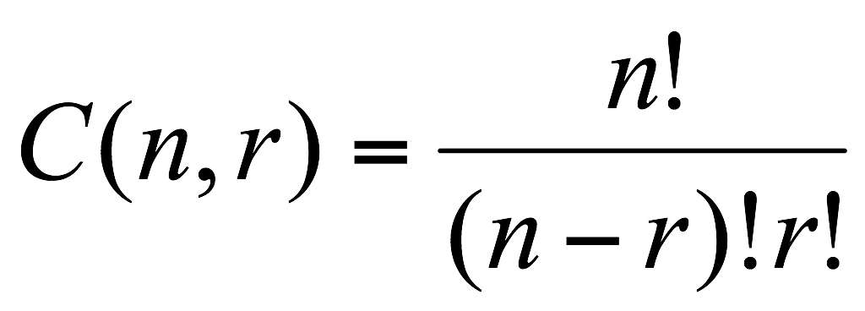
Counting problem: history
First known results on counting goes back to six century BCE’s India:
Using 6 different tastes, bitter, sour, salty, astringent, sweet, hot, one can make 63 different combinations…
first formula for counting combinations appears more than one thousand years later
# of ways to elect two class representatives
15

Slide 16
Counting is essential for studying probability, i.e., how likely something happens …
16

Slide 17
Ex: Probability problems
Suppose I choose one person randomly, what’s the probability that you will be chosen ?
Suppose I choose two persons randomly, what’s the probability that you and your neighbor are chosen ?
What’s the probability of winning NY lottery ?
17

Slide 18
Logic: a tool for reasoning and proving
18

Slide 19
An example
Your friend’s comment:
If the birds are flying south and the leaves are turning, then it must be fall. Falls brings cold weather. The leaves are turning but the weather is not cold. Therefore the birds are not flying south.
Do you agree with her ?
Is her argument sound/valid?
19

Slide 20
An example
Is her argument sound/valid?
Suppose the followings are true:
If the birds are flying south and the leaves are turning, the it must be fall.
Falls brings cold weather.
The leaves are turning but the weather is not cold.
Can one conclude “the birds are not flying south” ?
20

Slide 21
Reasoning & Proving
Prove by contradiction
Assume the birds are flying south,
then since leaves are turning too, then it must be fall.
Falls bring cold weather, so it must be cold.
But it’s actually not cold.
We have a contradiction, therefore our assumption that the birds are flying south is wrong.
21

Slide 22
So we have seen a list of topics …
Sequence
Set
Logic
Relation, Function
Counting
Probability
Graph
22

Slide 23
Goals
Master the basics of discrete mathematics
Develop mathematical and computational reasoning abilities
Become more comfortable and confident with both mathematics and computation
23

Slide 24
Discrete structure is essential for computer problem solving
24

Slide 25
Computer problem solving
Model real world entity
Student records in a registration system=> objects in a set
Network nodes => graph vertices
Develop/identify algorithm for solving specific problem
Search for a student record using name (or ID, …)
Query for a course using a prefix (all CSRU courses ?)
Find shortest path in a graph
Implement algorithm using a programming language that computers “understand”
25

Slide 26
Computer projects
We will learn basic web programming
Build your own web page
Learn HTML, JavaScript, …
Use Alice to build 3D animation clip
Cartoon, simple game …
26

Slide 27
Let’s look at syllabus …
27

Slide 28
Expectations of students
Think, think, think and practice
Make sense of the concepts, notations
Relate to your intuitions
Reflect about connections among different concepts
Active participation in class
There are no silly questions !
Keep up with homework
Take advantage of office hour and tutor room
28

