Slide 1
Pointers and Dynamic Variables
Fall 2018, CS2

Slide 2
Data, memory
memory address: every byte is identified by a numeric address in the memory.
a data value requiring multiple bytes are stored consecutively in memory cells and identified by the address of the first byte
In program we can:
find amount of memory (num. of bytes) assigned to a variable or a data type: sizeof(int), sizeof x
find the address of a variable: &x

Slide 3
Example
int x, y;
int takes 4 bytes
address of x is the address of its first byte…
1000
x
1004
y

Slide 4
Pointers Variables (or Pointers)
Pointer variables: a variable that stores memory address (of another variable)
is used to tell where a variable is stored in memory
Pointers "point" to a variable
Memory addresses can be used to access variables
Array variable actually stores address of the first element in array
int a[10]; cout <<a<<endl; cout <<&(a[0])<<endl;
When a variable is used as a call-by-reference argument, its address is passed

Slide 5
Declaring Pointers
Pointer variables must be declared to have a pointer type
Ex: To declare a pointer variable p that can "point" to a variable of type double: double *p;
The asterisk identifies p as a pointer variable

Slide 6
Declaring pointer variables
DataType * pointerVariable; //declare a pointerVariable that can be used to point to DataType variable
int * p;
char *cptr;
DayOfYear * pDate; //pDate is a pointer pointing to DayOfYear obj
double *q; //no space between * and variable name
Like other variables, before initialization, p and cptr might contain some arbitrary value
So, important to initialize:
int *p=NULL; // assign NULL constant to p, a pointer variable to indicate
// that p does not point to any valid data
// internally, NULL is value 0.
Common pitfall:
int *p1, *p2; //p1,p2 are both pointers that point to int
int *p1, p2; //p1 is pointer, but p2 is int
//* only applies to the variable that follows it, p1; not p2

Slide 7
pointer to different types
DataType * pointerVariable; //declare a pointerVariable that can be used to point to DataType variable
int * p=NULL;
char *cptr=NULL;
DayOfYear * pDate=NULL; //pDate is a pointer pointing to DayOfYear obj
double *q=NULL; //no space between * and variable name
Pointers to different types
have same size, sizeof(int *)==sizeof(double *) //8
why differentiate them?
int and double, char, … takes different number of bytes, and interpret data differently…

Slide 8
“address of” Operator
&variable: yield the address of a variable
can then be assigned to a pointer variable
int v1;
int * p1;
p1 = &v1; // assign “address of v1” to p1
//p1 is now a pointer (pointing) to v1
int a[10];
assert (a==&(a[0])); //array variable itself stores address

Slide 9
Example
int x, y;
int *p1, *p2;
address
name
1000
x
1004
address of x: 140724463361388
address of y: 140724463361384
address of p1:140724463361376
address of p2:140724463361368
y
1008
p1
address of x0x7ffcbf8f5a8c
address of y0x7ffcbf8f5a88
address of p10x7ffcbf8f5a80
address of p20x7ffcbf8f5a78
p2
1012

Slide 10
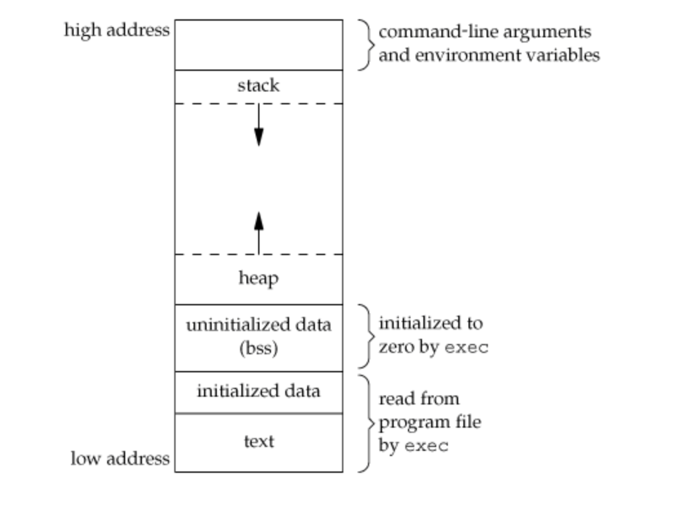
Typical layout of a program in memory
local variables
Global variables
static variables

Slide 11
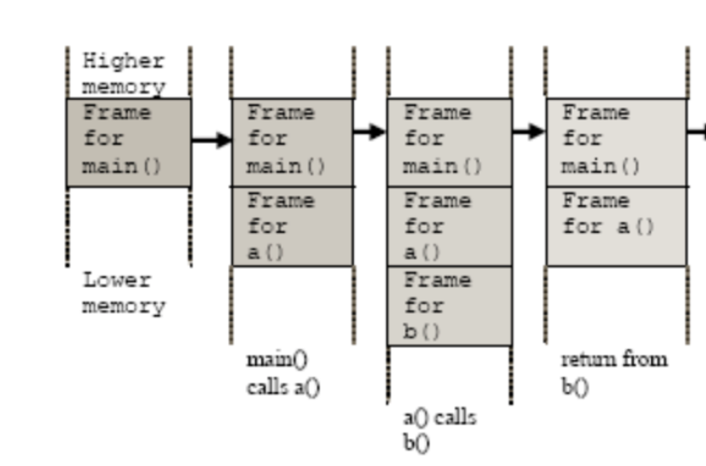
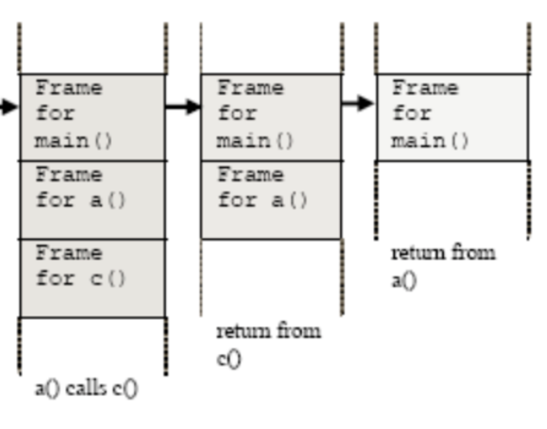
Stack and StackFrame
…..
int a()
{
b();
c();
return 0;
}
int b()
{ return 0; }
int c()
{ return 0; }
int main()
{
a();
return 0;
}

Slide 12
Example
int x, y;
int *p1, *p2;
x=-42;
y=163;
1000
-42
x
1004
163
y
1008
p1
1012
p2

Slide 13
Example
int x, y;
int *p1, *p2;
x=-42;
y=163;
p1=&x;
p2=&y;
1000
-42
x
1004
163
y
1008
1000
p1
1012
1004
p2

Slide 14
dereferencing Operator
*pointerVariable: the variable that pointerVariable points to
Here the * is dereferencing operator, pointerVariable is said to be dereferenced
int v1;
int *p1; //this * means p1 is a pointer
p1 = &v1; // assign “address of v1” to p1
cout << *p1; //display the int that p1 points to, i.e, v1
Pitfall/reminder: the context is important!
* used between type and name
vs. * before a pointer variable

Slide 15
Example
int x, y;
int *p1, *p2;
x=-42;
y=163;
p1=&x;
p2=&y;
*p1=17;
//*p1 is another name of for x
1000
-42
x
1004
163
y
1008
1000
p1
1012
1004
p2
1000
17
x
1004
163
y
1008
1000
p1
1012
1004
p2

Slide 16
Fundamental pointer operations
& address-of a variable. Its operand is a variable.
example: int *p; int a=10; p=&a;
* variable that a pointer is pointed to. Its operand is a pointer.
example: *p=5;
they are used to move back and forth between variables and pointers to those variables.
int *p;
*p=5; //the variable pointed to by aptr has to be valid
int *p=NULL; <=> int *p; p=NULL;

Slide 17
int i;
int *p;
i = 68;
p = &i;
printf("%d\n", i);
printf("%d\n", *p);
printf("%p\n", *p); /*value pointed to by p */
printf("%p\n", p); /*value of p, i.e., address of value pointed to by p */
printf("%u\n", p); /*value of p, i.e., address of value pointed to by p */
*p = 12;
printf("%d\n", i);
printf("%d\n", *p);
printf function is a function similar to cout
68
68
0x44
0xbfcc8b0c
3217853196
12
12

Slide 18
example
int x, y;
int *p1, *p2;
x=-42;
y=163;
p1=&x;
p2=&y;
*p1=17; /* another name of for x*/
p1=p2; /* pointer assignment, now two pointers point to the same location*/
1000
17
x
1004
163
y
1008
1000
p1
1012
1004
p2
1000
17
x
1004
163
y
1008
1004
p1
1012
1004
p2

Slide 19
example
int x, y;
int *p1, *p2;
x=-42;
y=163;
p1=&x;
p2=&y;
*p1=17; /* another name of for x*/
*p1=*p2; /*value assignment*/
//think of *p1 as another name of the variable p1 points to.
1000
17
x
1004
163
y
1008
1000
p1
1012
1004
p2
1000
163
x
1004
163
y
1008
1000
p1
1012
1004
p2

Slide 20
Usage of pointers
Allow one to refer to a large data structure in a compact way.
Each pointer (or memory address) typically fits in four bytes of memory!
Array: static or dynamic arrays
Different parts of a program can share same data:
passing parameters by reference (passing address between different functions), or by pointers
One can reserve new memory in a running program: dynamic memory allocation
Build complicated data structures by linking different data items

Slide 21
Passing parameters by reference using pointers
Suppose we want to set x (defined in main() function) to zero,
compare the following code:
/*pass by value*/
void SetToZero1 (int var) {
var=0;
}
/*pass by pointer*/
void SetToZero2(int *ip) {
*ip=0;
}
int main()
{
int x=163;
SetToZero1(x)
SetToZero2 (&x);
}

Slide 22
int main ()
{
…
x=163;
SetToZero(x);
…
…
}
void SetToZero (int var) {
var=0;
}
1000
163
x
stack
frame
for main() in our computer’s memory
1004
1008
1012
1208
163
var
stack
frame
for SetToZero1() in our computer’s memory
1212

Slide 23
int main ()
{
…
x=163;
SetToZero(x);
…
…
}
void SetToZero (int var) {
var=0;
}
1000
163
x
1004
stack
frame
1008
1012
1208
0
var
stack
frame
1212

Slide 24
1000
163
x
int main ()
{
…
x=163;
SetToZero2(&x);
…
…
}
void SetToZero2(int *ip)
{
*ip=0;
}
1004
stack frame of main()
1008
1012
1208
1000
ip
stack frame of SetToZero2
1212

Slide 25
1000
0
x
int main ()
{
…
x=163;
SetToZero(&x);
…
…
}
void SetToZero(int *ip)
{
*ip=0;
}
1004
stack
frame
1008
1012
1208
1000
ip
stack
frame
1212

Slide 26
Passing parameters
main stack frame
SetToZero1 stack frame
void SetToZero1 (int var) {
var=0;
}
SetToZero(x);
/* has no effect on x*/
void SetToZero2(int *ip) {
*ip=0;
}
SetToZero2(&x);
void SetToZero3 (int & var){
var = 0;
}
SetToZero3 (x);
SetToZero(x);
var=x;
var=0;
stack frame
SetToZero2 stack frame
SetToZero(&x);
ip=&x;//ip points to x
*ip=0;
stack frame
SetToZero3 stack frame
SetToZero3(x);
var refers to x
var=0; //x=0

Slide 27
Example
write a program to solve quadratic equation:
ax^2 + bx + c = 0;
program structure:
input phase: accept values of coefficients from users;
void GetCoefficients(double *pa, double *pb, double *pc);
computation phase: solve the equation based on those coefficients;
void SolveQuadratic(double a, double b, double c, double *px1, double *px2);
output phase: display the roots of the equation on the screen
void DisplayRoots(double x1, double x2);

Slide 28
Variable Scopes and Lifetimes
—- a bigger picture about memory used by a program

Slide 29
Global Variables
Variables declared outside any function are global variables
they have “global scope”, i.e., they can be accessed by the name from all parts of a program —- unless there is an eclipse!
they comes into being when program starts, and disappears when program ends ==> static lifetime
We discourage the usage of global variables
too many cooks in the kitchen: everyone can modify it

Slide 30
Local Variables
Variables declared in a function are local variables
they have “local scope”: they can be accessed using the name from the function/block
They are typically created when the function is called, and destroyed when the function call ends ==> automatic lifetime
Local variable with static lifetime?
void some_func()
{
static int counter=0; //created at program starts,
//destroyed when program ends
counter++;
cout <<"called " << counter<<" times\n”;
//…
}

Slide 31
Dynamic Variables
Programmer/Code can create variables and then destroy them using operators new and delete
such variables are dynamic variables, their lifetime is dynamic (decided at running time, based upon running time condition). They have no name.
e.g.,
int *p1; //declare a pointer variable
p1 = new int; //create a int variable, save its address in p1
This variable can only be referred by address (as it has no name), *p1
*p1 can be used any place an integer variable can cin >> *p1; *p1 = *p1 + 7;

Slide 32
Display 9.2

Slide 33
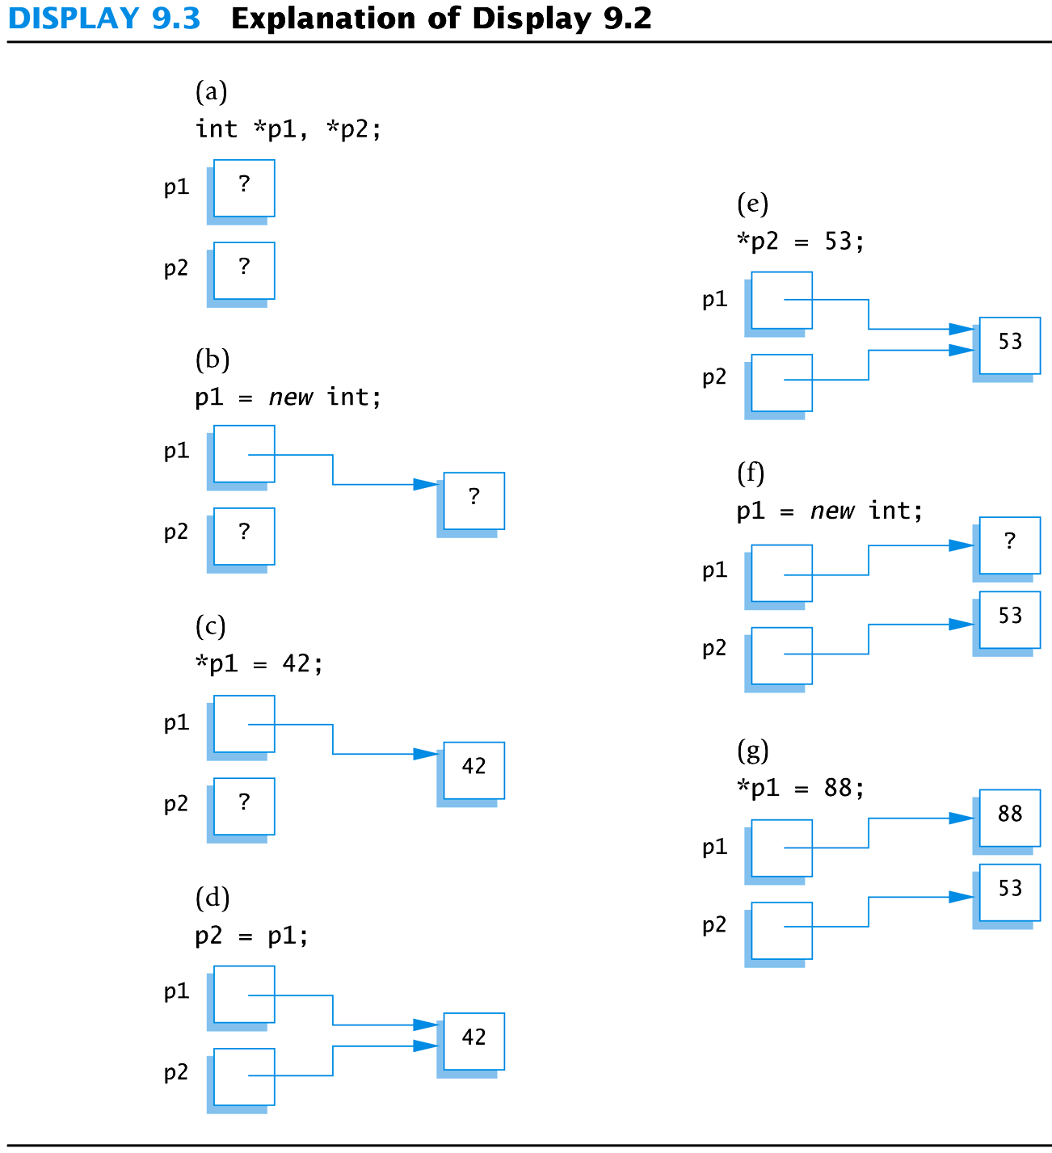
Display 9.3

Slide 34
Caution! Pointer Assignments
Some care is required making assignments to pointer variables
p1= p3; // changes the location that p1 "points" to
*p1 = *p3; // changes the value at the location that // p1 "points" to

Slide 35
Basic Memory Management
An area of memory called the freestore/heap is reserved for dynamic variables
New dynamic variables use memory in the freestore
If all of the freestore is used, calls to new will fail
Unneeded memory can be recycled
When variables are no longer needed, they need to be deleted and the memory they used is returned to the freestore

Slide 36
delete Operator
When dynamic variables are no longer needed, delete them to recycle memory to freestore
e.g., delete p; memory used by the variable that p pointed to is back in freestore. p still stores that address.
*p=10; // Disaster!!!
p = NULL; //value of p is now NULL

Slide 37
Dangling Pointers
Using delete on a pointer variable destroys the dynamic variable pointed to
If another pointer variable was pointing to the dynamic variable, that variable is also undefined
Undefined pointer variables are called dangling pointers
Dereferencing a dangling pointer (*p) is usually disasterous

Slide 38
Type Definitions
A name can be assigned to a type definition, then used to declare variables
The keyword typedef is used to define new type names
Syntax:
typedef Known_Type_Definition New_Type_Name;
Known_Type_Definition can be any type

Slide 39
Defining Pointer Types
To avoid mistakes using pointers, define a pointer type name
Example:
typedef int* IntPtr;
Defines a new type, IntPtr, for pointer variables containing pointers to int variables
IntPtr p;
is equivalent to
int *p;

Slide 40
Multiple Declarations Again
Using our new pointer type defined as typedef int* IntPtr;
Then, we can prevent this error in pointer declaration: int *P1, P2;//Only P1 is a pointer variable
with
IntPtr P1, P2;
// P1 and P2 are pointer variables

Slide 41
Pointer Reference Parameters
A second advantage in using typedef to define a pointer type is seen in parameter lists
Example:
void sample_function(IntPtr& pointer_var); is less confusing than
void sample_function( int*& pointer_var);

