Slide 1
Review of Important Topics in CS1600
Functions
Arrays
C-strings

Slide 2
Array Basics

Slide 3
Arrays
An array is used to process a collection of data of the same type
Examples: A list of names A list of temperatures
Why do we need arrays?
Imagine keeping track of 5 test scores, or 100, or 1000 in memory
How would you name all the variables?
How would you process each of the variables?

Slide 4
Declaring an Array
An array, named score, containing five variables of type int can be declared as int score[5];
This is like declaring 5 variables of type int: score[0], score[1], … , score[4]
The value in brackets is called
A subscript
An index

Slide 5
The Array Variables
The variables making up the array are referred to as
Indexed variables
Subscripted variables
Elements of the array
The number of indexed variables in an array is the declared size, or size, of the array
The largest index is one less than the size
The first index value is zero
Not all variables are actually being used all the time!

Slide 6
Array Variable Types
An array can have indexed variables of any type
All indexed variables in an array are of the same type
This is the base type of the array
An indexed variable can be used anywhere an ordinary variable of the base type is used

Slide 7
Using [ ] With Arrays
In an array declaration, [ ]'s enclose the size of the array such as this array of 5 integers: int score [5];
When referring to one of the indexed variables, the [ ]'s enclose a number identifying one of the indexed variables
E.g.,
score[3]=7;
score[3] is one of the indexed variables
The value in the [ ]'s can be any expression that evaluates to one of the integers 0 to (size -1)

Slide 8
Indexed Variable Assignment
To assign a value to an indexed variable, use the assignment operator: int n = 2; score[n + 1] = 99;
In this example, variable score[3] is assigned 99

Slide 9
Loops And Arrays
for-loops are commonly used to step through arrays
Example: for (int i = 0; i < 5; i++) { cout << score[i] << " off by “ << (max – score[i]) << endl; } could display the difference between each score and the maximum score stored in an array
First index is 0
Last index is (size – 1)
Display 7.1

Slide 10
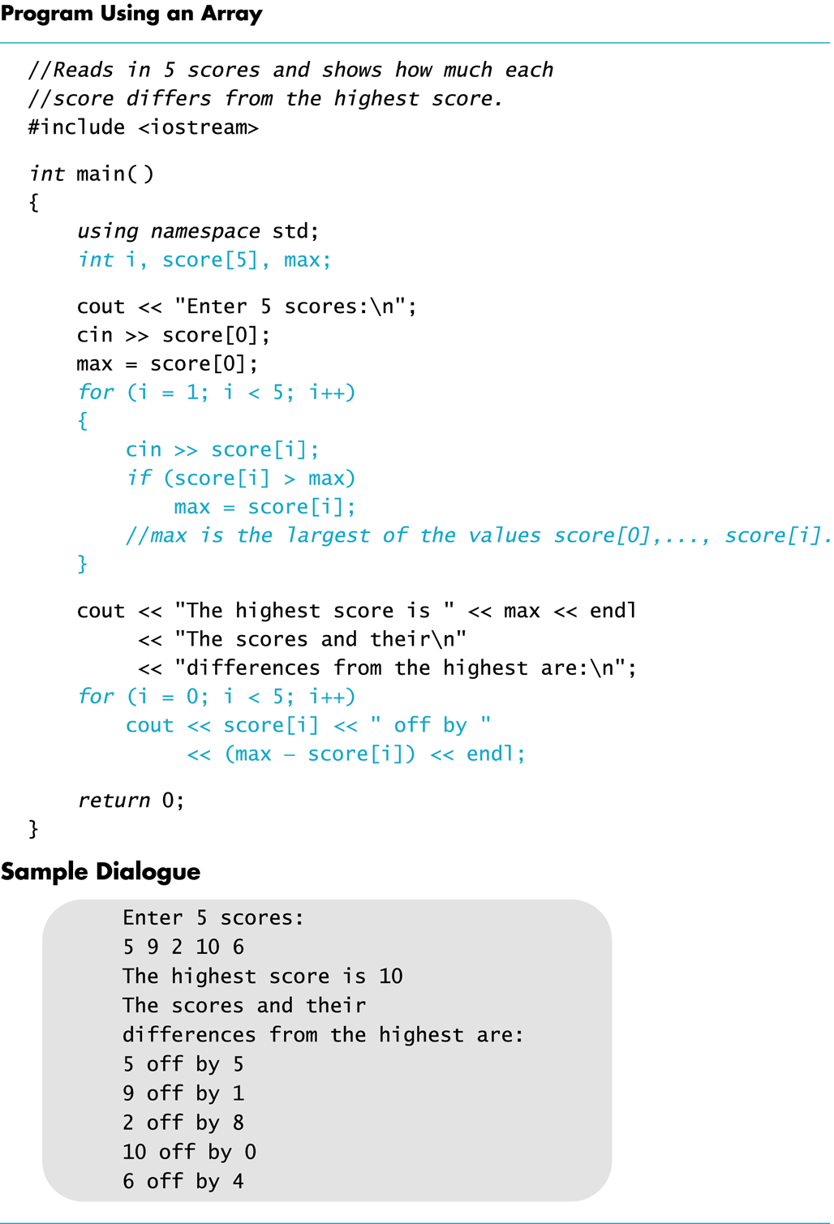
Display 7.1

Slide 11
Constants and Arrays
Use constants to declare the size of an array
Using a constant allows your code to be easily altered for use on a smaller or larger set of data
Example:
const int NUMBER_OF_STUDENTS = 50;
int score[NUMBER_OF_STUDENTS];
for ( i = 0; i < NUMBER_OF_STUDENTS; i++)
cout << score[i] << " off by “ << (max – score[i]) << endl;
Only the value of the constant must be changed to make this code work for any number of students

Slide 12
Variables and Declarations
Most compilers do not allow the use of a variable to declare the size of an array Example:
cout << "Enter number of students: "; cin >> number; int score[number];
This code is illegal on many compilers

Slide 13
Array Declaration Syntax
To declare an array, use the syntax: Type_Name Array_Name[Declared_Size];
Type_Name can be any type
Declared_Size can be a constant to make your program more versatile
Once declared, the array consists of the indexed variables: Array_Name[0] to Array_Name[Declared_Size -1]

Slide 14
Arrays and Memory
Declaring the array
int a[6];
Reserves memory for six variables of type int
The variables are stored one after another
The address of a[0] is remembered by C++
The addresses of the other indexed variables is not remembered by C++
To determine the address of a[3]
C++ starts at a[0]
C++ counts past enough memory for three integers to find a[3]
Display 7.2

Slide 15
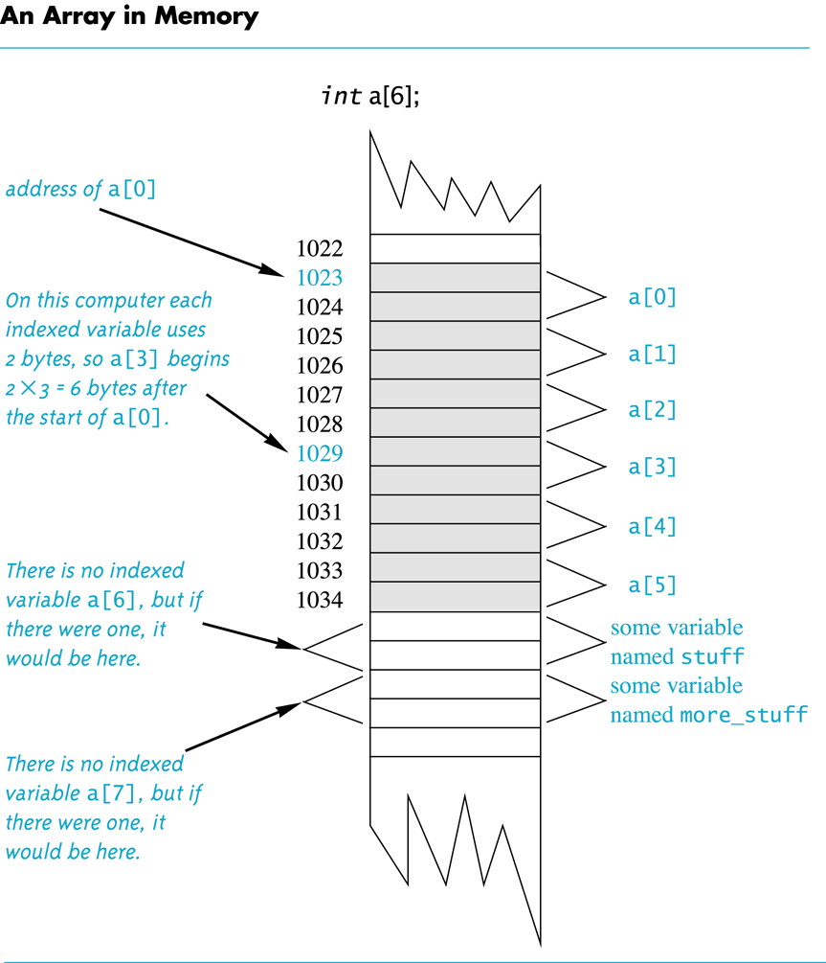
in this example, each int variable uses 2 bytes, but typically an int variable uses 4 bytes.
Display 7.2
Recall:
Computer memory consists of numbered locations called bytes
A byte's number is its address
A simple variable is stored in consecutive bytes
The number of bytes depends on the variable's type
A variable's address is the address of its first byte

Slide 16
Array Index Out of Range
A common error is using a nonexistent index
Index values for int a[6] are the values 0 through 5
An index value not allowed by the array declaration is out of range
Using an out of range index value doe not produce an error message!

Slide 17
Out of Range Problems
If an array is declared as: int a[6]; and an integer is declared as: int i = 7;
Executing the statement a[i] = 238; causes…
The computer to calculate the address of the illegal a[7]
(This address could be where some other variable is stored)
The value 238 is stored at the address calculated for a[7]
No warning is given!

Slide 18
Initializing Arrays
To initialize an array when it is declared
The values for the indexed variables are enclosed in braces and separated by commas
Example: int children[3] = { 2, 12, 1 }; is equivalent to: int children[3]; children[0] = 2; children[1] = 12; children[2] = 1;

Slide 19
Default Values
If too few values are listed in an initialization statement
The listed values are used to initialize the first of the indexed variables
The remaining indexed variables are initialized to a zero of the base type
Example: int a[10] = {5, 5}; initializes a[0] and a[1] to 5 and a[2] through a[9] to 0

Slide 20
Un-initialized Arrays
If no values are listed in the array declaration, some compilers will initialize each variable to a zero of the base type
DO NOT DEPEND ON THIS!

Slide 21
Arrays in Functions

Slide 22
Arrays in Functions
Indexed variables can be arguments to functions
Example: If a program contains these declarations: int i, n, a[10]; void my_function(int n);
Variables a[0] through a[9] are of type int, making these calls legal: my_function( a[ 0 ] ); my_function( a[ 3 ] ); my_function( a[ i ] );
Display 7.3

Slide 23
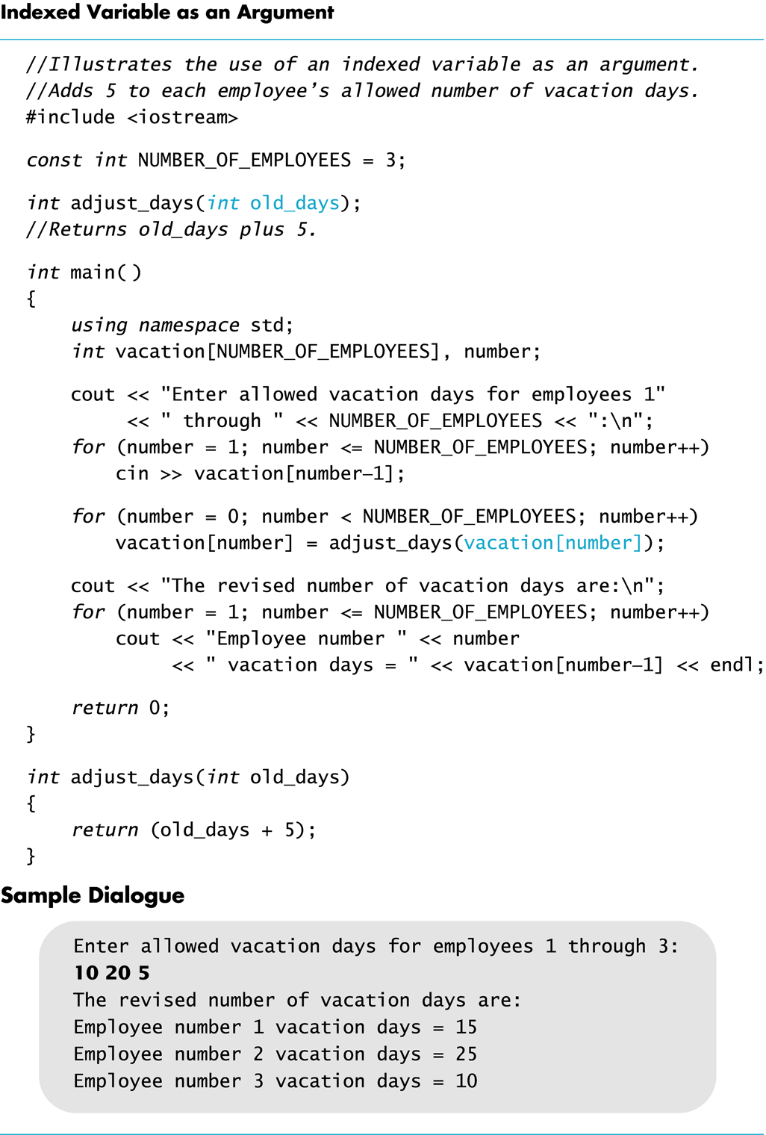
Display 7.3

Slide 24
Arrays as Function Arguments
A formal parameter can be for an entire array
Such a parameter is called
an array parameter
It is not a call-by-value parameter
It is not a call-by-reference parameter
Array parameters behave much like call-by-reference parameters

Slide 25
Array Parameter Declaration
An array parameter is indicated using empty brackets in the parameter list such as void fill_up(int a[ ], int size);

Slide 26
Function Calls With Arrays
If function fill_up is declared in this way: void fill_up( int a[ ] , int size);
and array score is declared this way: int score[5], number_of_scores;
fill_up is called in this way: fill_up(score, number_of_scores);
Display 7.4

Slide 27
Display 7.4

Slide 28
Function Call Details
A formal parameter is identified as an array parameter by the [ ]'s with no index expression void fill_up(int a[ ], int size);
An array argument does not use the [ ]'s fill_up(score, number_of_scores);

Slide 29
Array Formal Parameters
An array formal parameter is a placeholder for the argument
When an array is an argument in a function call, an action performed on the array parameter is performed on the array argument
The values of the indexed variables (i.e., the array argument) can be changed by the function

Slide 30
Array Argument Details
What does the computer know about an array once it is declared?
The base type
The address of the first indexed variable
The number of indexed variables
What does a function know about an array argument during a function call?
The base type
The address of the first indexed variable

Slide 31
Array Parameter Considerations
Because a function does not know the size of an array argument…
The programmer should include a formal parameter that specifies the size of the array
The function can process arrays of various sizes
Function fill_up from Display 7.4 can be used to fill an array of any size:
int score[5];
int time[10];
fill_up(score, 5);
fill_up(time, 10);

Slide 32
const Modifier
Recall: array parameters allow a function to change the values stored in the array argument
If a function should not change the values of the array argument, use the modifier const
An array parameter modified with const is a constant array parameter
Example: void display_array(const int a[ ], int size);

Slide 33
Using const With Arrays
If const is used to modify an array parameter:
const is used in both the function declaration and definition to modify the array parameter
The compiler will issue an error if you write code that changes the values stored in the array parameter

Slide 34
Function calls and const
If a function with a constant array parameter calls another function using the constant array parameter as an argument…
The called function must use a constant array parameter as a placeholder for the array
The compiler will issue an error if a function is called that does not have a const array parameter to accept the array argument

Slide 35
const Parameters Example
double compute_average(int a[ ], int size); void show_difference(const int a[ ], int size) { double average = compute_average(a, size); … }
compute_average has no constant array parameter
This code generates an error message because compute_average could change the array parameter

Slide 36
Returning An Array
Recall that functions can return (via return-statement) a value of type int, double, char, …
Functions cannot return arrays
We learn later how to return a pointer to an array

Slide 37
Programming with Arrays

Slide 38
Programming With Arrays
The size needed for an array is changeable
Often varies from one run of a program to another
Is often not known when the program is written
A common solution to the size problem
Declare the array size to be the largest that could be needed
Decide how to deal with partially filled arrays

Slide 39
Partially Filled Arrays
When using arrays that are partially filled
A parameter, number_used, may be sufficient to ensure that referenced index values are legal
Functions dealing with the array may not need to know the declared size of the array, only how many elements are stored in the array
A function such as fill_array in Display 7.9 needs to know the declared size of the array
Display 7.9 (1)
Display 7.9 (2)
Display 7.9 (3)

Slide 40
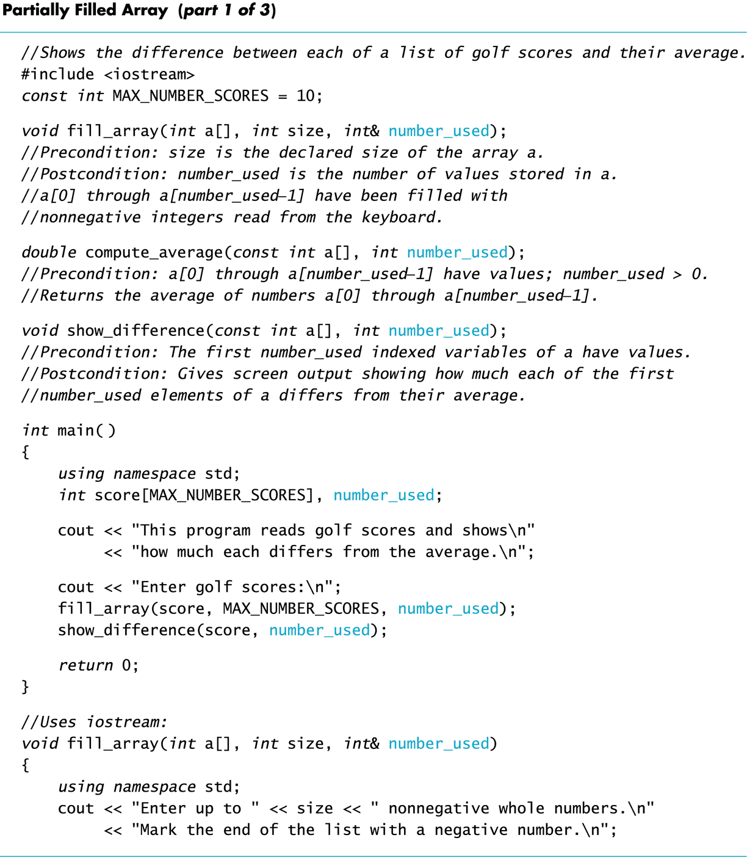
Display 7.9 (1/3)

Slide 41
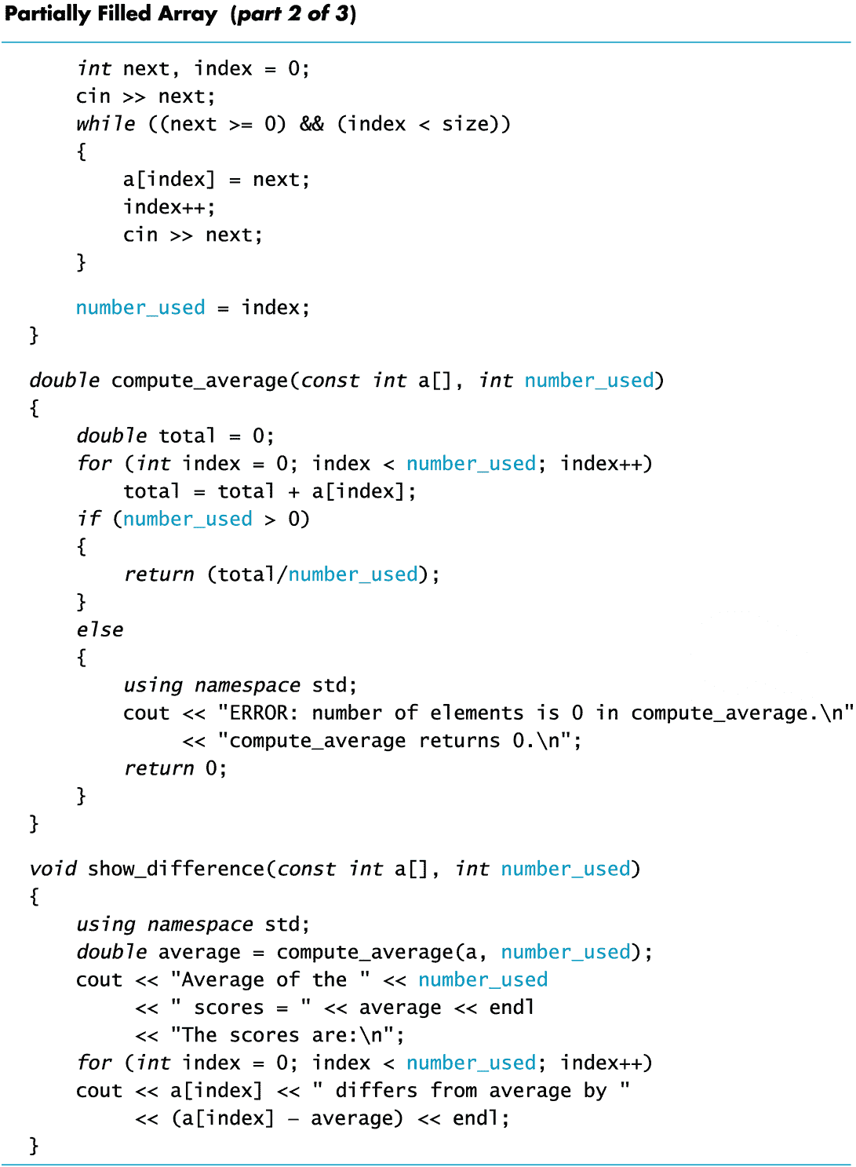
Display 7.9 (2/3)

Slide 42
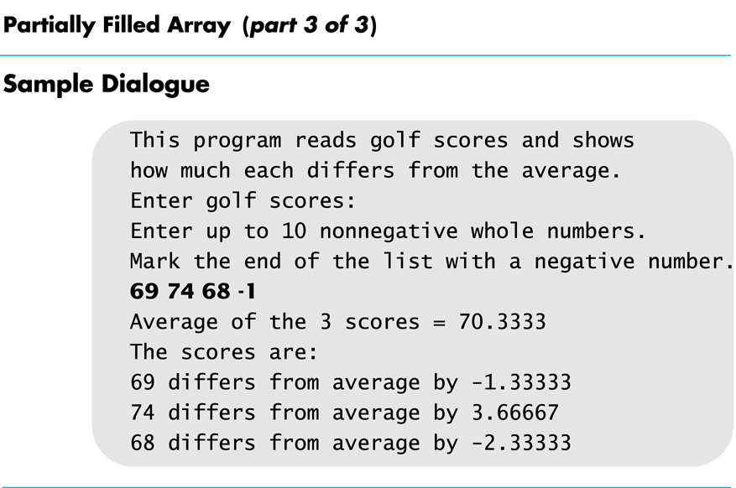
Display 7.9 (3/3)

Slide 43
Searching Arrays
A sequential search is one way to search an array for a given value
Look at each element from first to last to see if the target value is equal to any of the array elements
The index of the target value can be returned to indicate where the value was found in the array
A value of -1 can be returned if the value was not found

Slide 44
The search Function
The search function of Display 7.10…
Uses a while loop to compare array elements to the target value
Sets a variable of type bool to true if the target value is found, ending the loop
Checks the boolean variable when the loop ends to see if the target value was found
Returns the index of the target value if found, otherwise returns -1
Display 7.10 (1)
Display 7.10 (2)

Slide 45
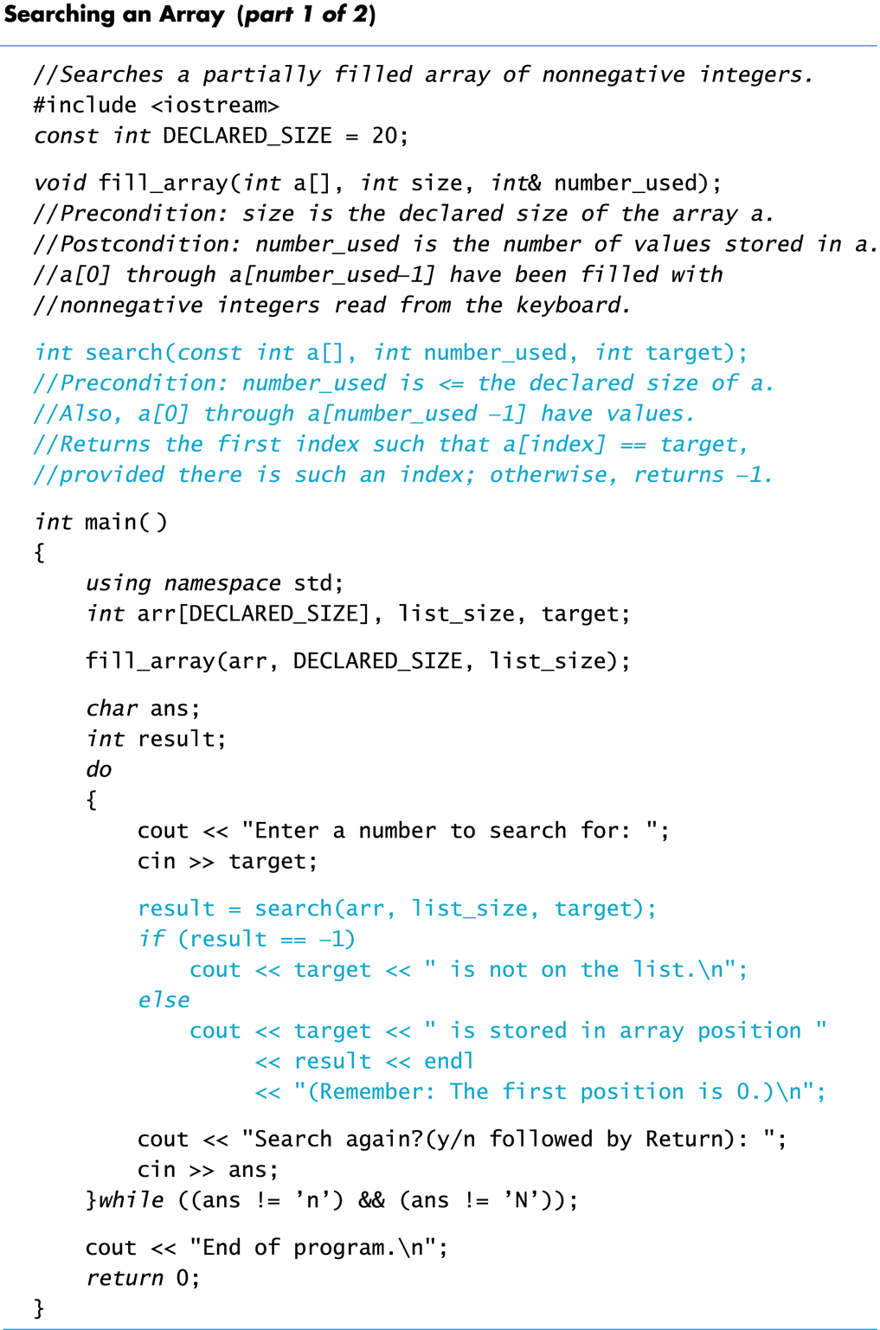
Display 7.10 (1/2)

Slide 46
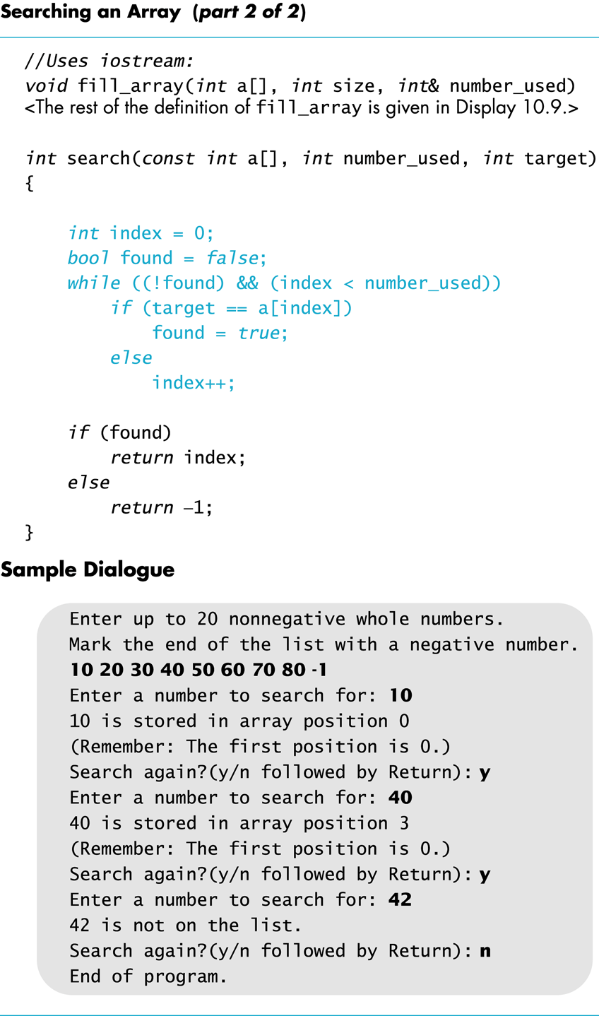
Display 7.10 (2/2)

Slide 47
Go over this page:
http://storm.cis.fordham.edu/~zhang/cs2000/grading.html
Also documentation for function declaration, definition.

Slide 48
Program Example: Sorting an Array
Sorting a list of values is very common task
Create an alphabetical listing
Create a list of values in ascending order
Create a list of values in descending order
Many sorting algorithms exist
Some are very efficient
Some are easier to understand

Slide 49
Program Example: The Selection Sort Algorithm
When the sort is complete, the elements of the array are ordered such that a[0] < a[1] < … < a [ number_used -1]
Outline of the algorithm
for (int index = 0; index < number_used; index++) place the index-th smallest element in a[index]

Slide 50
Program Example: Sort Algorithm Development
One array is sufficient to do our sorting
Search for the smallest value in the array
Place this value in a[0], and place the value that was in a[0] in the location where the smallest was found
Starting at a[1], find the smallest remaining value swap it with the value currently in a[1]
Starting at a[2], continue the process until the array is sorted
Display 7.11
Display 7.12 (1-2)

Slide 51
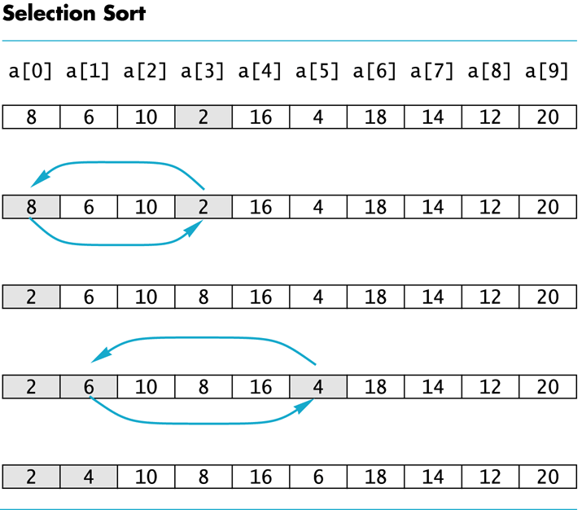
Display 7.11

Slide 52
go over the source code http://storm.cis.fordham.edu/~zhang/cs2000/CodeExample_Savitch/Chapter07/07-12.cpp

Slide 53
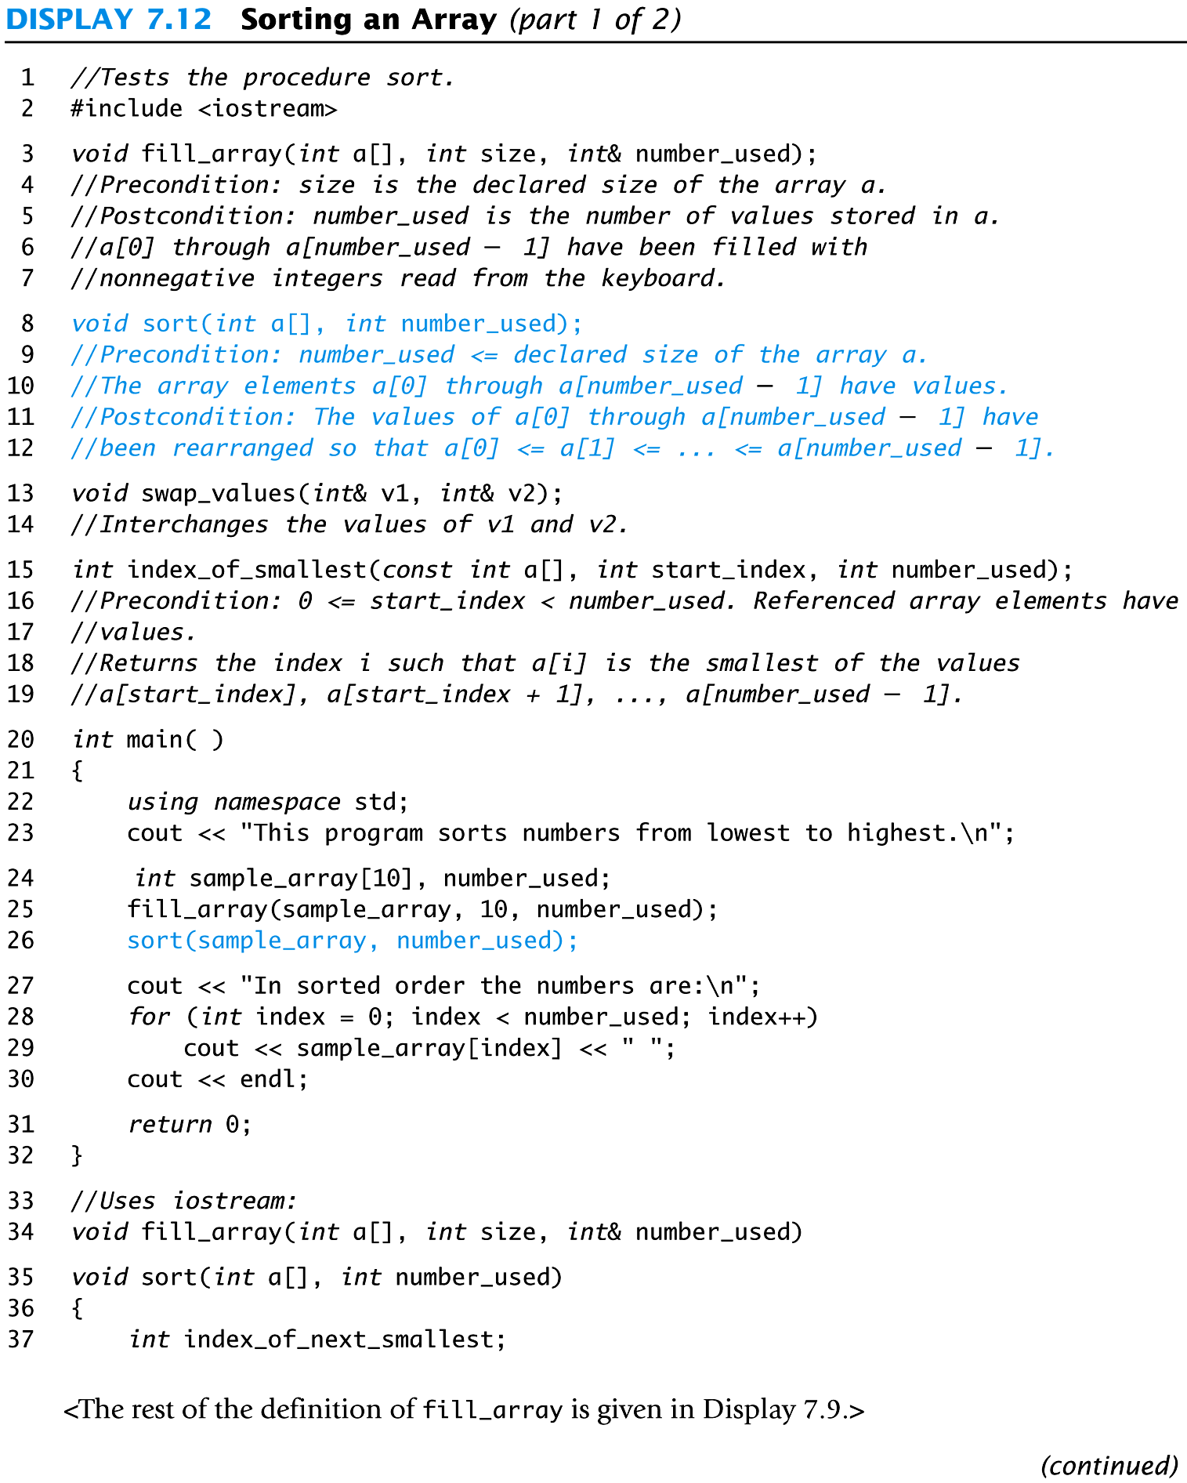
Display 7.12 (1/2)

Slide 54
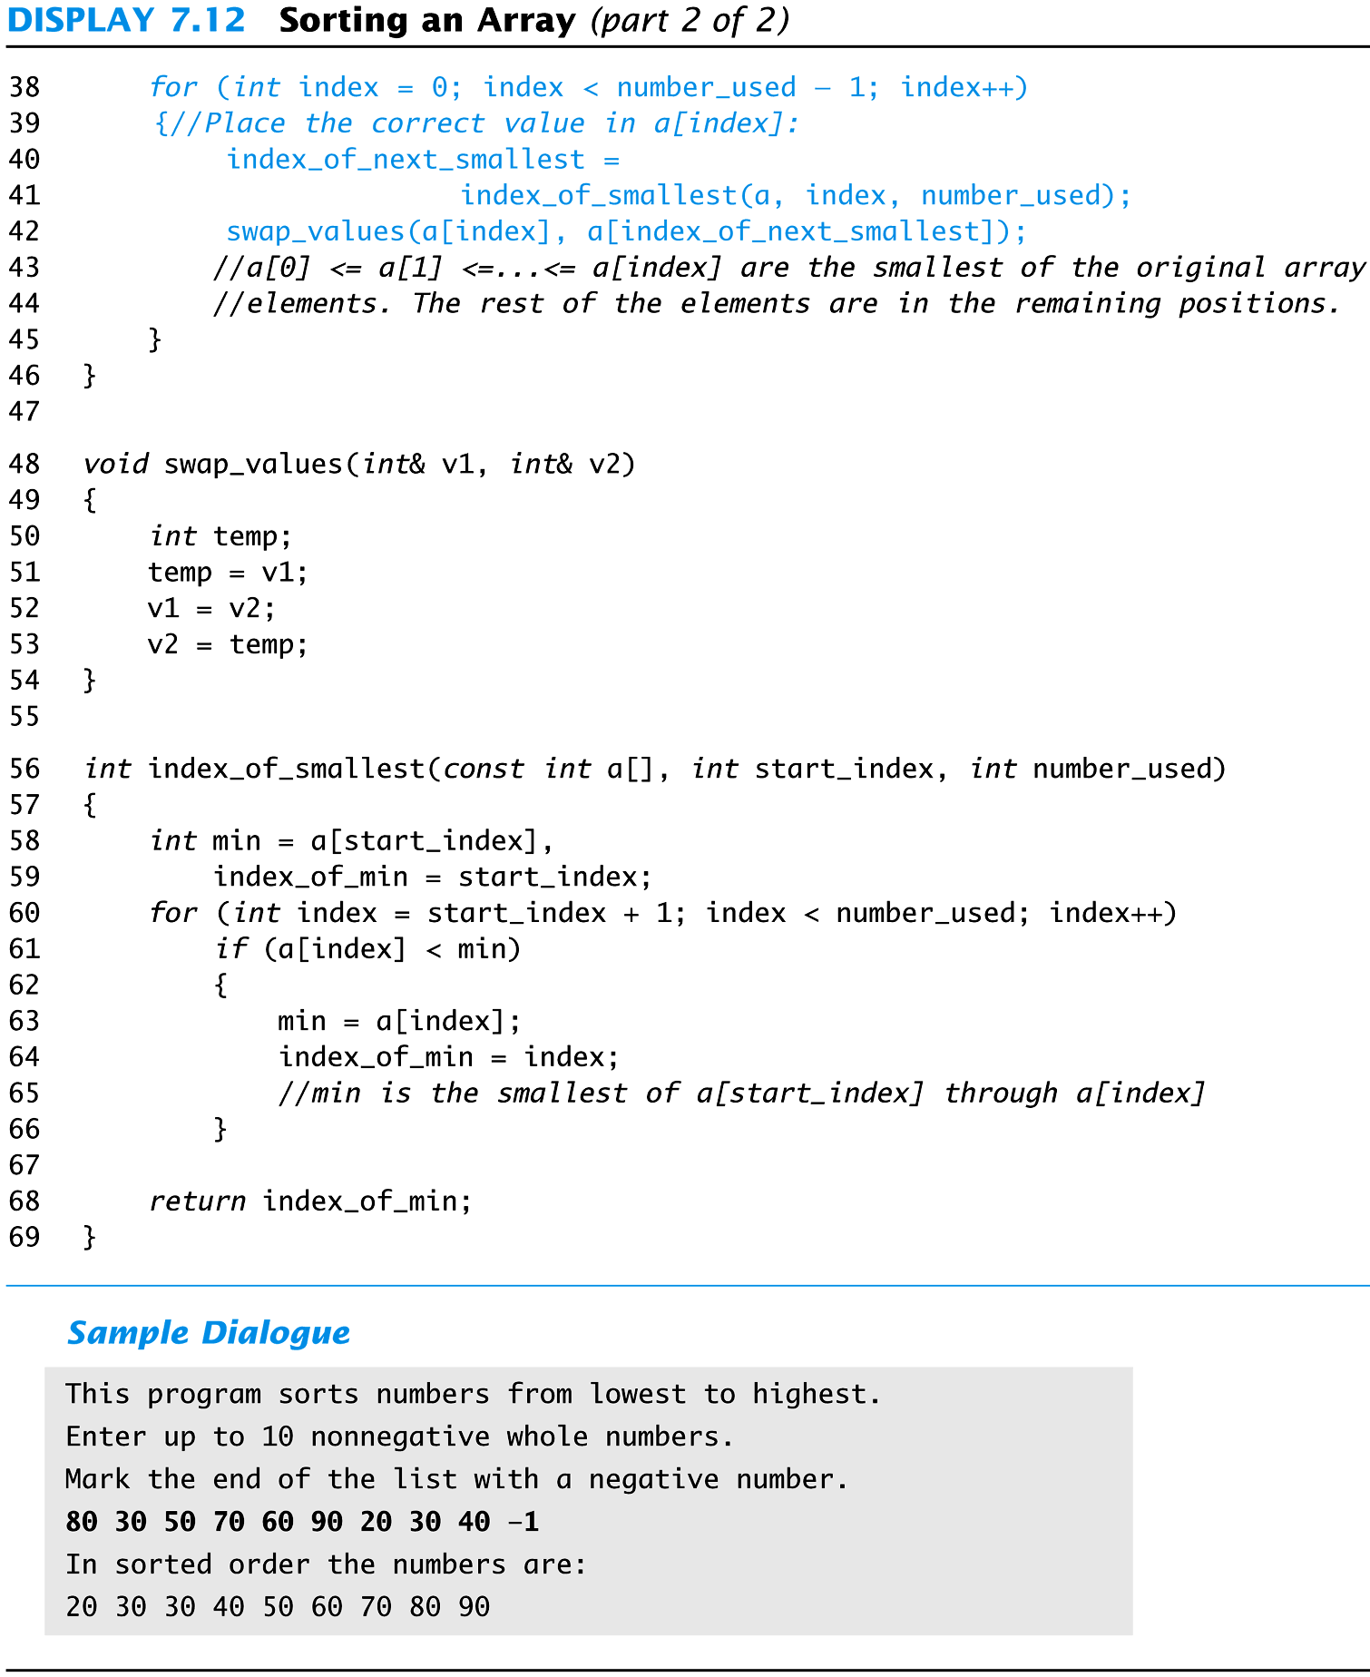
Display 7.12 (2/2)

Slide 55
Exercise
Write a program that will read up to 10 letters into an array and write the letters back to the screen in the reverse order? abcd should be output as dcba Use a period as a sentinel value to mark the end of input

Slide 56
A side note: Recall variables and memory

Slide 57
Computer Memory
Computer memory consists of numbered locations called bytes
A byte's number is its address
A simple variable is stored in consecutive bytes
The number of bytes depends on the variable's type
A variable's address is the address of its first byte

Slide 58
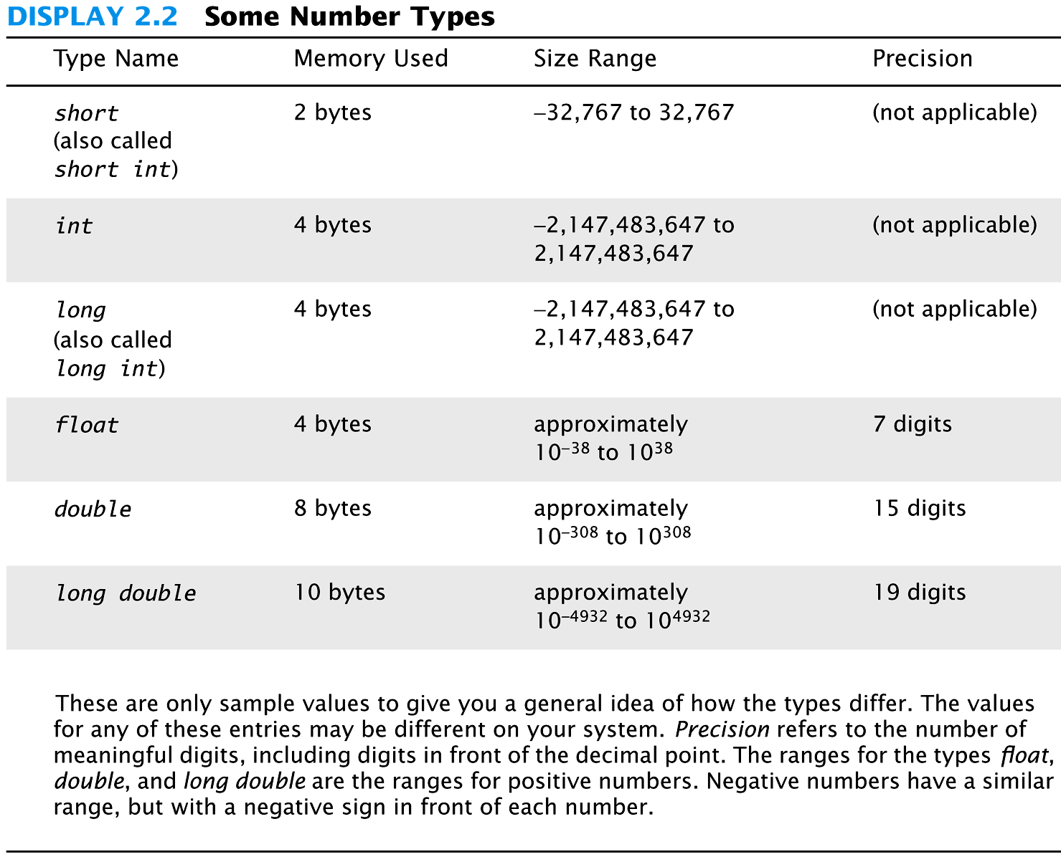
Recall ...

Slide 59
Recall: types and Objects
A type defines a set of possible values and a set of operations
A value is a sequence of bits in memory, interpreted according to its type
An object is a piece of memory that holds a value of a given type
int a = 7;
char c = 'x';
string s = "qwerty";
a:
7
c:
x
String object keeps the # of
chars in the string, and the chars ..
We will learn how to access each char,
s[0], s[1], …
s:
6
qwerty

Slide 60
More example
What’s the difference?
double x=12;
string s2=“12”;
x stores the value of number 12
s2 stores the two characters, ‘1’,’2’
applicable operations are different
x: arithmetic operations, numerical comparison,
s2: string concatenation, string comparison
x:
12
s2:
2
12

Slide 61
value: a sequence of bits in memory
interpreted according to a type
E,g, int x=8;
represented in memory as a seq. of binary digits (i.e., bits):
An integer value is stored using the value’s binary representation
In everyday life, we use decimal representation
x:
8
0 | 0 | 0 | 0 | 0 | 0 | 0 | 0 | 0 | 0 | 0 | 0 | 0 | 0 | 0 | 0 | 0 | 0 | 0 | 0 | 0 | 0 | 0 | 0 | 0 | 0 | 0 | 0 | 1 | 0 | 0 | 0

Slide 62
value: a sequence of bits in memory (cont’d)
interpreted according to a type
E,g, char x=‘8’;
is represented in memory as a seq. of binary digits (i.e., bits)
A char value is stored using char’s ASCII code
(American Standard Code for Information Interchange )
x:
‘8’
0 | 0 | 1 | 1 | 1 | 0 | 0 | 0

Slide 63
ASCII Code

Slide 64
Interpretation of a bit sequence
Given a bit sequence in memory
If it’s interpreted as integer, then it represents value 8
1*2³=8
If interpreted as char, there are two chars, a NULL char, and a BACKSPACE char
0 | 0 | 0 | 0 | 0 | 0 | 0 | 0 | 0 | 0 | 0 | 0 | 1 | 0 | 0 | 0

Slide 65
A technical detail
In computer memory, everything is just bits; type is what gives meaning to the bits
char c = 'a';
cout << c; // print the value of character variable c, which is a
int i = c;
cout << i; // print the integer value of the character c, which is 97
int i = c;
Assign a char value to a int type variable ?!
A safe type conversion.
Left-hand-side (LHS)
is an int type variable
Right-hand-side (RHS) is
a value of char type

Slide 66
Sizeof operator
Yields size of its operand
Measured by the size of type char, i.e., a byte
cout <<"sizeof bool is " << sizeof (bool) << "\n"
<<"sizeof char is " << sizeof (char) << "\n"
<<"sizeof int is " << sizeof (int) << "\n"
<<"sizeof short is " << sizeof (short) << "\n"
<<"sizeof long is " << sizeof (long) << "\n"
<<"sizeof double is " << sizeof (double) << "\n"
<<"sizeof float is " << sizeof (float) << "\n";
sizeof bool is 1
sizeof char is 1
sizeof int is 4
sizeof short is 2
sizeof long is 8
sizeof double is 8
sizeof float is 4

Slide 67
Char-to-int conversion
c:
01100001
char c = 'a';
cout << c; // print the value of character variable c, which is a
int i = c;
cout << i; // print the integer value of the character c, which is 97
No information is lost in the conversion
char c2=i; //c2 has same value as c
Can convert int back to char type, and get the original value
Safe conversion:
bool to char, int, double
char to int, double
int to double
i:
0000000000000000000000001100001

Slide 68
#include <iostream>
using namespace std;
int main()
{
int pennies = 8; //what if change 8 to "eight"?
int dimes = 4;
int quarters = 3;
double total = pennies * 0.01 + dimes * 0.10
+ quarters * 0.25; // Total value of the coins
cout << "Total value = " << total << "\n";
return 0;
}
Implicit type conversion
int to double

Slide 69
A type-safety violation (“implicit narrowing”)
Beware: C++ does not prevent you from trying to put a large value into a small variable (though a compiler may warn)
int main()
{
int a = 20000;
char c = a;
int b = c;
if (a != b) // != means “not equal”
cout << "oops!: " << a << "!=" << b << '\n';
else
cout << "Wow! We have large characters\n";
}
a
20000
c:
???
b
??

Slide 70
“narrowing” conversion
int main()
{
double d =0;
while (cin>>d) { // repeat the statements below // as long as we type in numbers
int i = d; // try to squeeze a double into an int
char c = i; // try to squeeze an int into a char
int i2 = c; // get the integer value of the character
cout << "d==" << d // the original double
<< " i=="<< i // converted to int
<< " i2==" << i2 // int value of char
<< " char(" << c << ")\n"; // the char
}

Slide 71
A type-safety violation (Uninitialized variables)
// Beware: C++ does not prevent you from trying to use a variable before you have initialized it (though a compiler typically warns)
int main()
{
int x; // x gets a “random” initial value
char c; // c gets a “random” initial value
double d; // d gets a “random” initial value
// – not every bit pattern is a valid floating-point value
double dd = d; // potential error: some implementations
// can’t copy invalid floating-point values
cout << " x: " << x << " c: " << c << " d: " << d << '\n';
}
Always initialize your variables
valid exception to this rule: input variable

Slide 72
Multi-dimensional Array Read Section 7.4

Slide 73
Multi-Dimensional Arrays
C++ allows arrays with multiple index values
char page [30] [100]; declares an array of characters named page
page has two index values: The first ranges from 0 to 29 The second ranges from 0 to 99
Each index in enclosed in its own brackets
Page can be visualized as an array of 30 rows and 100 columns

Slide 74
Index Values of page
The indexed variables for array page are page[0][0], page[0][1], …, page[0][99] page[1][0], page[1][1], …, page[1][99]
… page[29][0], page[29][1], … , page[29][99]
page is actually an array of size 30
page's base type is an array of 100 characters

Slide 75
Multidimensional Array Parameters
Recall that the size of an array is not needed when declaring a formal parameter: void display_line(const char a[ ], int size);
The base type of a multi-dimensional array must be completely specified in the parameter declaration
C++ treats a as an array of arrays
void display_page(const char page[ ] [100], int size_dimension_1);

Slide 76
Program Example: Grading Program
Grade records for a class can be stored in a two-dimensional array
For a class with 4 students and 3 quizzes the array could be declared as int grade[4][3];
The first array index refers to the number of a student
The second array index refers to a quiz number
Since student and quiz numbers start with one, we subtract one to obtain the correct index

Slide 77
Grading Program: average scores
The grading program uses one-dimensional arrays to store…
Each student's average score
Each quiz's average score
The functions that calculate these averages use global constants for the size of the arrays
This was done because the functions seem to be particular to this program
Display 7.13 (1-3)

Slide 78
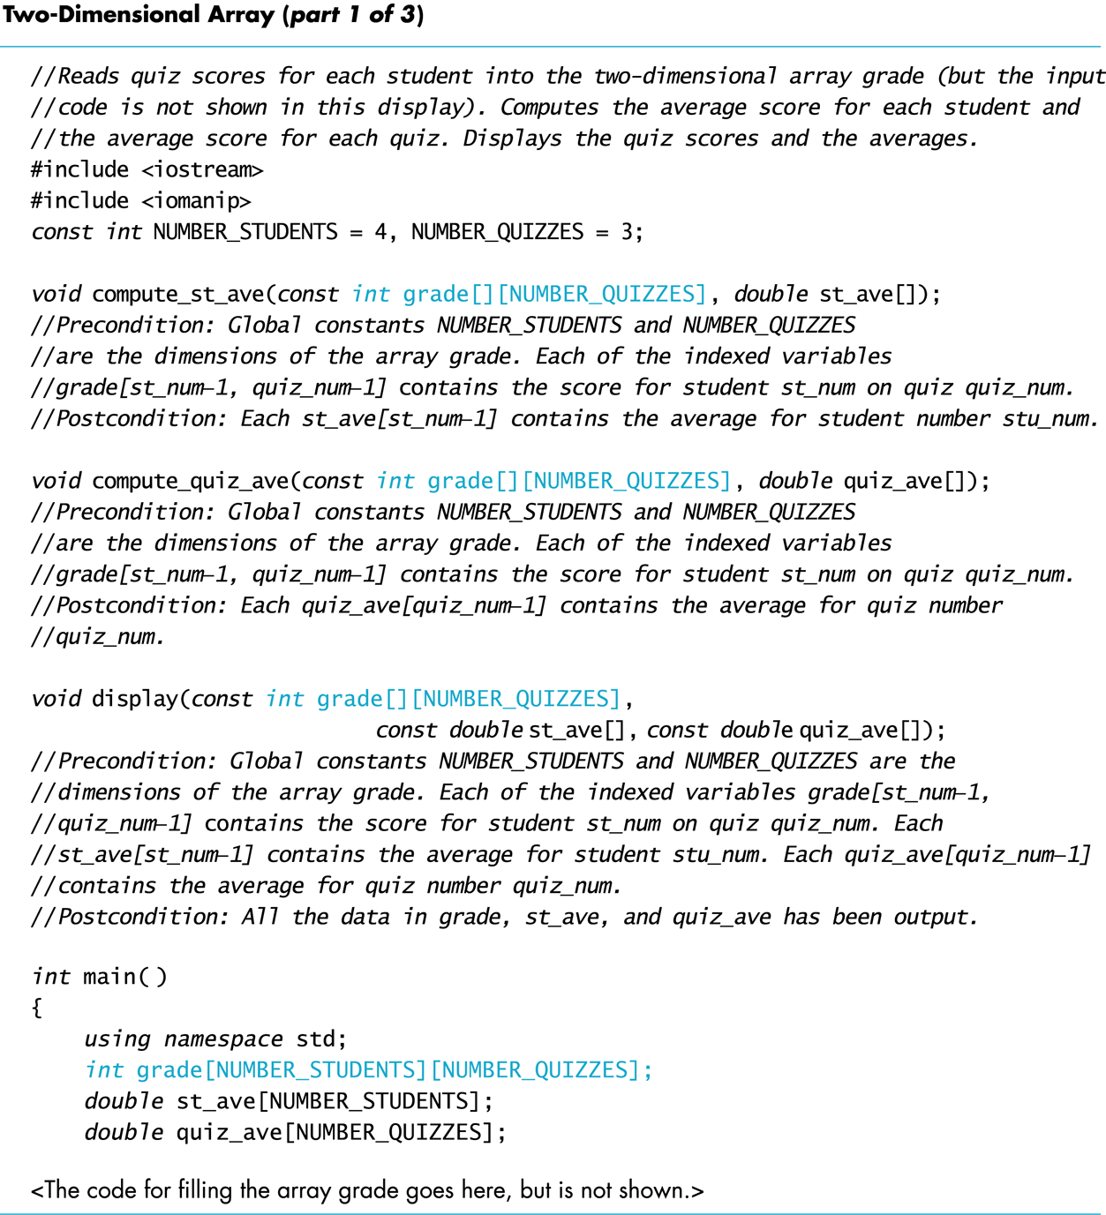
Display 7.13 (1/3)

Slide 79
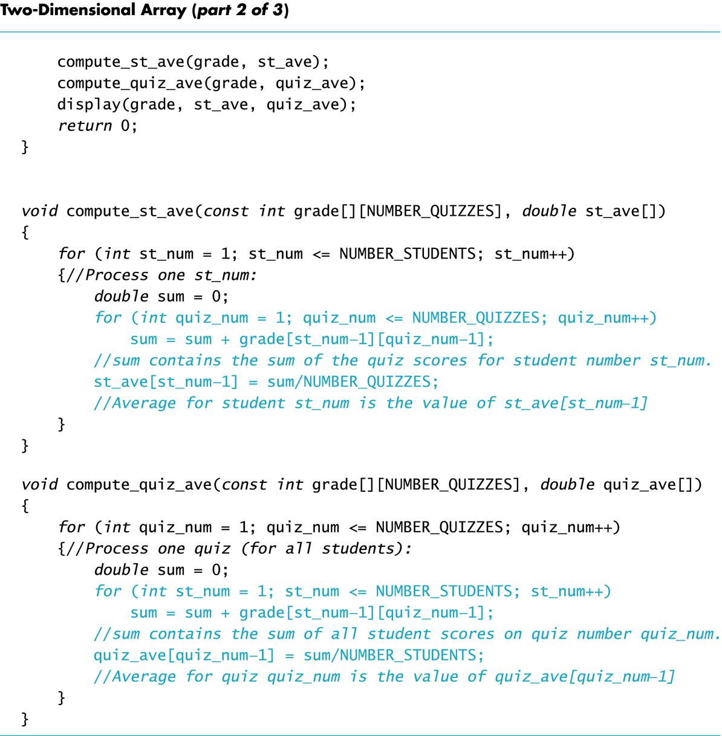
Display 7.13 (2/3)

Slide 80
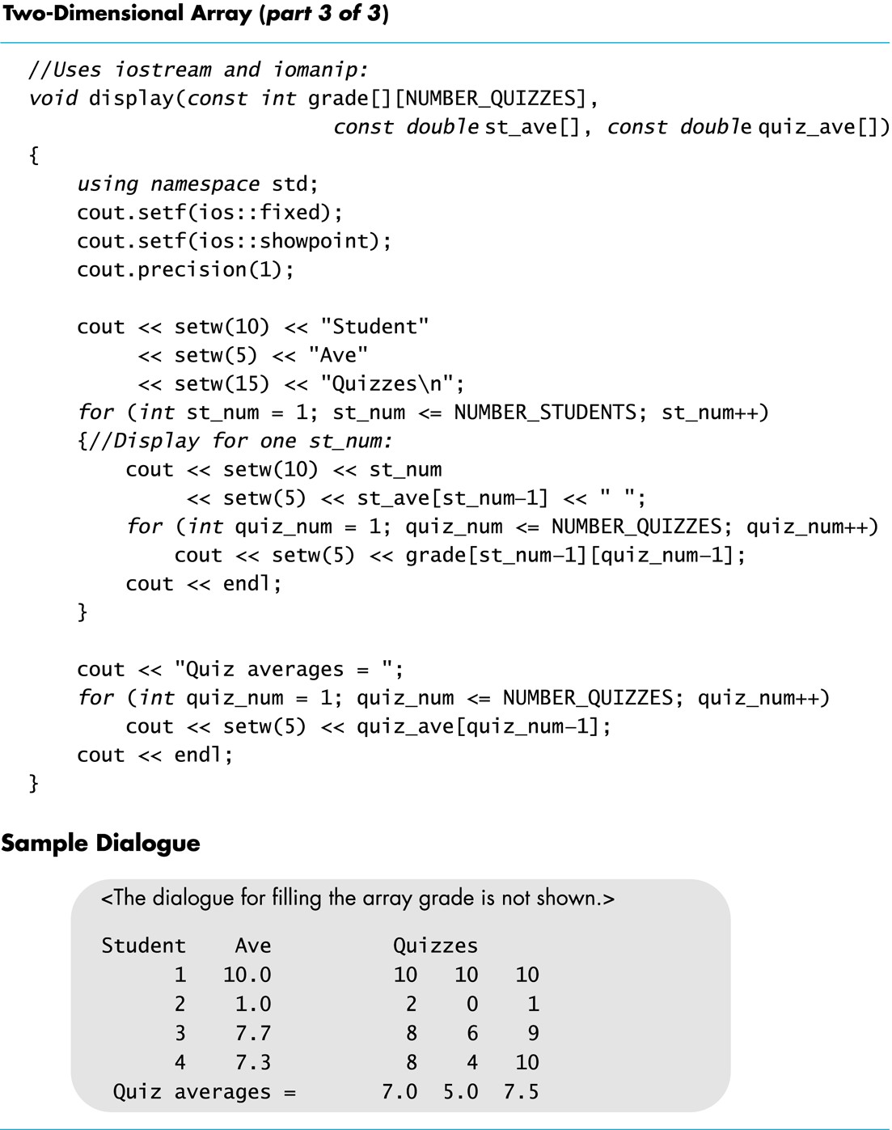
Display 7.13 (3/3)

Slide 81
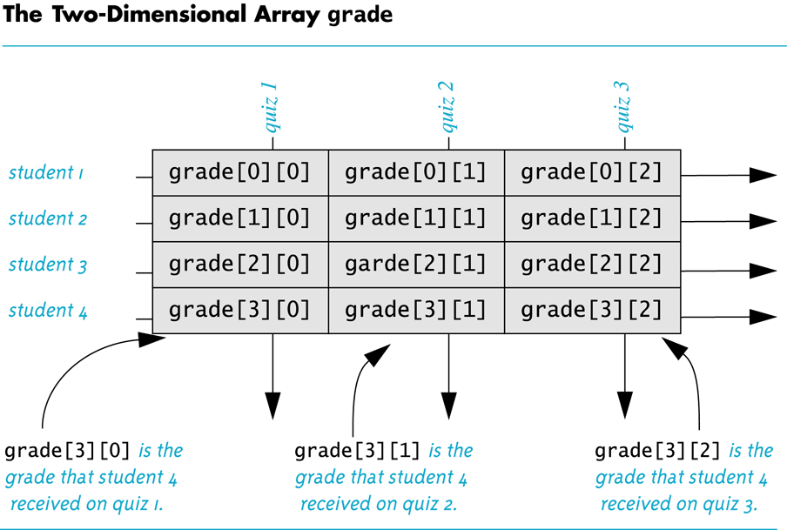
Display 7.14

Slide 82
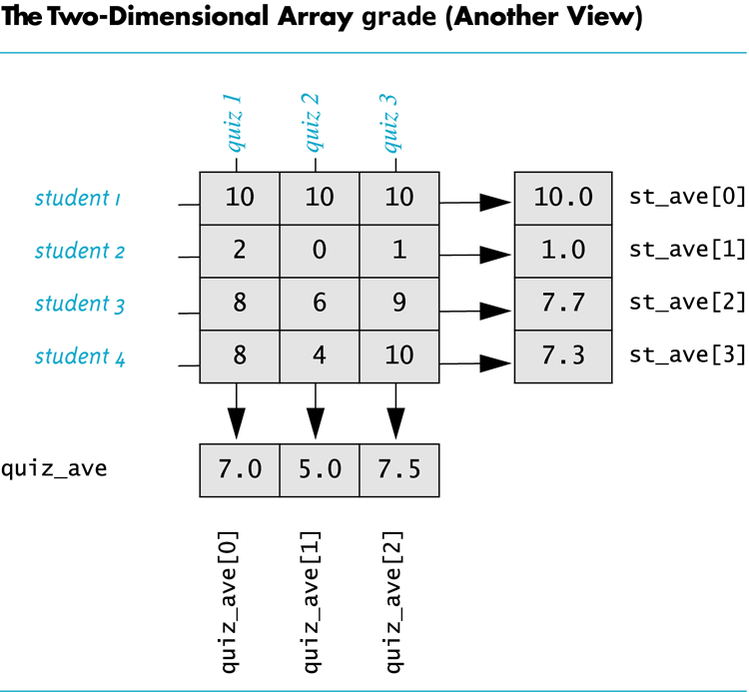
Display 7.15

Slide 83
Showing Decimal Places
To specify fixed point notation
setf(ios::fixed)
To specify that the decimal point will always be shown
setf(ios::showpoint)
To specify that two decimal places will always be shown
precision(2)
Example: cout.setf(ios::fixed); cout.setf(ios::showpoint); cout.precision(2); cout << "The price is " << price << endl;

