Slide 1
Functions
Programmer-Defined Functions
Local Variables in Functions
Overloading Function Names
void Functions,
Call-By-Reference Parameters in Functions

Slide 2
Programmer-Defined Functions

Slide 3
function declaration
function call
function header
function body
function definition

Slide 4
Programmer-Defined Functions
Two components
Function declaration (or function prototype)
Shows how the function is called
Must appear in the code before the function can be called
Syntax: Type_returned Function_Name(Parameter_List); //Comment describing what function does
Function definition
Describes how the function does its task
Can appear before or after the function is called
Syntax: Type_returned Function_Name(Parameter_List) { //code to make the function work }
;

Slide 5
Function Declaration
Tells the return type
Tells the name of the function
Tells how many arguments are needed
Tells the types of the arguments
Tells the formal parameter names
Formal parameters are like placeholders for the actual arguments used when the function is called
Formal parameter names can be any valid identifier
Example:
double total_cost(int number_par, double price_par); // Compute total cost including 5% sales tax on // number_par items at cost of price_par each

Slide 6
Function Definition
Provides the same information as the declaration
Describes how the function does its task
Example: double total_cost(int number_par, double price_par) { const double TAX_RATE = 0.05; //5% tax double subtotal; subtotal = price_par * number_par; return (subtotal + subtotal * TAX_RATE); }
function body

Slide 7
The return Statement
Ends the function call
Returns the value calculated by the function
Syntax: return expression;
expression performs the calculation or
expression is a variable containing the calculated value
Example: return subtotal + subtotal * TAX_RATE;

Slide 8
Function Call Details
The values of the arguments are plugged into the formal parameters (Call-by-Value mechanism with call-by-value parameters)
The first argument is used for the first formal parameter, the second argument for the second formal parameter, and so forth.
The value plugged into the formal parameter is used in all instances of the formal parameter in the function body

Slide 9
1. Before the function is called, values of the variable number and price are set to 2 and 10, by cin statements.
As for this function call, number and price are arguments
2. The function call executes and the value of number (which is 2) plugged in for number_par and value of price (which is 10.10) plugged in for price_par.

Slide 10
3. The body of the function executes with number_par set to 2 and price_par set to 10.10, producing the value 20.20 in subtotal.
4. When the return statement is executed, the value of the expression after return is evaluated and returned by the function in this case.
(subtotal + subtotal * TAX_RATE) is
(20.20+20.20*0.05) or 21.21.

Slide 11
5. The value 21.21 is returned to where the function was invoked or called. The result is that total_cost (number, price) is replaced by the return value of 21.21. The value of bill is set equal to 21.21 when the statement
bill=total_cost(number,price);
ends.

Slide 12
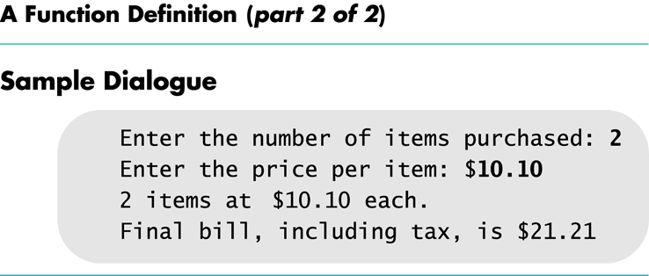

Slide 13
Function Call
Tells the name of the function to use
Lists the arguments
Is used in a statement where the returned value makes sense
Example: double bill = total_cost(number, price);

Slide 14
Automatic Type Conversion
Given the definition double mpg(double miles, double gallons) { return (miles / gallons); } what will happen if mpg is called in this way? cout << mpg(45, 2) << “ miles per gallon”;
The values of the arguments will automatically be converted to type double (45.0 and 2.0)

Slide 15
Function Declarations
Two forms for function declarations
List formal parameter names
List types of formal parameters, but not names
Description of the function in comments
Examples:
double total_cost(int number_par, double price_par); double total_cost(int, double);
But in definition, function headers must always list formal parameter names!

Slide 16
Order of Arguments
Compiler checks that the types of the arguments are correct and in the correct order!
Compiler cannot check that arguments are in the correct logical order
Example: Given the function declaration:
char grade(int received_par, int min_score_par); int received = 95, min_score = 60; cout << grade( min_score, received);
Produces a faulty result because the arguments are not in the correct logical order. The compiler will not catch this!

Slide 17
Function Definition Syntax
within a function definition …
Variables must be declared before they are used
Variables are typically declared before the executable statements begin
double total_cost(int number_par, double price_par) { const double TAX_RATE = 0.05; //5% tax double subtotal; subtotal = price_par * number_par; return (subtotal + subtotal * TAX_RATE); }
At least one return statement must end the function
Each branch of an if-else statement or a switch statement might have its own return statement
Example: char grade(int received_par, int min_score_par)

Slide 19
Placing Definitions
A function call must be preceded by either
The function’s declaration or
The function’s definition
If the function’s definition precedes the call, a declaration is not needed
Placing the function declaration prior to the main function and the function definition after the main function leads naturally to building your own libraries in the future.

Slide 20
Formal Parameter Names
Functions are designed as self-contained modules
Programmers choose meaningful names for formal parameters
Formal parameter names may or may not match variable names used in the main part of the program
It does not matter if formal parameter names match other variable names in the program
Remember that only the value of the argument is plugged into the formal parameter
Recall the memory structure of a program.
Example next

Slide 22
Program Testing
Programs that compile and run can still produce errors
Testing increases confidence that the program works correctly
Run the program with data that has known output
You may have determined this output with pencil and paper or a calculator
Run the program on several different sets of data
Your first set of data may produce correct results in spite of a logical error in the code
Remember the integer division problem? If there is no fractional remainder, integer division will give apparently correct results

Slide 23
Use Pseudocode
Pseudocode is a mixture of English and the programming language in use
Pseudocode simplifies algorithm design by allowing you to ignore the specific syntax of the programming language as you work out the details of the algorithm
If the step is obvious, use C++
If the step is difficult to express in C++, use English

Slide 24
Local Variables in Functions

Slide 25
Local variables in a function
Variables declared in a function:
Are local to that function, i.e., they cannot be used from outside the function
Have the function as their scope
Variables declared in the main part of a program:
Are local to the main part of the program, they cannot be used from outside the main part
Have the main part as their scope

Slide 26
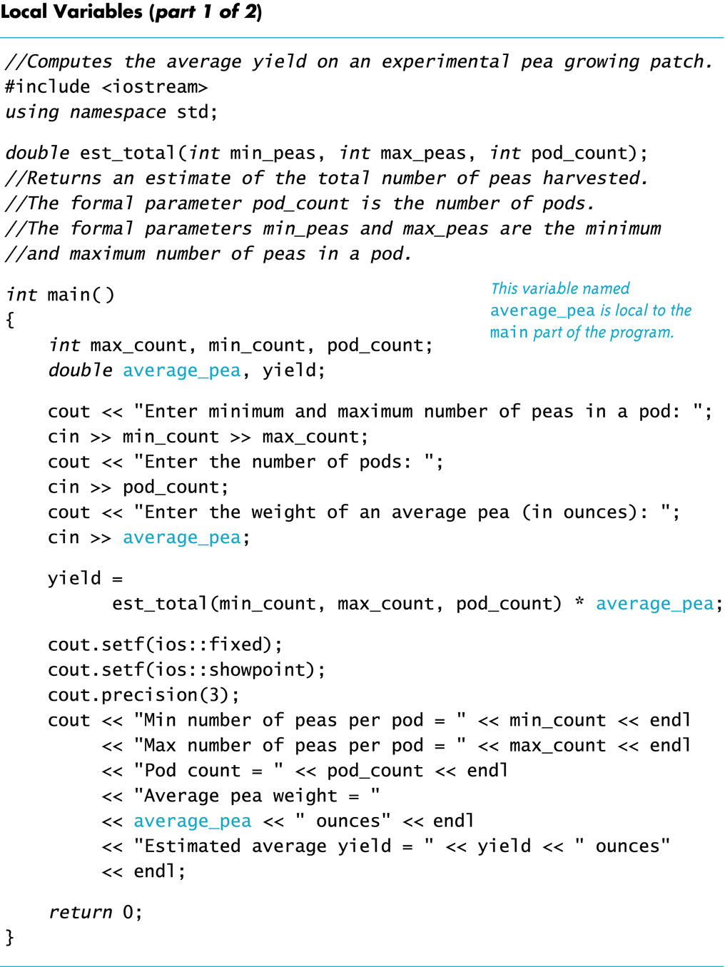

Slide 27
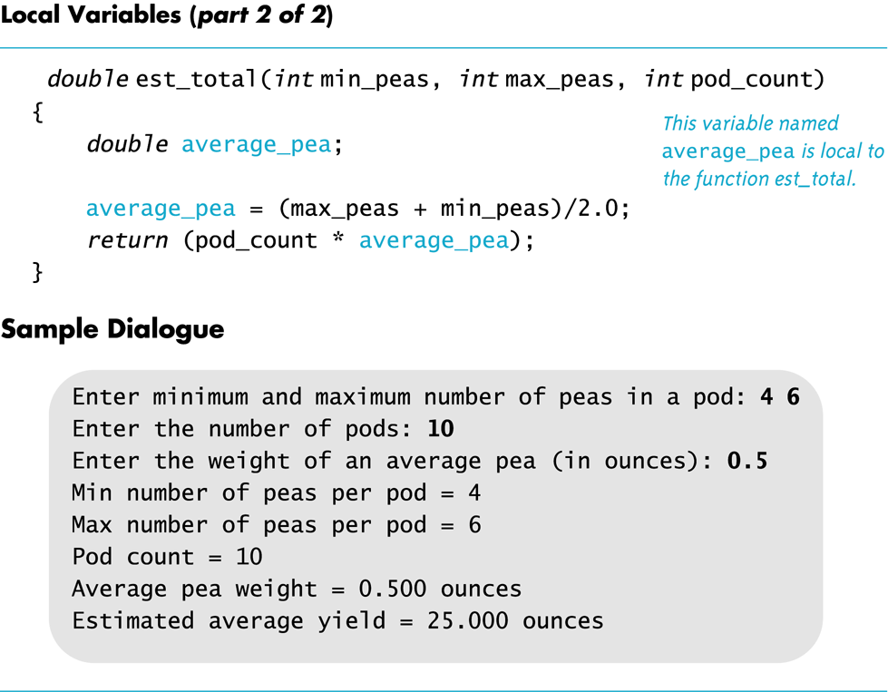

Slide 28
Global Constants
Global Named Constant
declared outside any function body
declared outside the main function body
declared before any function that uses it
available to more than one function as well as the main part of the program
Example:
const double PI = 3.14159; double area(double); int main() {…}
PI is available to the main function and to function volume

Slide 29
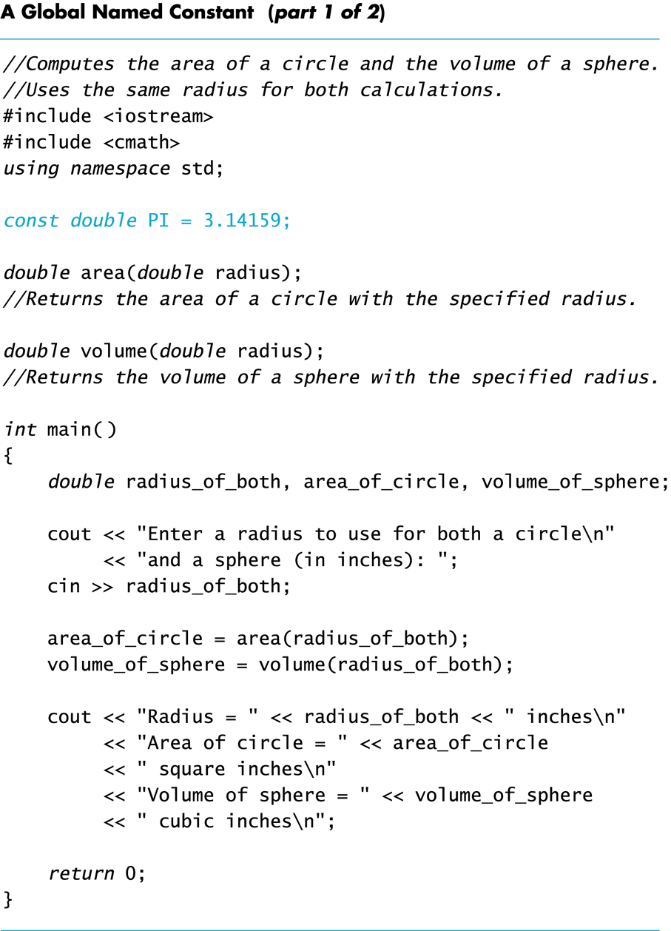

Slide 31
Global Variables
Global Variable -- rarely used when more than one function must use a common variable
Declared just like a global constant except keyword const is not used
Generally make programs more difficult to understand and maintain

Slide 32
Formal Parameters are Local Variables
Formal Parameters are variables that are local to the function definition
They are used just as if they were declared in the function body
Do NOT re-declare the formal parameters in the function body, as they are declared in the function declaration
The call-by-value mechanism
When a function is called the formal parameters are initialized to the values of the arguments in the function call

Slide 33
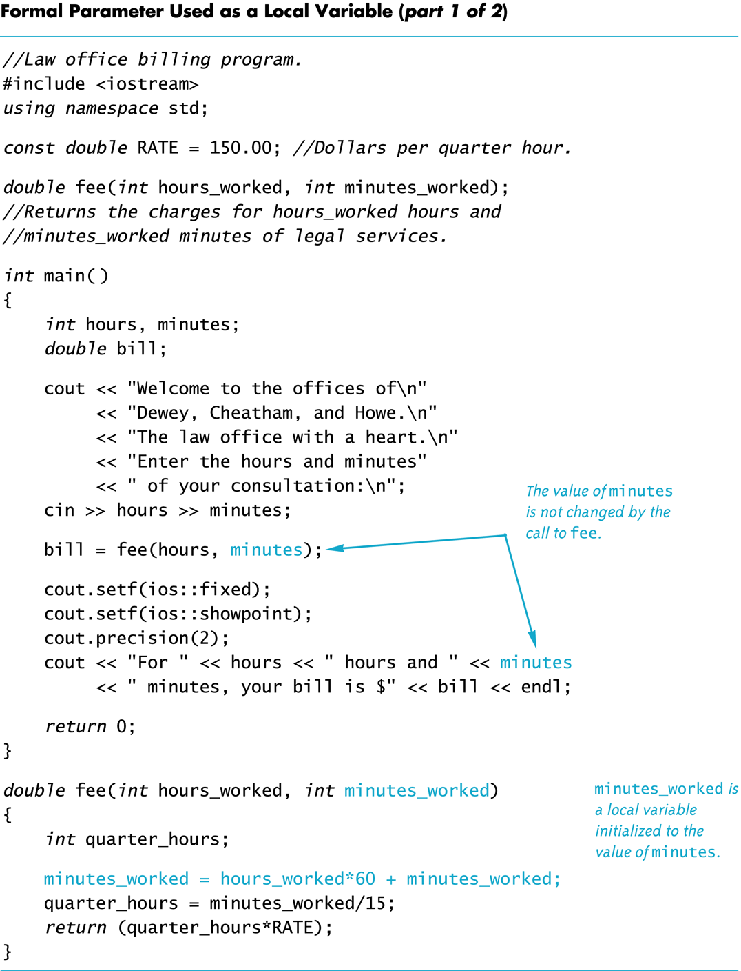
Another example

Slide 34
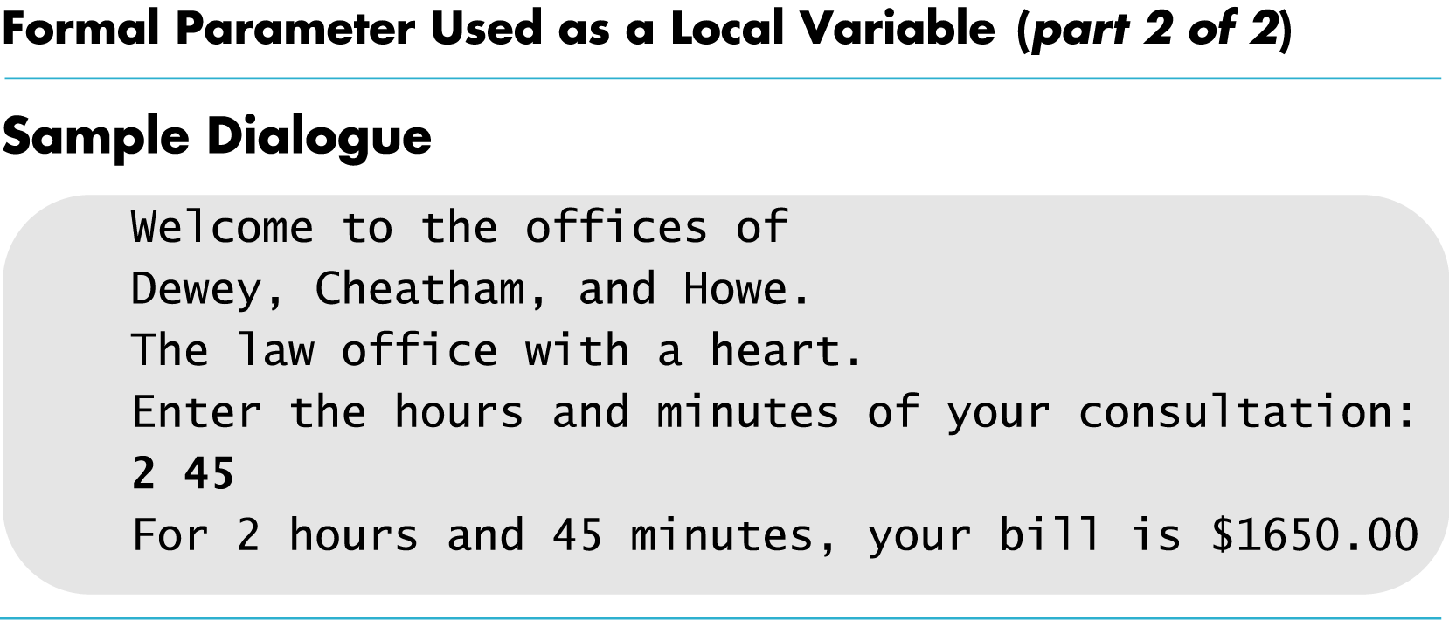

Slide 35
Block Scope
Local and global variables conform to the rules of Block Scope
The code block, generally specified by the { },
where an identifier like a variable is declared.
It determines the scope of the identifier.
Blocks can be nested

Slide 36
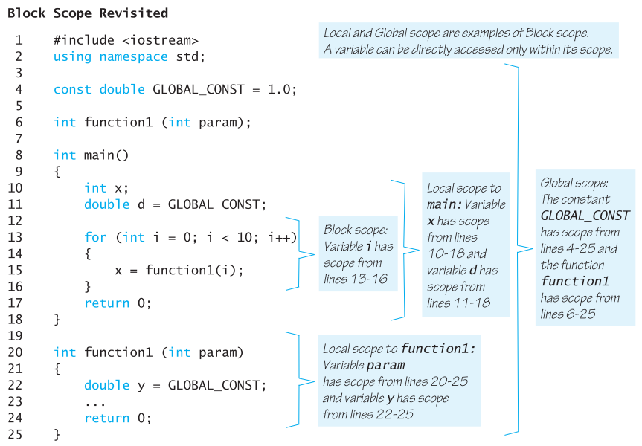
A variable can be directly accessed only within its scope.
Local and Global scopes are examples of Block Scope.

Slide 37
Namespaces Revisited
The start of a file is not always the best place for using namespace std;
Different functions may use different namespaces
Placing using namespace std;
inside the starting brace of a function
Allows the use of different namespaces in different functions
Makes the “using” directive local to the function

Slide 38
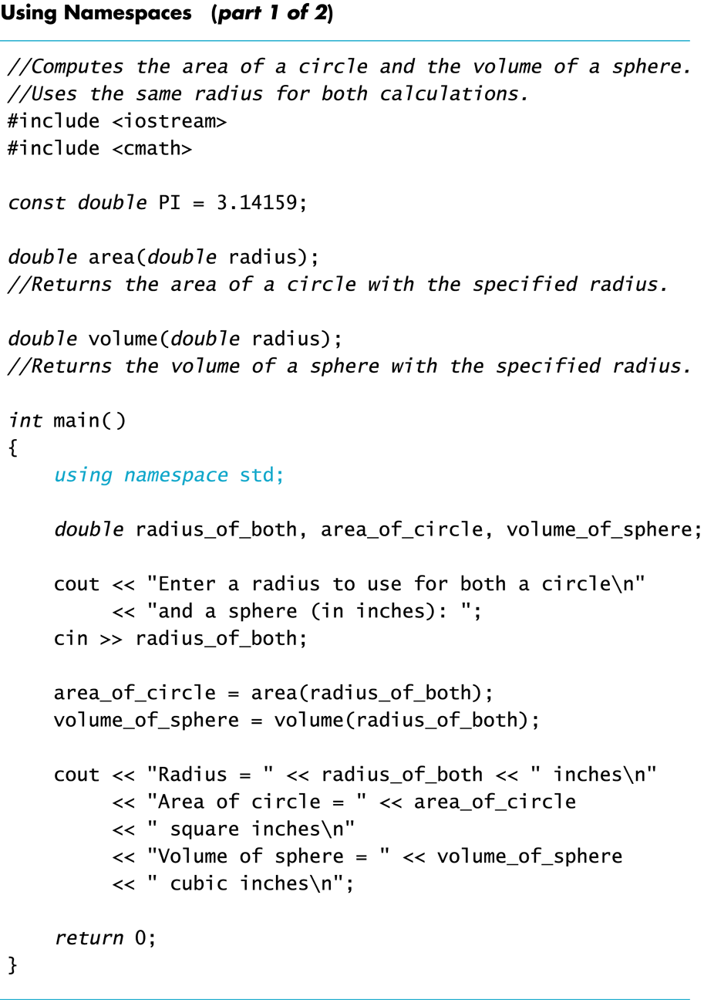

Slide 40
Overloading Function Names

Slide 41
Overloading Function Names
Overloading a function name means
providing more than one declaration and definition using the same function name
C++ allows more than one definition for the same function name
Very convenient for situations in which the “same” function is needed for different numbers or types of arguments

Slide 42
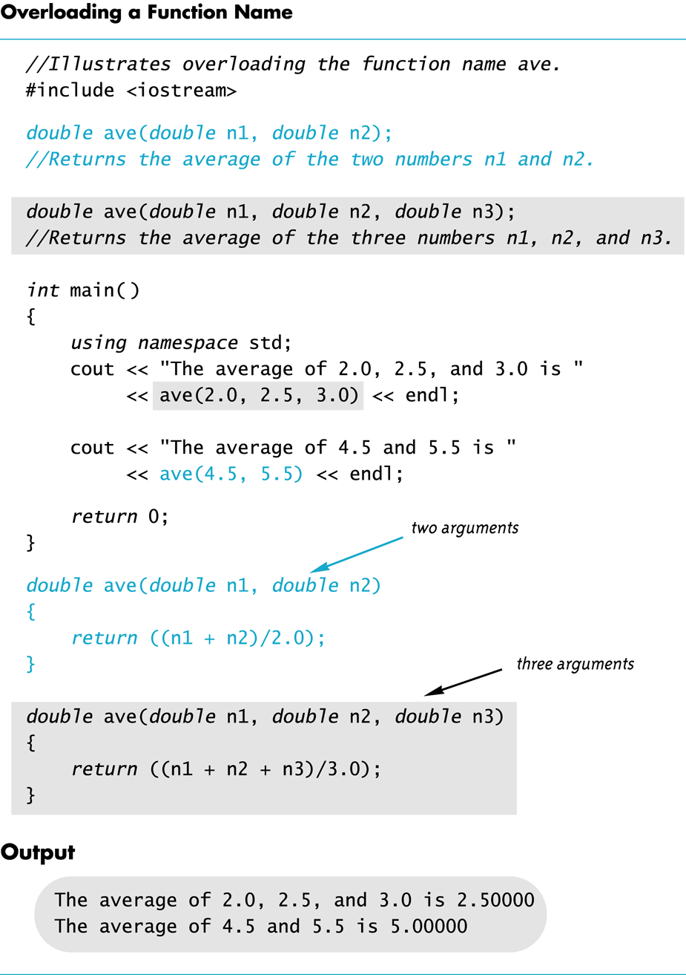

Slide 43
Overloading Examples
double ave(double n1, double n2) { return ((n1 + n2) / 2); }
double ave(double n1, double n2, double n3) { return (( n1 + n2 + n3) / 3); }
Compiler checks the number and types of arguments in the function call to decide which function to use cout << ave( 10, 20, 30); uses the second definition

Slide 44
Overloading Details
Overloaded functions
must return a value of the same type
in addition, they ...
must have different numbers of formal parameters AND / OR
must have at least one different type of parameter

Slide 45
Overloading Example
Revising the Pizza Buying program
Rectangular pizzas are now offered!
Change the input and add a function to compute the unit price of a rectangular pizza
The new function could be named unitprice_rectangular
Or, the new function could be a new (overloaded) version of the unitprice function that is already used
Example:
double unitprice(int length, int width, double price)
{ double area = length * width; return (price / area);
}

Slide 46
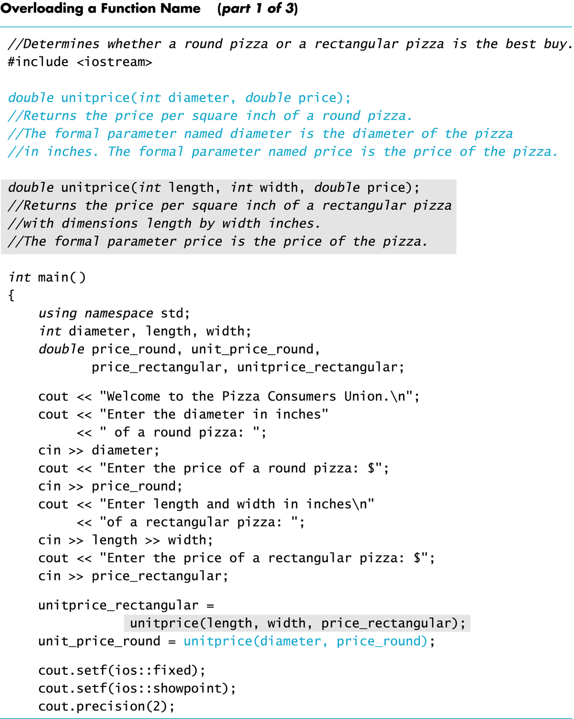

Slide 47
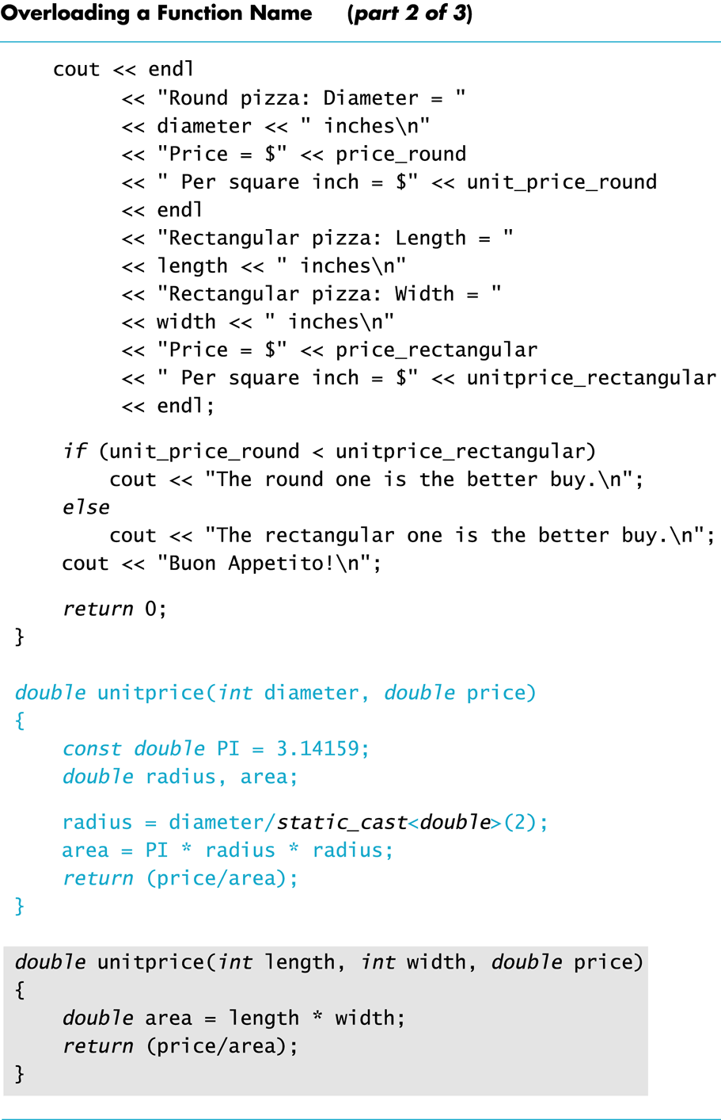

Slide 49
void Functions

Slide 50
Function regarded as code to do some subtask
A subtask might produce
No value (e.g., input or output) to be used by a calling function.
One value to be used by the calling function.
Multiple values to be used by the calling function.
We have seen how to implement functions that return one value, through a return statement
A void-function implements a subtask that ...
either does not give back any value to the calling function
no return statement
or use return;
or gives back multiple values to the calling function, via the call-by-reference parameters

Slide 51
void-Function Definition
Differences between void-function definitions and the definitions of functions that return one value thru return statement.
Keyword void replaces the type of the value returned
void means that no value is returned by the function thru return statement
The return statement does not include and expression, or can be removed in some situations.
Example: void show_results(double f_degrees, double c_degrees) { using namespace std; cout << f_degrees <<“ degrees Fahrenheit is euivalent to “
<< endl << c_degrees << “ degrees Celsius.” << endl; return; }

Slide 52
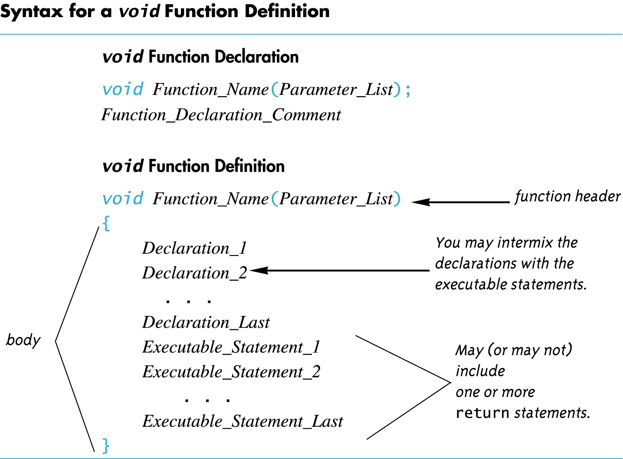

Slide 53
Calling a void-Function
A void-function call
does not need to be part of another statement
it ends with a semi-colon
Example: show_results(32.5, 0.3); NOT: cout << show_results(32.5, 0.3);

Slide 54
void-Function Calls
Mechanism is nearly the same as the function calls we have seen
Argument values are substituted for (or plugged in) the formal parameters
It is fairly common to have no parameters in void-functions
In this case there will be no arguments in the function call
Statements in function body are executed
Optional return statement ends the function
Return statement does not include a value to return
Return statement is implicit if it is not included

Slide 55
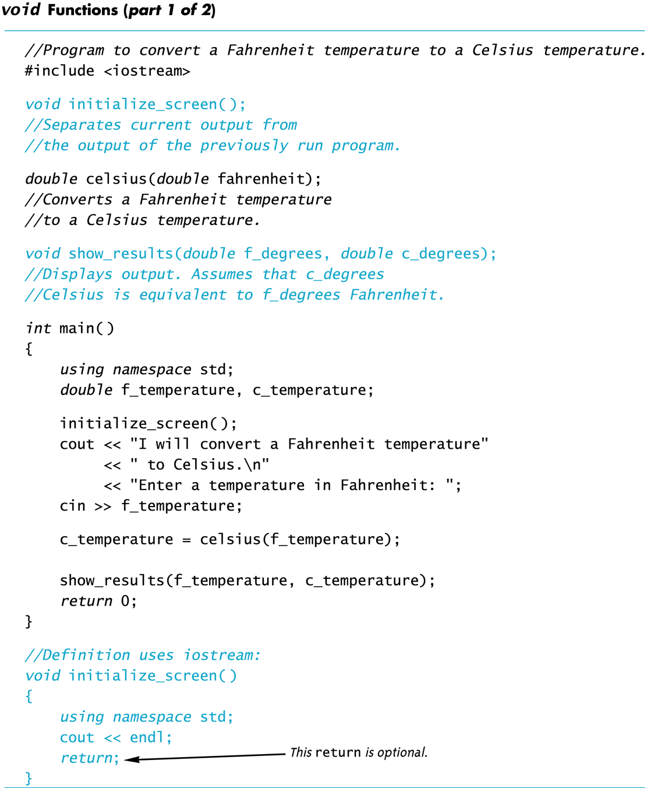

Slide 56
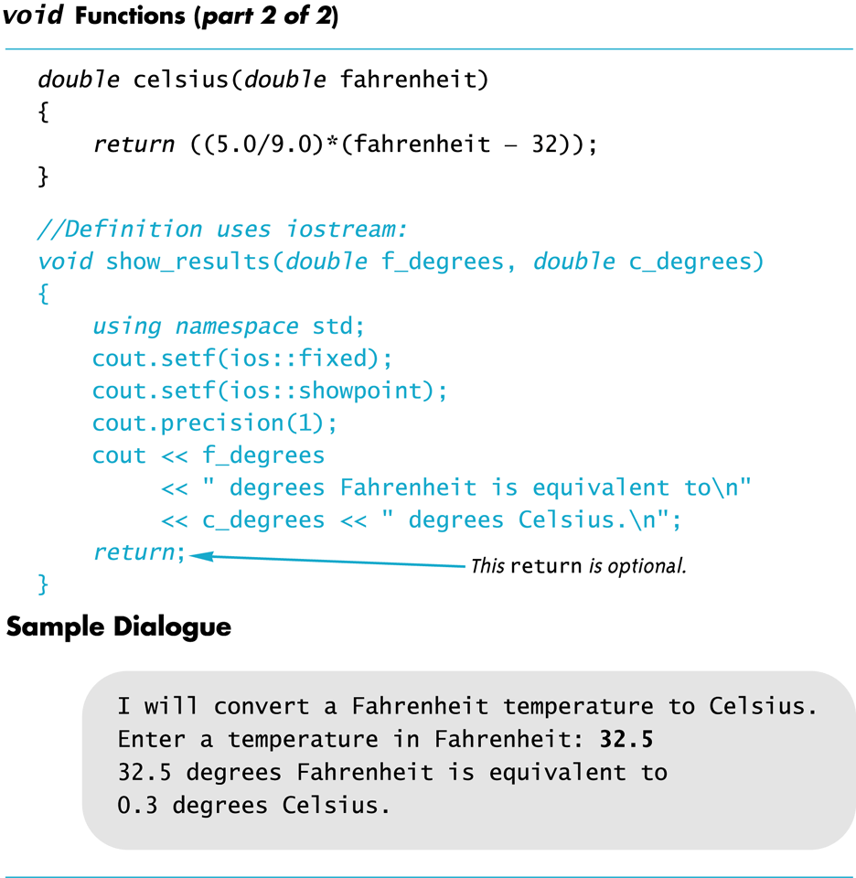

Slide 57
void-Functions: Why use a return?
Is a return statement ever needed in a void-function since no value is returned?
Yes for some scenarios, e.g.
a branch of an if-else statement requires that the function ends to avoid producing more output, or creating a mathematical error.
void-function in the example on next page (Display 5.3), avoids division by zero with a return statement

Slide 58
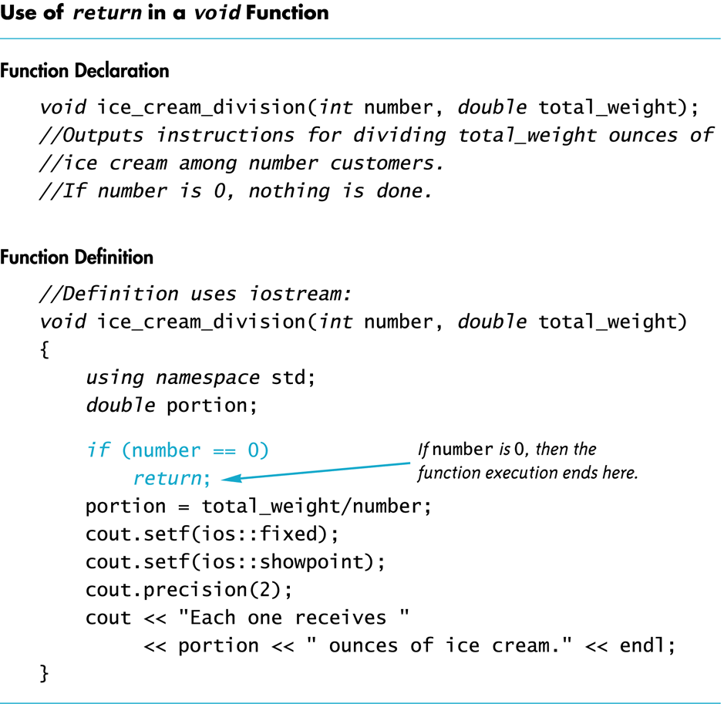

Slide 59
The Main Function
The main function in a program is used like a void function…do you have to end the program with a return-statement?
Because the main function is defined to return a value of type int, the return is needed
C++ standard says the return 0 can be omitted, but many compilers still require it

Slide 60
Call-By-Reference Parameters in Functions

Slide 61
Call-by-Reference Parameters
Call-by-value
A call-by-value parameter of a function receives the values of the corresponding argument during the execution of the function call
Any change made to the value of the parameter in the function body dose not affect the value of the argument
Call-by-reference
A call-by-reference parameter of a function is just another name of the corresponding argument during the execution of the function call
The call-by-reference parameter and the argument refers to the same memory bock.
Any change made on the value of the parameter in the function body is essentially the change made on the value of the argument
Arguments for call-by-reference parameters must be variables, not numbers

Slide 62
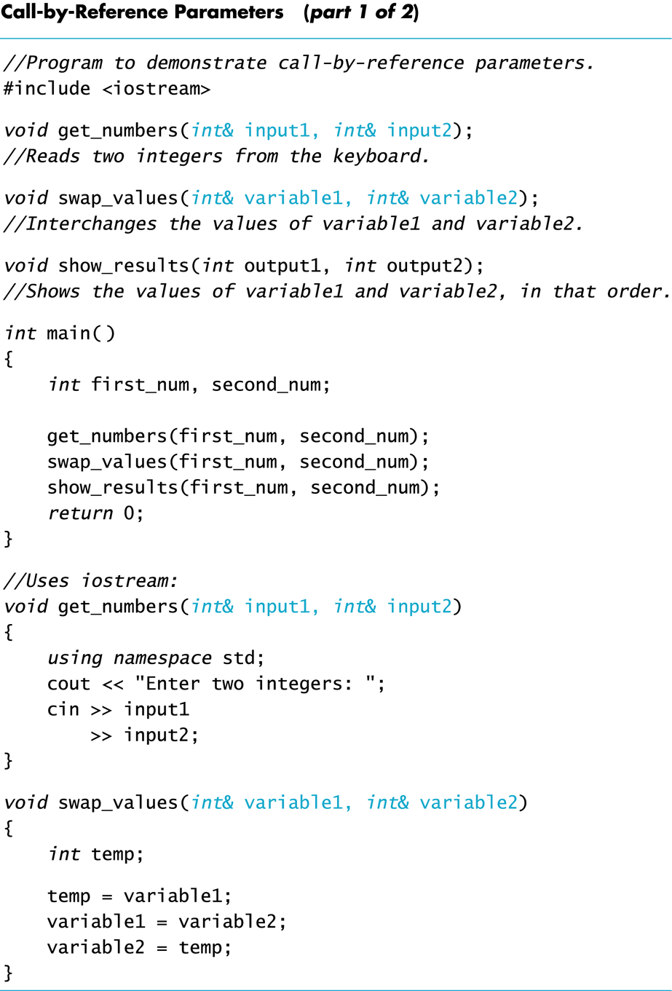

Slide 64
Example: swap_values
void swap(int& variable1, int& variable2) { int temp = variable1; variable1 = variable2; variable2 = temp; }
& symbol (ampersand) identifies variable1 and variable2 as call-by-reference parameters
used in both declaration and definition!
If called with statement ...
swap(first_num, second_num);
first_num is substituted for variable1 in the parameter list
first_num and variable1 are two names for the same variable
second_num is substituted for variable2 in the parameter list
second_num and variable2 are two names for the same variable
temp is assigned the value of variable1 (or first_num)
variable1 (or first_num) is assigned the value in variable2 (or second_num)
variable2 (or second_num) is assigned the original value of variable1 (or first_num) which was stored in temp

Slide 65
Call-By-Reference Details
Call-by-reference works almost as if the argument variable is substituted for the formal parameter, not the argument’s value
In reality, the memory location of the argument variable is given to the formal parameter
Whatever is done to a formal parameter in the function body, is actually done to the value at the memory location of the argument variable

Slide 66
Mixed Parameter Lists
Call-by-value and call-by-reference parameters can be mixed in the same function
Example, consider the following function declaration void good_stuff(int& par1, int par2, double& par3);
par1 and par3 are call-by-reference formal parameters
Changes in par1 and par3 are the changes made on the corresponding argument variables during function call.
par2 is a call-by-value formal parameter
Changes in par2 do not change the argument variable during function call

Slide 67
Choosing Parameter Types
How do you decide whether a call-by-reference or call-by-value formal parameter is needed?
Does the function need to change the value of the variable used as an argument?
Yes? Use a call-by-reference formal parameter
No? Use a call-by-value formal parameter

Slide 68
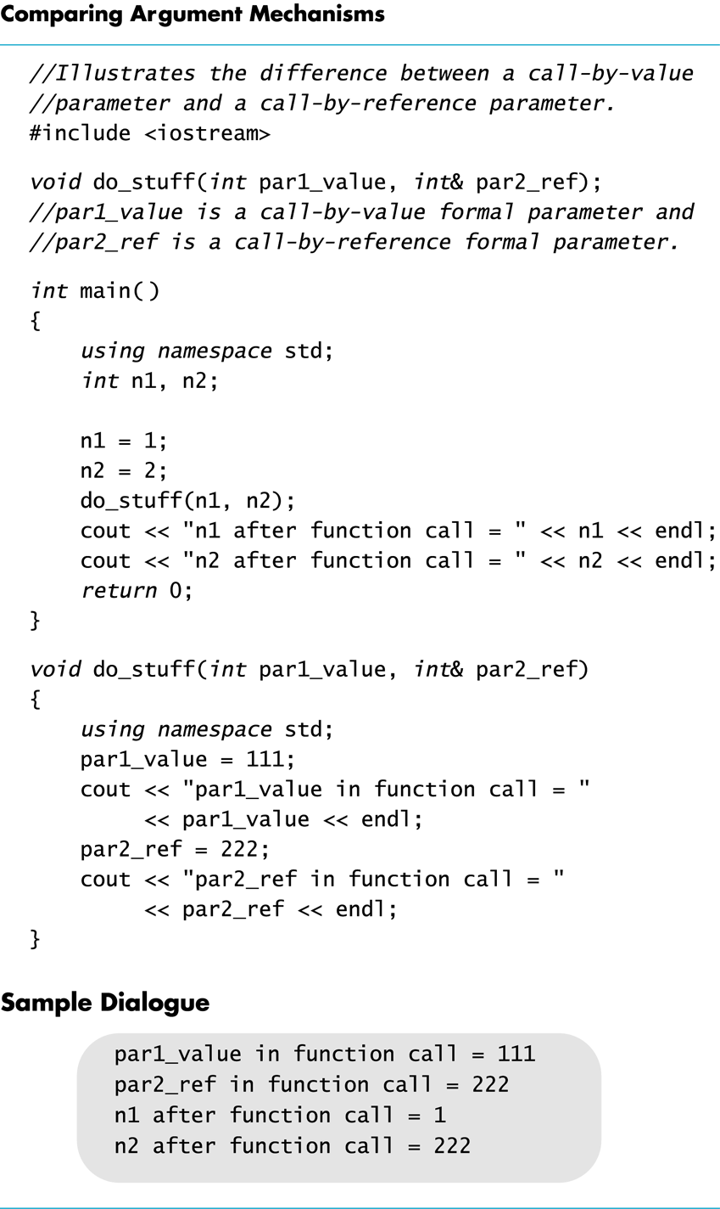

Slide 69
Inadvertent Local Variables
If a function is to change the value of a variable the corresponding formal parameter must be a call-by-reference parameter with an ampersand (&) attached
Forgetting the ampersand (&) creates a call-by-value parameter
The value of the variable will not be changed
The formal parameter is a local variable that has no effect outside the function
Hard error to find…it looks right!

Slide 70
