Slide 1
Inheritance
Chapter 15 & additional topics

Slide 2
Overview
Inheritance Introduction
Three different kinds of inheritance
Changing an inherited member function
More Inheritance Details
Polymorphism

Slide 3
Inheritance Introduction

Slide 4
Motivating Example: Employee Classes
Design a record-keeping program with records for salaried and hourly employees
Salaried and hourly employees belong to a class of people who share the property "employee"
Salaried employee
A subset of employees with a fixed wage
Hourly employees
Another subset of employees earn hourly wages
All employees have a name and SSN
Functions to manipulate name and SSN are the same for hourly and salaried employees

Slide 5
First define a class called Employee for all kinds of employees
The Employee class will be used later to define classes for hourly and salaried employees

Slide 6
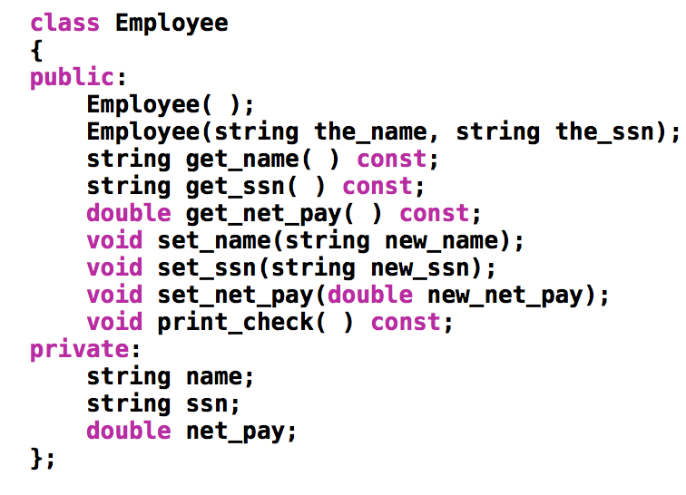
employee.h
Employee
name
ssn
net_pay
Employee()
Employee(string, string)
print_check()
get_name()
get_ssn()
get_net_pay()
set_name()
set_ssn()
set_net_pay()

Slide 7
We now use Employee class to create an HourlyEmployee class

Slide 8
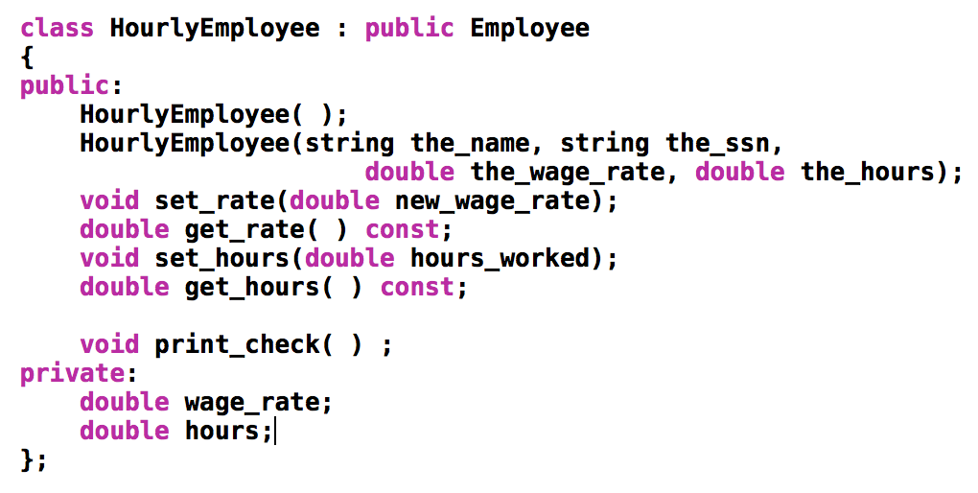
see book Display 15.3
hourlyemployee.h
HourlyEmployee is derived from Class Employee
HourlyEmployee inherits all member functions and member variables of Employee
NOT SHOWN explicitly in HourlyEmployee’s defn
The class definition begins class HourlyEmployee : public Employee
note that :public Employee shows that HourlyEmployee is derived from class Employee
HourlyEmployee declares additional member variables wage_rate and hours

Slide 9
Employee
name
ssn
Inheritance：
a new class, called a derived class, is created from another class (i.e., the base class)
A derived class automatically has all the member variables and functions of the base class
A derived class can have additional member variables and/or member functions
net_pay
Employee()
Employee(string, string)
print_check()
get_name()
get_ssn()
get_net_pay()
set_name()
set_ssn()
set_net_pay()
is
HourlyEmployee
name
ssn
wage_rate
hours
net_pay
Employee()
Employee(string, string)
print_check()
set_rate()
get_rate()
get_name()
get_ssn()
get_net_pay()
set_hours ()
get_hours ()
set_name()
set_ssn()
set_net_pay()

Slide 10
A derived class automatically has all the member variables and functions of the base class.
But, the derived class might not have the same access rights as the base class when accessing those inherited members! (To be discussed soon…)

Slide 11
Inherited Members
A derived class inherits all the members (data members, functions) of the parent class
The derived class should not re-declare or re-define a member function inherited from the parent unless …
The derived class wants to use the inherited member function for doing something different
The derived class can add member variables & member functions

Slide 12
Display 15.3
hourlyemployee.h
Only list the declaration of an inherited member function if you want to change the defn of the function.

Slide 13
Why re-define print_check() ?
A practical concern here…
print_check will have different definitions to print different checks for each type of employee
An Employee object lacks sufficient information to print a check
Each derived class will have sufficient information to print a check

Slide 14
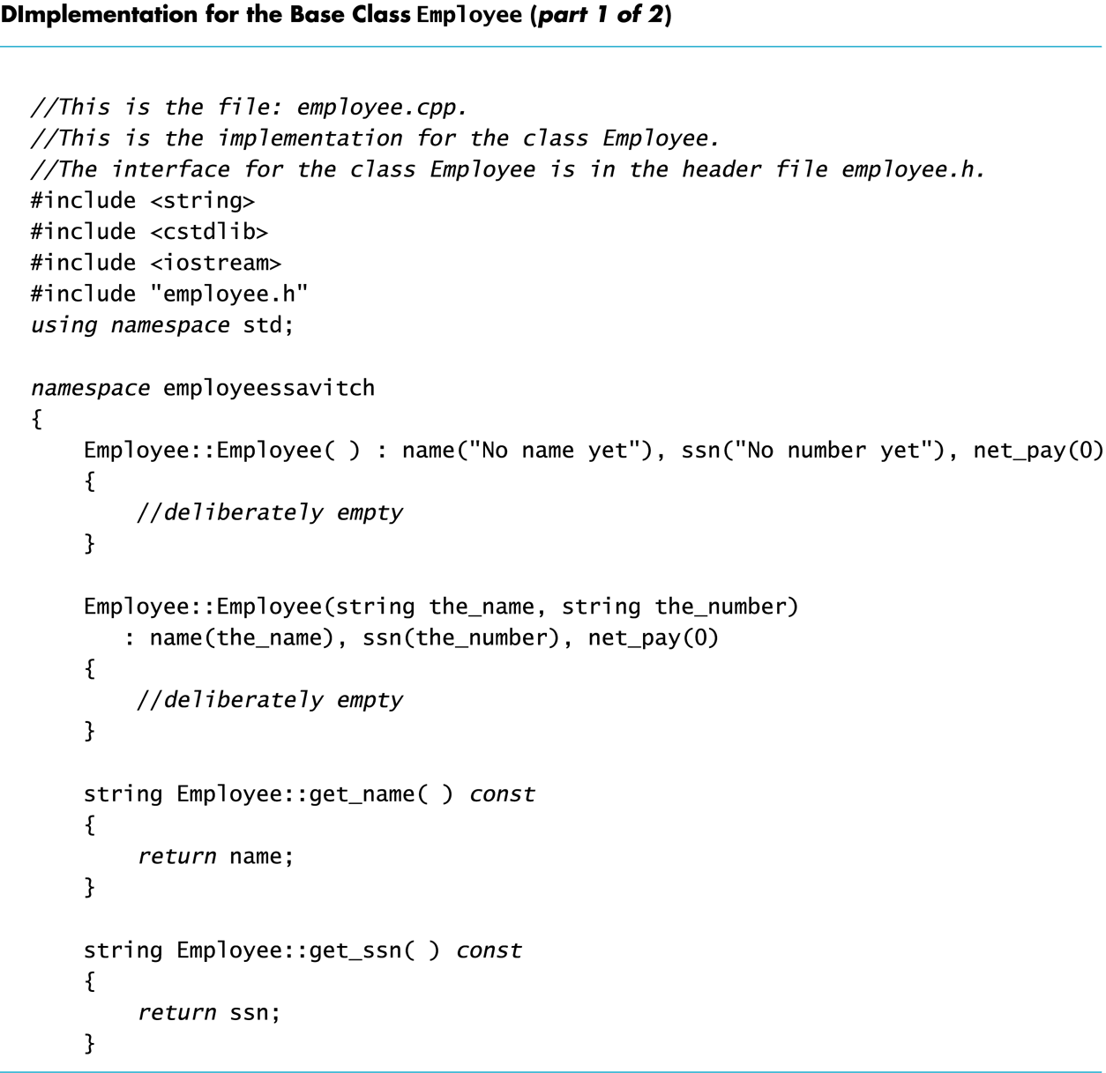
employee.cpp

Slide 15
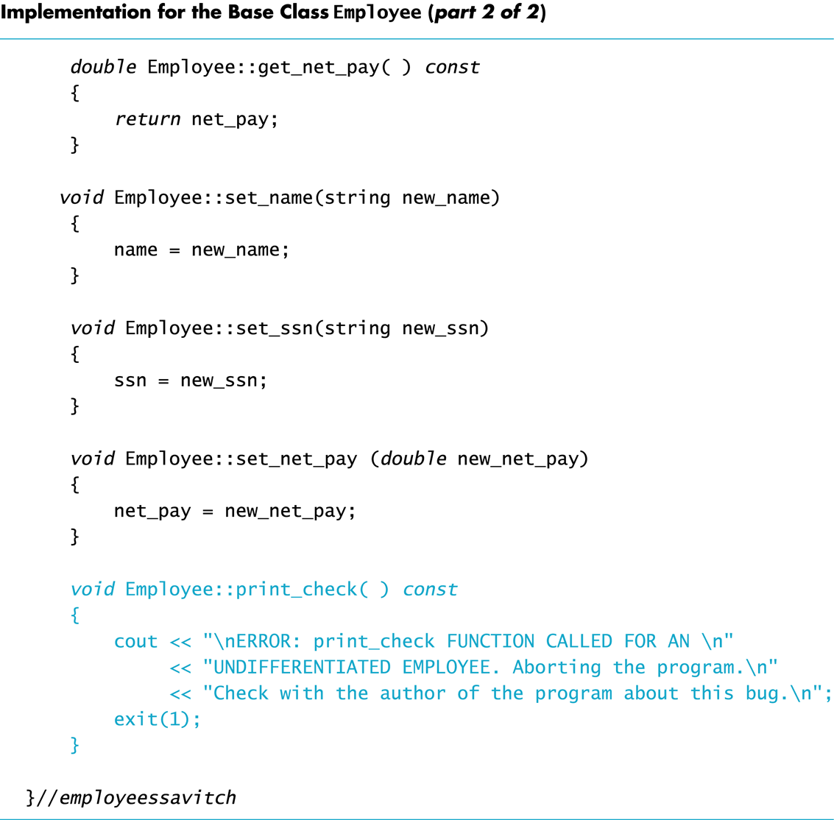
employee.cpp

Slide 16
Implementing a Derived Class
Any member function added in the derived class are defined in the implementation file for the derived class
Definitions are not given for inherited functions that are not to be changed
The HourlyEmployee class is implemented in HourlyEmployee.cpp
Textbook Display 15.5

Slide 17
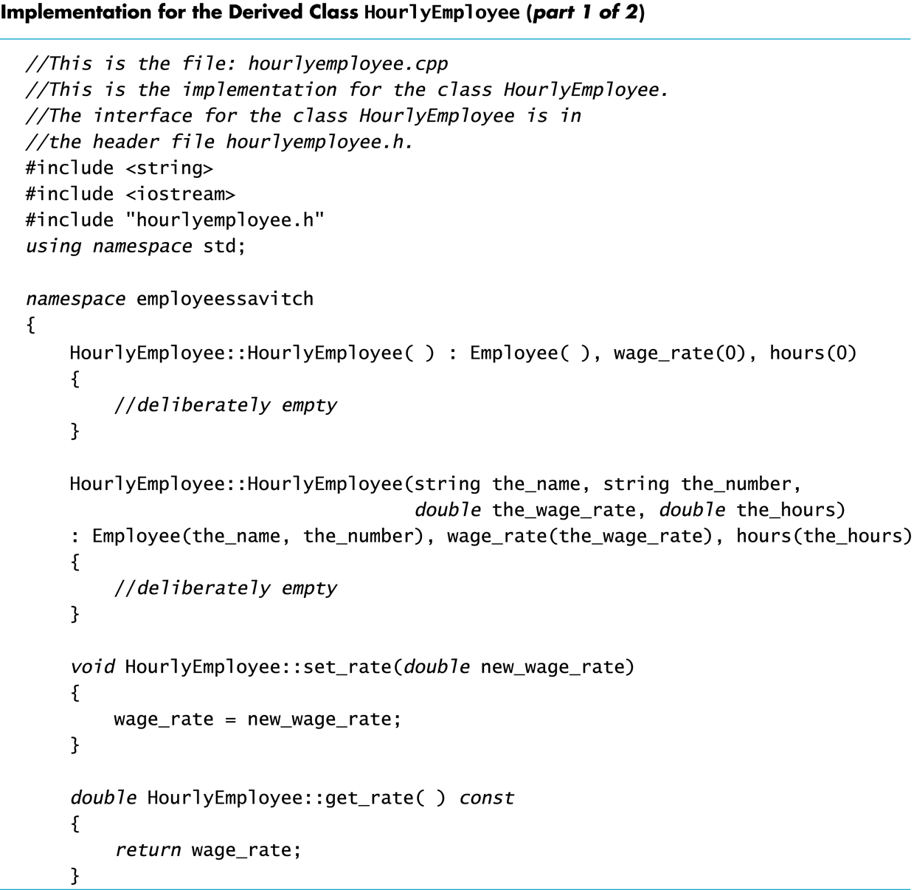
Display 15.5 (1/2)

Slide 18
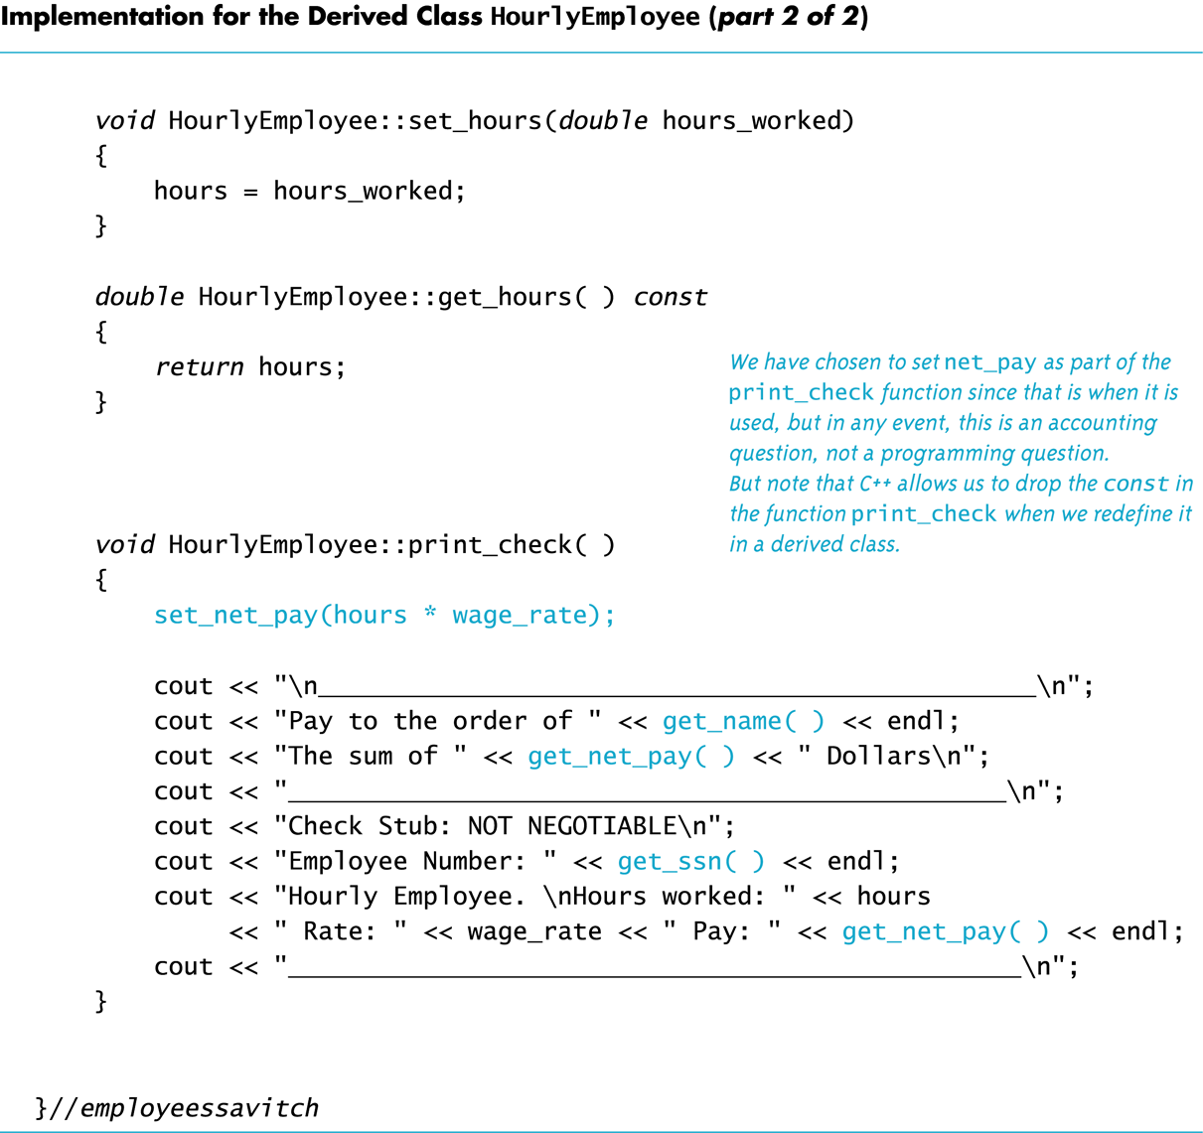
Display 15.5 (2/2)

Slide 19
We now use Employee class to create an SalariedEmployee class

Slide 20
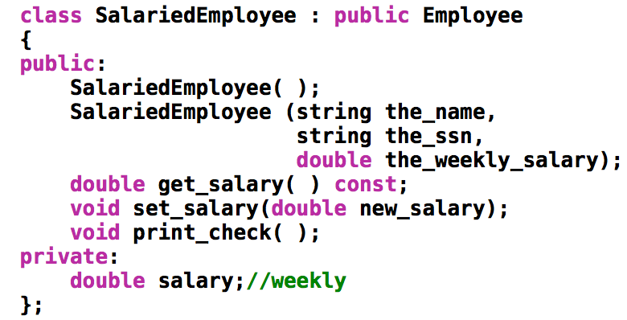
Class SalariedEmployee
salariedemployee.h
The class SalariedEmployee is also derived from Employee
Function print_check is redefined to have a meaning specific to salaried employees
SalariedEmployee adds a member variable salary

Slide 21
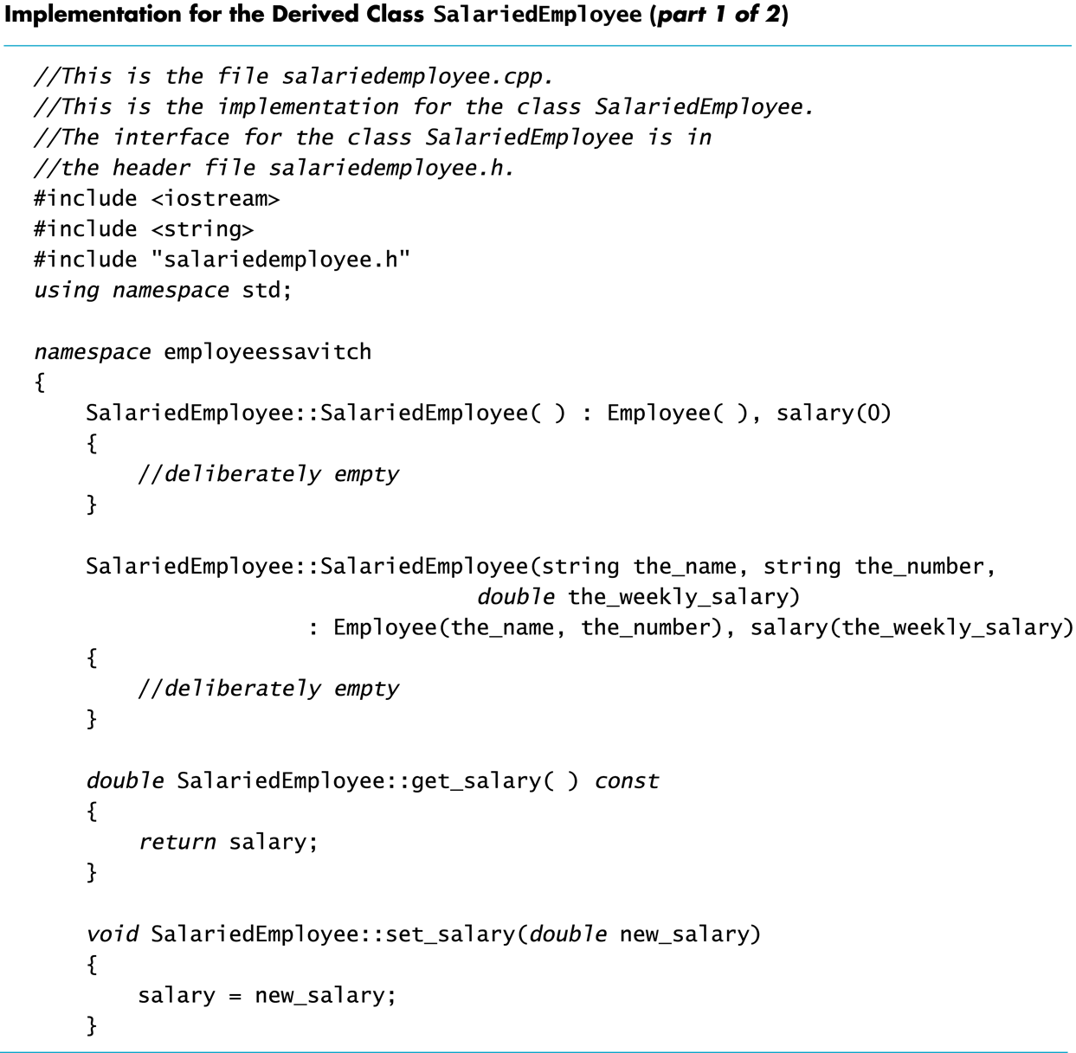
Display 15.6 (1/2)
salariedemployee.cpp

Slide 22
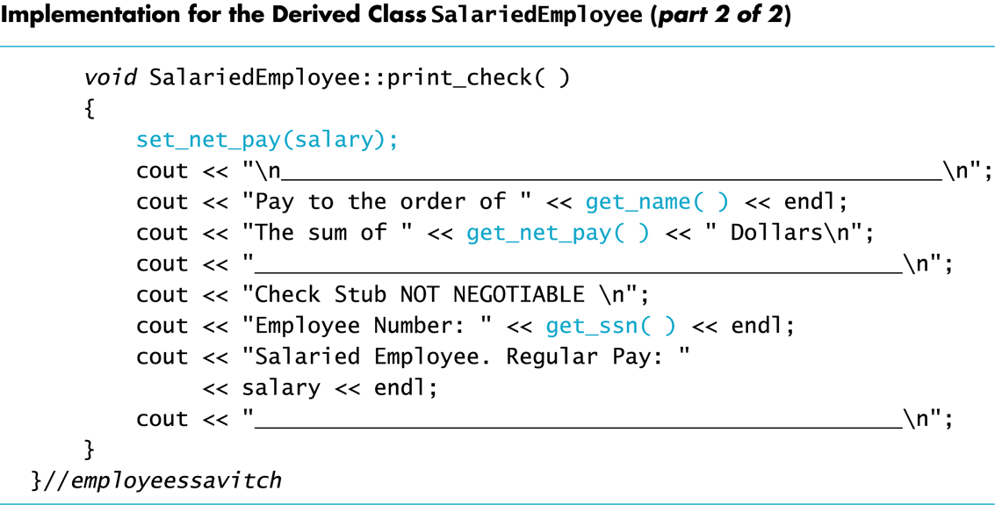
Display 15.6 (2/2)

Slide 23
Parent and Child Classes
Recall that a child class automatically has all the members of the parent class
The parent class is an ancestor of the child class
The child class is a descendent of the parent class
The parent class (Employee) contains all the code common to the child classes
You do not have to re-write the code for each child
Employee
HourlyEmployee
SalariedEmployee

Slide 24
Parent and Child Classes (cont’d)
An hourly employee is an employee
An object of type HourlyEmployee can be used wherever an object of type Employee can be used
An object of a class type can be used wherever any of its ancestors can be used
An ancestor cannot be used in a place where one of its descendents is expected
void fun1(Employee x);
void fun2(HourlyEmployee y);
int main()
{
Employee a;
HourlyEmployee b;
fun1(a); //correct
fun1(b); //correct
fun2(a); //incorrect
fun2(b); //correct
}
public inheritance is an
is-a relationship

Slide 25
Derived Class’s Constructors
A base class’s constructor is not inherited in a derived class
The base class constructor can be invoked by the constructor of the derived class
The constructor of a derived class begins by invoking the constructor of the base class in the initialization section:
HourlyEmployee::HourlyEmployee : Employee( ), wage_rate( 0), hours(0) { //no code needed }
Call a constructor for Employee

Slide 26
Default Initialization
If a derived class constructor does not invoke a base class constructor explicitly, the base class default constructor will be used automatically
If class B is derived from class A and class C is derived from class B
When a object of class C is created
The base class A's constructor is the first invoked
Class B's constructor is invoked next
C's constructor completes execution

Slide 27
Private is Private
A member variable (or function) that is private in the parent class is not directly accessible by the member functions in the child class
This code is illegal as net_pay is a private member of Employee! void HourlyEmployee::print_check( ) { net_pay = hours * wage_rage;
}
The parent class member functions must be used to access the private members of the parent
A member function of a class can NOT directly access its own member variable (inherited, private to its base class)!

Slide 28
The protected Qualifier
protected members of a class appear to be private outside the class, but are directly accessible within a derived classes
If member variables name, net_pay, is listed as protected (not private) in the Employee class, this code becomes legal: HourlyEmployee::print_check( ) { net_pay = hours * wage_rage;
access_specifiers_demo.cpp

Slide 29
Using protected or not?
Using protected members of a class is a convenience to facilitate writing the code of derived classes.
Protected members are not necessary
Derived classes can use the public methods of their ancestor classes to access private members
Many programming authorities consider it bad style to use protected member variables

Slide 30
Overview
Inheritance Introduction
Three different kinds of inheritance
Changing an inherited member function
More Inheritance Details
Polymorphism

Slide 31
Three different kinds of inheritance

Slide 32
Three different ways for classes to inherit from other classes: public, private, and protected.
// Inherit from Base publicly
class D1: public Base
{ };
// Inherit from Base privately
class D2: private Base
{ };
// Inherit from Base protectedly
class D3: protected Base
{ };
class D4: Base // Defaults to private inheritance
{ };
If you do not choose an inheritance type, C++ defaults to private inheritance (just like members default to private access if you do not specify otherwise).

Slide 33
Public inheritance
// Inherit from Base publicly
class D1: public Base
{ };
All members keep their original access specifications.
Private members stay private, protected members stay protected, and public members stay public.
public inheritance
Base class access specifier | Derived class access specifiier (implicitly given) | Directly accessible in member functions of derived class? | Directly accessible in any other code?
public | public | yes | yes
private | private | no | no
protected | protected | yes | no

Slide 34
Private inheritance
// Inherit from Base privately
class D2: private Base
{ };
All members from the base class are inherited as private.
private members stay private, and protected and public members become private.
This does not affect that way that the derived class accesses members inherited from its parent! It only affects the code trying to access those members through the derived class.
private inheritance
Base class access specifier | Derived class access specifiier (implicitly given) | Directly accessible in member functions of derived class? | Directly accessible in any other code?
public | private | yes | no
private | private | no | no
protected | private | yes | no

Slide 35
Protected inheritance
// Inherit from Base protectedly
class D3: protected Base
{ };
Rarely used. The public and protected members become protected, and private members stay private.
protected inheritance
Base class access specifier | Derived class access specifiier (implicitly given) | Directly accessible in member functions of derived class? | Directly accessible in any other code?
public | protected | yes | no
private | private | no | no
protected | protected | yes | no

Slide 36
Member functions of a derived classes have access to its inherited members based ONLY on the access specifiers of its immediate parent, not affected by the inheritance method used!
Base class access specifier for members | Derived class access specifiier (implicitly given for inherited members) | Directly accessible in member functions of derived class? | Directly accessible in any other code?
public inheritance
public | public | yes | yes
private | private | no | no
protected | protected | yes | no
private inheritance
public | private | yes | no
private | private | no | no
protected | private | yes | no
protected inheritance
public | protected | yes | no
private | private | no | no
protected | protected | yes | no

Slide 37
Overview
Inheritance Introduction
Three different kinds of inheritance
Changing an inherited member function
More Inheritance Details
Polymorphism

Slide 38
Changing an inherited member function

Slide 39
Redefinition of Member Functions
When defining a derived class, list the inherited functions that you wish to change for the derived class
The function is declared in the class definition
HourlyEmployee and SalariedEmployee each have their own definitions of print_check
Next page demonstrates the use of the derived classes defined in HourlyEmployee.h and SalariedEmployee.h.

Slide 40
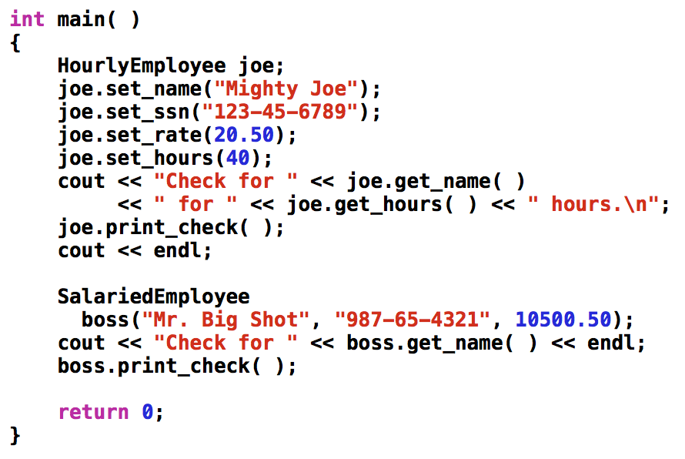
Functions defined in Employee class
set_name()
set_ssn()
print_check()
Functions defined in HourlyEmployee class
set_rate()
set_hours()
print_check()

Slide 41
Redefining vs. Overloading
A function redefined in a derived class has the same number and type of parameters
The prototype (return value, function name, and parameters) of the function in the derived class must be exactly identical to that in the base class.
The derived class has only one function with the same name as the base class
An overloaded function has a different number and/or type of parameters than the base class
For example, the derived class has two functions with the same name as the base class: one is overloading, one is redefining.
void set_name(string first_name, string last_name);//overloading
void set_name(string new_name); //redefine

Slide 42
A side note: function signatures
An overloaded function has multiple signatures
A function signature is the function's name with the sequence of types in the parameter list, not including any const or '&'
Some compilers allow overloading based on including const or not including const

Slide 43
Change access specifier for an inherited member (data or function)
When re-define a function in a derived class,
The re-defined function uses whatever access specifier it is given in the derived class
The re-defined function does not inherit the access specifier of the function with the same prototype in the base class.
Therefore,
You can hide an inherited member (originally public in base class) by specifying it as private
You can expose an inherited member (originally protected in base class) by specifying it as public
However, you can only change the access specifiers of base members the class are accessible in the derived class.
You can never change the access specifier of a base member from private to protected or public, because derived classes do not have access to private members of the base class.

Slide 44
Access to a Redefined Base Function
When a function of a base class is redefined in a derived class, the base class function can still be used
To specify that you want to use the base class version of the redefined function:
int main()
{
HourlyEmployee sally_h; sally_h.Employee::print_check( );
}

Slide 45
Adding new functionality to an inherited member function
See derived_changes_inherited_members.cpp file.
void Circle::display()
{
Shape::display();
cout << "Calling Circle's display() ...\n";
}

Slide 46
Hide the functionality of an inherited member function
Hide the functionality of an inherited member function from any other code.
Redefine the member function (discussed before)
Or, give it a new access specifier private when re-defining it in the derived class.
Or, simply list it in the private section like this:
class Circle : public Shape()
{
private:
Shape::display;
//display() is a function defined as public in Shape
without even re-defining it.
See derived_changes_inherited_members.cpp file

Slide 47
Expose an inherited member (originally protected in base class)
Read this file derived_exposes_inherited_members.cpp
stopped here 4/4.

Slide 48
Overview
Inheritance Introduction
Three different kinds of inheritance
Changing an inherited member function
More Inheritance Details
Polymorphism

Slide 49
More Inheritance Details

Slide 50
Some special functions are not inherited by a derived class. They include
The assignment operator
Copy constructors
Destructors

Slide 51
The Assignment Operator
In implementing an assignment operator (operator=) in a derived class
It is normal to use the assignment operator from the base class in the definition of the derived class's assignment operator
Recall that the assignment operator is written as a member function of a class

Slide 52
The Operator = Implementation
This code segment shows how to begin the implementation of the = operator for a derived class: Derived& Derived::operator= (const Derived& rhs) { Base::operator=(rhs);
/*
Base is the name of the parent class
This line handles the assignment of the inherited member variables by calling the base class assignment operator
The remaining code would assign the member variables introduced in the derived class
*/

Slide 53
Operator = and Derived Classes
If a base class has a defined assignment operator = but the derived class does not, then
When assigning an object of the derived class to another object of the derived class, C++ will use a default operator that will have nothing to do with the base class assignment operator!

Slide 54
Copy Constructors and Derived Classes
If a copy constructor is not defined in a derived class, C++ will generate a default copy constructor
This copy constructor copies only the contents of member variables and will not work with pointers and dynamic variables
The base class copy constructor will not be used (even if it is defined)

Slide 55
The Copy Constructor
Implementation of the derived class copy constructor is much like that of the assignment operator: Derived::Derived(const Derived& object) :Base(object), <other initializing> {…}
Invoking the base class copy constructor sets up the inherited member variables
Since object is of type Derived it is also of type Base

Slide 56
Destructors and Derived Classes
A destructor is not inherited by a derived class
The derived class should define its own destructor

Slide 57
Destructors in Derived Classes
If the base class has a programmer-defined destructor, then defining the destructor for the derived class is relatively easy
When the destructor for a derived class is called, the destructor for the base class is automatically called
The derived class destructor only need to release memory for the dynamic variables added in the derived class

Slide 58
Destruction Sequence
If class B is derived from class A
and class C is derived from class B…
When an object of class C goes out of scope
The destructor of class C is called
Then the destructor of class B
Then the destructor of class A
Notice that destructors are called in the reverse order of constructor calls

Slide 59
Overview
Inheritance Introduction
Three different kinds of inheritance
Changing an inherited member function
More Inheritance Details
Polymorphism

Slide 60
Polymorphism

Slide 61
Polymorphism
Polymorphism refers to the ability to associate multiple definitions with one function declaration using a mechanism called late binding
Polymorphism is a key component of the philosophy of object oriented programming

Slide 62
Binding & Early binding
Binding
The process to convert identifiers (such as variable and function names) into machine language addresses.
Early binding (or static binding)
An C++ compiler directly associates an identifier name (such as a function or variable name) with a machine address during compilation process.
Note that all functions have a unique machine address.
When the compiler encounters a function call, it replaces the function call with an instruction that tells the CPU to jump to the address of the function.
Late binding (or dynamic binding)
To be discussed very soon…

Slide 63
A motivating example
Imagine a graphics program with several types of figures
Each figure may be an object of a different class, such as a circle, oval, rectangle, etc.
Each is a descendant of a class Figure
Each has a function draw( ) implemented with code specific to each shape
Class Figure has functions common to all figures

Slide 64
class Figure
public:
center()
{ …
draw()
…
}
draw()
c.center();
When a member function is called with a derived class object, the compiler first looks to see if that member exists in the derived class. If not, it begins walking up the inheritance chain and checking whether the member has been defined in any of the inherited classes or the top base class. It uses the first one it finds.
Circle
public:
draw()//re-defined
//center() is inherited
Traingle
public:
draw()//re-defined
//center() is inherited
int man()
{
Circle c;
c.draw(); //which draw() is called?
c.center(); //which draw() is called inside center()?
}
Look at : figure_demo.cpp

Slide 65
A Problem
Class Figure has a function center
Function center moves a figure to the center of the screen by erasing the figure and redrawing it in the center of the screen
Function center is inherited by each of the derived classes
Function center SHOULD use each derived object's draw function to draw the figure
But, Figure class does not know about its derived classes, so how can it know how to invoke a derived object's draw function?

Slide 66
Virtual Functions
Virtual functions can be used to address the previous problem.
Making a function virtual tells the compiler that ...
The programmer doesn't know how the function is implemented when the programmer is defining a base class
The programmer wants to wait until the function of an object is used in a program. Only at that time, the implementation of the function is clear, i.e., it is given by the class type of the object.
This is called late binding

Slide 67
How to use virtual functions?
Add keyword virtual to a function’s declaration in the base class
virtual is not added to the function definition
Define the function differently in a derived class
This is the intention of introducing virtual function
virtual is not needed for the function declaration in the derived class, but is often included
Note that, virtual functions require considerable overhead so excessive use reduces program efficiency
figure_demo_virtual.cpp

Slide 68
class Figure
void center()
{ …
draw()
…
}
virtual void draw()
Circle
virtual void draw()//re-defined
//center() is inherited
Traingle
virtual void draw()//re-defined
//center() is inherited
Look at :
figure_demo_virtual.cpp
int main()
{
Circle c;
c.draw() //which draw() is called?
c.center() //which draw() is called inside center()?
}

Slide 69
Another Example of Virtual Functions
As another example, let's design a record- keeping program for an auto parts store
We want to introduce a bill function, and we want a versatile program, but we do not know all the possible types of sales we might have to account for
Later we may add mail-order and discount sales
Functions to compute bills will have to be added later when we know what type of sales to add
To accommodate the future possibilities, we will make the bill function a virtual function

Slide 70
The Sale Class
All sales will be derived from the base class Sale
The bill function of the Sale class is virtual
The Sale class interface and implementation are shown in
Display 15.8
Display 15.9

Slide 71
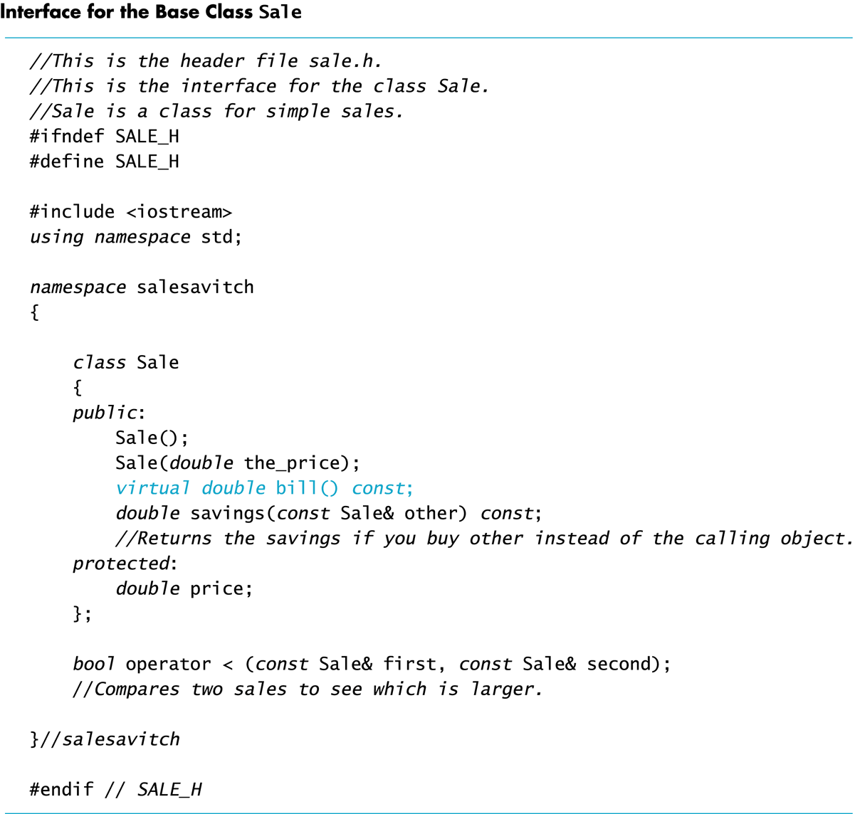
Display 15.8

Slide 72
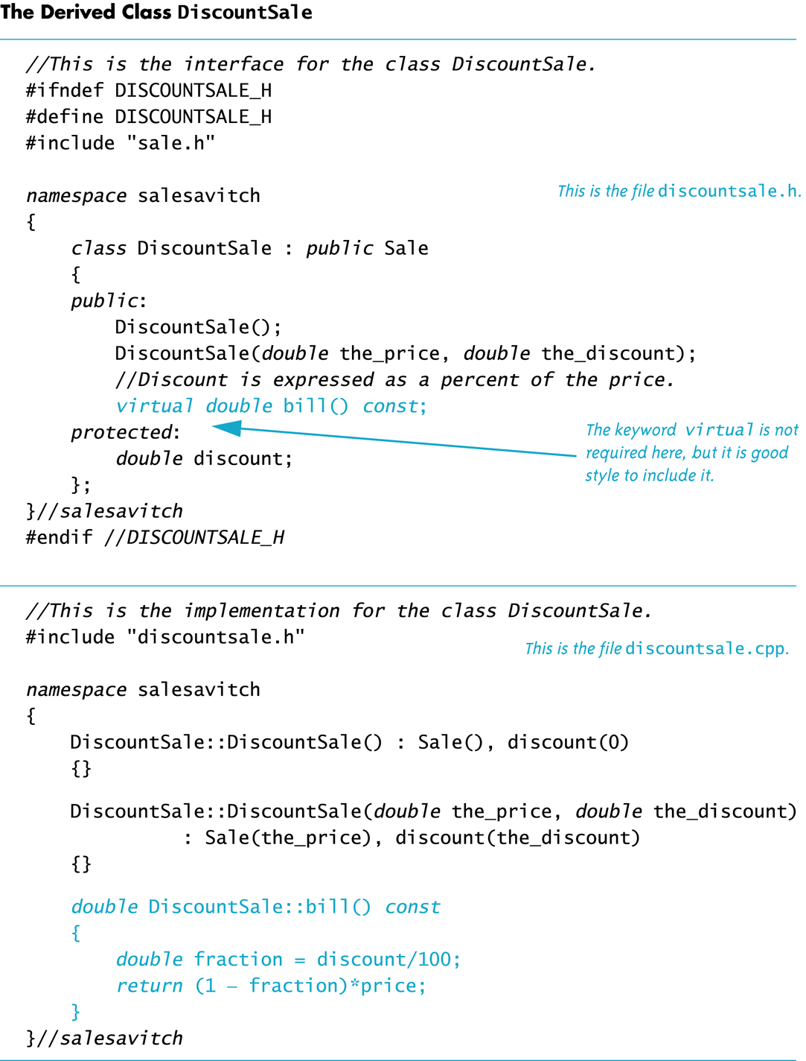
Sale, DiscountSale

Slide 73
DiscountSale::bill
Class DiscountSale has its own version of virtual function bill
Even though class Sale is already compiled, Sale::savings( ) and Sale::operator< can still use function bill from the DiscountSale class
The keyword virtual tells C++ to wait until bill is used in a program to get the implementation of bill from the calling object

Slide 74
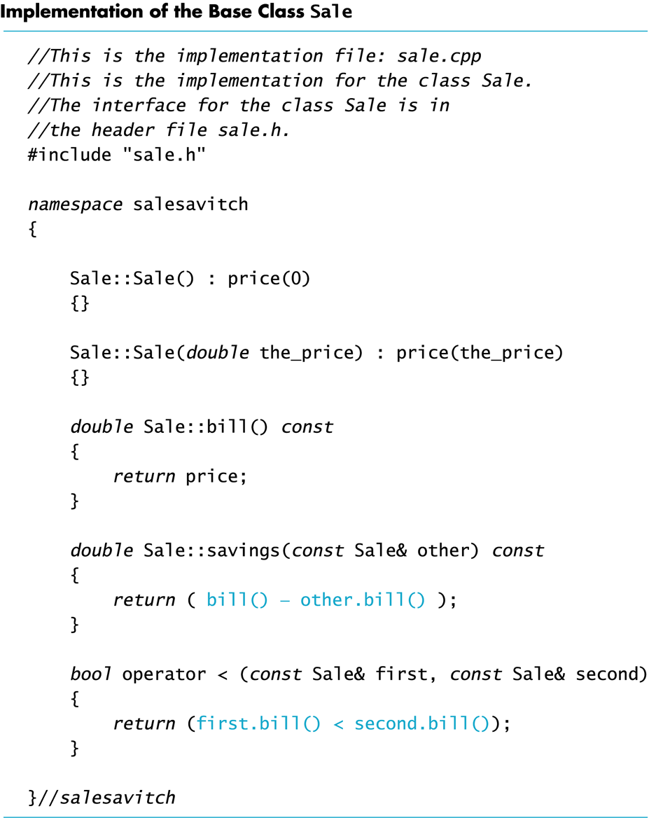
Display 15.9
Because function bill is virtual in class Sale, function savings and operator<, defined only in the base class, can in turn use a version of bill found in a derived class
When a DiscountSale object calls its savings function, defined only in the base class, function savings calls function bill
Because bill is a virtual function in class Sale, C++ uses the version of bill defined in the object that called savings

Slide 75
Sale
virtual bill()
savings()
Q:
Since bill() is a virtual function, what will happen in the following code?
If bill() is not a virtual function, what will happen in the following code?
DiscountSale
virtual bill()
//no re-defined savings()
Sale simple(10.00);
DiscountSale d1(11.0, 10);
DiscountSale d2(11.0, 10);
if (d1 < simple)
{
cout << “Saving is $” << simple.savings(d1);
}
if (d1 < d2)
{
cout << “Saving is $” << d2.savings(d1);
}

Slide 76
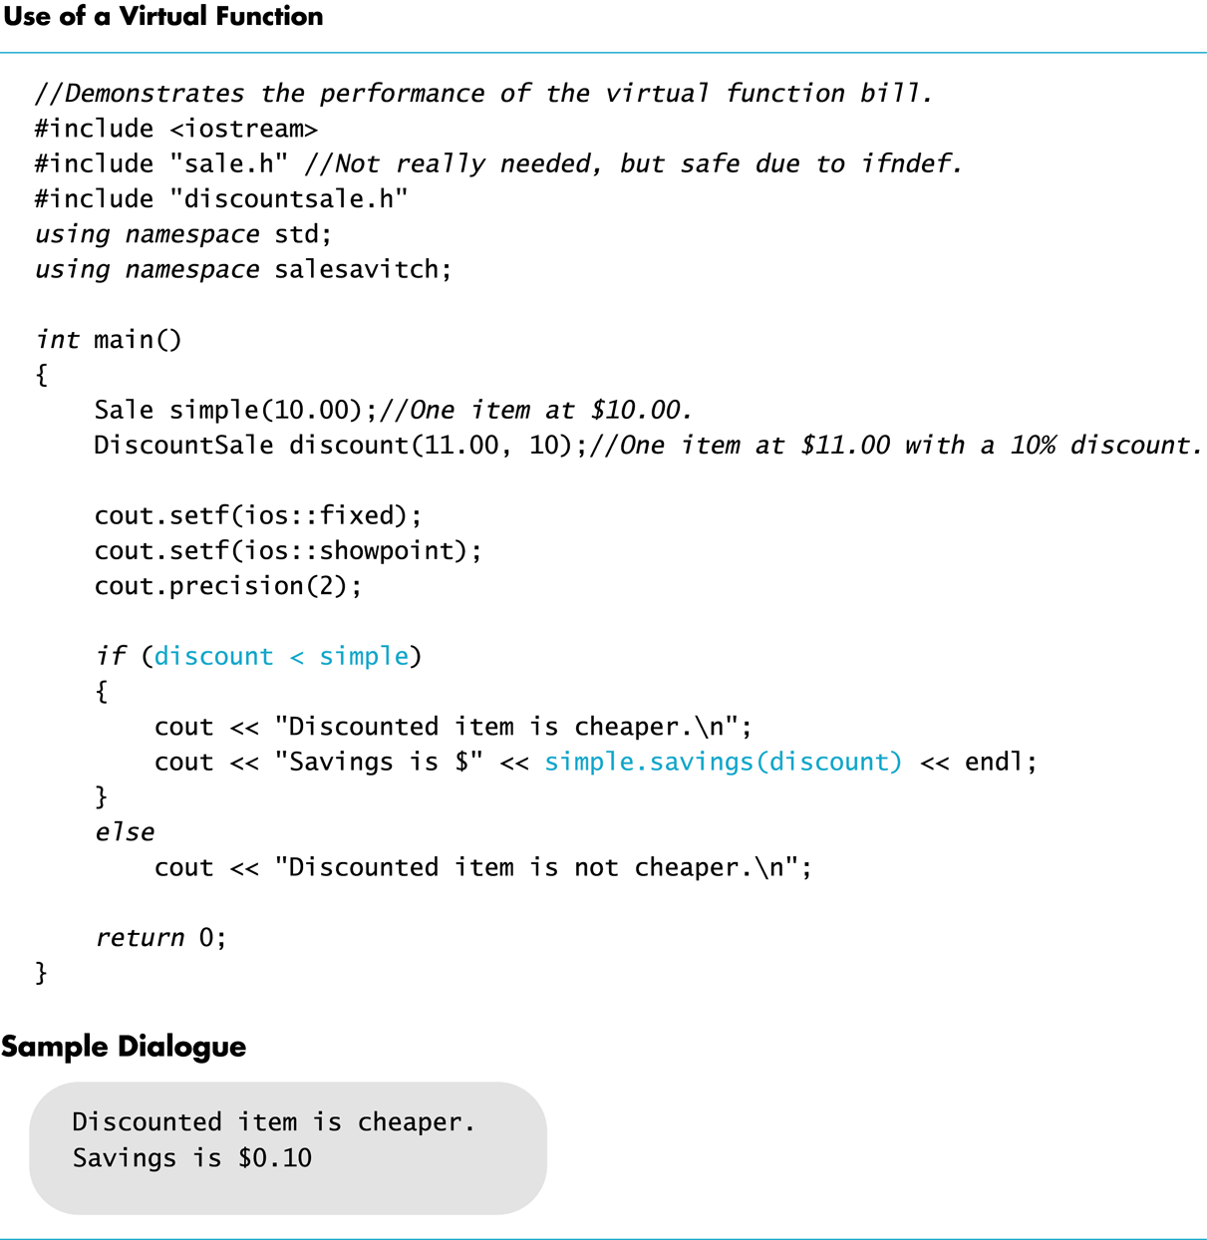
Display 15.11

Slide 77
Override vs. Redefine
Virtual functions whose definitions are changed in a derived class are said to be overridden
Non-virtual functions whose definitions are changed in a derived class are redefined

Slide 78
A potential slicing problem if we do not use virtual functions. Stopped here on 4/8/13

Slide 79
Preliminary: C++’s Type Checking
C++ carefully checks for type mismatches in the use of values and variables
This is referred to as strong type checking
Generally, the type of a value assigned to a variable must match the type of the variable
E.g., double a = “Hello”; //incorrect.
Recall that some automatic type casting occurs
E.g., int a = 20.34; //correct
Strong type checking interferes with the concepts of inheritance

Slide 80
Type Checking and Inheritance
Pet
print()
name
Consider class Pet { public: virtual void print(); string name; }
class Dog : public Pet { public: virtual void print(); string breed; }
Dog
print() //overridden
name
breed

Slide 81
Slicing problem: A Sliced Dog is a Pet
C++ allows the following assignments: vdog.name = "Tiny"; vdog.breed = "Great Dane"; vpet = vdog;
However, vpet will lose the breed member of vdog since an object of class Pet has no breed member
This code would be illegal:
cout << vpet.breed;
vdog
vpet
Dog
print() //overridden
name
breed
Pet
print()
name

Slide 82
The Slicing Problem
It is legal to assign a derived class object into a base class variable (not a reference), however...
This slices off data in the derived class that is not also part of the base class
Some member functions and member variables are lost
vdog
vpet
Dog
print() //overridden
name
breed
Pet
print()
name

Slide 83
Extended Type Compatibility
It is possible in C++ to avoid the slicing problem
Using pointers to dynamic variables and virtual functions, we can still access the added members of the derived class object.

Slide 84
Dynamic Variables and Derived Classes
Example:
ppet->print( ); is legal and produces:
name: Tiny
breed: Great Dane
Pet *ppet; Dog *pdog; pdog = new Dog; pdog->name = "Tiny"; pdog->breed = "Great Dane"; ppet = pdog;
void Dog::print( ) { cout << "name: " << name << endl; cout << "breed: " << breed << endl; }
Display 15.12 (1-2)

Slide 85
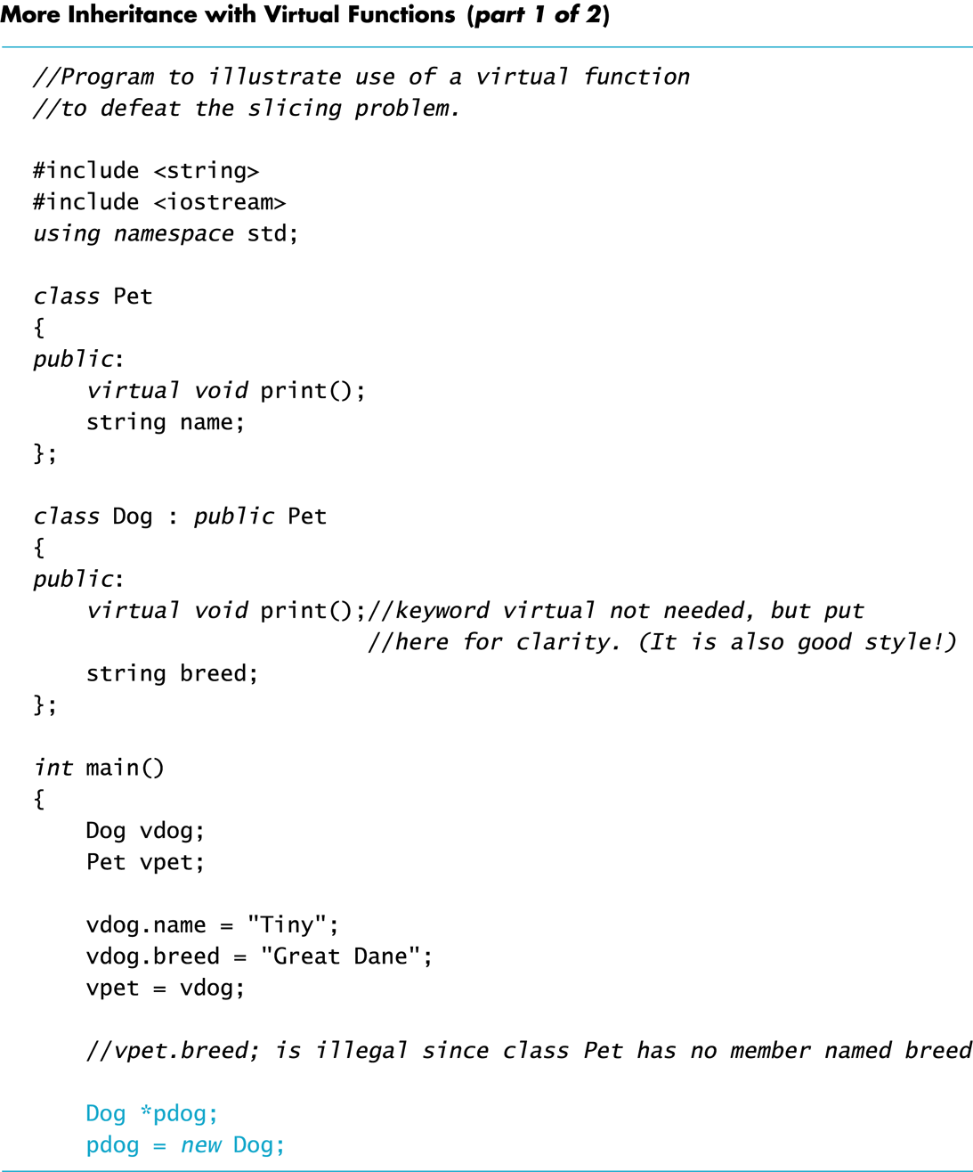
Display 15.12 (1/2)

Slide 86
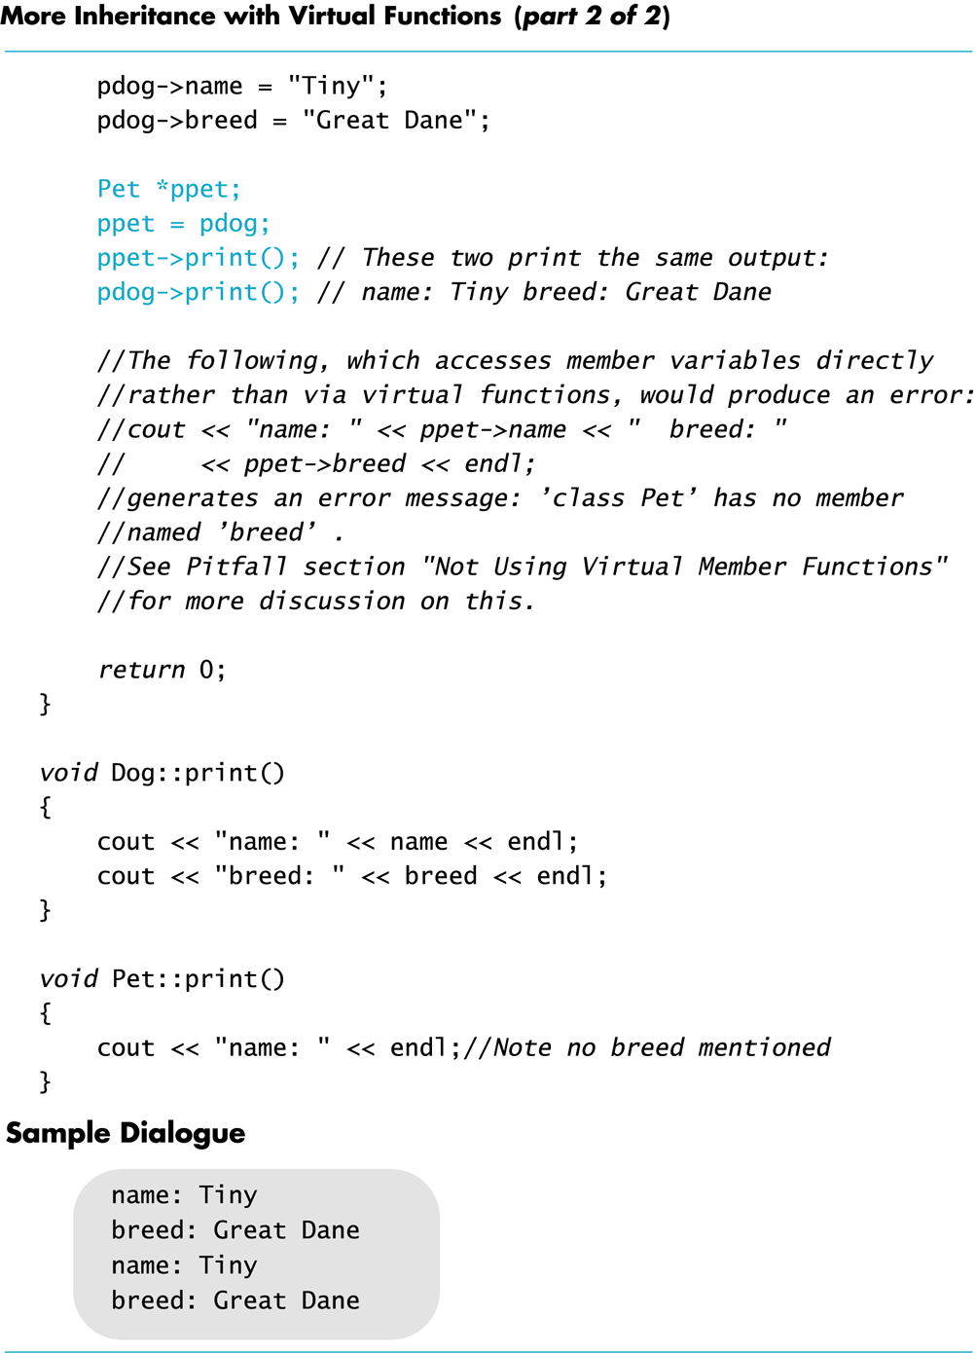
Display 15.12 (2/2)

Slide 87
Use Virtual Functions
The previous example: ppet->print( ); worked because print was declared as a virtual function
The following code would still produce an error:
cout << "name: " << ppet->name << "breed: " << ppet->breed;
//name, breed are public member
//but we still cannot use a base class
//pointer to DIRECTLY access them
//but we can use virtual functions to access them

Slide 88
Why?
ppet->breed is still illegal because ppet is a pointer to a Pet object that has no breed member
breed is just a data member, not a virtual function!
Function print( ) was declared virtual by class Pet
When the computer sees ppet->print( ), it checks the virtual table for classes Pet and Dog and finds that ppet points to an object of type Dog
Because ppet points to a Dog object, code for Dog::print( ) is used

Slide 89
Remember Two Rules
If the domain type of the pointer p_ancestor is a base class for the domain type of pointer p_descendant, the following assignment of pointers is allowed
p_ancestor = p_descendant;
and we can use p_ancestor and virtual functions to access those data members added only by the derived class (i.e., no data members will be inaccessible)
Although all the fields of the p_descendant are there, virtual functions are required to access them
You can NOT directly access an inherited member (even though it is public)

Slide 91
A side note on reference (1/3)
A reference has to be initialized at the time when declared (except as a function parameter)
int x=10;
int& y = x;
//when & is used in between a type and a variable name,
// & specifies the name immediately after it as a reference.
// Similarly, double fun1(int & y)
cout << &x <<endl;
//& is an operator to get the address of variable x.
//Here, & does not specify x as a reference
cout << &y <<endl;
A reference cannot be redirected to refer to something else.
Use references

Slide 92
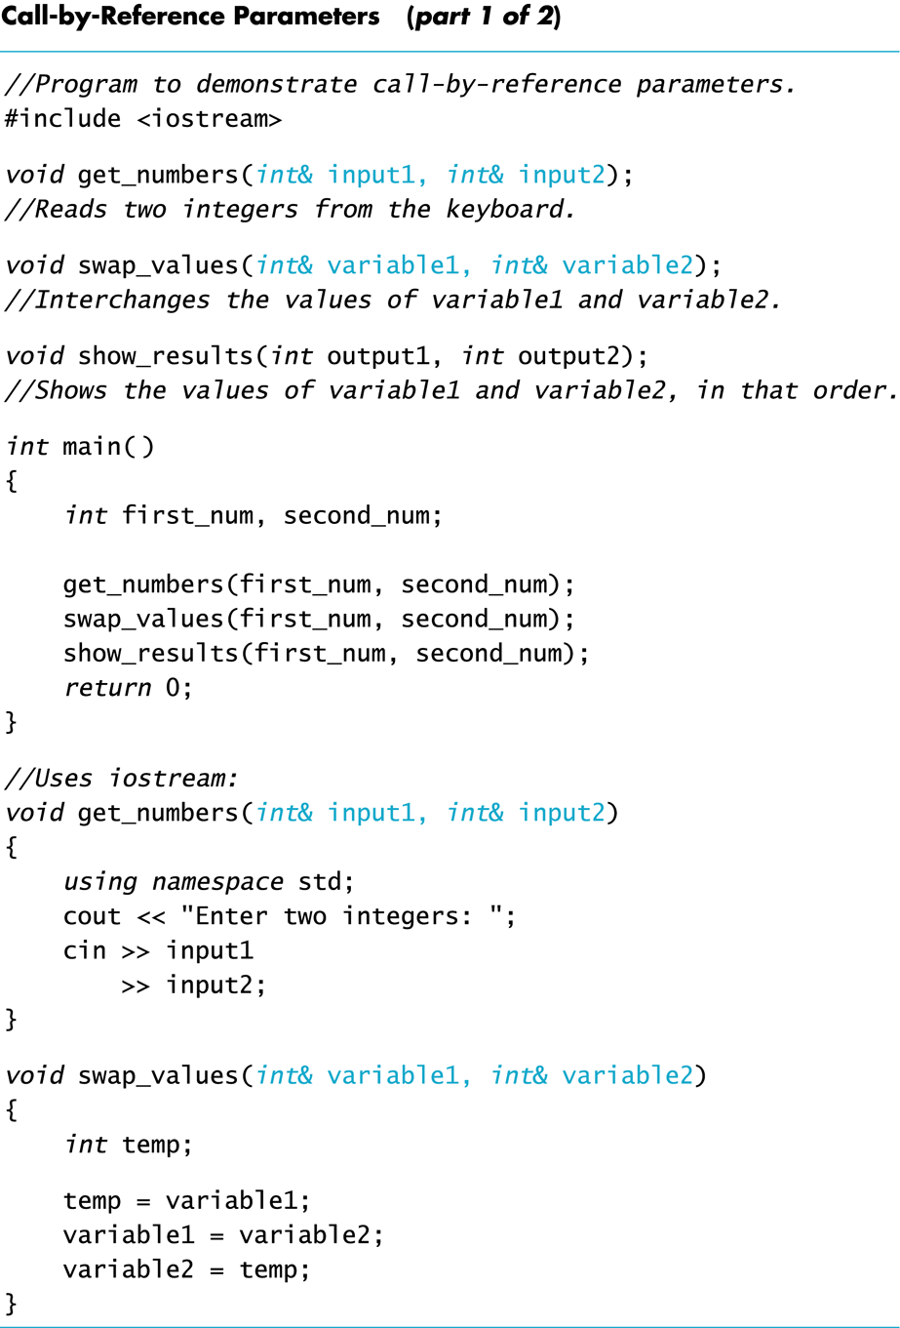
A side note on reference (2/3)
Use reference as function parameters
Recall this example
(from the textbook)

Slide 93
A side note on reference (3/3):
Variable name, reference, pointer
C++
reference to a variable (or object) ---- another name for a variable, and it will never be changed to be a reference to a different variable
pointer to a variable (or object) ---- can be modified to point to different variables
imagine it as an erasable address tag
Java
reference to a variable---- can be modified to refer to different variables
imagine it as an erasable name tag, or a named hat that can be given to different persons to wear

Slide 95
More benefits of virtual functions
Write code that works for a base class will also work for all of its derived class if virtual functions are used.
Examples: function parameters, array of base class objects
Write a newly derived class that will automatically (without modification) work with the existing code that works for the base class.
See example program
virtual_functions_demo_1.cpp

Slide 96
More than two classes in a chain of inheritance hierarchy
inheritance hierarchy
Dog d ;
Animal &animal_ref = d;
cout << animal_ref.GetClassName();
C++ will check every inherited class between Animal and Dog (including Animal and Dog) and use the most-derived version of the function that it finds.
Animal
virtual getClassName()
Pet
virtual getClassName()
Dog
virtual getClassName()
virtual_functions_demo_2.cpp

Slide 97
Calling a base class’s virtual function
Covariant return type
virtual_functions_demo_3.cpp
//illustrate covariant return type
virtual_functions_demo_4.cpp

Slide 98
Virtual Destructors
Destructors should be made virtual
Example: virtual_destructors_demo.cpp

Slide 99
Consider Base *pBase = new Derived; … delete pBase;
If the destructor in Base is virtual, the destructor for Derived is invoked when pBase points to a Derived object, returning Derived members to the freestore
The Derived destructor in turn automatically calls the Base destructor
If the Base destructor is not virtual, only the Base destructor is invoked
This leaves Derived members, not part of Base, in memory

Slide 100
Pure virtual function
Consider this situation:
We have a function that we want to put in the base class, but we know that only the derived classes know what the function should do.
Then, make the function pure virtual
virtual_functions_demo_5.cpp

Slide 101
Pure virtual function
If a class has a pure virtual function, then the class cannot be instantiated, and the derived classes of the class have to define these function before they can be instantiated.
This ensures the derived classes NOT forget to redefine those pure virtual functions (which is what the base class hopes)
virtual_functions_demo_5.cpp

Slide 102
Revisit Employee class
print_check() function should be a pure virtual function in the defn of Employee class.
the original implementation in Employee class’s print_check() prints out an error msg is not a good design, as it leaves the problem checking to the run time, not compile time.

Slide 103
Design suggestions
Simple virtual function
Inheriting it implies → inherit both interface and a default implementation.
In your derive class, you need to support this function, but if you don’t want to write your own, you can fall back on the default version in base class.
Danger: if a derived class might not want to use the default implementation from the base class, but forget to define its own, then it will use the inherited one (which is not what it wants!)

Slide 104
Design suggestions
Pure virtual function
Inheriting it implies → inherit interface only
In your derived class (that can be instantiated), you must define it, but the base class has not idea how you are going to implement it.
The danger mentioned for the simple virtual function does not exist.

Slide 105
Design suggestions
Regular non-virutal function
Don’t redefine an inherited non-virtual function (even though allowed by C++). Make sure the “is-a” relationship always true for public inheritance.
class B
{ public:
void fun1();
}
class D: public B
{public: void fun1(//different implementation);}
//inconsistent, confusing behavior.
//same object D, but different fun1() is called,
// when D is pointed to by different ptr types
// (also true if references used)
D d;
B *pB=&d;
pB ->fun1();// B::fun1() is called!!
D *pD=&d;
pD ->fun1();//D::fun1() is called!!

Slide 106
Interface Class
An interface class is a class that …
has no members variables,
all of the functions are pure virtual!
The class is only an interface definition, no actual implementation.
Why use interface?
When you want to define the functionality that derived classes must implement, but leave the details of how the derived class implements that functionality entirely up to the derived class.
virtual_functions_demo_6.cpp

