Slide 1
Graph: representation and traversal CISC5835, Computer Algorithms
CIS, Fordham Univ.
Instructor: X. Zhang

Slide 2
Acknowledgement
The set of slides have use materials from the following resources
Slides for textbook by Dr. Y. Chen from Shanghai Jiaotong Univ.
Slides from Dr. M. Nicolescu from UNR
Slides sets by Dr. K. Wayne from Princeton
which in turn have borrowed materials from other resources

Slide 3
Outline
Graph Definition
Graph Representation
Path, Cycle, Tree, Connectivity
Graph Traversal Algorithms
Breath first search/traversal
Depth first search/traversal
…
Minimal Spaning Tree algorithms
Dijkstra algorithm: shortest path a

Slide 4
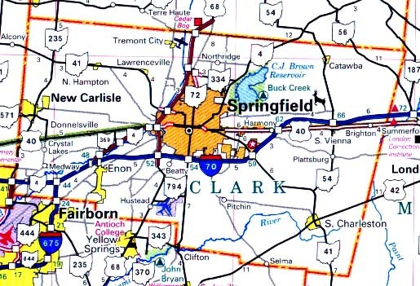
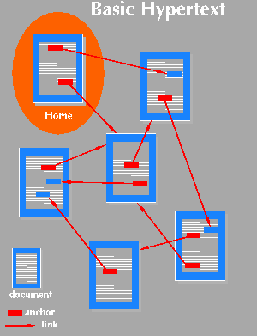
Graphs
Applications that involve not only a set of items, but also the connections between them
Maps
Schedules
Computer networks
Hypertext
Circuits

Slide 6
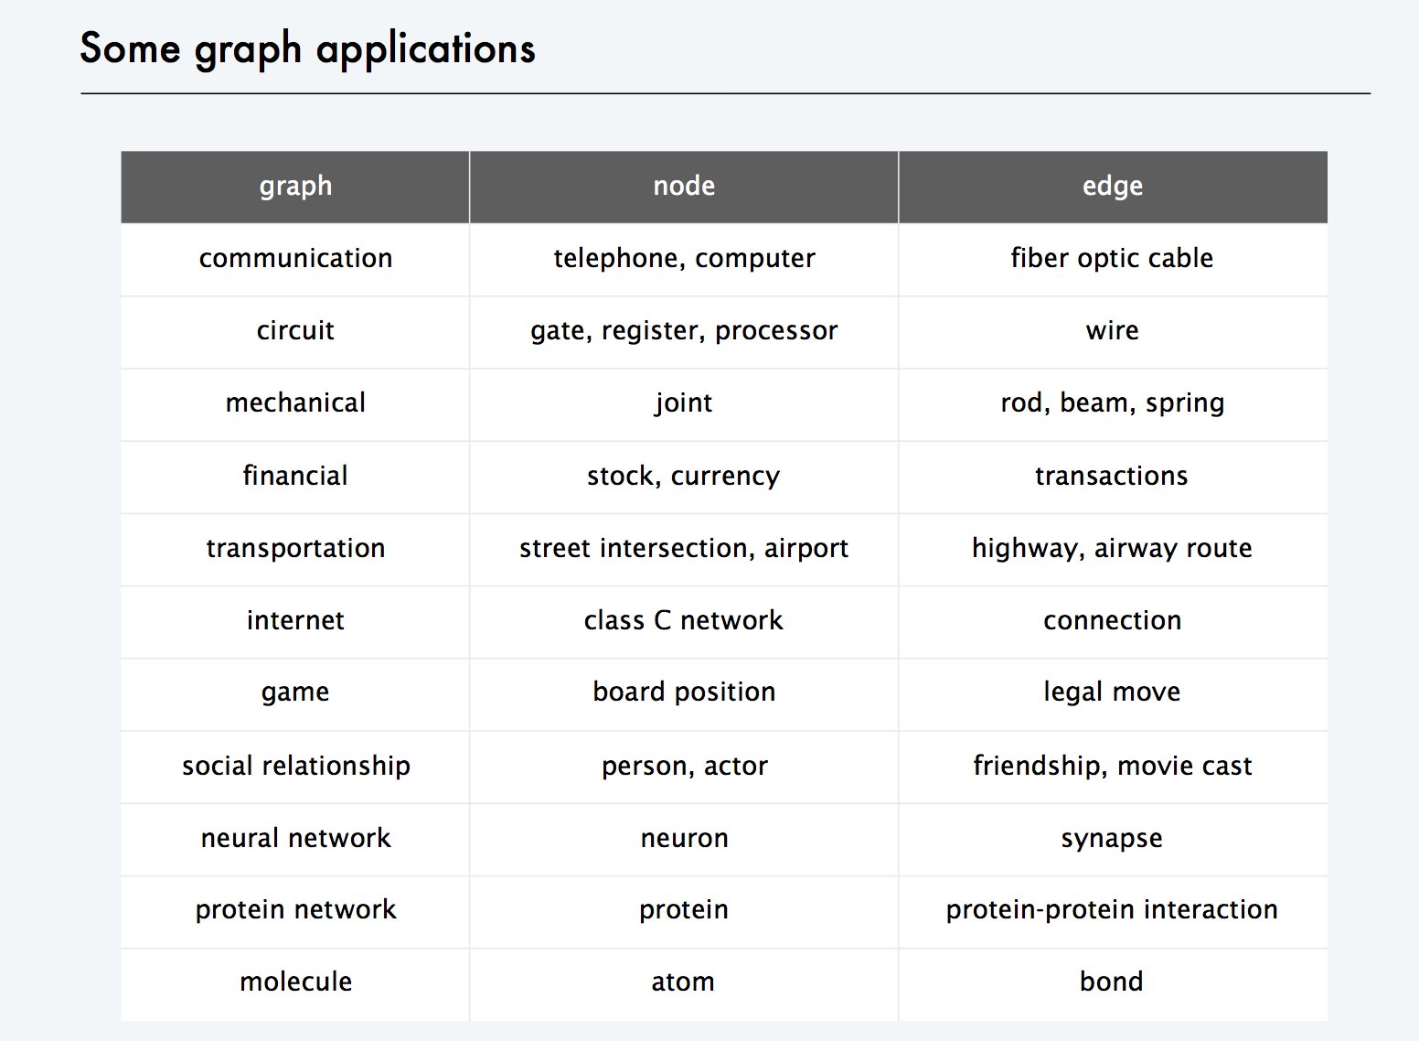

Slide 7
Graphs - Background
Graphs = a set of nodes (vertices) with edges (links) between them.
Notations:
G = (V, E) - graph
V = set of vertices (size of V = n)
E = set of edges (size of E = m)
1
2
1
2
1
2
3
4
3
4
3
4
Directed
graph
Undirected
graph
Acyclic
graph

Slide 8
Other Types of Graphs
A graph is connected if there is a path between every two vertices
A bipartite graph is an undirected graph G = (V, E) in which V = V₁ + V₂ and there are edges only between vertices in V₁ and V₂
1
2
1
2
3
4
3
4
Connected
Not connected
1
2
9
4
8
3
6
7
4

Slide 9
Graph Representation
Adjacency list representation of G = (V, E)
An array of n lists, one for each vertex in V
Each list Adj[u] contains all the vertices v such that there is an edge between u and v
Adj[u] contains the vertices adjacent to u (in arbitrary order)
Can be used for both directed and undirected graphs
1
2
5 | /
1
2
2
1
5
3
4 | /
3
3
2
4
4
2
5
3 | /
5
4
5
4
1
2
Undirected graph

Slide 10
Properties of Adjacency List Representation
Sum of the lengths of all the adjacency lists
Directed graph:
Edge (u, v) appears only once in u’s list
Undirected graph:
u and v appear in each other’s adjacency lists: edge (u, v) appears twice
1
2
size of E (m)
3
4
Directed graph
1
2
2* size of E (2m)
3
5
4
Undirected graph

Slide 11
Properties of Adjacency List Representation
Memory required
Θ(m+n)
Preferred when
the graph is sparse: m << n²
Disadvantage
no quick way to determine whether there is an edge between node u and v
Time to determine if (u, v) exists: O(degree(u))
Time to list all vertices adjacent to u:
Θ(degree(u))
1
2
3
5
4
Undirected graph
1
2
3
4
Directed graph

Slide 12
Graph Representation
Adjacency matrix representation of G = (V, E)
Assume vertices are numbered 1, 2, … n
The representation consists of a matrix A_{nxn}
a_{ij} = 1 if (i, j) belongs to E, if there is edge (i,j)
0 otherwise
1
2
3
4
5
1
0
1
0
0
1
For undirected graphs matrix A is symmetric:
a_{ij} = a_{ji}
A = A^{T}
1
2
2
1
0
1
1
1
3
3
0
1
0
1
0
5
4
4
0
1
1
0
1
Undirected graph
5
1
1
0
1
0

Slide 13
Properties of Adjacency Matrix Representation
Memory required
Θ(n²), independent on the number of edges in G
Preferred when
The graph is dense: m is close to n²
need to quickly determine if there is an edge between two vertices
Time to list all vertices adjacent to u:
Θ(n)
Time to determine if (u, v) belongs to E:
Θ(1)

Slide 14
Weighted Graphs
Weighted graphs = graphs for which each edge has an associated weight w(u, v)
w: E -> R, weight function
Storing the weights of a graph
Adjacency list:
Store w(u,v) along with vertex v in u’s adjacency list
Adjacency matrix:
Store w(u, v) at location (u, v) in the matrix

Slide 15
NetworkX: a Python graph library
http://networkx.github.io/
Node: any hashable object as a node. Hashable objects include strings, tuples, integers, and more.
Arbitrary edge attributes: weights and labels can be associated with an edge.
internal data structures: based on an adjacency list representation and uses Python dictionary.
adjacency structure: implemented as a dictionary of dictionaries
top-level (outer) dictionary: keyed by nodes to values that are themselves dictionaries keyed by neighboring node to edge attributes associated with that edge.
Support: fast addition, deletion, and lookup of nodes and neighbors in large graphs.
underlying datastructure is accessed directly by methods

Slide 16
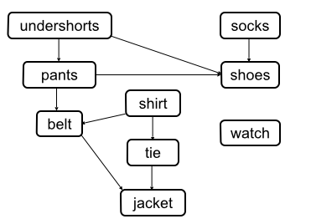
Graphs Everywhere
Prerequisite graph for CIS undergrad courses
Three jugs of capacity 8, 5 and 3 liters, initially filled with 8, 0 and 0 liters respectively. How to pour water between them so that in the end we have 4, 4 and 0 liters in the three jugs?
what’s this graph
representing?

Slide 17
Outline
Graph Definition
Graph Representation
Path, Cycle, Tree, Connectivity
Graph Traversal Algorithms
basis of other algorithms

Slide 18
Paths
A Path in an undirected graph G=(V,E) is a sequence of nodes v1,v2,…,vk with the property that each consecutive pair vi-1, vi is joined by an edge in E.
A path is simple if all nodes in the path are distinct.
A cycle is a path v1,v2,…,vk where v1=vk, k>2, and the first k-1 nodes are all distinct
An undirected graph is connected if for every pair of nodes u and v, there is a path between u and v

Slide 19
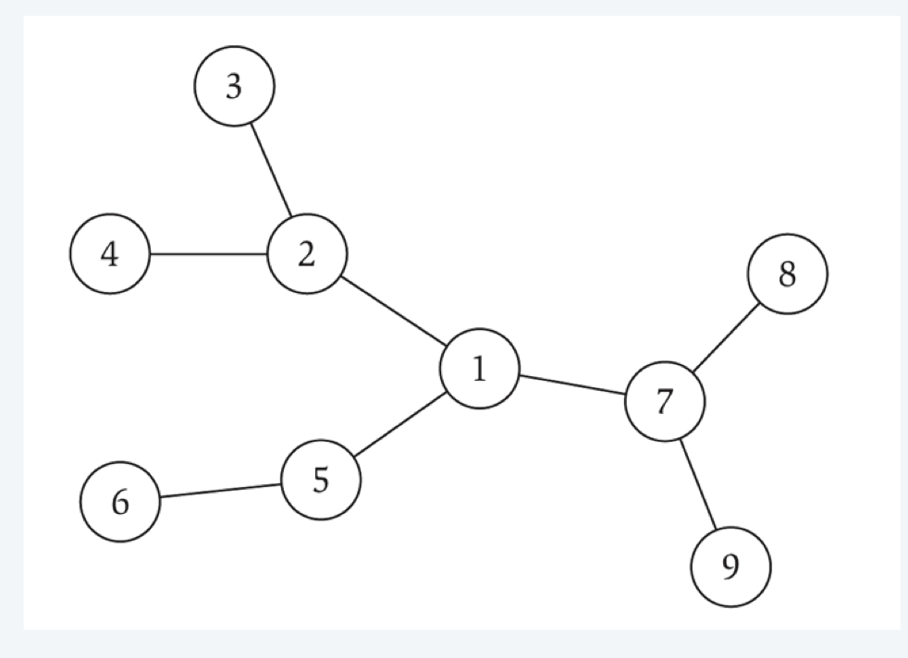
Trees
A undirected graph is a tree if it is connected and does not contain a cycle.
Theorem: Let G be an undirected graph on n nodes. Any two of the following imply the third.
G is connected
G does not contain a cycle
G has n-1 edges

Slide 20
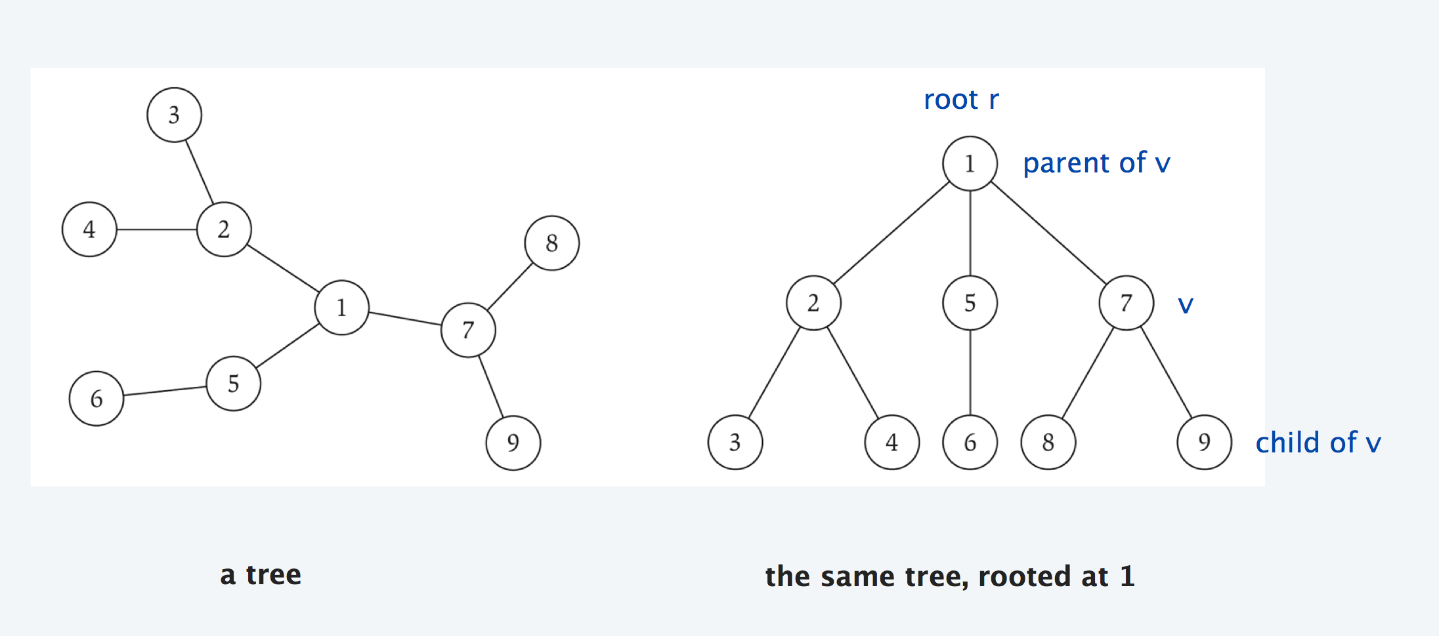
Rooted Trees
Given a tree T, choose a root node r and orient each edge away from r.
Importance: models hierarchy structure

Slide 21
Outline
Graph Definition
Graph Representation
Path, Cycle, Tree, Connectivity
Graph Traversal Algorithms
basis of other algorithms

Slide 22
Searching in a Graph
Graph searching = systematically follow the edges of the graph to visit all vertices of the graph
Graph algorithms are typically elaborations of the basic graph-searching algorithms
e.g. puzzle solving, maze walking…
Two basic graph searching algorithms:
Breadth-first search
Depth-first search
Difference: the order in which they explore unvisited edges of the graph

Slide 23
Breadth-First Search (BFS)
Input:
A graph G = (V, E) (directed or undirected)
A source vertex s from V
Goal:
Explore the edges of G to “discover” every vertex reachable from s, taking the ones closest to s first
Output:
d[v] = distance (smallest # of edges) from s to v, for all v from V
A “breadth-first tree” rooted at s that contains all reachable vertices

Slide 24
Breadth-First Search (cont.)
Keeping track of progress:
Color each vertex in either white, gray or black
Initially, all vertices are white
When being discovered a vertex becomes gray
After discovering all its adjacent vertices the node becomes black
Use FIFO queue Q to maintain the set of gray vertices
source
1
2
3
5
4
1
2
3
5
4
1
2
3
5
4

Slide 25
Breadth-First Tree
BFS constructs a breadth-first tree
Initially contains root (source vertex s)
When vertex v is discovered while scanning adjacency list of a vertex u ⇒ vertex v and edge (u, v) are added to the tree
A vertex is discovered only once ⇒ it has only one parent
u is the predecessor (parent) of v in the breadth-first tree
Breath-first tree contains nodes that are reachable from source node, and all edges from each node’s predecessor to the node
source
1
2
3
5
4

Slide 26
BFS Application
BFS constructs a breadth-first tree
BFS finds shortest (hop-count) path from src node to all other reachable nodes
E.g., What’s shortest path from 1 to 3?
perform BFS using node 1 as source node
Node 2 is discovered while exploring 1’s adjacent nodes => pred. of node 2 is node 1
Node 3 is discovered while exploring node 2’s adjacent nodes => pred. of node 3 is node 2
so shortest hop count path is: 1, 2, 3
Useful when we want to find minimal steps to reach a state
source
1
2
3
5
4

Slide 27
BFS: Implementation Detail
G = (V, E) represented using adjacency lists
color[u] – color of vertex u in V
pred[u] – predecessor of u
If u = s (root) or node u has not yet been discovered then pred[u] = NIL
d[u] – distance (hop count) from source s to vertex u
Use a FIFO queue Q to maintain set of gray vertices
source
d=1
pred =1
1
2
3
d=2
pred =2
5
4
d=1
pred =1
d=2
pred=5

Slide 28
BFS(V, E, s)
for each u in V - {s}
do color[u] = WHITE
d[u] ← ∞
pred[u] = NIL
color[s] = GRAY
d[s] ← 0
pred[s] = NIL
Q = empty
Q ← ENQUEUE(Q, s)
r
s
t
u
v
w
x
y
r
s
t
u
∞
∞
∞
∞
∞
∞
∞
v
w
x
y
r
s
t
u
∞
0
∞
∞
∞
∞
∞
∞
v
w
x
y
Q: s

Slide 29
BFS(V, E, s)
r
s
t
u
while Q not empty
do u ← DEQUEUE(Q)
for each v in Adj[u]
do if color[v] = WHITE
then color[v] = GRAY
d[v] ← d[u] + 1
pred[v] = u
ENQUEUE(Q, v)
color[u] = BLACK
∞
0
∞
∞
Q: s
∞
∞
∞
∞
v
w
x
y
r
s
t
u
∞
0
∞
∞
Q: w
∞
1
∞
∞
v
w
x
y
r
s
t
u
1
0
∞
∞
Q: w, r
∞
1
∞
∞
v
w
x
y

Slide 30
Example
r
s
t
u
r
s
t
u
r
s
t
u
∞
0
∞
∞
1
0
∞
∞
1
0
2
∞
∞
∞
∞
∞
∞
1
∞
∞
∞
1
2
∞
v
w
x
y
v
w
x
y
v
w
x
y
Q: s
Q: w, r
Q: r, t, x
r
s
t
u
r
s
t
u
r
s
t
u
1
0
2
∞
1
0
2
3
1
0
2
3
2
1
2
∞
2
1
2
∞
2
1
2
3
v
w
x
y
v
w
x
y
v
w
x
y
Q: t, x, v
Q: x, v, u
Q: v, u, y
r
s
t
u
r
s
t
u
r
s
t
u
1
0
2
3
1
0
2
3
1
0
2
3
2
1
2
3
2
1
2
3
2
1
2
3
v
w
x
y
v
w
x
y
v
w
x
y
Q: u, y
Q: y
Q: ∅
CS 477/677 - Lecture 19

Slide 31
Analysis of BFS
for each u ∈ V - {s}
do color[u] ← WHITE
d[u] ← ∞
pred[u] = NIL
color[s] ← GRAY
d[s] ← 0
pred[s] = NIL
Q ← ∅
Q ← ENQUEUE(Q, s)
O(|V|)
Θ(1)

Slide 32
Analysis of BFS
while Q not empty
do u ← DEQUEUE(Q)
for each v in Adj[u]
do if color[v] = WHITE
then color[v] = GRAY
d[v] ← d[u] + 1
pred[v] = u
ENQUEUE(Q, v)
color[u] = BLACK
Θ(1)
Scan Adj[u] for all vertices u in the graph
Each vertex u is processed only once, when the vertex is dequeued
Sum of lengths of all adjacency lists = Θ(|E|)
Scanning operations: O(|E|)
Θ(1)
Total running time for BFS = O(|V| + |E|)

Slide 33
Shortest Paths Property
BFS finds the shortest-path distance from the source vertex s ∈ V to each node in the graph
Shortest-path distance = d(s, u)
Minimum number of edges in any path from s to u
source
r
s
t
u
1
0
2
3
2
1
2
3
v
w
x
y

Slide 34
Outline
Graph Definition
Graph Representation
Path, Cycle, Tree, Connectivity
Graph Traversal Algorithms
Breath first search/traversal
Depth first search/traversal
…

Slide 35
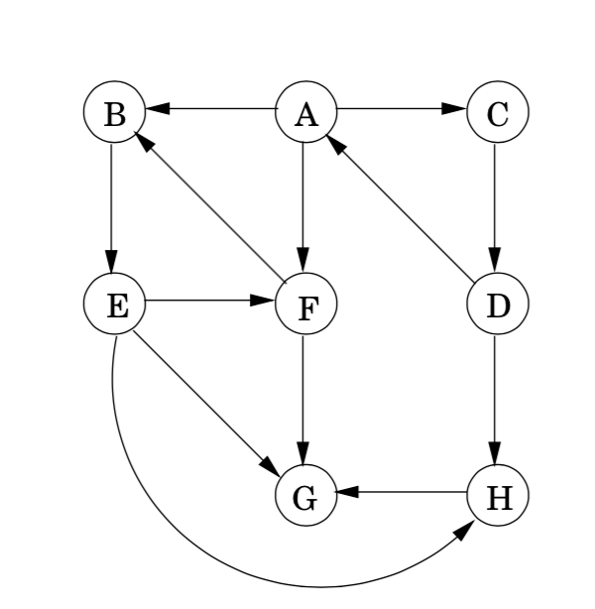
Depth-First Search
Input:
G = (V, E) (No source vertex given!)
Goal:
Explore edges of G to “discover” every vertex in V starting at most current visited node
Search may be repeated from multiple sources
Output:
2 timestamps on each vertex:
d[v] = discovery time (time when v is first reached)
f[v] = finishing time (done with examining v’s adjacency list)
Depth-first forest

Slide 36
Depth-First Search: idea
Search “deeper” in graph whenever possible
explore edges of most recently discovered vertex v (that still has unexplored edges)
After all edges of v have been explored, “backtracks” to parent of v
Continue until all vertices reachable from original source have been discovered
If undiscovered vertices remain, choose one of them as a new source and repeat search from that vertex
different from BFS!!!
DFS creates a “depth-first forest”

Slide 38
DFS Additional Data Structures
Global variable: time-step
Incremented when nodes are discovered/finished
color[u] – color of node u
White not discovered, gray discovered and being processing and black when finished processing
pred[u] – predecessor of u (from which node we discover u)
d[u]– discovery (time when u turns gray)
f[u] – finish time (time when u turns black)
1 ≤ d[u] < f [u] ≤ 2 |V|
WHITE
GRAY
BLACK
0
d[u]
f[u]
2|V|

Slide 39
DFS(V, E): top level
for each u ∈ V
do color[u] ← WHITE
pred[u] ← NIL
time ← 0
for each u ∈ V
do if color[u] = WHITE
then DFS-VISIT(u)
Every time DFS-VISIT(u) is called, u becomes the root of a new tree in the depth-first forest
u
v
w
x
y
z

Slide 40
DFS-VISIT(u): DFS exploration from u
color[u] ← GRAY
time ← time+1
d[u] ← time
for each v ∈ Adj[u]
do if color[v] = WHITE
then pred[v] ← u
DFS-VISIT(v)
color[u] ← BLACK //done with u
time ← time + 1
f[u] ← time //finish time
u
v
w
x
y
z
time = 1
u
v
w
1/
x
y
z
u
v
w
1/
2/
x
y
z

Slide 41
Example
u
v
w
u
v
w
u
v
w
1/
1/
2/
1/
2/
3/
x
y
z
x
y
z
x
y
z
u
v
w
u
v
w
u
v
w
1/
2/
1/
2/
1/
2/
B
B
4/
3/
4/
3/
4/5
3/
x
y
z
x
y
z
x
y
z
u
v
w
u
v
w
u
v
w
1/
2/
1/
2/7
1/
2/7
B
B
F
B
4/5
3/6
4/5
3/6
4/5
3/6
x
y
z
x
y
z
x
y
z

Slide 42
Example (cont.)
u
v
w
u
v
w
u
v
w
1/8
2/7
1/8
2/7
9/
1/8
2/7
C
9/
F
B
F
B
F
B
4/5
3/6
4/5
3/6
4/5
3/6
x
y
z
x
y
z
x
y
z
u
v
w
u
v
w
u
v
w
1/8
2/7
C
9/
1/8
2/7
C
9/
1/8
2/7
C
9/
F
B
F
B
B
F
B
B
4/5
3/6
10/
4/5
3/6
10/
4/5
3/6
10/11
x
y
z
x
y
z
x
y
z
u
v
w
The results of DFS may depend on:
The order in which nodes are explored in procedure DFS
The order in which the neighbors of a vertex are visited in DFS-VISIT
1/8
2/7
C
9/12
F
B
B
4/5
3/6
10/11
x
y
z

Slide 43
Properties of DFS
u = pred[v] ⟺ DFS-VISIT(v) was called during a search of u’s adjacency list
u is the predecessor (parent) of v
More generally, vertex v is a descendant of vertex u in depth first forest ⟺ v is discovered while u is gray
u
v
w
1/
2/
3/
x
y
z

Slide 44
DAG
Directed acyclic graphs (DAGs)
Used to represent precedence of events or processes that have a partial order
undershorts
socks
Put on socks before put on shoes
pants
shoes
shirt
No precedence between belts and shoes
belt
watch
tie
jacket
Topological sort helps us establish a total order/linear order. Useful for task scheduling.

Slide 45
Topological Sort
Topological sort of a directed acyclic graph G = (V, E): a linear order of vertices such that if there exists an edge (u, v), then u appears before v in the ordering.
undershorts
socks
pants
shoes
shirt
belt
watch
tie
jacket
socks
undershorts
pants
shoes
watch
shirt
belt
tie
jacket
Topological sort:
an ordering of vertices so that
all directed edges go from left to right.

Slide 46
Topological Sort via DFS
TS requires that we put u before v if there is a path from u to v
e.g., socks before shoes
undershorts before jacket
Observation: If we perform DFS on a DAG, if there is a path from u to v, then f[u]>f[v]
So arrange nodes in reverse order of their finish time
undershorts
socks
pants
shoes
shirt
belt
watch
tie
jacket
Consider when DFS_visit(undershorts) is called, jacket is either
white: then jacket will be discovered in DFS_visit(undershorts), turn black, before eventually
undershorts finishes. f[jacket] < f[undershorts]
black (if DFS_visit(jacket) was called): then f[jacket] < f[undershorts]
* node jacket cannot be gray (which would mean that DFS_visit(jacket) is ongoing …)

Slide 47
Topological Sort
11/
16
17/
18
TOPOLOGICAL-SORT(V, E)
Call DFS(V, E) (to compute finishing times f[v] for each vertex v): when a node is finished, push it on to a stack
pop nodes in stack and arrange them in a list
undershorts
socks
12/
15
pants
shoes
13/
14
shirt
1/
8
6/
7
belt
watch
9/
10
tie
2/
5
jacket
3/
4
socks
undershorts
pants
shoes
watch
shirt
belt
tie
jacket
Running time: Θ(|V| + |E|)

Slide 48
Edge Classification*
Via DFS traversal, graph edges can be classified into four types.
When in DFS_visit (u), we follow edge (u,v) and find node, if v is:
WHITE vertex: then (u,v) is a tree edge
v was first discovered by exploring edge (u, v)
GRAY node: then (u,v) is a Back edge
(u, v) connects u to an ancestor v in a depth first tree
Self loops (in directed graphs) are also back edges
u
v
w
1/
x
y
z
(u,v) is a tree edge
u
v
w
1/
2/
B
4/
3/
x
y
z
(x,v) is a back edge

Slide 49
Edge Classification*
if v is black vertex, and d[u]<d[v], (u,v) is a Forward edge (u,v):
Non-tree edge (u, v) that connects a vertex u to a descendant v in a depth first tree
if v is black vertex, and d[u] > d[v], (u,v) is a Cross edge (u,v):
go between vertices in same depth-first tree (as long as there is no ancestor / descendant relation) or between different depth-first trees
u
v
w
1/
2/7
F
B
4/5
3/6
x
y
z
(u,x) is a forward edge
u
v
w
1/8
2/7
C
9/
F
B
4/5
3/6
x
y
z
(w,y) is a cross edge

Slide 50
Analysis of DFS(V, E)
for each u ∈ V
do color[u] ← WHITE
pred[u] ← NIL
time ← 0
for each u ∈ V
do if color[u] = WHITE
then DFS-VISIT(u)
Θ(|V|)
Θ(|V|) – without counting the time for
DFS-VISIT

Slide 51
Analysis of DFS-VISIT(u)
color[u] ← GRAY
time ← time+1
d[u] ← time
for each v ∈ Adj[u]
do if color[v] = WHITE
then pred[v] ← u
DFS-VISIT(v)
color[u] ← BLACK
time ← time + 1
f[u] ← time
DFS-VISIT is called exactly once for each vertex
Each loop takes
|Adj[u]|
Total: Σ_{u∈V} |Adj[u]| + Θ(|V|) =
Θ(|E|)
= Θ(|V| + |E|)

Slide 52
DFS without recursion*
Data Structure: use stack (Last In First Out!)
to store all gray nodes
Pseudocode:
Start by push source node to stack
Explore node at stack top, i.e.,
* push its next white adj. node to stack)
* if all its adj nodes are black, the node turns black, pop it from stack
3. Continue (go back 2) until stack is empty
4. If there are white nodes remaining, go back to 1 using another white node as source node

Slide 53
Parenthesis Theorem*
In any DFS of a graph G, for all u, v, exactly one of the following holds:
[d[u], f[u]] and [d[v], f[v]] are disjoint, and neither of u and v is a descendant of the other
[d[v], f[v]] is entirely within [d[u], f[u]] and v is a descendant of u
[d[u], f[u]] is entirely within [d[v], f[v]] and u is a descendant of v
y
z
s
t
3/6
2/9
1/10
11/16
4/5
7/8
12/13
14/15
x
w
v
u
s
t
z
v
u
y
w
x
1
2
3
4
5
6
7
8
9
10
11
12
13
14
15
16
(s
(z
(y
(x
x)
y)
(w
w)
z)
s)
(t
(v
v)
(u
u)
t)
Well-formed expression: parenthesis are
properly nested

Slide 54
Other Properties of DFS*
Corollary
Vertex v is a proper descendant of u
⟺ d[u] < d[v] < f[v] < f[u]
Theorem (White-path Theorem)
In a depth-first forest of a graph G, vertex v is a descendant of u if and only if at time d[u], there is a path u  v consisting of only white vertices.
u
1/8
2/7
C
9/12
F
B
B
4/5
3/6
10/11
v
u
1/
2/
v

Slide 55
Cycle detection via DFS
A directed graph is acyclic ⟺ a DFS on G yields no back edges.
Proof:
“⇒”: acyclic ⇒ no back edge
Assume back edge ⇒ prove cycle
Assume there is a back edge (u, v)
⇒ v is an ancestor of u
⇒ there is a path from v to u in G (v  u)
⇒ v  u + the back edge (u, v) yield a cycle
v
(u, v)
u

Slide 56
three graph algorithms

Slide 57
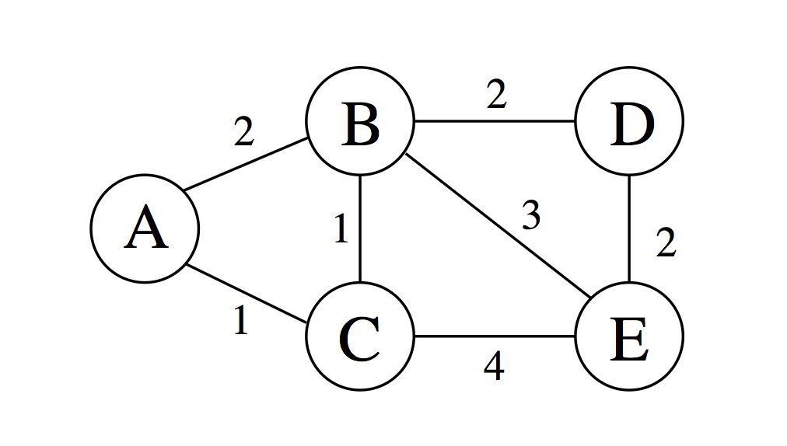
Shortest Distance Paths
Distance/Cost of a path in weighted graph
sum of weights of all edges on the path
path A,B,E, cost is 2+3=5
path A, B, C, E, cost is 2+1+4=7
How to find shortest distance path from a node, A, to all another node?
assuming: all weights are positive
This implies no cycle in the shortest distance path
Why? Prove by contradiction.
If A->B->C->..->B->D is shortest path, then A->B->D is a shorter!
d[u]: the distance of the shortest-distance path from A to u
d[A] = 0
d[D] = min {d[B]+2, d[E]+2}
because B, E are the two only possible previous node in path to D

Slide 58
Dijkstra Algorithm
Input: positive weighted graph G, source node s
Output: shortest distance path from s to all other nodes that is reachable from s
Expanding frontier (one hop a time)
1). Starting from A:
We can go to B with cost B, go to C with cost 1
going to all other nodes (here D, E) has to pass B or C
are there cheaper paths to go to C?
are there cheaper paths to B?
2). Where can we go from C? B, E
Two new paths: (A,C,B), (A,C,E)
Better paths than before? => update current optimal path
Are there cheaper paths to B?
3). Where can we go from B?
…
S
for each node u, keep track pred[u] (previous node in the path leading to u),
d[u] current shortest distance

Slide 59
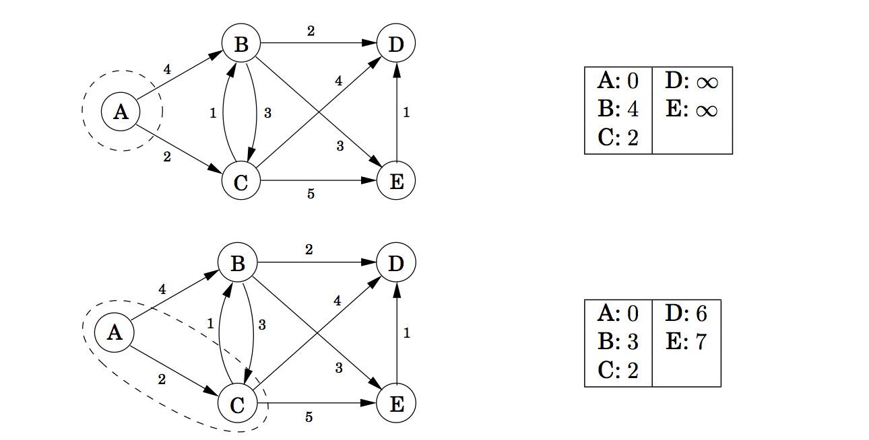
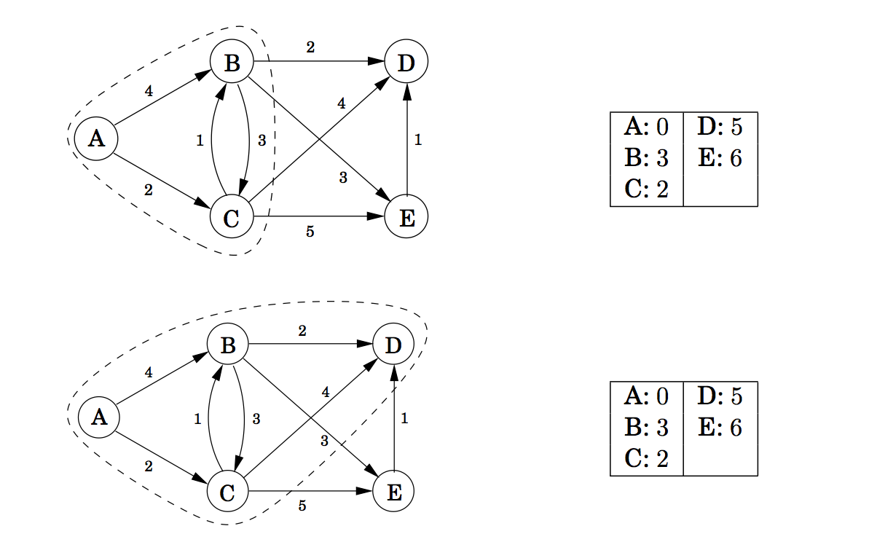
dist
pred
A: null
B: A
C: A
D: null,
E: null
Q: C(2), B(4), D, E
best paths to each node via
nodes circled &
associated distance
A: null
B: C
C: A
D: C,
E: C
Q: B(3), D(6), E(7)
A: null
B: C
C: A
D: B,
E: B
Q: D(5), E(6)
A: null
B: C
C: A
D: B,
E: B
Dijkstra Alg
Demo
Q: E(6)

Slide 60
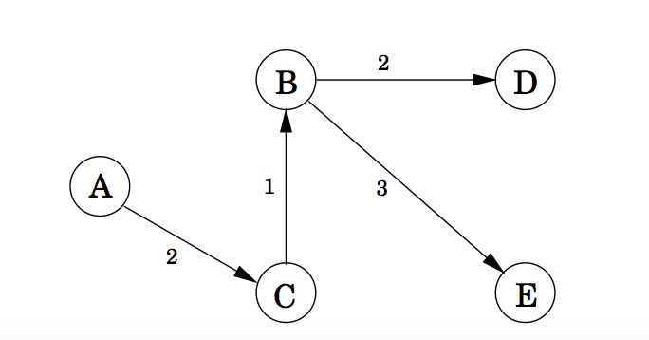
dist
pred
A: null
B: C
C: A
D: B,
E: B
best paths to each node via
nodes circled &
associated distance
Q: D(5), E(6)
A: null
B: C
C: A
D: B,
E: B
Q: E(6)
Dijkstra Alg
Demo

Slide 61
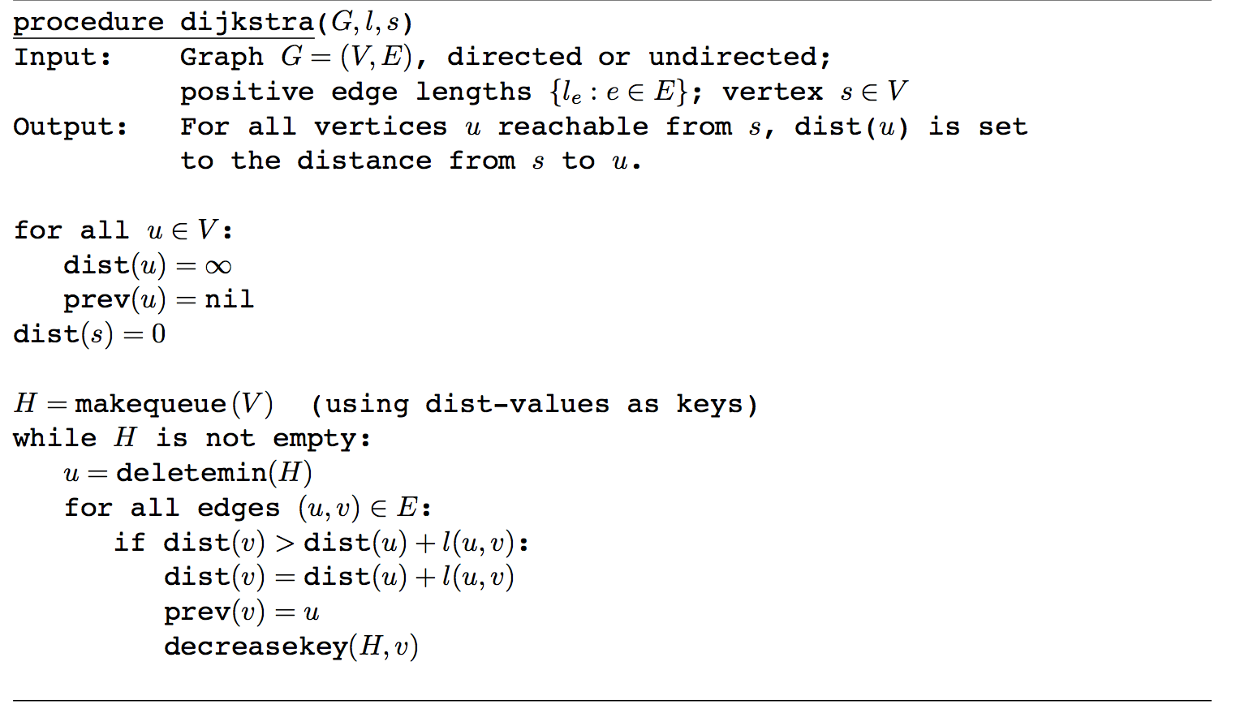
Dijkstra’s algorithm & snapshot
H: priority queue (min-heap in this case)
C(dist=1), B(dist=2), D(dist=inf), E (dist=inf)
prev=A
dist=2
prev=nil
dist=inf
s=A
prev=nil
dist=0
prev=A
dist=1
prev=nil
dist=inf

Slide 62
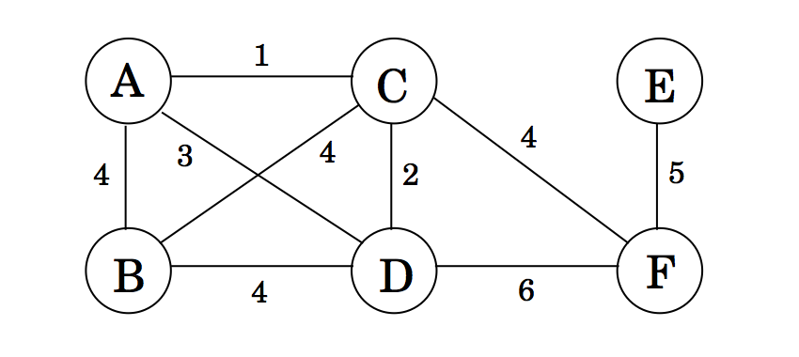
Minimum Spanning Trees
Minimum Spanning Tree Problem: Given a weighted graph, choose a subset of edges so that resulting subgraph is connected, and the total weights of edges is minimized
to minimize total weights, it never pays to have cycles, so resulting connection graph is connected, undirected, and acyclic, i.e., a tree.
Applications:
Communication networks
Circuit design
Layout of highway systems

Slide 63
Formal Definition of MST
Given a connected, undirected, weighted graph G = (V, E), a spanning tree is an acyclic subset of edges T ⊆ E that connects all vertices together.
cost of a spanning tree T : the sum of edge weights in the spanning tree
w(T) = ∑_{(u,v)∈T} w(u,v)
A minimum spanning tree (MST) is a spanning tree of minimum weight.

Slide 64
Minimum Spanning Trees
Given: Connected, undirected, weighted graph, G
Find: Minimum - weight spanning tree, T
Notice: there are many spanning trees for a graph
We want to find the one with the minimum cost
Such problems are optimization problems: there are multiple
viable solutions, we want to find best (lowest cost, best perf) one.
Acyclic subset of edges(E) that connects all vertices of G.

Slide 65
Greedy Algorithms
A problem solving strategy (like divide-and-conquer)
Idea: build up a solution piece by piece, in each step always choose the option that offers best immediate benefits (a myopic approach)
Local optimization: choose what seems best right now
not worrying about long term benefits/global benefits
Sometimes yield optimal solution, sometimes yield suboptimal (i.e., not optimal)
Sometimes we can bound difference from optimal…

Slide 66
Minimum Spanning Trees
Given: Connected, undirected, weighted graph, G
Find: Minimum - weight spanning tree, T
How to greedily build a spanning tree?
* Always choose lightest edge? Might lead to cycle.
* Repeat for n-1 times:
find next lightest edge that does not introduce cycle,
add the edge into tree
=> Kruskal’s algorithm

Slide 67
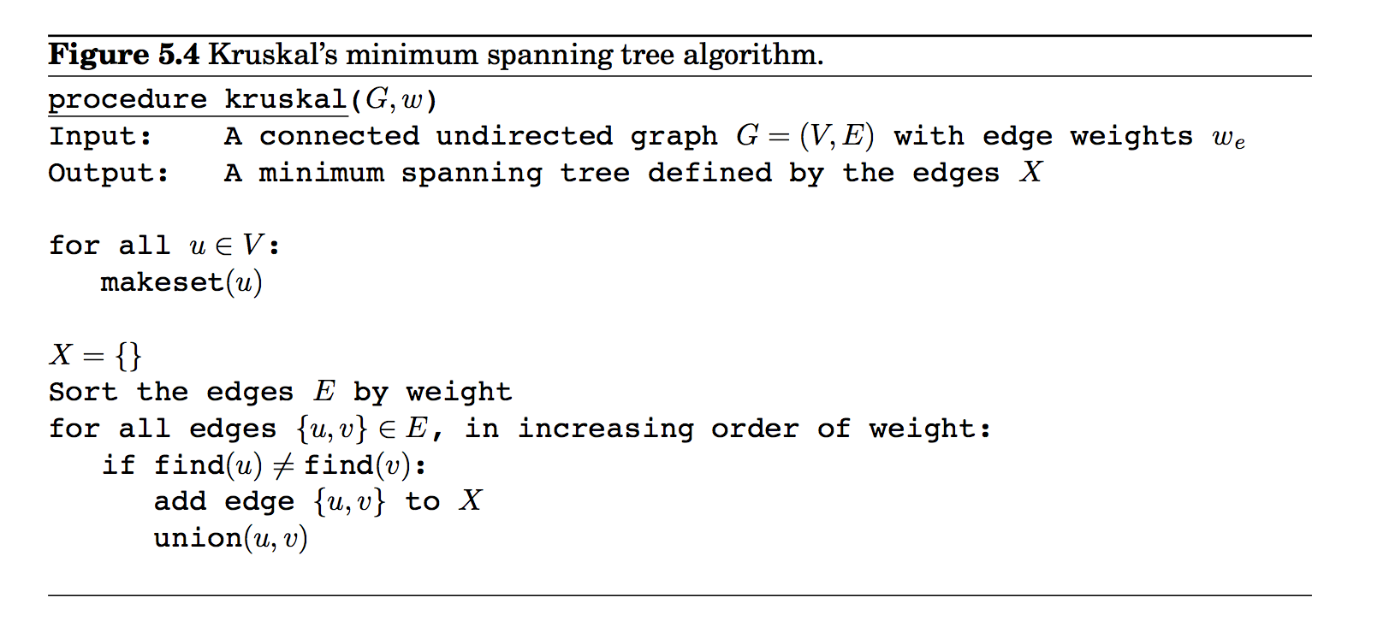
Kruskal’s Algorithm
Implementation detail:
Maintain sets of nodes that are connected by tree edges
find(u): return the set that u belongs to
find(u)=find(v) means u, v belongs to same group (i.e., u and v
are already connected)

Slide 68
Minimum Spanning Trees
Given: Connected, undirected, weighted graph, G
Find: Minimum - weight spanning tree, T
How to greedily build a spanning tree?
* Grow the tree from a node (any node),
* Repeat for n-1 times:
* connect one node to the tree by choosing
node with lightest edge connecting to tree nodes
This is Prim algorithm.
Example:
Suppose we start grow tree from C,
step 1. A has lightest edge to tree, add A and the edge (A-C) to tree
// tree is now A-C
step 2: D has lightest edge to tree
add D and the edge (C-D) to tree
….

Slide 69
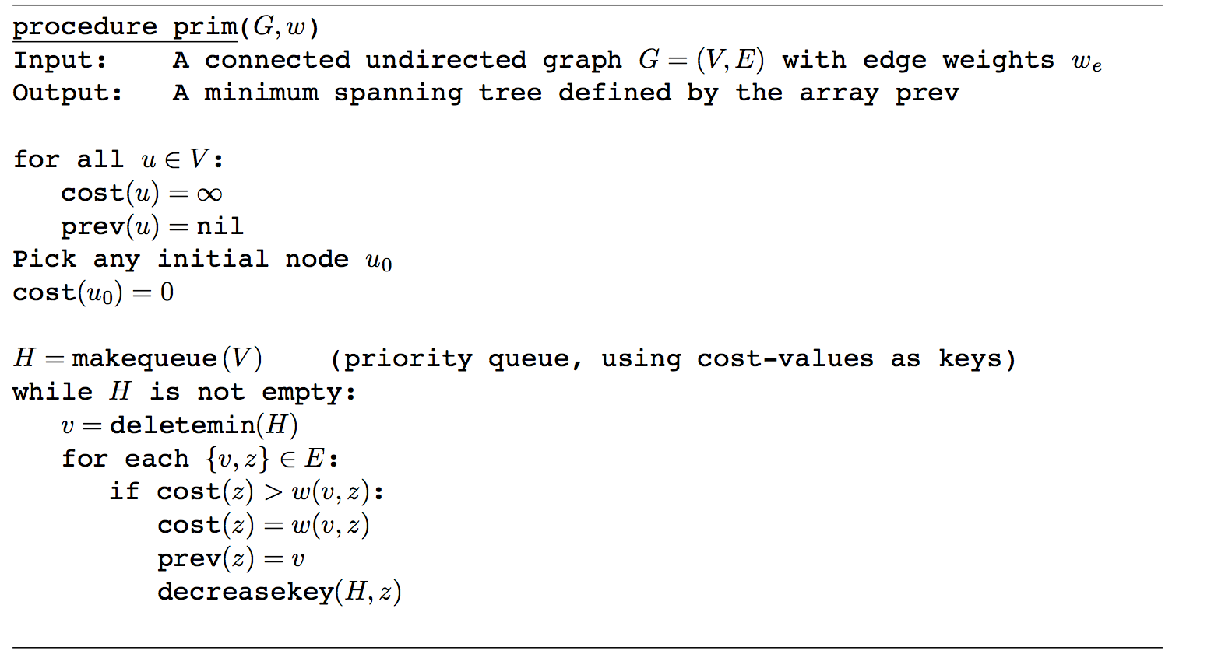
Prim’s Algorithm
cost[u]: stores weight of lightest edge connecting u to current tree
It will be updated as the tree grows
deletemin() takes node v with lowest cost out
* this means node v is done(added to tree) // v, and edge v - prev(v) added to tree
H is a priority queue (usually implemented as heap,
here it’s min-heap: node with lostest cost at root)

Slide 70
Summary
Graph everywhere: represent binary relation
Graph Representation
Adjacent lists, Adjacent matrix
Path, Cycle, Tree, Connectivity
Graph Traversal Algorithm: systematic way to explore graph (nodes)
BFS yields a fat and short tree
App: find shortest hop path from a node to other nodes
DFS yields forest made up of lean and tall tree
App: detect cycles and topological sorting (for DAG)

