Slide 1
Algorithms with numbers (1) CISC4080, Computer Algorithms
CIS, Fordham Univ.
Instructor: X. Zhang
Spring 2017

Slide 2
Acknowledgement
The set of slides have used materials from the following resources
Slides for textbook by Dr. Y. Chen from Shanghai Jiaotong Univ.
Slides from Dr. M. Nicolescu from UNR
Slides sets by Dr. K. Wayne from Princeton
which in turn have borrowed materials from other resources
Other online resources

Slide 3
Outline
Motivation
Algorithm for integer addition
Algorithms for multiplication
grade-school algorithm
recursive algorithm
divide-and-conquer algorithm
Division
Exponentiation

Slide 4
Algorithms for integer arithmetics
We study adding/multiplying two integers
earliest algorithms!
mostly what you learned in grade school!
Analyze running time of these algorithms by counting number of elementary operations on individual bits when adding/multiplying two N-bits long ints (so called bit complexity)
input size N: the length of operands
for example, to add two N-bits integer numbers, we need to O(n) bit operations (such as adding three bits together).

Slide 5
Practical consideration
But, why bother?
Given that with a single (machine) instruction, one can add/subtract/multiply integers whose size in bits is within word length of computer – 32, or 64.
i.e., they are implemented in hardware
Bit complexity of arithmetic operations algorithms captures amount of hardware (transistors and wires) necessary for implementing algorithm using digital logic circuit.
e.g., number of logic gates needed …

Slide 6
Support for Big Integer
What if we need to handle numbers that are several thousand bits long?
need to implement arithmetic operations of large integers in software.
Ex: Use an array of ints to store the (decimal or binary) digits of integer,
int digits[3]={2,4,6}; //represents 642
int digits1[10]={3,4,5,7,0,7,8}; //represent 8707543
int bindigits[4]={1,0,1,0}; //represent 0101, i.e., 3
Algorithms studied here are presented assuming base 2
those for other base (e.g., base 10) are similar

Slide 7
Support for Big Integer*
But notice that each int variable can store up to 64 bits, and we can add/subtract/multiple 64-bits ints in one machine instruction
To save space and time, one could divide big integer into chunks of 63 bits long, and store each chunk in a int
101100… 10 1111110…101110 111111…0000110011110111
63 bits 63 bits 63 bits
int chunks[3]={32, 121254, 145246};
//represent a value of
When adding two numbers, adding corresponding chunks together, carry over are added to the next chunks…

Slide 8
Outline
Motivation
Algorithm for integer addition
Algorithms for multiplication
grade-school algorithm
recursive algorithm
divide-and-conquer algorithm
Division
Exponentiation

Slide 9
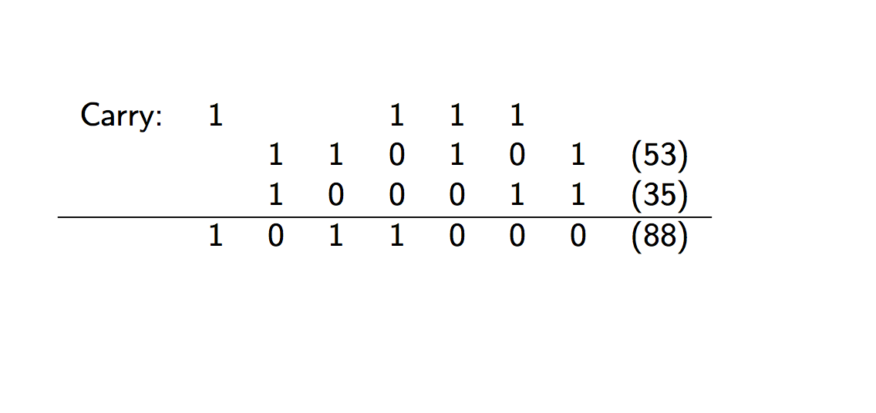
Adding two binary number

Slide 10
Algorithm for adding integers
Sum of any three single-digit numbers is at most two digits long. (holds for any base)
In binary the largest possible sum of three single-bit numbers is 3, which is a 2-bit number.
In decimal, the max possible sum of three single digit numbers is 27 (9+9+9), which is a 2-digit number
Algorithms for addition (in any base):
align their right-hand ends,
perform a single right-to-left pass
the sum is computed digit by digit, maintaining overflow as a carry
since we know each individual sum is a two-digit number, the carry is always a single digit, and so at any given step, three single-digit numbers are added)

Slide 11
Sorting applications

Slide 12
Ubiquitous log2N
log2N is the power to which you need to raise 2 in order to obtain N.
e.g., log28=3 (as 2³=8), log2 1024=10(as 2¹⁰=1024).
Going backward, it can be seen as the number of times you must halve N to get down to 1, more precisely:
e.g., N=10, ; N=8,
It is the number of bits in binary representation of N, more precisely:
e.g., hw1 questions
It is the depth of a complete binary tree with N nodes, more precisely:
height of a heap with N nodes …
It is even the sum 1+1/2+1/3+...+1/N, to within a constant factor.

Slide 13
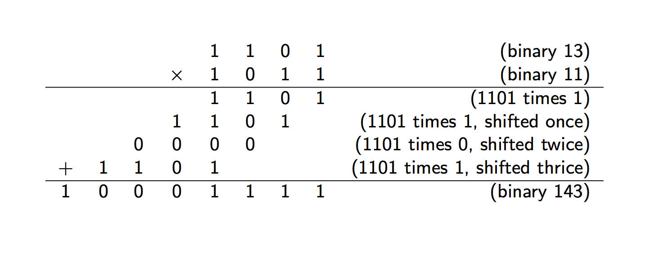
Multiplication in base 2
The grade-school algorithm for multiplying two numbers x and y:
create an array of intermediate sums, each representing the product of x by a single digit of y.
these values are appropriately left-shifted and then added up.

Slide 14
Multiplication in base 2
If x and y are both n bits, then there are n intermediate rows, with lengths of up to 2n bits.
The total time taken to add up these rows, doing two numbers at a time, is
which is O(n²).

Slide 15
Multiplication: top-down approach
Totally, n recursive calls, because at each call y is halved (i.e., n decreases by 1)
In each recursive call: a division by 2 (right shift), a test for odd/even (looking up the last bit); a multiplication by 2 (left shift); and possibly one addition => a total of O(n) bit operations.
The total time taken is thus O(n²).

Slide 16
Divide-and-conquer

Slide 17
Running time
Our method for multiplying n-bit numbers
1. making recursive calls to multiply these four pairs of n/2-bit numbers,
2. evaluates the above expression in O(n) time
Writing T(n) for the overall running time on n-bit inputs, we get the recurrence relation:
T(n) = 4T(n/2) + O(n)
By master theorem, T(n)=(n²)

Slide 18
Can we do better?
By Master Theorem:

Slide 19
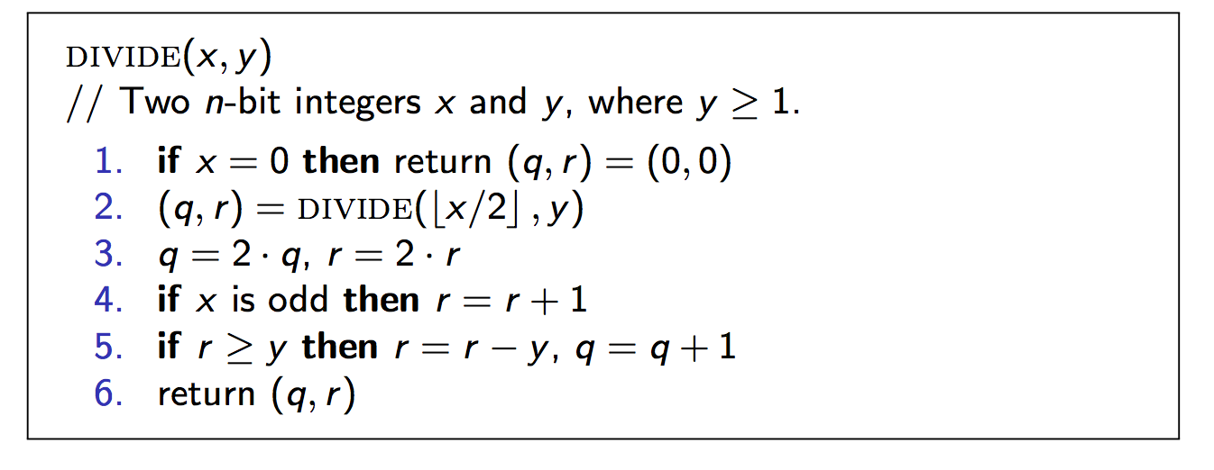
Integer Division

Slide 20
Readings
Chapter 1.1

