Slide 1
Algorithms for Big Data CISC5835
Fordham Univ.
Instructor: X. Zhang
Lecture 1

Slide 2
Outline
What is algorithm: word origin, first algorithms, algorithms of today’s world
Sequential algorithms, Parallel algorithms, approximation algorithms, randomized algorithms
Scope of the course
A few algorithms and pseudocode
Introduction to algorithm analysis: fibonacci seq calculation
counting number of “computer steps”
recursive formula for running time of recursive algorithm
Asymptotic notations
Algorithm running time classes: P, NP

Slide 3
What are Algorithms?

Slide 4
Algorithms Etymology
CS 477/677 - Lecture 1

Slide 5
Goal/Scope of this course
Goal: provide essential algorithmic background for MS Data Analytics students
algorithm analysis: space and time efficiency of algorithms
classical algorithms (sorting, searching, selection, graph…)
algorithms for big data
algorithms implementation in Python
We will not cover:
Machine Learning algorithms (topics for Data Mining, Machine Learning courses)
Implementing algorithms in big data cluster environment is left to Big Data Programming

Slide 6
Part I: computer algorithms
a general foundations and background for computer science
understand difficulty of problems (P, NP…)
understand key data structure (hash, tree)
understand time and space efficiency of algorithm
Basic algorithms:
sorting, searching, selection algorithms
algorithmic paradigm: divide & conquer, greedy, dynamic programming, randomization
Hashing and universal hashing
Graph algorithms/Analytics (path/connectivity/community/centrality analysis)
Assumption: whole input can be stored in main memory (organized using some data structure…)

Slide 7
Part II: Big Data Algorithms
Big Data: volume is too big to be stored in main memory of a single computer
This class:
Stream: m elements from universe of size n,
Goal: compute a function of stream (e.g, counting, median, longest increasing sequence…)
limited working memory, sublunar in n and m
access data sequentially (each element can be accessed only once)
process each element quickly
Matrix operations and algorithms: for large matrices
Such algorithms are randomized and approximate

Slide 8
Outline
What is algorithm: word origin, first algorithms, algorithms of today’s world
Scope of the course
A few algorithms and pseudocode
Introduction to algorithm analysis: fibonacci seq calculation
counting number of “computer steps”
recursive formula for running time of recursive algorithm
Asymptotic notations
Algorithm running time classes: P, NP

Slide 9
Oldest Algorithms
Al Khwarizmi laid out basic methods for
adding, multiplying and dividing numbers
extracting square roots
calculating digits of pi, …
These procedures were precise, unambiguous, mechanical, efficient, correct. i.e., they were algorithms, a term coined to honor Al Khwarizmi after decimal system was adopted in Europe many centuries later.

Slide 10
Example: Selection Sort
Input: a list of elements, L[1…n]
Output: rearrange elements in List, so that L[1]<=L[2]<=L[3]<…L[n]
Note that “list” is an ADT (could be implemented using array, linked list)
Ideas (in two sentences)
First, find location of smallest element in sub list L[1…n], and swap it with first element in the sublist
repeat the same procedure for sublist L[2…n], L[3…n], …, L[n-1…n]

Slide 11
Selection Sort (idea=>pseudocode)
for i=1 to n-1
// find location of smallest element in sub list L[i…n]
minIndex = i;
for k=i+1 to n
if L[k]<L[minIndex]: minIndex=k
//swap it with first element in the sublist
if (minIndex!=i)
swap (L[i], L[minIndex]);
// Correctness: L[i] is now the i-th smallest element

Slide 12
Introduction to algorithm analysis
Consider calculation of Fibonacci sequence, in particular, the n-th number in sequence:
0, 1, 1, 2, 3, 5, 8, 13, 21, 34, …

Slide 13
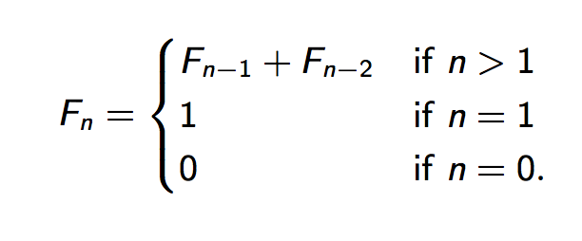
Fibonacci Sequence
0, 1, 1, 2, 3, 5, 8, 13, 21, 34, …
Formally,
Problem: How to calculate n-th term, e.g., what is F100, F200?

Slide 14
A recursive algorithm
Three questions:
Is it correct?
yes, as the code mirrors the definition…
Resource requirement: How fast is it? Memory requirement?
Can we do better? (faster?)
Observation: we reduce a large problem into two smaller problems

Slide 15
Outline
What is algorithm: word origin, first algorithms, algorithms of today’s world
Scope of the course
A few algorithms and pseudocode
Introduction to algorithm analysis: fibonacci seq calculation
counting number of “computer steps”
recursive formula for running time of recursive algorithm
Asymptotic notations
Algorithm running time classes: P, NP

Slide 16
Efficiency of algorithms
We want to solve problems using less resource:
Space: how much (main) memory is needed?
Time: how fast can we get the result?
Usually, the bigger input, the more memory it takes and the longer it takes
it takes longer to calculate 200-th number in Fibonacci sequence than the 10th number
it takes longer to sort larger array
it takes longer to multiple two large matrices
Efficient algorithms are critical for large input size/problem instance
Finding F100, Searching Web …
Two different approaches to evaluate efficiency of algorithms: Measurement vs. analysis

Slide 17
Experimental approach
Measure how much time elapses from algorithm starts to finishes
needs to implement, instrument and deploy
e.g.,
import time
….
start_time = time.time()
BubbleSort (listOfNumbers) # any code of yours
end_time = time.time()
elapsed_time = end_time - start_time

Slide 18
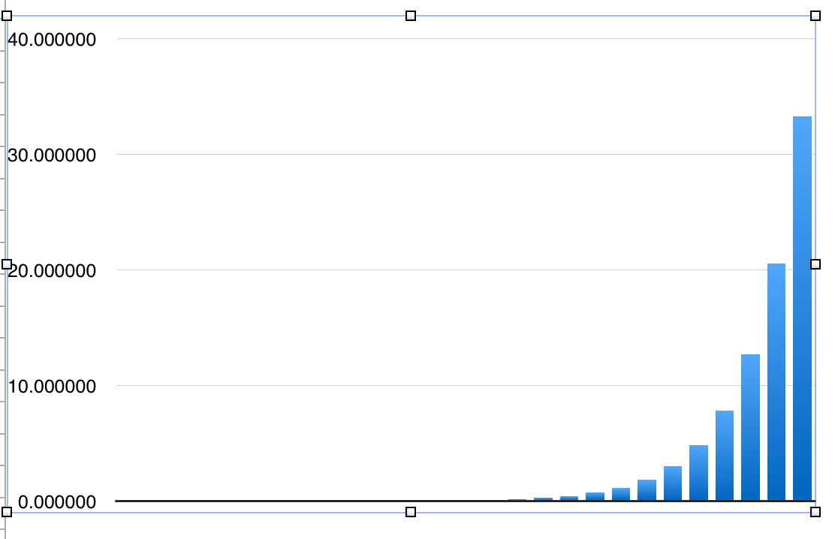
Example (Fib1: recursive)
n T(n)ofFib1 F(n)
10 3e-06 55
11 2e-06 89
12 4e-06 144
13 7e-06 233
14 1.1e-05 377
15 1.7e-05 610
16 2.9e-05 987
17 4.7e-05 1597
18 7.6e-05 2584
19 0.000122 4181
20 0.000198 6765
21 0.000318 10946
22 0.000515 17711
23 0.000842 28657
24 0.001413 46368
25 0.002261 75025
26 0.003688 121393
27 0.006264 196418
28 0.009285 317811
29 0.014995 514229
30 0.02429 832040
31 0.039288 1346269
32 0.063543 2178309
33 0.102821 3524578
34 0.166956 5702887
35 0.269394 9227465
36 0.435607 14930352
37 0.701372 24157817
38 1.15612 39088169
39 1.84103 63245986
40 2.9964 102334155
41 4.85536 165580141
42 7.85187 267914296
43 12.6805 433494437
44 20.513 701408733
Time (in seconds)
n
Running time seems to grows
exponentially as n increases

Slide 19
Experimental approach
results are realistic, specific and random
specific to language, run time system (Java VM, OS), caching effect, other processes running
possible to perform model-fitting to find out T(n): running time of the algorithms given input size
Cons:
time consuming, maybe too late
Does not explain why?
Measurement is important for a “production” system/end product; but not informative for algorithm efficiency studies/comparison/prediction

Slide 20
Analytic approach
Is it possible to find out how running time grows when input size grows, analytically?
Does running time stay constant, increase linearly, logarithmically, quadratically, … exponentially?
Yes: analyze pseudocode/code to calculate total number of steps in terms of input size, and study its order of growth
results are general: not specific to language, run time system, caching effect, other processes sharing computer

Slide 21
Running time analysis
Given an algorithm in pseudocode or actual program
When the input size is n, what is the total number of computer steps executed by the algorithm, T(n)?
Size of input: size of an array, polynomial degree, # of elements in a matrix, vertices and edges in a graph, or # of bits in the binary representation of input
Computer steps: arithmetic operations, data movement, control, decision making (if, while), comparison,…
each step take a constant amount of time
Ignore: overhead of function calls (call stack frame allocation, passing parameters, and return values)

Slide 22
Case Studies: Fib1(n)
Let T(n) be number of computer steps needed to compute fib1(n)
T(0)=1: when n=0, first step is executed
T(1)=2: when n=1, first two steps are executed
For n >1, T(n)=T(n-1)+T(n-2)+3: first two steps are executed, fib1(n-1) is called (with T(n-1) steps), fib1(n-2) is called (T(n-2) steps), return values are added (1 step)
Can you see that T(n) > Fn ?

Slide 23
Running Time analysis
Let T(n) be number of computer steps to compute fib1(n)
T(0)=1
T(1)=2
T(n)=T(n-1)+T(n-2)+3, n>1
Analyze running time of recursive algorithm
first, write a recursive formula for its running time
then, recursive formula => closed formula, asymptotic result

Slide 24
Fibonacci numbers
F0=0, F1=1, Fn=Fn-1+Fn-2
Fn is lower bounded by
In fact, there is a tighter lower bound 2^{0.694n}
Recall T(n): number of computer steps to compute fib1(n),
T(0)=1
T(1)=2
T(n)=T(n-1)+T(n-2)+3, n>1

Slide 25
Exponential running time
Running time of Fib1: T(n)> 2^{0.694n}
Running time of Fib1 is exponential in n
calculate F200, it takes at least 2¹³⁸ computer steps
On NEC Earth Simulator (fastest computer 2002-2004)
Executes 40 trillion (10¹²) steps per second, 40 teraflots
Assuming each step takes same amount of time as a “floating point operation”
Time to calculate F200: at least 2⁹² seconds, i.e.,1.57x10²⁰ years
Can we throw more computing power to the problem?
Moore’s law: computer speeds double about every 18 months (or 2 years according to newer version)

Slide 26
Exponential running time
Running time of Fib1: T(n)> 2^{0.694n} =1.6177^{n}
Moore’s law: computer speeds double about every 18 months (or 2 years according to newer version)
If it takes fastest CPU of this year 6 minutes to calculate F50,
fastest CPU in two years from today can calculate F52 in 6 minutes
Algorithms with exponential running time are not efficient, not scalable
not practical solution for large input

Slide 27
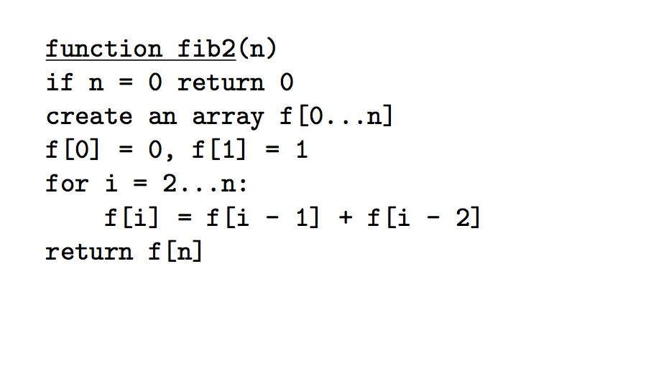
Can we do better?
Draw recursive function call tree for fib1(5)
Observation: wasteful repeated calculation
Idea: Store solutions to subproblems in array (key of Dynamic Programming)

Slide 28
Running time fib2(n)
Analyze running time of iterative (non-recursive) algorithm:
T(n)=1 // if n=0 return 0
+n // create an array of f[0…n]
+2 // f[0]=0, f[1]=1
+(n-1) // for loop: repeated for n-1 times
= 2n+2
T(n) is a linear function of n, or fib2(n) has linear running time

Slide 29
Alternatively…
Estimation based upon CPU:
takes 1000us,
takes 200n us
each assignment takes 60us
addition and assignment takes 800us…
How long does it take for fib2(n) finish?
T(n)=1000 +200n+2*60+(n-1)*800=1000n+320 // in unit of us
Again: T(n) is a linear function of n
Constants are not important: different on different computers
System effects (caching, OS scheduling) makes it pointless to do such fine-grained analysis anyway!
Algorithm analysis focuses on how running time grows as problem size grows (constant, linear, quadratic, exponential?)
not actual real world time

Slide 30
Summary: Running time analysis
Given an algorithm in pseudocode or actual program
When the input size is n, how many total number of computer steps are executed?
Size of input: size of an array, polynomial degree, # of elements in a matrix, vertices and edges in a graph, or # of bits in the binary representation of input
Computer steps: arithmetic operations, data movement, control, decision making (if, while), comparison,…
each step take a constant amount of time
Ignore:
Overhead of function calls (call stack frame allocation, passing parameters, and return values)
Different execution time for different steps

Slide 31
Time for exercises/examples
1. Reading algorithms in pseudocode
2. Writing algorithms in pseudocode
3. Analyzing algorithms

Slide 32
Algorithm Analysis: Example
What’s the running time of MIN?
Algorithm/Function.: MIN (a[1…n])
input: an array of numbers a[1…n]
output: the minimum number among a[1…n]
m = a[1]
for i=2 to n:
if a[i] < m: m = a[i]
return m
How do we measure the size of input for this algorithm?
How many computer steps when the input’s size is n?

Slide 33
Algorithm Analysis: bubble sort
Algorithm/Function.: bubblesort (a[1…n])
input: a list of numbers a[1…n]
output: a sorted version of this list
for endp=n to 2:
for i=1 to endp-1:
if a[i] > a[i+1]: swap (a[i], a[i+1])
return a
How do you choose to measure the size of input?
length of list a, i.e., n
the longer the input list, the longer it takes to sort it
Problem instance: a particular input to the algorithm
e.g., a[1…6]={1, 4, 6, 2, 7, 3}
e.g., a[1…6]={1, 4, 5, 6, 7, 9}

Slide 34
Algorithm Analysis: bubble sort
Algorithm/Function.: bubblesort (a[1…n])
input: an array of numbers a[1…n]
output: a sorted version of this array
for endp=n to 2:
for i=1 to endp-1:
if a[i] > a[i+1]: swap (a[i], a[i+1])
return a
endp=n: inner loop (for j=1 to endp-1) repeats for n-1 times
endp=n-1: inner loop repeats for n-2 times
endp=n-2: inner loop repeats for n-3 times
…
endp=2: inner loop repeats for 1 times
Total # of steps: T(n) = (n-1)+(n-2)+(n-3)+…+1=n(n-1)/2
a compute step

Slide 35
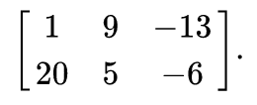
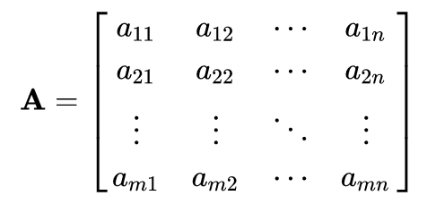
Matrix and Vector
Matrix: a 2D (rectangular) array of numbers, symbols, or expressions, arranged in rows and columns.
e.g., a 2 × 3 matrix B=
Row vector of a matrix is a vector made up of a row of elements from the matrix: [1 9 -13] is a row vector of B
Column vector of a matrix is a vector made up of a column of elements from the matrix: [-13 -6] is a column vector of B
a matrix
Each element of a matrix is denoted by a variable with two subscripts, A2,1 element at second row and first column of a matrix A

Slide 36
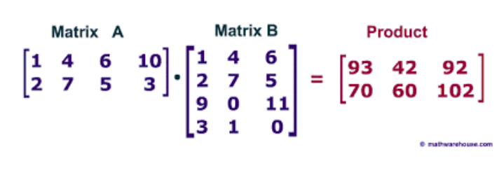
Matrix Multiplication
Matrix Multiplication:
C2,2=[2 7 5 3 ] x [4 7 0 1] = 2*4+7*7+5*0+3*1=60
Dimension of A, B, and A x B?
The (i,j) element of AB is the dot product of i-th row of A with the j-th column of B

Slide 37
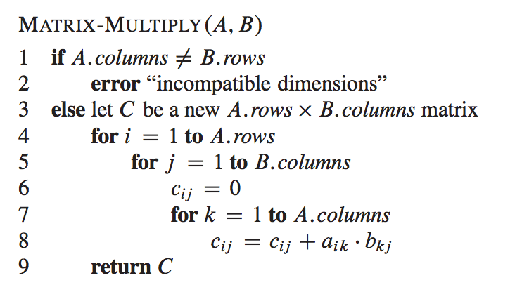
Matrix Multiplication
Dimension of A, B, and A x B?
Matrix Multiplication:
Total (scalar) multiplication: 4x2x3=24
Total (scalar) multiplication: n2xn1xn3

Slide 38
Algorithm Analysis: Binary Search
Algorithm/Function.: search (a[L…R], value)
input: a list of numbers a[L…R] sorted in ascending order, a number value
output: the index of value in list a (if value is in it), or -1 if not found
if (L>R): return -1
m = (L+R)/2
if (a[m]==value):
return m
else:
if (a[m]>value):
return search (a[L…m-1], value)
else:
return search (a[m+1…R], value)
What’s the size of input in this algorithm?
length of list a[L…R]

Slide 39
Algorithm Analysis: Binary Search
Algorithm/Function.: search (a[L…R], value)
input: a list of numbers a[L…R] sorted in ascending order, a number value
output: the index of value in list a (if value is in it), or -1 if not found
if (L>R): return -1
m = (L+R)/2
if (a[m]==value):
return m
else:
if (a[m]>value):
return search (a[L…m-1], value)
else:
return search (a[m+1…R], value)
Let T(n) be number of steps to search an list of size n
best case (value is in middle point), T(n)=3
worst case (when value is not in list) provides an upper bound

Slide 40
Algorithm Analysis: Binary Search
Algorithm/Function.: search (a[L…R], value)
input: a list of numbers a[L…R] sorted in ascending order, a number value
output: the index of value in list a (if value is in it), or -1 if not found
if (L>R): return -1
m = (L+R)/2
if (a[m]==value):
return m
else:
if (a[m]>value):
return search (a[L…m-1], value)
else:
return search (a[m+1…R], value)
Let T(n) be number of steps to search an list of size n in worst case
T(0)=1 //base case, when L>R
T(n)=3+T(n/2) //general case, reduce problem size by half
Next chapter: master theorem solving T(n)=log2n

Slide 41
Outline
What is algorithm: word origin, first algorithms, algorithms of today’s world
Sequential algorithms, Parallel algorithms, approximation algorithms, randomized algorithms
Scope of the course
A few algorithms and pseudocode
Introduction to algorithm analysis: fibonacci seq calculation
counting number of “computer steps”
recursive formula for running time of recursive algorithm
Asymptotic growth rate, big-O notations
Algorithm running time classes: P, NP

Slide 42
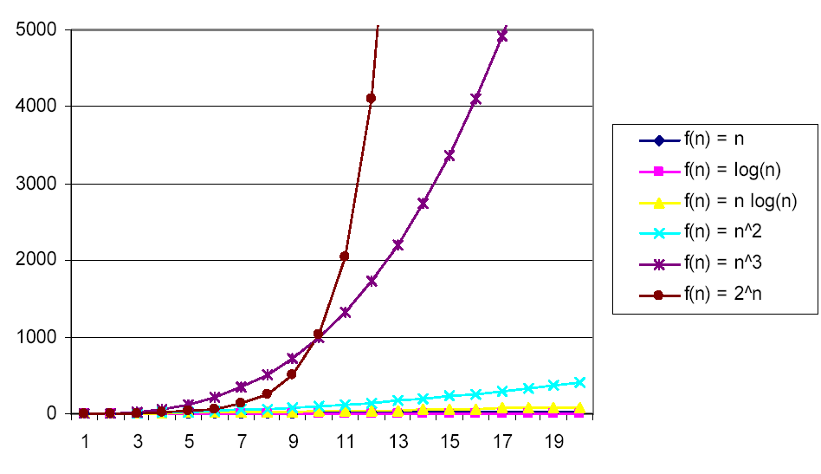
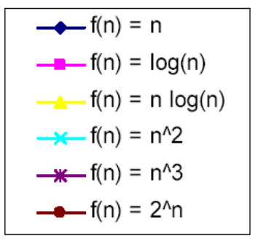
Growth Rate of functions
Growth rate: How fast f(x) increases as x increases
slope (derivative)
f(x)=2x: constant growth rate (slope is 2)
: growth rate increases as x increases (see figure above)
: growth rate decreases as x increases

Slide 43
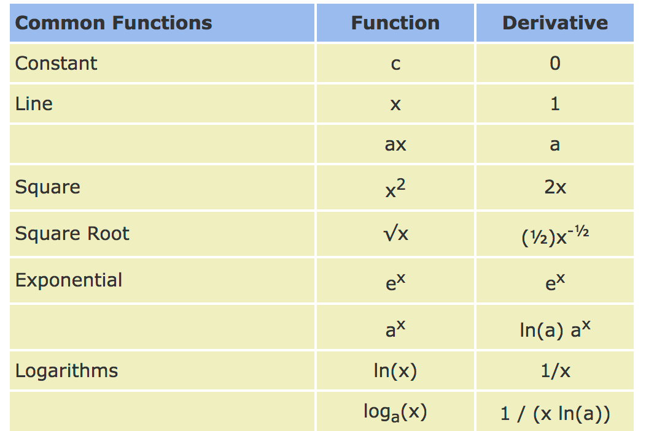
Derivatives of Common Functions

Slide 44
Asymptotic Growth Rate of functions
Asymptotic Growth rate: growth rate of function when
slope (derivative) when x is very big
The larger asym. growth rate, the larger f(x) when
e.g., f(x)=2x: asymptotic growth rate is 2
: very big!
(Asymptotic) Growth rate of functions of n (from low to high):
log(n) < n < nlog(n) < n² < n³ < n⁴ < ….< 1.5^{n} < 2^{n} < 3^{n}

Slide 45
Compare Growth Rate of functions(2)
Two sorting algorithms:
yours:
your friend:
Which one is better (for large arrays)?
evaluate their ratio when n is large
They are same! In general, the lower order term can be dropped.

Slide 46
Focus on Asymptotic Growth Rate
In answering “How fast T(n) grows as n grows?”, leave out
lower-order terms
constant coefficient: not reliable info. (arbitrarily counts # of computer steps), and hardware difference makes them not important
Note: you still want to optimize your code to bring down constant coefficients. It’s only that they don’t affect “asymptotic growth rate”
e.g. bubble sort executes steps to sort a list of n elements
bubble sort’s running time, T(n)’s (asymptotic) growth rate is same as n², i.e.,
bubble sort has a quadratic running time

Slide 47
Outline
What is algorithm: word origin, first algorithms, algorithms of today’s world
Sequential algorithms, Parallel algorithms, approximation algorithms, randomized algorithms
Scope of the course
A few algorithms and pseudocode
Introduction to algorithm analysis: fibonacci seq calculation
counting number of “computer steps”
recursive formula for running time of recursive algorithm
Asymptotic growth rate, big-O notations
Algorithm running time classes: P, NP

Slide 48
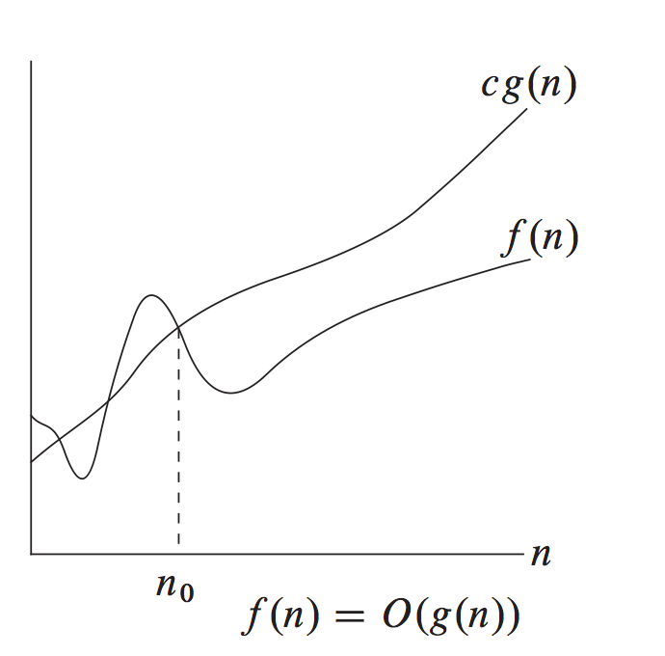
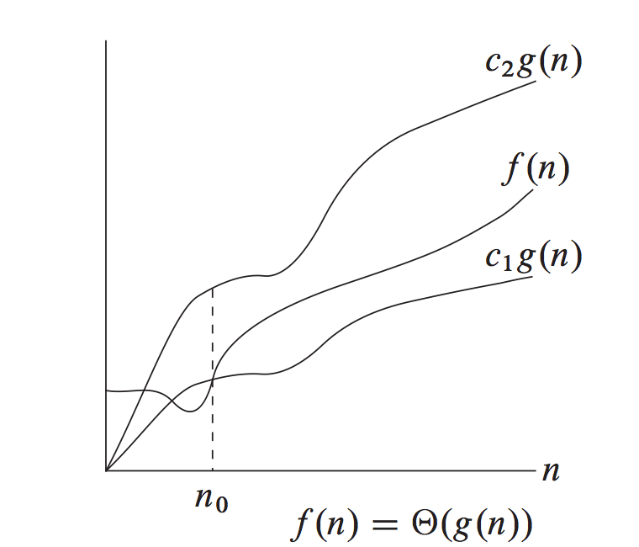
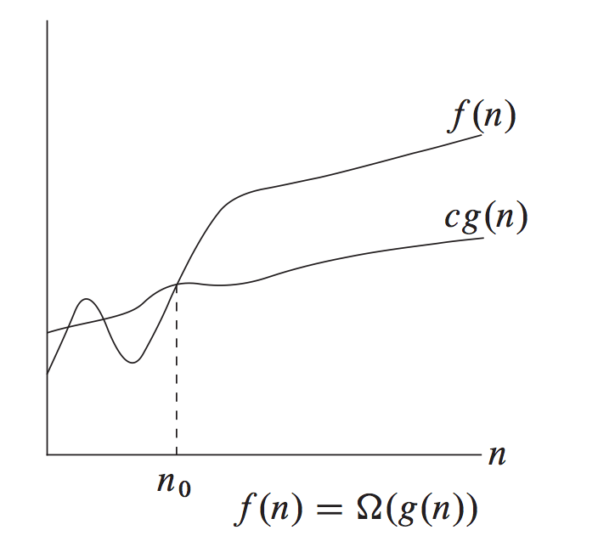
Big-O notation
f(n) and g(n): two functions from positive integers to positive real numbers
In reference textbook (CLR),
for all n>n0,
f grows no faster than g,
g is asymptotic upper
bound of f
f grows no slower and no
faster than g, f grows at
same rate as g
f grows no slower than g,
g is asymptotic lower
bound of f

Slide 49
Big-O notation
f=O(g) if there is a constant c>0 and n0, such that for all n>n0,
f(n) is smaller than some positive constant times g(n) for all n that is large enough
e.g., f(n)=100n², g(n)=n³
f(n)=O(g(n)), as there exists c=100, n0=1, such that for all n>n0, f(n)<=c*g(n)
Looking to bound by a positive constant for all n large enough…
Some books write ,
O(g) denotes the set of all functions h(n) for which there is a constant c>0, such that

Slide 50
Big-O: Exercise
For the following four pairs of f(), g(), is f(n)=O(g(n)) ?
f(n)=1, g(n)=2n
f(n)=100n²+8n, g(n)=n²
f(n)=nlog(n), g(n)=n²

Slide 51
Big-Ω notations
Consider this pairs of f, g:
f(n)=O(g(n)) is not true:
impossible to find c, n0, s.t., for all n>n0,
instead, let c=0.5, n0=2, then for all n>=n0,
f(n) grows no slower than g(n), i.e., f=Ω(g) (g is asymptotic lower bound of f)
if and only if there is a positive constant c, n0, such that for all n,

Slide 52
Big-Ω notations Exercises
For following pairs of f(n), g(n), is
f(n)=100n², g(n)=n
f(n)=100n²+8n, g(n)=n²
f(n)=2^{n}, g(n)=n⁸

Slide 53
Big- notations
Consider f(n)=100n²+8n, g(n)=n²
i.e., f grows no faster, an no slower faster than g, f grows at same rate as g asymptotically
We denote this as
Def: there are constants c1, c2, no>0, s.t.,
f can be sandwiched between g by two constant factors

Slide 54
Big- Exercise
For following pairs of f and g, is ?
(1) f(n)=10000n², g(n)=n²
(2)
(3)

Slide 55
mini-summary
in analyzing running time of algorithms, what’s important is scalability (perform well for large input)
focus on higher order which dominates lower order parts
a three-level nested loop dominates a single-level loop
multiplicative constants can be omitted: 14n² becomes n²
nª dominates n^{b} if a>b, e.g.,
any exponential dominates any polynomial:
3^{n} dominates n⁵
any polynomial dominates any logarithms: n dominates (logn)³
E.g.,

Slide 56
Outline
What is algorithm: word origin, first algorithms, algorithms of today’s world
Sequential algorithms, Parallel algorithms, approximation algorithms, randomized algorithms
Scope of the course
A few algorithms and pseudocode
Introduction to algorithm analysis: fibonacci seq calculation
counting number of “computer steps”
recursive formula for running time of recursive algorithm
Asymptotic growth rate and big-O notations
Problem complexity class: P, NP

Slide 57
Typical Running Time
1 (constant running time):
Instructions are executed once or a few times
log(n) (logarithmic), e.g., binary search
A big problem is solved by cutting original problem in smaller sizes, by a constant fraction at each step
n (linear): linear search, calculate mean, variance, …
A small amount of processing is done on each input element
n log(n): merge sort
A problem is solved by dividing it into smaller problems, solving them independently and combining the solution

Slide 58
Typical Running Time Functions
n² (quadratic): bubble sort
Typical for algorithms that process all pairs of data items (double nested loops)
n³ (cubic)
matrix multiplication
n^{K} (polynomial)
2^{0.694n} (exponential): Fib1
2^{n} (exponential):
Few exponential algorithms are appropriate for practical use
3^{n} (exponential), …

Slide 59
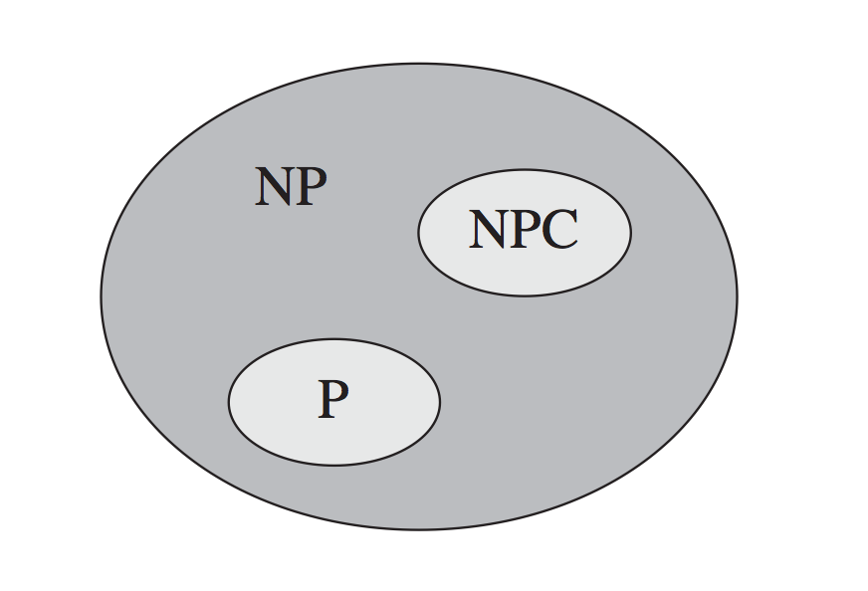
P=NP?
P: the set of problems that have known polynomial algorithms
NP: the set of problems for which there exists a polynomial alg. to verify a solution
Many NP problems have no polynomial time algorithms … yet, despite intensive research by many
Will we ever find one? Not likely…
we’ve tried a long time
many problems in NPC (if we can
solve one in polynomial, then we can solve all others in polynomial.

Slide 60
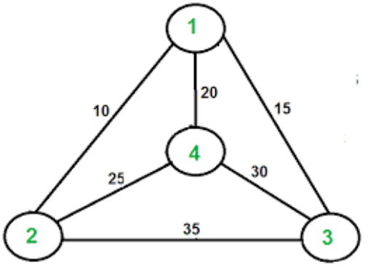
NPC: Traveling Salesman Problem
Given n vertices 1, . . . , n, and all n(n − 1)/2 distances between them, as well as a budget b.
Output: find a tour (a cycle that passes through every vertex exactly once) of total cost b or less – or to report that no such tour exists.
TSP as a search problem
given an instance, find a tour within the budget (or report that none exists).
Usually, TSP is posed as optimization problem
find shortest possible tour
1->2->3->4, total cost: 60
TSP is NP problem

Slide 61
Summary
This class focused on algorithm running time analysis
start with running time function, expressing number of computer steps in terms of input size
Focus on very large problem size, i.e., asymptotic running time
big-O notations => focus on dominating terms in running time function
Constant, linear, polynomial, exponential time algorithms …
NP, NP complete problem

Slide 62
Assignment
Lab1
Chapter 0 of DPV

