Slide 1
HashTable
CISC4080, Computer Algorithms
CIS, Fordham Univ.
Instructor: X. Zhang
Spring 2018

Slide 2
Acknowledgement
The set of slides have used materials from the following resources
Slides for textbook by Dr. Y. Chen from Shanghai Jiaotong Univ.
Slides from Dr. M. Nicolescu from UNR
Slides sets by Dr. K. Wayne from Princeton
which in turn have borrowed materials from other resources
Other online resources

Slide 3
Support for Dictionary
Dictionary ADT: a dynamic set of elements supporting INSERT, DELETE, SEARCH operations
elements have distinct key fields
DELETE, SEARCH by key
Different ways to implement Dictionary
unsorted array
insert O(1), delete O(n), search O(n)
sorted array
insert O(n), delete O(n), search O(log n)
binary search tree
insert O(log n), delete O(log n), search O(log n)
linked list …
Can we have “almost” constant time insert/delete/search?

Slide 4
Towards constant time
Direct address table: use key as index into the array
T[i] stores the element whose key is i
How big is the table?
big enough to have one slot for every possible key
T
NULL
0
Insert ( element(2,Alice))
T[2]=element(2, Alice);
Delete (element(4))
T[4]=NULL;
Search (element(5))
return T[5];
1
2, Alice
2
NULL
4, Bob
U: the set of all
possible key values
5, Ed
….
K: actual
set of keys
in your data

Slide 5
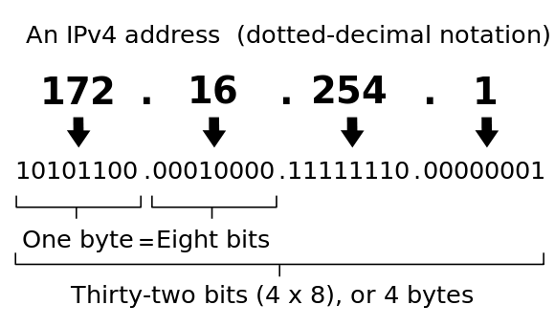
Case studies
A web server: maintains all active clients’ info, using IP addr. as key
Universe of keys: the set of all possible IPv4 addr., |U|=2³²
much bigger than total # of active clients
Too big to use direct access table:
a table with 2³² entries, if each entry is 32bytes, then 128GB is needed!
How to have constant accessing time, while not requiring huge memory usage?
U: the set of all
possible key values
K: actual
set of keys
in your data

Slide 6
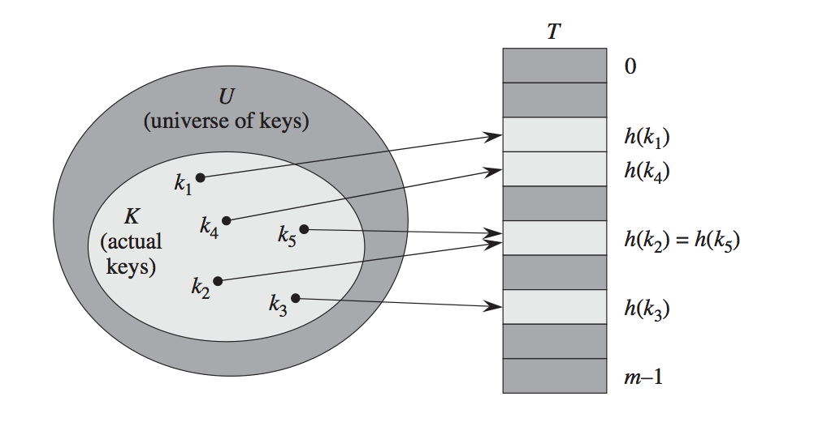
Hash Table
Hash Table: use a (hash) function to map key to index of the table (array)
Element x is stored in T[h(x.key)]
hash function: int hash (Key k) // return value 0…m-1
Collision: when two different keys
are mapped to same index.
Can collision be avoided?
Is it possible to design a hash function that is one-to-one?
Hint: domain and condomain of hash()?

Slide 7
Hashing: unavoidable collision
a large universe set U
A set K of actually occurred keys, |K| << |U| (much much smaller)
Table T of size m,
A hash function:
Given |U| > |m|, hash function is many-to-one
by pigeonhole theorem
Collisions cannot be avoided but its chances can be reduced using a “good” hash function
So that we don’t waste memory space

Slide 8
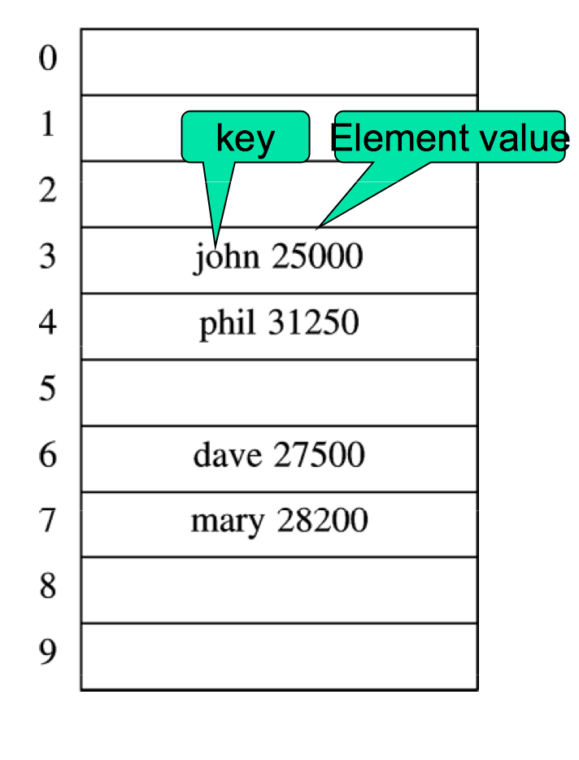
HashTable Operations
If there is no collision:
Insert
Table[h(“john”)]=Element(“John”, 25000)
Delete
Table[h(“john”)]=NULL
Search
return Table[h(“john”)]
All constant time O(1)

Slide 9
Hash Function
A hash function: . Given an element x, x is stored in T[h(x.key)]
Good hash function:
fast to compute
Ideally, map any key equally likely to any of the slots, independent of other keys
Hash Function:
first stage: map non-integer key to integer
second stage: map integer to [0…m-1]

Slide 10
First stage: any type to integer
Any basic type is represented in binary
Composite type which is made up of basic type
a character string (each char is coded as an int by ASCII code), e.g.,“pt”
add all chars up, ‘p’+’t’=112+116=228
radix notation: ‘p’*128+’t’=14452
treat “pt” as base 128 number…
a point type: (x,y) an ordered pair of int
x+y
ax+by // pick some non-zero constants a, b
…
IP address:four integers in range of 0…255
add them up
radix notation: 150*256³+108*256²+68*256+26

Slide 11
Hash Function: second stage
Division method: divide integer by m (size of hash table) and take remainder
h(key) = key mod m
if key’s value are randomly uniformly distributed all integer values, the above hash function is uniform
But often times data are not randomly distributed,
What if m=100, all keys have same last two digits?
Similarly, if m=2^{p}, then result is simply the lowest-ordre p bits
Rule of thumbs: choose m to be a prime not too close to exact powers of 2

Slide 12
Hash Function: second stage
Multiplication method: pick a constant A in the range of (0,1),
take fraction part of kA, and multiply with m
e.g., m=10000, h(123456)=41.
Advantage: m could be exact power of 2…

Slide 13
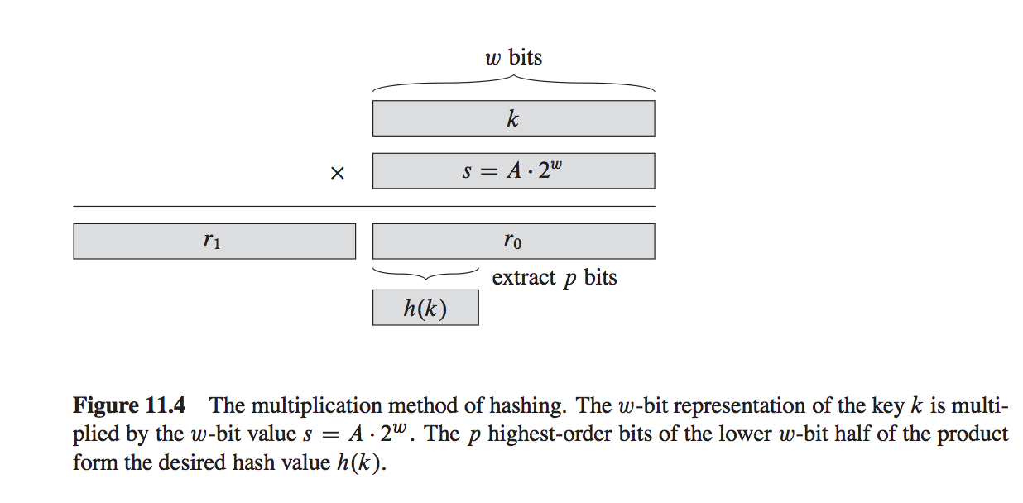
Multiplication Method

Slide 14
Exercise
Write a hash function that maps string type to a hash table of size 250
First stage: using radix notation
“Hello!” => ‘H’*128^5+’e’*128^4+…+’!’
Second stage:
x mod 250
How do you implement it efficiently?
Recall modular arithmetic theorem?
(x+y) mod n = ((x mod n)+(y mod n)) mod n
(x * y) mod n = ((x mod n)*(y mod n)) mod n
(x^e) mod n = (x mod n)^e mod n
X

Slide 15
Exercise
Write a hash function that maps a point type as below to a hash table of size 100
class point{
int x, y;
}

Slide 16
Collision Resolution
Recall that h(.) is not one-to-one, so it maps multiple keys to same slot:
for distinct k1, k2, h(k1)=h(k2) => collision
Two different ways to resolve collision
Chaining: store colliding keys in a linked list (bucket) at the hash table slot
dynamic memory allocation, storing pointers (overhead)
Open addressing: if slot is taken, try another, and another (a probing sequence)
clustering problem.

Slide 17
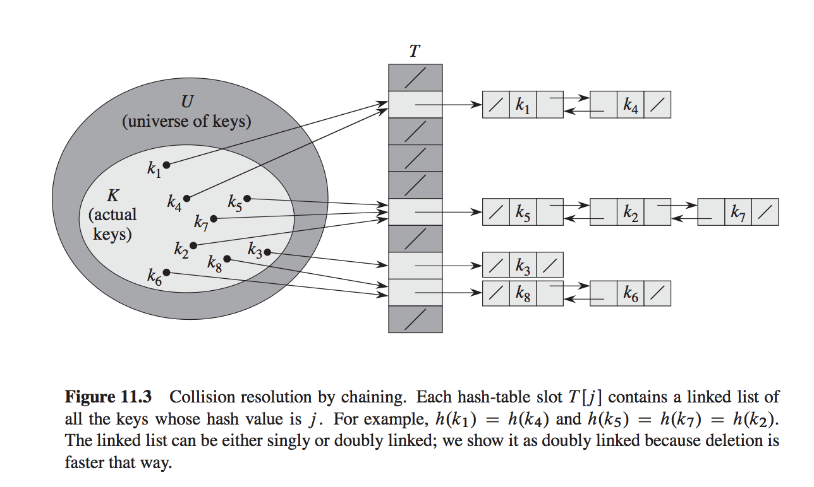
Chaining
Chaining: store colliding elements in a linked list at the same hash table slot
if all keys are hashed to same slot, hash table degenerates to a linked list.
C++: NodePtr T[m];
STL: vector<list<HashedObject>> T;
Here doubly-linked list is used

Slide 18
Chaining: operations
Insert (T,x):
insert x at the head of T[h(x.key)]
Running time (worst and best case): O(1)
Search (T,k)
search for an element with key x in list T[h(k)]
Delete (T,x)
Delete x from the list T[h(x.key)]
Running time of search and delete: proportional to length of list stored in h(x.key)

Slide 19
Chaining: analysis
Consider a hash table T with m slots stores n elements.
load factor
If any given element is equally likely to hash into any of the m slots, independently of where any other element is hashed to, then average length of lists is
search and delete takes
If all keys are hashed to same slot, hash table degenerates to a linked list
search and delete takes

Slide 20
Collision Resolution
Open addressing: store colliding elements elsewhere in the table
Advantage: no need for dynamic allocation, no need to store pointers
When inserting:
examine (probe) a sequence of positions in hash table until find empty slot
e.g., linear probing: if T[h(x.key)] is taken, try slots: h(x.key)+1, h(x.key+2), …
When searching/deleting:
examine (probe) a sequence of positions in hash table until find element

Slide 21
Open Addressing
Hash function: extended to probe sequence (m functions):
insert element with key x: if h0(x) is taken, try h1(x), and then h2(x), until find an empty/deleted slot
Search for key x: if element at h0(x) is not a match, try h1(x), and then h2(x), ..until find matching element, or reach an empty slot
Delete key x: mark its slot as DELETED

Slide 22
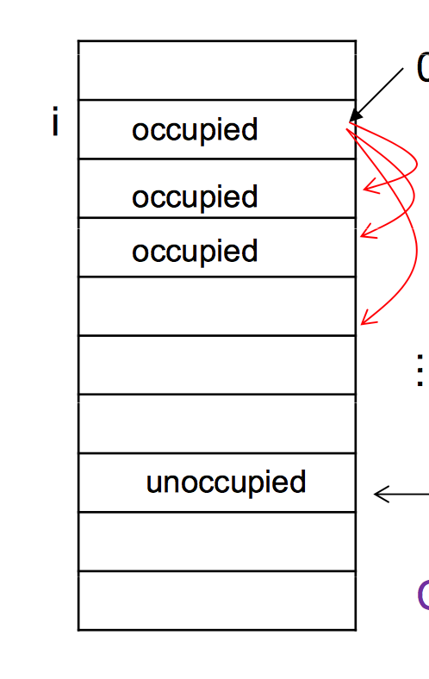
Linear Probing
Probing sequence
hi(x)=(h(x)+i) mod m
probe sequence: h(x),h(x)+1, h(x)+2, …
Continue until an empty slot is found
Problem: primary clustering
if there are multiple keys mapped to a slot, the slots after it tends to be occupied
Reason: all keys using same probing: +1, +2, …

Slide 23
Quadratic Probing
probe sequence:
h0(x)=h(x) mod m
h1(x)=(h(x)+c1+c2) mod m
h2(x)=(h(x)+2c1+4c2) mod m
…
Problem:
secondary clustering
choose c1,c2,m carefully so that all slots are probed

Slide 24
Double Hashing
Use two functions f1,f2:
Probe sequence:
h0(x)=f1(x) mod m,
h1(x)=(f1(x)+f2(x)) mod m
h2(x)=(f1(x)+2f2(x)) mod m,…
f2(x) and m must be relatively prime for entire hash table to be searched/used
Two integers a, b are relatively prime with each other if their greatest common divisor is 1
e.g., m=2^{k}, f2(x) be odd
or, m be prime, f2(x)<m

Slide 25
Exercises
Hash function, Chaining, Open addressing
Implementing HashTable
Using C++ STL containers (implemented using hashtable)
unordered_set<int> // a set of int
unordered_map<string,int> lookup; //key, value
unordered_multiset
You can specify your own hash function
In contrast, set, map, multimap are implemented using binary search tree (keys are ordered)
All are associative container: where elements are referenced by key, not by position/index
e.g., lookup[“john”]=100;

Slide 26
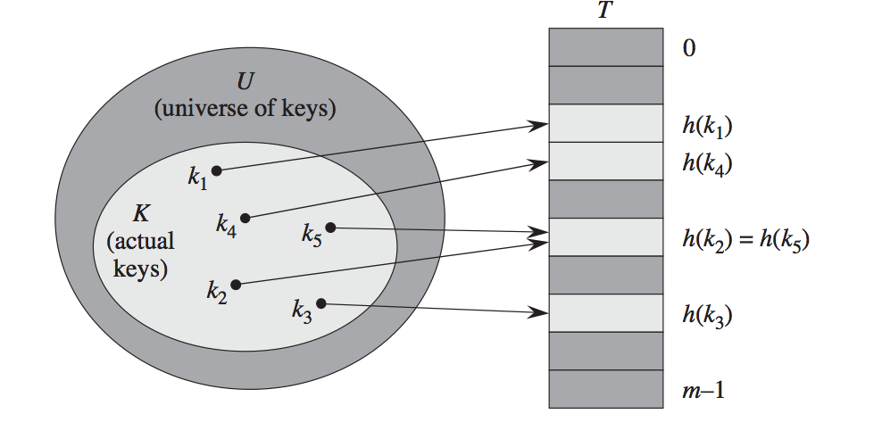
Design Hash Function
Goal: reduce collision by spread the hash values uniformly to 0…m-1
so that for any key, it’s equally likely to be hashed to 0, 1, …m-1
We know the U, the set of possible values that keys can take
But sometimes we don’t know K beforehand…

Slide 27
Case studies
A web server: maintains all active clients’ info, using IP addr. as key
key is 32 bits long int, or x1.x2.x3.x4 (each 8 bits long, between 0 and 255)
Let’s try to use hash table to organize the data!
Suppose that we expect about 250 active clients…
So we use a table of length 250 (m=250)

Slide 28
Hash function
A hash function h maps IP addr to positions in the table
Each position of table is in fact a bucket (a linked list that contains all IP addresses that are mapped to it)
(i.e., chaining is used)

Slide 29
Design of Hash Function
One possible hash function would map an IP address to the 8-bit number that is its last segment:
h(x1.x2.x3.x4) = x4 mod m
e.g., h(128.32.168.80) = 80 mod 250 = 250
But is this a good hash function?
Not if the last segment of an IP address tends to be a small number; then low-numbered buckets would be crowded.
Taking first segment of IP address also invites disaster, e.g., if most of our customers come from a certain area.

Slide 30
How to choose a hash function?
There is nothing inherently wrong with these two functions.
If our IP addr. were uniformly drawn from all 2³² possibilities, then these functions would behave well.
… the last segment would be equally likely to be any value from 0 to 255, so the table is balanced…
The problem is we have no guarantee that the probability of seeing all IP addresses is uniform.
these are dynamic and changing over time.

Slide 31
How to choose a hash function?
In most application:
fixed U, but the set of data K (i.e., IP addrs) are not necessarily uniformly randomly drawn from U
There is no single hash function that behaves well on all possible sets of data.
Given any hash function maps |U|=2³² IP addrs to m=250 slots
there exists a collection of at least 2³²/250=2²⁴ ≈16,000,000 IP addr that are mapped to same slot (or collide).
if data set K all come from this collection, hash table becomes linked list!

Slide 32
In General…
If , then for any hash function h, there exists a set of N keys in U, such that all keys are hashed to same slot
Proof.(General pigeon-hole principle) if every slot has at most N-1 keys mapped to it under h, then there are at most (n-1)m elements in U. But we know |U| is larger than this, so …
Implication: no matter how careful you choose a hash function, there is always some input (S) that leads to a linear insertion/deletion/search time

Slide 33
Solution: Universal Hashing
For any fixed hash function, h(.), there exists a set of n keys, such that all keys are hashed to same slot
Solution: randomly select a hash function from a carefully designed class of hash functions
For any input, we might choose a bad hash function on a run, and good hash function on another run…
averaged on different runs, performance is good

Slide 34
A family of hash functions
Let us make the table size to be m = 257, a prime number!
Every IP address x as a quadruple x = (x₁, x₂, x₃, x₄) of integers (all less than m).
Fix any four numbers (less than 257), e.g., 87, 23, 125, and 4, we can define a function h() as follows:
In general, for any four coefficients a₁,...,a₄ ∈{0,1,…, n−1}write a = (a₁, a₂, a₃, a₄), and define ha as follows:

Slide 35
Universal hash
Consider any pair of distinct IP addresses x = (x1,...,x4) and y = (y1,...,y4). If the coefficients a = (a1, . . . , a4) are chosen uniformly at random from {0,1,..., m− 1}, then
Proof omitted.
Implication: given any pair of diff keys, the randomly selected hash function maps them to same slot with prob. 1/m.
For a set S of data, the average/expected chain length is |S|/m=n/m=
=> Very good average performance

Slide 36
A class of universal hash
Let
The above set of hash functions is universal: For any two distinct data items x and y, exactly 1/m of all the hash functions in H map x and y to the slot, where n is the number of slots.

Slide 37
Two-level hash table
Perfect hashing: if we fix the set S, can we find a hash function h so that all lookups are constant time?
Use universal hash functions with 2-level scheme
hash into a table of size m using universal hashing (some collision unless really lucky)
rehash each slot, here we pick a random h, and try it out, if collision, try another one, …

Slide 38
Note: Cryptographic hash function
It is a mathematical algorithm
maps data of arbitrary size to a bit string of a fixed size (a hash function)
designed to be a one-way function, that is, a function which is infeasible to invert.
only way to recreate input data from an ideal cryptographic hash function's output is to attempt a brute-force search of possible inputs to see if they produce a match, or use a "rainbow table" of matched hashes.

Slide 39
Properties of crypt. hash function
Ideally,
it is deterministic so the same message always results in the same hash
it is quick to compute the hash value for any given message
it is infeasible to generate a message from its hash value except by trying all possible messages
a small change to a message should change the hash value so extensively that the new hash value appears uncorrelated with the old hash value
it is infeasible to find two different messages with the same hash value

Slide 40
Cryp. hash functions
Application of crypt. hash function:
ensure integrity of everything from digital certificates for HTTPS websites, to managing commits in code repositories, and protecting users against forged documents.
Recently, Google announced a public collision in the SHA-1 algorithm
with enough computing power — roughly 110 years of computing from a single GPU — you can produce a collision, effectively breaking the algorithm.
Two PDF files were shown to be hashed to same hash
Allow malicious parties to tamper with Web contents…

