Slide 1
Smart Phone-Based Sensor Mining
A tutorial
These slides available from http://storm.cis.fordham.edu/~gweiss/presentations.html
Gary M. Weiss
Fordham University
gweiss@cis.fordham.edu

Slide 2
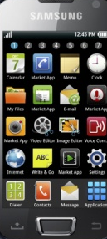
What is a Smart Phone?
What is a smart phone and what does it do? What devices can it replace?
  Play along and for now forget the topic of this talk
  A smart phone is:
    A mobile wireless communication device (a “phone”)
    A network computer: Web access, email, and computing
    A music device (MP3 player) and a gaming device
    A camera & video recorder
    A calendar, address book, memo pad– a PDA
    Also a very diverse sensor array

Slide 3
Can You Guess the Sensors?
What sensors are found on smart phones?
  Audio sensor (microphone)
  Image sensor (camera, video recorder)
  Tri-Axial Accelerometer
  Location sensor (GPS, cell tower, WiFi)
  Proximity sensor (infrared); Light sensor
  Magnetic compass; Temperature sensor
  Virtual/calculated sensors:
    Proximity (via light), gravity, orientation, gyroscope

Slide 4
The Advent of Smart Phones
Smart phone growth is extremely strong
  In 4th quarter of 2010 exceeded PC sales first time¹
Smart phones becoming ubiquitous
  We carry them everywhere we go
Smart phones are becoming more powerful
  Faster, more memory, and more sensors!
Other devices behave similarly (have sensors)
  Portable game & MP3 players (Gameboy, iPod Touch), tablet computers (iPad, Xoom)

Slide 5
Data & Sensor Mining
Data mining: application of computational methods to extract knowledge from data
  Most data mining involves inferring predictive models, often for classification
Sensor mining: application of computational methods to extract knowledge from sensor data
Smart phone sensor mining: …
This tutorial does not focus on mining methods
  Since the methods are not new but smart phone sensor mining is new

Slide 6
The Right Time for Smart Phone Sensor Data Mining
“The number of diverse and powerful sensors on smart phones, combined with their mobility and ubiquity, combined again with their increasing computational power, makes this the right time for work on Smart Phone-Based Data Mining”
– Gary Weiss

Slide 7
Goals for this Tutorial
Provide basic introduction to the area
  Taxonomy of the work that has been done
  Highlight some of the many applications
Encourage/motivate/promote R&D
  Creative applications waiting to be discovered!
Identify challenges and opportunities
  Highlight relevant engineering issues

Slide 8
Who Might be Interested in This?
This tutorial will not be overly technical and should be of interest to a wide audience
  Those interested in expanding use of data mining
  Those interested in expanding use of sensors
  Those interested in mobile communications and ubiquitous computing
  Those interested in interesting software apps and impacting the world (and perhaps getting rich)

Slide 9
A Little Bit About Myself …
Previous research focused on fundamental issues related to data mining (class imbalance)
  While important, not so interesting to undergrads and little immediate impact
Two years ago started what is now WISDM
  Android based with papers on activity recognition, and hard and soft biometrics, design & architecture
  In process of deploying working apps
  Project has ability to make impact on large population of users

Slide 10
Tutorial Overview
Relatively quick overview:
  Tour of main application areas
  Research challenges and engineering issues
More detailed examination
  Some common themes & issues
  Survey of key application areas
  Architecture and design Issues
Finishing Touches
  Relevant workshops, conferences, & journals

Slide 11
Overview of Application Areas
Who is the user?
  Biometric identification & identifying traits
What is the user doing?
  Activity recognition
Where and When is the user?
  Location and spatial based data mining applications
  Temporal based data mining applications
Who, What, Where, When, and Why?
  Social networking & context sensitive applications

Slide 12
Overview of Architecture & Design
Mobile platforms:
  which platform to use & tradeoffs
Resource constraints
  Battery, CPU, RAM, bandwidth, …
    Moore’s law implies battery biggest future concern
Security and privacy
Architecture
  How much on client vs. server

Slide 13


Bad
Good

Slide 14
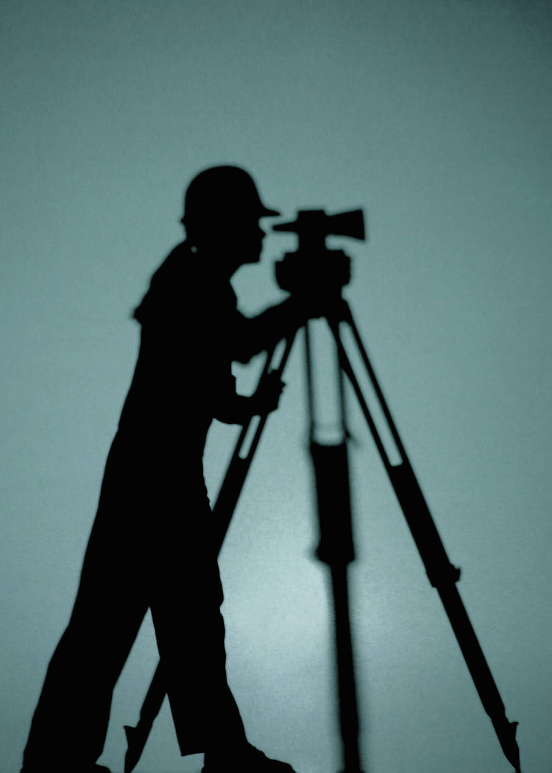
Survey of Application Areas

Slide 15
But First: Common Themes & Issues

Slide 16
Method for Collecting Training Data
Training data is needed to build predictive models for activity recognition etc.
For some applications labeled training data requires no extra effort (e.g., hard biometrics)
  The label is the identity and if we know the owner of the phone then labels are easy
For many applications labels are not free
  Researcher can control the training phase
  But for popular apps we need easy self-training
    One study has users label activities² & another location types²¹

Slide 17
Two Types of Predictive Models
Universal Model vs. Personal Model
  Universal model: built on one set of users and then applied to everyone else
    No requirement on new user– no run-time training
  Personal model: acquire training data for user & then generate model
    Places data collection requirement on user, but may sometimes by easily automated
  Personal models almost always do significantly better, even using much less training data^{15,16}

Slide 18
Feature Extraction
Sensor data is time-series data
Common data mining prediction algorithms expect “examples” and not time-series
  Typical method moves a sliding window across data to extract higher level features
    Average acceleration per axis, distribution of acceleration values, speed from GPS data, etc.
    WISDM uses a 10 second window for activity recognition¹⁵
    Other study uses ~7s window with 50% overlap⁴
  Alternative is to use time series prediction methods directly, but few applications do this

Slide 19
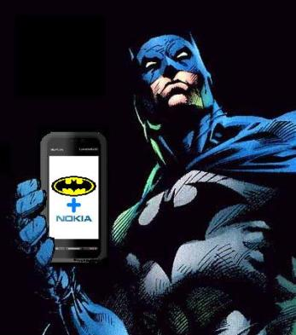
Crowdsourcing
Crowdsourcing is the outsourcing of a task to a large group or community of people
  Examples: ESP Game (Google Image Labeler), Amazon Mechanical Turk
By collecting phone sensor data from many users can create useful apps
  In “The Dark Knight” Batman relies on a distributed sensor network to track The Joker
  Google Navigator & many location-based apps

Slide 20
Non-intrusive Interaction
Ubiquitous sensor mining applications often require non-intrusive interaction with user
  Apps may provide useful but non-essential information and cannot be distracting
  PeopleTones¹⁷ system detects and notifies you when a buddy is near using vibrotactile cues.
    Semantically meaningful auditory cues are most useful
    PeopleTones has special software to convert auditory cues into vibrations.
  CenceMe²¹ allows user to bind a gesture to action or state (e.g., a circle means “going to lunch”.

Slide 21

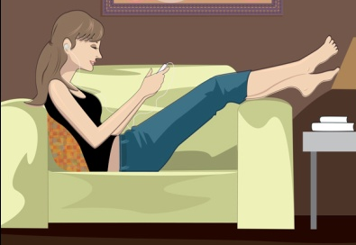
Activity Recognition

Slide 22
Why is Activity Recognition Useful?
Context-sensitive applications
  Handle phone calls differently depending on context
  Play music to suit your activity
  Fuse with other info (GPS) for better results
    Can confirm you are on subway vs. traveling in a car¹⁹
  Untold new & innovative apps to make phones smarter
Tracking & Health applications
  Track overall activity levels and generate fitness profiles
  Detect dangerous situations (falling); care of elderly⁵
Social applications
  Link users with similar behaviors (joggers, hunters)

Slide 23
Activity Recognition w/o Smart Phones
Dedicated accelerometers placed on a variety of body parts^{2,13,14,25}
A single accelerometer but custom hardware
  Pedometers (limited function); FitBit⁸
Multi-sensor solutions
  eWatch¹⁹: accelometer + light sensor, multiple locs.
  Smartbuckle: accelerometer + image sensor on belt
Use Phone but not a central component
  Motionbands¹⁰ multi-sensor/location transmits data to smart phone for storage

Slide 24
Location on Body of Smart Phone
The location of the smart phone will impact activity recognition
  WISDM study currently assumes phone in pocket¹⁵
  CenceMe study showed pocket and belt clip yield similar results²¹
  Phone in pocket book & elsewhere needs study
Phone orientation can have impact
  WISDM study indicates may not be a problem
  Can correct for orientation using orientation info

Slide 25
Smart Phone Accelerometer
Measures acceleration along 3 spatial axes
Detects/measures gravity
  Orientation impacts g values
Measurement range typically -2g to +2g
  Okay for most activities but falling yields higher values
  Range & sensitivity may be adjustable
Sampling rates ~20-50 Hz
  Study found 20Hz required for activity recognition⁴
  WISDM project found could not reliably sample beyond 20Hz (50ms) and this might limit activity recognition¹⁸

Slide 26
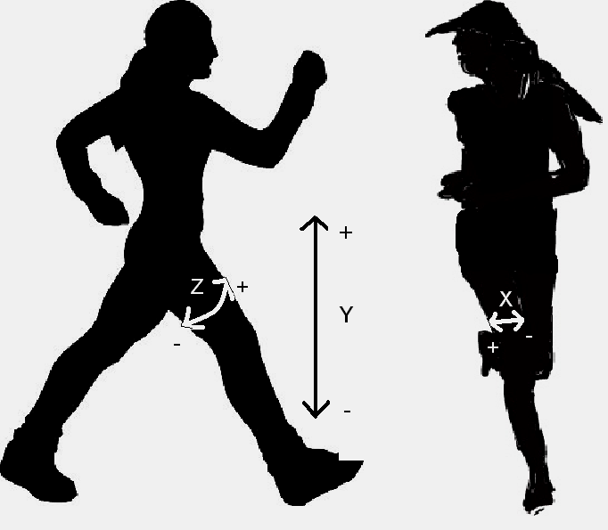
Accelerometer Data for Six Activites
Accelerometer data from Android phone¹⁵
  Walking
  Jogging
  Climbing Stairs
  Lying Down
  Sitting
  Standing

Slide 27
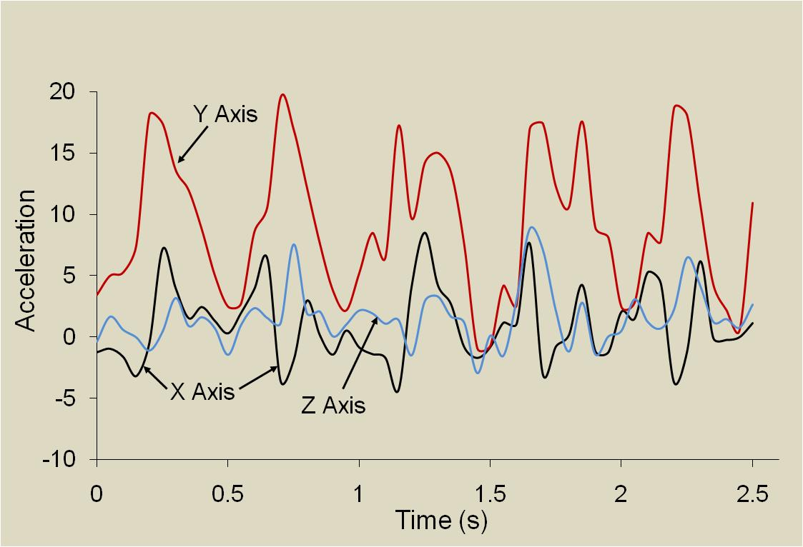
Accelerometer Data for “Walking”

Slide 28
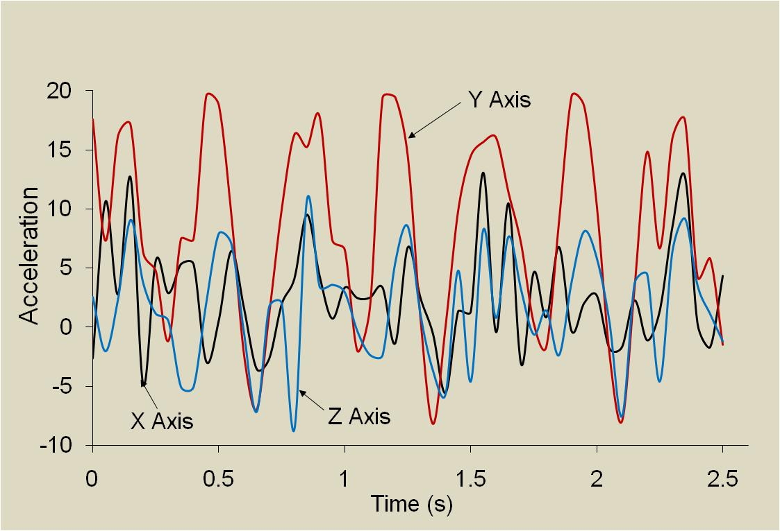
Accelerometer Data for “Jogging”

Slide 29
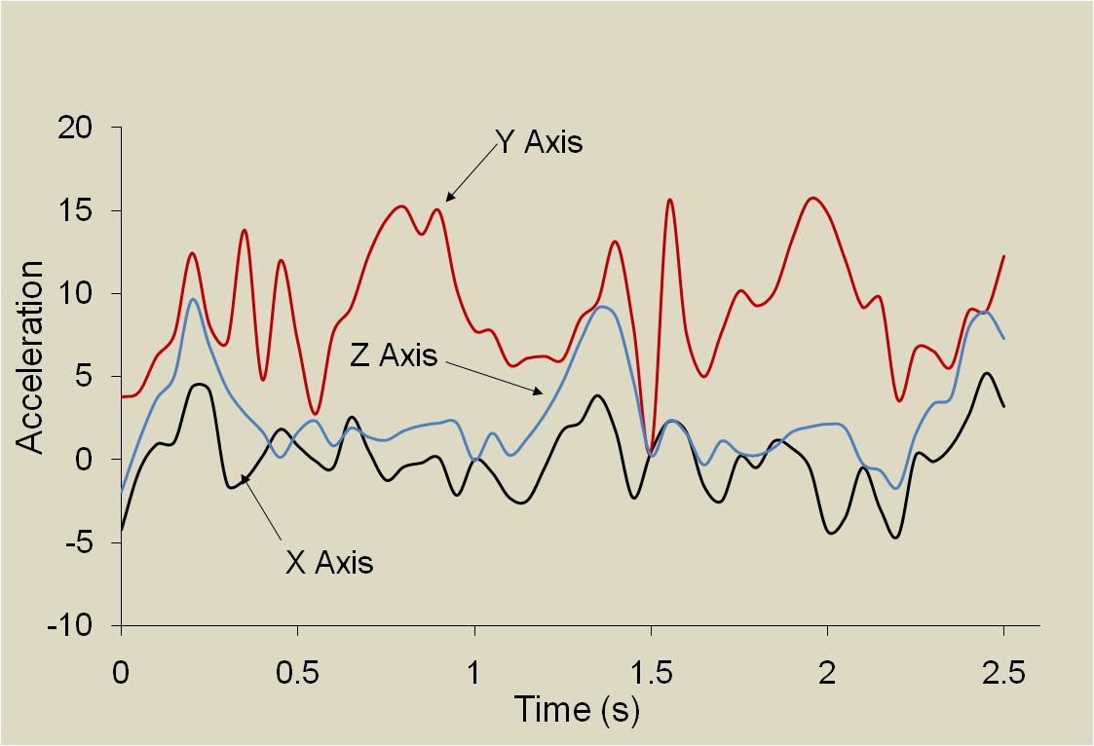
Accelerometer Data for “Up Stairs”

Slide 30
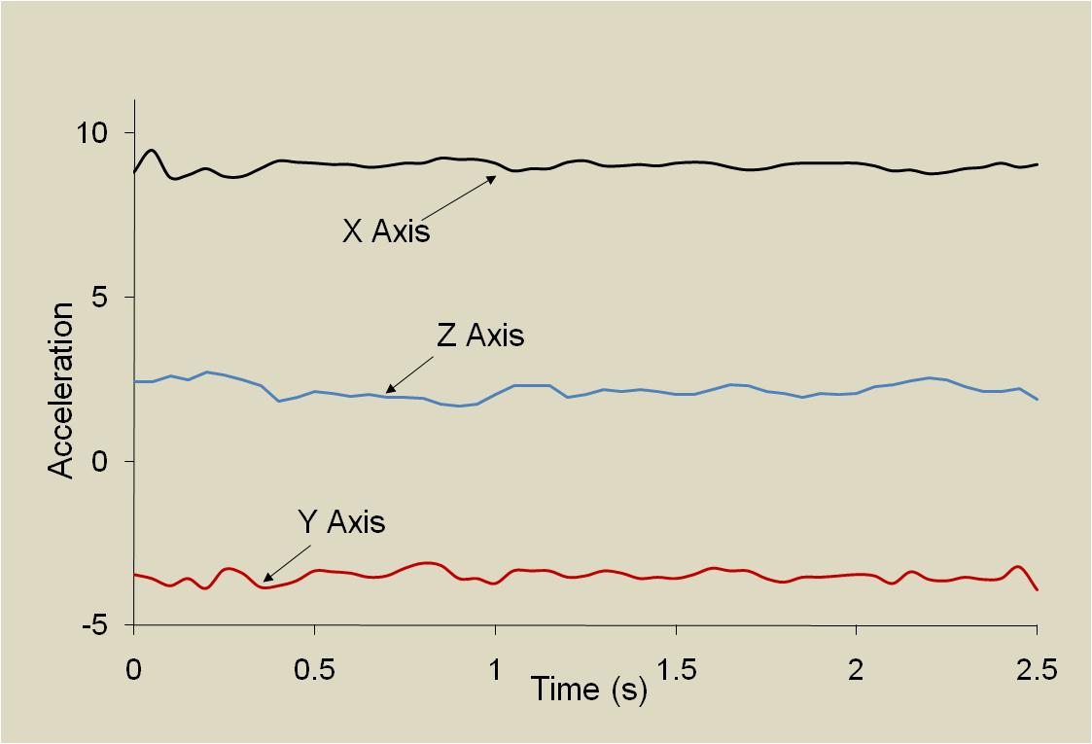
Accelerometer Data for “Lying Down”

Slide 31
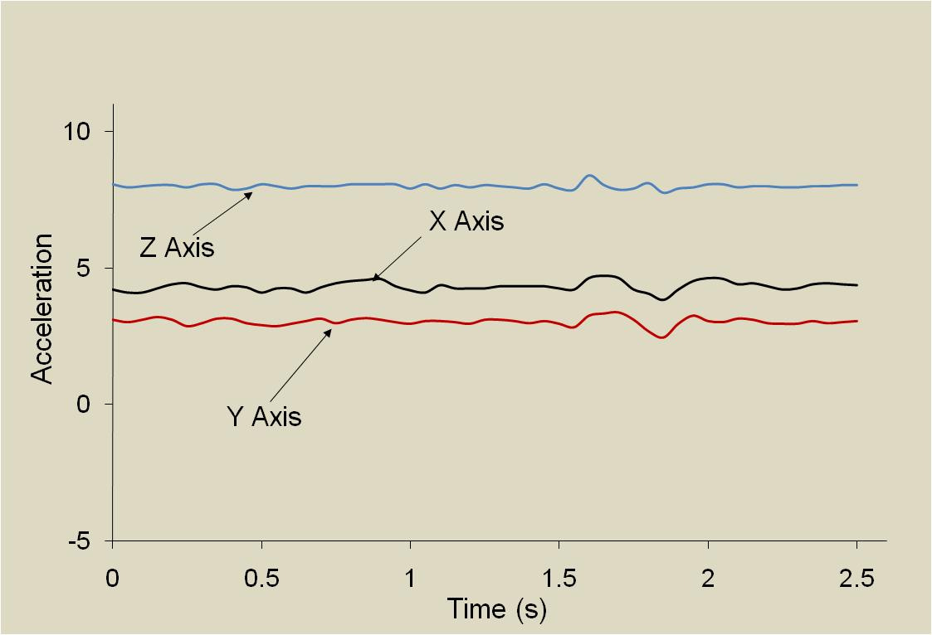
Accelerometer Data for “Sitting”
Z axis

Slide 32
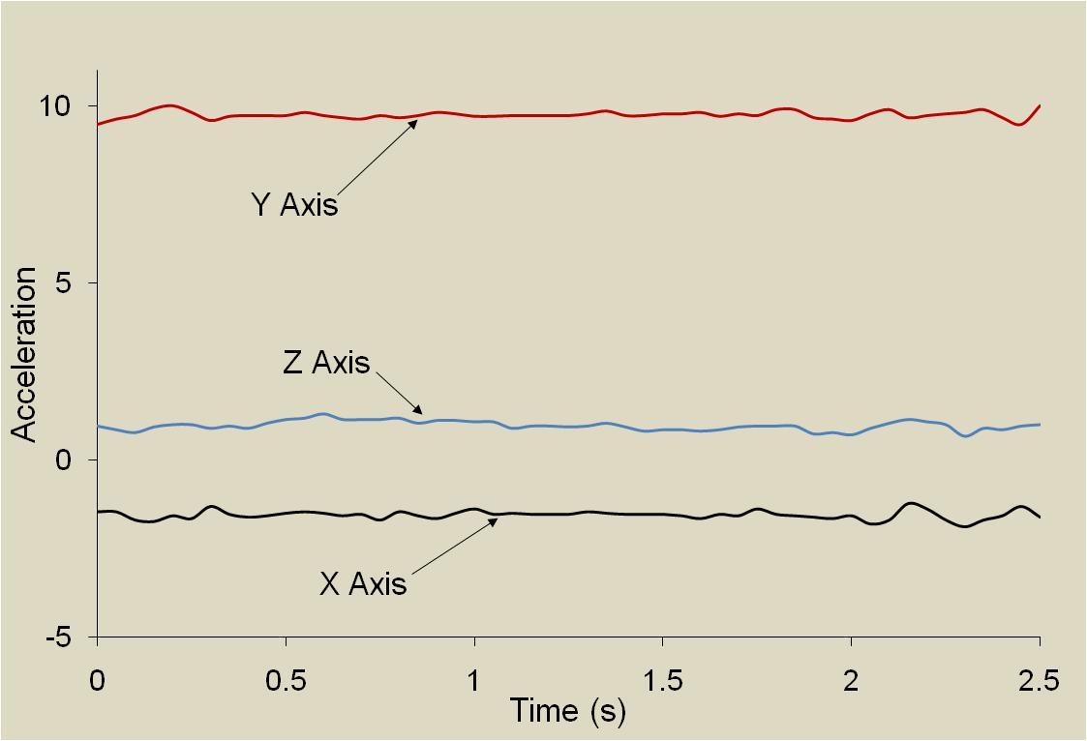
Accelerometer Data for “Standing”

Slide 33
Fall Detection
Mainly focused on helping the elderly
  Aging populations will yield great future challenges
Mostly camera & accelerometer based
  May also use acoustic or pressure sensors
  GE QuietCare: camera-based system (nursing homes)
Accelerometer-based approach ^{11,24,27}
  Sensor at waist generally best
  Threshold-based mechanism³ (between 2.5g and 3.5g)
  Elderly don’t accelerate quickly so fall detection easier
  Most data from simulated falls

Slide 34
Determining Transportation Modes
Nokia n95 system²³ uses GPS & Accelerometer
  GIS info may be missing or mode may be ambiguous
  Modes: stationary, walking, running, biking, motorized
  Precision & recall both equal 91.3% using a decision tree and 93.6% when using DT combined with HMM
  Using generalized classifier drops accuracy only 1.1%
  To save power shuts off GPS when inside
    Triggers GPS based on change in primary cell phone tower
    GPS lock takes a while so even trying it occasionally saps power
Alternatives:
  use GPS & GIS info²² or only accelerometer

Slide 35
Activity Recognition Results

Slide 36
Non-Phone Based System
Activity Recognition from User-Annotated Acceleration Data²
Accelerometer on 4 limbs & waist, universal model
Activity | Accuracy | Activity | Accuracy
Walking | 89.71 | Walking carrying items | 82.10
Sitting & Relaxing | 94.78 | Working on Computer | 97.49
Standing Still | 95.67 | Eating or Drinking | 88.67
Watching TV | 77.29 | Reading | 91.79
Running | 87.68 | Bicycling | 96.29
Stretching | 41.42 | Strength-training | 82.51
Scrubbing | 81.09 | Vacuuming | 96.41
Folding Laundry | 95.14 | Lying Down & Relaxing | 94.96
Brushing Teeth | 85.27 | Climbing Stairs | 85.61
Riding Elevator | 43.58 | Riding Escalator | 70.56

Slide 37
Non-Phone Based System (cont)
Classifier | Personalized Model | Universal Model
Decision Table | 36.32 | 46.75
Instance-Based | 69.21 | 82.70
C4.5 | 71.58 | 84.26
Naïve Bayes | 34.94 | 52.35
Universal models perform best. The increase in the amount of data more than compensates for the fact that people move differently. This does not appear to be the case for phone based systems with measurements on one body location.

Slide 38
WISDM Activity Recognition¹⁵
Smart-phone based (Android)
Six activities: walking, jogging, stairs, sitting, standing, lying down (more to come)
Labeled data collected from over 50 users
Data transformed via 10-second windows
  Accelerometer data sampled (x,y,z) every 50m
  Features (per axis):
    average, SD, ave diff from mean, ave resultant accel, binned distribution, time between peaks

Slide 39
WISDM Activity Recognition¹⁵
The 43 features used to build a classifier
  WEKA data mining suite used, multiple techniques
  Personal, universal, hybrid models built
    Universal models built using leave-one-out validation
Architecture (for now) uses “dumb” client
Basis of soon to be released actitracker service
  Provides web based view of activities over time

Slide 40
WISDM Results
WISDM results¹⁵ are presented using:
  Confusion matrices and accuracy
Results are shown for various things
  Personal, universal, and hybrid models
  Most results aggregated over all users but a few per user to show how performance varies by user
  Results for 6 activities (ones shown in the plots)

Slide 41
WISDM Universal Model- IB3 Matrix
72.4% Accuracy |  | Predicted Class
 |  | Walking | Jogging | Stairs | Sitting | Standing | Lying Down
Actual Class | Walking | 2209 | 46 | 789 | 2 | 4 | 0
 | Jogging | 45 | 1656 | 148 | 1 | 0 | 0
 | Stairs | 412 | 54 | 869 | 3 | 1 | 0
 | Sitting | 10 | 0 | 47 | 553 | 30 | 241
 | Standing | 8 | 0 | 57 | 6 | 448 | 3
 | Lying Down | 5 | 1 | 7 | 301 | 13 | 131

Slide 42
WISDM Personal Model- IB3 Matrix
98.4% accuracy |  | Predicted Class
 |  | Walking | Jogging | Stairs | Sitting | Standing | Lying Down
Actual Class | Walking | 3033 | 1 | 24 | 0 | 0 | 0
 | Jogging | 4 | 1788 | 4 | 0 | 0 | 0
 | Stairs | 42 | 4 | 1292 | 1 | 0 | 0
 | Sitting | 0 | 0 | 4 | 870 | 2 | 6
 | Standing | 5 | 0 | 11 | 1 | 509 | 0
 | Lying Down | 4 | 0 | 8 | 7 | 0 | 442

Slide 43
WISDM Hybrid Model- IB3 Matrix
97.1% Accuracy |  | Predicted Class
 |  | Walking | Jogging | Stairs | Sitting | Standing | Lying Down
Actual Class | Walking | 3028 | 2 | 32 | 2 | 2 | 0
 | Jogging | 5 | 1803 | 5 | 1 | 0 | 0
 | Stairs | 86 | 13 | 1288 | 3 | 0 | 0
 | Sitting | 4 | 1 | 6 | 903 | 2 | 24
 | Standing | 2 | 0 | 14 | 1 | 520 | 3
 | Lying Down | 3 | 2 | 5 | 22 | 0 | 421

Slide 44
WISDM Accuracy Results
 | % of Records Correctly Classified
 | Personal |  |  | Universal |  |  | Straw Man
 | IB3 | J48 | NN | IB3 | J48 | NN
Walking | 99.2 | 97.5 | 99.1 | 72.4 | 77.3 | 60.6 | 37.7
Jogging | 99.6 | 98.9 | 99.9 | 89.5 | 89.7 | 89.9 | 22.8
Stairs | 96.5 | 91.7 | 98.0 | 64.9 | 56.7 | 67.6 | 16.5
Sitting | 98.6 | 97.6 | 97.7 | 62.8 | 78.0 | 67.6 | 10.9
Standing | 96.8 | 96.4 | 97.3 | 85.8 | 92.0 | 93.6 | 6.4
Lying Down | 95.9 | 95.0 | 96.9 | 28.6 | 26.2 | 60.7 | 5.7
Overall | 98.4 | 96.6 | 98.7 | 72.4 | 74.9 | 71.2 | 37.7

Slide 45
WISDM Per-User Performance

Slide 46
WISDM Per-User Performance

Slide 47
CenceMe Results²¹
 | Sitting | Standing | Walking | Running
Sitting | 0.682 | 0.282 | 0.364 | 0.000
Standing | 0.210 | 0.784 | 0.006 | 0.000
Walking | 0.003 | 0.046 | 0.944 | 0.008
Running | 0.008 | 0.070 | 0.177 | 0.745

Slide 48
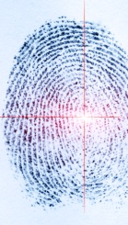
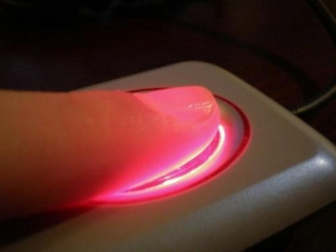
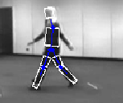

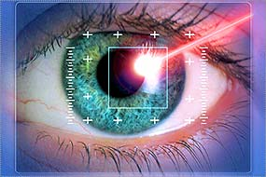
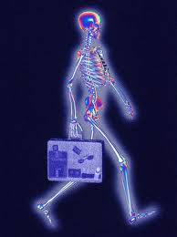
Biometric Identification

Slide 49
Biometrics
Biometrics concerns unique identification based on physical or behavioral traits
  Hard biometrics involves traits that are sufficient to uniquely identify a person
    Fingerprints, DNA, iris, etc.
  Soft biometric traits are not sufficiently distinctive, but may help
    Physical traits: Sex, age, height, weight, etc.
    Behavioral traits: gait, clothes, travel patterns, etc.

Slide 50
Biometrics for Everyone
Equipment getting smaller, cheaper
Biometrics needs sensors and processing
  Laptops have sensors and processing
    Face recognition now an option
Smart phones also have sensors & processing!
  Camera might be relevant, but so is accelerometer
Substantial work on gait based biometrics
  Much of it is vision based since can be used widely
    Airports, etc.

Slide 51
Gait-Based Biometrics
Numerous accelerometer-based systems that use dedicated and/or multiple sensors
  See related work section of Cell Phone-Based Biometric Identification¹⁶ for details
Two smart phone-based biometric systems
  Possible uses
    Phone security (e.g., to automatically unlock phone)⁹
    Automatic device customization¹⁶
    To better track people for shared devices
    Perhaps for secondary level of physical security

Slide 52
Using Time Delay Embeddings
System from McGill university⁹
  Provides alternative way of extracting features
  Used methods from nonlinear time series analysis
  Uses fewer than a dozen features
  Runs entirely on Android HTC G1 phone
  Collected 12-120 seconds of data from 25 people
  Results: 100% accuracy!
  Video clip from Discovery channel⁷
    Shows that can quickly identify a user and use it to unlock phone

Slide 53
WISDM Biometric System
Same setup as WISDM activity recognition
  Same data collection, feature extraction, WEKA, …
Used for identification and authentication
  Identification means predicting identity from pool of all users (36 in this study)
  Authentication is a binary class prediction
Evaluate single and mixed activities
  Evaluate using 10 sec. and several min. of test data
    Longer sample classify with “Most Frequent Prediction”

Slide 54
WISDM Biometrics Data Set
 | Walk | Jog | Up | Down | Aggregate (Total)
Sum | 2081 | 1625 | 632 | 528 | 4866
% | 42.8 | 33.4 | 13.0 | 10.8 | 100
Number of 10-second examples by activity type

Slide 55
WISDM Biometric Prediction Results
 | Aggregate | Walk | Jog | Up | Down | Aggregate (Oracle)
J48 | 72.2 | 84.0 | 83.0 | 65.8 | 61.0 | 76.1
Neural Net | 69.5 | 90.9 | 92.2 | 63.3 | 54.5 | 78.6
Straw Man | 4.3 | 4.2 | 5.0 | 6.5 | 4.7 | 4.3
Based on 10 second test samples
 | Aggregate | Walk | Jog | Up | Down | Aggregate (Oracle)
J48 | 36/36 | 36/36 | 31/32 | 31/31 | 28/31 | 36/36
Neural Net | 36/36 | 36/36 | 32/32 | 28.5/31 | 25/31 | 36/36
Based on most frequent prediction for 5-10 minutes of data

Slide 56
WISDM Biometric Authentication Results
Authentication results:
  Positive authentication of a user
    10 second sample: ~85%
    Most frequent class over 5-10 min: 100%
  Negative Authentication of a user (an imposter)
    10 second sample: ~96%
    Most frequent class over 5-10 min: 100%

Slide 57
Biometric Identification Summary
Can do remarkably well with short amounts of accelerometer data (10s – 2 min)
Results may not be good enough for rigorous applications but sufficient for many
  Automatic customization
  First level security
    The system described in the Discovery channel clip unlocked the phone using biometrics to avoid entering a password, which also could be used

Slide 58
Trait Identification

Slide 59
Soft Biometrics and User Traits
Soft biometrics traits are not distinctive enough for identification unless combined with other traits
  Sex, height, weight, …
But do we have better uses for these “soft” traits than for identification?
  As data miners, of course we do!
  We want to know everything we possibly can about a person. Somehow we will exploit this.
    We could use weight to improve calories burned

Slide 60
Expanding the Definition of Trait
Normally think about traits as being:
  Unchanging: race, skin color, eye color, etc.
  Slow changing: Height, weight, etc.
But want to know everything about a person:
  What they wear, how they feel, if they are tired, etc.
I have not seen this goal stated in context of mobile sensor data mining
  It is the focus of Identifying user traits by mining smart phone accelerometer data²⁶

Slide 61
Related Work
Very little explicit work on this topic
  Some work related to biometrics but incidental
    Work on gait recognition mentions factors that influence recognition, like weight of footwear & sex
Other communities work in related areas
  Ergonomics & kinesiology study factors that impact gait
    Texture of footwear, type of shoe, sex, age, heel height
    Interaction between gait speed, obesity, and race

Slide 62
WISDM Trait Identification²⁶
Data collected from ~70 people
  Accelerometer and survey data
  Survey data includes anything we could think of that might somehow be predictable
    Sex, height, weight, age, race, handedness, disability
    Type of area grew up in {rural, suburban, urban}
    Shoe size, footwear type, size of heels, type of clothing
    # hours academic work , # hours exercise
  Too few subjects investigate all factors
    Many were not predictable (maybe with more data)

Slide 63
WISDM Trait Identification Results
Accuracy 71.2% | Male | Female
Male | 31 | 7
Female | 12 | 16
Accuracy 83.3% | Short | Tall
Short | 15 | 5
Tall | 2 | 20
Accuracy 78.9% | Light | Heavy
Light | 13 | 7
Heavy | 2 | 17
Results for IB3 classifier. For height and weight middle categories removed.

Slide 64
Trait Identification Summary
A wide open area for data mining research
  A marketers dream
Clear privacy issues
Room for creativity & insight for finding traits
Probably many interesting commercial and research applications
  Imagine diagnosing back problems via your mobile phone via gait analysis …

Slide 65
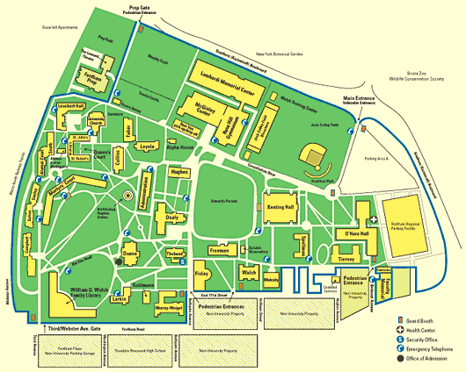
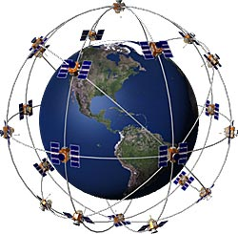
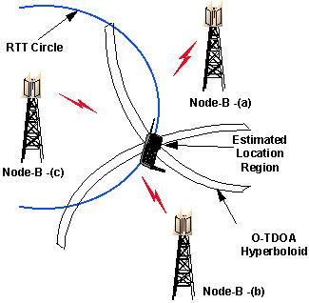
Location-Based Applications

Slide 66
Significant Locations
Significant locations are important locations
  Usually defined based on frequency with which one person or a population visits a location
Extract locations where people stay and then cluster them to merge similar points
  Stay points: points a user has spent more than ThresTime in within ThresDistance of the point¹²
  Interesting locations: locations that include stay points from many (>ThresCount) people

Slide 67
Significant Location System¹²
Data collected from 165 users over 2 years
  62 users contains 3.5M GPS points
  ThresTime = 20 min and ThresDistance = 0.2 KM
    Allows us to ignore most cases where sitting in traffic
User | # GPS Points | # Stay Points | # Interesting Locations Visited
User 1 | 910,147 | 469 | 9
User 2 | 860,635 | 181 | 8
User 3 | 753,678 | 134 | 13
User 4 | 188,480 | 82 | 4
User 5 | 89,145 | 8 | 1

Slide 68
Significant Location System¹²
Table below holds top most interesting places
  Results show that subjects are highly educated
  Can characterize and group people by the interesting places that they visit
Latitude | Longitude | Frequency | Interesting Locations
40.00 | 116.327 | 309 | Main Building, Tshingua Univ.
39.976 | 116.331 | 122 | China Sigma Center, Microsoft China R&D
40.01 | 116.315 | 74 | Da Yi Tea Culture Center, Tea House
39.975 | 116.331 | 58 | Cuigong Hotel
39.985 | 116.32 | 36 | Loongson Technology Service Center

Slide 69
Significant Locations: Assoc. Rules
Locations visited in a day can represent itemset
  Mary: {Supermarket, Park, Post Office, School}
  John: {Supermarket, Park, School, McDonald’s}
Rule: {Supermarket, Park} → {School}

Slide 70
Improving Transportation
Use location data from many users (crowdsource)
  Avoid congested roads: Google Navigator
  Manage traffic dispersion
  Mine historical data to predict traffic patterns
Augment road maps with lane information
  determine lane boundaries
  deviation of a car → save a life
  dynamic lane closures: short of cars in a lane → accident or roadwork

Slide 71
Role of Location in Social Networks
Build Social Communities based on location
  Proximity
  Time
  Frequency
Google Latitude
  “See where friends are and what they are up to”
Facebook “Check-Ins”
  “Check-In” to a certain location using a cell phone, created by a Facebook user, tag friends
  See who else is in this location

Slide 72
A Mining Safety Application¹
Heavy equipment in mining is dangerous
  Collisions, open pits, bad visibility
  Tend to move fast when moving between areas
  Existing systems use GPS for collision avoidance
    So lots of GPS data
  Goal is to use GPS data to improve mine safety
    Risk assessment & operator guidance
    Beyond immediate collision warnings
      Collision avoidance may not be effective if context ignored

Slide 73
A Mining Safety Application (cont.)
Situational awareness– context matters
Dependent on location within mine & activity
  Example: at main excavation site being loaded with copper ore
  Don’t alarm when a vehicle loads or unloads another
Helps to have knowledge of significant places
  Care about places where vehicle interactions differ
    Haulage roads, intersections, loading bays, parking lots
    Here length of stay not used to determine significant place
    Once determine type of places can link/fuse on map

Slide 74
A Mining Safety Application (cont.)
Speed is critical & significant places classified as high or low speed
  High speed: haulage roads and (high interaction) intersections
  Low speed: dumping, parking, etc. where vehicles tend to bunch up
Crowdsourcing since data from all vehicles
  Know type of vehicle and speeds
    so have good idea where loading, hauling etc occurs
    Can identify normal mining functions
    Can identify normal characteristics (speed, closeness, etc.)

Slide 75
Integration with Other Info/Apps
Learn more about locations using other info
  Activity impacts location
    walk/jog in park
    drive on roads
    sleep in hotel/house
  Demographics impacts location
    High schools have lots of teenagers
      May know age from some phone apps
All of this works in other direction too
  Location impacts activity, tells us something about those at the site

Slide 76
Some Location-Based Apps
iMapMy* where * = {Run, Walk, Ride, Hike}
  tracks route, distance, pace, & more in real-time
  Share the details of your fitness activities with friends & family, via email, Facebook, or Twitter
  This data can be mined for exercise-related info
WHERE helps you discover & share favorite places
  Recommendation engine learns your preferences and recommends great places
    Create lists of your favorite places and share with friends

Slide 77
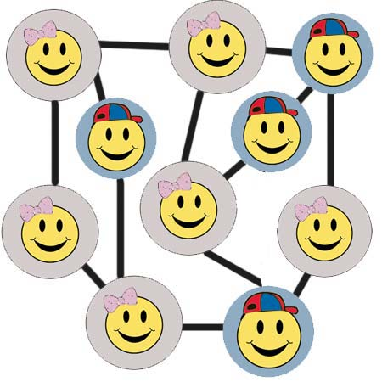
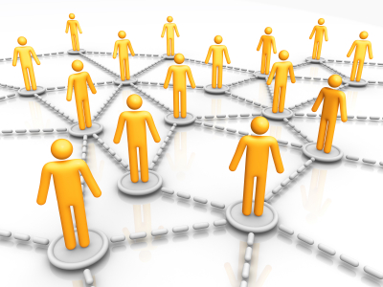
Social Networking Applications

Slide 78
CenceMe Application
Sensing meets mobile sensor networks²¹
Classifiers:
  Audio classifier uses microphone to determine if human voice is present (based on frequency)
  Conversation classifier uses this info to identify a conversation (human voice must exceed threshold)
    > 85% accuracy in noisy indoor environments
  Activity classifier (DT) uses accelerometer and determines sitting, standing, walking, running

Slide 79
CenceMe Application
  Social context classifier derived from multiple sources
    Neighborhood info: CenceMe buddies around?
    Social status: uses conversation & activity classifier
      Can tell if talking to buddies at a restaurant, alone, or at a party
      Partying and dancing are social status states that use activity and sound volume (volume used to identify parties)
  Mobility mode detector uses GPS to determine if in a vehicle or not (standing, walking, running)
  Location classifier uses GIS info and (shared) user created bindings to map to a icon and location type

Slide 80
CenceMe Application
Summarize info by using social stereotypes or behavior patterns, calculated daily and viewable
  Nerdy: based on being alone, lots of time in libraries, and few conversations
  Party Animal: frequency & duration of parties, level of social interaction
  Cultured: frequency & duration of visits to museums, theatre
  Healthy: physically active (walking, jogging, cycling)
  Greeny: low environmental impact (walk not drive)

Slide 81
CenceMe Application
Based on user study of 22 people over 3 weeks the things people liked the most:
  Location information
  Activity & conversation information
  Social context
  Random images
    When your phone is open the phone takes & posts pics
    People like it because it forms a daily diary
      “Oh yeah … that chair … I was in classroom 112 at 2PM”

Slide 82
CenceMe Application
One survey comment was:
  “CenceMe made me realize I’m lazier than I thought and encouraged me to exercise a bit more”

Slide 83
CenceMe Results
 | Sitting | Standing | Walking | Running
Sitting | 0.682 | 0.282 | 0.364 | 0.000
Standing | 0.210 | 0.784 | 0.006 | 0.000
Walking | 0.003 | 0.046 | 0.944 | 0.008
Running | 0.008 | 0.070 | 0.177 | 0.745
 | Conversation | Non-Conversation
Conversation | 0.838 | 0.162
Non-Conversation | 0.368* | 0.632
* High False Positives due to background conversations

Slide 84
Architecture & Design Issues
Resource Issues, Platform Considerations, Client vs. Server Responsibilities, Security & Privacy

Slide 85
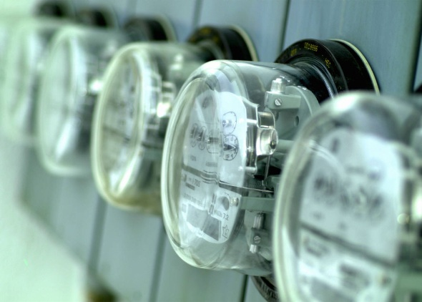
Resource Issues
Power, RAM & CPU
“Smart phone sensor mining is NOT the phone’s main priority and this sometimes becomes very evident” – Gary Weiss

Slide 86
Sensors are not a Priority
Example of sensors not being a priority
  The Android OS tries to preserve battery life
  Screen hibernation is one key to saving power
    But screen hibernation puts sensors to sleep!¹⁸
      Continuous monitoring of sensors was either not considered or viewed as secondary
      Developers debate whether this is a feature or a bug
      Work around: CPU “Wake Lock” which prevents hibernation; we compensate by turning screen off
      We don’t think this is the ideal solution (CPU still in normal mode)

Slide 87
Power Consumption
GPS and GSM localization take lots of power
  Turn off GPS when not needed/when inside²³
    uses cell towers not GPS to determine when go outside
  Sample at lower rate if acceptable to application
    But because GPS lock takes time and energy, small reductions in high sampling rates not helpful
      CenceMe says Nokia takes 120s for lock & active 30s more
    PeopleTones¹⁷ buddy notification checks every 90 sec.
    Use adaptive sampling rate (e.g., PeopleTones increases rate when buddy is transitioning from near to far).

Slide 88
Power Consumption
Uploading data can take significant power
  Upload via cellular network takes even more if cell phone tower is far away
  WiFi takes less so if not time-sensitive, send when WiFi available
Sleep cycles may improve battery life for various applications
  CenceMe noted little benefit for sleep cycle <10s but longer sleep cycles really hurt the application²¹

Slide 89
Power Consumption Nokia n95²³
Activity | Power (Watts)
Phone Idle | 0.054
Accelerometer Sampling (32 Hz) | 0.111
GPS Assisted Lock | 0.718
GPS Lock | 0.407
GPS Sampling (1 Hz) | 0.380
Music Player | 0.447
Video Player (Screen on) | 0.747
Active Call | 0.603
Gaming (Screen On) | 1.173
Generating Features & Executing Classifier | 0.003
App to Determine Transport Mode | 0.425

Slide 90
CenceMe Power Consumption
Activity | Power (Watts)
No CenceMe & Idle | 0.08
CenceMe & no user interaction | 0.90
Conversation & Social Setting Classifier (rest idle) | 0.80
Activity Classifier (rest idle) | 0.16
Results for Nokia N95
Running full CenceMe suite: 6.22 ± 0.59 hours
  Not ideal, needs further power optimization

Slide 91
Power Consumption for WISDM¹⁸
Activity | Power (Watts)
Android | 0.001
Sensor Collector | 0.043
Lit up Screen | 0.525
Battery Test on HTC EVO with GPS off
Sensor Collector is WISDM App to collect and store sensor data, but does not apply predictive models to it.
Sensor collector has minimal impact on battery life, thus it is feasible to continuously collect sensor data.
  When device on idle, SensorCollector takes 6.6% of power

Slide 92
Memory & CPU Usage Nokia n95²³
Activity | CPU % | RAM (MB)
Phone Idle | 2.18 | 28.91
Active Call | 2.31 | 30.00
Music Player | 30.86 | 30.26
Video Player | 14.63 | 32.58
Game Playing | 97.34 | 37.52
App to Determine Transport Mode | 6.91 | 29.64

Slide 93
Memory & CPU Usage Nokia n95²¹
Activity | CPU % | RAM (MB)
Phone Idle | 2 | 34.08
Accel. & Activity Classification | 33 | 34.18
Audio Sampling & Classification | 60 | 34.59
Activity, Audio, & Bluetooth | 60 | 36.10
CenceMe | 60 | 36.90

Slide 94
Resource Issues Summary
In almost all cases power is much more of a limiting resource than CPU or RAM
Typical sensor mining apps might drain the battery in 6 or 7 hours
  This is not really acceptable for apps that are designed to run continuously.
  We need to work hard to only use power when needed (adaptively)
  May not be a good solution at this time

Slide 95

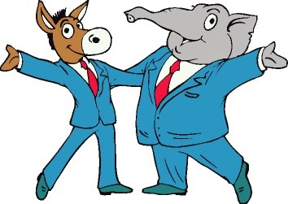


Mobile Platform Considerations
Apple iOS, Android, Windows Phone 7, …

Slide 96
Mobile Platform Considerations
Criterion | Apple iOS | Android | Windows Phone 7
Language | Objective C | Java | Visual Basic
Language Popularity | Low (Difficult) | High | Low
Multiprocessing | No | Yes | Yes
Developer Tools:
Free | No | Yes | Yes
Documentation | Limited | Extensive | Emerging
Open Source | No | Yes | No
App Approval | Strict Oversight | None | Some Oversight
Market Share | 13.80% | 14.50% | < 6%
Hardware Venders | Apple | Many | Many
Mobile Operating System Comparison¹⁸

Slide 97
WISDM Project Experiences
Adopted Android because easy to program, easy to deploy, free, open, & multi-vendor
Android was changing quickly when started
  Big differences between versions
Many vendors → lots of compatibility testing
  Found bugs in some versions but not others
Would Apple let us post our app? Not sure. Android little oversight.
WEKA data mining suite written in Java

Slide 98
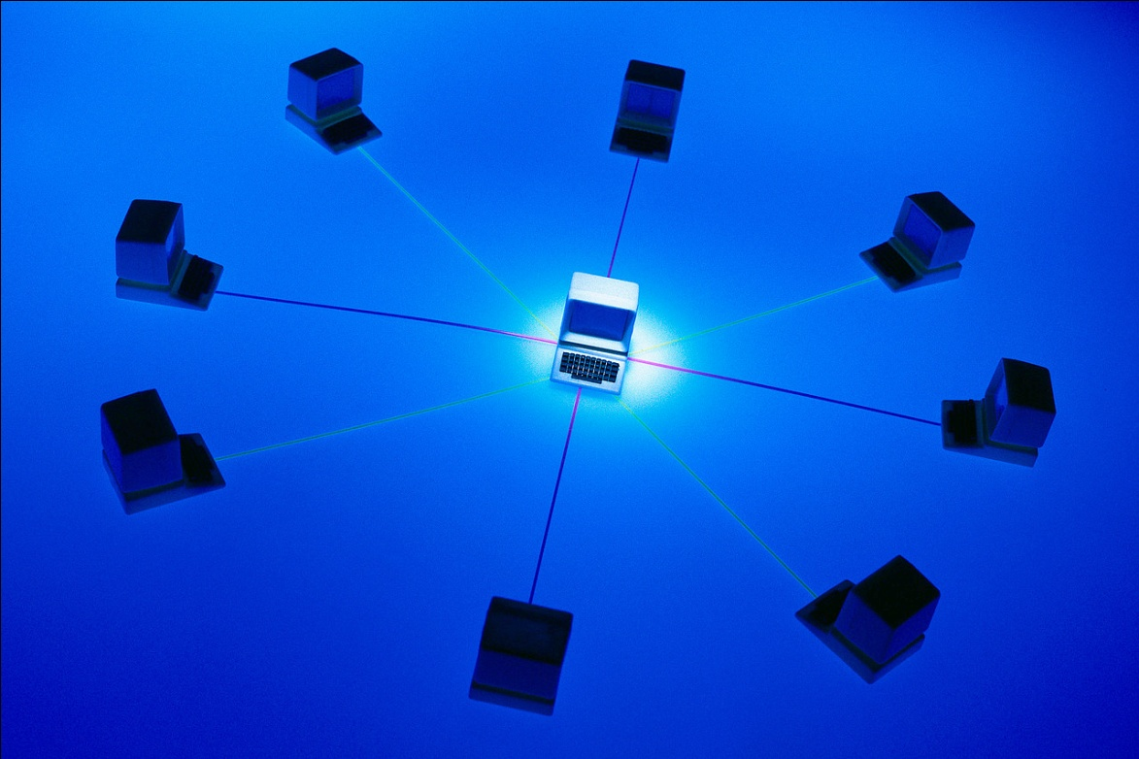
Client vs. Server Responsibilities

Slide 99
Division of Client and Server Tasks
Division of labor has tradeoffs
  More processing on client (phone) means:
    Application/platform more scalable
    Increased privacy
    Bigger drain on power, CPU, & RAM, but not bandwidth
  More processing on server means:
    Data captured for future research and other uses
    Can exploit data not otherwise available (crowdsourcing)

Slide 100
Division of Client and Server Tasks
Client Type: | 1/Dumb | 2 | 3 | 4 | 5 | 6/Smart
Data Collection | • | • | • | • | • | •
Data Transformation |  | • | • | • | • | •
Classification |  |  | • | • | • | •
Model Generation |  |  |  | • |  | •
Data Storage |  |  |  |  | • | •
Data Reporting |  |  |  |  | • | •
WISDM Possible Division of Client and Server Responsibilities¹⁸

Slide 101
Division for CenceMe Application²¹
Backend servers generate higher level “facts”
based on phone classifications (“primitives”)
  Audio classifier runs on phone to detect presence of human voice but server executes conversation classifier
  Higher level facts include social context (meeting, partying, dancing), significant places, & crowdsourcing
Features generated from raw data on the phone
Activity classifier trained off line on server but universal model exported to phone (small DT)

Slide 102
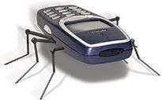
Security & Privacy

Slide 103
Security and Privacy
Security policies vary widely
  Some mobile OS’s have strict security policies
    Symbian requires properly signed keys to remove restrictions on using certain APIs
  Android has few restrictions
    My WISDM project has had no problem tapping into sensors and transmitting results
    Android does notify the user of services that are used
      SYSTEM PERMISSIONS FOR WISDM SensorCollector
        ACCESS_COARSE_LOCATION, ACCESS_FINE_LOCATION
        INTERNET, WAKE_LOCK, WRITE_EXTERNAL_STORAGE

Slide 104
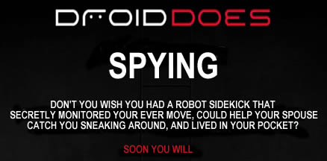
Security and Privacy
Applications that access sensor data can easily spy on you (they do by design)
  Location data is probably most sensitive
  A few bad apps could damage the field
  Note below from http://www.androidspysoftware.com

Slide 105
Security and Privacy
Even legitimate applications have to be concerned with privacy & security
  For example, WISDM will encrypt data in transit, include secure accounts with passwords, etc.
  Need to ensure than any aggregated info is made public only if cannot be traced to individual
As research study WISDM needs to be careful
  Do we want others to know where we are 24x7, when we are active, asleep, etc?

Slide 106
Security and Privacy
What to do?
  Make it clear what you are monitoring and storing
  Provide application level control for the user
  For example, allow the users to turn on/off monitoring of specific sensors and show which ones are on
  Of course if they use an option to upload the information to Facebook then little privacy!
Since legitimate and illegitimate apps function alike, no easy way to distinguish them
  Could try to use only certified apps, but quite limiting

Slide 107
Security & Privacy: iPhone Controversy
Why is my iPhone logging my location?
The iPhone is not logging your location. Rather, it’s maintaining a database of Wi-Fi hotspots and cell towers around your current location, some of which may be located more than one hundred miles away from your iPhone, to help your iPhone rapidly and accurately calculate its location when requested. Calculating a phone’s location using just GPS satellite data can take up to several minutes. iPhone can reduce this time to just a few seconds by using Wi-Fi hotspot and cell tower data to quickly find GPS satellites, and even triangulate its location using just Wi-Fi hotspot and cell tower data when GPS is not available (such as indoors or in basements). These calculations are performed live on the iPhone using a crowd-sourced database of Wi-Fi hotspot and cell tower data that is generated by tens of millions of iPhones sending the geo-tagged locations of nearby Wi-Fi hotspots and cell towers in an anonymous and encrypted form to Apple.

Slide 108
Security & Privacy: iPhone Controversy
People have identified up to a year’s worth of location data being stored on the iPhone. Why does my iPhone need so much data in order to assist it in finding my location today?
This data is not the iPhone’s location data—it is a subset (cache) of the crowd-sourced Wi-Fi hotspot and cell tower database … to assist the iPhone in rapidly and accurately calculating location. The reason the iPhone stores so much data is a bug we uncovered and plan to fix shortly. We don’t think the iPhone needs to store more than seven days of this data.
When I turn off Location Services, why does my iPhone sometimes continue updating its Wi-Fi and cell tower data from Apple’s crowd-sourced database?
It shouldn’t. This is a bug, which we plan to fix shortly.

Slide 109
Relevant Resources
Conferences & Workshops (partial list)
  International Workshop on Knowledge Discovery from Sensor Data (SensorKDD-11)
  International Workshop on Mobile Sensor Networks (MSN-11)
  International Joint Conference on Biometrics (IJCB-11)
  ACM Conference on Embedded Networked Sensor Systems (SenSys 2011)
  International PhoneSense Workshop on Sensing Apps. on Mobile Phones

Slide 110
Journals
International Journal of Wireless Sensor Networks
International Symposium on Wearable Computers
International Conference on Pervasive Computing
Relevant AI and Data Mining Journals

Slide 111
My Contact Information
Gary Weiss
  Fordham University, Bronx NY 10458
  gweiss@cis.fordham.edu
  http://storm.cis.fordham.edu/~gweiss/
WISDM Information
  http://www.cis.fordham.edu/wisdm/
    WISDM papers available: click “About” then “Publications”
  Sensorcollector eventually available for collecting sensor data (sensorcollector.com)
  Actitracker will shortly allow you to log in and track your activities via our Android app (actitracker.com)

Slide 112
Special Thanks To …
WISDM research group
  Current Members
    Anthony Alcaro, Alex Armero, Shaun Gallagher, Andrew Grosner, Margo Flynn, Jeff Lockhart, Paul McHugh, Luigi Paterno, Tony Pulickal, Greg Rivas, Priscilla Twum, Bethany Wolff, Jack Xue
  Key Former Members
    Jennifer Kwapisz, Sam Moore, Shane Skowron, Alvan Wong

Slide 113

These slides available from:
http://storm.cis.fordham.edu/~gweiss/presentations.html

Slide 114
References
Agamennoni, G., Nieto, J., and Nebot, E. 2009. Mining GPS data for extracting significant places, Proceedings of the 2009 IEEE international conference on Robotics and Automation.
Bao, L. and Intille, S.. 2004. Activity recognition from user-annotated acceleration data, Lecture Notes Computer Science, vol. 3001, pp. 1-17.
Bourke, A.K., O'Brien, J.V., and Lyons, G.M. 2007. Evaluation of threshold-based tri-axial accelerometer fall detection algorithm, Gait & Posture 26(2): 194-99.
Bouten, C.V., Koekkoek, K.T., Verduin, M., Kodde, R., and Janssen, J.D. 1997. A triaxial accelerometer and portable data processing unit for the assessment of daily physical activity, IEEE Transactions on Bio-Medical Engineering, 44(3):136-147.
Brezmes, T., Rersa, M., Gorricho, J-L, and Cotrina, J. 2010. Surveillance with Alert Management System using Conventional Cell Phones, Proceedings of the 5th International Multi-Conference on Computing in the Global Information Technology, 121-125.
Cho, Y., Nam, Y., Choi, Y-J, and Cho, W-D. 2008,.Smart-Buckle: human activity recognition using a 3-axis accelerometer and a wearable camera, HealthNet.
Discovery channel video about a Smart phone-based biometric system for securing smart phones (based on the research in X16). The relevant portion is about 2/3 thru the video clip which contains two segments. Url: http://watch.discoverychannel.ca/#clip370449

Slide 115
References
FitBit. http://www.fitbit.com
Frank, J., Mannor, S., and Precup, D. 2010. Activity and gait recognition with time-delay embeddings, Proceedings of the 24th AAAI Conference on Artificial Intelligence.
Gyorbiro, N., Fabian, A., and Homanyi, G. 2008. An activity recognition system for mobile phones, Mobile Networks and Applications, 14 (1), 82-91.
Ketabdar, H., and Polzehl., T. 2009. Fall and emergency detection with mobile phones, Assets '09 Proc. of the 11th International ACM SIGACCESS Conference on Computers and Accessibility ACM, 241-42.
Khetarpaul, S., Chaujan, R., Gupta, S.K., Subramaniam, L.V., and Nambiar, U. 2011. Mining GPS data to determine interesting locations, Proceedings of the 8th International Workshop on Information Integration on the Web.
Krishnan, N., Colbry, D., Juillard, C., and Panchanathan, S. 2008. Real time human activity recognition using tri-Axial accelerometers, In Sensors, Signals and Information Processing Workshop.
Krishnan, N., and Panchanathan, S. 2008. Analysis of low resolution accelerometer data for continuous human activity recognition, in IEEE Int. Conf. on Acoustics, Speech and Signal Processing, pp. 3337-3340.
Kwapisz, J.R., Weiss, G.M., and Moore, S.A. 2010. Activity recognition using cell phone accelerometers, Proceedings of the Fourth International Workshop on Knowledge Discovery from Sensor Data, 10-18.

Slide 116
References
Kwapisz, J.R.,Weiss, G.M., and Moore, S.A. 2010. Cell phone-based biometric identification, Proceedings of the IEEE Fourth International Conference on Biometrics: Theory, Applications and Systems.
Li, K.A., Sohn, T.Y., Huang, S, and Griswold, W.G. 2008. PeopleTones: A System for the detection and notification of buddy proximity on mobile phones, Proceedings of the 6th International Conference on Mobile Systems.
Lockhart, J.W., Weiss, G.M., Xue, J.C., Gallagher, S.T., Grosner, A.B., and Pulickal, T.T. 2011. Design considerations for the WISDM smart phone-based sensor mining architecture, In Proceedings of the Fifth International Workshop on Knowledge Discovery from Sensor Data, San Diego, CA.
Maurer, U., Smailagic, A., Siewiorek, D., and Deisher, M. 2006. Activity recognition and monitoring using multiple sensors on different body positions, In IEEE Proceedings on the International Workshop on Wearable and Implantable Sensor Networks, 30(5).
Menn, J. February 8, 2011. Smartphone shipments surpass PCs. Retrieved from http://www.ft.com/cms/s/2/d96e3bd8-33ca-11e0-b1ed-00144feabdc0.html#axzz1L2wKclC7
Miluzzo, E., Lane, N.D., Fodor, K, Peterson, R., Lu, H., Musolesi, M., Eisenman, S.B., Zheng, X., and Campbell, A.T. 2008. Sensing meets mobile social networks: the design, implementation and evlauation of the CenceMe application, Proceedings of the 6th ACM on Embedded Network Sensor Systems, 337-350.

Slide 117
References
Patterson, D., Liao, L., Fox, D, and Kautz, H. 2003. Inferring high-level behavior from low-level sensors. Lecture Notes in Computer Science, Springer-Verlag, 73-89.
Reddy, S. Mun, M. Burke, J. Estrin, D, Hansen, M. and Srivastava, M. 2010. Using mobile phones to determine transportation modes. ACM Transaction on Sensor Networks, 6(2).
Sposaro, F., and Tyson, G. 2009. iFall: An android application for fall monitoring and response, 31st Annual International Conference of the IEEE Engineering in Medicine and Biology Society.
Tapia, E.M., Intille, S. et al. 2007. Real-Time recognition of physical activities and their intensities using wireless accelerometers and a heart rate monitor, In Proc. of the 2007 11th IEEE International Symposium on Wearable Computers.
Weiss, G.M., and Lockhart, J.W. 2011. Identifying user traits by mining smart phone accelerometer data, Proceedings of the 5th International Workshop on Knowledge Discovery from Sensor Data.
Zhang, T., Wang, J., Liu, P., and Hou, J. 2006. Fall detection by embedding an accelerometer in cellphone and using KFD algorithm, International Journal of Computer Science and Network Security, 6(10): 277-284.

