Slide 1
Algorithms
X. Zhang
Fordham Univ.
1

Slide 2
Real World applications of algorithms
Algorithms for solving specific, complex, real world problems:
Google's success is largely due to its PageRank algorithm, which determines “importance" of web pages
Prim's algorithm allow a cable company to determine how to connect all homes in a town using least amount of cable
Dijkstra's algorithm can be used to find the shortest route between a city and all other cities
RSA encryption algorithm makes e-commerce possible by allowing for secure transactions over Web
2

Slide 3
Example of algorithms
Algorithms for set operations
Union: take two sets A and B as input, and generate as output
Intersection, Difference, Cartesian product,
Data structures and algorithms that operate on them
Data structure: set, list, tree, graph are widely used in computer system for storing information
Algorithms for these data structure are critical for most computer system
merge two sets,
sort a list,
search in a tree,
finding shortest path in a graph,
a CS course is devoted to data structure
3

Slide 4
What is an algorithm?
There are many ways to define an algorithm
An algorithm is a step-by-step procedure for carrying out a task or solving a problem
an unambiguous computational procedure that takes some input and generates some output
a sequence of well-defined instructions for completing a task with a finite amount of effort in a finite amount of time
a sequence of instructions that can be mechanically performed in order to solve a problem
4

Slide 5
Key aspects of an algorithm
An algorithm must be precise
clear and detailed enough for someone (or something) to execute it
One way to ensure:
use actual computer code, which is guaranteed to be unambiguous
pseudocode is often used, readable by humans
We will use English-like pseudocode
With some special notations…
5

Slide 6
Key aspects of an algorithm
An algorithm operates on input and generates output
E.g., The “looking up a name in phonebook” algorithm has two inputs: the phone book and the name to look up; generates one output: the phone number
E.g., Input to FindMax algorithm: a list of numbers; output is the maximum value in the list
An algorithm completes in a finite number of steps
This is a non-trivial requirement since certain methods may sometimes run forever!
6

Slide 7
Algorithms and Computers
Algorithms have been used for thousands of years and have been executed by humans (possibly with pencil and paper)
Algorithm for performing long division
Algorithm for conversion between different base numeral systems
Work on algorithms exploded with development of digital computers and are a cornerstone of Computer Science
Many algorithms are only feasible when implemented on computers
But even with today's fast computers, some problems still cannot be solved using existing algorithms
Search for better and more efficient algorithms continues
Interestingly enough, some problems have been shown to have no algorithmic solution
7

Slide 8
Halting Problem
Halting Problem: given a description of a computer program and input to the program, decide whether the program finishes running or continues to run forever.
Alan Turing proved in 1936: a general algorithm to solve the halting problem for all possible program-input pairs cannot exist.
a mathematical definition of a computer and program, what became known as a Turing machine;
the halting problem is undecidable over Turing machines
Turing (a novel about computation) by Christos H. Papadimitriou, CS Professor at UC Berkeley
8

Slide 9
Uncomputable problem
Alan Turing (1912-1954)
English mathematician, logician, cryptanalyst, and computer scientist
Turing, A. M., “On Computable Numbers, with an Application to the Entscheidungsproblem“, Proceedings of the London Mathematical Society, Series 2, 42:230-265 and 43:544-546, 1937.
9

Slide 10
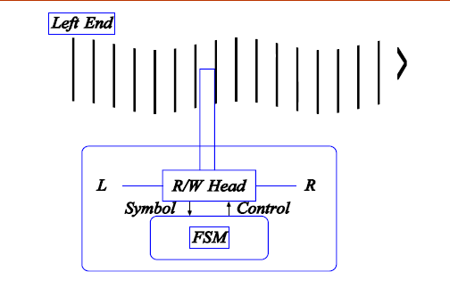
Turing Machine
Although simple, one can simulate a general computer using a TM
10

Slide 11
Universal Turing Machine
A Turing machine that is able to simulate any other Turing machine is called a universal Turing machine
Read the description of the TM to be simulated from the tape …
This is similar to a general-purpose computer
CPU reads the program (Word, Internet Explorer, PowerPoint, MediaPlayer …) from the disk, and carries out the instructions specified in the program line by line …
11

Slide 12
Stored-program computer
Also called von Neumann architecture
named after mathematician and early computer scientist John von Neumann (12/28/1903 – 2/8/1957), “the last of the great mathematicians”, “
Central processing unit (CPU): capable of performing arithmetic operations, read & write memory, branch operations, …
Memory: stores both instructions and data
Such architecture makes computer a general
purpose machine => one can write diff programs to make
computer do diff tasks
12

Slide 13
Now to more easy topics
13

Slide 14
Searching and Sorting Algorithms
Two of the most studied classes of algorithms in CS:
searching and sorting algorithms
Search algorithms are important because quickly locating information is central to many tasks
Sorting algorithms are important because information can be located much more quickly if it is first sorted
E.g. phone book
Searching and sorting algorithms as introduction to the topic of algorithms
14

Slide 15
Searching Algorithms
Problem: determine if an element x is in a list L
We will look at two simple searching algorithms
Linear search
Binary search
List: elements stored in a list in a sequential way
There is a first element, second element, ..
To make life easier: we use L[i] or L_{i} to refer to the i-th element in list L, we refer i as the index of element L_{i}
L = (l₁, l₂,.., l_{n})
Elements are not necessarily ordered
15

Slide 16
Linear Search Algorithm
The algorithm below will search for an element x in List L and will return “FOUND" if x is in the list and “NOT FOUND" otherwise.
L has n items and L[i ] refers to the i-th element in L.
Linear Search Algorithm
1 repeat as i varies from 1 to n
2 if L[i ] = x then return “FOUND" and stop
3 return “ FOUND"
Note:
Repeat: means do step 2 for i=1, i=2, i=3,…i=n
We indent line 2 to show that it’s part of the loop/iteration
Return: means exits the algorithm and returns the output
16

Slide 17
Efficiency of Linear Search Algorithm
If x appears once in L, on average how many comparisons (line 2) would the algorithm to make on average?
On average n/2 comparisons
If x does not appear in L, how many comparisons would the algorithm make?
n comparisons
Would such an algorithm be useful for finding someone in a large (unsorted) phone book?
No, it would require scanning through entire phone book!
Need a better way!
17

Slide 18
Binary Search Algorithm Overview
Binary search algorithm assumes that L is sorted
Ascending order or descending order
This algorithm need not examine each element, it maintains a “window" in which element x may reside
window is defined by indices min and max which specify the leftmost and rightmost boundaries in L
In the beginning, x can be anyway in L, i.e., min=1, max=n
At each iteration of the algorithm, the window is cut in half
Remember number guessing game ?
I am thinking about the number between 1 and 100, you guess it by asking question such as “Is the number larger than 30”?
18

Slide 19
Binary Search Algorithm
Binary Search Algorithm assuming L has been sorted in ascending order
1 set min to 1 and set max to n
2 Repeat until min > max
3 Set midpoint to (min + max)/2
4 Compare x to L[midpoint], three possible results:
(a) if x = L[midpoint] then return “FOUND"
(b) if x > L[midpoint] then set min to (midpoint + 1)
(c) if x < L[midpoint] then set max to (midpoint -1)
5 return “FOUND"
Note: the repeat loop spans lines 2-4.
Can you modify the algorithm to work for L sorted in descending order?
19

Slide 20
Binary Search Example
Use binary search to find element “4" in sorted list (1 3 4 5 6 7 8 9). List values of min, max and midpoint after each iteration of step 4. How many values are compared to “4"?
1 Min = 1 and max = 8 and midpoint = 1/2 (1 + 8) = 4 (round down). Since L[4] = 5 and since 4 < 5 we execute step 4c and max = midpoint - 1 = 3.
2 Now min = 1, max = 3 and midpoint = 1/2 (1 + 3) = 2. Since L[2] = 3 and 4 > 3, we execute step 4b and min = midpoint + 1 = 3.
3 Now min = 3, max = 3 and midpoint = 1/2 (3 + 3) = 3. Since L[3] = 4 and 4 = 4, we execute step 4a and return “FOUND.“
we check three values: 3, 4, and 5.
Since we cut the window in half each iteration, it will shrink very quickly (about log₂ n comparisons).
20

Slide 21
Analysis of Algorithms
An algorithm is a set of instructions that solves a problem for all possible input instances
There may be many algorithms solving one problem and all of these are not equally good
12 sorting algorithms described in Wikipedia
One criteria for evaluating an algorithm is efficiency
Of course, correctness is first consideration
Analysis of Algorithm: determining the efficiency of an algorithm
21

Slide 22
What’s in an algorithm?
Consider this problem: find the largest number in a list of numbers, given by L, i.e., (L₁, L₂, …, L_{n})
How would you solve the problem?
How to specify your solution?
22

Slide 23
Algorithm analysis
23

Slide 24
How to evaluate algorithms?
When solving tasks, what are we most concerned with?
Most of us are pretty concerned with time, and time is actually the main concern in evaluating the efficiency of algorithms
Space: maximum amount of memory the algorithm requires at any time
There is a trade-off between time and space efficiency
We will focus on time, although for some problems, space can actually be the main concern.
24

Slide 25
How to measure time efficiency?
We could run the algorithm on a computer and measure the time it takes to complete
But what computer do we run it on?
Different computers have different speeds.
We could pick one benchmark computer, but it would not stick around forever
Worse yet, running time is usually impacted by the specific input, so how do we handle that?
25

Slide 26
Run Time Complexity
Standard solution: number of operations performed by the algorithm w.r.t. the size of the input
Size of the input: the length of the list to be sorted/searched, the number of nodes/edges in the graph, …
Inputs of same size sometimes results in different numbers of operations
E.g., linear search, 1 v.s. n
focus on worst-case performance, i.e., assume hardest input possible (most unlucky case)
E.g., worst case input for linear search is when item to be searched is not in the list or last element in the list
26

Slide 27
Running time of BubbleSort and MergeSort
One way to find out number of operations:
implement the algorithm as a computer program (which also record # of operations)
run program on inputs of various length
record # of operations performed and find out worst-case, average-case, …
E.g.: bubblesortOps(n) and mergesortOps(n) represent avg # of operations performed to sort list with n elements
n 2 4 8 16 32 64
bubblesortOps(n) 4 16 64 256 1024 4096
mergesortOps(n) 2 8 24 64 160 384
27

Slide 28
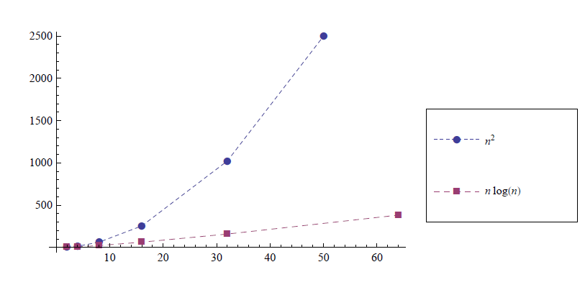
Run Time Complexity
From the data, we can determine closed formulas for bubblesortOps(n) and mergesortOps(n)
bubblesortOps(n) = n²
mergesortOps(n) = n log2 n
28

Slide 29
Analysis of Linear Search Algorithm
Linear Search Algorithm
1 repeat as i varies from 1 to n
2 if L[i ] = x then return "FOUND" and stop
3 return "FOUND"
How many comparison operations does it perform?
The algorithm checks at most n elements against x,
worst-case: requires n comparisions.
This occurs when x is not in the list or is the last element in the list.
What is the best-case complexity of the algorithm?
1, which occurs when x is the first item on the list
29

Slide 30
Average Case Complexity
If you know that the element x to be matched is in the list, what is the average-case complexity of the algorithm?
The average case complexity of the algorithm should be n/2, since on average you should have to search half of the list
At least for introductory courses on algorithms, the worst-case complexity is what is reported, since it is generally much easier to compute than the average case complexity.
30

Slide 31
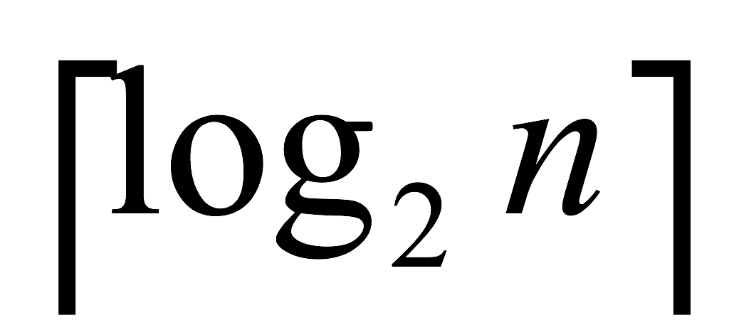
Analysis of Binary Search
binary search algorithm, which assumes a sorted list, repeatedly cuts the list to be searched in half
If there is 1 element, it will require 1 comparison
If there are 2 elements, it may require 2 comparisons
If there are 4 elements, it may require 3 comparisons
If there are 8 elements, it may require 4 comparisons
In general, if there are n elements, how many comparisons will be required?
It will require log2n comparisons
If n is not a power of 2, you will need to round up the number of comparisons
i.e., it requires comparisons
Thus if there are 3 elements it may require 3 comparisons
31

Slide 32
Linear Search vs Binary Search
linear search: requires n comparisons worst case
binary search: requires log2n comparisions worst case
Which one is faster? Is the difference significant?
binary search algorithm is much faster, in that it requires many fewer comparisons
If a list has 1 million elements,
linear search requires 1,000,000 comparisons
binary search requires only about 20 comparisons!
But binary search requires list to be sorted first
sorting requires nlog2n operations, more than n operations
it only makes sense to sort and then use binary search if many searches will be made
This is the case with dictionaries, phone books, etc.
32

Slide 33
Sorting algorithm
33

Slide 34
Sorting Algorithms
Sorting algorithms are one of the most heavily studied topics in Computer Science
Sorting is critical to improve searching efficiency
There are many well known sorting algorithms in Computer Science, we focus on two:
BubbleSort: a very simple but inefficient sorting algorithm
MergeSort: a slightly more complex but efficient sorting algorithm
34

Slide 35
BubbleSort Algorithm Overview
BubbleSort: repeatedly scan the list, in each iteration “bubbles" largest element in unsorted part of the list to the end, e.g., for list 9 2 8 4 1 3
After 1 iteration, largest element in last position, 2 8 4 1 3 9
After 2 iterations, largest element in last position and second largest element in second to last position, 2 4 1 3 8 9
3rd: 2 1 3 4 8 9
4th: 1 2 3 4 8 9
5-th iteration: 1 2 3 4 8 9 (done!)
requires n-1 iterations
at (n-1)-th iteration, only one item left, must already be in proper position (i.e., the smallest must be in the leftmost position)
35

Slide 36
BubbleSort Algorithm
Input: n-element list L = (l₁, l₂,.., l_{n})
Bublesort Algorithm
1 Repeat as i varies from n down to 2
Repeat as j varies from 1 to i – 1
If l_{j} > l_{j+1} swap l_{j} with l_{j+1}
i controls which part of list is checked each iteration. (Only unsorted part is checked.)
In 1st iteration, check everything, l₁, l₂, … l_{n-1}
In 2nd iteration, check everything except last element, l₁, l₂, …, l_{n-2}
…
Inner loop (2-3): bubble up largest element in unsorted part of list
36

Slide 37
BubbleSort Example
Use BubbleSort to sort list of number (9 2 8 4 1 3) into increasing order.
How many comparisons did you do each iteration? Can you find a pattern?
This will be useful later when we analyze the performance of the algorithm.
37

Slide 38
MergeSort Algorithm Overview
MergeSort is a divide-and-conquer algorithm
it divides the problem into smaller problems
solves the smaller problems
then combines solutions to smaller problems, to find solution to original problem
Much more efficient than bubblesort algorithm
Key: combining two sorted lists into a sorted list is very easy
How would you combine (1 4 7 8) and (2 5 9 10 11)?
place your fingers at the start of each list, copy over the smaller element, then advance that one finger.
Above description is not mechanical enough … What if no where to advance the finger? When to stop?
38

Slide 39
MergeSort Algorithm
MergeSort Algorithm
function mergesort(L)
1. if L has one element then return(L); otherwise continue
2. l₁ = mergesort(left half of L)
3. l₂ = mergesort(right half of L)
4. L = merge(l₁, l₂)
5. return(L)
Note: l₁ = mergesort(left half of L) means:
set the result of mergesort (left half of L) to list l₁
We have intuitively solved merge(l₁,l₂) in last slide, can you write out its algorithm?
39

Slide 40
Description of MergeSort
MergeSort is a recursive function
That means it calls itself
If input list contains one element, it is trivially sorted so mergesort is done
Otherwise mergesort calls itself on the left and right half of the list and then merges the two lists
Each of these two calls to itself may lead to additional calls to itself
Mergesort completely sort left half of the list before it starts sorting the right half
40

Slide 41
Example of MergeSort
Trace mergesort with input (9 2 8 4 1 3)
41

Slide 42
Analysis of BubbleSort
Analyzing BubbleSort algorithm means determining the number of comparisons required to sort a list
Recall that BubbleSort works by repeatedly bubbling up the largest element in the unsorted part of the list
We can determine the number of comparisons by carefully analyzing the BubbleSort example we worked through earlier, when we sorted (9 2 8 4 1 3)
But we need to generalize from this example, so our analysis holds for all examples
42

Slide 43
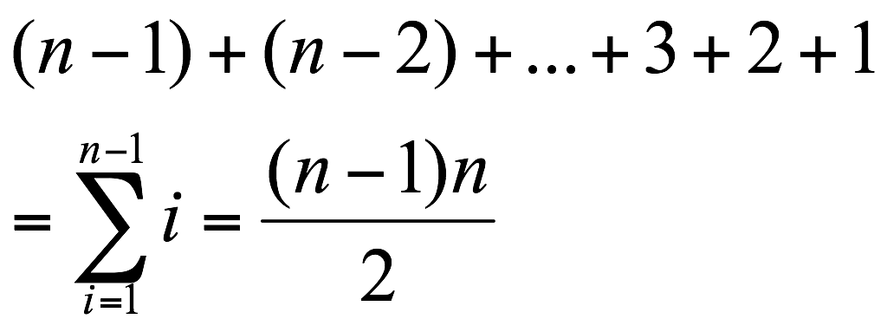
Analysis of BubbleSort
If we apply BubbleSort to (9 2 8 4 1 3) how many comparisons do we do each iteration?
On iteration 1 we do 5 comparisons (6 unsorted numbers)
On iteration 2 we do 4 comparisons (5 unsorted numbers)
On iteration 3 we do 3 comparisons (4 unsorted numbers)
On iteration 4 we do 2 comparisons (3 unsorted numbers)
On iteration 5 we do 1 comparison (2 unsorted numbers)
On iteration 6 we do 0 comparisons (1 unsorted number)
So how many total comparisons for a list with 6 items?
Number of comparisons = 5 + 4 + 3 + 2 + 1 = 15
So how many comparisons for a list with n items?
43

Slide 44
Analysis of BubbleSort
We want to know how the number of operations grows with n
This is not obvious with the summation so we need to replace it with a closed formula
We can do this since it is known that
This was proven in the section on induction but is also based on the sum of n values equaling n times the average value
The average value of 1; 2; : : : ; n is 1/2 (n + 1)
In this case, we are summing up to n-1 and not n, so substituting n- 1 for n we get:
Number BubbleSort comparisons =
44

Slide 45
Analysis of BubbleSort
So BubbleSort requires 1/2 (n²- n) comparisons
Computer scientists usually focus on the highest order term, so we say that the number of comparisons in bubblesort grows as n² or as the square of the length of the list
BubbleSort can have problems if the list is very long
45

Slide 46
Analysis of MergeSort
Analysis of mergesort
number of comparisons grows proportional to n log2n
n log2n grows much more slowly than n²
so do not use bubblesort unless for a very short list
46

