Slide 1
CISC 1600/1610 Computer Science I
Flow Control

Slide 2
Linear execution of statements
Each action performed in written order
What is the result of this set of statements?
int a=1, b=2, c;
c = a+b;
a=5;
cout << c;

Slide 3
Linear execution of statements
Each action performed in written order
What is the result of this set of statements?
int a=1, b=2, c;
a=5;
c = a+b;
cout << c;
Statement 1
Statement 2
Statement 3
Statement 4

Slide 4
Alternatives to “linear execution”
Conditional actions
> ./myProgram
What is your name? Joe
What time is it? 0900
Good morning, Joe.
> ./myProgam
What is your name? Laura
What time is it? 1400
Good afternoon, Laura.
>
Conditional Statement 1
Statement 2a
Statement 2b
Statement 3
Statement 4

Slide 5
The if-else statement
if-else is used to perform a two way branch
if ( condition )
statement1;
else
statement2;
statement1 is performed if condition is true
statement2 is performed if condition is false
Only one of the two statements is performed!

Slide 6
condition – a Boolean expression
Boolean expressions are either true or false
Conditions often consist of comparisons
TotalPurchase $≥$ 30 // can get free shipping
age < 4 // can ride subway for free
collegeYear == 2 // you are a sophomore

Slide 7
Comparisons in C++
Operator Example
= equal to == a == b
$≠$ not equal to != a != b
< less than < a < b
$≤$ less than or <= a <= b
equal to
> greater than > a > b
$≥$ greater than or >= a >= b
equal to

Slide 8
Be careful with =
= is the assignment operator
a=b; assigns the value of b to a
== tests equivalence
a==b determines if a and b have the same value

Slide 9
Some Spaces Matter
Where spaces matter:
Correct: a>=b a<=b a!=b
Incorrect: a> =b a< =b a! =b
No space between > and =, < and =, ! and =
Where spaces don’t matter:
Correct: a>=b a <=b a !=b

Slide 10
if statement
Try it now
Can write if statement without else
> ./myProgram
Enter charge: 32.00
Free delivery!
Thanks for shopping!
> ./myProgram
Enter charge: 10.00
Thanks for shopping!
>
Charge card
$≥$30
$<$30
“Free delivery!”
“Thanks for shopping!”

Slide 11
Compound statements: the use of { }
Must group multiple statements with { } in if-else
if ( condition )
{
statement1;
statement2;
statement3;
}
else
{
statement4;
statement5;
}

Slide 12
What does this do?
int numBagels=5;
cout << "You are getting" << numBagels;
cout << " bagels!\n";
if ( numBagels>12 ) {
numBagels=numBagels+1; //baker's dozen
cout << "You also get an extra bagel free!";
cout << endl;
}
cout << "Have a good day.\n“;

Slide 13
Compound Boolean expressions
Expressions can be combined with logical operators
The AND operator &&: expression1 && expression2 true only if both expression1 and expression2 are true
if ( ( 2<x ) && ( x<7 ) )
true only if x is between 2 and 7, e.g, x is 4, x is 6
false otherwise, e.g., x is 0, x is 10
Equivalently: if ( 2<x && x<7 )
Invalid: if ( 2<x<7 )

Slide 14
Compound Boolean expressions
Expressions can be combined with logical operators
The OR operator ||: expression1 || expression2 true only if at least one of expression1 and expression2 are true
if ( ( ageZoe==20 ) || ( ageZoe==25 ) )
true only if ageZoe is 20 or 25
false otherwise
Equivalently: if ( ageZoe==20 || ageZoe==25 )

Slide 15
Logical operators, continued
Expressions can be altered with logical operators
The NOT operator !: !expression true only if expression is false
if ( !( ageZoe>20 ) )
true only if ageZoe is below 20
false otherwise
Preferably: if ( ageZoe<=20 )
Preferable to avoid !expression

Slide 16
What does this do?
int numBagels=5;
cout << "You are getting" << numBagels;
cout << " bagels!\n";
if ( numBagels>12 )
{
numBagels=numBagels+1;
cout << "You also get an extra bagel free!";
cout << endl;
}
cout << "Have a good day.\n“;

Slide 17
In summary
AND
OR
a | b | a && b
true | true | true
true | false | false
false | true | false
false | false | false
a | b | a || b
true | true | true
true | false | true
false | true | true
false | false | false
NOT
a | !a
true | false
false | true

Slide 18
What does this code do?
#include<iostream>
using namespace std;
int main () {
float soupTemp;
cout << "What is your soup temperature? ";
cin >> soupTemp;
if ((soupTemp > 80) && (soupTemp<95))
cout << "This soup is just right!\n";
else
cout << "This soup is no good!\n";
return 0;
}
Build It

Slide 19
When do we need parentheses? Try these in your code
(soupTemp > 80) && (soupTemp<95)
is the same as
soupTemp > 80 && soupTemp<95
(soupTemp > 80) && !(soupTemp>=95)
is not the same as
soupTemp > 80 && !soupTemp>=95

Slide 20
Order of operations for logic Precedent
Parentheses: ()
Negation: !
Comparison: <, >, <=, >=, ==, !=
And: &&
Or: ||
Operations on same level evaluated left-to-right

Slide 21
Cautionary notes
!
Be careful using !
Easy to mis-read
Can avoid it by being explicit, e.g. bool IsChild = true;
Instead of:
If (!IsChild)
Try:
If (IsChild == false)
Remember int-to-bool conversion
0 as false
1 (or any non-zero number) as true e.g. while(5)

Slide 22
Size of Variables on our system. Use sizeof(<type>)
Build It
bool: 1 bytes
char: 1 bytes
wchar_t: 4 bytes
char16_t: 2 bytes
char32_t: 4 bytes
short: 2 bytes
int: 4 bytes
long: 8 bytes
long long: 8 bytes
float: 4 bytes
double: 8 bytes
long double: 16 bytes
#include <iostream>
// example if we left out using namespace std;
int main()
{
std::cout << "bool:\t\t" << sizeof(bool) << " bytes" << std::endl;
std::cout << "char:\t\t" << sizeof(char) << " bytes" << std::endl;
std::cout << "wchar_t:\t" << sizeof(wchar_t) << " bytes" << std::endl;
std::cout << "char16_t:\t" << sizeof(char16_t) << " bytes" << std::endl;
std::cout << "char32_t:\t" << sizeof(char32_t) << " bytes" << std::endl;
std::cout << "short:\t\t" << sizeof(short) << " bytes" << std::endl;
std::cout << "int:\t\t" << sizeof(int) << " bytes" << std::endl;
std::cout << "long:\t\t" << sizeof(long) << " bytes" << std::endl;
std::cout << "long long:\t" << sizeof(long long) << " bytes" << std::endl;
std::cout << "float:\t\t" << sizeof(float) << " bytes" << std::endl;
std::cout << "double:\t\t" << sizeof(double) << " bytes" << std::endl;
std::cout << "long double:\t" << sizeof(long double) << " bytes" << std::endl;
return 0;
}

Slide 23
More Flow control
More if statements

Slide 24
The if Statement
Allows statements to be conditionally executed or skipped over
Models the way we mentally evaluate situations:
"If it is raining, take an umbrella."
"If it is cold outside, wear a coat."

Slide 25
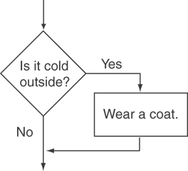
Flowchart for Evaluating a Decision

Slide 26
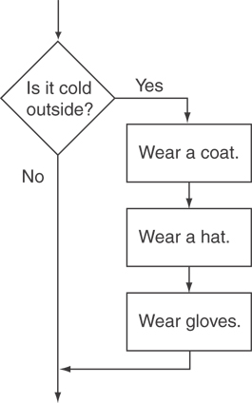
Flowchart for Evaluating a Decision

Slide 27
The if Statement
General Format: if (expression)
statement1;
Compound expressions (i.e. !, &&, ||):
if (expr1 && expr2 …)
statement2;
if (expr3 || expr4 …)
statement3;

Slide 28
if Statement Notes
Do not place ; after (expression)
Place statement; on a separate line after (expression), indented:
if (score > 90)
grade = 'A';
Be careful testing floats and doubles for equality because of precision
0 is false; any other value is true

Slide 29
The if/else statement and Modulus Operator in Program 4-8

Slide 30
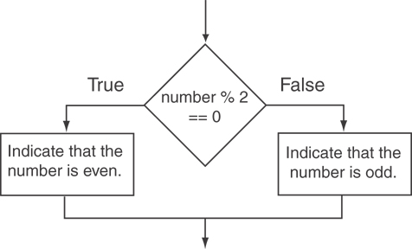
If-else flowchart Program 4-8

Slide 31
Different parts of the afternoon
Conditional actions
> ./myProgram
What is your name? Jill
What time is it? 1400
Good afternoon, Jill.
> ./myProgam
What is your name? Leon
What time is it? 2100
Good evening, Leon.
>

Slide 32
Nested ifs. How do they work?
if ( time > 1200)
if (time < 1800)
cout << "Good afternoon\n";
else
cout << "Good evening\n";
else
cout << "Good morning\n";

Slide 33
Nested ifs. else goes with nearest if
if ( time > 1200)
if (time < 1800)
cout << "Good afternoon\n";
else
cout << "Good evening\n";
else
cout << "Good morning\n";

Slide 34
Using const
Constant variables – replace numbers with meaningful names
int time; // from 0 to 2400 (100*hr+min)
const int NOON=1200, EVENING_START=1800;
if ( time > NOON)
if (time < EVENING_START)
cout << "Good afternoon\n";
else
cout << "Good evening\n";
else
cout << "Good morning\n";

Slide 35
Grouping of if and else
else statement is connected with closest if unless…
{ } curly braces group code into blocks under if or else
if (expr){
statement1;
if (another_expr)
statement_1a;
statement2;
} else {
statement3;
statement4;
}
Code in a block is in its own context or scope.
Indentation is ignored by the compiler!
However, it makes code more readable.
So does white space (e.g. tab, space, newline).

Slide 36
Nested Example for flowchart
Nested if-else are used when multiple conditions must hold
Example below can be implemented with a compound expression.
Recent grads who are employed are entitled to special interest rate.
Who is employed?
Of those employed, who is a recent grad?
Graduated from college in the last 2 years.

Slide 37
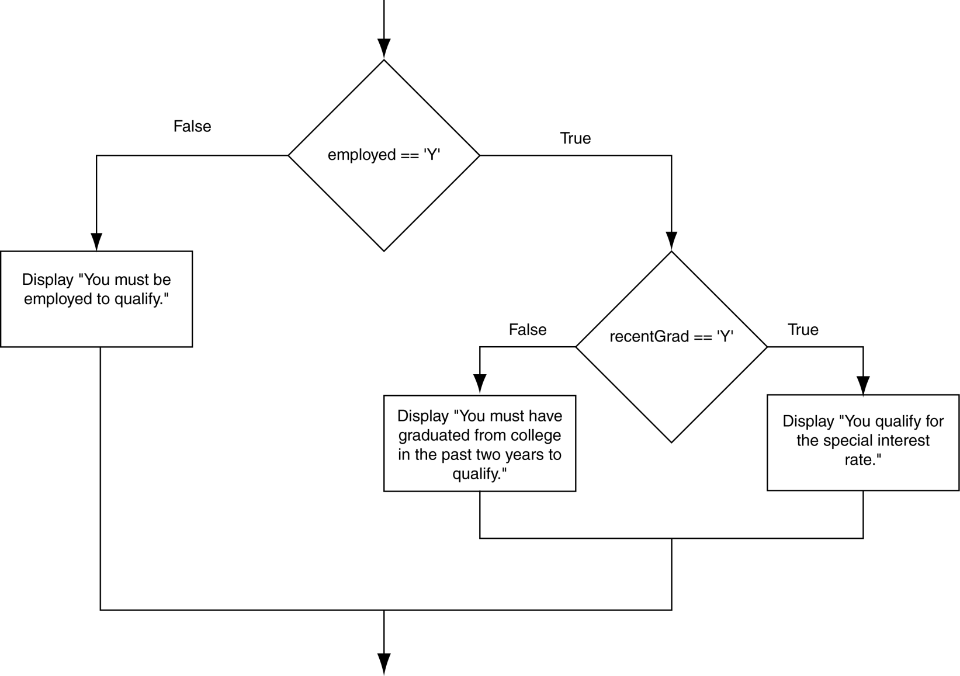
Flowchart for a Nested if Statement

Slide 38
Use Proper Indentation!

Slide 39
What does this code do?
// buying a laptop
int price=500; // $500
float weight=50.5; // 50.5 pounds
if (weight<5.5)
if (price<1000)
cout << "Buy this!" << endl;
else
cout << "Too heavy!" << endl;
Notes:
Don’t TRUST Indentation

Slide 40
What does this code do?
// buying a laptop
int price=500; // $500
float weight=50.5; // 50.5 pounds
if (weight<5.5)
if (price<1000)
cout << "Buy this!" << endl;
else
cout << "Too heavy!" << endl;

Slide 41
Multiway if-else statement
Actions for multiple mutually-exclusive conditions
if ( expression1)
statement1;
else if ( expression2 )
statement2;
. . .
else if ( expressionN )
statementN;
else // all above expressions false
statementLast;

Slide 42
Branching on grade
> ./myProgram
Enter score: 94
You get an A.
> ./myProgram
Enter score: 78
You get a C
Score input
$≥$90
<90, $≥$80
<80, $≥7$0
<70, $≥6$0
“A”
“B”
“C”
“D”
“F”
Exit

Slide 43
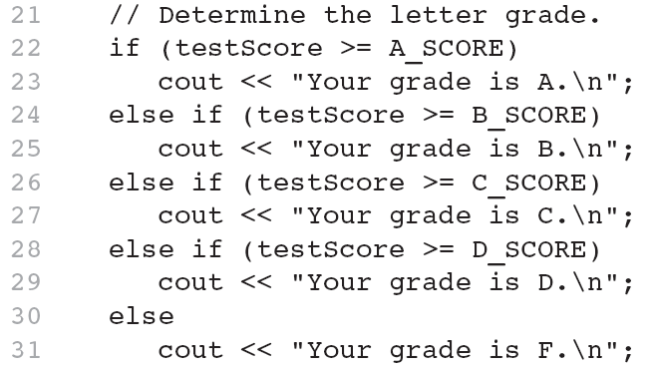
The if/else if Statement in Program 4-13
This trailing else catches failing test scores

Slide 44
Switch statements

Slide 45
Multiway switch statement
switch picks which statements to perform based on value of controlStatement
switch ( controlStatement )
{
. . .
case constant :
statementSequenceX
break;
. . .
}
Essentially, a series of IF statements in a row.
This is actually how the compiler translates it!

Slide 46
Full switch syntax
switch ( controlStatement )
{
case constant1 :
statementSequence1
break;
. . .
case constantN :
statementSequence3
break;
default :
statementSequence
}

Slide 47
switch Statement
Must return a result value of type:
bool
integer (int, and related types)
char
case statement
case constantX : tells program to start running following code if controlStatement has given value
break statement
break; exits the current block of code

Slide 48
switch example
switch ( letter ) {
case 'A':
cout << "A is for apple\n";
break; /* if this break is forgotten, then 'B' will also execute! */
case 'B':
cout << "B is for banana\n";
break;
case 'C' :
cout << "C is for cherry\n";
break;
default :
cout << "No fruit for you\n";
break;
}

Slide 49
switch example
A
Char letter = 'A';
switch ( letter ) {
case 'A':
cout << "A is for apple\n";
break;
case 'B':
cout << "B is for banana\n";
break;
case 'C' :
cout << "C is for cherry\n";
break;
default :
cout << "No fruit for you\n";
break;
}

Slide 50
switch example
C
switch ( letter ) {
case 'A':
cout << "A is for apple\n";
break;
case 'B':
cout << "B is for banana\n";
break;
case 'C' :
cout << "C is for cherry\n";
break;
default :
cout << "No fruit for you\n";
break;
}

Slide 51
Can omit break statements to group conditions
switch ( letter ) {
case 'A':
case 'a':
cout << "A is for apple\n";
break;
case 'B':
case 'b':
cout << "B is for banana\n";
break;
case 'C' :
case 'c' :
cout << "C is for cherry\n";
break;
default :
cout << "No fruit for you\n";
break;
}

Slide 52
Lab 3A Season-if
Write a program that reads in the month as a number from the user – a number between 1 and 12 (1 is January, 2 is February…).
Print a message saying:
For 12,1,2: "It is Winter"
For 3,4,5: "It is Spring"
For 6,7,8: "It is Summer"
For 9,10,11: "It is Fall"
Lab 3A: Build this with 'if' statements

Slide 53
Lab 3B Season-switch
Write a program that reads in the month as a number from the user – a number between 1 and 12 (1 is January, 2 is February…).
Print a message saying:
For 12,1,2: "It is Winter"
For 3,4,5: "It is Spring"
For 6,7,8: "It is Summer"
For 9,10,11: "It is Fall"
In Lab 3A, You built this with 'if' statements
Lab 3B: Now build it with a 'switch' statement

Slide 54
Example with Precedence
Logical Operators: Example
int a = 0, b = 3, c = 1, d = 4;
a && b || !c || d

Slide 55
Precedence

Slide 56
Short-circuit evaluations
If the value of the leftmost sub-expression determines the value of the full expression, the rest of the expression is not evaluated
At what point can these expressions be answered correctly?
A = 0; B=1; C=2
If (A || (B >C) || (C==2))
If (!A || (C>B))
If (A || ((B==1) && (C==2)))

Slide 57
Sometimes…
We don’t have to evaluate every part of a condition.
Once we determine an expression is either true or false, we can stop evaluating.
People do this all the time.
Let’s say we want to sign up for a course but…
We don’t want to get up before 8 and must leave by 4
We don’t want to go to school on Wednesdays
If the class starts before 10 or it ends after 4 or if it meets on Wednesday, swipe left; can’t schedule.
All we have to see is one wrong thing!

Slide 58
Short-circuit evaluations
Try these & discuss
float x=0, y=20;
if ( x!=0 && y/x>=3 ) // OK?
{
// block of statements
}
if (y/x >= 3 && x!=0) // error
// divide-by-0

Slide 59
Short-circuit evaluations
float x=0, y=20;
if ( x==0 || y/x>=3 ) // only x==0
// evaluated
{ . . .
}

Slide 60
Short-circuit Evaluations
When evaluating logical &&, and
If the first expression is false, no need to evaluate further. Why? Because… all paths lead to false.
false && false = false
false && true = false
If the first expression is true, must evaluate the second. Why? Because… it’s still unknown.
true && false = false
true && true = true ✔
&&, and is true only if both expressions are true.

Slide 61
Short-circuit Evaluations
When evaluating logical ||, or
If the first expression is true, no need to evaluate further. Why? Because… all paths lead to true.
true || false = true ✔
true || true = true ✔
If the first expression is false, must evaluate the second. Why? Because… it’s still unknown.
false || true = true ✔
false || false = false
||, or is true if any expression is true.

Slide 62
Scope. Important Concept!
Variables declared inside a block are not “visible” outside the block
Variables declared in an outer block are visible to inner blocks
Blocks are enclosed by braces { }

Slide 63
What does this code do?
int main () {
int a=5, b=10;
if ( a >= 3) {
int a=8;
cout << a << " " << b << endl;
}
cout << a << " " << b << endl;
return 0;
}
Notes:
Variable a is unchanged outside of the block.

Slide 64
What does this code do?
int main () {
int a=5, b=10;
if ( a >= 3) {
int a=8, c=5;
cout << a << " " << b << endl;
}
cout << a << " " << c << endl;
return 0;
}
Notes:
Doesn’t compile because c cannot be seen outside of the block.

Slide 65
What does this code do?
int main () {
int a=5, b=10, c=5;
if ( a >= 3) {
int a=8;
b=12;
cout << a << " " << b << endl;
}
cout << b << " " << c << endl;
return 0;
}
Notes:
Variable b is changed because it is only declared once outside of the block.

Slide 66
So far…
Variables have types (e.g. int, float, double, char) and hold values.
Mathematical operators (e.g. *, /, %, +, - ) do calculations.
Programs sometimes need special case logic, use
if (cost > 30)
// free shipping
Programs sometimes must do either this or that, use
if (time < 1200)
// good morning
else
// good afternoon

Slide 67
So far (con’t)…
To express conditions we can use both Relational and Logical operators.
Relational operators (e.g. <, >, ==, !=, <=, >= ) do comparisons.
Logical operators (e.g. !, &&, || ) combine multiple comparisons (in that order).
Remember == is not the same as =
DO NOT do (x < y < z) because it doesn’t work right.
Operators cannot contain whitespace (i.e. blank, tab, newline)
If (a ! = b) is an ERROR!

Slide 68
So far (con’t)…
To group multiple statements use {} curly braces or a block
if (condition)
{
statement1;
statement2;
}
else {
statement3;
statement4;
}

Slide 69
Repetition
Any Lab questions before we go on?

Slide 70
Exercise
Ask the user for a minimum and maximum number (integer)
Use a 'while loop' to calculate the sum of the numbers between minimum and maximum
E.g., if min is 3 and max is 6, sum is 3+4+5+6=18
Extra: Ask the user for two numbers (don’t specify the order) and have the computer figure out the min and max
Extra 2: Compute the product of the numbers between min and max (E.g., 3x4x5x6=360)

Slide 71
Alternatives to “linear execution”
Repeated actions
> ./myProgram
5
4
3
2
1
Blast off!
Statement 1
Statement 2
Statement 3

Slide 72
The while loop
while ( condition )
statement_to_repeat;
OR
while (condition)
{
statement_to_repeat1;
. . .
statement_to_repeatN;
}
block of
statements

Slide 73
How can we “Count down from 5?”
int counter =5;
while ( counter >0 ) //True until $==$0
{
cout << counter << endl;
counter--;// decrement counter
}
cout << "Blastoff!\n";

Slide 74
Execution of while loop
If condition is true, enter while loop
Complete all statements in block
Return to top (re-evaluate condition)
Otherwise, continue to statements beyond loop

Slide 75
Execution of while loop
If condition is true, enter while loop
Complete all statements in block
Return to top (re-evaluate condition)
Otherwise, continue to statements beyond loop
int x=2;
while ( x>0 )
{
x--;
cout << "Hello world.\n";
}
How many
“Hello world”s
are output?

Slide 76
Exercise
Ask the user for a minimum and maximum number (integer)
Use a 'while loop' to calculate the sum of the numbers between minimum and maximum
E.g., if min is 3 and max is 6, sum is 3+4+5+6=18
Extra: Ask the user for two numbers (don’t specify the order) and have the computer figure out the min and max
Extra 2: Compute the product of the numbers between min and max (E.g., 3x4x5x6=360)

Slide 77
The Increment and Decrement Operators
++ is the increment operator. It adds one to a variable.
val++; is the same as val = val + 1;
++ can be used before (prefix) or after (postfix) a variable:
++val; val++;

Slide 78
The Increment and Decrement Operators
-- is the decrement operator. It subtracts one from a variable.
val--; is the same as val = val - 1;
-- can be also used before (prefix) or after (postfix) a variable:
--val; val--;

Slide 79
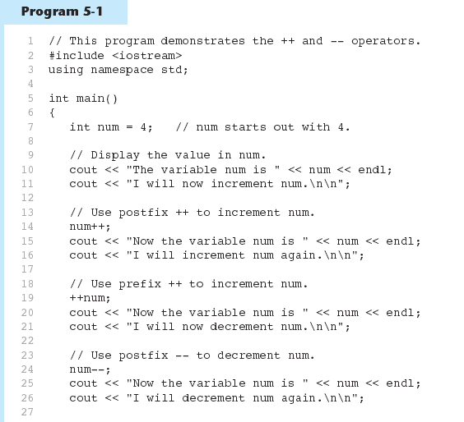
Increment and Decrement Operators in Program 5-1
Continued…

Slide 80
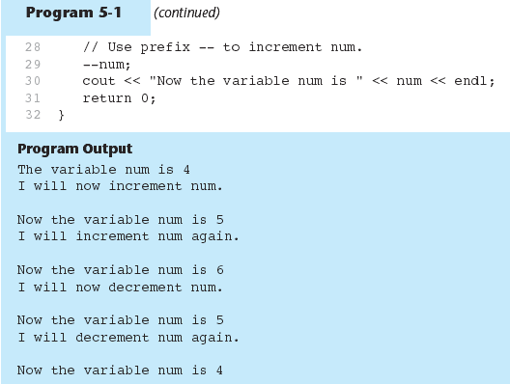
Increment and Decrement Operators in Program 5-1

Slide 81
Prefix vs. Postfix
++ and -- operators can be used in complex statements and expressions
In prefix mode (++val, --val) the operator increments or decrements, then returns the value of the variable
In postfix mode (val++, val--) the operator returns the value of the variable, then increments or decrements

Slide 82
a++ vs. ++a
a++ returns value of a, then adds 1 to a
Updates a 'after the fact'
++a adds 1 to a, then returns value of a
Great way to make an error that will take ages to find!
Different results.
Increments after a is used Increments before a is used
int a=0;
while (a++ < 3)
cout << "Hi!\n";
int a=0;
while (++a < 3)
cout << "Hi!\n";

Slide 83
Prefix vs. Postfix - Examples
int num, val = 12;
cout << val++; // displays 12,
// val is now 13;
cout << ++val; // sets val to 14,
// then displays it
num = --val; // sets val to 13,
// stores 13 in num
num = val--; // stores 13 in num,
// sets val to 12

Slide 84
Notes on Increment and Decrement
Can be used in expressions:
result = num1++ + --num2;
Must be applied to something that has a location in memory. Cannot have:
result = (num1 + num2)++;
Can be used in relational expressions:
if (++num > limit)
pre- and post-operations will cause different comparisons

Slide 85
What code will do this for us?
> ./myProgram
1 mississippi
2 mississippi
3 mississippi
4 mississippi
5 mississippi
>

Slide 86
do-while loop
while evaluates condition, then performs statements if condition is true
do-while performs statements, then evaluates condition to determine whether to perform statements again
do
{
statement1;
. . .
statement N;
}while ( condition ); // must have ;
Always runs through at least one time!

Slide 87
What does this code do?
How to do this:
For each variable, make a box (the memory that holds the variable).
Update it step by step.
a
Do the cout when called
int main () {
int a=5;
do {
cout << "one ";
a-=2;
cout << "two\n";
} while ( a > 0); // must have ;
return 0;
}
5
->1
->3
-> -1

Slide 88
What does this code do?
int main () {
int a=5;
do {
cout << "one ";
a-=2;
cout << "two\n";
} while ( a != 0);
return 0;
}

Slide 89
Getting Valid Input A great use of do-while
int main ()
{
int userInt;
do {
cout << "Give me an even#";
cin >> userInt;
} while ( userInt %2 != 0);// or == 1
cout << "Got " << userInt << endl;
return 0;
}

Slide 90
Beware of infinite loops!
Loops that never stop are called 'infinite loops'
while (2*2 == 4) // oops!
{
}
Typically, write code so each loop will stop

Slide 91
Beware of infinite loops!
Loops that never stop are called 'infinite loops'
while (true) // intentional
{
// keep pumping (heart code)
}
Typically, write code so each loop will stop

Slide 92
Let’s Evaluate These
Assume int count = 0 and int limit = 10, try these:
count == 0 && limit < 20
!(count == 12)
(count == 1) && (x < y)
(limit < 20) && (limit/count > 1)
(limit > 10) || (count <= 0) && (count++ >= 0)
! ( ((count < 10) || (x < y) ) && (count >= 0))
(5 && 7) + 16

Slide 93
Let’s Evaluate Some examples
Assume the following
int a = 2, b = 4, c = 6;
True or false? Don’t worry about short-circuit, doesn’t matter here.
a == 4 || b > 2
6 <= c && a > 3
1 != b && c != 3
a >= -1 || a <= b
! ( a > 2 )
b || (c – a – b) && (a + b) < c
b < 6 <= c

Slide 94
condition – a Boolean expression
Review
Boolean expressions are either true or false
bool hasAmazonPrime = true;
if (hasAmazonPrime)
{
cout << "Free shipping!\n";
}
Conditions often consist of comparisons
if (TotalSale $≥$ 30 )
cout << "Free shipping!\n";

Slide 95
Lab 3C: FordhamAir.cpp
We will write a small program for Fordham Airlines to allow the customer to purchase flights, calculating how much the customer owes, taking payment, and calculating change.
The airline sells tickets for travel during two time periods: daytime (departing 5am-7pm, inclusive) and nighttime (departing after 7pm up and before 5am).
The airline sells tickets for three destinations: Chicago, Miami, and Portland.
The airline sells tickets for two types of days: weekday and weekend (you could use 'D' for weekday and 'E' for weekend).

Slide 96
Example scenario – a simple 'use case'
A use case is a sample interaction between a user and a program.
You can write your own example scenarios or use cases with inputs and outputs. The write-up contains a few too.
This will help you write the code because it clarifies functionality.
Since we have a rigid auto-tester, starter code will give at least part to you so your text matches.

Slide 97
Fordham Airlines Use Case
Welcome to Fordham Airlines!
What is your destination? ([C]hicago, [M]iami, [P]ortland) M
What time will you travel? (Enter time between 0-2359) 1345
What type of day are you traveling? (week[E]nd or week[D]ay) D Each ticket will cost: $150.00
How many tickets do you want? 3
You owe: $450.00
Amount paid? 500.00
You will get in change: $50.00
Your tickets have been ordered!

Slide 98
Lab 3C: FordhamAir.cpp
What variables should you declare for these?
//C=Chicago, P=Portland, M=Miami
//D=weekDay E=weekEnd

Slide 99
Lab 3C: FordhamAir.cpp
Some more variables:
int flightTime; //military time
float ticketPrice;
char destination; //C=Chicago, P=Portland, M=Miami
char typeOfDay; //D=weekDay E=weekEnd better name? weekEndOrWeekDayLetter

Slide 100
Lab 3C: FordhamAir.cpp Other variables ?
Define isWeekend as _________
How can you calculate isWeekend?
Define isDayflight as _________
Define numTickets as __________
Define totalCost as __________
Define userPayment as ________
Define change as __________

Slide 101
Lab 3C: FordhamAir.cpp Suggested variables: what type?
Define destination as a _________
Define ticketPrice as a _________
Define flightTime as an ____________
Define isWeekend as a _________
Define isDayflight as a _________
Define weekEndOrWeekDayLetter as a _______
Define numTickets as an __________
Define totalCost as a __________
Define userPayment as a ________
Define change as a __________

Slide 102
Lab 3C: FordhamAir.cpp
Pricing

Slide 103
boolean –use it to simplify your code
If you have a situation that has only two states:
Examples:
bool IsDay;// (vs. is not day)
bool Is Weekend;// (vs. weekday)
1) Read in 'raw' info
cout << "time of flight? (0-2300)";
cin >> time;
cout << "Week[e]nd or Week[d]ay? char weekChar;
cin >> weekChar;
2) Convert to the Boolean
if (time >=500) && (time<1700)
isDay=true;
else
isDay = false;
if (weekChar == 'e')
isWeekend = true;
else
isWeekend = false;

Slide 104
boolean –use it to simplify your code
if (isWeekend)
if(isDay)
ticketPrice = 180;
else // isnight & weekend
ticketPrice = 120;
else // is not weekend, i.e. weekday
if(isDay)
ticketPrice = 150;
else // isnight & weekend
ticketPrice = 100;

Slide 105
Loops so far
The 'while' version
int i=1;
while (i<=5)
{
cout << i ;
cout << " Mississippi";
cout << endl;
i++;
}
The ‘do while' version:
int i=1;
do
{
cout << i ;
cout << " Mississippi";
cout << endl;
i++;
} while (i <= 5);

Slide 106
For loop

Slide 107
What are the parts of a 'for loop'?
// what code might you find in each ______ ?
for ( _______ ; ______________; _______)
{
// lines inside the for loop
}
for(int ageCounter=1; ageCounter < BirthdayAge ; ageCounter++)
cout << "Are you " << ageCounter << "?" << endl;

Slide 108
init – initialization of variable(s)
condition – statement about variable, while true, loop keeps running
update – updates the variable after each loop execution (after the ending '}' if it exists

Slide 109
for loop a compact, while loop alternative
for ( init; condition; update )
{
statement1;
. . .
statement N;
}

Slide 110
for loop a compact, while loop alternative
for ( init; condition; update )
{
statement1;
. . .
statement N;
}
Init –runs first. Declare and initialize variables here.

Slide 111
for loop a compact, while loop alternative
for ( init; condition; update )
{
statement1;
. . .
statement N;
}
Init –runs first. Declare and initialize variables here.
if condition is non-zero, enter block.
Otherwise, skip block.

Slide 112
for loop a compact, while loop alternative
for ( init; condition; update )
{
statement1;
. . .
statement N;
}
Init –runs first. Declare and initialize variables here.
if condition is non-zero, enter block.
Otherwise, skip block.

Slide 113
for loop a compact, while loop alternative
for ( init; condition; update )
{
statement1;
. . .
statement N;
}
Init –runs first. Declare and initialize variables here.
if condition is non-zero, enter block.
Otherwise, skip block.
Update – runs after the loop statements.

Slide 114
for loop a compact, while loop alternative
for ( init; condition; update )
{
statement1;
. . .
statement N;
}
Init –runs first. Declare and initialize variables.
Condition – if non-zero, enters loop.
Update – runs after the loop statements. After update, test condition again

Slide 115
for loop a compact, while loop alternative
Syntax: for(init ; bool ; final){ ... }
The 'while' version
int i=1;
while (i<=5)
{
cout << i ;
cout << " Mississippi";
cout << endl;
i++;
}
The 'for' version:
for (int i=1; i<=5; i++)
{
cout << i ;
cout << " Mississippi";
cout << endl;
}

Slide 116
Example for loop
When compiled & executed:
value of a: 10
value of a: 11
value of a: 12
value of a: 13
value of a: 14
value of a: 15
value of a: 16
value of a: 17
value of a: 18
value of a: 19
#include <iostream>
using namespace std;
int main ()
{
// for loop (init ; bool condition ; final)
for( int a = 10; a < 20; a = a + 1 )
{
cout << "value of a: " << a << endl;
}
return 0;
}

Slide 117
Scope
BLOCK
What's declared in the
{
}
Stays in the
{
}
BLOCK
Which includes the governing for(…. ; …. ; ) { }

Slide 118
Reviewing scope
Example 1: Counter i exists outside of loop
int i, product=1;
for ( i=1; i<=5; i++)
{
product = product*i;
}
Example 2: Counter i exists only inside of loop
int product=1;
for ( int i=1; i<=5; i++)
{
product = product*i;
}
1
2
Where can you sensibly put:
cout<< "i = " << i<< endl;
3
4
5
6

Slide 119
What does this code do?
int main ()
{
int i, product=1;
for ( i=1; i<=5; i++);
product = product*i;
cout << i << "! = " << product << endl;
return 0;
}

Slide 120
Beware the misplaced ;
Placing a semicolon after the parentheses of a for loop causes an empty statement as the body of the loop
for (int i =1; i<5000; i++);
{
// Lots of complicated code
}

Slide 121
for loop a compact, while loop alternative
Syntax: for(init ; condition ; final update){ ... }
Clever, but will fail you. What is wrong?
for (int i=1,sum =0; i<=5; i++)
{
sum = sum + i;
}
cout << "Sum is " << sum << endl;

Slide 122
Picking a loop
do-while if you need to perform the action at least once
for if there is a standard repeated mathematical update to your loop variable (e.g., count++) hint: for each
while loop might never execute
“loop variable” is the variable tested by the condition in your given loop

Slide 123
Picking a loop
do-while if you need to perform the action at least once
for if there is a standard repeated mathematical update to your loop variable (e.g., count++) hint: for each
while loop might never execute
“loop variable” is the variable tested by the condition in your given loop

Slide 124
Drawline
Using a loop, print out 5 stars so the output is:
*****

Slide 125
DrawSquare
How can we print out the line 4 times?
*****
*****
*****
*****

Slide 126
DrawRightTriangle
How can we print out a right triangle, like this?
*
**
***
****
*****

Slide 127
DrawTriangle
How can we print out an equilateral triangle, like this?
*
***
*****
*******

Slide 128
Accumulating Interest
If you start with $100 credit card balance
And pay 2% per month in interest
(And don't buy anything else)
How much do you owe after 1 month?
Your original $100 PLUS .02 * $100
= 100 + .02 *100 = 100 + 2 = 102
After one more month?
= 102 + .02 * 102 = 102 + 2.04 = 104.04 …

Slide 129
Money and Precision of Float/Double
To display all decimal numbers with two decimal places (e.g., $4.52 dollars), include the following code in your main function before your first decimal output:
cout.setf(ios::fixed);
cout.setf(ios::showpoint); // show decimals
// even if not needed
cout.precision(2);

Slide 130
The General Equation?
AmountOwedAfter1MoreMonth =
Prior amount + Interest * Prior Amount

Slide 131
Hazards
misplaced nested else
;
scoping (a benefit, but beware)

Slide 132
Program It!
Ask the user for a dollar value between 1 and 100.
Which loop do you use?
What type is dollarValue ?
Ask the user for a monthly interest rate between .01 (1%) and .1 (10%).
What type is Interest?
3) Use a loop to determine how many months it takes to double your debt

