Slide 1
5.11
Using Files for Data Storage

Slide 2
Using Files for Data Storage
Can use files instead of keyboard, monitor screen for program input, output
Allows data to be retained between program runs
Steps:
Open the file
Use the file (read from, write to, or both)
Close the file

Slide 3
Files: What is Needed
Use fstream header file for file access
#include <fstream>
File stream types:
ifstream for input from a file
ofstream for output to a file
fstream for input from or output to a file
Define file stream objects:
ifstream infile;
ofstream outfile;

Slide 4
Opening Files
Create a link between file name (outside the program) and file stream object (inside the program)
Use the open member function:
infile.open("inventory.dat");
outfile.open("report.txt");
Filename may include drive, path info.
Output file will be created if necessary; existing file will be erased first
Input file must exist for open to work

Slide 5
Testing for File Open Errors
Can test a file stream object to detect if an open operation failed:
infile.open("test.txt");
if (!infile)
{
cout << "File open failure!";
}
Can also use the fail member function

Slide 6
Using Files
Can use output file object and << to send data to a file:
outfile << "Inventory report";
Can use input file object and >> to copy data from file to variables:
infile >> partNum;
infile >> qtyInStock >> qtyOnOrder;

Slide 7
Using Loops to Process Files
The stream extraction operator >> returns true when a value was successfully read, false otherwise
Can be tested in a while loop to continue execution as long as values are read from the file:
while (inputFile >> number) ...

Slide 8
Closing Files
Use the close member function:
infile.close();
outfile.close();
Don’t wait for operating system to close files at program end:
may be limit on number of open files
may be buffered output data waiting to send to file

Slide 9
Letting the User Specify a Filename
In many cases, you will want the user to specify the name of a file for the program to open.
In C++ 11, you can pass a string object as an argument to a file stream object’s open member function.
Test if the open(filename) call fails using:
infile.open(filename);
if (infile.failed()) {
cout << “Filename “ << filename << “ cannot be opened.” << endl;
return 0; // can also use exit(1);
}

Slide 10
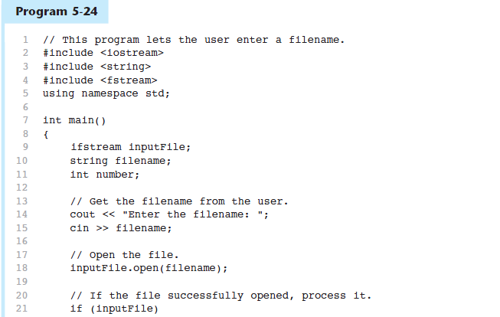
Letting the User Specify a Filename in Program 5-24
Continued…

Slide 11
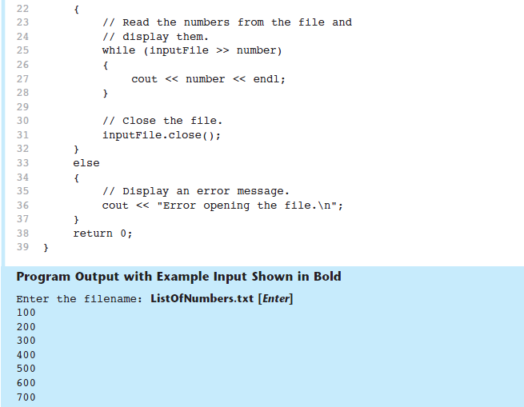
Letting the User Specify a Filename in Program 5-24

