Slide 1
CISC 1600/1610 Computer Science I
Scope, binary, addresses,
pass by value, pass-by-reference,
swap
jharazduk@fordham.edu
JMH 338

Slide 2
Variable scope
Remember: What's defined in the function stays in the function.
(Just like blocks { } )
Variables declared in a function
are local to that function
are invisible to all other functions
int main() is a function

Slide 3
What does this code do?
int newFunc(int a);
int main() {
int a=5, b, c=5;
b = newFunc(a);
cout << a << " " << b << " "
<< c << endl;
return 0;
}
int newFunc(int a) {
int c=12;
return a*5+c;
}

Slide 4
Formal parameters
“Formal parameters” are the variables in the function header
float triple(float inNum)
{
float tripledNum;
tripledNum=3*inNum;
return tripledNum;
}
Function head
Function body

Slide 5
Formal parameters
Local to the function
Used as if they were declared in function body – do not re-declare in function body
When function is called, parameters initialized to the values of the arguments in the function call
float triple(float inNum)
{
float tripledNum;
tripledNum=3*inNum;
return tripledNum;
}

Slide 6
Formal parameter names
Typically, argument names do not match parameter names
Example declaration:
int mymin(int oneNum, int anotherNum);
..
Example call:
int x=6; int y=4;
mymin(x,y);

Slide 7
Broader scope: global variables
Global variables visible to all functions
Declared outside of all functions
Must be declared prior to first use
#include<iostream>
using namespace std;
const float PI=3.14;
// visible to main and to areaCircle
// compute area of circle
float areaCircle(float radius);
int main() { ...}
float areaCircle(float radius) {...}

Slide 8
More on global variables
Useful to define global constants
Very risky to define non-constant global variables.
try to keep track of what functions change the variable

Slide 9
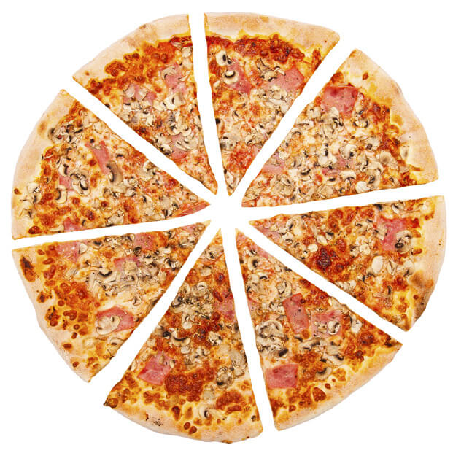
Let's Order Pizza
But how many?
Depends how many people we have
Make a function to figure it out

Slide 10
1 Input Parameters, 1 output
int numLgPizzaToOrder (int numPeople)
{
/* algorithm (formula) is from many years of experience. */
const int slicesPerPerson =3;
int nPizzas;
nPizzas = ceil(numPeople * slicesPerPerson / 8);
return(nPizzas);
}

Slide 11
Memory usage by functions
2 styles: “Call-by-value” & "Call-by-Reference"
Variables
Address Value
x
04902340 00000001 04902348 00010110
04902356 11011101
04902364 01010000
04902372 00101100
04902380 11011110
04902388 01010000
numStudents
(in main)
i
Notes:
Different variable types take up different amounts of memory

Slide 12
“Call-by-value”:
provide function with the value held in a variable input
Copies the value to new internal variable
Variables
Address Value
04902340 00000001 04902348 00010110
04902356 11011101
04902364 01010000
04902372 00100110
04902380 11011110
04902388 00010110
numStudents
(in main)
Copies the Value to an address used by the function.
numPeople
(in numLgPizzaToOrder)
Notes:
Different variable types take up different amounts of memory

Slide 13
“Call-by-value”
ERASES the local value when leaving the function.
Why? The variable is 'out of scope' & gone
Variables
Address Value
04902340 00000001 04902348 00010110
04902356 11011101
04902364 01010000
04902372 00100110
04902380 11011110
04902388 00010110
numStudents
(in main)
Copies the Value to an address used by the function.
numPeople
(in numLgPizzaToOrder)
Notes:
Different variable types take up different amounts of memory

Slide 14
“Call-by-reference”
Does not copy
Sends the ADDRESS of the original variable
Allows you to change the value of the original variable
Variables
Address Value
04902340 00000001 04902348 00010110
04902356 11011101
04902364 01010000
04902372 00101100
04902380 11011110
04902388 01010000
numStudents
(in main)
numPeople
(in numLgPizzaToOrder)
Notes:
Different variable types take up different amounts of memory

Slide 15
Address Of
&
Notice that:
address of numStudents = address of numPeople below
Variables
Address Value
04902340 00000001 04902348 00010110
04902356 11011101
04902364 01010000
04902372 00100110
04902380 11011110
04902388 01010000
numStudents
(in main)
numPeople
(in numLgPizzaToOrder)
Notes:
Different variable types take up different amounts of memory

Slide 16
Call-by-Reference Syntax
Use & to indicate a variable is called by reference
Use & both in declaration and definition
& can be located anywhere between the type and variable

Slide 17
Call-by-Reference Example
Declaration (top of file). Matches definition,but add ;
void get_letters(char& letter1, char& letter2);
Definition (preferably above main)
void get_letters(char& letter1, char& letter2)
{
cout << "Enter two letters: ";
cin >> letter1 >> letter2;
}
Calling the function
main()
{
char a,b;
get_letters(a,b);
cout << "After get_letters " ;
cout << "a= " << a << " b= " << b<< endl;
}

Slide 18
Call-by-reference vs. Call-by-value
Call-by-value preserves the value of the original input argument
Call-by-reference can change the value of the original input argument
Effectively allows return of multiple values from function

Slide 19
What does this do?
int mysteryFunc(int& num1);
int main()
{
int a=5;
cout << mysteryFunc(a) << endl;
cout << a << endl;
return 0;
}
int mysteryFunc(int &num1)
{
num1 += 3;
return num1/4;
}

Slide 20
What does this do?
int mysteryFunc2(int inNum);
int main()
{
int a=3;
cout << mysteryFunc2(a);
cout << a;
return 0;
}
int mysteryFunc2(int inNum)
{
inNum = inNum*inNum;
return inNum;
}

Slide 21
Call-by-reference: Input arguments
Arguments must be variables
If declaration is:
void myFunc(float& inputNum);
Good call:
float inputVariable;
myFunc(inputVariable);
myFunc(25.4); BAD call. Why?

Slide 22
Swap Lab Part 1: Input
Write a function Get2Ints to read 2 integers:
name them a and b.
What should that definition look like?

Slide 23
Swap Lab Part 2. Print
Write a function Print2Ints to print 2 integers:
name them a and b.
What should that definition look like?

Slide 24
Swap Lab Part 3. Swap
Write a function Swap that will swap the values of 2 integers.
name the values val1 and val2;
Even though you do not yet know how to write the code ..
Can you can still write the declaration ?

Slide 25
Swap Lab Part B
1) Write a function swap which swaps two integers
How to swap:
Requires an extra 'Temp' variable of the same type.
Example: Suppose you have two variables x and y and you want to swap their values. Let X=10 and Y=20 to start.
X=10
Temp
Y=20

Slide 26
How To Swap
Step 1:
Assign the value of X (10) to Temp
X=10
Temp=10
Y=20

Slide 27
How To Swap
Step 2:
Assign the value of Y (20) to X
X=20
Temp=10
Y=20

Slide 28
How To Swap
Step 3:
Assign the value of Temp (10, the old X)
to Y
X=20
Temp=10
Y=10
Now X=20 and Y=10

Slide 29
Swap
Add code to do the swap

Slide 30
Swap Lab. Design
From main :
Could you write the code for Get2Ints and Print2Ints and the code for Swap and get the same answer?
Sure!
But we won't.. ☺

Slide 31
Swap Lab. Part 4 (Final)
From main :
Get two ints
Print them
Swap them
Print them again (should be reversed)
Swap them
Print them again (should be back to the original)
Put it all together

Slide 32
A puzzle (and interview question)
Write swap without using a temporary variable

Slide 33
A puzzle (clever)
swap(int &x, int & y)
{
x = x + y;
y = x - y; // (x+y) – y (so orig x, what we want)
x = x - y; // (x+y) - y ( y is the orig x)
}

Slide 34
Code it now: More usage of &
int x = 5;
int& y=x; // y and x point to same address
y=10;
cout << x << endl; // output x value
cout << &x << endl; // output x address
cout << y << endl; // output y value
cout << &y << endl; // output y address

