Slide 1
CISC 1600/1610 Computer Science I
Arrays

Slide 2
Data types
Single pieces of information
one integer – int
one symbol – char
one truth value – bool
Multiple pieces of information
group of characters – string
group of a single type – array

Slide 3
Array Declaration
An array is a list containing
a fixed number of entries AND
all entries are the same type
Syntax:
type name [ numelements ];
Examples:
int grades[5]; // declares an array of 5 ints
float hoursWorked[7]; //An array of 7 floats

Slide 4
More on Arrays, proper C++
An array can be made from ANY type.
bool answers[5];
An array has a positive upper bound.
char alphabet[26];
An array upper bound must be a constant.
int arrayOfOne[1];
An array lower bound always starts at 0.

Slide 5
Zero-indexing
To access an element, we use an index in [ ].
An array with n elements is accessed with indices 0 through n-1
float dailyTemperatures[365];
So…
cout << dailyTemperatures[4] ;
Actually accesses fifth element of the dailyTemperatures array!

Slide 6
Example Array and Terms
int grades[5]; // subscripts 0..4
Entries:
Index: 0 1 2 3 4
87 | 81 | 75 | 93 | 46
Synonyms: index = subscript
entry = element = cell
The first entry is at index 0.
Now you know why my for loops start with 0.

Slide 7
Example Array and Terms
int grades[5]; // subscripts 0..4
Entries:
Index: 0 1 2 3 4
87 | 81 | 75 | 93 | 46
One entry: grades[ 2 ] = 88; // overwrites 75
Commonly said: 'grades sub 1'
which means grades[1]
(also sometimes said: 'grades of 1')

Slide 8
Example Array Initialization
int grades[5]; // subscripts 0..4
Entries:
Index: 0 1 2 3 4
87 | 81 | 75 | 93 | 46
Initializing inside a program:
for (int j=0; j < 5; j++)
grades[ j ] = 100; // everyone gets 100!

Slide 9
Other Array Initializations
Initializing an array when declared:
char LetterGrades[3]={'A', 'B', 'C'};
int scores[6]={84,91,98,57,72,85};
Array declared larger than #values:
float heights[26]={5.5, 4.9, 6, 4.5};
//Un-filled slots will default to zero
Implicit Array sizing:
float heights[ ]={5.5, 4.9, 6, 4.5};

Slide 10
Other Array Initializations
Implicit Array sizing:
int grades[ ]={92,89,75,60,92,-1};
System knows # elements. Do you?
How to make a loop if you don't?
Have a special terminating value as the last element also known as sentinel value.
Example: Grades are 0 to 100
Value = -1

Slide 11
Array Initialization from User
Read from the user:
// read into nextval but can read into myIntArray[x]
int nextval;
for(int x=0; x< MAXENTRIES; x++)
{
cout << "Next Number? " ; // optional
cin >> nextval;
myIntArray [x] = nextval;
}

Slide 12
Print & Format
cout << "grades[" << i << "]=" << grades[i] << endl;
grades[4]=92
#include <iomanip> // necessary to use setw
Print Spacing : setw(N) // set width for next value printed (not just array elements)
Example:
cout << 'X' << setw(5) << grades[4] << 'X' << endl;
X 92X //3 spaces between the X and 9

Slide 13
Memory allocation
int scores[10];
Declaration of array with n elements takes contiguous* chunks of memory to hold each of the n elements
* contiguous: sharing a common border; touching. In computers, typically sequential as well
Variable Byte Address Value
scores[0] | 4902340 | 87
scores[1] | 4902344 | 93
scores[2] | 4902348 | 62
scores[3] | 4902352 | 87
scores[4] | 4902356 | 83
scores[5] | 4902360 | 91
scores[6] | 4902364 | 78
scores[7] | 4902368 | 50
scores[8] | 4902372 | 95
scores[9] | 4902376 | 85

Slide 14
Declaration Examples
Array must* be declared with constant number of entries
const int classSize=26;
char grades[classSize];
float heights[50];
char greeting[]= "How are you?"

Slide 15
Find the Errors
int measurements[-5]; // is this legal?
float readings[4.5]; // how about this?
int size;
string names[size]; // what happens here?
double array[0]; // how about here?

Slide 16
Find the Errors
int measurements[-5];
float readings[4.5];
int size;
string names[size];

Slide 17
Arrays and loops
'for loops' are well-structured to handle arrays
const int classSize=26;
char grades[classSize];
for(int i=0; i< classSize; i++){
cout << grades[i] << endl;
}

Slide 18
Can print less than the whole array
What if we only want to print the first half of the class?
const int classSize=26;
char grades[classSize];
int sizeToPrint = classSize/2;
for(int i=0; i< sizeToPrint; i++){
cout << grades[i] << endl;
}

Slide 19
What does this code do?
int a[5]={1,3,6,4,2};
cout << a[3] << endl;
int i=1;
while(i<4) {
cout << a[i+1]-a[i] << endl;
i++;
}

Slide 20
What does this code do?
int a[5]={1,3,6,4,2};
int b[5], bNextFreeIndex=0;
int i=0;
while(i<4) {
if (a[i]>3) {
b[bNextFreeIndex]=a[i];
bNextFreeIndex++;
}
i++;
}

Slide 21
Out-of-range indexing
An index value not allowed by array declaration is “out of range”
char a[10];
cin >> a[10]; // out of range!
Out-of-range index produces no compiler error, but can cause serious program problems
Reading/writing incorrect memory locations

Slide 22
Out-of-range indexing
int scores[4]={1,2},
idNum;
idNum=34253;
scores[5]=12;
cout << idNum;
???
???
1
2
0
0
???
34253
???
scores[0]
scores[1]
scores[2]
scores[3]
12
idNum

Slide 23
Review
What is an Array?
What is the syntax for declaring an array?
What is required to define the upper bound?
Define element, index, subscript, entry?
How can we initialize arrays at time of declaration?
What is initialization doesn’t have enough elements?
What happens if an array index is negative or above the upper bound?

Slide 24
Lab: RandArray Part 1
In main() for now: do these - one at a time, each in it's own loop (we will make functions out of them later
Declare an array RandArray with 20 integers
Assign each of the 20 values with a random values from 0 to 99
Hint: Use rand()%100
For mimir: Do not call srand at the top of main.
// normally: Call srand(time(0)) at the top of main
(you need #include<cstdlib>)
Write another loop that prints the array, with index values
Example:
randArray[0] = 42
randArray[1] = 15

Slide 25
Lab: RandArray Part 2
How to find the largest value:
Create 2 variables
int largestFoundSoFar = -1; // if you know all values are >0
// We often use the first value in our array. randArray[0]
int indexOfLargest = -1; // sign that it is not initialized
Loop through all indices and update largestFoundSoFar (and the indexOfLargest) if the value in the array is even larger.
At the end, print the largestFoundsoFar, and the index.

Slide 26
Lab: RandArray Part 3
Make each of these a separate loop or section of code:
Write a loop that finds the smallest value. Print it and the index

Slide 27
#8 Array Assignment:
Defining and Printing an Array
How to read the instructions?
Create an array called myArray with 10 elements
Store a value which is 10 plus the index in each element.
Print out the array elements so you see the index and the value of the array elements.

Slide 28
Lab: RandArray Part 4
Get a value from the user and using a loop, search for the value in the array.
If it is there, report any/all index values. (Might be more than one)
If it is not, print a message saying it is not in the array

Slide 29
Search an array for all
What kind of statements are needed?
Look at every value in the array
Compare it to a value that was read from the keyboard.

Slide 30
Final RandArray (Part 5)
1. Revise the output from your printed array
delete the << endl of the original line
add this as the next line:
cout << "Address is:" << &randArray[index] << endl;
2. After printing randArray, add this line:
cout << "Address of randArray is " << &randArray << endl;
** Look at the values of randArray and randArray[0]
(Are they the same? They should be!)

Slide 31
Remaining CS1 Topics?
Array elements as parameters in functions
Arrays as parameters in functions
Partially filled arrays (big arrays that are not full)
string object is an object containing an array
2 D arrays (tables)
Companion (parallel) arrays
Vectors
Recursion (not arrays but we need to cover this!)

Slide 32
Array elements in functions
Array element accepted as normal function argument
Similar to…
int my_function(int n);
int a[10], b;
We can use array elements:
b=my_function(a[2]);
b=my_function(a[5]);

Slide 33
Array elements in Functions
The base type of the array is the type of the element: what does this do?
void swap(int &a, int &b);
int main() {
int array[] = { 1, 3, 5, 7, 9 }; // base type is int
for (int i = 0, j = 4; i < j; i++, j--)
swap(array[i], array[j]);
for (int i = 0; I < 5; i++)
cout << array[i] << endl;
}

Slide 34
Arrays in functions
We can pass (access to) the full array in a function
Function declaration
void printArray(int myArray[], int size2print);
This is how it is called
const int DAYS_PER_WEEK =5;
int workHours[DAYS_PER_WEEK];
printArray(workHours, DAYS_PER_WEEK );
Important:
Just the name. No []s and no number

Slide 35
Array parameter syntax
Array parameter declaration
type function( type array_name[], int size);
Notice the empty [].
Need both array and size.
Functions that work on array parameters take the size as an argument, unless the array ends in a sentinel value (ex. -1)
Makes the function more general, but that’s why we need to pass in size.

Slide 36
Array argument syntax
FunctionName(array_name, size);
To pass in an array argument, just name it.
The name of the array refers to the beginning of the memory for the array.
It’s the same as the name of any variable…
Except, it can be changed in the function without explicitly saying &.

Slide 37
Roughly “pass by reference”
By default, elements of input array can be changed by function (a[ ] is an address, actually it’s the name that is the address)
void fillArray(char a[],int size);
// Precondition: Receives blank list
// of chars and size of list
// Postcondition: list of chars is
// filled by user

Slide 38
Roughly “pass by reference”
Function will see variable type and memory location of first element
Notice formal parameter reporting array size
void fillArray(char a[],int size);
// Precondition: Receives blank list
// of chars and size of list
// Postcondition: list of chars is
// filled by user

Slide 39
How to pass an array to a function
void fillArray(int myArray[], int myArraySize) // Array and size passed in
{
// srand(time(NULL)); // remove if using mimir
for (int i = 0; i<myArraySize; i++)
{
myArray[i] = rand() % 100;
}
}
void main()
{
const int arraySize = 20;
int RandArray[arraySize];
fillArray(RandArray, arraySize);
}

Slide 40
Programming with arrays
What are some things we do with arrays?
Spend some time thinking about the following.
Very common:
Search – is number x in my array?
Sort – arrange numbers from small to large
Find max or min value – specific kind of search
Compare two arrays, how would you do it?
Use a partially filled array

Slide 41
Programming with arrays
The size needed for an array is changeable
Often varies from one run of a program to another
Is often not known when the program is written
A common solution to the size problem
Declare the array size to be the largest that could be needed
Decide how to deal with partially filled arrays

Slide 42
Partially Filled Arrays
When using arrays that are partially filled
A const is defined for the CAPACITY (or MAX_SIZE).
A parameter, number_used, is needed to keep track of the elements in the array
Functions dealing with the array may not need to know the declared size of the array, only how many elements are stored in the array
A function fill_array needs to know the declared size of the return the number_used.

Slide 43
Program with Partially Filled Array
A program that reads a bunch of golf scores. We’ll never have more than 100.
It computes the average of the scores
It finds the difference of each score and the average score.

Slide 44
Program to show score difference
const int MAX_SIZE=100;
void fill_array(int a[], int max_size, int& number_used);
// precondition: a is an array with capacity equals max_size.
// postcondition: a has number_used elements <= capacity.
double compute_average(const int a[], int number_used);
void show_difference(const int a[], int number_used);
int main() {
int scores[MAX_SIZE], number_used = 0;
cout << “Program reads golf scores and shows how much each “;
cout << “differs from the average\n”;
fill_array(scores, MAX_SIZE, number_used);
show_difference(scores, number_used);
return 0;
}

Slide 45
fill_array
// Precondition: a is an array of max_size capacity.
// Postcondition: a has num_used elements <= max_size.
// reads either max_size integers or fewer ending with 0.
void fill_array(int a[], int max_size, int& num_used) {
cout << “Enter up to “ << max_size << “ scores “
<< “or end by entering 0\n”;
for (num_used = 0; num_used < max_size; num_used++) {
cin >> a[num_used];
if (num_used == 0)
break;
}
}

Slide 46
Compute_average
// precondition: a is an array of number_used golf scores.
// returns the average of the golf scores.
double compute_average(const int a[], int number_used)
{
double sum = 0;
for (int i = 0; i < number_used; i++)
{
sum += a[i];
}
return sum / number_used;
}

Slide 47
Show_difference
// Precondition: a is an array of golf scores
// Call function compute_average and show the difference
void show_difference(const int a[], int number_used)
{
double average = compute_average(a, number_used);
cout << “The average of the scores is “ << average << endl;
for (int i = 0; i < number_used; i++) {
cout << a[i] << “ differs from average by “
<<(a[i] - average) << endl;
}
}

Slide 48
7.8
Two-Dimensional Arrays

Slide 49
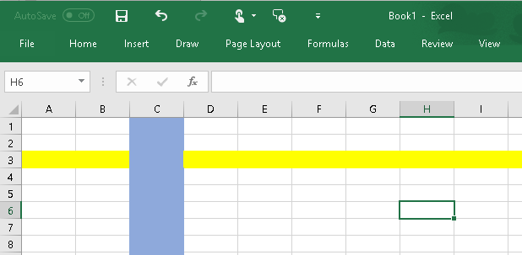
2D Arrays
Rows and Columns, just like Excel

Slide 50
2-Dimensional arrays
Storing a table of data
const int NUMSTUDENTS=5, NUMTESTS=3;
char grades[NUMSTUDENTS][NUMTESTS];
grades[2][0]='A';
grades[3][0]='B';
grades
 | Test1 | Test2 | Test3
Amy | ??? | ??? | ???
Rob | ??? | ??? | ???
David | A | ??? | ???
Bill | B | ??? | ???
Alice | ??? | ??? | ???

Slide 51
Column versus Row
Col 0 Col 1 Col2 Col3 Col 4
Notes:
Columns are ionic style

Slide 52
Column versus Row Fill Top to Bottom Array[rowNum][columnNum]
Col 0 Col 1 Col2 Col3 Col 4
87
93
96
89
91
Row#0
78
89
79
92
95
Row#1
58
99
97
90
98
Row#2
Notes:
Columns are ionic style

Slide 53
Two-Dimensional Arrays
Can define one array for multiple sets of data
Like a table in a spreadsheet
Use two size declarators in definition:
const int ROWS = 4, COLS = 3; int exams[ROWS][COLS];
First declarator is number of rows; second is number of columns

Slide 54
Two-Dimensional Array Representation
const int ROWS = 4, COLS = 3; int exams[ROWS][COLS];
Use two subscripts to access element:
exams[2][2] = 86;
columns
exams[0][0] | exams[0][1] | exams[0][2]
exams[1][0] | exams[1][1] | exams[1][2]
exams[2][0] | exams[2][1] | exams[2][2]
exams[3][0] | exams[3][1] | exams[3][2]
r
o
w
s

Slide 55
2D Array Initialization
Two-dimensional arrays are initialized row-by-row: const int ROWS = 2, COLS = 2; int exams[ROWS][COLS] = { {84, 78},
{92, 97} };
Can omit inner { }, some initial values in a row – array elements without initial values will be set to 0 or NULL
84 | 78
92 | 97

Slide 56
Two-Dimensional Array as Parameter, Argument
Use array name as argument in function call:
getExams(exams, 2);
Use empty [] for row, size declarator for column in prototype, header: const int COLS = 2; // Prototype void getExams(int [][COLS], int); // Header void getExams(int exams[][COLS], int rows)

Slide 57
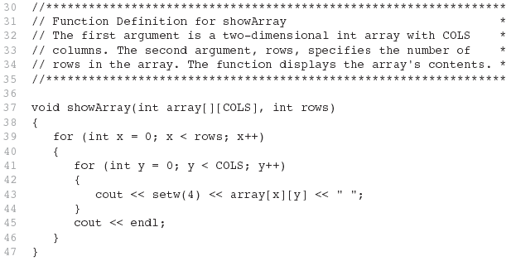
Example – The showArray Function from Program 7-22

Slide 58
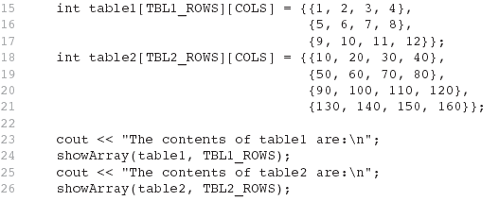
How showArray is Called

Slide 59
Summing All the Elements in a Two-Dimensional Array
Given the following definitions:
const int NUM_ROWS = 5; // Number of rows
const int NUM_COLS = 5; // Number of columns
int total = 0; // Accumulator
int numbers[NUM_ROWS][NUM_COLS] =
{{2, 7, 9, 6, 4},
{6, 1, 8, 9, 4},
{4, 3, 7, 2, 9},
{9, 9, 0, 3, 1},
{6, 2, 7, 4, 1}};

Slide 60
Summing All the Elements in a Two-Dimensional Array
// Sum the array elements.
for (int row = 0; row < NUM_ROWS; row++)
{
for (int col = 0; col < NUM_COLS; col++)
total += numbers[row][col];
}
// Display the sum.
cout << "The total is " << total << endl;

Slide 61
Summing the Rows of a Two-Dimensional Array
Given the following definitions:
const int NUM_STUDENTS = 3;
const int NUM_SCORES = 5;
double total; // Accumulator
double average; // To hold average scores
double scores[NUM_STUDENTS][NUM_SCORES] =
{{88, 97, 79, 86, 94},
{86, 91, 78, 79, 84},
{82, 73, 77, 82, 89}};

Slide 62
Summing the Rows of a Two-Dimensional Array
// Get each student's average score.
for (int row = 0; row < NUM_STUDENTS; row++)
{
// Set the accumulator.
total = 0;
// Sum a row.
for (int col = 0; col < NUM_SCORES; col++)
total += scores[row][col];
// Get the average
average = total / NUM_SCORES;
// Display the average.
cout << "Score average for student "
<< (row + 1) << " is " << average <<endl;
}

Slide 63
Summing the Columns of a Two-Dimensional Array
Given the following definitions:
const int NUM_STUDENTS = 3;
const int NUM_SCORES = 5;
double total; // Accumulator
double average; // To hold average scores
double scores[NUM_STUDENTS][NUM_SCORES] =
{{88, 97, 79, 86, 94},
{86, 91, 78, 79, 84},
{82, 73, 77, 82, 89}};

Slide 64
Summing the Columns of a Two-Dimensional Array
// Get the class average for each score.
for (int col = 0; col < NUM_SCORES; col++)
{
// Reset the accumulator.
total = 0;
// Sum a column
for (int row = 0; row < NUM_STUDENTS; row++)
total += scores[row][col];
// Get the average
average = total / NUM_STUDENTS;
// Display the class average.
cout << "Class average for test " << (col + 1)
<< " is " << average << endl;
}

Slide 65
Lab 12: Create the Multiplication Tables
Declare 2 constant values:
rowsize = 12;
colsize = 10;
2. Define a 12 row by 10 column array
multArray

Slide 66
Lab 12: 2 Loops to Load the array
for (int rindex = 0; rindex < rowSize; rindex++)
//goes through each rowindex in the array
{
for (int cindex = 0; cindex < colsize; cindex++) //goes through each columnindex in the array
{
int cval = cindex + 1;
int rval = rindex + 1;
myArray[rindex][cindex] = cval*rval;
}
}

Slide 67
Lab 12: Print the Multiplication Tables
Use the double loops to print it
#include <iomanip> // required for std::setw
setw to set each value to be up to 6 characters
Extra:
Print Row and Column Headers, add lines

Slide 68
string object

Slide 69
An Object
What is an object?
A collection of data, called 'members'
Member functions (also called methods) that operate on them

Slide 70
String – your first object
#include <string>
String data:
A string is essentially an array of characters, ending with a '\0'

Slide 71
String – data
string name = "hannah";
Really looks like this in memory:
Value
[Index]
String data:
A string is essentially an array of characters, ending with a '\0'
h | a | n | n | a | h | \0
[0] | [1] | [2] | [3] | [4] | [5] | [6]

Slide 72
String – Member Functions
length() - returns the length of the string
cout << name.length(); // actual chars (not \0)
6
[i] - returns the character at location I
cout << name[4];
a
http://www.cplusplus.com/reference/string/string/
h | a | n | n | a | h | \0
[0] | [1] | [2] | [3] | [4] | [5] | [6]

Slide 73
More string functions
How to read a full line (spaces included)
string s;
getline(cin, s); // reads the string
//until the 'end of line'
s.at(5); // returns the character at index 5

Slide 74
More string functions
s.length() // total COUNT of characters
Can access elements in a string like an array:
s[5] ='q'; OR s.at(8)='q';
NOTE: array A cannot be accessed with A.at(5)
You must use A[5]

Slide 75
More string functions
How to read a full line (spaces included)
string s = "Fordham University";
getline(cin, s); // reads the string
//until the 'end of line'
cout << s.at(5); // returns the character at index 5
a
cout << s[5]; // also returns the character at index 5
a

Slide 76
More string functions
s.length() // total COUNT of characters
Can access elements in a string like an array:
s[5] ='q'; OR s.at(8)='q';

Slide 77
More string related functions
#include <cstdlib>
int x = atoi("657"); // ASCII to integer
double price = atof("12.30");
string FullName = firstname + " " + lastname;

Slide 78
7.6
Using Parallel Arrays

Slide 79
Using Parallel Arrays
Parallel arrays: two or more arrays that contain related data
A subscript is used to relate arrays: elements at same subscript are related
Arrays may be of different types

Slide 80
Parallel Array Example
const int SIZE = 5; // Array size
int id[SIZE]; // student ID
double average[SIZE]; // course average
char grade[SIZE]; // course grade
...
for(int i = 0; i < SIZE; i++) {
cout << "Student ID: " << id[i]
<< " average: " << average[i]
<< " grade: " << grade[i]
<< endl; }

Slide 81
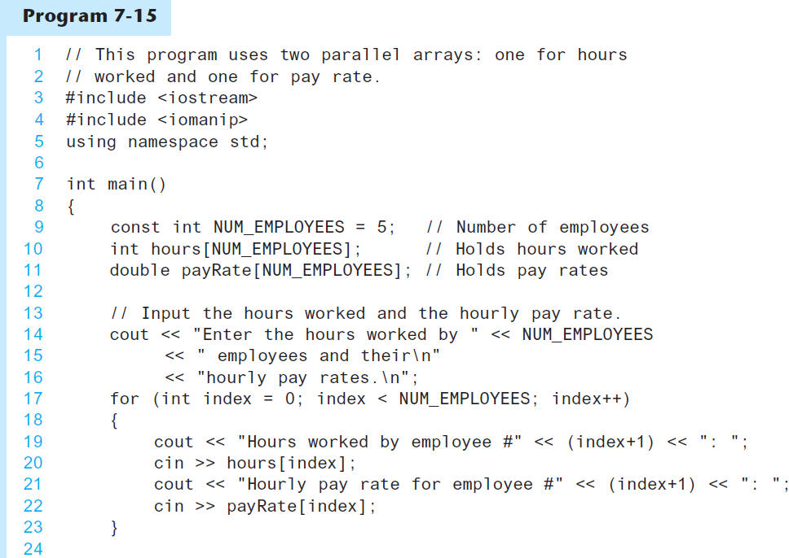
Parallel Arrays in Program 7-15
(Program Continues)

Slide 82
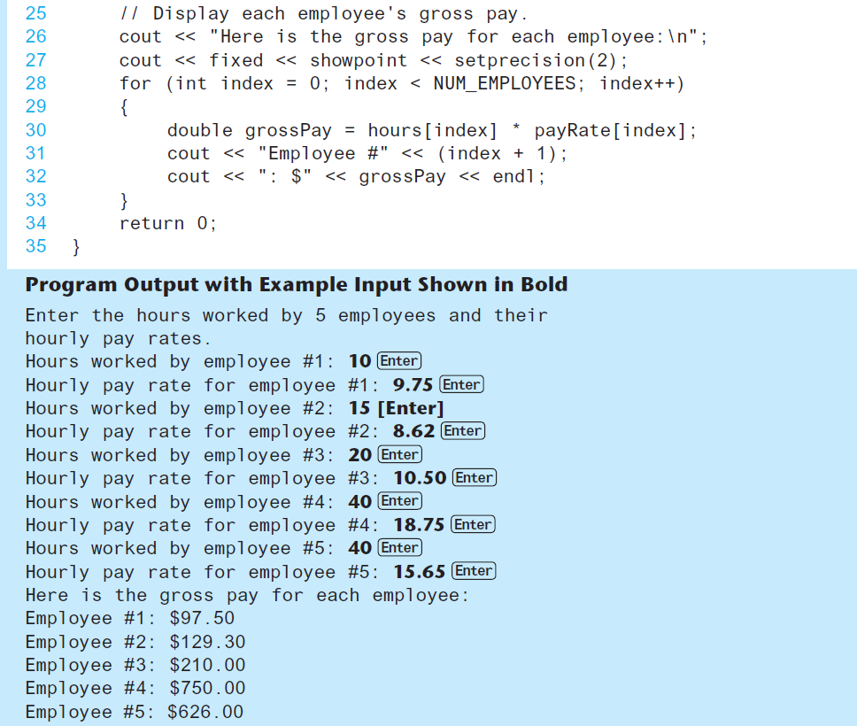
Parallel Arrays in Program 7-15

Slide 83
Parallel (helper) Arrays
Create a 3x7 array to hold work hours
Create an array for each day's 'name'
Create an array to hold a 3 names
 | Sun | Mon | Tues | Wed | Thurs | Fri | Sat
Anna
Mark
James

Slide 84
Parallel Arrays
Now calculate the Average Work Hours (per day)
 | Sun | Mon | Tues | Wed | Thurs | Fri | Sat
Anna
Mark
James
Average

Slide 85
Parallel Arrays
How do you calculate the average of the first day (Sunday) ?

Slide 86
Lab 13: Parallel Arrays. Step 1
In a function, read in up to 50 employee names, one per line. If the name is "quit", stop reading.
Name
Anna
Mark
James
Create a function called
getEmployeeNames
Arguments:
Name array (first and last name)
Maximum size
Return the number of names filled.

Slide 87
Lab 13: Parallel Arrays . Step 2
For each employee, read in their hourly pay rate.
Create a function called
getHourlyPay
Arguments:
NameArray (filled in Step 1)
HourlyPayArray (starts empty)
NumberOfNamesFilled (from Step1)
Name
Anna
Mark
James
Hourly Pay
19
18
25

Slide 88
Lab 13: Parallel Arrays. Step 3
For each employee, read in their hours for each day. If it was a day off, a 0 is entered.
Name
Anna
Mark
James
Hourly Pay
19
18
25
WorkHours
3.5 | 4 | 3 | 0 | 0 | 3 | 3.2
0 | 5 | 6 | 2 | 2 | 4 | 0
3 | 0 | 0 | 4 | 4.6 | 0 | 0
In main(), read in a 2D array of WorkHours
– Not have to be in a function
Assume 7 days per week

Slide 89
Lab 13: Parallel Arrays. Step 4
Calculate the Total Hours for each employee
Total Hours
13.2
19
11.75
Name
Anna
Mark
James
Hourly Pay
19
18
25
WorkHours
3.5 | 4 | 3 | 0 | 0 | 3 | 3.2
0 | 5 | 6 | 2 | 2 | 4 | 0
3 | 0 | 0 | 4 | 4.75 | 0 | 0
In main():
Using WorkHours, calculate the Total Hours, which is stored in a new array called WorkHours

Slide 90
Lab 13: Parallel Arrays. Step 6
Total Hours
13.2
19
11.75
Gross Pay
250.80
342.00
293.75
Name
Anna
Mark
James
Print on each row:
Employee Name (in a 20 character field)
TotalHours (in 12 chars) and
Gross Pay (in 10 chars)

Slide 91
Lab 13: Parallel Arrays. Step 7
Use a function to determine the highest paid to any employee. Give their name and pay.
Hint: find the INDEX of the highest paid and return that to also print the name.
Use another function to find the lowest paid. Give their pay and full name.
Hint: find the INDEX of the lowest paid and return that to also print the name.
Example:
Highest Pay: $342.00 Mark
Lowest Pay: $250.80 Anna

Slide 92
7.11
Introduction to the STL vector

Slide 93
Introduction to the STL vector
A data type defined in the Standard Template Library (covered more in Chapter 17)
Can hold values of any type:
vector<int> scores;
Automatically adds space as more is needed – no need to determine size at definition
Can use [] to access elements

Slide 94
Declaring Vectors
You must #include<vector>
Declare a vector to hold int element:
vector<int> scores;
Declare a vector with initial size 30:
vector<int> scores(30);
Declare a vector and initialize all elements to 0:
vector<int> scores(30, 0);
Declare a vector initialized to size and contents of another vector:
vector<int> finals(scores);

Slide 95
Adding Elements to a Vector
If you are using C++ 11, you can initialize a vector with a list of values:
vector<int> numbers { 10, 20, 30, 40 };
Use push_back member function to add element to a full array or to an array that had no defined size:
scores.push_back(75);
Use size member function to determine size of a vector:
howbig = scores.size();

Slide 96
Removing Vector Elements
Use pop_back member function to remove last element from vector:
scores.pop_back();
To remove all contents of vector, use clear member function:
scores.clear();
To determine if vector is empty, use empty member function:
while (!scores.empty()) ...

Slide 97
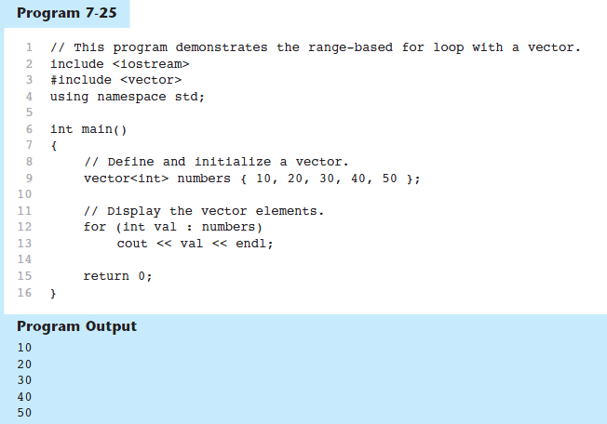
Using the Range-Based for Loop with a vector

Slide 98
Other Useful Member Functions
Member Function | Description | Example
at(i) | Returns the value of the element at position i in the vector | cout << vec1.at(i);
capacity() | Returns the maximum number of elements a vector can store without allocating more memory | maxElements = vec1.capacity();
reverse() | Reverse the order of the elements in a vector | vec1.reverse();
resize (n, val) | Resizes the vector so it contains n elements. If new elements are added, they are initialized to val. | vec1.resize(5, 0);
swap(vec2) | Exchange the contents of two vectors | vec1.swap(vec2);

Slide 99
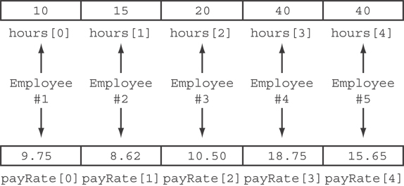
Parallel Arrays in Program 7-15
The hours and payRate arrays are related through their subscripts:

Slide 100
7.4
The Range-Based for Loop

Slide 101
The Range-Based for Loop
C++ 11 provides another for loop designed for arrays.
The range-based for loop is a loop that iterates once for each element in an array without indexing.
Each time the loop iterates, it copies an element from the array into a temporary variable.
Automatically knows the number of elements in an array.
You do not have to use a counter variable.
You do not have to worry about stepping outside the bounds of the array.

Slide 102
Range-based for loop
A range-based for loop visits every element of array in nextElement
dataType is the data type of an element in the array.
nextElement is the name of the range variable to receive the array element. This variable will receive the value of a different array element during each loop iteration.
array is the name of an array on which you wish the loop to operate.
statement is a statement that executes during a loop iteration. If you need to execute more than one statement in the loop, enclose the statements in a set of braces.
for (dataType nextElement : array)
statement;

Slide 103
Printing the Contents of an Array
In C++ 11 you can use the range-based for loop to display an array's contents, as shown here:
int numbers[]={1,3,5,7,9,11};
for (int val : numbers)
cout << val << endl;

Slide 104
Summing and Averaging Array Elements
In C++ 11 you can use the range-based for loop to do calculations, as shown here:
double total = 0; // Initialize accumulator
double average; // Will hold the average
for (int val : scores)
total += val;
average = total / NUM_SCORES;

Slide 105
Searching
In C++ 11 you can use the range-based for loop to search an array, as shown here:
int target = 90;
Int count = 0;
double scores[]={80,85,90,95,75,80,90};
// Count the number of occurrences of target
for (int val : scores)
if (val == target)
count++;

Slide 106
Modifying an Array with a Range-Based for Loop
As the range-based for loop executes, its range variable contains only a copy of an array element.
You cannot use a range-based for loop to modify the contents of an array unless you declare the range variable as a reference.
To declare the range variable as a reference variable, simply write an ampersand (&) in front of its name in the loop header.
Program 7-12 demonstrates

Slide 107
Modifying an Array with a Range-Based for Loop in Program 7-12
const int SIZE = 5; int numbers[5]; // Get values for the array. for (int &val : numbers) { cout << "Enter an integer value: "; cin >> val; } // Display the values in the array. cout << "Here are the values you entered:\n"; for (int val : numbers) cout << val << endl;

Slide 108
Modifying an Array with a Range-Based for Loop
You can use the auto key word with a reference range variable. For example, the code in lines 12 through 16 in Program 7-12 could have been written like this:
for (auto &val : numbers)
{
cout << "Enter an integer value: ";
cin >> val;
}

