Slide 1
Review of Everything Arrays
Array Basics
Arrays in Functions
Programming with Arrays
Simple linear search, simple selection sort.
Multi-dimensional Arrays

Slide 2
Array Basics

Slide 3
Arrays
An array is used to process a collection of data of the same type
Examples: A list of names A list of temperatures
Why do we need arrays?
Imagine keeping track of 5 test scores, or 100, or 1000 in memory
How would you name all the variables?
How would you process each of the variables?

Slide 4
Declaring an Array
An array, named score, containing five variables of type int can be declared as int score[5];
This is like declaring 5 variables of type int: score[0], score[1], … , score[4]
The value in brackets is called
A subscript
An index

Slide 5
The Array Variables
The variables making up the array are referred to as
Indexed variables
Subscripted variables
Elements of the array
The number of indexed variables in an array is the declared size, or size, of the array
The largest index is one less than the size
The first index value is zero
Not all variables are actually being used all the time!

Slide 6
Array Variable Types
An array can have indexed variables of any type
All indexed variables in an array are of the same type
This is the base type of the array
An indexed variable can be used anywhere an ordinary variable of the base type is used

Slide 7
Using [ ] With Arrays
In an array declaration, [ ]'s enclose the size of the array such as this array of 5 integers: int score [5];
When referring to one of the indexed variables, the [ ]'s enclose a number identifying one of the indexed variables
E.g.,
score[3]=7;
score[3] is one of the indexed variables
The value in the [ ]'s can be any expression that evaluates to one of the integers 0 to (size -1)

Slide 8
Indexed Variable Assignment
To assign a value to an indexed variable, use the assignment operator: int n = 2; score[n + 1] = 99;
In this example, variable score[3] is assigned 99

Slide 9
Loops And Arrays
for-loops are commonly used to step through arrays
Example: for (int i = 0; i < 5; i++) { cout << score[i] << " off by “ << (max – score[i]) << endl; } could display the difference between each score and the maximum score stored in an array
First index is 0
Last index is (size – 1)
Display 7.1

Slide 10
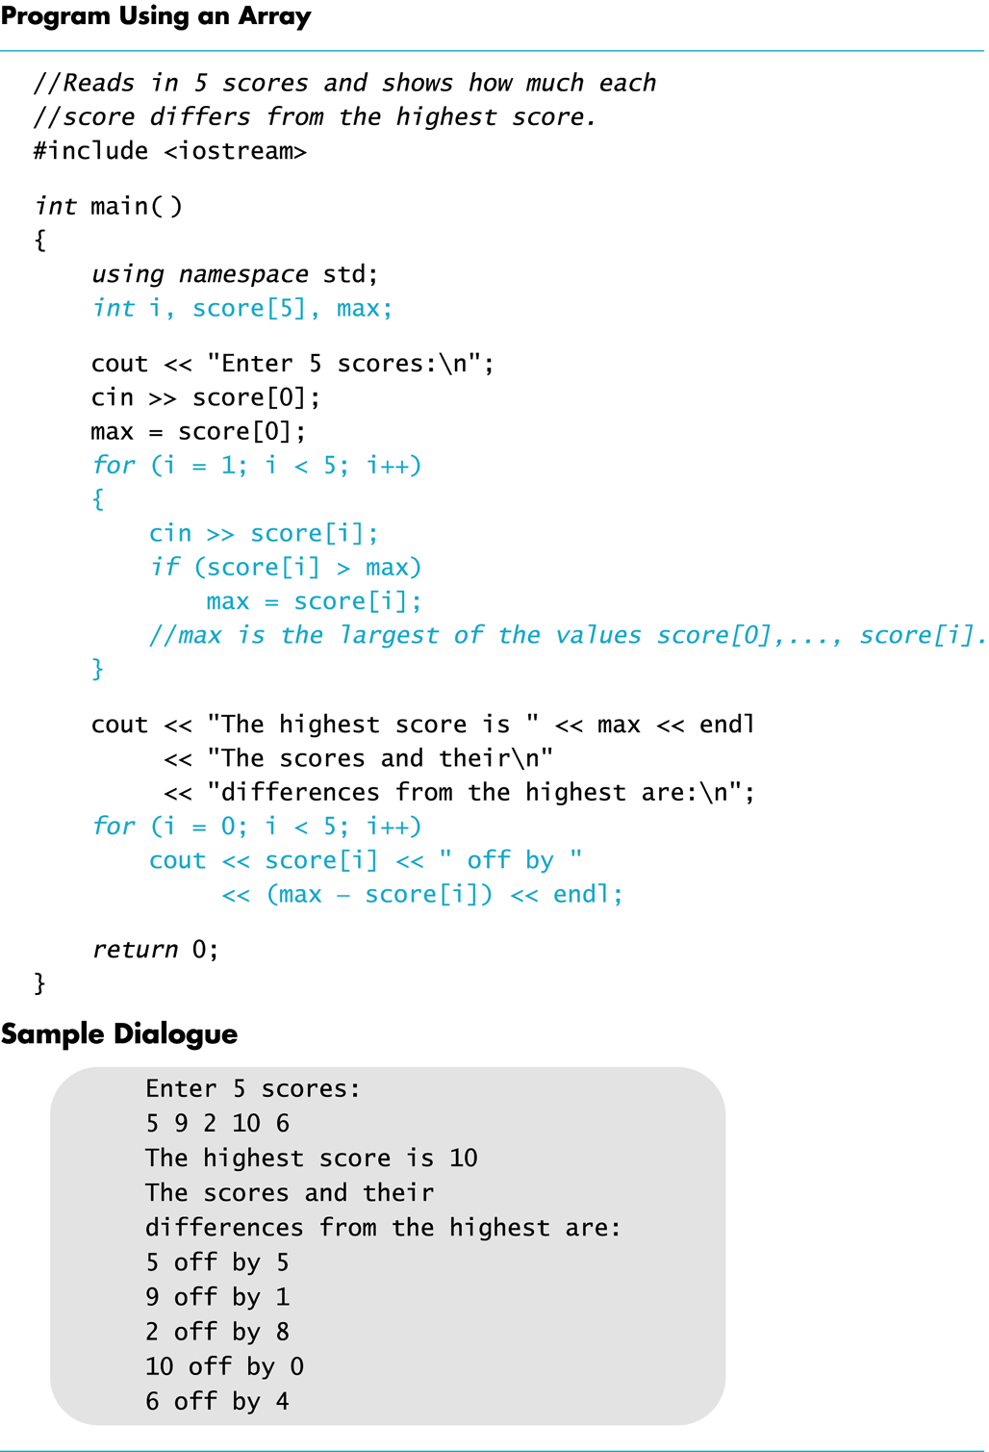
Display 7.1

Slide 11
Constants and Arrays
Use constants to declare the size of an array
Using a constant allows your code to be easily altered for use on a smaller or larger set of data
Example:
const int NUMBER_OF_STUDENTS = 50;
int score[NUMBER_OF_STUDENTS];
for ( i = 0; i < NUMBER_OF_STUDENTS; i++)
cout << score[i] << " off by “ << (max – score[i]) << endl;
Only the value of the constant must be changed to make this code work for any number of students

Slide 12
Variables and Declarations
Most compilers do not allow the use of a variable to declare the size of an array Example:
cout << "Enter number of students: "; cin >> number; int score[number];
This code is illegal on many compilers
But it works on our version of g++. It is an extension.

Slide 13
Array Declaration Syntax
To declare an array, use the syntax: Type_Name Array_Name[Declared_Size];
Type_Name can be any type
Declared_Size can be a constant to make your program more versatile
Once declared, the array consists of the indexed variables: Array_Name[0] to Array_Name[Declared_Size-1]

Slide 14
Arrays and Memory
Declaring the array
int a[6];
Reserves memory for six variables of type int
The variables are stored one after another
The address of a[0] is remembered by C++
The addresses of the other indexed variables are not remembered by C++
To determine the address of a[3]
C++ starts at a[0]
C++ adds a[0] + 3 * sizeof(int) to get to a[3].
Display 7.2

Slide 15
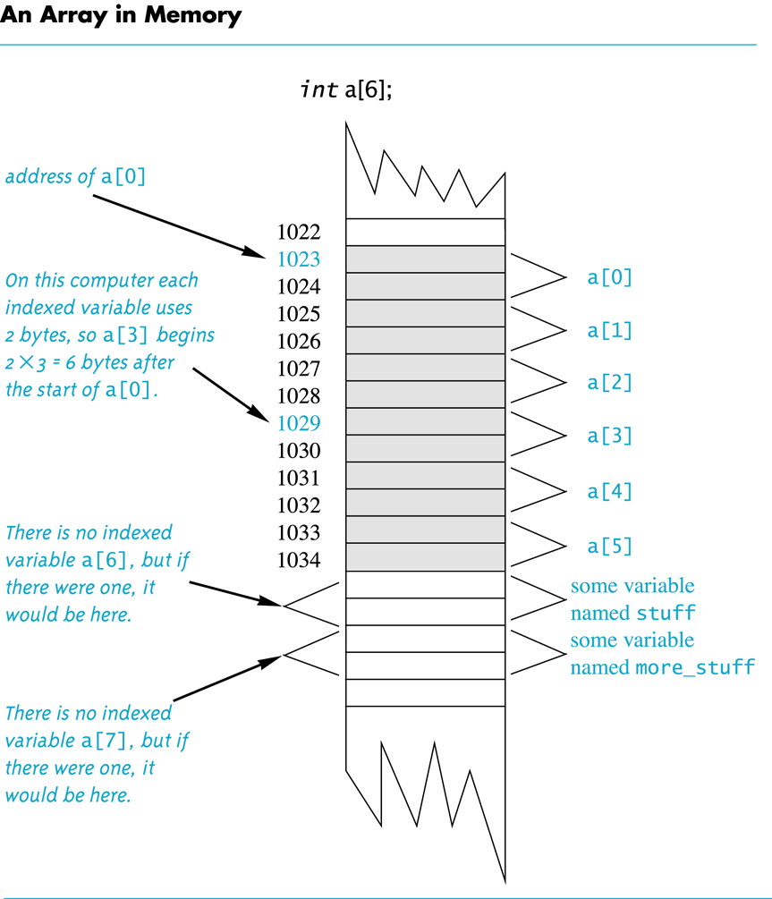
in this example, each int variable uses 2 bytes, but typically an int variable uses 4 bytes.
Display 7.2
Recall:
Computer memory consists of numbered locations called bytes
A byte's number is its address
A simple variable is stored in consecutive bytes
The number of bytes depends on the variable's type
A variable's address is the address of its first byte

Slide 16
Array Index Out of Range
A common error is using a nonexistent index
Index values for int a[6] are the values 0 through 5
An index value not allowed by the array declaration is out of range
Using an out of range index value does not produce an error message!

Slide 17
Out of Range Problems
If an array is declared as: int a[6]; and an integer is declared as: int i = 7;
Executing the statement a[i] = 238; causes…
The computer to calculate the address of the illegal a[7]
(This address could be where some other variable is stored)
The value 238 is stored at the address calculated for a[7]
No warning is given!
What happens if i = 6?

Slide 18
Initializing Arrays
To initialize an array when it is declared
The values for the indexed variables are enclosed in braces and separated by commas
Example: int children[3] = { 2, 12, 1 }; is equivalent to: int children[3]; children[0] = 2; children[1] = 12; children[2] = 1;

Slide 19
Default Values
If too few values are listed in an initialization statement
The listed values are used to initialize the first of the indexed variables
The remaining indexed variables are initialized to a zero of the base type
Example: int a[10] = {5, 5}; initializes a[0] and a[1] to 5 and a[2] through a[9] to 0

Slide 20
Un-initialized Arrays
If no values are listed in the array declaration, some compilers will initialize each variable to the equivalent of zero of the base type.
Don’t rely on this if you are writing code that will be shared with a large development community.

Slide 21
Too many initializers
If there are too many initialization values for the array size most compilers will give an error.
This is considered an illegal state.
Some compilers only warn but it is not legal C++.
I tested this and g++ issues this error:
error: too many initializers for ‘int [3]’

Slide 22
Arrays in Functions

Slide 23
Arrays in Functions
Indexed variables can be arguments to functions
Example: If a program contains these declarations: int i, n, a[10]; void my_function(int n);
Variables a[0] through a[9] are of type int, making these calls legal: my_function( a[ 0 ] ); my_function( a[ 3 ] ); my_function( a[ i ] );
Display 7.3

Slide 24
Program to adjust vacation days
Let’s assume that a company changes it’s policy to be 5 more vacation days per year.
Using an array, ask the user to input the number of vacation days for each employee.
Write a function called adjust_days that adds 5 to the number passed in and returns the result.
Print the adjusted array.

Slide 25
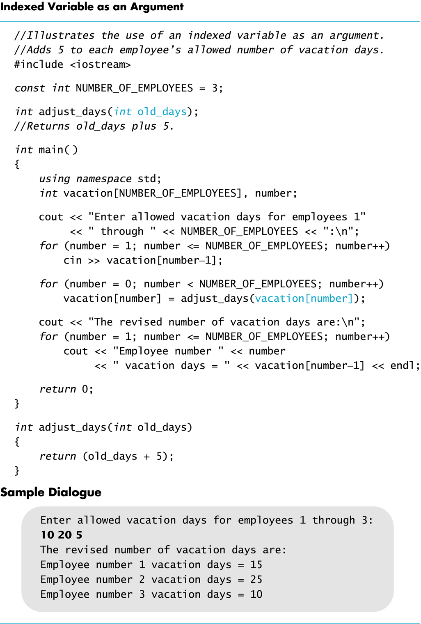
Display 7.3

Slide 26
Arrays as Function Arguments
A formal parameter can be for an entire array
Such a parameter is called
an array parameter
It is not a call-by-value parameter
It is not a call-by-reference parameter
Array parameters behave much like call-by-reference parameters because
Array parameters are just pointers to the memory that was allocated for the array.

Slide 27
Go over this page:
http://storm.cis.fordham.edu/~harazduk/cs2000/grading.html
Also documentation for function declaration, definition.

Slide 28
Program Example: Sorting an Array
Sorting a list of values is very common task
Create an alphabetical listing
Create a list of values in ascending order
Create a list of values in descending order
Many sorting algorithms exist
Some are very efficient
Some are easier to understand
Savitch chapter 7.3; Gaddis chapter 8.3

Slide 29
Program Example: The Selection Sort Algorithm
When the sort is complete, the elements of the array are ordered such that a[0] < a[1] < … < a [ number_used -1]
Outline of the algorithm
for (int index = 0; index < number_used; index++) place the index-th smallest element in a[index]

Slide 30
Program Example: Sort Algorithm Development
One array is sufficient to do our sorting
Search for the smallest value in the array
Place this value in a[0], and place the value that was in a[0] in the location where the smallest was found
Starting at a[1], find the smallest remaining value swap it with the value currently in a[1]
Starting at a[2], continue the process until the array is sorted
Display 7.11
Display 7.12 (1-2)

Slide 31
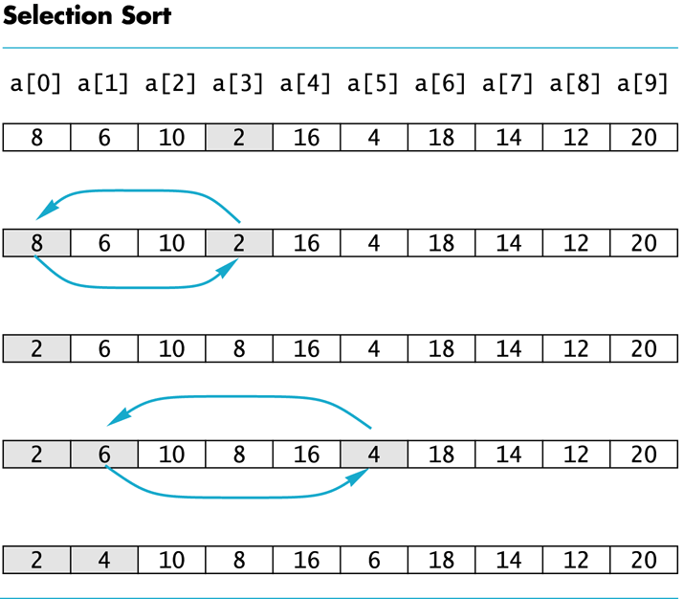
Display 7.11

Slide 32
go over the source code http://storm.cis.fordham.edu/~harazduk/cs2000/CodeExample_Savitch/Chapter07/07-12.cpp

Slide 33
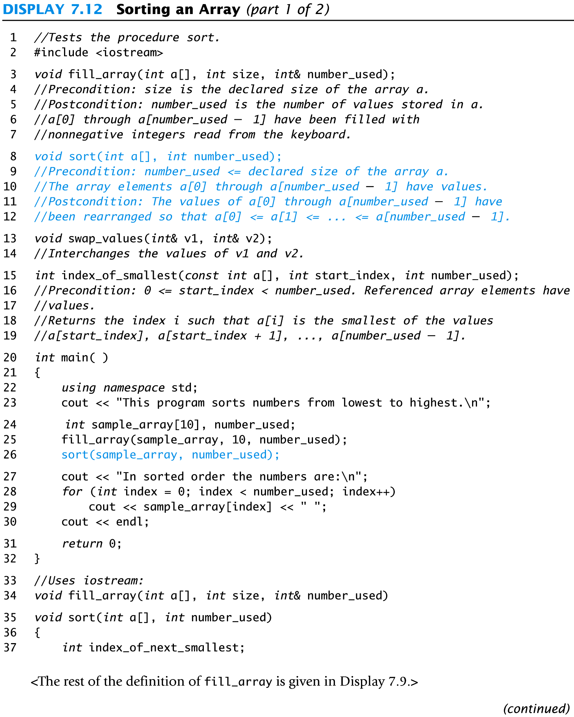
Display 7.12 (1/2)

Slide 34
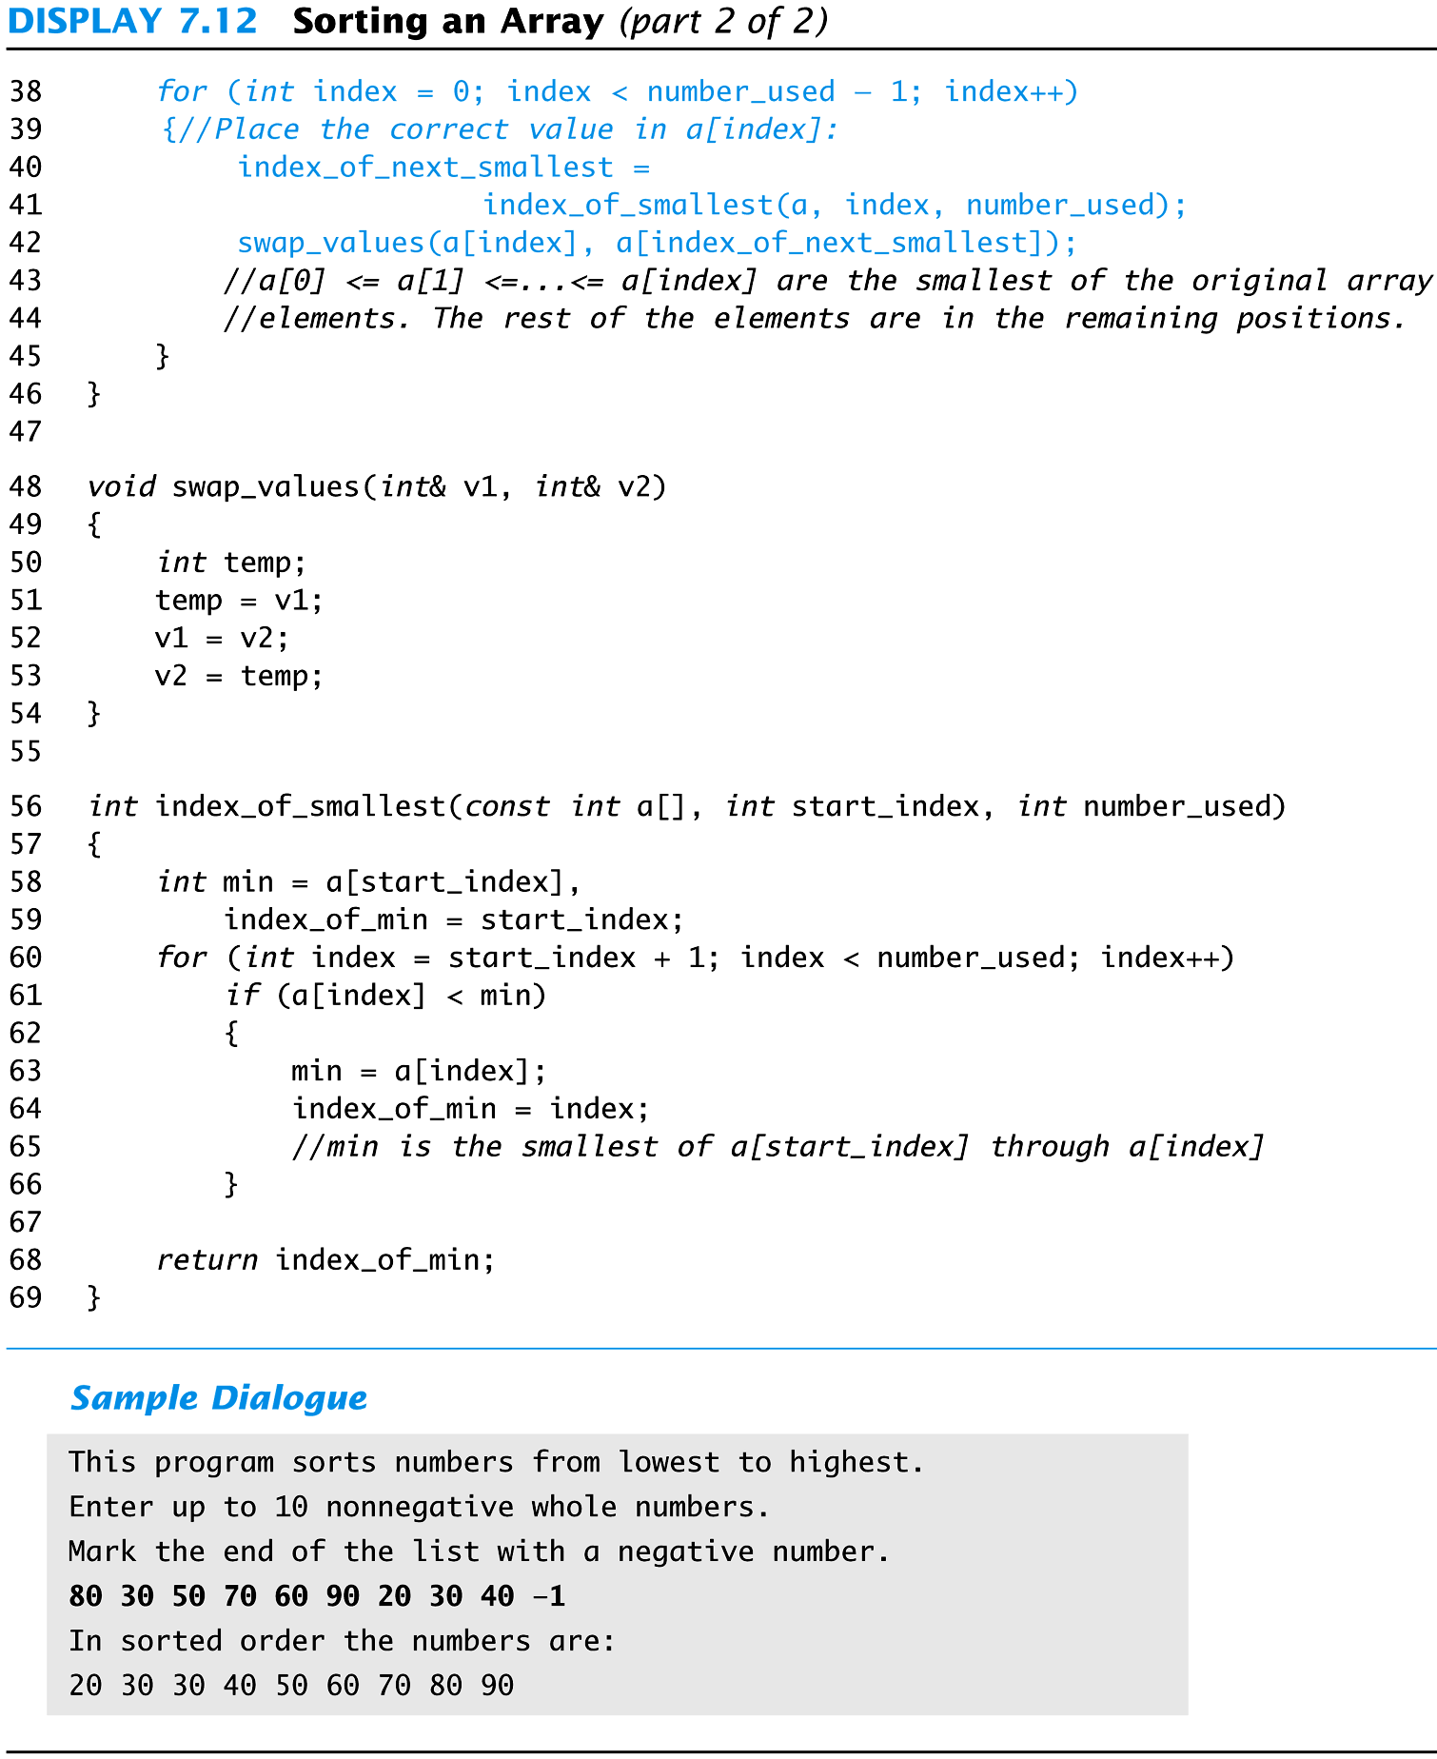
Display 7.12 (2/2)

Slide 35
Implicit Array Sizing
Can determine array size by the size of the initialization list:
int quizzes[]={12,17,15,11};
Must use either array size declarator or initialization list at array definition
12 | 17 | 15 | 11

Slide 36
Array assignment
Cannot initialize an array to another array!
int arr1[] = { 1, 2, 3, 4 };
int arr2[4] = arr1; // Illegal! Error!
arr2 = arr1; // Illegal! Error!
To copy an array, each element must be set one at a time.
for (int i = 0; i < size; i++)
arr2[i] = arr1[i];

Slide 37
Exercise
Write a program that will read up to 20 letters into an array and write the letters back to the screen in the reverse order? abcd should be output as dcba Use a period as a sentinel value to mark the end of input
Write a program that reverses the contents of an array.

Slide 38
The Range-Based for Loop
C++ 11 provides a specialized version of the for loop that, in many circumstances, simplifies array processing.
The range-based for loop is a loop that iterates once for each element in an array.
Each time the loop iterates, it copies an element from the array to a built-in variable, known as the range variable.
The range-based for loop automatically knows the number of elements in an array.
You do not have to use a counter variable.
You do not have to worry about stepping outside the bounds of the array.

Slide 39
The Range-Based for Loop
Here is the general format of the range-based for loop:
dataType is the data type of the range variable.
rangeVariable is the name of the range variable. This variable will receive the value of a different array element during each loop iteration.
array is the name of an array on which you wish the loop to operate.
statement is a statement that executes during a loop iteration. If you need to execute more than one statement in the loop, enclose the statements in a set of braces.
for (dataType rangeVariable : array)
statement;

Slide 40
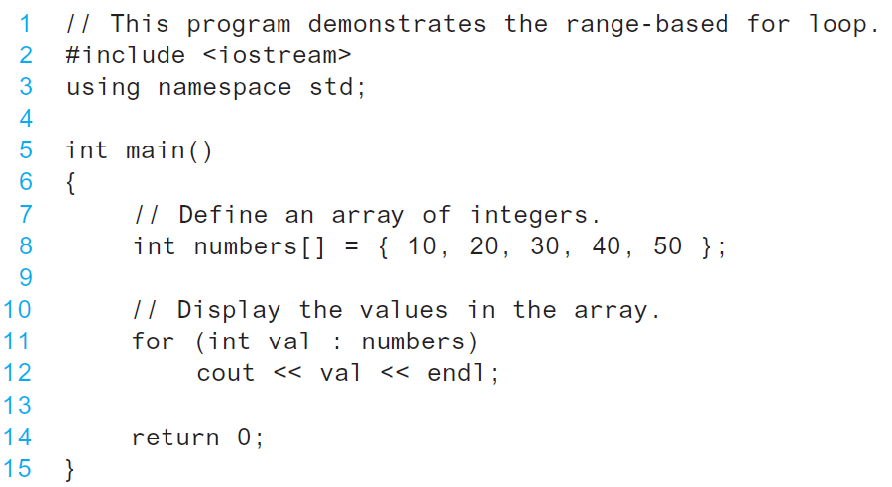
The range-based for loop in Program 7-10

Slide 41
Modifying an Array with a Range-Based for Loop
As the range-based for loop executes, its range variable contains only a copy of an array element.
You cannot use a range-based for loop to modify the contents of an array unless you declare the range variable as a reference.
To declare the range variable as a reference variable, simply write an ampersand (&) in front of its name in the loop header.
Program 7-12 demonstrates

Slide 42
Modifying an Array with a Range-Based for Loop in Program 7-12
const int SIZE = 5; int numbers[5]; // Get values for the array. for (int &val : numbers) { cout << "Enter an integer value: "; cin >> val; } // Display the values in the array. cout << "Here are the values you entered:\n"; for (int val : numbers) cout << val << endl;

Slide 43
Modifying an Array with a Range-Based for Loop
You can use the auto key word with a reference range variable. For example, the code in lines 12 through 16 in Program 7-12 could have been written like this:
for (auto &val : numbers)
{
cout << "Enter an integer value: ";
cin >> val;
}

Slide 44
The Range-Based for Loop versus the Regular for Loop
The range-based for loop can be used in any situation where you need to step through the elements of an array, and you do not need to use the element subscripts.
If you need the element subscript for some purpose, use the regular for loop.

Slide 45
Multi-dimensional Array Read Section 7.4

Slide 46
Multi-Dimensional Arrays
C++ allows arrays with multiple index values
char page [30] [100]; declares an array of characters named page
page has two index values: The first ranges from 0 to 29 The second ranges from 0 to 99
Each index in enclosed in its own brackets
Page can be visualized as an array of 30 rows and 100 columns

Slide 47
Index Values of page
The indexed variables for array page are page[0][0], page[0][1], …, page[0][99] page[1][0], page[1][1], …, page[1][99]
… page[29][0], page[29][1], … , page[29][99]
page is actually an array of size 30
page's base type is an array of 100 characters

Slide 48
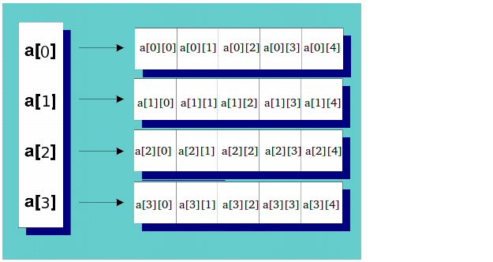
A Two Dimensional Array in C++ is an array of arrays: int a[4][5];
A two dimensional array is really an array of pointers to arrays
When declared this way, it is guaranteed to be in sequential memory.
The first index is the row index, the second index is the column index.

Slide 49
Multidimensional Array Parameters
Recall that the size of an array is not needed when declaring a formal parameter: void display_line(const char a[ ], int size);
The base type of a multi-dimensional array must be completely specified in the parameter declaration
C++ treats a as an array of arrays
void display_page(const char page[ ] [100], int size_dimension_1);

Slide 50
Program Example: Grading Program
Grade records for a class can be stored in a two-dimensional array
For a class with 4 students and 3 quizzes the array could be declared as int grade[4][3];
The first array index refers to the student number
The second array index refers to the quiz number
Since student and quiz numbers start with one, we subtract one to obtain the correct index

Slide 51
Grading Program: average scores
The grading program uses one-dimensional arrays to store…
Each student's average score
Each quiz's average score
The functions that calculate these averages use global constants for the size of the arrays
This was done because the functions seem to be particular to this program
Display 7.13 (1-3)

Slide 52
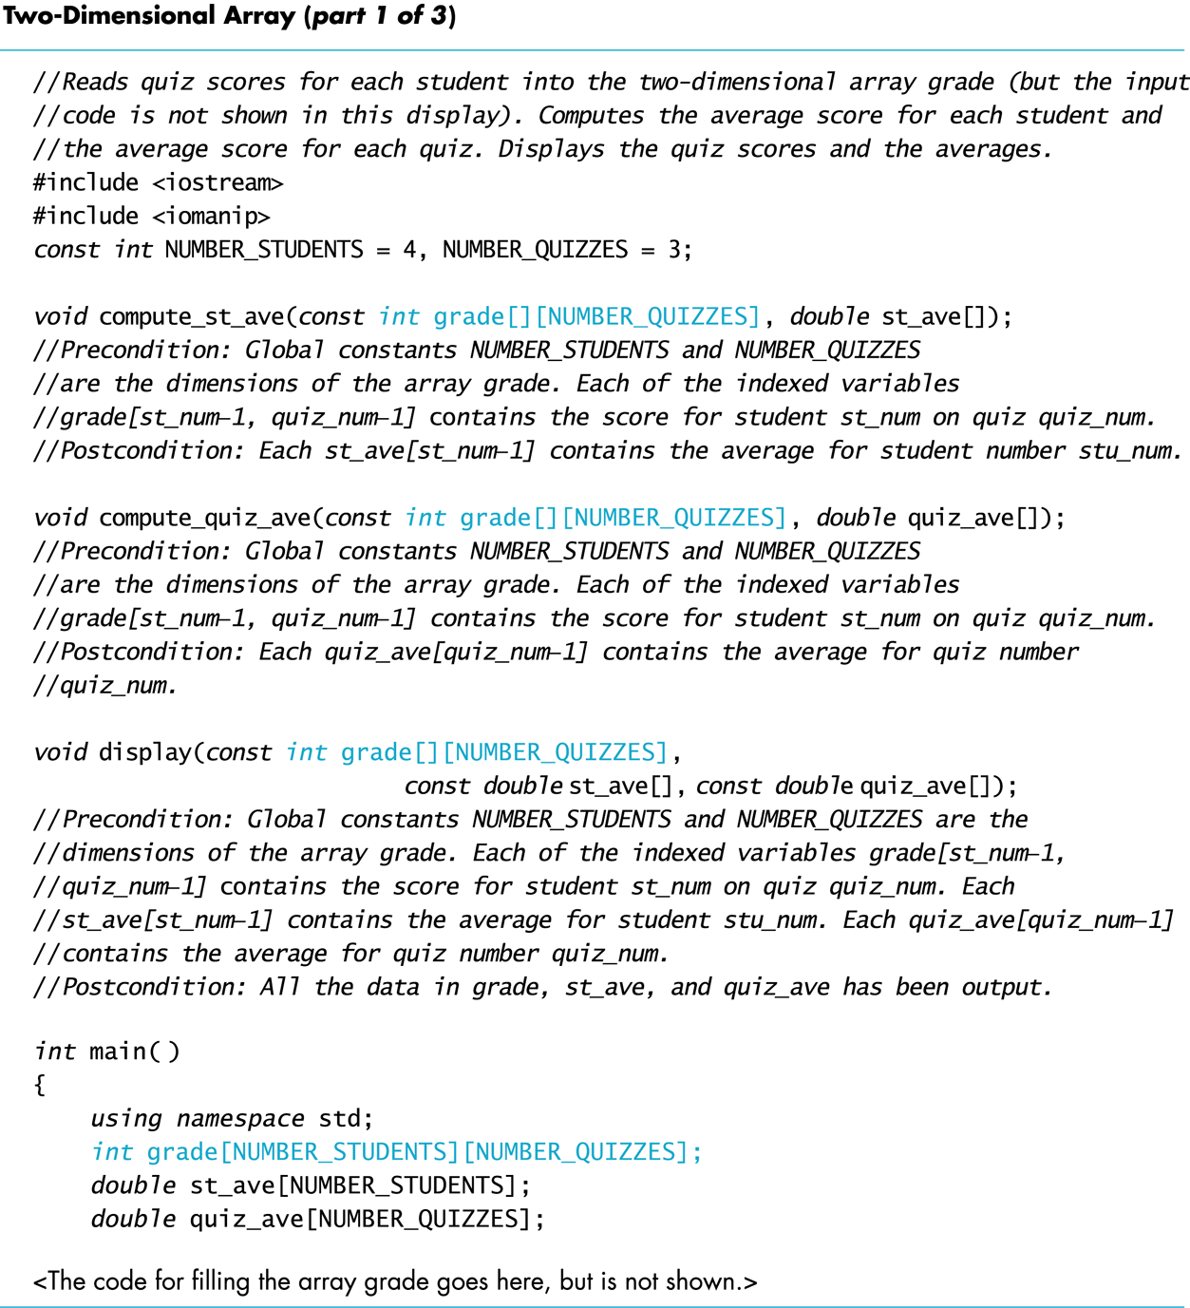
Display 7.13 (1/3)

Slide 53
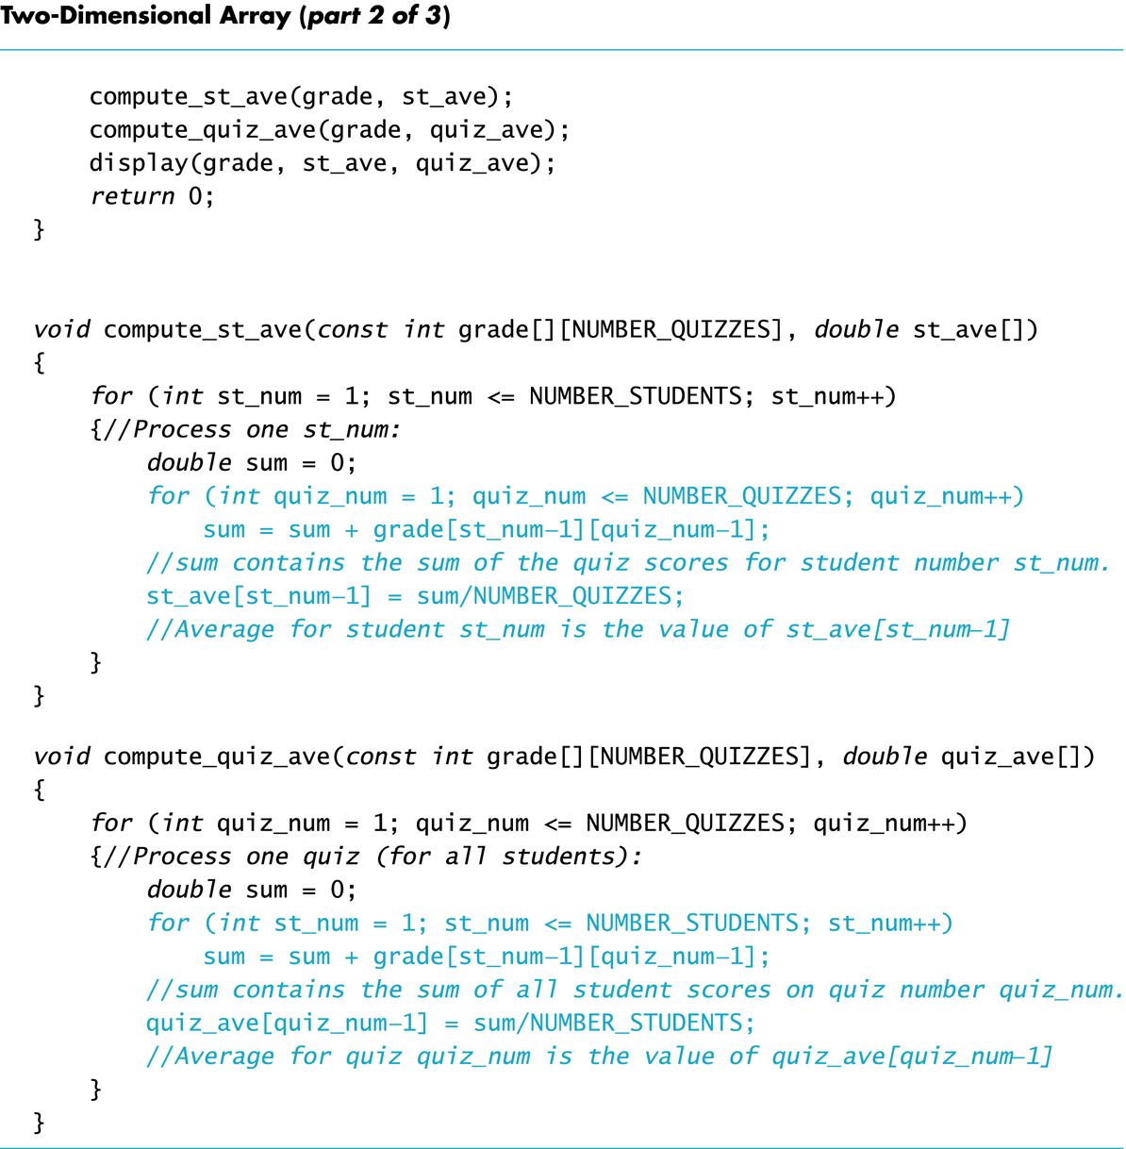
Display 7.13 (2/3)

Slide 54
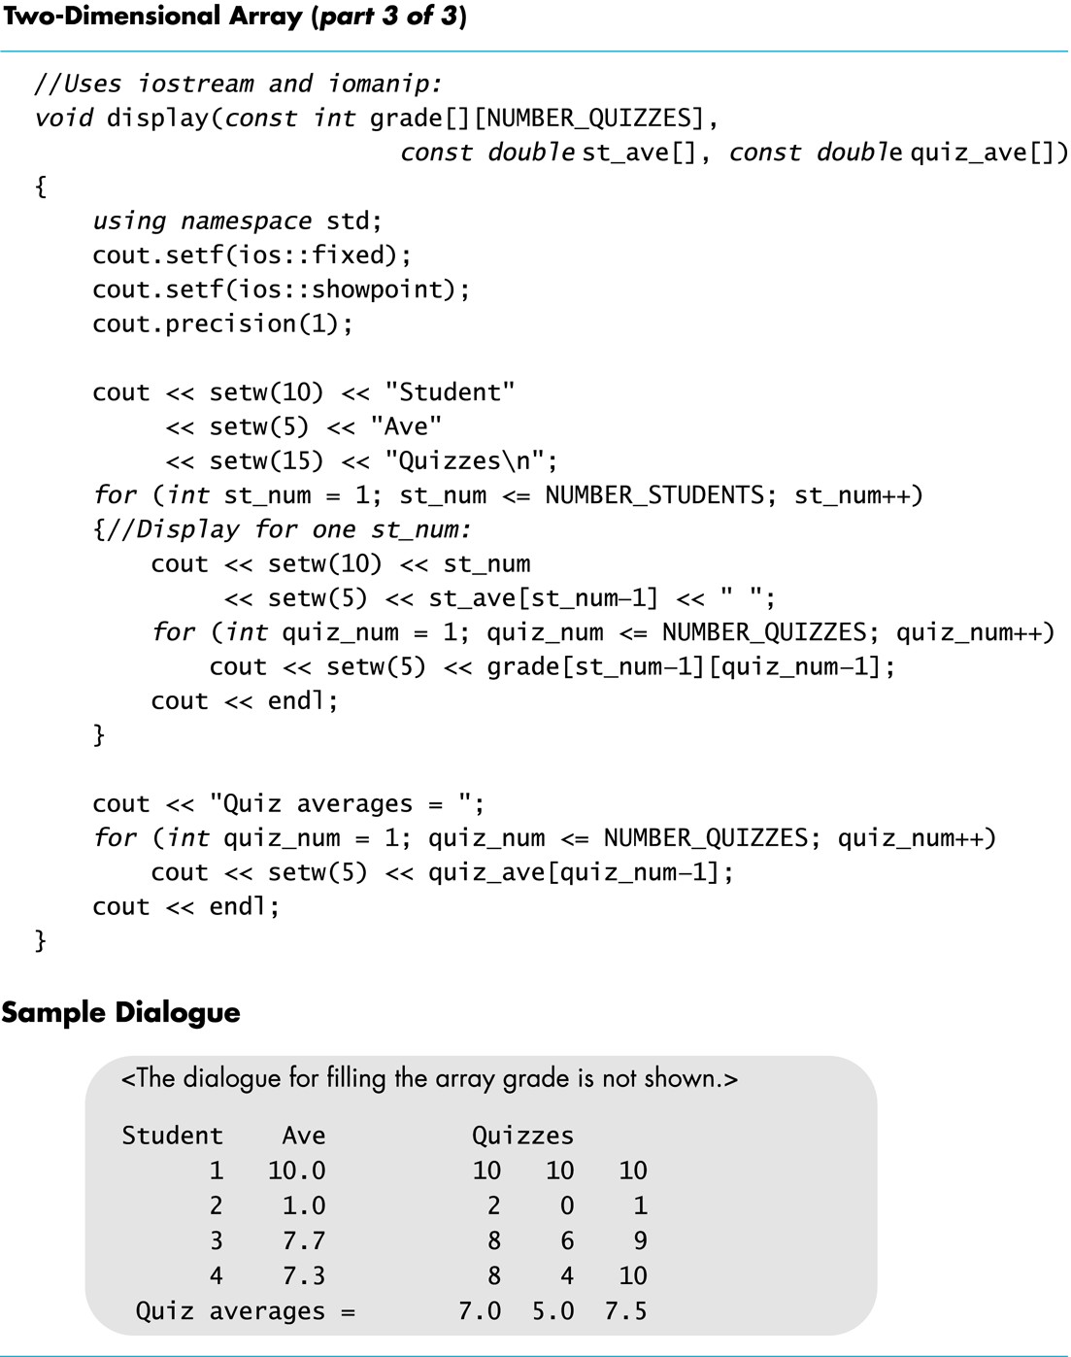
Display 7.13 (3/3)

Slide 55
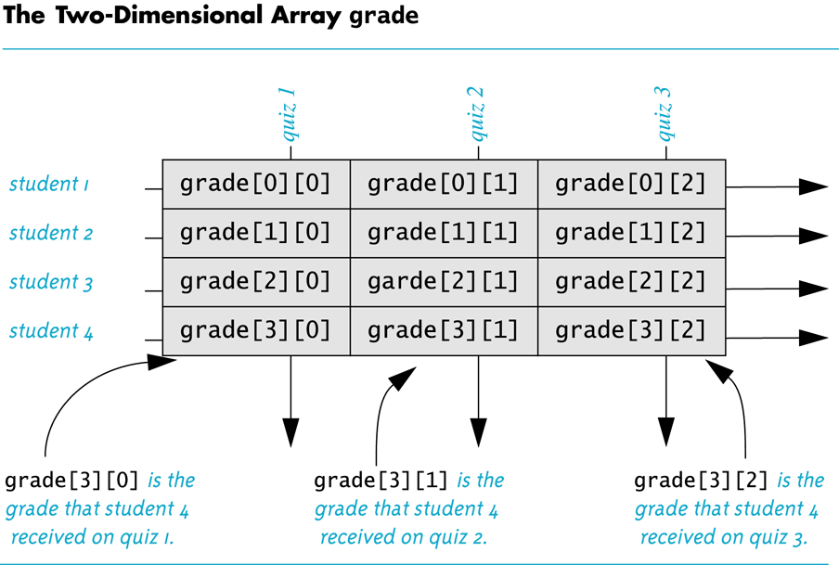
Display 7.14

Slide 56
Multidimensional array flattens in memory in a row wise manner.
Array Cell | Address in Memory
Address of grade[0][0] | 0x7ffefe98eaf0
Address of grade[0][1] | 0x7ffefe98eaf4
Address of grade[0][2] | 0x7ffefe98eaf8
Address of grade[1][0] | 0x7ffefe98eafc
Address of grade[1][1] | 0x7ffefe98eb00
Address of grade[1][2] | 0x7ffefe98eb04
Address of grade[2][0] | 0x7ffefe98eb08
Address of grade[2][1] | 0x7ffefe98eb0c
Address of grade[2][2] | 0x7ffefe98eb10
Address of grade[3][0] | 0x7ffefe98eb14
Address of grade[3][1] | 0x7ffefe98eb18

Slide 57
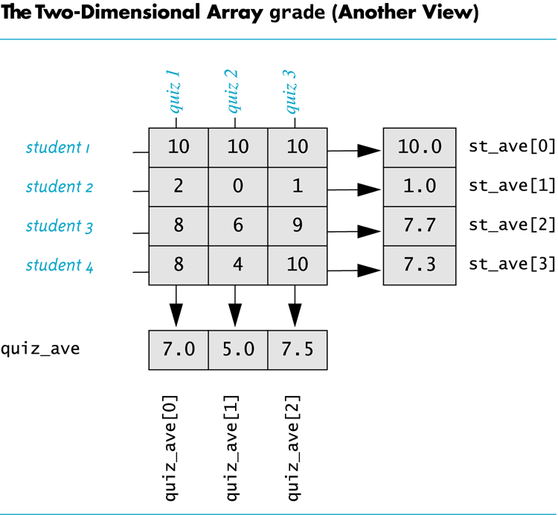
Display 7.15

Slide 58
Showing Decimal Places
To specify fixed point notation
setf(ios::fixed)
To specify that the decimal point will always be shown
setf(ios::showpoint)
To specify that two decimal places will always be shown
precision(2)
Example: cout.setf(ios::fixed); cout.setf(ios::showpoint); cout.precision(2); cout << "The price is " << price << endl;

