Slide 1
Functions Review
Programmer-Defined Functions
Function Call Details
More Function Details
Call-By-Reference Parameters in Functions
void Functions
Overloading Function Names
Default values

Slide 2
Programmer-Defined Functions

Slide 3
Example: Add sales tax to bulk order
Let’s look at a program that…
Inputs an integer for the number of items e.g. 2
Inputs a decimal for the price of the item e.g. 10.10
Uses a function to calculate the total cost which adds a 5% sales tax to the order.
Lastly, the program prints…
2 items at $10.10 each.
Final bill, including tax, is $21.21

Slide 4
function declaration
(aka prototype)
function call
function header
function body
function definition

Slide 5
Programmer-Defined Functions
Function declaration (or Function prototype)
Tells the compiler about the function and how it is called.
Must be declared before the function can be called.
Syntax:
Type_returned Function_Name(Parameter_List); //Comment describing what function does
Function definition (or Function implementation)
Tells the compiler how the function does its task
Can appear before or after the function is called
Syntax:
// Comment describing preconditions/postcondition Type_returned Function_Name(Parameter_List) { //code to make the function work }
;

Slide 6
Function Call
Tells the name of the function to use
Lists the arguments
Is used in a statement where the return value makes sense
Example: total_cost(number, price) is the function call double bill = total_cost(number, price);

Slide 7
Function Call Details
The values of the arguments are plugged into the formal parameters (Call-by-Value mechanism with call-by-value parameters)
Left to right order…
The first argument is used for the first formal parameter, the second argument for the second formal parameter, and so forth.
The value plugged into the formal parameter is used in all instances of the formal parameter in the function body

Slide 8
1. Before the function is called, values of number and price are set to 2 and 10.10, by cin statements.
2. The function call executes and the value of number (which is 2) plugged in for number_par and value of price (which is 10.10) plugged in for price_par.

Slide 9
3. The body of the function executes with number_par set to 2 and price_par set to 10.10, producing the value 20.20 in subtotal.
4. When the return statement is executed, the value of the expression after return is evaluated and returned by the function in this case.
(subtotal + subtotal * TAX_RATE) is
(20.20+20.20*0.05) or 21.21.

Slide 10
The return Statement
Ends the function call
Returns the value calculated by the function
Syntax: return expression;
expression performs the calculation or
expression is a variable containing the calculated value
Example: return subtotal + subtotal * TAX_RATE;

Slide 11
5. The value 21.21 is returned to where the function was invoked or called. The result is that total_cost (number, price) is replaced by the return value of 21.21. The value of bill is set equal to 21.21 when the statement
bill=total_cost(number,price);
ends.

Slide 12
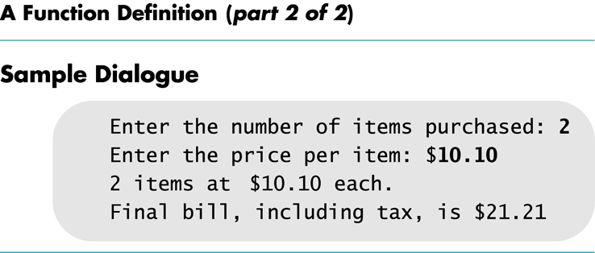

Slide 13
Function Details

Slide 14
Declare before you Use
In C++, everything must be declared before used.
#include <iostream> declares cin and cout and their classes (istream and ostream) before anything else.
The compiler uses declarations to ensure identifiers are being used correctly.

Slide 15
Placing Prototypes & Definitions
Place the function prototypes above the main function.
In C++, you must declare it before you use it.
Place the function definitions below the main function.
Doing this leads to building your own libraries!
No declaration is needed if the definition comes first.

Slide 16
Function Declarations
Two forms for function declarations
List formal parameter names
List types of formal parameters, but not names
Description of the function in comments
Examples:
double total_cost(int number_par, double price_par); double total_cost(int, double); // don’t do it!!
But in definition, function headers must always list formal parameter names!

Slide 17
Order of Arguments
Compiler checks that the types of the arguments are correct in the order they are given
Compiler cannot check that arguments are in the correct logical order when the types are the same
Example: Given the function declaration:
char grade(int received_par, int min_score_par); int received = 95, min_score = 60; cout << grade( min_score, received);
Produces a faulty result because the arguments are not in the correct logical order. The compiler will not catch this!

Slide 18
Automatic Type Conversion
Given the definition (miles per gallon) double mpg(double miles, double gallons) { return (miles / gallons); } what will happen if mpg is called in this way? cout << mpg(45, 2) << “ miles per gallon”;
The values of the arguments will automatically be converted to type double (45.0 and 2.0)

Slide 19
Function Definition Syntax
within a function definition …
Variables must always be declared before they are used
Variables are typically declared before the executable statements begin
double total_cost(int number_par, double price_par) { const double TAX_RATE = 0.05; //5% tax double subtotal; subtotal = price_par * number_par; return (subtotal + subtotal * TAX_RATE); }
At least one return statement must end the function when not void.
Each branch of an if-else statement or a switch statement might have its own return statement
Example: char grade(int received_par, int min_score_par)

Slide 20
Formal Parameter Names
Functions are designed as self-contained modules
Programmers choose meaningful names for formal parameters
Formal parameter names may or may not match variable names used in the main part of the program
It does not matter if formal parameter names match other variable names in the program
Remember that only the value of the argument is plugged into the formal parameter
Recall the memory structure of a program.
Example next

Slide 21
Function call details

Slide 22
How do the parameters get set
When the function call is made
… the arguments are copied (in order) into the parameters (on the stack)
… the return address has to be saved
… the code jumps to function which uses the parameters set to the argument values
… local variables may be declared, function statements execute sequentially
… return statement may shorten execution.

Slide 23
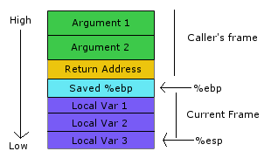
Function Stack
Stack grows from highest memory address to lowest.
Function caller puts arguments on stack into the parameters.
System puts return address, then jumps into the function.
Local variables get created on the stack next!
ebp - points to beginning of previous frame
esp – next stack position.
Arguments are pushed onto stack in order they appear.
Return address is pushed on before the call is made.
Local variables are pushed onto stack in order they appear.

Slide 24
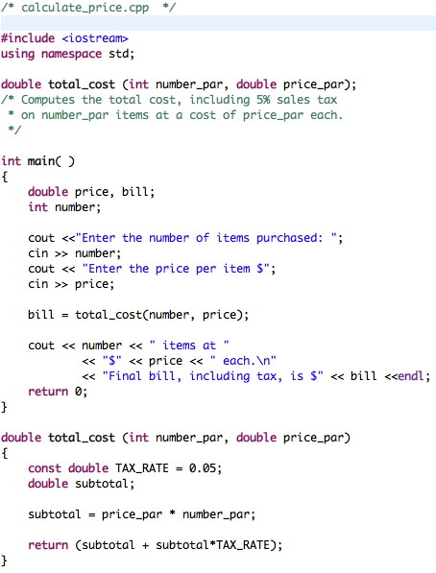
Stack for main
price | 10.10
bill
number | 2
price | 10.10
bill | 21.21
number | 2
Stack for total_cost
number_par | 2
price_par | 10.10
return address | Line 19, =
TAX_RATE
subtotal
number_par | 2
price_par
return address
TAX_RATE
subtotal
number_par | 2
price_par | 10.10
return address | Line 19, =
TAX_RATE | .05
subtotal
number_par | 2
price_par | 10.10
return address | Line 19, =
TAX_RATE | .05
subtotal | 20.20
number_par
price_par
return address
TAX_RATE
subtotal

Slide 25
Program in memory
Arguments are pushed onto
the stack as parameters
when a function is called.
Local variables are created
on the stack and popped
on return.
Dynamic Memory
Allocation (later)
Global variables
Program code

Slide 26
Quick review questions
What is the syntax for a function declaration?
What is the syntax for a function definition?
What is the syntax of a function call?
What is the difference between invoking a function and calling a function?
What happens when the following line of code is executed in the example program:
bill = total_cost(10, 35.50);
bill = total_cost(2.5, 30);

Slide 27
Call-By-Reference Parameters in Functions

Slide 28
Call-by-reference Example Program
Let’s write a program to swap 2 integers.
We can do it in three functions:
Write a function to get_numbers
Write a function to swap_values
Write a function to show_results
If you remember call-by-reference, this program is very simple. Do it now.

Slide 29
Call-by-Reference Parameters
Call-by-value
A call-by-value parameter receives a copy of the value of the argument during the execution of the function call
Any change made to the value of the parameter in the function body does not affect the value of the argument
Call-by-reference
A call-by-reference parameter is another name for the argument location during the execution of the function call
The call-by-reference parameter and the argument refers to the same memory location.
Any change made to the value of the parameter in the function body changes the value of the argument!
Arguments for call-by-reference parameters must be variables, not numbers or other expressions!

Slide 30
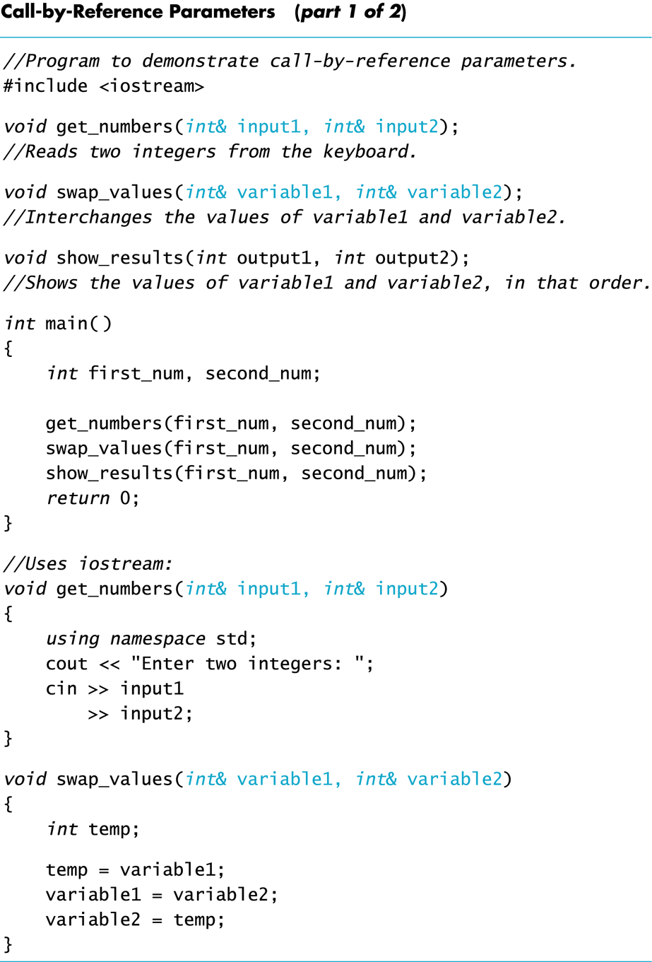
main stack
first_num | 5
second_num | ?
first_num | ?
second_num | ?
first_num | 5
second_num | 10
get_number stack
input1 | &first_num
input2 | &second_num

Slide 31
main stack
first_num | 10
second_num | 5
first_num | 5
second_num | 10
first_num | 10
second_num | 10
first_num | ?
second_num | ?
swap_values stack
variable1 | &first_num
variable2 | &second_num
temp | 5
variable1 | &first_num
variable2 | &second_num
temp | ?

Slide 32
main stack
first_num | 5
second_num | 10
first_num | 10
second_num | 5
first_num | ?
second_num | ?
first_num | 10
second_num | 10

Slide 34
Example: swap_values
void swap(int& variable1, int& variable2) { int temp = variable1; variable1 = variable2; variable2 = temp; }
& symbol (ampersand) identifies variable1 and variable2 as call-by-reference parameters
used in both declaration and definition!
If called with statement ...
swap(first_num, second_num);
temp
value1
value2

Slide 35
Example: swap_values
void swap(int& variable1, int& variable2) { int temp = variable1; variable1 = variable2; variable2 = temp; }
& symbol (ampersand) identifies variable1 and variable2 as call-by-reference parameters
used in both declaration and definition!
If called with statement ...
swap(first_num, second_num);
value1
value1
value2

Slide 36
Example: swap_values
void swap(int& variable1, int& variable2) { int temp = variable1; variable1 = variable2; variable2 = temp; }
& symbol (ampersand) identifies variable1 and variable2 as call-by-reference parameters
used in both declaration and definition!
If called with statement ...
swap(first_num, second_num);
value1
value2
value2

Slide 37
Example: swap_values
void swap(int& variable1, int& variable2) { int temp = variable1; variable1 = variable2; variable2 = temp; }
& symbol (ampersand) identifies variable1 and variable2 as call-by-reference parameters
used in both declaration and definition!
If called with statement ...
swap(first_num, second_num);
value1
value2
value1

Slide 38
Call-By-Reference Details
Call-by-reference works like an alias for the argument, not just the value of the argument.
In reality, the memory location of the argument variable is given to the formal parameter, but
Whatever is done to a formal parameter in the function body, is actually done to the value at the memory location of the argument variable
We end up with two names for the same location.

Slide 39
Mixed Parameter Lists
Call-by-value and call-by-reference parameters can be mixed in the same function
Example, consider the following function declaration void good_stuff(int& par1, int par2, double& par3);
par1 and par3 are call-by-reference formal parameters
Changes in par1 and par3 are the changes made on the corresponding argument variables during function call.
par2 is a call-by-value formal parameter
Changes in par2 do not change the argument variable during function call

Slide 40
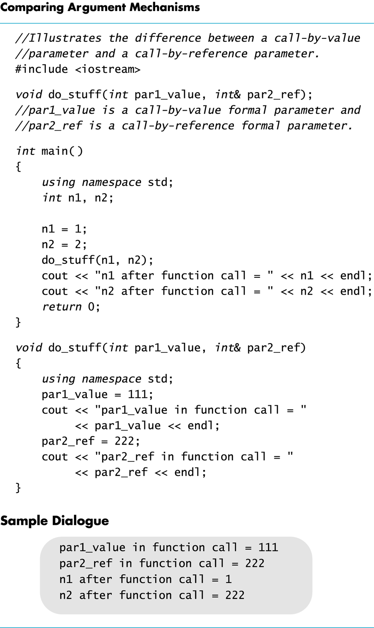

Slide 41
Inadvertent Local Variables
If a function is to change the value of a variable the corresponding formal parameter must be a call-by-reference parameter with an ampersand (&) attached
Forgetting the ampersand (&) creates a call-by-value parameter
The value of the variable will not be changed
The formal parameter is a local variable that has no effect outside the function
Hard error to find…it looks right!

Slide 42
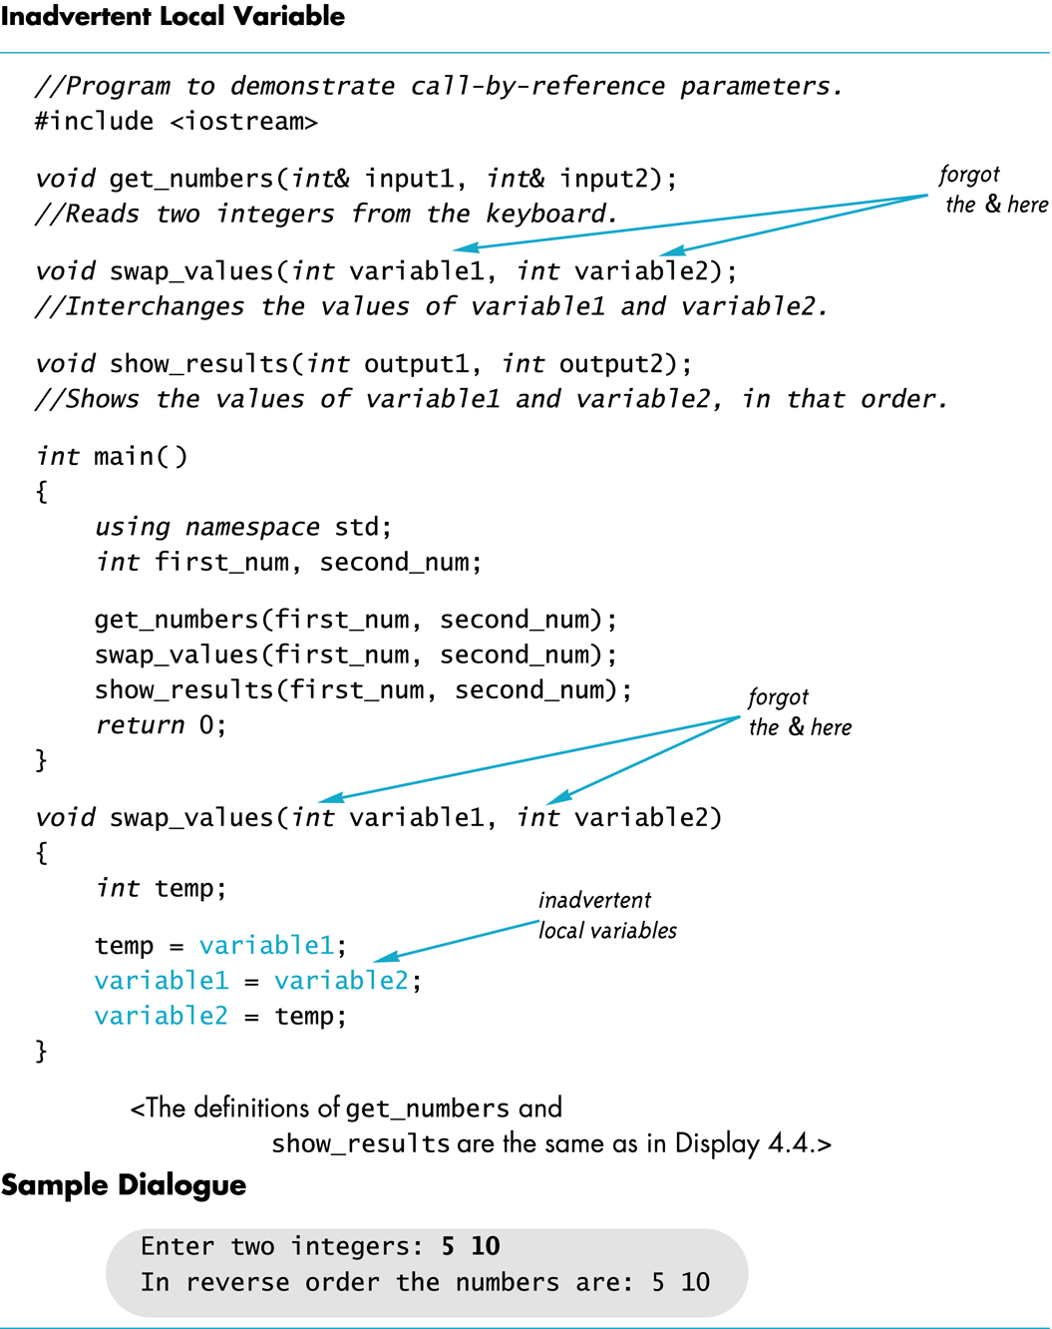

Slide 43
Choosing Parameter Types
How do you decide whether a call-by-reference or call-by-value formal parameter is needed?
Does the function need to change the value of the variable used as an argument?
Yes? Use a call-by-reference formal parameter
No? Use a call-by-value formal parameter

Slide 44
Functions as a black box
function_call( arguments )
Input almost always in parameters
inputs
Input sometimes cin:
When function name has “read”, “get”, “input”
Function
Black box
Output almost always in return statement
outputs
Call-by-reference
Output sometimes cout:
When function name has “write”, “print”, “display”

Slide 45
Global, local, block Scope

Slide 46
Global Constants
Global Named Constant
declared outside any function body
declared outside the main function body
declared before any function that uses it
available to more than one function as well as the main part of the program
Example:
const double PI = 3.14159; double area(double); int main() {…}
PI is available to the main function and to function volume

Slide 48
Global Variables
Global Variable -- rarely used when more than one function must use a common variable
Declared just like a global constant except keyword const is not used
Generally make programs more difficult to understand and maintain

Slide 49
Local variables in a function
Variables declared in a function:
Are local to that function, i.e., they cannot be used from outside the function
Have the function as their scope
Variables declared in the main function of a program:
Are local to the main function of the program, they cannot be used from outside the main part
Have the main part as their scope

Slide 50
Block Scope
Local and global variables conform to the rules of Block Scope
The code block, generally specified by the { },
where an identifier like a variable is declared.
It determines the scope of the identifier.
Blocks can be nested

Slide 51
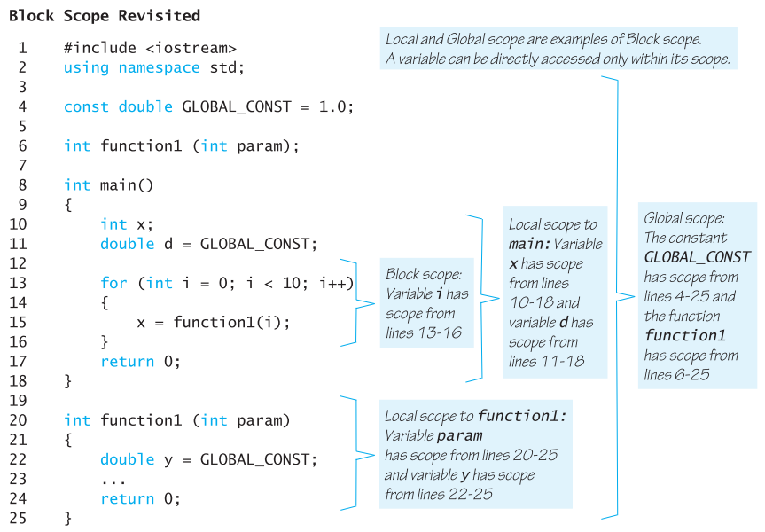
A variable can be directly accessed only within its scope.
Local and Global scopes are examples of Block Scope.

Slide 52
Example: From the textbook
Let’s look at a program that calculates a grade
Grade is computed from 3 exams. The minimum grade is tossed and the average of the 2 is the final grade (simplified for class).
Let’s decompose into smaller problems
Reads in three letter grades (A, B, C, D, F)
Converts letter grades to numbers (4, 3, 2, 1, 0)
Finds the minimum grade and removes it. (one?)
Takes the average
Converts average back to letter grade

Slide 53
Now that we have the logic
Let’s start a program and stub it out
Where are the functions?
Reads in 3 letter grades (A, B, C, D, F)
Convert letter grades to numbers (4, 3, 2, 1, 0)
Finds the minimum grade and tosses it. (just one?)
2 functions: 1) one for the sum; 2) the other for the min
Compute the average (do we need a function?)
Converts average back to letter grade
Note: A more general solution would be to use arrays!

Slide 54
Functions – what’s needed?
float convert2number(string grade);
// Converts letter grade to numeric grade
string convert2letter(float grade);
// Converts numeric grade to letter grade
void getGrades(string& g1,string& g2,string& g3);
// returns 3 letter grades, generalize to array
float calcTotal(float gr1, float gr2, float gr3);
// Calculates total, generalize to array.
float min(float gr1, float gr2, float gr3);
// returns the minimum value, generalize to array.

Slide 55
Formal Parameters are Local Variables
Formal Parameters are variables that are local to the function definition
They are used just as if they were declared in the function body
Do NOT re-declare the formal parameters in the function body, as they are declared in the function declaration
The call-by-value mechanism
When a function is called the formal parameters are initialized to the values of the arguments in the function call

Slide 56
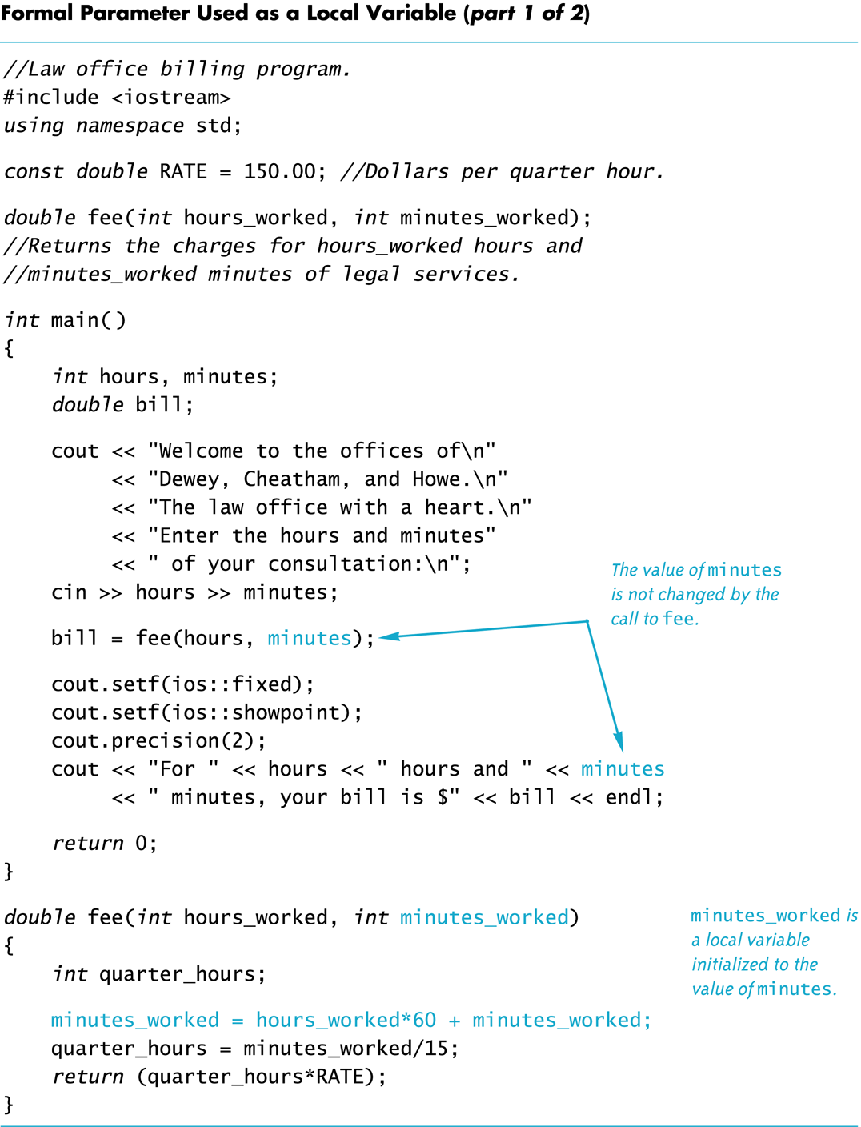
Another example

Slide 57
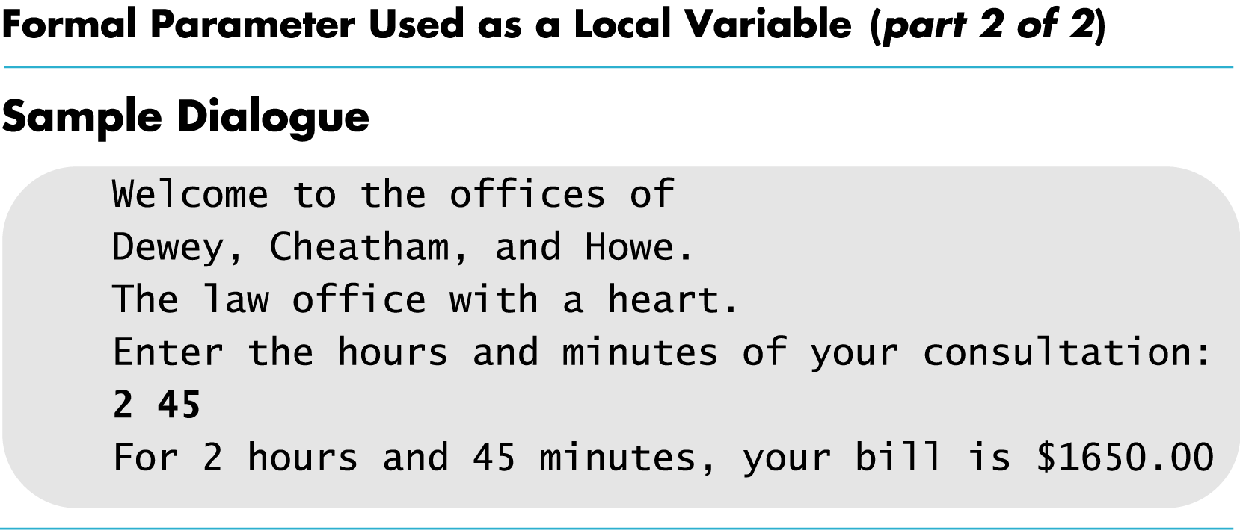

Slide 58
Default Values in Functions

Slide 59
Default Arguments
A Default argument is an argument that is passed automatically to a parameter if the argument is missing on the function call.
Must be constant set in declared prototype:
int max(int val1, int val2, int val3=0);
Can be declared in header if no prototype
Multi-parameter functions may have default arguments for some or all of them:
int getSum(int n1, int n2=0, int n3=0);

Slide 60
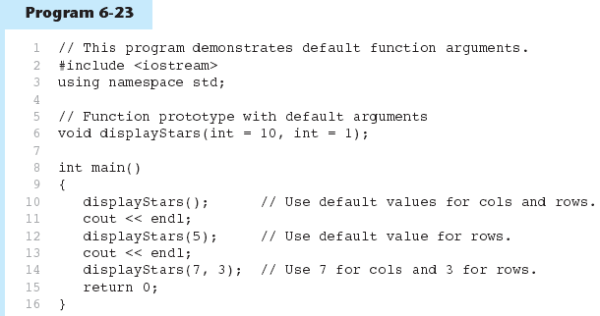
Default Arguments in Program
Default arguments are specified in the prototype
( int cols = 10, int rows = 1);
(Program Continues)

Slide 61
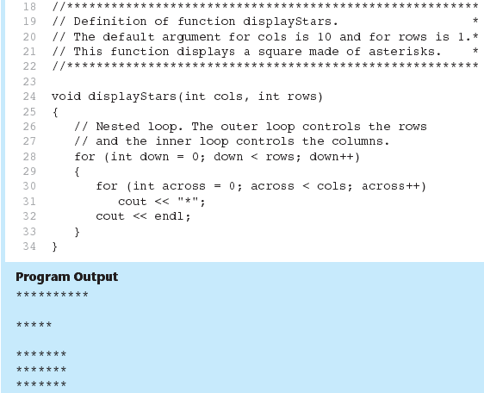
Default Arguments in Program
Default arguments are not specified
in the header

Slide 62
Default Arguments
If not all parameters to a function have default values, the defaultless ones are declared first in the parameter list:
int getSum(int n1,int n2=0, int n3=0);// OK
int getSum(int n1,int n2=0, int n3); // NO
When an argument is omitted from a function call, all arguments after it must also be omitted:
sum = getSum(n1, n2); // OK
sum = getSum(n1, n3); // NO

Slide 63
Overloading Function Names

Slide 64
Overloading Function Names
Overloading a function name means
providing more than one declaration and definition using the same function name
C++ allows more than one definition for the same function name
Very convenient for situations in which the “same” function is needed for different numbers or types of arguments

Slide 65
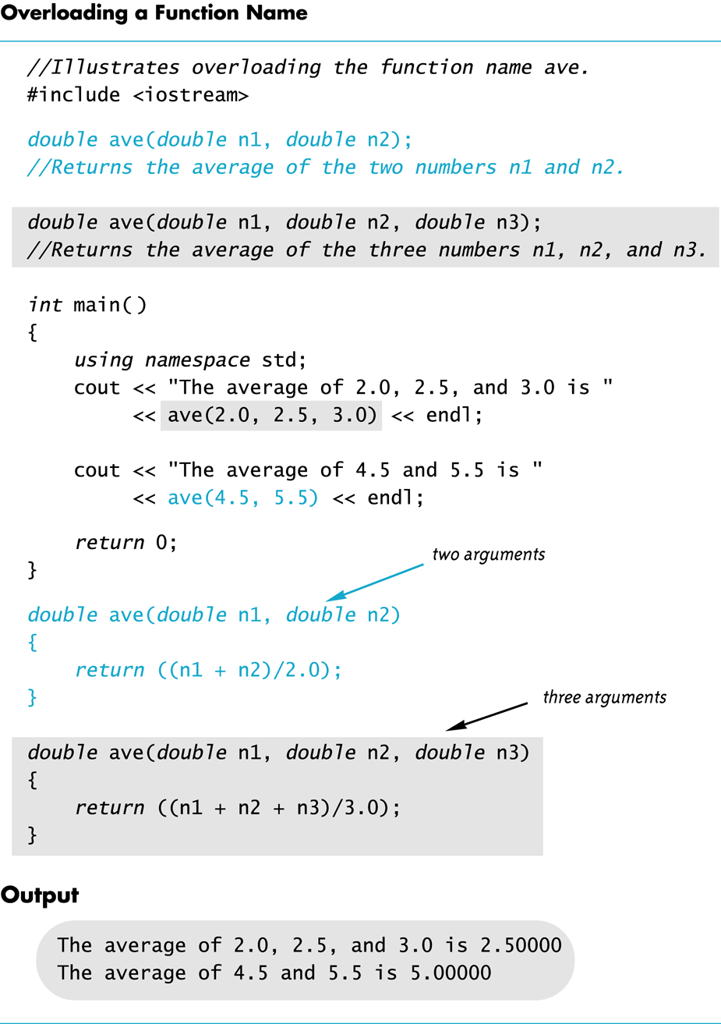

Slide 66
Overloading Examples
double ave(double n1, double n2) { return ((n1 + n2) / 2); }
double ave(double n1, double n2, double n3) { return (( n1 + n2 + n3) / 3); }
Compiler checks the number and types of arguments in the function call to decide which function to use cout << ave( 10, 20, 30); uses the second definition

Slide 67
Overloading Details
Overloaded functions
must have different numbers of formal parameters AND / OR
must have at least one different type of parameter
However…
do not have to return values of the same type.

Slide 68
Case Study – Buying Pizza (ch 4)
Figure out which pizza size is the best value.
Given two pizza sizes: 10in and 12in diameters which is the better value?
Get the price for each pizza from the user.
Calculate the unit price for each pizza.
Compare unit prices to see which is the better buy.
double unitprice(int diameter, double price) {
double radius = diameter / static_cast<double>(2);
double area = PI * radius * radius;
return price / area;
}

Slide 69
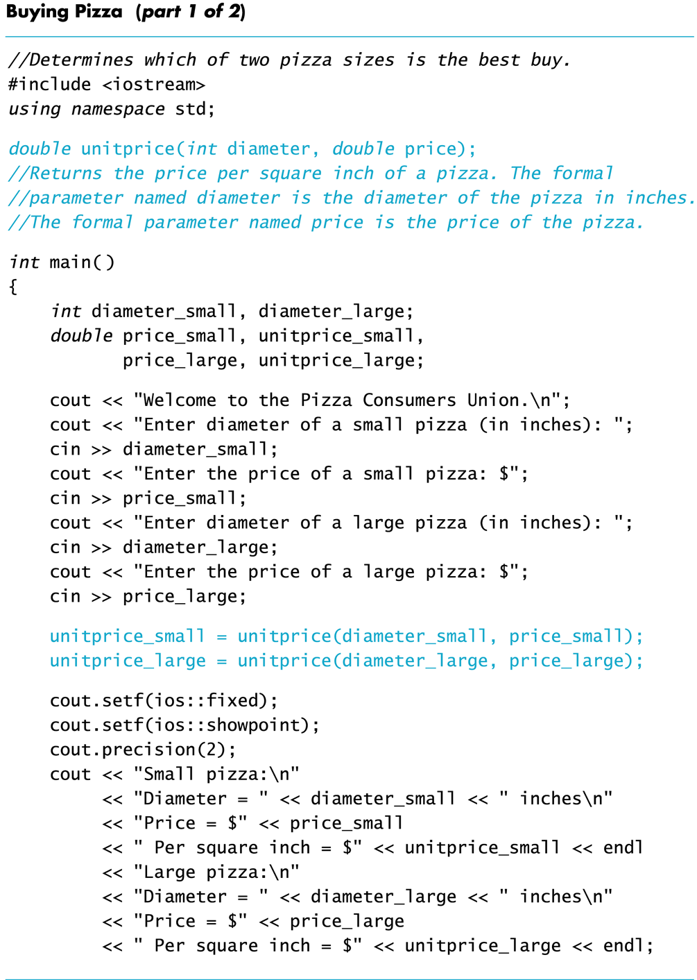
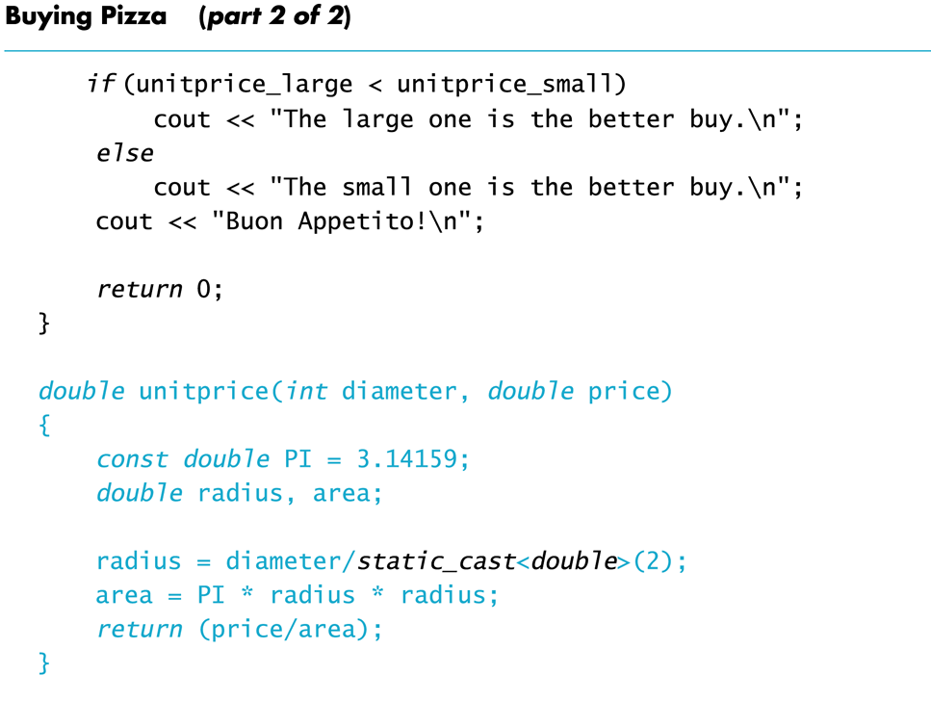
The original pizza buying
Program calculates the price
per square inch of pizza with
a single unitprice function.
We pass in the diameter of each
pizza and calculate price/area.

Slide 70
Overloading Example
Revising the Pizza Buying program
Rectangular pizzas are now offered!
Change the input and add a function to compute the unit price of a rectangular pizza
The new function could be named unitprice_rectangular
Or, the new function could be a new (overloaded) version of the unitprice function that is already used
Example:
double unitprice(int length, int width, double price)
{ double area = length * width; return (price / area);
}

Slide 71
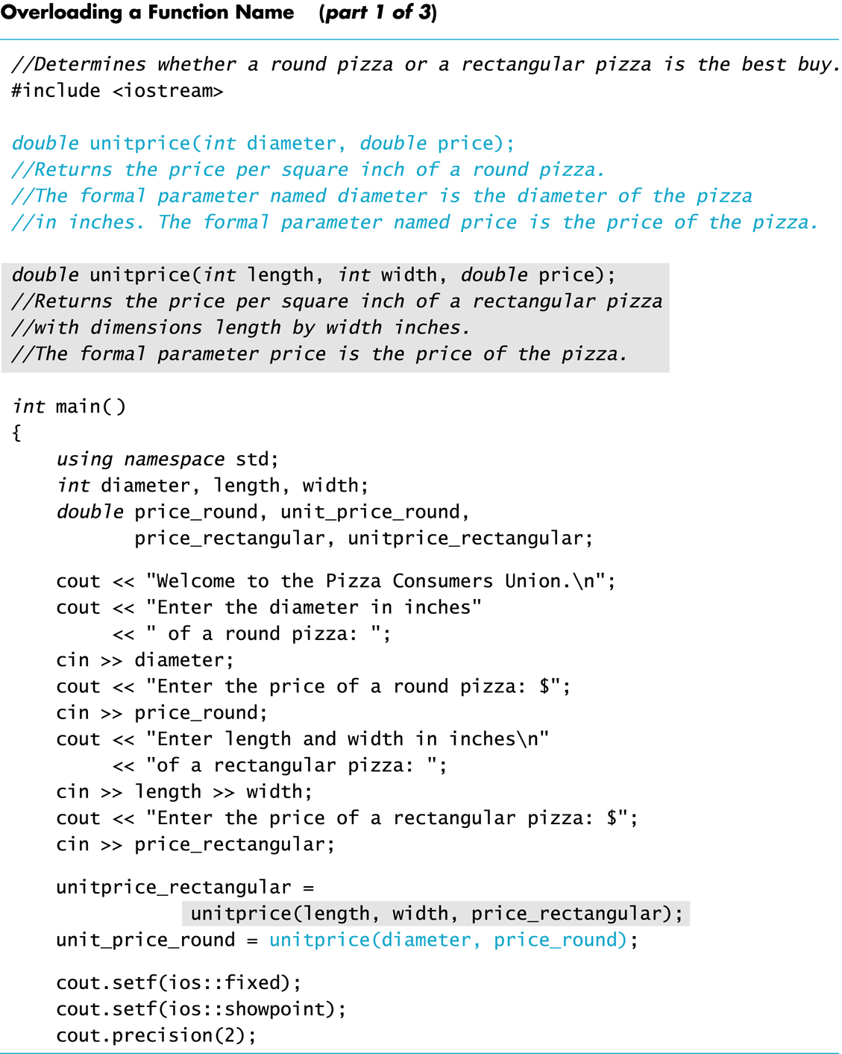
main stack
diameter | 10
length | ?
width | ?
price_round | 8.50
unitprice_round | ?
price_rect | ?
unitprice_rect | ?
diameter | 10
length | 6
width | 4
price_round | 8.50
unitprice_round | ?
price_rect | ?
unitprice_rect | ?
diameter | 10
length | 6
width | 4
price_round | 8.50
unitprice_round | ?
price_rect | 7.55
unitprice_rect | ?
diameter | ?
length | ?
width | ?
price_round | ?
unitprice_round | ?
price_rect | ?
unitprice_rect | ?
diameter | 10
length | ?
width | ?
price_round | ?
unitprice_round | ?
price_rect | ?
unitprice_rect | ?

Slide 72
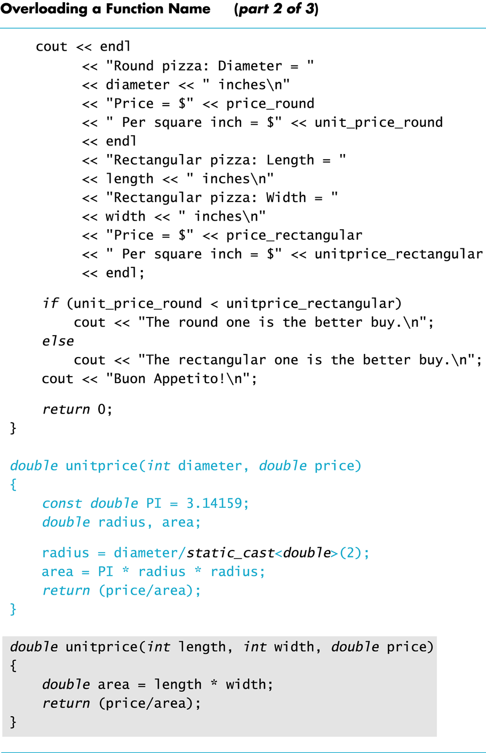
unitprice stack
length | 6
width | 4
price | 7.55
area | 24
length | 6
width | 4
price | 7.55
length | ?
width | ?
price | ?
length | 6
width | ?
price | ?
length | 6
width | 4
price | ?

Slide 73
main stack
diameter | 10
length | 6
width | 4
price_round | 8.50
unitprice_round | ?
price_rect | 7.55
unitprice_rect | ?
diameter | 10
length | 6
width | 4
price_round | 8.50
unitprice_round | ?
price_rect | 7.55
unitprice_rect | 0.31

Slide 74
unitprice stack
diameter | 10
price | 8.50
radius | 5.0
area | ?
diameter | 10
price | 8.50
radius | 5.0
area | 78.53975
diameter | 10
price | 8.50
radius | ?
area | ?
diameter | 10
price | 8.50
diameter | 10
price | ?
diameter | ?
price | ?

Slide 75
main stack
diameter | 10
length | 6
width | 4
price_round | 8.50
unitprice_round | 0.11
price_rect | 7.55
unitprice_rect | 0.31
diameter | 10
length | 6
width | 4
price_round | 8.50
unitprice_round | ?
price_rect | 7.55
unitprice_rect | 0.31

Slide 77
void Functions

Slide 78
Function contains code to do some subtask
A subtask might produce
No value (e.g., input or output) to be used by a calling function.
One value to be used by the calling function.
Multiple values to be used by the calling function.
We use a return statement to return ONE value
A void-function implements a subtask that ...
Either does not give back any value to the calling function
It may have NO return statement or
It may use return; with NO expression.
or gives back multiple values to the calling function, via the call-by-reference parameters

Slide 79
void-Function Definition
Differences between void-function definitions and the definitions of functions that return one value thru return statement.
Keyword void replaces the type of the value returned
void means that no value is returned by the function thru return statement
The return statement does not include an expression, or can be removed in some situations.
Example: void show_results(double f_degrees, double c_degrees) { using namespace std; cout << f_degrees <<“ degrees Fahrenheit is euivalent to “
<< endl << c_degrees << “ degrees Celsius.” << endl; return; }

Slide 80
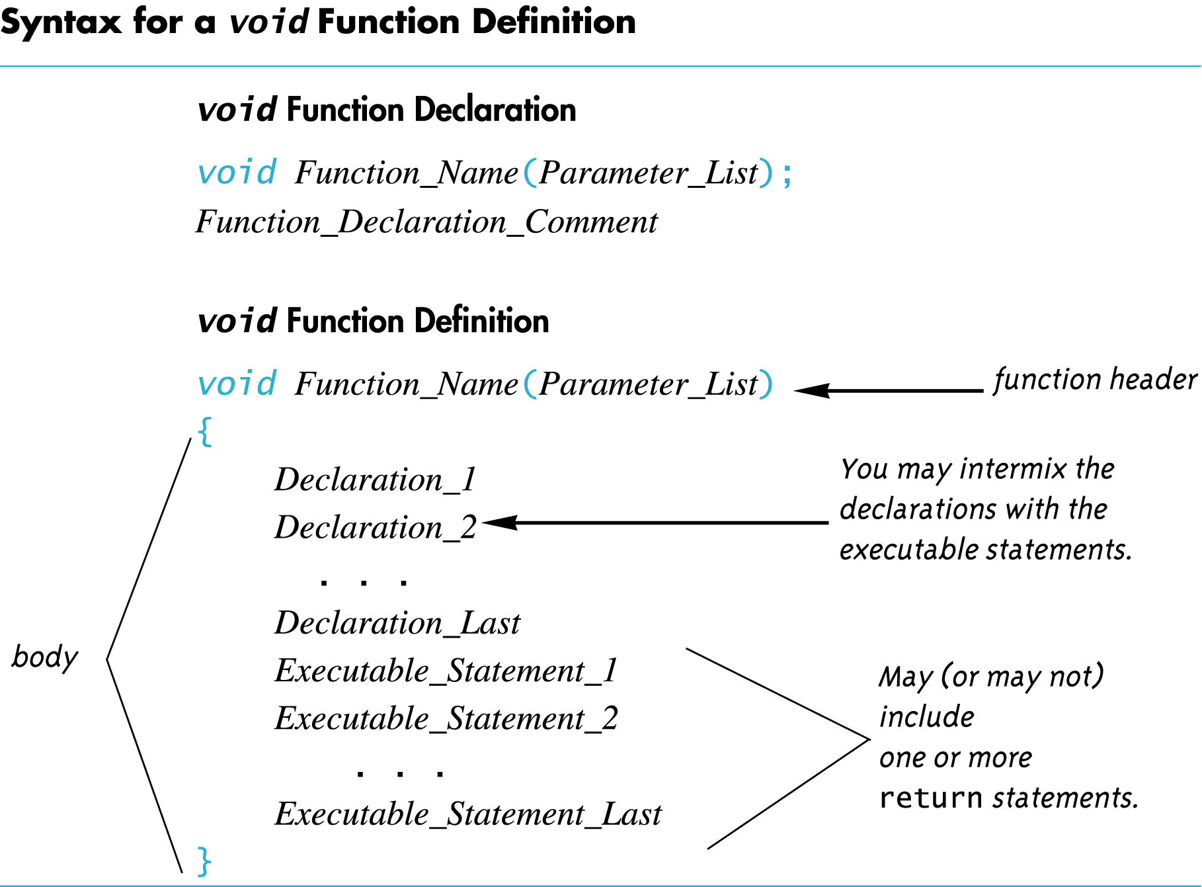

Slide 81
Calling a void-Function
A void-function call
does not need to be part of another statement
it ends with a semi-colon
Example: show_results(32.5, 0.3); NOT: cout << show_results(32.5, 0.3);

Slide 82
void-Function Calls
Mechanism is nearly the same as the function calls we have seen
Argument values are substituted for (or plugged in) the formal parameters
It is fairly common to have no parameters in void-functions
In this case there will be no arguments in the function call
Statements in function body are executed
Optional return statement ends the function
Return statement does not include a value to return
Return statement is implicit if it is not included

Slide 83
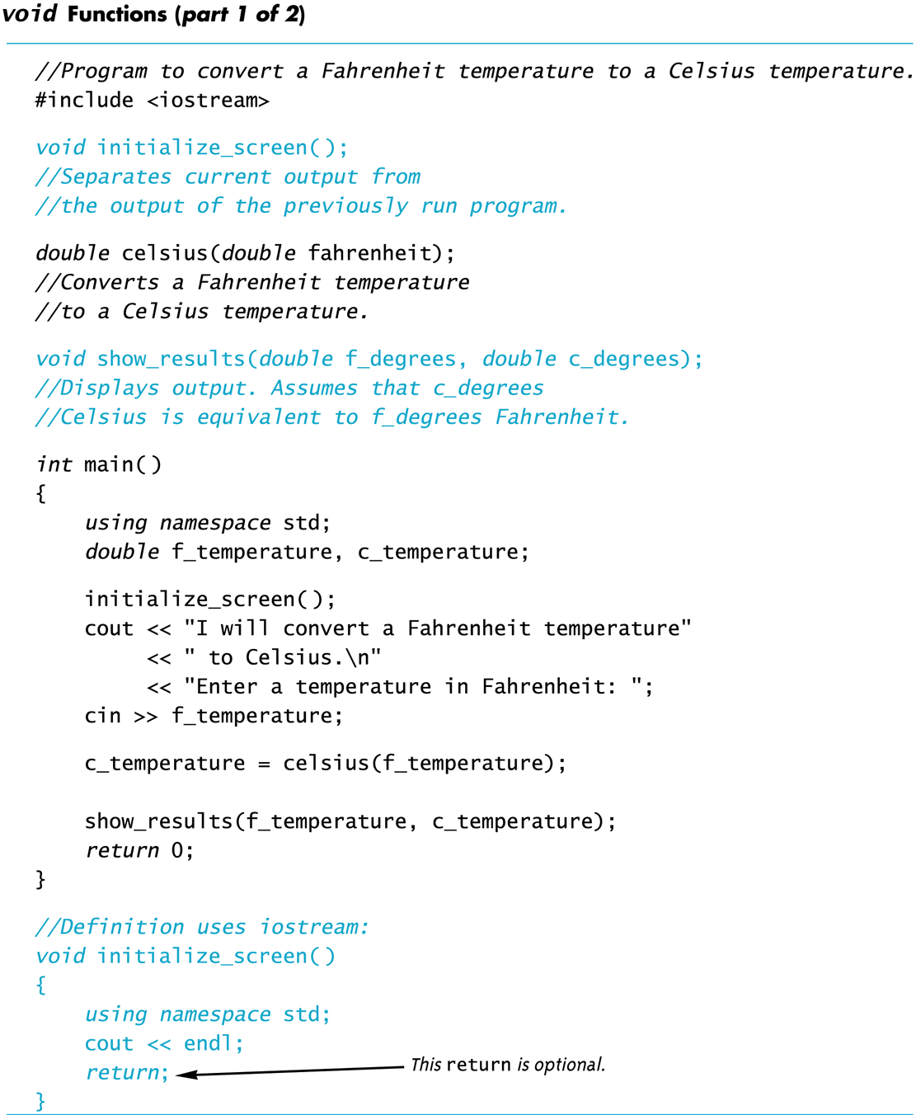

Slide 84
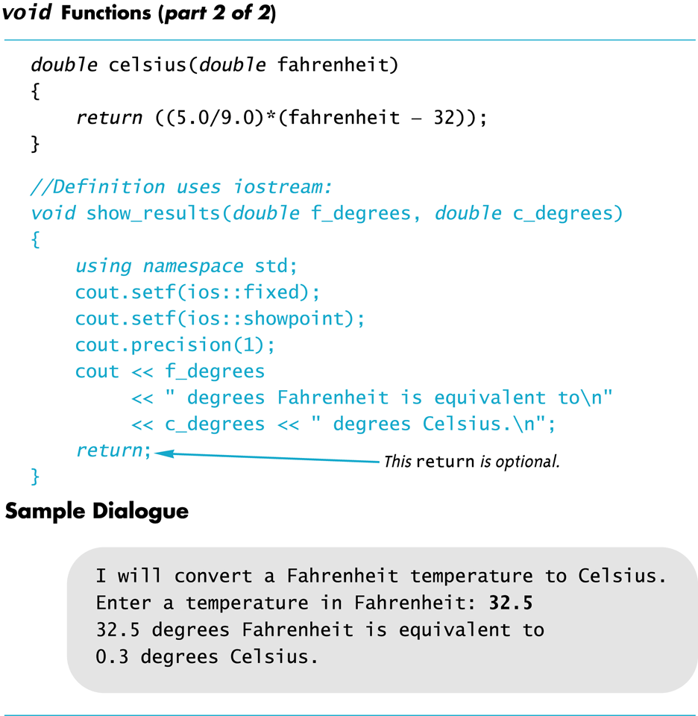

Slide 85
void-Functions: Why use a return?
A function that has no return value uses void as the return-type
Is a return statement ever needed in a void-function since no value is returned?
Yes for some scenarios, e.g.
a branch of an if-else statement requires that the function ends to avoid producing more output, or creating a mathematical error.
void-function in the example on next page (Display 5.3), avoids division by zero with a return statement

Slide 86
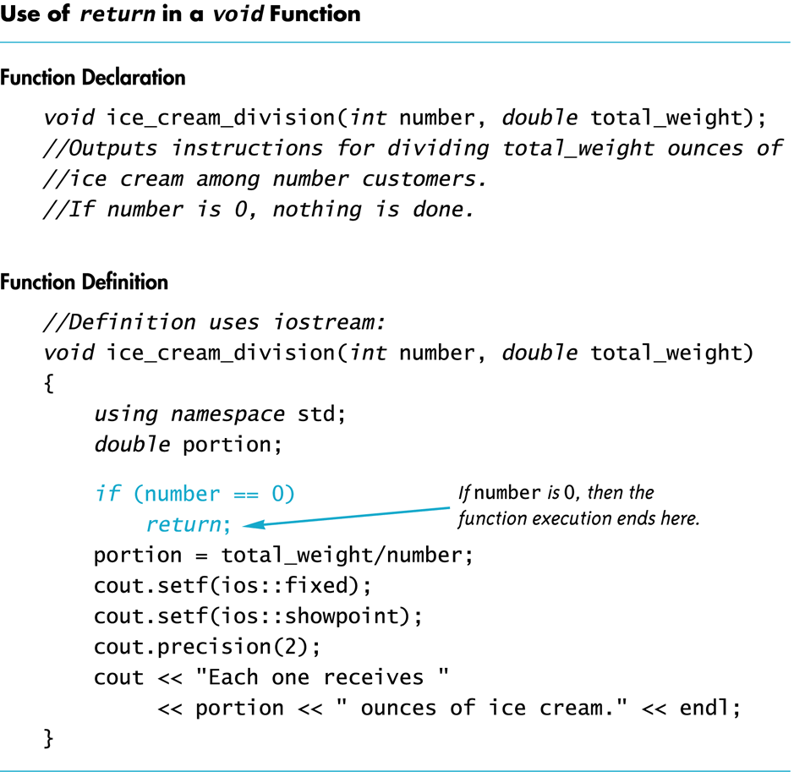

Slide 87
Functions – label parts
Function call
----A----- function (-------B-------); ← // -----C----
int main()
{
--A-- result;
result = function(------D------); ←// ------E------
}
----A----- function (-------B-------) ←// ----F----
{
-----G-------; ----H-----
}
Function header
Return-type
Function definition
Function body
Parameter-list
Argument-list
Function prototype

Slide 88
Functions – label parts
Return-type
----A----- function (-------B-------); ← // -----C----
int main()
{
--A-- result;
result = function(------D------); ←// ------E------
}
----A----- function (-------B-------) ←// ----F----
{
-----G-------; ----H-----
}
Parameter-list
Function prototype
Return-type
Argument-list
Function call
Return-type
Parameter-list
Function header
Function body
Function definition

Slide 89
Program Tracing functions
void Sum(int a, int b, int & c)
{
a = b + c;
b = a + c;
c = a + b;
}
int main() {
int x=2, y=3;
Sum(x, y, y);
cout << x << " " << y << endl;
return 0;
}

Slide 90
Program Tracing functions
void Mystery(int & a, int & b, int c)
{
c = b + a;
a = c - a;
b = c - b;
}
void Print() {
int x = 0, y = 1, z = 2;
Mystery(x, y, z);
cout << x << “ “ << y << “ “ << z;
Mystery(x, y, z);
cout << x << “ “ << y << “ “ << z << endl;
}

Slide 91
6.16
Stubs and Drivers

Slide 92
The Main Function
The main function in a program is used like a void function…do you have to end the program with a return-statement?
Because the main function is defined to return a value of type int, the return is needed
C++ standard says the return 0 can be omitted, but some compilers still require it
g++ does not.

Slide 93
Use Pseudocode
Pseudocode is a mixture of English and the programming language in use
Pseudocode simplifies algorithm design by allowing you to ignore the specific syntax of the programming language as you work out the details of the algorithm
If the step is obvious, use C++
If the step is difficult to express in C++, use English

Slide 94
Program Testing
Programs that compile and run can still produce errors
Testing increases confidence that the program works correctly
Run the program with data that has known output
You may have determined this output with pencil and paper or a calculator
Run the program on several different sets of data
Your first set of data may produce correct results in spite of a logical error in the code
Remember the integer division problem? If there is no fractional remainder, integer division will give apparently correct results

Slide 95
Stubs and Drivers
Useful for testing and debugging program and function logic and design
Stub: A dummy function used in place of an actual function
Usually displays a message indicating it was called. May also display parameters
Driver: A function that tests another function by calling it
Various arguments are passed and return values are tested

