Slide 1
Pointers
Chapter 9 Savitch
Chapter 9 Gaddis

Slide 2
What have we learned about when we learned about function parameters?

Slide 3
What have we learned about when we learned about function parameters?
Call-by-Value – also known as scalars (eg. int, double, char, float)
Call-by-Reference – which “refer” to the location of the variable (aka alias)
Arrays – which is neither “by-value” nor “by-reference” but they behave like “reference”
What can we learn from array parameters?

Slide 4
Data is stored in memory
every variable has a memory address, whether a byte is needed or 4 (char vs int)
when a variable is defined, it’s memory address cannot be predicted. It is determined by the system.
example: int temp;
any data value requiring multiple bytes is stored consecutively in memory and identified by the address of the first byte.
to find the amount of memory (number of bytes) assigned to a variable or a data type? Use
sizeof(int), or sizeof x

Slide 5
Pointers
Pointer: a pointer is the memory address of a variable
An address of a variable is stored in memory as a pointer
Pointers "point" to a variable similarly to references
References are memory addresses that can’t be changed once assigned to an address.
When a variable is used as a call-by-reference argument, its address is passed. It is bound to that address forever.
Pointers can be changed by being assigned to a different address!

Slide 6
Declaring Pointers
Pointer variables must be declared to have a pointer type
Example: To declare a pointer variable p that can "point" to a variable of type double: double *p;
The asterisk identifies p as a pointer variable
double dValue;
How do you get the address of a variable?
double *p = &dValue;

Slide 7
Terminology: Lvalues & rvalues
pointer value is the address of an lvalue.
a variable, a reference, or any assignable thing including pointers.
lvalue: any expression that refers to an internal memory location capable of storing data. It can appear on the left hand side of an assignment.
Example: x=1.0;
rvalue: includes all lvalues plus expressions

Slide 8
Declaring pointer variables
Examples of declaring pointers:
int *p;
char *cptr;
(initially, p and cptr contain some garbage values,
so, a good practice is: int *p=NULL;)
Note: pointers to different data types are different!
Difference?
int *p1, *p2;
int *p1, p2;

Slide 9
The “address of” Operator
The & operator can be used to get the address of a variable which can be assigned to a pointer variable
Example:
p1 = &v1;
p1 is now a pointer to v1
v1 can be called v1 or "the variable pointed to by p1"

Slide 10
The Dereferencing Operator
C++ also uses the * operator with pointers
The phrase "The variable pointed to by p" is translated into C++ as *p
Here the * is the dereferencing operator
p is said to be dereferenced

Slide 11
Fundamental pointer operations
& address-of
example: int *p; int a=10; p=&a;
* variable that is pointed to
(* also called dereferencing operation)
example: *p=5;
they are used to move back and forth between variables and pointers to those variables.
Problem?
int *aptr;
*aptr=5; //the variable pointed to by aptr has to be valid
int *p=NULL; <=> int *p; p=NULL;

Slide 12
Why pointers
Allow one to refer to a large data structure in a compact way. Passing around the address is efficient.
Each pointer (or memory address) typically fits in four or eight bytes of memory! (32-bit is 4 bytes; 64-bit is 8 bytes)
Different parts of a program can share the same data:
passing parameters by reference (passing address between different functions) can change the original argument.
One can reserve new memory in a running program: dynamic memory allocation
Build complicated data structures by linking different data items

Slide 13
Initialize a pointer variable?
Lets assume a variable named array is a pointer variable, then …
int *p=array;
or
int *p;
p=array;

Slide 14
Example
int x, y;
int *p1, *p2;
1000
x
1004
y
1008
p1
1012
p2

Slide 15
Example
int x, y;
int *p1, *p2;
x=-42;
y=163;
1000
-42
x
163
1004
y
1008
p1
1012
p2

Slide 16
Example
int x, y;
int *p1, *p2;
x=-42;
y=163;
p1=&x;
p2=&y;
1000
-42
x
163
1004
y
1000
1008
p1
1004
1012
p2

Slide 17
Example
int x, y;
int *p1, *p2;
x=-42;
y=163;
p1=&x;
p2=&y;
*p1=17;
//*p1 is another name of for x
1000
-42
x
163
1004
y
1000
1008
p1
1004
1012
p2
1000
17
x
163
1004
y
1000
1008
p1
1004
1012
p2

Slide 18
A Pointer Example
v1 = 0; p1 = &v1;
cout << *p1; //same as cout<<v1;
cout <<p1;
*p1 = 42;
cout << v1 << endl; cout << *p1 << endl;

Slide 19
output: 42 42

Slide 20
int i;
int *p;
i = 68;
p = &i;
printf("%d\n", i);
printf("%d\n", *p);
printf("%p\n", *p); /*value pointed to by p */
printf("%p\n", p); /*value of p, i.e., address of value pointed to by p */
printf("%u\n", p); /*value of p, i.e., address of value pointed to by p */
*p = 12;
printf("%d\n", i);
printf("%d\n", *p);
printf function is a function similar to cout
68
68
0x44
0xbfcc8b0c
3217853196
12
12

Slide 21
example
int x, y;
int *p1, *p2;
x=-42;
y=163;
p1=&x;
p2=&y;
*p1=17; /* another name of for x*/
p1=p2; /* pointer assignment, now two pointers point to the same lacation*/
1000
17
x
163
1004
y
1000
1008
p1
1004
1012
p2
1000
17
x
163
1004
y
1004
1008
p1
1004
1012
p2

Slide 22
example
int x, y;
int *p1, *p2;
x=-42;
y=163;
p1=&x;
p2=&y;
*p1=17; /* another name of for x*/
*p1=*p2; /*value assignment*/
//think of *p1 as another name of the variable p1 points to.
1000
17
x
163
1004
y
1000
1008
p1
1004
1012
p2
1000
163
x
163
1004
y
1000
1008
p1
1004
1012
p2

Slide 23
NULL pointer
assign NULL constant to a pointer variable to indicate that it does not point to any valid data
internally, NULL is value 0.
Recall our example…
int *p;
char *cptr;
(initially, p and cptr contain some garbage values,
so, a good practice is: int *p=NULL;)

Slide 24
Passing pointers as parameters behave like pass by reference.
Suppose we want to set x (defined in main() function) to zero,
compare the following code:
int x=7;
/*pass by value*/
void SetToZero (int var) {
var=0;
}
SetToZero(x);
/*pass by reference*/
void SetToZero(int *ip) {
*ip=0;
}
SetToZero(&x);
//we are still copying the value of “&x” into local
//variable ip in function SetToZero

Slide 25
int main ()
{
…
x=163;
SetToZero(x);
…
…
}
void SetToZero (int var) {
var=0;
}
1000
163
x
stack
frame
for main() in our computer’s memory
1004
1008
1012
163
1208
var
stack
frame
for SetToZero() in our computer’s memory
1212

Slide 26
int main ()
{
…
x=163;
SetToZero(x);
…
…
}
void SetToZero (int var) {
var=0;
}
1000
163
x
1004
stack
frame
1008
1012
0
1208
var
stack
frame
1212

Slide 27
1000
163
x
int main ()
{
…
x=163;
SetToZero(&x);
…
…
}
void SetToZero(int *ip)
{
*ip=0;
}
1004
stack
frame
1008
1012
1000
1208
ip
stack
frame
1212

Slide 28
1000
0
x
int main ()
{
…
x=163;
SetToZero(&x);
…
…
}
void SetToZero(int *ip)
{
*ip=0;
}
1004
stack
frame
1008
1012
1000
1208
ip
stack
frame
1212

Slide 29
Passing parameters by reference via pointers
Suppose we want to set x to zero,
compare the following code:
void SetToZero (int var) {
var=0;
}
SetToZero(x);
/* has no effect on x*/
void SetToZero(int *ip) {
*ip=0;
}
SetToZero(&x);
/* x is set to zero, call by reference */
stack frame
stack frame
SetToZero(x);
var=x;
var=0;
stack frame
stack frame
SetToZero(&x);
ip=&x;
*ip=0;
Call by reference
equivalently, this means:
copy the pointer (to that variable) into the pointer parameter

Slide 30
Let’s convert swap to pointers
First write it as a function with references
Change the parameters to pointers
Change the code to use pointers
What’s the difference?
Are references clearer or pointers?
Google C++ standard bans call-by-reference claiming it is unclear when reading code that has reference parameters. It’s not obvious.
But, references were added to avoid problems!

Slide 31
References vs. Pointers
References are assigned for the life of the reference. Can’t be changed.
How would one change a reference?
int x, y,
int& z = x; // references must be assigned
z = y; // this assigns the value of y to x
Pointers can be changed by reassigning them.
int v, w;
int* p = &v; *p = 5; p = &w;

Slide 32
Example: Let’s do this in lab
write a program to solve quadratic equation:
ax^2 + bx + c = 0;
program structure:
input phase: accept values of coefficients from users;
computation phase: solve the equation based on those coefficients;
output phase: display the roots of the equation on the screen
static void GetCoefficients(double *pa, double *pb, double *pc);
static void SolveQuadratic(double a, double b, double c,
double *px1, double *px2);
static void DisplayRoots(double x1, double x2);
three values passed from phase 1 to phase 2
two values passed from phase 2 to phase 3
need to pass parameters by reference!

Slide 33
So far…

Slide 34
The new Operator
Using pointers, variables can be manipulated even if there is no identifier (or name) for them
To create a pointer to a new "nameless" variable of type int:
int *p1; p1 = new int;
The new variable is referred to as *p1
*p1 can be used anyplace an integer variable can cin >> *p1; *p1 = *p1 + 7;

Slide 35
Dynamic Variables
Variables created using the new operator are called dynamic variables
Dynamic variables are created and destroyed while the program is running
Additional examples of pointers and dynamic variables are shown in An illustration of the code in Display 9.2 is seen in
Display 9.2
Display 9.3

Slide 36
Display 9.2

Slide 37
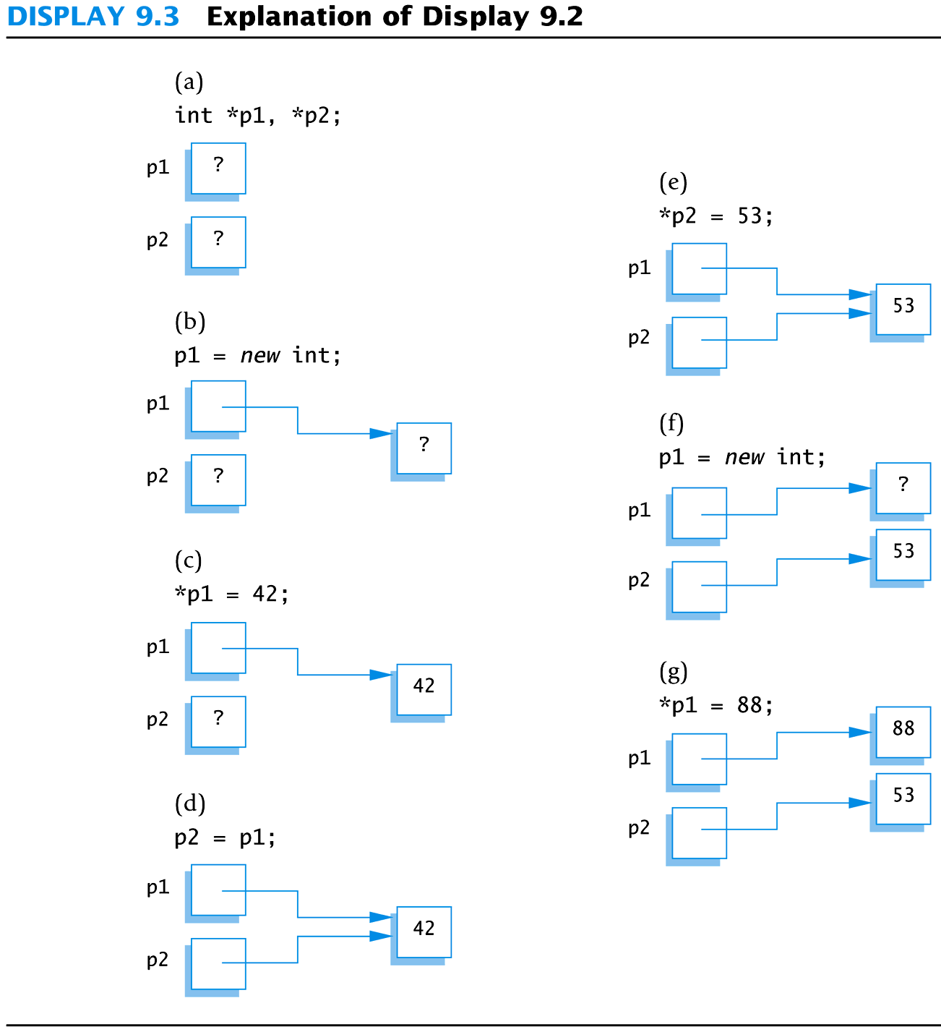
Display 9.3

Slide 38
Caution! Pointer Assignments
Some care is required making assignments to pointer variables
p1= p3; // changes the location that p1 "points" to
*p1 = *p3; // changes the value at the location that // p1 "points" to

Slide 39
Basic Memory Management
An area of memory called the freestore is reserved for dynamic variables
New dynamic variables use memory in the freestore
If all of the freestore is used, calls to new will fail
Unneeded memory can be recycled
When variables are no longer needed, they can be deleted and the memory they used is returned to the freestore

Slide 40
The delete Operator
When dynamic variables are no longer needed, delete them to return memory to the freestore
Example: delete p; The value of p is now undefined and the memory used by the variable that p pointed to is back in the freestore

Slide 41
Dangling Pointers
Using delete on a pointer variable destroys the dynamic variable pointed to
If another pointer variable was pointing to the dynamic variable, that variable is also undefined
Undefined pointer variables are called dangling pointers
Dereferencing a dangling pointer (*p) is usually disasterous
STOPPED HERE

Slide 42
Automatic Variables
Variables declared in a function are created by C++ when calling the function, and they are destroyed when the function call ends
These are called automatic variables because their creation and destruction is controlled automatically
The programmer manually controls creation and destruction of dymamic variables with operators new and delete

Slide 43
Global Variables
Variables declared outside any function definition are global variables
Global variables are available to all parts of a program
Global variables are not generally used

Slide 44
Type Definitions
A name can be assigned to a type definition, then used to declare variables
The keyword typedef is used to define new type names
Syntax:
typedef Known_Type_Definition New_Type_Name;
Known_Type_Definition can be any type

Slide 45
Defining Pointer Types
To avoid mistakes using pointers, define a pointer type name
Example:
typedef int* IntPtr;
Defines a new type, IntPtr, for pointer variables containing pointers to int variables
IntPtr p;
is equivalent to
int *p;

Slide 46
Multiple Declarations Again
Using our new pointer type defined as typedef int* IntPtr;
Then, we can prevent this error in pointer declaration: int *P1, P2;//Only P1 is a pointer variable
with
IntPtr P1, P2;
// P1 and P2 are pointer variables

Slide 47
Pointer Variables and Array Variables
Array variables are actually pointer variables that point to the first indexed variable
Example: int a[10]; typedef int* IntPtr; IntPtr p;
Variables a and p are the same kind of variable
Since a is a pointer variable that points to a[0], p = a; causes p to point to the same location as a

Slide 48
Pointer Variables As Array Variables
Continuing the previous example: Pointer variable p can be used as if it were an array variable
Example: p[0], p[1], …p[9] are all legal ways to use p
Variable a can be used as a pointer variable except the pointer value in a cannot be changed
This is not legal:
IntPtr p2; … // p2 is assigned a value a = p2 // attempt to change a
Display 9.4
Display 9.5

Slide 49
Display 9.4

Slide 50
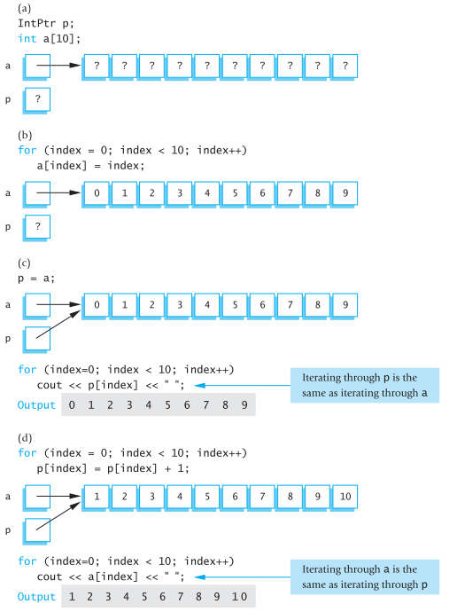

Slide 51
Pointer Reference Parameters
A second advantage in using typedef to define a pointer type is seen in parameter lists
Example:
void sample_function(IntPtr& pointer_var); is less confusing than
void sample_function( int*& pointer_var);

Slide 52
Dynamic Arrays

Slide 53
Dynamic Arrays
A dynamic array is an array whose size is determined when the program is running, not at the time when you write the program

Slide 54
Creating Dynamic Arrays
Normal arrays require that the programmer determine the size of the array when the program is written
What if the programmer estimates too large?
Memory is wasted
What if the programmer estimates too small?
The program may not work in some situations
Dynamic arrays can be created with just the right size while the program is running

Slide 55
Creating Dynamic Arrays
Dynamic arrays are created using the new operator
Example: To create an array of 10 elements of type double: typedef double* DoublePtr; DoublePtr d; d = new double[10];
d can now be used as if it were an ordinary array!

Slide 56
Dynamic Arrays (cont.)
Pointer variable d is a pointer to d[0]
When finished with the array, it should be deleted to return memory to the freestore
Example: delete [ ] d;
The brackets tell C++ a dynamic array is being deleted so it must check the size to know how many indexed variables to remove
If forget to write the brackets, it would tell the computer to remove only one variable
Display 9.6 (1)
Display 9.6 (2)

Slide 57
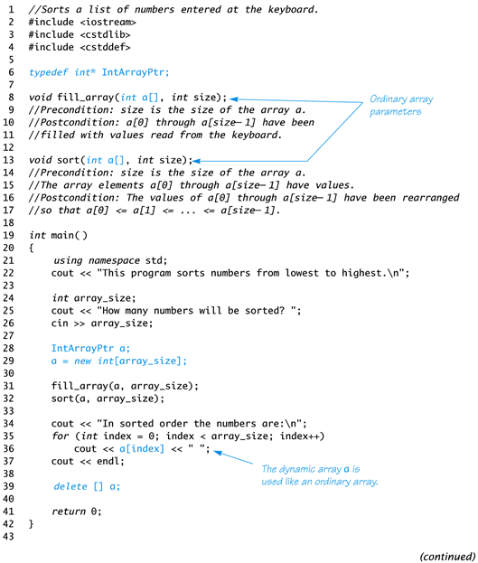
Display 9.6 (1/2)

Slide 58
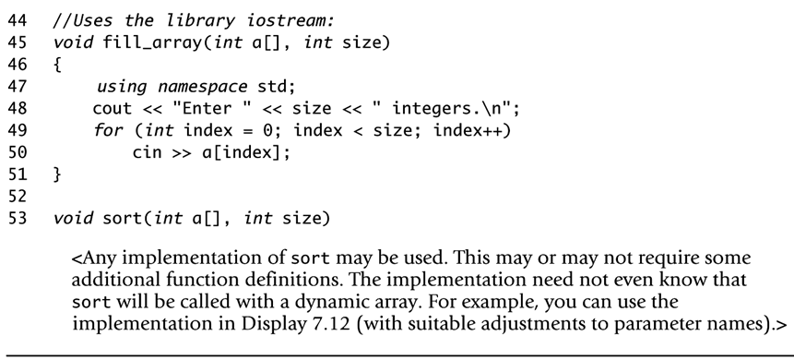
Display 9.6 (2/2)

Slide 59
Pointer Arithmetic
Arithmetic can be performed on the addresses contained in pointers
Recall the dynamic array of doubles, d, declared previously;
Recall that d points to d[0]
The expression d+1 evaluates to the address of d[1] and d+2 evaluates to the address of d[2]
Notice that adding one adds enough bytes for one variable of the type stored in the array

Slide 60
pointers and arrays
1000 |  | list[0]
1008 |  | list[1]
1016 |  | list[2]
1024
double list[3];
&list[1] ?
1008
how does the system find out this address?
1000+1*8

Slide 61
pointer arithmetic
pointer arithmetic must take into account the size of the base type.
double list[3]={1.0, 1.1, 1.2};
double *p;
what’s in p after the following operations?
p=&list[0];
p=p+2; /*recall each double value takes 8 bytes*/
p=p-1;
1000 | 1.0 | list[0]
1008 | 1.1 | list[1]
1016 | 1.2 | list[2]
1024 |  | p
Here, implicitly the compiler knows the base type that p is pointing to.

Slide 62
pointer arithmetic
pointer arithmetic must take into account the size of the base type.
p=&list[0];
p=p+2; /*recall each double value takes 8 bytes*/
p=p-1;
1000 |  | list[0]
1008 |  | list[1]
1016 |  | list[2]
1024 |  | p

Slide 63
pointer arithmetic
it makes no sense to use *, /, % in pointer arithmetic
one cannot add two pointers together: p1+p2 is illegal
but one can subtract one pointer from another pointer: p1-p2 is legal

Slide 64
Pointer Arthmetic Operations
The ++ and - - operators can be used
Two pointers of the same type can be subtracted to obtain the number of indexed variables between
The pointers should be in the same array!
This code shows one way to use pointer arithmetic: for (int i = 0; i < array_size; i++) cout << *(d + i) << " " ; // same as cout << d[i] << " " ;

Slide 65
valid pointer operations
assignment of pointers of the same type
add or substract a pointer and an integer
substract or compare two pointers to members of the same array
assign or compare to zero

Slide 66
pointer arithmetic
*p++ is equivalent to *(p++);
recall that ++ has higher precedence over *, then this statement means what?
1. dereference p; 2. increment p

Slide 67
relationship between pointers and arrays
array name is a pointer to the first elem in the array.
int intList[5]; /* intList same as &intList[0] */
array name and pointer are treated the same when passing parameters in function calls.
sum=sumIntegerArray(intList, 5);
these two prototypes are the same
int sumIntegerArray(int array[], int n);
int sumIntegerArray(int *array, int n);

Slide 68
differences between pointers and arrays
declarations
int array[5];
/*memory has been allocated for 5 integers*/
int *p;
/*memory has been allocated for 1 pointer to integer, but content or value of this pointer is some garbage number initially. */

Slide 69
differences between pointers and arrays
pointer is a variable, but array name is not a variable!
int intList[5];
intList=p; /*incorrect uses*/
intList++; /*incorrect uses*/

Slide 70
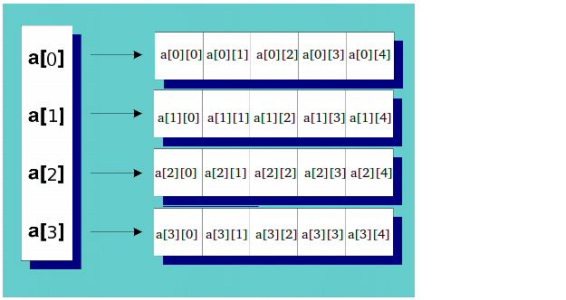
Multidimensional Arrays
Recall that multidimension arrays are just arrays of arrays: int a[4][5];

Slide 71
Multidimensional dynamic arrays
Recall that a pointer can point to a static array declared as
int a[5], *p = a;
So, int * is the same as int [] because they are interchangeable.
For a 2 dimensional array declared as
int a[4][5], **p = a;
Because, int ** is the same as int [][] they also are interchangeable.
You can substitute * for [] in general.

Slide 72
Multidimensional Dynamic Arrays
To create a 3x4 multidimensional dynamic array
View multidimensional arrays as arrays of arrays
First create a one-dimensional dynamic array
Start with a new definition: typedef int* IntArrayPtr;
Now create a dynamic array of pointers named m: IntArrayPtr *m = new IntArrayPtr[3];
For each pointer in m, create a dynamic array of int's
for (int i = 0; i<3; i++) m[i] = new int[4];

Slide 73
A Multidimensial Dynamic Array
The dynamic array created on the previous slide could be visualized like this:
m
IntArrayPtr
IntArrayPtr *
int's

Slide 74
Deleting Multidimensional Arrays
To delete a multidimensional dynamic array
Each call to new that created an array must have a corresponding call to delete[ ]
Example: To delete the dynamic array created on a previous slide
for ( i = 0; i < 3; i++) delete [ ] m[i]; //delete the arrays of 4 int's
delete [ ] m; // delete the array of IntArrayPtr's
Display 9.7 (1)
Display 9.7 (2)

Slide 75
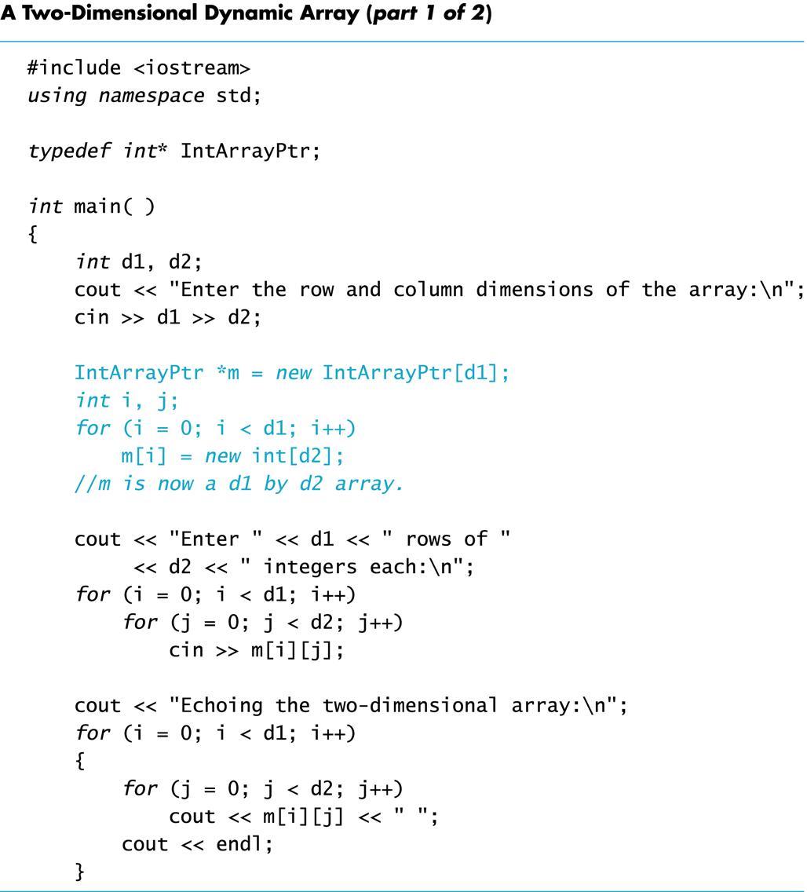
Display 9.7 (1/2)

Slide 76
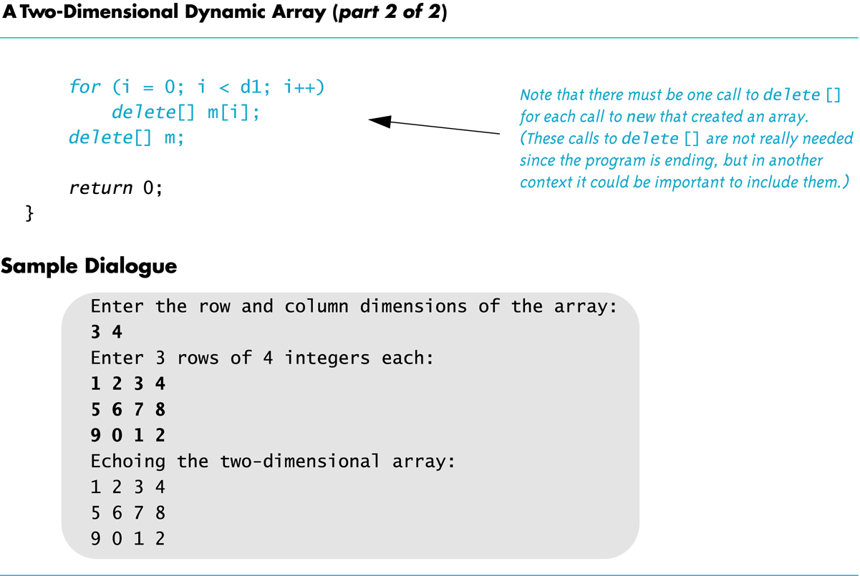
Display 9.7 (2/2)
Back
Next

Slide 77
Section 9.2 Exercises
Can you
Write a definition for pointer variables that will be used to point to dynamic arrays? The array elements are of type char. Call the type CharArray.
Write code to fill array "entry" with 10 numbers typed at the keyboard? int * entry; entry = new int[10];

Slide 78
9.10
Using Smart Pointers to Avoid Memory Leaks

Slide 79
Using Smart Pointers to Avoid Memory Leaks
In C++ 11, you can use smart pointers to dynamically allocate memory and not worry about deleting the memory when you are finished using it.
Three types of smart pointer:
Must #include the memory header file:
In this book, we introduce unique_ptr:
unique_ptr
shared_ptr
weak_ptr
#include <memory>
unique_ptr<int> ptr( new int );

Slide 80
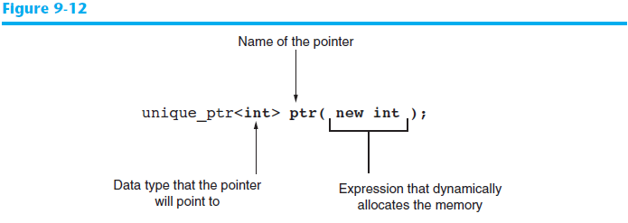
Using Smart Pointers to Avoid Memory Leaks
The notation <int> indicates that the pointer can point to an int .
The name of the pointer is ptr .
The expression new int allocates a chunk of memory to hold an int.
The address of the chunk of memory will be assigned to ptr.

Slide 81
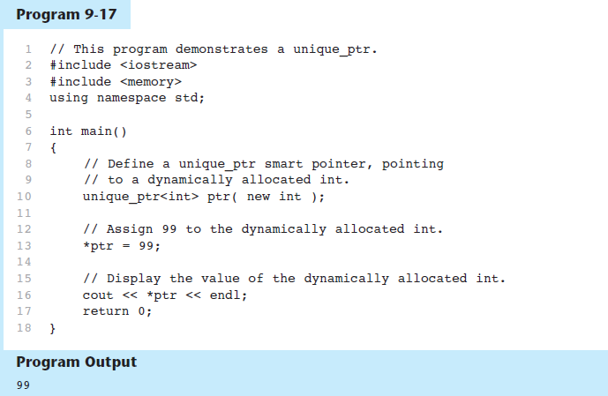
Using Smart Pointers in Program 9-17

