Slide 1
11.0
Class parameters, const

Slide 2
Parameter passing efficiency
A call-by-value parameter less efficient than a call-by-reference parameter
The parameter is a local variable initialized to the value of the argument
This results in two copies of the argument
For vectors and strings, it means dynamic allocation and copying the values. Expensive!!
A call-by-reference parameter is more efficient
The parameter is a placeholder replaced by the argument
There is only one copy of the argument

Slide 3
Class Parameters
It can be much more efficient to use call-by-reference parameters when the parameter is of a class type
When using a call-by-reference parameter
If the function does not change the value of the parameter, mark the parameter so the compiler knows it should not be changed

Slide 4
const Parameter Modifier
To mark a call-by-reference parameter so it cannot be changed:
Use the modifier const before the parameter type
The parameter becomes a constant parameter
const used in the function declaration and definition

Slide 5
Chapter 10
Defining Classes

Slide 6
What Is a Class?
A class is a data type that is defined by a user to represent an object.
Most of the data types we have used are built-in types, such as
int, char, float, double, long, char*
We can define our own data types using
typedefs -> typedef type TypeName;
structs
classes

Slide 7
Class Definitions
A class definition includes
Properties and functions that apply to the entire class [class variables, class methods]
Properties that are common to every member. [instance variables]
Functions that are available to every member. [methods or member functions]
We will start by defining structures as a first step toward defining classes

Slide 8
Overview
10.1 Structures
10.2 Classes
10.3 Abstract Data Types
10.4 Introduction to Inheritance

Slide 9
10.1
Structures

Slide 10
Structures
A structure can be viewed as an object
Used when multiple values are needed to describe an object. Examples?
Doesn’t need to contain member functions (The structures used here have no member functions)
Contains multiple values of possibly different types
The multiple values are logically related as a single item
Example: A bank Certificate of Deposit (CD) has the following values: a balance an interest rate a term (months to maturity)

Slide 11
The CD Definition
The Certificate of Deposit structure can be defined as struct CDAccount { double balance; double interest_rate; int term; //months to maturity };
Keyword struct begins a structure definition
CDAccount is the structure tag
Member names are identifiers declared in the braces
Remember this semicolon!

Slide 12
Using the Structure
Structure definition is generally placed outside any function definition in the global space.
This makes the structure type available to all code that follows the structure definition
To declare two variables of type CDAccount: CDAccount my_account, your_account;
My_account and your_account contain distinct member variables balance, interest_rate, and term

Slide 13
The Structure Value
The Value of a Structure
Consists of the values of the member variables of the structure
The value of an object of type CDAccount
Consists of the values of the member variables balance interest_rate term

Slide 14
Specifying Member Variables
Member variables are specific to the structure variable in which they are declared
Syntax to specify a member variable: Structure_Variable_Name.Member_Variable_Name
Given the declaration: CDAccount my_account, your_account;
Use the dot operator to specify a member variable my_account.balance my_account.interest_rate my_account.term

Slide 15
Using Member Variables
Member variables can be used just as any other variable of the same type
my_account.balance = 1000; your_account.balance = 2500;
Notice that my_account.balance and your_account.balance are different variables!
my_account.balance = my_account.balance + interest;
Display 10.1 (1)
Display 10.1 (2)

Slide 16
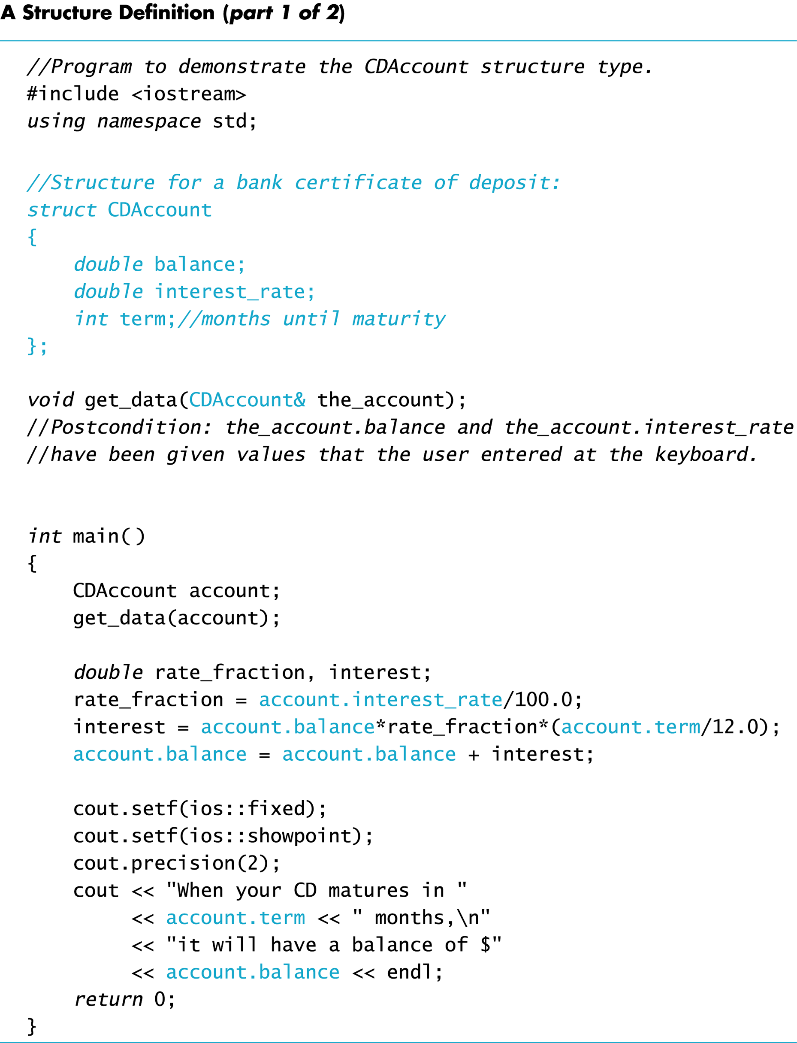
Display 10.1 (1/2)

Slide 17
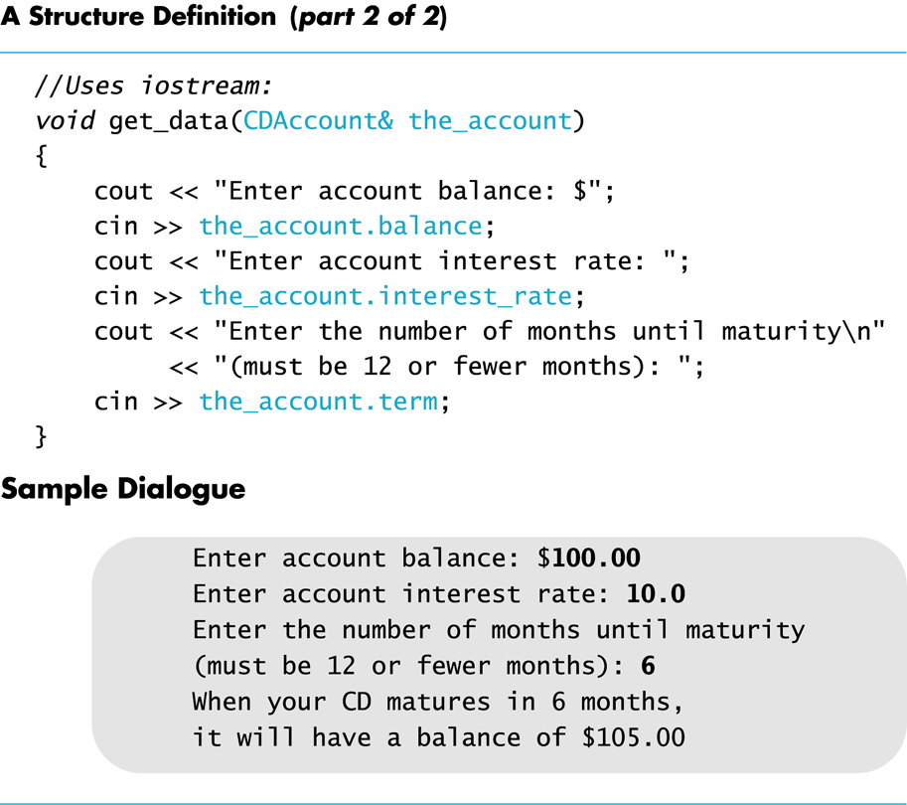
Display 10.1 (2/2)

Slide 18
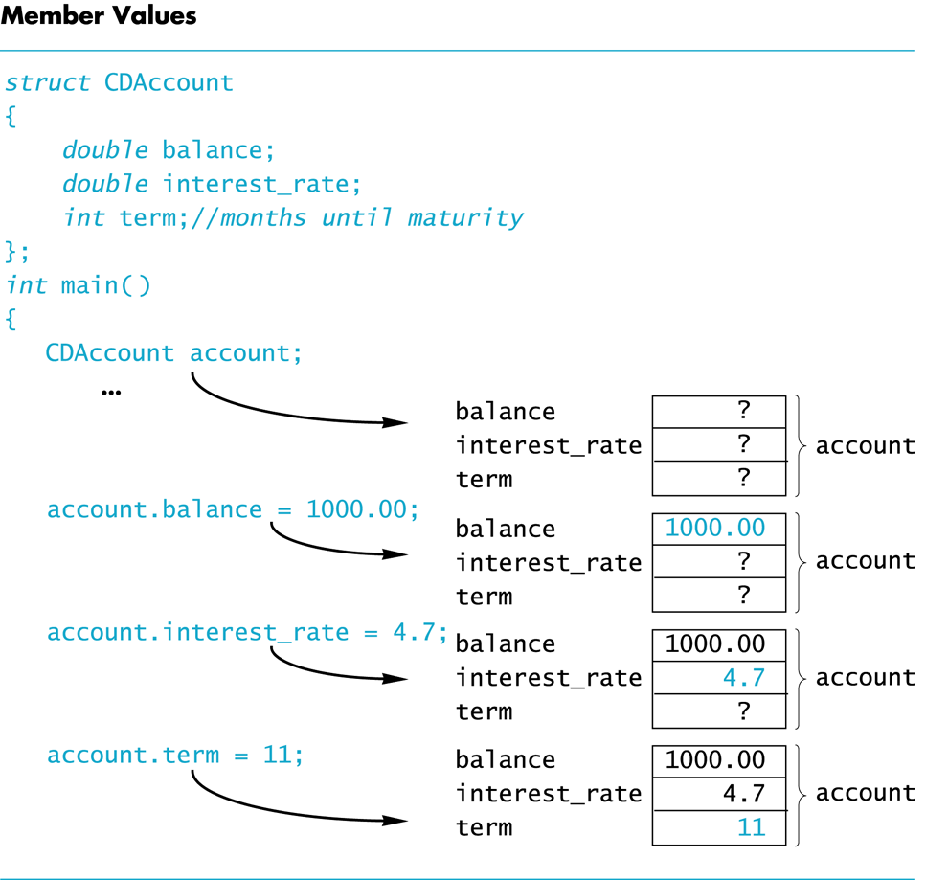
Display 10.2

Slide 19
Duplicate Names
Member variable names duplicated between structure types are not a problem.
super_grow.quantity and apples.quantity are different variables stored in different locations
struct FertilizerStock { double quantity; double nitrogen_content; }; FertilizerStock super_grow;
struct CropYield { int quantity; double size; }; CropYield apples;

Slide 20
Structures as Arguments
Structures can be arguments in function calls
The formal parameter can be call-by-value
The formal parameter can be call-by-reference
Example: void get_data(CDAccount& the_account);
Uses the structure type CDAccount we saw earlier as the type for a call-by-reference parameter

Slide 21
Assignment and Structures
The assignment operator can be used to assign values to structure types
Using the CDAccount structure again: CDAccount my_account, your_account; my_account.balance = 1000.00; my_account.interest_rate = 5.1; my_account.term = 12; your_account = my_account;
Assigns all member variables in your_account the corresponding values in my_account

Slide 22
Structures as Return Types
Structures can be the type of a value returned by a function.
Example: CDAccount shrink_wrap(double the_balance, double the_rate, int the_term) { CDAccount temp; temp.balance = the_balance; temp.interest_rate = the_rate; temp.term = the_term; return temp; }

Slide 23
Using Function shrink_wrap
shrink_wrap builds a complete structure value in temp, which is returned by the function
We can use shrink_wrap to give a variable of type CDAccount a value in this way:
CDAccount new_account;
new_account = shrink_wrap(1000.00, 5.1, 11);
The above assignment operator copies the whole structure content (given by the return statement) into new_account.

Slide 24
Hierarchical Structures
Structures can contain member variables that are also structures
struct PersonInfo contains a Date structure
struct PersonInfo { double height; int weight; Date birthday; };
struct Date { int month;
int day;
int year; };

Slide 25
Using PersonInfo
A variable of type PersonInfo is declared by
PersonInfo person1;
To display the birth year of person1, first access the birthday member of person1 cout << person1.birthday…
But we want the year, so we now specify the year member of the birthday member cout << person1.birthday.year;

Slide 26
Initializing Classes
A structure can be initialized when declared
Example: struct Date { int month; int day; int year; };
Can be initialized in this way Date due_date = {12, 31, 2004};
Compare with array initialization

Slide 27
Section 10.1 Exercise
Can you
Write a definition for a structure type for records consisting of a person’s wage rate, accrued vacation (in whole days), and status (hourly or salaried). Represent the status as one of the two character values ‘H’ and ‘S’. Call the type EmployeeRecord.

Slide 28
Structure EmployeeRecord
Define a structure called EmployeeRecord that has the following fields:
A wage rate – to hold a monetary value
Accrued vacation – in whole days
A wage status for hourly vs salaried
What types do these fields have?

Slide 29
Struct EmployeeRecord
Now we can definition the EmployeeRecord
struct EmployeeRecord {
double wage_rate; // hourly or annual rate
int accrued_vacation; // in whole days
char wage_status; // ‘H’ = hourly; ‘S’=annual
};

Slide 30
Structs (and Classes) as parameters

Slide 31
Passing structs as arguments
Pass-by-values copies the struct member by member onto the stack into the parameters. - waste of time and space.
Pass-by-reference copies only the address of the object onto the stack but the argument can be changed.
- dangerous unless change is expected.
We want an efficient way to pass objects (structs and classes) as arguments.

Slide 32
Struct as Function Arguments
Using value parameter for structure can slow down a program, waste space with object copy
Using a reference parameter will speed up program, but function may change data in structure
Using a const reference parameter allows read-only access to reference parameter, does not waste space, speed
void displayDate(const Date& date) {
cout << date.month << ‘/’ <<
date.day << ‘/’ << date.year;
}

Slide 33
11.9
Pointers to Structures

Slide 34
Pointers to Structures
A structure variable has an address
Pointers to structures are variables that can hold the address of a structure:
Student *stuPtr;
Can use & operator to assign address:
stuPtr = & stu1;
Structure pointer can be a function parameter

Slide 35
Accessing Structure Members via Pointer Variables
Must use () to dereference pointer variable, not field within structure:
cout << (*stuPtr).studentID;
Can use structure pointer operator to eliminate () and use clearer notation:
cout << stuPtr->studentID;

Slide 36
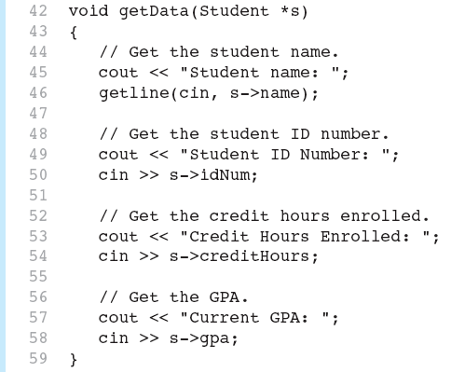
From Program 11-8

Slide 37
10.2
Classes

Slide 38
Classes
A class is a data type whose variables are called objects.
The definition of a class includes
Description of the kinds of values of the member variables
Description of the member functions
A class description is like a structure definition except that members are private by default…

Slide 39
A Class Example
To create a new type named DayOfYear as a class definition
Decide on the values to represent
This example’s values are dates such as July 4 using an integer for the number of the month
Member variable month is an int (Jan = 1, Feb = 2, etc.)
Member variable day is an int
Decide on the member functions needed
We use just one member function named output

Slide 40
Class DayOfYear Definition
class DayOfYear { public: void output( ); int month; int day; };
Member Function Declaration

Slide 41
Struct vs Class – the true difference!
Structs have public data members and functions by default
Access struct members directly using the ‘.’ (dot) operator:
cout << bday.month << “/” << bday.year;
Classes have private data members and functions by default.
Access class members using member functions called with the ‘.’ (dot) operator
bday.output();

Slide 42
Public or Private Members
The keyword public identifies the members of a class that can be accessed from outside the class
Members that follow the keyword public are public members of the class (can be accessed by anyone)
The keyword private identifies the members of a class that can be accessed only by member functions of the class (can only be accessed by class)
Members that follow the keyword private are private members of the class

Slide 43
Defining a Member Function
Member functions are declared in the class declaration
Member function definitions identify the class in which the function is a member
void DayOfYear::output() { cout << “month = “ << month << “, day = “ << day << endl; }

Slide 44
Member Function Definition
Member function definition syntax: Returned_Type Class_Name::Function_Name(Parameter_List) { Function Body Statements }
Example:
void DayOfYear::output( )
{ cout << “month = “ << month << “, day = “ << day << endl;
}

Slide 45
The ‘::’ Operator
‘::’ is the scope resolution operator
Tells the class a member function is a member of
void DayOfYear::output( ) indicates that function output is a member of the DayOfYear class
The class name that precedes ‘::’ is a type qualifier

Slide 46
‘::’ and ‘.’
:: used with classes to identify a member void DayOfYear::output( ) { // function body }
. used with variables (or objects) to identify a member DayOfYear birthday; birthday.output( );

Slide 47
Calling Member Functions
Calling the DayOfYear member function output is done in this way: DayOfYear today, birthday; today.output( ); birthday.output( );
Note that today and birthday have their own versions of the month and day variables for use by the output function
Display 10.3 (1)
Display 10.3 (2)

Slide 48
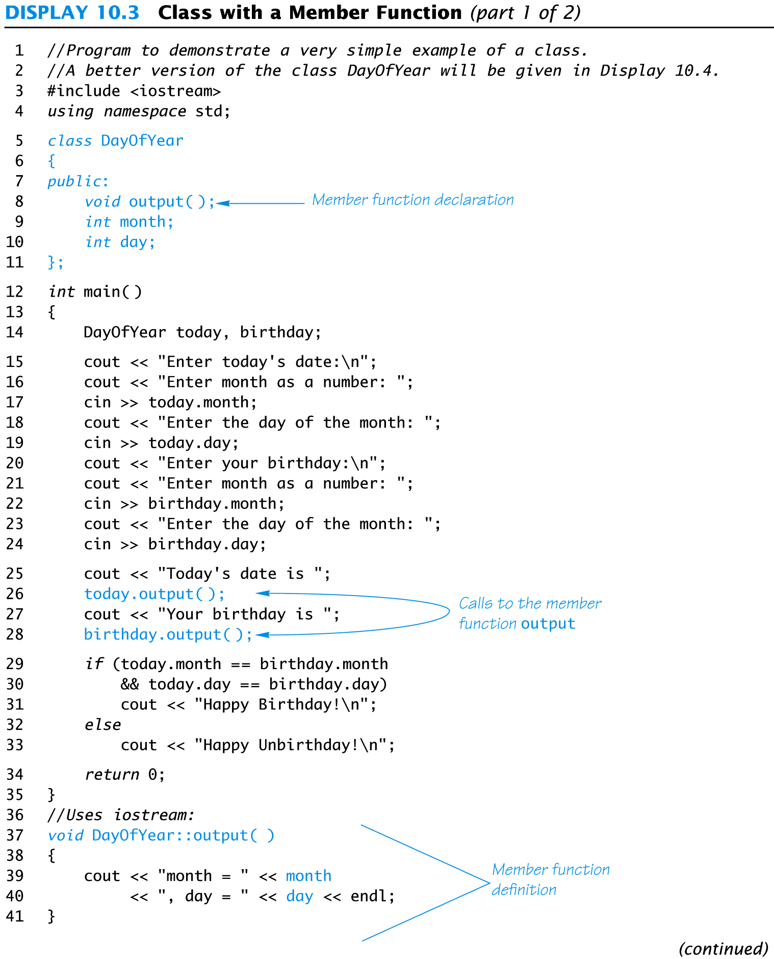
Display 10.3 (1/2)

Slide 49
Display 10.3 (2/2)

Slide 50
Ideal Class Definitions
Changing the implementation of DayOfYear requires changes to the program that uses DayOfYear
An ideal class definition of DayOfYear could be changed without requiring changes to the program that uses DayOfYear

Slide 51
Problems With DayOfYear
Changing how the month is stored in the class DayOfYear requires changes to the main program
If we decide to store the month as four characters (JAN, FEB, etc.) instead of an int
cin >> today.month will no longer work because we now have three character variables to read
if(today.month == birthday.month) will no longer work to compare months
The member function “output” no longer works

Slide 52
Fixing DayOfYear
To fix DayOfYear
We need to add member functions to use when changing or accessing the member variables
If the program (that uses DayOfYear) never directly references the member variables of DayOfYear, changing how the variables are stored will not require changing the program
We need to be sure that the program does not ever directly reference the member variables

Slide 53
Public Or Private?
C++ helps us restrict the program from directly referencing member variables
Private members of a class can only be referenced within the definitions of member functions
If the program (other than through member functions) tries to access a private member, the compiler gives an error message
Private members can be variables or functions

Slide 54
Private Variables
Private variables cannot be accessed directly by the program
Changing their values requires the use of public member functions of the class
To set the private month and day variables in a new DayOfYear class use a member function such as
void DayOfYear::set(int new_month, int new_day)
{ month = new_month; day = new_day;
}

Slide 55
Public or Private Members
The keyword private identifies the members of a class that can be accessed only by member functions of the class
Members that follow the keyword private are private members of the class
The keyword public identifies the members of a class that can be accessed from outside the class
Members that follow the keyword public are public members of the class

Slide 56
A New DayOfYear
The new DayOfYear class demonstrated in Display 10.4…
All member variables are private
Uses member functions to do all manipulation of the private member variables
Private member variables and member function definitions can be changed without changes to the program that uses DayOfYear
Display 10.4 (1)
Display 10.4 (2)

Slide 57
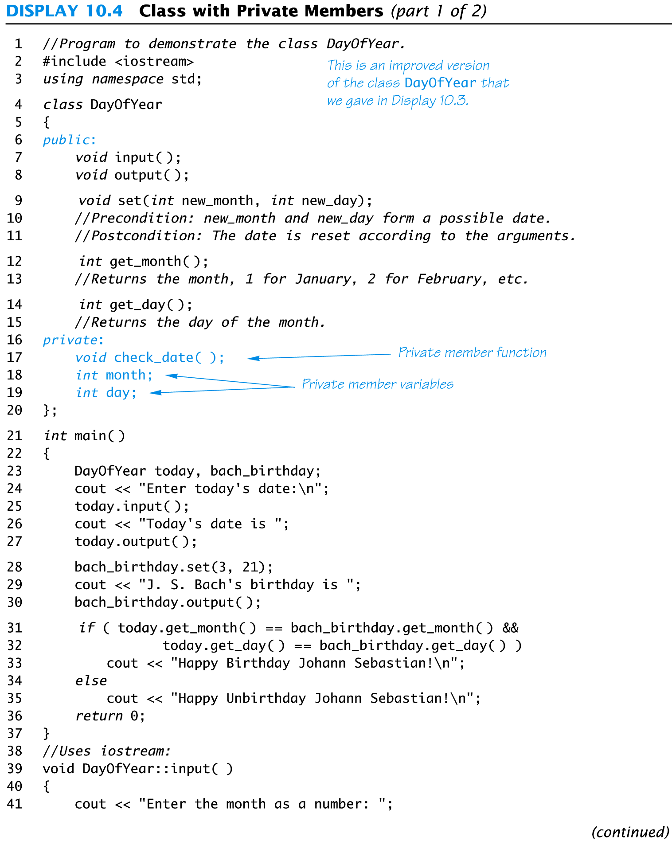
Display 10.4 (1/2)

Slide 58
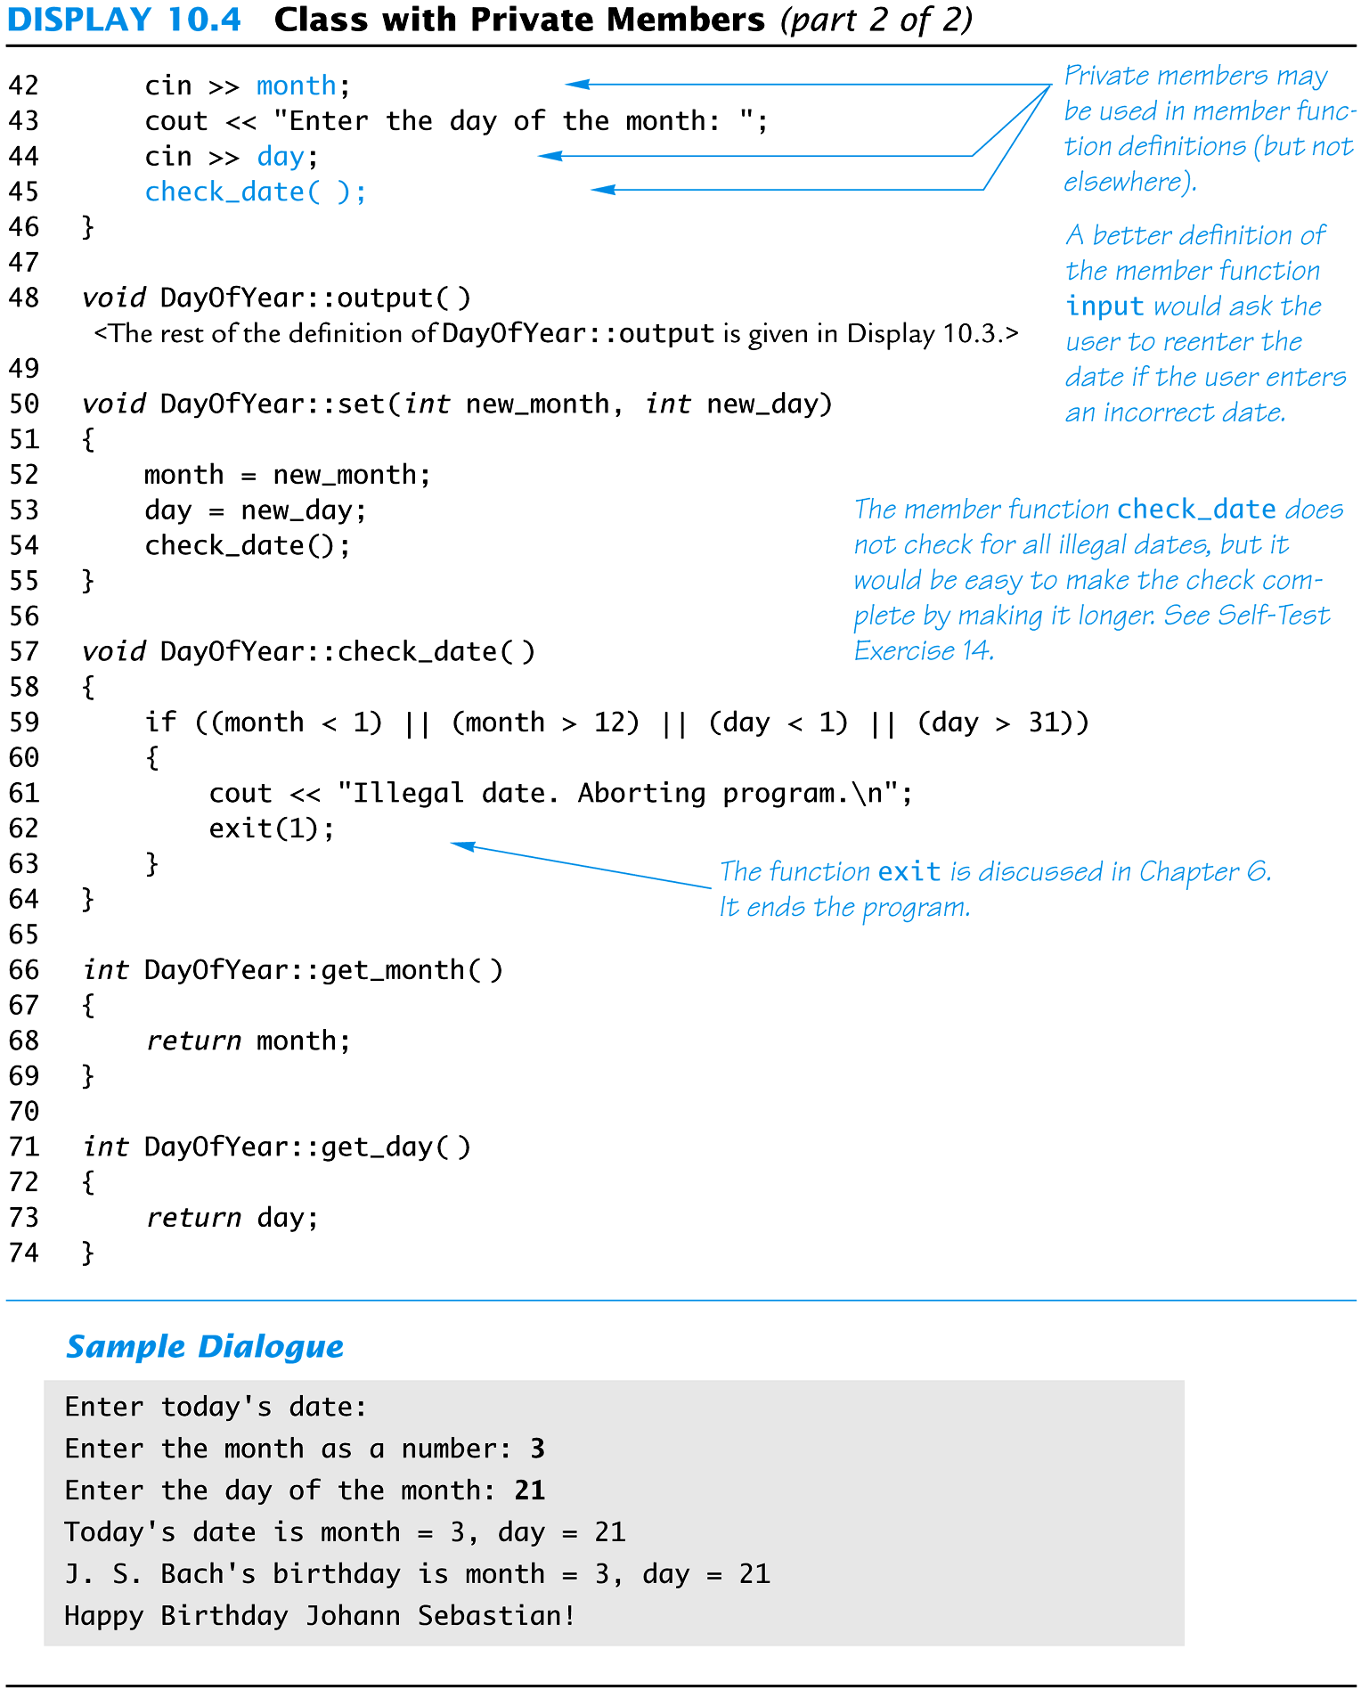
Display 10.4 (2/2)

Slide 59
Ideal Class Definitions
Changing the implementation of DayOfYear requires changes to the program that uses DayOfYear
An ideal class definition of DayOfYear could be changed without requiring changes to the program that uses DayOfYear
Member functions for
set(int month, int day), input(), output()
get_month() and get_day()

Slide 60
Using Private Variables
It is normal to make all member variables private
Private variables require member functions to perform all changing and retrieving of values
Accessor functions allow you to obtain the values of member variables
Example: get_day in class DayOfYear
Mutator functions allow you to change the values of member variables
Example: set in class DayOfYear
Another term for Accessor is getter and Mutator is setter.

Slide 61
Even more Ideal
Implement a member function that tells if one DayOfYear object is equal to another.
Remember that to call a member function requires an object and the ‘.’ operator.
What is the return type?
What is the parameter type?
What is the code?

Slide 62
bool isEqual(DayOfYear doy)
bool DayOfYear::isEqual(DayOfYear doy)
{
if (month == doy.get_month() &&
day == doy.get_day())
return true;
return false;
}

Slide 63
General Class Definitions
The syntax for a class definition is
class Class_Name { public: Member_Specification_1 Member_Specification_2 … Member_Specification_3 private: Member_Specification_n+1 Member_Specification_n+2 … };

Slide 64
The Assignment Operator
Objects and structures can be assigned values with the assignment operator (=)
Example:
DayOfYear due_date, tomorrow;
tomorrow.set(11, 19);
due_date = tomorrow;

Slide 65
Structs and classes syntax so far…
Structs
Classes
struct NewStruct {
type variable1;
…
};
void passReference(NewStruct& ns);
NewStruct shrink_wrap(var1,…);
NewStruct aStructVar;
NewStruct bStructVar;
// Assignment is supported
aStructVar = shrink_wrap(var1,…);
bStructVar = aStructVar;
class NewClass {
public:
type set(type var1,…);
private:
type privMemberFunc();
type variable1;
};
void passReference(NewClass& nc);
// Assignment is supported
NewClass aClassVar, bClassVar;
aClassVar.set(var1, …);
bClassVar = aClassVar;

Slide 66
Declaring an Object
Once a class is defined, an object of the class is declared just as variables of any other type
Example:
To create two objects of type Bicycle:
class Bicycle { // class definition lines }; Bicycle my_bike, your_bike;

Slide 67
Bicycle as a struct or class
struct Bicycle { // all members public
int wheel_height;
int num_wheels;
int num_gears;
}; // separate functions to set values
Bicycle initBicycle(int wht, int nw, int ng) {
Bicycle tempBike;
tempBike.wheel_height = wht;
tempBike.num_wheels = nw;
tempBike.num_gears = ng;
return tempBike;
}
// myBike and yourBike are distinct.
Bicycle myBike = initBicycle(15,2,10);
Bicycle yourBike = myBike;
class Bicycle { // public methods
public:
void set(int wht, int nw, int ng);
…
private: // private members, functions
int wheel_height;
int num_wheels;
int num_gears;
}; // member functions access fields directly
void Bicycle::set(int wht, int nw, int ng) {
wheel_height = wht;
num_wheels = nw;
num_gears = ng;
}
Bicycle myBike.set(15, 2, 10);

Slide 68
Encapsulation
Encapsulation is
Combining a number of items, such as variables and functions, into a single package such as an object of a class
Keeps the data or properties together with the functions that operate on them.
Why is encapsulation desirable?
Reusable, Maintainable.

Slide 69
Structs and classes
When do we use structs? When do we use classes?
Mostly, we use classes but…
Structs are useful when code has to be accessible to both c and c++.
Structs are useful to describe an object that is internal to a class or if direct access to data members is required
But even then, it’s probably better to just make it a class.

Slide 70
Consider a rectangle class
What is needed to describe a rectangle?
What functions can we do with a rectangle?
Consider using a rectangle in math class?

Slide 71
Class Rectangle
class Rectangle {
public:
int getHeight() const;
int getWidth() const;
int calcPerimeter() const;
int calcArea() const;
void set(int h, int w);
void addTo(int hDim, int wDim);
void draw();
private:
int height;
int width;
};
Public Members
Private Members

Slide 72
Access Specifiers
Used to control access to members of the class
public: can be accessed by functions outside of the class
private: can only be called by or accessed by functions that are members of the class

Slide 73
More on Access Specifiers
Can be listed in any order in a class
Can appear multiple times in a class
If not specified, the default is private

Slide 74
Constructors
Member function that is automatically called when an object is created
Purpose is to construct an object
Constructor function name is class name
Has no return type

Slide 75
Default Constructors
A default constructor is a constructor that takes no arguments.
If you write a class with no constructor at all, C++ will write a default constructor for you, one that does nothing.
A simple instantiation of a class (with no arguments) calls the default constructor:
Rectangle r;

Slide 76
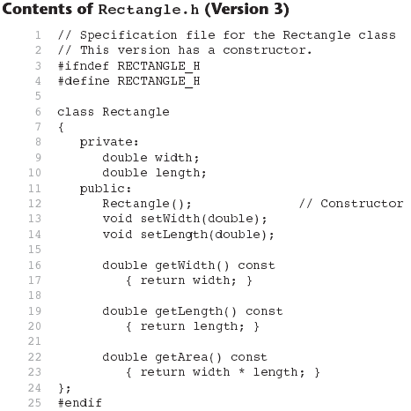

Slide 77
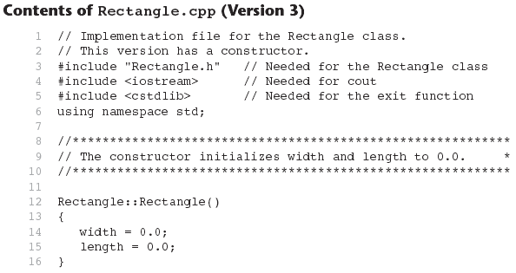
Continues...

Slide 78
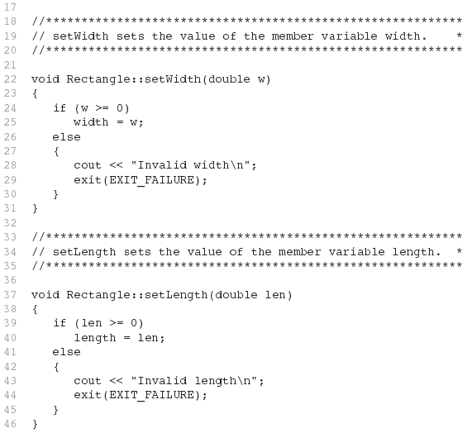
Contents of Rectangle.ccp Version3
(continued)

Slide 79
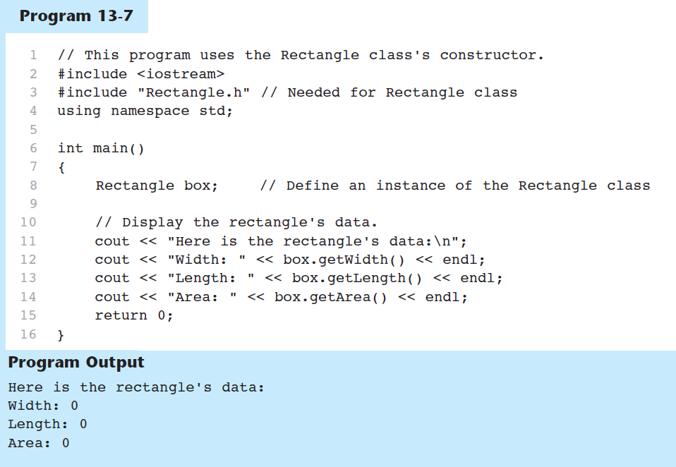

Slide 80
Default Constructors
If your program does not provide any constructor for a class defined by you, C++ generates a default one for you that does nothing.
If your program does provide some constructor (maybe only one), but no default constructor, C++ does NOT generate a default one.
See the demo program...

Slide 81
13.8
Passing Arguments to Constructors

Slide 82
Passing Arguments to Constructors
To create a constructor that takes arguments:
indicate parameters in prototype: Rectangle(double, double);
Use parameters in the definition: Rectangle::Rectangle(double w, double len) { width = w; length = len; }

Slide 83
Passing Arguments to Constructors
You can pass arguments to the constructor when you create an object:
Rectangle r(10, 5);

Slide 84
Classes with No Default Constructor
When all of a class's constructors require arguments, then the class has NO default constructor.
When this is the case, you must pass the required arguments to the constructor when creating an object.

Slide 85
Using const With Member Functions
const appearing after the parentheses in a member function declaration specifies that the function will not change any data in the calling object.

Slide 86
Defining a Member Function
When defining a member function:
Put prototype in class declaration
Define function using class name and scope resolution operator (::)
int Rectangle::setWidth(double w)
{
width = w;
}

Slide 87
Remember Accessors and Mutators
Mutator: a member function that stores a value in a private member variable, or changes its value in some way
Accessor: function that retrieves a value from a private member variable. Accessors do not change an object's data, so they should be marked const.

Slide 88
13.3
Defining an Instance of a Class

Slide 89
Defining an Instance of a Class
An object is an instance of a class
Defined like structure variables:
Rectangle r;
Access members using dot operator:
r.setWidth(5.2);
cout << r.getWidth();
Compiler error if attempt to access private member using dot operator

Slide 90
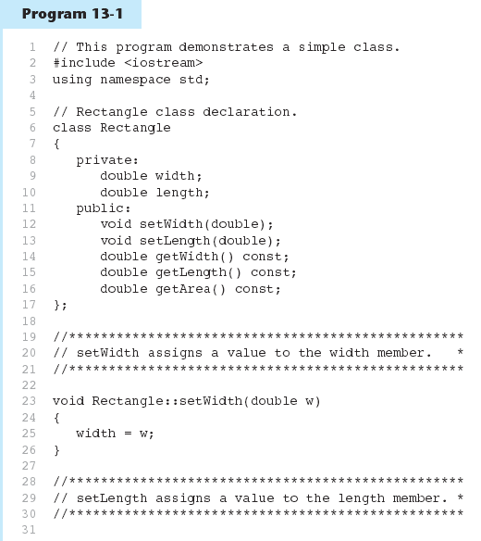

Slide 91
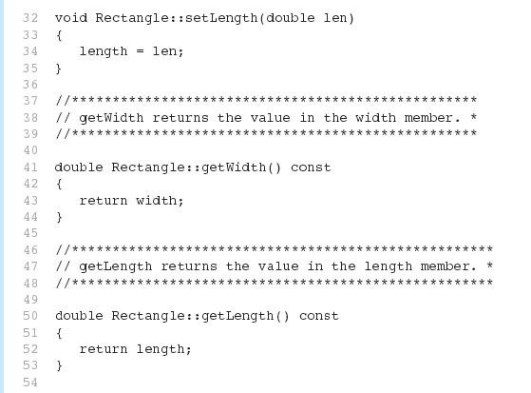
Program 13-1 (Continued)

Slide 92
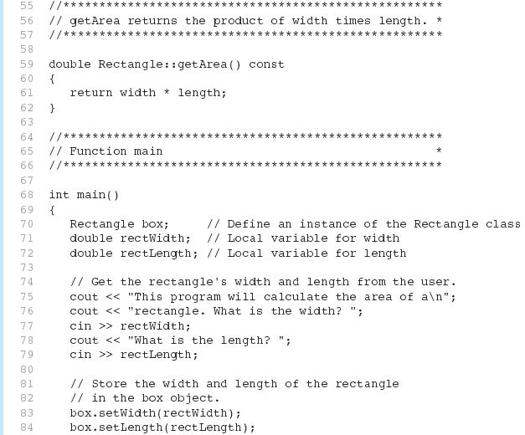
Program 13-1 (Continued)

Slide 93
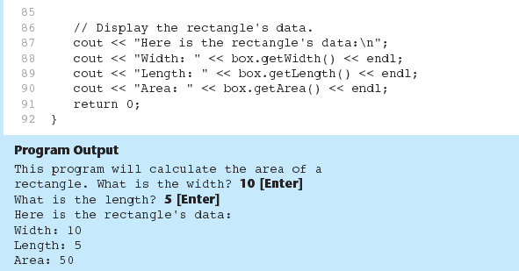
Program 13-1 (Continued)

Slide 94
Avoiding Stale Data
Some data is the result of a calculation.
In the Rectangle class the area of a rectangle is calculated.
length x width
If we were to use an area variable here in the Rectangle class, its value would be dependent on the length and the width.
If we change length or width without updating area, then area would become stale.
To avoid stale data, it is best to calculate the value of that data within a member function rather than store it in a variable.

Slide 95
13.10
Overloading Constructors

Slide 96
Overloading Constructors
A class can have more than one constructor
Overloaded constructors in a class must have different parameter lists:
Rectangle(); Rectangle(double);
Rectangle(double, double);

Slide 97
More About Default Constructors
If all of a constructor's parameters have default arguments, then it is a default constructor. Done in declaration. For example:
Rectangle(double w= 0, double l= 0);
Creating an object and passing no arguments will cause this constructor to execute: Rectangle r;

Slide 98
Initialization Section
C++ constructors have a special section that can be used to initialize data members:
Rectangle::Rectangle(int w, int l) : width(w), length(l)
{
// purposely left empty
}

Slide 99
Simple InventoryItem
A simple object to describe an InventoryItem would include:
A text description of the item.
A cost of the item.
A price might also be included (not in book).
The number of units.
A SKU (stock keeping unit) for the item.

Slide 100
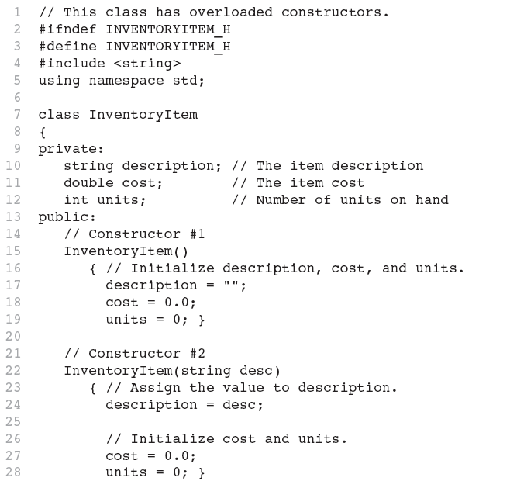
Continues...

Slide 101
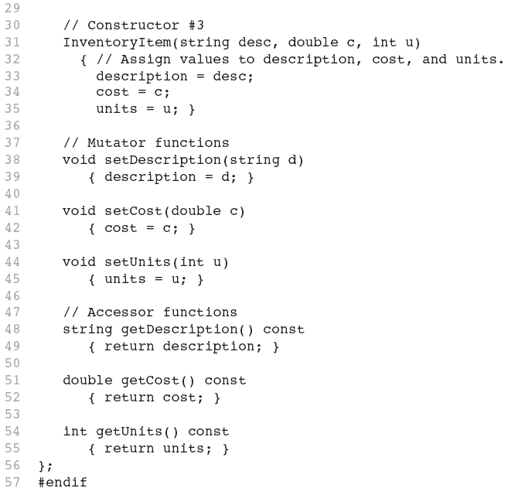

Slide 102
3.11
Using Private Member Functions

Slide 103
Section 10.2 Exercises
Can you answer the following:
Describe the difference between a class and a structure?
Explain why member variables are usually private?
Describe the purpose and usage of a constructor?
Use an initialization section in a constructor?
What is the purpose of a default constructor and when is one supplied automatically in a class.

Slide 104
Answers to Exercises
Describe the difference between a class and a structure?
structs are public by default; classes are private by default.
Explain why member variables are usually private?
Protect programs from class changes and objects from internal corruption.
Describe purpose and usage of a constructor?
Constructors are invoked when an object is created.
Used to declare variables.

Slide 105
Answers to Exercisess
Use initialization section in a constructor?
(See slide 98, see slide 111)
DayOfYear::DayOfYear(int m, int d) : month(m), day(d) { }
DayOfYear::DayOfYear() : month(1), day(1) { }
What is the purpose and when is a default constructor provided automatically?
If a class does not provide a constructor, a default constructor will automatically be provided that does nothing.
A default constructor is needed to declare objects.

Slide 106
As practice consider the following
Take our DayOfYear class and add two constructors: one that takes the month and day to initialize both data members and a default constructor.
Even though, we already added a member function called isEquals, try it on your own. Remember it takes a DayOfYear object as parameter.
Add a member function called isAfter that compares the invoking object to an object passed in as a parameter. if the calling object is later in the year, then return true. Otherwise false.

Slide 107
class DayOfYear { public:
int getMonth();
int getDay();
void output(ostream& outs);
void input(istream& ins);
private:
void check_date();
int month;
int day;
};

Slide 108
Start with the class DayOfYear
On the previous slide is the class DayOfYear before you make your changes.
The slides that follow show changes
Add the two constructors OR
Add one constructor with default values.
But this is equivalent to 3 constructors:
DayOfYear(); // default month = 1, day=1
DayOfYear(int mon); // default day = 1
DayOfYear(int mon, int day);

Slide 109
class DayOfYear { public:
DayOfYear();
DayOfYear(int mon, int day);
int getMonth();
int getDay();
void output(ostream& outs);
void input(istream& ins);
private:
void check_date();
int month,day;
};

Slide 110
class DayOfYear { public:
DayOfYear(int mon=1, int day=1);
int getMonth();
int getDay();
void output(ostream& outs);
void input(istream& ins);
private:
void check_date();
int month,day;
};

Slide 111
Implementation of Constructor
// Set data members in initialization
// section, check_date() exits if not
// valid
DayOfYear::DayOfYear(int m, int d) : month(m), day(d)
{
check_date();
}
Not necessary to use initialization section!

Slide 112
Overloaded constructors
Remember Rectangle class with the following constructors:
Rectangle();
Rectangle(double side);
Rectangle(double w, double l);
What if we added?
Rectangle(double w); // Compiler error
Overloaded functions must have different number and/or types of parameters!!!

Slide 113
isAfter() member function
It’s tempting to pass an int month and int day, but let’s compare to another DayOfYear!
// Add to public part of class
bool isAfter(DayOfYear d);
// Implementation outside of the class
bool DayOfYear::isAfter(DayOfYear d)
{
return (getMonth() > d.getMonth() ||
(getMonth() == d.getMonth() &&
getDay() > d.getDay()));
}

Slide 114
Practice Finding the errors.
class Automobile {
public:
void setPrice(double price);
void setProfit(double profit);
double get_price();
private:
double get_profit();
double price;
double profit;
}; Automobile jaguar, hyundai;
hyundai.price=4999.99; jaquar.set_price(59,000.00);
double a_price = jaguar.get_price(), a_profit = hyundai.get_profit();
if (hyundai == jaguar)
cout << “Want to swap cars?” << endl;
hyundai = jaguar;

Slide 115
See Errors
If a data member or member function is private, it cannot be accessed outside of the class.
Errors are in red.

Slide 116
Practice Finding the errors.
class Automobile {
public:
void set_price(double price);
void set_profit(double profit);
double get_price();
private:
double get_profit();
double price;
double profit;
}; Automobile jaguar, hyundai;
hyundai.price=4999.99; jaquar.set_price(59,000.00);
double a_price = jaguar.get_price(), a_profit = hyundai.get_profit();
if (hyundai == jaguar) // No operator == exists for Automobile
cout << “Want to swap cars?” << endl;
hyundai = jaguar;

Slide 117
Consider a BankAccount class
First ask, what is it?
Answering “what it is?” gives us the data
Could be several data representations
E.g. a rational number could be…
3.1459 or 2/3 but is a fraction.
Then ask, what does it do?
Answering “what it does?” gives us the functions.

Slide 118
BankAccount
What it is?
A balance (but that balance can be expressed as…)
double balance; // Fractional cents problem
int cents; // More exact
int dollars, int cents; // Multiple components
An interest rate
An account number
unsigned long acctNumber;
string acctNumber; // Mix of chars, digits

Slide 119
BankAccount
When a BankAccount is created, there is an initial deposit.
BankAccount(int dollars = 0, int cents = 0);
Typical banking functions include:
makeDeposit(double amount)
makeWithdrawl(double amount)
makeTransfer(double amnt, BankAccount ba)
addAccruedInterest(double rate)
issueMonthlyStatement()

Slide 120
BankAccount con’t
In order to issue a monthly statement, we need to keep track of transactions.
An easy way to do that is to create a Transaction structure that is used by the BankAccount object.
Private data for BankAccount includes:
double balance;
double interest_rate;
vector <Transaction> transactions;

Slide 121
struct transaction
Every transaction has a dollar amount.
Every transaction has a date (and time).
Every transaction has a type.
We’ll use a similar construct as wage_status in a previous example.
There are 5 different transaction types:
Deposits Transfers
Withdrawls Overdraft
Interest payments

Slide 122
Struct transaction
Here’s the struct that represents Transaction type in our BankAccount application.
struct Transaction {
char type; // ‘D’, ‘W’, ‘O’, ‘I’, ‘T’
double amount;
Date date; // Date struct or class
};
In order to issue a monthly statement, we need to keep a list of Transactions.

Slide 123
struct Transaction
How do we keep track of transactions for the month?
vector<Transaction> transactions;
Write a method to shrink_wrap or initialize a transaction to be stored in transactions.
How do we get a month’s worth of transactions?
Write a method to start at the end and go backwards until we hit the previous month.

Slide 124
Class BankAccount
Remember that we want BankAccount to support normal banking functions such as:
makeDeposit(double amount)
makeWithdrawl(double amount)
makeTransfer(double amnt, BankAccount ba)
addAccruedInterest(double rate)
issueMonthlyStatement(DayOfYear from)
getBalance(), getInterestRate(), getAccountNum()
Each banking function will be represented by a member function.

Slide 125
Class BankAccount and struct Transaction
/*
* BankAccount class
* keeps the data along with all of the functions that apply to a BankAccount.
*/
class BankAccount {
public:
BankAccount(int dollars = 0, int cents = 0); // Includes default constructor
// Constants that apply to the whole class
static const char DEPOSIT = 'D';
static const char WITHDRAWL = 'W’;
static const char INTEREST = 'I';
static const char OVERDRAFT = ‘O’;
static const char TRANSFER = ‘T’;
// Accessors/Mutators (setters/getters)
void set(double balance, double interest_rate);
double getBalance();
double getInterestRate();

Slide 126
Class BankAccount and struct Transaction
unsigned long getAccountNum();
// Public method interface
double makeDeposit(double deposit);
double makeWithdrawl(double withdrawl);
double makeTransfer(double transfer, BankAccount toAcct);
double addAccruedInterest();
void issueMonthlyStatement(DayOfYear from, DayOfYear until);
private:
// Private utility methods
Transaction shrink_wrap(char type, double amount, time_t date=0);
void record_transaction(unsigned long account, char type, double amount, Date td);
// Instance variables
unsigned long account_num; // Accommodates a long number
int cents; // No danger of fractional cents.
double interest_rate;
vector<Transaction> transactions; // Audit trail of all transactions.
};

Slide 127
10.3
Abstract Data Types

Slide 128
Object-Oriented Programming Terminology
class: like a struct (allows bundling of related variables), but variables and functions in the class can have different properties than in a struct
object: an instance of a class, in the same way that a variable can be an instance of a struct

Slide 129
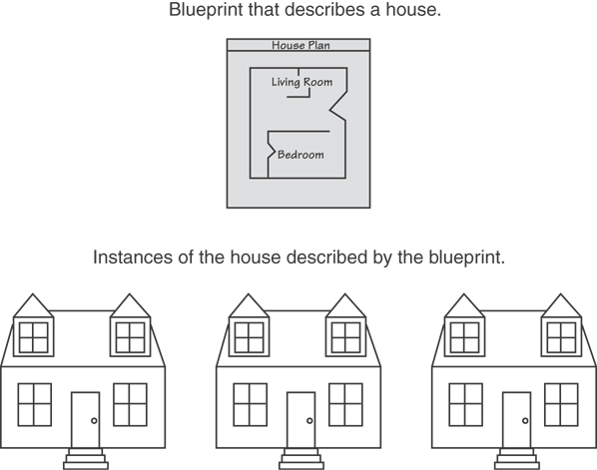
Classes and Objects
A Class is like a blueprint and objects are like houses (instances) built from the blueprint

Slide 130
Object-Oriented Programming Terminology
properties: data members of a class aka instance variables.
methods or behaviors: member functions of a class are known as methods.
invoking object is the calling object.
When a method is invoked there is always an invoking object that is copied into a special pointer known as the this pointer

Slide 131
Abstract Data Types
A data type consists of a collection of values together with a set of basic operations defined on the values
example: int type and its associated valid operations
A data type is an Abstract Data Type (ADT) if programmers using the type do not have access to the details of how the values and operations are implemented
example: int, double

Slide 132
Procedural and Object-Oriented Programming
Procedural programming focuses on the process/actions that occur in a program
Object-Oriented programming is based on the data and the functions that operate on it. Objects are instances of ADTs that represent the data and its functions

Slide 133
Classes To Produce ADTs
To define a class so it is an ADT
Separate the specification of how the type is used by a programmer from the details of how the type is implemented
Make all member variables private members
Helper functions should be private members
Basic operations a programmer needs should be public member functions
Fully specify how to use each public function

Slide 134
More on Objects
data hiding: restricting access to certain members of an object
Protects programs from changes in classes.
Protects objects from data corruption.
public interface: members of an object that are available outside of the object. This allows the object to provide access to some data and functions without sharing its internal details and design, and provides some protection from data corruption

Slide 135
ADT Interface
The ADT interface tells how to use the ADT in a program
The interface consists of
The public member functions’ declarations or prototypes
The comments that explain how to use those functions
The interface should be all that is needed to know how to use the ADT in a program

Slide 136
ADT Implementation
The ADT implementation tells how the interface is realized in C++
The implementation consists of
The private members of the class
The definitions of public and private member functions
The implementation of a class’s interface is needed to run a program that uses the class.
The implementation is not needed to write the main part of a program or any non-member functions

Slide 137
ADT Benefits
Changing an ADT implementation does not require changing a program that uses the ADT
ADT’s make it easier to divide work among different programmers
One or more can write the ADT
One or more can write code that uses the ADT
Writing and using ADTs breaks the larger programming task into smaller tasks

Slide 138
Program Example The BankAccount ADT
In the version of the BankAccount ADT shown in Display 10.7.
Data is stored as three member variables
The dollars part of the account balance
The cents part of the account balance
The interest rate
This version stores the interest rate as a fraction
The public portion of the class definition remains unchanged from the version of Display 10.6
Same interface, different implementation
Display 10.6
Display 10.7

Slide 139
Display 10.6 (1/3)

Slide 140
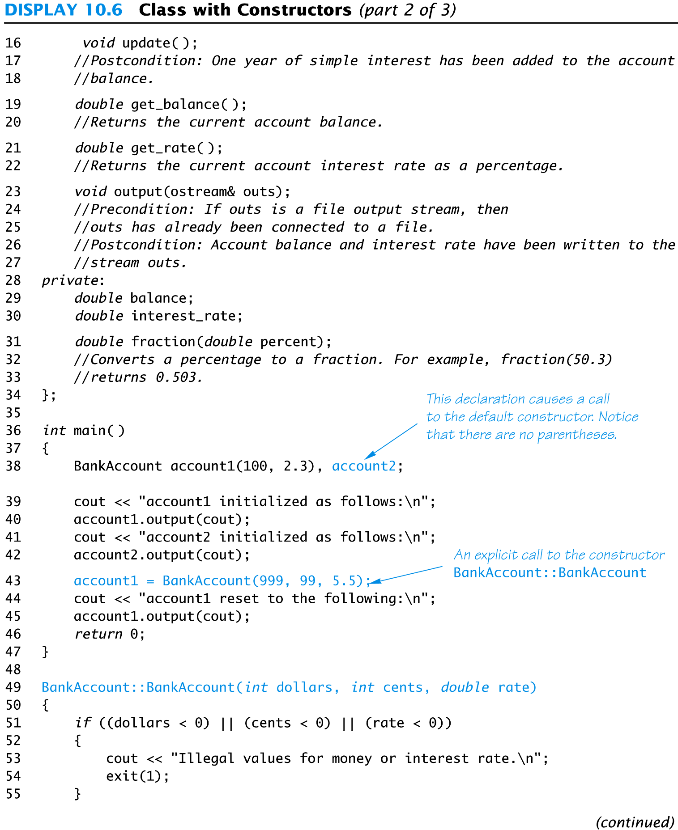
Display 10.6 (2/3)

Slide 141
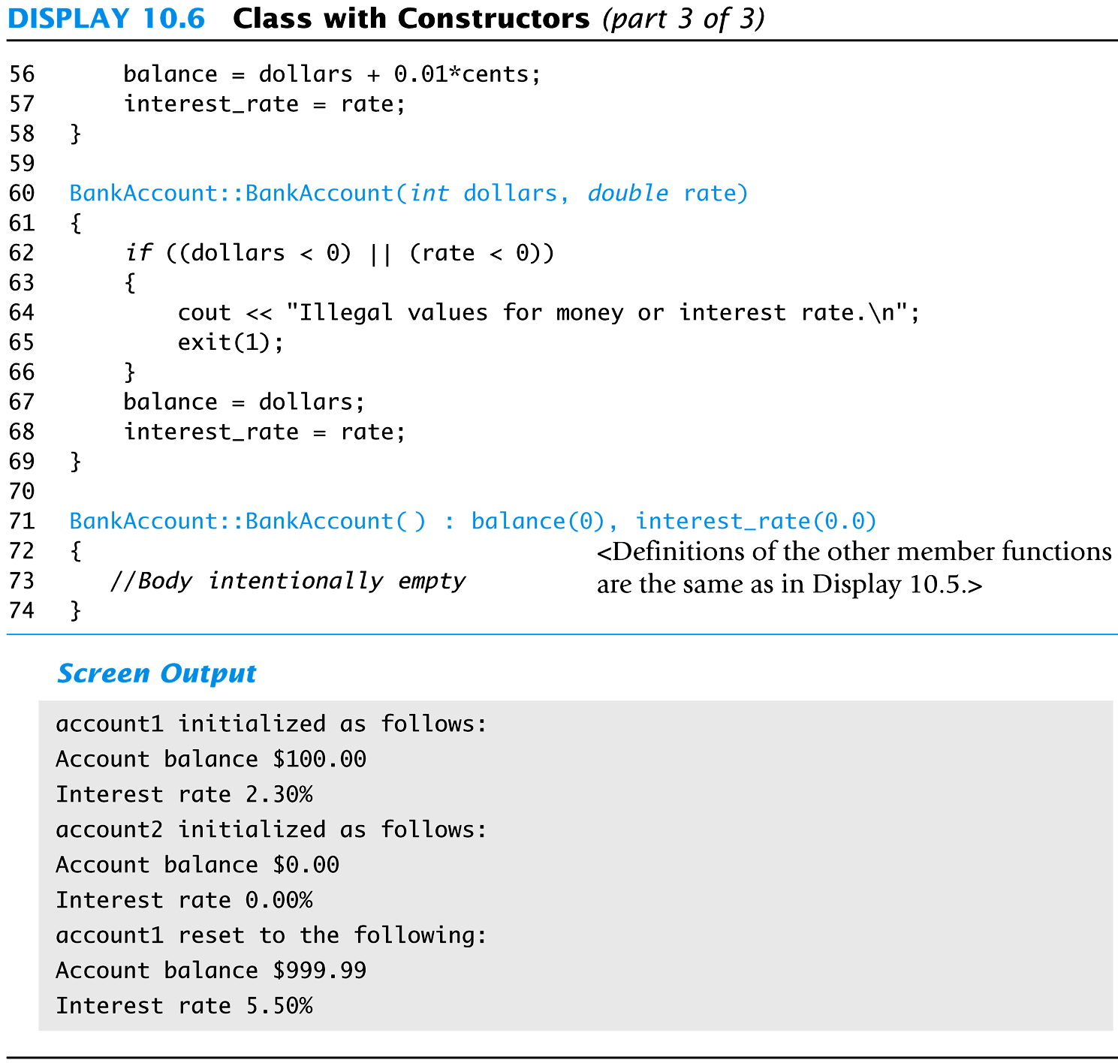
Display 10.6 (3/3)

Slide 142
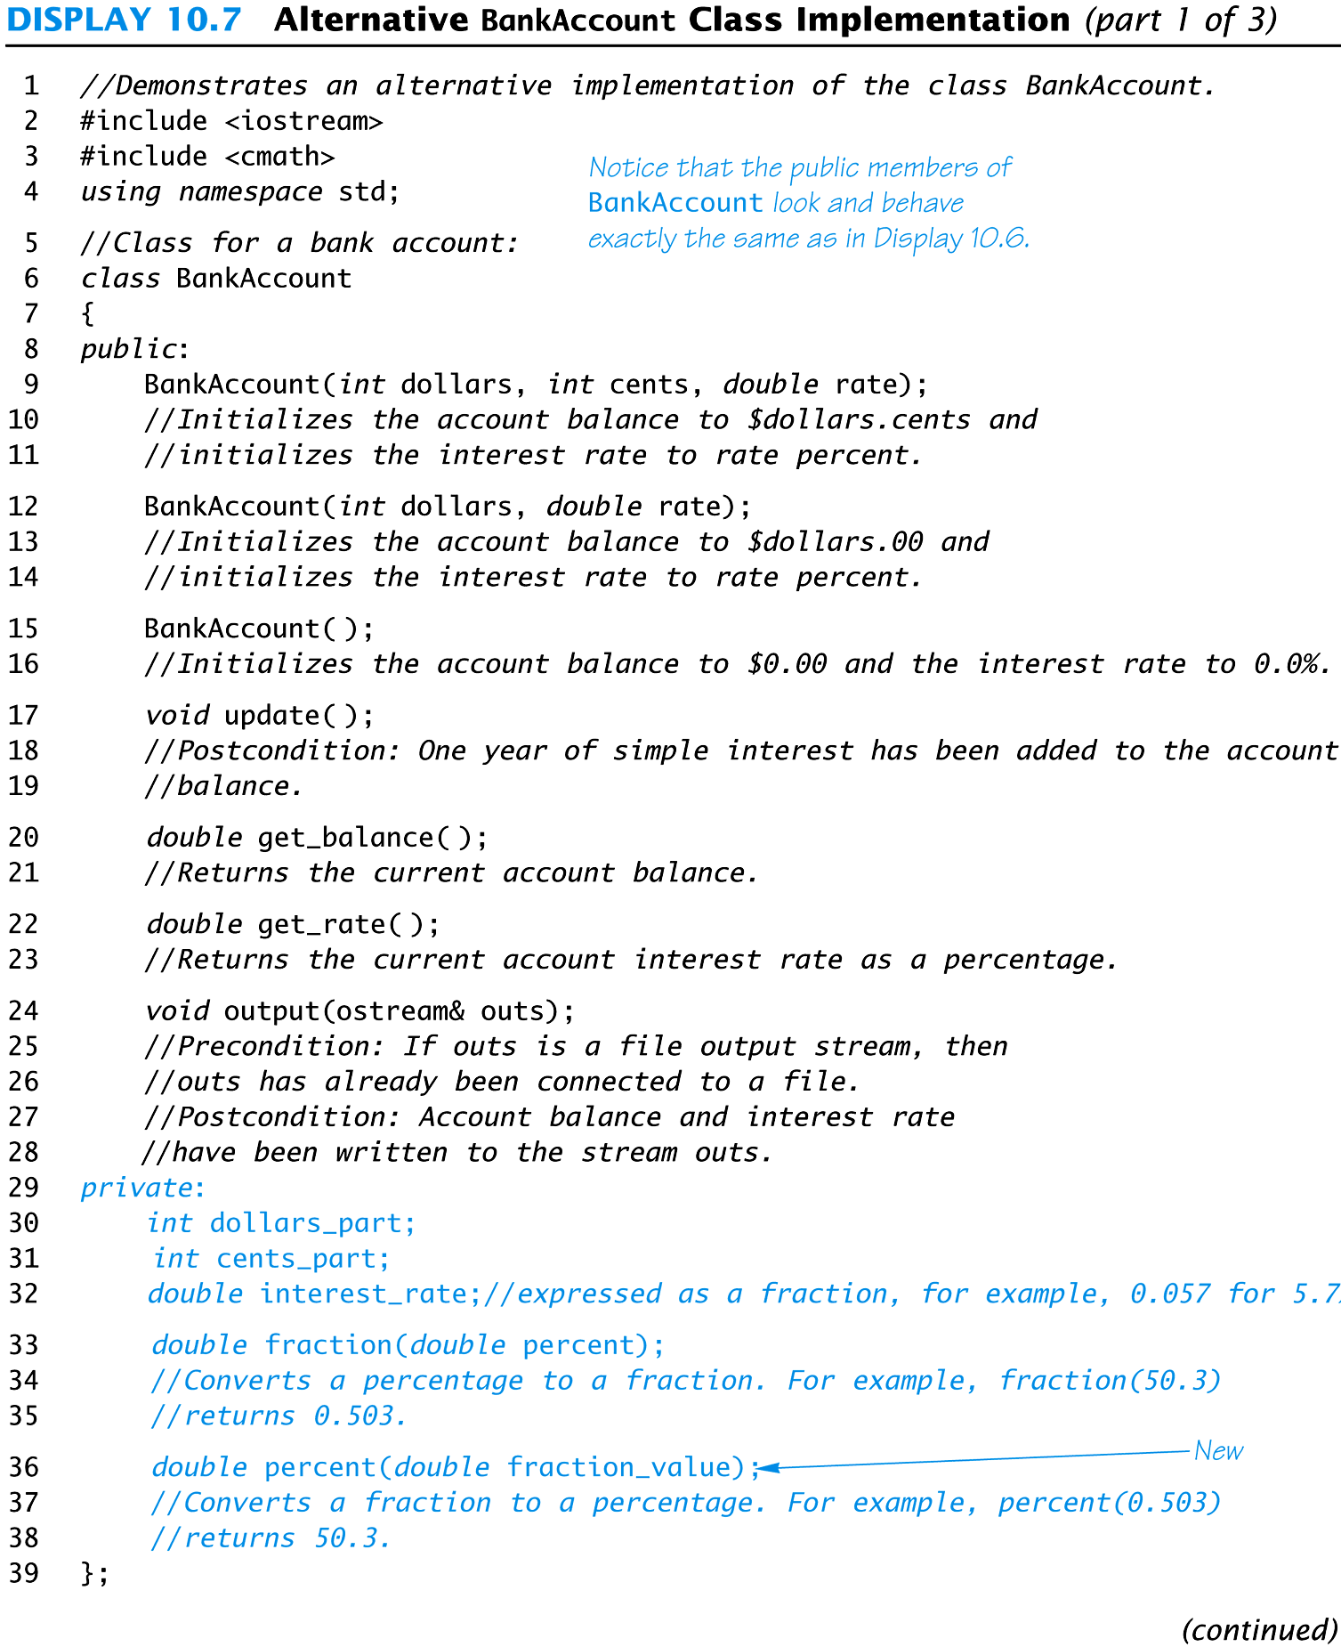
Display 10.7 (1/3)

Slide 143
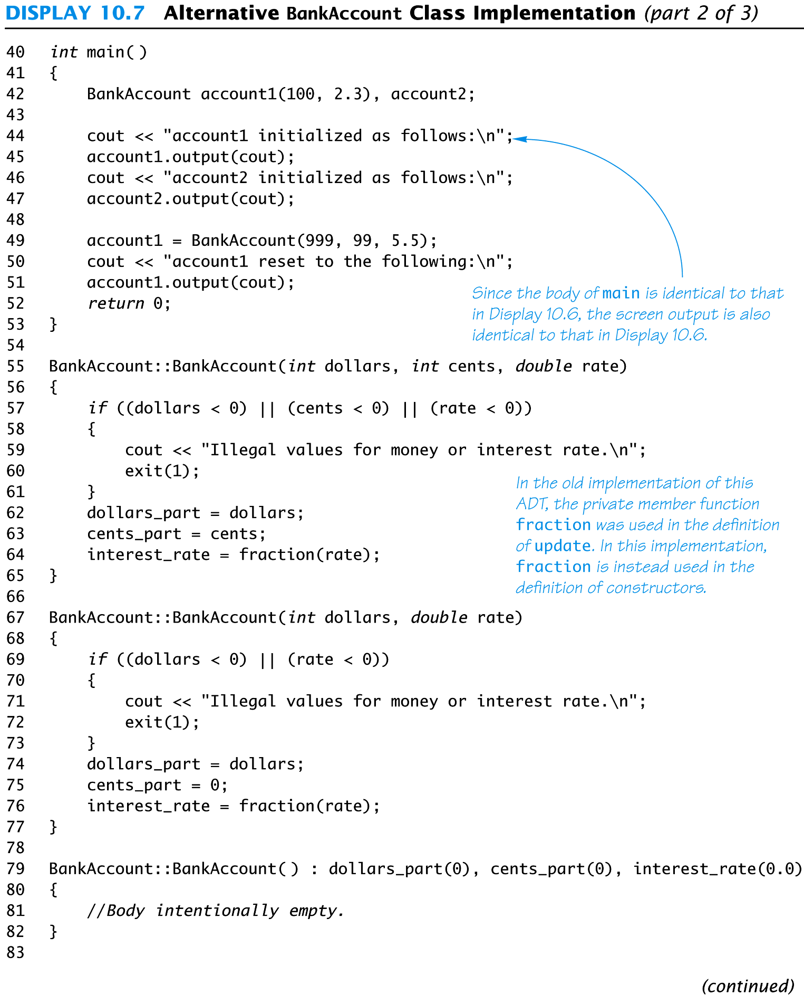
Display 10.7 (2/3)

Slide 144
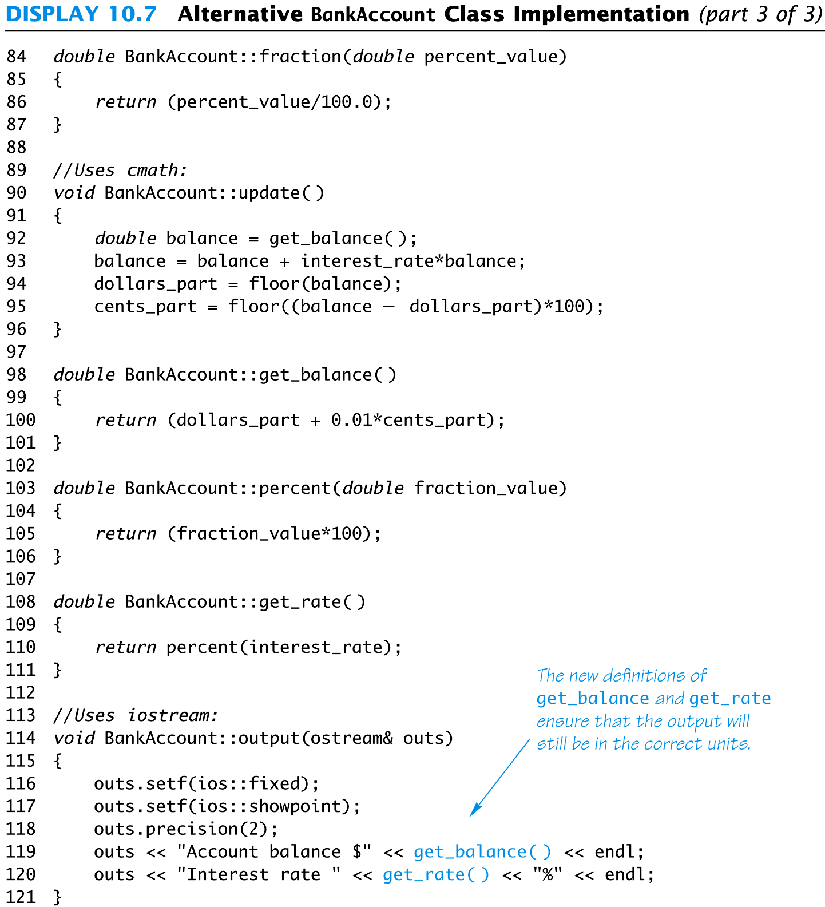
Display 10.7 (3/3)

Slide 145
Interface Preservation
To preserve the interface of an ADT so that programs using it do not need to be changed
Public member declarations cannot be changed
Public member definitions (i.e., implementation or realization) can be changed
Private member functions can be added, deleted, or changed

Slide 146
Information Hiding
Information hiding was referred to earlier as writing functions so they can be used like black boxes
ADT’s does information hiding because
The interface is all that is needed to use the ADT
Implementation details of the ADT are not needed to know how to use the ADT
Implementation details of the data values are not needed to know how to use the ADT

Slide 147
Section 10.3 Exercises
Can you
Describe an ADT?
Describe how to implement an ADT in C++?
Define the interface of an ADT?
Define the implementation of an ADT?

Slide 148
Another example
Let’s create an ADT called Rectangle.
When we define an ADT we have to think about what it needs to do and what it needs to be.
What an ADT needs to be is defined by the member variables.
What an ADT needs to do is defined by the member functions.

Slide 149
A Rectangle needs to be…
A shape with a positive, non-zero length and a height.
A shape that can have equal length and height which makes it the special case of a Square.
A shape that can be drawn needs a position and orientation (angle).

Slide 150
Rectangle
What kinds of things do you do with a Rectangle?
Get length and height
Calculate Perimeter
Calculate Area
isSquare
hasSamePerimeter
hasSameArea
Draw, Move, Rotate… // drawing program.

Slide 151
Rectangle constructors
Define a default constructor
Define a constructor for the special case of square.
Define a constructor for initializing both dimensions at creation.

Slide 152
Class Rectangle – public part
class Rectangle {
public:
Rectangle(); //default constructor
Rectangle(int side); // Square
Rectangle(int length, int height);
int get_length(); // length accessor
int get_height(); // height accessor
int calculatePerimeter();
int calculateArea();
bool hasSameArea(const Rectangle& r);
bool hasSamePerimeter(const Rectangle& r);
bool isSquare();

Slide 153
class Rectangle - private
class Rectangle {
public:
// see previous slide
void input(const istream& in);
void output(const ostream& out);
private:
int length; // member variables
int height;
bool check_dimensions();
};

Slide 154
10.4
Introduction to Inheritance

Slide 155
Inheritance
Inheritance refers to derived classes
Derived classes are obtained from another class by adding features
A derived class inherits the member functions and variables from its parent class without having to re-write them
Using inheritance establishes an Is-A relationship where is the derived class Is-A more specific version of the parent class.

Slide 156
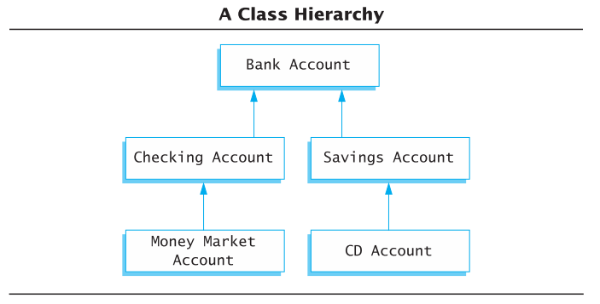
Inheritance Example
Natural hierarchy of bank accounts
Most general: A Bank Account stores a balance
A Checking Account “IS A” Bank Account that allows customers to write checks
A Savings Account “IS A” Bank Account without checks but higher interest
Accounts are more specific as we go down the hierarchy
Each box can be a class

Slide 157
Display 10.8

Slide 158
Inheritance Relationships
The more specific class is a derived or child class
The more general class is the base, super, or parent class
If class B is derived from class A
Class B is a derived class of class A
Class B is a child of class A
Class A is the parent of class B
Class B inherits the member functions and variables of class A

Slide 159
Is-A is different from Has-A
When an object is a more specific version of another object, use inheritance.
SavingsAccount is-a BankAccount
SalariedEmployee is-an Employee
When an object is a part (component) of another object, use composition.
BankAccount has-a balance (Money)
Employee has-a startDate (Date)

Slide 160
Inheritance hierarchy
Base class A
Derived class B
Subclass D
Derived class C
Subclass E
More general
Super class
Parent class
Child
class
More
specific

Slide 161
Inheritance hierarchy – general to specific
Shape
Rectangle
Ellipse
Circle
Square
More general
Super class
Parent class
Child
class
More
specific

Slide 162
Define Derived Classes
Give the class name as normal, but add a colon and then the name of the base class
Objects of type SavingsAccount can access member functions defined in SavingsAccount or BankAccount
class SavingsAccount : public BankAccount
{
…
}
Display 10.9 (1-3)

Slide 163
Display 10.7 (1/3)

Slide 164
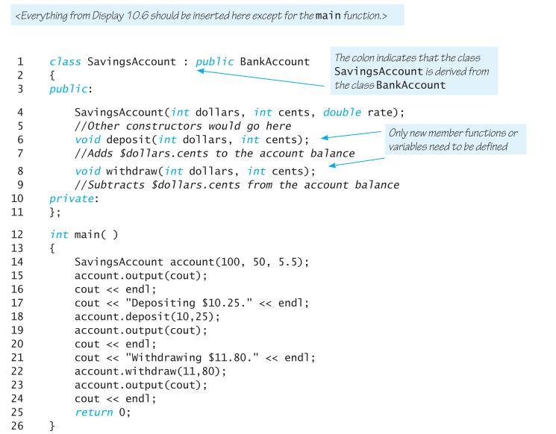
Display 10.9 (1/3)

Slide 165
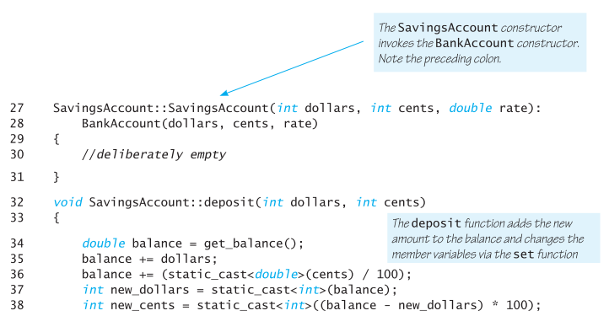
Display 10.9 (2/3)
For more information on type casting,
http://www.cplusplus.com/doc/tutorial/typecasting/

Slide 166
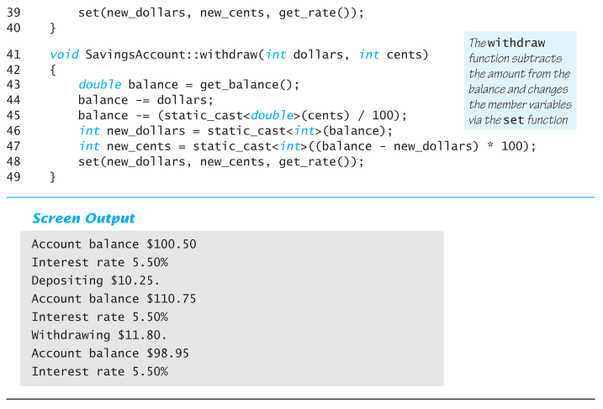
Display 10.9(3/3)

Slide 167
Section 10.4 Exercises
Can you
Define object?
Define class?
Describe the relationship between parent and child classes?
Describe the benefit of inheritance?

