Slide 1
11.0
Class parameters, const

Slide 2
Parameter passing efficiency
A call-by-value parameter less efficient than a
call-by-reference parameter
  The parameter is a local variable initialized to the
  value of the argument
    This results in two copies of the argument
A call-by-reference parameter is more efficient
  The parameter is a placeholder replaced by the
  argument
    There is only one copy of the argument

Slide 3
Class Parameters
It can be much more efficient to use
call-by-reference parameters when the parameter
is of a class type
When using a call-by-reference parameter
  If the function does not change the value of the
  parameter, mark the parameter so the compiler
  knows it should not be changed

Slide 4
const Parameter Modifier
To mark a call-by-reference parameter so it
cannot be changed:
  Use the modifier const before the parameter type
  The parameter becomes a constant parameter
  const used in the function declaration and definition

Slide 5
const Modifier Example
Let’s define a regular function IsSameDay that takes a Date and a DayOfYear, we can define it in one of two ways:
  bool IsSameDay(Date date, DayOfYear day);
  bool IsSameDay(const Date& date, const DayOfYear& day);
The first is call-by-value, which copies every member variable onto the function stack.
The second is call-by-reference which copies only the address onto the function stack. The keyword const ensures it can’t be changed.

Slide 6
const Considerations
When a function has a constant parameter,
the compiler will make certain the parameter
cannot be changed by the function
  What if the parameter calls a member function?
  bool IsSameDay(const Date& date,
  const DayOfYear& day)
  { …
  return (date.get_day() == day.get_day() &&
          date.get_month() == day.get_month())
          }
  How does the compiler know that get_day() and get_month() will not change parameter date or day?

Slide 7
const Modifier for Accessor functions
If a constant parameter makes a member function
call
  const is used to mark functions and let the compiler know that it will not change the value of an object
  const is used in the function declaration and the
  function definition.
  class DayOfYear {
  public:
  int get_day() const;
  int get_month() const;
  …
  };

Slide 8
Const in Function definition
To define a function that will not change the
value of any member variables:
  Use const in the same location as the function declaration
  int DayOfYear::get_day() const
  {
  return day;
  }

Slide 9
const Wrapup
Using const to modify parameters of class types
improves program efficiency
  const is typed in front of the parameter's type
Member functions called by constant parameters
must also use const to let the compiler know that
they do not change the value of the parameter
  const is typed following the parameter list in the
  declaration and definition

Slide 10
When to use const function modifier
Once a parameter is modified by using const to
make it a constant parameter
  Any member functions that are called by the
  parameter must also be modified using const to
  tell the compiler they will not change the parameter
  It is a good idea to modify, with const, every
  member function that does not change a member
  variable

Slide 11
Using const reference parameters
What is not allowed?
  It can’t be assigned using =, +=, -=
  Can’t call non-const member functions
  Can’t pass it in as a call-by-reference.
What is allowed when using const?
  We can use member functions labeled const.
  We can pass the object into a function as a call-by-value, const call-by-reference.

Slide 12
Conclusion
Can you
  Describe the promise that you make to the
  compiler when you modify a parameter with const?
  Explain why this declaration is probably not
  correct?
  class Money
  { …
  public:
  void input(istream& ins) const;
  …
  };

Slide 13
Static modifier

Slide 14
Global static variables
The static keyword is used to limit the scope of a global variable.
      static int counter = 0;
When a global variable (outside of main) is declared static, the scope is the module or source file.
Soon, we will be splitting programs into multiple files

Slide 15
Static variables in functions
Keeping state in a function can be done with static variables in a function.
Think about srand(int seed) and rand(),
  rand() uses the previous result to calculate the next
  srand() must use a global static variable that is accessible to both srand() and rand()
  rand() must use a static variable in the function to remember the previous value.

Slide 16
Class variables declared static
class variables are static variables in classes.
  only one copy is created
  all instances have access
  can be public or private
  must be defined outside of the class
    Remember that a class declaration is a blueprint, no memory allocated.
    class Employee {
    public:
    static const char HOURLY=‘H’;
    static const char SALARIED=‘S’;

Slide 17
Classes can have static functions
Class functions declared with the static keyword are global to the class
No invoking object for static functions, we call them with the scope operator.

Slide 18
Employee::getNumberInstances(); // calls it
class Employee
{
public:
Employee();
static int getNumberInstances()
{ return numberInstances; }
private:
…
static int numberInstances;
};
int Employee::numberInstances; // allocates it.

Slide 19
11.1
Friend Functions

Slide 20
Friend Functions?
Most operations performed on classes should be implemented as member functions.
Some operations are better implemented as ordinary nonmember functions.
Usually this is needed when the operation involves two classes that are unrelated except for the function in question.
We need a way to provide full access at times.

Slide 21
Example: An IsSameDay function
Let’s say we have a Date class that is defined as follows:
    class Date {
    public:
    void output(ostream& out) const;
    Date(int month, int day, int year);
    ….
    private:
      int day;
      int month;
      int year;
      };

Slide 22
Friend: A IsSameDay Function
Remember DayOfYear class from previous chapter?
Let’s say we have an application where we need to compare the current Date to the DayOfYear for some special days.
Maybe holidays or quarterly reporting days. On these days our application does something special.

Slide 23
Need an IsSameDay function
We need an equals function that compares an object of type Date to a DayOfYear.
We only want to compare the month and day parts of Date with the same parts of DayOfYear.
We need a function that can access the private parts of both classes.

Slide 24
Let’s define IsSameDay
IsSameDay returns a bool if the day and month of both given Date and DayOfYear are the same.
The IsSameDay function requires a parameter for each type that is compared.
  bool IsSameDay(const Date &date, const DayOfYear &day);
Notice that IsSameDay is not a member function of either class.

Slide 25
Defining IsSameDay
The function is not a member of either class, therefore:
  It must use public accessor functions to obtain the fields we want to compare.
  IsSameDay can be defined this way:
  bool IsSameDay(const Date &date, const DayOfYear &day) {
  return (date.get_day() == day.get_day()
  &&
  date.get_month() == day.get_month());
  }

Slide 26
Using IsSameDay Function
The IsSameDay function can be used in the following way:
if ( IsSameDay(today, bachsBirthday) )
cout << “It’s Bach’s Birthday!”;
But is the function IsSameDay efficient?
Direct access to the member variables would be more efficient.
  Especially when processing reams of data!

Slide 27
A more efficient version of IsSameDay
As defined here, IsSameDay is more efficient but not legal!
  bool IsSameDay(const Date &date, const DayOfYear &day) {
  return (date.day == day.day
  &&
  date.month == day.month);
  }
The code is more efficient but not legal because member variables are private!

Slide 28
Friend Functions
Friend functions are not members of a class but they can access private member variables of the class.
  A friend function is defined using the keyword friend in the class declaration.
    A friend function is not a member function.
    A friend function is an ordinary function.
    A friend function has extraordinary access to private data members of a class.
  As a friend function, IsSameDay is perfectly legal.

Slide 29
Declaring a friend function.
Here’s the change to Date class
class Date {
  public:
  friend IsSameDay(const Date &date, const class DayOfYear &day);
  …
  private:
  …
  };
Here’s the change to DayOfYear class
class DayOfYear {
public:
friend IsSameDay(const class Date& date, const DayOfYear& day);
private:
…
};

Slide 30
Notice class DayOfYear and class Date
When declaring these friend functions, notice that in class Date, the DayOfYear parameter is preceded by const class DayOfYear& and vice versa.
We either have to predeclare DayOfYear as a class before it is used or state it is a class in the parameter list. Same with Date.
    class DayOfYear; // Compiler needs to know it is a class.
    class Date; // Same with Date.
Since class Date refers to DayOfYear and class DayOfYear refers to Date, it’s circular. Being explicit that it’s a class in the parameter list resolves the issue.

Slide 31
Friend Functions
A friend function is declared as a friend in the class definition.
A friend function is defined as a nonmember function without using the “::” scope operator.
A friend function is called without using the ‘.’ (dot) operator.

Slide 32
Friend Function Syntax
The syntax for declaring friend function is
class class_name
{
friend Declaration_for_Friend_Function_1;
friend Declaration_for_Friend_Function_2;
public:
…
Member_Function_Declarations
private:
Private_Member_Declarations
};

Slide 33
When are friend functions needed?
The example that the book uses is an equals function between two objects of the same type. This is not necessary! A member function would do quite nicely.
There are two other choices for comparing two objects of the same type, which are both very efficient: public member function and overloaded operator==.
However, there are cases where this level of efficiency is need between objects of different types.
Consider the problem of having to process a terabyte of data? Efficiency becomes paramount!

Slide 34
Choosing Friends
How do you know when you should use friend functions?
  The book says to use member functions when dealing with only one object (the calling object).
  The book says to use nonmember functions when dealing with more than one object.
  Use friend functions sparingly, with multiple classes when efficiencies are needed.
  Or in the special case of operators that we’ll look at next.

Slide 35
11.2
Overloading Operators

Slide 36
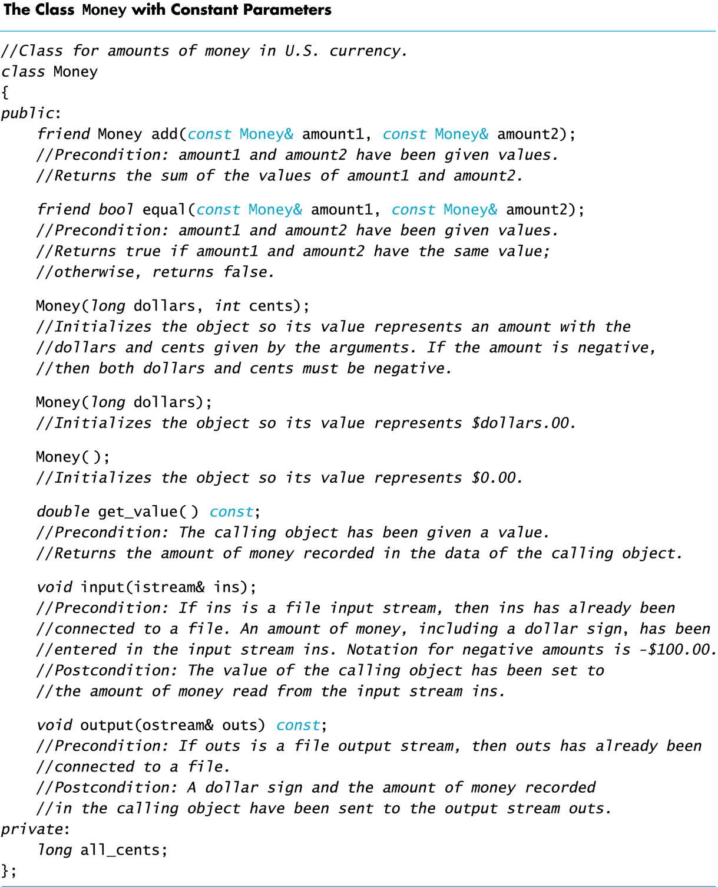
Class Money Declaration has
2 friend functions,
3 constructors,
2 const member functions
1 non-const member function.

Slide 37
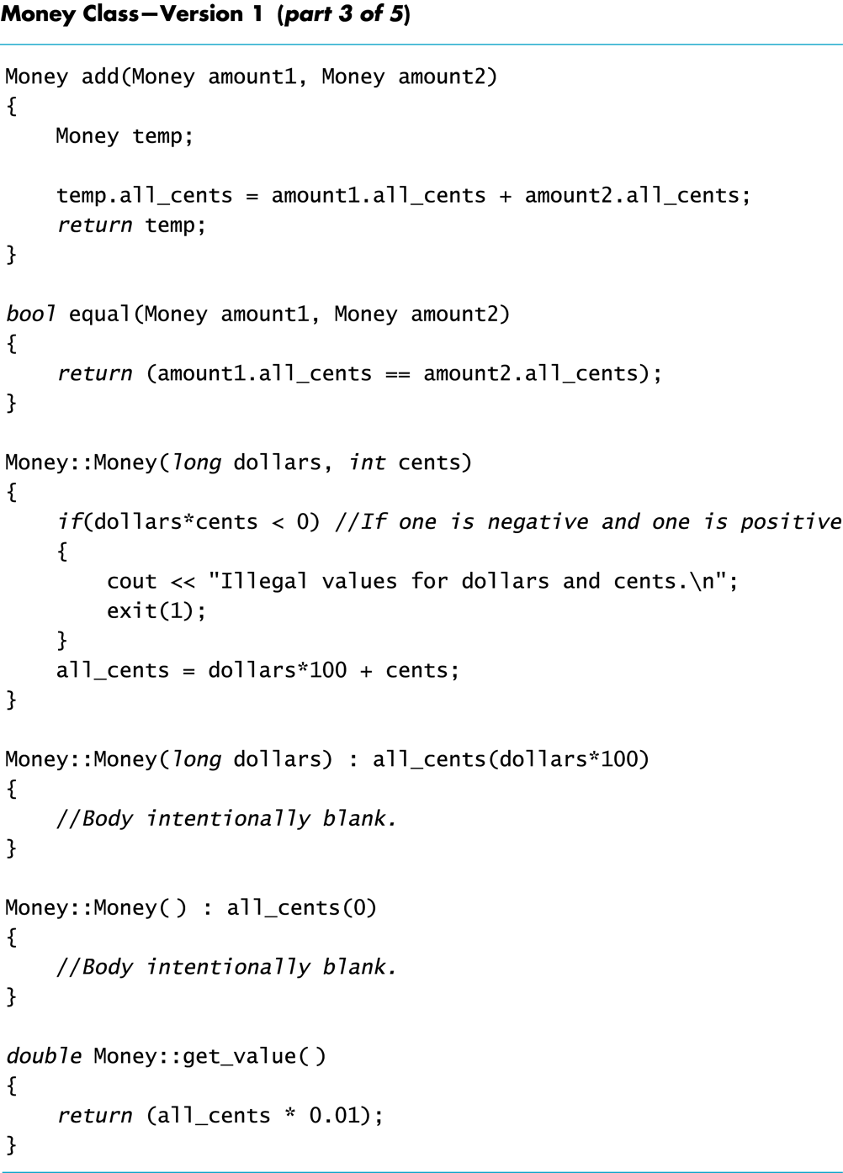
Class Money definition.
2 friend functions are add and equal.
3 constructors take 2, 1 and 0 arguments
1 const member function get_value.
Member functions input and output
are left out for brevity.
const

Slide 38
Overloading Operators
In the Money class, function add was used to
add two objects of type Money
In this section we see how to use the '+' operator
to make the following code legal:
Money total, cost, tax;
…
total = cost + tax;
// instead of total = add(cost, tax);

Slide 39
Operators As Functions
An operator is a function used differently than
an ordinary function
  An ordinary function call enclosed its arguments in
  parenthesis
  add(cost, tax)
  With a binary operator, the arguments are on either
  side of the operator
  cost + tax

Slide 40
Operator Overloading
Operators can be overloaded
The definition of operator + for the Money
class is nearly the same as member function add
To overload the + operator for the Money class
  Use the name + in place of the name add
  Use keyword operator in front of the +
  Example:
  friend Money operator + (const Money& amount1,
  const Money& amount2)

Slide 41
Operator Overloading Rules
At least one argument of an overloaded operator
must be of a class type
An overloaded operator can be a friend of a class
The number of arguments for an operator cannot
be changed
The precedence of an operator cannot be changed
., ::, *, and ?: cannot be overloaded
  c = (a < b) ? a : b;

Slide 42
Program Example:
Overloading Operators
The Money class with overloaded operators
+ and == is demonstrated in
Display 11.5 (1)
Display 11.5 (2)

Slide 43
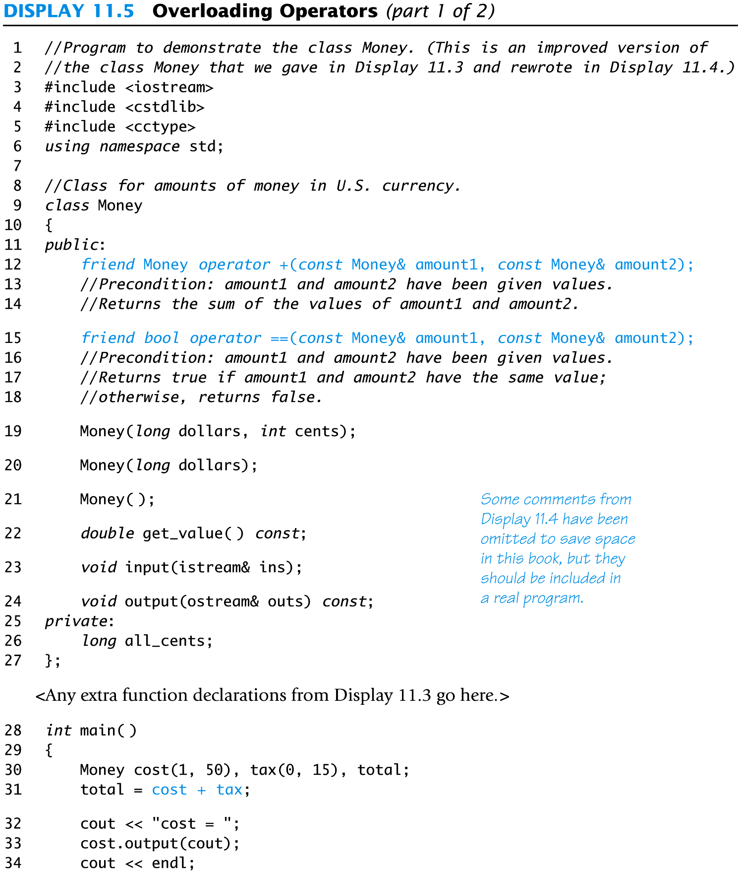
Display 11.5
(1/2)

Slide 44
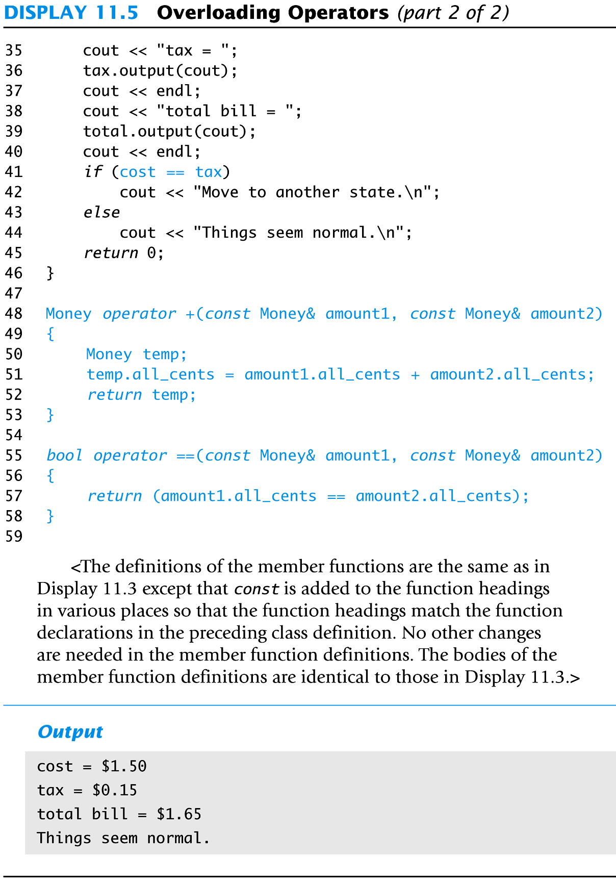
Display 11.5 (2/2)

Slide 45
Automatic Type Conversion
With the right constructors, the system can do
type conversions for your classes
  The following code (from Display 11.5) actually works
  Money base_amount(100, 60), full_amount;
  full_amount = base_amount + 25;
  The integer 25 is converted to type Money so it
  can be added to base_amount!
  How does that happen?

Slide 46
Type Conversion Event 1
When the compiler sees base_amount + 25,
it first looks for an overloaded + operator to
perform
Money_object + some-integer
  If it exists, it might look like this
  friend Money operator +(const Money& amount1,
  const int& amount2);

Slide 47
Type Conversion Event 2
When the appropriate version of + is not found,
the compiler looks for a constructor that takes
a single integer
  The Money constructor that takes a single parameter of type long will work
  The constructor Money(long dollars) converts 25
  to a Money object so the two values can be added!

Slide 48
Type Conversion Again
Although the compiler was able to find a
way to add
base_amount + 25
this addition will cause an error
base_amount + 25.67
  There is no constructor in the Money class that takes a single argument of type double

Slide 49
A Constructor For double
To permit base_amount + 25.67, the following
constructor should be declared and defined
class Money
{
public:
…
Money(double amount);
// Initialize object so its value is $amount
…

Slide 50
Overloading Unary Operators
Unary operators take a single argument
The unary – operator is used to negate a value
x = -y
++ and - - are also unary operators
Unary operators can be overloaded
  The Money class of Display 11.6 can include
    A binary – operator
    A unary – operator

Slide 51
Overloading -
Overloading the – operator with two parameters
allows us to subtract Money objects as in
Money amount1, amount2, amount2;
…
amount3 = amount1 – amount2;
Overloading the – operator with one parameter
allows us to negate a money value like this
amount3 = - amount1;
Display 11.6

Slide 52
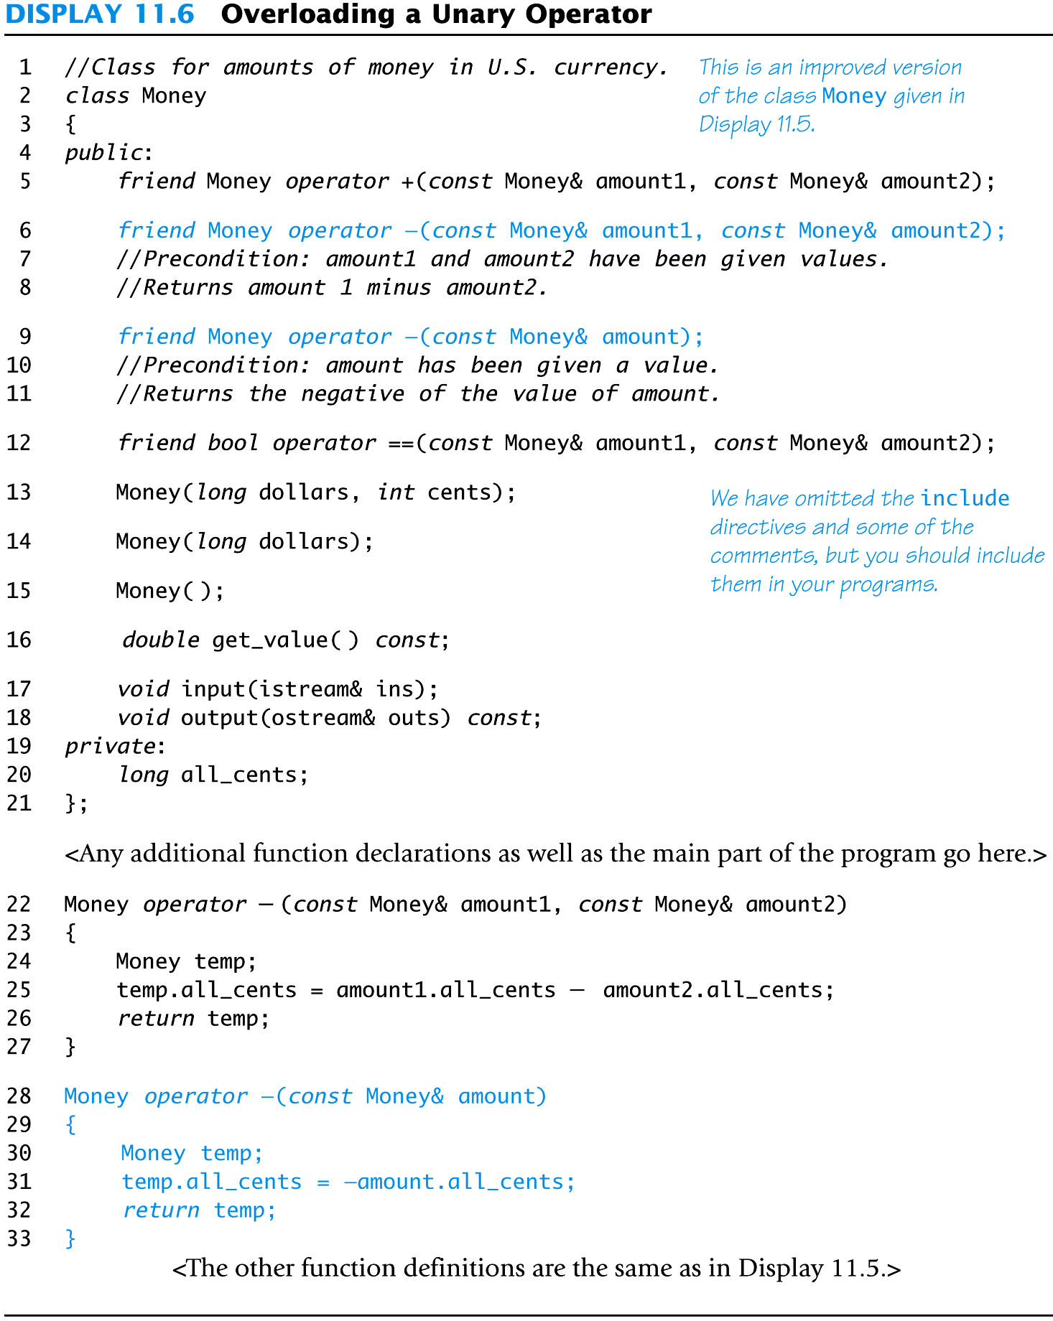
Display
11.6

Slide 53
Overloading << and >>
The insertion operator << is a binary operator
  The first operand is the output stream
  The second operand is the value following <<
  cout << "Hello out there.\n";
Operand 1
Operand 2
Operator

Slide 54
Replacing Function output
Overloading the << operator allows us to
use << instead of Money's output function
  Given the declaration: Money amount(100);
  amount.output( cout );
  can become
  cout << amount;

Slide 55
What Does << Return?
Because << is a binary operator
cout << "I have " << amount << " in my purse.";
seems as if it could be grouped as
( (cout << "I have" ) << amount) << "in my purse.";
To provide cout as an argument for << amount,
(cout << "I have") must return cout
Display 11.7

Slide 56
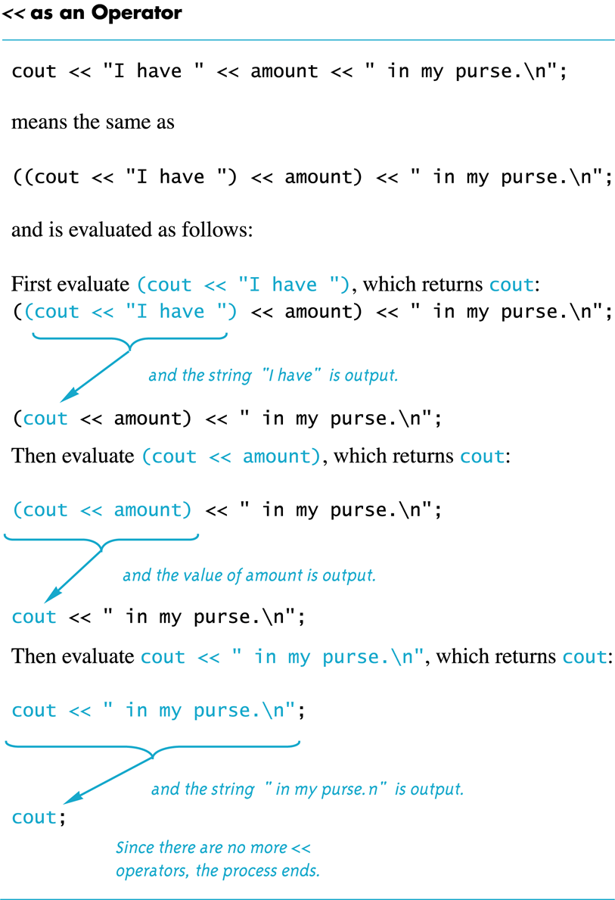
Display 11.7

Slide 57
Overloaded << Declaration
Based on the previous example, << should return
its first argument, the output stream
  This leads to a declaration of the overloaded
  << operator for the Money class:
  class Money
  {
  public:
  …
  friend ostream& operator << (ostream& outs,
  const Money& amount);
  …

Slide 58
Overloaded << Definition
The following defines the << operator
  ostream& operator <<(ostream& outs,
  const Money& amount)
  {
  <Same as the body of Money::output in
  Display 11.3 (except all_cents is replaced
  with amount.all_cents) >
  return outs;
  }

Slide 59
Return ostream& ?
The & means a reference is returned
  So far all our functions have returned values
The value of a stream object is not so simple to
return
  The value of a stream might be an entire file, the
  keyboard, or the screen!
We want to return a reference to the stream , not the value of the stream
The & means that we want to return a reference to the stream, not its value

Slide 60
Overloading >>
Overloading the extraction >> operator for input is very similar to overloading the << for output
>> could be defined this way for the Money class
istream& operator >>(istream& ins, Money& amount)
{
<This part is the same as the body of
Money::input in Display 11.3 (except that
all_cents is replaced with amount.all_cents)>
return ins;
}
Display 11.8 (1-4)

Slide 61
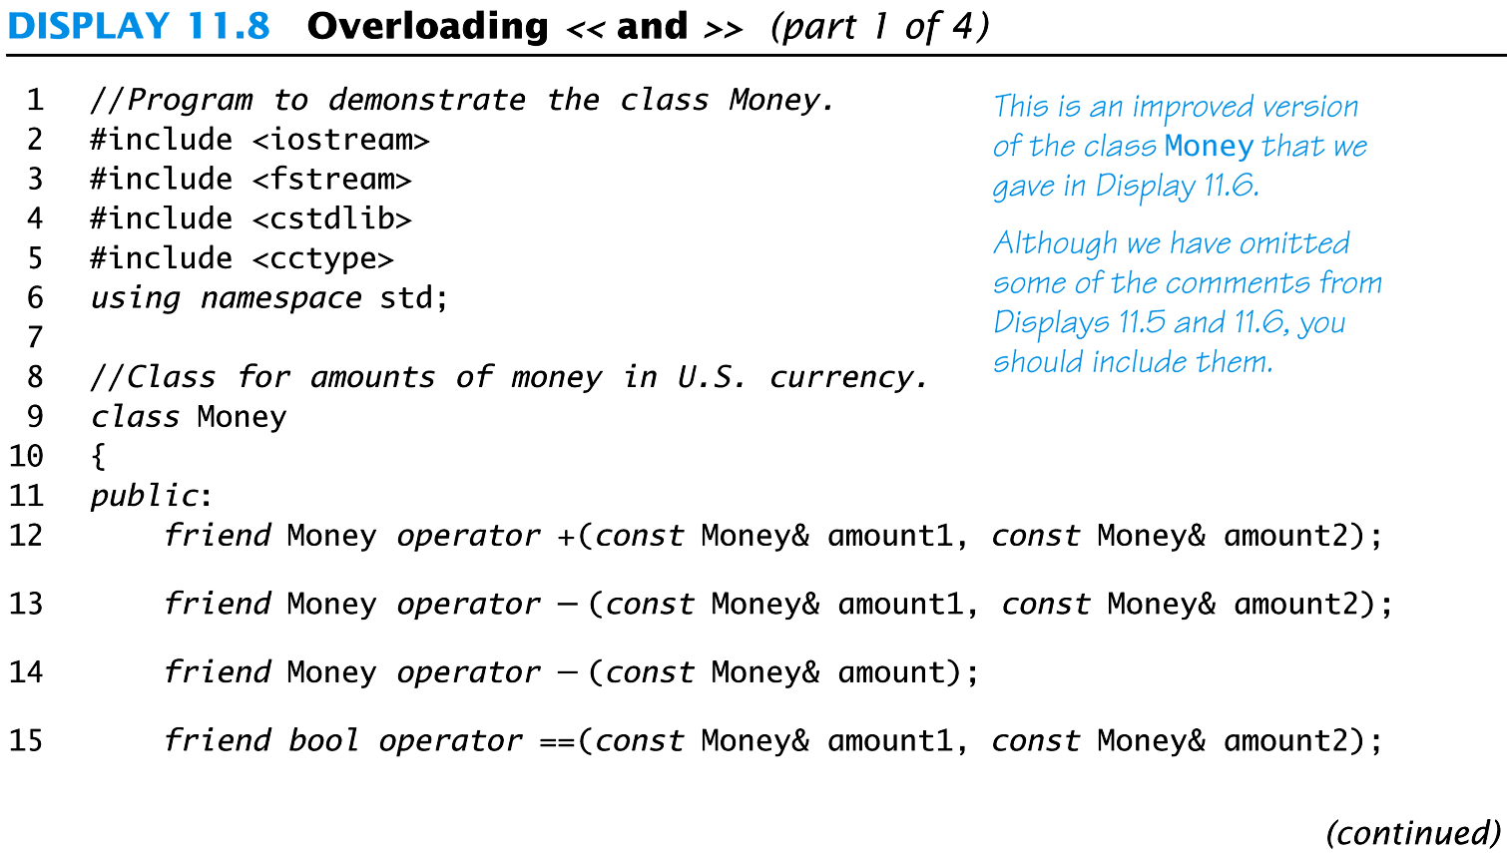
Display 11.8
(1/4)

Slide 62
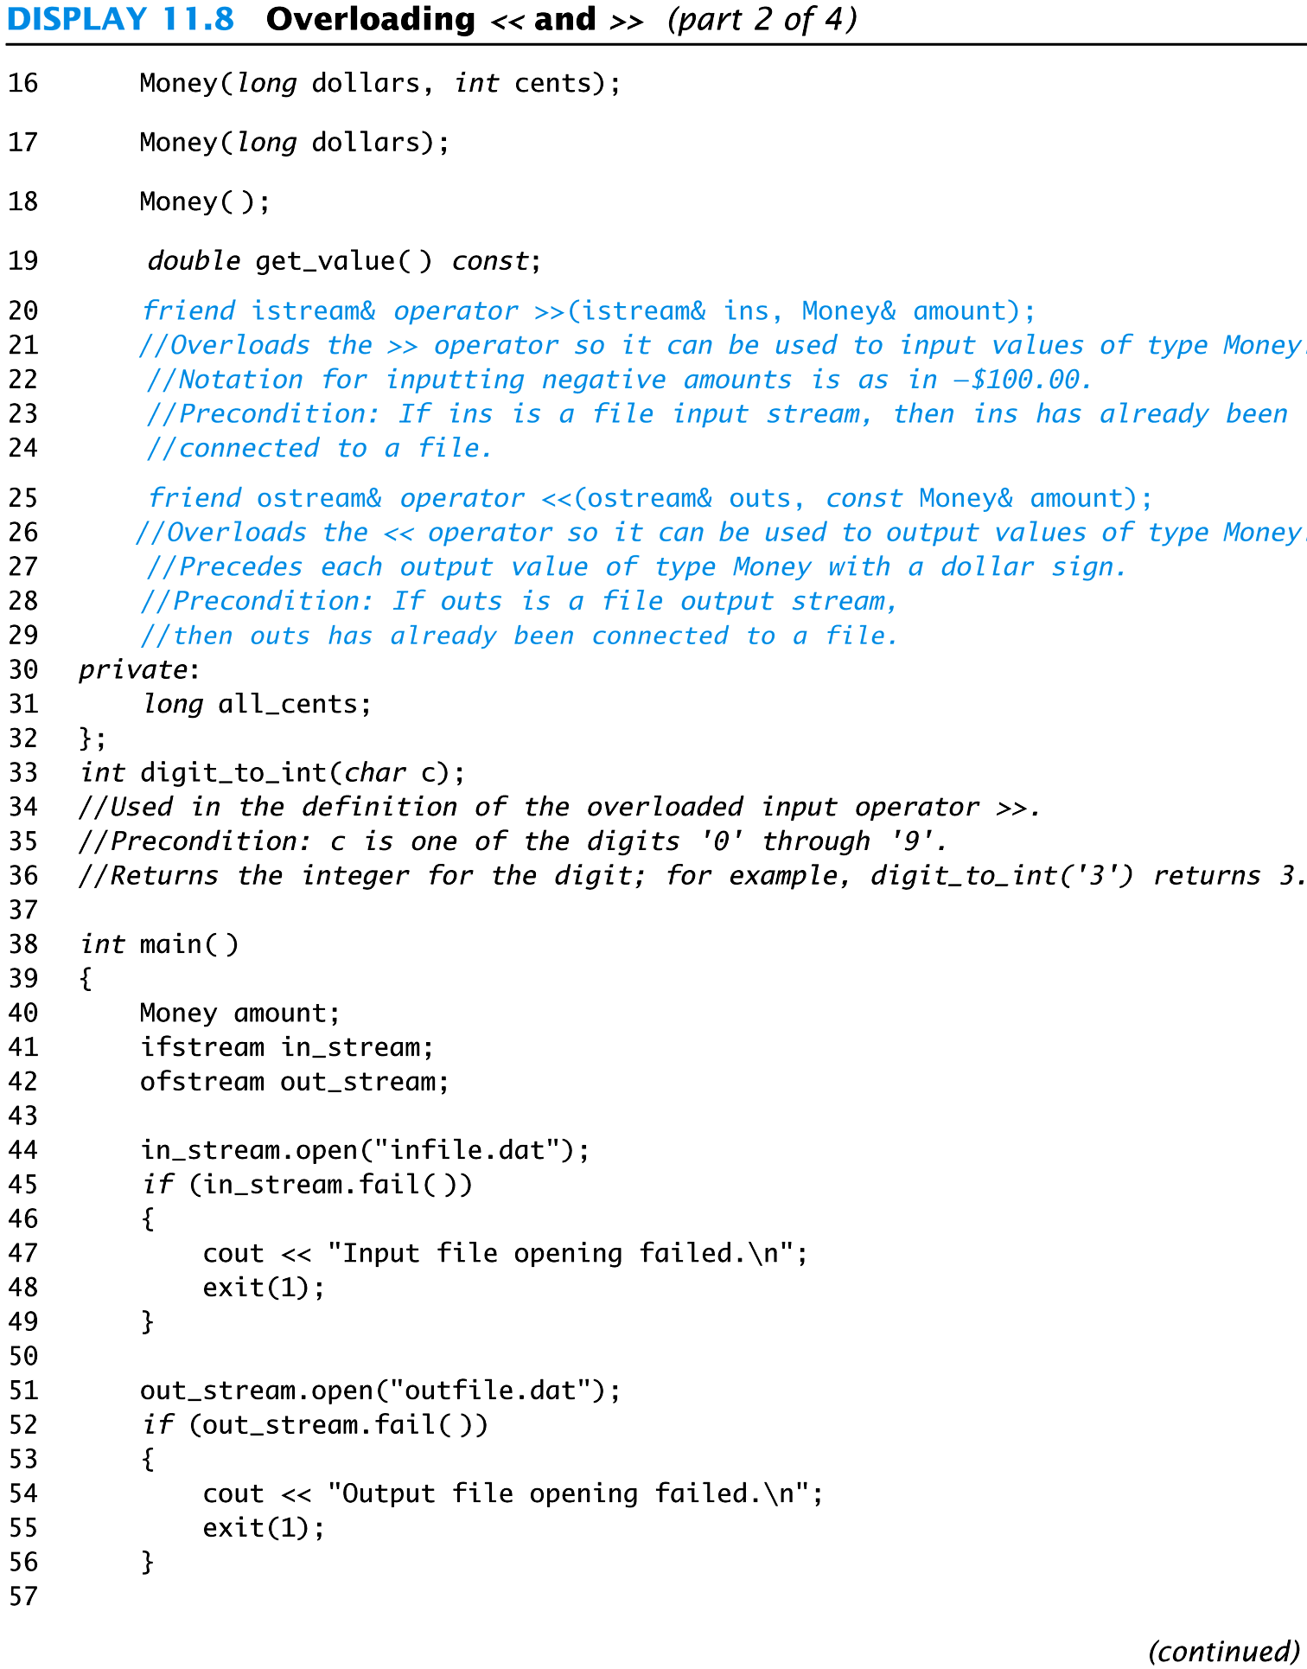
Display 11.8(2/4)

Slide 63
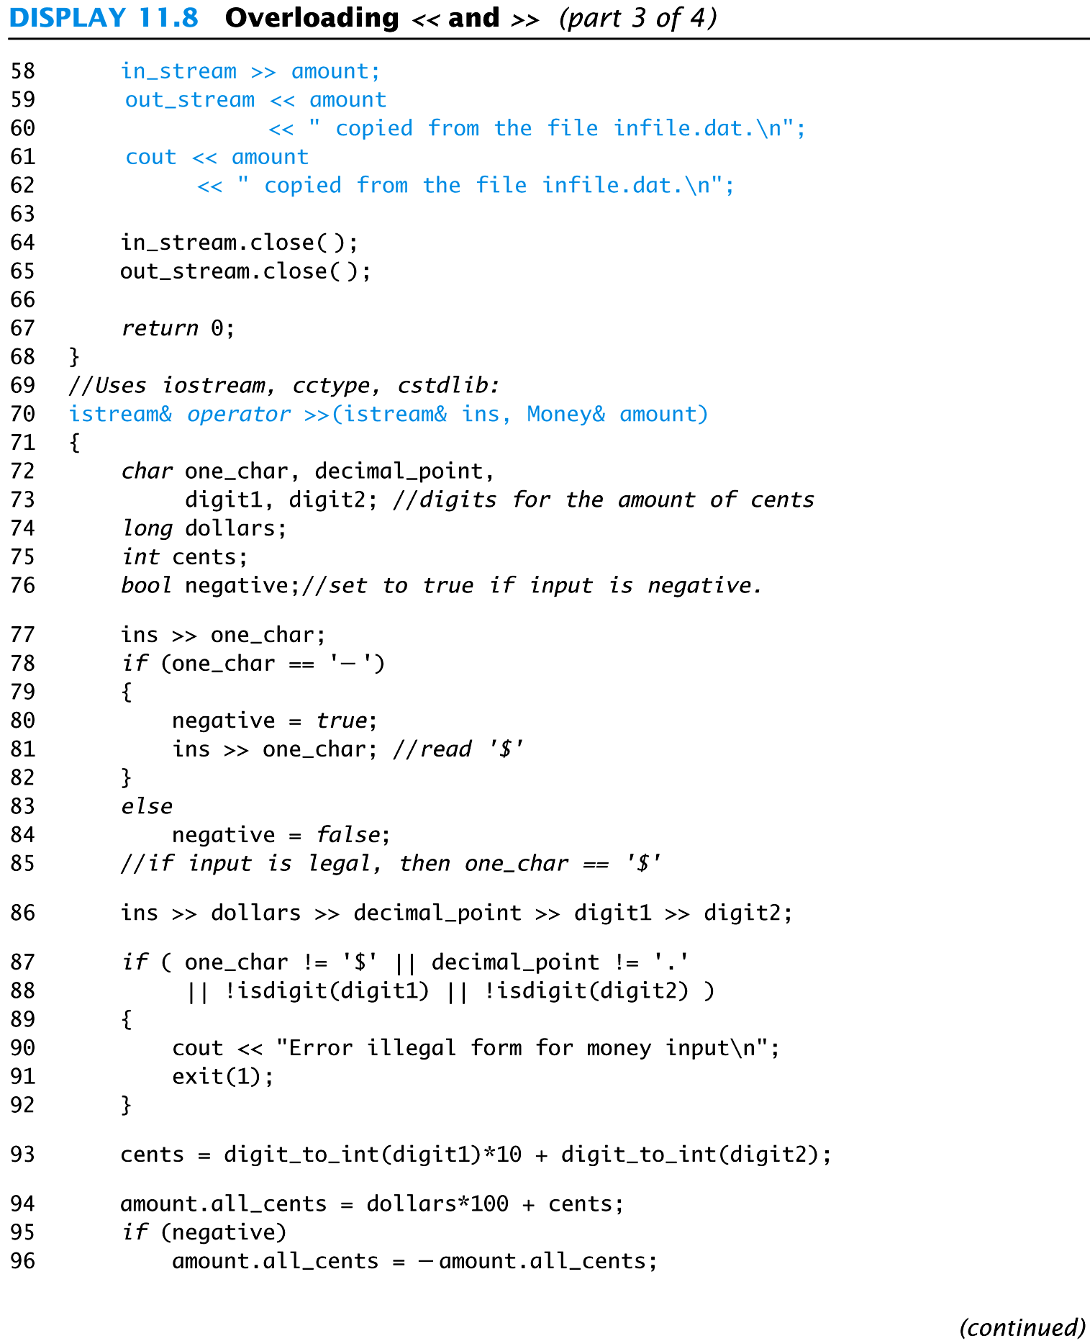
Display 11.8 (3/4)

Slide 64
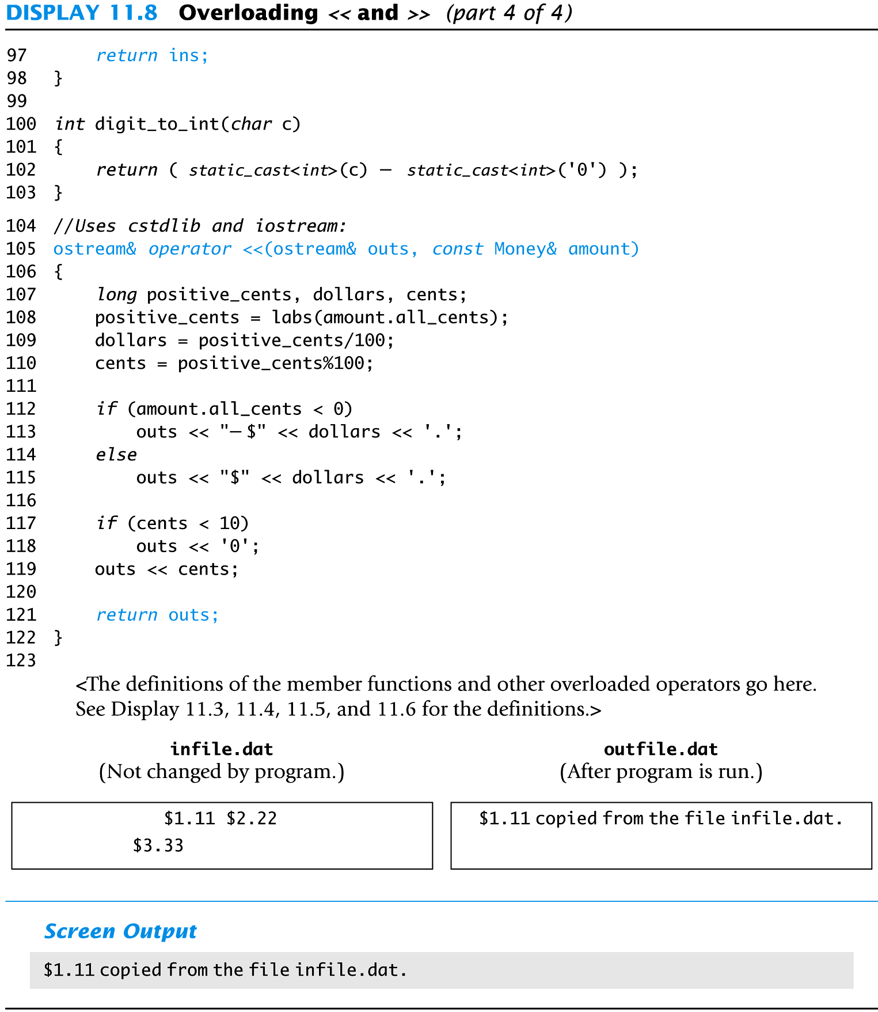
Display 11.8 (4/4)
File input and output will be discussed soon.

Slide 65
Section 11.2 Exercises
Can you
  Describe the purpose of a making a function a friend?
  Describe the use of constant parameters?
  Identify the return type of the overloaded operators << and >>?

Slide 66
A bit more about member functions
Every member function is part of the class.
To call a member function requires an object
  Object.memberFunction(arguments);
What happens when calling a member function?
  C++ takes the address of the Object
  Copies it to the this pointer that is in every member function.
  You can then access the data members:
    this->dataMember1 = parameter1;
    (*this).dataMember2 = parameter2;

Slide 67
11.3
Arrays and Classes

Slide 68
Arrays and Classes
Arrays can use structures or classes as their
base types
  Example: struct WindInfo
  {
  double velocity;
  char direction;
  }
  WindInfo data_point[10];

Slide 69
Accessing Members
When an array's base type is a structure or a
class…
  Use the dot operator to access the members of an indexed variable
  Example: for (i = 0; i < 10; i++)
  {
  cout << "Enter velocity: ";
  cin >> data_point[i].velocity;
  …
  }

Slide 70
An Array of Money
The Money class of Chapter 11 can be the base
type for an array
When an array of classes is declared
  The default constructor is called to initialize the indexed variables
An array of class Money is demonstrated in
Display 11.9 (1-3)

Slide 71
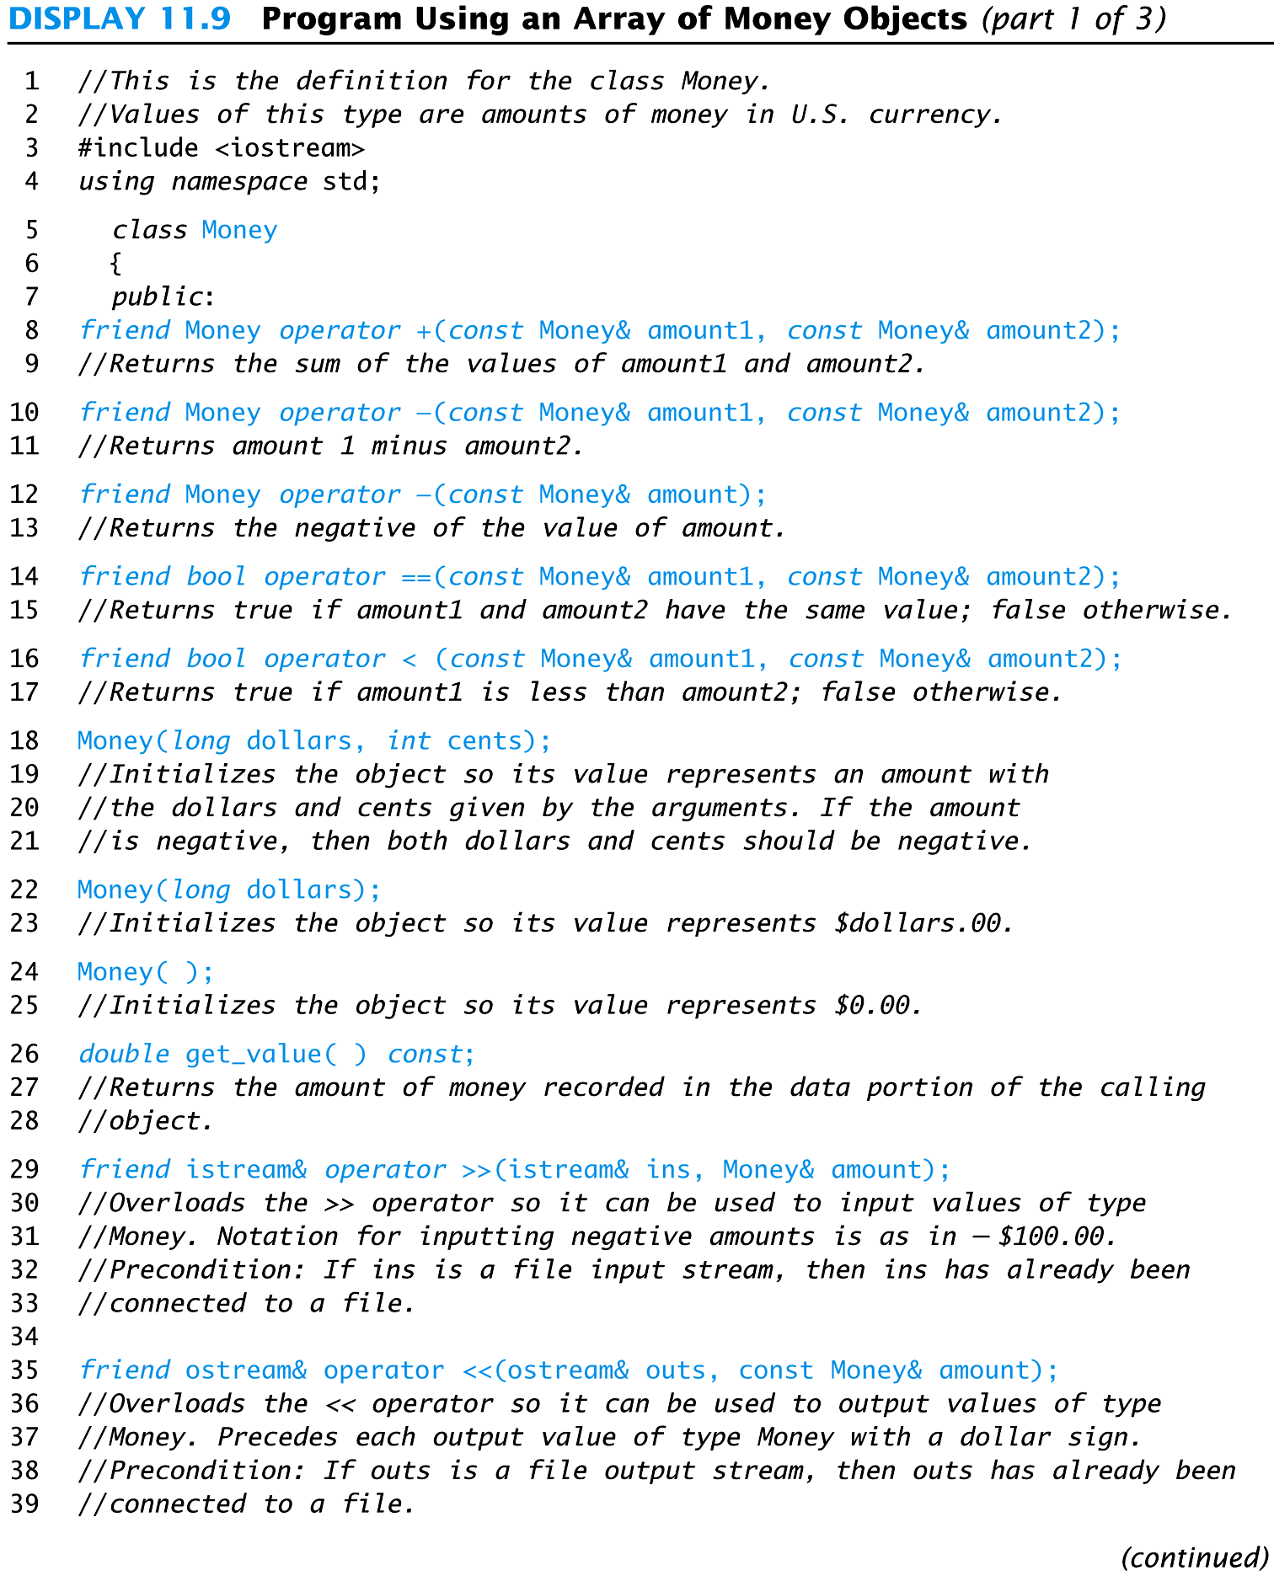
Display 11.9 (1/3)

Slide 72
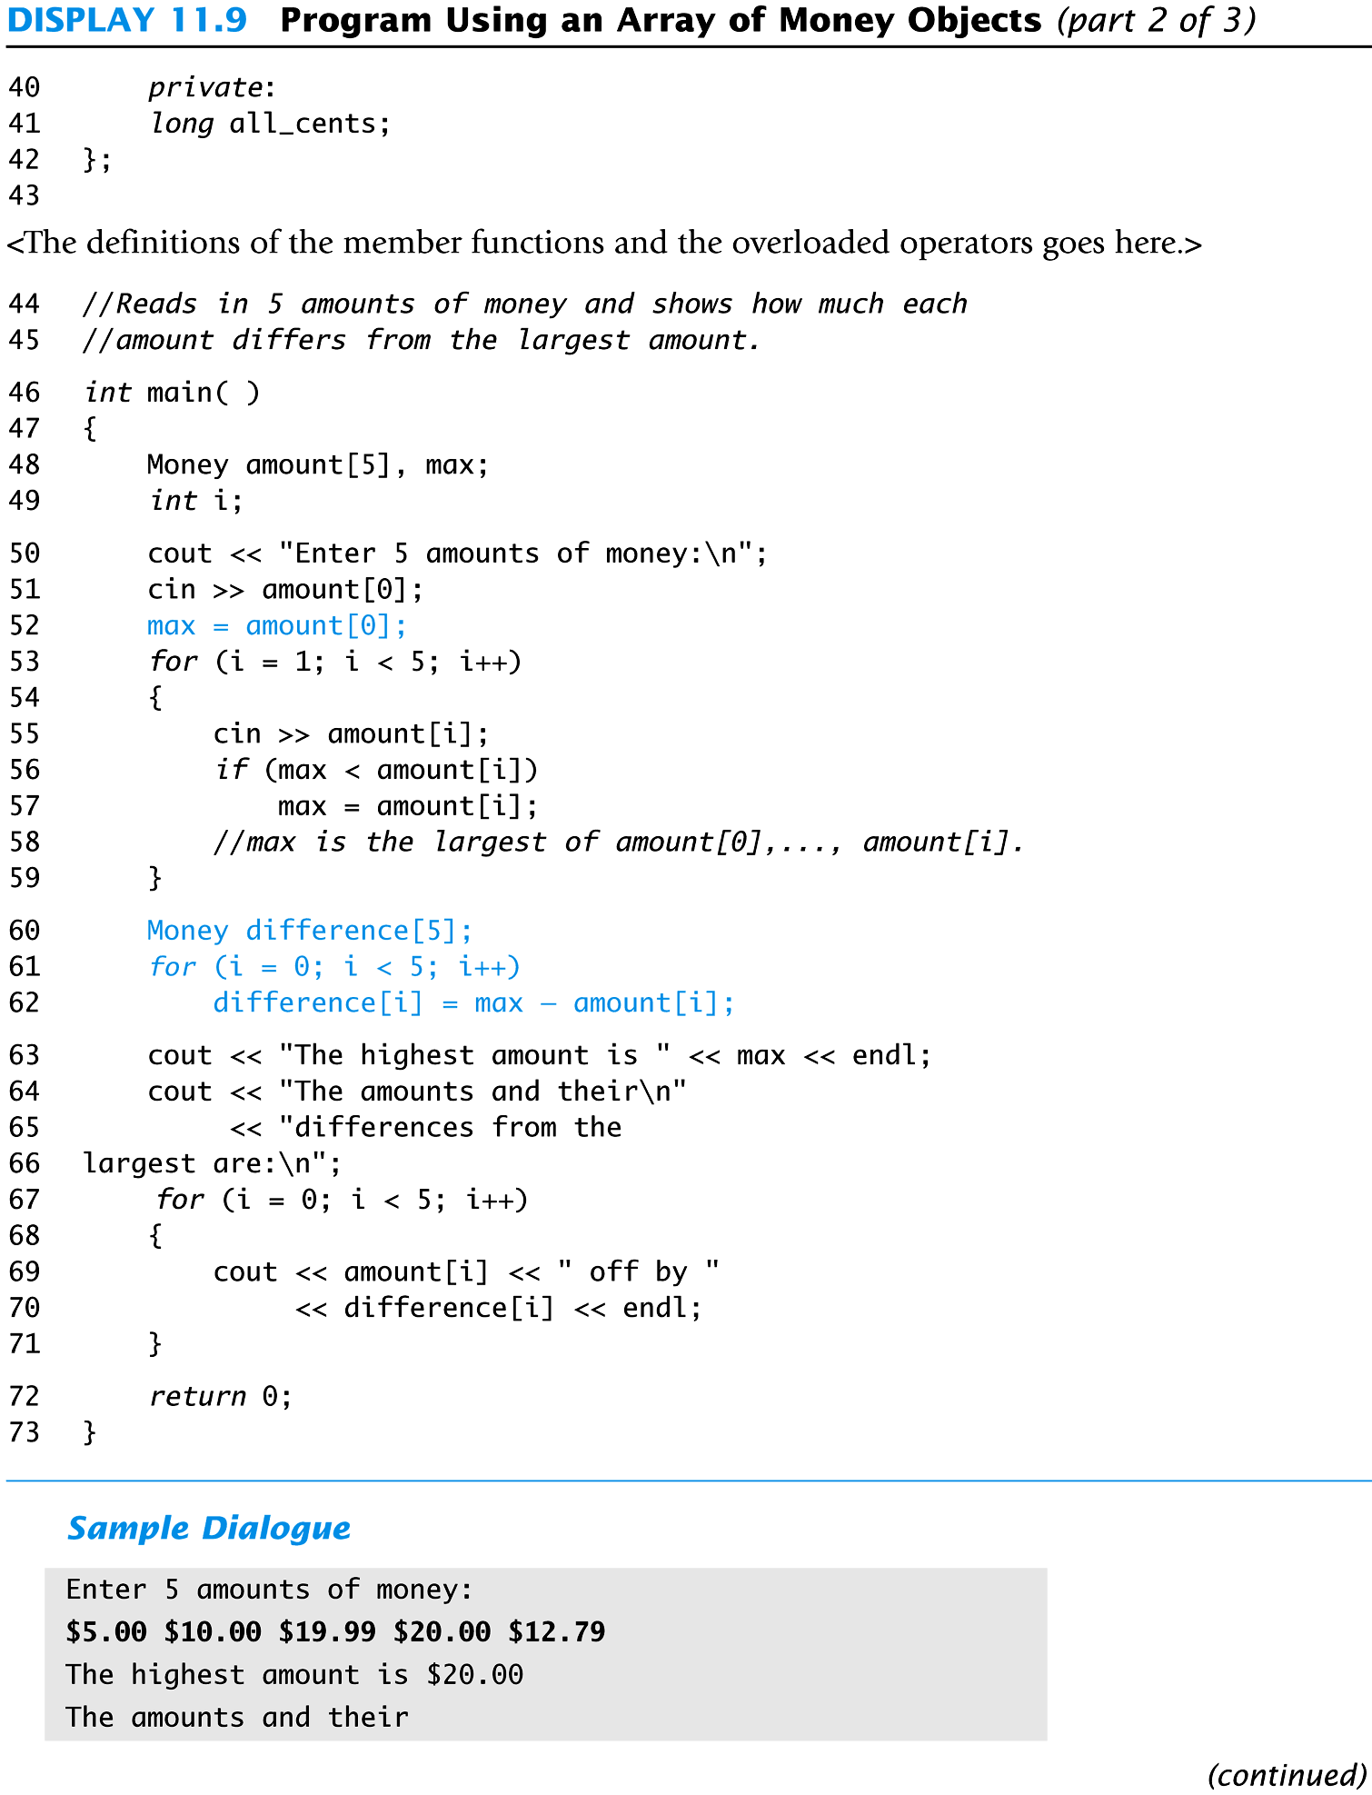
Display 11.9 (2/3)

Slide 73
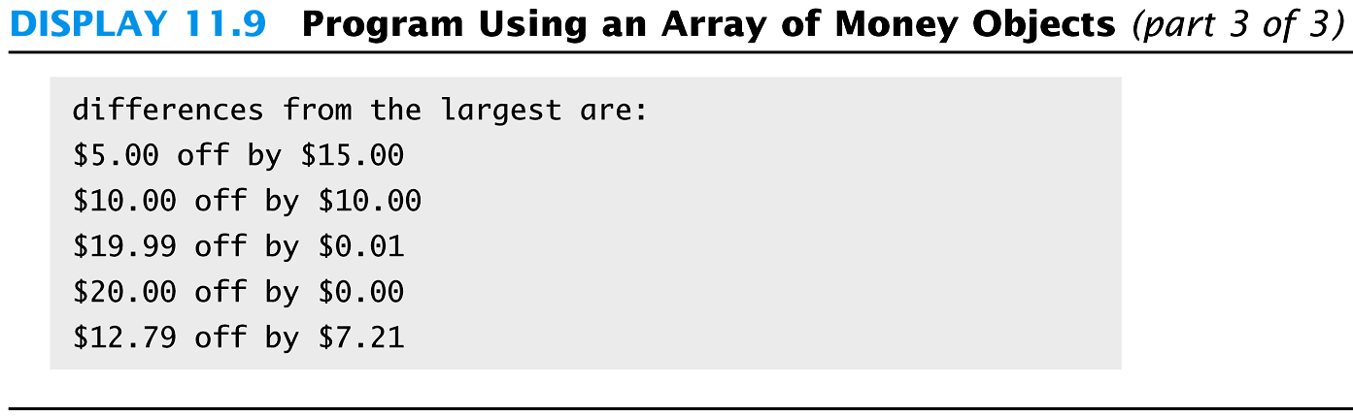
Display 11.9
(3/3)

Slide 74
Arrays as Structure Members
A structure can contain an array as a member
  Example: struct Data
  {
  double time[10];
  int distance;
  }
  Data my_best;
  my_best contains an array of type double

Slide 75
Accessing Array Elements
To access the array elements within a structure
  Use the dot operator to identify the array within the structure
  Use the [ ]'s to identify the indexed variable desired
  Example: my_best.time[i]
  references the i-th indexed variable of the variable time in the structure my_best

Slide 76
Arrays as Class Members
Class TemperatureList includes an array
  The array, named list, contains temperatures
  Member variable size is the number of items stored
  class TemperatureList
  {
  public:
  TemperatureList( );
  //Member functions
  void add_temp(double temp); // adds temp to the end of the list.
  double at(int index); // accessor
  private:
  double list [MAX_LIST_SIZE];
  // the allocated memory??
  int size;
  };

Slide 77
Overview of TemperatureList
To create an object of type TemperatureList:
  TemperatureList my_data;
To add a temperature to the list:
  My_data.add_temperature(77);
    A check is made to see if the array is full
<< is overloaded so output of the list is
  cout << my_data;
Display 11.10 (1-2)

Slide 78
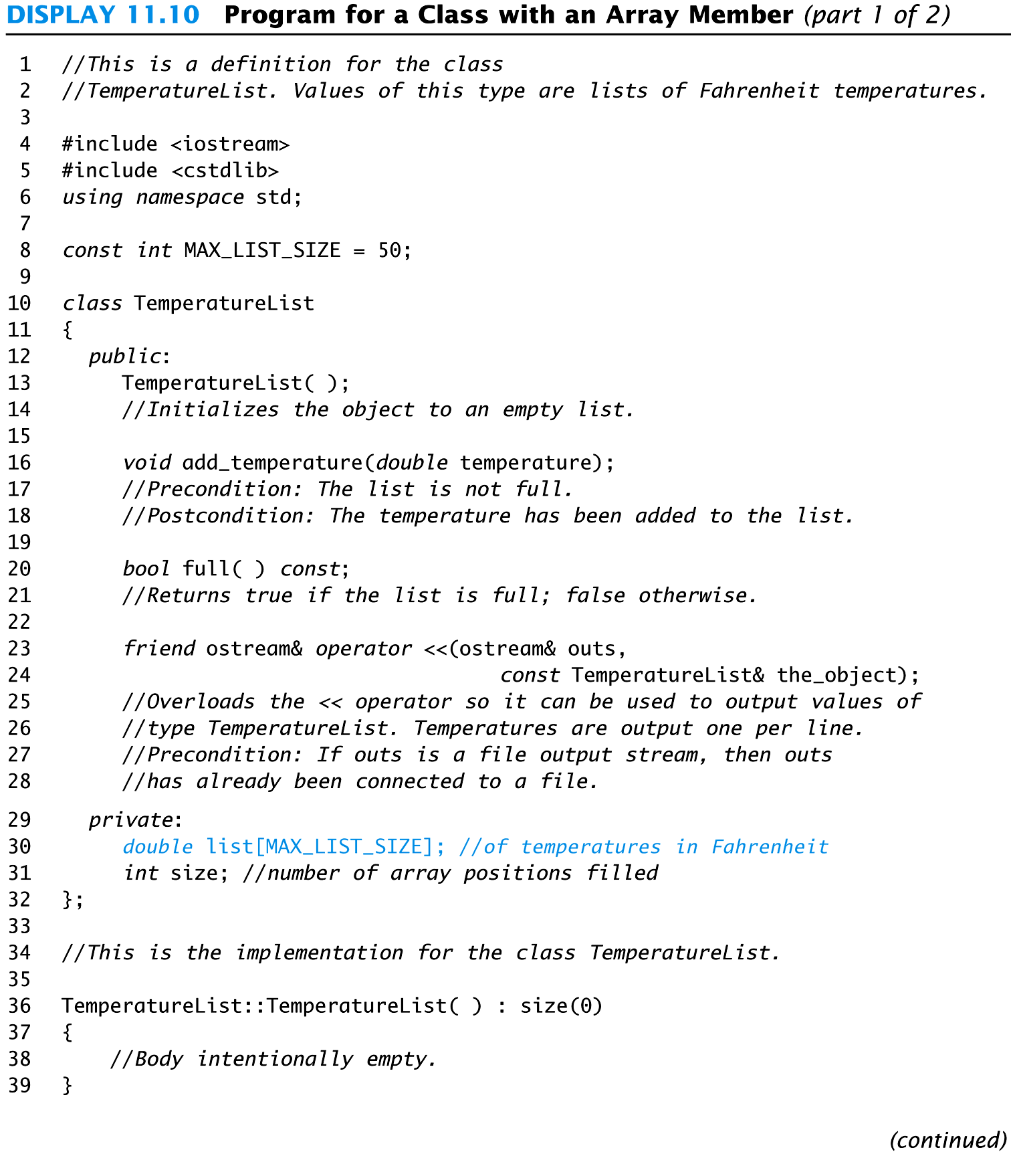
Display 11.10 (1/2)
size is also used for next potentially available position in the array.

Slide 79
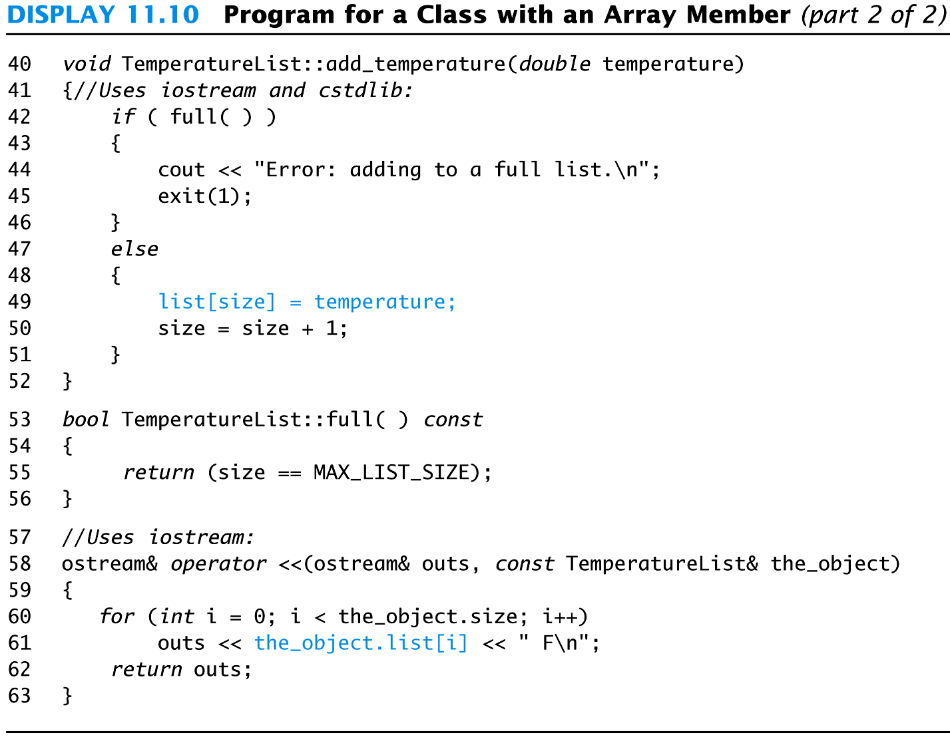
Display 11.10
(2/2)

Slide 80
Section 11.3 Conclusion
Can you
  Declare an array as a member of a class?
  Declare an array of objects of a class?
  Write code to call a member function of an element in an array of objects of a class?
  Write code to access an element of an array of doubles that is a member of a class?

Slide 81
A program to repeat Experiments
We have TempList from the previous example
  class TempList {
    void add_temp(double temp);
    private:
    double list[MAX_TEMPS];
    int numberTemps=0;
    };
An experiment is an array of TempList objects
  TempList experiments[MAX_EXPERIMENTS];
Call a member function of an element in an array of objects
  experiments[index].add_temp(99.9);

Slide 82
Experiments con’t
Write code to get an element of an array of doubles that is a member of a class?
  class TempList {
    void add_temp(double temp);
    double at(int index) const;
    private:
    double list[MAX_TEMPS];
    int numberTemps=0;
    };
    double TempList::at(int index) {
    if (index >= 0 && index <= numberTemps) return list[index];
    else {cout << “Error: index out of range.”; exit(1); }
    }

Slide 83
Experiment con’t
Write code to set an element of an array of doubles that is a member of a class?
  class TempList {
    void add_temp(double temp);
    double at(int index) const;
    private:
    double list[MAX_TEMPS];
    int numberTemps=0;
    };
    void TempList::add_temp(double temp) {
    if (numberTemps != MAX_TEMPS) list[numberTemps++] = temp;
    else { cout << “Error: list already full.” ; exit(1) }
    }

Slide 84
Classes and Dynamic Arrays
A dynamic array can have a class as its base type (fractions array in lab7)
  rational *rptr = new rational[n];
  string *sptr = new string[n];
  delete [] rptr; delete [] sptr;
A class can have a member variable that is a
dynamic array
  In this section you will see a class using a dynamic array as a member variable.

Slide 85
Program Example:
A String Variable Class
We will define the class StringVar
  StringVar objects will be string variables
  StringVar objects use dynamic arrays whose size is determined when the program is running
  The StringVar class is similar to the string class that we all know and love.
  Remember that a c-string ends with a ‘\0’ character.

Slide 86
The StringVar Constructors
Three StringVar constructors:
  The default constructor creates an object with a maximum string length of 100
  Another takes an integer argument which determines the maximum string length of the object
  A third constructor takes a C-string and…
    sets maximum length to the length of the C-string
    copies the C-string into the object's string value

Slide 87
The StringVar Interface
In addition to constructors, the StringVar
interface includes:
  Member functions
    int length( );
    void input_line(istream& ins);
    friend ostream& operator << (ostream& outs,
    const StringVar& the_string);
  Copy Constructor …discussed later
  Destructor …discussed later
  See code on website for StringVar.h, StringVar.cpp

Slide 88
The StringVar Implementation
StringVar uses a dynamic array to store its string
  StringVar constructors call new to create the dynamic array for member variable value
  '\0' is used to terminate the string
  The size of the array is not determined until the array is declared
    Constructor arguments determine the size

Slide 89
Dynamic Variables
Remember that Dynamic variables do not "go away" unless delete is called
  Even if a local pointer variable goes away at the end of a function, the dynamic variable it pointed to remains unless delete is called (C++11 actually has smart pointers)
  A user of the StringVar class could not know that a dynamic array is a member of the class, so could not be expected to call delete when finished with a StringVar object

Slide 90
Destructors
A destructor is a member function that is called automatically when a locally declared object goes out of scope
  The destructor contains code to delete all dynamic variables created by the object
  A class has only one destructor with no arguments
  The name of the destructor is distinguished from the default constructor by the tilde symbol ~. Example: ~StringVar( );

Slide 91
~StringVar
The destructor in the StringVar class must call
delete [ ] to return the memory of any dynamic
variables to the freestore
  Example: StringVar::~StringVar( )
  {
  delete [ ] value;
  }

Slide 92
Copying an object for call-by-value
All call-by-value parameters are copied into the parameter from the argument
A completely separate location must be allocated for the parameter.
When it’s an object, how does that happen?
Recall that a constructor is always called to create an object.

Slide 93
Calling a Copy Constructor
A copy constructor can be called as any other
constructor when declaring an object
The copy constructor is called automatically
  When an argument of the class type is plugged in for a call-by-value parameter
  When a function returns a value of the class type
  When a class object is defined and initialized by an object of the same class

Slide 94
Copy Constructors
The problem with using call-by-value parameters with pointer variables is solved by the copy constructor.
A copy constructor is a constructor with one
parameter of the same type as the class
  The parameter is a call-by-reference parameter
  The parameter is usually a constant parameter
  The constructor creates a complete, independent copy of its argument

Slide 95
Why a Copy Constructor?
This code (assuming no copy constructor)
illustrates the need for a copy constructor
  void show_string(StringVar the_string)
  { …}
  main() {
  StringVar greeting("Hello");
  show_string(greeting);
  cout << greeting << endl; }
  When function show_string is called, greeting is copied into the_string.

Slide 96
The Need For a Copy Constructor (cont.)
Since greeting.value and the_string.value are
pointers, they now point to the same dynamic
array
"Hello"
greeting.value
the_string.value

Slide 97
Why a Copy Constructor (cont.)
Two problems now exist for object greeting
  Attempting to output greeting.value is likely to produce an error
    In some instances all could go OK
  When greeting goes out of scope, its destructor will be called
    Calling a destructor for the same location twice is likely to produce a system crashing error with a core dump!

Slide 98
StringVar copy constructor
class StringVar {
public:
StringVar(); // Default constructor
. . .
StringVar(const StringVar& sv); // Copy constructor
~StringVar(); // Destructor
private:
char *value;
int length;
};
StringVar::StringVar(const StringVar& sv) : length(sv.length) {
value = new char[length + 1];
strcpy(value, sv.value);
}

Slide 99
Copy Constructor Demonstration
Using the same example, but with a copy
constructor defined
  greeting.value and the_string.value point to
  different locations in memory
"Hello"
"Hello"
greeting.value
the_string.value

Slide 100
Copy Constructor Demonstration (cont.)
When the_string goes out of scope, the destructor is called, returning the_string.value to the freestore
  greeting.value still exists and can be accessed or deleted without problems
"Hello"
undefined
greeting.value
the_string.value

Slide 101
When To Include a
Copy Constructor
When a class definition involves pointers and
dynamically allocated memory using "new",
include a copy constructor
Any resource that needs to be cleaned up once the object is ready to be deleted should be handled in the destructor.
Classes that do not involve pointers and
dynamically allocated memory do not need
copy constructors

Slide 102
The Big Three or C++ Rule of Three
The big three include
  The copy constructor
  The assignment operator
  The destructor
If you need to define one, you need to define all

Slide 103
The Assignment Operator
Given these declarations:
StringVar string1(10), string2(“Hello World”);
the statement
string1 = string2;
is legal
But, since StringVar's member value is a
pointer, we have string1.value and string2.value
pointing to the same memory location

Slide 104
The Need For a assignment operator=(cont.)
Since string1.value and string2.value end up as
the same pointers, they now point to the same dynamic
array
""
“Hello World"
before
string1.value
=
string2.value
after
string1.value

Slide 105
Overloading =
The solution is to overload the assignment
operator = so it works for StringVar
  operator = is overloaded as a member function
  Example: operator = declaration
  void operator=(const StringVar& right_side);
    Right_side is the argument from the right side of the = operator
    Technically, void is the wrong return type for operator=, this will be corrected in later slides.

Slide 106
Definition of =
The definition of = for StringVar could be:
void StringVar::operator= (const StringVar& right_side)
{
int new_length = strlen(right_side.value);
if (( new_length) > max_length)
new_length = max_length;
for(int i = 0; i < new_length; i++)
value[i] = right_side.value[i];
value[new_length] = '\0';
}

Slide 107
= Details
This version of = for StringVar
  Compares the lengths of the two StringVar's
  Uses only as many characters as fit in the
  left hand StringVar object
  Makes an independent copy of the right hand object in the left hand object
  Returns a reference to the invoking object.

Slide 108
Problems with =
The definition of operator = has a problem
  Usually we want a copy of the right hand argument regardless of its size
  To do this, we need to delete the dynamic array in the left hand argument and allocate a new array large enough for the right hand side's dynamic array
  The next slide shows this (buggy) attempt at
  overloading the assignment operator

Slide 109
Another Attempt at =
void StringVar::operator= (const StringVar& right_side)
{
delete [ ] value;
int new_length = strlen(right_side.value);
max_length = new_length;
value = new char[max_length + 1];
for(int i = 0; i < new_length; i++)
value[i] = right_side.value[i];
value[new_length] = '\0';
}

Slide 110
A New Problem With =
The new definition of operator = has a problem
  What happens if we happen to have the same object on each side of the assignment operator?
  my_string = my_string;
  This version of operator = first deletes the dynamic array in the left hand argument.
  Since the objects are the same object, there is no longer an array to copy from the right hand side!

Slide 111
A Better = Operator
void StringVar::operator = (const StringVar& right_side)
{
int new_length = strlen(right_side.value);
if (new_length > max_length) //delete value only
{ // if more space
delete [ ] value; // is needed
max_length = new_length;
value = new char[max_length + 1];
}
// could also use strcpy.
for (int I = 0; i< new_length; i++)
value[i] = right_side.value[i];
value[new_length] = '\0';
}

Slide 112
Even better operator= with this
There are some problems with previous implementations of the assignment operator:
  s1 = s1; // legal
  Unnecessary copy in our previous version.
  s1 = s2 = s3; // illegal but shouldn’t be
  Cannot chain =‘s because of void return type.
  1. We need a way to compare the parameter to the invoking object to see if it’s the same.
  2. We need a way to return a reference to the invoking object.

Slide 113
Invoking member functions
Remember that member functions can only be called from an object of the class.
  When the object is automatic (local variable or parameter) we use the ‘.’ operator to invoke member functions.
  void function(StringVar strvar) {
    StringVar temp = strvar;
    ….
    }
  When the object is a data member in a class, we can also use the ‘.’ operator to invoke member functions of the data member.

Slide 114
Object pointers and the -> operator
When we dynamically allocate an object of a class using the new operator, a pointer is returned.
To access the member functions of a class when you have a pointer, use the ‘->’ pointer operator:
  StringVar* str = new StringVar(“Hello”);
  cout << “The length of str is “ << str->length();
  delete str;
  Or, you can dereference and use the ‘.’ dot operator
  cout << “The length of str is “ << (*str).length();

Slide 115
Back to the question… Remember?
We need to be able to compare the invoking object to the parameter.
We need to be able to return a reference to the calling object.
Every member function has access to the invoking object using the ‘this’ pointer.
Data members and member functions are directly accessible within member functions without using the ‘this’ pointer.
The value of ‘this’ isn’t defined until runtime.

Slide 116
Runtime vs. Compile time
When we write code and run g++ that is compile time.
  Remember our first lab. We identified different stages of compilation:
    Pre-process brings in #include and #ifdef
    Compile turns C++ into assembly language
    Assemble turns assembly into object code.
When we run the program, that is runtime. If an action depends on the value in a variable, it is runtime.

Slide 117
Assignment operator= with this pointer
StringVar& StringVar::opertor=(const StringVar& str) {
  if (this != &str) { // str is different from invoking object.
    int new_length = strlen(right_side.value);
    if (new_length > max_length) //delete value only
    { // if more space
    delete [ ] value; // is needed
    max_length = new_length;
    value = new char[max_length + 1];
    }
    strcpy(value, str.value); // copies ‘\0’ too
    }
    return *this;
    }

Slide 118
Section 11.4 Conclusion
Can you
  Explain why an overloaded assignment operator is not needed when the only data consist of built-in types?
  Explain what a destructor does?
  Explain when a copy constructor is called?

