Slide 1
Strings and Vectors
C-Strings, Strings, Vectors, STL

Slide 2
Overview
10.2 An Array Type for Strings
10.7 The Standard string Class
7.11 Vectors

Slide 3
10.1
Character Testing

Slide 4
Character Testing
Requires cctype header file
FUNCTION | MEANING
isalpha | true if arg. is a letter, false otherwise
isalnum | true if arg. is a letter or digit, false otherwise
isdigit | true if arg. is a digit 0-9, false otherwise
islower | true if arg. is lowercase letter, false otherwise
isprint | true if arg. is a printable character, false otherwise
ispunct | true if arg. is a punctuation character, false otherwise
isupper | true if arg. is an uppercase letter, false otherwise
isspace | true if arg. is a whitespace character, false otherwise

Slide 5
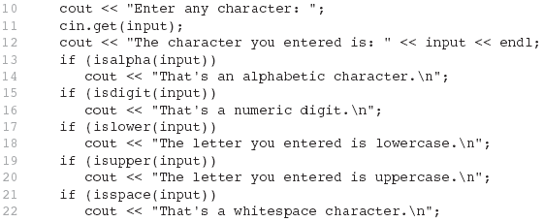
From Program 10-1

Slide 6
10.2
Character Case Conversion

Slide 7
Character Case Conversion
Require cctype header file
Functions:
toupper: if char argument is lowercase letter, return uppercase equivalent; otherwise, return input unchanged
char ch1 = 'H'; char ch2 = 'e'; char ch3 = '!';
cout << toupper(ch1); // displays 'H'
cout << toupper(ch2); // displays 'E'
cout << toupper(ch3); // displays '!'

Slide 8
Character Case Conversion
Functions:
tolower: if char argument is uppercase letter, return lowercase equivalent; otherwise, return input unchanged
char ch1 = 'H'; char ch2 = 'e'; char ch3 = '!';
cout << tolower(ch1); // displays 'h'
cout << tolower(ch2); // displays 'e'
cout << tolower(ch3); // displays '!'

Slide 9
C-strings
An Array Type for Strings

Slide 10
10.3
C-Strings

Slide 11
C-Strings
C-string: sequence of characters stored in adjacent memory locations and terminated by NULL character
String literal (string constant): sequence of characters enclosed in double quotes " " : "Hi there!"
H
i
t
h
e
r
e
!
\0

Slide 12
An Array Type for Strings
Arrays that are used to represent strings are called c-strings.
C-strings are stored as arrays of characters
C-strings use the null character '\0' to end a string.
The Null character is a single character (ascii value 0)
Remember sentinel values to end arrays?
An array with only positive integers ends in -1.
2
3
8
9
12
13
-1

Slide 13
C-Strings
C-strings can be used to represent strings of characters.
Declaring a C-string as char s[10] creates space for only nine characters
The null character terminator requires one space
To declare a C-String that can hold 10 characters, declare a char array of 11.
char s[11];

Slide 14
C-String array
A C-string variable does not need a size variable
The null character immediately follows the last character of the string
Example:
char greeting[11];
s[0] s[1] s[2] s[3] s[4] s[5] s[6] s[7] s[8] s[9] s[10]
‘H’
‘e’
‘l’
‘l’
‘o’
‘W’
‘o’
‘r’
‘l’
‘d’
’\0’

Slide 15
Declaring c-strings
To declare a C-string variable, use the syntax: char Array_name[ Maximum_C_String_Size + 1];
+ 1 reserves the additional character needed by '\0'

Slide 16
Initializing C-Strings
To initialize a C-string during declaration: char my_message[20] = "Hi there.";
The null character '\0' is added for you
Another alternative: char short_string[ ] = "abc"; but not this: char short_string[ ] = {'a', 'b', 'c’};
Why?
How is the second example displayed?

Slide 17
Initializing c-strings
This attempt to initialize a C-string does not cause the \0 to be inserted in the array
char short_string[ ] = {'a', 'b', 'c’};
How do we correct this?

Slide 18
Initializing c-strings
This attempt to initialize a C-string does not cause the \0 to be inserted in the array
char short_string[ ] = {'a', 'b', 'c’};
How do we correct this?
char short_string[ ] = {'a', 'b', ‘c’, ‘\0’ };

Slide 19
Looping with c-strings
Look for the special value at the end.
Make sure not to overwrite it or disaster!
If the null character is lost, the array cannot act like a C-string
Example: int index = 0; while (our_string[index] != '\0') { our_string[index] = 'X'; index++; }
This code depends on finding the null character!

Slide 20
Don’t need size but it is safer!
The loop on the previous slide depended on finding the '\0' character
It would be wiser to use this version in case the '\0' character had been removed int index = 0; while (our_string[index] != '\0' && index < SIZE) { our_string[index] = 'X'; index++; }

Slide 21
Finding the length of a c-string
How do we find the length of a string?
Can loop and count characters or use the
c-string function strlen in the c-library.
#include <cstring>
Example: #include <iostream>
#include <cstring>
char a_string[] = “Greetings!”;
int length = strlen(a_string); cout << a_string << “ has “ << length
<< “ characters\n”;

Slide 22
C-strings are just arrays!
This statement is legal:
char a_string[6] = “Hello”;
This statement is illegal: a_string = "Hello";
This is an assignment statement, not an initialization
The assignment operator does not work with C-strings
Remember that Arrays do not work with the assignment operator!

Slide 23
How to initialize a c-string.
A common method to assign a value to a C-string variable is to use strcpy, defined in the cstring library
Example: #include <cstring> … char a_string[ 11]; strcpy (a_string, "Hello"); Places "Hello" followed by the null character in a_string
Any problems with this?

Slide 24
Problems with strcpy
strcpy can create problems if not used carefully
strcpy does not check the declared length of the first argument
It is possible for strcpy to write characters beyond the declared size of the array
strncpy(a_string, “Hello”, 6);
We often use strncpy to copy substrings

Slide 25
Comparing two c-strings
Just like arrays, the == operator does not work as expected with C-strings
The predefined function strcmp is used to compare C-string variables
Example: #include <cstring> … if (strcmp(c_string1, c_string2)) cout << "Strings are not the same."; else cout << "String are the same.";

Slide 26
strcmp(char *s1, char *s2)
strcmp compares the contents in the C-strings a character at a time
s1[i] < s2[i] strcmp returns a negative value < 0
s1[i] > s2[i] strcmp returns a positive value > 0
s1[i] == s2[i] strcmp returns 0
which is interpreted as false
How does it do this?

Slide 27
strcmp(char *s1, char *s2)
strcmp compares the contents in the C-strings a character at a time
s1[i] < s2[i] strcmp returns a negative value < 0
s1[i] > s2[i] strcmp returns a positive value > 0
s1[i] == s2[i] strcmp returns 0
which is interpreted as false
As soon as the characters do not match
strcmp returns a negative value if the numeric code in the first parameter is less
strcmp returns a positive value if the numeric code in the second parameter is less
Non-zero values are interpreted as true

Slide 28
strcat(char* s1, char *s2)
The cstring library includes other functions
strcat concatenates two C-strings
The second argument is added to the end of the first
The result is placed in the first argument
Example: char string_var[20] = "The rain"; strcat(string_var, "in Spain"); Now string_var contains "The rainin Spain"

Slide 29
strncat(char *s1, char *s2)
strncat is a safer version of strcat
A third parameter specifies a limit for the number of characters to concatenate (not more than n characters added to the end).
Example:
char string_var[20] = "The rain"; strncat(string_var, "in Spain", 11);

Slide 30
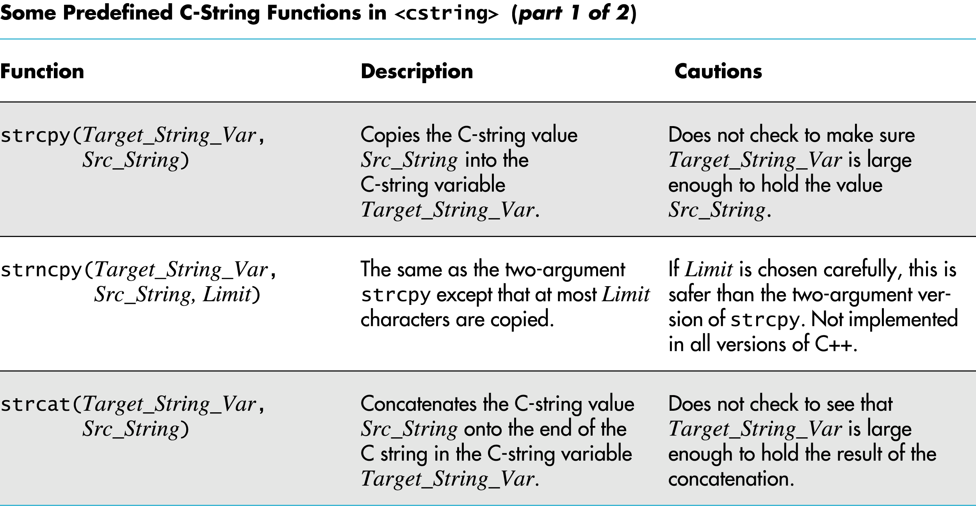
cstring library functions

Slide 31
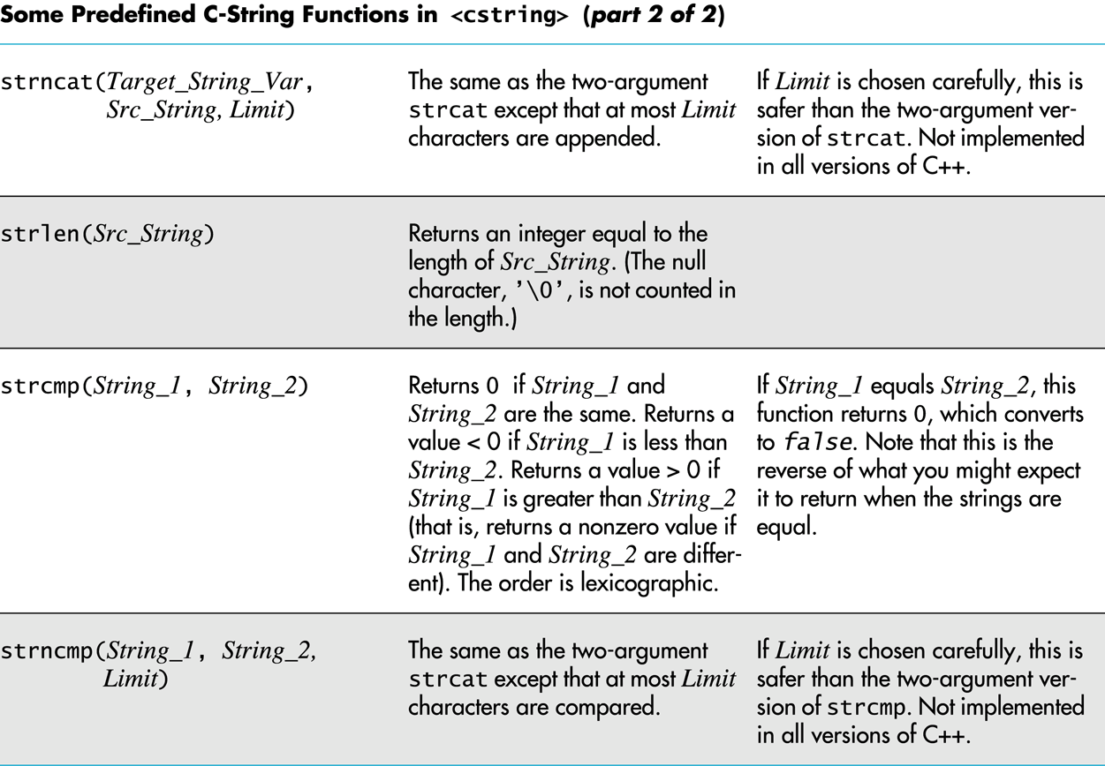
cstring library functions

Slide 32
C-Strings as parameters
C-string variables are arrays
C-string arguments and parameters are used just like arrays
If a function changes the value of a C-string parameter, it is best to include a parameter for the declared size of the C-string
If a function does not change the value of a C-string parameter, the null character can detect the end of the string and no size argument is needed

Slide 33
C-strings output
C-strings can be output with the insertion operator
Example: char news[ ] = "C-strings"; cout << news << " Wow." << endl;
C-strings are different than other arrays:
To display arrays of every other type, you have to loop!
To display a c-string, cout assumes that a char* or char[] is a string and loops for you.
Remember char* is the same as char[]

Slide 34
Consequences: c-strings output
Declare a pointer to a char (same as a c-string)
char* t = NULL;
cout << t << endl; // what happens?
cout assumes that every char* is a c-string
problem with cout is it doesn’t test for NULL.
When set to just an address of a char
char c = ‘X’;
char* t = &c;
cout << t << endl; // what happens?

Slide 35
C-string input
The extraction operator >> can fill a C-string
Whitespace ends reading of data
Example: char a[80], b[80]; cout << "Enter input: " << endl; cin >> a >> b; cout << a << b << "End of Output"; could produce: Enter input: Do be do to you! DobeEnd of Output

Slide 36
Reading a line with whitespace: getline(char* cstr, int length)
getline is a member of all input streams
getline has two arguments
The first is a C-string variable to receive input
The second is an integer specifying the max characters to read.
It is usually the size of the first argument.
getline stops reading when either the max characters less one is read into the c-string OR the end of line is reached in the input.
one character is reserved for the ‘\0’ character
getline stops even if the end of the line has not been reached

Slide 37
cin.getline(char[], int)
The following code is used to read an entire line including spaces into a single C-string variable
char a[80]; cout << "Enter input:\n"; cin.getline(a, 80); cout << a << End Of Output\n"; and could produce: Enter some input: Do be do to you! Do be do to you!End of Output

Slide 38
Convert c-strings to other types
"1234" is a string of characters
1234 is a number
When doing numeric input, it is useful to read input as a string of characters, then convert the string to a number
Reading money may involve a dollar sign
Reading percentages may involve a percent sign

Slide 39
int atoi(char* str)
To read an integer as characters
Read input as characters into a C-string, removing unwanted characters
Use the predefined function atoi to convert the C-string to an int value
Example: atoi("1234") returns the integer 1234
atoi("#123") returns 0 because # is not a digit

Slide 40
float atof(char *str)
C-strings can be converted to type double using the predefined function atof
atof returns a value of type double
Example: atof("9.99") returns 9.99 atof("$9.99") returns 0.0 because the $ is not a digit

Slide 41
Conversions
The conversion functions int atoi(char *s) long atol(char *s) float atof(char *s)
double atod(char *s) are found in the library cstdlib
To use the functions use the include directive #include <cstdlib>

Slide 42
String class
A Class for strings

Slide 43
string class
The string class allows the programmer to treat strings as a basic data type
No need to deal with the implementation as with C-strings
The string class is defined in the string library and the names are in the standard namespace
To use the string class you need these lines: #include <string> using namespace std;

Slide 44
string concatenation
Variables of type string can be concatenated with the + operator
Example: string s1, s2, s3; … s3 = s1 + s2;
If s3 is not large enough to contain s1 + s2, more space is allocated

Slide 45
string constructors
The default string constructor initializes the string to the empty string
Another string constructor takes a C-string argument
Example: string phrase; // empty string string noun("ants"); // a string version // of "ants"

Slide 46
It is natural to work with strings in the following manner string phrase = "I love" + adjective + " " + noun + "!";
It is not so easy for C++!
It must either convert the null-terminated C-strings, such as "I love", to strings, or it must use an overloaded + operator that works with strings and C-strings
We will learn more about both later

Slide 47
Declaration of string class
Variables of type string can be assigned with the = operator
Example: string s1, s2, s3; … s3 = s2;
Quoted strings are type cast to type string
Example: string s1 = "Hello Mom!";

Slide 48
Example

Slide 49
I/O with string
The insertion operator << is used to output objects of type string
Example: string s = "Hello Mom!"; cout << s;
The extraction operator >> can be used to input data for objects of type string
Example: string s1; cin >> s1;
>> skips whitespace and stops on encountering more whitespace

Slide 50
getline and Type string
A getline function exists to read entire lines into a string variable
This version of getline is not a member of the istream class, it is a non-member function
Syntax for using this getline is different than that used with cin: cin.getline(…)
Syntax for using getline with string objects: getline(Istream_Object, String_Object);

Slide 51
getline example
This code demonstrates the use of getline with string objects
string line; cout "Enter a line of input:\n"; getline(cin, line); cout << line << "END OF OUTPUT\n"; Output could be: Enter some input: Do be do to you! Do be do to you!END OF OUTPUT

Slide 52
getline(cin, string) and cin.get
The extraction >> operator cannot be used to read a blank character
To read one character at a time remember to use cin.get
cin.get reads values of type char, not type string
The use of getline, and cin.get for string input are demonstrated in the following program.

Slide 53
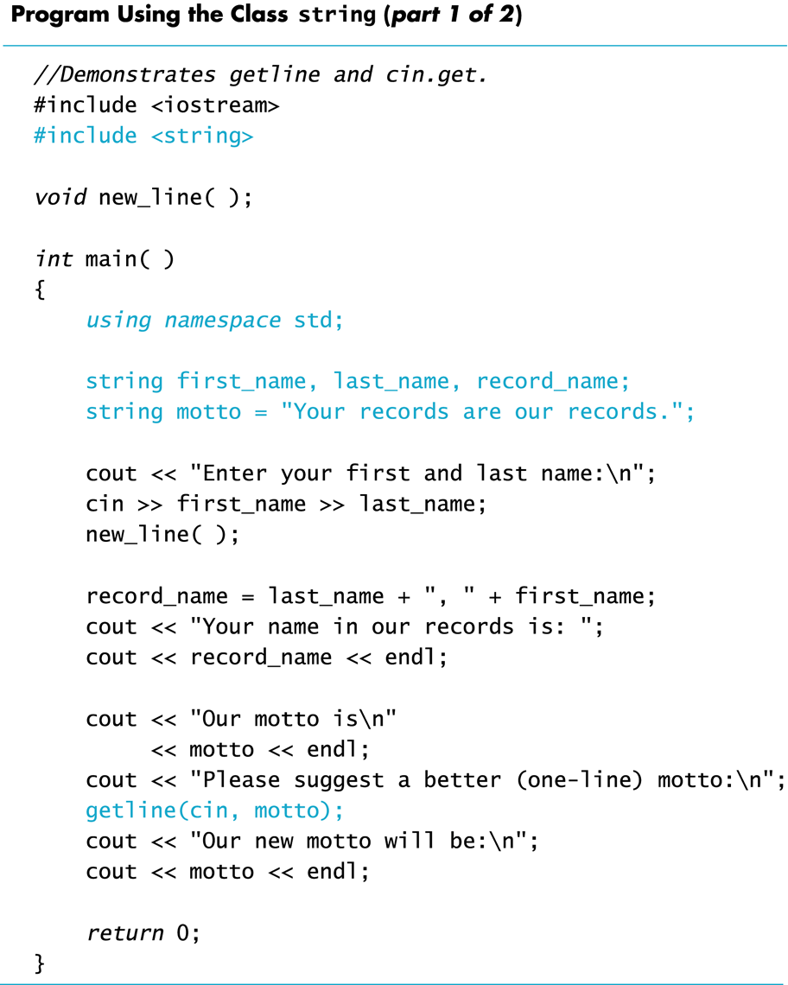

Slide 55
getline specifying a delimiter
The versions of getline we have seen, stop reading at the end of line marker '\n'
getline can stop reading at a character specified in the argument list
This code stops reading when a '?' is read string line; cout <<"Enter some input: \n"; getline(cin, line, '?');

Slide 56
getline returns a istream&
These are the declarations of the versions of getline for string objects we have seen
istream& getline(istream& ins, string& str_var, char delimiter);
istream& getline(istream& ins, string& str_var);
Getline returns a reference to an istream.
cin is a reference to an istream.

Slide 57
getline returns a reference to its first argument
This code will read in a line of text into s1 and a string of non-whitespace characters into s2: string s1, s2; getline(cin, s1) >> s2;
returns
cin >> s2;

Slide 58
The to_string Function

Slide 59
Use str[i] and str.length()
The string class allows the same operations we used with C-strings…and more
Characters in a string object can be accessed as if they are in an array
last_name[i] provides access to a single character as in an array
Index values are not checked for validity!
The member function length() returns the number of characters in the string object:
Example: int n = string_var.length( );

Slide 60
str.at(i) same as str[i]
at is an alternative to using [ ]'s to access characters in a string.
at checks for valid index values
Example: string str("Mary"); cout << str[3] << endl; cout << str.at(3) << endl; str[2] = 'X'; str.at(2) = 'X';

Slide 61
Comparing strings like builtins
Comparison operators work with string objects
Objects are compared using lexicographic order (Alphabetical ordering using the order of symbols in the ASCII character set.)
== returns true if two string objects contain the same characters in the same order
Remember strcmp for C-strings?
<, >, <=, >= can be used to compare string objects

Slide 62
C-string auto-convert to string
Recall the automatic conversion from C-string to string:
char a_c_string[] = "C-string"; string_variable = a_c_string;
BUT strings are not converted to C-strings
Both of these statements are illegal:
a_c_string = string_variable;
strcpy(a_c_string, string_variable);

Slide 63
Use str.c_str() for c-string
The string class member function c_str() returns the C-string version of a string object
Example: strcpy(a_c_string, string_variable.c_str( ) );
This line is still illegal a_c_string = string_variable.c_str( ) ;
Recall that operator = does not work with C-strings

Slide 64
Other Definitions of C++ strings
Definition | Meaning
string name; | defines an empty string object
string myname("Chris"); | defines a string and initializes it
string yourname(myname); | defines a string and initializes it
string aname(myname, 3); | defines a string and initializes it with first 3 characters of myname
string verb(myname,3,2); | defines a string and initializes it with 2 characters from myname starting at position 3
string noname('A', 5); | defines string and initializes it to 5 'A's

Slide 65
string Operators
OPERATOR | MEANING
>> | extracts characters from stream up to whitespace, insert into string
<< | inserts string into stream
= | assigns string on right to string object on left
+= | appends string on right to end of contents on left
+ | concatenates two strings
[] | references character in string using array notation
>, >=, <, <=, ==, != | relational operators for string comparison. Return true or false

Slide 66
string Member Functions
Are behind many overloaded operators
Categories:
assignment: assign, copy, data
modification: append, clear, erase, insert, replace, swap
space management: capacity, empty, length, resize, size
substrings: find, front, back, at, substr
comparison: compare
See Table 10-8 for a list of functions
Or below

Slide 67
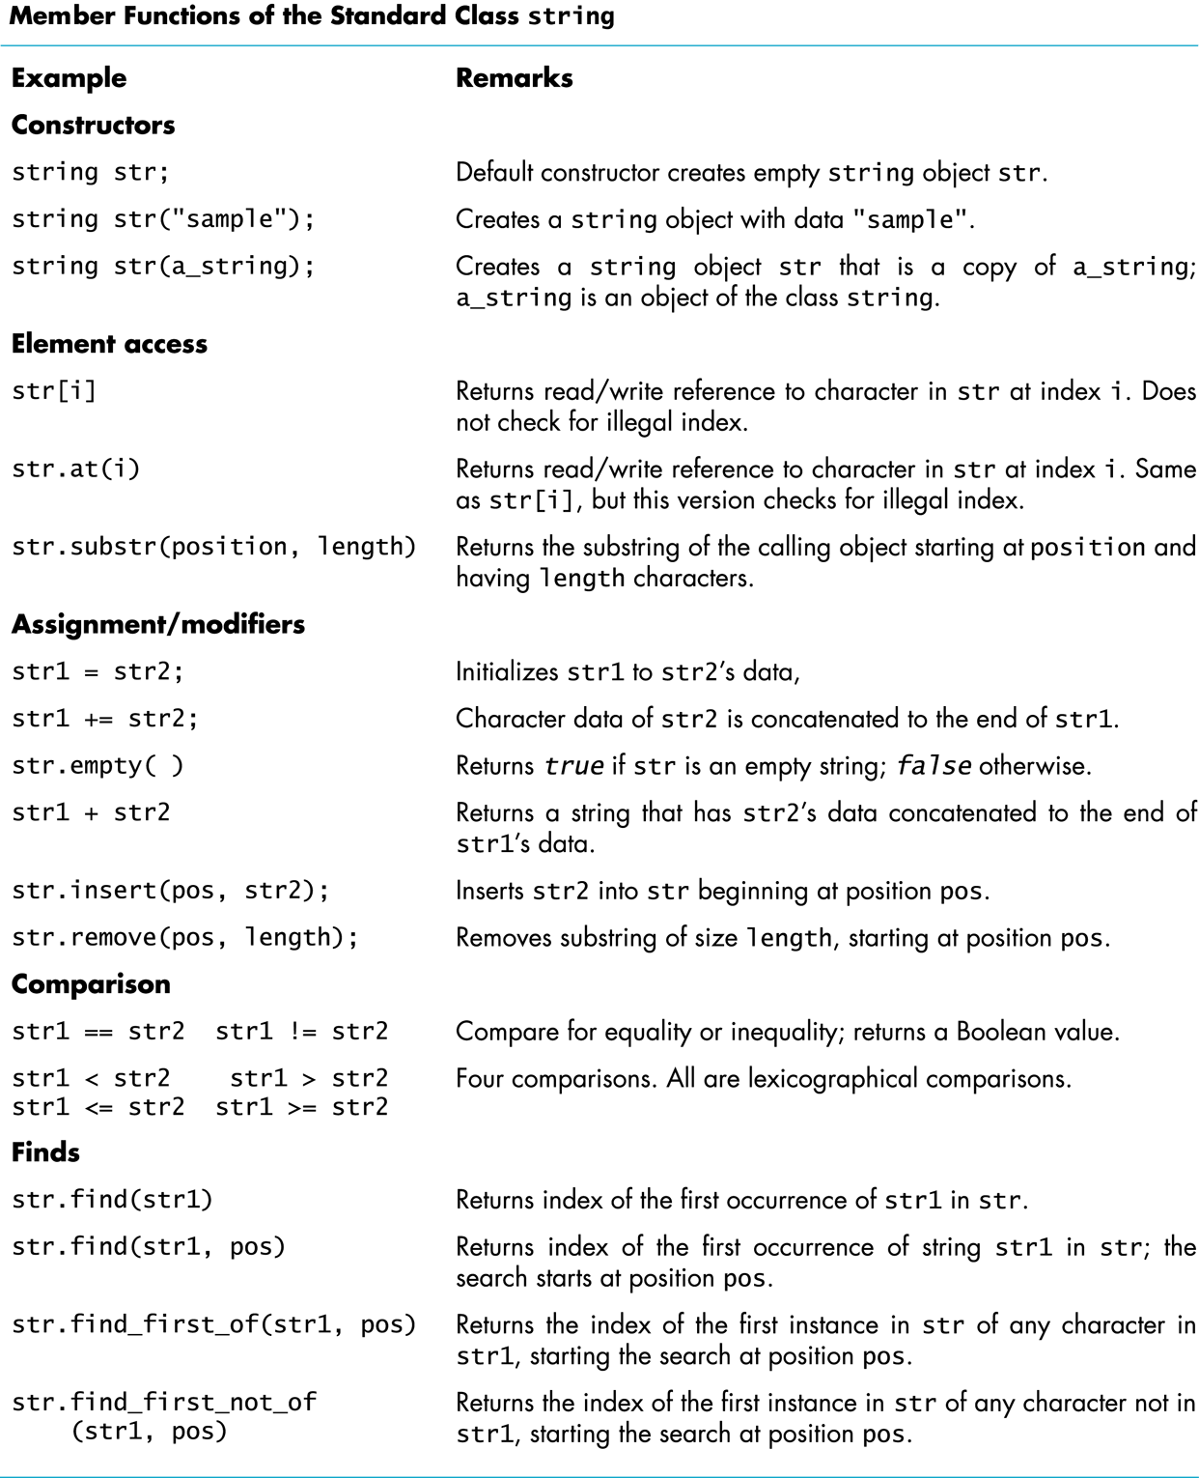

Slide 68
Palindrome Program
What is a palindrome?
A palindrome is a string that is the same when read left to right as when read right to left.
Examples:
Able was I 'ere I saw Elba.
Madam, I'm Adam.
Racecar

Slide 69
Two implementations of Palindrome
c-string implementation
Changes strings in place
Dynamic arrays for intermediate results.
Functions to manipulate c-strings
Takes more code to implement
string class implementation
Uses local string variables to manipulate copies.
Uses string class operators ==, +=, =.

Slide 70
Palindrome Algorithm
Clean the input string.
Remove all punctuation
Convert to lower case
Create a reverse copy of the string
Use the reverse code from the lab with the swap function.
Compare the clean version to the reverse version. If the clean string equals the reverse, it is a palindrome, otherwise not…

Slide 71
When writing code, start with the simplest function
Convert to lower is the simplest
Use functions islower(char c), tolower(char c)
For every character in the input string, convert it to lowercase.
for (int i = 0; doneProcessing(str,i); i++) {
str[i] = tolower(str[i])
}
Define doneProcessing(str, i) for c-string?
Define doneProcessing(str, i) for string class?

Slide 72
Two versions of convert_to_lower
char* convert_to_lower(char* str)
// Precondition: a c-string that may have mixed
// case in it.
// Postcondition: returns a lowercase string
{
for (int i = 0; str[i] != ‘\0’ i++)
{
// tolower is defined in cstdlib
str[i] = tolower(str[i]);
}
cout << "convert_to_lower: " << str << endl;
return str;
}
string convert_to_lower(const string& str)
// Precondition: a string that may have mixed
// case in it.
// Postcondition: returns a lowercase string
{
string clean_str;
for (int i = 0; i < str.length(); i++)
{
// tolower is defined in cstdlib
clean_str += tolower(str[i]);
}
cout << "convert_to_lower: " << clean_str << endl;
return clean_str;
}

Slide 73
remove_punctuation & space
For every character in the input string, if it is not punctuation (or space), add it to the temp string.
for (int i = 0; i < length; i++) {
if the next char is not punctuation or space
copy it to temp or copy only alphanumeric.
}
How do we determine the next char is not punctuation?

Slide 74
More on remove_punctuation
How do we determine a character is not punctuation (or is punctuation)?
Create a string of punctuation characters and see if it is in that string (from Savitch).
Use a utility function in cctype called ispunct(char c) and isspace(char c)
How do we determine a character is alphanumeric
Create a string a digits and alphabetic characters.
Use a utility function from cctype isalnum(char c)

Slide 75
Two versions of remove_punct
char* remove_punct(char* str)
// Precondition: a string that may have punctuation
// Postcondition: return a string w/o punctuation
{
// Create a dynamic String for the result.
char *clean_str = new char[strlen(str)+1];
int next = 0; // next char in clean_str
for (int i = 0; str[i] != '\0'; i++)
{ // if not punctuation, add to end of new string
if (!ispunct(str[i]) && !isspace(str[i])) {
clean_str[next++] = str[i];
}
}
clean_str[next] = '\0’; // have to end clean_str
strcpy(str, clean_str); // copy to str to cleanup.
delete [] clean_str; // cleanup dynamic string
return str;
}
string remove_punct(const string& str)
// Precondition: a string that may have punctuation
// Postcondition: return a string w/o punctuation.
{
// A string for the result
string clean_str;
for (int i = 0; i < str.length(); i++)
{ // if alpha numeric
if (isalpha(str[i]) || isdigit(str[i])) {
clean_str += str[i];
}
}
return clean_str;
}

Slide 76
What does is_palindrome look like?
Remember that we have to do these things:
Remove punctuation.
Convert the input string to lower case.
Reverse the normalized string
Compare the original string to the reverse.
Depending on the implementation (c-strings vs. string class), the code varies.
Which is more complicated?

Slide 77
Two versions of is_palindrome
bool is_palindrome(char* str)
{
bool is_pal = false; // for result during cleanup
int length= strlen(str); // for two dynamic strings
char* cleanstr = new char[length+1];
strcpy(cleanstr, str);
convert_to_lower(remove_punct(cleanstr));
char* revstr = new char[length+1];
strcpy(revstr, cleanstr);
reverse(revstr);
if (strcmp(revstr,cleanstr) == 0) {
is_pal = true;
}
// cleanup memory
delete [] cleanstr;
delete [] revstr;
return is_pal;
}
bool is_palindrome(string str)
// Precondition: a string that may have punctuation
// and mixed case but could also be a palindrome.
// Postcondition: returns true if it is a palindrome.
// leaves the original string in tact.
{
string cleanstr = convert_to_lower(remove_punct(str));
string revstr = reverse(cleanstr);
return (revstr == cleanstr);
}

Slide 78
What’s the difference?
C-string version
strlen() to get the length
strcmp() to compare
strcpy() to copy
str[next++] to concatenate char
str[length]=‘\0’ to end string
Memory management
char* tmp = new[strlen(str)+1];
// process str into tmp.
strcpy(str,tmp);
delete [] tmp;
return str;
String class
string.length() to get the length
= operator to copy
== operator to compare
+= operator to concatenate char
Automatic string end handling
No memory management
string tmp;
// process str into tmp
return tmp;

Slide 79
Vectors
A dynamic array class

Slide 80
Vectors are like dynamic arrays
Vectors are like arrays that can change size as your program runs
Vectors, like arrays, have a base type
To declare an empty vector with base type int: vector<int> v;
<int> identifies vector as a template class
You can use any base type in a template class: vector<string> v;

Slide 81
Index vector elements with []
Vectors elements are indexed starting with 0
[ ]'s are used to read or change the value of an item: v[i] = 42; cout << v[i];
[ ]'s cannot be used to initialize a vector element [Note: C++11 allows vector initialization similar to arrays using {}.]

Slide 82
Use push_back to append
Elements are added to a vector using the member function push_back
push_back adds an element in the next available position
Example: vector<double> sample; sample.push_back(0.0); sample.push_back(1.1); sample.push_back(2.2);

Slide 83
Use member function size()
The member function size returns the number of elements in a vector
Example: To print each element of a vector given the previous vector initialization: for (int i= 0; i < sample.size( ); i++) cout << sample[i] << endl;

Slide 84
unsigned int size()
The vector class member function size returns an unsigned int
Unsigned int's are nonnegative integers
Some compilers will give a warning if the previous for-loop is not changed to: for (unsigned int i= 0; i < sample.size( ); i++) cout << sample[i] << endl;
[NOTE: g++ does not complain if you use int.]

Slide 85
Initializers
A vector constructor exists that takes an integer argument and initializes that number of elements
Works for other classes too!
Example: vector<int> v(10); initializes the first 10 elements to 0 v.size( ) would return 10
[ ]'s can now be used to assign elements 0 through 9
push_back is used to assign elements greater than 9

Slide 86
Vectors of any type
The vector constructor with an integer argument
Initializes elements of number types to zero
Initializes elements of class types using the default constructor for the class
To use the vector class
Include the vector library #include <vector>
Vector names are placed in the standard namespace: using namespace std;

Slide 87
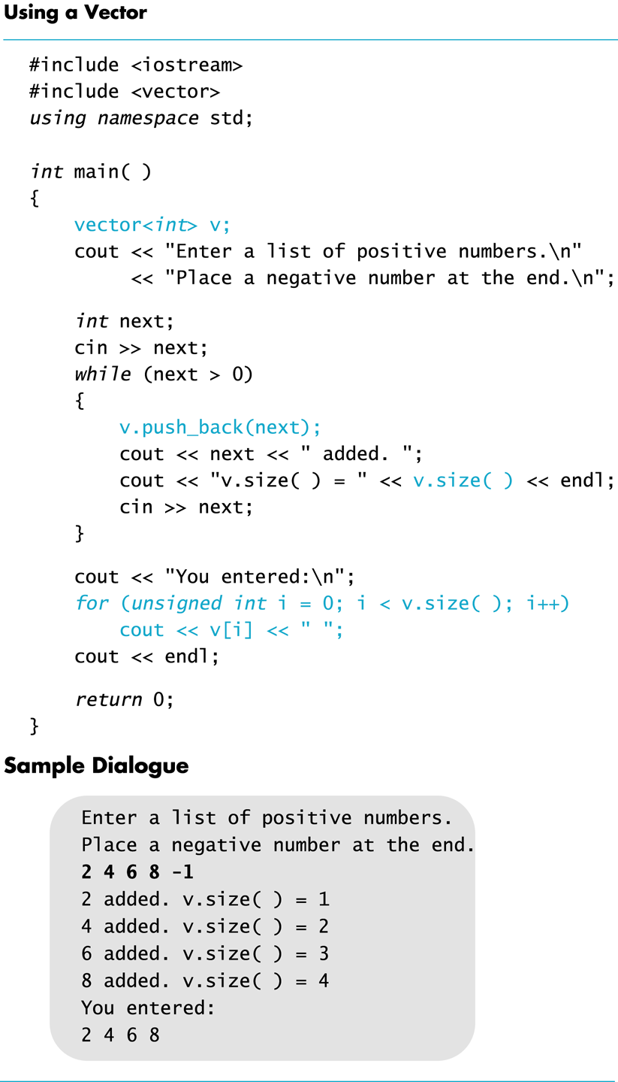

Slide 88
Vector issues
Attempting to use [ ] to set a value beyond the size of a vector may not generate an error BUT
The program will probably misbehave
Unlike arrays, assignment = operator with vectors does an element by element copy of the right hand vector
For class types, the assignment operator must make independent copies.

Slide 89
Vector efficiency
A vector's capacity is the number of elements allocated in memory
Accessible using the capacity( ) member function
size() is the number of elements initialized
When a vector runs out of space, the capacity is automatically increased
A common scheme is to double the size of a vector
More efficient than allocating smaller chunks of memory

Slide 90
Resize to grow or shrink
When efficiency is an issue
Member function reserve can increase the capacity of a vector
Example:
v.reserve(32); // at least 32 elements v.reserve(v.size( ) + 10); // at least 10 more
resize can be used to shrink a vector
Example: v.resize(24);
//elements beyond 24 are lost

Slide 91
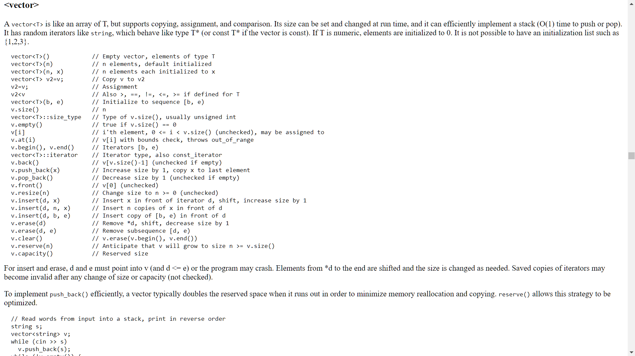

Slide 92
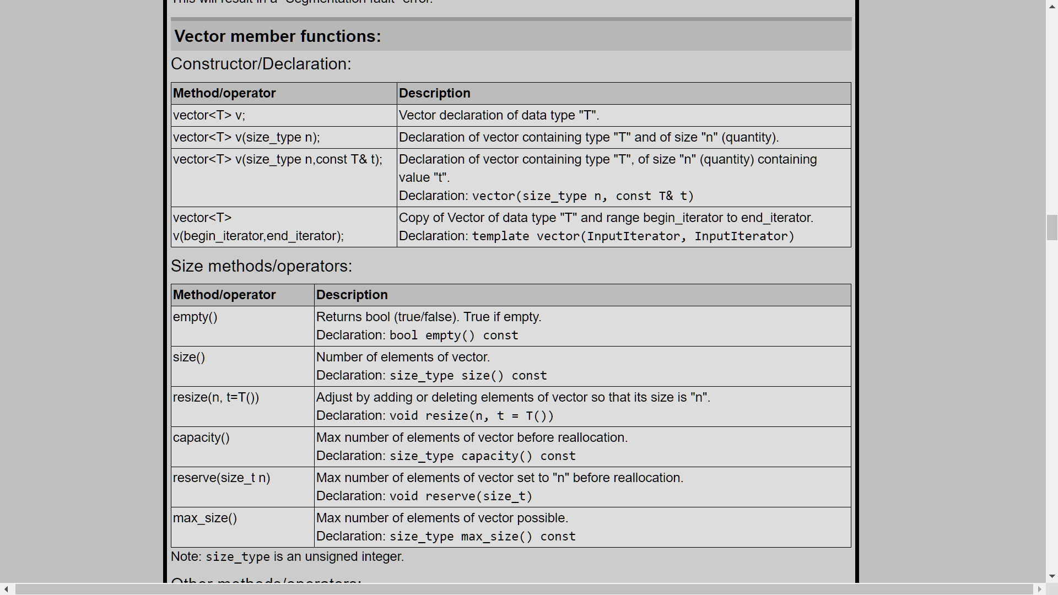
vector<type> v;

Slide 93
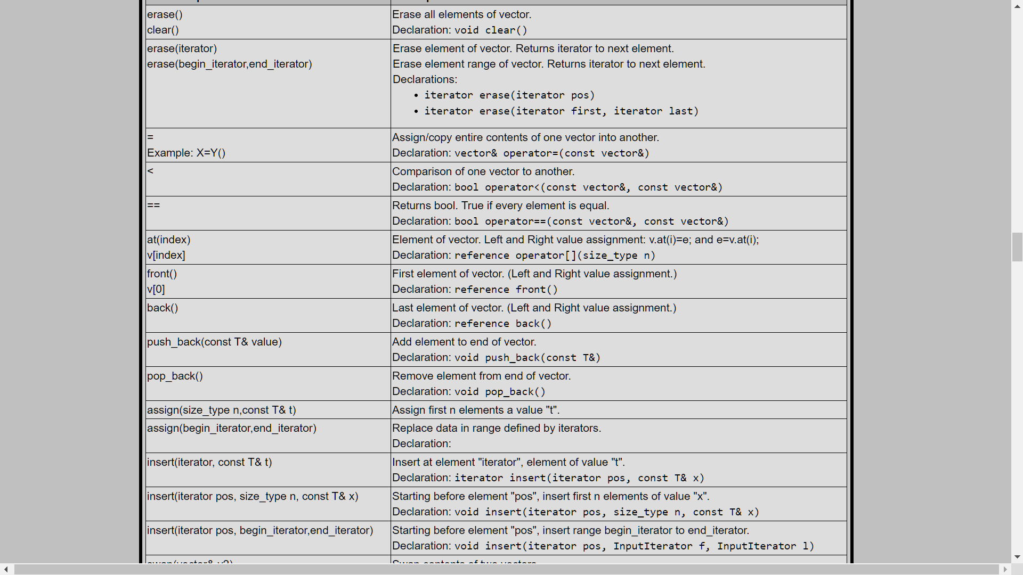
vector<type> methods

Slide 94
vector<type>::iterator
An iterator allows us to loop.
for (vector<type>::const_iterator it = v.begin(); it != v.end(); it++)
cout << *it << endl;

