Slide 1
Inheritance
Chapter 15 & additional topics

Slide 2
Overview
Inheritance Introduction
Three different kinds of inheritance
Changing an inherited member function
More Inheritance Details
Polymorphism

Slide 3
Inheritance Introduction

Slide 4
Motivating Example: Employee Classes
Design a record-keeping program with records for salaried and hourly employees
Salaried and hourly employees belong to a class of people who share the property "employee"
Salaried employee
A subset of employees with a fixed wage
Hourly employees
Another subset of employees earn hourly wages
All employees have a name and SSN
Functions to manipulate name and SSN are the same for hourly and salaried employees

Slide 5
First define a class called Employee for all kinds of employees
The Employee class will be used later to define classes for hourly and salaried employees

Slide 6
employee.h
Employee
name
ssn
Employee()
net_pay
Employee(string, string)
print_check()
get_name()
get_ssn()
get_net_pay()
set_name()
set_ssn()
set_net_pay()

Slide 7
We now use Employee class to create an HourlyEmployee class

Slide 8
see book Display 15.3
hourlyemployee.h
HourlyEmployee is derived from Class Employee
HourlyEmployee inherits all member functions and member variables of Employee
NOT SHOWN explicitly in HourlyEmployee’s defn
The class definition begins class HourlyEmployee : public Employee
note that :public Employee shows that HourlyEmployee is derived from class Employee
HourlyEmployee declares additional member variables wage_rate and hours

Slide 9
Employee
name
ssn
Inheritance：
a new class, called a derived class, is created from another class (i.e., the base class)
A derived class automatically has all the member variables and functions of the base class
A derived class can have additional member variables and/or member functions
Employee()
net_pay
Employee(string, string)
print_check()
get_name()
get_ssn()
get_net_pay()
set_name()
set_ssn()
set_net_pay()
is
HourlyEmployee
name
ssn
wage_rate
hours
Employee()
net_pay
Employee(string, string)
print_check()
set_rate()
get_rate()
get_name()
get_ssn()
get_net_pay()
set_hours ()
get_hours ()
set_name()
set_ssn()
set_net_pay()

Slide 10
A derived class automatically has all the member variables and functions of the base class.
But, the derived class might not have the same access rights as the base class when accessing those inherited members! (To be discussed soon…)

Slide 11
Inherited Members
A derived class inherits all the members (data members, functions) of the parent class
The derived class should not re-declare or re-define a member function inherited from the parent unless …
The derived class wants to use the inherited member function for doing something different
The derived class can add member variables & member functions

Slide 12
Display 15.3
hourlyemployee.h
Only list the declaration of an inherited member function if you want to change the defn of the function.

Slide 13
Why re-define print_check() ?
A practical concern here…
print_check will have different definitions to print different checks for each type of employee
An Employee object lacks sufficient information to print a check
Each derived class will have sufficient information to print a check

Slide 14
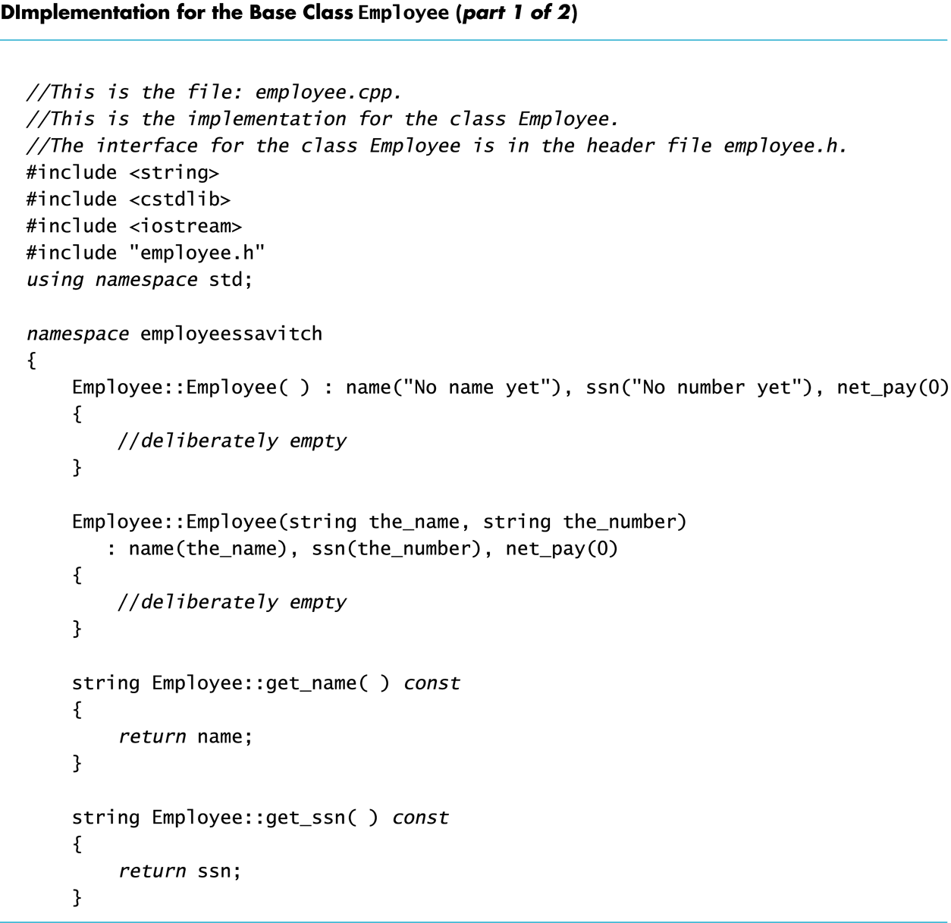
employee.cpp

Slide 15
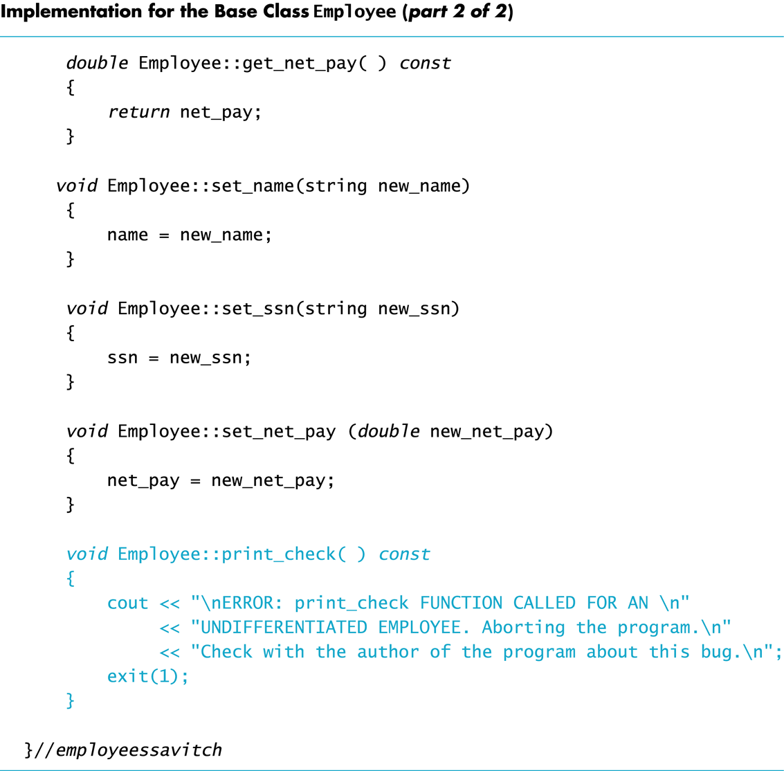
employee.cpp

Slide 16
Implementing a Derived Class
Any member function added in the derived class are defined in the implementation file for the derived class
Definitions are not given for inherited functions that are not to be changed
The HourlyEmployee class is implemented in HourlyEmployee.cpp
Textbook Display 15.5

Slide 17
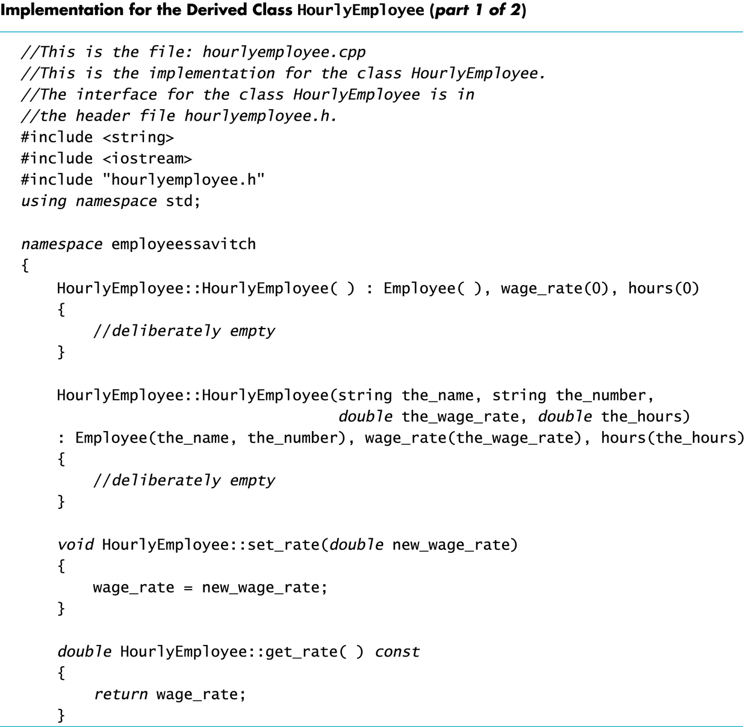
Display 15.5 (1/2)

Slide 18
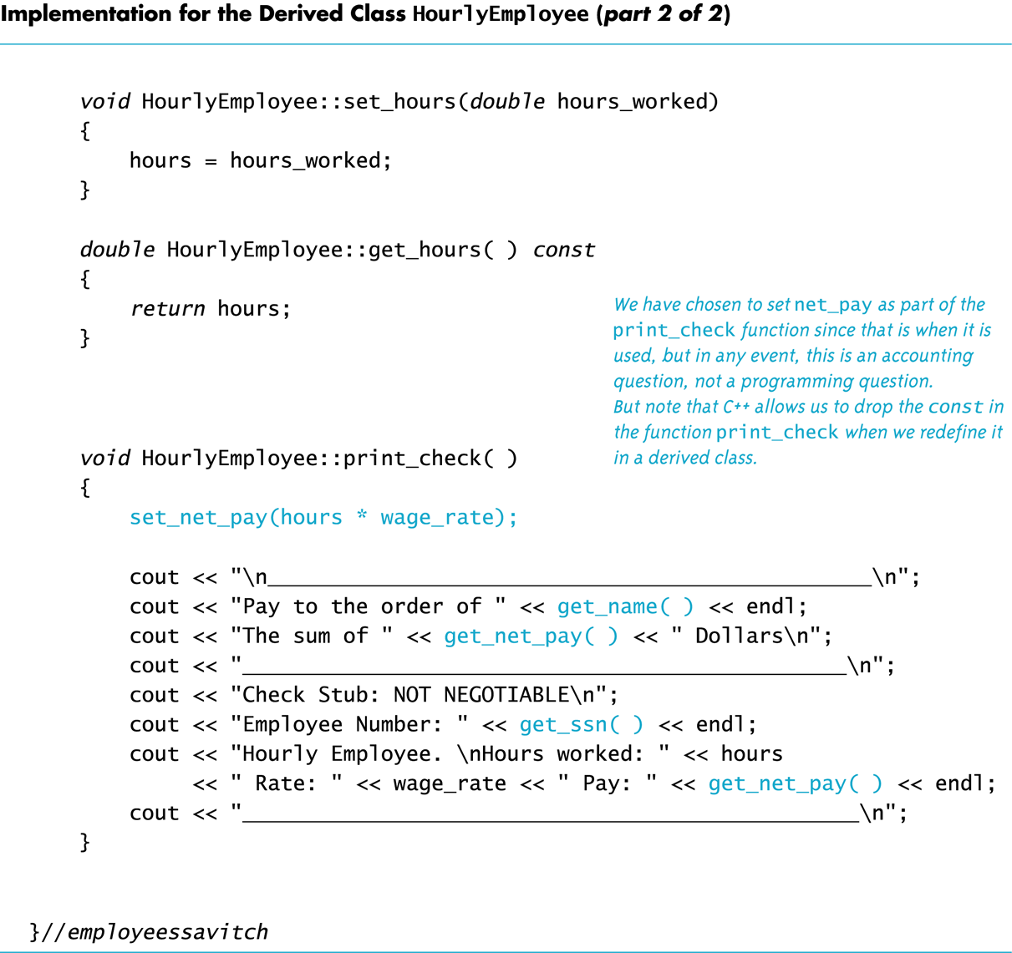
Display 15.5 (2/2)

Slide 19
We now use Employee class to create an SalariedEmployee class

Slide 20
Class SalariedEmployee
salariedemployee.h
The class SalariedEmployee is also derived from Employee
Function print_check is redefined to have a meaning specific to salaried employees
SalariedEmployee adds a member variable salary

Slide 21
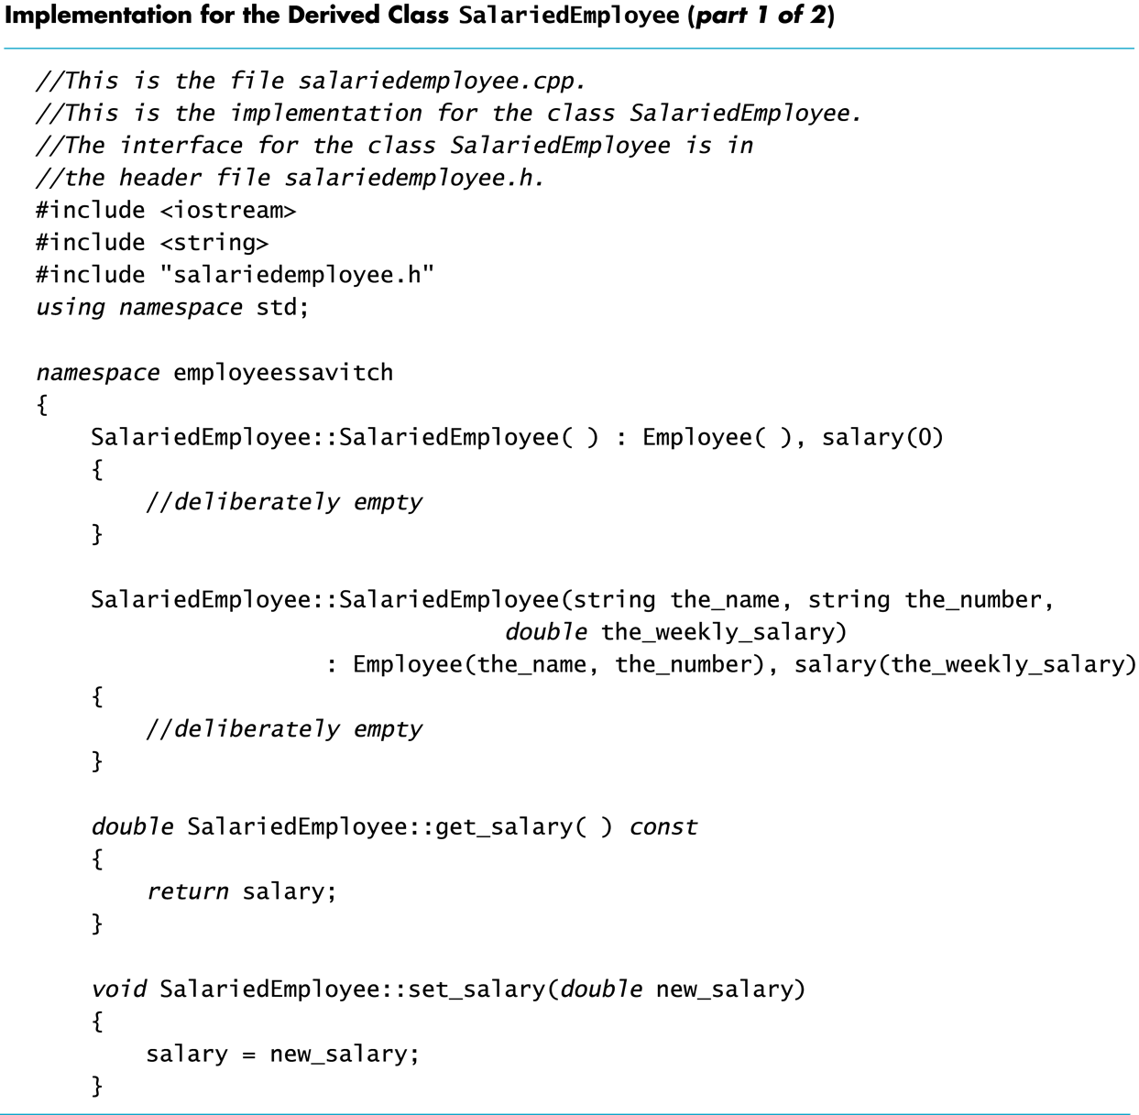
Display 15.6 (1/2)
salariedemployee.cpp

Slide 22
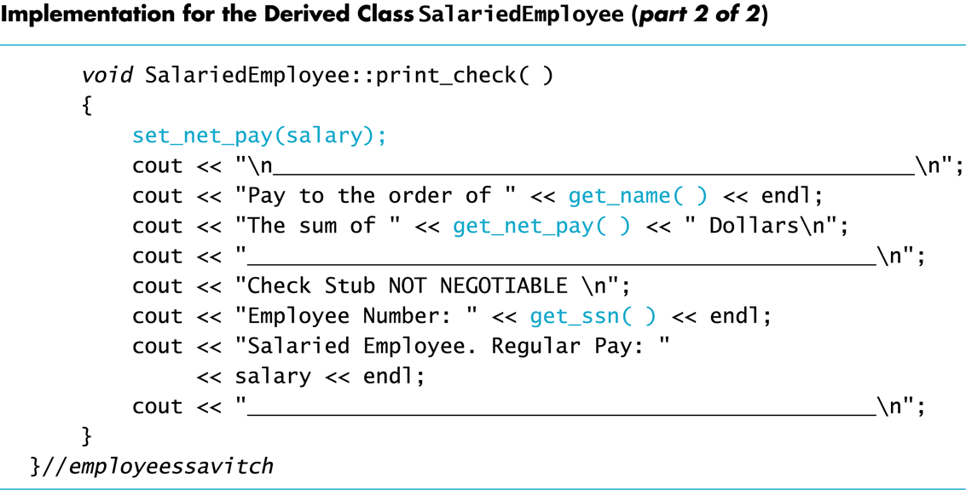
Display 15.6 (2/2)

Slide 23
Parent and Child Classes
Recall that a child class automatically has all the members of the parent class
The parent class is an ancestor of the child class
The child class is a descendent of the parent class
The parent class (Employee) contains all the code common to the child classes
You do not have to re-write the code for each child
Employee
HourlyEmployee
SalariedEmployee

Slide 24
Is-A relationship is one way
The child is-a version of the parent, but the parent is NOT a version of the child.
The child has ALL features of the parent but the child has ADDED features.
Only the child knows about the parent. The parent does not know about the children.

Slide 25
Parent and Child Classes (cont’d)
An hourly employee is an employee
An object of type HourlyEmployee can be used wherever an object of type Employee can be used
An object of a class type can be used wherever any of its ancestors can be used
An ancestor cannot be used in a place where one of its descendents is expected
void fun1(Employee x);
void fun2(HourlyEmployee y);
int main()
{
Employee a;
HourlyEmployee b;
fun1(a); //correct
fun1(b); //correct
fun2(a); //incorrect
fun2(b); //correct
}
public inheritance is an
is-a relationship

Slide 26
Derived Class’s Constructors
A base class’s constructor is not inherited in a derived class
The base class constructor can be invoked by the constructor of the derived class
The constructor of a derived class begins by invoking the constructor of the base class in the initialization section:
HourlyEmployee::HourlyEmployee : Employee( ), wage_rate( 0), hours(0) { //no code needed }
Call a constructor for Employee

Slide 27
Default Initialization
If a derived class constructor does not invoke a base class constructor explicitly, the base class default constructor will be used automatically
If class B is derived from class A and class C is derived from class B
When a object of class C is created
The base class A's constructor is the first invoked
Class B's constructor is invoked next
C's constructor completes execution

Slide 28
What is the order?
int main()
{
C c;
}
class A {
public:
A() { cout << “A()” << “ “; }
};
class B : public A {
public:
B(): A(){ cout << “B()” << “ “; }
};
class C : public B {
public:
C() : B() { cout << “C()” << “ “; }
};
A() B() C()

Slide 29
Private is Private
A member variable (or function) that is private in the parent class is not directly accessible by the member functions in the child class
This code is illegal as net_pay is a private member of Employee! void HourlyEmployee::print_check( ) { net_pay = hours * wage_rage;
}
The parent class member functions must be used to access the private members of the parent
A member function of a class can NOT directly access its own member variable (inherited, private to its base class)!

Slide 30
The protected Qualifier
protected members of a class appear to be private outside the class, but are directly accessible within a derived classes
If member variables name, net_pay, is listed as protected (not private) in the Employee class, this code becomes legal: HourlyEmployee::print_check( ) { net_pay = hours * wage_rage;
access_specifiers_demo.cpp

Slide 31
Using protected or not?
Using protected members of a class is a convenience to facilitate writing the code of derived classes.
Protected members are not necessary
Derived classes can use the public methods of their ancestor classes to access private members
Many programming authorities consider it bad style to use protected member variables
It breaks encapsulation forcing changes in the base class to be handled in children.

Slide 32
Overview
Inheritance Introduction
Three different kinds of inheritance
Changing an inherited member function
More Inheritance Details
Polymorphism

Slide 33
Three different kinds of inheritance

Slide 34
Inherit Visibility of Access Qualifiers
Parent – Base class
p
r
i
v
a
t
e
Outside
World
private is visible only to parent
public
visible
To All
public
p
r
o
t
e
c
t
e
d
protected visible to parent & child
Child – Derived class

Slide 35
Three different ways for classes to inherit from other classes: public, private, and protected.
// Inherit from Base publicly
class D1: public Base
{ };
// Inherit from Base privately
class D2: private Base
{ };
// Inherit from Base protectedly
class D3: protected Base
{ };
class D4: Base // Defaults to private inheritance
{ };
If you do not choose an inheritance type, C++ defaults to private inheritance (just like members default to private access if you do not specify otherwise).

Slide 36
Public inheritance
// Inherit from Base publicly
class D1: public Base
{ };
All members keep their original access specifications.
Private members stay private, protected members stay protected, and public members stay public.
public inheritance
Base class access specifier | Derived class access specifiier (implicitly given) | Directly accessible in member functions of derived class? | Directly accessible in any other code?
public | public | yes | yes
private | private | no | no
protected | protected | yes | no

Slide 37
Private inheritance
// Inherit from Base privately
class D2: private Base
{ };
All members from the base class are inherited as private.
private members stay private, and protected and public members become private.
This does not affect that way that the derived class accesses members inherited from its parent! It only affects the code trying to access those members through the derived class.
private inheritance
Base class access specifier | Derived class access specifiier (implicitly given) | Directly accessible in member functions of derived class? | Directly accessible thru objects of derived class in any other code?
public | private | yes | no
private | private | no | no
protected | private | yes | no

Slide 38
Protected inheritance
// Inherit from Base protectedly
class D3: protected Base
{ };
Rarely used. The public and protected members become protected, and private members stay private.
protected inheritance
Base class access specifier | Derived class access specifiier (implicitly given) | Directly accessible in member functions of derived class? | Directly accessible thru objects of derived class in any other code?
public | protected | yes | no
private | private | no | no
protected | protected | yes | no

Slide 39
Member functions of a derived classes have access to its inherited members based ONLY on the access specifiers of its immediate parent, not affected by the inheritance method used!
Base class access specifier for members | Derived class access specifiier (implicitly given for inherited members) | Directly accessible in member functions of derived class? | Directly accessible in any other code?
public inheritance
public | public | yes | yes
private | private | no | no
protected | protected | yes | no
private inheritance
public | private | yes | no
private | private | no | no
protected | private | yes | no
protected inheritance
public | protected | yes | no
private | private | no | no
protected | protected | yes | no

Slide 40
Access Qualifiers
class B : public A // B’s children can access x,y
{
// x is public
// y is protected
// z is not accessible from B
};
class C : protected A // C’s children can access x,y
{
// x is protected
// y is protected
// z is not accessible from C
};
class A
{
public:
int x;
protected:
int y;
private:
int z;
};
class D : private A { // defaults to ‘private’
Outside of class: {
public maintains access ‘as-is’ // x is private
protected makes it all inaccessible // y is private
private makes it all inaccessible // z is not accessible from D
};
IMPORTANT NOTE: Classes B, C and D all contain the variables x, y and z. It is just a question of access

Slide 41
Inheritance Qualifiers
When derived public, all qualifiers of the parent stay the same in the derived.
“As-is” inheritance.
When derived protected, both public and protected base members become protected in the derived.
Not visible outside, but visible to children
When derived private, both public and protected become private in the derived.
Not visible outside, not visible to children.

Slide 42
Overview
Inheritance Introduction
Three different kinds of inheritance
Changing an inherited member function
More Inheritance Details
Polymorphism

Slide 43
Changing an inherited member function

Slide 44
Redefinition of Member Functions
When defining a derived class, list the inherited functions that you wish to change for the derived class
The function is declared in the class definition
HourlyEmployee and SalariedEmployee each have their own definitions of print_check
Next page demonstrates the use of the derived classes defined in HourlyEmployee.h and SalariedEmployee.h.

Slide 45
Functions defined in Employee class
set_name()
set_ssn()
print_check()
Functions defined in HourlyEmployee class
set_rate()
set_hours()
print_check()

Slide 46
Redefining vs. Overloading
A function redefined in a derived class has the same number and type of parameters
The prototype (return value, function name, and parameters) of the function in the derived class must be exactly identical to that in the base class.
The derived class has only one function with the same name as the base class
An overloaded function has a different number and/or type of parameters than the base class
For example, the derived class has two functions with the same name as the base class: one is overloading, one is redefining.
void set_name(string first_name, string last_name);//overloading
void set_name(string new_name); //redefine

Slide 47
A side note: function signatures
An overloaded function has multiple signatures
A function signature is the function's name with the sequence of types in the parameter list, not including any const or '&'
Some compilers allow overloading based on including const or not including const

Slide 48
Change access specifier for an inherited member (data or function)
When re-define a function in a derived class,
The re-defined function uses whatever access specifier it is given in the derived class
The re-defined function does not inherit the access specifier of the function with the same prototype in the base class.
Therefore,
You can hide an inherited member (originally public in base class) by specifying it as private or protected
You can expose an inherited member (originally protected in base class) by specifying it as public
However, you can only change the access specifiers of base members the class are accessible in the derived class.
You can never change the access specifier of a base member from private to protected or public, because derived classes do not have access to private members of the base class.

Slide 49
Changing Access Qualifiers in Child
A base class member that is private
CANNOT BE CHANGED!
A base class member that is protected
Can be changed to public or private in child.
A base class member that is public
Can be changed to protected or private in child.

Slide 50
Access to a Redefined Base Function
When a function of a base class is redefined in a derived class, the base class function can still be used
To specify that you want to use the base class version of the redefined function:
int main()
{
HourlyEmployee sally_h; sally_h.Employee::print_check( );
}

Slide 51
Hierarchy with DayOfYear to Date
class DayOfYear {
public:
DayOfYear(int mon, int day);
void set(int mon, int day);
private:
int month, day;
};
class Date : public DayOfYear {
public:
Date(int mon, int day, int y) : DayOfYear(mon, day), year(y) {}
using DayOfYear::set; // Make visible in Child
void set(int mon, int day, int y);
private:
int year;
};

Slide 52
Overloaded function between classes
int main() {
Date birthday(4, 19, 2001);
birthday.set(4, 17); // Can’t do this, hidden
birthday.DayOfYear::set(4,17);
}

Slide 53
Adding new functionality to an inherited member function
See derived_changes_inherited_members.cpp file.
void HourlyEmployee::print_check()
{
set_net_pay(hours*rate);
Employee::print_check();
cout << “Hours worked: “ << hours;
…
}

Slide 54
Hide the functionality of an inherited member function
Hide the functionality of an inherited member function from any other code.
Redefine the member function (discussed before)
Or, give it a new access specifier private when re-defining it in the derived class.
Or, simply list it in the private section like this:
class Circle : public Shape()
{
private:
using Shape::display;
//display() is a function defined as public in Shape
without even re-defining it.
See derived_changes_inherited_members.cpp file

Slide 55
Expose an inherited member (originally protected in base class)
Read this file derived_exposes_inherited_members.cpp
stopped here 4/4.

Slide 56
Overview
Inheritance Introduction
Three different kinds of inheritance
Changing an inherited member function
More Inheritance Details
Polymorphism

Slide 57
Review what was covered so far…
What is the relationship between parent class and child class?
What are some names for parent class and some names for child class?
What is an access qualifier? Name them.
When should a member function that is defined in the parent be included in the child declaration?
How do we access member functions in the parent class from child objects?

Slide 58
More Inheritance Details

Slide 59
Some special functions are not inherited by a derived class. They include
The assignment operator
Copy constructors
Destructors
Even though they are not inherited derived classes still benefit from the base class.
Derived classes only have to implement the big three when they allocate memory.

Slide 60
The Assignment Operator
In implementing an assignment operator (operator=) in a derived class
It is normal to use the assignment operator from the base class in the definition of the derived class's assignment operator
Recall that the assignment operator is written as a member function of a class
Only implement the assignment operator in the derived class if it is required in the derived class.
The default behavior is correct.

Slide 61
The Operator = Implementation
This code segment shows how to begin the implementation of the = operator for a derived class when required: Derived& Derived::operator= (const Derived& rhs) { Base::operator=(rhs);
/*
Base is the name of the parent class
This line handles the assignment of the inherited member variables by calling the base class assignment operator
The remaining code would assign the member variables introduced in the derived class
*/

Slide 62
Operator = and Derived Classes
If a base class has a defined assignment operator= but the derived class does not, then
The derived class operator= will automatically call the base class version.
That’s because there is only one assignment operator= in any class.

Slide 63
Copy Constructors and Derived Classes
If a copy constructor is not defined in a derived class, C++ will generate a default copy constructor
This copy constructor calls the base class copy constructor by default.
Since there is only one copy constructor, the derived class calls the one that hanldes dynamic memory.

Slide 64
The Copy Constructor
Implementation of the derived class copy constructor is much like that of any other derived class constructor, pass up the parameter to the base in the initializer section: Derived::Derived(const Derived& object) :Base(object), <other initializing> {…}
Invoking the base class copy constructor sets up the inherited member variables
Since object is of type Derived it is also of type Base

Slide 65
Destructors and Derived Classes
A destructor is not inherited by a derived class
The derived class should define its own destructor if necessary
If the base class defines a destructor, there is no need to define a destructor in the derived class unless it is needed for dynamic member variables declared in the derived class.

Slide 66
Destructors in Derived Classes
If the base class has a programmer-defined destructor, then defining the destructor for the derived class is relatively easy
When the destructor for a derived class is called, the destructor for the base class is automatically called
The derived class destructor only need to release memory for the dynamic variables added in the derived class

Slide 67
Destruction Sequence
A is at the root of the hierarchy.
If class B is derived from class A
and class C is derived from class B…
When an object of class C goes out of scope
The destructor of class C is called
Then the destructor of class B
Then the destructor of class A
Notice that destructors are called in the reverse order of constructor calls

Slide 68
Overview
Inheritance Introduction
Three different kinds of inheritance
Changing an inherited member function
More Inheritance Details
Polymorphism

Slide 69
Polymorphism

Slide 70
Polymorphism
Polymorphism refers to the ability to associate multiple definitions with one function declaration using a mechanism called late binding
Polymorphism is a key component of the philosophy of object oriented programming

Slide 71
Binding & Early binding
Binding
The process to convert identifiers (such as variable and function names) into machine language addresses.
Early binding (or static binding)
An C++ compiler directly associates an identifier name (such as a function or variable name) with a machine address during compilation process.
Note that all functions have a unique machine address.
When the compiler encounters a function call, it replaces the function call with an instruction that tells the CPU to jump to the address of the function.
Late binding (or dynamic binding)
To be discussed very soon…

Slide 72
Functions defined in Employee class
set_name()
set_ssn()
print_check()
Functions defined in HourlyEmployee class
set_rate()
set_hours()
print_check()
Compile-time binding

Slide 73
A motivating example
Imagine a graphics program with several types of figures
Each figure may be an object of a different class, such as a circle, oval, rectangle, etc.
Each is a descendant of a class Figure
Each has a function draw( ) implemented with code specific to each shape
Class Figure has functions common to all figures

Slide 74
class Figure
public:
center()
{ …
draw()
…
}
draw()
c.center();
When a member function is called with a derived class object, the compiler first looks to see if that member exists in the derived class. If not, it begins walking up the inheritance chain and checking whether the member has been defined in any of the inherited classes or the top base class. It uses the first one it finds.
Circle
public:
draw()//re-defined
//center() is inherited
Triangle
public:
draw()//re-defined
//center() is inherited
int man()
{
Circle c;
c.draw(); //which draw() is called?
c.center(); //which draw() is called inside center()?
}
Look at : figure_demo.cpp

Slide 75
A Problem
Class Figure has a function center
Function center moves a figure to the center of the screen by erasing the figure and redrawing it in the center of the screen
Function center is inherited by each of the derived classes
Function center SHOULD use each derived object's draw function to draw the figure
But, Figure class does not know about its derived classes, so how can it know how to invoke a derived object's draw function?

Slide 76
Virtual Functions
Virtual functions can be used to address the previous problem.
Making a function virtual tells the compiler that ...
The programmer doesn't know how the function is implemented when the programmer is defining a base class
The programmer wants to wait until the function of an object is used in a program. Only at that time, the implementation of the function is clear, i.e., it is given by the class type of the object.
This is called late binding

Slide 77
How to use virtual functions?
Add keyword virtual to a function’s declaration in the base class
virtual is not added to the function definition
Define the function differently in a derived class
This is the intention of introducing virtual function
virtual is not needed for the function declaration in the derived class, but is often included
Note that, virtual functions require considerable overhead so excessive use reduces program efficiency
However, don’t sacrifice design for efficiency.
figure_demo_virtual.cpp

Slide 78
class Figure
void center()
{ …
draw()
…
}
virtual void draw()
Circle
virtual void draw()//re-defined
//center() is inherited
Traingle
virtual void draw()//re-defined
//center() is inherited
Look at :
figure_demo_virtual.cpp
int main()
{
Circle c;
c.draw() //which draw() is called?
c.center() //which draw() is called inside center()?
}

Slide 79
Another Example of Virtual Functions
As another example, let's design a record- keeping program for an auto parts store
We want to introduce a bill function, and we want a versatile program, and we do not know all the possible types of sales we might have to account for
Later we may add mail-order and discount sales
Functions to compute bills will have to be added later when we know what type of sales to add
To accommodate the future possibilities, we will make the bill function a virtual function

Slide 80
The Sale Class
All sales will be derived from the base class Sale
The bill function of the Sale class is virtual
The Sale class interface and implementation are shown in
Display 15.8
Display 15.9

Slide 81
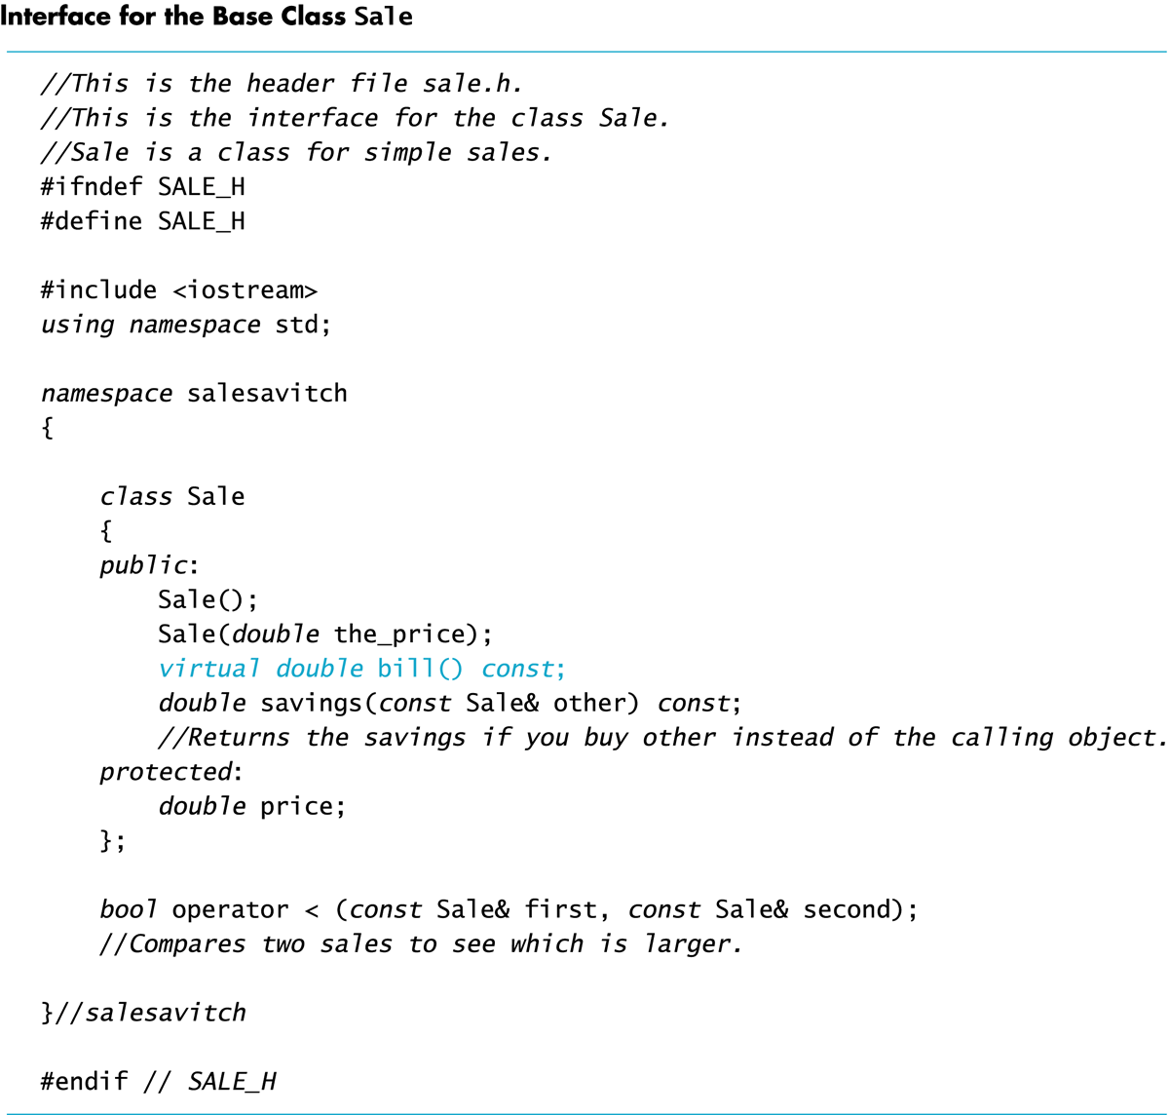
Display 15.8

Slide 82
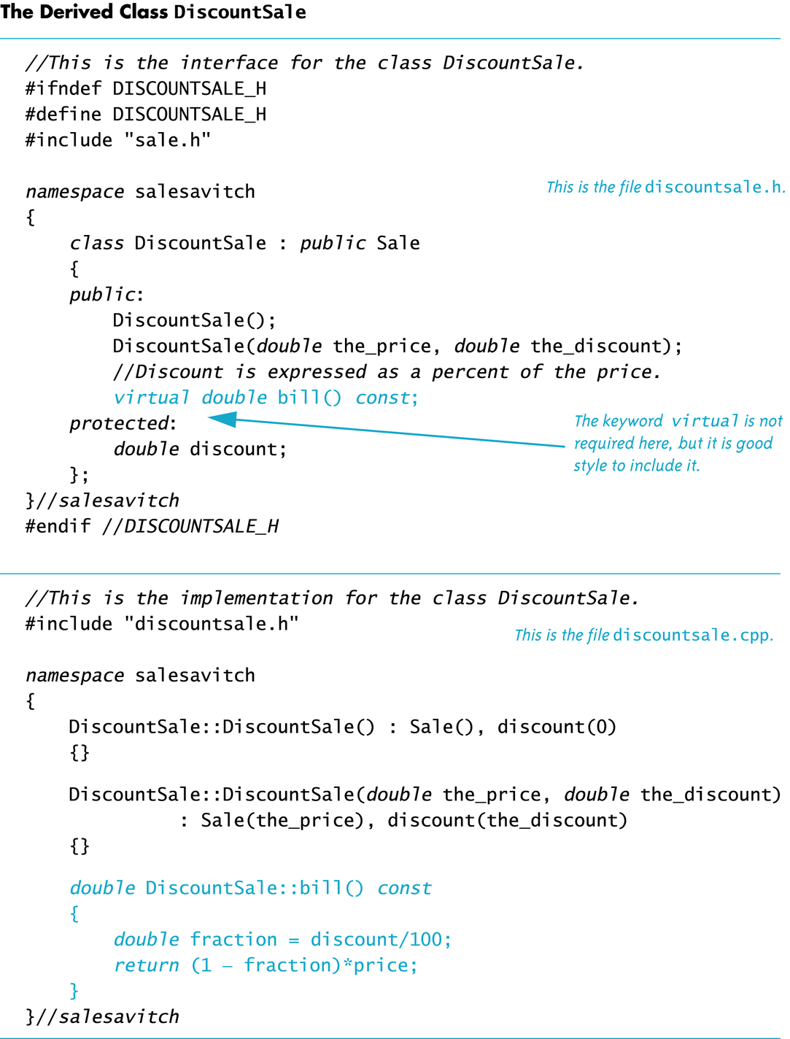
Sale, DiscountSale

Slide 83
DiscountSale::bill
Class DiscountSale has its own version of virtual function bill
Even though class Sale is already compiled, Sale::savings( ) and Sale::operator< can still use function bill from the DiscountSale class
The keyword virtual tells C++ to wait until bill is used in a program to get the implementation of bill from the calling object

Slide 84
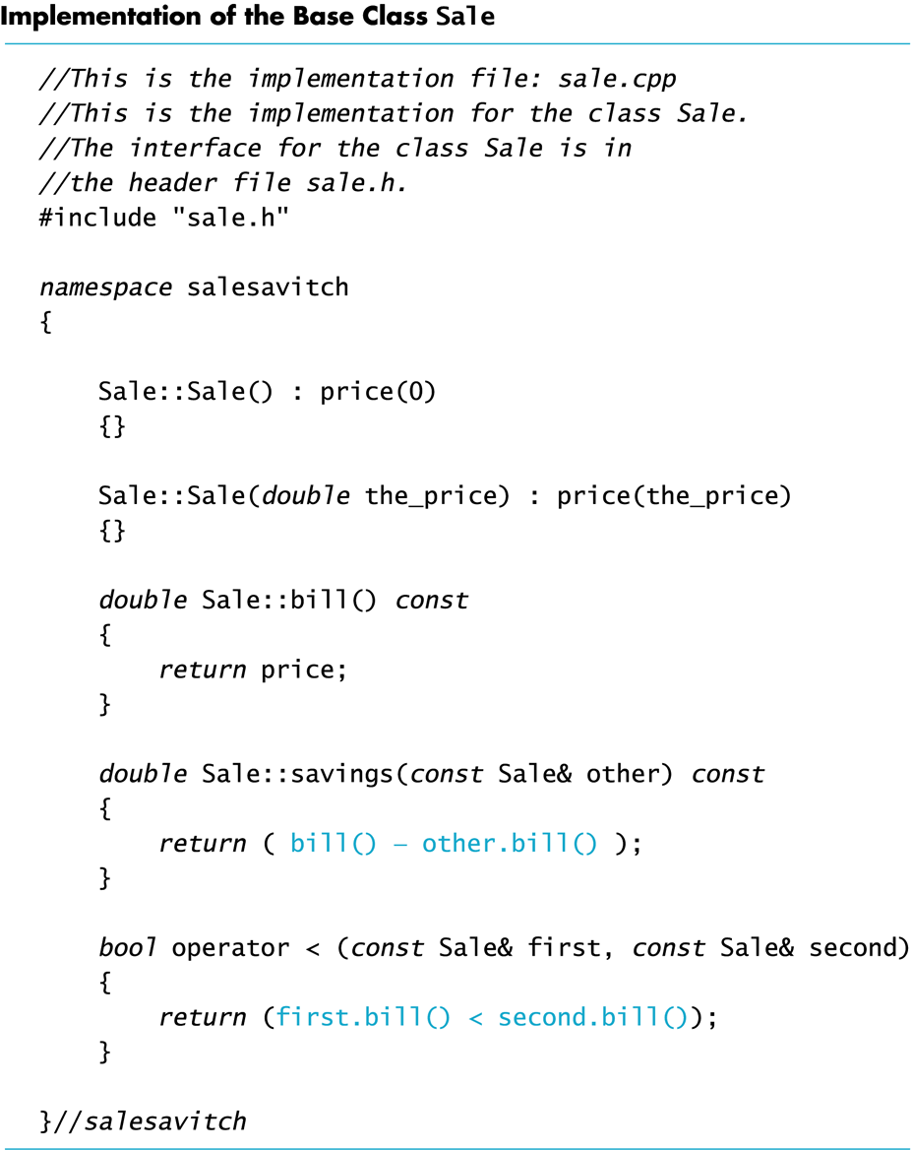
Display 15.9
Because function bill is virtual in class Sale, function savings and operator<, defined only in the base class, can in turn use a version of bill found in a derived class
When a DiscountSale object calls its savings function, defined only in the base class, function savings calls function bill
Because bill is a virtual function in class Sale, C++ uses the version of bill defined in the object that called savings

Slide 85
Sale
virtual bill()
savings()
Q:
Since bill() is a virtual function, what will happen in the following code?
If bill() is not a virtual function, what will happen in the following code?
DiscountSale
virtual bill()
//no re-defined savings()
Sale simple(10.00);
DiscountSale d1(11.0, 10);
DiscountSale d2(11.0, 10);
if (d1 < simple)
{
cout << “Saving is $” << simple.savings(d1);
}
if (d1 < d2)
{
cout << “Saving is $” << d2.savings(d1);
}

Slide 86
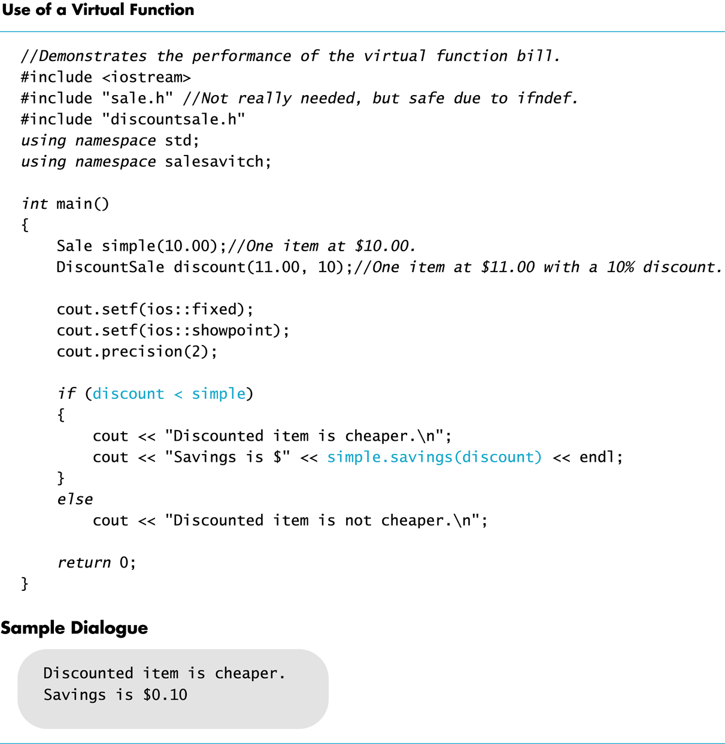
Display 15.11

Slide 87
Override vs. Redefine
Virtual functions whose definitions are changed in a derived class are said to be overridden
Non-virtual functions whose definitions are changed in a derived class are redefined

Slide 88
A potential slicing problem if we do not use virtual functions.

Slide 89
Preliminary: C++’s Type Checking
C++ carefully checks for type mismatches in the use of values and variables
This is referred to as strong type checking
Generally, the type of a value assigned to a variable must match the type of the variable
E.g., double a = “Hello”; //incorrect. No relationship
Recall that some automatic type casting occurs
E.g., int a = 20.34; //correct, but what happens?
When a double is assigned to an int, what happens?

Slide 90
Slicing Problem is special to C++
C++ is one of the few OOP languages to support objects as automatic variables
Automatic variables are local variables or value parameters.
Memory for these objects is “automatically” allocated and destroyed on the stack by scope.
Java, C#, python only allow primitive types and object references as local variables.
No slicing problem when everything is a reference
OOP=object-oriented programming

Slide 91
Type Checking and Inheritance
Pet
Pet::print()
name
Consider class Pet { public: virtual void print(); string name; }
class Dog : public Pet { public: virtual void print(); string breed; }
Dog
Dog::print() //overridden
name
breed

Slide 92
Slicing problem: A Sliced Dog is a Pet
C++ allows the following assignments: Dog vdog; Pet vpet; vdog.name = "Tiny"; vdog.breed = "Great Dane"; vpet = vdog;
However, vpet will lose the breed member of vdog since an object of class Pet has no breed member, copying member for member.
This code would be illegal:
cout << vpet.breed;
vdog
vpet
Dog
Dog::print() //overridden
name
breed
Pet
Pet::print()
name

Slide 93
Only the Pet part gets copied over
vpet = vdog;
vpet
vdog
Pet
Pet::name=“Tiny”
Pet::print()
Dog
Pet::name= “Fluffy”
Dog::print() //overridden
Dog::breed=“Shitzhu”
vdog
vpet
Dog
Pet::name
Dog::print() //overridden
Dog::breed
Pet
Pet::name=“Fluffy”
Pet::print()

Slide 94
The Slicing Problem
It is legal to assign a derived class object into a base class variable (not a reference), however...
This slices off data in the derived class that is not also part of the base class
Some member functions and member variables are lost
vdog
vpet
Dog
Dog::print() //overridden
name
breed
Pet
Pet::print()
name

Slide 95
Extended Type Compatibility
It is possible in C++ to avoid the slicing problem
Using pointers to dynamic variables and virtual functions, we can still access the added members of the derived class object.

Slide 96
Dynamic Variables and Derived Classes
Example:
ppet->print( ); is legal and produces:
name: Tiny
breed: Great Dane
Pet *ppet; Dog *pdog; pdog = new Dog; pdog->name = "Tiny"; pdog->breed = "Great Dane"; ppet = pdog; //or &vdog
void Dog::print( ) { cout << "name: " << name << endl; cout << "breed: " << breed << endl; }
Display 15.12 (1-2)

Slide 97
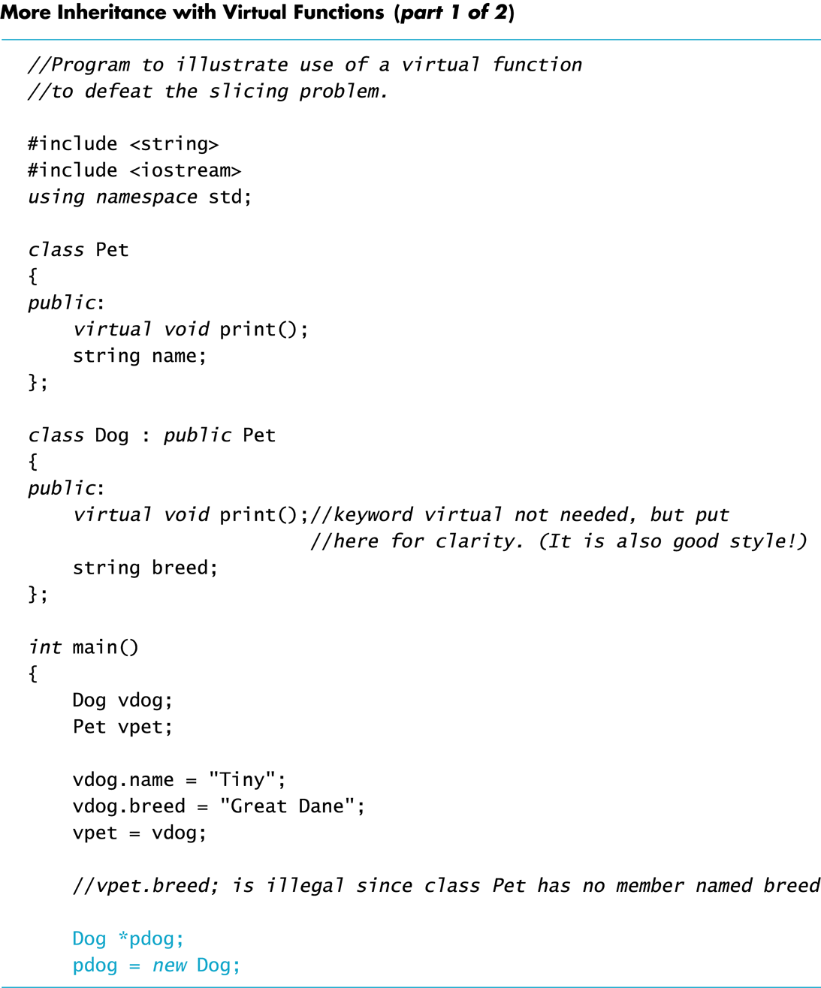
Display 15.12 (1/2)

Slide 98
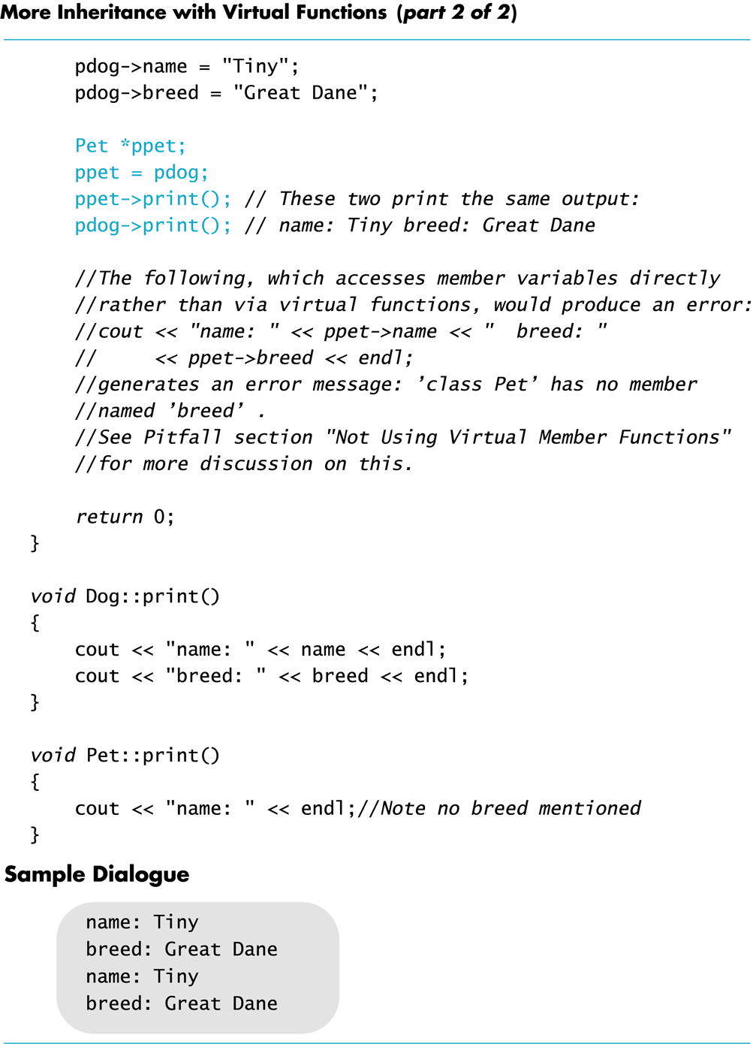
Display 15.12 (2/2)

Slide 99
Use Virtual Functions
The previous example: ppet->print( ); worked because print was declared as a virtual function
The following code would still produce an error:
cout << "name: " << ppet->name << "breed: " << ppet->breed;
//breed is a public member
//but we still cannot use a base class pointer
//to DIRECTLY access it! However,
//We can use virtual functions to access them.

Slide 100
Why?
ppet->breed is still illegal because ppet is a pointer to a Pet object that has no breed member
breed is just a data member, not a virtual function!
Function print( ) was declared virtual by class Pet
When the computer sees ppet->print( ), it checks the virtual table for classes Pet and Dog and finds that ppet points to an object of type Dog
Because ppet points to a Dog object, code for Dog::print( ) is used

Slide 101
Remember this…
If the type of the pointer p_ancestor is a base class for the pointer p_descendant, the following assignment
p_ancestor = p_descendant;
Allows us to use p_ancestor to call virtual functions. The invoking object is still p_descendant,therefore
It will invoke the derived class function which has access to all derived class data members.
(i.e., no data members will be inaccessible)
BUT we CANNOT directly access a derived class member from p_ancestor

Slide 102
A side note on reference (1/3)
A reference has to be initialized at the time when declared (except as a function parameter)
int x=10;
int& y = x;
// Reference y is another name for x, see the address of x
cout << &x <<endl;
// Here, the address of y will be exactly the same as x!
cout << &y <<endl;
A reference cannot be redirected to refer to something else once it is defined. Cannot be changed!
Use references

Slide 103
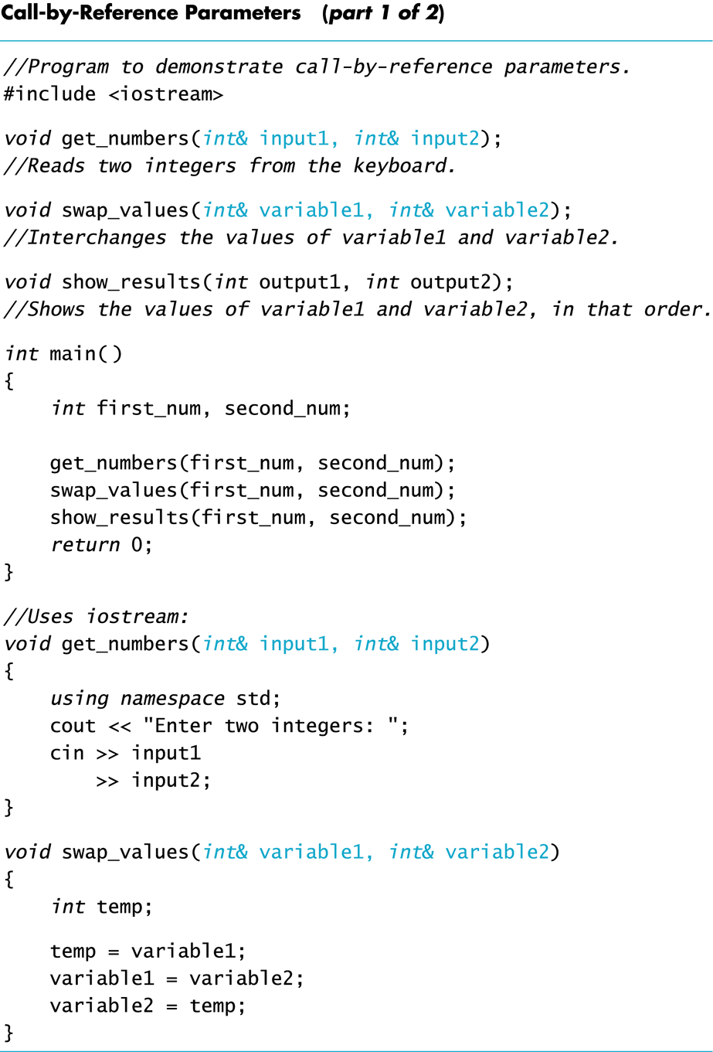
A side note on reference (2/3)
Use reference as function parameters
Recall this example
(from the textbook)

Slide 104
A side note on reference (3/3):
Variable name, reference, pointer
C++
reference to a variable (or object) ---- another name for a variable, and it will never be changed to be a reference to a different variable, immutable
pointer to a variable (or object) ---- can be modified to point to different variables , mutable
imagine it as an erasable address tag
Java
reference to a variable---- can be modified to refer to different variables
imagine it as an erasable name tag, or a named hat that can be given to different persons to wear

Slide 105
Benefits of virtual functions…
Allow us to refer to each derived object by the base class but still behaves like the derived class.
Allow us to add derived types as needed.
Allow us to use a pass-by-reference for the base class, but pass in derived class arguments to get the desired result.
Allow us to define collections of the base class (eg. vector<base*> list). We can call a function on every element knowing that the correct one will be called (eg. employeePtrs[i]->print_check(), list[i]->draw())

Slide 106
So far…
What is the difference between non-virtual and virtual functions?
What is the advantage of virtual functions?
What is the slicing problem? How can we avoid it?
How do we access derived data members using base class objects?
What is the difference between references in C++ and other object-oriented languages like Java?

Slide 107
More than two classes in a chain of inheritance hierarchy
inheritance hierarchy
Dog d ;
Animal &animal_ref = d;
cout << animal_ref.GetClassName();
C++ will check every inherited class between Animal and Dog (including Animal and Dog) and use the most-derived version of the function that it finds.
Animal
virtual getClassName()
Pet
virtual getClassName()
Dog
virtual getClassName()
virtual_functions_demo_2.cpp

Slide 108
More details
Pure virtual functions
Don’t redefine, better to override functions
Abstraction – interfaces
Virtual destructors
When working with base classes, virtual destructors ensure no memory leaks
Covariant return types
Overriding functions that return an object pointer or reference

Slide 109
Pure virtual functions
Abstract classes

Slide 110
Refers to the Figure::center example
The base class assumes that there is an implementation of all needed functions.
If Figure::center() function uses erase(), move(int x, int y) and draw() function, all but one must be done in the child.
Move just sets x, y for the Figure. Can be done in Figure.
Figure::erase() and Figure::draw() must be defined virtual because only the child knows how to implement them.

Slide 111
Pure virtual function – abstract class
Let’s say we need to declare a function in the base class, but only the derived classes know how to implement the function.
Ex. Shape::draw(), Employee::get_net_pay()
Make the function pure virtual.
Classes with pure virtual functions are abstract.
No concrete variables can be created
Only references and pointers

Slide 112
Pure virtual function
If a class has a pure virtual function, then the class cannot be instantiated, and the derived classes of the class have to define these function before they can be instantiated.
This ensures the derived classes NOT forget to redefine those pure virtual functions (which is what the base class hopes)
Syntax of pure virtual function:
virtual return-type function(type parameter) = 0;
This tells the compiler that the class is abstract so it cannot be used to directly declare object instances.

Slide 113
Revisit Employee class
get_net_pay() function should be a pure virtual function in the declaration of Employee class.
Find the error at compile time instead of waitin until runtime.
When a base class contains pure virtual functions, it cannot be used to declare variables. It can only be used as a parameter, a reference or a pointer.

Slide 114
Calling a base class’s virtual function
virtual_functions_demo_4.cpp

Slide 115
Calling a base class’s virtual function
We’ve actually seen this in the overridden assignment operator=(const Derived& obj).
Remember that the overloading operator= in a derived class starts with Base::operator=(obj)
Derived& operator=(const Derived& obj) {
if (this != &obj) {
Base::operator=(obj);
// Derived assignment part.
return *this;
} }

Slide 116
Why call base implementation of virtual function?
There are many cases where you might want to call the base class implementation of a virtual function inside of a derived class function:
Assignment of base member variables
Common functionality like print_check(), where presentation of base class components could be done first followed by derived class info.
Serialization – reading and writing the object into/from a file.
Data members of the base class should handled before the derived class just like operator=

Slide 117
Virtual Destructors
Destructors should be made virtual
Example: destructors.cpp
What about copy assignment operators?
Virtual assignment operators, allow
Base* b = &vDerived;
*b = otherDerived;

Slide 118
Consider Base *pBase = new Derived; … delete pBase;
If the destructor in Base is virtual, the destructor for Derived is invoked when pBase points to a Derived object, returning Derived members to the freestore
The Derived destructor in turn automatically calls the Base destructor
If the Base destructor is not virtual, only the Base destructor is invoked
This leaves Derived members, not part of Base, in memory

Slide 119
Covariant return type
virtual_functions_demo_3.cpp
//illustrate covariant return type

Slide 120
Covariant Return type Motivation
class Base {
public:
virtual Base * clone() const {
return new Base(*this);
}
};
class Derived : public Base {
public:
virtual Base * clone() const override {
return new Derived(*this);
}
};
Derived *d1 = new Derived();
Base * b = d1->clone();
Derived *d2 = dynamic_cast<Derived *>(b);
d2->Derived::OtherFunc();
Base class defines a virtual member function Base::clone that returns a copy of the given object.
Derived class overrides this function and ends up returning a pointer of type Base class even though what we really want is a Derived*.
C++ allows the derived type to implement a overridden function with return type that is a sub-type of the return type of the base function.

Slide 121
Covariant Return Types
class Base {
public:
virtual Base * clone() const {
return new Base(*this);
}
};
class Derived : public Base {
public:
virtual Derived * clone() const override {
return new Derived(*this);
}
};
Derived *d1 = new Derived();
Derived *d2 = d1->clone();
d2->Derived::OtherFunc();
Covariant Return Types help avoid awkward dynamic_cast.
This is one reason that a C++ function signature does not include the return type.
The Derived::clone() function overrides the Base::clone() function even though return types are different.

Slide 122
Design suggestions
Simple virtual function
Inheriting it implies → inherit both interface and a default implementation.
In your derive class, you need to support this function, but if you don’t want to write your own, you can fall back on the default version in base class.
Danger: if a derived class might not want to use the default implementation from the base class, but forget to define its own, then it will use the inherited one (which is not what it wants!)

Slide 123
Design suggestions
Pure virtual function
Inheriting it implies → inherit interface only
In your derived class (that can be instantiated), you must define it, but the base class has no idea how you are going to implement it.
The danger mentioned for the simple virtual function does not exist.

Slide 124
Design suggestions
Regular non-virtual function
Don’t redefine an inherited non-virtual function (even though allowed by C++). Make sure the “is-a” relationship always true for public inheritance.
class B
{ public:
void fun1();
}
class D: public B
{public: void fun1(//different implementation);}
//inconsistent, confusing behavior.
//same object D, but different fun1() is called,
// when D is pointed to by different ptr types
// (also true if references used)
D d;
B *pB=&d;
pB ->fun1();// B::fun1() is called!!
D *pD=&d;
pD ->fun1();//D::fun1() is called!!

Slide 125
Interface Class
An interface class is a class that …
has no members variables,
all of the functions are pure virtual!
The class is only an interface definition, no actual implementation.
Why use interface?
When you want to define the functionality that derived classes must implement, but leave the details of how the derived class implements that functionality entirely up to the derived class.
virtual_functions_demo_6.cpp

