Slide 1
Chapter 3: Processes

Slide 2
Chapter 3: Processes
Process Concept
  What’s the difference between a program and a process?
Process Scheduling
  From the 10,000 foot view.
Operations on Processes
  What is the life-cycle of a process? Various process states.
Interprocess Communication
  How do processes communicate?
Examples of IPC Systems
Communication in Client-Server Systems

Slide 3
Objectives
To introduce the notion of a process -- a program in execution, which forms the basis of all computation
To describe the various features of processes, including scheduling, creation and termination, and communication
To explore interprocess communication using shared memory, message passing via pipes, remote procedure calls, and sockets.
To describe communication in client-server systems

Slide 4
Process Concept
An operating system executes a variety of programs:
  Batch system – jobs
  Time-shared systems – user programs or tasks
Textbook uses the terms job and process almost interchangeably
Process – a program in execution; process execution must progress in a sequential fashion
Multiple parts
  The program code, also called text section
  Current activity including program counter, processor registers
  Stack containing temporary data
    Function parameters, return addresses, local variables
  Data section containing global variables
  Heap containing memory dynamically allocated during run time

Slide 5
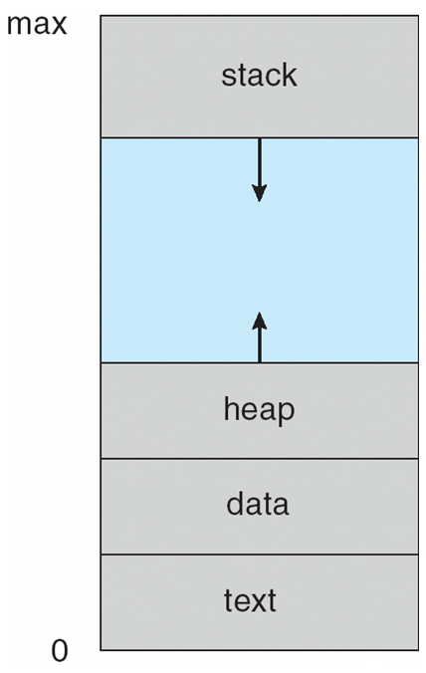
Process in Memory
Notes:
Data section is actually split up into initialized and uninitialized which is called bss section.

Slide 6
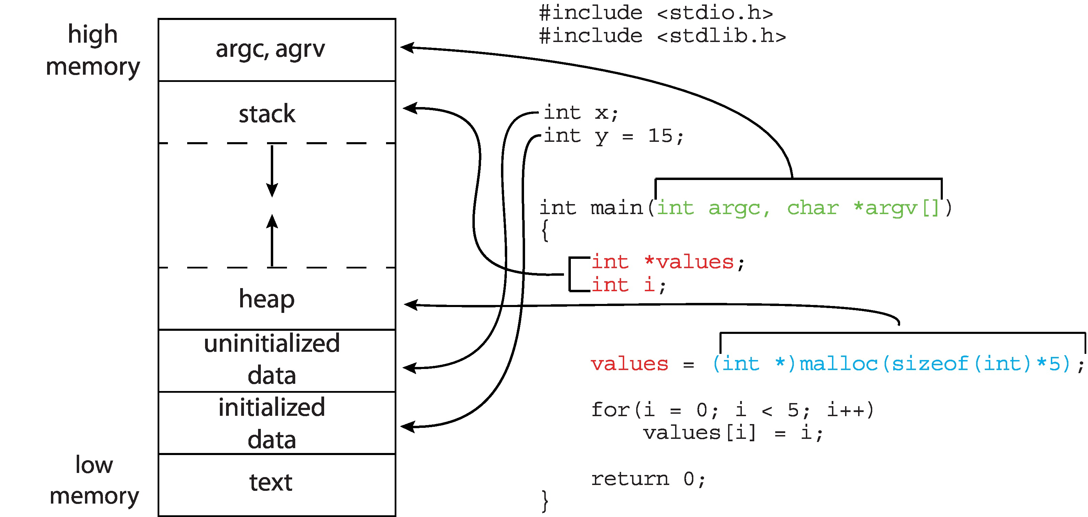
Memory Layout of a C Program

Slide 7
Linkers and Loaders
Source code compiled into object files designed to be loaded into any physical memory location – relocatable object file
Linker combines these into single binary executable file
  Also brings in libraries
Program resides on secondary storage as binary executable
Must be brought into memory by loader to be executed
  Relocation assigns final addresses to program parts and adjusts code and data in program to match those addresses
Modern general purpose systems don’t link libraries into executables
  Rather, dynamically linked libraries (in Windows, DLLs) are loaded as needed, shared by all that use the same version of that same library (loaded once)
Object, executable files have standard formats, so operating system knows how to load and start them

Slide 8
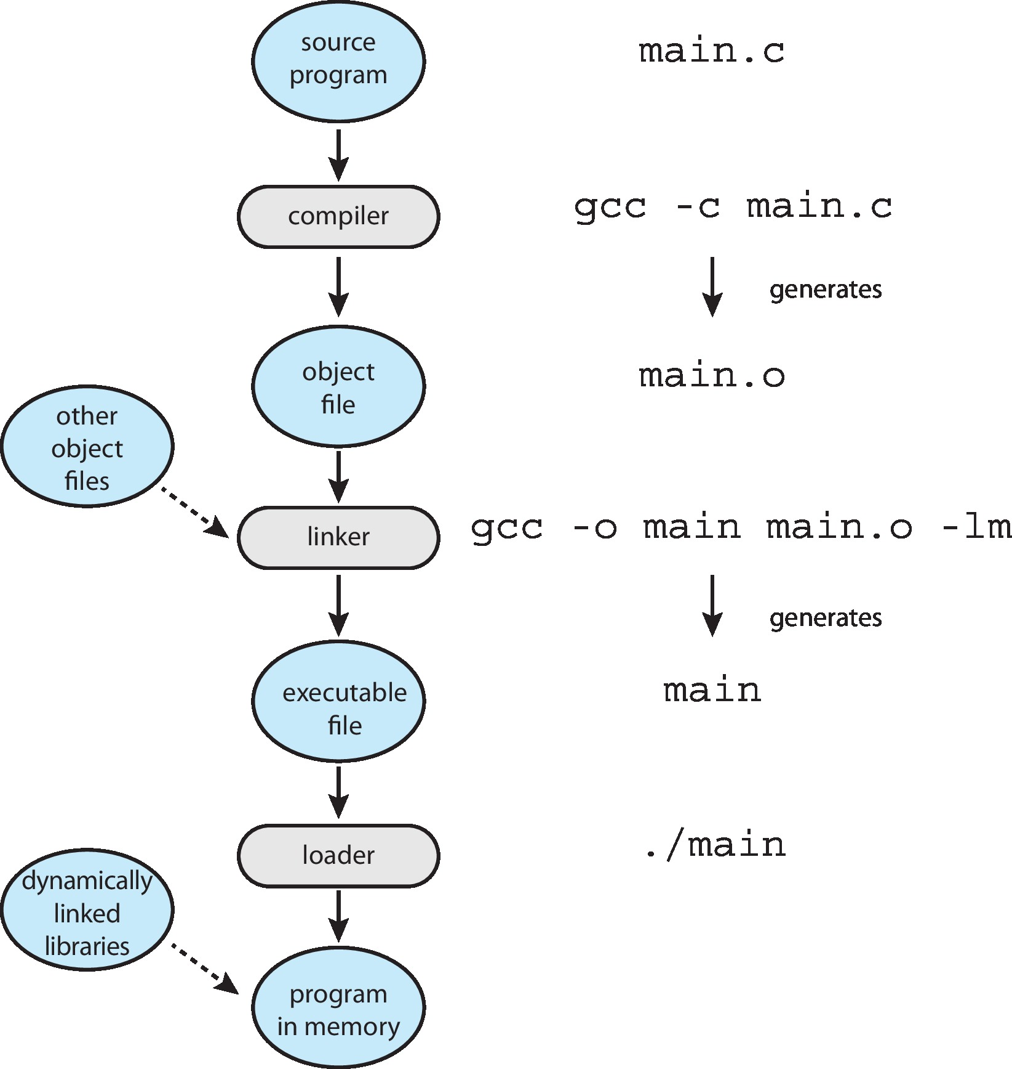
The Role of the Linker and Loader

Slide 9
Why Applications are Operating System Specific
Apps compiled on one system usually not executable on other operating systems
Each operating system provides its own unique system calls
  Own file formats, etc
Apps can be multi-operating system
  Written in interpreted language like Python, Ruby, and interpreter available on multiple operating systems
  App written in language that includes a VM containing the running app (like Java)
  Use standard language (like C), compile separately on each operating system to run on each
Application Binary Interface (ABI) is architecture equivalent of API, defines how different components of binary code can interface for a given operating system on a given architecture, CPU, etc

Slide 10
Process Concept (Cont.)
Program is passive entity stored on disk (executable file), process is active
  Program becomes process when executable file loaded into memory
Execution of program started via GUI mouse clicks, command line entry of its name, etc
One program can be several processes
  Consider multiple users executing the same program
One process can be several threads (chapter 4)

Slide 11
Process State
As a process executes, it changes state
  new: The process is being created
  running: Instructions are being executed
  waiting: The process is waiting for some event to occur
  ready: The process is waiting to be assigned to a processor
  terminated: The process has finished execution

Slide 12
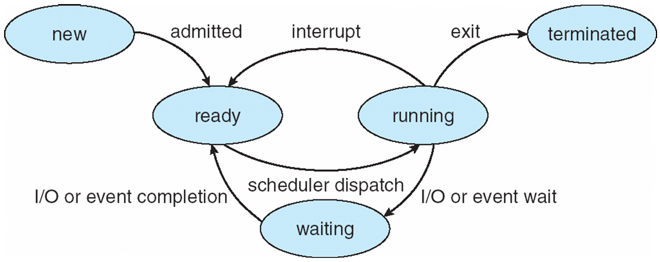
Diagram of Process State
Notes:
All processes start out in the new state and move to the ready queue once admitted.

Slide 13
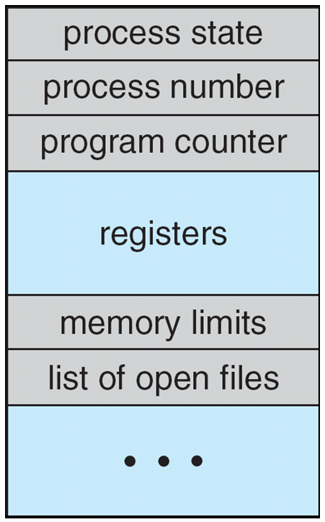
Process Control Block (PCB)
Information associated with each process
(also called task control block)
Process id, state – running, waiting, etc
Program counter – location of instruction to next execute
CPU registers – contents of all process-centric registers
CPU scheduling information- priorities, scheduling queue pointers
Memory-management information – memory allocated to the process
Accounting information – CPU used, clock time elapsed since start, time limits
I/O status information – I/O devices allocated to process, list of open files
, ID
Notes:
Review Tuesday, details and ask the class questions.

Slide 14
Threads
So far, process has a single thread of execution
Consider having multiple program counters per process
  Multiple stacks
  Multiple locations can execute at once
    Multiple threads of control -> threads
Must then have storage for thread details, multiple program counters in PCB
See next chapter

Slide 15
Process Scheduling
Maximize CPU use, quickly switch processes onto CPU for time sharing
Process scheduler selects among available processes for next execution on CPU
Maintains scheduling queues of processes
  Job queue – set of all processes in the system
  Ready queue – set of all processes residing in main memory, ready and waiting to execute
  Device queues – set of processes waiting for an I/O device
  Processes migrate among the various queues

Slide 16
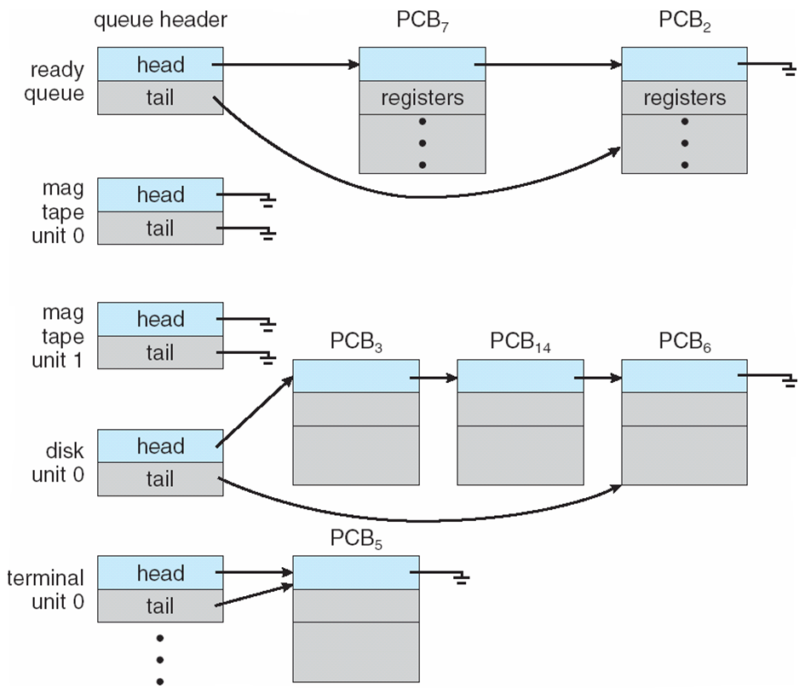
Ready Queue And Various I/O Device Queues
Notes:
Remember that there are multiple queues in the kernel that link through the process control blocks.

Slide 17
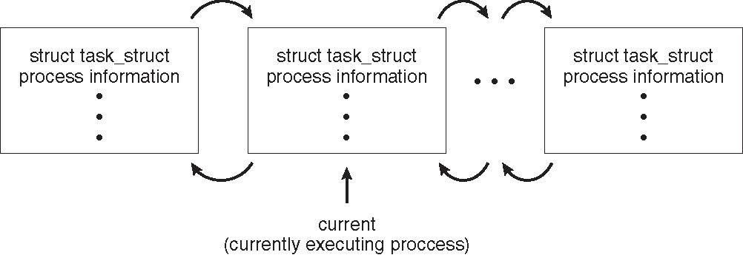
Process Representation in Linux
Represented by the C structure task_struct
pid t_pid; /* process identifier */
long state; /* state of the process */
unsigned int time_slice /* scheduling information */
struct task_struct *parent; /* this process’s parent */
struct list_head children; /* this process’s children */
struct files_struct *files; /* list of open files */
struct mm_struct *mm; /* address space of this process */

Slide 18
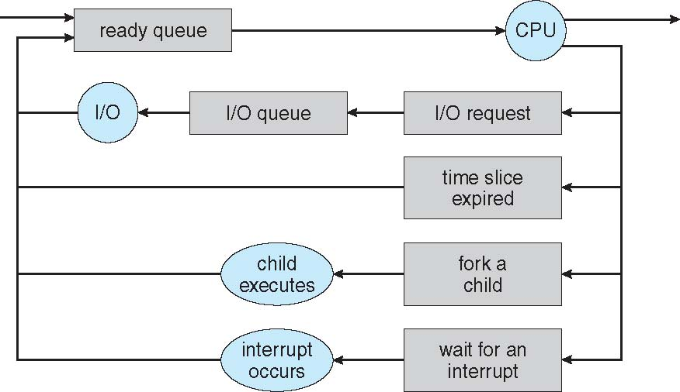
Representation of Process Scheduling
Queueing diagram represents queues, resources, flows
Notes:
Think of OS is largely queue management.

Slide 19
Operations on Processes
System must provide mechanisms for:
  process creation,
  process termination,
  and so on as detailed next

Slide 20
Process Creation
Parent process create children processes, which, in turn create other processes, forming a tree of processes
Generally, process identified and managed via a process identifier (pid)
Resource sharing options
  Parent and children share all resources
  Children share subset of parent’s resources
  Parent and child share no resources
Execution options
  Parent and children execute concurrently
  Parent waits until children terminate

Slide 21
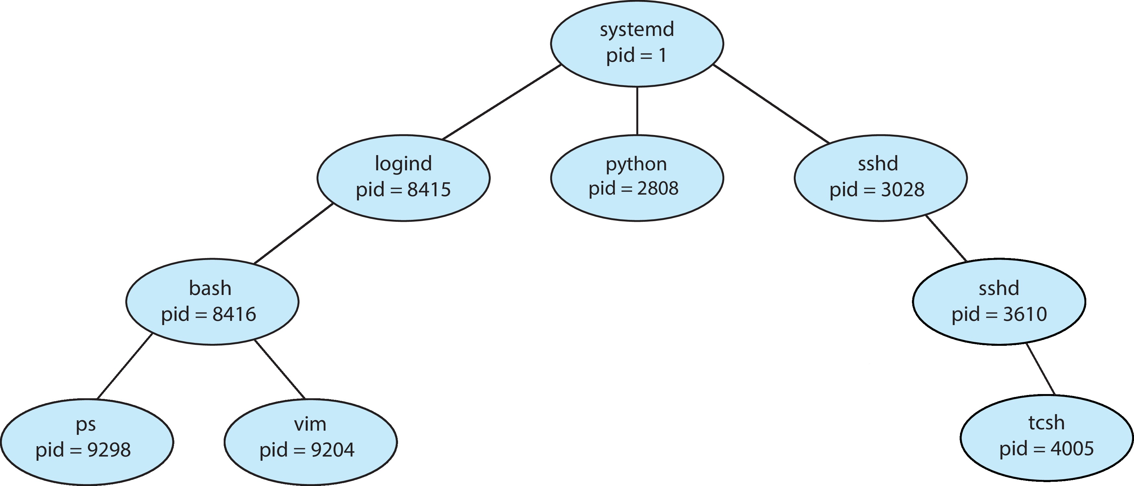
A Tree of Processes in Linux

Slide 22
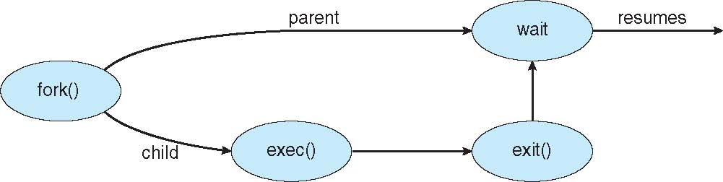
Process Creation (Cont.)
Address space
  Child duplicate of parent
  Child has a program loaded into it
UNIX examples
  fork() system call creates new process
  exec() system call used after a fork() to replace the process’ memory space with a new program

Slide 23
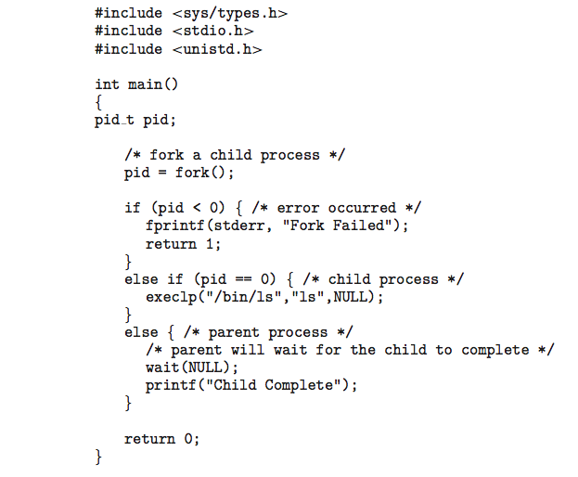
C Program Forking Separate Process

Slide 24
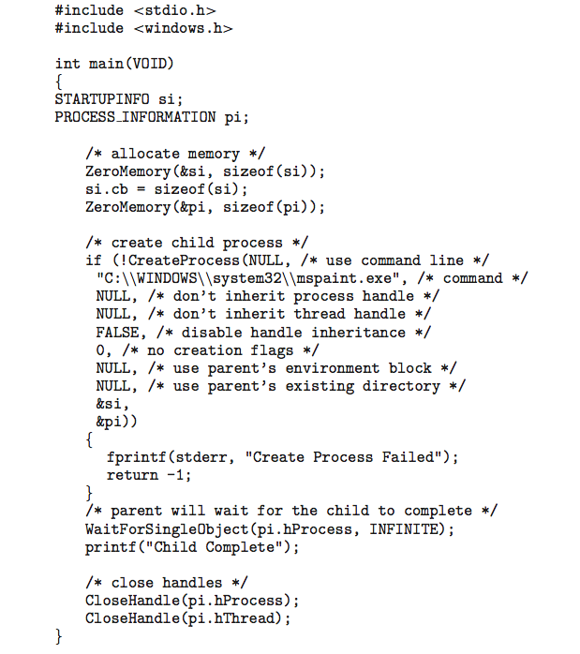
Creating a Separate Process via Windows API

Slide 25
Process Creation (Cont.)
Address space
  Child duplicate of parent
  Child has a program loaded into it
UNIX examples
  fork() system call creates new process
  exec() system call used after a fork() to replace the process’ memory space with a new program

Slide 26
Process Termination
Process executes last statement and then asks the operating system to delete it using the exit() system call.
  Returns status data from child to parent (via wait())
  Process’ resources are deallocated by operating system
Parent may terminate the execution of children processes using the abort() system call. Some reasons for doing so:
  Child has exceeded allocated resources
  Task assigned to child is no longer required
  The parent is exiting and the operating systems does not allow a child to continue if its parent terminates

Slide 27
Process Termination
Some operating systems do not allow child to exist if its parent has terminated. If a process terminates, then all its children must also be terminated.
  cascading termination. All children, grandchildren, etc. are terminated.
  The termination is initiated by the operating system.
The parent process may wait for termination of a child process by using the wait()system call. The call returns status information and the pid of the terminated process
pid = wait(&status);
If no parent waiting (did not invoke wait()) process is a zombie
  Zombie process is still listed in PCB but no longer running, exit status never picked up or reaped. Wastes space in PCB.
If parent terminated without invoking wait , process is an orphan

Slide 28
Schedulers
Short-term scheduler (or CPU scheduler) – selects which process should be executed next and allocates CPU
  Sometimes the only scheduler in a system
  Short-term scheduler is invoked frequently (milliseconds) ⇒ (must be fast)
Long-term scheduler (or job scheduler) – selects which processes should be brought into the ready queue
  Long-term scheduler is invoked infrequently (seconds, minutes) ⇒ (may be slow)
  The long-term scheduler controls the degree of multiprogramming
Processes can be described as either:
  I/O-bound process – spends more time doing I/O than computations, many short CPU bursts
  CPU-bound process – spends more time doing computations; few very long CPU bursts
Long-term scheduler strives for good process mix
Notes:
Might think of long-term scheduler like cron which you can configure jobs to run every minute, 5 minutes, daily, weekly.

Slide 29
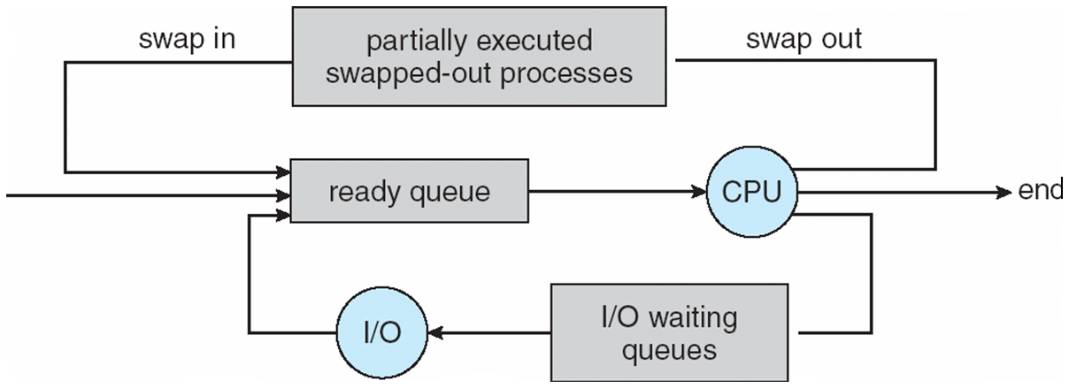
Addition of Medium Term Scheduling
Medium-term scheduler can be added if degree of multiple programming needs to decrease
  Remove process from memory, store on disk, bring back in from disk to continue execution: swapping
Notes:
Mistakenly said this was the long term scheduler. Swapping out to disk.

Slide 30
Context Switch
When CPU switches to another process, the system must save the state of the old process and load the saved state for the new process via a context switch
Context of a process represented in the PCB
Context-switch time is overhead; the system does no useful work while switching
  The more complex the OS and the PCB ➔ the longer the context switch
Time dependent on hardware support
  Some hardware provides multiple sets of registers per CPU ➔ multiple contexts loaded at once

Slide 31
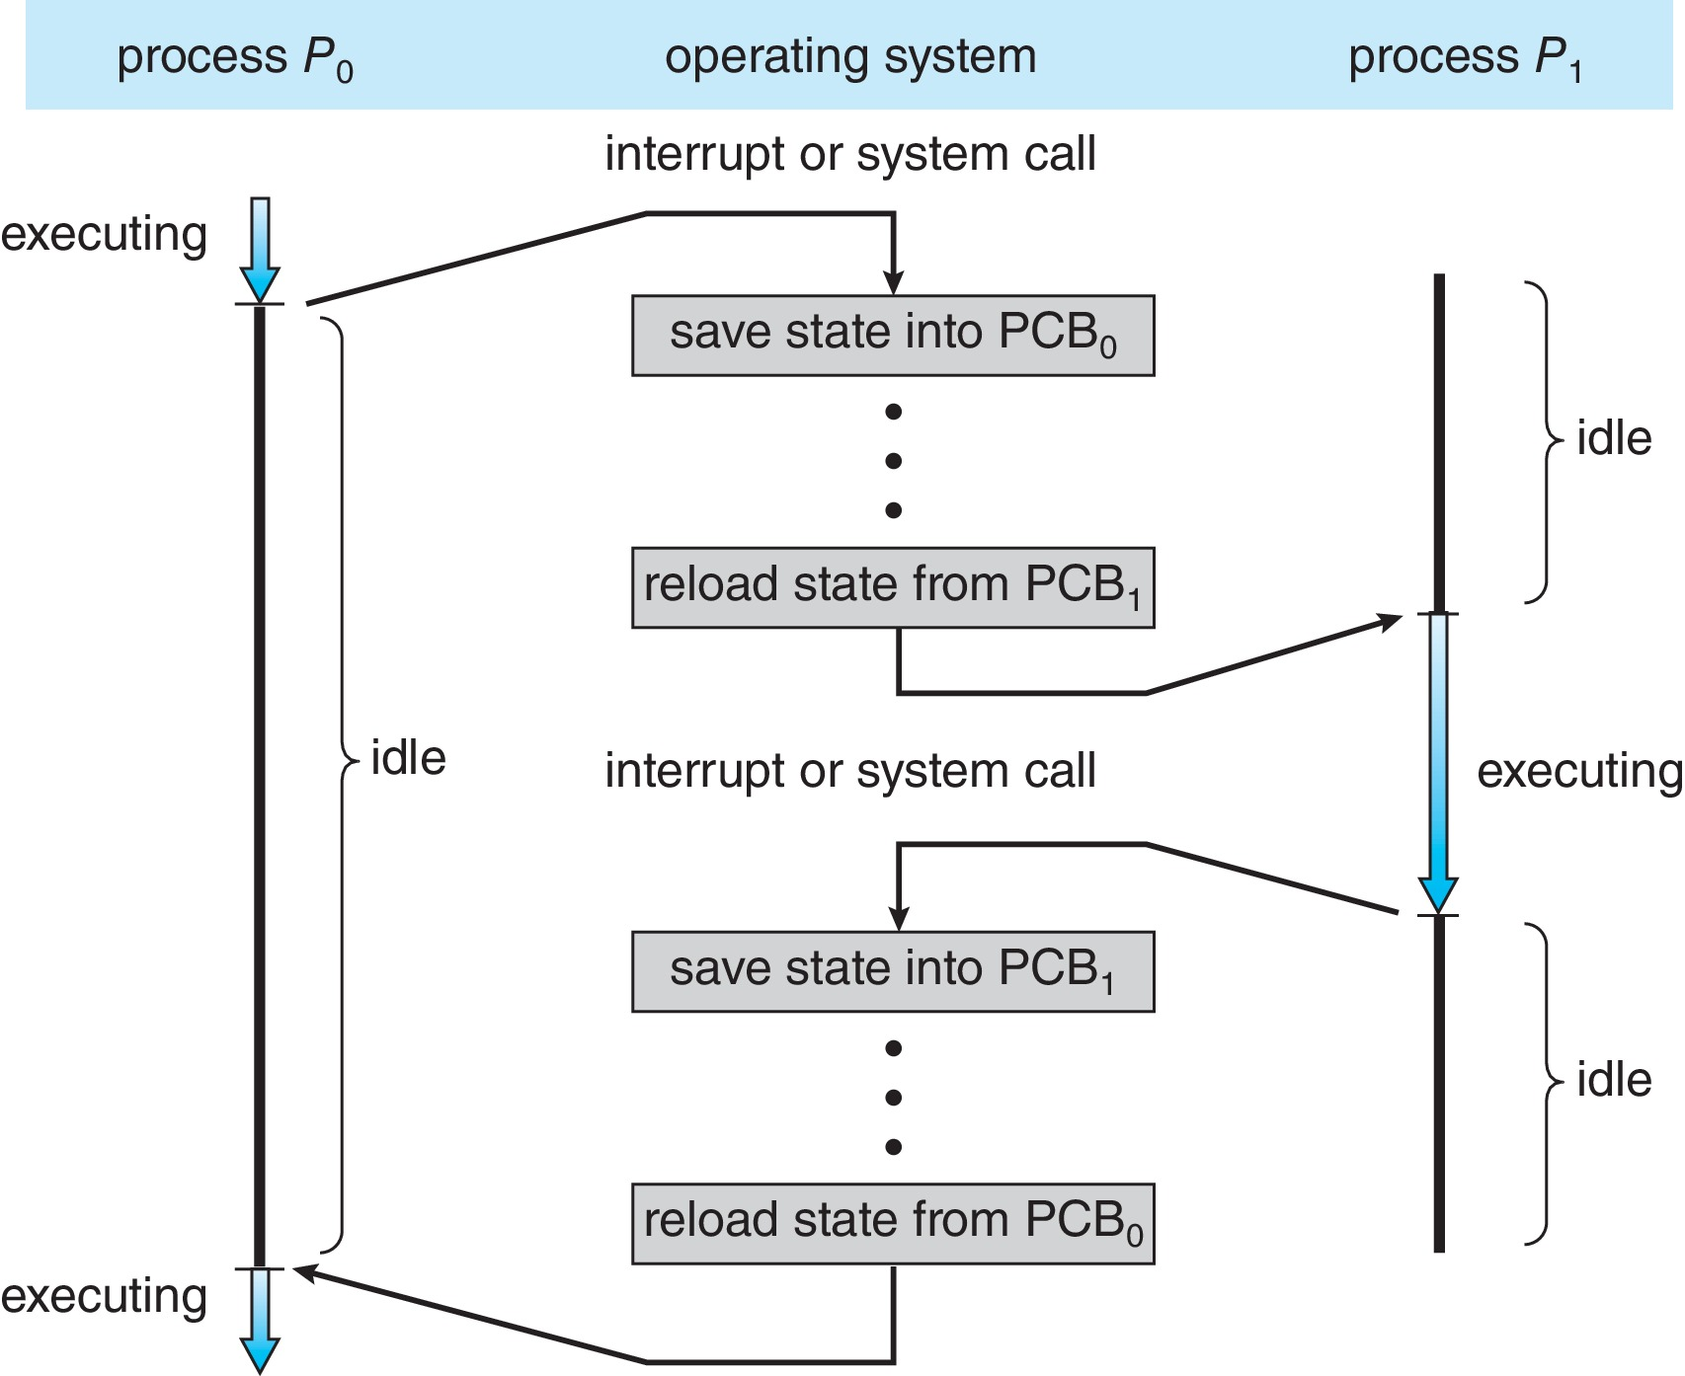
CPU Switch From Process to Process
A context switch occurs when the CPU
switches from one process to another.

Slide 32
Multitasking in Mobile Systems
Some mobile systems (e.g., early version of iOS) allow only one process to run, others suspended
Due to screen real estate, user interface limits iOS provides for a
  Single foreground process- controlled via user interface
  Multiple background processes– in memory, running, but not on the display, and with limits
  Limits include single, short task, receiving notification of events, specific long-running tasks like audio playback
Android runs foreground and background, with fewer limits
  Background process uses a service to perform tasks
  Service can keep running even if background process is suspended
  Service has no user interface, small memory use
  https://developer.android.com/guide/components/services.html
Notes:
Don’t actually have the code o create a process, but this is the basic idea.

Slide 33
Android Process Importance Hierarchy
Mobile operating systems often have to terminate processes to reclaim system resources such as memory. From most to least important:
Foreground process
Visible process
Service process
Background process
Empty process
Android will begin terminating processes that are least important.

Slide 34
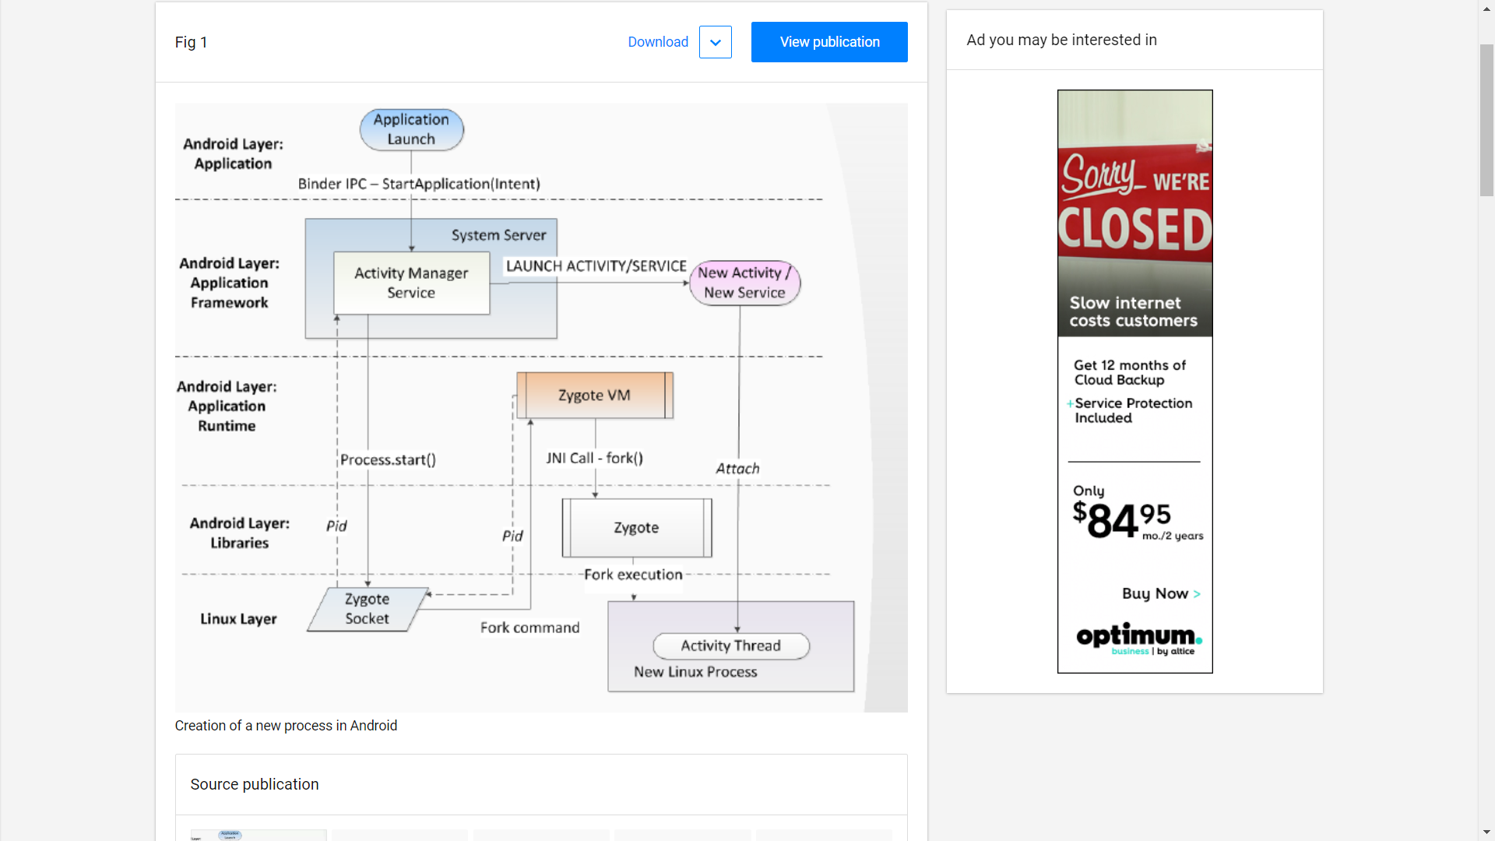
Android Process Management
Notes:
Android is hybrid, has a linux layer. Applications used to be compiled just in time to run, now they are pre-compiled on install. Every process runs in a VM.

Slide 35
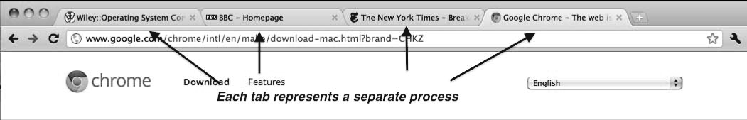
Multiprocess Architecture – Chrome Browser
Many web browsers ran as single process (some still do)
  If one web site causes trouble, entire browser can hang or crash
  The real problem was waiting for rendering to complete
Google Chrome Browser is multiprocess with 3 different types of processes:
  Browser process manages user interface, disk and network I/O
  Renderer process renders web pages, deals with HTML, Javascript. A new renderer created for each website opened
    Runs in sandbox restricting disk and network I/O, minimizing effect of security exploits
  Plug-in process for each type of plug-in

Slide 36
Review Process Management
What is the difference between a program and a process?
What are the possible process states?
What is the term for switching out one process and replacing it with another process?
On Linux/Unix systems, how do we create a new process?

Slide 37
Review Process Management
What is the difference between a program and a process?
  A program is a passive entity and a process is an active entity.
  Both have code, but a process has a state, a stack, a heap, a program counter, registers, paging information, possibly file descriptors and other resources, possibly child processes or threads.
What are the possible process states?
  New, Ready, Running, Waiting (multiple forms), Terminated
What is the term for switching out one process and replacing it with another process?
  Context switch – can take 1-2 thousand machine instructions.
On Linux/Unix systems, how do we create a new process?
  fork() – made more efficient by using “Copy-on-Write”, used to be vfork()
  exec() – overwrites a process with program specified in arguments.

Slide 38
Review Process Control Block
How do we terminate a process?
What information is contained in the process control block?

Slide 39
Review Process Control Block
How do we terminate a process?
  exit – called from within a process to terminate
  abort – called from outside to terminate (usually by the parent).
What information is contained in the process control block?
  Process id and state – running, waiting, etc
  Program counter – location of instruction to next execute
  CPU registers – contents of all process-centric registers
  CPU scheduling information- priorities, scheduling queue pointers
  Memory-management information – memory allocated to the process
  Accounting information – CPU used, clock time elapsed since start, time limits
  I/O status information – I/O devices allocated to process, list of open files

Slide 40
Threads
So far, process has a single thread of execution, old school.
Consider having multiple program counters per process
  Multiple locations can execute at once
    Multiple threads of control -> threads
Must then have storage for thread details, multiple program counters in PCB
Multiple threads even a bigger deal when we look at current state of Multicore CPU with SMT (Simultaneous Multithreading) or Hyperthread support.
See chapter 4 on Threads

Slide 41
What happens in this program?
#include <iostream>
#include <unistd.h>
#include <sys/types.h>
using namespace std;
int main() // fork a process in a loop and increment the counter.
{
for (int i = 0; i < 4; i++) {
fork();
cout << "Process pid=" << getpid() << " has i=" << i << endl;
}
}

Slide 42
Fork Program Output
Process pid=9756 has i=1
Process pid=9756 has i=2
Process pid=9757 has i=1
Process pid=9758 has i=2
Process pid=9756 has i=3
Process pid=9759 has i=3
Process pid=9758 has i=3
Process pid=9757 has i=2
Process pid=9760 has i=3
Process pid=9761 has i=2
Process pid=9757 has i=3
Process pid=9762 has i=3
Process pid=9761 has i=3
Process pid=9763 has i=3
There are 2^{n} processes.
Notice the pid’s.
Once created, they run randomly.
Notice ‘i’ is not shared.
Each process gets its own copy of i.
Try this with a global variable.

Slide 43
Interprocess Communication
Processes within a system may be independent or cooperating
Cooperating process can affect or be affected by other processes, including sharing data
Reasons for cooperating processes:
  Information sharing
  Computation speedup to increase throughput
  Modularity for creating separable services that can cooperate
  Convenience such as piping output of one command into another
Cooperating processes need interprocess communication (IPC)
Two models of IPC
  Shared memory
  Message passing

Slide 44
Communications Models
(a) Message passing. (b) shared memory.
Notes:
Message passing involves a message queue, synchronization may be handled by OS. Shared memory is all on the processes

Slide 45
Cooperating Processes
Independent process cannot affect or be affected by the execution of another process
Cooperating process can affect or be affected by the execution of another process
Advantages of process cooperation
  Information sharing
  Computation speed-up
  Modularity
  Convenience

Slide 46
Producer-Consumer Problem
Paradigm for cooperating processes, producer process produces information that is consumed by a consumer process
  unbounded-buffer places no practical limit on the size of the buffer
  bounded-buffer assumes that there is a fixed buffer size
Any problems?
An unbounded-buffer dynamically expands to the need of the data passed. Subject to hardware or system limits.
  Consumer should be as fast or faster than producer
A bounded-buffer fixed buffer size may be a multiple of the message size or may be a function of the page size.

Slide 47
Bounded-Buffer – Shared-Memory Solution
Shared data
      #define BUFFER_SIZE 10
      typedef struct {
      . . .
      } item;
      item buffer[BUFFER_SIZE];
      int in = 0;
      int out = 0;
Solution is correct, but can only use BUFFER_SIZE-1 elements
Assume that item defines the format of the data passed between processes: e.g. a database record.
Circular buffer starts at in=0, out=0 but circles around when it gets to the end.

Slide 48
Bounded-Buffer – Producer
item next_produced;
while (true) {
/* produce an item in next produced */
while (((in + 1) % BUFFER_SIZE) == out)
; /* do nothing */
buffer[in] = next_produced;
in = (in + 1) % BUFFER_SIZE;
}
// Busy wait loop. The process keeps the CPU busy checking.
// Put a sleep or wait in the loop, let’s another process run.

Slide 49
Bounded Buffer – Consumer
item next_consumed;
while (true) {
while (in == out)
; /* do nothing */
next_consumed = buffer[out];
out = (out + 1) % BUFFER_SIZE;
/* consume the item in next consumed */
}
// Busy wait loop. The process keeps the CPU busy checking.
// Put a sleep or wait in the loop, let’s another process run.

Slide 50
Interprocess Communication – Shared Memory
An area of memory shared among the processes that wish to communicate
The communication is under the control of the users processes not the operating system.
Major issues is to provide mechanism that will allow the user processes to synchronize their actions when they access shared memory.
Synchronization is discussed in great detail in Chapters 6 & 7.

Slide 51
Fork Program with shared variable
static int *nptr;
int main() {
nptr = (int*)mmap(NULL, sizeof *nptr, PROT_READ | PROT_WRITE,
MAP_SHARED | MAP_ANONYMOUS, -1, 0);
if (nptr != NULL) {
int& n = *nptr = 0; // assign a reference to the shared segment.
for (int i = 0; i < 4; i++) {
fork();
cout << "Process pid=" << getpid() << " has n=" << ++n << endl;
}
}
munmap(nptr, sizeof *nptr);
return 0;
}

Slide 52
Linux Man Pages
MMAP(2) Linux Programmer's Manual MMAP(2)
NAME
mmap, munmap - map or unmap files or devices into memory
SYNOPSIS
#include <sys/mman.h>
void *mmap(void *addr, size_t length, int prot, int flags,
int fd, off_t offset);
int munmap(void *addr, size_t length);

Slide 53
mmap
#include <unistd.h>
#include <sys/mman.h>
#include <sys/types.h>
void *mmap(void *addr, size_t length, int prot, int flags, int fd, off_t offset);
-addr is a hint about where to create the region, usually NULL
-length is the size of the region being requested
-prot describes the protection as executable, read, write and/or none.
PROT_EXEC, PROT_READ, PROT_WRITE, PROT_NONE.
-flags describes how updates are made available to other processes
    MAP_SHARED (visible), MAP_PRIVATE (copy-on-write)
    MAP_ANON (no file map), MAP_FIXED (use addr), etc…
-fd if mapping to a file, -1 if MAP_ANON. –offst offset into the file.

Slide 54
Fork Program Output
Process pid=29703 has n=1
Process pid=29703 has n=2
Process pid=29703 has n=3
Process pid=29704 has n=3
Process pid=29705 has n=4
Process pid=29706 has n=5
Process pid=29704 has n=5
Process pid=29705 has n=5
Process pid=29707 has n=6
Process pid=29704 has n=6
Process pid=29709 has n=7
Process pid=29707 has n=7
Process pid=29708 has n=7
Process pid=29710 has n=7
There are 2^{n} processes.
Notice the pid’s.
Once created, they run randomly.
Notice ‘n’ is shared.
Each process shares n.
Synchronization is a problem.

Slide 55
Recall Interprocess Communication
Two ways of performing interprocess communication (there might be several different implementations for them)?
What are the significant differences between them?
What is the producer-consumer problem?
Which mechanism was used?

Slide 56
Recall Interprocess Communication
Two ways of performing interprocess communication (there might be several different implementations for them)?
  Message passing
  Shared memory
What are the significant differences between them?
  Message passing – synchronization/protection handled by the system,
  Shared memory – processes must coordinate and synchronize
What is the producer-consumer problem?
  Producer adds to buffer, waits for space if full
  Consumer removes from buffer, waits for producer to add if empty.
Which mechanism is used?
  Shared memory – can be done with message passing, but for smaller outputs.

Slide 57
Interprocess Communication – Message Passing
Mechanism for processes to communicate and to synchronize their actions
Message system – processes communicate with each other without resorting to shared variables
IPC facility provides two operations:
  send(message)
  receive(message)
The message size is either fixed or variable
  Fixed message size is agreed on in advance.
  Variable message size has to send information about the size in the message.

Slide 58
Message Passing (Cont.)
If processes P and Q wish to communicate, they need to:
  Establish a communication link between them
  Exchange messages via send/receive
Implementation issues:
  How are links established?
  Can a link be associated with more than two processes?
  How many links can there be between every pair of communicating processes?
  What is the capacity of a link?
  Is the size of a message that the link can accommodate fixed or variable?
  Is a link unidirectional or bi-directional?

Slide 59
Message Passing (Cont.)
Implementation of communication link
  Physical:
    Shared memory
    Hardware bus
    Network
  Logical:
    Direct or indirect (via an intermediary like a mailbox)
    Synchronous or asynchronous
    Automatic or explicit buffering (message queuing)

Slide 60
Direct Communication
Processes must name each other explicitly:
  send (P, message) – send a message to process P
  receive(Q, message) – receive a message from process Q
Properties of communication link
  Links are established automatically
  A link is associated with exactly one pair of communicating processes
  Between each pair there exists exactly one link
  The link may be unidirectional, but is usually bi-directional

Slide 61
Indirect Communication
Messages are directed and received from mailboxes (also referred to as ports)
  Each mailbox has a unique id
  Processes can communicate only if they share a mailbox
Properties of communication link
  Link established only if processes share a common mailbox
  A link may be associated with many processes
  Each pair of processes may share several communication links
  Link may be unidirectional or bi-directional

Slide 62
Indirect Communication
Operations
  create a new mailbox (port)
  send and receive messages through mailbox
  destroy a mailbox
Primitives are defined as:
send(A, message) – send a message to mailbox A
receive(A, message) – receive a message from mailbox A

Slide 63
Indirect Communication
Mailbox sharing
  P₁, P₂, and P₃ share mailbox A
  P₁, sends; P₂ and P₃ receive
  Who gets the message?
Solutions
  Allow a link to be associated with at most two processes
  Allow only one process at a time to execute a receive operation
  Allow the system to select arbitrarily the receiver. Sender is notified who the receiver was.

Slide 64
Synchronization
Message passing may be either blocking or non-blocking
Blocking is considered synchronous
  Blocking send -- the sender is blocked until the message is received
  Blocking receive -- the receiver is blocked until a message is available
Non-blocking is considered asynchronous
  Non-blocking send -- the sender sends the message and continues
  Non-blocking receive -- the receiver receives:
    A valid message, or
    Null message
Different combinations possible
  If both send and receive are blocking, we have a rendezvous

Slide 65
Synchronization (Cont.)
Producer-consumer becomes trivial when blocking
message next_produced;
while (true) {
/* produce an item in next produced */
send(next_produced);
}
message next_consumed;
while (true) {
receive(next_consumed);
/* consume the item in next consumed */
}

Slide 66
Buffering
Queue of messages attached to the link.
implemented in one of three ways
  1. Zero capacity – no messages are queued on a link.
  Sender must wait for receiver (rendezvous)
  2. Bounded capacity – finite length of n messages
  Sender must wait if link full
  3. Unbounded capacity – infinite length
  Sender never wait
One important consideration is always removing bottlenecks
  We want the consumer to keep up with the producer or have enough consumers to process the load.

Slide 67
Examples of IPC Systems - POSIX
POSIX Shared Memory
  Process first creates shared memory segment
  shmfd = shm_open(name, O CREAT | O RDWR, 0666);
  Also used to open an existing segment to share it
  Set the size of the object (up or down)
ftruncate(shmfd, SIZE);
  Must then map the memory from the shm_fd into the program
    ptr=mmap(0,SIZE,PROT_WRITE,MAP_SHARED,shmfd,0);
  Now the process can write to the shared memory
  sprintf(ptr, "Writing to shared memory");
  NOTE: Replaces shmget, shmat, shmdt, shmctl old UNIX System V model.

Slide 68
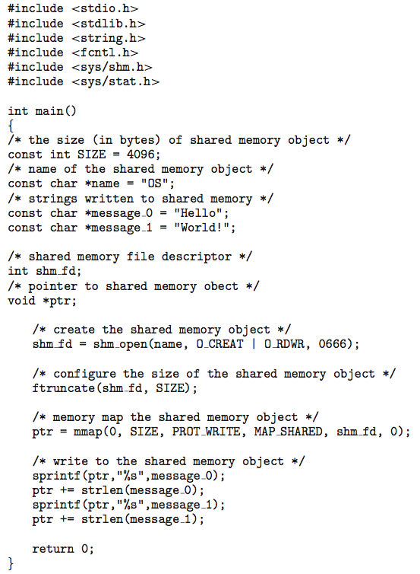
IPC POSIX Producer
Notice sprintf puts
message into region.
Move ptr to next pos

Slide 69
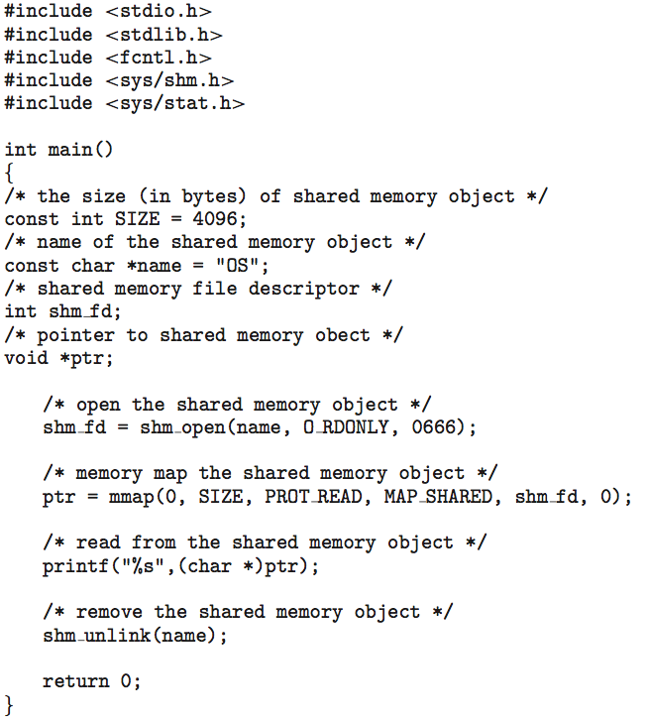
IPC POSIX Consumer
Notice message is in region. Use printf to access message via ptr.

Slide 70
Examples of IPC Systems - Mach
Recall that Mach was based on microkernel technology.
Mach communication is message based
  Even system calls are messages
  Each task gets two mailboxes at creation- Kernel and Notify
  Only three system calls needed for message transfer
  msg_send(), msg_receive(), msg_rpc()
  Mailboxes needed for commuication, created via
  port_allocate()
  Send and receive are flexible, for example four options if mailbox full:
    Wait indefinitely
    Wait at most n milliseconds
    Return immediately
    Temporarily cache a message
Notes:
msg_rpc – send followed by a receive using the same buffer.

Slide 71
Examples of IPC Systems – Windows
Message-passing centric via advanced local procedure call (LPC) facility
  Only works between processes on the same system
  Uses ports (like mailboxes) to establish and maintain communication channels
  Communication works as follows:
    The client opens a handle to the subsystem’s connection port object.
    The client sends a connection request.
    The server creates two private communication ports and returns the handle for one of them to the client.
    The client and server use the corresponding port handle to send messages or callbacks and to listen for replies.

Slide 72
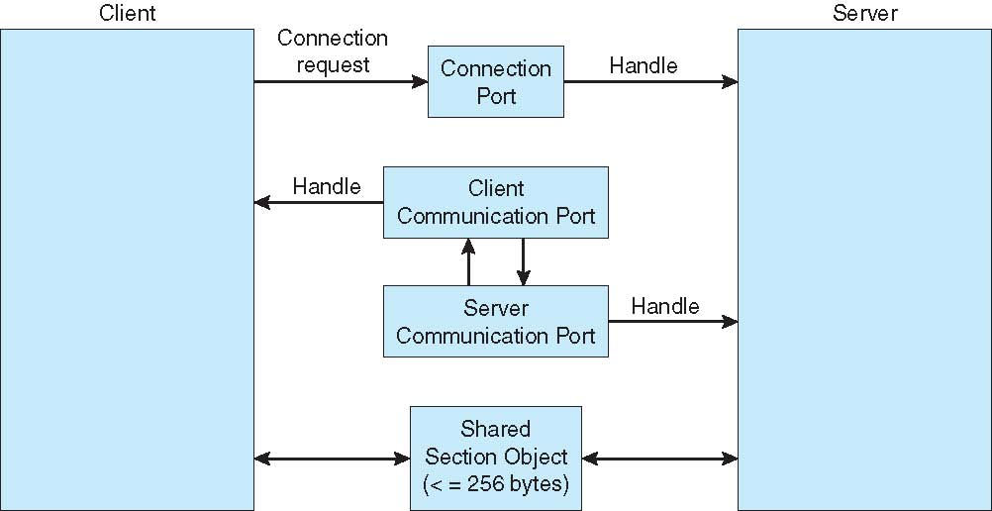
Local Procedure Calls in Windows

Slide 73
Communications in Client-Server Systems
Pipes
Remote Procedure Calls
Sockets
Remote Method Invocation (Java)

Slide 74
Pipes
Acts as a conduit allowing two processes to communicate
Issues:
  Is communication unidirectional or bidirectional?
  In the case of two-way communication, is it half or full-duplex? (full is simultaneous, two way)
  Must there exist a relationship (i.e., parent-child) between the communicating processes?
  Can the pipes be used over a network?
Ordinary pipes – cannot be accessed from outside the process that created it. Typically, a parent process creates a pipe and uses it to communicate with a child process that it created.
Named pipes – can be accessed without a parent-child relationship.

Slide 75
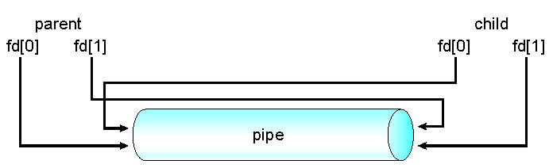
Ordinary Pipes
Ordinary Pipes allow communication in standard producer-consumer style
Producer writes to one end (the write-end of the pipe)
Consumer reads from the other end (the read-end of the pipe)
Ordinary pipes are therefore unidirectional
Require parent-child relationship between communicating processes
Windows calls these anonymous pipes
See Unix and Windows code samples in textbook

Slide 76
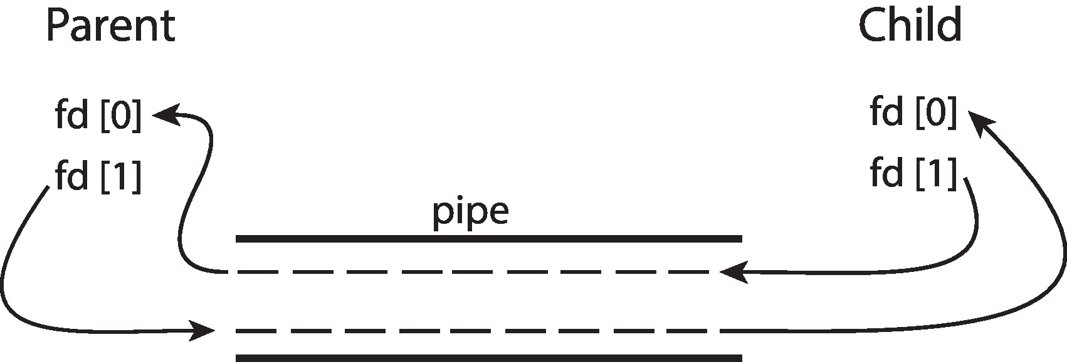
Ordinary Pipes
Ordinary Pipes allow communication in standard producer-consumer style
Producer writes to one end (the write-end of the pipe)
Consumer reads from the other end (the read-end of the pipe)
Ordinary pipes are therefore unidirectional
Require parent-child relationship between communicating processes
Windows calls these anonymous pipes

Slide 77
Named Pipes
Named Pipes are more powerful than ordinary pipes
Communication is bidirectional
No parent-child relationship is necessary between the communicating processes
Several processes can use the named pipe for communication
Provided on both UNIX and Windows systems

Slide 78
Remote Procedure Calls
Remote procedure call (RPC) abstracts procedure calls between processes on networked systems
  Again uses ports for service differentiation
Stubs – client-side proxy for the actual procedure on the server
The client-side stub locates the server and marshalls the parameters
The server-side stub receives this message, unpacks the marshalled parameters, and performs the procedure on the server
On Windows, stub code compile from specification written in Microsoft Interface Definition Language (MIDL)

Slide 79
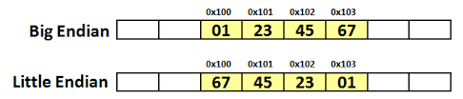
Remote Procedure Calls (Cont.)
641 × 137 - thebittheories.co
Data representation handled via External Data Representation (XDL) format to account for different architectures
  Big-endian (RISC) and little-endian (Intel)
Big-endian is also known as Network order (TCP/IP)
Remote communication has more failure scenarios than local
  Messages can be delivered exactly once (timestamp and ACK) rather than at most once (timestamp and drop dups)
OS typically provides a rendezvous (or matchmaker) service to connect client and server
Notes:
Matchmaker functionality more commonly called portmapper in Windows/Linux-type OS’s

Slide 80
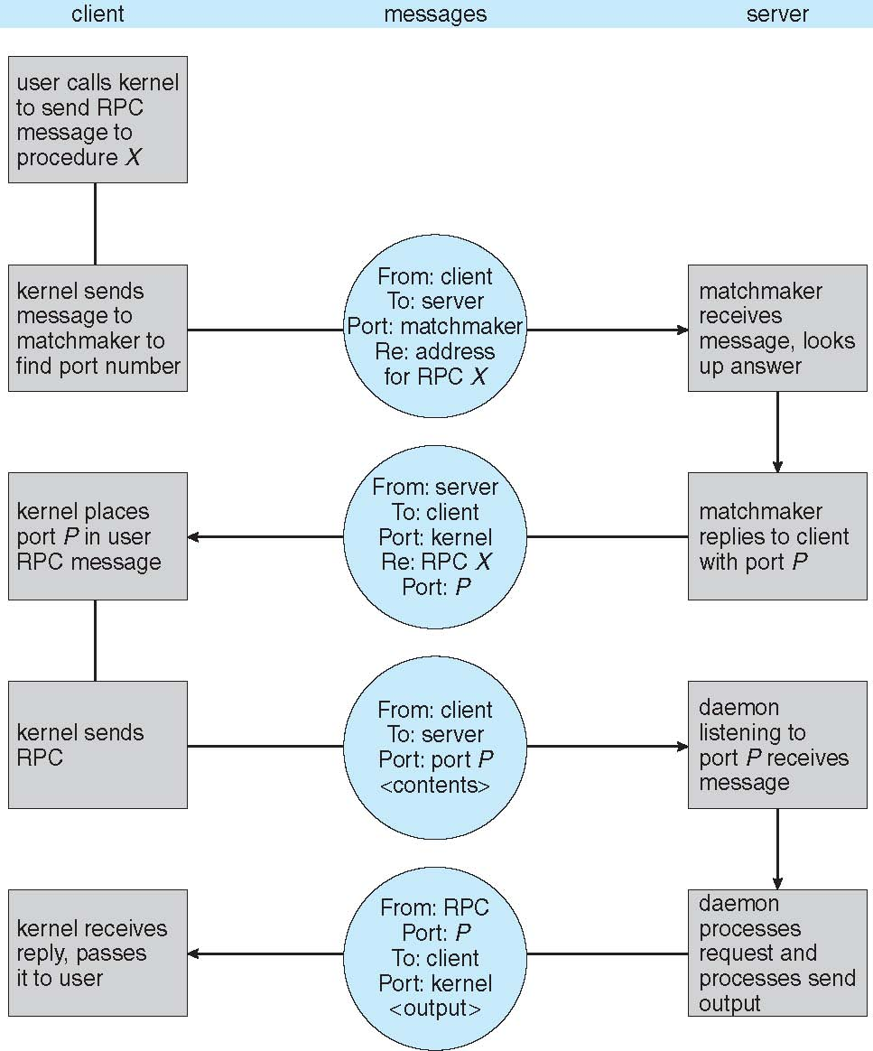
Execution of RPC
Name to Port Lookup
Execute RPC
Notes:
Two full round trips!

Slide 81
Sockets
A socket is defined as an endpoint for communication
Concatenation of IP address and port – a number included at start of message packet to differentiate network services on a host
The socket 161.25.19.8:1625 refers to port 1625 on host 161.25.19.8
Communication consists between a pair of sockets
All ports below 1024 are well known, used for standard services
Special IP address 127.0.0.1 (loopback) to refer to system on which process is running

Slide 82
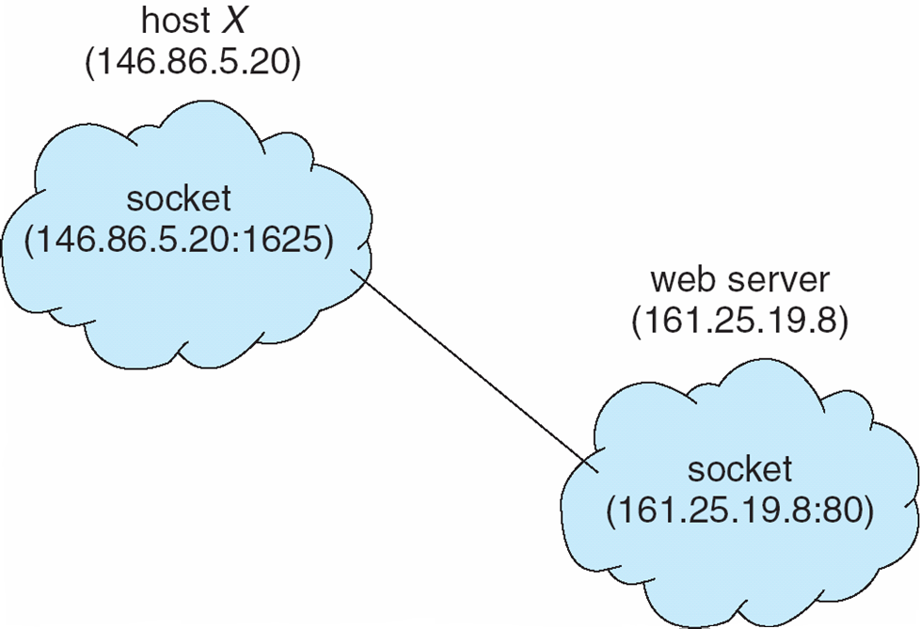
Socket Communication
Notes:
Socket is bi-directional. Used to communicate over the WWW. Protocols are TCP/IP or UDP/IP. TCP is connection based, UDP is connectionless. Packets.

Slide 83
Sockets
Sockets are bi-directional even if used unidirectional manner.
Sockets are identified by their protocol
  TCP – transmission control protocol
    Connection oriented, complex keepalive protocol
  UDP – user datagram protocol
    Connectionless, missed messages are lost.
Locally bound to IP/port pair to a remote IP/port pair.
Sockets can be on the same machine using loopback.

Slide 84
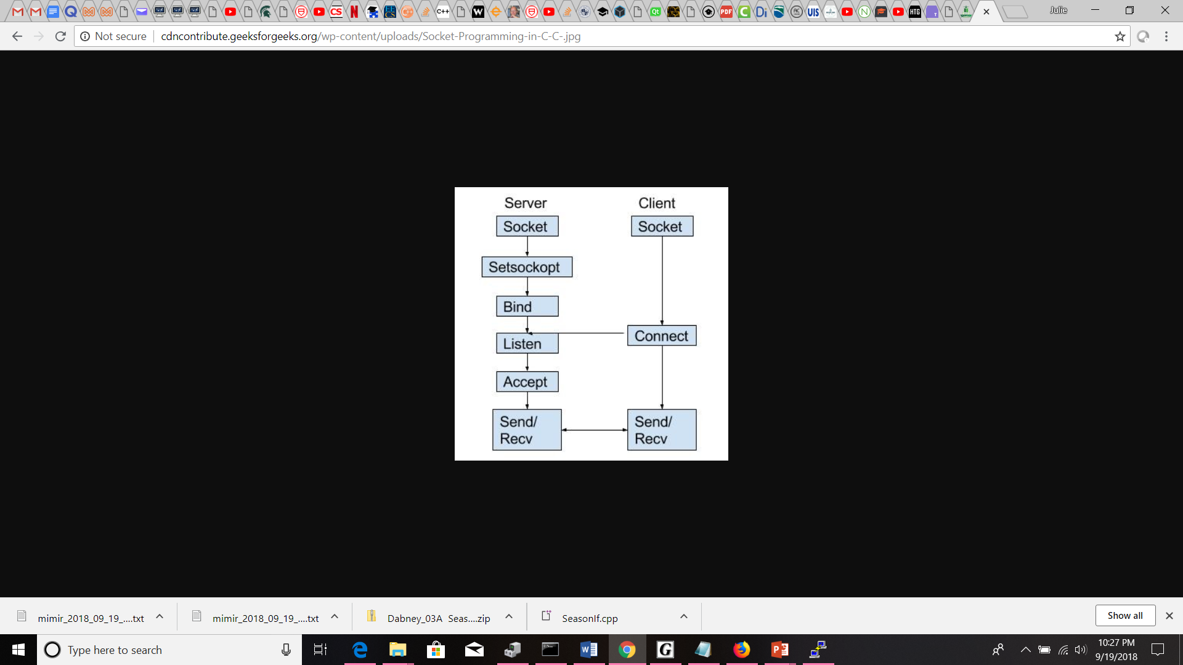
Socket Connections
https://www.geeksforgeeks.org/socket-programming-cc/

Slide 85
Socket Calls
Socket: Create a new socket in the kernel and return a file descriptor.
  int socket(int domain, int type, int protocol).
Bind: Attach a local address to a socket
  Binds the host address to the file descriptor.
Listen: Announce willingness to accept connections
  Associate backlog size for messages.
Accept: Block caller until a connection request arrives - Server
  Server side blocks until client makes contact
Connect: Actively attempt to establish a connection - Client
Send: Send some data over connection
Receive: Receive some data over connection
Close: Release the connection

Slide 86
Socket Creation
    int socket(int domain, int type, int protocol)
Domain
  AF_UNIX, AF_LOCAL Local communication unix(7)
  AF_INET IPv4 Internet protocols ip(7)
  AF_INET6 IPv6 Internet protocols ipv6(7)
  AF_NETLINK Kernel user interface device netlink(7)
  AF_X25 ITU-T X.25 / ISO-8208 protocol x25(7)
Type
  SOCK_STREAM Sequenced, reliable, two-way, connection-based byte streams.
  SOCK_DGRAM Supports datagrams (connectionless, unreliable messages of a fixed maximum length).
  SOCK_RAW Provides raw network protocol access.

Slide 87
Socket Creation (con’t)
Type
  SOCK_SEQPACKET Sequenced, reliable, two-way connection-based data transmission path for datagrams of fixed maximum length; a consumer is required to read an entire packet with each input system call.
  SOCK_RDM Provides a reliable datagram layer that does not guarantee ordering.
Including Bitwise OR
  SOCK_NONBLOCK Set the O_NONBLOCK file status flag on the new open file description. Using this flag saves extra calls to fcntl(2) to achieve the same result.
  SOCK_CLOEXEC Set the close-on-exec (FD_CLOEXEC) flag on the new file descriptor. See the description of the O_CLOEXEC flag in open(2) for reasons why this may be useful.
Protocol - Usually can be set to 0. See /etc/protocols or getprotent.

Slide 88
Server Socket Creation
int serverFD = 0, clientFD = 0; // declare 2 file descriptors
struct sockaddr_in ipOfServer;
serverFD = socket(AF_INET, SOCK_STREAM, 0); // creating socket
memset(&ipOfServer, '0', sizeof(ipOfServer));
ipOfServer.sin_family = AF_INET;
ipOfServer.sin_addr.s_addr = htonl(INADDR_ANY); // bind to all interfaces
ipOfServer.sin_port = htons(2017); // this is the port of running server
bind(serverFD, (struct sockaddr*)&ipOfServer , sizeof(ipOfServer));
listen(serverFD, 20); // listen sets up the backlog queue
while(1) {
clientFD = accept(serverFD, (struct sockaddr*)NULL, NULL); // blocking
// Ready to Read/Write using clientFD
Notes:
serverFD is where the server sits waiting for requests to connect. clientFD is where the client connection ends up.

Slide 89
Client Socket Creation
int socketFD = 0; // declre 1 socket file descriptor
struct sockaddr_in ipOfServer;
// Create an TCP IPV4 socket.
if((socketFD = socket(AF_INET, SOCK_STREAM, 0))< 0) {
printf("Socket not created \n");
return 1;
}
ipOfServer.sin_family = AF_INET;
ipOfServer.sin_port = htons(2017);
ipOfServer.sin_addr.s_addr = inet_addr("127.0.0.1"); // loopback
if(connect(socketFD, (struct sockaddr *)&ipOfServer, sizeof(ipOfServer))<0){
printf("Connection failed due to port and ip problems\n");
return 1;
} // Ready to read/write

Slide 90
Header files
#include <sys/socket.h>
#include <sys/types.h>
#include <netinet/in.h>
#include <netdb.h>
#include <stdio.h>
#include <string.h>
#include <stdlib.h>
#include <unistd.h>
#include <errno.h>
#include <arpa/inet.h>

Slide 91
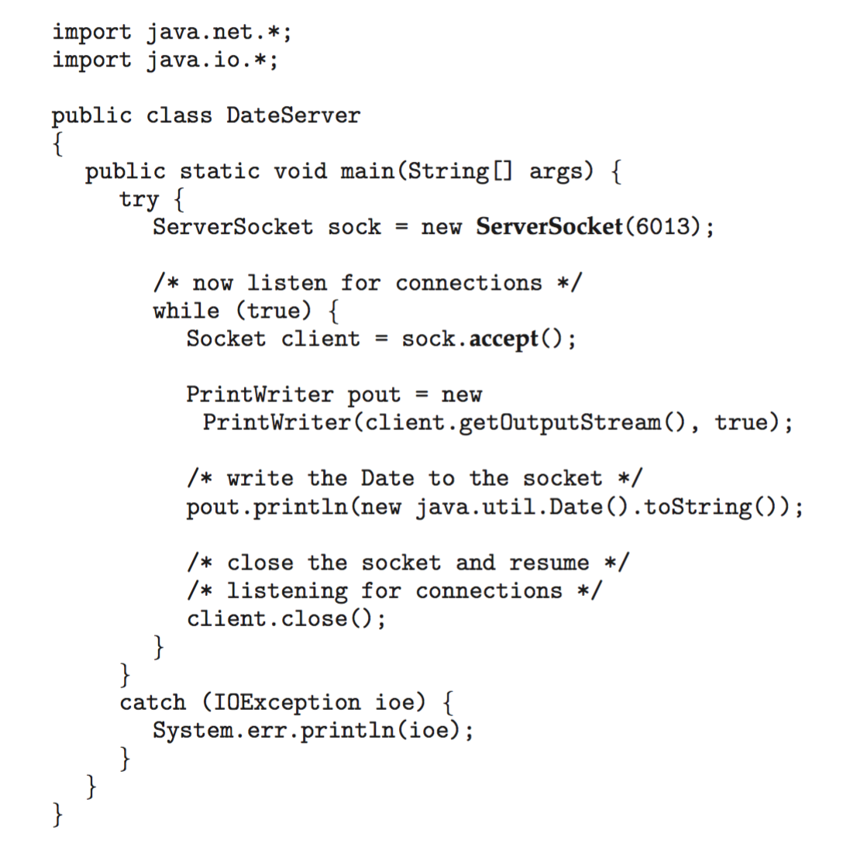
Sockets in Java
Three types of sockets
  Connection-oriented (TCP)
  Connectionless (UDP)
  MulticastSocket class– data can be sent to multiple recipients
Consider this “Date” server in Java:

Slide 92
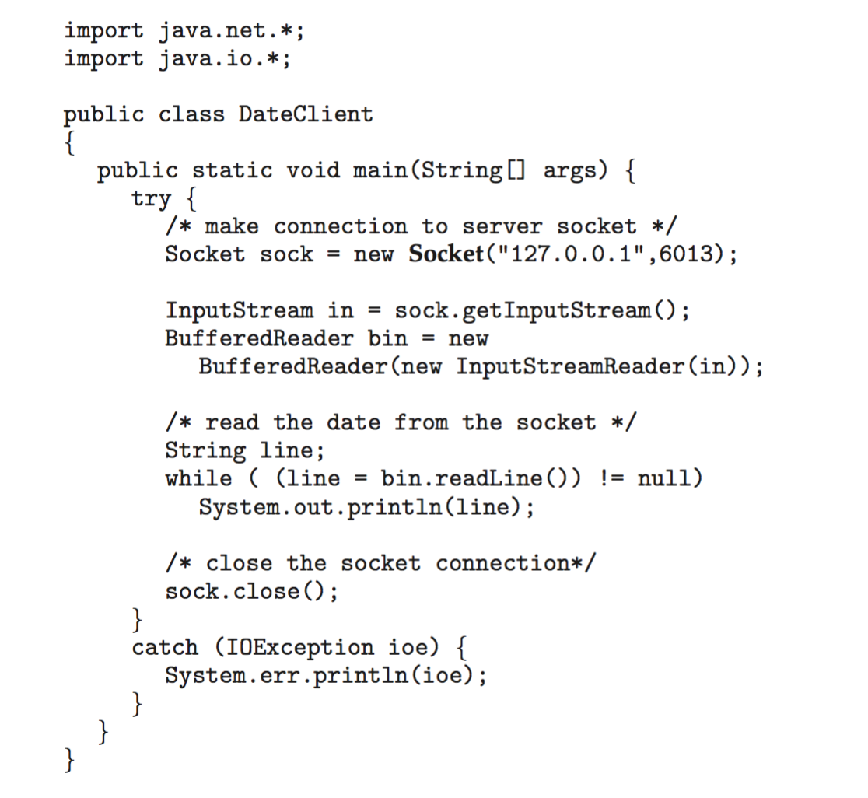
Sockets in Java
The equivalent Date client

Slide 93
Fixed vs Variable Messages
Who has the harder job? Operating System or Application?
For fixed message size, the Operating System can create a channel to optimize the fixed size. The programmer has to pad short messages and figure out a continuation scheme for longer messages.
For variable message size, the application may have to include the message size in the message header, but it is still harder for the Operating System to transmit mixed sized messages. The application can just count bytes and send them out. No special padding or continuation logic. It is always the same.

Slide 94
IPC Messaging Review
What are three mechanisms that implement the message passing model?
What are three ways to handle message queues? What are the implications?
What is the form of a socket address?
Starting a server that uses sockets involves which calls? Cwhat about client?

Slide 95
IPC Messaging Review
What are three mechanisms that implement the message passing model?
  Pipes – usually unidirectional, come in pairs
  Sockets – bidirectional, server listens and accepts client connections
  RPCs – two round trips: 1) name to port map 2) message data & result
What are three ways to handle message queues? What are the implications?
  Bounded – if full, then process blocked
  Unbounded – unlimited, left to the processes to manage
  Zero Capacity – requires a rendezvous (synchronous communication)
What is the form of a socket address?
  Ip-address:port e.g. 192.168.129.2:22
Starting a server that uses sockets involves which calls? Cwhat about client?
  Server: socket, setsockopt, bind, listen, accept
  Client: socket, connect

Slide 96
Processing argc, argv
  int main(int argc, char* argv[])
First argv, argv[0] = name of program
What is the minimum value of argc?
If a minimum number of arguments is required, output an error if argc < MIN_ARGS and exit.
If args are needed in a function, use the address of the first argv needed.
  argv[1], in our case this is the command.
  http://www.cplusplus.com/articles/DEN36Up4/

Slide 97
argc, argv, execvp
Remember that argc is the count of args and is always >= 1
  because argc includes the running program name (e.g. lab1)
Man for execvp says to allocate an array that is the same size as argv but copy from argv[1] until argv[argc-2] and set argv[argc-1] = NULL
  However, our parent process is the result of the shell forking and exec-ing our program, so argv[argc-1] may already terminate with NULL.
As a result, execv will still work if you use argv[1], &argv[1] as arguments without copying.
Remember to check for errors from all system calls.
  Use perror to print an error using when the system call fails.
Follow the instructions for the rest of the output:
  Child process pid is 48033
  Parent process pid is 48032

