Slide 1
Chapter 5: CPU Scheduling

Slide 2
Chapter 5: CPU Scheduling
Basic Concepts
Scheduling Criteria
Scheduling Algorithms
Thread Scheduling
Multiple-Processor Scheduling
Real-Time CPU Scheduling
Operating Systems Examples
Algorithm Evaluation

Slide 3
Objectives
To introduce CPU scheduling, which is the basis for multiprogrammed operating systems
To describe various CPU-scheduling algorithms
To discuss evaluation criteria for selecting a CPU-scheduling algorithm for a particular system
To examine the scheduling algorithms of several operating systems

Slide 4
Basic Concepts
Maximum CPU utilization obtained with multiprogramming
CPU–I/O Burst Cycle – Process execution consists of a cycle of CPU execution and I/O wait
CPU burst followed by I/O burst
CPU burst distribution is of main concern
Most programs alternate between CPU and I/O activity.
Studies show that programs either have high frequency of short CPU bursts or low frequency of long CPU bursts.
Scheduling to maximize CPU utilization.

Slide 5
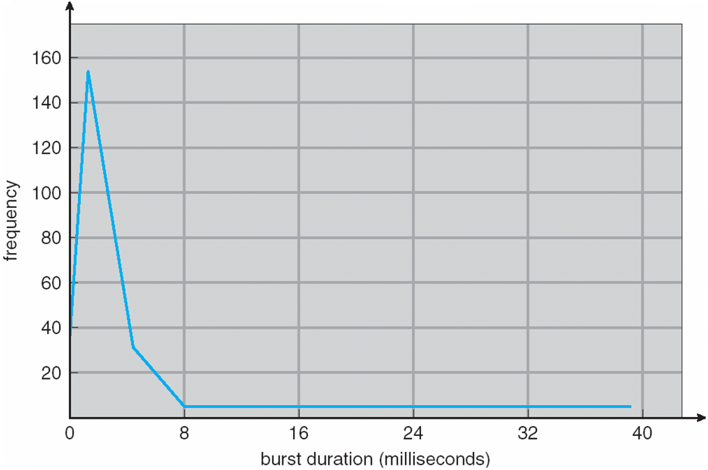
Histogram of CPU-burst Times
Notes:
Studies of computer activites continually show a high frequeny of short burts and a low frequency of long bursts.

Slide 6
CPU Scheduler
Short-term scheduler selects from among the processes in ready queue, and allocates the CPU to one of them
  Queue may be ordered in various ways
CPU scheduling decisions may take place when a process:
  1. Switches from running to waiting state
  2. Switches from running to ready state
  3. Switches from waiting to ready
  Terminates
Scheduling under 1 and 4 is nonpreemptive
All other scheduling is preemptive
  Consider access to shared data
  Consider preemption while in kernel mode
  Consider interrupts occurring during crucial OS activities

Slide 7
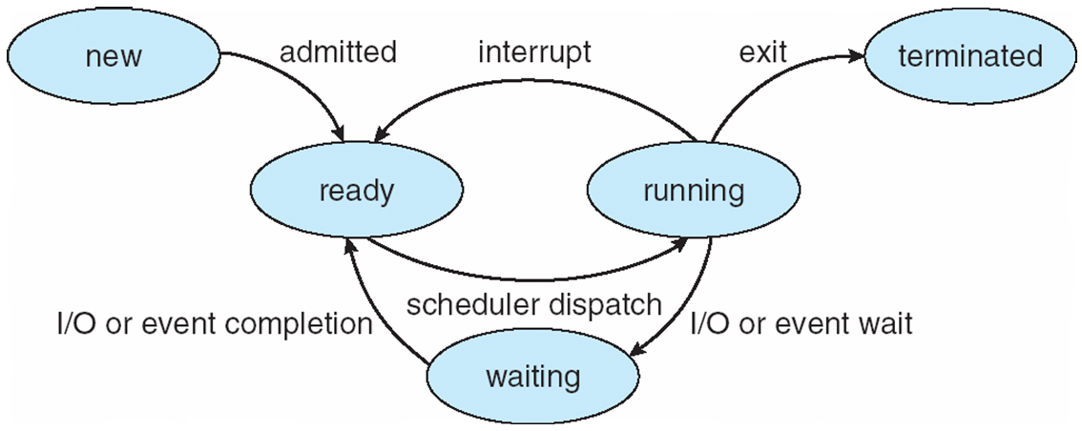
Diagram of Process State

Slide 8
Dispatcher
Dispatcher module gives control of the CPU to the process selected by the short-term scheduler; this involves:
  switching context
  switching to user mode
  jumping to the proper location in the user program to restart that program

Slide 9
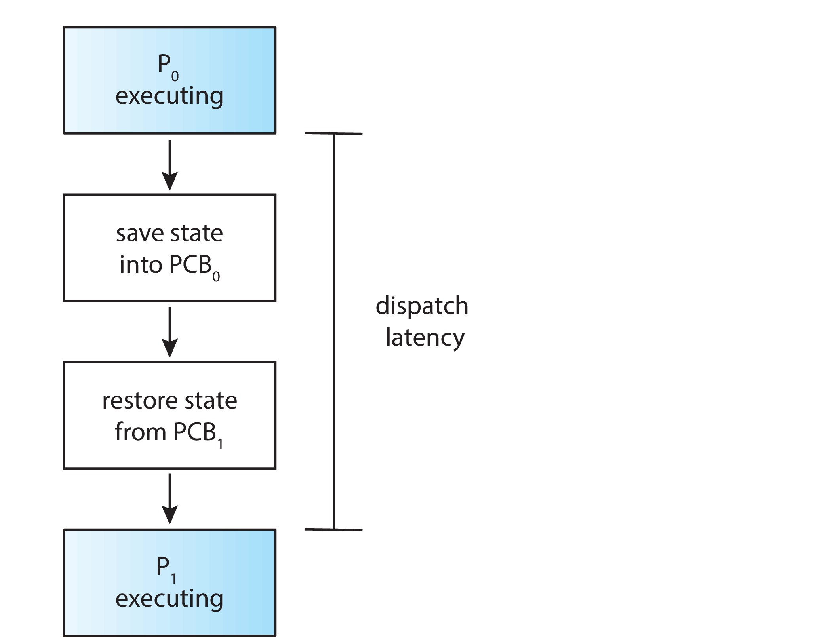
Dispatch Latency
Dispatch latency – time it takes for the dispatcher to stop one process and start another running

Slide 10
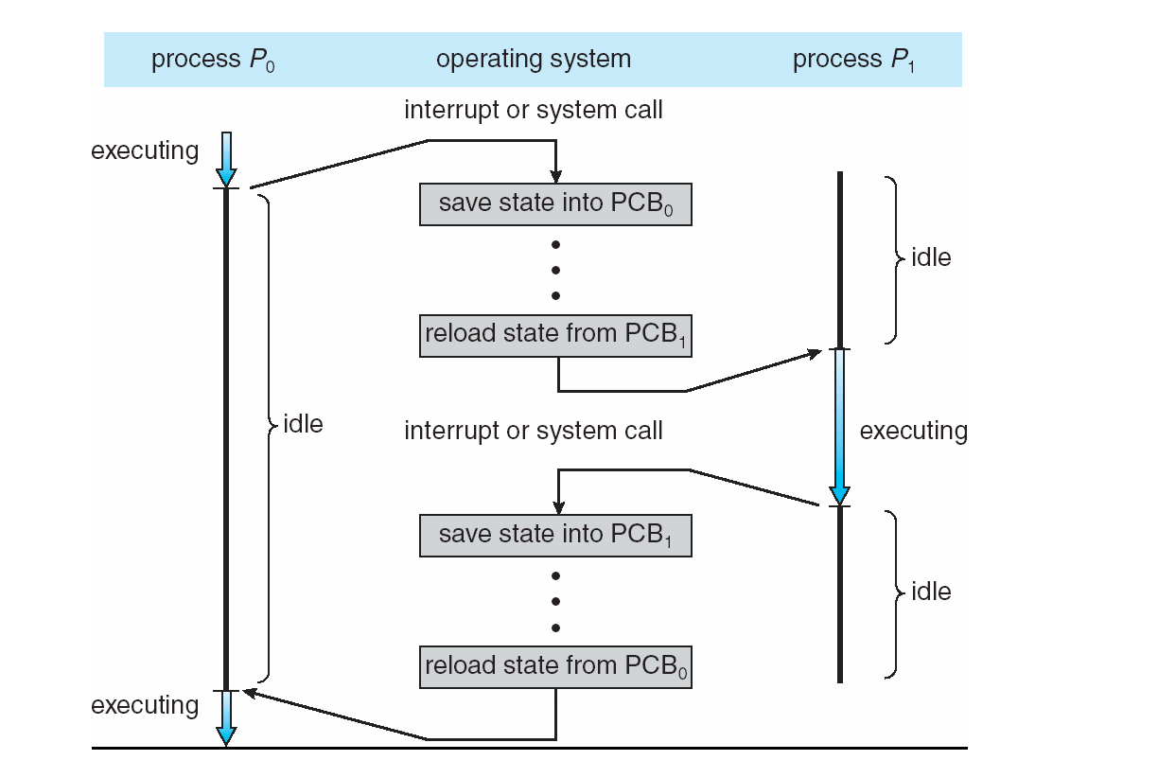
CPU Switch From Process to Process
Notes:
Point out that how much time is spent switching vs. how much time actually running.

Slide 11
Scheduling Criteria
CPU utilization – keep the CPU as busy as possible
Throughput – # of processes that complete their execution per time unit
Turnaround time – amount of time to execute a particular process
Waiting time – amount of time a process has been waiting in the ready queue
Response time – amount of time it takes from when a request was submitted until the first response is produced, not output (for time-sharing environment)

Slide 12
Scheduling Algorithm Optimization Criteria
Max CPU utilization
Max throughput
Min turnaround time
Min waiting time
Min response time

Slide 13
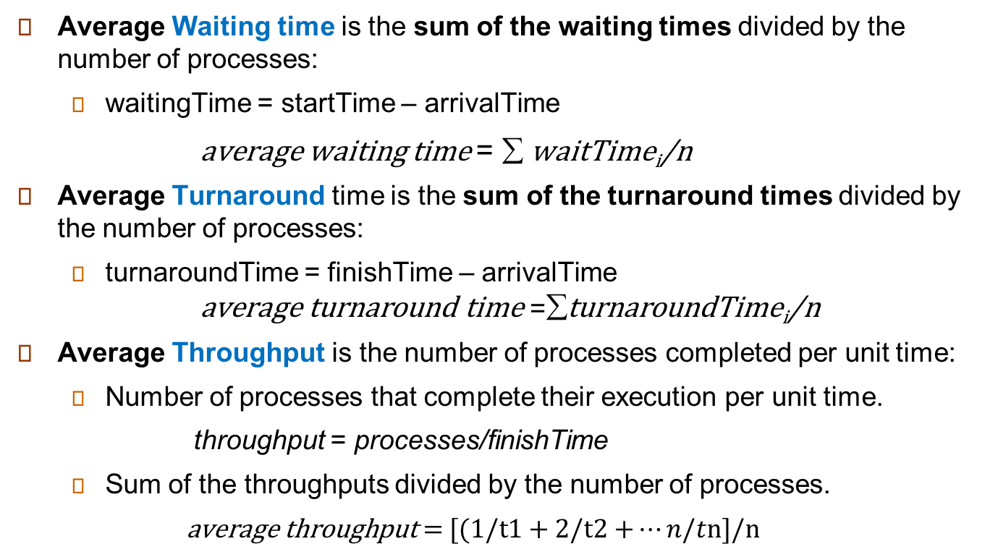
CPU Scheduling Analytics
Average Waiting time is the sum of the waiting times divided by the number of processes:
  waitingTime = startTime – arrivalTime
        average waiting time = $\text{å}$waitTime_{i}/n
Average Turnaround time is the sum of the turnaround times divided by the number of processes:
  turnaroundTime = finishTime – arrivalTime
        $$\text{average} \text{turnaround} \text{t}\text{ime} \text{=}\text{å}\text{turnaround}\text{Time}\text{i}\text{/}\text{n}$$
Average Throughput is the number of processes completed per unit time:
  Number of processes that complete their execution per unit time.
    throughput = processes/finishTime
  Sum of the throughputs divided by the number of processes.
  $\text{average} \text{throughput} \text{= [(1/}\text{t}\text{1 + 2/}\text{t}\text{2 +}…n/t\text{n}\text{]/}\text{n}$

Slide 14
First- Come, First-Served (FCFS) Scheduling
Process Burst Time
P₁ 24
P₂ 3
P₃ 3
Suppose that the processes arrive in the order: P₁ , P₂ , P₃
The Gantt Chart for the schedule is:
Waiting time for P₁ = 0; P₂ = 24; P₃ = 27
Average waiting time: (0 + 24 + 27)/3 = 17
Average throughput = [1/24 + 2/27 + 3/30 ]/3 = .072 process/msec
Average turnaround = (24 + 27 + 30)/3 = 27

Slide 15
FCFS Scheduling (Cont.)
Suppose that the processes arrive in the order:
P₂ , P₃ , P₁
The Gantt chart for the schedule is:
Waiting time for P₁ = 6; P₂ = 0; P₃ = 3
Average waiting time: (6 + 0 + 3)/3 = 3
Much better than previous case
Convoy effect - short process backed up behind long process
  Consider one CPU-bound and many I/O-bound processes
  Is there a change in throughput? .2555
  Is there a change in turnaround? 13

Slide 16
Shortest-Job-First (SJF) Scheduling
Associate with each process the length of its next CPU burst
  Use these lengths to schedule the process with the shortest time
SJF is optimal – gives minimum average waiting time for a given set of processes
  The difficulty is knowing the length of the next CPU request
  Could ask the user

Slide 17
Example of SJF
ProcessArriva l Time Burst Time
P₁ 0.0 6
P₂ 2.0 8
P₃ 4.0 7
P₄ 5.0 3
SJF scheduling chart
Average waiting time = (3 + 16 + 9 + 0) / 4 = 7
Average throughput time = [1/3 + 2/9 + 3/16 + 4/24]/4 = .227proc/msec
Average turnaround time = (3 + 9 + 16 + 24)/4 = 13

Slide 18
Determining Length of Next CPU Burst
Can only estimate the length – should be similar to the previous one
  Then pick process with shortest predicted next CPU burst
Can be done by using the length of previous CPU bursts, using exponential averaging.
Commonly, α set to ½
Preemptive version called shortest-remaining-time-first
Exponential averaging is a weighted average that gives the most weight to the most recent bursts.
  It’s a way of predicting the next CPU burst.

Slide 19
Prediction of the Length of the Next CPU Burst
(1/2)6+(1/2)10 = 8 (1/2)4+(1/2)8=6 (1/2)6+(1/2)6
Notes:
Shows a sequence of bursts and the guesses that are made for subsequent bursts. Take

Slide 20
Examples of Exponential Averaging
α =0
  τ_{n+1} = τ_{n}
  Recent history does not count
α =1
  τ_{n+1} = α t_{n}
  Only the actual last CPU burst counts
If we expand the formula, we get:
    τ_{n+1} = α t_{n}+(1 - α)α t_{n} ₋₁ + …
    +(1 - α )^{j} α t_{n} _{-j} + …
    +(1 - α )^{n +1} τ₀
Since both α and (1 - α) are less than or equal to 1, each successive term has less weight than its predecessor
The previous term is the previous prediction vs current burst

Slide 21
Example of Shortest-remaining-time-first
Now we add the concepts of varying arrival times and preemption to the analysis
ProcessA arri Arrival TimeT Burst Time
P₁ 0 8
P₂ 1 4
P₃ 2 9
P₄ 3 5
Preemptive SJF Gantt Chart
Average waiting time = [(10-1)+(1-1)+(17-2)+5-3)]/4 = 26/4 = 6.5 msec
Average throughput = [

Slide 22
Round Robin (RR)
Each process gets a small unit of CPU time (time quantum q), usually 10-100 milliseconds. After this time has elapsed, the process is preempted and added to the end of the ready queue.
If there are n processes in the ready queue and the time quantum is q, then each process gets 1/n of the CPU time in chunks of at most q time units at once. No process waits more than (n-1)q time units.
Timer interrupts every quantum to schedule next process
Performance
  q large ⇒ FIFO
  q small ⇒ q must be large with respect to context switch, otherwise overhead is too high

Slide 23
Example of RR with Time Quantum = 4
Process Burst Time
P₁ 24
P₂ 3
P₃ 3
The Gantt chart is:
Typically, higher average turnaround than SJF, but better response
q should be large compared to context switch time
q usually 10ms to 100ms, context switch < 10 usec

Slide 24
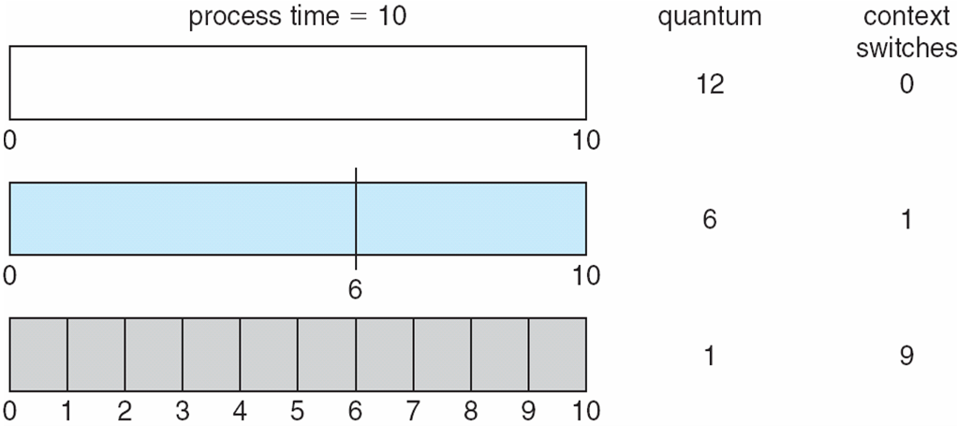
Time Quantum and Context Switch Time
The greater the time quantum, the fewer the number of context
Switches.
Number of context switches is inversely related to time quantum.
Notes:
The greater the time quantum the fewer the context switches. Number of context switches is inversely related to time quantum.

Slide 25
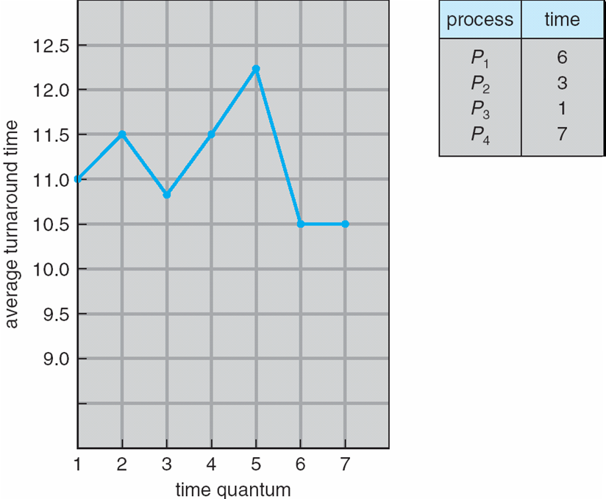
Turnaround Time Varies With The Time Quantum
80% of CPU bursts should be shorter than q

Slide 26
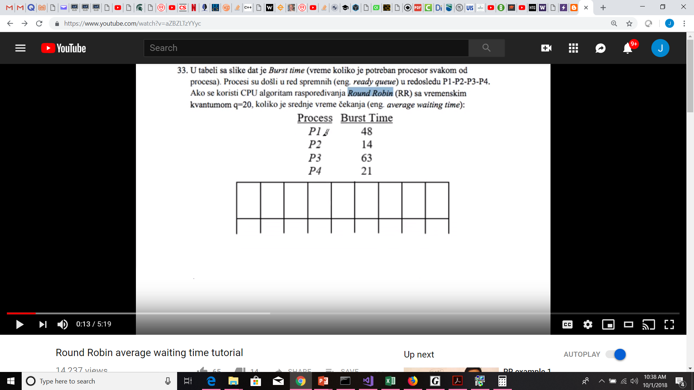
Round Robin Example
Calculating Average Waiting time in Round-Robin Scheduling.
Let’s create a Gantt Chart for the following scenario. We have 4 processes each with the following CPU Burst times:
How would you calculate Average Waiting time?
Assume a quantum = 20 (aka Time Slice)
CPU
Process Burst
P1 48
P2 14
P3 63
P4 21
P1
P2
P3
P4
P1
P3
P4
P1
P3
P4

Slide 27
Priority Scheduling
A priority number (integer) is associated with each process
The CPU is allocated to the process with the highest priority (smallest integer ≡ highest priority)
  Preemptive
  Nonpreemptive
SJF is priority scheduling where priority is the inverse of predicted next CPU burst time
Problem ≡ Starvation – low priority processes may never execute
Solution ≡ Aging – as time progresses increase the priority of the process

Slide 28

Example of Priority Scheduling
ProcessA arri Burst TimeT Priority
P₁ 10 3
P₂ 1 1
P₃ 2 4
P₄ 1 5
P₅ 5 2
Priority scheduling Gantt Chart
Average waiting time = (0+1+6+16+18)/5 = 8.2 msec
Average turn-around = (1+6+16+18+19)/5 = 12 msec
Average throughput = (1/1 + 2/6 + 3/16 + 4/18 + 5/19)/5 = .402 jobs/msec

Slide 29
Multilevel Queue
Ready queue is partitioned into separate queues, eg:
  foreground (interactive)
  background (batch)
Process permanently in a given queue
Each queue has its own scheduling algorithm:
  foreground – RR
  background – FCFS
Scheduling must be done between the queues:
  Fixed priority scheduling; (i.e., serve all from foreground then from background). Possibility of starvation.
  Time slice – each queue gets a certain amount of CPU time which it can schedule amongst its processes; i.e., 80% to foreground in RR
  20% to background in FCFS

Slide 30
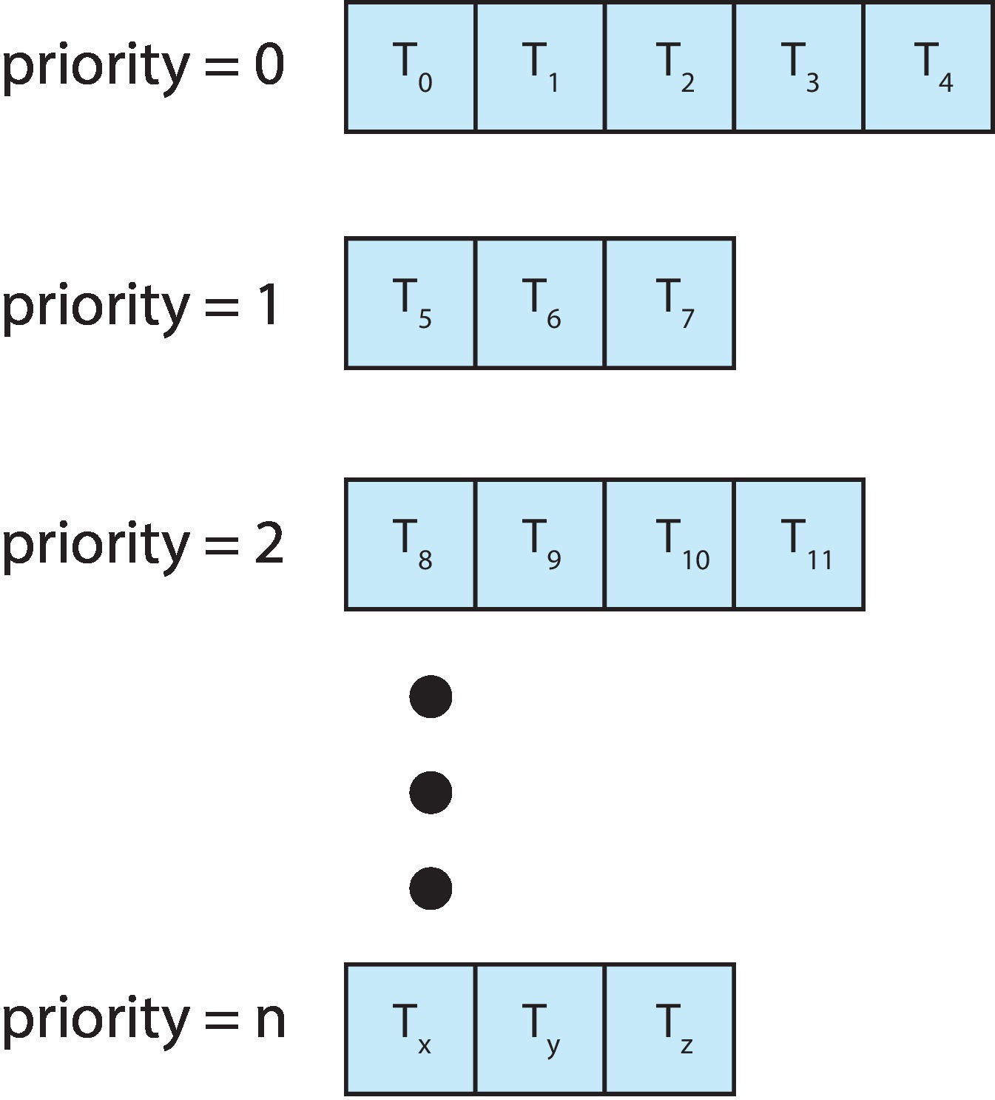
Multilevel Queue
With priority scheduling, have separate queues for each priority.
Schedule the process in the highest-priority queue!

Slide 31
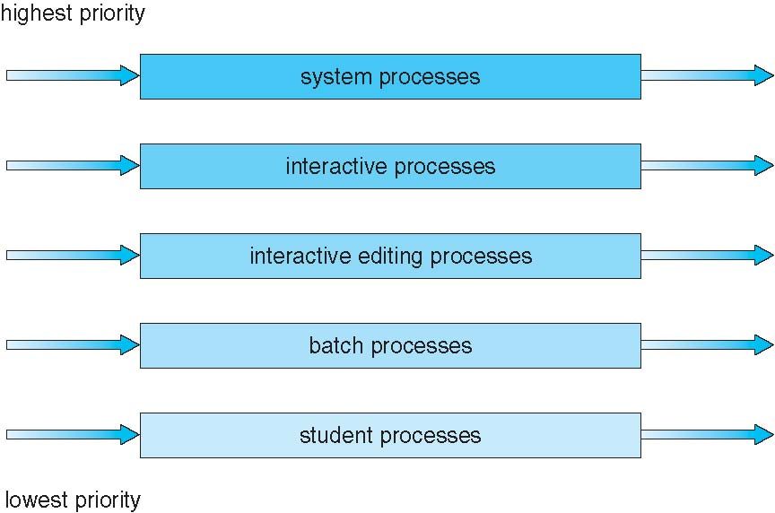
Multilevel Queue Scheduling

Slide 32
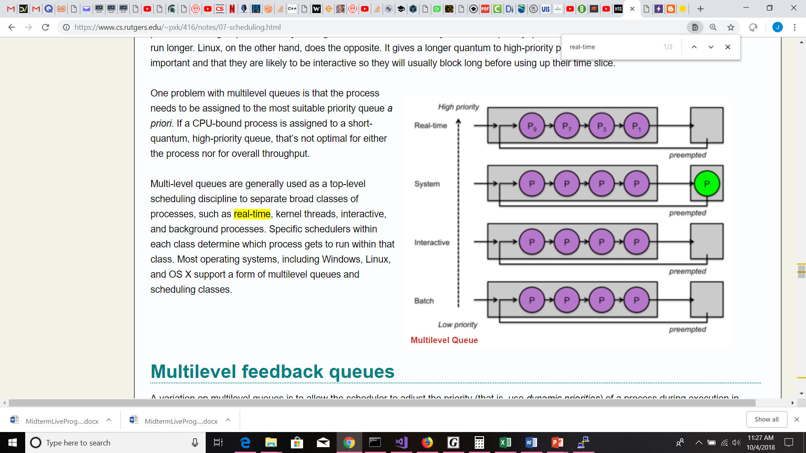
Multilevel-Queue Scheduling

Slide 33
Multilevel Feedback Queue
A process can move between the various queues; aging can be implemented this way
Multilevel-feedback-queue scheduler defined by the following parameters:
  number of queues
  scheduling algorithms for each queue
  method used to determine when to upgrade a process
  method used to determine when to demote a process
  method used to determine which queue a process will enter when that process needs service
Most operating systems, including Windows, Linux, and OS X support a form of multilevel queues and scheduling classes.

Slide 34
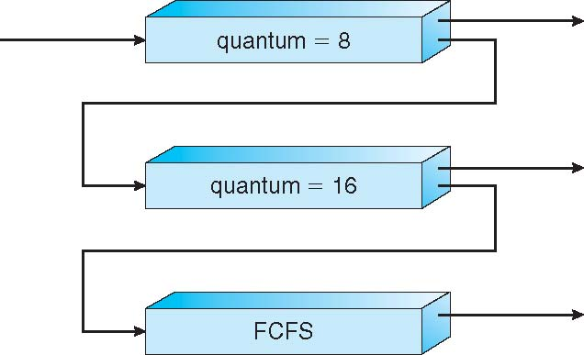
Example of Multilevel Feedback Queue
Three queues:
  Q₀ – RR with time quantum 8 milliseconds
  Q₁ – RR time quantum 16 milliseconds
  Q₂ – FCFS
Scheduling
  A new job enters queue Q₀ which is served FCFS
    When it gains CPU, job receives 8 milliseconds
    If it does not finish in 8 milliseconds, job is moved to queue Q₁
  At Q₁ job is again served FCFS and receives 16 additional milliseconds
    If it still does not complete, it is preempted and moved to queue Q₂

Slide 35
Multilevel vs Multilevel Feedback
Multilevel Queue is permanently assigned to a queue based on properties of the process.
  Priority Queues based on assigned priority
  Priority Queues based on process type
    Real-time process queue
    System initiated process queue
    Interactive process queue
    Batch process queue
Multilevel Feedback Queue adjusts process queues based on process performance.
  method used to determine when to upgrade a process
  method used to determine when to demote a process
  method used to determine which queue a process will enter when that process needs service

Slide 36
Thread Scheduling
Distinction between user-level and kernel-level threads
When threads supported, threads scheduled, not processes
Many-to-one and many-to-many models, thread library schedules user-level threads to run on LWP
  Known as process-contention scope (PCS) since scheduling competition is between threads within the same process
  Typically done via priority set by programmer, managed by the thread library.
Kernel thread scheduled onto available CPU is system-contention scope (SCS) – competition among all threads in system
  One to one user to kernel threads, system schedules the threads.

Slide 37
Pthread Scheduling
API allows specifying either PCS or SCS during thread creation
  PTHREAD_SCOPE_PROCESS schedules threads using PCS scheduling -- schedules user threads onto available LWPs using the Many-to-many model.
  PTHREAD_SCOPE_SYSTEM schedules threads using SCS scheduling -- binds a thread to particular LWPs like one-to-one model.
Can be limited by OS – Linux and Mac OS X only allow PTHREAD_SCOPE_SYSTEM
Pthread_attr_getscope/pthread_attr_setscope for determining and setting the scope contention respectively

Slide 38
Pthread Scheduling
PTHREAD_SCOPE_SYSTEM
  The thread competes for resources with all other threads in all other processes on the system that are in the same scheduling allocation domain (a group of one or more processors).
PTHREAD_SCOPE_PROCESS
  The thread competes for resources with all other threads in the same process that were also created with this scope.
  Posix.1 leaves it unspecified how these threads contend with other threads in other process on the system or with other threads in the same process that were created with the PTHREAD_SCOPE_SYSTEM contention scope.
POSIX.1 requires that an implementation support at least one of these contention scopes. Linux supports PTHREAD_SCOPE_SYSTEM, but not PTHREAD_SCOPE_PROCESS. IT IS IGNORED!

Slide 39
Pthread Scheduling API
#include <pthread.h>
#include <stdio.h>
#define NUM_THREADS 5
int main(int argc, char *argv[]) {
int i, scope;
pthread_t tid[NUM THREADS];
pthread_attr_t attr;
/* get the default attributes */
pthread_attr_init(&attr);
/* first inquire on the current scope */
if (pthread_attr_getscope(&attr, &scope) != 0)
fprintf(stderr, "Unable to get scheduling scope\n");
else {
if (scope == PTHREAD_SCOPE_PROCESS)
printf("PTHREAD_SCOPE_PROCESS");
else if (scope == PTHREAD_SCOPE_SYSTEM)
printf("PTHREAD_SCOPE_SYSTEM");
else
fprintf(stderr, "Illegal scope value.\n");
}

Slide 40
Pthread Scheduling API
/* set the scheduling algorithm to PCS or SCS */
pthread_attr_setscope(&attr, PTHREAD_SCOPE_SYSTEM);
/* create the threads */
for (i = 0; i < NUM_THREADS; i++)
pthread_create(&tid[i],&attr,runner,NULL);
/* now join on each thread */
for (i = 0; i < NUM_THREADS; i++)
pthread_join(tid[i], NULL);
}
/* Each thread will begin control in this function */
void *runner(void *param)
{
/* do some work ... */
pthread_exit(0);
}

Slide 41
Multiple-Processor Scheduling
CPU scheduling more complex when multiple CPUs are available
Load sharing revolves around balancing the processor load.
Homogeneous processors within a multiprocessor are equivalent and interchangeable.
Heterogenous processors are specialized processors, not considered here.
Asymmetric multiprocessing – only one processor is the master, accesses the system data structures, controlling activities and alleviating the need for data sharing. Simple.
Symmetric multiprocessing (SMP) – each processor is self-scheduling, all processes in common ready queue, or each has its own private queue of ready processes
  Currently, most common

Slide 42
Processor Affinity
Processor affinity – process has affinity for processor on which it is currently running – Why?
  soft affinity – system tries to keep processes on same CPU
  hard affinity – process specifies that it is not to be moved between CPUs.
  Variations including processor sets
  Main memory architecture can also affect processor affinity if a particular processor has faster access to memory on the same chip or board.
  If a process has an affinity to a particular CPU, then it should be preferentially assigned memory storage in fast access areas.

Slide 43
NUMA and CPU Scheduling
Note that memory-placement algorithms can also consider affinity
Notes:
Non-uniform Memory Access – CPU has to access non-local memory

Slide 44
Multiple-Processor Scheduling – Load Balancing
If SMP, need to keep all CPUs loaded for efficiency
Load balancing attempts to keep workload evenly distributed
The scheduler tries to load balance the CPUs to make sure that they have a sufficient number of tasks in their run queue. There are two approaches to load balancing among processors:
Push migration is where the operating system checks the load (number of processes in the run queue) on each processor periodically. If there’s an imbalance, some processes will be moved from one processor onto another.
Pull migration is where a scheduler finds that there are no more processes in the run queue for the processor. In this case, it raids another processor’s run queue and transfers a process onto its own queue so it will have something to run.
It is common to combine both push and pull migration (Linux does it, for example).

Slide 45
Multiple-Processor Scheduling – Load Balancing
Note that moving from processes from processor to processor works against processor affinity.
  One reason caching. Clearing and reloading cache is expensive.
Moving processes involves rebuilding caches which is high overhead. Should only be done when imbalance is above a certain threshold.

Slide 46
Multicore Processors
Traditional SMP required multiple CPU chips to run multiple kernel threads concurrently.
Recent trends are to place multiple processor cores on same physical chip
Faster and consumes less power
Multiple threads per core also growing
  By assigning multiple kernel threads per core, one thread can be running while another thread waits for memory
  Takes advantage of memory stall to make progress
Two ways to multithread a processor:
  Coarse-grained switches only when one thread blocks
  Fine-grained multithreading on small, regular intervals, requires architectural support for low overhead switching.

Slide 47
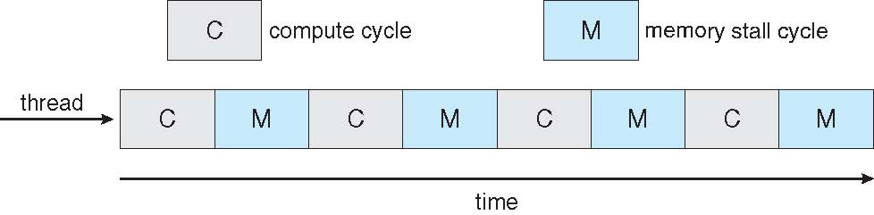

Multithreaded Multicore System

Slide 48
Virtualization and Scheduling
Virtualization software schedules multiple guests onto CPU(s)
A key use of virtualization technology is server virtualization, which uses a software layer called a hypervisor to emulate the underlying hardware.
  Hypervisor is designed to sit directly on bare metal and provide the ability to virtualize the hardware platform for use by the virtual machines (VMs).
  KVM virtualization is a Linux kernel-based hypervisor that provides Type 1 virtualization benefits similar to other hypervisors.
Each guest sits on top of a hypervisor doing its own scheduling
  Doesn’t know about other hypervisors sharing the CPUs
  Can result in poor response time
  Can effect time-of-day clocks in guests
Notes:
Clock ticks don’t come thru the hypervisor. Virtual reality is not reality. Virtual clock. Software lock

Slide 49
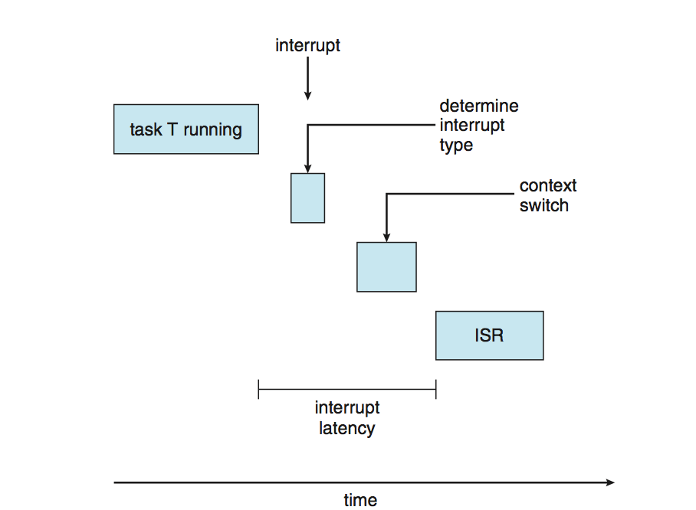
Real-Time CPU Scheduling
Can present obvious challenges
Soft real-time systems – no guarantee as to when critical real-time process will be scheduled
Hard real-time systems – task must be serviced by its deadline
Two types of latencies affect performance
  Interrupt latency – time from arrival of interrupt to start of routine that services interrupt
  Dispatch latency – time for schedule to take current process off CPU and switch to another

Slide 50
Real-Time CPU Scheduling (Cont.)
Conflict phase of dispatch latency:
  Preemption of any process running in kernel mode
  Release by low-priority process of resources needed by high-priority processes

Slide 51
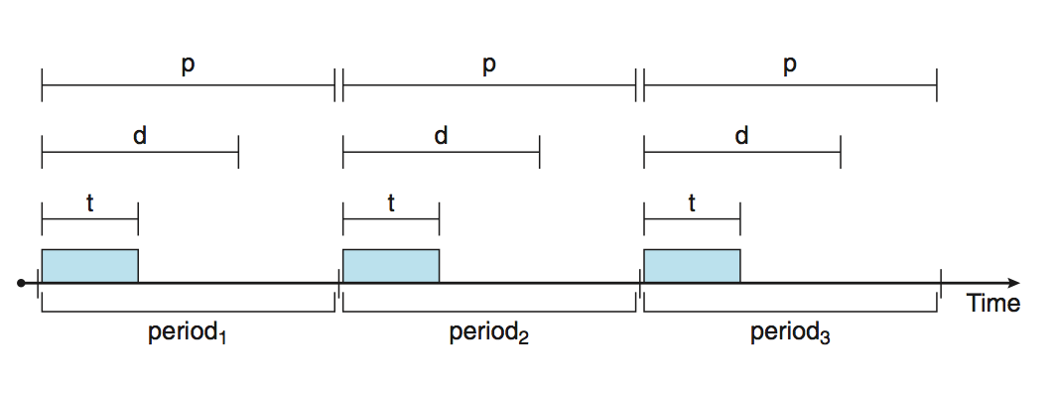
Priority-based Scheduling
For real-time scheduling, scheduler must support preemptive, priority-based scheduling
  But only guarantees soft real-time
For hard real-time must also provide ability to meet deadlines
Processes have new characteristics: periodic ones require CPU at constant intervals
  Has processing time t, deadline d, period p
  0 ≤ t ≤ d ≤ p
  Rate of periodic task is 1/p

Slide 52
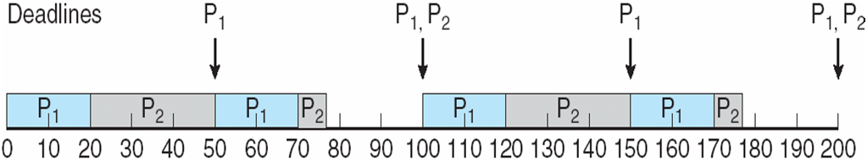
Rate Monotonic Scheduling
Uses preemptive scheduling with static priorities.
A priority is assigned based on the inverse of its period
Shorter periods = higher priority;
Longer periods = lower priority
P₁ is assigned a higher priority than P₂.
Notes:
Continuous, non-increasing or non-decreasing but not both. Real-time version of shortest job first

Slide 53
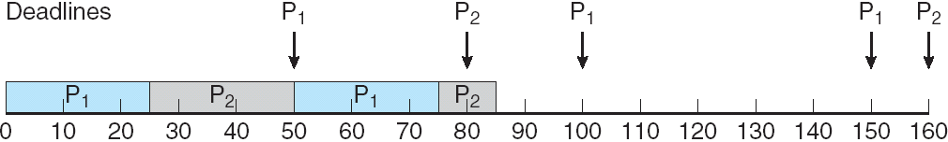
Missed Deadlines with Rate Monotonic Scheduling

Slide 54
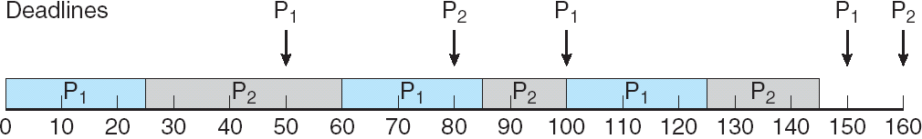
Earliest Deadline First Scheduling (EDF)
Same as Deadline Monotonic
Priorities are assigned according to deadlines:
the earlier the deadline, the higher the priority;
the later the deadline, the lower the priority
Notes:
Preemptive version of rt sjf

Slide 55
Proportional Share Scheduling
T shares are allocated among all processes in the system
An application receives N shares where N < T
This ensures each application will receive N / T of the total processor time
Uses a Lottery Scheduler but gives more tickets to higher priority processes.

Slide 56
POSIX Real-Time Scheduling
The POSIX.1b standard
API provides functions for managing real-time threads
Defines two scheduling classes for real-time threads:
SCHED_FIFO - threads are scheduled using a FCFS strategy with a FIFO queue. There is no time-slicing for threads of equal priority
SCHED_RR - similar to SCHED_FIFO except time-slicing occurs for threads of equal priority
Defines two functions for getting and setting scheduling policy:
pthread_attr_getschedpolicy(pthread_attr_t *attr, int *policy)
pthread_attr_setschedpolicy(pthread_attr_t *attr, int policy)

Slide 57
POSIX Real-Time Scheduling API
#include <pthread.h>
#include <stdio.h>
#define NUM_THREADS 5
int main(int argc, char *argv[])
{
int i, policy;
pthread_t_tid[NUM_THREADS];
pthread_attr_t attr;
/* get the default attributes */
pthread_attr_init(&attr);
/* get the current scheduling policy */
if (pthread_attr_getschedpolicy(&attr, &policy) != 0)
fprintf(stderr, "Unable to get policy.\n");
else {
if (policy == SCHED_OTHER) printf("SCHED_OTHER\n");
else if (policy == SCHED_RR) printf("SCHED_RR\n");
else if (policy == SCHED_FIFO) printf("SCHED_FIFO\n");
}

Slide 58
POSIX Real-Time Scheduling API (Cont.)
/* set the scheduling policy - FIFO, RR, or OTHER */
if (pthread_attr_setschedpolicy(&attr, SCHED_FIFO) != 0)
fprintf(stderr, "Unable to set policy.\n");
/* create the threads */
for (i = 0; i < NUM_THREADS; i++)
pthread_create(&tid[i],&attr,runner,NULL);
/* now join on each thread */
for (i = 0; i < NUM_THREADS; i++)
pthread_join(tid[i], NULL);
}
/* Each thread will begin control in this function */
void *runner(void *param)
{
/* do some work ... */
pthread_exit(0);
}

Slide 59
Operating System Examples
Linux scheduling
Windows scheduling
Android scheduling

Slide 60
Linux Scheduling Through Version 2.5
Prior to kernel version 2.5, ran variation of standard UNIX scheduling algorithm
Version 2.5 moved to constant order O(1) scheduling time
  Preemptive, priority based
  Two priority ranges: time-sharing and real-time
  Real-time range from 0 to 99 and nice value from 100 to 140
  Map into global priority with numerically lower values indicating higher priority
  Higher priority gets larger quantum
  Task run-able as long as time left in time slice (active) even blocked
  If no time left (expired), not run-able until all other tasks use their slices
  All run-able tasks tracked in per-CPU runqueue data structure
    Two priority arrays (active, expired)
    Tasks indexed by priority
    When no more active, arrays are exchanged
  Worked well, but poor response times for interactive processes

Slide 61
Linux Scheduling in Version 2.6.23 +
Completely Fair Scheduler (CFS)
Scheduling classes
  Each has specific priority
  Scheduler picks highest priority task in highest scheduling class
  Rather than quantum based on fixed time allotments, based on proportion of CPU time
  2 scheduling classes included, others can be added
    default
    real-time
Quantum calculated based on nice value from -20 to +19
  Lower value is higher priority
  Calculates target latency – interval of time during which task should run at least once
  Target latency can increase if say number of active tasks increases
CFS scheduler maintains per task virtual run time in variable vruntime
  Associated with decay factor based on priority of task – lower priority is higher decay rate
  Normal default priority yields virtual run time = actual run time
To decide next task to run, scheduler picks task with lowest virtual run time

Slide 62
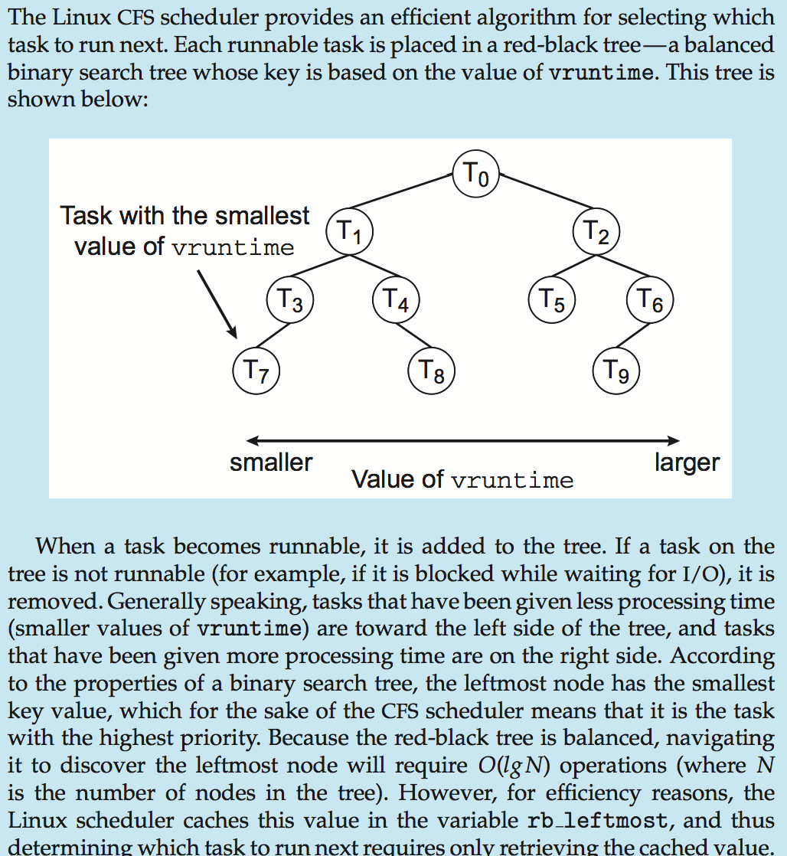
CFS Performance

Slide 63
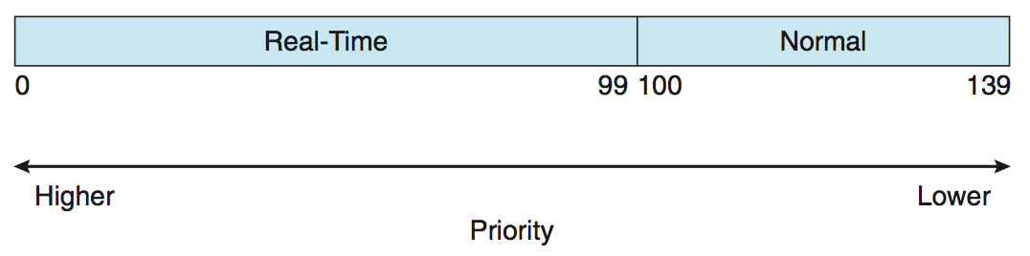
Linux Scheduling (Cont.)
Real-time scheduling according to POSIX.1b
  Real-time tasks have static priorities
Real-time plus normal map into global priority scheme
Nice value of -20 maps to global priority 100
Nice value of +19 maps to priority 139

Slide 64
Windows Scheduling
Windows uses priority-based preemptive scheduling
Highest-priority thread runs next
Dispatcher is scheduler
Thread runs until (1) blocks, (2) uses time slice, (3) preempted by higher-priority thread
Real-time threads can preempt non-real-time
32-level priority scheme
Variable class is 1-15, real-time class is 16-31
Priority 0 is memory-management thread
Queue for each priority
If no run-able thread, runs idle thread

Slide 65
Windows Priority Classes
Win32 API identifies several priority classes to which a process can belong
  REALTIME_PRIORITY_CLASS, HIGH_PRIORITY_CLASS, ABOVE_NORMAL_PRIORITY_CLASS,NORMAL_PRIORITY_CLASS, BELOW_NORMAL_PRIORITY_CLASS, IDLE_PRIORITY_CLASS
  All are variable except REALTIME
A thread within a given priority class has a relative priority
  TIME_CRITICAL, HIGHEST, ABOVE_NORMAL, NORMAL, BELOW_NORMAL, LOWEST, IDLE
Priority class and relative priority combine to give numeric priority
Base priority is NORMAL within the class
If quantum expires, priority lowered, but never below base

Slide 66
Windows Priority Classes (Cont.)
If wait occurs, priority boosted depending on what was waited for
Foreground window given 3x priority boost
Windows 7 added user-mode scheduling (UMS)
  Applications create and manage threads independent of kernel
  For large number of threads, much more efficient
  UMS schedulers come from programming language libraries like C++ Concurrent Runtime (ConcRT) framework

Slide 67
Windows Priorities

Slide 68
Android Scheduling
Android uses a Linux kernel at its core which is a preemptive kernel.
  preemptive scheduling vs cooperative scheduling where processes voluntarily give up resources.
The Task Scheduler is responsible for distributing CPUs among a large number of running tasks.
Task scheduler is triggered at a hard-coded, constant interval, the scheduling interval. This is usually every 10 milliseconds on Android devices.
Since version 2.6.23, Linux kernel uses a highly sophisticated task scheduler, the Completely Fair Scheduler (CFS)
Complex scheduler that only a handful of developers can contribute code.

Slide 69
Tweaking the CFS Scheduler
:
su
Listing Parameters and their current values in a terminal app
  sysctl –a
To get only the task scheduler-related parameters, we could give the following command:
  sysctl –a | grep sched
We can change a parameter using a command in the form
  sysctl –w parameter=value
Keep in mind that changes do not survive a reboot. You can use an init.d script to apply any needed changes at boot time.
Requires root privileges. You can get root privileges in a Terminal App by giving the following command(s):
  su
  sudo

Slide 70
Tunable Kernel Parameters
kernel.sched_min_granularity_ns
  Processor-bound tasks are guaranteed to run for this minimum time before they are preempted. [Quantum or Timeslice]
  Generally, increasing this value will increase a system’s throughput. On the other hand, values too high might reduce device responsiveness.
kernel.sched_latency_ns
  All of the tasks on the CFS’s run queue are guaranteed to be scheduled at least once within this period.
kernel.sched_tunable_scaling
  This controls whether the scheduler can automatically adjust sched_latency_ns, based on number of online CPUs. Possible values are 0 (do not adjust) , 1 (logarithmic adjustment), and 2 (linear adjustment).

Slide 71
Tunable Kernel Parameters
kernel.sched_wakeup_granularity_ns
  A sleeping task that wakes up after an event will run for at least the amount of time defined by this parameter. An example is a process waiting for data to arrive from a sensor.
  Why would this be an independent parameter?
kernel.sched_child_runs_first
  This parameter defines whether a freshly forked child runs before the parent continues execution (for example a messaging App that starts a background message sync service).
  sysctl -w kernel.sched_child_runs_first=1

Slide 72
Gaming Parameter
Giving them higher run time on the CPU might help reduce hangs and sound artifacts.
Most games typically run several code execution threads in the background. Letting these threads run as soon as possible might be beneficial.
Tunable scaling is set to off, to make sure kernel.scheduler_latency_ns remains constant.
  kernel.sched_min_granularity_ns=6000000
  kernel.sched_latency_ns=20000000
  kernel.sched_wakeup_granularity_ns=10000000
  kernel.sched_child_runs_first=1
  kernel.sched_tunable_scaling=0

Slide 73
Device Responsiveness
High device responsiveness generally needs low scheduling latencies. We can help keep latencies low by reducing the tasks minimum run time.
  kernel.sched_min_granularity_ns=1000000
  kernel.sched_wakeup_granularity_ns=2000000
  kernel.sched_child_runs_first=1
  kernel.sched_tunable_scaling=1 or kernel.sched_tunable_scaling=2
(results differ between devices and workloads)

Slide 74
Low Battery Consumption
Task Scheduler can greatly affect battery consumption.
A high rate of task swapping on the CPU will introduce some scheduler-related workload on the system. This might increase battery consumption.
However, a very low rate of task swapping (very high minimum granularity and/or latency values) will severely decrease responsiveness.
Best balance is somewhere in the middle4
  kernel.sched_min_granularity_ns=2000000
  kernel.sched_latency_ns=15000000
  kernel.sched_wakeup_granularity_ns=10000000
  kernel.sched_child_runs_first=0
  kernel.sched_tunable_scaling=0

Slide 75
Gaming Tweaks
kernel.sched_min_granularity_ns=6000000
kernel.sched_latency_ns=20000000
kernel.sched_wakeup_granularity_ns=10000000
kernel.sched_child_runs_first=1
kernel.sched_tunable_scaling=0

Slide 76
PTHREAD Scope
Many:1 (M:1) model, only PTHREAD_SCOPE_PROCESS is supported because scheduling must take place on a process level.
  The system schedules on a process level. Competition happens only between threads in a single process.
1:1 model, only PTHREAD_SCOPE_SYSTEM is supported because all threads compete regardless of process.
  Threads are scheduled by the system. Competition is system-wide
Many:Many (M:N) model, user threads can have either system or process contention scope. This is also called mixed scope.
  Threads can be scheduled by the system to compete only within a process or with all threads system-wide.

Slide 77
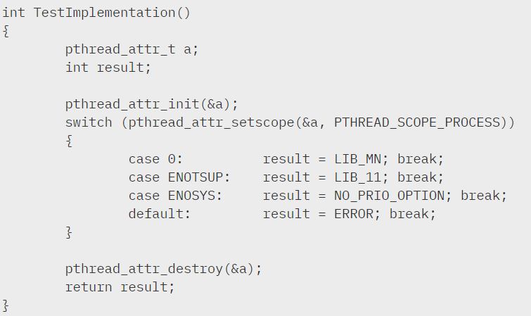
Test Thread Scheduling Scope

Slide 78
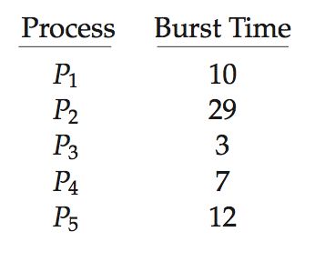
Algorithm Evaluation
How to select CPU-scheduling algorithm for an OS?
Determine criteria, then evaluate algorithms
Deterministic modeling
  Type of analytic evaluation
  Takes a particular predetermined workload and defines the performance of each algorithm for that workload
Consider 5 processes arriving at time 0:

Slide 79
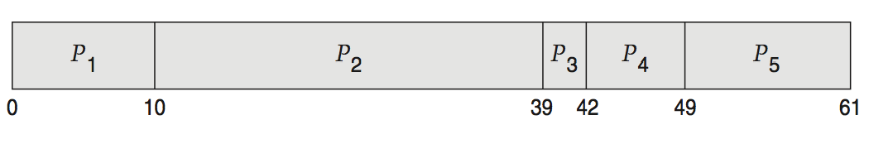
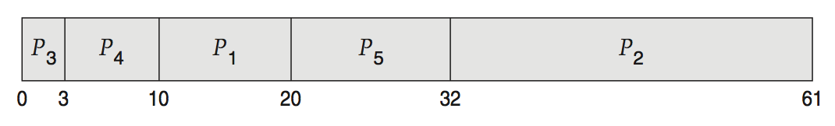
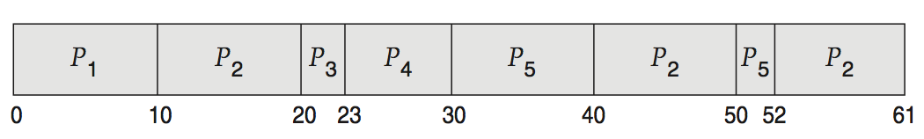
Deterministic Evaluation
For each algorithm, calculate minimum average waiting time
Simple and fast, but requires exact numbers for input, applies only to those inputs
  FCFS is 28ms:
  Non-preemptive SJF is 13ms:
  RR is 23ms:

Slide 80
Queueing Models
Describes the arrival of processes, and CPU and I/O bursts probabilistically
  Commonly exponential, and described by mean
  Computes average throughput, utilization, waiting time, etc
Computer system described as network of servers, each with queue of waiting processes
  Knowing arrival rates and service rates
  Computes utilization, average queue length, average wait time, etc

Slide 81
Little’s Formula
n = average queue length
W = average waiting time in queue
λ = average arrival rate into queue
Little’s law – in steady state, processes leaving queue must equal processes arriving, thus:
n = λ x W
  Valid for any scheduling algorithm and arrival distribution
For example, if on average 7 processes arrive per second, and normally 14 processes in queue, then average wait time per process = 2 seconds
  14 = 7 * W = 14/7 = 2

Slide 82
Little’s Formula from his Paper
Caroline is a wine buff and bon vivant.
She likes to stop and browse wines at her favorite wine shop, Transcendental Wines.
Occasionally, she buys a few bottles to add to her collection.
She and her partner dine out frequently, but when they eat at home, they share a bottle from the cellar.
The wine rack holds up to 240 bottles, but is never full. It is usually about 2/3rds full or about 160 bottles on average.
One day, she reads an article that wines improve with age and wonders how long she has been keeping her wine.
She estimates that she buys about 8 bottles per month.
How can she calculate the average age of her bottles?

Slide 83
Little’s Law
A “queuing system” consists of discrete objects called “items” that “arrive” at some “rate“ to the system
Let’s take Caroline’s wine cellar as the system.
Little’s Law states that under steady state conditions, the average number of items in a queuing system equals the average rate at which items arrive multiplied by the average time that an item spends in the system:
  n = average number of items in the queuing system
  W = average waiting time in the system for an item
  λ = average number of items arriving per unit time
  n = λW
To calculate the average time an “item” is in the system.
  n = 2/3*240 = 160 λ = 12*8 = 96 bottles/year
  W = 160/96 = 1.67 years (20 months).

Slide 84
Simulations
Queueing models limited
Simulations more accurate (benchmarking)
  Programmed model of computer system
  Clock is a variable
  Gather statistics indicating algorithm performance
  Data to drive simulation gathered via
    Random number generator according to probabilities
    Distributions defined mathematically or empirically
    Trace tapes record sequences of real events in real systems

Slide 85
Evaluation of CPU Schedulers by Simulation

Slide 86
Implementation
Even simulations have limited accuracy
Just implement new scheduler and test in real systems
  High cost, high risk
  Environments vary
Most flexible schedulers can be modified per-site or per-system
Or APIs to modify priorities
But again environments vary

Slide 87
End of Chapter 6

