Slide 1
Operating Systems
CISC 3595

Slide 2
Operating Systems
Instructor: Julie Harazduk, jharazduk@fordham.edu, 914-432-2768
Course dates: Jan 20 – Dec 10
Course Times: M/T 11:30-12:45pm Section R01, JMH330
Personal Zoom: https://fordham.zoom.us/j/2382029517
Office Hours: Tue/Fri 11:30-12:45 & Wed 11am, Thu 1 by appt
Text: Operating Systems Concepts, Silberschatz, Galvin & Gagne, 10 Ed., Wiley 2018; Print ISBN: 978-1-119-32091-3, eText
Supplemental Course Website: https://storm.cis.fordham.edu/harazduk/OS, https://storm.cis.fordham.edu/harazduk/cs3595

Slide 3
Schedule
Date Topics to be covered
WK1 OS definition, responsibilities Chapter 1, Chapter 2
Assignment 1.
WK2 OS Structures, Processes Chapter 2, Chapter 3
WK3 Processes, Interprocess Communication Chapter 3
Assignment 1 due. Assignment 2.
WK4 Threads Chapter 4
WK5 CPU Scheduling Chapter 6
Assignment 2 due, Assignment 3
WK6 Process Synchronization Chapter 5
WK7 Review, Midterm Chapters 1-5
Assignment 3 due.
WK8 More Process Synchronization Chapter 6-7
Assignment 4.

Slide 4
Schedule
WK09 Deadlock Chapter 8
WK10 File System interface Chapter 13
WK10 File System implementation Chapter 14
Assignment 4 due. Assignment 5, Project Assigned
WK11 Memory management swapping, paging Chapter 9
Segmentation
WK12 Virtual memory, demand paging Chapter 10
Assignment 5 Due. Assignment 6 .
WK13 Review,
Assignment 6 due. Project Due TBD.
05/7 Extra Review Class

Slide 5
Grading
5-6 Assignments (30%), 2-4 participation
3-4 Programming Projects (20%)
1 Team Project (10%)
1 Midterm (20%),
1 Final (20%).
Participation exercises (like extra credit, ¼ - ½ of regular assignment points for doing them).

Slide 6
Operating Systems
An Human Perspective

Slide 7
How do Humans Manage many tasks?

Slide 8
Humans manage tasks
Using To Do lists
Using Calendars
Using Apps that…
Remind us
Keep lists
Schedule activities

Slide 9
Many Humans Try to Multitask

Slide 10
Humans Multitasking
Humans can only keep 1-2 maybe 3 thoughts in their brains at once.
We are single minded
We have limited cognitive capacity
The average teenager believes they can follow 6 forms of media at once.
Not really at once, they juggle them
Not really at once, they switch back and forth

Slide 11
How Humans multitask
Humans don’t notice the switching because it’s “papered over”
Creates a seamless experience of consciousness
Humans reconfigure their brains every time they switch subjects
Moment to moment, task to task
Comes with a cost
Humans have to remember specifics about the task once switched, which takes time

Slide 12
How are Humans and Computers Alike?

Slide 13
How are Humans like Computers?
Humans can multitask and so can computers
Humans have to juggle when switching from one task to another, so do computers.
Humans have to remember specifics about the task to pick up where they left off.
Humans keep notes to remind them,
Humans use outside resources to help them schedule tasks

Slide 14
Humans and Computers differ
Computers can be reconfigured to add resources (humans?)
more than one brain
more memory
faster memory
Computers can run software such as Operating Systems to help manage the resources

Slide 15
Motivating Questions?
What is a computing system? What are the components?
How do we access the components of a computing system? (10,000 ft view)
How do we make sure that the components are used well?
What do we mean by used well? Depends on Perspective.
How is the hardware organized to allow us to use it well?
How does the operating system find out that we have needs? That computing components have needs?
What are the different areas of responsibility given to the operating system?
Notes:
Computing system is hardware, operating system, systems and applications programs and users.
We access components through the interface which is often considered part of the OS.
We need an operating system to make sure components are used well, to allocate resources and to provide protection and security
The hardware devices sit on a common bus with shared memory and functions independently of each other to work in parallel.
Interrupts, traps and exceptions are used to tell the operating system that we and devices have needs.
See slides for different areas of responsibilities.

Slide 16
What is An ‘Operating System’?
A program that acts as an intermediary between a user of a computer and the computer hardware.
Makes the computer more usable by managing the resources of the system.
Operating system goals:
Execute programs that make solving problems easier.
Make the computer system more convenient to use.
Use the computer hardware in an efficient manner.

Slide 17
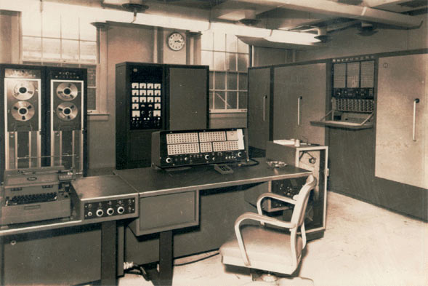
History of Operating Systems
Early computers had no special OS program – you programmed memory directly and toggled a ‘go’ switch.
Burroughs 205 circa 1960

Slide 18
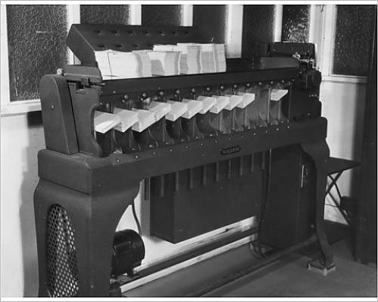
Hollerith Cards

Slide 19
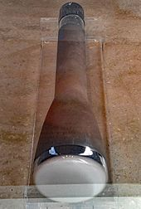
Stored Program Computers
Victoria University of Manchester
1948 Manchester Mark 1 was one of the earliest stored program computers
Made use of the Williams Tube (below)
an early form of computer memory based on a standard cathode ray tube (CRT)
Previously, programming involved
rewiring, or via plugs & patch panels.
- Based on von Neuman architecture

Slide 20
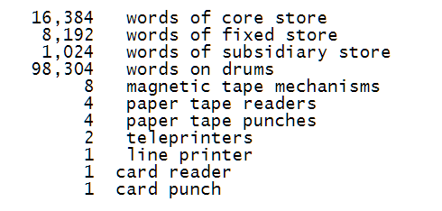
Early Operating System
Atlas Supervisor managed processing resources for the Manchester University's Atlas Computer.
Considered the first Operating System:
Implemented multitasking
Implemented virtual memory management

Slide 21
The Atlas Supervisor
Called directly from programs via extracode instructions that invoke Supervisor Extracode Routines. These did things like…
Request for transfer from or to a peripheral
Monitoring overflow conditions
Called from peripherals needing attention via interrupts
E.g. Completed a block read/write from core

Slide 22
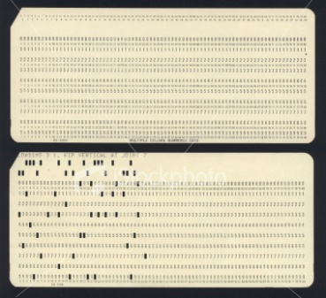
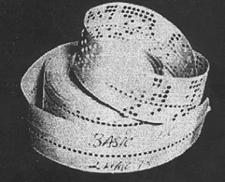
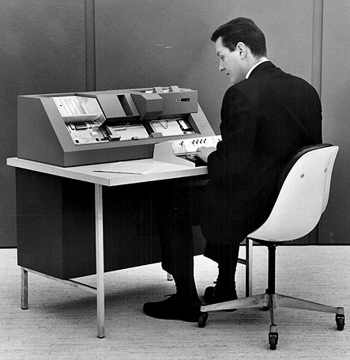
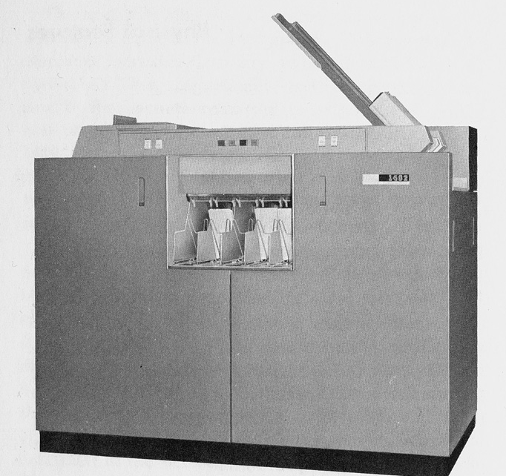
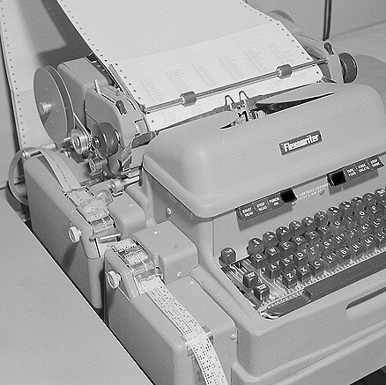
History of Operating Systems
Later computers used card readers or tape readers, and a ‘library’ could be stacked along with a user program, allowing more sophisticated input and output

Slide 23
Computer Punch Cards

Slide 24
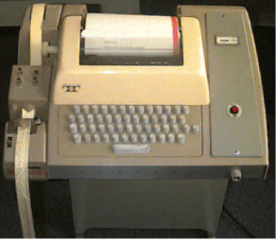
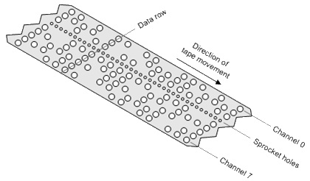
Paper Tape Reader

Slide 25
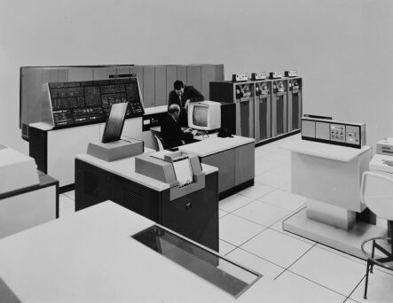
History of Operating Systems
Early commercial computers came with a vendor specific variety of OS like software.
The IBM 360 was the first to standardize across multiple computers, OS/360.
System 360/195, circa 1970
(Mainframe computer)

Slide 26
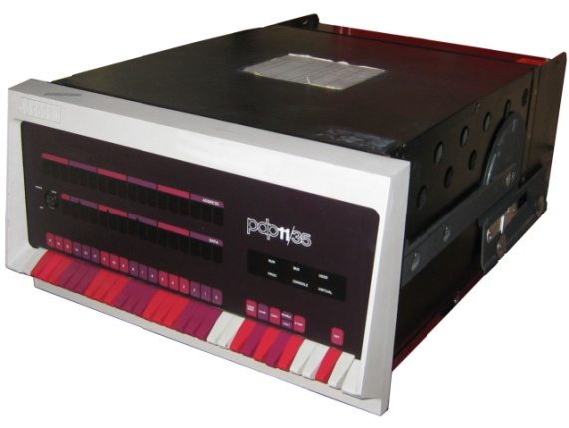
History of Operating Systems
Late 1960’s, IBM/MIT/GE developed MULTICS for the GE-645 computer.
Ken Thompson and Dennis Ritchie go on to build a more efficient version for the DEC PDP-7 then PDP-11, called UNICS and then UNIX. Source code is available
(at first).
DEC PDP 11/35 circa 1970
(Minicomputer)

Slide 27
Multics and Unix
Tom van Vleck tells of a ACM SIGOPS conference in Elmsford, NY in 1973, Ken and Dennis gave a talk there, presenting Unix…
“Several of us Multicians went to the conference, and sat with the Bell Labs ex-Multicians and applauded the paper… [that] won the best paper award.”
At MIT, Tom organized an MIT PDP-11 users' group and encouraged them to look into Unix and invited Dennis Ritchie to talk to them.
At lunch, Tom remarked to Dennis, “…easily half the code I was writing in Multics was error recovery code.
He said, "We left all that stuff out. If there's an error, we have this routine called panic, and when it is called, the machine crashes, and you holler down the hall, 'Hey, reboot it.'"

Slide 28
History of Operating Systems
The development of microcomputers made inexpensive computing available for the small business and hobbyist
Apple DOS for the Apple II (1978)
MS-DOS for the IBM-PC (1981)
MacOS (1984)
Windows (1985; but 1992 for v3)
……..

Slide 29
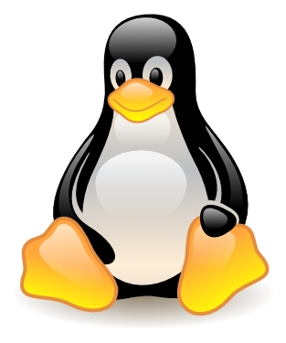
History of Operating Systems
Linux, Linus Torvalds, 1991, since UNIX had become proprietary
GNU/Linux (Richard Stallman)
Freely distributable, UNIX like system

Slide 30
End of Introduction
- Remember to sign in before you go: name, email address, phone number!
Do you have an account on storm?
Can you access the website on storm?
http://storm.cis.Fordham.edu/harazduk/cs3595 http://storm.cis.fordham.edu/harazduk/OS
WELCOME BACK!
SEE YOU NEXT CLASS

