Slide 1
Dimensionality reduction
CISC 5800
Professor Daniel Leeds

Slide 2
The benefits of extra dimensions
Finds existing complex separations between classes

Slide 3
The risks of too-many dimensions
High dimensions with kernels over-fit the outlier data
Two dimensions ignore the outlier data

Slide 4
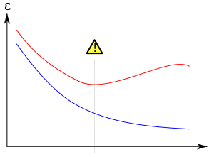
Training vs. testing
Training: learn parameters from set of data in each class
Testing: measure how often classifier correctly identifies new data
More training reduces classifier error $ε$
More gradient ascent steps
More learned feature
Too much training causes worse testing error – overfitting
error
training epochs

Slide 5
Goal: High Performance, Few Parameters
“Information criterion”: performance/parameter trade-off
Variables to consider:
L likelihood of train data after learning
k number of parameters (e.g., number of features)
m number of points of training data
Popular information criteria:
Akaike information criterion AIC: log(L) - k
Bayesian information criterion BIC: log(L) - 0.5 k log(m)

Slide 6
Goal: |Data| > |Parameters|
Need more data points than parameters
“Probably approximately correct” (PAC) learning
Aim: $P\left({error}_{true}<ε\right)>1−δ$
Number of data points : $m>\frac{1}{ε}\left(\log\left|H\right|−\log{δ}\right)$
|H| - possible combinations of parameter values

Slide 7
Decreasing parameters
Force parameter values to 0
L1 regularization
Support Vector selection
Feature selection/removal
Consolidate feature space
Component analysis

Slide 8
Feature removal
Start with feature set: F={x₁, …, x_{k}}
Find classifier performance with set F: perform(F)
Loop
Find classifier performance for removing feature x₁, x₂, …, x_{k}: argmax_{i} perform(F-x₁)
Remove feature that causes least decrease in performance: F=F-x_{i}
Repeat, using AIC or BIC as termination criterion
AIC: log(L) - k
BIC: log(L) - 0.5 k log(m)

Slide 9
AIC testing: log(L)-k
Features | k (num features) | L (likelihood) | AIC
F | 40 | 0.1 | -42.3
F-{x₃} | 39 | 0.03 | -41.5
F-{x₃,x₂₄} | 38 | 0.005 | -41.3
F-{x₃,x₂₄,x₃₂} | 37 | 0.001 | -40.9
F-{x₃,x₂₄,x₃₂,x₁₅} | 36 | 0.0001 | -41.2

Slide 10
Feature selection
Find classifier performance for just set of 1 feature: argmax_{i} perform({x_{i}})
Add feature with highest performance: F={x_{i}}
Loop
Find classifier performance for adding one new feature: argmax_{i} perform(F+{x_{i}})
Add to F feature with highest performance increase: F=F+{x_{i}}
Repeat, using AIC or BIC as termination criterion
AIC: log(L) - k
BIC: log(L) - 0.5 k log(m)

Slide 11
Defining new feature axes
Identify a common trend
$$u_{1}=\left[\begin{matrix}0.91 \\ 0.45\end{matrix}\right]$$
Map data onto new dimension u₁

Slide 12

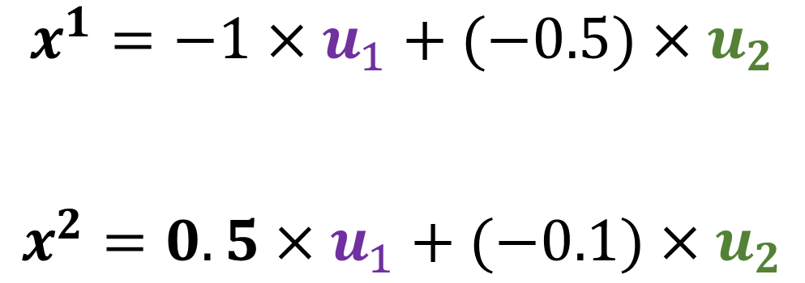

Defining data points with new axes
$$x^{2}$$
$$x^{1}=−1×u_{1}+(−0.5)×u_{2}$$
$$x^{2}=0.5×u_{1}+(−0.1)×u_{2}$$
$$x^{1}$$

Slide 13
Component analysis
Each data point x^{i} in D can be reconstructed as sum of components u:
$x^{i}=\sum_{q=1}^{T}{z_{q}^{i}u_{q}}$
$z_{q}^{i}$ is weight on q^{th} component to reconstruct data point x^{i}

Slide 14
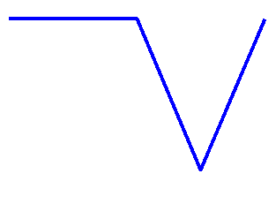
Component analysis: examples
Components
Data
2
-1
0

Slide 15
Component analysis: examples
“Eigenfaces” – learned from set of face images
u: nine components
x^{i}: data reconstructed

Slide 16

Types of component analysis
$$x^{i}=\sum_{q=1}^{T}{z_{q}^{i}u_{q}}$$
Learn new axes from data sets: common “components”
Principal component analysis (PCA):
Best reconstruction of each data point x^{i} with first t components
Each component perpendicular to all others: ${\left(u_{i}\right)}^{T}u_{j}=0 ∀i≠j$
Independent component analysis (ICA):
Minimize number of components to describe each $x_{}^{i}$
Can focus on different components for different $x_{}^{i}$
Non-negative matrix factorization (NMF):
All data x^{i} non-negative
All components and weights non-negative $u_{j}^{}≥0, z_{q}^{i}≥0 ∀i,q$

Slide 17
Principle component analysis (PCA)
Start with
D = {x¹,…,x^{n}} , data 0-center
Component index: q=1
Loop
Find direction of highest variance: $u_{q}$
Ensure $|u_{q}|=1$
Remove u_{q} from data: $D=\left\{x^{1}−z_{q}^{1} u_{q},⋯,x^{n}−z_{q}^{n}u_{q}\right\}$
We require ${\left(u_{i}\right)}^{T}u_{j}=0 ∀i≠j$
Thus, we guarantee $z_{j}^{i}=u_{j}^{T}x^{i}$

Slide 18
Independent component analysis (ICA)
Start with
D = {x¹,…,x^{n}} , data 0-center
Find group(s) for each data point
Find direction for each group u_{q}
Ensure $|u_{q}|=1$
We do not require${\left(u_{i}\right)}^{T}u_{j}=0 ∀i≠j$
Thus, we cannot guarantee $z_{j}^{i}=u_{j}^{T}x^{i}$

Slide 19
Evaluating components
Components learned in order of descriptive power
Compute reconstruction error for all data by using first v components:
$error=\sum_{i}{\left(\sum_{j}{{\left(x_{j}^{i}−\sum_{q=1}^{v}{a_{q}^{i}u_{q,j}}\right)}^{2}}\right)}$

