Slide 1
Follow-ups to HMMs Graphical Models Semi-supervised learning
CISC 5800
Professor Daniel Leeds

Slide 2
Approaches to learning/classification
For classification, find highest probability class given features
P(x₁,…,x_{n}|y=?)
Approaches:
Learn/use function(s) for probability
P(rumble|Y=dog)=$N(μ_{dog},σ_{dog})$
Learn/use probability look-up table for each combination of features:
letter₁ | P(letter₁ | word=“duck”)
“a” | 0.001
“b” | 0.001
“c” | 0.001
“d” | 0.950

Slide 3
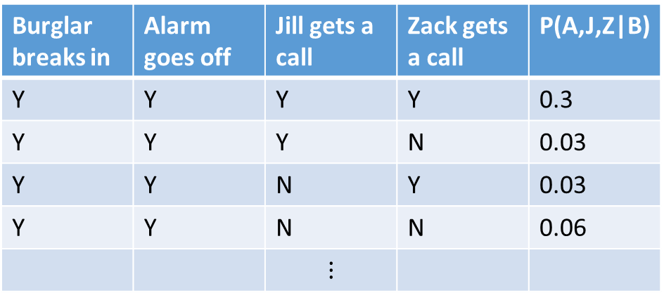
Joint probability over N features
Problem with learning table with N features:
If all dependent, exponential number of model parameters
Naïve Bayes – all independent
Linear number of model parameters
What if not all features are independent?
Burglar breaks in | Alarm goes off | Jill gets a call | Zack gets a call | P(A,J,Z|B)
Y | Y | Y | Y | 0.3
Y | Y | Y | N | 0.03
Y | Y | N | Y | 0.03
Y | Y | N | N | 0.06
 |  | $$⋮$$

Slide 4
Bayes nets: conditional independence
B – Burglar
E – Earthquake
A – Alarm goes off
J – Jill is called
Z – Zack is called
In Naïve Bayes: P(x₁,x₂,x₃|y) = P(x₁|y)P(x₂|y)P(x₃|y)
In Bayes nets, some variables depend on other variables:
P(B, E, A, J, Z) = P(B) P(E) P(A|B,E) P(J|A) P(Z|A)
In general for Bayes nets:
P(x₁,…,x_{n}) = $\prod_{i}{P(x_{i}|Pa(x_{i}))}$
Pa(x_{i}) are the “parents” of x_{i} – the variables x_{i} is conditioned on
B
E
A
J
Z

Slide 5
Example evaluation of Bayes nets
B – Burglar
E – Earthquake
A – Alarm goes off
J – Jill is called
Z – Zack is called
Use joint probabilities to find more probable variable value
Compute P(E=yes|A,J,Z), P(E=no|A,J,Z)
$P\left(E | A,J,Z\right)=\frac{P(E,A,J,Z)}{P(A,J,Z)}=\frac{\sum_{B}{P(E,B,A,J,Z)}}{\sum_{E}{\sum_{B}{P(E,B,A,J,Z)}}}$
$=\frac{\sum_{B}{P\left(E\right)P\left(B\right)P(A|E,B)P(J|A)P(Z|A)}}{\sum_{E}{\sum_{B}{P\left(E\right)P\left(B\right)P(A|E,B)P(J|A)P(Z|A)}}}$
B
E
A
J
Z

Slide 6
Conditional independence
B – Burglar
E – Earthquake
A – Alarm goes off
J – Jill is called
Z – Zack is called
If two variables x_{i} and x_{j} share same “parent,” the x_{i} and x_{j} are independent given that parent
J and Z are independent given A: “$J⊥Z|A$”
B
E
A
J
Z

Slide 7
HMM: a kind-of example of Bayes nets
P(q₁,q₂,q₃,o₁,o₂,o₃) =
q₁
q₂
q₃
o₁
o₂
o₃

Slide 8
Back to Expectation-Maximization
Problem: Uncertain of y^{i} (class), uncertain of $θ^{i}$ (parameters)
Solution: Guess y^{i}, deduce $θ^{i}$, re-compute y^{i}, re-compute $θ^{i}$ … etc. OR: Guess $θ^{i}$, deduce y^{i}, re-compute $θ^{i}$, re-compute y^{i}
Will converge to a solution
E step: Fill in expected values for missing variables
M step: Regular MLE given known and filled-in variables
Also useful when there are holes in your data

Slide 9
Types of learning
Supervised: each training data point has known features and class label
Most examples so far
Unsupervised: each training data point has known features, but no class label
ICA – each component meant to describe subset of data points
Semi-supervised: each train data point has known features, but only some have class labels
Related to expectation maximization

Slide 10
Document classification example
Two classes: {farm, zoo}
5 labeled zoo articles, 5 labeled jungle articles
100 unlabeled training articles
Features: [% bat, % elephant, % monkey, % snake, % lion, %penguin]
E.g., % bat^{i} = #{wordsInArticle^{i}==bat}/#{wordsInArticle^{i}}
Logistic regression classifier

Slide 11
Iterative learning
Learn w with labeled training data
Use classifier to assign labels to originally unlabeled training data
Learn w with known and newly-assigned labels
Use classifier to re-assign labels to originally unlabeled training data
Converges to a stable answer

