Slide 1
Counting
(Enumerative Combinatorics)
X. Zhang, Fordham Univ.
1

Slide 2
Chance of winning ?
What’s the chances of winning New York Mega-million Jackpot
  “just pick 5 numbers from 1 to 56, plus a mega ball number from 1 to 46, then you could win biggest potential Jackpot ever !”
    If your 6-number combination matches winning 6-number combination (5 winning numbers plus the Mega Ball), then you win First prize jackpot.
  There are many possible ways to choose 6-number
  Only one of them is the winning combination…
  If each 6-number combination is equally likely to be the winning combination …
    Then the prob. of winning for any 6-number is 1/X
2

Slide 3
Counting
How many bits are need to represent 26 different letters?
How many different paths are there from a city to another, giving the road map?
3

Slide 4
Counting rule #1: just count it
If you can count directly the number of outcomes, just count them.
For example:
  How many ways are there to select an English letter ?
    26 as there are 26 English letters
  How many three digits integers are there ?
    These are integers that have value ranging from 100 to 999.
    How many integers are there from 100 to 999 ?
      999-100+1=900
4

Slide 5
Example of first rule
How many integers lies within the range of 1 and 782 inclusive ?
  782, we just know this !
How many integers lies within the range of 12 and 782 inclusive ?
  Well, from 1 to 782, there are 782 integers
  Among them, there are 11 number within range from 1 to 11.
  So, we have 782-(12-1)=782-12+1 numbers between 12 and 782
5

Slide 6
Quick Exercise
So the number of integers between two integers, S (smaller number) and L (larger number) is: L-S+1
How many integers are there in the range 123 to 928 inclusive ?
How many ways are there to choose a number within the range of 12 to 23, inclusive ?
6

Slide 7
A little more complex problems
How many possible license plates are available for NY state ?
  3 letters followed by 4 digits (repetition allowed)
How many 5 digits odd numbers if no digits can be repeated ?
How many ways are there to seat 10 guests in a table?
How many possible outcomes are there if draw 2 cards from a deck of cards ?
Key: all above problems ask about # of combinations/arrangements of people/digits/letters/…
7

Slide 8
How to count ?
Count in a systematical way to avoid double-counting or miss counting
Ex: to count num. of students present …
  First count students on first row, second row, …
  First count girls, then count boys
8

Slide 9
How to count (2)?
Count in a systematical way to avoid double-counting or miss counting
Ex: to buy a pair of jeans …
  Styles available: standard fit, loose fit, boot fit and slim fit
  Colors available: blue, black
  How many ways can you select a pair of jeans ?
9

Slide 10
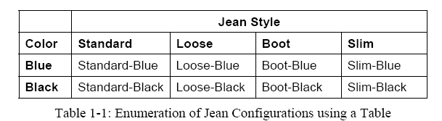
Use Table to organize counting
Fix color first, and vary styles
  Table is a nature solution
What if we can also choose size, Medium, Small or Large?
  3D table ?
10

Slide 11
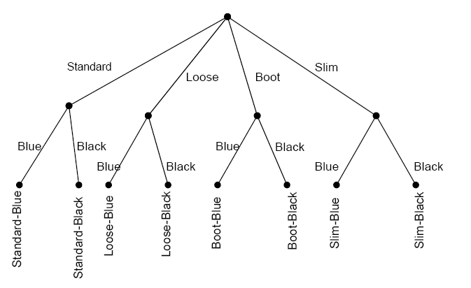
Selection/Decision tree
style
color
color
color
color
Node: a feature/variable
Branch: a possible selection for the feature
Leaf: a configuration/combination
11

Slide 12
Let’s try an example
Enumerate all 3-letter words formed using letters from word “cat”
  assuming each letter is used once.
How would you do that ?
  Choose a letter to put in 1st position, 2nd and 3rd position
12

Slide 13
Exercises
Use a tree to find all possible ways to buy a car
  Color can be any from {Red, Blue, Silver, Black}
  Interior can be either leather or fiber
  Engine can be either 4 cylinder or 6 cylinder
How many different outcomes are there for a “best of 3” tennis match between player A and B?
  Whoever wins 2 games win the match…
13

Slide 14
Terminology
When buying a pair of jean, one can choose style and color
We call style and color features/variables
For each feature, there is a set of possible choices/options
  For “style”, the set of options is {standard, loose, boot, slim}
  For “color”, the set of options is {blue,black}
Each configuration, i.e., standard-blue, is called an outcome/possibility
14

Slide 15
Outline on Counting
Just count it
Organize counting: table, trees
Multiplication rule
Permutation
Combination
Addition rule, Generalized addition rule
Exercises
15

Slide 16
Counting rule #2: multiplication rule
C₁
If we have two features/decisions C₁ and C₂
  C₁ has n₁ possible outcomes/options
  C₂ has n₂ possible outcomes/options
Then total number of outcomes is n₁*n₂
In general, if we have k decisions to make:
  C₁ has n₁ possible options
  …
  C_{k} has n_{k} possible options
  then the total number of outcomes is n₁*n₂*…*n_{k}.
“AND rule”:
  You must make all the decisions…
  i.e., C₁, C₂ , …, C_{k} must all occur
…
n₁
C₂
C₂
C₂
…
n₂
n₂
…
…
16

Slide 17
Jean Example
Problem Statement
  Two decisions to make: C₁=Chossing style, C₂=choosing color
  Options for C₁ are {standard fit, loose fit, boot fit, slim fit}, n₁=4
  Options for C₂ are {black, blue}, n₂=2
To choose a jean, one must choose a style and choose a color
  C₁ and C₂ must both occur, use multiplication rule
So the total # of outcomes is n₁*n₂=4*2=8.
17

Slide 18
Coin flipping
Flip a coin twice and record the outcome (head or tail) for each flip. How many possible outcomes are there ?
Problem statement:
  Two steps for the experiment, C₁= “first flip”, C₂=“second flip”
  Possible outcomes for C₁ is {H, T}, n₁=2
  Possible outcomes for C₂ is {H,T}, n₂=2
  C₁ occurs and C₂ occurs: total # of outcomes is n₁*n₂=4
18

Slide 19
License Plates
Suppose license plates starts with two different letters, followed by 4 letters or numbers (which can be the same). How many possible license plates ?
Steps to choose a license plage:
  Pick two different letters AND pick 4 letters/numbers.
  C₁: Pick a letter
  C₂: Pick a letter different from the first
  C3,C4,C5,C6: Repeat for 4 times: pick a number or letter
Total # of possibilities:
  26*25*36*36*36*36 = 1091750400
Note: the num. of options for a feature/variable might be affected by previous features
19

Slide 20
Exercises:
In a car racing game, you can choose from 4 difficulty level, 3 different terrains, and 5 different cars, how many different ways can you choose to play the game ?
How many ways can you arrange 10 different numbers (i.e., put them in a sequence)?
20

Slide 21
Relation to other topics
It might feel like that we are topics-hopping
  Set, logic, function, relation …
Counting:
  What is being counted ?
    A finite set, i.e., we are evaluate some set’s cardinality when we tackle a counting problem
  How to count ?
    So rules about set cardinality apply !
    Inclusion/exclusion principle
    Power set cardinality
    Cartisian set cardinality
21

Slide 22
Learn new things by reviewing old…
Sets cardinality: number of elements in set
  |AxB| = |A| x |B|
  The number of diff. ways to pair elements in A with elements in B, i.e., |AxB|, equals to |A| x |B|
Example
  A={standard, loose, boot}, the set of styles
  B={blue, black}, the set of colors
  AxB= {(standard, blue), (standard, black), (loose, blue), (loose, black), (boot, blue), (boot, black)}, the set of different jeans
  |AxB|: # of different jeans we can form by choosing from A the style, and from B the color
22

Slide 23
Let’s look at more examples…
23

Slide 24
Seating problem
How many different ways are there to seat 5 children in a row of 5 seats?
  Pick a child to sit on first chair
  Pick a child to sit on second chair
  Pick a child to sit on third chair
  …
    The outcome can be represented as an ordered list: e.g. Alice, Peter, Bob, Cathy, Kim
  By multiplication rule: there are 5*4*3*2*1=120 different ways to sit them.
  Note, “Pick a chair for 1st child” etc. also works
24

Slide 25
Job assignment problem
How many ways to assign 5 diff. jobs to 10 volunteers, assuming each person takes at most one job, and one job assigned to one person ?
  Pick one person to assign to first job: 10 options
  Pick one person to assign to second job: 9 options
  Pick one person to assign to third job: 8 options
  …
  In total, there are 10*9*8*7*6 different ways to go about the job assignments.
25

Slide 26
Permutation
Some counting problems are similar
  How many ways are there to arrange 6 kids in a line ?
  How many ways to assign 5 jobs to 10 volunteers, assuming each person takes at most one job, and one job assigned to one person ?
  How many different poker hands are possible, i.e. drawing five cards from a deck of card where order matters ?
26

Slide 27
Permutation
A permutation of objects is an arrangement where order/position matters.
  Note: “arrangement” implies each object cannot be picked more than once.
  Seating of children
    Positions matters: Alice, Peter, Bob, Cathy, Kim is different from Peter, Bob, Cathy, Kim, Alice
  Job assignment: choose 5 people out of 10 and arrange them (to 5 jobs)
  Select a president, VP and secretary from a club
27

Slide 28

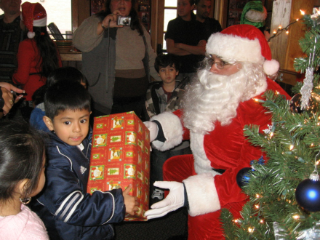
Permutations
Generally, consider choosing r objects out of a total of n objects, and arrange them in r positions.
n objects
(n gifts)
…
1
2
3
r-1
r
r positions (r behaving
Children)
28

Slide 29
Counting Permutations
Let P(n,r) be the number of permutations of r items chosen from a total of n items, where r≤n
  n objects and r positions
    Pick an object to put in 1st position, # of ways:
    Pick an object to put in 2nd position, # of ways:
    Pick an object to put in 3rd position, # of ways:
    …
    Pick an object to put in r-th position, # of ways:
    By multiplication rule,
n
n-1
n-2
n-(r-1)
29

Slide 30
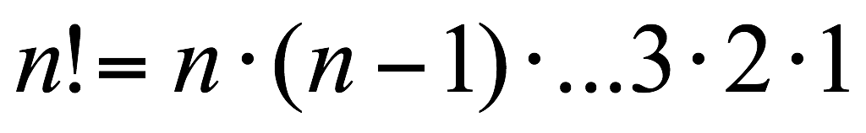
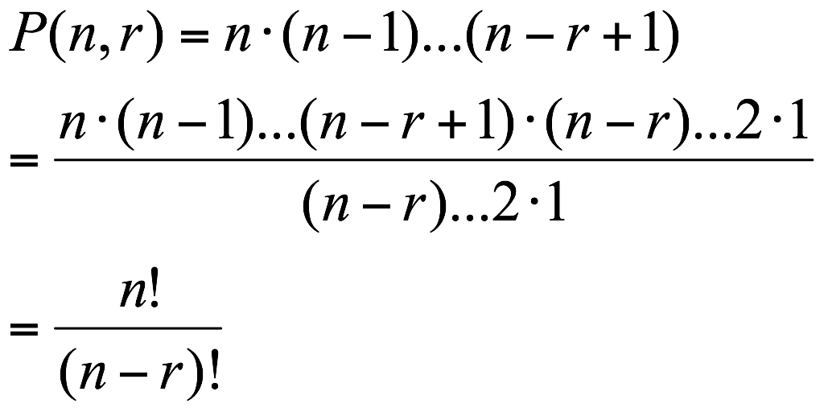
Note: factorial
n! stands for “n factorial”, where n is positive integers, is defined as
Now
30

Slide 31
Examples
How many five letter words can we form using distinct letters from set {a,b,c,d,e,f,g,h} ?
  It’s a permutation problem, as the order matters and each object (letter) can be used at most once.
  P(8,5)
31

Slide 32
Examples
How many ways can one select a president, vice president and a secretary from a class of 28 people, assuming each student takes at most one position ?
  A permutation of 3 people selecting from 28 people: P(28,3)=28*27*26
32

Slide 33
Exercises
What does P(10,2) stand for ? Calculate P(10,2).
How about P(12,12)?
How many 5 digits numbers are there where no digits are repeated and 0 is not used ?
33

Slide 34
Examples: die rolling
If we roll a six-sided die three times and record results as an ordered list of length 3
  How many possible outcomes are there ?
    6*6*6=216
  How many possible outcomes have different results for each roll ?
    6*5*4
  How many possible outcomes do not contain 1 ?
    5*5*5=125
34

Slide 35

Combinations
Many selection problems do not care about position/order
  from a committee of 3 from a club of 24 people
  Santa select 8 million toys from store
  Buy three different fruits
Combination problem: select r objects from a set of n distinct objects, where order does not matter.
35

Slide 36
Combination formula
C(n,r): number of combinations of r objects chosen from n distinct objects (n>=r)
  Ex: ways to buy 3 different fruits, choosing from apple, orange, banana, grape, kiwi: C(5,3)
  Ex: ways to form a committee of two people from a group of 24 people: C(24,2)
  Ex: Number of subsets of {1,2,3,4} that has two elements: C(4,2)
Next: derive formula for C(n,r)
36

Slide 37
Deriving Combination formula
How many ways are there to form a committee of 2 for a group of 24 people ?
  Order of selection doesn’t matter
Let’s try to count:
  There are 24 ways to select a first member
  And 23 ways to select the second member
  So there are 24*23=P(24,2) ways to select two peoples in sequence
In above counting, each two people combination is counted twice
  e.g., For combination of Alice and Bob, we counted twice: (Alice, Bob) and (Bob, Alice).
To delete overcounting
  P(24,2)/2
37

Slide 38
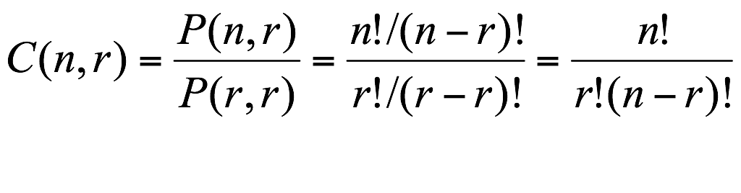
General formula
when selecting r items out of n distinct items
  If order of selection matters, there are P(n,r) ways
  For each combination (set) of r items, they have been counted many times, as they can be selected in different orders:
    For r items, there are P(r,r) different possible selection order
      e.g., {Alice, Bob} can be counted twice: (Alice, Bob) and (Bob, Alice). (if r=2)
    Therefore, each set of r items are counted P(r,r) times.
  The # of combinations is:
38

Slide 39
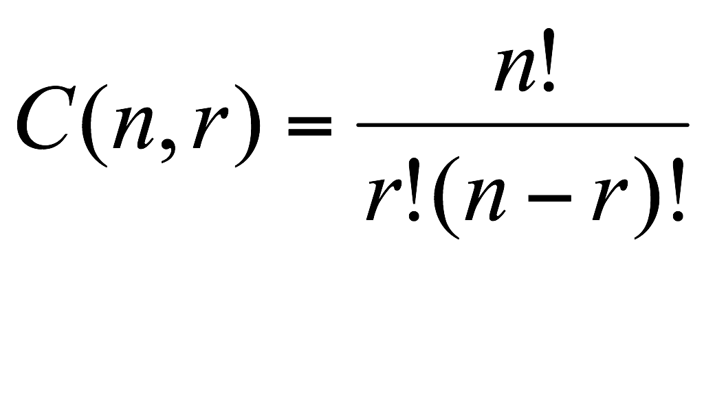
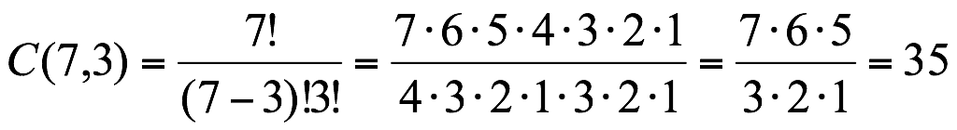
A few exercise with C(n,r)
Calculate C(7,3)
What is C(n,n) ? How about C(n,0)?
Show C(n,r)=C(n,n-r).
39

Slide 40
Committee Forming
How many different committees of size 7 can be formed out of 20-person office ?
  C(20,7)
  Three members (Mary, Sue and Tom) are carpooling. How many committees meet following requirement ?
    All three of them are on committee:
    None of them are on the committee:
C(20-7,4)
C(20-7,7)
40

Slide 41
Outline on Counting
Just count it
Organize counting: table, trees
Multiplication rule
Permutation
Combination
Addition rule, Generalized addition rule
Exercises
41

Slide 42
Set Related Example
How many subsets of {1,2,3,4,5,6} have 3 elements ?
  C(6,3)
How many subsets of {1,2,3,4,5,6} have an odd number of elements ?
  Either the subset has 1, or 3, or 5 elements.
  C(6,1)+C(6,3)+C(6,5)
42

Slide 43


Knapsack Problem
There are n objects
  The i-th object has weight w_{i}, and value v_{i}
You want to choose objects to take away, how many possible ways are possible ?
  2*2*…*2=2^{n}
  C(n,0)+C(n,1)+…+C(n,n)
Knapsack problem:
  You can only carry W pound stuff
  What shall you choose to maximize the value ?
  Classical NP hard problem
43

Slide 44
Addition Rule
If the events/outcomes that we count can be decomposed into k cases C₁, C₂, …, C_{k}, each having n₁, n₂, … n_{k}, possible outcomes respectively,
  (either C₁ occurs, or C₂ occurs, or C₃ occurs, …. or C_{k} occurs)
Then the total number of outcomes is n₁+n₂+…+n_{k} .
C₁
C₃
C₂
C₄
44

Slide 45
Key to Addition Rule
Decompose what you are counting into simpler, easier to count scenarios, C₁, C₂, …, C_{k}
Count each scenario separately, n₁,n₂,…,n_{k}
Add the number together, n₁+n₂+…+n_{k}
C₁
C₃
C₂
C₄
45

Slide 46
Examples: die rolling
If we roll a six-sided die three times and record results as an ordered list of length 3
  How many of the possible outcomes contain exactly one 1, e.g. 1,3,2 or, 3,2,1, or 5,1,3 ?
    Let’s try multiplication rule by analyzing what kind of outcomes satisfy this ?
    First roll: 6 possible outcomes
    Second roll: # of outcomes ?
      If first roll is 1, second roll can be any number but 1
      If first roll is not 1, second roll can be any number
    Third roll: # of outcomes ??
46

Slide 47
Examples: die rolling
If we roll a six-sided die three times and record results as an ordered list of length 3
  how many of the possible outcomes contain exactly one 1 ?
  Let’s try to consider three different possibilities:
    The only 1 appears in first roll, C₁
    The only1 appears in second roll, C₂
    The only1 appears in third roll, C₃
  We get exactly one 1 if C₁ occurs, or C₂ occurs, or C₃ occurs
  Result: 5*5+5*5+5*5=75
47

Slide 48
Examples: die rolling
If we roll a six-sided die three times, how many of the possible outcomes contain exactly one 1 ? Let’s try another approach :
  First we select where 1 appears in the list
    3 possible ways
  Then we select outcome for the first of remaining positions
    5 possible ways
  Then we select outcome for the second of remaining positions
    5 possible ways
Result: 3*5*5=75
48

Slide 49
Example: Number counting
How many positive integers less than 1,000 consists only of distinct digits from {1,3,7,9} ?
To make such integers, we either
  Pick a digit from set {1,3,7,9} and get an one-digit integer
  Take 2 digits from set {1,3,7,9} and arrange them to form a two-digit integer
    permutation of length 2 with digits from {1,3,7,9}.
  Take 3 digits from set {1,3,7,9} and arrange them to form a 3-digit integer
    a permutation of length 3 with digits from {1,3,7,9}.
49

Slide 50
Example: Number Counting
Use permutation formula for each scenario (event)
  # of one digit number: P(4,1)=3
  # of 2 digit number: P(4,2)=4*3=12
  # of 3 digit number: P(4,3)=4*3*2=24
Use addition rule, i.e., “OR” rule
  Total # of integers less than 1000 that consists of {1,3,7,9}: 3+12+24=39
50

Slide 51
Example: computer shipment
Suppose a shipment of 100 computers contains 4 defective ones, and we choose a sample of 6 computers to test.
  How many different samples are possible ?
    C(100,6)
  How many ways are there to choose 6 computers if all four defective computers are chosen?
    C(4,4)*C(96,2)
  How many ways are there to choose 6 computers if one or more defective computers are chosen?
    C(4,4)*C(96,2)+C(4,3)*C(96,3)+C(4,2)*C(96,4)+C(4,1)*C(96,5)
    C(100,6)-C(96,6)
51

Slide 52
Generalized addition rule
If we roll a six-sided die three times how many outcomes have exactly one 1 or exactly one 6 ?
  How many have exactly one 1 ?
    3*5*5
  How many have exactly one 6 ?
    3*5*5
  Just add them together ?
    Those have exactly one 1 and one 6 have been counted twice
    How many outcomes have exactly one 1 and one 6 ?
      C(4,1)P(3,3)=4*3*2
52

Slide 53
Generalized addition rule
If we have two choices C₁ and C₂,
  C₁ has n₁ possible outcomes,
  C₂ has n₂ possible outcomes,
  C₁ and C₂ both occurs has n₃ possible outcomes
then total number of outcomes for C₁ or C₂ occurring is n₁+n₂-n₃.
C₃
C₂
C₁
53

Slide 54
Generalized addition rule
If we roll a six-sided die three times how many outcomes have exactly one 1 or exactly one 6 ?
  3*5*5+3*5*5-3*2*4
Outcomes that have
exactly one 1 and one 6,
such as (1,2,6), (3,1,6)
Outcomes that have
exactly one 1, such as
(1,2,3), (1,3,6), (2,3,1)
Outcomes that have
exactly one 6, such as
(2,3,6), (1,3,6), (1,1,6)
54

Slide 55
Example
A class of 15 people are choosing 3 representatives, how many possible ways to choose the representatives such that Alice or Bob is one of the three being chosen? Note that they can be both chosen.
55

Slide 56
Summary: Counting
How to tackle a counting problem?
  Some problems are easy enough to just count it, by enumerating all possibilities.
  Otherwise, does multiplication rule apply, i.e., a sequence of decisions is involved, each with a certain number of options?
56

Slide 57
Summary: Counting
How to tackle a counting problem?
  3. Otherwise, is it a permutation problem ?
57

Slide 58
Summary: Counting (cont’d)
How to tackle a counting problem?
  4. Is it a combination problem ?
58

Slide 59
Summary: Counting (cont’d)
How to tackle a counting problem?
  Can we break up all possibilities into different situations/cases, and count each of them more easily?
59

Slide 60
Summary: Counting (cont’d)
How to tackle a counting problem?
  Often you use multiple rules when solving a particular problem.
    First step is hardest.
  Practice makes perfect.
60

Slide 61
Exercise
A class has 15 women and 10 men. How many ways are there to:
  choose one class member to take attendance?
  choose 2 people to clean the board?
  choose one person to take attendance and one to clean the board?
  choose one to take attendance and one to clean the board if both jobs cannot be filled with people of same gender?
  choose one to take attendance and one to clean the board if both jobs must be filled with people of same gender?
61

Slide 62
Exercise
A Fordham Univ. club has 25 members of which 5 are freshman, 5 are sophomores, 10 are juniors and 5 are seniors. How many ways are there to
  Select a president if freshman is illegible to be president?
  Select two seniors to serve on College Council?
  Select 8 members to form a team so that each class is represented by 2 team members?
62

Slide 63
Cards problems
A deck of cards contains 52 cards.
  four suits: clubs, diamonds, hearts and spades
  thirteen denominations: 2, 3, 4, 5, 6, 7, 8, 9, 10, J(ack), Q(ueen), K(ing), A(ce).
  begin with a complete deck, cards dealt are not put back into the deck
  abbreviate a card using denomination and then suit, such that 2H represents a 2 of Hearts.
63

Slide 64
How many different flush hands?
A poker player is dealt a hand of 5 cards from a freshly mixed deck (order doesn’t matter).
  How many ways can you draw a flush? Note: a flush means that all five cards are of the same suit.
64

Slide 65
More Exercises
A poker player is dealt a hand of 5 cards from a freshly mixed deck (order doesn’t matter).
  How many different hands have 4 aces in them?
  How many different hands have 4 of a kind, i.e., you have four cards that are the same denomination?
  How many different hands have a royal flush (i.e., contains an Ace, King, Queen, Jack and 10, all of the same suit)?
65

Slide 66
Shirt-buying Example*
A shopper is buying three shirts from a store that stocks 9 different types of shirts. How many ways are there to do this, assuming the shopper is willing to buy more than one of the same shirt?
  There are only the following possibilities,
    She buys three of the same type:
    Or, she buys three different type of shirts:
    Or, she buy two of the same type shirts, and one shift of another type:
  Total number of ways: 9+C(9,3)+9*8
9
C(9,3)
9*8
66

Slide 67
Round table seating
How many ways are there to arrange four children (A,B,C,D) to sit along a round table, suppose only relative position matters ?
  As only relative position matters, let’s first fix a child, A, how many ways are there to seat B,C,D relatively to A?
    P(3,3)
A
D
B
C
C
B
Same seating
D
A
67

Slide 68
Some challenges
In how many ways can four boys and four girls sit around a round table if they must alternate boy-girl-boy-girl?
  Hints:
    fix a boy to stand at a position
    Arrange 3 other boys
    Arrange 4 girls
68

Slide 69
Some challenges
A bag has 32 balls – 8 each of orange, white, red and yellow. All balls of the same color are indistinguishable. A juggler randomly picks three balls from the bag to juggle. How many possible groupings of balls are there?
  Hint: cannot use combination formula, as balls are not all distinct as balls of same color are indistinguishable
69

