Slide 1
Logic
X. Zhang,
Fordham Univ.
1

Slide 2
Motivating example
Four machines A, B, C, D are connected on a network. It is feared that a computer virus may have infected the network. Your security team makes the following statements:
  If D is infected, then so is C.
  If C is infected, then so is A.
  If D is clean, then B is clean but C is infected.
  If A is infected, then either B is infected or C is clean.
Based on these statements, what can you conclude about status of the four machines?
2

Slide 3
Smullyan’s Island Puzzle
You meet two inhabitants of Smullyan’s Island (where each one is either a liar or a truth-teller).
  A says, “Either B is lying or I am”
  B says, “A is lying”
Who is telling the truth ?
3

Slide 4
Symbolic logic
Subjects: statements that is either true or false, i.e., propositions
Understand relations between statements
  Equivalent statement: can we simplify and therefore understand a statement better ?
  Contradictory statements: can both statements be true ?
  Reasoning: does a statement follow from a set of hypothesis ?
Application: solve logic puzzle, decide validity of reasoning/proof …
4

Slide 5


Roadmap
Simple Proposition
Logic operations & compound proposition
  Unary operation: negation
  Binary operation: conjuction (AND) , disjuction (OR), conditional ( ) , biconditional ( )
  Evaluating order & truth table
Tautology, contradiction, equivalence
Logic operation laws
Applications: solving logic puzzles
5

Slide 6
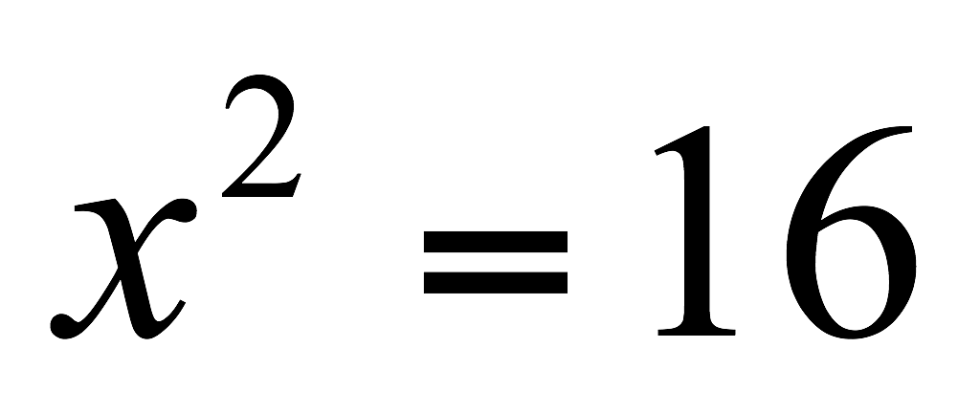
Proposition
Proposition: a statement which is either true or false
  For example:
    Ten is less than seven.
    There are life forms on other planets in the universe.
    A set of cardinality n has 2^{n} subsets.
  The followings are not propositions:
    How are you ?
    x+y<10
6

Slide 7
Proposition
If a proposition is true, we say it has a truth value of true; otherwise, we say it has a truth value of false.
a lower case letter is used to represent a proposition
  Let p stands for “Ten is smaller than seven”
  p has truth value of false, i.e., F.
Analogy to numerical algebra
  Variables represented by letters
  Possible values for variables are {T, F}
7

Slide 8
Compound Proposition
One can connect propositions using “and”, “or”, “not”, “only if” …to form compound proposition:
  It will not rain tomorrow.
  Fishes are jumping and the cotton is high.
  If the ground is wet then it rains last night.
Truth value of compound proposition depends on truth value of the simple propositions
  We will formalize above connectives as operations on propositions
8

Slide 9
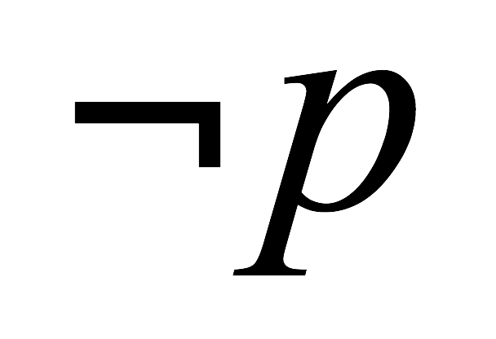

Negation
It will not rain tomorrow.
  It’s not the true that it will rain tomorrow.
  It’s false that it will rain tomorrow.
Negation ( ) applies to a single proposition
  If p is true, then is false
  If p is false, then is true
We can use a table to summarize :
p
p
T | F
F | T
All possible values of
the input
, output/function values
10

Slide 10
Truth table
Truth table: a table that defines a logic operation or function, i.e., allow one to look up the function’s value under given input values
p
T | F
F | T
All possible values of
the input
, output/function values
11

Slide 11


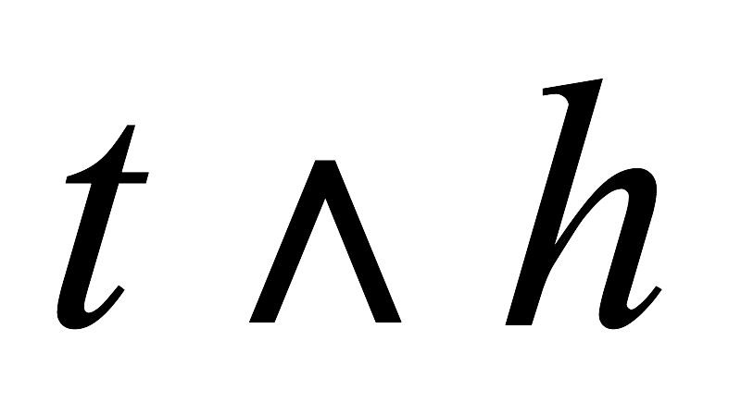
Logical Conjunction (AND, )
To say two propositions are both true:
  Peter is tall and thin.
  The hero is American and the movie is good.
The whole statement is true if both simple propositions are true; otherwise it’s false.
  We use (read as “and”) to denote logic conjuction:
t | h
T | T | T
T | F | F
F | T | F
F | F | F
12

Slide 12
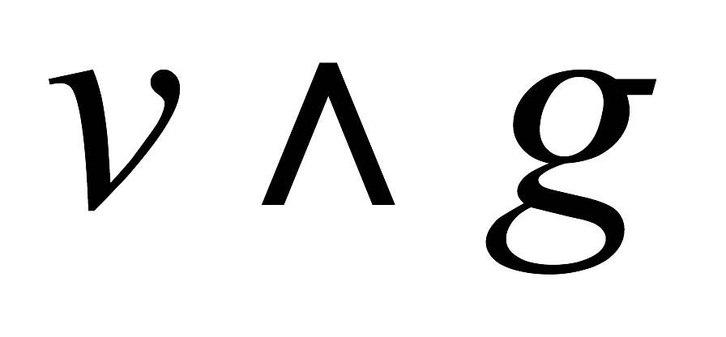
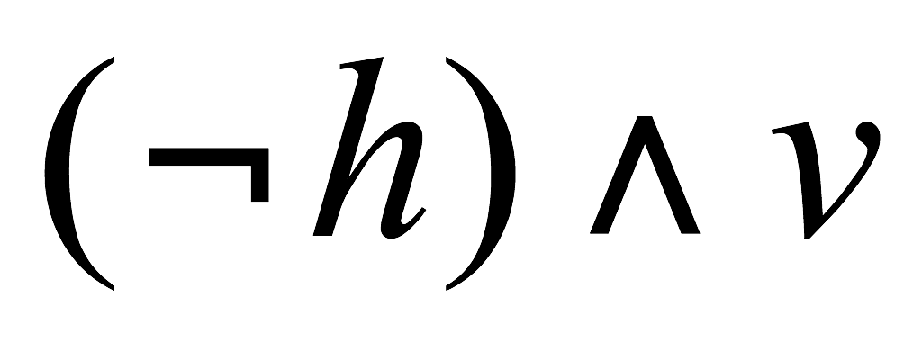
Recognizing conjunction connectives
English words connecting the propositions might be “but”, “nevertheless”, “unfortunately”, …. For example:
  Although the villain is French, the movie is good.
  The hero is not American, but the villain is French.
As long as it means that both simple propositions are true, it’s an AND operation.
13

Slide 13
Practice
Introduce letters to stand for simple propositions, and write the following statements as compound propositions:
  It’s sunny and cold.
  The movie is not long, but it’s very interesting.

Slide 14
Different meaning of “OR”
“… or …, but not both”.
  You may have coffee or you may have tea.
  Mike is at the tennis court or at the swimming pool.
“… or …, or both”.
  The processor is fast or the printer is slow.
To avoid confusion:
  By default we assume the second meaning, unless it explicitly states “not both”.
15

Slide 15

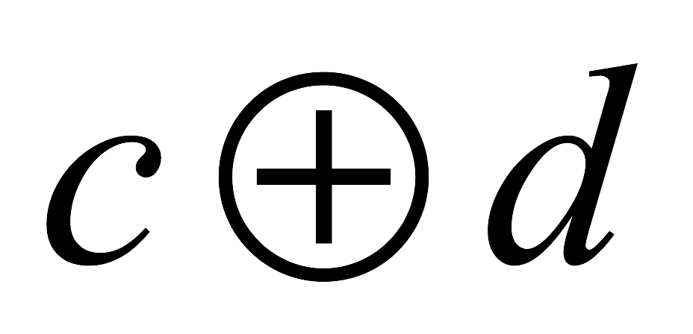
Exclusive Or
Exclusive or ( ) : exactly one of the two statements is true, cannot both be true
  I will watch movies or read a book tonight, but not both.
  You may have coffee or you may have tea, but not both.
  Mike is at the tennis court or at the swimming pool.
c | d
T | T | F
T | F | T
F | T | T
F | F | F
16

Slide 16

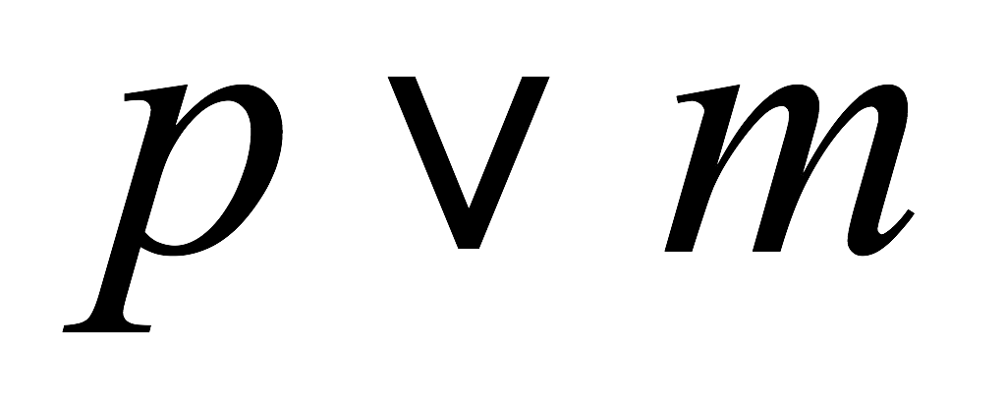
Logical Disjunction (Inclusive Or)
Inclusive or ( ) : at least one of the two statements is true (can be both true)
The processor is small or the memory is small.
  “The process is small” (p) or “The memory is small” (m), denoted as
Truth table for inclusive or:
p | m
T | T | T
T | F | T
F | T | T
F | F | F
17

Slide 17
Outline
Simple Proposition
Logic operations & compound proposition
  Unary operation: negation
  Binary operation: conjuction (AND) , disjuction (OR), conditional ( ) , biconditional ( )
  Evaluating order & truth table
Logic equivalence
  Logic operation laws
Applications: solving logic puzzles
18

Slide 18
Logic Connection: implication/conditional
Some compound propositions states logical connection between two simple propositions (rather than their actual truthfulness)
  If it rains, then the ground is wet.
Logic implication statement has two parts:
  If part: hypothesis
  Then part: conclusion
  If the hypothesis is true, then the conclusion is true.
  use to connect hypothesis and conclusion
logic implication is called conditional in textbook
19

Slide 19
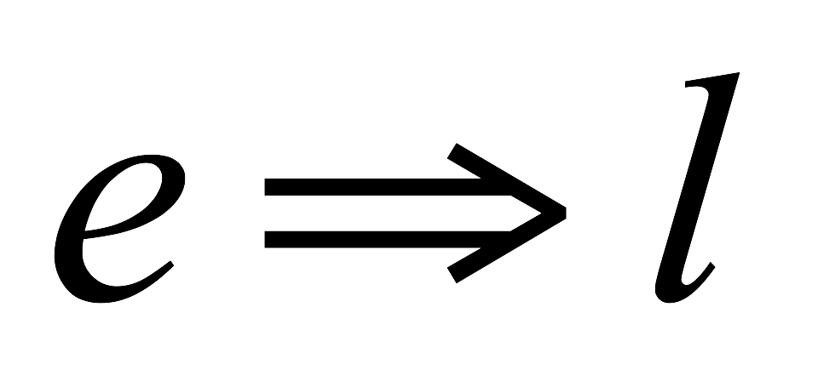
Truth table for logic implication
  “If I am elected, then I will lower the taxes next year”.
    e: I am elected.
    l: I lower the taxes next year.
    i.e., if e is true, then l must be true.
    We use to denote this compound statement.
e | l
T | T | T
T | F | F
F | T | T
F | F | T
20

Slide 20
Understand logic implication
Under what conditions, the promise is broken, i.e., the statement is false ?
  When I am elected, but I do not lower the taxes next year.
For all other scenarios, I keep my promise, i.e., the statement is true.
  I am elected, and lower the taxes next year
  I am not elected, I lower the taxes next year.
  I am not elected, I do not lower the taxes next year.
e | l
T | T | T
T | F | F
F | T | T
F | F | T
21

Slide 21
Many different English Expressions
  In spoken language, there are many ways to express implication (if … then…)
    It rains, therefore the ground is wet.
  Wet ground follows rain.
  As long as it rains, the ground is wet.
  Rain is a sufficient condition for the ground to be wet.
When translating English to proposition forms
  Rephrase sentence to “if …. Then…” without change its meaning
22

Slide 22
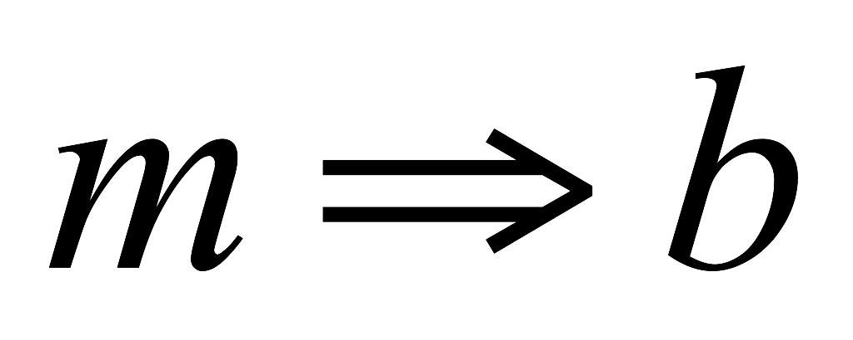
Example: from English to Proposition form
Write the following in proposition form:
  A British heroine is a necessary condition for the movie to be good.
  b: “The heroine is a British”.
  m: “The movie is good”
  The heroine needs/has to be a British for the movie to be true.
  If the movie is good, then the heroine is a British.
  So the propositional form is
23

Slide 23
Write following in propositional forms:
If the movie is good, only if the hero is American.
A good diet is a necessary condition for a healthy cat.
A failed central switch is a sufficient condition for a total network failure.
24

Slide 24
Some exercises
Purchasing a lottery ticket is a ______ condition for winning the lottery.
  Winning the lottery is a ______ condition for purchasing a lottery ticket.
You have to take the final exam in order to pass the CISC1100 course.
  Taking the final exam is a ______ condition of passing CISC1100.
  Passing CISC1100 is a _______ condition of taking the final exam.
25

Slide 25
Outline
Simple Proposition
Logic operations & compound proposition
  Unary operation: negation
  Binary operation: conjuction (AND) , disjuction (OR), conditional ( ) , biconditional ( )
  Evaluating order & truth table
Tautology, contradiction, equivalent
Logic operation laws
Applications: solving logic puzzles
26

Slide 26
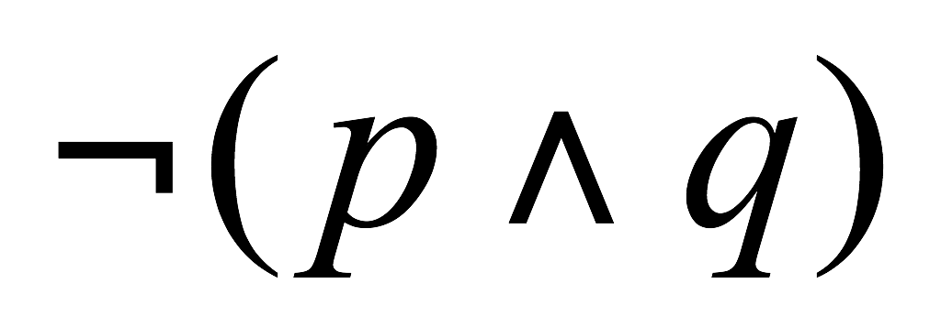
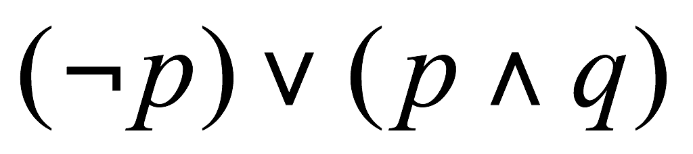
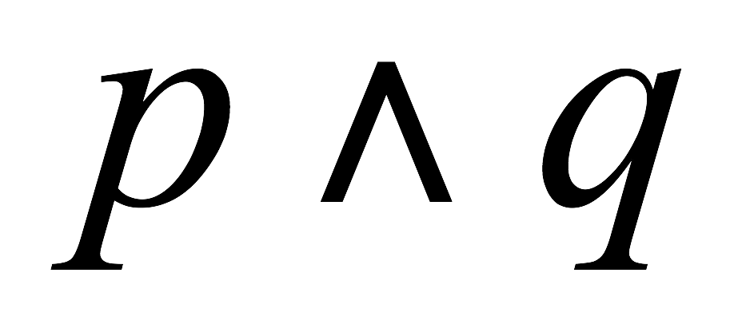
Complicated propositions
Connectives can be applied to compound propositions, e.g.:
The order of evaluation (book P. 43)
p | q
T | T | T | F
T | F | F | T
F | T | F | T
F | F | F | T
27

Slide 27
Writing truth table :
First fill in all possible input values
  For 2 variables, p, q, there are 4 possible input values:
Next, create a column for each compound propositions,
Third, fill in the columns one by one, starting from simple ones
p | q
T | T
T | F
F | T
F | F
28

Slide 28
Input values
For a propositions with n variables
  There are 2^{n} possible input value combinations, i.e., 2^{n} rows for the truth table
Use the following pattern to enumerate all input value combinations
  The last variable follows TFTF… pattern (1)
  The second last variable: TTFFTTFF… pattern (2)
  The third last: TTTTFFFFTTTTFFFF... (4)
  The fourth last: TTTTTTTTFFFFFFFF … (8)
  …
29

Slide 29
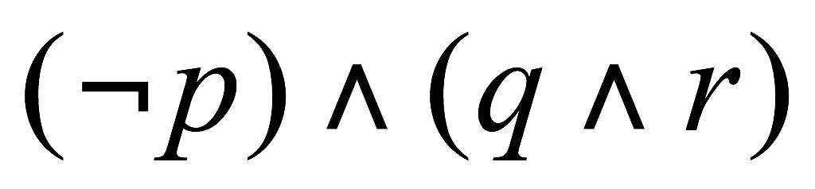
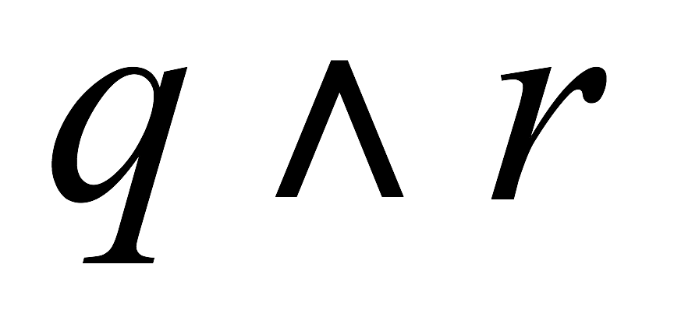
An example
For a form with 3 simple propositions
p | q | r
T | T | T | F | T | F
T | T | F | F | F | F
T | F | T | F | F | F
T | F | F | F | F | F
F | T | T | T | T | T
F | T | F | T | F | F
F | F | T | T | F | F
F | F | F | T | F | F
30

Slide 30
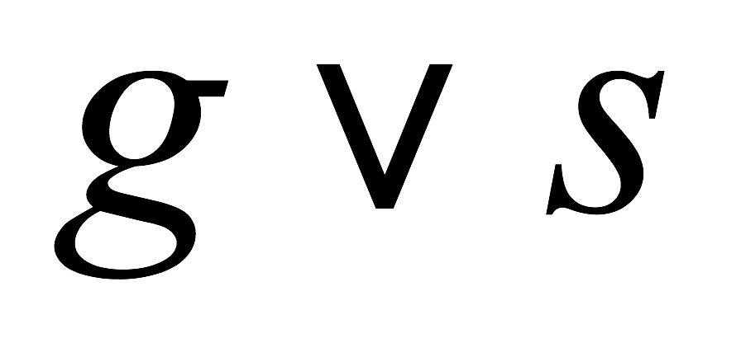
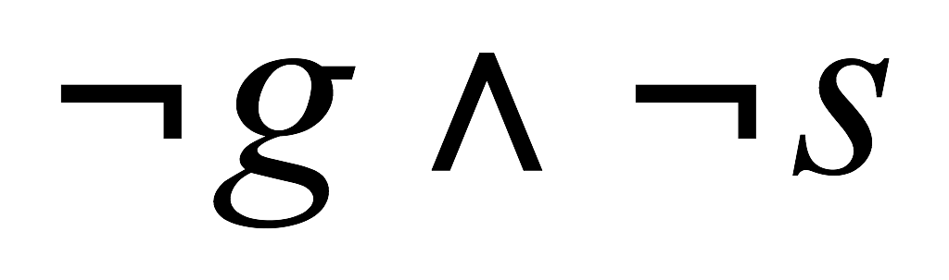
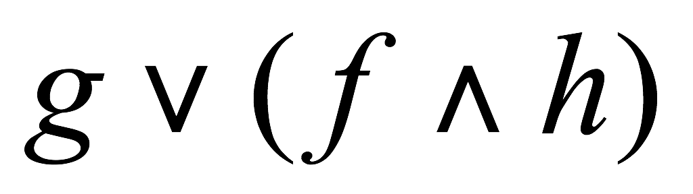
Practice
Introduce letters to stand for simple propositions, and write the following statements as compound propositions:
  The food is good or the service is excellent.
  Neither the food is good nor the service is excellent.
  He is good at math, or his girl friend is and helps him.

Slide 31
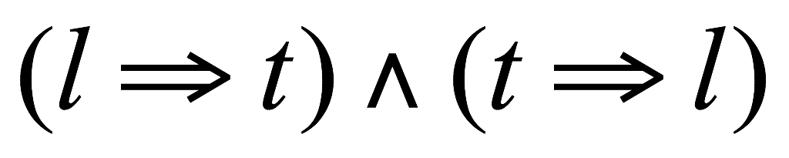
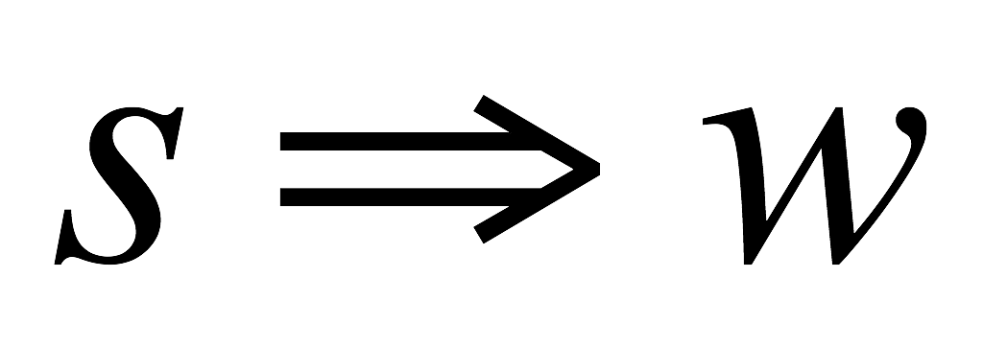
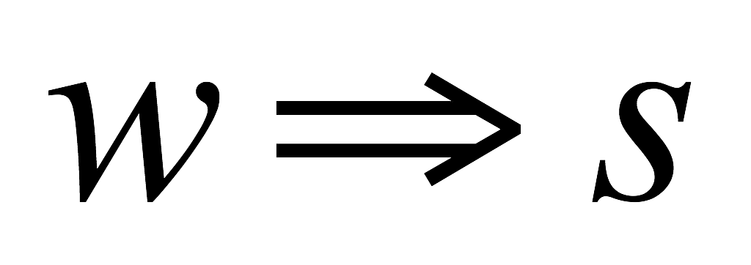
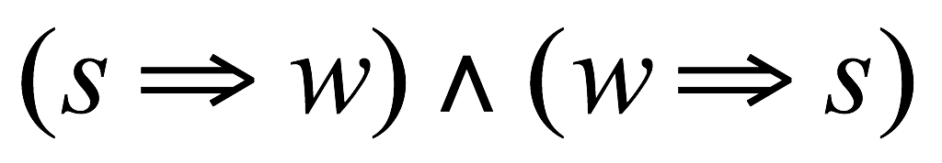
Sufficient and necessary condition
Examples:
  Lighting is sufficient and necessary condition for thunder.
  The knight will win if and only if the armor is strong.
    The knight will win if the armor is strong.
    The knight will win only if the armor is strong.
32

Slide 32
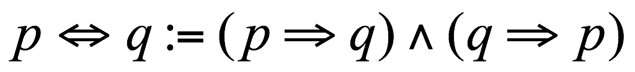
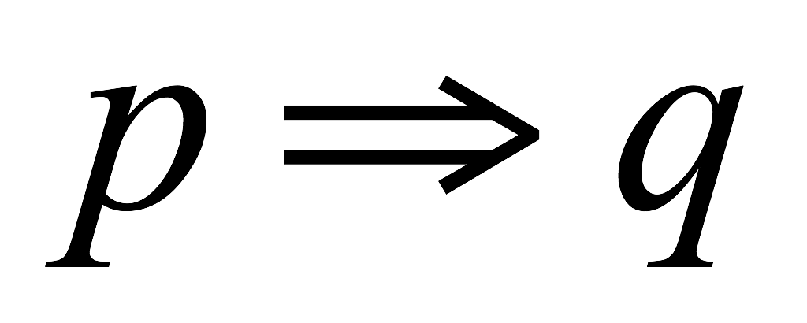
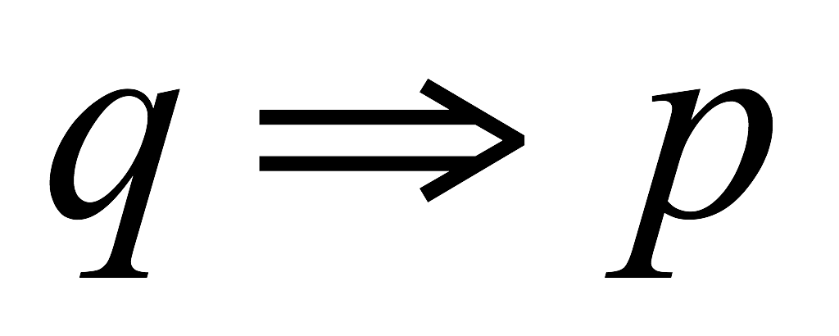
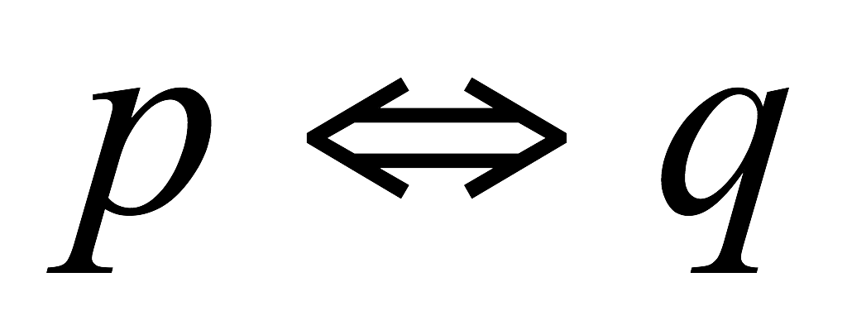
Biconditional connective
p if and only if q,
p is sufficient and necessary condition of q
p | q
T | T | T | T | T
T | F | F | T | F
F | T | T | F | F
F | F | T | T | T
33

Slide 33
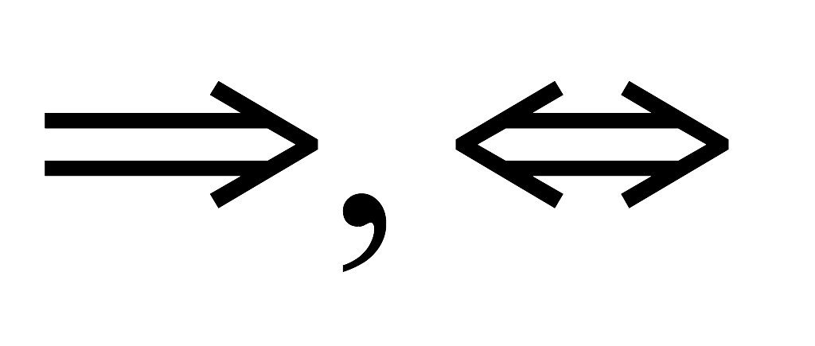
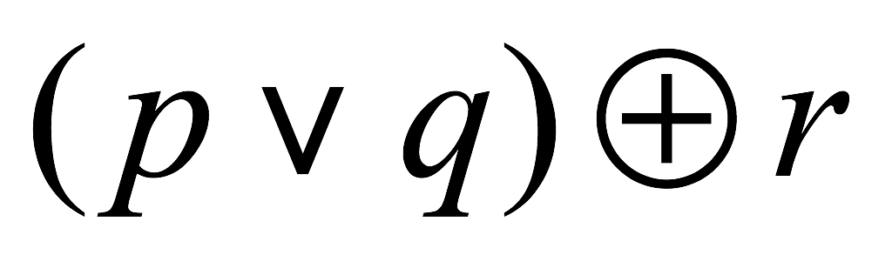
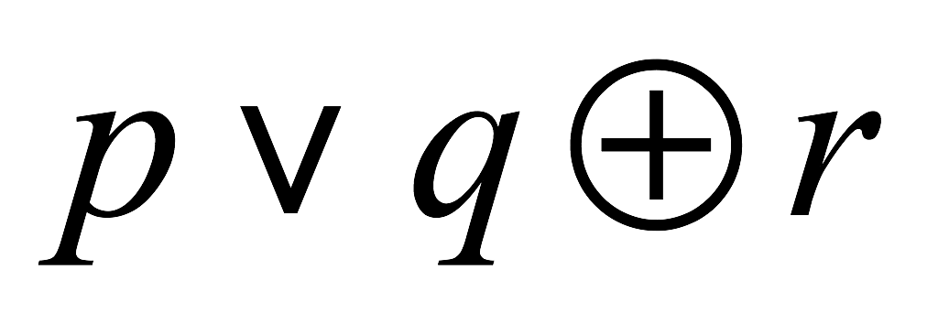
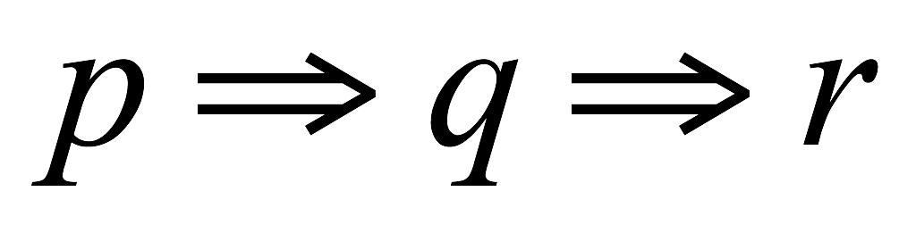
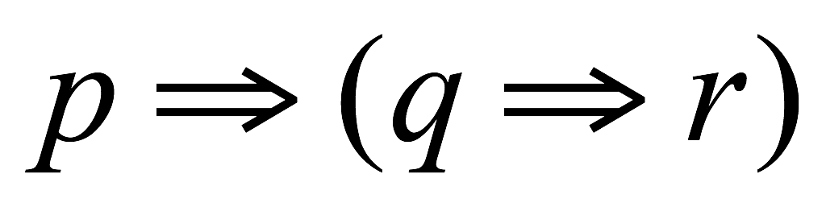
Precedence Rules
Parenthesized subexpressions come first
Precedence hierarchy
  Negation (˥) comes next
  Multiplicative operations (∧) is done before additive operations (⋁,⊕)
  Conditional-type operations ( ) are done last
In case of a tie, operations are evaluated in left-to-right order, except for conditional operator ( ) which is evaluated in right-to-left order
  is evaluated as
  is evaluated as
34

Slide 34
Outline
Simple Proposition
Logic operations & compound proposition
  Unary operation: negation
  Binary operation: conjuction (AND) , disjuction (OR), conditional ( ) , biconditional ( )
  Evaluating order & truth table
Propositional equivalence
  Propositional identities
Applications: solving logic puzzles
35

Slide 35
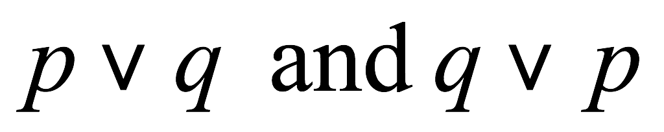
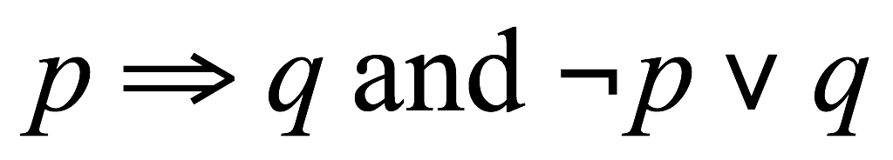

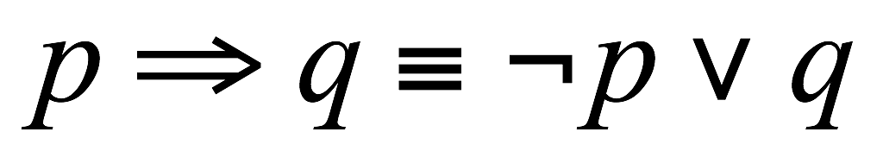
Logical equivalence
Two propositional forms are logically equivalent, if they have same truth value under all conditions
  Analogous to algebra rules
We represent logical equivalence using
To prove or disprove logical equivalency
  Draw and Compare true tables of the two forms
36

Slide 36
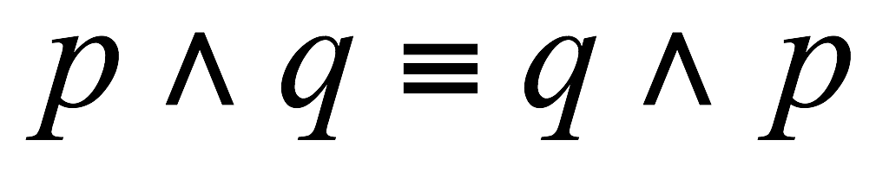
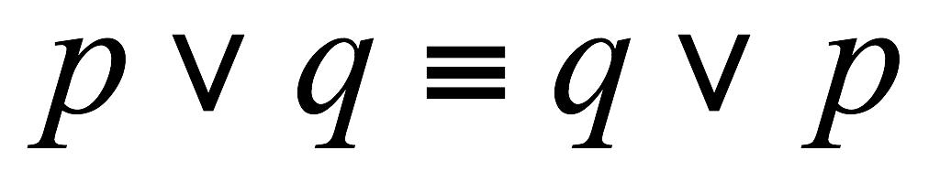
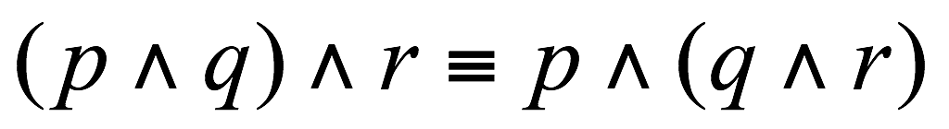
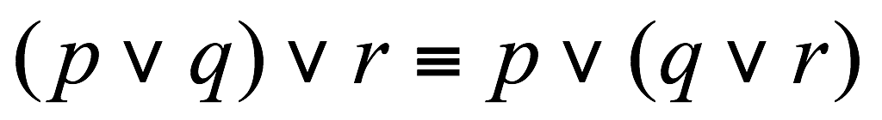
Logic Identities (1)
Commutative
  1.
  2.
Associative
  1.
  2.
38

Slide 37
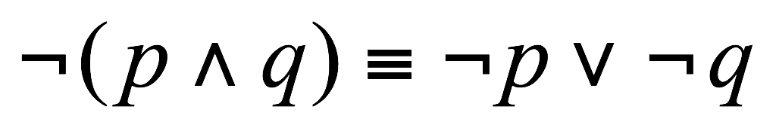
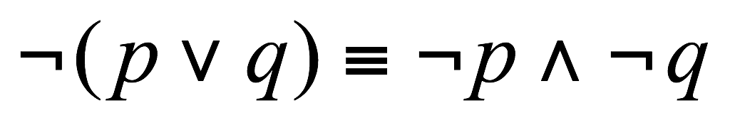
Logic Identities (2)
DeMorgan’s laws
  1.
  2.
39

Slide 38
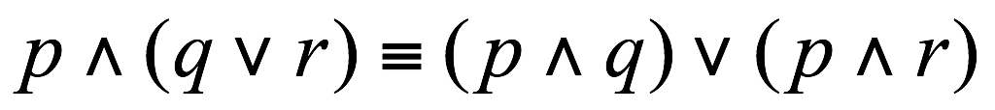
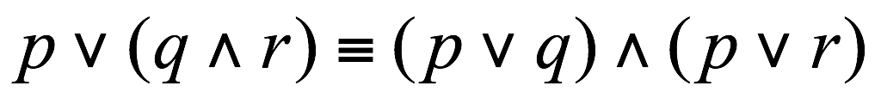
Logic Identities (3)
Distributive
  1.
  2.
40

Slide 39
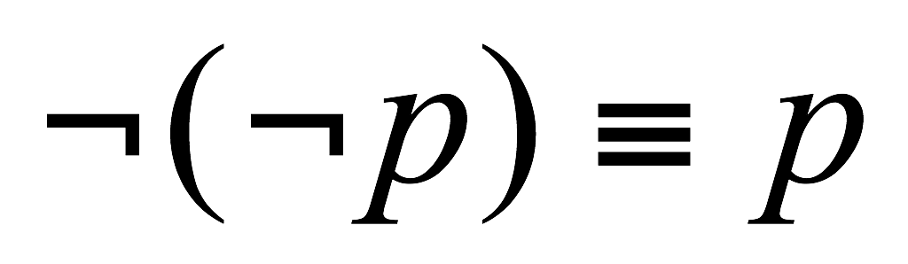
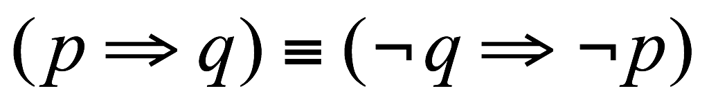
Logic Identities (4)
Double negative
Contrapositive
41

Slide 40
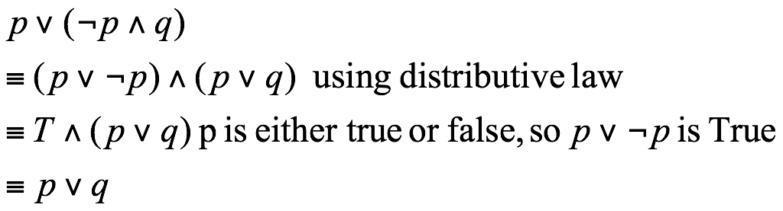
Simplify propositional forms
  Human beings understand the simplified form much better…
    Put negation closer to simple proposition
    Get rid of double negation
  Simplify following propositional forms, i.e., find a simpler equivalent form
Key: apply logical equivalence rules such as DeMorgan Law, implication law, double negation …
42

Slide 41
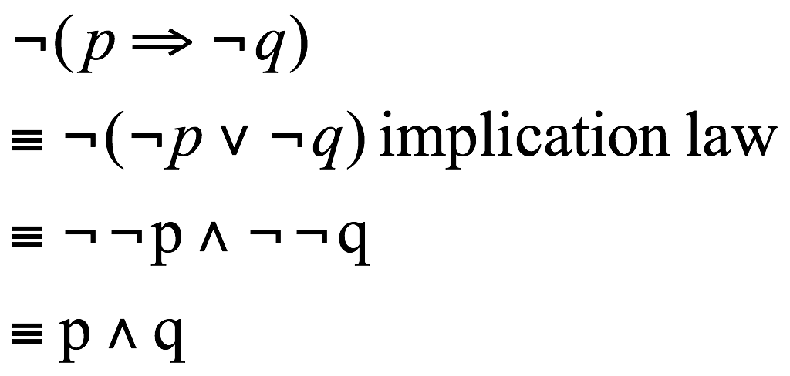
Simplify propositional forms (2)
Key: apply logical equivalence rules such as DeMorgan Law, implication law, double negation …
  We don’t know how to directly negate a “if … then” form
  First apply implication law, then use DeMorgan law:
43

Slide 42
Outline
Simple Proposition
Logic operations & compound proposition
  Unary operation: negation
  Binary operation: conjuction (AND) , disjuction (OR), conditional ( ) , biconditional ( )
  Evaluating order & truth table
Propositional equivalence
  Propositional identities
Applications: solving logic puzzles
44

Slide 43
Solving problem using logic
Four machines A, B, C, D are connected on a network. It is feared that a computer virus may have infected the network. Your security team makes the following statements:
  If D is infected, then so is C.
  If C is infected, then so is A.
  If D is clean, then B is clean but C is infected.
  If A is infected, then either B is infected or C is clean.
45

Slide 44
Solving problem using logic
Four machines A, B, C, D are connected on a network. It is feared that a computer virus may have infected the network. Your security team makes the following statements:
  If D is infected, then so is C.
  If C is infected, then so is A.
  If D is clean, then B is clean but C is infected.
  If A is infected, then either B is infected or C is clean.
How many possibilities are there ?
  A, B,C, D are all be clean
  A, B,C are clean, D is infected,
  A,B,D are clean, C is infected,
  ….
  …
Is the first case possible ? The second ? …
46

Slide 45
Application of Logic
A case study
47

Slide 46
An example
Your friend’s comment:
  If the birds are flying south and the leaves are turning, then it must be fall. Falls brings cold weather. The leaves are turning but the weather is not cold. Therefore the birds are not flying south.
Is her argument sound/valid?
48

Slide 47
An example
Is her argument sound/valid?
  Suppose the followings are true:
    If the birds are flying south and the leaves are turning, the it must be fall.
    Falls brings cold weather.
    The leaves are turning but the weather is not cold.
  Can one conclude “the birds are not flying south” ?
49

Slide 48
Reasoning & Proving
Prove by contradiction
  Assume the birds are flying south,
  then since leaves are turning too, then it must be fall.
  Falls bring cold weather, so it must be cold.
  But it’s actually not cold.
  We have a contradiction, therefore our assumption that the birds are flying south is wrong.
50

Slide 49
Indirect Proofs (Section 3.1.8)
Direct Proof vs Indirect Proof
Show that the square of an odd number is also an odd number
  Suppose that m is an odd number,
  We will show that m² is also an odd number.
  Direct Proof: (from givens to the conclusion)
    Let m=2n+1 (since m is an odd number)
    Then m²=(2n+1)²=4n²+4n+1=2(2n²+2n)+1
    Therefore m² is an odd number
51

Slide 50
Indirect Proof technique
Proof by contradiction:
  Rather than proving the conclusion is true, we assume that it is false, and see whether this assumption leads to some kind of contradiction.
  A contradiction would mean the assumption is wrong, i.e., the conclusion is true
522

Slide 51
Indirect Proof technique
Show that square of an odd number is also an odd number
  Suppose that m is an odd number,
  We will show that m² is also an odd number.
  Indirect Proof:
    Assume m² is an even number
    As m²=m*m, m must be an even number. This contradicts with the fact that m is an odd number.
    Therefore the assuming cannot be true, and therefore m² is odd
532

Slide 52
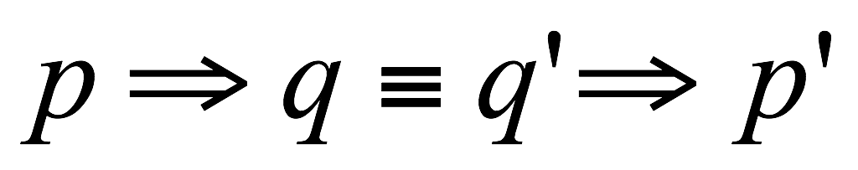
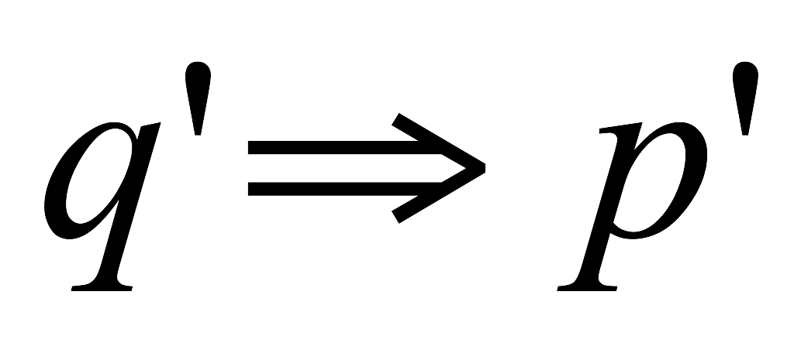
Underlying logic laws
We can prove the following logic equivalence
Therefore, in order to prove , we prove
54

Slide 53
Next: application to computer
55

Slide 54
Other Positional Numeral System
Base: number of digits (symbols) used in the system.
  Base 2 (i.e., binary): only use 0 and 1
  Base 8 (octal): only use 0,1,…7
  Base 16 (hexadecimal): use 0,1,…9, A,B,C,D,E,F
Like in decimal system,
  Rightmost digit: represents its value times the base to the zeroth power
  The next digit to the left: times the base to the first power
  The next digit to the left: times the base to the second power
  …
  For example: binary number 10101
  = 1*2⁴+0*2³+1*2²+0*2¹+1*2⁰=16+4+1=21
56

Slide 55
Why binary number?
Computer uses binary numeral system, i.e., base 2 positional number system
  Each unit of memory media (hard disk, tape, CD …) has two states to represent 0 and 1
  Such physical (electronic) device is easier to make, less prone to error
    E.g., a voltage value between 0-3mv is 0, a value between 3-6 is 1 …
57

Slide 56
Binary => Decimal
Interpret binary numbers (transform to base 10)
  1101
  = 1*2³+1*2²+0*2¹+1*2⁰=8+4+0+1=13
Translate the following binary number to decimal number
  101011
58

Slide 57
Generally you can consider other bases
Base 8 (Octal number)
  Use symbols: 0, 1, 2, …7
  Convert octal number 725 to base 10:
  =7*8²+2*8¹+5=…
  Now you try:
  (1752)₈ =
Base 16 (Hexadecimal)
  Use symbols: 0, 1, 2, …9, A, B, C,D,E, F
  (10A)₁₆ = 1*16²+10*16⁰=..
59

Slide 58
Binary number arithmetic
Analogous to decimal number arithmetics
How would you perform addition?
  0+0=0
  0+1=1
  1+1=10 (a carry-over)
  Multiple digit addition: 11001+101=
Subtraction:
  Basic rule:
  Borrow one from next left digit
60

Slide 59
From Base 10 to Base 2: using table
Input : a decimal number
Output: the equivalent number in base 2
Procedure:
  Write a table as follows
  Find the largest two’s power that is smaller than the number
    Decimal number 234 => largest two’s power is 128
  Fill in 1 in corresponding digit, subtract 128 from the number => 106
  Repeat 1-2, until the number is 0
  Fill in empty digits with 0
  Result is 11101010
… | 512 | 256 | 128 | 64 | 32 | 16 | 8 | 4 | 2 | 1
 |  |  | 1 | 1 | 1 | 0 | 1 | 0 | 1 | 0
61

Slide 60
From Base 10 to Base 2: the recipe
Input : a decimal number
Output: the equivalent number in base 2
Procedure:
  Divide the decimal number by 2
  Make the remainder the next digit to the left of the answer
  Replace the decimal number with the quotient
  If quotient is not zero, Repeat 1-4; otherwise, done
62

Slide 61
Convert 100 to binary number
100 % 2 = 0 => last digit
100 / 2 = 50
50 % 2 = 0 => second last digit
50/2 = 25
25 % 2 = 1
=> 3rd last digit
25 / 2 = 12
12 % 2 = 0 => 4th last digit
12 / 2 = 6
6 % 2 = 0 => 5th last digit
6 / 2 = 3
3 % 2 = 1
=> 6th last digit
3 / 2 =1
1 % 2 = 1
=> 7th last digit
1 / 2 = 0
Stop as the decimal # becomes 0
The result is 1100100
63

Slide 62
Data Representation in Computer
In modern computers, all information is represented using binary values.
Each storage location (cell): has two states
  low-voltage signal => 0
  High-voltage signal => 1
  i.e., it can store a binary digit, i.e., bit
Eight bits grouped together to form a byte
Several bytes grouped together to form a word
  Word length of a computer, e.g., 32 bits computer, 64 bits computer
64

Slide 63
Different types of data
Numbers
  Whole number, fractional number, …
Text
  ASCII code, unicode
Audio
Image and graphics
video
How can they all be represented as binary strings?
65

Slide 64
Representing Numbers
Positive whole numbers
  We already know one way to represent them: i.e., just use base 2 number system
All integers, i.e., including negative integers
  Set aside a bit for storing the sign
    1 for +, 0 for –
Decimal numbers, e.g., 3.1415936, 100.34
  Floating point representation:
    sign * mantissa * 2 ^{exp}
  64 bits: one for sign, some for mantissa, some for exp.
66

Slide 65
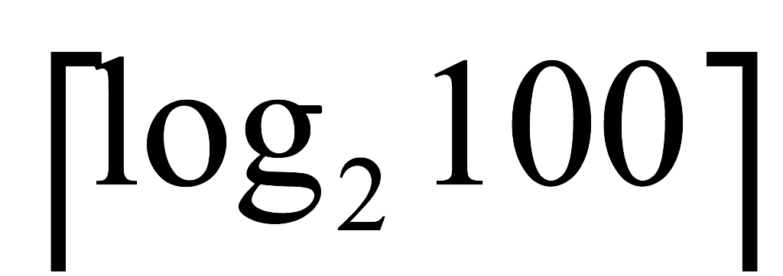
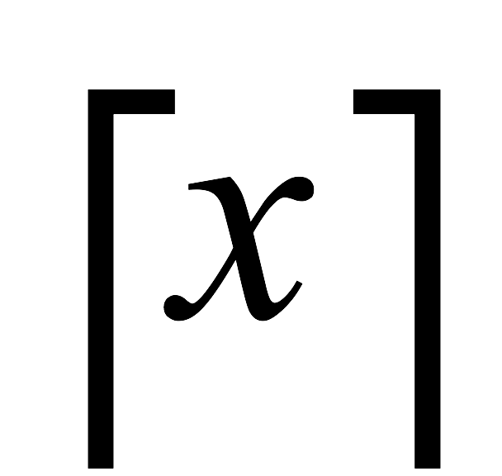
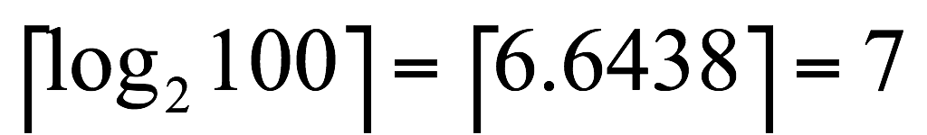
Representing Text
Take English text for example
Text is a series of characters
  letters, punctuation marks, digits 0, 1, …9, spaces, return (change a line), space, tab, …
How many bits do we need to represent a character?
  1 bit can be used to represent 2 different things
  2 bit … 2*2 = 2² different things
  n bit 2^{n} different things
In order to represent 100 diff. character
  Solve 2^{n} = 100 for n
  n = , here the refers to the ceiling of x, i.e., the smallest integer that is larger than x:
67

Slide 66
There needs a standard way
ASCII code: American Standard Code for Information Interchange
  ASCII codes represent text in computers, communications equipment, and other devices that use text.
  128 characters:
    33 are non-printing control characters (now mostly obsolete)^{[7]} that affect how text and space is processed
    94 are printable characters
    space is considered an invisible graphic
68

Slide 67

ASCII code
69

Slide 68
There needs a standard way
Unicode
  international/multilingual text character encoding system, tentatively called Unicode
  Currently: 21 bits code space
  How many diff. characters?
Encoding forms:
  UTF-8: each Unicode character represented as one to four 8-but bytes
  UTF-16: one or two 16-bit code units
  UTF-32: a single 32-but code unit
70

Slide 69
How computer processing data?
Through manipulate digital signals (high/low)
Using addition as example
  10000111
  + 0001110
Input: the two operands, each consisting of 32 bits (i.e., 32 electronic signals)
Output: the sum
How ?
71

Slide 70
Digital Logic
Performs operation on one or more logic inputs and produces a single logic output.
Can be implemented
  electronically using diodes or transistors
  Using electromagnetic relays
  Or other: fluidics, optics, molecules, or even mechanical elements
We won’t go into the physics of how is it done, instead we focus on the input/output, and logic
72

Slide 71




Basic building block
Basic Digital logic is based on primary functions (the basic gates):
  AND
  OR
  XOR
  NOT
73

Slide 72
AND Logic Symbol
Inputs
Output
If both inputs are 1, the output is 1
If any input is 0, the output is 0
74

Slide 73
AND Logic Symbol
0
Inputs
0
Output
0
Determine the output
Animated Slide
75

Slide 74
AND Logic Symbol
0
Inputs
0
Output
1
Determine the output
Animated Slide
76

Slide 75
AND Logic Symbol
1
Inputs
1
Output
1
Determine the output
Animated Slide
77

Slide 76
AND Truth Table
To help understand the function of a digital device, a Truth Table is used:
Input |  | Output
0 | 0 | 0
0 | 1 | 0
1 | 0 | 0
1 | 1 | 1
Every possible input combination
AND Function
78

Slide 77
OR Logic Symbol
Inputs
Output
If any input is 1, the output is 1
If all inputs are 0, the output is 0
79

Slide 78
OR Logic Symbol
0
Inputs
0
Output
0
Determine the output
Animated Slide
80

Slide 79
OR Logic Symbol
0
Inputs
1
Output
1
Determine the output
Animated Slide
81

Slide 80
OR Logic Symbol
1
Inputs
1
Output
1
Determine the output
Animated Slide
82

Slide 81
OR Truth Table
Truth Table
Input |  | Output
0 | 0 | 0
0 | 1 | 1
1 | 0 | 1
1 | 1 | 1
OR Function
83

Slide 82

XOR Gate
The XOR function:
  if exactly one input is high, the output is high
  If both inputs are high, or both are low, the output is low
84

Slide 83
XOR Truth Table
Truth Table
Input |  | Output
0 | 0 | 0
0 | 1 | 1
1 | 0 | 1
1 | 1 | 0
XOR Function
85

Slide 84
NOT Logic Symbol
Input
Output
If the input is 1, the output is 0
If the input is 0, the output is 1
86

Slide 85
NOT Logic Symbol
Input
0
1
Output
Determine the output
Animated Slide
87

Slide 86
NOT Logic Symbol
Input
1
0
Output
Determine the output
Animated Slide
88

Slide 87

Combinational logic
A circuit that utilizes more that one logic function has Combinational Logic.
  How would your describe the output of this combinational logic circuit?
89

Slide 88

Combinational Logic: Half Adder
Electronic circuit for performing single digit binary addition
Sum= A XOR B
Carry = A AND B
A | B | Sum | Carry
0 | 0 | 0 | 0
0 | 1 | 1 | 0
1 | 0 | 1 | 0
1 | 1 | 0 | 1
90

Slide 89


Full Adder
One bit full adder with carry-in and carry-out
A | B | CI | Q | CO
0 | 0 | 0 | 0 | 0
0 | 0 | 1 | 1 | 0
0 | 1 | 0 | 1 | 0
0 | 1 | 1 | 0 | 1
1 | 0 | 0 | 1 | 0
1 | 0 | 1 | 0 | 1
1 | 1 | 0 | 1 | 0
1 | 1 | 1 | 1 | 1
91

Slide 90

Full adder: 4-digit binary addition
Chain 4 full-adders together, lower digit’s carry-out is fed into the higher digit as carry-in
92

Slide 91

Integrated Circuit
Also called chip
  A piece of silicon on which
multiple gates are embedded
  mounted on a package with pins, each pin is either an input, input, power or ground
Classification based on # of gates
  VLSI (Very Large-Scale Integration) > 100,000 gates
93

Slide 92


CPU (Central Processing Unit)
Many pins to connect to memory, I/O
Instruction set: the set of machine instructions
supported by an architecture (such as Pentium)
  Move data (between register and memory)
  Arithmetic Operations
  Logic Operations:
  Floating point arithmetic
  Input/Output
94

