Slide 1
Probability
Dr. Zhang
Fordham Univ.
1

Slide 2
Probability: outline
Introduction
  Experiment, event, sample space
  Probability of events
Calculate Probability
  Through counting
  Sum rule and general sum rule
  Product rule and general product rule
  Conditional probability
Probability distribution function
Bernoulli process
2

Slide 3


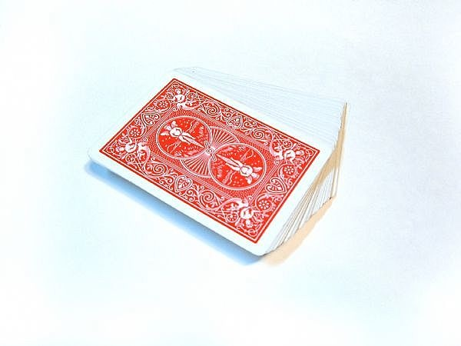
Start with our intuition
What’s the probability/odd/chance of
  getting “head” when tossing a coin?
    0.5 if it’s a fair coin.
  getting a number larger than 4 with a roll of a die ?
    2/6=1/3, if the die is fair one
  drawing either the ace of clubs or the queen of diamonds from a deck of cards (52) ?
    2/52
3

Slide 4
Our approach
Divide # of outcomes of interests by total # of possible outcomes
Hidden assumptions: different outcomes are equally likely to happen
  Fair coin (head and tail)
  Fair dice
  Each card is equally likely to be drawn
4

Slide 5
Another example
In your history class, there are 24 people. Professor randomly picks 2 students to quiz them. What’s the probability that you will be picked ?
  Total # of outcomes?
  # of outcomes with you being picked?
5

Slide 6
Terminology: Experiment, Sample Space
Experiment: action that have a measurable outcome, e.g., :
  Toss coins, draw cards, roll dices, pick a student from the class
Outcome: result of the experiment
  For tossing a coin, outcomes are getting a head, H, or getting a tail, T.
  For tossing a coin twice, outcomes are HH, HT, TH, or TT.
  When picking two students to quiz, outcomes are subsets of size two
Sample space of an experiment: the set that contains all possible outcomes of the experiment, denoted by S.
  Tossing a coin once: sample space is {H,T}
  Rolling a dice: sample space is {1,2,3,4,5,6} .
  …
S is universe set as it
includes all possible outcomes
Venn Diagram
S
outcomes
6

Slide 7
Example
When the professor picks 2 students (to quiz) from a class of 24 students…
  What’s the sample space?
    All the different outcomes of picking 2 students out of 24
  How many possible outcomes are there?
    That is same as asking “How many different outcomes are possible when picking 2 students from a class of 24 students?”
    It’s a counting problem!
    C(24,2): order does not matter
7

Slide 8
Events
Event : a subset of sample space S
  “getting number larger than 4” is an event for rolling a die experiment
  “you are picked to take quiz” is an event for picking two students to quiz
  An event is said to occur if an outcome in the subset occurs
Some special events:
  Elementary event: event that contains exactly one outcome
  { }: null event
  S: sure event
Getting a number
larger than 4
1
S
2
5
4
3
6
Rolling a die experiment
“Getting a number larger
than 4” occurs if 5 or 6
occurs
8

Slide 9
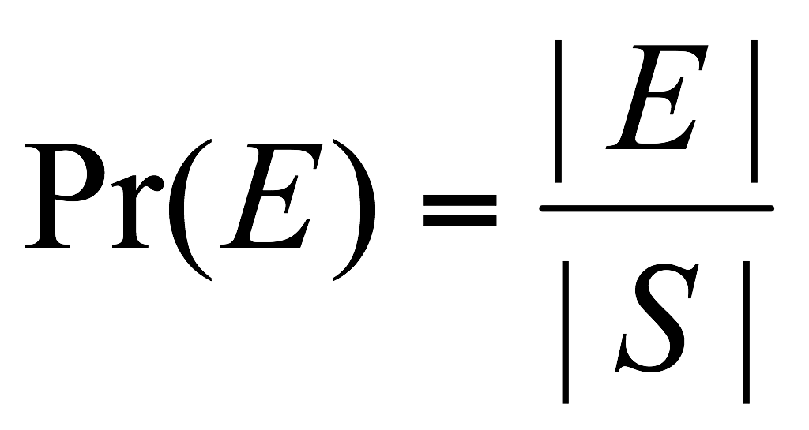
(Discrete) Probability
If sample space S is a finite set of equally likely outcomes, then the probability of event E occurs, Pr(E) is defined as:
  Likelihood or chance that the event occurs, e.g., if one repeats experiment for many times, frequency that the event happens
  Note: sometimes we write P(E). It should be clear from context whether P stands for “probability” or “power set”
  This captures our intuition of probability.
9

Slide 10
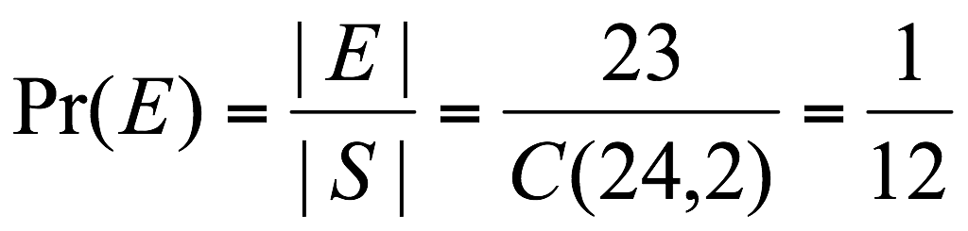
Example
When the professor picks 2 students (to quiz) from a class of 24 students…
  What’s the sample space?
    All the different outcomes of picking 2 students out of 24
  How many possible outcomes are there?
    |S| = C(24,2)
  Event of interest: you are one of the two being picked
    How many outcomes in the event ? i.e., how many outcomes have you as one of the two picked ?
    |E| = C(1,1) C(23,1)
  Prob. of you being picked:
10

Slide 11
Probability: outline
Introduction
  Experiment, event, sample space
  Probability of events
Calculate Probability
  through counting
  Sum rule and general sum rule
  Product rule and general product rule
11

Slide 12
Calculate probability by counting
If sample space S is a finite set of equally likely outcomes, then the probability of event E occurs is:
To calculate probability of an event for an experiment,
  Identify sample space of the experiment, S, i.e., what are the possible outcomes ?
  Count number of all possible outcomes, i.e., cardinality of sample space, |S|
  Count number of outcomes in the event, i.e., cardinality of event, |E|
  Obtain prob. of event as Pr(E)=|E|/|S|
12

Slide 13
Example: Toss a coin
if we toss a coin once, we either get a tail or get a head.
  sample space can be represented as {Head, Tail} or simply {H,T}.
  The event of getting a head is the set {H}.
    Prob ({H})=|{H}| / | {H,T}| = 1/2
  The event of getting a tail is the set {T}
  The event of getting a head or tail is the set {H,T}, i.e., the whole sample space
13

Slide 14
Example: coin tossing
If we toss a coin 3 times, what’s the probability of getting three heads?
  Sample space, S: {HHH, HHT, ..., TTT}
  There are 2x2x2=8 possible outcomes, |S|=8
  There is one outcome that has three heads, HHH. |E|=1
  So probability of getting three head is: |E|/|S|=1/8
What’s the probability of getting same results on last two tosses, E ?
  Outcomes in E are HHH, THH, HTT, TTT, so |E|=4
  Or how many outcomes have same results on last two tosses?
    2*2=4
  Prob. of getting same results on last two tosses: 4/8=1/2.
14

Slide 15

Example: poke cards
When we draw a card from a standard deck of cards (52 cards, 13 cards for each suits).
  Sample space is:
    All 52 cards
  Num. of outcomes that getting an ace is:
    |E|=4
  Probability of getting an ace is:
    |E|/|S|=4/52
  Probability of getting a red card or an ace is:
    |E|=26 red cards+2 black ace cards=28
    Pr (E)=28/52
15

Slide 16

Example: dice rolling
If we roll a pair of dice and record sum of face-up numbers, what’s the probability of getting a 10 ?
  The sum of face-up numbers can be any of the following: 2,3,4,5,6,7,8,9,10,11,12.
    S={2,3,4,5,6,7,8,9,10,11,12}
  So the prob. of getting a 10 is 1/11
    Pr(|E|)=|E|/|S|=1/11
  Any problem in above calculation?
    Are all outcomes in sample space equally like to happen ?
    No, there are two ways to get 10 (by getting 4 and 6, or getting 5 and 5), there are just one way to get 2 (by getting 1 and 1),…
16
CSRU1400/1100 Fall 2009
Xiaolan Zhang
16

Slide 17
Example: dice rolling (cont’d)
If we roll a pair of dice and record sum of face-up numbers, what’s the probability of getting a 10 ?
  Represent outcomes as ordered pair of numbers, i.e. (1,5) means getting a 1 and then a 5
  How many outcomes are there ? i.e., |S|=?
    6*6
  Event of getting a 10 is: {(4,6),(5,5),(6,4)}
  Prob. of getting 10 is: 3/(6*6)
17

Slide 18
Example: counting outcomes
Drawing two cards from the top of a deck of 52 cards, the probability that two cards having same suit ?
  Sample space S:
    |S|=52*51 , 52 choices for first draw, 51 for second
  Event that two cards have same value, E:
    |E|=52*12, 52 choices for first draw, 12 for second (from remaining 12 cards of same suit as first card)
  Pr (E)=|E|/|S|=(52*12)/(52*51)=12/51
18

Slide 19
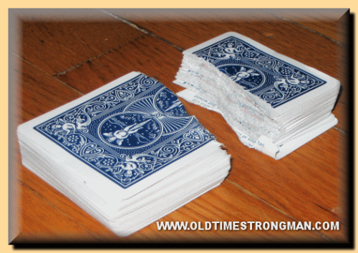
Example: card game
At a party, each card in a standard deck is torn in half and both haves are placed in a box. Two guests each draw a half-card from the box. What’s the probability that they draw two halves of the same card ?
  Size of sample space, i.e., how many ways are there to draw two from the 52*2 half-cards ?
    104*103
  How many ways to draw two halves of same card?
    104*1
  Prob. that they draw two halves of same card
    104/(104*103)=1/103.
19

Slide 20
NY Jackpot Lottery
“pick 5 numbers from 1 to 56, plus a mega ball number from 1 to 46,”
  If your 5-number combination matches winning 5-number combination, and mega ball number matches the winning Mega Ball, then you win !
  Order for the 5 numbers does not matter.
Sample space: all different ways one can choose 5-number combination, and a mega ball number
  |S|= ?
Winning event contains the single outcome in sample space, i.e., the winning comb. and mega ball number
  |E|=1, Pr(E)=1/|S|=
20
CSRU1400 Fall 2008
Ellen Zhang
20

Slide 21
Probability of Winning
Lottery Game
In one lottery game, you pick 7 distinct numbers from {1,2,…,80}.
On Wednesday nights, someone’s grandmother draws 11 numbered balls from a set of balls numbered from {1,2,…80}.
If the 7 numbers you picked appear among the 11 drawn numbers, you win.
What is your probability of winning?
Questions:
  What is the experiment, sample space ?
  What is the winning event ?
21

Slide 22
Probability: outline
Introduction
  Experiment, event, sample space
  Probability of events
Calculate Probability through counting
  Examples, exercises
Sum rule and general sum rule
  Examples and exercises
Product rule and general product rule
  Conditional probability
22

Slide 23
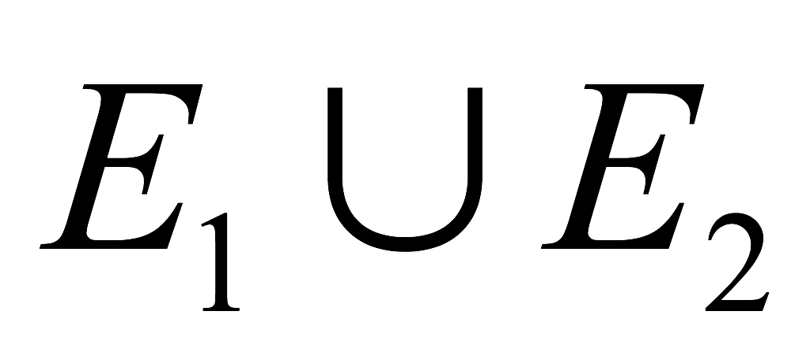
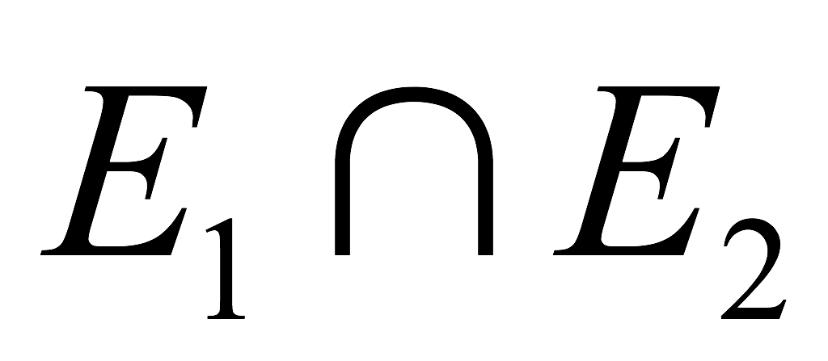
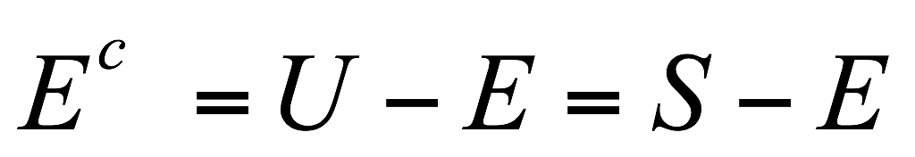
Events are sets
Event of an experiment: any subset of sample space S, e.g.
Events are sets, therefore all set operations apply to events
  Union:
    E₁ or E₂ occurs
  Intersection:
    E₁ and E₂ both occurs
  Complements:
    E does not occur
E₂
E₁
1
S
2
5
4
3
6
Die rolling experiment
E₁: getting a number greater than 3
E₂: getting a number smaller than 5
23

Slide 24
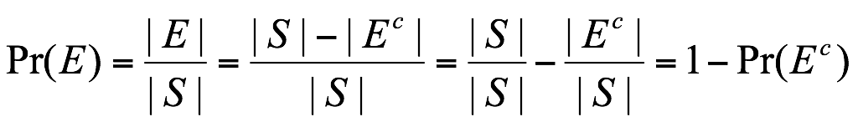
Properties of probability
Recall: For an experiment, if its sample space S is a finite set of equally likely outcomes, then the probability of event E occurs, Pr(E) is given by :
For any event E, we have 0≤ |E|≤|S|, so
  0≤Pr(E)≤1
  Extreme cases: P(S)=1, P({})=0
Sometimes, counting |E| (# of outcomes in event E) is hard
  And it’s easier to count number of outcomes that are not in E, i.e., |E^{c}|
24

Slide 25
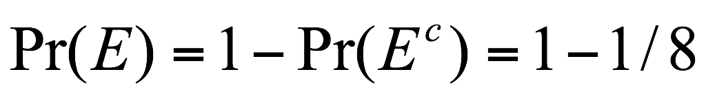
Tossing a coin 3 times
What’s the probability of getting at least one head ?
  How large is our sample space ?
    2*2*2=8
  How many outcomes have at least one head ???
    How many outcomes has no head ?
    # of outcomes that have at least one head is:
    2*2*2-1=7
  Prob. of getting at least one head is 7/8
  Alternatively,
1
25

Slide 26
Example: Birthday problem
What is the probability that in one class of 8 students, there are at least two students having birthdays in the same month (E), assuming each student is equally likely to have a birthday in the 12 months ?
  Sample space: 12⁸
  Consider E^{c} :all students were born in different months
    Outcomes that all students were born in diff. months is a permutation of 12 months to 8 students, therefore total # of outcomes in E^{c}: P(12,8)
  Pr (E^{c}) = P(12,8)/12⁸
  Answer: Pr(E)=1-Pr(E^{c})=1 - P(12,8)/12⁸
26

Slide 27
Exercise:
A class with 14 women and 16 men are choosing 6 people randomly to take part in an event
What’s the probability that at least one woman is selected?
What’s the probability that at least 3 women are selected?
27

Slide 28
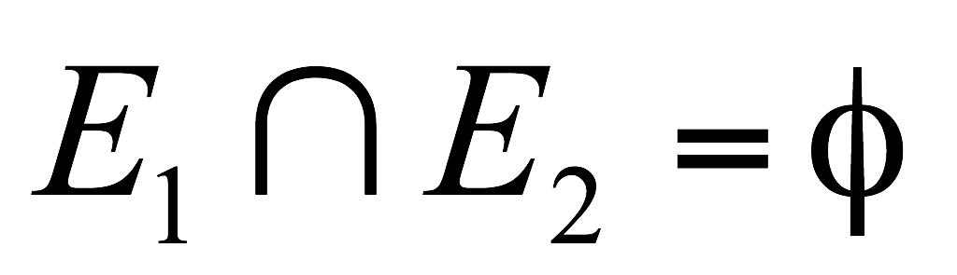
Disjoint event
Two events E₁, E₂ for an experiment are said to be disjoint (or mutually exclusive) if they cannot occur simultaneously, i.e.
tossing a die once
  “getting a 3” and “getting a 4”
    disjoint
  “getting a 3” and “not getting a 6”
    not disjoint
tosses of a die twice
  “getting a 3 on the first roll” and “getting a 4 on the second roll”
    not disjoint.
S
E₁
E₂
28

Slide 29
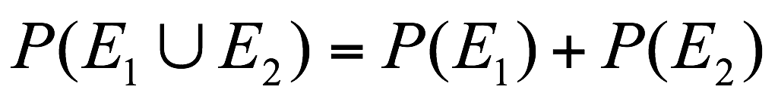
Addition rule of probability
if E₁ are E₂ are disjoint,
Generally,
S
E₁
E₂
S
E₁
E₂
29

Slide 30
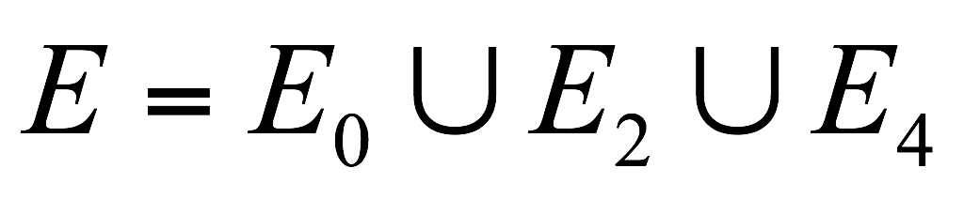
Applying addition Rule
When you toss a coin 5 times, what’s the probability of getting an even number of heads?
  Getting an even number of heads = “getting 0 heads” or “getting 2 heads” or “getting 4 heads”
  i.e.,
  It’s like addition rule for counting. We decompose the event into smaller events which are easier to count, and each smaller events have no overlap.
  So Pr(E)=Pr(E₀)+Pr(E₂)+Pr(E₄)
  Try to find Pr(E₀), Pr(E₂), and Pr(E₄)…
30

Slide 31
Example of applying rules
The professor is randomly picking 3 students from a class of 24 students to quiz. What’s the prob. that you or your best friend (or both) is selected?
  Calculate it directly:
    |E|: how many ways are there to pick 3 students so that either you or your best friend or both of you are selected.
  Or: Let E1 be the event that you are selected, E2: your best friend is selected
    Is an empty event?
31

Slide 32
Exercise: addition rule
You draw 2 cards randomly from a deck of 52 cards, what’s the probability that the 2 cards have the same value or are of the same color ?
You draw 2 cards randomly from a deck of 52 cards, what’s the probability that the 2 cards have the same value or are of the same suit ?
32

Slide 33
Probability: outline
Introduction
  Experiment, event, sample space
  Probability of events
Calculate Probability through counting
  Examples, exercises
Sum rule and general sum rule
  Examples and exercises
Product rule and general product rule
  Conditional probability
33

Slide 34
Independent event
Two events, E₁ and E₂, are said to be independent if occurrence of E₁ event is not influenced by occurrence (or non-occurrence) of E₂, and vice versa
Tossing of a coin for 10 times
  “getting a head on first toss”, and “getting a head on second toss”
  “getting 9 heads on first 9 tosses”, “getting a tail on 10th toss”
34

Slide 35
Independent event
A drawer contains 3 red paperclips, 4 green paperclips, and 5 blue paperclips. One paperclip is taken from the drawer and then replaced. Another paperclip is taken from the drawer.
  E1: the first paperclip is red
  E2: the second paperclip is blue
  E1 and E2 are independent
Typically, independent events refer to
  Different and independent aspects of experiment outcome
35

Slide 36
A drawer contains 3 red paperclips, 4 green paperclips, and 5 blue paperclips. One paperclip is taken from the drawer and not put back in the drawer. Another paperclip is taken from the drawer.
  E1: the first paperclip is red
  E2: the second paperclip is blue
  Are E1 and E2 independent?
    If E1 happens,
36

Slide 37
Independent event: example
Choosing a committee of three people from a club with 8 men and 12 women, “the committee has a woman” (E₁) and “the committee has a man” (E₂)
  If E₁ occurs, …
  If E₁ does not occur (i.e., the committee has no woman), then E₂ occurs for sure
  So, E₁ and E₂ are not independent
37

Slide 38
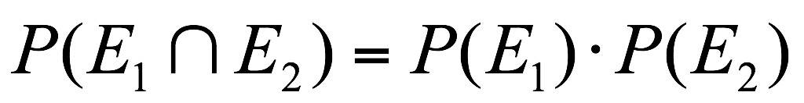
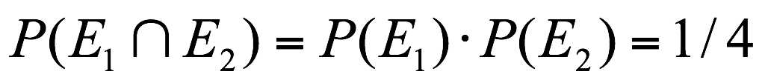
Product rule (Multiplication rule)
If E₁ and E₂ are independent events in a given experiment, then the probability that both E₁ and E₂ occur is the product of P(E₁) and P(E₂):
  Prob. of getting two heads in two coin flips
    E₁: getting head in first flip, P(E₁)=1/2
    E₂: getting head in second flip, P(E₂)=1/2
    E₁ and E₂ are independent
38

Slide 39
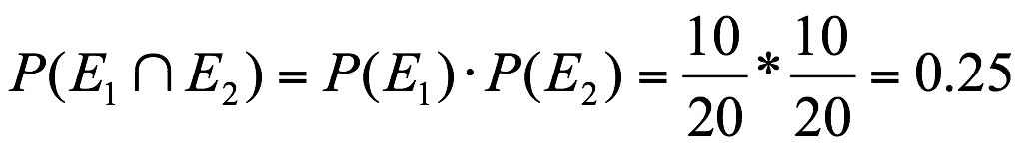
Independent event
Pick 2 marbles one by one randomly from a bag of 10 black marbles and 10 blue marbles, with replacement (i.e., first marble drawn is put back to bag)
  Prob. of getting a black marble first time and getting a blue marble second time ?
  E₁: getting a black marble first time
  E₂: getting a blue marble second time
  E₁ and E₂ are independent (because of replacement)
39

Slide 40
What if no replacement ?
Pick 2 marbles one by one randomly from a bag of 10 black marbles and 10 blue marbles, without replacement (i.e., first marble drawn is not put back)
  Prob. of getting a black marble first, and getting a blue marble second time ?
  E₁: getting a black marble in first draw
  E₂: getting a blue marble in second draw
  Are E₁ and E₂ independent ?
    If E₁ occurs, prob. of E₂ occurs is 10/19
    If E₁ does not occurs, prob. of E₂ occurs is: 9/19
  So, they are not independent
40

Slide 41
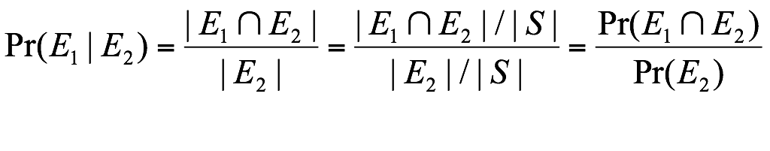
Conditional Probability
Probability of E₁ given that E₂ occurs, P (E₁|E₂), is given by:
Given E₂ occurs, our sample space is now E₂
  Prob. that E₁ happens equals
  to # of outcomes in E₁ (and E₂)
  divided by sample space size,
  and hence above definition.
S
E₁
E₂
41

Slide 42
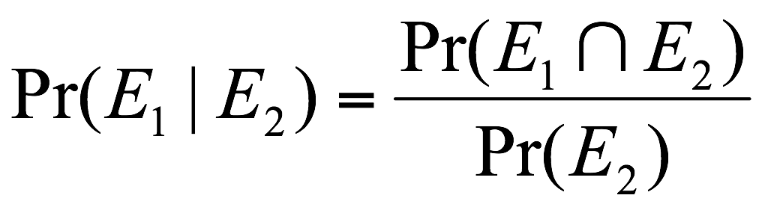
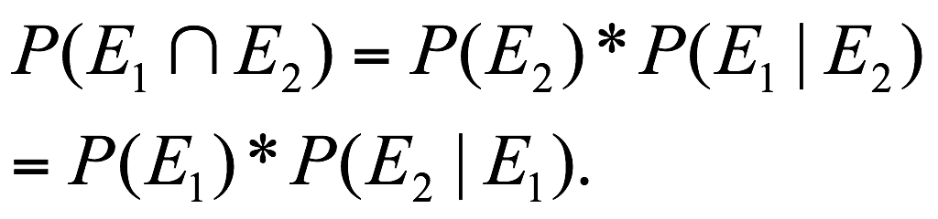
General Product Rule*
Conditional probability leads to general product rule:
If E₁ and E₂ are any events in a given experiment, the probability that both E₁ and E₂ occur is given by
S
E₁
E₂
42

Slide 43

Using product rule
Two marbles are chosen from a bag of 3 red, 5 white, and 8 green marbles, without replacement
  What’s the probability that both are red ?
    Pr(first one is red and second one is red) =?
    Pr (First one is red)=3/16
    Pr (second one is red | first one is red) = 2/15
    Pr (first one is red and second one is red)
    = Pr(first one is red) * Pr(second one is red | first one is red)
    = 3/16*2/15
43

Slide 44
Using product rule
Two marbles are chosen from a bag of 3 red, 5 white, and 8 green marbles, without replacement
  What’s the probability that one is white and one is green ?
    Either the first is white, and second is green
      (5/16)*(8/15)
    Or the first is green, and second is white
      (8/16)*(5/15)
    So answer is (5/16)*(8/15)+ (8/16)*(5/15)
44

Slide 45
Probability: outline
Introduction
  Experiment, event, sample space
  Probability of events
Calculate Probability through counting
Sum rule and general sum rule
Product rule and general product rule
  Conditional probability
Probability distribution function*
Bernoulli process
45

Slide 46
Probability Distribution*
How to handle a biased coin ?
  e.g. getting head is 3 times more likely than getting tail.
Sample space is still {H, T}, but outcomes H and T are not equally likely.
  Pr(getting head)+Pr (getting tail) = 1
  Pr (getting head)=3* Pr (getting tail)
  So we let Pr(getting head)=3/4
  Pr (getting tail)=1/4
  This is called a probability distribution
46

Slide 47
Probability Distribution*
A discrete probability function, p(x), is a function that satisfies the following properties. The probability that x can take a specific value is p(x).
  p(x) is non-negative for all real x.
  The sum of p(x) over all possible values of x is 1, that is
  One consequence of properties 1 and 2 is:
  0 ≤ p(x) ≤1.
47

Slide 48
Bernoulli Trials*
Bernoulli trial: an experiment whose outcome is random and can be either of two possible outcomes
  Toss a coin: {H, T}
  Gender of a new born: {Girl, Boy}
  Guess a number: {Right, Wrong}
  ….
48

Slide 49
Bernoulli Process*
Consists of repeatedly performing independent but identical Bernoulli trials
Example: Tossing a coin five times
  what is the probability of getting exactly three heads?
  What’s the probability of getting the first head in the fourth toss ?
49

Slide 50
Conditional probability, Pr(E₁|E₂)
So far we see example where E₁ naturally depends on E_{2.}
We next see a different example.
50

Slide 51
Calculating conditional probability*
Toss a fair coin twice, what’s the probability of getting two heads (E₁)given that at least one of the tosses results in heads (E₂) ?
  First approach: guess ?
51

Slide 52
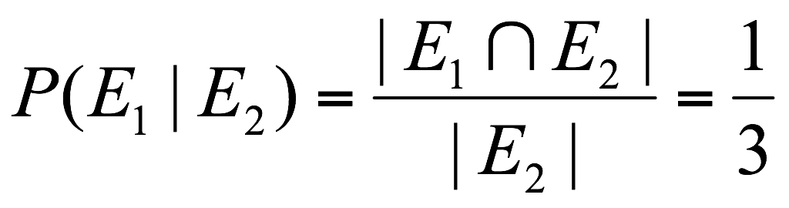
Conditional Prob. Example*
Toss a fair coin twice, what’s the probability of getting two heads (E₁) given that at least one of the tosses results in heads (E₂) ?
  Second approach
    Given that at least one result is head, our sample space is {HH,HT,TH}
    Among them event of interest is {HH}
    So prob. of getting two heads given … is 1/3
52

Slide 53
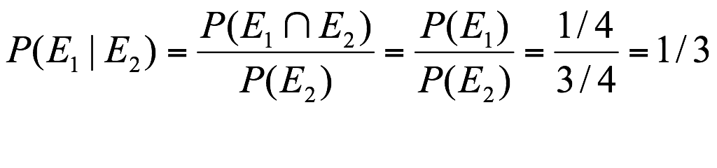
Conditional Prob. Example*
Toss a fair coin twice, what’s the probability of getting two heads (E₁) given that at least one of the tosses results in heads (E₂) ?
  Third approach
53

Slide 54

Example 2*
In a blackjack deal (first card face-down, second card face-up)
  T: face-down card has a value of 10
  A: face-up card is an ace
  Calculate P(T|A)
    Pr(T|A)=4/51
  Use P(T|A) to calculate P(T and A)
    P(T and A) = Pr(A)*Pr(T|A)=4/52*4/51
  Use P(A|T) to calculate P(T and A)
    P(T and A)=Pr(T)*Pr(A|T)=4/52*4/51
54

Slide 55
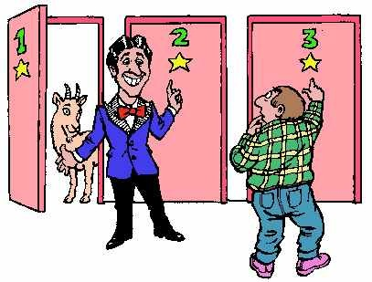
Monty Hall Problem***
You are presented with three doors (door 1, door 2, door 3). one door has a car behind it. the other two have goats behind them.
You pick one door and announce it.
Monty counters by showing you one of the doors with a goat behind it and asks you if you would like to keep the door you chose, or switch to the other unknown door.
Should you switch?
55

Slide 56
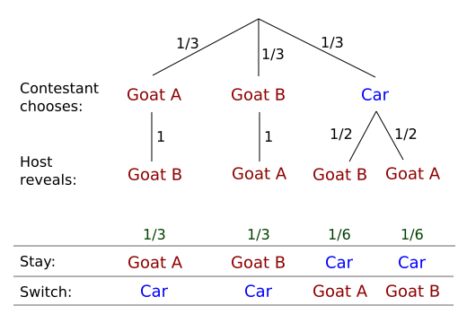
Monty Hall Problem***
56

