Slide 1
Chapter 4
Procedural Abstraction and Functions That Return a Value

Slide 2
Overview
Predefined Functions
Programmer-Defined Functions
  Local Variables
  Overloading Function Names
Top-Down Design and Procedural Abstraction

Slide 3
C++ Functions
Function: a packaged segment of code (i.e., has a name) that implement a well-defined functionality, e.g.,
  To calculate square root of a double value, named sqrt
  To read from keyboard the number of items to order, named GetItemNum,
  To calculate area of a circle with a given radius
Blackbox analogy: a function takes some input and produces some output
  Input: the value to calculate square root of, the item’s name, radius
  Output: the result of calculation, or user’s input (as in GetItemNum)
  Input provided as parameters, output as return value …

Slide 4
Program structure
Function declaration, function definition, function call
  Syntax, formal parameters, actual arguments
  Function must be declared before being called
int GetItemNumber (string itemName);
int main( )
{
GetItemNumber (“14-inch pizza”);
}
int GetItemNumber (string itemName)
{
int value;
cout <<“Enter the number of item “ << itemName <<“:”;
cin >> value;
return value;
}
function declaration
actual arguments
function call
formal parameters
function definition

Slide 5
function call
You can call a function from main, from any function (including the function itself, i.e., recursive function)
  value = sqrt (9.0)+12.0;
  area = AreaCircle (12.00);
  cout << ”Area of a circle with diameter “<< diameter
  << “ is “ <<AreaCircle (diameter/2.0);
  Note: if you declare and define a function, but do not call the function from main(), the function will not be executed

Slide 6
function call
Parameter passing (pass-by-value): the values of arguments are assigned to parameters based on order
  Normally, arguments can be expressions, variables, or constants
  Type of arguments should match with corresponding parameters (recall they will be assigned to the parameters)
Return from function:
  When reach return statement, or end of function body
  Go back to caller function, to the statement where function is called

Slide 7
Predefined Functions
C++ comes with libraries of predefined functions
Example: sqrt function that returns, or computes, square root of a number
  the_root = sqrt(9.0);
    the number, 9, is called the argument
    the_root will contain 3.0
sqrt(9.0) is a function call
  It invokes, or sets in action, the sqrt function
  argument (here it is 9), can also be a variable or an expression
  A function call can be used like any expression
    bonus = sqrt(sales) / 10;
    Cout << “The side of a square with area “ << area
    << “ is “
    << sqrt(area);

Slide 8
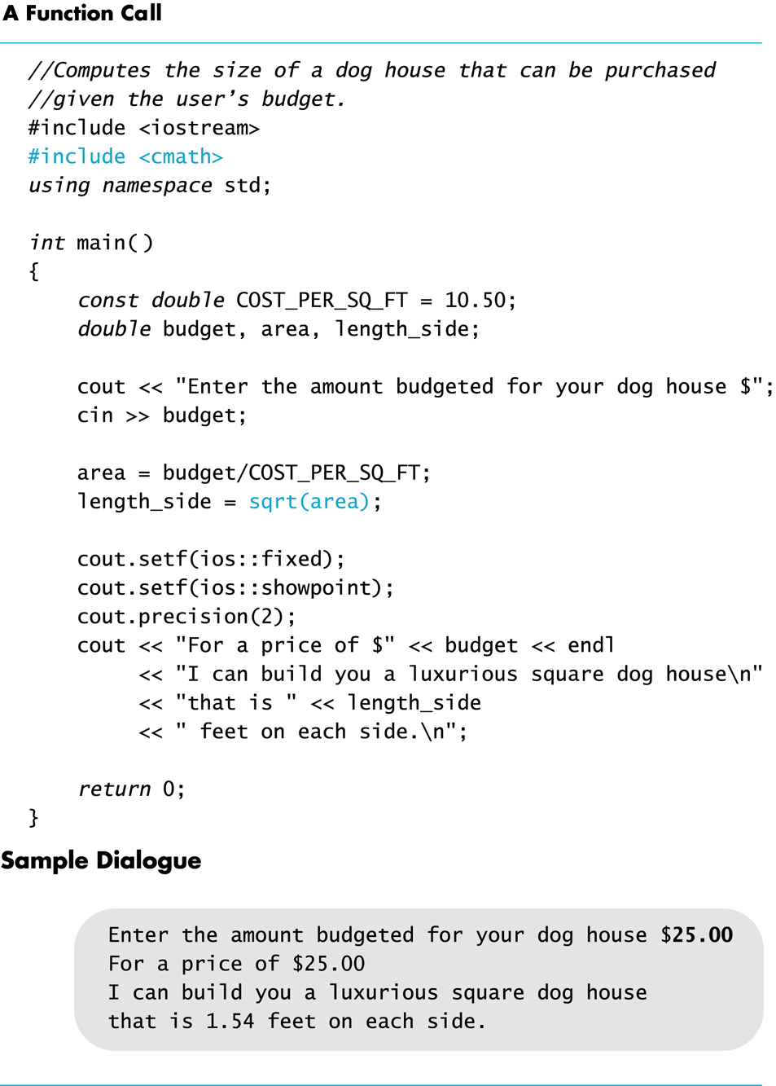

Slide 9
Function Call Syntax
Function_name (Argument_List)
  Argument_List is a comma separated list:
  (Argument_1, Argument_2, … , Argument_Last)
Example:
  side = sqrt(area);
  cout << “2.5 to the power 3.0 is “
  << pow(2.5, 3.0);

Slide 10
Function Libraries
Predefined functions are found in libraries
The library must be “included” in a program to make the functions available
An include directive tells the compiler which library header file to include.
To include the math library containing sqrt():
#include <cmath>
Newer standard libraries, such as cmath, also require directive
using namespace std;

Slide 11
Other Predefined Functions
abs(x) --- int value = abs(-8);
  Returns absolute value of argument x
  Return value is of type int
  Argument is of type x
  Found in the library cstdlib
fabs(x) --- double value = fabs(-8.0);
  Returns the absolute value of argument x
  Return value is of type double
  Argument is of type double
  Found in the library cmath

Slide 12
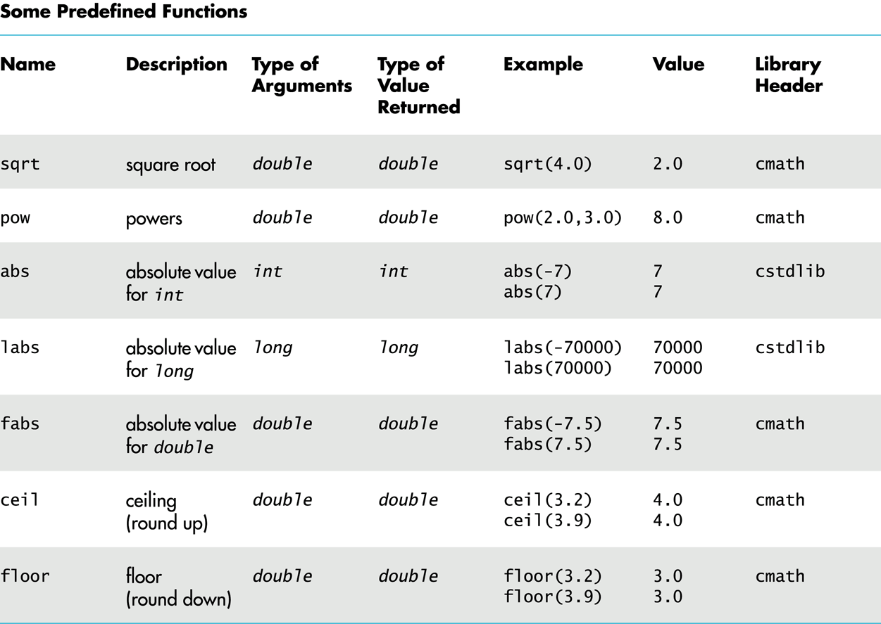

Slide 13
Random Number Generation
Really pseudo-random numbers
1. Seed the random number generator only once
#include <cstdlib>
#include <ctime>
srand(time(0));
2. rand() function returns a random integer that is greater than or equal to 0 and less than RAND_MAX
rand();

Slide 14
Random Numbers
Use % and + to scale to the number range you want
For example to get a random number from 1-6 to simulate rolling a six-sided die:
int die = (rand() % 6) + 1;
Can you simulate rolling two dice?
Generating a random number x where 10 < x < 21?

Slide 15
Type Casting
Recall the problem with integer division:
int total_candy = 9, number_of_people = 4;
double candy_per_person;
candy_per_person = total_candy / number_of_people;
  candy_per_person = 2, not 2.25!
A Type Cast produces a value of one type from another type
  static_cast<double>(total_candy) produces a double
  representing integer value of total_candy

Slide 16
Type Cast Example
int total_candy = 9, number_of_people = 4;
double candy_per_person;
candy_per_person = static_cast<double>(total_candy)
/ number_of_people;
  candy_per_person now is 2.25!
This would also work:
candy_per_person = total_candy /
static_cast<double>( number_of_people);
This would not!
candy_per_person = static_cast<double>( total_candy /
number_of_people);
Integer division occurs before type cast

Slide 17
Old Style Type Cast
C++ is an evolving language
This older method of type casting may be discontinued in future versions of C++
candy_per_person = double(total_candy)/number_of_people;

Slide 18
Exercises
Determine the value of d?
double d = 11 / 2;
Determine the value of
pow(2,3) fabs(-3.5) sqrt(pow(3,2))
7 / abs(-2) ceil(5.8) floor(5.8)
Convert the following to C++

Slide 19
Overview
Predefined Functions
Programmer-Defined Functions
  Local Variables
  Overloading Function Names
Top-Down Design and Procedural Abstraction

Slide 20
Programmer-Defined Functions
Two components of a function definition
  Function declaration (or function prototype)
    Shows how the function is called
    Must appear in the code before the function can be called
    Syntax:
    Type_returned Function_Name(Parameter_List);
    //Comment describing what function does
  Function definition
    Describes how the function does its task
    Can appear before or after the function is called
    Syntax:
    Type_returned Function_Name(Parameter_List)
    {
    //code to make the function work
    }
;

Slide 21
Function Declaration
Example:
double total_cost(int number_par, double price_par);
// Compute total cost including 5% sales tax on
// number_par items at cost of price_par each
Tell compiler about total_cost function:
  the return type
  the name of the function
  how many arguments are needed
  the types of the arguments
  the formal parameter names
    Formal parameters are like placeholders for the actual
    arguments used when the function is called
    Formal parameter names can be any valid identifier

Slide 22
Alternate Declarations
  Two forms of function declaration:
  double total_cost(int number_par, double price_par);
  // List formal parameter names
  // Compute total cost including 5% sales tax on
  // number_par items at cost of price_par each
double total_cost(int, double);
  //List types of formal parmeters, but not names
  // The first parameter is number of items, and the second is the unit price //Compute total cost including 5% sales tax on the specified number of
  // items at given unit price
First aids description of the function in comments
  Function headers must always list formal parameter names!

Slide 23
Placing Definitions
A function call must be preceded by either
  The function’s declaration, see example code
  or
  The function’s definition, see example code
    If the function’s definition precedes the call, a declaration is not needed
Placing the function declaration prior to main function and the function definition after the main function leads naturally to building your own libraries in the future.

Slide 24
Function Definition
Function header: Provides the same information as the declaration
Function body: Describes how the function does its task
Example:
double total_cost(int number_par, double price_par)
{
const double TAX_RATE = 0.05; //5% tax
double subtotal;
subtotal = price_par * number_par;
return (subtotal + subtotal * TAX_RATE);
}
Within a function definition
  Variables must be declared before they are used
    Variables are typically declared before the executable statements begin
  At least one return statement must end the function
    Each branch of an if-else statement might have its own return statement
function header
function body

Slide 25
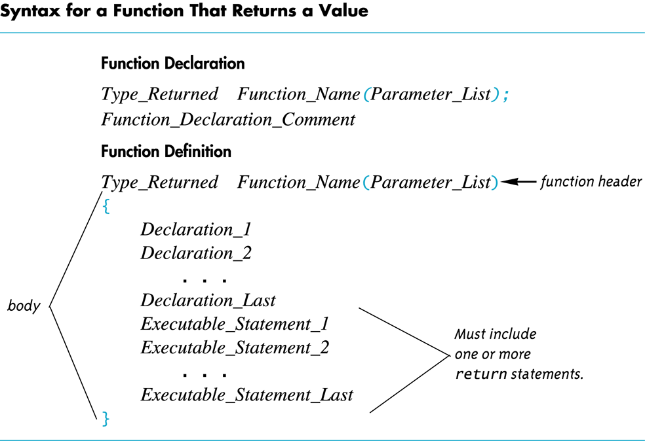

Slide 26
Return Statement
Ends the function call
Returns the value calculated by the function
Syntax:
return expression;
  expression performs the calculation or a variable containing the calculated value
Example:
area=PI*radius*radius;
return area;
or
return PI*radius*radius;

Slide 27
Overview
Predefined Functions
Programmer-Defined Functions
  Local Variables
  Overloading Function Names
Top-Down Design and Procedural Abstraction

Slide 28
Local Variables
Variables declared in a function:
  Are local to that function, they cannot be used from outside function
  Have the function as their scope
Variables declared in the main function of a program:
  Are local to the main function, they cannot be used from outside main function
  Have the main part as their scope

Slide 29
Formal Parameters are Local Variables
Formal Parameters are actually variables that are local to the function definition
  They are used just as if they were declared in function body
  Do NOT re-declare formal parameters in function body, they are declared in the function declaration
call-by-value mechanism
  When a function is called, formal parameters are initialized to values of the arguments in the function call

Slide 30
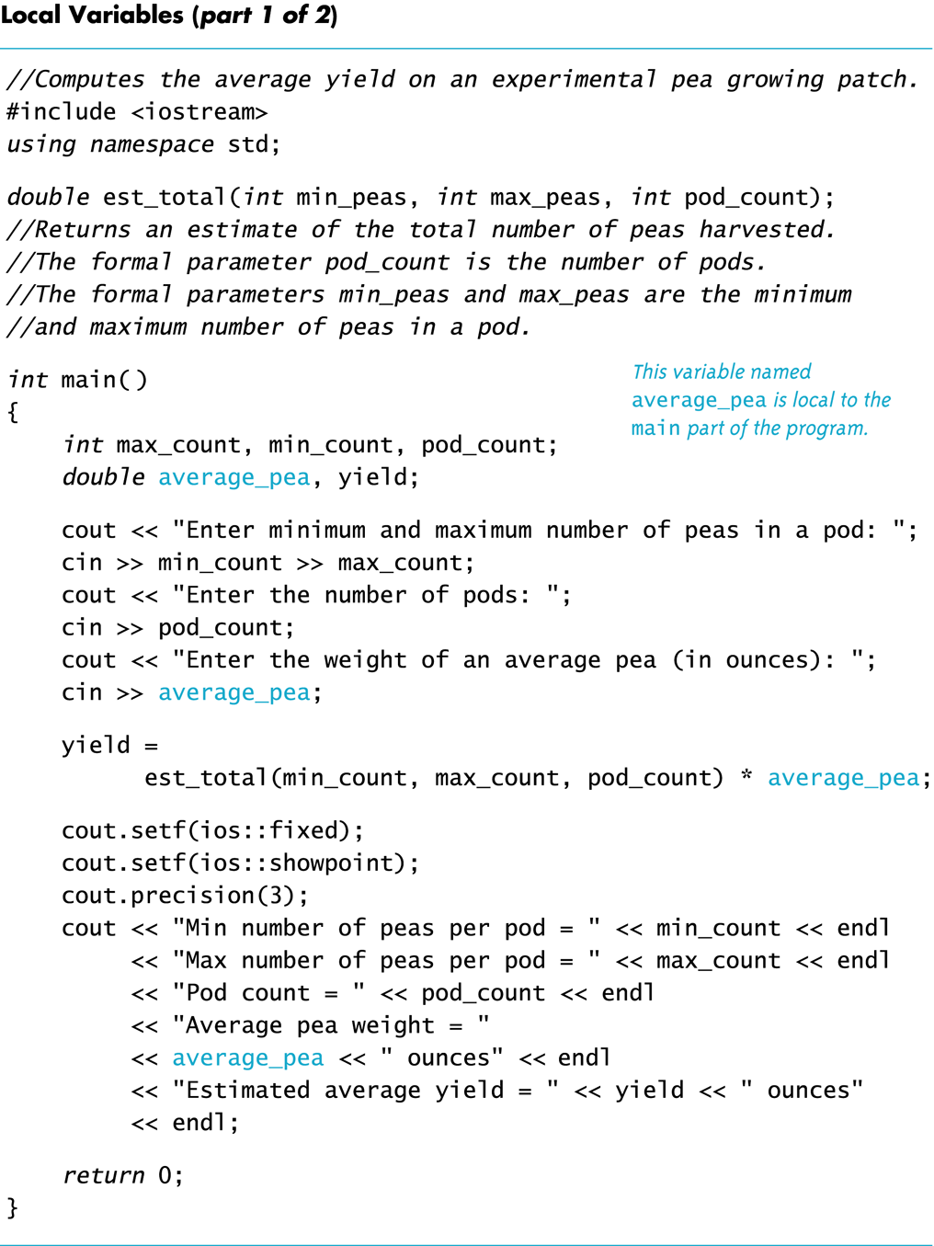

Slide 31
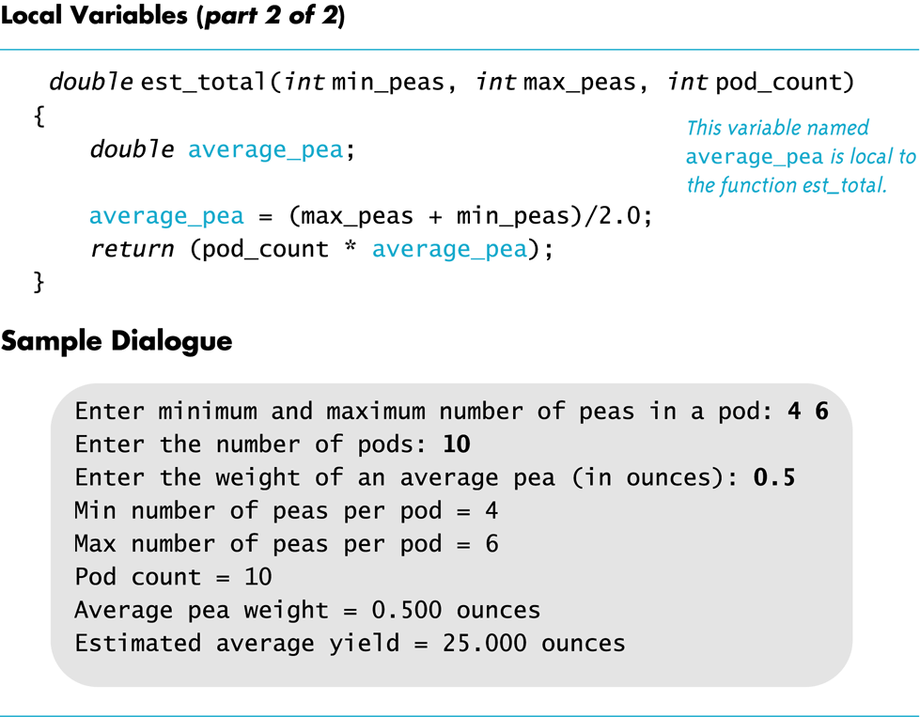

Slide 32
Global Variables
Global Variable -- used when more than one function must use a common variable
  Available to more than one function as well as main part of the program
  Declared outside any function body
  Declared outside the main function body
  Declared before any function that uses it
Generally make programs more difficult to understand and maintain

Slide 33
Global Constants
Global Named Constant
  A global variable that is constant
Example:
const double PI = 3.14159;
double volume(double);
int main()
{
…
}
…
  PI is available to the main function and to function volume

Slide 34
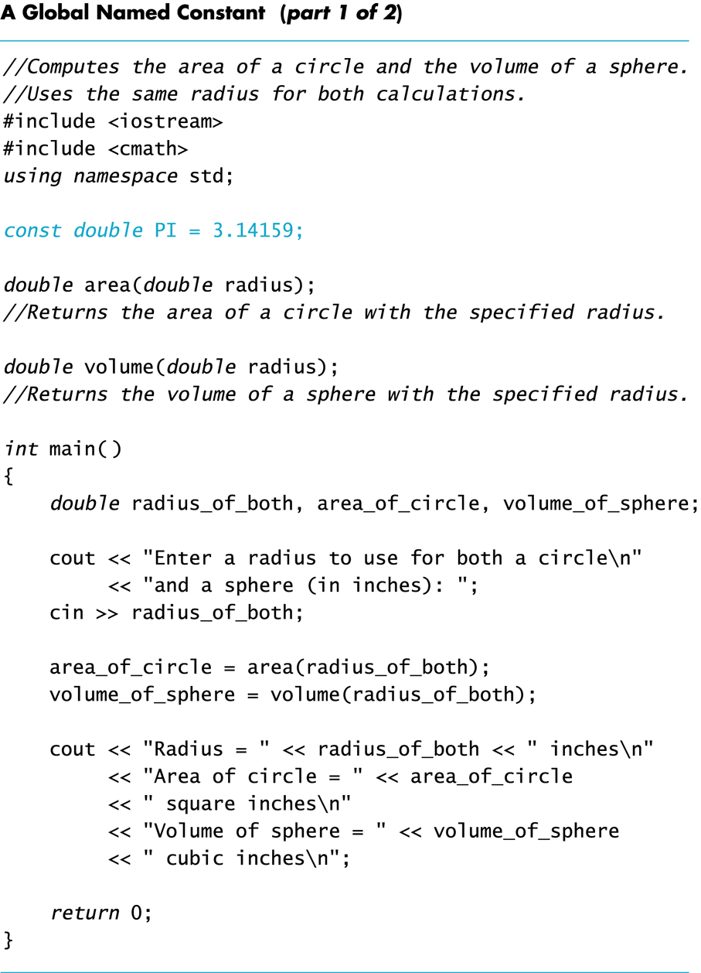
demo_pi.cpp

Slide 35
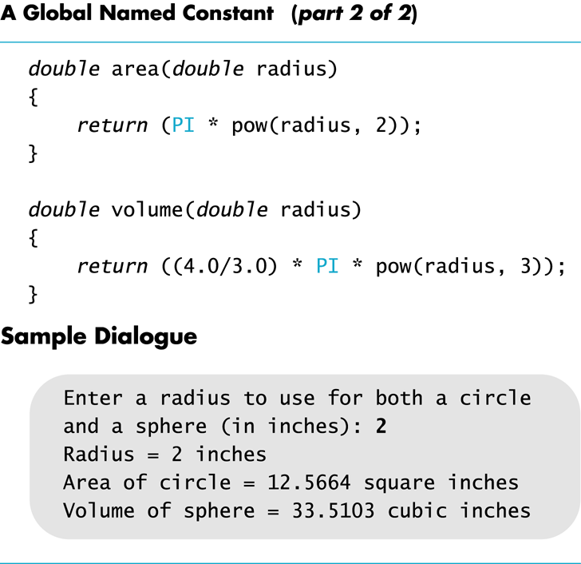

Slide 36
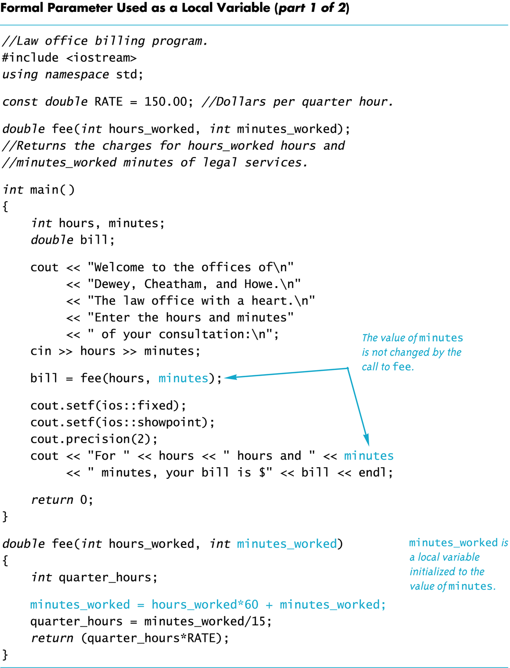
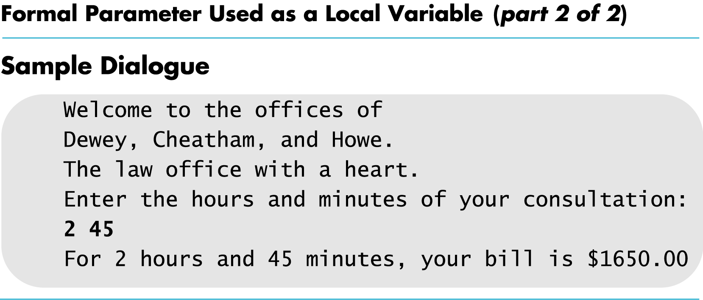

Slide 37
Block Scope
A block, or block statement, or code block: C++ code/statements enclosed in braces
  Global block: the outermost block that encompasses all code in a program
  Blocks can be nested: function block within global block, a for loop block within a function block, …
Block scope rule: identifier (variable) declared within a block is local to the block, i.e., only accessible from point of declaration to end of block
  Ex: local and global variables

Slide 38
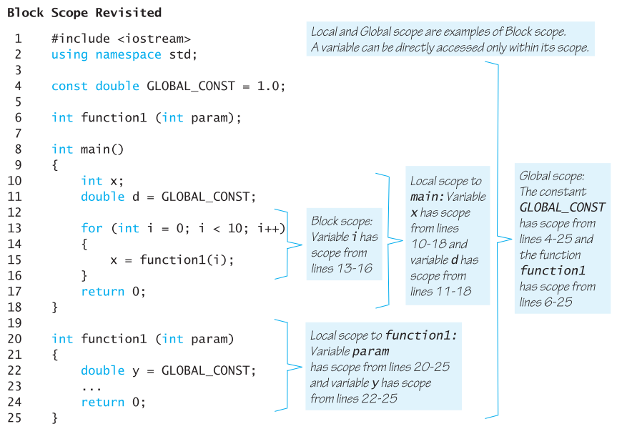

Slide 39
Exercises
Which of the following statements about variables is true?
  The same variable name can be used in two different functions.
  The same variable name cannot be used for two different variables in a single function.
  You should use global variables whenever possible.
  A variable is visible from the point at which it is defined until the end of the program.

Slide 40
Exercises
Which of the following is correct about a global variable?
  It is declared before all the functions in a program.
  It is visible to all the functions declared after it.
  It is declared in the main function.
  It is declared within the scope of a function.

Slide 41
Brush up your emacs skill
How to cut and paste?

Slide 42
Emacs keystroke notations
Ctrl key: C- prefix to denote holding down Ctrl while pressing another key.
  holding down Ctrl and pressing x is denoted as C-x
Meta key: M- prefix, pressing Esc once and releasing it
  M-x, press Esc and release it, then press x
M-C- prefix: press and release Esc, then hold down Ctrl while pressing the final key in command.
Examples
  C-x C-c: Press and hold Ctrl, then press x , followed by c .
  M-x shell: Press and release Esc, then press x . Then type shell and press Enter.
  M-C-p: Press and release Esc, then press and hold Ctrl and press p .

Slide 43
undo
Undo: reverses recent changes (not yet saved to file)
  You can undo all the changes one at a time
Keystrokes for undo
  C-/: press ctrl and / together
  C-x u: press ctrl and x together, and then u
  C-_: press ctrl and space together

Slide 44
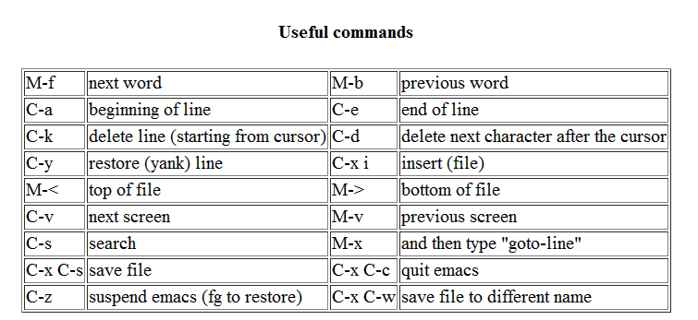
Other emacs commands

Slide 45
How to cut/copy/ paste ?
First select part of texts that you want to cut or copy
  First set a mark at one end, then move cursor to other end.
    To set mark, press C-SPC or C-@
  Region is all of the text from mark to cursor.
Then cut or copy
  To cut selected text, press C-w (Ctrl-w)
  To copy selected text, press M-w (Press Esc, release it, and then press w)
To paste text that has just been cut/copied
  press C-y (Ctrl-y)

Slide 46
Overview
Predefined Functions
Programmer-Defined Functions
  Local Variables
  Function call: how to trace?
  Overloading Function Names
Top-Down Design and Procedural Abstraction

Slide 47
Recall handtracing
Purpose: identify logic errors, understand others’ code, verify your code/design
What you needs:
  The program
  Paper and pencil
Keys:
  Arrows: pointing to current statement
  A variable table: keeping track of variable values
  Input region: what have been entered by user in keyboard, what have been read by the program?
  Output region: keeping track of information displayed in terminal (standard output)

Slide 48
Tracing Function Call
Create a new variable table for function’s local variables
  Include formal parameters, those listed inside (…)
Parameter Passing: assign values of arguments to formal parameters based on order (not by names…)
  first argument assigned to first formal parameter
  second argument for second formal parameter, and so forth
  So called “pass-by-value” parameters
Start to execute function body from first statement, until a return statement, or } (end of function)
Value returned to the caller, and resume execution in caller function (at the point where function is called)

Slide 49
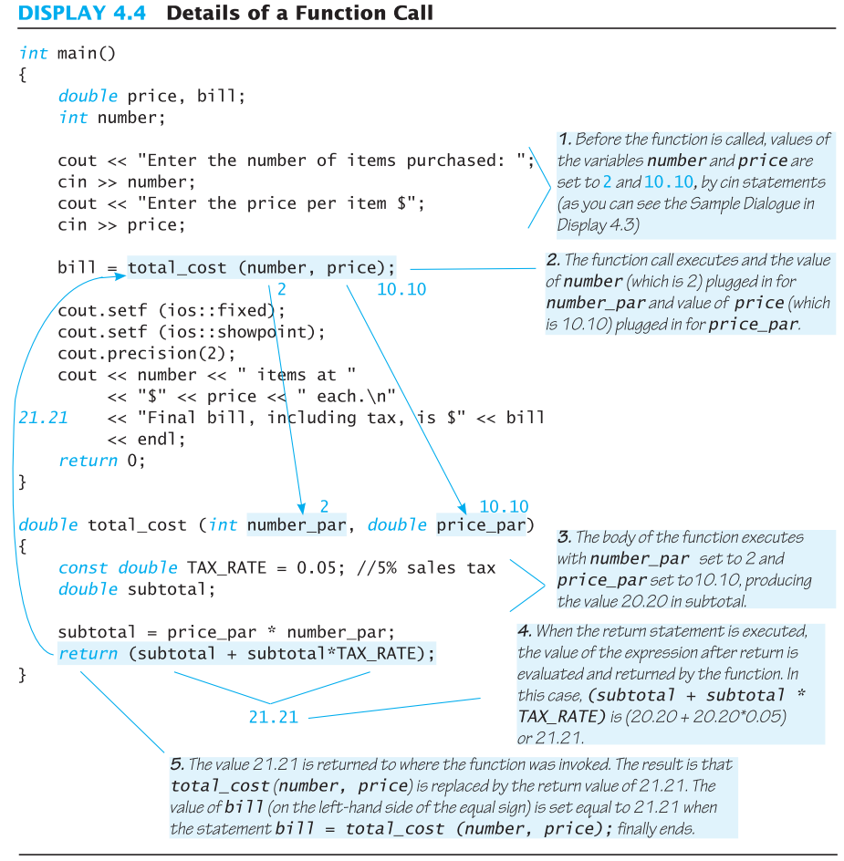

Slide 50
Example: Factorial
n! Represents the factorial function
n! = 1 x 2 x 3 x … x n
C++ version of the factorial function
  Requires one argument of type int, n
  Returns a value of type int
Algorithm
  Uses a local variable to store current product
  Decrements n each time it does another multiplication
  n * n-1 * n-2 * … * 1

Slide 51
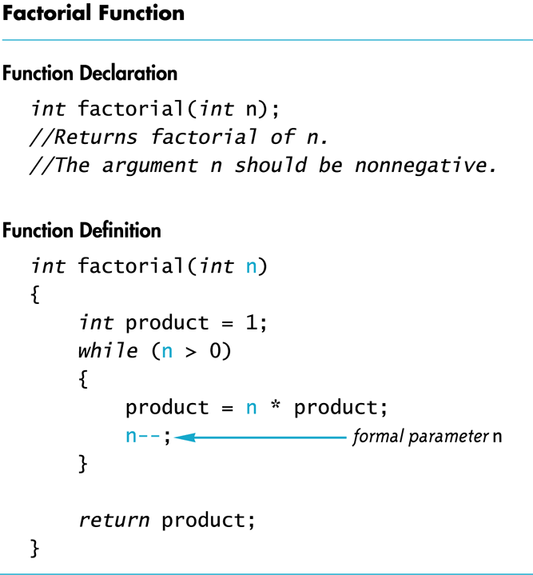

Slide 52
Factorial.cpp
int main ()
{
int k;
cout << "Enter a natural number:";
cin >> k;
int result = factorial (k);
cout <<"factorial of " << k << "="
<< result << endl;
}
int factorial(int k)
{
int product = 1;
while (k > 0)
{
product = k * product;
k--;
}
return product;
}
main() local variables
k
result
factorial(k) local variables
k
product
Input/Output:
Enter a natural number: 4

Slide 53
Trace with help of computer
Add cout statements to trace the execution of program
  Before and after each chunk of code
  before and after loop
  Before and after function calls
  Inside function call: entry point and exit point
    To make sure parameters have been passed correctly
  Anywhere you suspect something has gone wrong:
    Binary search to identify where errors occur
  Example: fact_trace.cpp
You can also add some “break points”:
  Example: fact_trace2.cpp
Tools: gdb or IDE to trace your program

Slide 54
Order of Arguments
Compiler checks that types of arguments are correct and in the correct sequence.
Compiler cannot check that arguments are in the correct logical order
Example: Given the function declaration:
char grade(int received_par, int min_score_par);
int received = 95, min_score = 60;
cout << grade( min_score, received);
  Produces a faulty result because the arguments are not in
  the correct logical order. The compiler will not catch this!

Slide 55
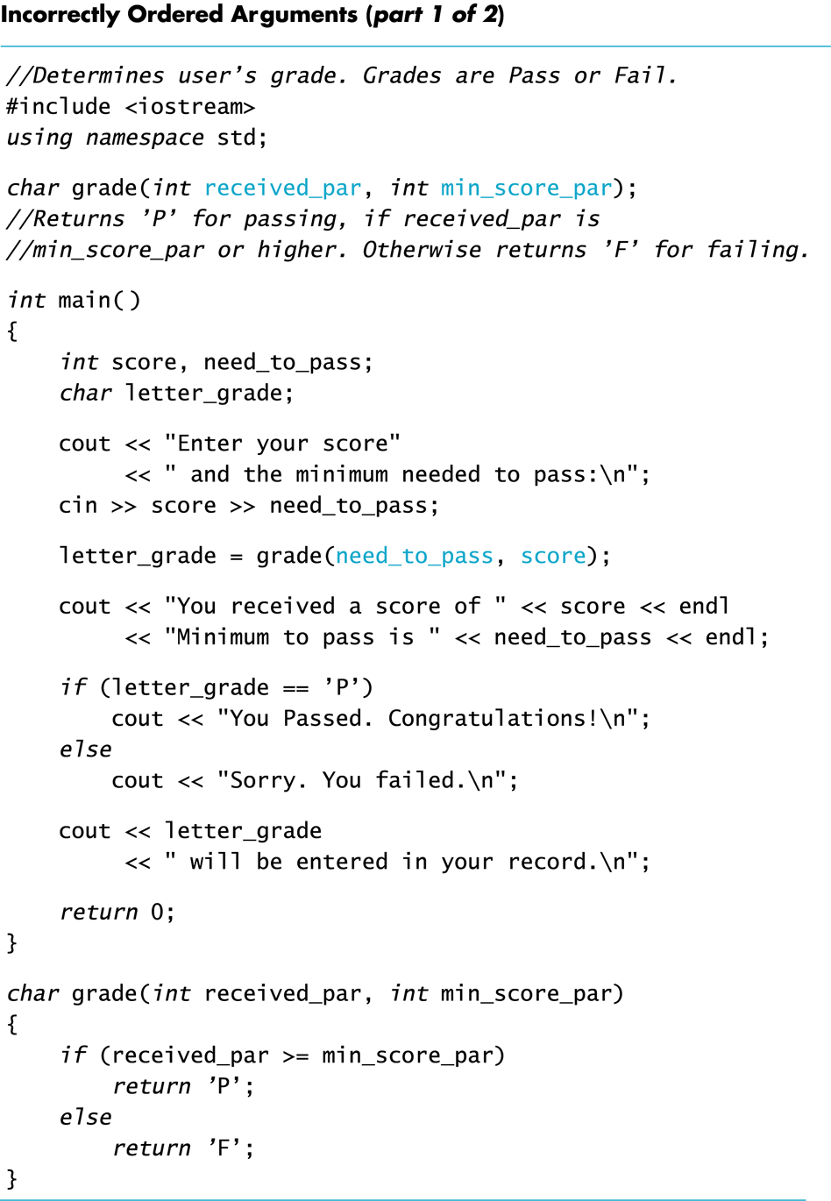
grade.cpp
Although formal
parameter names
only matters in terms of style
(like indentation), good names
prevent such mistakes.
Imagine this and no comment:
char grade (int a, int b);

Slide 56
Automatic Type Conversion
Given the definition
double mpg(double miles, double gallons)
{
return (miles / gallons);
}
what will happen if mpg is called in this way?
cout << mpg(45, 2) << “ miles per gallon”;
values of arguments will automatically be converted to type double (45.0 and 2.0)

Slide 57
bool Return Values
A function can return a bool value
  Such a function can be used where a boolean expression is expected
if (((rate >=10) && ( rate < 20)) || (rate == 0))
…
if (appropriate (rate))
…
bool appropriate(int rate)
{
return (((rate >=10) && ( rate < 20)) || (rate == 0));
}

Slide 58
Example
Write a function for testing leap year, it takes the year as parameter, and return true if the year is leap year; and return false otherwise.
  Start with declaration, comment (a kind of contract, requirement analysis: what does this function do?)
  Then move on to definition (i.e., actual implementation: how does the function achieve it?)

Slide 59
Example
Write a function that returns the number of days in a month.
  Function declaration:
    What parameter(s) (i.e., input) the function needs?
    What output the function generates (i.e., return value)?
  Function definition:

Slide 60
Overview
Predefined Functions
Programmer-Defined Functions
  Local Variables
  Function call: how to trace?
  Overloading Function Names
Top-Down Design and Procedural Abstraction

Slide 61
Overloading Function Names
C++ allows more than one definition for same function name
  Very convenient for situations in which “same” function is needed for different numbers or types of arguments
  E.g., average of integers, average of doubles
  E.g., area of circle, area of rectangle, …
Overloading a function name: more than one declaration and definition using same function name

Slide 62
Overloading Examples
double ave(double n1, double n2)
{
return ((n1 + n2) / 2);
}
double ave(double n1, double n2, double n3)
{
return (( n1 + n2 + n3) / 3);
}
Compiler checks number and types of arguments
in function call to decide which function to use
cout << ave( 10, 20, 30);
uses the second definition

Slide 63
Overloading Details
Overloaded functions
  Must return a value of the same type
  Must have different numbers of formal parameters, or at least one parameter is of different type
Example: overload_test.cpp

Slide 64
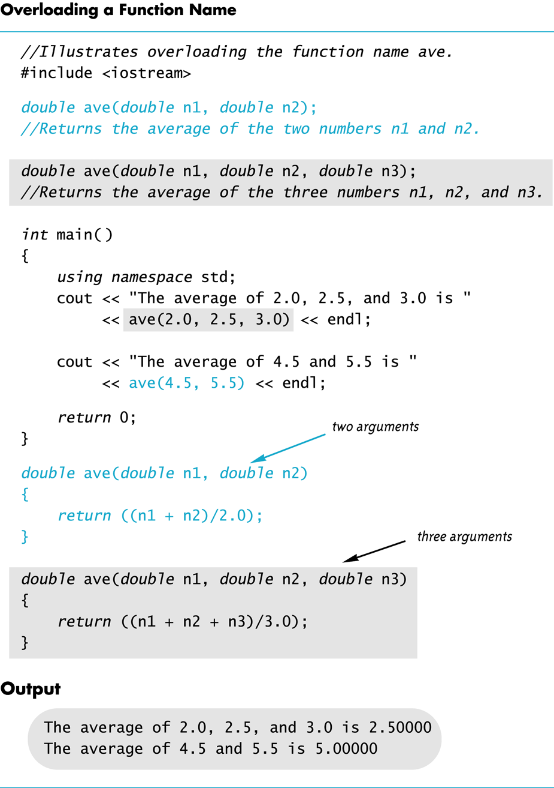
overload_ex.cpp

Slide 65
Function overloading mpg.cpp
double mpg(double miles, double gallons) //return miles per gallon
{
return (miles / gallons);
}
int mpg(int goals, int misses)
// returns the Measure of Perfect Goals
{
return (goals – misses);
}
what happens if mpg is called as follows?
cout << mpg(45, 2) << “ miles per gallon”;
  Compiler chooses function that matches parameter types so Measure of Perfect Goals will be calculated
Do not use the same function name for unrelated functions

Slide 66
Overview
Predefined Functions
Programmer-Defined Functions
  Local Variables
  Function call: how to trace?
  Overloading Function Names
Why functions?
  Procedural Abstraction
  How does it help with problem solving, i.e., Top-Down Design

Slide 67
Without functions
If there is no function
  We need to use C++ statements to write codes to calculate square root, exponentials, logarithm, write to a disk file, write to terminal
  Everything will be located in a super long main( )
  We have to copy code around, as we might need to calculate square root in multiple locations in the code
Hard to re-use code:
  if a friend of yours implemented calculating square root, you have to copy/embed his/her code in your main, making sure there is no name conlision
Code: hard to read, understand, maintain !

Slide 68
Function to rescure
We “package” codes that implement a well-defined functionalities into a “function”
  For example, code to calculate square root
  To read an order of an item
We then call the function from multiple places
  GetItemNumber (“12-inch pizza”);
  GetItemNumber (“14-inch pizza);
Share it with others, therefore we have iostream, cmath library which are a collection of function definitions
  #include <cmath> //add math function declarations into your program, so you can call them…
Change function’s implementation without affect callers

Slide 69
Procedural Abstraction
Black Box: refers to something that we know how to use (inputs, buttons, menus and output), but the method of operation is unknown
  A person using a program does not need to know how it is coded, but he know what the function does
  E.g., you know brake is for slowing down, but do not know how it works …
Functions and Black Box Analogy
  A programmer who uses a function needs to know
  what the function does, not how it does it
    Only function header, and comment (Header: specify input and output of the function)
    E.g., you do not know how sqrt() is implemented …

Slide 70
Procedural Abstraction and C++
Procedural Abstraction is writing and using functions as if they were black boxes
  Procedure is a general term meaning a “function like”
  set of instructions
  Abstraction: when you use a function as a black box, you abstract away details of code in the function body

Slide 71
Guideline for function design
Each function does one well-defined thing
  Do not do multiple things in one function, e.g., read item number and calculate the cost …
  And possibly needed for future
  One-liner, 2-liners are not well suited for function
In general, return the result, instead of cout the result
  Let the caller function decides what to do with
Information hiding: function can be used without knowing how it is coded (function body can be “hidden from view”), declaration and comment is all a programmer needs to know
  comment should tell all conditions required of parameters to function, and choose meaningful names for formal parameters,
  Comment should describe the returned value

Slide 72
Overview
Predefined Functions
Programmer-Defined Functions
  Local Variables
  Function call: how to trace?
  Overloading Function Names
Why functions?
  Procedural Abstraction
  How does it help with problem solving, i.e., Top-Down Design

Slide 73
Top Down Design
To write a program
  Develop algorithm that program will use
  Translate algorithm into programming language
Top Down Design (also called stepwise refinement)
  Break the algorithm into subtasks
  Break each subtask into smaller subtasks
  Eventually smaller subtasks are trivial to implement in programming language
    Very often, subtasks are implemented as functions

Slide 74
Function Implementations and The Black Box
Designing with the black box in mind allows us
  To change or improve a function definition without
  forcing programmers using the function to change
  what they have done
  To know how to use a function simply by reading the
  function declaration and its comment

Slide 75
Benefits of Top Down Design
Subtasks, or functions in C++, make programs easier to
  Write: as you can focus on a simpler function, blocking out other tasks
  Test and debug: because of simplicity of each function,
  Understand
  Change
  Teamwork

Slide 76
Case Study Buying Pizza
What size pizza is the best buy?
  Which size gives the lowest cost per square inch?
  Pizza sizes given in diameter
  Quantity of pizza is based on the area which
  is proportional to the square of the radius

Slide 77
Buying Pizza Problem Definition
Input:
  Diameter of two sizes of pizza
  Cost of the same two sizes of pizza
Output:
  Cost per square inch for each size of pizza
  Which size is the best buy
    Based on lowest price per square inch
    If cost per square inch is the same, the smaller size
    will be the better buy

Slide 78
Buying Pizza Problem Analysis
Subtask 1
  Get the input data for each size of pizza
Subtask 2
  Compute price per inch for smaller pizza
Subtask 3
  Compute price per inch for larger pizza
Subtask 4
  Determine which size is the better buy
Subtask 5
  Output the results

Slide 79
Buying Pizza Function Analysis
Subtask 2 and subtask 3 should be implemented
as a single function because
  Subtask 2 and subtask 3 are identical tasks
    The calculation for subtask 3 is the same as the
    calculation for subtask 2 with different arguments
  Subtask 2 and subtask 3 each return a single
  value
Choose an appropriate name for the function
  We’ll use unitprice

Slide 80
Buying Pizza unitprice Declaration
double unitprice(int diameter, int double price);
//Returns the price per square inch of a pizza
//The formal parameter named diameter is the
//diameter of the pizza in inches. The formal
// parameter named price is the price of the
// pizza.

Slide 81
Buying Pizza Algorithm Design
Subtask 1
  Ask for the input values and store them in variables
    diameter_small diameter_large
    price_small price_large
Subtask 4
  Compare cost per square inch of the two pizzas using
  the less than operator
Subtask 5
  Standard output of the results

Slide 82
Buying Pizza unitprice Algorithm
Subtasks 2 and 3 are implemented as calls to
function unitprice
unitprice algorithm
  Compute the radius of the pizza
  Computer the area of the pizza using
  Return the value of (price / area)

Slide 83
Buying Pizza unitprice Pseudocode
Pseudocode
  Mixture of C++ and english
  Allows us to make the algorithm more precise without worrying about the details of C++ syntax
unitprice pseudocode
  radius = one half of diameter;
  area = π * radius * radius
  return (price / area)

Slide 84
Buying Pizza The Calls of unitprice
Main part of the program implements calls
of unitprice as
  double unit_price_small, unit_price_large;
  unit_price_small = unitprice(diameter_small, price_small);
  unit_price_large = unitprice(diameter_large, price_large);

Slide 85
Buying Pizza First try at unitprice
double unitprice (int diameter, double price)
{
const double PI = 3.14159;
double radius, area;
radius = diameter / 2;
area = PI * radius * radius;
return (price / area);
}
  Oops! Radius should include the fractional part

Slide 86
Buying Pizza Second try at unitprice
double unitprice (int diameter, double price)
{
const double PI = 3.14159;
double radius, area;
radius = diameter / static_cast<double>(2) ;
area = PI * radius * radius;
return (price / area);
}
  Now radius will include fractional parts
    radius = diameter / 2.0 ; // This would also work

Slide 87
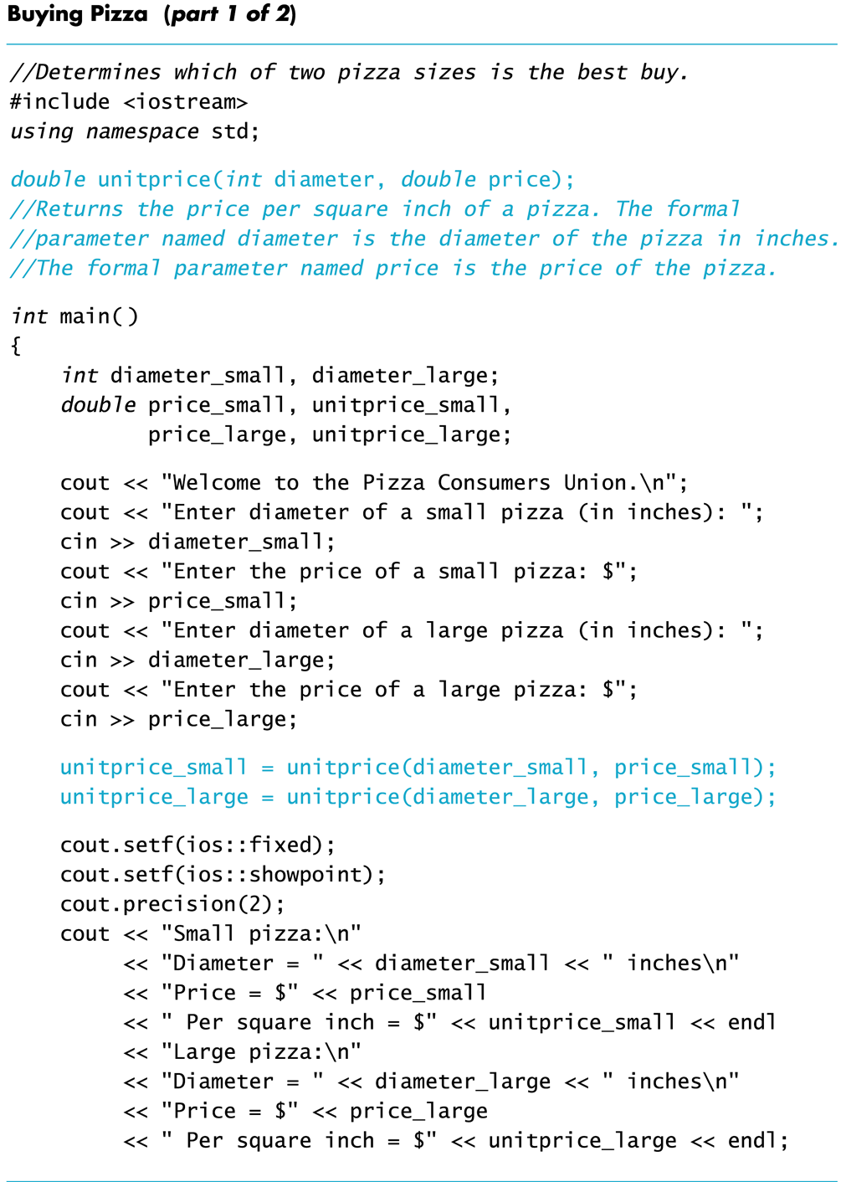

Slide 88
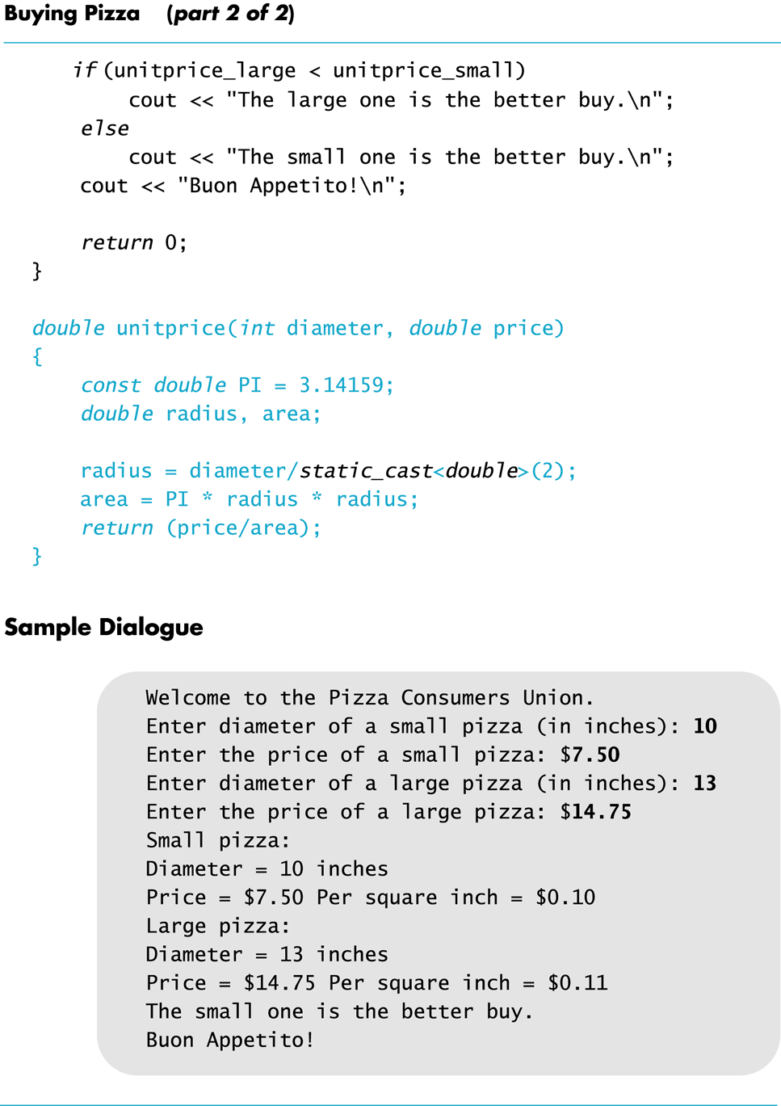
Display 4.10 (2/2)
Back
Next

Slide 89
Overloading Example
Revising Pizza Buying program
  Rectangular pizzas are now offered!
  Change input and add a function to compute unit price of a rectangular pizza
    new function could be named unitprice_rectangular
    Or, new function could be a new (overloaded) version of unitprice function that is already used
    double unitprice(int length, int width, double price)
    {
    double area = length * width;
    return (price / area);
    }

Slide 90
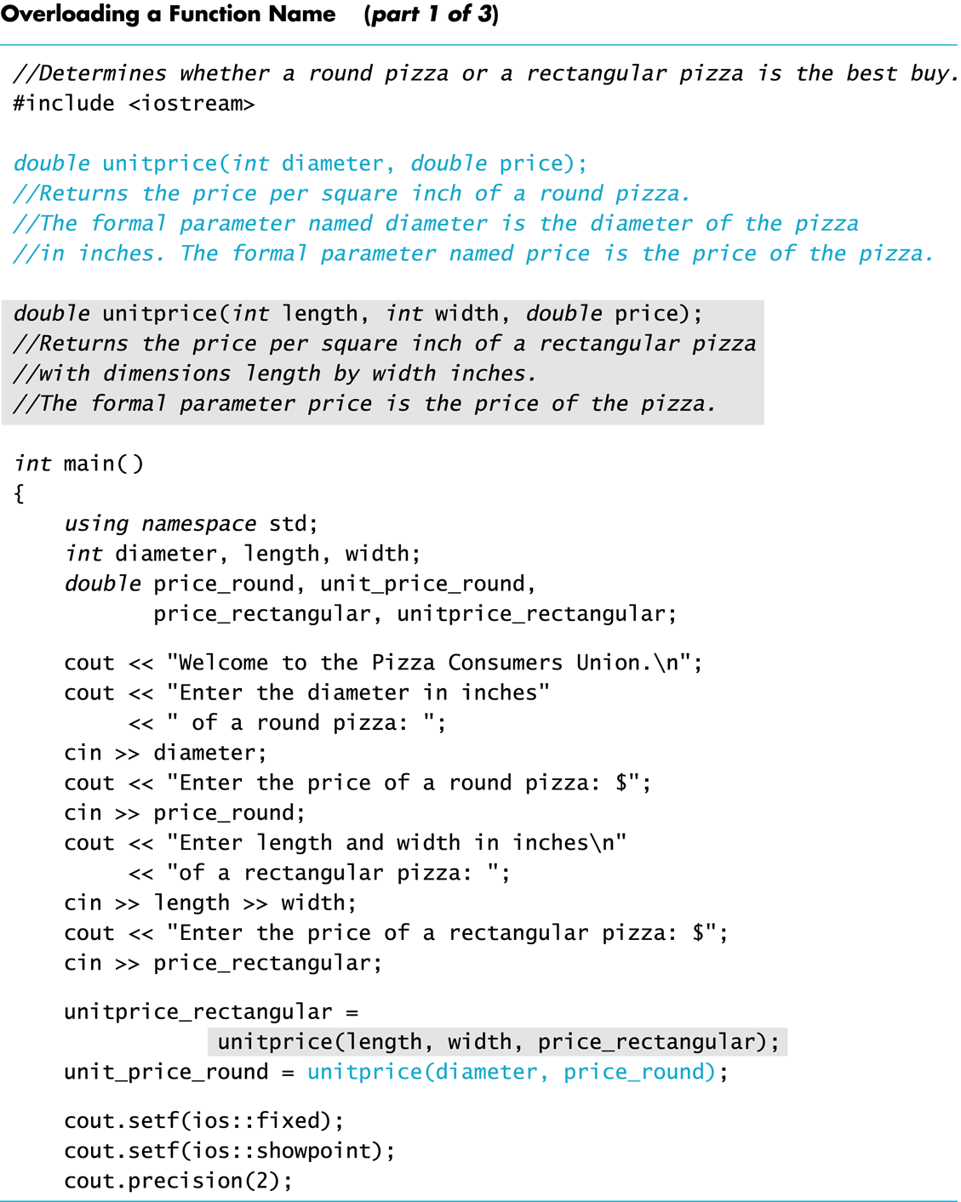

Slide 91
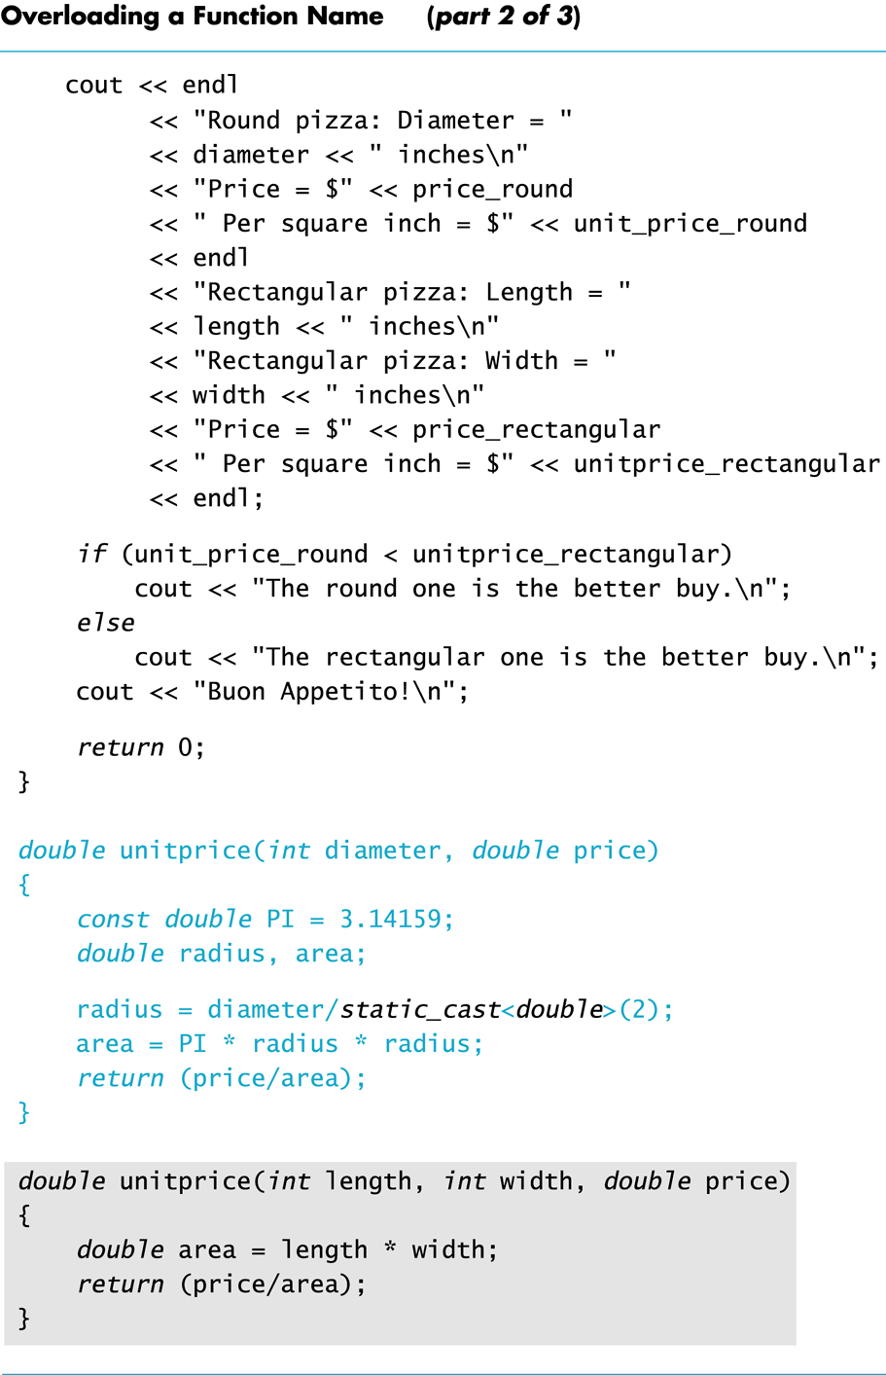

Slide 92
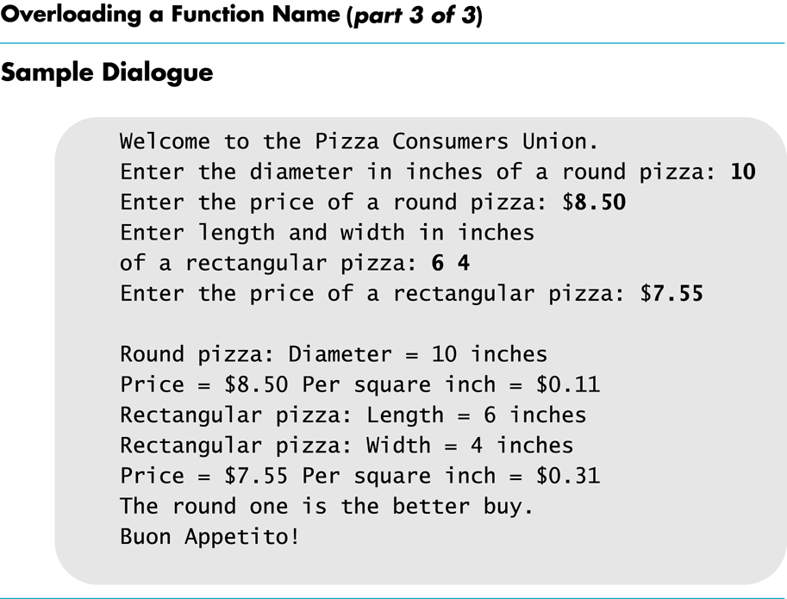

Slide 93
Program Testing
Programs that compile and run can still produce errors
Testing increases confidence that the program works correctly
  Run the program with data that has known output
    You may have determined this output with pencil and paper
    or a calculator
  Run the program on several different sets of data
    Your first set of data may produce correct results in
    spite of a logical error in the code
      Remember the integer division problem? If there is no fractional
      remainder, integer division will give apparently correct results

Slide 94
Use Pseudocode
Pseudocode is a mixture of English and the
programming language in use
Pseudocode simplifies algorithm design by
allowing you to ignore the specific syntax of
the programming language as you work out
the details of the algorithm
  If the step is obvious, use C++
  If the step is difficult to express in C++, use English

Slide 95
Exercises
Describe the purpose of the comment that
accompanies a function declaration?
Describe what it means to say a programmer should be able to treat a function as a black box?
Describe what it means for two functions to be
black box equivalent?

Slide 96
Exercises
Describe Top-Down Design?
Describe the types of tasks we have seen so far
that could be implemented as C++ functions?
Describe the principles of
  The black box
  Procedural abstraction
  Information hiding
Define “local variable”?
Overload a function name?

Slide 97
Summary
Predefined Functions
Programmer-Defined Functions
  Local Variables
  Function call: how to trace?
  Overloading Function Names
Why functions?
  Procedural Abstraction
  How does it help with problem solving, i.e., Top-Down Design

