Slide 1
CHAPTER 4
ELEMENTARY NUMBER THEORY AND METHODS OF PROOF
Copyright © Cengage Learning. All rights reserved.

Slide 2
SECTION 4.1
Direct Proof and Counterexample I:Introduction
Copyright © Cengage Learning. All rights reserved.

Slide 3
Discovery and Proof
Both discovery and proof are integral parts of problem solving.
When you think you have discovered that a certain statement is true, try to figure out why it is true.
If you succeed, you will know that your discovery is genuine.
Even if you fail, the process of trying will give you insight into the nature of the problem and may lead to the discovery that the statement is false.
For complex problems, the interplay between discovery and proof is not reserved to the end of the problem-solving process but, rather, is an important part of each step.

Slide 4
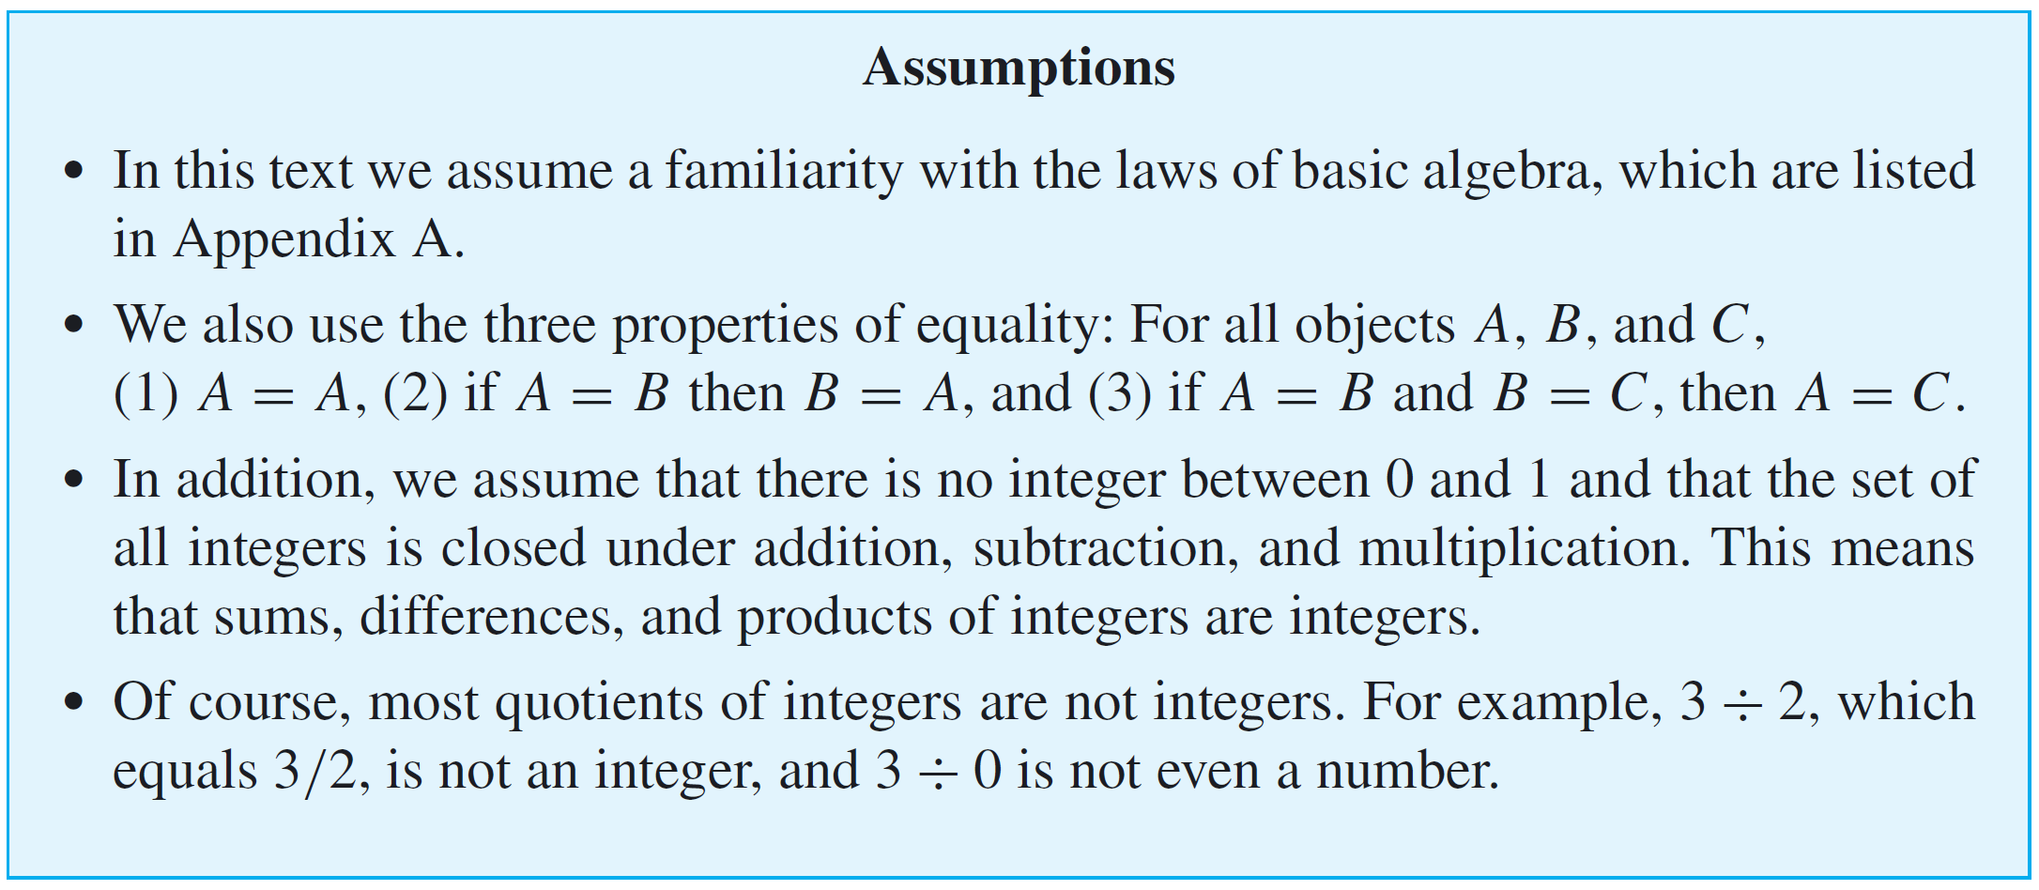
Direct Proof and Counterexample I: Introduction

Slide 5
Definitions
In order to evaluate the truth or falsity of a statement, you must understand what the statement is about.
You must know the meanings of all terms that occur in the statement.
Mathematicians define terms very carefully and precisely and consider it important to learn definitions virtually word for word.

Slide 6
Example 1 – Even and Odd Integers
Use the definitions of even and odd to justify your answers to the following questions.
a. Is 0 even?
b. Is −301 odd?
c. If a and b are integers, is 6a²b even?
d. If a and b are integers, is 10a + 8b + 1 odd?
e. Is every integer either even or odd?

Slide 7
Example 2 – Prime and Composite Numbers
a. Is 1 prime?
b. Is every integer greater than 1 either prime or composite?
c. Write the first six prime numbers.
d. Write the first six composite numbers.

Slide 8
Proving Existential Statements

Slide 9
Proving Existential Statements
We have known that a statement in the form
∃x ∈ D such that Q(x)
is true if, and only if,
Q(x) is true for at least one x in D.
One way to prove this is to find an x in D that makes Q(x) true.
Another way is to give a set of directions for finding such an x. Both of these methods are called constructive proofs of existence.

Slide 10
Example 3 – Constructive Proofs of Existence
a. Prove the following: ∃ an even integer n that can be written in two ways as a sum of two prime numbers.
b. Suppose that r and s are integers. Prove the following: ∃ an integer k such that 22r + 18s = 2k.

Slide 11
Proving Existential Statements
A nonconstructive proof of existence involves showing either
(a) that the existence of a value of x that makes Q(x) true is guaranteed by an axiom or a previously proved theorem or
(b) that the assumption that there is no such x leads to a contradiction.
The disadvantage of a nonconstructive proof is that it may give virtually no clue about where or how x may be found.

Slide 12
Disproving Universal Statements by Counterexample

Slide 13
Disproving Universal Statements by Counterexample
To disprove a statement means to show that it is false.
To disprove a statement of the form
∀x in D, if P(x) then Q(x).
Showing that this statement is false is equivalent to showing that its negation is true:
∃x in D such that P(x) and not Q(x).
To show the existential statement is true, we generally give an example, and because the example is used to show that the original statement is false, we call it a counterexample. Thus the method of disproof by counterexample.

Slide 14
Disproving Universal Statements by Counterexample

Slide 15
Example 4 – Disproof by Counterexample
Disprove the following statement by finding a counterexample:
∀ real numbers a and b, if a² = b² then a = b.
Solution:
To disprove this statement, you need to find real numbers a and b such that the hypothesis a² = b² is true and the conclusion a = b is false.
The fact that both positive and negative integers have positive squares helps in the search.

Slide 16
Example 4 – Solution
cont’d
If you flip through some possibilities in your mind, you will quickly see that 1 and –1 will work (or 2 and –2, or 0.5 and –0.5, and so forth).

Slide 17
Proving Universal Statements

Slide 18
Proving Universal Statements
The vast majority of mathematical statements to be proved are universal. In discussing how to prove such statements, it is helpful to imagine them in a standard form:
∀x ∈ D, if P(x) then Q(x).
When D is finite or when only a finite number of elements satisfy P(x), such a statement can be proved by the method of exhaustion.

Slide 19
Example: The Method of Exhaustion
Use the method of exhaustion to prove the following statement:
∀n ∈ Z, if n is even and 4 ≤ n ≤ 26, then n can be written as a sum of two prime numbers.
Solution:

Slide 20
Proving Universal Statements
Most powerful technique for proving a universal statement is one that works regardless of the size of the domain over which the statement is quantified.
It is called the method of generalizing from the generic particular.

Slide 21
Example 6 – Generalizing from the Generic Particular
At some time you may have been shown a “mathematical trick” like the following.
You ask a person to pick any number, add 5, multiply by 4, subtract 6, divide by 2, and subtract twice the original number.
Then you astound the person by announcing that their final result was 7. How does this “trick” work?

Slide 22
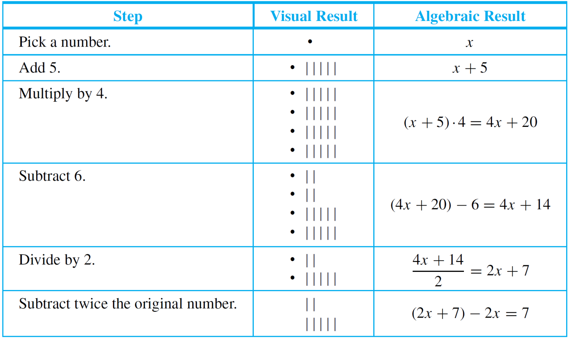
Example 6 – Generalizing from the Generic Particular
cont’d
Let an empty box ● or the symbol x stand for the number the person picks.
Here is what happens when the person follows your directions:

Slide 23
Example 6 – Generalizing from the Generic Particular
cont’d
Thus no matter what number the person starts with, the result will always be 7.
Note that the x in the analysis above is particular (because it represents a single quantity), but it is also arbitrarily chosen or generic (because any number whatsoever can be put in its place).
This illustrates the process of drawing a general conclusion from a particular but generic object.

Slide 24
Proving Universal Statements
When the method of generalizing from the generic particular is applied to a property of the form “If P(x) then Q(x),” the result is the method of direct proof.
We have known that the only way an if-then statement can be false is for the hypothesis to be true and the conclusion to be false.
Thus, given the statement “If P(x) then Q(x),” if you can show that the truth of P(x) compels the truth of Q(x), then you will have proved the statement.

Slide 25
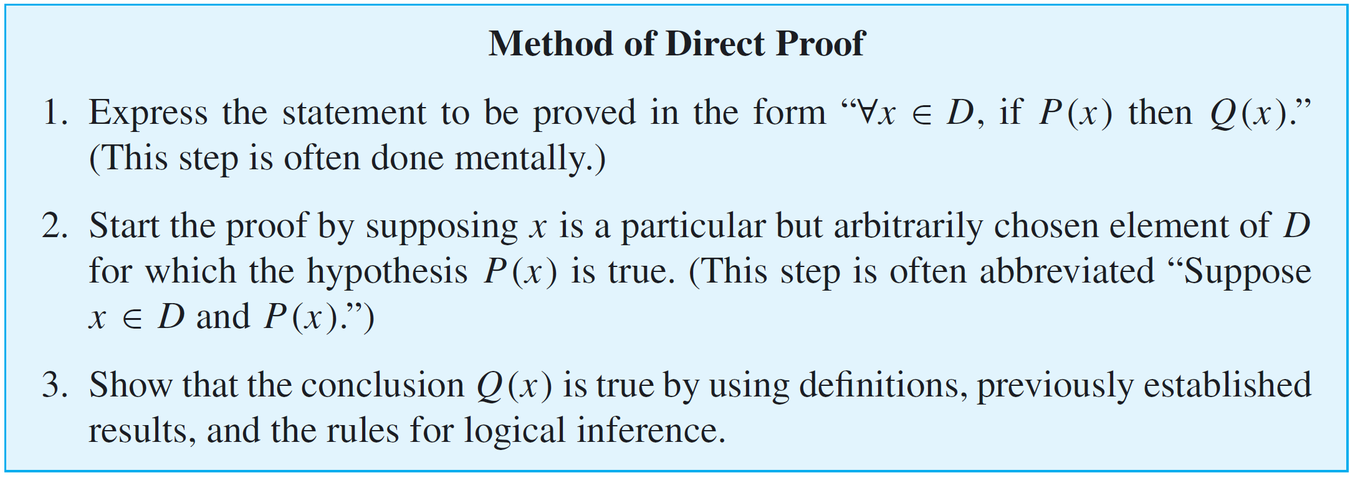
Proving Universal Statements
It follows by the method of generalizing from the generic particular that to show that “∀x, if P(x) then Q(x),” is true for all elements x in a set D, you suppose x is a particular but arbitrarily chosen element of D that makes P(x) true, and then you show that x makes Q(x) true.

Slide 26
Example 7 – A Direct Proof of a Theorem
Prove that the sum of any two even integers is even.
Solution:
In this case you might imagine some pairs of even integers, say 2 + 4, 6 + 10, 12 + 12, 28 + 54, and mentally check that their sums are even.

Slide 27
Example 7 – Solution
cont’d
However, since you cannot possibly check all pairs of even numbers, you cannot know for sure that the statement is true in general by checking its truth in these particular instances.
Many properties hold for a large number of examples and yet fail to be true in general.
To prove this statement in general, you need to show that no matter what even integers are given, their sum is even. But given any two even integers, it is possible to represent them as 2r and 2s for some integers r and s.

Slide 28
Example 7 – Solution
cont’d
And by the distributive law of algebra, 2r + 2s = 2(r + s), which is even. Thus the statement is true in general.
Suppose the statement to be proved were much more complicated than this. What is the method you could use to derive a proof?
Formal Restatement: ∀ integers m and n, if m and n are even then m + n is even.
This statement is universally quantified over an infinite domain. Thus to prove it in general, you need to show that no matter what two integers you might be given, if both of them are even then their sum will also be even.

Slide 29
Example 7 – Solution
cont’d
Next ask yourself, “Where am I starting from?” or “What am I supposing?” The answer to such a question gives you the starting point, or first sentence, of the proof.
Starting Point: Suppose m and n are particular but arbitrarily chosen integers that are even.
Or, in abbreviated form:
Suppose m and n are any even integers.
Then ask yourself, “What conclusion do I need to show in order to complete the proof?”

Slide 30
Example 7 – Solution
cont’d
To Show: m + n is even.
At this point you need to ask yourself, “How do I get from the starting point to the conclusion?” Since both involve the term even integer, you must use the definition of this term—and thus you must know what it means for an integer to be even.
It follows from the definition that since m and n are even, each equals twice some integer.

Slide 31
Example 7 – Solution
cont’d
One of the basic laws of logic, called existential instantiation, says, in effect, that if you know something exists, you can give it a name.
However, you cannot use the same name to refer to two different things, both of which are currently under discussion.

Slide 32
Example 7 – Solution
cont’d
Thus since m equals twice some integer, you can give that integer a name, and since n equals twice some integer, you can also give that integer a name:
Now what you want to show is that m + n is even. In other words, you want to show that m + n equals 2 ● (some integer). Having just found alternative representations for m (as 2r) and n (as 2s), it seems reasonable to substitute these representations in place of m and n:

Slide 33
Example 7 – Solution
cont’d
Your goal is to show that m + n is even. By definition of even, this means that m + n can be written in the form
This analysis narrows the gap between the starting point and what is to be shown to showing that
Why is this true? First, because of the distributive law from algebra, which says that
and, second, because the sum of any two integers is an integer, which implies that r + s is an integer.

Slide 34
Example 7 – Solution
cont’d
This discussion is summarized by rewriting the statement as a theorem and giving a formal proof of it. (In mathematics, the word theorem refers to a statement that is known to be true because it has been proved.)
Such comments are purely a convenience for the reader and could be omitted entirely. For this reason they are italicized and enclosed in italic square brackets: [ ].
Donald Knuth, one of the pioneers of the science of computing, has compared constructing a computer program from a set of specifications to writing a mathematical proof based on a set of axioms.

Slide 35
Example 7 – Solution
cont’d
In keeping with this analogy, the bracketed comments can be thought of as similar to the explanatory documentation provided by a good programmer. Documentation is not necessary for a program to run, but it helps a human reader understand what is going on.
Proof:
Suppose m and n are [particular but arbitrarily chosen] even integers. [We must show that m + n is even.]

Slide 36
Example 7 – Solution
cont’d
By definition of even, m = 2r and n = 2s for some integers r and s. Then
Let t = r + s. Note that t is an integer because it is a sum of integers. Hence
It follows by definition of even that m + n is even. [This is what we needed to show.]

Slide 37
Directions for Writing Proofs of Universal Statements

Slide 38
Directions for Writing Proofs of Universal Statements
Think of a proof as a way to communicate a convincing argument for the truth of a mathematical statement.
Over the years, the following rules of style have become fairly standard for writing the final versions of proofs:
1. Copy the statement of the theorem to be proved on your paper.
2. Clearly mark the beginning of your proof with the word Proof.
3. Make your proof self-contained.

Slide 39
Directions for Writing Proofs of Universal Statements
This means that you should explain the meaning of each variable used in your proof in the body of the proof. Thus you will begin proofs by introducing the initial variables and stating what kind of objects they are.
At a later point in your proof, you may introduce a new variable to represent a quantity that is known at that point to exist.
4. Write your proof in complete, gramatically correct sentences.
This does not mean that you should avoid using symbols and shorthand abbreviations, just that you should incorporate them into sentences.

Slide 40
Directions for Writing Proofs of Universal Statements
5. Keep your reader informed about the status of each statement in your proof.
Your reader should never be in doubt about whether something in your proof has been assumed or established or is still to be deduced. If something is assumed, preface it with a word like Suppose or Assume.
If it is still to be shown, preface it with words like, We must show that or In other words, we must show that. This is especially important if you introduce a variable in rephrasing what you need to show.

Slide 41
Directions for Writing Proofs of Universal Statements
6. Give a reason for each assertion in your proof.
Each assertion in a proof should come directly from the hypothesis of the theorem, or follow from the definition of one of the terms in the theorem, or be a result obtained earlier in the proof, or be a mathematical result that has previously been established or is agreed to be assumed.
Indicate the reason for each step of your proof using phrases such as by hypothesis, by definition of . . . , and by theorem . . . .

Slide 42
Directions for Writing Proofs of Universal Statements
7. Include the “little words and phrases” that make the logic of your arguments clear.
When writing a mathematical argument, especially a proof, indicate how each sentence is related to the previous one.
Does it follow from the previous sentence or from a combination of the previous sentence and earlier ones? If so, start the sentence by stating the reason why it follows or by writing Then, or Thus, or So, or Hence, or Therefore, or Consequently, or It follows that, and include the reason at the end of the sentence.

Slide 43
Directions for Writing Proofs of Universal Statements
If a sentence expresses a new thought or fact that does not follow as an immediate consequence of the preceding statement but is needed for a later part of a proof, introduce it by writing Observe that, or Note that, or But, or Now.
Sometimes in a proof it is desirable to define a new variable in terms of previous variables. In such a case, introduce the new variable with the word Let.
8. Display equations and inequalities.
The convention is to display equations and inequalities on separate lines to increase readability, both for other people and for ourselves so that we can more easily check our work for accuracy.

Slide 44
Variations among Proofs
It is rare that two proofs of a given statement, written by two different people, are identical. Even when the basic mathematical steps are the same, the two people may use different notation or may give differing amounts of explanation for their steps, or may choose different words to link the steps together into paragraph form.
An important question is how detailed to make the explanations for the steps of a proof. This must ultimately be worked out between the writer of a proof and the intended reader, whether they be student and teacher, teacher and student, student and fellow student, or mathematician and colleague.

Slide 45
Common Mistakes

Slide 46
Common Mistakes
The following are some of the most common mistakes people make when writing mathematical proofs.
1. Arguing from examples.
Looking at examples is one of the most helpful practices a problem solver can engage in and is encouraged by all good mathematics teachers.
However, it is a mistake to think that a general statement can be proved by showing it to be true for some special cases. A property referred to in a universal statement may be true in many instances without being true in general.

Slide 47
Common Mistakes
2. Using the same letter to mean two different things.
Some beginning theorem provers give a new variable quantity the same letter name as a previously introduced variable.
3. Jumping to a conclusion.
To jump to a conclusion means to allege the truth of something without giving an adequate reason.
4. Circular reasoning.
To engage in circular reasoning means to assume what is to be proved; it is a variation of jumping to a conclusion.

Slide 48
Common Mistakes
5. Confusion between what is known and what is still to be shown.
A more subtle way to engage in circular reasoning occurs when the conclusion to be shown is restated using a variable.
6. Use of any rather than some.
There are a few situations in which the words any and some can be used interchangeably.

Slide 49
Common Mistakes
7. Misuse of the word if.
Another common error is not serious in itself, but it reflects imprecise thinking that sometimes leads to problems later in a proof. This error involves using the word if when the word because is really meant.

Slide 50
Getting Proofs Started

Slide 51
Getting Proofs Started
Believe it or not, once you understand the idea of generalizing from the generic particular and the method of direct proof, you can write the beginnings of proofs even for theorems you do not understand.
The reason is that the starting point and what is to be shown in a proof depend only on the linguistic form of the statement to be proved, not on the content of the statement.

Slide 52
Example 8 – Identifying the “Starting Point” and the “Conclusion to Be Shown”
Write the first sentence of a proof (the “starting point”) and the last sentence of a proof (the “conclusion to be shown”) for the following statement:
Every complete, bipartite graph is connected.
Solution:
It is helpful to rewrite the statement formally using a quantifier and a variable:
Formal Restatement:

Slide 53
Example 8 – Solution
cont’d
The first sentence, or starting point, of a proof supposes the existence of an object (in this case G) in the domain (in this case the set of all graphs) that satisfies the hypothesis of the if-then part of the statement (in this case that G is complete and bipartite).
The conclusion to be shown is just the conclusion of the if-then part of the statement (in this case that G is connected).

Slide 54
Example 8 – Solution
cont’d
Starting Point: Suppose G is a [particular but arbitrarily chosen] graph such that G is complete and bipartite.
Conclusion to Be Shown: G is connected.
Thus the proof has the following shape:
Proof:
Suppose G is a [particular but arbitrarily chosen] graph such that G is complete and bipartite.
Therefore, G is connected.
…

Slide 55
Showing That an Existential Statement Is False

Slide 56
Disprove an Existential Statement
We have known that the negation of an existential statement is universal.
It follows that to disprove an existential statement, you must prove its negation, a universal statement, is true.

Slide 57
Example 9 – Disproving an Existential Statement
Show that the following statement is false:
There is a positive integer n such that n² + 3n + 2 is prime.
Solution:
Proving that the given statement is false is equivalent to proving its negation is true.
The negation is
For all positive integers n, n² + 3n + 2 is not prime.
Because the negation is universal, it is proved by generalizing from the generic particular.

Slide 58
Example 9 – Solution
cont’d
Claim: The statement “There is a positive integer n such that n² + 3n + 2 is prime” is false.
Proof:
Suppose n is any [particular but arbitrarily chosen] positive integer. [We will show that n² + 3n + 2 is not prime.]
We can factor n² + 3n + 2 to obtain n² + 3n + 2 = (n + 1)(n + 2).
We also note that n + 1 and n + 2 are integers (because they are sums of integers) and that both n + 1 > 1 and n + 2 > 1 (because n ≥ 1).Thus n² + 3n + 2 is a product of two integers each greater than 1, and so n² + 3n + 2 is not prime.

Slide 59
Conjecture, Proof, and Disproof

Slide 60
Conjecture, Proof, and Disproof
More than 350 years ago, the French mathematician Pierre de Fermat claimed that it is impossible to find positive integers x, y, and z with x^{n} + y^{n} = z^{n} if n is an integer that is at least 3. (For n = 2, the equation has many integer solutions, such as 3² + 4² = 5² and 5² + 12² = 13².)

Slide 61
Conjecture, Proof, and Disproof
No proof, however, was found among his papers, and over the years some of the greatest mathematical minds tried and failed to discover a proof or a counterexample, for what came to be known as Fermat’s last theorem.
One of the oldest problems in mathematics that remains unsolved is the Goldbach conjecture. In Example 5 it was shown that every even integer from 4 to 26 can be represented as a sum of two prime numbers.
More than 250 years ago, Christian Goldbach (1690–1764) conjectured that every even integer greater than 2 can be so represented.

Slide 62
Conjecture, Proof, and Disproof
Explicit computer-aided calculations have shown the conjecture to be true up to at least 10¹⁸. But there is a huge chasm between 10¹⁸ and infinity.
As pointed out by James Gleick of the New York Times, many other plausible conjectures in number theory have proved false.
Leonhard Euler (1707–1783), for example, proposed in the eighteenth century that a⁴ + b⁴ + c⁴ = d⁴ had no nontrivial whole number solutions.

Slide 63
Conjecture, Proof, and Disproof
In other words, no three perfect fourth powers add up to another perfect fourth power. For small numbers, Euler’s conjecture looked good.
But in 1987 a Harvard mathematician, Noam Elkies, proved it wrong. One counterexample, found by Roger Frye of Thinking Machines Corporation in a long computer search, is 95,800⁴ + 217,519⁴ + 414,560⁴ = 422,481⁴.

Slide 64
SECTION 4.2
Direct Proof and Counterexample II: Rational Numbers
Copyright © Cengage Learning. All rights reserved.

Slide 65
Direct Proof and Counterexample II: Rational Numbers
Sums, differences, and products of integers are integers. But most quotients of integers are not integers. Quotients of integers are, however, important; they are known as rational numbers.

Slide 66
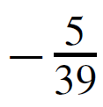
Example 1 – Determining Whether Numbers Are Rational or Irrational
a. Is 10/3 a rational number?
b. Is a rational number?
c. Is 0.281 a rational number?
d. Is 7 a rational number?
e. Is 0 a rational number?

Slide 67
Example 1 – Determining Whether Numbers Are Rational or Irrational
cont’d
f. Is 2/0 a rational number?
g. Is 2/0 an irrational number?
h. Is 0.12121212 . . . a rational number (where the digits 12 are assumed to repeat forever)?
i. If m and n are integers and neither m nor n is zero, is (m + n) /m n a rational number?

Slide 68
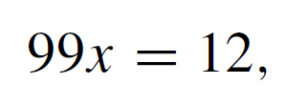
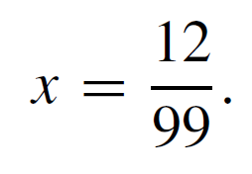
Example 1 – Solution
cont’d
h. Yes. Let Then
Thus
But also
Hence
And so
Therefore, 0.12121212…. = 12/99, which is a ratio of two nonzero integers and thus is a rational number.

Slide 69
Example 1 – Solution
cont’d
Note that you can use an argument similar to this one to show that any repeating decimal is a rational number.
i. Yes, since m and n are integers, so are m + n and m n (because sums and products of integers are integers). Also m n ≠ 0 by the zero product property.
One version of this property says the following:

Slide 70
More on Generalizing from the Generic Particular

Slide 71
More on Generalizing from the Generic Particular
Some people like to think of the method of generalizing from the generic particular as a challenge process.
If you claim a property holds for all elements in a domain, then someone can challenge your claim by picking any element in the domain whatsoever and asking you to prove that that element satisfies the property.
To prove your claim, you must be able to meet all such challenges. That is, you must have a way to convince the challenger that the property is true for an arbitrarily chosen element in the domain.

Slide 72
More on Generalizing from the Generic Particular
For example, suppose “A” claims that every integer is a rational number. “B” challenges this claim by asking “A” to prove it for n = 7.
“A” observes that
“B” accepts this explanation but challenges again with n = –12. “A” responds that

Slide 73
More on Generalizing from the Generic Particular
Next “B” tries to trip up “A” by challenging with n = 0, but “A” answers that
As you can see, “A” is able to respond effectively to all “B”s challenges because “A” has a general procedure for putting integers into the form of rational numbers: “A” just divides whatever integer “B” gives by 1.
That is, no matter what integer n “B” gives “A”, “A” writes

Slide 74
More on Generalizing from the Generic Particular
This discussion proves the following theorem.

Slide 75
Proving Properties of Rational Numbers

Slide 76
Example 2 – A Sum of Rationals Is Rational
Prove that the sum of any two rational numbers is rational.
Solution: Begin by mentally or explicitly rewriting the statement to be proved in the form “∀______, if ______ then ______.”
Formal Restatement: ∀ real numbers r and s, if r and s are rational then r + s is rational.
Next ask yourself, “Where am I starting from?” or “What am I supposing?” The answer gives you the starting point, or first sentence, of the proof.

Slide 77
Example 2 – Solution
cont’d
Starting Point: Suppose r and s are particular but arbitrarily chosen real numbers such that r and s are rational; or, more simply, Suppose r and s are rational numbers.
Then ask yourself, “What must I show to complete the proof?”
To Show: r + s is rational. Finally ask, “How do I get from the starting point to the conclusion?” or “Why must r + s be rational if both r and s are rational?” The answer depends in an essential way on the definition of rational.

Slide 78
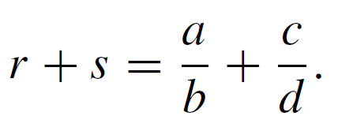
Example 2 – Solution
cont’d
Rational numbers are quotients of integers, so to say that r and s are rational means that
It follows by substitution that

Slide 79
Example 2 – Solution
cont’d
You need to show that r + s is rational, which means that r + s can be written as a single fraction or ratio of two integers with a nonzero denominator.
But the right-hand side of equation (4.2.1) in

Slide 80
Example 2 – Solution
cont’d
Is this fraction a ratio of integers? Yes. Because products and sums of integers are integers, ad + bc and bd are both integers.
Is the denominator bd ≠ 0? Yes, by the zero product property (since b ≠ 0 and d ≠ 0). Thus r + s is a rational number.
This discussion is summarized as follows:

Slide 81
Example 2 – Solution
cont’d
Proof: Suppose r and s are rational numbers. [We must show that r + s is rational.]
Then, by definition of rational, r = a/b and s = c/d for some integers a, b, c, and d with b ≠ 0 and d ≠ 0.
Thus

Slide 82
Example 2 – Solution
cont’d
Let p = ad + bc and q = bd. Then p and q are integers because products and sums of integers are integers and because a, b, c, and d are all integers.
Also q ≠ 0 by the zero product property.
Thus
Therefore, r + s is rational by definition of a rational number. [This is what was to be shown.]

Slide 83
Deriving New Mathematics from Old

Slide 84
Deriving New Mathematics from Old
In the future, when we ask you to prove something directly from the definitions, we will mean that you should restrict yourself to this approach.
However, once a collection of statements has been proved directly from the definitions, another method of proof becomes possible.
The statements in the collection can be used to derive additional results.

Slide 85
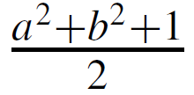
Example 3 – Deriving Additional Results about Even and Odd Integers
Suppose that you have already proved:
1. The sum, product, and difference of any two even integers are even.
2. The sum and difference of any two odd integers are even.
3. The product of any two odd integers is odd.
4. The product of any even integer and any odd integer is even.
5. The sum of any odd integer and any even integer is odd.
6. The difference of any odd integer minus any even integer is odd.
7. The difference of any even integer minus any odd integer is odd.
Use the properties listed above to prove that if a is any
even integer and b is any odd integer, then is an integer.

Slide 86
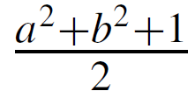
Example 3 – Solution
Suppose a is any even integer and b is any odd integer. By property 3, b² is odd, and by property 1, a² is even.
Then by property 5, a² + b² is odd, and because 1 is also odd, the sum is even by property 2.
Hence, by definition of even, there exists an integer k such that
Dividing both sides by 2 gives = k, which is an integer.
Thus is an integer [as was to be shown].

Slide 87
Deriving New Mathematics from Old
A corollary is a statement whose truth can be immediately deduced from a theorem that has already been proved.

Slide 88
Example 4 – The Double of a Rational Number
Derive the following as a corollary of Theorem 4.2.2.
Solution: The double of a number is just its sum with itself.
But since the sum of any two rational numbers is rational (Theorem 4.2.2), the sum of a rational number with itself is rational.
Hence the double of a rational number is rational.

Slide 89
Example 4 – Solution
cont’d
Here is a formal version of this argument:
Proof:
Suppose r is any rational number. Then 2r = r + r is a sum of two rational numbers.
So, by Theorem 4.2.2, 2r is rational.

Slide 90
SECTION 4.3
Direct Proof and Counterexample III: Divisibility
Copyright © Cengage Learning. All rights reserved.

Slide 91
Direct Proof and Counterexample III: Divisibility
The notion of divisibility is the central concept of one of the most beautiful subjects in advanced mathematics: number theory, the study of properties of integers.

Slide 92
Example 1 – Divisibility
a. Is 21 divisible by 3?
b. Does 5 divide 40?
c. Does 7 | 42?
d. Is 32 a multiple of −16?
e. Is 6 a factor of 54?
f. Is 7 a factor of −7?

Slide 93
Direct Proof and Counterexample III: Divisibility
Two useful properties of divisibility are
One of the most useful properties of divisibility is that it is transitive. If one number divides a second and the second number divides a third, then the first number divides the third.

Slide 94
Example 1 – Divisibility of Algebraic Expressions
a. If a and b are integers, is 3a + 3b divisible by 3?
b. If k and m are integers, is 10km divisible by 5?
Solution: a. Yes. By the distributive law of algebra, 3a + 3b = 3(a + b) and a + b is an integer because it is a sum of two integers.
b. Yes. By the associative law of algebra, 10km = 5 ● (2km) and 2km is an integer because it is a product of three integers.

Slide 95
Direct Proof and Counterexample III: Divisibility
When the definition of divides is rewritten formally using the existential quantifier, the result is
Since the negation of an existential statement is universal, it follows that d does not divide n (denoted ) if, and only if, ∀ integers k, n ≠ dk, or, in other words, the quotient n/d is not an integer.

Slide 96
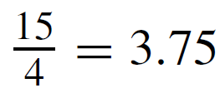
Example 4 – Checking Nondivisibility
Does 4 | 15?
Solution:
No, , which is not an integer.

Slide 97
Proving Properties of Divisibility

Slide 98
Example 6 – Transitivity of Divisibility
Prove that for all integers a, b, and c, if a | b and b | c, then a | c.
Solution: Since the statement to be proved is already written formally, you can immediately pick out the starting point, or first sentence of the proof, and the conclusion that must be shown.
Starting Point: Suppose a, b, and c are particular but arbitrarily chosen integers such that a | b and b | c.

Slide 99
Example 6 – Solution
cont’d
To Show: a | c.
You need to show that a | c, or, in other words, that
But since a | b,
And since b | c,
Equation 4.3.2 expresses c in terms of b, and equation 4.3.1 expresses b in terms of a.

Slide 100
Example 6 – Solution
cont’d
Thus if you substitute 4.3.1 into 4.3.2, you will have an equation that expresses c in terms of a.
But (ar)s = a(rs) by the associative law for multiplication. Hence
Now you are almost finished.

Slide 101
Example 6 – Solution
cont’d
You have expressed c as a ● (something). It remains only to verify that that something is an integer. But of course it is, because it is a product of two integers.

Slide 102
Example 6 – Solution
cont’d
Proof: Suppose a, b, and c are [particular but arbitrarily chosen] integers such that a divides b and b divides c. [We must show that a divides c.] By definition of divisibility,
By substitution

Slide 103
Example 6 – Solution
cont’d
Let k = rs. Then k is an integer since it is a product of integers, and therefore
Thus a divides c by definition of divisibility. [This is what was to be shown.]

Slide 104
Proving Properties of Divisibility

Slide 105
Counterexamples and Divisibility

Slide 106
Example 7 – Checking a Proposed Divisibility Property
Is the following statement true or false? For all integers a and b, if a | b and b | a then a = b.
Solution:
This statement is false. Can you think of a counterexample just by concentrating for a minute or so?
The following discussion describes a mental process that may take just a few seconds. It is helpful to be able to use it consciously, however, to solve more difficult problems.

Slide 107
Example 7 – Solution
cont’d
To discover the truth or falsity of the given statement, start off much as you would if you were trying to prove it.
Starting Point: Suppose a and b are integers such that a | b and b | a.
Ask yourself, “Must it follow that a = b, or could it happen that a ≠ b for some a and b?” Focus on the supposition. What does it mean? By definition of divisibility, the conditions a | b and b | a mean that

Slide 108
Example 7 – Solution
cont’d
Must it follow that a = b, or can you find integers a and b that satisfy these equations for which a ≠ b? The equations imply that
Since b | a, b ≠ 0, and so you can cancel b from the extreme left and right sides to obtain
In other words, k and l are divisors of 1. But, by Theorem 4.3.2, the only divisors of 1 are 1 and –1. Thus k and l are both 1 or are both –1. If k = l = 1, then b = a.

Slide 109
Example 7 – Solution
cont’d
But if k = l = –1, then b = –a and so a ≠ b.
This analysis suggests that you can find a counterexample by taking b = –a.
Here is a formal answer:

Slide 110
The Unique Factorization
of Integers Theorem

Slide 111
The Unique Factorization of Integers Theorem
The most comprehensive statement about divisibility of integers is contained in the unique factorization of integers theorem.
Because of its importance, this theorem is also called the fundamental theorem of arithmetic.
The unique factorization of integers theorem says that any integer greater than 1 either is prime or can be written as a product of prime numbers in a way that is unique except, perhaps, for the order in which the primes are written.

Slide 112
The Unique Factorization of Integers Theorem

Slide 113
Unique Factorization of Integers Theorem
Because of the unique factorization theorem, any integer n > 1 can be put into a standard factored form in which the prime factors are written in ascending order from left to right.

Slide 114
Example 9 – Using Unique Factorization to Solve a Problem
Suppose m is an integer such that
Does 17 | m?
Solution: Since 17 is one of the prime factors of the right-hand side of the equation, it is also a prime factor of the left-hand side (by the unique factorization of integers theorem).
But 17 does not equal any prime factor of 8, 7, 6, 5, 4, 3, or 2 (because it is too large). Hence 17 must occur as one of the prime factors of m, and so 17 | m.

Slide 115
SECTION 4.4
Direct Proof and Counterexample IV: Division into Cases and the Quotient-Remainder Theorem
Copyright © Cengage Learning. All rights reserved.

Slide 116
Direct Proof and Counterexample IV: Division into Cases and the Quotient-Remainder Theorem
The quotient-remainder theorem says that when any integer n is divided by any positive integer d, the result is a quotient q and a nonnegative remainder r that is smaller than d.

Slide 117
Example 1 – The Quotient-Remainder Theorem
For each of the following values of n and d, find integers q and r such that and
a. n = 54, d = 4 b. n = –54, d = 4 c. n = 54, d = 70
Solution:
a.
b.
c.

Slide 118
div and mod

Slide 119
div and mod
A number of computer languages have built-in functions that enable you to compute many values of q and r for the quotient-remainder theorem.
These functions are called div and mod in Pascal, are called / and % in C and C++, are called / and % in Java, and are called / (or \) and mod in .NET.
The functions give the values that satisfy the quotient-remainder theorem when a nonnegative integer n is divided by a positive integer d and the result is assigned to an integer variable.

Slide 120
div and mod
However, they do not give the values that satisfy the quotient-remainder theorem when a negative integer n is divided by a positive integer d.

Slide 121
div and mod
For instance, to compute n div d for a nonnegative integer n and a positive integer d, you just divide n by d and ignore the part of the answer to the right of the decimal point.
To find n mod d, you can use the fact that if then Thus and so
Hence, to find n mod d compute n div d, multiply by d, and subtract the result from n.

Slide 122
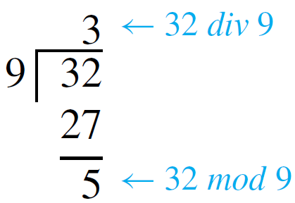
Example 2 – Computing div and mod
Compute 32 div 9 and 32 mod 9 by hand and with a calculator.
Solution: Performing the division by hand gives the following results:
If you use a four-function calculator to divide 32 by 9, you obtain an expression like 3.555555556.

Slide 123
Example 2 – Solution
cont’d
Discarding the fractional part gives 32 div 9 = 3, and so
A calculator with a built-in integer-part function iPart allows you to input a single expression for each computation:

Slide 124
Representations of Integers

Slide 125
Representations of Integers
We have defined, an even integer to have the form twice some integer. At that time we could have defined an odd integer to be one that was not even.
Instead, because it was more useful for proving theorems, we specified that an odd integer has the form twice some integer plus one.
The quotient-remainder theorem brings these two ways of describing odd integers together by guaranteeing that any integer is either even or odd.

Slide 126
Representations of Integers
To see why, let n be any integer, and consider what happens when n is divided by 2.
By the quotient-remainder theorem (with d = 2), there exist unique integers q and r such that
But the only integers that satisfy are r = 0 and r = 1.
It follows that given any integer n, there exists an integer q with

Slide 127
Representations of Integers
In the case that n is even. In the case that n is odd. Hence n is either even or odd, and, because of the uniqueness of q and r, n cannot be both even and odd.
The parity of an integer refers to whether the integer is even or odd. For instance, 5 has odd parity and 28 has even parity.
We call the fact that any integer is either even or odd the parity property.

Slide 128
Example 5 – Consecutive Integers Have Opposite Parity
Prove that given any two consecutive integers, one is even and the other is odd.
Solution: Two integers are called consecutive if, and only if, one is one more than the other. So if one integer is m, the next consecutive integer is m + 1.
To prove the given statement, start by supposing that you have two particular but arbitrarily chosen consecutive integers. If the smaller is m, then the larger will be m + 1.

Slide 129
Example 5 – Solution
cont’d
How do you know for sure that one of these is even and the other is odd? You might imagine some examples: 4, 5; 12, 13; 1,073, 1,074.
In the first two examples, the smaller of the two integers is even and the larger is odd; in the last example, it is the reverse. These observations suggest dividing the analysis into two cases.
Case 1: The smaller of the two integers is even.
Case 2: The smaller of the two integers is odd.

Slide 130
Example 5 – Solution
cont’d
In the first case, when m is even, it appears that the next consecutive integer is odd. Is this always true?
If an integer m is even, must m + 1 necessarily be odd? Of course the answer is yes. Because if m is even, then m = 2k for some integer k, and so m + 1 = 2k + 1, which is odd.
In the second case, when m is odd, it appears that the next consecutive integer is even. Is this always true? If an integer m is odd, must m + 1 necessarily be even?

Slide 131
Example 5 – Solution
cont’d
Again, the answer is yes. For if m is odd, then for some integer k, and so
which is even.

Slide 132
Example 5 – Solution
cont’d
This discussion is summarized as follows.
Proof: Suppose that two [particular but arbitrarily chosen] consecutive integers are given; call them m and m + 1. [We must show that one of m and m + 1 is even and that the other is odd.]

Slide 133
Example 5 – Solution
cont’d
By the parity property, either m is even or m is odd. [We break the proof into two cases depending on whether m is even or odd.]
Case 1 (m is even): In this case, m = 2k for some integer k, and so m + 1 = 2k + 1, which is odd [by definition of odd].
Hence in this case, one of m and m + 1 is even and the other is odd.

Slide 134
Example 5 – Solution
cont’d
Case 2 (m is odd): In this case, m = 2k + 1 for some integer k, and so .
But k + 1 is an integer because it is a sum of two integers. Therefore, m + 1 equals twice some integer, and thus m + 1 is even.
Hence in this case also, one of m and m + 1 is even and the other is odd.

Slide 135
Example 5 – Solution
cont’d
It follows that regardless of which case actually occurs for the particular m and m + 1 that are chosen, one of m and m + 1 is even and the other is odd. [This is what was to be shown.]

Slide 136
Representations of Integers
There are times when division into more than two cases is called for. Suppose that at some stage of developing a proof, you know that a statement of the form
is true, and suppose you want to deduce a conclusion C.
By definition of or, you know that at least one of the statements A_{i} is true (although you may not know which).
In this situation, you should use the method of division into cases.

Slide 137
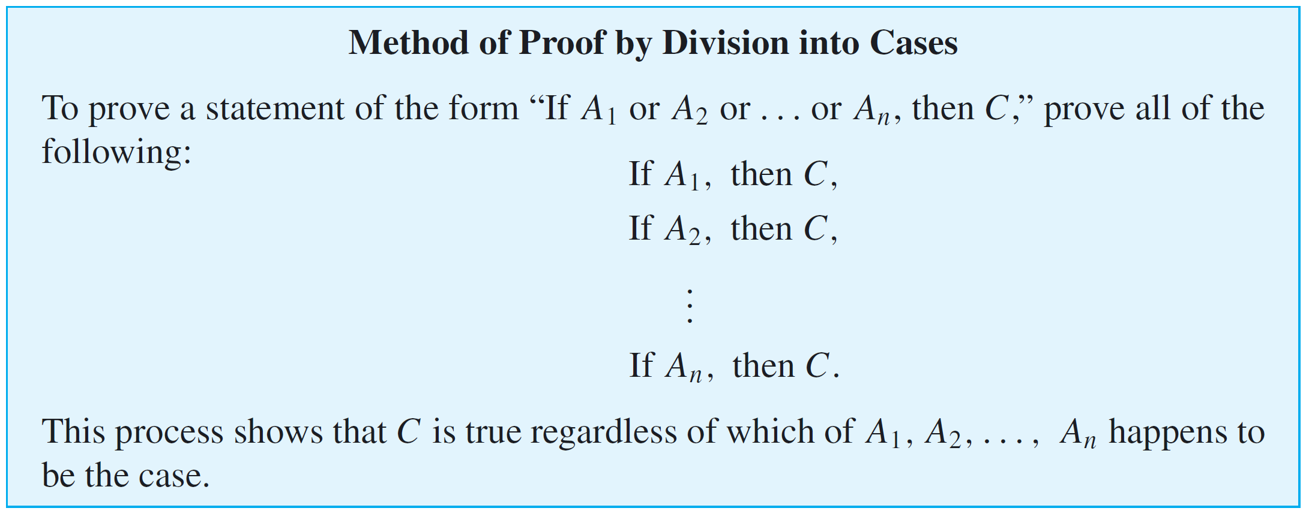
Representations of Integers
First assume A₁ is true and deduce C; next assume A₂ is true and deduce C; and so forth until you have assumed A_{n} is true and deduced C.
At that point, you can conclude that regardless of which statement A_{i} happens to be true, the truth of C follows.

Slide 138
Example 6 – Representations of Integers Modulo 4
Show that any integer can be written in one of the four forms
for some integer q.
Solution: Given any integer n, apply the quotient-remainder theorem to n with d = 4.
This implies that there exist an integer quotient q and a remainder r such that

Slide 139
Example 6 – Solution
cont’d
But the only nonnegative remainders r that are less than 4 are 0, 1, 2, and 3.
Hence
for some integer q.

Slide 140
Example 7 – The Square of an Odd Integer
Prove: The square of any odd integer has the form 8m + 1 for some integer m.
Solution: Begin by asking yourself, “Where am I starting from?” and “What do I need to show?” To help answer these questions, introduce variables to represent the quantities in the statement to be proved.
Formal Restatement: ∀ odd integers n, ∃ an integer m such that
From this, you can immediately identify the starting point and what is to be shown.

Slide 141
Example 7 – Solution
cont’d
Starting Point: Suppose n is a particular but arbitrarily chosen odd integer.
To Show: ∃ an integer m such that
This looks tough. Why should there be an integer m with the property that ?
That would say that (n² – 1)/8 is an integer, or that 8 divides n² – 1.

Slide 142
Example 7 – Solution
cont’d
That means that their product is divisible by 4. But that’s not enough. You need to show that the product is divisible by 8. This seems to be a blind alley.
You could try another tack. Since n is odd, you could represent n as 2q + 1 for some integer q.
Then

Slide 143
Example 7 – Solution
cont’d
It is clear from this analysis that n² can be written in the form 4m + 1, but it may not be clear that it can be written as 8m + 1. This also seems to be a blind alley.
You could try breaking into cases based on these two different forms.
It turns out that this last possibility works! In each of the two cases, the conclusion follows readily by direct calculation.

Slide 144
Example 7 – Solution
cont’d
The details are shown in the following formal proof:
Proof: Suppose n is a [particular but arbitrarily chosen] odd integer. By the quotient-remainder theorem, n can be written in one of the forms
for some integer q.
In fact, since n is odd and 4q and 4q + 2 are even, n must have one of the forms

Slide 145
Example 7 – Solution
cont’d
Case 1 (n = 4q + 1 for some integer q): [We must find an integer m such that ]

Slide 146
Example 7 – Solution
cont’d
Let Then m is an integer since 2 and q are integers and sums and products of integers are integers.
Thus, substituting,
where m is an integer.

Slide 147
Example 7 – Solution
cont’d
Case 2 (n = 4q + 3 for some integer q): [We must find an integer m such that ]

Slide 148
Example 7 – Solution
cont’d
[The motivation for the choice of algebra steps was the desire to write the expression in the form 8 ● (some integer) + 1.]
Let Then m is an integer since 1, 2, 3, and q are integers and sums and products of integers are integers.
Thus, substituting,
where m is an integer.

Slide 149
Example 7 – Solution
cont’d
Cases 1 and 2 show that given any odd integer, whether of the form for some integer m. [This is what we needed to show.]

Slide 150
Representations of Integers
Note that the result of Theorem 4.4.3 can also be written, “For any odd integer n, n² mod 8 = 1.”
In general, according to the quotient-remainder theorem, if an integer n is divided by an integer d, the possible remainders are 0, 1, 2, . . ., (d – 1).
This implies that n can be written in one of the forms for some integer q.

Slide 151
Representations of Integers
Many properties of integers can be obtained by giving d a variety of different values and analyzing the cases that result.

Slide 152
Absolute Value and the Triangle Inequality

Slide 153
Absolute Value and the Triangle Inequality
The triangle inequality is one of the most important results involving absolute value. It has applications in many areas of mathematics.

Slide 154
Absolute Value and the Triangle Inequality
A lemma is a statement that does not have much intrinsic interest but is helpful in deriving other results.

Slide 155
Absolute Value and the Triangle Inequality
Lemmas 4.4.4 and 4.4.5 now provide a basis for proving the triangle inequality.

