Slide 1
CHAPTER 10
GRAPHS AND TREES
Copyright © Cengage Learning. All rights reserved.

Slide 2
SECTION 10.1
Graphs: Definitions and Basic Properties
Copyright © Cengage Learning. All rights reserved.

Slide 3
Graphs: Definitions and Basic Properties
Imagine an organization that wants to set up teams of three to work on some projects.
In order to maximize the number of people on each team who had previous experience working together successfully, the director asked the members to provide names of their past partners.

Slide 4
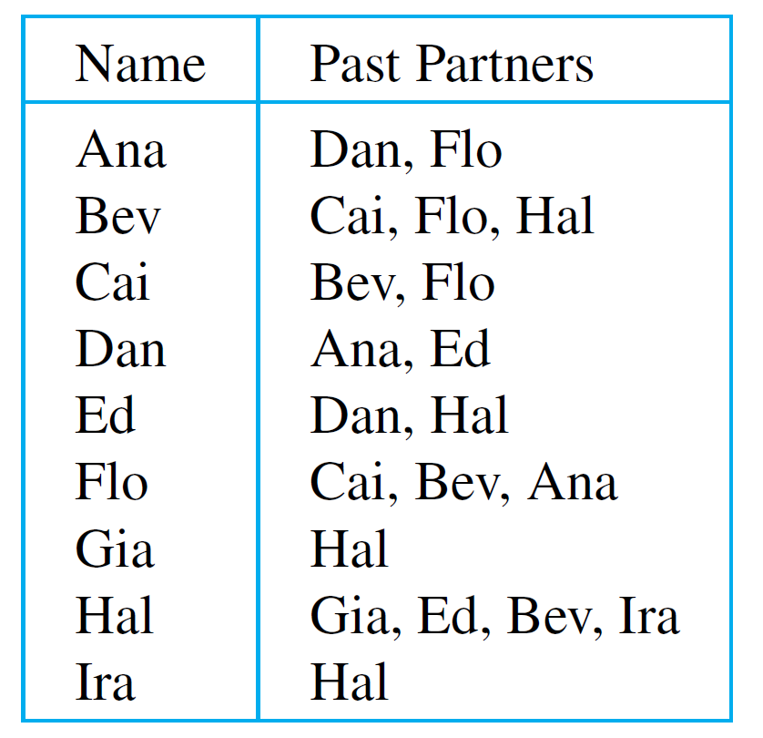
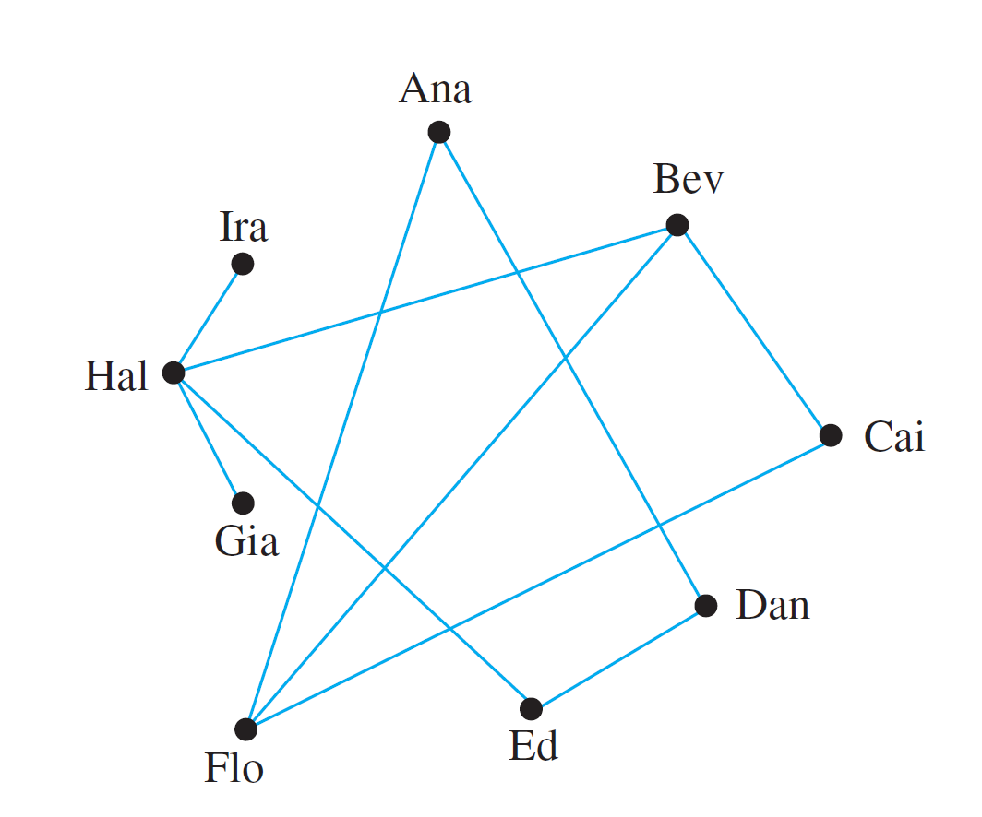
Graphs: Definitions and Basic Properties
This information is displayed below both in a table and in a diagram.

Slide 5
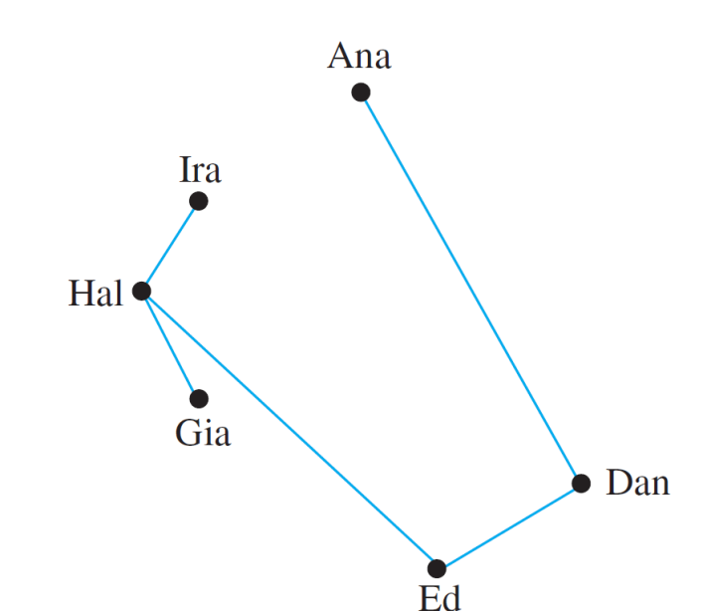
Graphs: Definitions and Basic Properties
From the diagram, it is easy to see that Bev, Cai, and Flo are a group of three past partners, and so they should form one of these teams.
The following figure shows the result when these three names are removed from the diagram.

Slide 6
Graphs: Definitions and Basic Properties
This drawing shows that placing Hal on the same team as Ed would leave Gia and Ira on a team containing no past partners.
However, if Hal is placed on a team with Gia and Ira, then the remaining team would consist of Ana, Dan, and Ed, and both teams would contain at least one pair of past partners.
Drawings such as those shown previously are illustrations of a structure known as a graph.
The dots are called vertices (plural of vertex) and the line segments joining vertices are called edges.

Slide 7
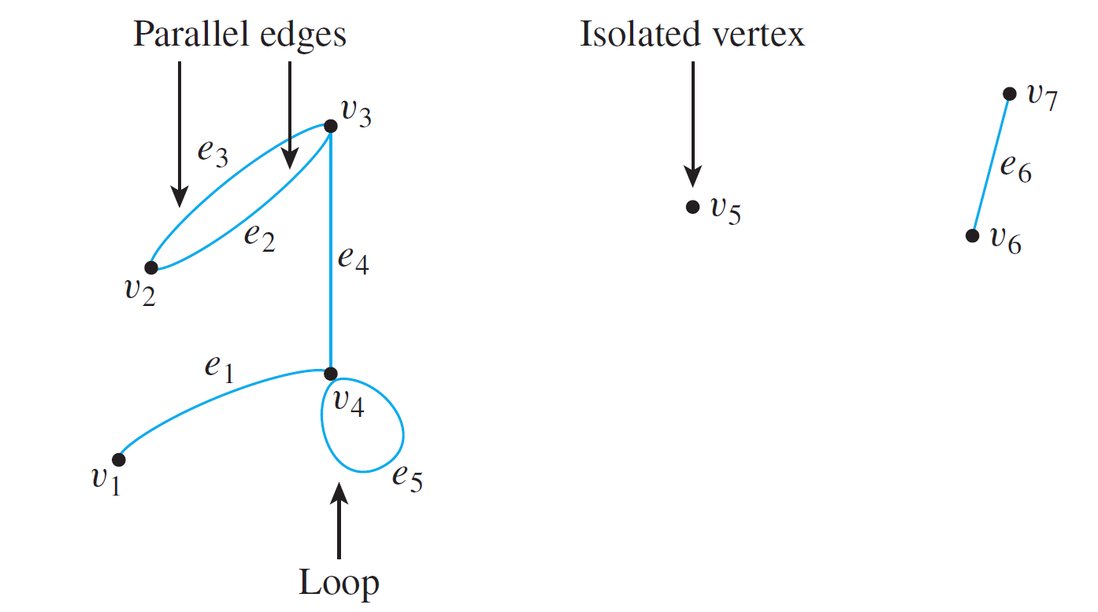
Graphs: Definitions and Basic Properties
The edges may be straight or curved and should either connect one vertex to another or a vertex to itself, as shown below.

Slide 8
Graphs: Definitions and Basic Properties
In this drawing, the vertices have been labeled with v ’s and the edges with e’s.
When an edge connects a vertex to itself (as e₅ does), it is called a loop. When two edges connect the same pair of vertices (as e₂ and e₃ do), they are said to be parallel.
It is quite possible for a vertex to be unconnected by an edge to any other vertex in the graph (as v₅ is), and in that case the vertex is said to be isolated.

Slide 9
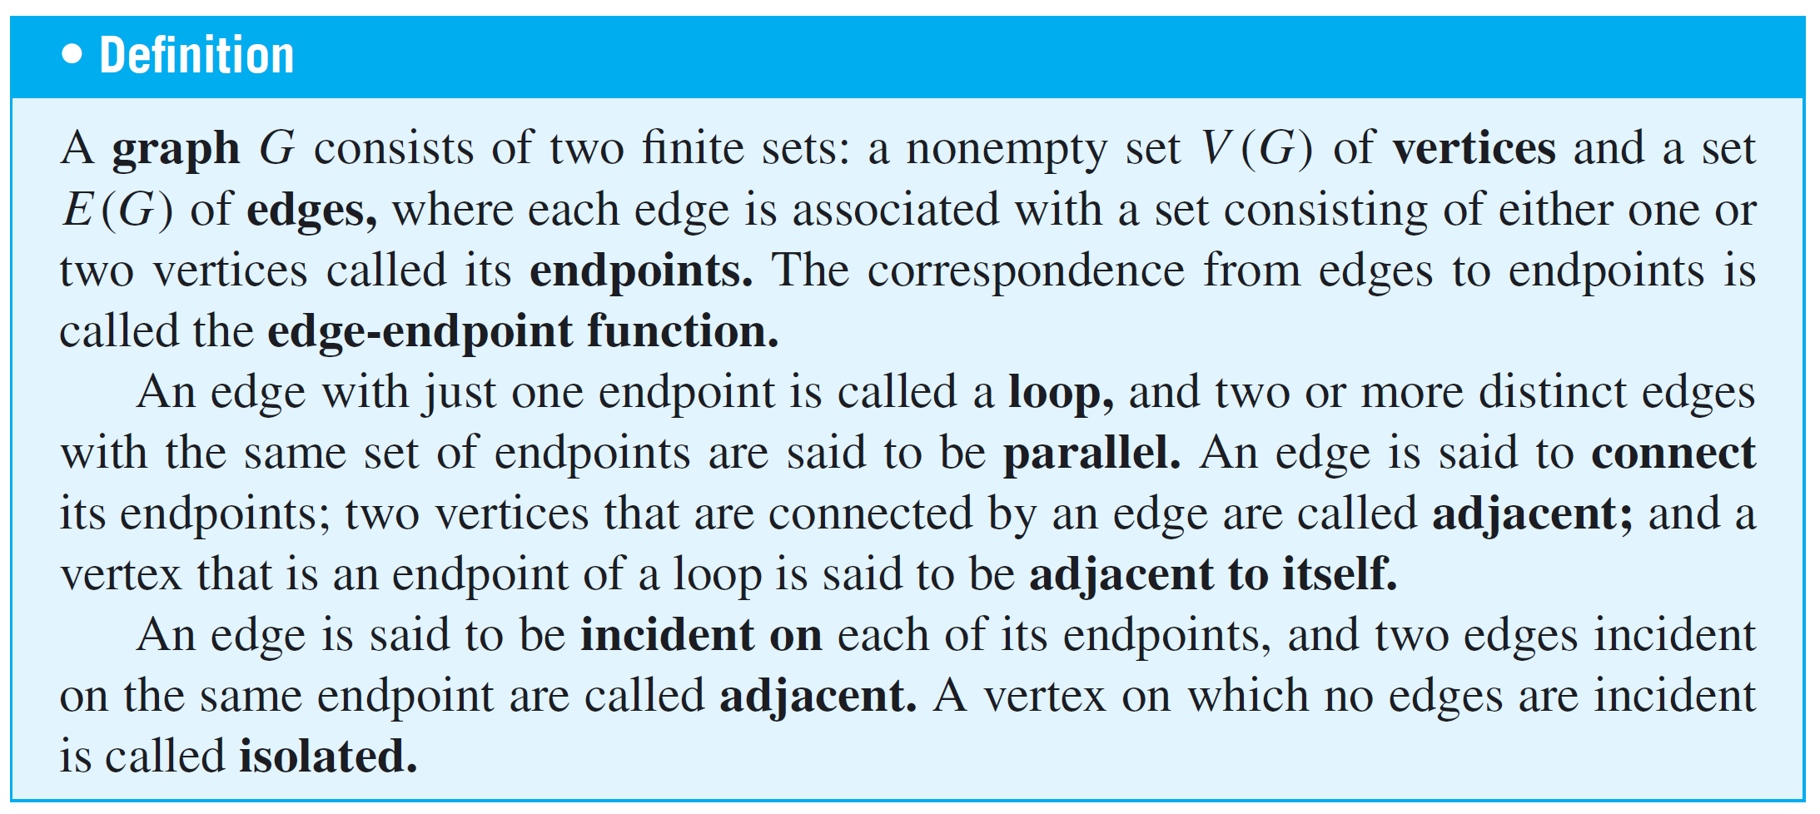
Graphs: Definitions and Basic Properties

Slide 10
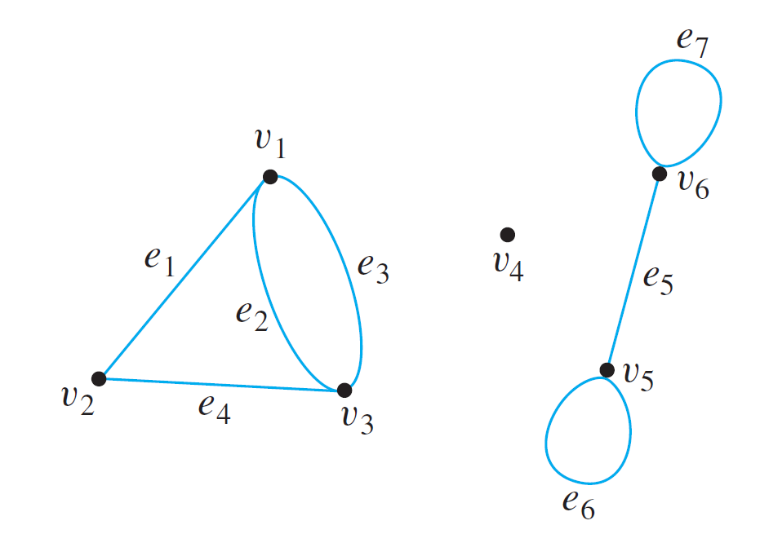
Example 1 – Terminology
Consider the following graph:
a. Write the vertex set and the edge set, and give a table showing the edge-endpoint function.
b. Find all edges that are incident on v₁, all vertices that are adjacent to v₁, all edges that are adjacent to e₁, all loops, all parallel edges, all vertices that are adjacent to themselves, and all isolated vertices.

Slide 11
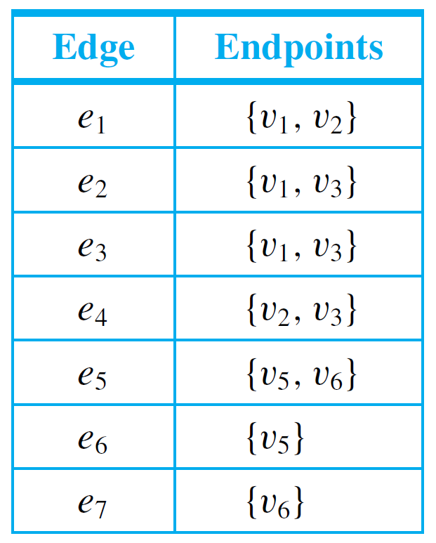
Example 1(a) – Solution
vertex set = {v₁, v₂, v₃, v₄, v₅, v₆}
edge set = {e₁, e₂, e₃, e₄, e₅, e₆, e₇}
edge-endpoint function:

Slide 12
Example 1(a) – Solution
cont’d
Note that the isolated vertex v₄ does not appear in this table.
Although each edge must have either one or two endpoints, a vertex need not be an endpoint of an edge.

Slide 13
Example 1(b) – Solution
cont’d
e₁, e₂, and e₃ are incident on v₁.
v₂ and v₃ are adjacent to v₁.
e₂, e₃, and e₄ are adjacent to e₁.
e₆ and e₇ are loops.
e₂ and e₃ are parallel.
v₅ and v₆ are adjacent to themselves.
v₄ is an isolated vertex.

Slide 14
Graphs: Definitions and Basic Properties
As noted earlier, a given pictorial representation uniquely determines a graph.
However, a given graph may have more than one pictorial representation.
Such things as the lengths or curvatures of the edges and the relative position of the vertices on the page may vary from one pictorial representation to another.

Slide 15
Graphs: Definitions and Basic Properties
We have discussed the directed graph of a binary relation on a set.
Directed graph is similar to graph, except that one associates an ordered pair of vertices with each edge instead of a set of vertices.
Thus each edge of a directed graph can be drawn as an arrow going from the first vertex to the second vertex of the ordered pair.

Slide 16
Graphs: Definitions and Basic Properties
Note that each directed graph has an associated ordinary (undirected) graph, which is obtained by ignoring the directions of the edges.

Slide 17
Examples of Graphs

Slide 18
Examples of Graphs
Graphs are a powerful problem-solving tool because they enable us to represent a complex situation with a single image that can be analyzed both visually and with the aid of a computer.

Slide 19
Example 4 – Using a Graph to Represent a Network
Telephone, electric power, gas pipeline, and air transport systems can all be represented by graphs, as can computer networks—from small local area networks to the global Internet system that connects millions of computers worldwide.
Questions that arise in the design of such systems involve choosing connecting edges to minimize cost, optimize a certain type of service, and so forth.

Slide 20
Example 4 – Using a Graph to Represent a Network
cont’d
A typical network, called a hub and spoke model, is shown below.

Slide 21
Special Graphs

Slide 22
Special Graphs
One important class of graphs consists of those that do not have any loops or parallel edges.
Such graphs are called simple. In a simple graph, no two edges share the same set of endpoints, so specifying two endpoints is sufficient to determine an edge.

Slide 23
Example 8 – A Simple Graph
Draw all simple graphs with the four vertices {u, v, w, x} and two edges, one of which is {u, v}.
Solution:
Each possible edge of a simple graph corresponds to a subset of two vertices.
Given four vertices, there are = 6 such subsets in all: {u, v}, {u, w}, {u, x}, {v, w}, {v, x}, and {w, x}.

Slide 24
Example 8 – Solution
cont’d
Now one edge of the graph is specified to be {u, v}, so any of the remaining five from this list can be chosen to be the second edge.
The possibilities are shown below.

Slide 25
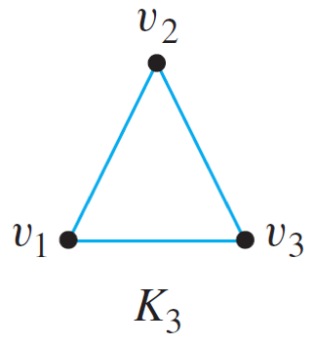
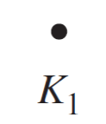
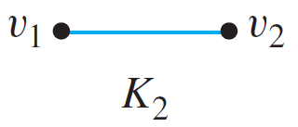
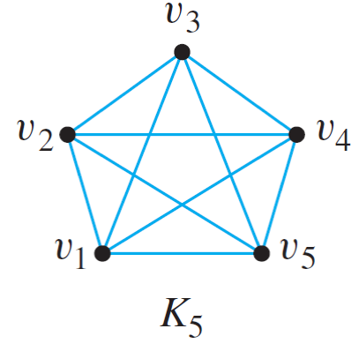
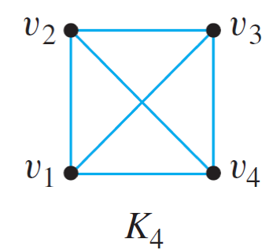
Complete Graphs on n Vertices: K₁, K₂, K₃, K₄, K₅
The complete graphs K₁, K₂, K₃, K₄, and K₅ can be drawn as follows:

Slide 26
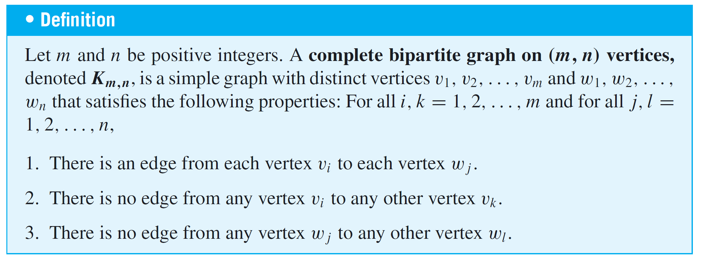
Special Graphs
In complete bipartite graph: the vertex set can be separated into two subsets: Each vertex in one of the subsets is connected by exactly one edge to each vertex in the other subset, but not to any vertices in its own subset.

Slide 27
Special Graphs

Slide 28
The Concept of Degree

Slide 29
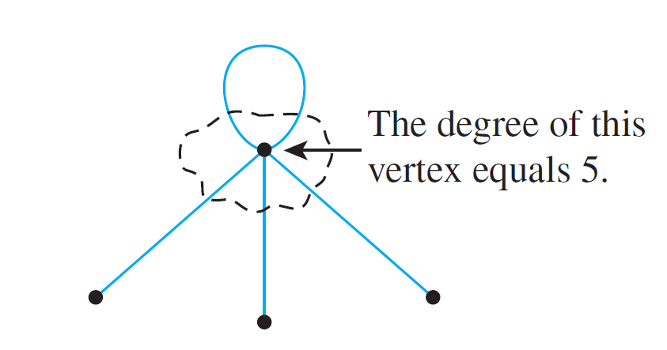
The Concept of Degree
The degree of a vertex is the number of end segments of edges that “stick out of” the vertex.

Slide 30
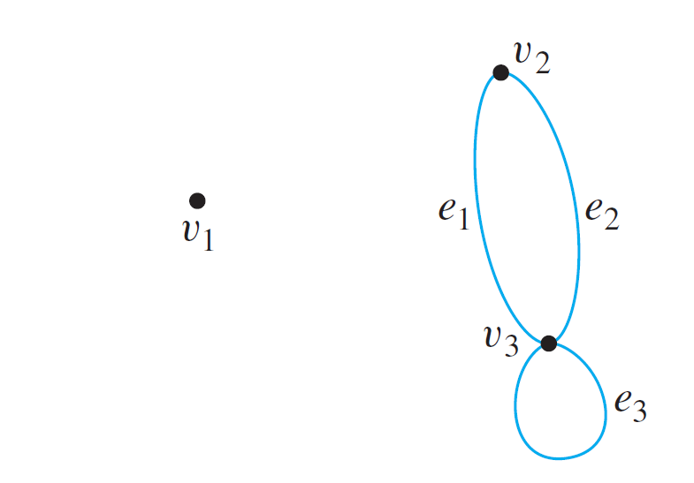
Example 12 – Degree of a Vertex and Total Degree of a Graph
Find the degree of each vertex of the graph G shown below. Then find the total degree of G.

Slide 31
Example 12 – Solution
deg(v₁) = 0 since no edge is incident on v₁ (v₁ is isolated).
deg(v₂) = 2 since both e₁ and e₂ are incident on v₂.
deg(v₃) = 4 since e₁ and e₂ are incident on v₃ and the loop e₃ is also incident on v₃ (and contributes 2 to the degree of v₃).
total degree of G = deg(v₁) + deg(v₂) + deg(v₃)
= 0 + 2 + 4
= 6.

Slide 32
The Concept of Degree
Note that the total degree of the graph G of Example 12, which is 6, equals twice the number of edges of G, which is 3.
Roughly speaking, this is true because each edge has two end segments, and each end segment is counted once toward the degree of some vertex. This result generalizes to any graph.
In fact, for any graph without loops, the general result can be explained as follows: Imagine a group of people at a party. Depending on how social they are, each person shakes hands with various other people.

Slide 33
The Concept of Degree
So each person participates in a certain number of handshakes—perhaps many, perhaps none—but because each handshake is experienced by two different people, if the numbers experienced by each person are added together, the sum will equal twice the total number of handshakes.
This is such an attractive way of understanding the situation that the following theorem is often called the handshake lemma or the handshake theorem.

Slide 34
The Concept of Degree
As the proof demonstrates, the conclusion is true even if the graph contains loops.

Slide 35
The Concept of Degree
The following proposition is easily deduced from Corollary 10.1.2 using properties of even and odd integers.

Slide 36
SECTION 10.2
Trails, Paths, and Circuits
Copyright © Cengage Learning. All rights reserved.

Slide 37
Trails, Paths, and Circuits
The subject of graph theory began in the year 1736 when the great mathematician Leonhard Euler published a paper giving the solution to the following puzzle:
The town of Königsberg in Prussia (now Kaliningrad in Russia) was built at a point where two branches of the Pregel River came together.
It consisted of an island and some land along the river banks.

Slide 38
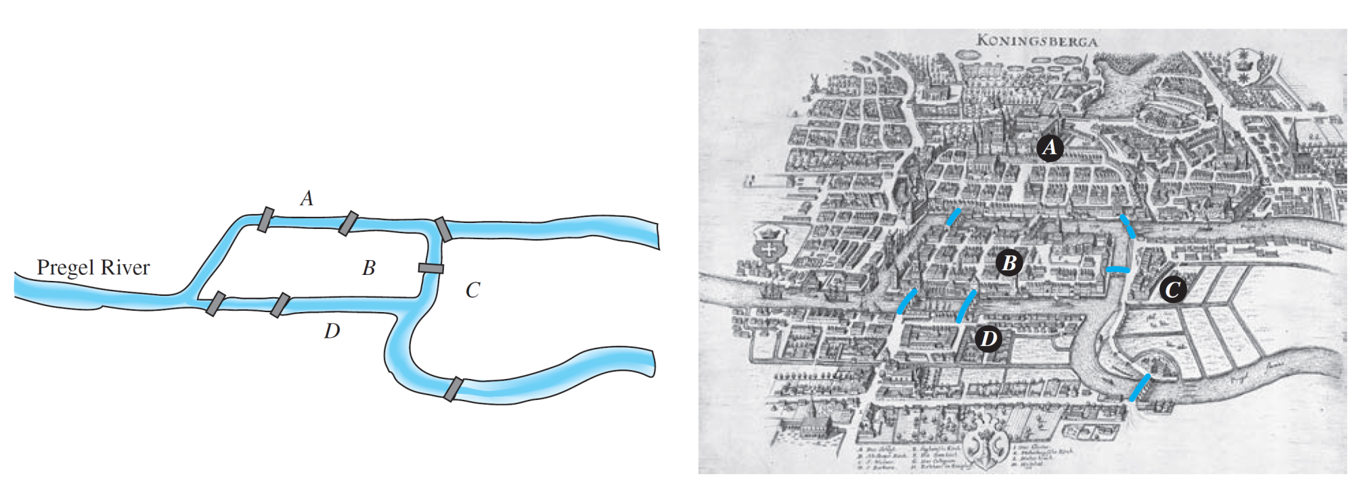
Trails, Paths, and Circuits
Is it possible for a person to take a walk around town, starting and ending at the same location and crossing each of the seven bridges exactly once?
To solve this puzzle, Euler translated it into a graph theory problem. He noticed that all points of a given land mass can be identified with each other since a person can travel from any one point to any other point of the same land mass without crossing a bridge.
The Seven Bridges of Königsberg

Slide 39
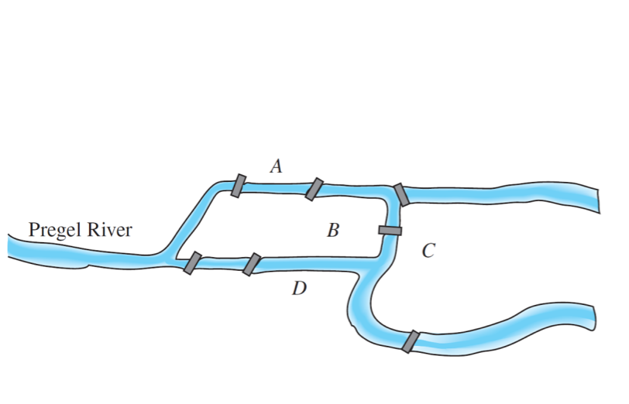
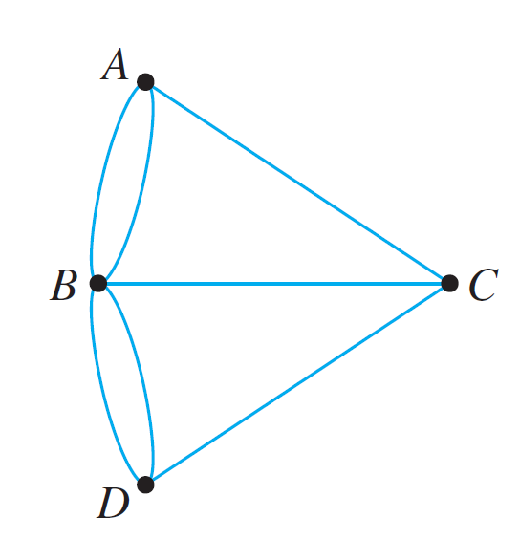
Trails, Paths, and Circuits
To solve this puzzle, Euler translated it into a graph theory problem.
He noticed that all points of a given land mass can be identified with each other since a person can travel from any one point to any other point of the same land mass without crossing a bridge.

Slide 40
Trails, Paths, and Circuits
Is it possible to find a route through the graph that starts and ends at some vertex, one of A, B, C, or D, and traverses each edge exactly once?
Equivalently: Is it possible to trace this graph, starting and ending at the same point, without ever lifting your pencil from the paper?

Slide 41
Trails, Paths, and Circuits
Take a few minutes to think about the question yourself. Can you find a route that meets the requirements? Try it!
Looking for a route is frustrating because you continually find yourself at a vertex that does not have an unused edge on which to leave, while elsewhere there are unused edges that must still be traversed.
If you start at vertex A, for example, each time you pass through vertex B, C, or D, you use up two edges because you arrive on one edge and depart on a different one.

Slide 42
Trails, Paths, and Circuits
So, if it is possible to find a route that uses all the edges of the graph and starts and ends at A, then the total umber of arrivals and departures from each vertex B, C, and D must be a multiple of 2.
Or, in other words, the degrees of the vertices B, C, and D must be even.
But they are not: deg(B) = 5, deg(C) = 3, and deg(D) = 3. Hence there is no route that solves the puzzle by starting and ending at A.

Slide 43
Trails, Paths, and Circuits
Similar reasoning can be used to show that there are no routes that solve the puzzle by starting and ending at B, C, or D.
Therefore, it is impossible to travel all around the city crossing each bridge exactly once.

Slide 44
Definitions

Slide 45
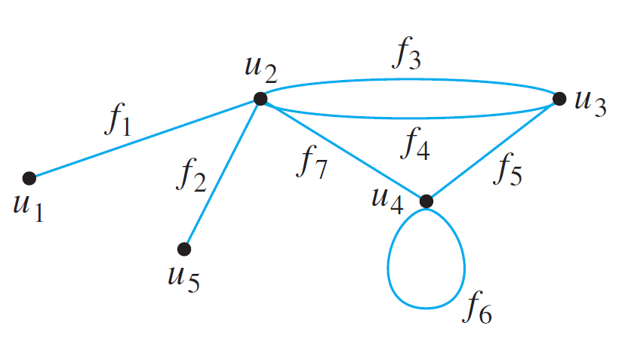
Definitions
Travel in a graph is accomplished by moving from one vertex to another along a sequence of adjacent edges.
In the graph below, for instance, you can go from u₁ to u₄ by taking f₁ to u₂ and then f₇ to u₄. This is represented by writing u₁f₁u₂f₇u₄.

Slide 46
Definitions
Or you could take the roundabout route
Certain types of sequences of adjacent vertices and edges are of special importance in graph theory: those that do not have a repeated edge, those that do not have a repeated vertex, and those that start and end at the same vertex.

Slide 47
Definitions

Slide 48
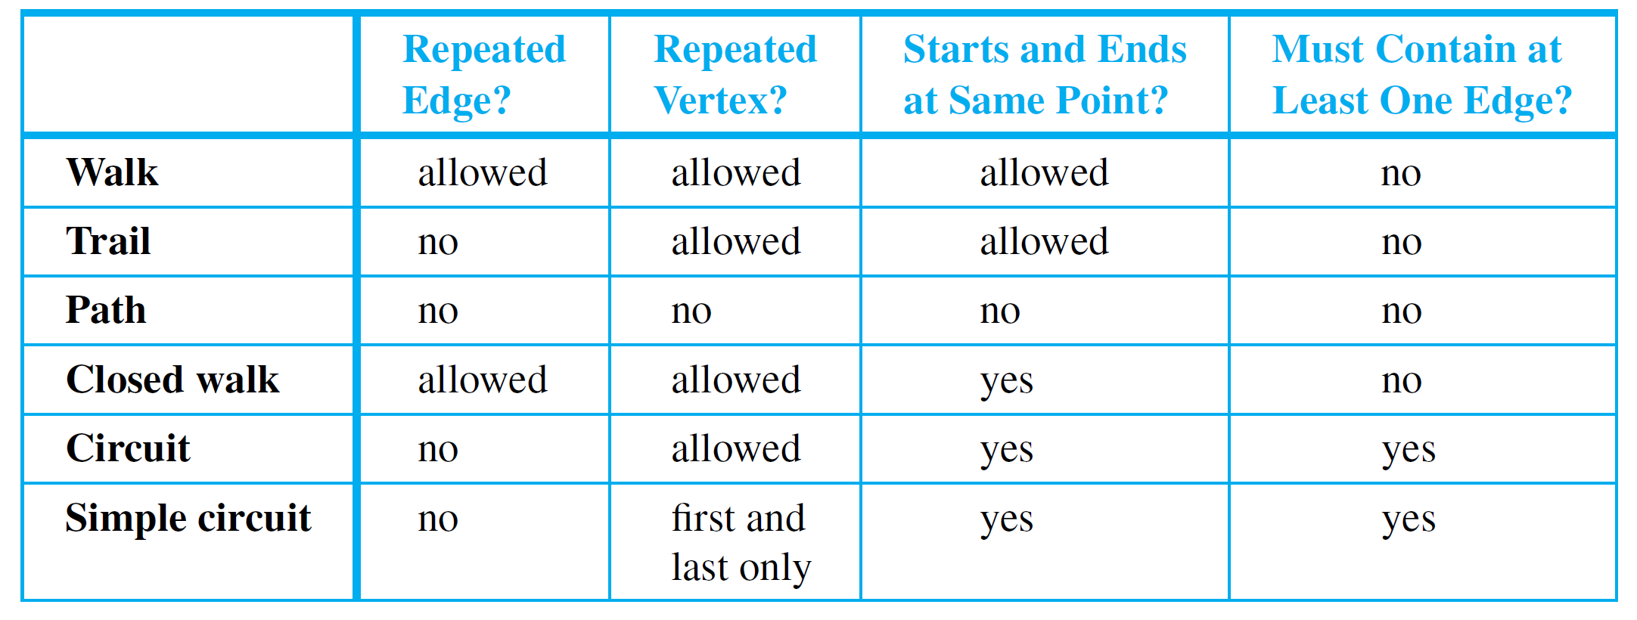
Definitions
For ease of reference, these definitions are summarized in the following table:
Often a walk can be specified unambiguously by giving either a sequence of edges or a sequence of vertices.

Slide 49
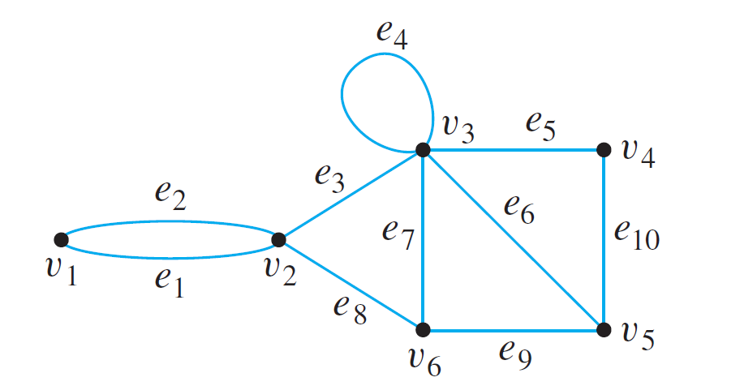
Example 2 – Walks, Trails Paths, and Circuits
In the graph below, determine which of the following walks are trails, paths, circuits, or simple circuits.
a. b. c.
d. e. f.

Slide 50
Example 2 – Solution
a. This walk has a repeated vertex but does not have a repeated edge, so it is a trail from v₁ to v₄ but not a path.
b. This is just a walk from v₁ to v₅. It is not a trail because it has a repeated edge.
c. This walk starts and ends at v₂, contains at least one edge, and does not have a repeated edge, so it is a circuit. Since the vertex v₃ is repeated in the middle, it is not a simple circuit.
d. This walk starts and ends at v₂, contains at least one edge, does not have a repeated edge, and does not have a repeated vertex. Thus it is a simple circuit.

Slide 51
Example 2 – Solution
cont’d
e. This is just a closed walk starting and ending at v₁. It is not a circuit because edge e₁ is repeated.
f. The first vertex of this walk is the same as its last vertex, but it does not contain an edge, and so it is not a circuit. It is a closed walk from v₁ to v₁. (It is also a trail from v₁ to v₁.)

Slide 52
Definitions
Because most of the major developments in graph theory have happened relatively recently and in a variety of different contexts, the terms used in the subject have not been standardized.
For example, what this book calls a graph is sometimes called a multigraph, what this book calls a simple graph is sometimes called a graph, what this book calls a vertex is sometimes called a node, and what this book calls an edge is sometimes called an arc.

Slide 53
Definitions
Similarly, instead of the word trail, the word path is sometimes used; instead of the word path, the words simple path are sometimes used; and instead of the words simple circuit, the word cycle is sometimes used.
The terminology in this book is among the most common, but if you consult other sources, be sure to check their definitions.

Slide 54
Connectedness

Slide 55
Connectedness
It is easy to understand the concept of connectedness on an intuitive level.
Roughly speaking, a graph is connected if it is possible to travel from any vertex to any other vertex along a sequence of adjacent edges of the graph.

Slide 56
Connectedness
The formal definition of connectedness is stated in terms of walks.
If you take the negation of this definition, you will see that a graph G is not connected if, and only if, there are two vertices of G that are not connected by any walk.

Slide 57
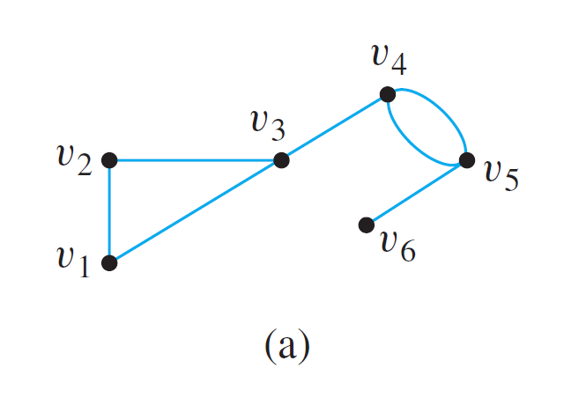
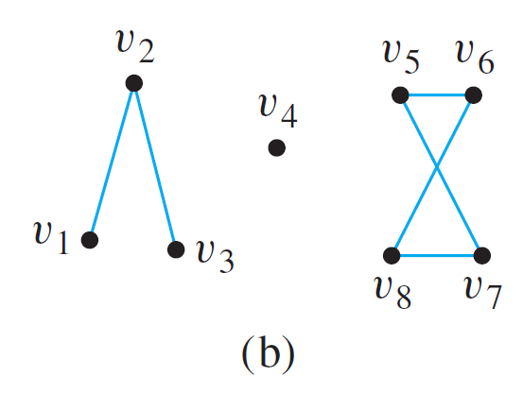
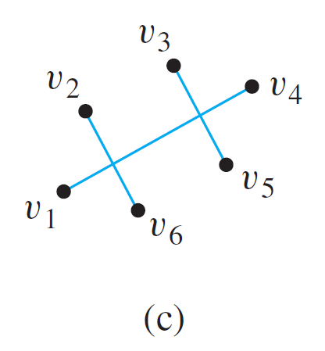
Example 3 – Connected and Disconnected Graphs
Which of the following graphs are connected?

Slide 58
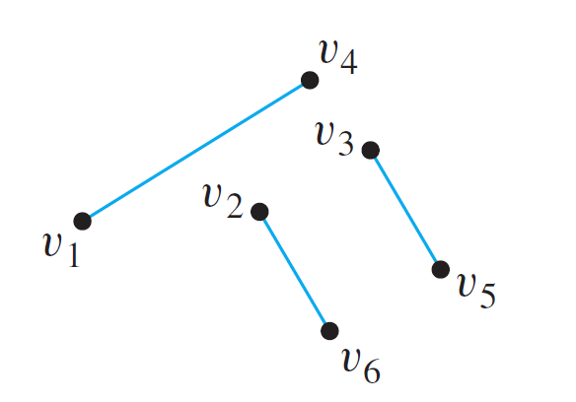
Example 3 – Solution
The graph represented in (a) is connected, whereas those of (b) and (c) are not. To understand why (c) is not connected, we know that in a drawing of a graph, two edges may cross at a point that is not a vertex.
Thus the graph in (c) can be redrawn as follows:

Slide 59
Connectedness
Some useful facts relating circuits and connectedness are collected in the following lemma.

Slide 60
Connectedness
The graphs in (b) and (c) are both made up of three pieces, each of which is itself a connected graph.
A connected component of a graph is a connected subgraph of largest possible size.

Slide 61
Connectedness
The fact is that any graph is a kind of union of its connected components.

Slide 62
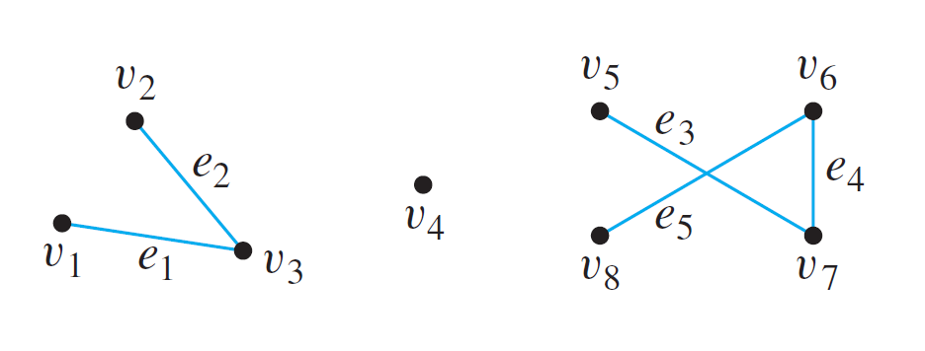
Example 4 – Connected Components
Find all connected components of the following graph G.
Solution:
G has three connected components: H₁, H₂, and H₃ with vertex sets V₁, V₂, and V₃ and edge sets E₁, E₂, and E₃, where

Slide 63
Euler Circuits

Slide 64
Euler Circuits
Now we return to consider general problems similar to the puzzle of the Königsberg bridges.
The following definition is made in honor of Euler.

Slide 65
Euler Circuits
The analysis used earlier to solve the puzzle of the Königsberg bridges generalizes to prove the following theorem:

Slide 66
Euler Circuits
We know that the contrapositive of a statement is logically equivalent to the statement.
The contrapositive of Theorem 10.2.2 is as follows:
This version of Theorem 10.2.2 is useful for showing that a given graph does not have an Euler circuit.

Slide 67
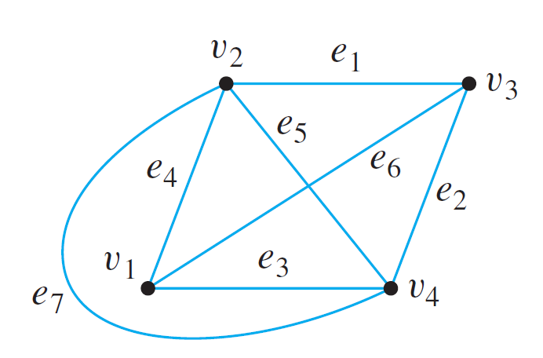
Example 5 – Showing That a Graph Does Not Have an Euler Circuit
Show that the graph below does not have an Euler circuit.
Solution:
Vertices v₁ and v₃ both have degree 3, which is odd. Hence by (the contrapositive form of) Theorem 10.2.2, this graph does not have an Euler circuit.

Slide 68
Euler Circuits
Now consider the converse of Theorem 10.2.2: If every vertex of a graph has even degree, then the graph has an Euler circuit. Is this true?
The answer is no. There is a graph G such that every vertex of G has even degree but G does not have an Euler circuit. In fact, there are many such graphs. The illustration below shows one example.

Slide 69
Euler Circuits
Note that the graph in the preceding drawing is not connected.
It turns out that although the converse of Theorem 10.2.2 is false, a modified converse is true: If every vertex of a graph has positive even degree and if the graph is connected, then the graph has an Euler circuit.

Slide 70
Euler Circuits
The proof of this fact is constructive: It contains an algorithm to find an Euler circuit for any connected graph in which every vertex has even degree.

Slide 71
Euler Circuits
A corollary to Theorem 10.2.4 gives a criterion for determining when it is possible to find a walk from one vertex of a graph to another, passing through every vertex of the graph at least once and every edge of the graph exactly once.

Slide 72
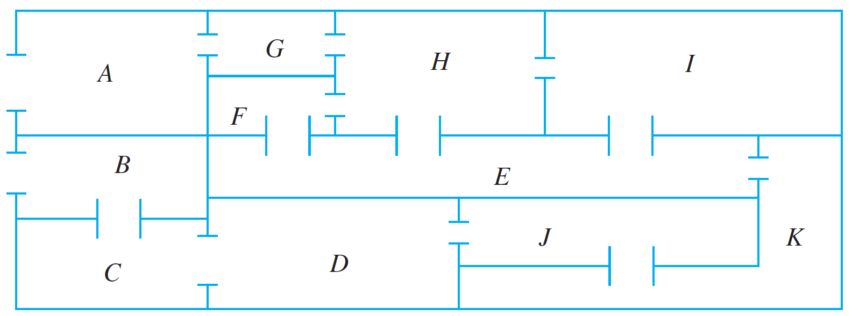
Example 7 – Finding an Euler Trail
The floor plan shown below is for a house that is open for public viewing. Is it possible to find a trail that starts in room A, ends in room B, and passes through every interior doorway of the house exactly once? If so, find such a trail.

Slide 73
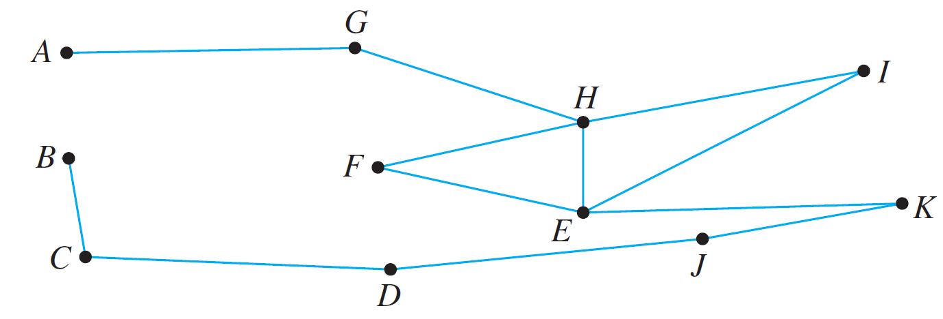
Example 7 – Solution
Let the floor plan of the house be represented by the graph below.
Each vertex of this graph has even degree except for A and B, each of which has degree 1.
Hence by Corollary 10.2.5, there is an Euler path from A to B. One such trail is
AGHFEIHEKJDCB.

Slide 74
Hamiltonian Circuits

Slide 75
Hamiltonian Circuits
Theorem 10.2.4 completely answers the following question:
Given a graph G, is it possible to find a circuit for G in which all the edges of G appear exactly once?
A related question is this: Given a graph G, is it possible to find a circuit for G in which all the vertices of G (except the first and the last) appear exactly once?

Slide 76
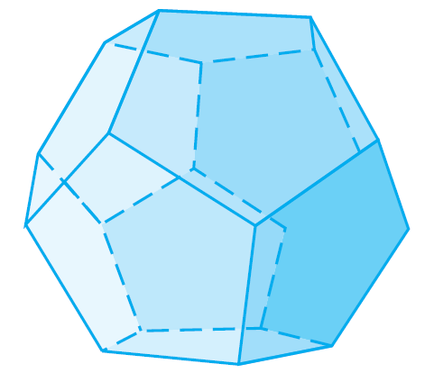
Hamiltonian Circuits
In 1859 the Irish mathematician Sir William Rowan Hamilton introduced a puzzle in the shape of a dodecahedron (DOH-dek-a-HEE-dron). (Figure 10.2.6 contains a drawing of a dodecahedron, which is a solid figure with 12 identical pentagonal faces.)
Dodecahedron
Figure 10.2.6

Slide 77
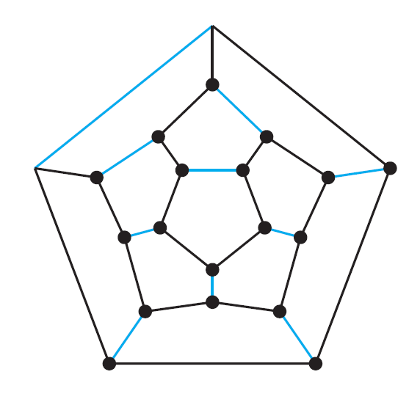
Hamiltonian Circuits
Each vertex was labeled with the name of a city—London, Paris, Hong Kong, New York, and so on.
The problem Hamilton posed was to start at one city and tour the world by visiting each other city exactly once and returning to the starting city.
One way to solve the puzzle is to imagine the surface of the dodecahedron stretched out and laid flat in the plane, as follows:

Slide 78
Hamiltonian Circuits
The circuit denoted with black lines is one solution. Note that although every city is visited, many edges are omitted from the circuit. (More difficult versions of the puzzle required that certain cities be visited in a certain order.)
The following definition is made in honor of Hamilton.

Slide 79
Hamiltonian Circuits
Note that although an Euler circuit for a graph G must include every vertex of G, it may visit some vertices more than once and hence may not be a Hamiltonian circuit.
On the other hand, a Hamiltonian circuit for G does not need to include all the edges of G and hence may not be an Euler circuit.
Despite the analogous-sounding definitions of Euler and Hamiltonian circuits, the mathematics of the two are very different.

Slide 80
Hamiltonian Circuits
Theorem 10.2.4 gives a simple criterion for determining whether a given graph has an Euler circuit.
Unfortunately, there is no analogous criterion for determining whether a given graph has a Hamiltonian circuit, nor is there even an efficient algorithm for finding such a circuit.

Slide 81
Hamiltonian Circuits
There is, however, a simple technique that can be used in many cases to show that a graph does not have a Hamiltonian circuit.
This follows from the following considerations:
Suppose a graph G with at least two vertices has a Hamiltonian circuit C given concretely as
Since C is a simple circuit, all the e_{i} are distinct and all the v_{j} are distinct except that v₀ = v_{n}. Let H be the subgraph of G that is formed using the vertices and edges of C.

Slide 82
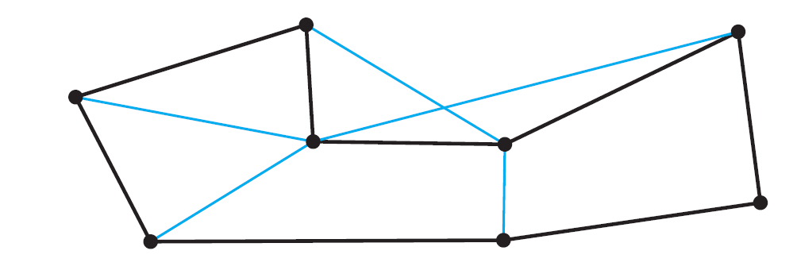
Hamiltonian Circuits
An example of such an H is shown below.
Note that H has the same number of edges as it has vertices since all its n edges are distinct and so are its n vertices v₁, v₂, . . . , v_{n}.
Also, by definition of Hamiltonian circuit, every vertex of G is a vertex of H, and H is connected since any two of its vertices lie on a circuit. In addition, every vertex of H has degree 2.

Slide 83
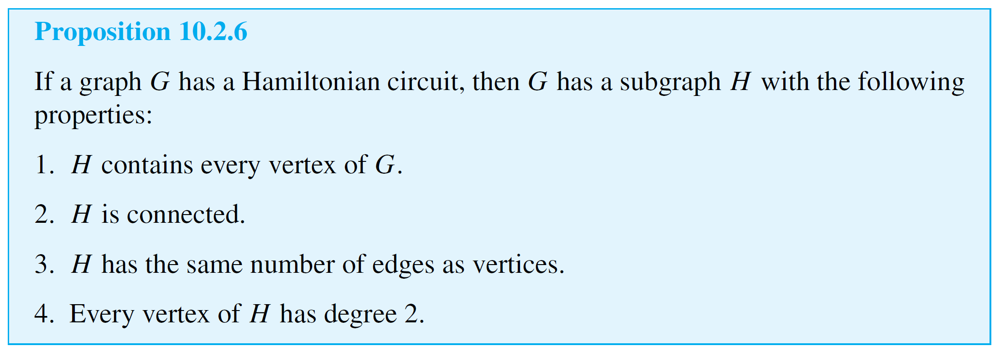
Hamiltonian Circuits
The reason for this is that there are exactly two edges incident on any vertex. These are e_{i} and e_{i+1} for any vertex v_{i} except v₀ = v_{n}, and they are e₁ and e_{n} for v₀ (= v_{n}).
These observations have established the truth of the following proposition in all cases where G has at least two vertices.

Slide 84
Hamiltonian Circuits
Note that if G contains only one vertex and G has a Hamiltonian circuit, then the circuit has the form v e v, where v is the vertex of G and e is an edge incident on v.
In this case, the subgraph H consisting of v and e satisfies conditions (1)–(4) of Proposition 10.2.6.

Slide 85
Hamiltonian Circuits
We know that the contrapositive of a statement is logically equivalent to the statement.
The contrapositive of Proposition 10.2.6 says that if a graph G does not have a subgraph H with properties (1)–(4), then G does not have a Hamiltonian circuit.
The next example illustrates a type of problem known as a traveling salesman problem. It is a variation of the problem of finding a Hamiltonian circuit for a graph.

Slide 86
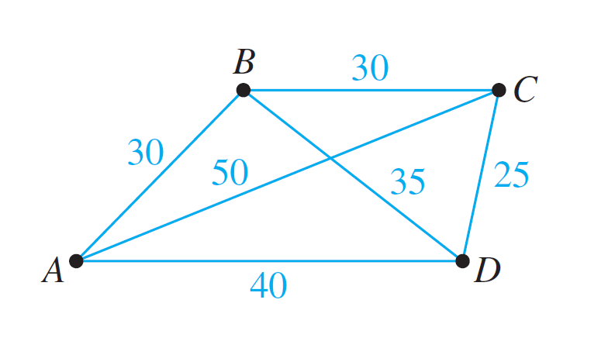
Example 9 – A Traveling Salesman Problem
Imagine that the drawing below is a map showing four cities and the distances in kilometers between them.
Suppose that a salesman must travel to each city exactly once, starting and ending in city A. Which route from city to city will minimize the total distance that must be traveled?

Slide 87
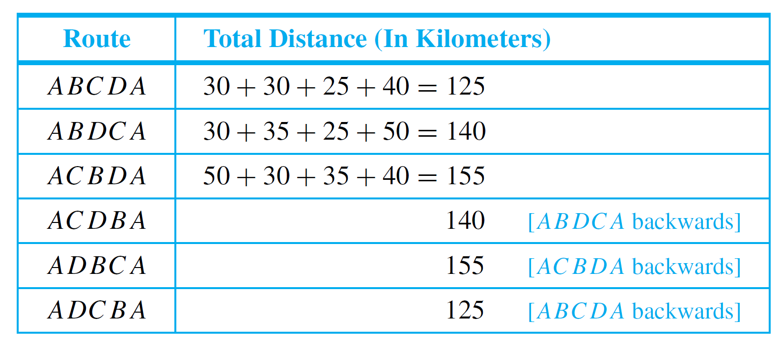
Example 9 – Solution
This problem can be solved by writing all possible Hamiltonian circuits starting and ending at A and calculating the total distance traveled for each.
Thus either route ABCDA or ADCBA gives a minimum total distance of 125 kilometers.

Slide 88
Hamiltonian Circuits
The general traveling salesman problem involves finding a Hamiltonian circuit to minimize the total distance traveled for an arbitrary graph with n vertices in which each edge is marked with a distance.
One way to solve the general problem is to use the method of Example 9: Write down all Hamiltonian circuits starting and ending at a particular vertex, compute the total distance for each, and pick one for which this total is minimal.

Slide 89
Hamiltonian Circuits
However, even for medium-sized values of n this method is impractical.
For a complete graph with 30 vertices, there would be Hamiltonian circuits starting and ending at a particular vertex to check.
Even if each circuit could be found and its total distance computed in just one nanosecond, it would require approximately 1.4 ⋅ 10¹⁴ years to finish the computation.

Slide 90
Hamiltonian Circuits
At present, there is no known algorithm for solving the general traveling salesman problem that is more efficient.
However, there are efficient algorithms that find “pretty good” solutions—that is, circuits that, while not necessarily having the least possible total distances, have smaller total distances than most other Hamiltonian circuits.

Slide 91
SECTION 10.3
Matrix Representations
of Graphs
Copyright © Cengage Learning. All rights reserved.

Slide 92
Matrix Representations of Graphs
All the information needed to specify a graph can be conveyed by a structure called a matrix, and matrices (matrices is the plural of matrix) are easy to represent inside computers.

Slide 93
Matrices

Slide 94
Matrices
Matrices are two-dimensional analogues of sequences. They are also called two-dimensional arrays.

Slide 95
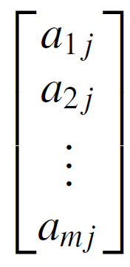
Matrices
The ith row of A is
and the jth column of A is
The entry a_{ij} in the ith row and jth column of A is called the i jth entry of A. An m ⋅ n matrix is said to have size m × n.

Slide 96
Matrices
If A and B are matrices, then A = B if, and only if, A and B have the same size and the corresponding entries of A and B are all equal; that is,
A matrix for which the numbers of rows and columns are equal is called a square matrix.

Slide 97
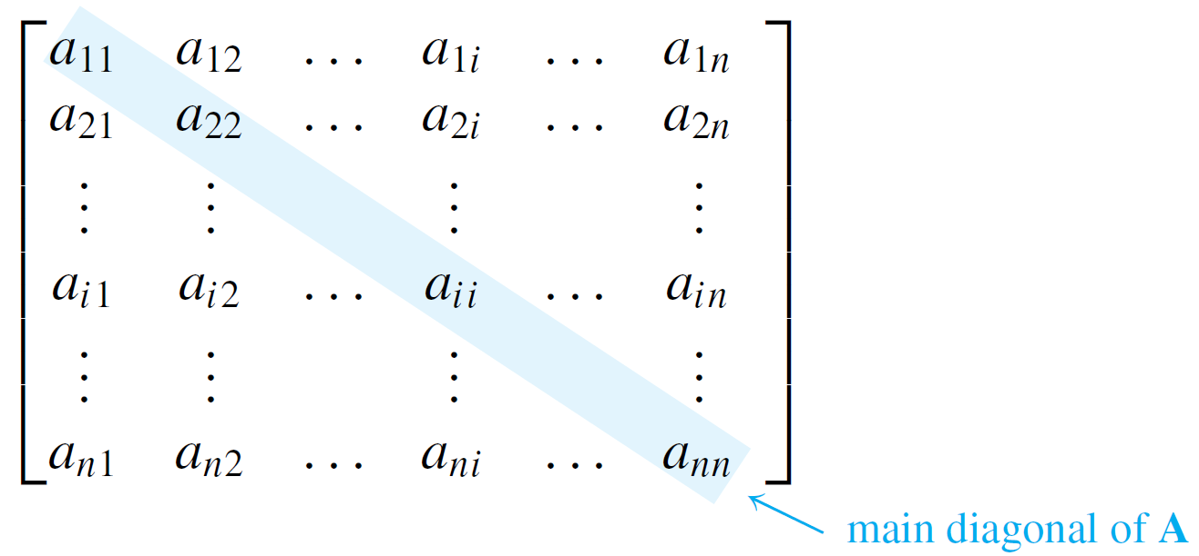
Matrices
If A is a square matrix of size n ⋅ n, then the main diagonal of A consists of all the entries a₁₁, a₂₂, . . . , a_{nn}:

Slide 98
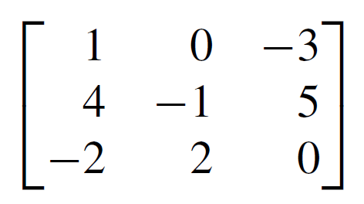
Example 1 – Matrix Terminology
The following is a 3 ⋅ 3 matrix over the set of integers.
a. What is the entry in row 2, column 3?
b. What is the second column of A?
c. What are the entries in the main diagonal of A?

Slide 99
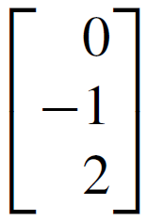
Example 1 – Solution
a. 5
b.
c. 1, –1 and 0

Slide 100
Matrices and Directed Graphs

Slide 101
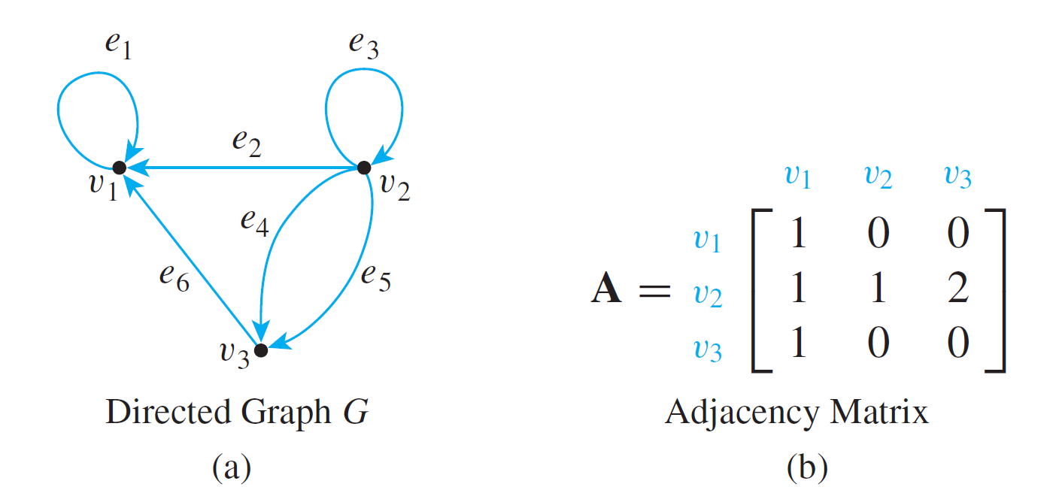
Matrices and Directed Graphs
Consider the directed graph shown in Figure 10.3.1.
A Directed Graph and Its Adjacency Matrix
Figure 10.3.1

Slide 102
Matrices and Directed Graphs
This graph can be represented by the matrix A = (a_{i j}) for which a_{i j} = the number of arrows from v_{i} to v_{j}, for all i = 1, 2, 3 and j = 1, 2, 3.
Thus a₁₁ = 1 because there is one arrow from v₁ to v₁, a₁₂ = 0 because there is no arrow from v₁ to v₂, a₂₃ = 2 because there are two arrows from v₂ to v₃, and so forth.
A is called the adjacency matrix of the directed graph.
For convenient reference, the rows and columns of A are often labeled with the vertices of the graph G.

Slide 103
Matrices and Directed Graphs
Note that nonzero entries along the main diagonal of an adjacency matrix indicate the presence of loops, and entries larger than 1 correspond to parallel edges.
Moreover, if the vertices of a directed graph are reordered, then the entries in the rows and columns of the corresponding adjacency matrix are moved around.

Slide 104
Example 2 – The Adjacency Matrix of a Graph
The two directed graphs shown below differ only in the ordering of their vertices. Find their adjacency matrices.
(a)
(b)

Slide 105
Example 2 – Solution
Since both graphs have three vertices, both adjacency matrices are 3 ⋅ 3 matrices.
For (a), all entries in the first row are 0 since there are no arrows from v₁ to any other vertex.
For (b), the first two entries in the first row are 1 and the third entry is 0 since from v₁ there are single arrows to v₁ and to v₂ and no arrows to v₃.

Slide 106
Example 2 – Solution
cont’d
Continuing the analysis in this way, you obtain the following two adjacency matrices:
(a)
(b)

Slide 107
Matrices and Directed Graphs
If you are given a square matrix with nonnegative integer entries, you can construct a directed graph with that matrix as its adjacency matrix.
However, the matrix does not tell you how to label the edges, so the directed graph is not uniquely determined.

Slide 108
Matrices and Undirected Graphs

Slide 109
Matrices and Undirected Graphs
Once you know how to associate a matrix with a directed graph, the definition of the matrix corresponding to an undirected graph should seem natural to you.
As before, you must order the vertices of the graph, but in this case you simply set the i j th entry of the adjacency matrix equal to the number of edges connecting the i th and j th vertices of the graph.

Slide 110
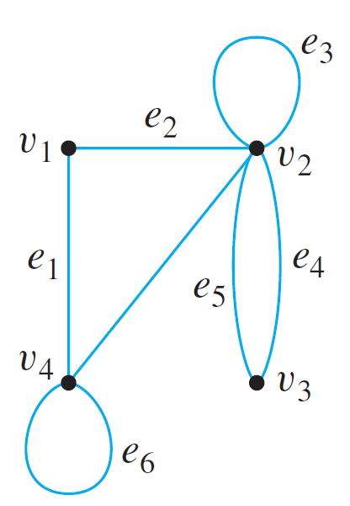
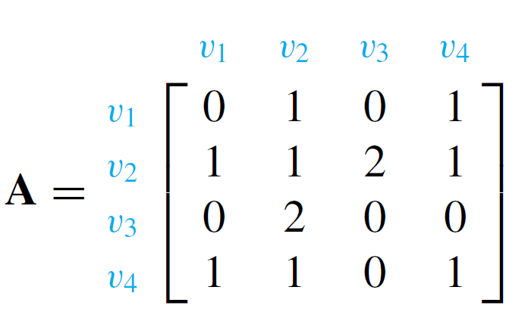
Example 4 – Finding the Adjacency Matrix of a Graph
Find the adjacency matrix for the graph G shown below.
Solution:

Slide 111
Matrices and Undirected Graphs
Note that if the matrix A = (a_{i j}) in Example 4 is flipped across its main diagonal, it looks the same: a_{i j} = a_{j i}, for i, j = 1, 2, . . . , n. Such a matrix is said to be symmetric.
It is easy to see that the matrix of any undirected graph is symmetric since it is always the case that the number of edges joining v_{i} and v_{j} equals the number of edges joining v_{j} and v_{i} for all i, j = 1, 2, . . . , n.

Slide 112
Matrices and Connected
Components

Slide 113
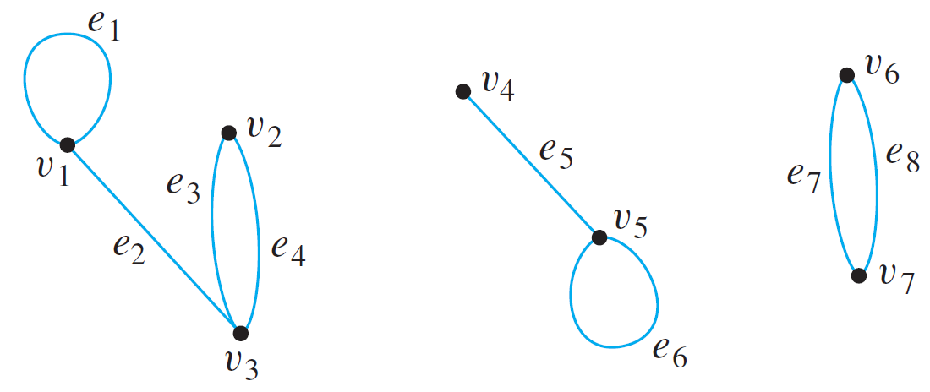
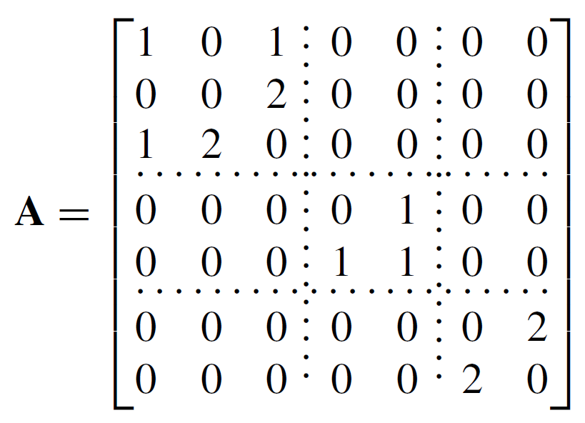
Matrices and Connected Components
Consider a graph G, as shown below, that consists of several connected components.
The adjacency matrix of G is

Slide 114
Matrices and Connected Components
As you can see, A consists of square matrix blocks (of different sizes) down its diagonal and blocks of 0’s everywhere else.
The reason is that vertices in each connected component share no edges with vertices in other connected components.
For instance, since v₁, v₂, and v₃ share no edges with v₄, v₅, v₆, or v₇, all entries in the top three rows to the right of the third column are 0 and all entries in the left three columns below the third row are also 0.
Sometimes matrices whose entries are all 0’s are themselves denoted 0.

Slide 115
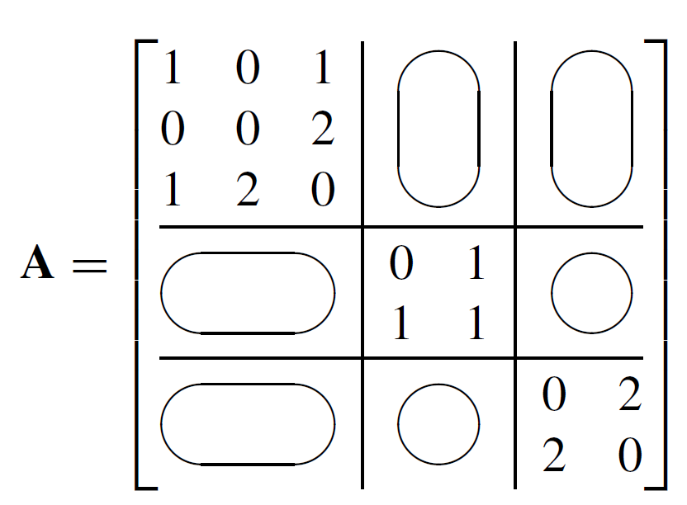
Matrices and Connected Components
If this convention is followed here, A is written as

Slide 116
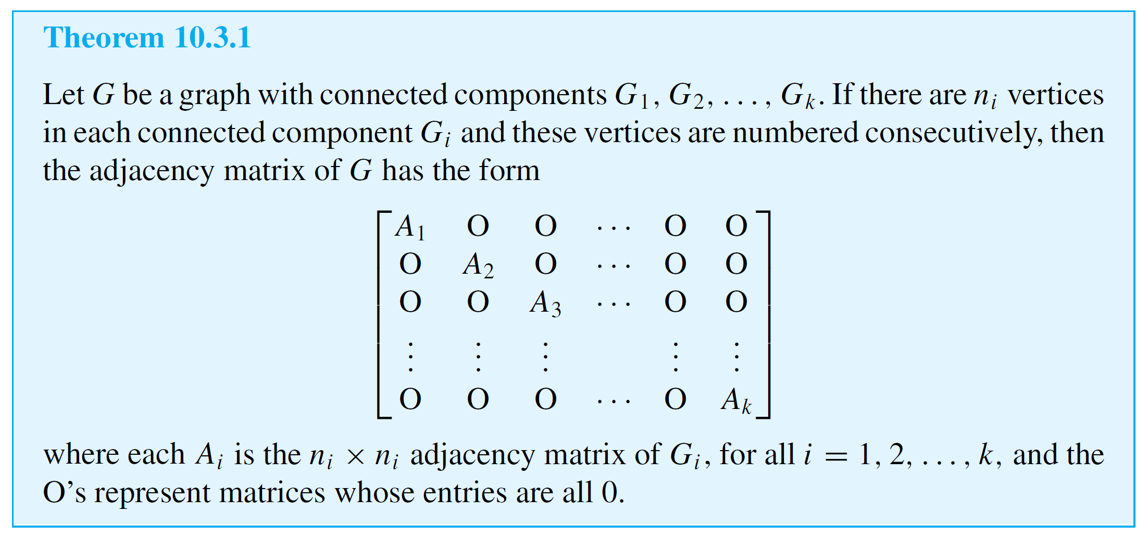
Matrices and Connected Components
The previous reasoning can be generalized to prove the following theorem:

Slide 117
Matrix Multiplication

Slide 118
Matrix Multiplication
Matrix multiplication is an enormously useful operation that arises in many contexts, including the investigation of walks in graphs.
Although matrix multiplication can be defined in quite abstract settings, the definition for matrices whose entries are real numbers will be sufficient for our applications.
The product of two matrices is built up of scalar or dot products of their individual rows and columns.

Slide 119
Matrix Multiplication
More generally, if A and B are matrices whose entries are real numbers and if A and B have compatible sizes in the sense that the number of columns of A equals the number of rows of B, then the product AB is defined.

Slide 120
Matrix Multiplication
It is the matrix whose i j th entry is the scalar product of the
i th row of A times the j th column of B, for all possible values of i and j.

Slide 121
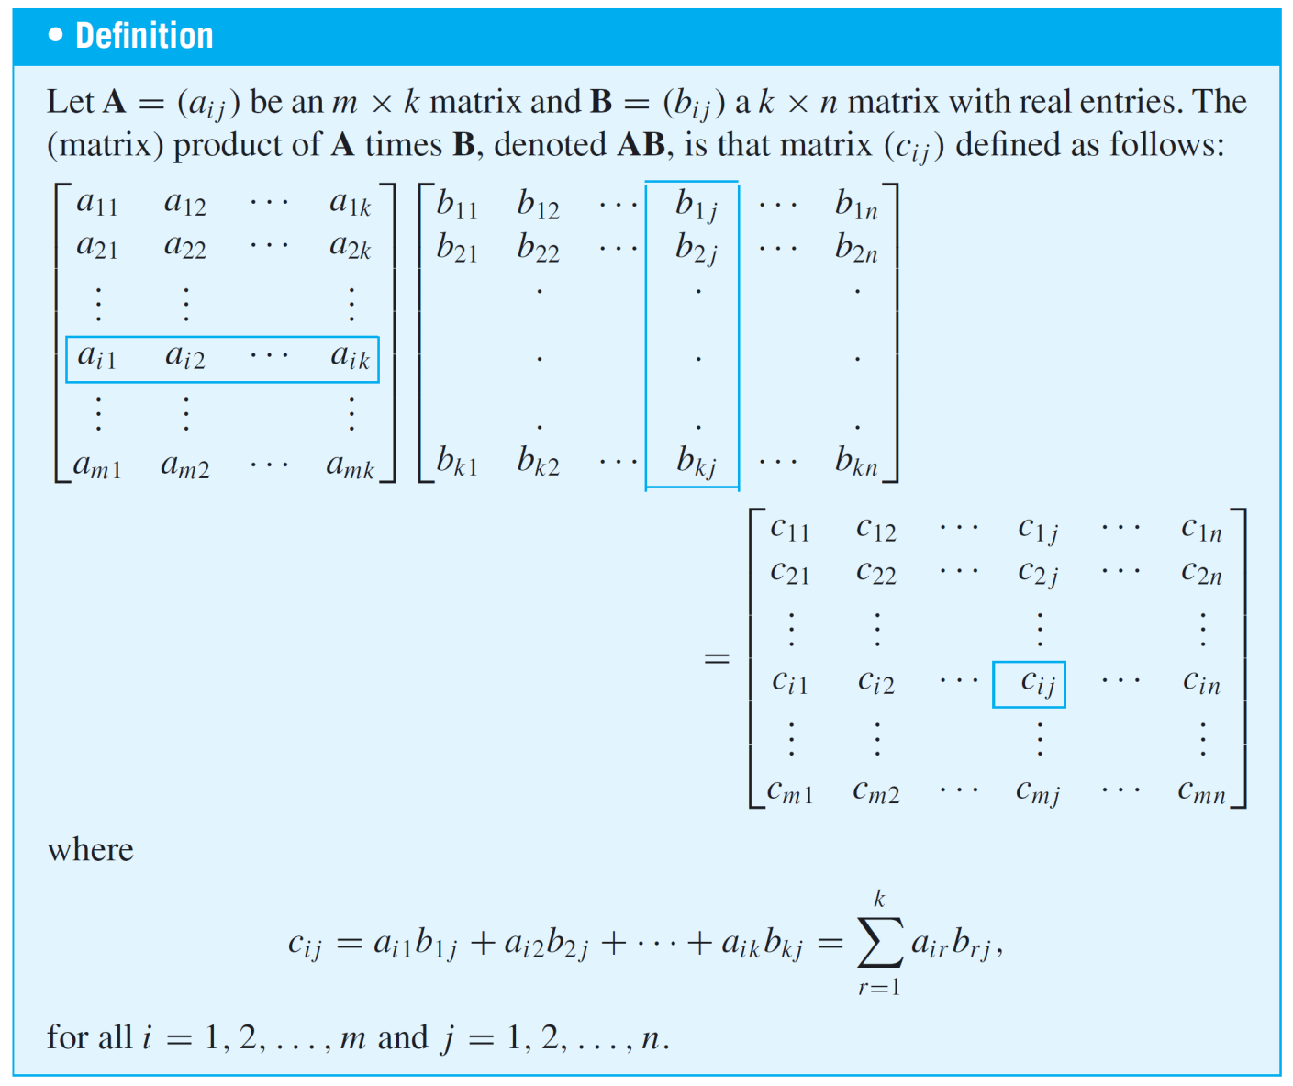
Matrix Multiplication

Slide 122
Example 7 – Computing a Matrix Product
Solution:
A has size 2 ⋅ 3 and B has size 3 ⋅ 2, so the number of columns of A equals the number of rows of B and the matrix product of A and B can be computed.

Slide 123
Example 7 – Solution
cont’d
Then
where

Slide 124
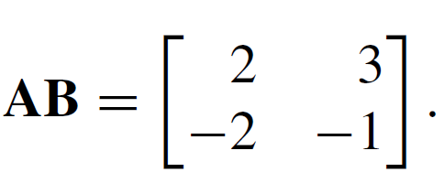
Example 7 – Solution
cont’d
Hence

Slide 125
Matrix Multiplication
Matrix multiplication is both similar to and different from multiplication of real numbers.
One difference is that although the product of any two numbers can be formed, only matrices with compatible sizes can be multiplied.
Also, multiplication of real numbers is commutative (for all real numbers a and b, ab = ba), whereas matrix multiplication is not.

Slide 126
Matrix Multiplication
For instance,
On the other hand, both real number and matrix multiplications are associative ((ab)c = a(bc), for all elements a, b, and c for which the products are defined).
As far as multiplicative identities are concerned, there are both similarities and differences between real numbers and matrices.

Slide 127
Matrix Multiplication
You know that the number 1 acts as a multiplicative
identity for products of real numbers.
It turns out that there are certain matrices, called identity matrices, that act as multiplicative identities for certain matrix products.

Slide 128
Matrix Multiplication
For instance, mentally perform the following matrix multiplications to check that for any real numbers a, b, c, d, e, f, g, h and i,
and

Slide 129
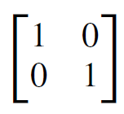
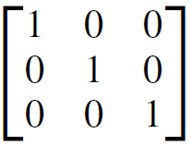
Matrix Multiplication
These computations show that acts as an identity on
the left side for multiplication with 2 ⋅ 3 matrices and that
acts as an identity on the right side for multiplication
with 3 ⋅ 3 matrices.

Slide 130
Matrix Multiplication
Note that cannot act as an identity on the right side for
multiplication with 2 ⋅ 3 matrices because the sizes are not compatible.
The German mathematician Leopold Kronecker introduced the symbol δ_{i j} to make matrix computations more convenient. In his honor, this symbol is called the Kronecker delta.

Slide 131
Example 9 – An Identity Matrix Acts as an Identity
Prove that if A is any m ⋅ n matrix and I is the n ⋅ n identity matrix, then AI = A.
Proof:
Let A be any n ⋅ n matrix and let a_{i j} be the i j th entry of A for all integers i = 1, 2, . . . ,m and j = 1, 2, . . . , n. Consider the product AI, where I is the n ⋅ n identity matrix.

Slide 132
Example 9 – An Identity Matrix Acts as an Identity
cont’d
Observe that
because

Slide 133
Example 9 – An Identity Matrix Acts as an Identity
cont’d
Thus AI = A, as was to be shown.

Slide 134
Matrix Multiplication
There are also similarities and differences between real numbers and matrices with respect to the computation of powers.
Any number can be raised to a nonnegative integer power, but a matrix can be multiplied by itself only if it has the same number of rows as columns.
As for real numbers, however, the definition of matrix powers is recursive.
Just as any number to the zero power is defined to be 1, so any n ⋅ n matrix to the zero power is defined to be the n ⋅ n identity matrix.

Slide 135
Matrix Multiplication
The nth power of an n ⋅ n matrix A is defined to be the product of A with its (n – 1)st power.

Slide 136
Example 10 – Powers of a Matrix
Solution:

Slide 137
Counting Walks of Length N

Slide 138
Counting Walks of Length N
A walk in a graph consists of an alternating sequence of vertices and edges.
If repeated edges are counted each time they occur, then the number of edges in the sequence is called the length of the walk.
For instance, the walk v₂e₃v₃e₄v₂e₂v₂e₃v₃ has length 4 (counting e₃ twice).

Slide 139
Counting Walks of Length N
Consider the following graph G:
How many distinct walks of length 2 connect v₂ and v₂?

Slide 140
Counting Walks of Length N
You can list the possibilities systematically as follows: From v₁, the first edge of the walk must go to some vertex of G: v₁, v₂, or v₃. There is one walk of length 2 from v₂ to v₂ that starts by going from v₂ to v₁:
v₂e₁v₁e₁v₂.
There is one walk of length 2 from v₂ to v₂ that starts by going from v₂ to v₂:
v₂e₂v₂e₂v₂.

Slide 141
Counting Walks of Length N
And there are four walks of length 2 from v₂ to v₂ that start by going from v₂ to v₃:
v₂e₃v₃e₄v₂,
v₂e₄v₃e₃v₂,
v₂e₃v₃e₃v₂,
v₂e₄v₃e₄v₂.
Thus the answer is six.

Slide 142
Counting Walks of Length N
The general question of finding the number of walks that have a given length and connect two particular vertices of a graph can easily be answered using matrix multiplication.
Consider the adjacency matrix A of the graph G.

Slide 143
Counting Walks of Length N
Compute A² as follows:
Note that the entry in the second row and the second column is 6, which equals the number of walks of length 2 from v₂ to v₂.

Slide 144
Counting Walks of Length N
This is no accident! To compute a₂₂, you multiply the second row of A times the second column of A to obtain a sum of three terms:
Observe that

Slide 145
Counting Walks of Length N
Now consider the ith term of this sum, for each i = 1, 2, and 3. It equals the number of edges from v₂ to v_{i} times the number of edges from v_{i} to v₂.
By the multiplication rule this equals the number of pairs of edges from v₂ to v_{i} and from v_{i} back to v₂.
But this equals the number of walks of length 2 that start and end at v₂ and pass through v_{i}.

Slide 146
Counting Walks of Length N
Since this analysis holds for each term of the sum for i = 1, 2, and 3, the sum as a whole equals the total number of walks of length 2 that start and end at v₂:
1·1 + 1·1 + 2·2 = 1 + 1 + 4 = 6.
More generally, if A is the adjacency matrix of a graph G, the i j th entry of A² equals the number of walks of length 2 connecting the i th vertex to the j th vertex of G.

Slide 147
Counting Walks of Length N
Even more generally, if n is any positive integer, the i j th entry of A^{n} equals the number of walks of length n connecting the i th and the j th vertices of G.

