Slide 1
Discrete Structure II: Introduction
Discrete Structure II, Fordham Univ., Fall 2015, Dr. Zhang

Slide 2
Outline
Overview of the course
Getting started, “speaking mathematically”
variables
universal, existential and conditional statements
set
relations and functions

Slide 3
Course Organization
What is the purpose of lab sections?
really problem solving sections, or recitations
working on problems (paper and pencils) under the guidance of the instructor, sometimes in groups
VERY important for your successful mastery of concepts/methods/skills taught in lectures.
Syllabus
Web site: http://storm.cis.fordham.edu/zhang/cs2100
Email is the best way to reach me
Office hours are open (just stop by)
Assessment: academic integrity

Slide 4
Course Overview
a more in-depth, rigorous study of following mathematical subjects that are important to computer science
Logic:
arguments, digital logic circuits,
quantified statements
Proof: how to construct a carefully reasoned argument to convince someone that a given statement is true
various methods: direct proof, proof by contradiction…
Mathematical induction: a powerful proof technique
Example: can we replace pennies with 3 cent coins?
Correctness of algorithms: reasoning about loops

Slide 5
Course Overview (2)
Recursion: recursively defined sequence and sets, recursive function
ex: recurrence relation, e.g., Pn=Pn-1+Pn-2
Recursive algorithms, e.g., Tower of Hanoi, merge sort, …
Set theory: go beyond basics,
Halting problem (Alan Turing): something that computers cannot do… (to be revisited in Theory of Computation)
Functions:
cardinality and computability
e.g., Are there more rationals than integers?

Slide 6
Course Overview (3)
Relations:
modular arithmetic and cryptography
PERT and CPM
Counting and Probability
Monty Hall Problem
Bayes’ Theorem, …
Analysis of algorithm efficiency
e.g., running time of binary search algorithm, merge sort algorithm? …

Slide 7
Outline
Overview of the course
Getting started, “speaking mathematically”
variables
universal, existential and conditional statements
set
relations and functions

Slide 8
Variables
There are two uses of a variable. To illustrate the first use, consider asking
Is there a number with the following property: doubling it and adding 3 gives the same result as squaring it?
In this sentence you can introduce a variable to replace the potentially ambiguous word “it”:
Is there a number x with the property that 2x + 3 = x²?

Slide 9
Variables
The advantage of using a variable is that it allows you to give a temporary name to what you are seeking so that you can perform concrete computations with it to help discover its possible values.
To illustrate the second use of variables, consider the statement:
No matter what number might be chosen, if it is greater than 2, then its square is greater than 4.

Slide 10
Variables
In this case introducing a variable to give a temporary name to the (arbitrary) number you might choose enables you to maintain the generality of the statement, and replacing all instances of the word “it” by the name of the variable ensures that possible ambiguity is avoided:
No matter what number n might be chosen, if n is greater than 2, then n² is greater than 4.

Slide 11
Example 1 – Writing Sentences Using Variables
Use variables to rewrite the following sentences more formally. a. Are there numbers with the property that the sum of their squares equals the square of their sum?
b. Given any real number, its square is nonnegative.
Solution:
a. Are there numbers a and b with the property that a² + b² = (a + b)²?
Or : Are there numbers a and b such that a² + b² = (a + b)²?

Slide 12
Example 1 – Solution
cont’d
Or : Do there exist any numbers a and b such that a² + b² = (a + b)²?
b. Given any real number r, r² is nonnegative. Or : For any real number r, r² ≥ 0. Or : For all real numbers r, r² ≥ 0.

Slide 13
Some Important Kinds of Mathematical Statements

Slide 14
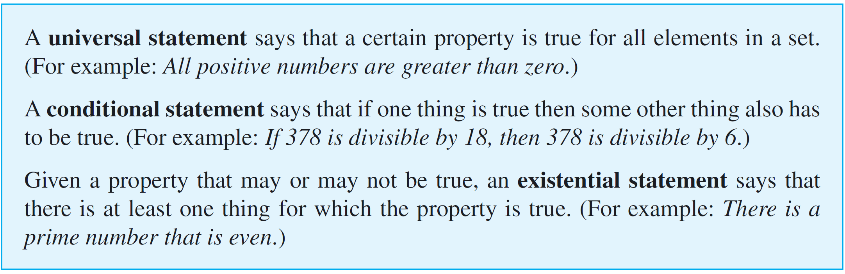
Some Important Kinds of Mathematical Statements
Three of the most important kinds of sentences in mathematics are universal statements, conditional statements, and existential statements:

Slide 15
Some Important Kinds of Mathematical Statements
Universal Condition Statements
Universal statements contain some variation of the words “for all” and conditional statements contain versions of the words “if-then.”

Slide 16
Some Important Kinds of Mathematical Statements
A universal conditional statement is a statement that is both universal and conditional. Here is an example:
For all animals a, if a is a dog, then a is a mammal.
One of the most important facts about universal conditional statements is that they can be rewritten in ways that make them appear to be purely universal or purely conditional.

Slide 17
Example 2 – Rewriting an Universal Conditional Statement
Fill in the blanks to rewrite the following statement: For all real numbers x, if x is nonzero then x² is positive.
a. If a real number is nonzero, then its square _____.
b. For all nonzero real numbers x, ____.
c. If x ____, then ____.
d. The square of any nonzero real number is ____.
e. All nonzero real numbers have ____.

Slide 18
Example 2 – Solution
a. is positive
b. x² is positive
c. is a nonzero real number; x² is positive
d. Positive
e. positive squares (or: squares that are positive)

Slide 19
Some Important Kinds of Mathematical Statements
Universal Existential Statements
A universal existential statement is a statement that is universal because its first part says that a certain property is true for all objects of a given type, and it is existential because its second part asserts the existence of something. For example:
Every real number has an additive inverse.
In this statement the property “has an additive inverse” applies universally to all real numbers.

Slide 20
Some Important Kinds of Mathematical Statements
“Has an additive inverse” asserts the existence of something—an additive inverse—for each real number.
However, the nature of the additive inverse depends on the real number; different real numbers have different additive inverses.

Slide 21
Example 3 – Rewriting an Universal Existential Statement
Fill in the blanks to rewrite the following statement: Every pot has a lid.
a. All pots _____.
b. For all pots P, there is ____.
c. For all pots P, there is a lid L such that _____.
Solution:
a. have lids
b. a lid for P
c. L is a lid for P

Slide 22
Some Important Kinds of Mathematical Statements
Existential Universal Statements
An existential universal statement is a statement that is existential because its first part asserts that a certain object exists and is universal because its second part says that the object satisfies a certain property for all things of a certain kind.

Slide 23
Some Important Kinds of Mathematical Statements
For example:
There is a positive integer that is less than or equal to every positive integer:
This statement is true because the number one is a positive integer, and it satisfies the property of being less than or equal to every positive integer.

Slide 24
Example 4 – Rewriting an Existential Universal Statement
Fill in the blanks to rewrite the following statement in three different ways:
There is a person in my class who is at least as old as every person in my class.
a. Some _____ is at least as old as _____.
b. There is a person p in my class such that p is _____.
c. There is a person p in my class with the property that for every person q in my class, p is _____.

Slide 25
Example 4 – Solution
a. person in my class; every person in my class
b. at least as old as every person in my class
c. at least as old as q

Slide 26
Some Important Kinds of Mathematical Statements
Some of the most important mathematical concepts, such as the definition of limit of a sequence, can only be defined using phrases that are universal, existential, and conditional, and they require the use of all three phrases “for all,” “there is,” and “if-then.”

Slide 27
Some Important Kinds of Mathematical Statements
For example, if a₁, a₂, a₃, . . . is a sequence of real numbers, saying that
the limit of a_{n} as n approaches infinity is L
means that
for all positive real numbers ε, there is an integer N such that
for all integers n, if n > N then –ε < a_{n} – L < ε.

Slide 28
Outline
Overview of the course
Getting started, “speaking mathematically”
variables
universal, existential and conditional statements
set
relations and functions

Slide 29
The Language of Sets
Use of the word set as a formal mathematical term was introduced in 1879 by Georg Cantor (1845–1918). For most mathematical purposes we can think of a set intuitively, as Cantor did, simply as a collection of elements.
For instance, if C is the set of all countries that are currently in the United Nations, then the United States is an element of C, and if I is the set of all integers from 1 to 100, then the number 57 is an element of I.

Slide 30
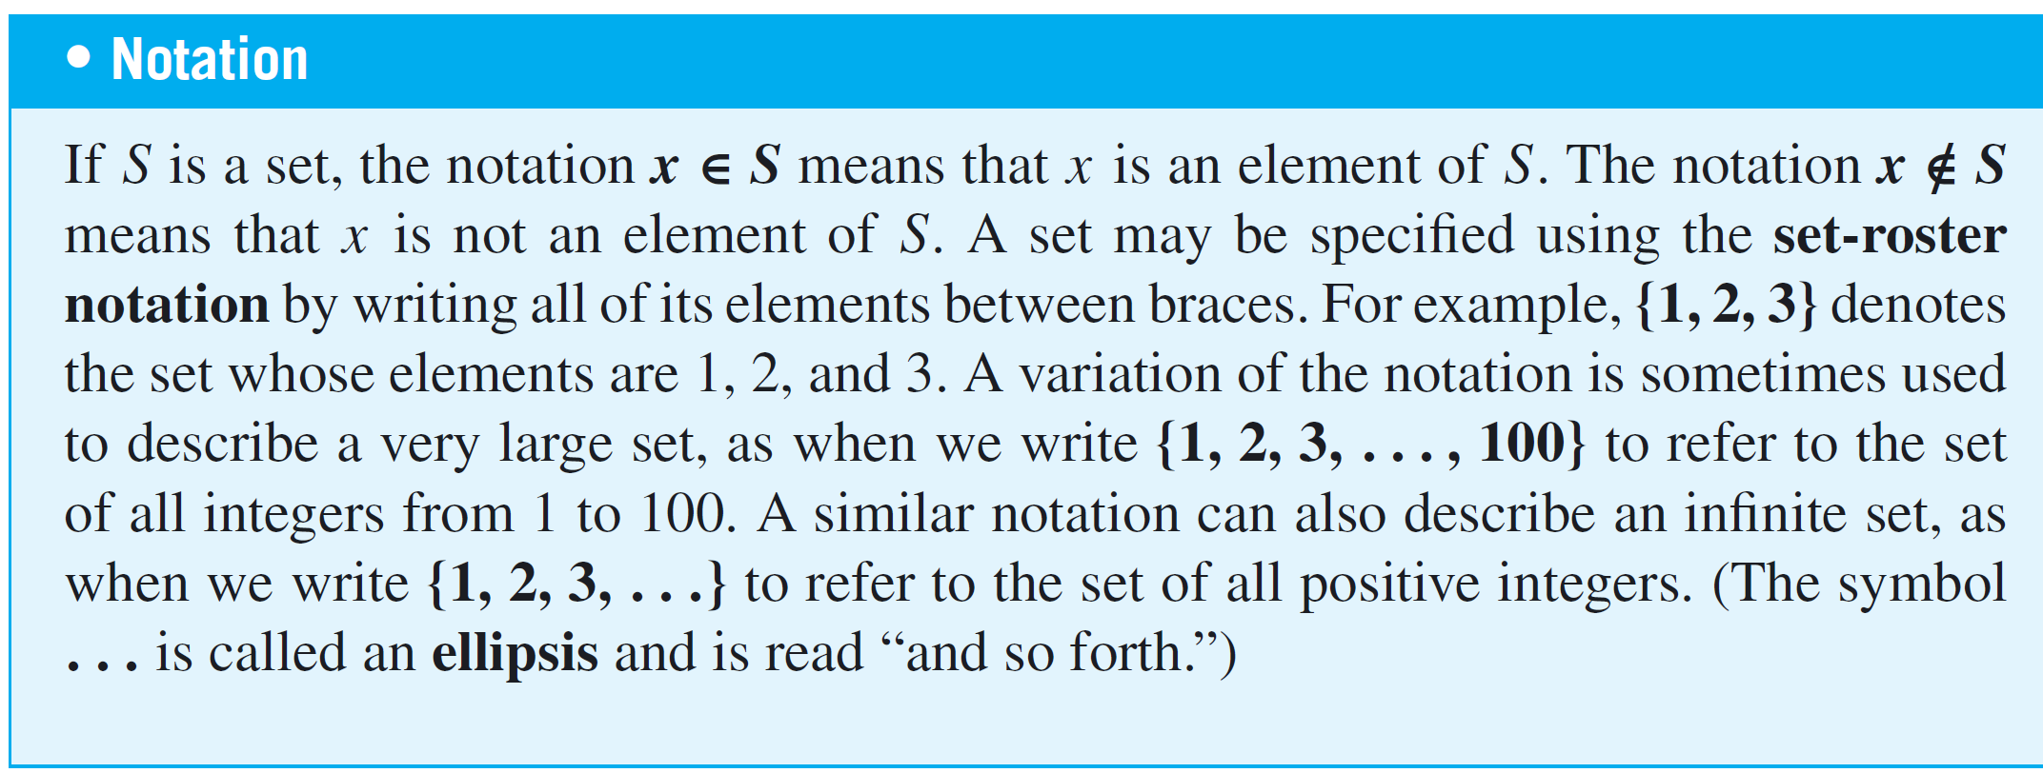
The Language of Sets
The axiom of extension says that a set is completely determined by what its elements are—not the order in which they might be listed or the fact that some elements might be listed more than once.

Slide 31
Example 1 – Using the Set-Roster Notation
a. Let A = {1, 2, 3}, B = {3, 1, 2}, and C = {1, 1, 2, 3, 3, 3}. What are the elements of A, B, and C? How are A, B, and C related?
b. Is {0} = 0?
c. How many elements are in the set {1, {1}}?
d. For each nonnegative integer n, let U_{n} = {n, –n}. Find U₁, U₂, and U₀.
Solution:
a. A, B, and C have exactly the same three elements: 1, 2, and 3. Therefore, A, B, and C are simply different ways to represent the same set.

Slide 32
Example 1 – Solution
cont’d
b. {0} ≠ 0 because {0} is a set with one element, namely 0, whereas 0 is just the symbol that represents the number zero.
c. The set {1, {1}} has two elements: 1 and the set whose only element is 1.
d. U₁ = {1, –1}, U₂ = {2, –2}, U₀ = {0, –0} = {0, 0} = {0}.

Slide 33
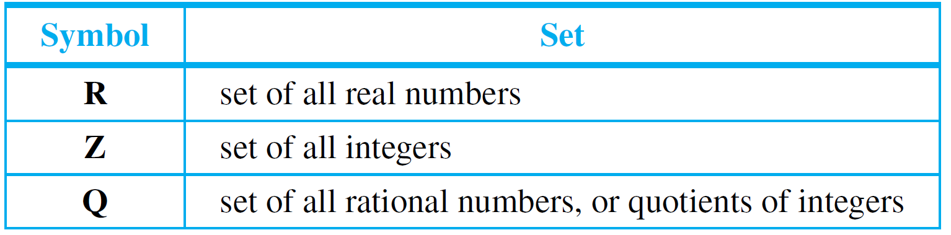
The Language of Sets
Certain sets of numbers are so frequently referred to that they are given special symbolic names. These are summarized in the following table:

Slide 34
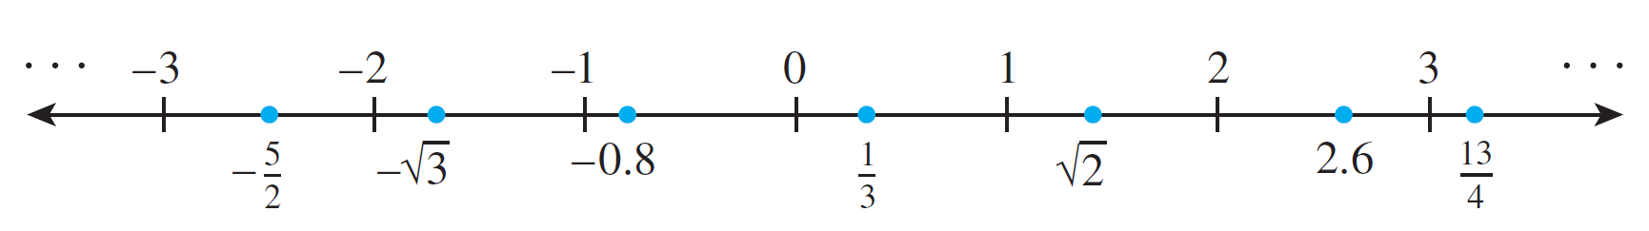
The Language of Sets
The set of real numbers is usually pictured as the set of all points on a line, as shown below.
The number 0 corresponds to a middle point, called the origin.
A unit of distance is marked off, and each point to the right of the origin corresponds to a positive real number found by computing its distance from the origin.

Slide 35
The Language of Sets
Each point to the left of the origin corresponds to a negative real number, which is denoted by computing its distance from the origin and putting a minus sign in front of the resulting number.
The set of real numbers is therefore divided into three parts: the set of positive real numbers, the set of negative real numbers, and the number 0.
Note that 0 is neither positive nor negative.

Slide 36
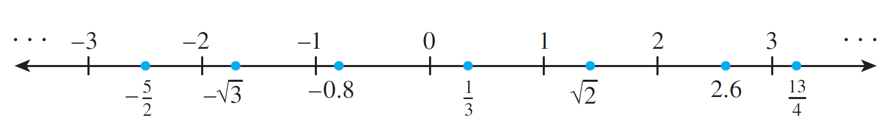
The Language of Sets
Labels are given for a few real numbers corresponding to points on the line shown below.
The real number line is called continuous because it is imagined to have no holes.
The set of integers corresponds to a collection of points located at fixed intervals along the real number line.

Slide 37
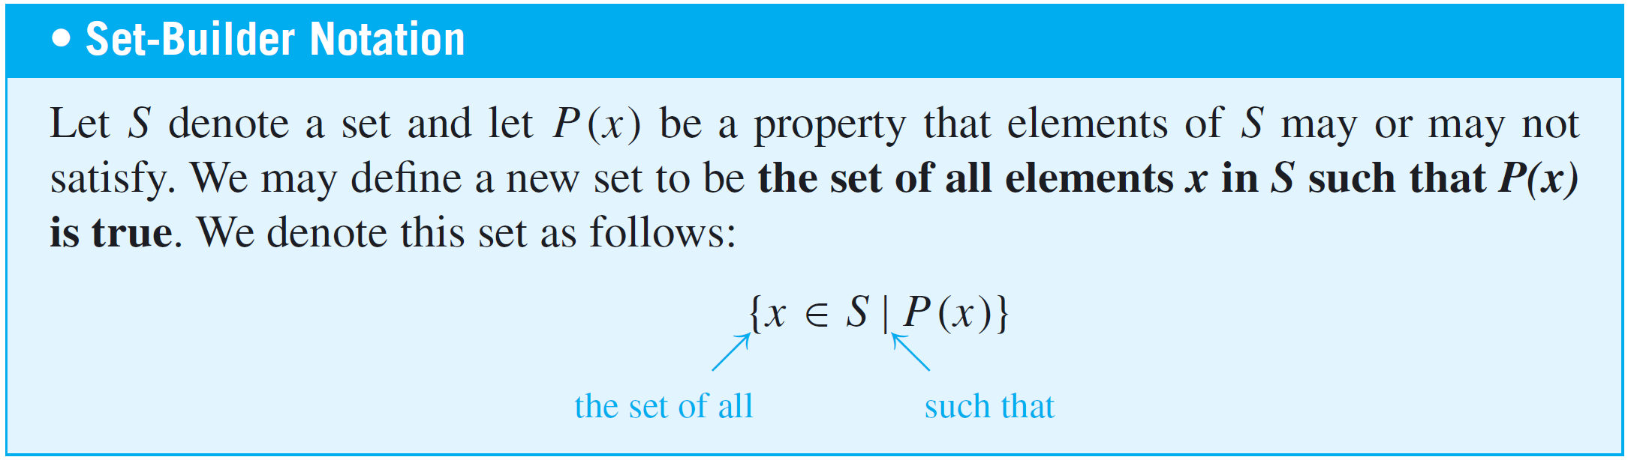
The Language of Sets
Thus every integer is a real number, and because the integers are all separated from each other, the set of integers is called discrete. The name discrete mathematics comes from the distinction between continuous and discrete mathematical objects.
Another way to specify a set uses what is called the set-builder notation.

Slide 38
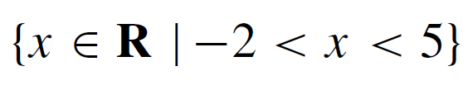


Example 2 – Using the Set-Builder Notation
Given that R denotes the set of all real numbers, Z the set of all integers, and Z⁺ the set of all positive integers, describe each of the following sets.
a.
b.
c.

Slide 39
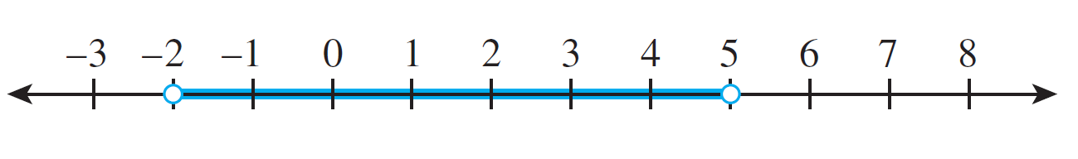
Example 2 – Solution
a. is the open interval of real numbers (strictly) between –2 and 5. It is pictured as follows:
b. is the set of all integers (strictly) between –2 and 5. It is equal to the set
{–1, 0, 1, 2, 3, 4}.
c. Since all the integers in Z⁺ are positive,

Slide 40
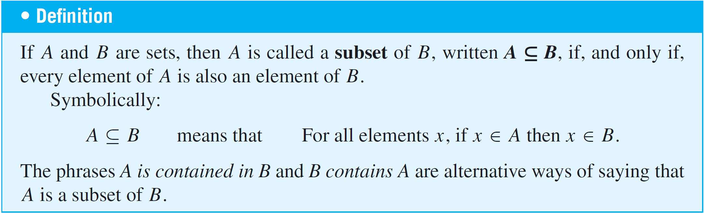
Subsets
A basic relation between sets is that of subset.

Slide 41
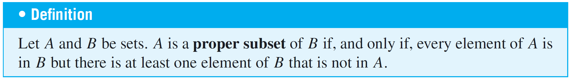
Subsets
It follows from the definition of subset that for a set A not to be a subset of a set B means that there is at least one element of A that is not an element of B.
Symbolically:

Slide 42
Example 4 – Distinction between ∈ and ⊆
Which of the following are true statements?
a. 2 ∈ {1, 2, 3} b. {2} ∈ {1, 2, 3} c. 2 ⊆ {1, 2, 3}
d. {2} ⊆ {1, 2, 3} e. {2} ⊆ {{1}, {2}} f. {2} ∈ {{1}, {2}}
Solution:
Only (a), (d), and (f) are true.
For (b) to be true, the set {1, 2, 3} would have to contain the element {2}. But the only elements of {1, 2, 3} are 1, 2, and 3, and 2 is not equal to {2}. Hence (b) is false.

Slide 43
Example 4 – Solution
cont’d
For (c) to be true, the number 2 would have to be a set and every element in the set 2 would have to be an element of {1, 2, 3}. This is not the case, so (c) is false.
For (e) to be true, every element in the set containing only the number 2 would have to be an element of the set whose elements are {1} and {2}. But 2 is not equal to either {1} or {2}, and so (e) is false.

Slide 44
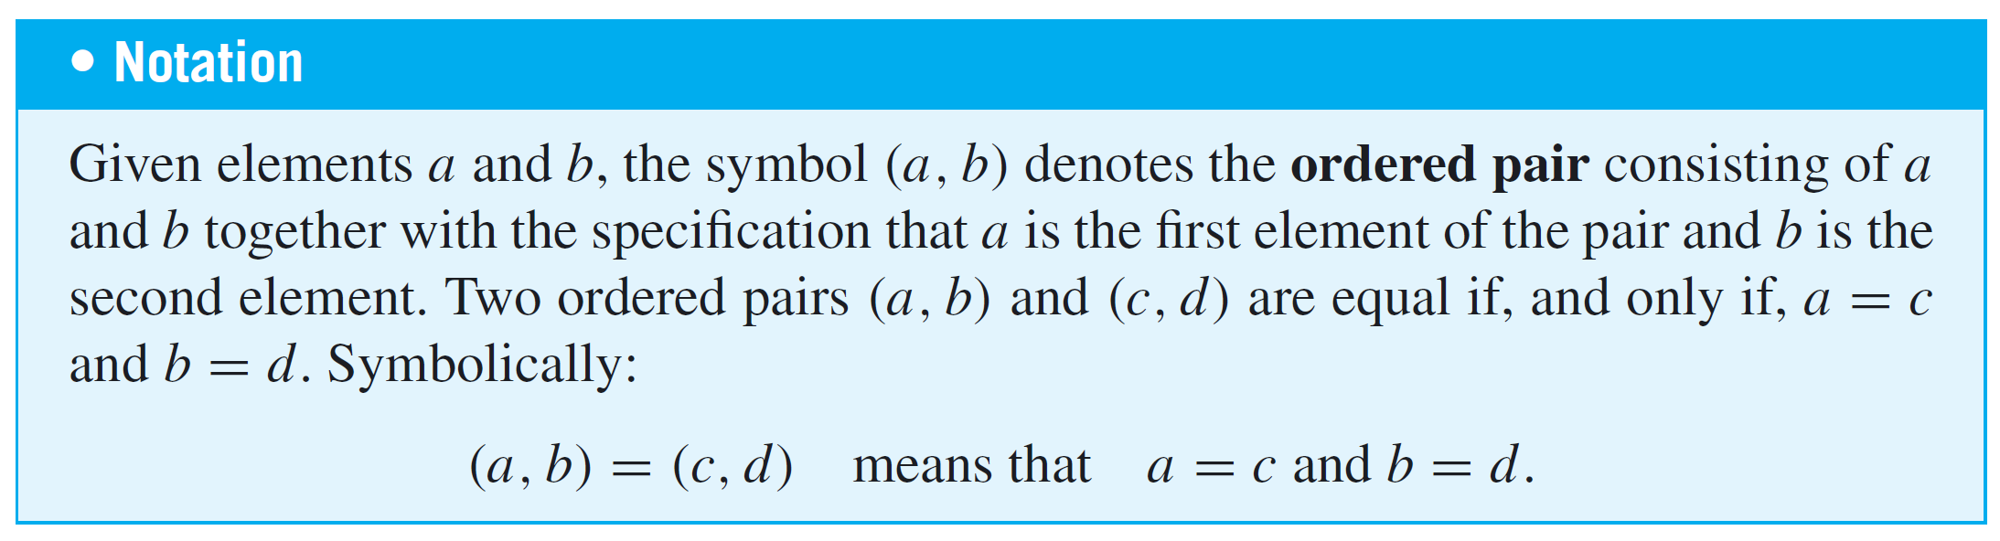
Cartesian Products

Slide 45
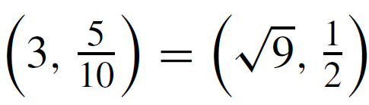
Example 5 – Ordered Pairs
a. Is (1, 2) = (2, 1)?
b. Is ?
c. What is the first element of (1, 1)?
Solution:
a. No. By definition of equality of ordered pairs,
(1, 2) = (2,1) if, and only if, 1 = 2 and 2 = 1.
But 1 ≠ 2, and so the ordered pairs are not equal.

Slide 46
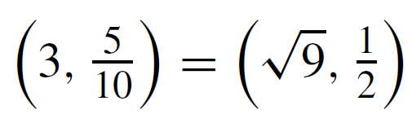


Example 5 – Solution
cont’d
b. Yes. By definition of equality of ordered pairs,
if, and only if, and
Because these equations are both true, the ordered pairs are equal.
c. In the ordered pair (1, 1), the first and the second elements are both 1.

Slide 47
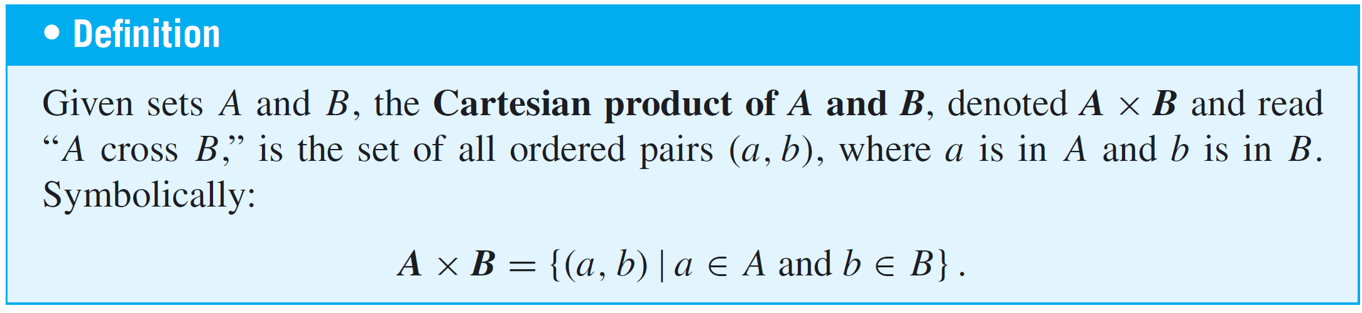
Cartesian Products

Slide 48
Example 6 – Cartesian Products
Let A = {1, 2, 3} and B = {u, v}.
a. Find A × B
b. Find B × A
c. Find B × B
d. How many elements are in A × B, B × A, and B × B?
e. Let R denote the set of all real numbers. Describe R × R.

Slide 49
Example 6 – Solution
a. A × B = {(1, u), (2, u), (3, u), (1, v), (2, v), (3, v)}
b. B × A = {(u, 1), (u, 2), (u, 3), (v, 1), (v, 2), (v, 3)}
c. B × B = {(u, u), (u, v), (v, u), (v, v)}
d. A × B has six elements. Note that this is the number of elements in A times the number of elements in B.
B × A has six elements, the number of elements in B times the number of elements in A. B × B has four elements, the number of elements in B times the number of elements in B.

Slide 50
Example 6 – Solution
cont’d
e. R × R is the set of all ordered pairs (x, y) where both x and y are real numbers.
If horizontal and vertical axes are drawn on a plane and a unit length is marked off, then each ordered pair in R × R corresponds to a unique point in the plane, with the first and second elements of the pair indicating, respectively, the horizontal and vertical positions of the point.

Slide 51
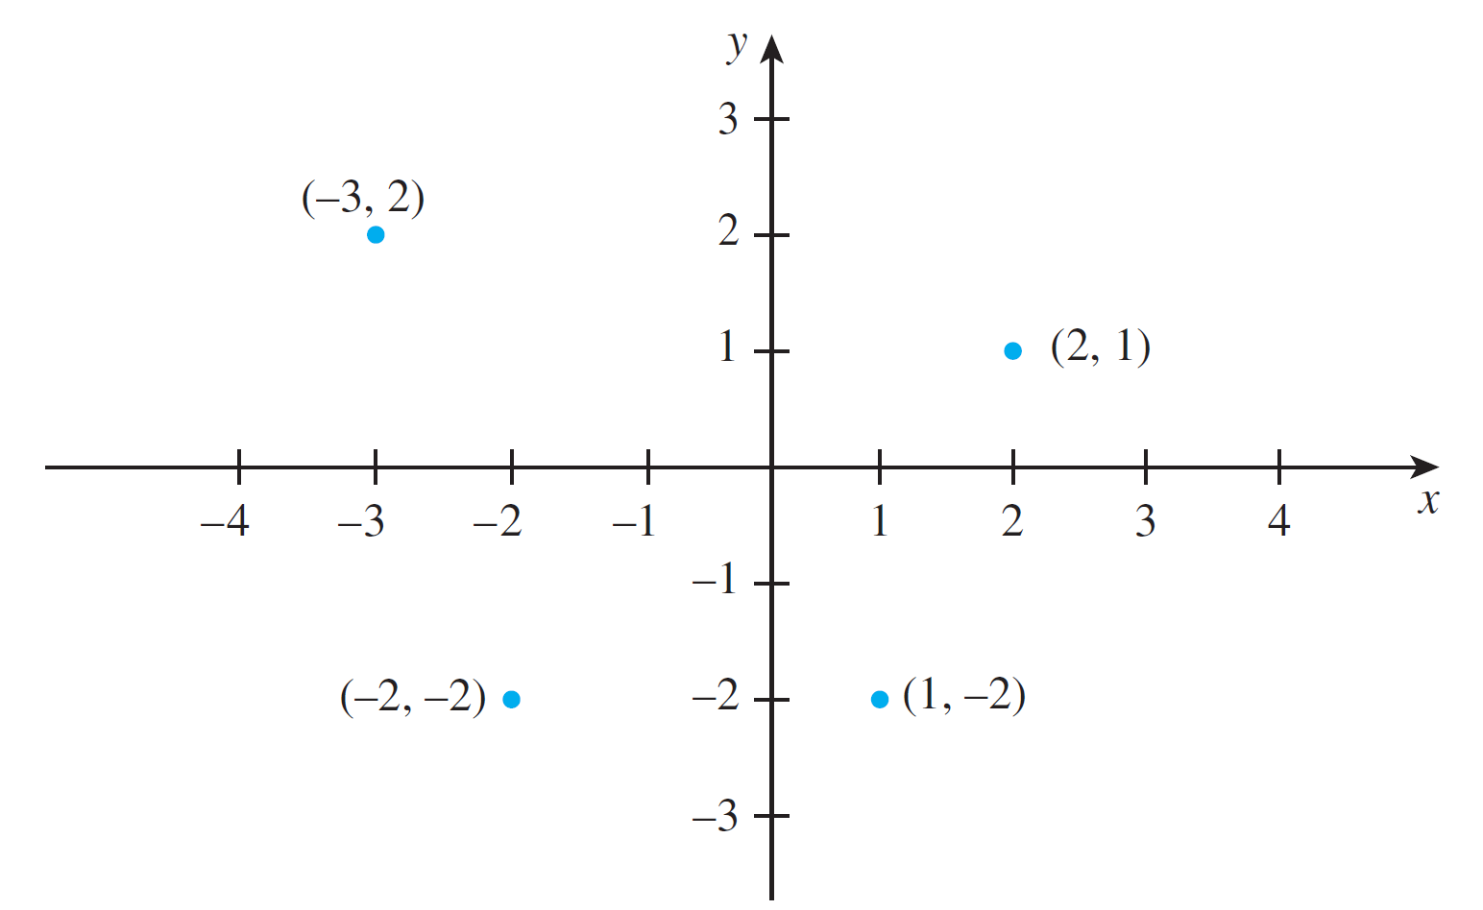
Example 6 – Solution
cont’d
The term Cartesian plane is often used to refer to a plane with this coordinate system, as illustrated in Figure 1.2.1.
A Cartesian Plane
Figure 1.2.1

Slide 52
Outline
Overview of the course
Getting started, “speaking mathematically”
variables
universal, existential and conditional statements
set
relations and functions

Slide 53
The Language of Relations and Functions
The objects of mathematics may be related in various ways.
A set A may be said to be related to a set B if A is a subset of B, or if A is not a subset of B, or if A and B have at least one element in common.
A number x may be said to be related to a number y if x < y, or if x is a factor of y, or if x² + y² = 1.
Let A = {0, 1, 2} and B = {1, 2, 3} and let us say that an element x in A is related to an element y in B if, and only if, x is less than y.

Slide 54
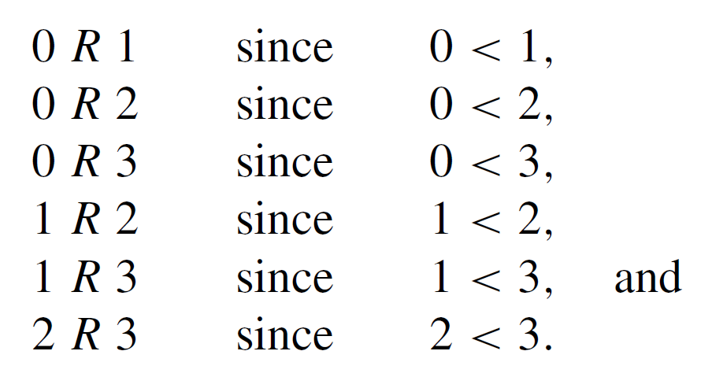

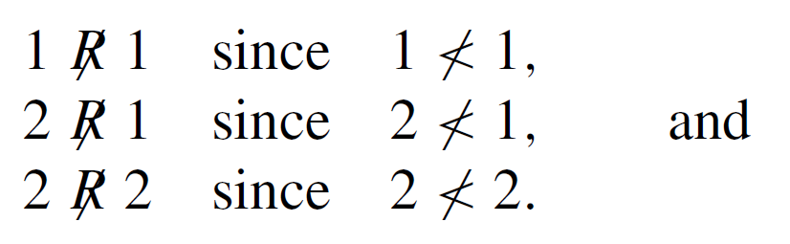
The Language of Relations and Functions
Let us use the notation x R y as a shorthand for the sentence “x is related to y.” Then
On the other hand, if the notation represents the sentence “x is not related to y,” then

Slide 55
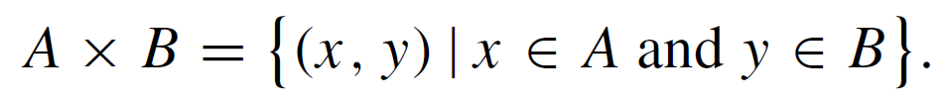
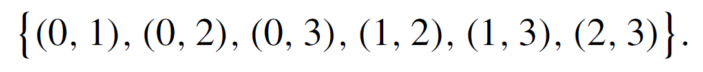
The Language of Relations and Functions
The Cartesian product of A and B, A ⋅ B, consists of all ordered pairs whose first element is in A and whose second element is in B:
In this case,
The elements of some ordered pairs in A ⋅ B are related, whereas the elements of other ordered pairs are not. Consider the set of all ordered pairs in A ⋅ B whose elements are related

Slide 56
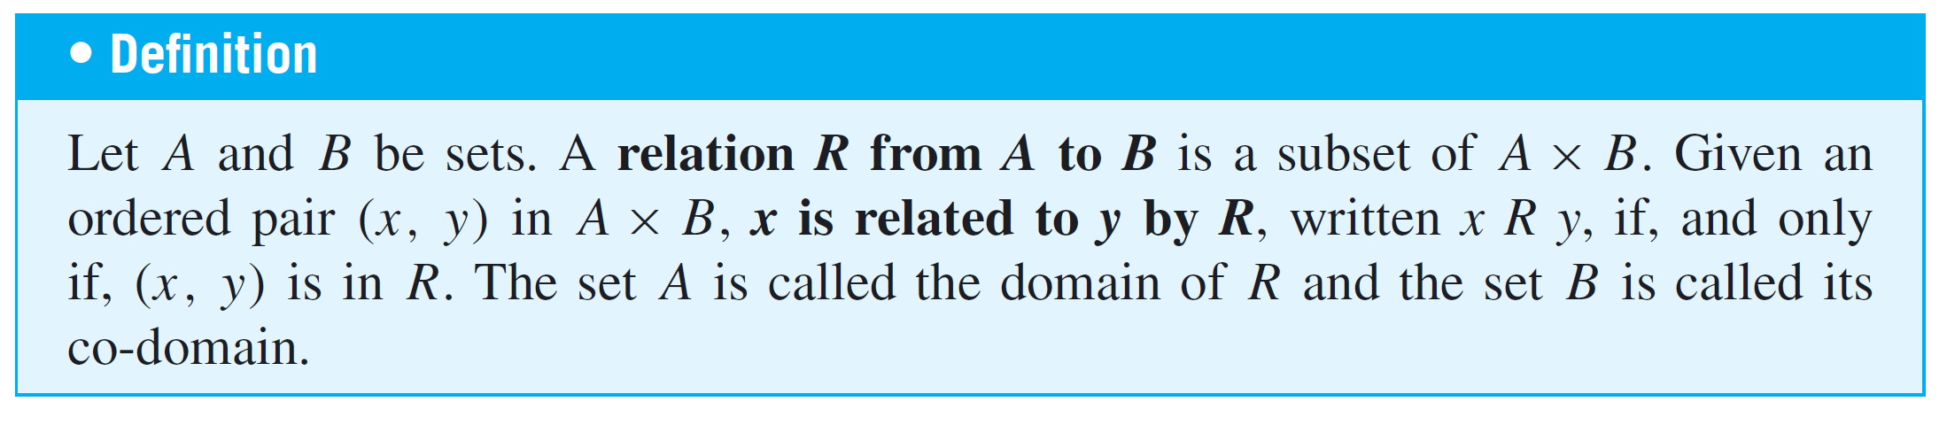
The Language of Relations and Functions
Observe that knowing which ordered pairs lie in this set is equivalent to knowing which elements are related to which.
The relation itself can therefore be thought of as the totality of ordered pairs whose elements are related by the given condition.

Slide 57

The Language of Relations and Functions
The notation for a relation R may be written symbolically as follows:
x R y means that (x, y ) ∈ R.
The notation x y means that x is not related to y by R:
x y means that (x, y ) ∉ R.

Slide 58
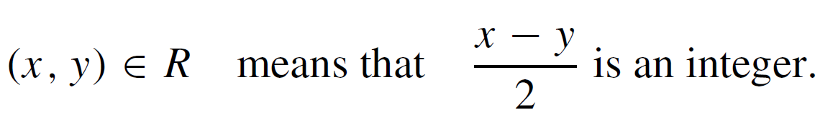
Example 1 – A Relation as a Subset
Let A = {1, 2} and B = {1, 2, 3} and define a relation R from A to B as follows: Given any (x, y) ∈ A ⋅ B,
a. State explicitly which ordered pairs are in A ⋅ B and which are in R.
b. Is 1 R 3? Is 2 R 3? Is 2 R 2?
c. What are the domain and co-domain of R?

Slide 59
Example 1 – Solution
a. A ⋅ B = {(1, 1), (1, 2), (1, 3), (2, 1), (2, 2), (2, 3)}. To determine explicitly the composition of R, examine each ordered pair in A ⋅ B to see whether its elements satisfy the defining condition for R.

Slide 60

Example 1 – Solution
cont’d
Thus
b.
c.

Slide 61
Arrow Diagram of a Relation

Slide 62
Arrow Diagram of a Relation
Suppose R is a relation from a set A to a set B. The arrow diagram for R is obtained as follows:
Represent the elements of A as points in one region and the elements of B as points in another region.
For each x in A and y in B, draw an arrow from x to y if,
and only if, x is related to y by R. Symbolically:
Draw an arrow from x to y
if, and only if, x R y
if, and only if, (x, y) ∈ R.

Slide 63
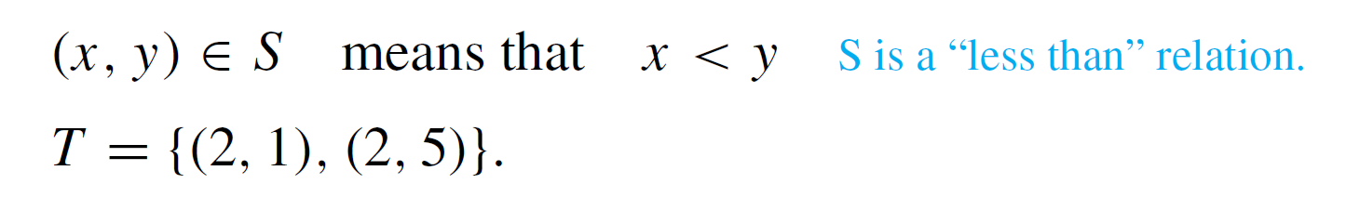
Example 3 – Arrow Diagrams of Relations
Let A = {1, 2, 3} and B = {1, 3, 5} and define relations S and T from A to B as follows:
For all (x, y ) ∈ A ⋅ B,
Draw arrow diagrams for S and T.

Slide 64
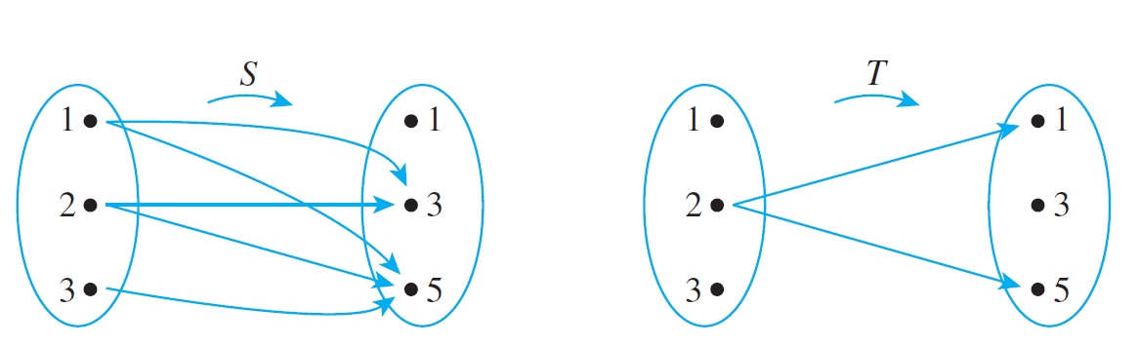
Example 3 – Solution
These example relations illustrate that it is possible to have several arrows coming out of the same element of A pointing in different directions.
Also, it is quite possible to have an element of A that does not have an arrow coming out of it.

Slide 65
Outline
Overview of the course
Getting started, “speaking mathematically”
variables
universal, existential and conditional statements
set
relations and functions

Slide 66
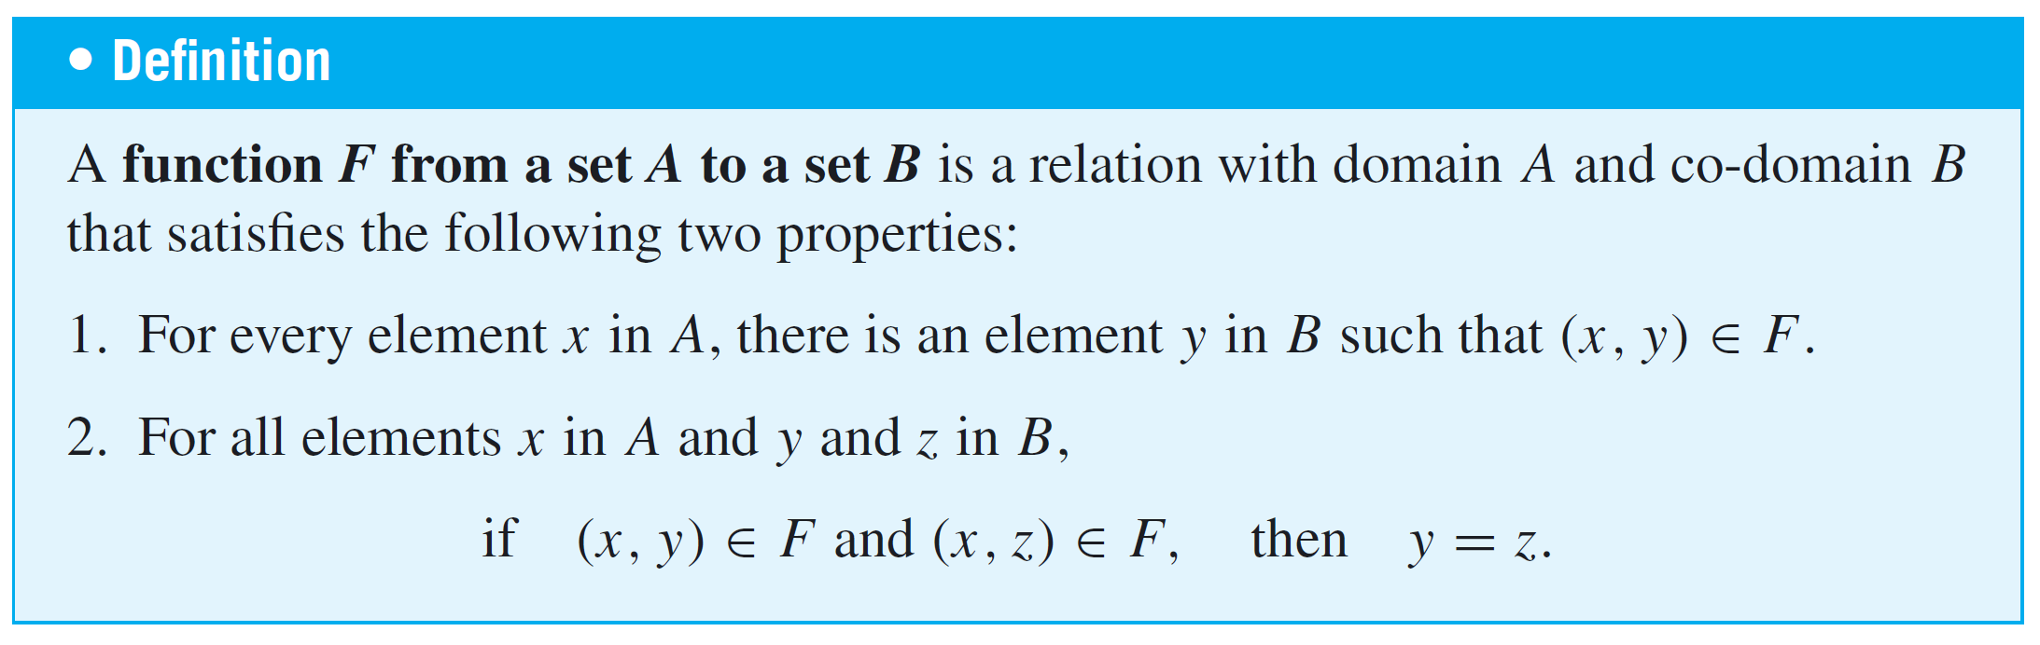
Functions

Slide 67
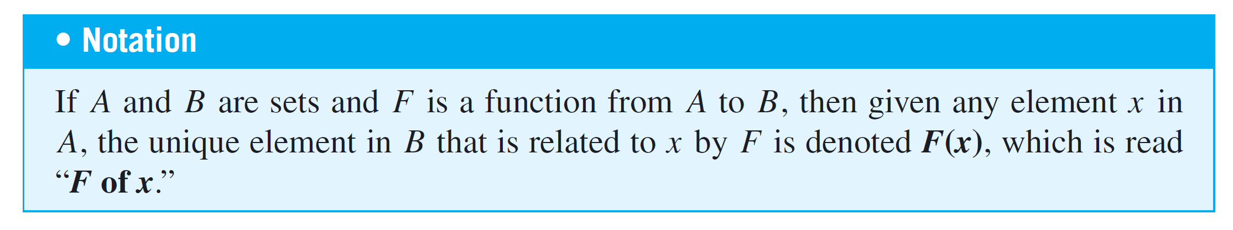
Functions
Properties (1) and (2) can be stated less formally as follows: A relation F from A to B is a function if, and only if:
1. Every element of A is the first element of an ordered pair of F.
2. No two distinct ordered pairs in F have the same first element.

Slide 68
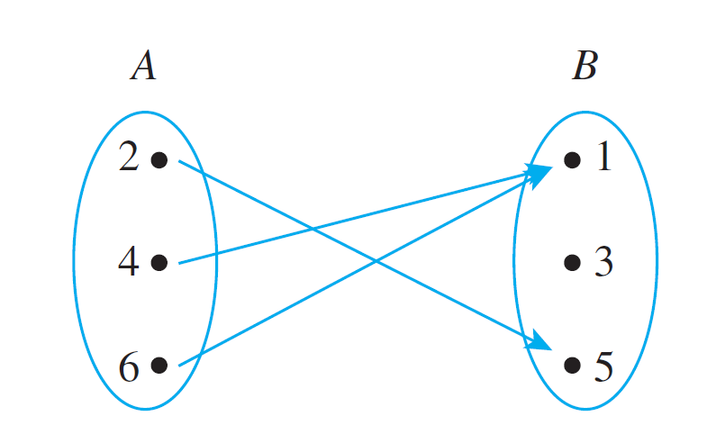
Example 4 – Functions and Relations on Finite Sets
Let A = {2, 4, 6} and B = {1, 3, 5}. Which of the relations R, S, and T defined below are functions from A to B?
a. R = {(2, 5), (4, 1), (4, 3), (6, 5)}
b. For all (x, y ) ∈ A ⋅ B, (x, y ) ∈ S means that y = x + 1.
c. T is defined by the arrow diagram

Slide 69
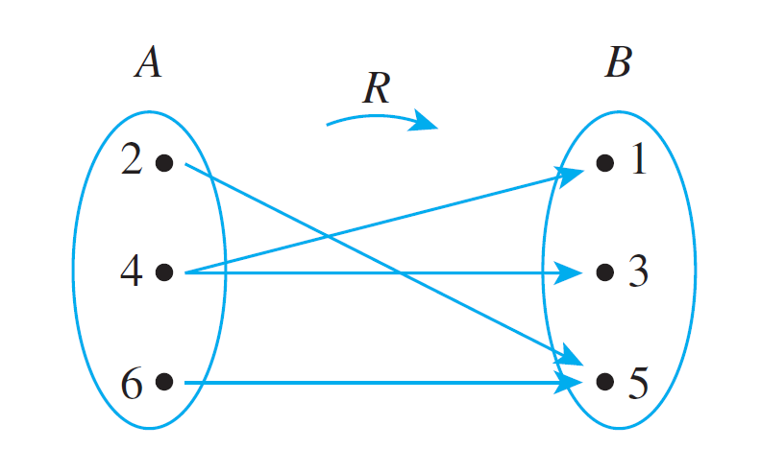
Example 4(a) – Solution
R is not a function because it does not satisfy property (2). The ordered pairs (4, 1) and (4, 3) have the same first element but different second elements.
You can see this graphically if you draw the arrow diagram for R. There are two arrows coming out of 4: One points to 1 and the other points to 3.

Slide 70
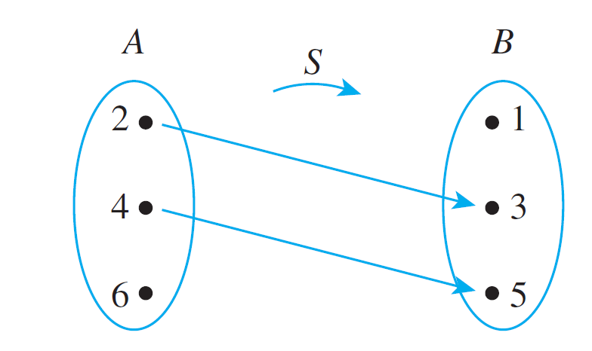
Example 4(b) – Solution
cont’d
S is not a function because it does not satisfy property (1). It is not true that every element of A is the first element of an ordered pair in S.
For example, 6 ∈ A but there is no y in B such that y = 6 + 1 = 7. You can also see this graphically by drawing the arrow diagram for S.

Slide 71
Example 4(c) – Solution
cont’d
T is a function: Each element in {2, 4, 6} is related to some element in {1, 3, 5} and no element in {2, 4, 6} is related to more than one element in {1, 3, 5}.
When these properties are stated in terms of the arrow diagram, they become (1) there is an arrow coming out of each element of the domain, and (2) no element of the domain has more than one arrow coming out of it.
So you can write T (2) = 5, T (4) = 1, and T (6) = 1.

Slide 72
Function Machines

Slide 73
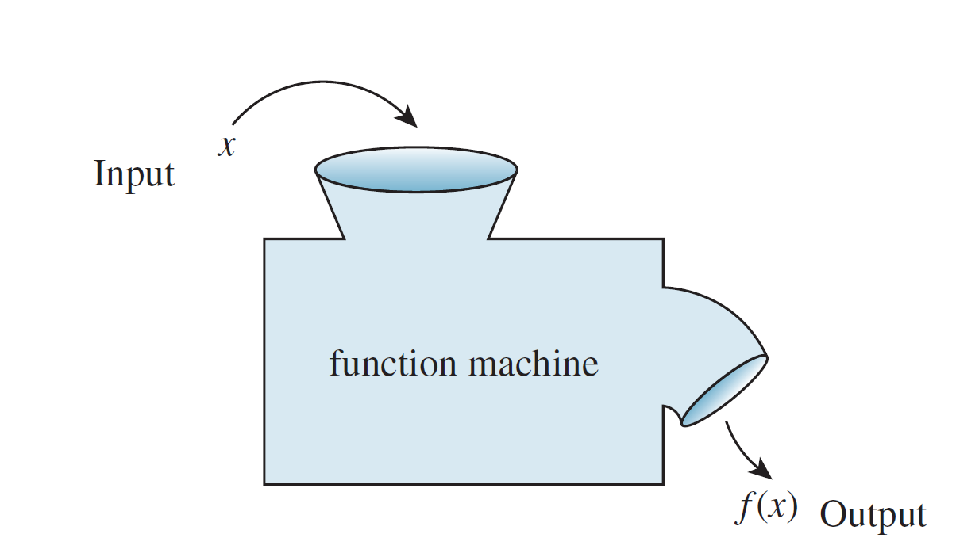
Function Machines
Another useful way to think of a function is as a machine. Suppose f is a function from X to Y and an input x of X is given.
Imagine f to be a machine that processes x in a certain way to produce the output f (x). This is illustrated in Figure 1.3.1
Figure 1.3.1

Slide 74
Example 6 – Functions Defined by Formulas
The squaring function f from R to R is defined by the formula f (x) = x² for all real numbers x.
This means that no matter what real number input is substituted for x, the output of f will be the square of that number.
This idea can be represented by writing f (● ) = ● ². In other words, f sends each real number x to x², or, symbolically, f : x → x². Note that the variable x is a dummy variable; any other symbol could replace it, as long as the replacement is made everywhere the x appears.

Slide 75
Example 6 – Functions Defined by Formulas
cont’d
The successor function g from Z to Z is defined by the formula g (n) = n + 1. Thus, no matter what integer is substituted for n, the output of g will be that number plus one: g (● ) = ● + 1.
In other words, g sends each integer n to n + 1, or, symbolically, g : n → n + 1.
An example of a constant function is the function h from Q to Z defined by the formula h (r) = 2 for all rational numbers r.

Slide 76
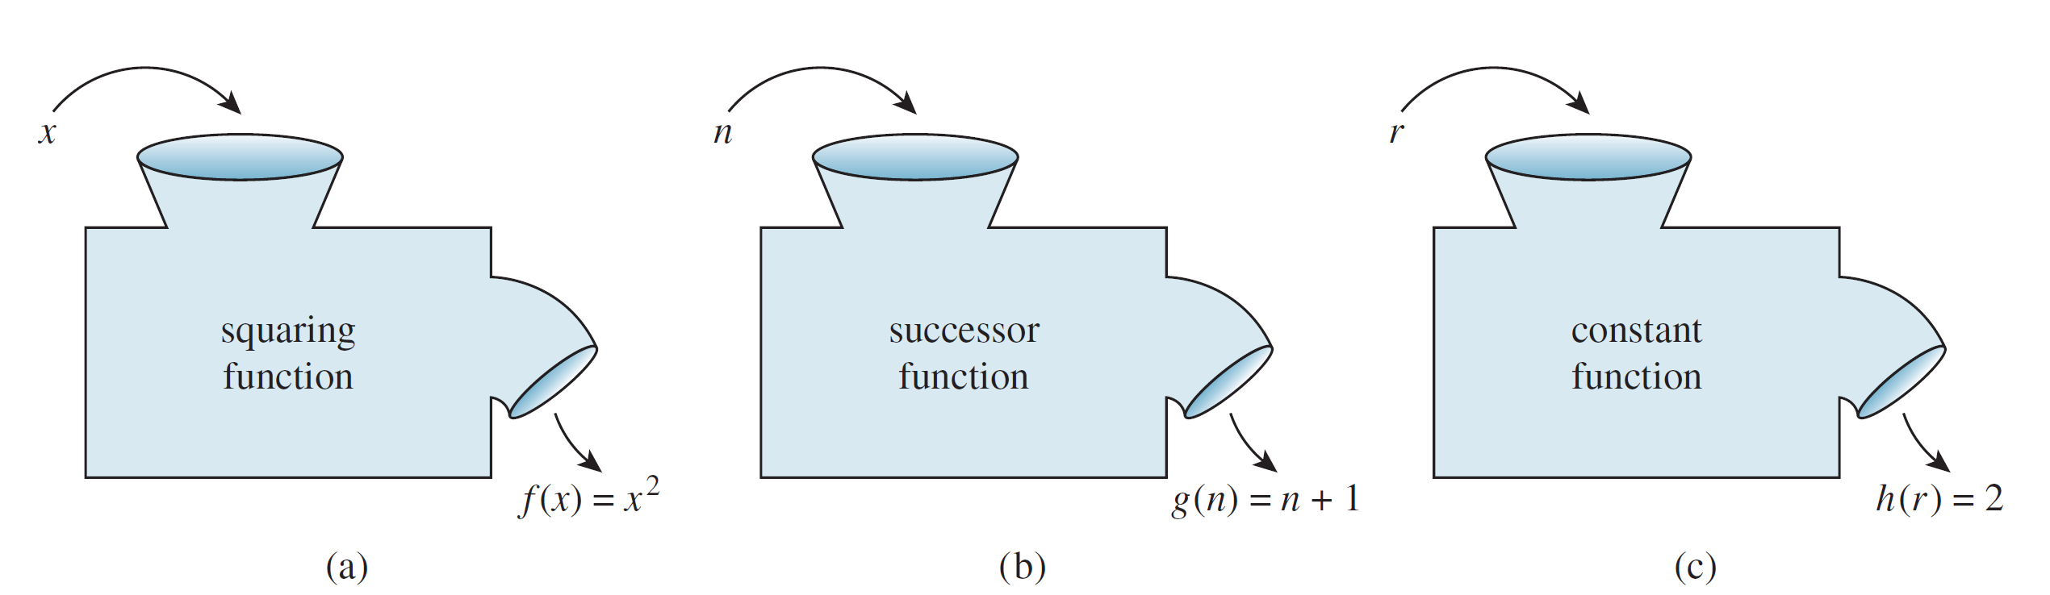
Example 6 – Functions Defined by Formulas
cont’d
This function sends each rational number r to 2. In other words, no matter what the input, the output is always 2: h(● ) = 2 or h : r → 2.
The functions f, g, and h are represented by the function machines in Figure 1.3.2.
Figure 1.3.2

Slide 77
Function Machines
A function is an entity in its own right. It can be thought of as a certain relationship between sets or as an input/output machine that operates according to a certain rule.
This is the reason why a function is generally denoted by a single symbol or string of symbols, such as f, G, of log, or sin.
A relation is a subset of a Cartesian product and a function is a special kind of relation.

Slide 78
Function Machines
Specifically, if f and g are functions from a set A to a set B, then
f = {(x, y) ∈ A × B | y = f (x)}
and
g = {(x, y) ∈ A × B | y = g (x)}.
It follows that
f equals g, written f = g, if, and only if, f (x) = g (x) for all x in A.

Slide 79
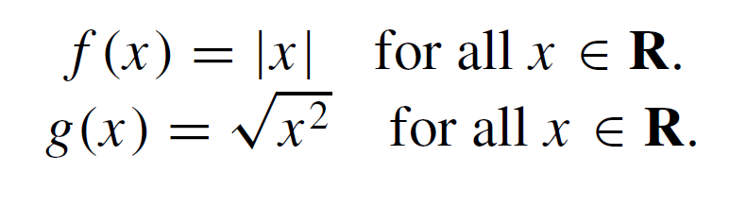
Example 7 – Equality of Functions
Define f : R → R and g: R → R by the following formulas:
Does f = g?
Solution:
Yes. Because the absolute value of any real number equals the square root of its square,

