Slide 1
Proposition logic and argument

Slide 2
SECTION 2.1
Logical Form and Logical Equivalence
Copyright © Cengage Learning. All rights reserved.

Slide 3
Statements

Slide 4
Statements
Most of the definitions of formal logic have been developed so that they agree with the natural or intuitive logic used by people who have been educated to think clearly and use language carefully.
The differences that exist between formal and intuitive logic are necessary to avoid ambiguity and obtain consistency.
In any mathematical theory, new terms are defined by using those that have been previously defined. However, this process has to start somewhere. A few initial terms necessarily remain undefined.

Slide 5
Statements
In logic, the words sentence, true, and false are the initial undefined terms.

Slide 6
Compound Statements

Slide 7
Compound Statements
We now introduce three symbols that are used to build more complicated logical expressions out of simpler ones. The symbol ~ denotes not, ∧ denotes and, and ∨ denotes or.
Given a statement p, the sentence “~p” is read “not p” or “It is not the case that p” and is called the negation of p. In some computer languages the symbol ● is used in place of ~.

Slide 8
Compound Statements
Given another statement q, the sentence “p ∧ q” is read “p and q” and is called the conjunction of p and q.
The sentence “p ∨ q” is read “p or q” and is called the disjunction of p and q.
In expressions that include the symbol ~ as well as ∧ or ∨, the order of operations specifies that ~ is performed first.
For instance, ~p ∧ q = (~p) ∧ q.

Slide 9
Compound Statements
In logical expressions, as in ordinary algebraic expressions, the order of operations can be overridden through the use of parentheses.
Thus ~(p ∧ q) represents the negation of the conjunction of p and q.
In this, as in most treatments of logic, the symbols ∧ and ∨ are considered coequal in order of operation, and an expression such as p ∧ q ∨ r is considered ambiguous.
This expression must be written as either (p ∧ q) ∨ r or p ∧ (q ∨ r) to have meaning.

Slide 10
Example 2 – Translating from English to Symbols: But and Neither-Nor
Write each of the following sentences symbolically, letting h = “It is hot” and s = “It is sunny.”
a. It is not hot but it is sunny.
b. It is neither hot nor sunny.
Solution:
a. The given sentence is equivalent to “It is not hot and it is sunny,” which can be written symbolically as ~h ∧ s.
b. To say it is neither hot nor sunny means that it is not hot and it is not sunny. Therefore, the given sentence can be written symbolically as ~h ∧ ~s.

Slide 11
Truth Values

Slide 12
Truth Values
In Example 2 we built compound sentences out of component statements and the terms not, and, and or.
If such sentences are to be statements, however, they must have well-defined truth values—they must be either true or false.
We now define such compound sentences as statements by specifying their truth values in terms of the statements that compose them.

Slide 13
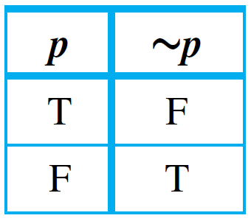
Truth Values
The negation of a statement is a statement that exactly expresses what it would mean for the statement to be false.
The truth values for negation are summarized in a truth table.
Truth Table for ~p

Slide 14
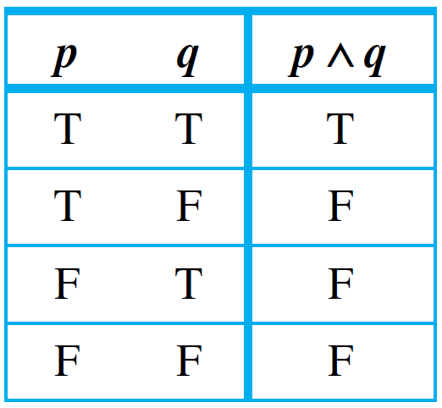
Truth Values
The truth values for conjunction can also be summarized in a truth table.
Truth Table for p ∧ q

Slide 15
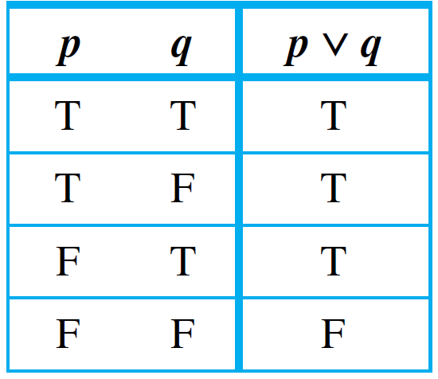
Truth Values
Here is the truth table for disjunction:
Truth Table for p ∨ q

Slide 16
Evaluating the Truth of More General Compound Statements

Slide 17
Evaluating the Truth of More General Compound Statements
Now that truth values have been assigned to ~p, p ∧ q, and p ∨ q, consider the question of assigning truth values to more complicated expressions such as ~p ∨ q, (p ∨ q) ∧ ~(p ∧ q), and (p ∧ q) ∨ r. Such expressions are called statement forms (or propositional forms).

Slide 18
Example 4 – Truth Table for Exclusive Or
Construct the truth table for the statement form (p ∨ q) ∧ ~(p ∧ q).
Note that when or is used in its exclusive sense, the statement “p or q” means “p or q but not both” or “p or q and not both p and q,” which translates into symbols as (p ∨ q) ∧ ~(p ∧ q).
This is sometimes abbreviated

Slide 19
Example 4 – Solution
Set up columns labeled p, q, p ∨ q, p ∧ q, ~(p ∧ q), and (p ∨ q) ∧ ~(p ∧ q).
Fill in p and q columns with all the logically possible combinations of T’s and F’s.
Use truth tables for ∨ and ∧ to fill in the p ∨ q and p ∧ q columns with appropriate truth values.
Fill in the ~(p ∧ q) column by taking the opposites of the truth values for p ∧ q, e.g., the entry for ~(p ∧ q) in the first row is F because in the first row the truth value of p ∧ q is T.
Fill in the (p ∨ q) ∧ ~(p ∧ q) column by considering the truth table for an and statement together with the computed truth values for p ∨ q and ~(p ∧ q).

Slide 20
Logical Equivalence

Slide 21
Logical Equivalence
The statements
6 is greater than 2 and 2 is less than 6
are two different ways of saying the same thing. Why? Because of the definition of the phrases greater than and less than. By contrast, although the statements
(1) Dogs bark and cats meow and (2) Cats meow and dogs bark are also two different ways of saying the same thing, the reason has nothing to do with the definition of the words.It has to do with the logical form of the statements.

Slide 22
Logical Equivalence
Any two statements whose logical forms are related in the same way as (1) and (2) would either both be true or both be false.
You can see this by examining the following truth table, where the statement variables p and q are substituted for the component statements “Dogs bark” and “Cats meow,” respectively.

Slide 23
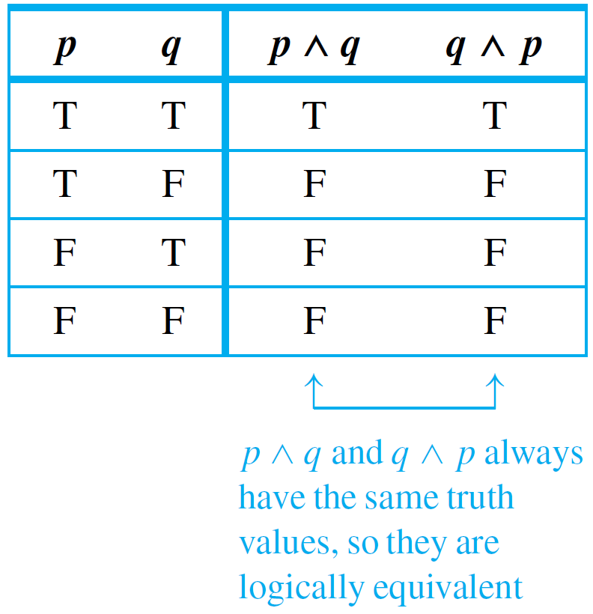
Logical Equivalence
The table shows that for each combination of truth values for p and q, p ∧ q is true when, and only when, q ∧ p is true.
In such a case, the statement forms are called logically equivalent, and we say that (1) and (2) are logically equivalent statements.

Slide 24
Logical Equivalence

Slide 25
Logical Equivalence
Testing Whether Two Statement Forms P and Q Are Logically Equivalent
1. Construct a truth table with one column for the truth values of P and another column for the truth values of Q. 2. Check each combination of truth values of the statement variables to see whether the truth value of P is the same as the truth value of Q.
a. If in each row the truth value of P is the same as the truth value of Q, then P and Q are logically equivalent.
b. If in some row P has a different truth value from Q, then P and Q are not logically equivalent.

Slide 26
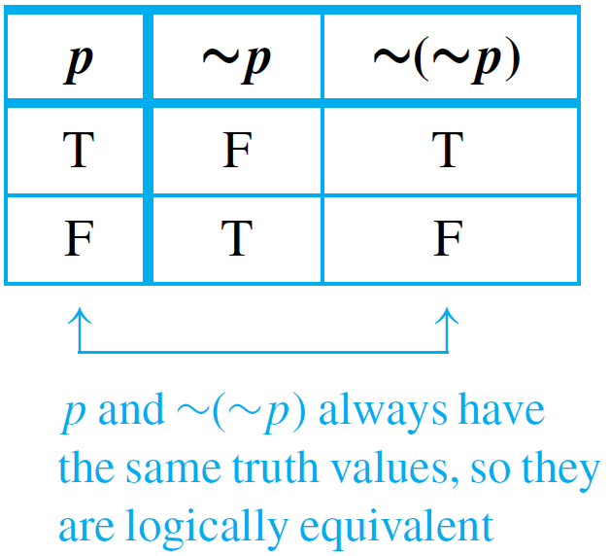
Example 6 – Double Negative Property: ∼(∼p) ≡ p
Construct a truth table to show that the negation of the negation of a statement is logically equivalent to the statement, annotating the table with a sentence of explanation.
Solution:

Slide 27
Logical Equivalence
There are two ways to show that statement forms P and Q are not logically equivalent. As indicated previously, one is to use a truth table to find rows for which their truth values differ.
The other way is to find concrete statements for each of the two forms, one of which is true and the other of which is false.
The next example illustrates both of these ways.

Slide 28
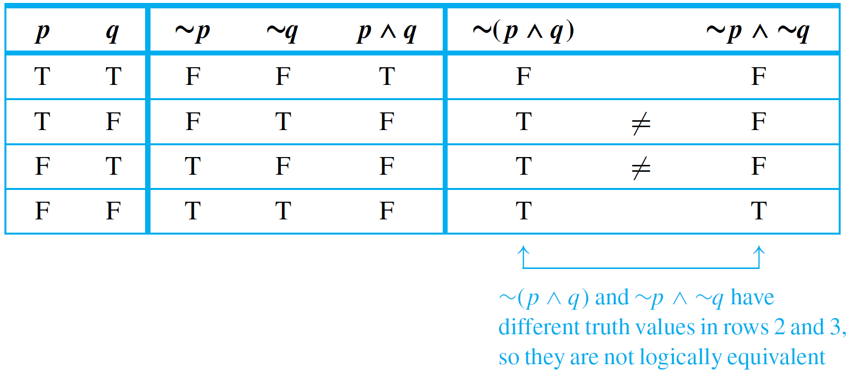
Example 7 – Showing Nonequivalence
Show that the statement forms ~(p ∧ q) and ~p ∧ ~q are not logically equivalent.
Solution:
a. This method uses a truth table annotated with a sentence of explanation.

Slide 29
Example 7 – Solution
cont’d
b. This method uses an example to show that ~(p ∧ q) and ~p ∧ ~q are not logically equivalent.
Let p be the statement “0 < 1” and let q be the statement “1 < 0.”
Then
which is true.
On the other hand,
which is false.

Slide 30
Example 7 – Solution
cont’d
This example shows that there are concrete statements you can substitute for p and q to make one of the statement forms true and the other false.
Therefore, the statement forms are not logically equivalent.

Slide 31
Logical Equivalence
The two logical equivalences are known as De Morgan’s laws of logic in honor of Augustus De Morgan, who was the first to state them in formal mathematical terms.

Slide 32
Logical Equivalence
Symbolically we can represent the two logic equivalences as: and

Slide 33
Example 9 – Applying De Morgan’s Laws
Write negations for each of the following statements:
a. John is 6 feet tall and he weighs at least 200 pounds.
b. The bus was late or Tom’s watch was slow.
Solution:
a. John is not 6 feet tall or he weighs less than 200 pounds.
b. The bus was not late and Tom’s watch was not slow.
Since the statement “neither p nor q” means the same as “~p and ~q,” an alternative answer for (b) is “Neither was the bus late nor was Tom’s watch slow.”

Slide 34
Tautologies and Contradictions

Slide 35
Tautologies and Contradictions
the truth of a tautological statement and the falsity of a contradictory statement are due to the logical structure of the statements themselves and are independent of the meanings of the statements.

Slide 36
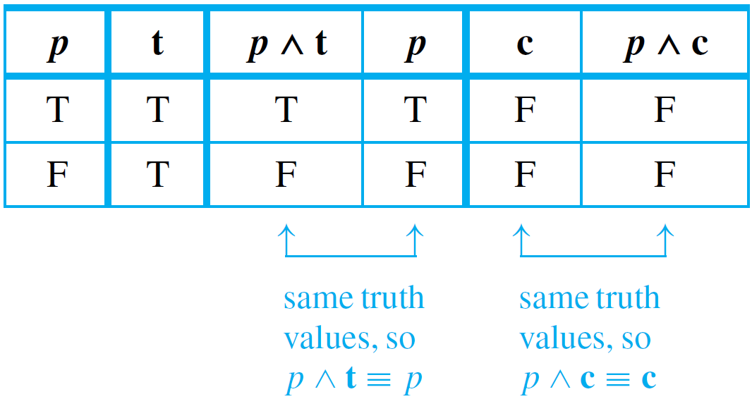
Example 13 – Logical Equivalence Involving Tautologies and Contradictions
If t is a tautology and c is a contradiction, show that p ∧ t ≡ p and p ∧ c ≡ c.
Solution:

Slide 37
Summary of Logical Equivalences

Slide 38
Summary of Logical Equivalences
Knowledge of logically equivalent statements is very useful for constructing arguments.
It often happens that it is difficult to see how a conclusion follows from one form of a statement, whereas it is easy to see how it follows from a logically equivalent form of the statement.

Slide 39
Summary of Logical Equivalences

Slide 40
Example 14 – Simplifying Statement Forms
Use Theorem 2.1.1 to verify the logical equivalence
Solution:
Use the laws of Theorem 2.1.1 to replace sections of the statement form on the left by logically equivalent expressions.
Each time you do this, you obtain a logically equivalent statement form.

Slide 41
Example 14 – Solution
cont’d
Continue making replacements until you obtain the statement form on the right.

Slide 42
SECTION 2.2
Conditional Statements
Copyright © Cengage Learning. All rights reserved.

Slide 43
Conditional Statements
Let p and q be statements. A sentence of the form “If p then q” is denoted symbolically by “p → q”; p is called the hypothesis and q is called the conclusion, e.g.,
Such a sentence is called conditional because the truth of statement q is conditioned on the truth of statement p.

Slide 44
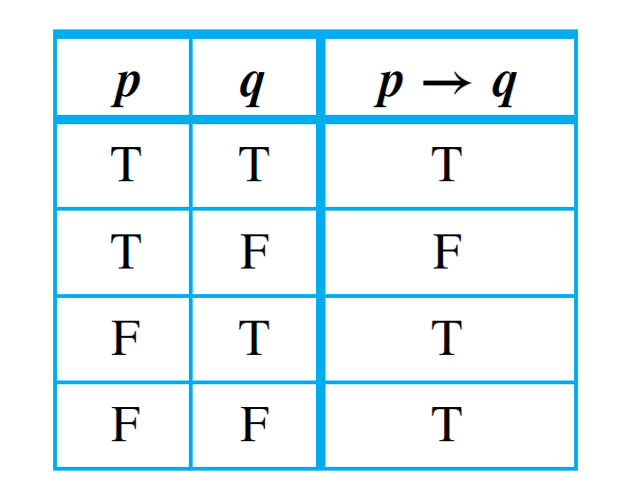
Conditional Statements
As is the case with other connectives, formal definition of truth values for →(if-then) is based on its everyday, intuitive meaning.
Manager: “If you show up for work Monday morning, then you will get the job”
When will you be able to say that the manager lies?
A conditional statement that is true by virtue of the fact that its hypothesis is false is often called vacuously true or true by default.
Thus the statement is vacuously true if you do not show up for work Monday morning.
In general, when the “if” part of an if-then statement is false, the statement as a whole is said to be true, regardless of whether the conclusion is true or false.
Truth Table for p ↔ q

Slide 45
Conditional Statements

Slide 46
Example 1 – A Conditional Statement with a False Hypothesis
Consider the statement:
If 0 = 1 then 1 = 2.
As strange as it may seem, since the hypothesis of this statement is false, the statement as a whole is true.

Slide 47
Conditional Statements
In expressions that include → as well as other logical operators such as ∧, ∨, and ∼, the order of operations is that → is performed last.
Thus, according to the specification of order of operations, ∼ is performed first, then ∧ and ∨, and finally →.

Slide 48
Example 2 – Truth Table for p ∨ ∼ q → ∼p
Construct a truth table for the statement form p ∨ ∼q → ∼p.
Solution: By the order of operations given above, the following two expressions are equivalent: p ∨ ∼q → ∼p and (p ∨ (∼q)) → (∼p), and this order governs the construction of the truth table.
First fill in the four possible combinations of truth values for p and q, and then enter the truth values for ∼p and ∼q using the definition of negation.

Slide 49
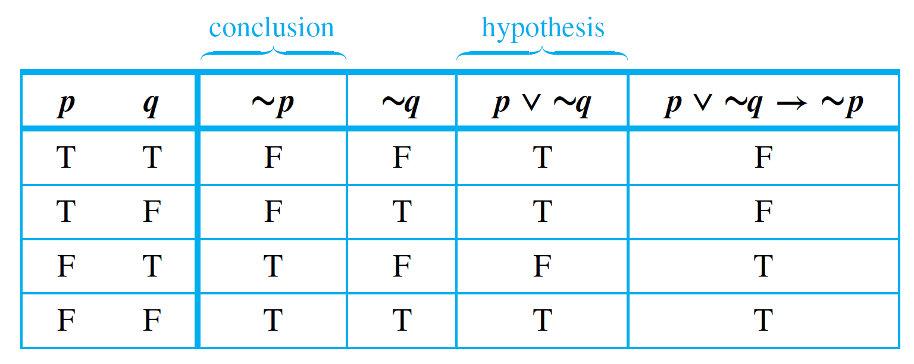
Example 2 – Solution
cont’d
Next fill in the p ∨ ∼q column using the definition of ∨. Finally, fill in the p ∨ ∼q → ∼p column using the definition of →.
The only rows in which the hypothesis p ∨ ∼q is true and the conclusion ∼p is false are the first and second rows.
So you put F’s in those two rows and T’s in the other two rows.

Slide 50
Logical Equivalences Involving →

Slide 51
Example 3 – Division into Cases: Showing that p ∨ q → r ≡ ( p → r) ∧ (q → r)
Use truth tables to show the logical equivalence of the statement forms p ∨ q → r and (p → r ) ∧ (q → r). Annotate the table with a sentence of explanation.
Solution: First fill in the eight possible combinations of truth values for p, q, and r.
Then fill in the columns for p ∨ q, p → r , and q → r using the definitions of or and if-then.

Slide 52
Example 3 – Solution
cont’d
For instance, the p → r column has F’s in the second and fourth rows because these are the rows in which p is true and q is false.
Next fill in the p ∨ q → r column using the definition of if-then. The rows in which the hypothesis p ∨ q is true and the conclusion r is false are the second, fourth, and sixth.
So F’s go in these rows and T’s in all the others.

Slide 53
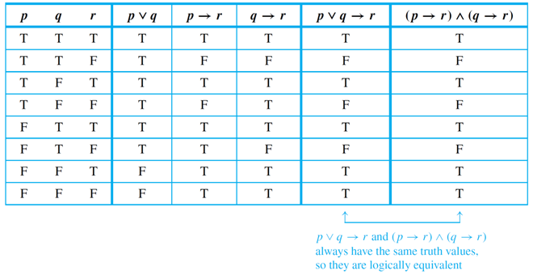
Example 3 – Solution
cont’d
The complete table shows that p ∨ q → r and (p → r) ∧ (q → r) have the same truth values for each combination of truth values of p, q, and r. Hence the two statement forms are logically equivalent.

Slide 54
Representation of If-Then As Or

Slide 55
Example 4 – Application of the Equivalence between ∼ p ∨ q and p → q
Rewrite the following statement in if-then form.
Either you get to work on time or you are fired.
Solution: Let ∼p be You get to work on time.
and q be You are fired.
Then the given statement is ∼p ∨ q. Also p is
You do not get to work on time.
So the equivalent if-then version, p → q, is
If you do not get to work on time, then you are fired.

Slide 56
The Negation of a Conditional Statement

Slide 57
Negation of a Conditional Statement
By definition, p → q is false if, and only if, its hypothesis, p, is true and its conclusion, q, is false. It follows that
This can be restated symbolically as follows:

Slide 58
Example 5 – Negations of If-Then Statements
Write negations for each of the following statements:
a. If my car is in the repair shop, then I cannot get to class.
b. If Sara lives in Athens, then she lives in Greece.
Solution:
a. My car is in the repair shop and I can get to class.
b. Sara lives in Athens and she does not live in Greece. (Sara might live in Athens, Georgia; Athens, Ohio; or Athens, Wisconsin.)

Slide 59
Contrapositive of a Conditional Statement

Slide 60
Contrapositive of a Conditional Statement
One of the most fundamental laws of logic is the equivalence between a conditional statement and its contrapositive.
The fact is that

Slide 61
Example 6 – Writing the Contrapositive
Write each of the following statements in its equivalent contrapositive form:
a. If Howard can swim across the lake, then Howard can swim to the island.
b. If today is Easter, then tomorrow is Monday.
Solution: a. If Howard cannot swim to the island, then Howard cannot swim across the lake.
b. If tomorrow is not Monday, then today is not Easter.

Slide 62
The Converse and Inverse of a Conditional Statement

Slide 63
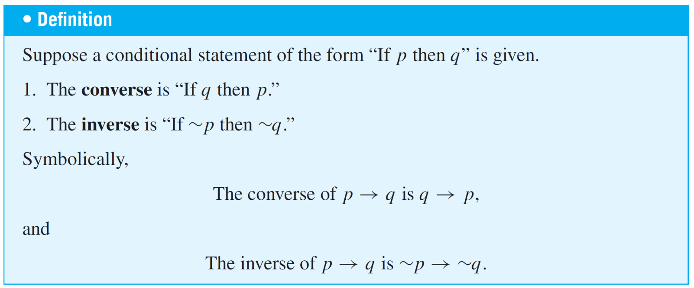
The Converse and Inverse of a Conditional Statement
The fact that a conditional statement and its contrapositive are logically equivalent is very important and has wide application. Two other variants of a conditional statement are not logically equivalent to the statement.

Slide 64
Example 7 – Writing the Converse and the Inverse
Write the converse and inverse of each of the following statements:
a. If Howard can swim across the lake, then Howard can swim to the island.
b. If today is Easter, then tomorrow is Monday.
Solution: a. Converse: If Howard can swim to the island, then Howard can swim across the lake.
Inverse: If Howard cannot swim across the lake, then Howard cannot swim to the island.

Slide 65
Example 7 – Solution
cont’d
b. Converse: If tomorrow is Monday, then today is Easter.
Inverse: If today is not Easter, then tomorrow is not Monday.

Slide 66
The Converse and Inverse of a Conditional Statement
1. A conditional statement and its converse are not logically equivalent.
2. A conditional statement and its inverse are not logically equivalent.
3. The converse and the inverse of a conditional statement are logically equivalent to each other.

Slide 67
Only If and the Biconditional

Slide 68
Only If and the Biconditional
To say “p only if q” means that p can take place only if q takes place also. That is, if q does not take place, then p cannot take place.
Another way to say this is that if p occurs, then q must also occur (by the logical equivalence between a statement and its contrapositive).

Slide 69
Example 8 – Converting Only If to If-Then
Rewrite the following statement in if-then form in two ways, one of which is the contrapositive of the other.
John will break the world’s record for the mile run only if he runs the mile in under four minutes.
Solution: Version 1: If John does not run the mile in under four minutes, then he will not break the world’s record.
Version 2: If John breaks the world’s record, then he will have run the mile in under four minutes.

Slide 70
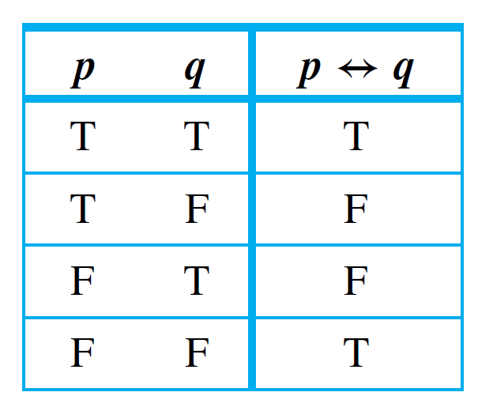
Only If and the Biconditional
The biconditional has the following truth table:
Truth Table for p ↔ q

Slide 71
Only If and the Biconditional
In order of operations ↔ is coequal with →. As with ∧ and ∨, the only way to indicate precedence between them is to use parentheses.
The full hierarchy of operations for the five logical operators is:

Slide 72
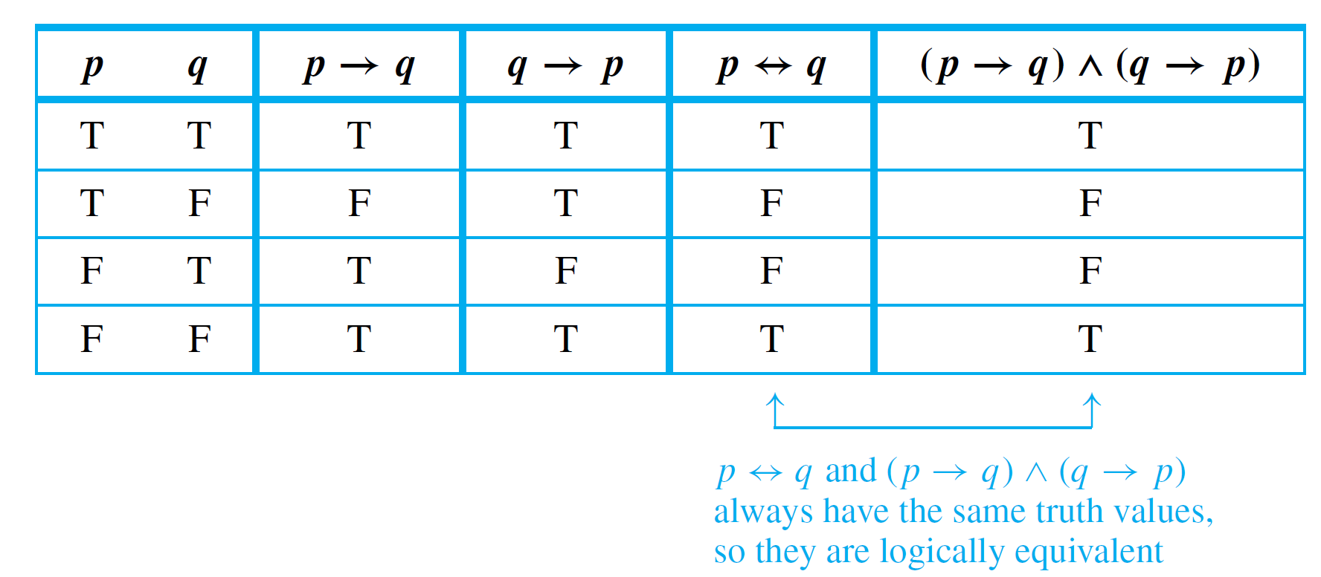
Only If and the Biconditional
According to the separate definitions of if and only if, saying “p if, and only if, q” should mean the same as saying both “p if q” and “p only if q.”
The following annotated truth table shows that this is the case:
Truth Table Showing that p ↔ q ≡ (p → q) ∧ (q → p)

Slide 73
Example 9 – If and Only If
Rewrite the following statement as a conjunction of two if-then statements:
This computer program is correct if, and only if, it produces correct answers for all possible sets of input data.
Solution: If this program is correct, then it produces the correct answers for all possible sets of input data; and if this program produces the correct answers for all possible sets of input data, then it is correct.

Slide 74
Necessary and Sufficient Conditions

Slide 75
Necessary and Sufficient Conditions
The phrases necessary condition and sufficient condition, as used in formal English, correspond exactly to their definitions in logic.
In other words, to say “r is a sufficient condition for s” means that the occurrence of r is sufficient to guarantee the occurrence of s.

Slide 76
Necessary and Sufficient Conditions
On the other hand, to say “r is a necessary condition for s” means that if r does not occur, then s cannot occur either: The occurrence of r is necessary to obtain the occurrence of s. Note that because of the equivalence between a statement and its contrapositive,
Consequently,

Slide 77
Example 10 – Interpreting Necessary and Sufficient Conditions
Consider the statement “If John is eligible to vote, then he is at least 18 years old.”
The truth of the condition “John is eligible to vote” is sufficient to ensure the truth of the condition “John is at least 18 years old.”
In addition, the condition “John is at least 18 years old” is necessary for the condition “John is eligible to vote” to be true.
If John were younger than 18, then he would not be eligible to vote.

Slide 78
SECTION 2.3
Valid and Invalid Arguments
Copyright © Cengage Learning. All rights reserved.

Slide 79
Valid and Invalid Arguments
In mathematics and logic an argument is not a dispute. It is a sequence of statements ending in a conclusion.
How to determine whether an argument is valid — that is, whether the conclusion follows necessarily from the preceding statements.
This determination depends only on the form of an argument, not on its content.

Slide 80
Valid and Invalid Arguments
For example, the argument
If Socrates is a man, then Socrates is mortal.
Socrates is a man.
Socrates is mortal.
has the abstract form
If p then q
p
q
p and q as variables for which statements may be substituted.
An argument form is called valid if, and only if, whenever statements are substituted that make all the premises true, the conclusion is also true.

Slide 81
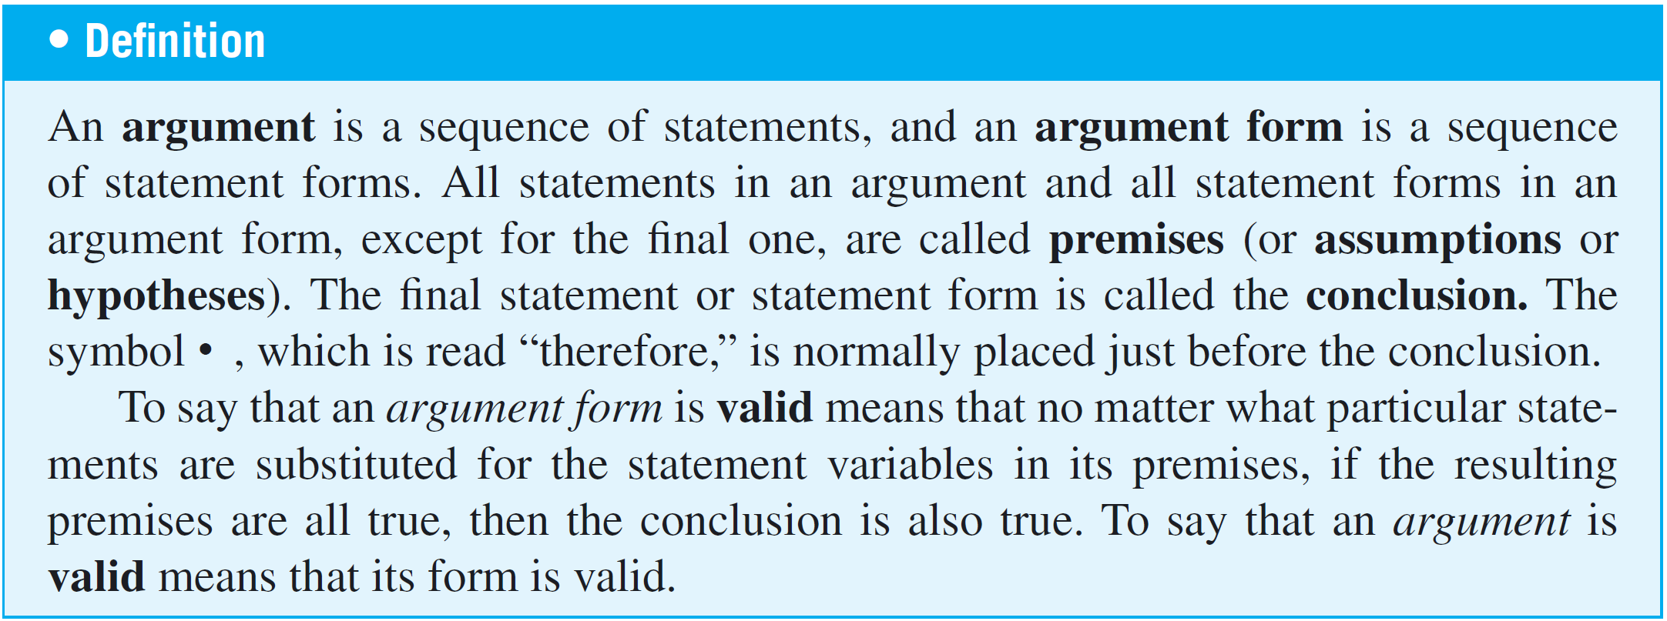
Valid and Invalid Arguments
When an argument is valid and its premises are true, the truth of the conclusion is said to be inferred or deduced from the truth of the premises.

Slide 82
Testing validity of argument form
1. Identify premises and conclusion of argument form.
2. Construct a truth table showing truth values of all premises and conclusion, under all possible truth values for variables.
3. A row of the truth table in which all the premises are true is called a critical row.
If there is a critical row in which conclusion is false, then it is possible for an argument of the given form to have true premises and a false conclusion, and so the argument form is invalid.
If conclusion in every critical row is true, then argument form is valid.

Slide 83
Example 1 – Determining Validity or Invalidity
cont’d
p → q ∨ ∼r
q → p ∧ r
p → r
Solution:
there is one situation (row 4) where the premises are true and the conclusion is false.

Slide 84
Modus Ponens and Modus Tollens

Slide 85
Modus Ponens
An argument form consisting of two premises and a conclusion is called a syllogism.
The first and second premises are called the major premise and minor premise, respectively.
The most famous form of syllogism in logic is called modus ponens with the following form:
If p then q.
p
q

Slide 86
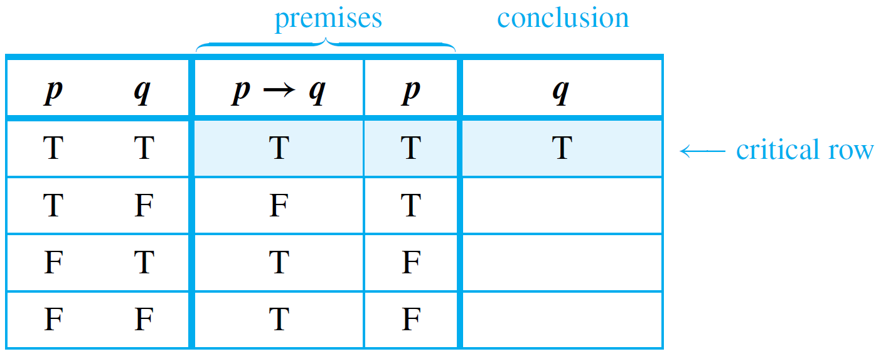
Modus Ponens
It is instructive to prove that modus ponens is a valid form of argument, if for no other reason than to confirm the agreement between the formal definition of validity and the intuitive concept.
To do so, we construct a truth table for the premises and conclusion.

Slide 87
Modus Tollens
Now consider another valid argument form called modus tollens. It has the following form:
If p then q.
∼q
∼p

Slide 88
Example 2 – Recognizing Modus Ponens and Modus Tollens
Use modus ponens or modus tollens to fill in the blanks of the following arguments so that they become valid inferences.
a. If there are more pigeons than there are pigeonholes, then at least two pigeons roost in the same hole. There are more pigeons than there are pigeonholes. • .
b. If 870,232 is divisible by 6, then it is divisible by 3. 870,232 is not divisible by 3.
• .

Slide 89
Example 2 – Solution
a. At least two pigeons roost in the same hole.
b. 870,232 is not divisible by 6.

Slide 90
Additional Valid Argument Forms: Rules of Inference

Slide 91
Additional Valid Argument Forms: Rules of Inference
A rule of inference is a form of argument that is valid. Thus modus ponens and modus tollens are both rules of inference.
The following are additional examples of rules of inference that are frequently used in deductive reasoning.

Slide 92
Example 3 – Generalization
The following argument forms are valid:
a. p b. q
• p ∨ q • p ∨ q
These argument forms are used for making generalizations. For instance, according to the first, if p is true, then, more generally, “p or q” is true for any other statement q.
As an example, suppose you are given the job of counting the upperclassmen at your school. You ask what class Anton is in and are told he is a junior.

Slide 93
Example 3 – Generalization
cont’d
You reason as follows:
Anton is a junior.
• (more generally) Anton is a junior or Anton is a senior.
Knowing that upperclassman means junior or senior, you add Anton to your list.

Slide 94
Example 4 – Specialization
The following argument forms are valid:
a. p ∧ q b. p ∧ q
p q
These argument forms are used for specializing. When classifying objects according to some property, you often know much more about them than whether they do or do not have that property.
When this happens, you discard extraneous information as you concentrate on the particular property of interest.

Slide 95
Example 4 – Specialization
cont’d
For instance, suppose you are looking for a person who knows graph algorithms to work with you on a project. You discover that Ana knows both numerical analysis and graph algorithms. You reason as follows:
Ana knows numerical analysis and Ana knows graph algorithms.
• (in particular) Ana knows graph algorithms.
Accordingly, you invite her to work with you on your project.

Slide 96
Additional Valid Argument Forms: Rules of Inference
Both generalization and specialization are used frequently in mathematics to tailor facts to fit into hypotheses of known theorems in order to draw further conclusions.
Elimination, transitivity, and proof by division into cases are also widely used tools.

Slide 97
Example 5 – Elimination
The following argument forms are valid:
a. p ∨ q b. p ∨ q
∼q ∼p
p q
These argument forms say that when you have only two possibilities and you can rule one out, the other must be the case. For instance, suppose you know that for a particular number x,

Slide 98
Example 5 – Elimination
cont’d
If you also know that x is not negative, then x ≠ −2, so
By elimination, you can then conclude that

Slide 99
Example 6 – Transitivity
The following argument form is valid:
p → q
q → r
• p → r
Many arguments in mathematics contain chains of if-then statements.
From the fact that one statement implies a second and the second implies a third, you can conclude that the first statement implies the third.

Slide 100
Example 6 – Transitivity
cont’d
Here is an example:
If 18,486 is divisible by 18, then 18,486 is divisible by 9.
If 18,486 is divisible by 9, then the sum of the digits of 18,486 is divisible by 9.
• If 18,486 is divisible by 18, then the sum of the digits of 18,486 is divisible by 9.

Slide 101
Example 7 – Proof by Division into Cases
The following argument form is valid:
p ∨ q
p → r
q → r
r
It often happens that you know one thing or another is true. If you can show that in either case a certain conclusion follows, then this conclusion must also be true.
For instance, suppose you know that x is a particular nonzero real number.

Slide 102
Example 7 – Proof by Division into Cases
cont’d
The trichotomy property of the real numbers says that any number is positive, negative, or zero. Thus (by elimination) you know that x is positive or x is negative.
You can deduce that x² > 0 by arguing as follows:
x is positive or x is negative.
If x is positive, then x² > 0.
If x is negative, then x² > 0.
• x² > 0.

Slide 103
Additional Valid Argument Forms: Rules of Inference
The rules of valid inference are used constantly in problem solving. Here is an example from everyday life.

Slide 104
Example 8 – Application: A More Complex Deduction
You are about to leave for school in the morning and discover that you don’t have your glasses. You know the following statements are true:
a. If I was reading the newspaper in the kitchen, then my glasses are on the kitchen table.
b. If my glasses are on the kitchen table, then I saw them at breakfast.
c. I did not see my glasses at breakfast.
d. I was reading the newspaper in the living room or I was reading the newspaper in the kitchen.
e. If I was reading the newspaper in the living room then my glasses are on the coffee table.
Where are the glasses?

Slide 105
Example 8 – Application: A More Complex Deduction
cont’d
Solution:
Let RK = I was reading the newspaper in the kitchen.
GK = My glasses are on the kitchen table.
SB = I saw my glasses at breakfast.
RL = I was reading the newspaper in the living room.
GC = My glasses are on the coffee table.

Slide 106
Example 8 – Solution
cont’d
Here is a sequence of steps you might use to reach the answer, together with the rules of inference that allow you to draw the conclusion of each step:
1.
2.

Slide 107
Example 8 – Solution
cont’d
3.
4.
Thus the glasses are on the coffee table.

Slide 108
Fallacies

Slide 109
Fallacies
A fallacy is an error in reasoning that results in an invalid argument. Three common fallacies are using ambiguous premises, and treating them as if they were unambiguous, circular reasoning (assuming what is to be proved without having derived it from the premises), and jumping to a conclusion (without adequate grounds).
In this section we discuss two other fallacies, called converse error and inverse error, which give rise to arguments that superficially resemble those that are valid by modus ponens and modus tollens but are not, in fact, valid.

Slide 110
Fallacies

Slide 111
Example 9 – Converse Error
Show that the following argument is invalid:
If Zeke is a cheater, then Zeke sits in the back row.
Zeke sits in the back row.
• Zeke is a cheater.
Solution: Many people recognize the invalidity of the above argument intuitively, reasoning something like this: The first premise gives information about Zeke if it is known he is a cheater. It doesn’t give any information about him if it is not already known that he is a cheater.

Slide 112
Example 9 – Solution
cont’d
One can certainly imagine a person who is not a cheater but happens to sit in the back row. Then if that person’s name is substituted for Zeke, the first premise is true by default and the second premise is also true but the conclusion is false.
The general form of the previous argument is as follows:
p → q
q
p

Slide 113
Fallacies
The fallacy underlying this invalid argument form is called the converse error because the conclusion of the argument would follow from the premises if the premise p → q were replaced by its converse.
Such a replacement is not allowed, however, because a conditional statement is not logically equivalent to its converse. Converse error is also known as the fallacy of affirming the consequent.
Another common error in reasoning is called the inverse error.

Slide 114
Example 10 – Inverse Error
Consider the following argument:
If interest rates are going up, stock market prices will go down.
Interest rates are not going up.
Stock market prices will not go down.
Note that this argument has the following form:
p → q
∼p
• ∼q

Slide 115
Example 10 – Inverse Error
cont’d
The fallacy underlying this invalid argument form is called the inverse error because the conclusion of the argument would follow from the premises if the premise p → q were replaced by its inverse.
Such a replacement is not allowed, however, because a conditional statement is not logically equivalent to its inverse. Inverse error is also known as the fallacy of denying the antecedent.

Slide 116
Example 11 – A Valid Argument with a False Premise and a False Conclusion
The argument below is valid by modus ponens. But its major premise is false, and so is its conclusion.
If John Lennon was a rock star, then John Lennon had red hair.
John Lennon was a rock star.
• John Lennon had red hair.

Slide 117
Example 12 – An Invalid Argument with True Premises and a True Conclusion
The argument below is invalid by the converse error, but it has a true conclusion.
If New York is a big city, then New York has tall buildings.
New York has tall buildings.
• New York is a big city.

Slide 118
Fallacies

Slide 119
Contradictions and Valid Arguments

Slide 120
Contradictions and Valid Arguments
The concept of logical contradiction can be used to make inferences through a technique of reasoning called the contradiction rule. Suppose p is some statement whose truth you wish to deduce.

Slide 121
Example 13 – Contradiction Rule
Show that the following argument form is valid:
∼p → c, where c is a contradiction
• p
Solution: Construct a truth table for the premise and the conclusion of this argument.

Slide 122
Contradictions and Valid Arguments
The contradiction rule is the logical heart of the method of proof by contradiction.
A slight variation also provides the basis for solving many logical puzzles by eliminating contradictory answers: If an assumption leads to a contradiction, then that assumption must be false.

Slide 123
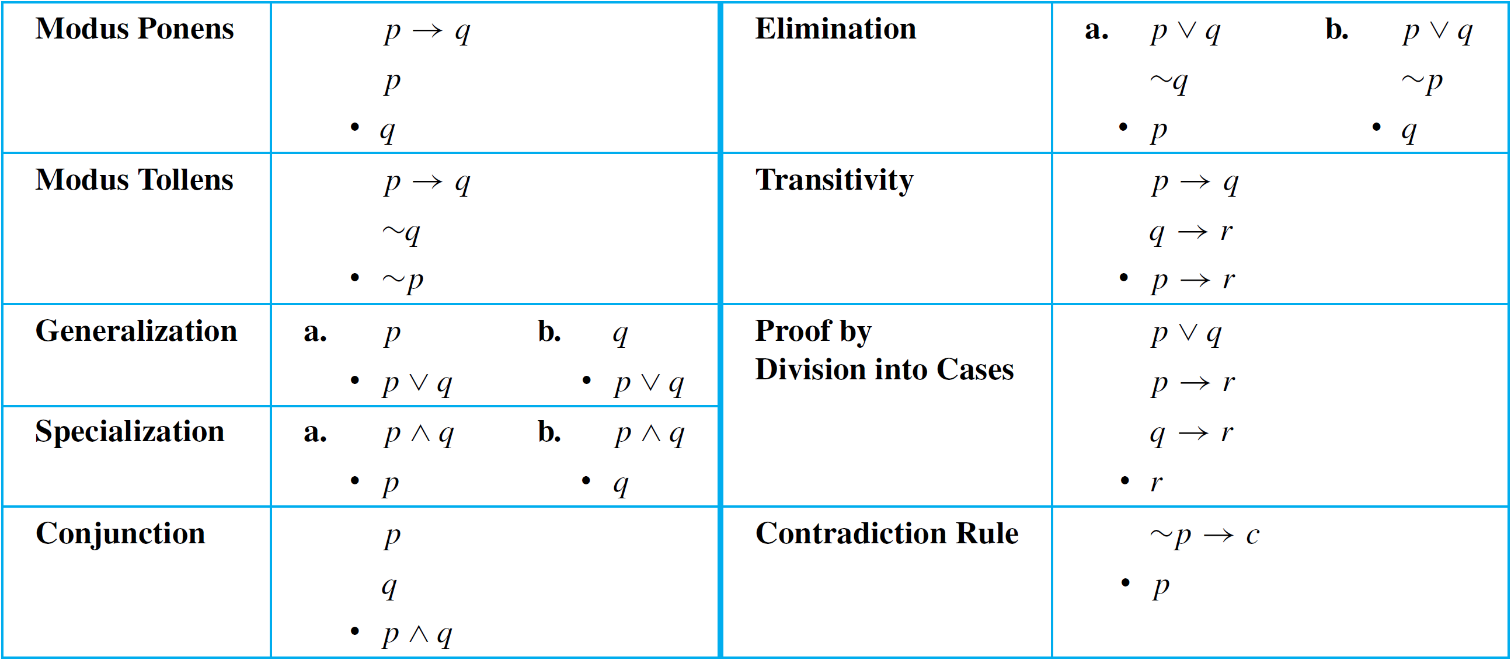
Summary of Rules of Inference
Valid Argument Forms
Table 2.3.1

