Slide 1
CHAPTER 3
THE LOGIC OF
QUANTIFIED
STATEMENTS
Copyright © Cengage Learning. All rights reserved.

Slide 2
SECTION 3.1
Predicates and Quantified Statements I
Copyright © Cengage Learning. All rights reserved.

Slide 3
Predicates and Quantified Statements I
In logic, predicates can be obtained by removing some or all of the nouns from a statement.
Alice is a student at Bedford College.
P stand for “is a student at Bedford College”
Q stand for “is a student at.”
Both are predicate symbols.
The sentences “x is a student at Bedford College” and “x is a student at y” are symbolized as P(x) and as Q(x, y) respectively, where x and y are predicate variables that take values in appropriate sets.
When concrete values are substituted in place of predicate variables, a statement results.

Slide 4
Predicates and Quantified Statements I
For simplicity, we define a predicate to be a predicate symbol together with suitable predicate variables. In some other treatments of logic, such objects are referred to as propositional functions or open sentences.

Slide 5
Predicates and Quantified Statements I

Slide 6
Example 2 – Finding the Truth Set of a Predicate
Let Q(n) be the predicate “n is a factor of 8.” Find the truth set of Q(n) if
a. the domain of n is the set Z⁺ of all positive integers
b. the domain of n is the set Z of all integers.
Solution:
a. The truth set is {1, 2, 4, 8} because these are exactly the positive integers that divide 8 evenly.
b. The truth set is {1, 2, 4, 8,−1,−2,−4,−8} because the negative integers −1,−2,−4, and −8 also divide into 8 without leaving a remainder.

Slide 7
The Universal Quantifier: ∀

Slide 8
The Universal Quantifier: ∀
One sure way to change predicates into statements is to assign specific values to all their variables.
For example, if x represents the number 35, the sentence “x is (evenly) divisible by 5” is a true statement since 35 = 5 ● 7. Another way to obtain statements from predicates is to add quantifiers.
Quantifiers are words that refer to quantities such as “some” or “all” and tell for how many elements a given predicate is true.

Slide 9
The Universal Quantifier: ∀
The symbol ∀ denotes “for all” and is called the universal quantifier.
The domain of the predicate variable is generally indicated between the ∀ symbol and the variable name or immediately following the variable name. Some other expressions that can be used instead of for all are for every, for arbitrary, for any, for each, and given any.

Slide 10
The Universal Quantifier: ∀
Sentences that are quantified universally are defined as statements by giving them the truth values specified in the following definition:

Slide 11
Example 3 – Truth and Falsity of Universal Statements
a. Let D = {1, 2, 3, 4, 5}, and consider the statement
Show that this statement is true.
b. Consider the statement
Find a counterexample to show that this statement is false.

Slide 12
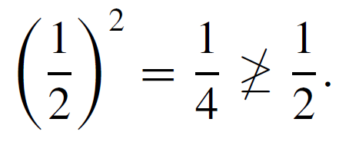
Example 3 – Solution
a. Check that “x² ≥ x” is true for each individual x in D.
Hence “∀x ∈ D, x² ≥ x” is true.
b. Counterexample: Take x = . Then x is in R (since is a real number) and
Hence “∀x ∈ R, x² ≥ x” is false.

Slide 13
The Universal Quantifier: ∀
The technique used to show the truth of the universal statement in Example 3(a) is called the method of exhaustion.
It consists of showing the truth of the predicate separately for each individual element of the domain.
This method can, in theory, be used whenever the domain of the predicate variable is finite.

Slide 14
The Existential Quantifier: ∃

Slide 15
The Existential Quantifier: ∃
The symbol ∃ denotes “there exists” and is called the existential quantifier. For example, the sentence “There is a student in Math 140” can be written as
∃ a person p such that p is a student in Math 140,
or, more formally,
∃p ∈ P such that p is a student in Math 140,
where P is the set of all people. The domain of the predicate variable is generally indicated either between the ∃ symbol and the variable name or immediately following the variable name.

Slide 16
The Existential Quantifier: ∃
The words such that are inserted just before the predicate. Some other expressions that can be used in place of there exists are there is a, we can find a, there is at least one, for some, and for at least one.
In a sentence such as “∃ integers m and n such that m + n = m ● n,” the ∃ symbol is understood to refer to both m and n.

Slide 17
The Existential Quantifier: ∃
Sentences that are quantified existentially are defined as statements by giving them the truth values specified in the following definition.

Slide 18
Example 4 – Truth and Falsity of Existential Statements
a. Consider the statement
∃m ∈ Z⁺ such that m² = m.
Show that this statement is true.
b. Let E = {5, 6, 7, 8} and consider the statement
∃m ∈ E such that m² = m.
Show that this statement is false.

Slide 19
Example 4 – Solution
a. Observe that 1² = 1. Thus “m² = m” is true for at least one integer m. Hence “∃m ∈ Z such that m² = m” is true.
b. Note that m² = m is not true for any integers m from 5 through 8:
Thus “∃m ∈ E such that m² = m” is false.

Slide 20
Formal Versus Informal Language

Slide 21
Formal Versus Informal Language
It is important to be able to translate from formal to informal language when trying to make sense of mathematical concepts that are new to you.
It is equally important to be able to translate from informal to formal language when thinking out a complicated problem.

Slide 22
Example 5 – Translating from Formal to Informal Language
Rewrite the following formal statements in a variety of equivalent but more informal ways. Do not use the symbol ∀ or ∃.
a.
b.
c.

Slide 23
Example 5 – Solution
a. All real numbers have nonnegative squares.
Or: Every real number has a nonnegative square.
Or: Any real number has a nonnegative square.
Or: The square of each real number is nonnegative.
b. All real numbers have squares that are not equal to −1.
Or: No real numbers have squares equal to −1. (The words none are or no . . . are are equivalent to the words all are not.)

Slide 24
Example 5 – Solution
cont’d
c. There is a positive integer whose square is equal to itself.
Or: We can find at least one positive integer equal to its own square.
Or: Some positive integer equals its own square.
Or: Some positive integers equal their own squares.

Slide 25
Universal Conditional Statements

Slide 26
Universal Conditional Statements
A reasonable argument can be made that the most important form of statement in mathematics is the universal conditional statement:
∀x, if P(x) then Q(x).
Familiarity with statements of this form is essential if you are to learn to speak mathematics.

Slide 27
Example 8 – Writing Universal Conditional Statements Informally
Rewrite the following statement informally, without quantifiers or variables.
∀x ∈ R, if x > 2 then x² > 4.
Solution:
If a real number is greater than 2 then its square is greater than 4.
Or: Whenever a real number is greater than 2, its square is greater than 4.

Slide 28
Example 8 – Solution
cont’d
Or: The square of any real number greater than 2 is greater than 4.
Or: The squares of all real numbers greater than 2 are greater than 4.

Slide 29
Equivalent Forms of Universal
and Existential Statements

Slide 30
Equivalent Forms of Universal and Existential Statements
Observe that the two statements “∀ real numbers x, if x is an integer then x is rational” and “∀ integers x, x is rational” mean the same thing.
Both have informal translations “All integers are rational.” In fact, a statement of the form
can always be rewritten in the form
by narrowing U to be the domain D consisting of all values of the variable x that make P(x) true.

Slide 31
Equivalent Forms of Universal and Existential Statements
Conversely, a statement of the form
can be rewritten as

Slide 32
Example 10 – Equivalent Forms for Universal Statements
Rewrite the following statement in the two forms “∀x, if ______ then ______” and “∀ ______x, _______”: All squares are rectangles.
Solution:
∀x, if x is a square then x is a rectangle.
∀ squares x, x is a rectangle.

Slide 33
Equivalent Forms of Universal and Existential Statements
Similarly, a statement of the form
“∃x such that p(x) and Q(x)”
can be rewritten as
“∃x εD such that Q(x),”
where D is the set of all x for which P(x) is true.

Slide 34
Example 11 – Equivalent Forms for Existential Statements
A prime number is an integer greater than 1 whose only positive integer factors are itself and 1. Consider the statement “There is an integer that is both prime and even.”
Let Prime(n) be “n is prime” and Even(n) be “n is even.” Use the notation Prime(n) and Even(n) to rewrite this statement in the following two forms:
a. ∃n such that ______ ∧ ______ .
b. ∃ ______ n such that ______.

Slide 35
Example 11 – Solution
a. ∃n such that Prime(n) ∧ Even(n).
b. Two answers: ∃ a prime number n such that Even(n).
∃ an even number n such that Prime(n).

Slide 36
Implicit Quantification

Slide 37
Implicit Quantification
Mathematical writing contains many examples of implicitly quantified statements. Some occur, through the presence of the word a or an. Others occur in cases where the general context of a sentence supplies part of its meaning.
For example, in an algebra course in which the letter x is always used to indicate a real number, the predicate
If x > 2 then x² > 4
is interpreted to mean the same as the statement
∀ real numbers x, if x > 2 then x² > 4.

Slide 38
Implicit Quantification
Mathematicians often use a double arrow to indicate implicit quantification symbolically.
For instance, they might express the above statement as
x > 2 ⇒ x² > 4.

Slide 39
Example 12 – Using ⇒ and ⇔
Let
Q(n) be “n is a factor of 8,”
R(n) be “n is a factor of 4,”
S(n) be “n < 5 and n ≠ 3,”
and suppose the domain of n is Z⁺, the set of positive integers. Use the ⇒ and ⇔ symbols to indicate true relationships among Q(n), R(n), and S(n).

Slide 40
Example 12 – Solution
1. As noted in Example 2, the truth set of Q(n) is {1, 2, 4, 8} when the domain of n is Z⁺. By similar reasoning the truth set of R(n) is {1, 2, 4}.
Thus it is true that every element in the truth set of R(n) is in the truth set of Q(n), or, equivalently,
∀n in Z⁺, R(n) → Q(n).
So R(n) ⇒ Q(n), or, equivalently
n is a factor of 4 ⇒ n is a factor of 8.

Slide 41
Example 12 – Solution
cont’d
2. The truth set of S(n) is {1, 2, 4}, which is identical to the truth set of R(n), or, equivalently,
∀n in Z⁺, R(n) ↔ S(n).
So R(n) ⇔ S(n), or, equivalently,
n is a factor of 4 ⇔ n < 5 and n ≠ 3.
Moreover, since every element in the truth set of S(n) is in the truth set of Q(n), or, equivalently,
∀n in Z⁺, S(n) → Q(n), then S(n) ⇒ Q(n), or, equivalently,
n < 5 and n ≠ 3 ⇒ n is a factor of 8.

Slide 42
Tarski’s World

Slide 43
Tarski’s World
Tarski’s World is a computer program developed by information scientists Jon Barwise and John Etchemendy to help teach the principles of logic.
It is described in their book The Language of First-Order Logic, which is accompanied by a CD-Rom containing the program Tarski’s World, named after the great logician Alfred Tarski.

Slide 44
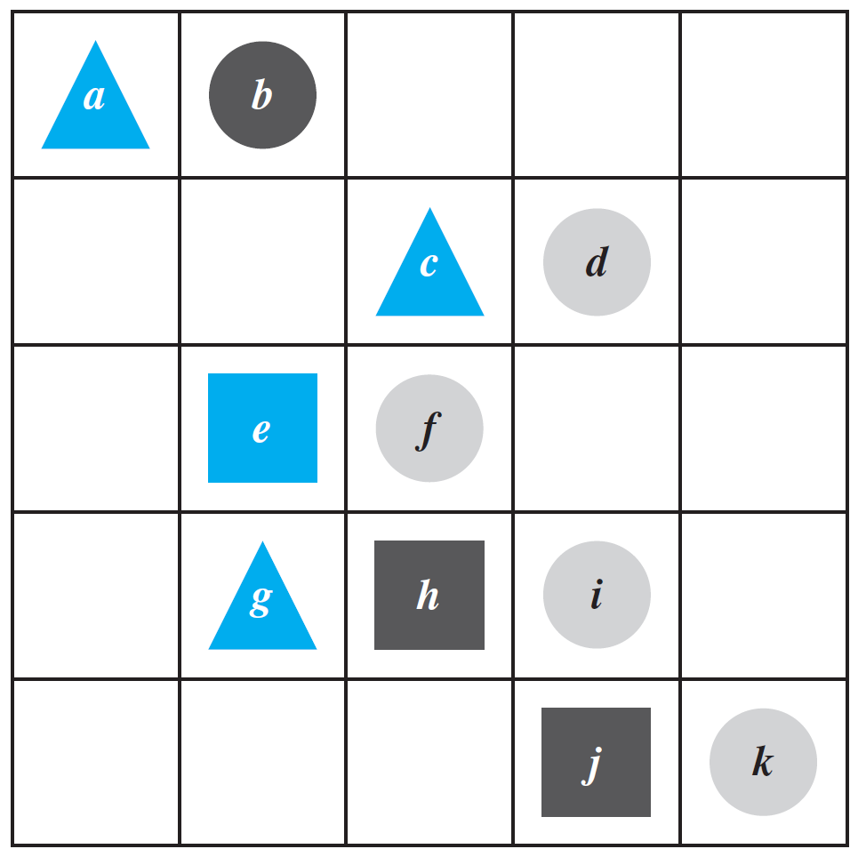
Example 13 – Investigating Tarski’s World
The program for Tarski’s World provides pictures of blocks of various sizes, shapes, and colors, which are located on a grid. Shown in Figure 3.1.1 is a picture of an arrangement of objects in a two-dimensional Tarski world.
Figure 3.1.1

Slide 45
Example 13 – Investigating Tarski’s World
cont’d
The configuration can be described using logical operators and—for the two-dimensional version—notation such as Triangle(x), meaning “x is a triangle,” Blue(y), meaning “y is blue,” and RightOf(x, y), meaning “x is to the right of y (but possibly in a different row).” Individual objects can be given names such as a, b, or c.

Slide 46
Example 13 – Investigating Tarski’s World
cont’d
Determine the truth or falsity of each of the following statements. The domain for all variables is the set of objects in the Tarski world shown above.
a. ∀t, Triangle(t) → Blue(t).
b. ∀x, Blue(x) → Triangle(x).
c. ∃y such that Square(y) ∧ RightOf(d, y).
d. ∃z such that Square(z) ∧ Gray(z).

Slide 47
Example 13 – Solution
a. This statement is true: All the triangles are blue.
b. This statement is false. As a counterexample, note that e is blue and it is not a triangle.
c. This statement is true because e and h are both square and d is to their right.
d. This statement is false: All the squares are either blue or black.

Slide 49
SECTION 3.2
Predicates and Quantified Statements II
Copyright © Cengage Learning. All rights reserved.

Slide 50
Negations of Quantified Statements

Slide 51
Negations of Quantified Statements
The general form of the negation of a universal statement follows immediately from the definitions of negation and of the truth values for universal and existential statements.

Slide 52
Negations of Quantified Statements
Thus
The negation of a universal statement (“all are”) is logically equivalent to an existential statement (“some are not” or “there is at least one that is not”).
Note that when we speak of logical equivalence for quantified statements, we mean that the statements always have identical truth values no matter what predicates are substituted for the predicate symbols and no matter what sets are used for the domains of the predicate variables.

Slide 53
Negations of Quantified Statements
The general form for the negation of an existential statement follows immediately from the definitions of negation and of the truth values for existential and universal statements.

Slide 54
Negations of Quantified Statements
Thus
The negation of an existential statement (“some are”) is logically equivalent to a universal statement (“none are” or “all are not”).

Slide 55
Example 1 – Negating Quantified Statements
Write formal negations for the following statements:
a. ∀ primes p, p is odd.
b. ∃ a triangle T such that the sum of the angles of T equals 200°.
Solution:
a. By applying the rule for the negation of a ∀ statement, you can see that the answer is
∃a prime p such that p is not odd.

Slide 56
Example 1 – Solution
cont’d
b. By applying the rule for the negation of a ∃ statement, you can see that the answer is
∀ triangles T, the sum of the angles of T does not equal 200°.

Slide 57
Negations of Universal Conditional Statements

Slide 58
Negations of Universal Conditional Statements
Negations of universal conditional statements are of special importance in mathematics.
The form of such negations can be derived from facts that have already been established.
By definition of the negation of a for all statement,
But the negation of an if-then statement is logically equivalent to an and statement. More precisely,

Slide 59
Negations of Universal Conditional Statements
Substituting (3.2.2) into (3.2.1) gives
Written less symbolically, this becomes

Slide 60
Example 4 – Negating Universal Conditional Statements
Write a formal negation for statement (a) and an informal negation for statement (b).
a. ∀ people p, if p is blond then p has blue eyes.
b. If a computer program has more than 100,000 lines, then it contains a bug.
Solution: a. ∃ a person p such that p is blond and p does not have blue eyes.

Slide 61
Example 4 – Solution
cont’d
b. There is at least one computer program that has more than 100,000 lines and does not contain a bug.

Slide 62
The Relation among ∀, ∃, ∧, and ∨

Slide 63
The Relation among ∀, ∃, ∧, and ∨
The negation of a for all statement is a there exists statement, and the negation of a there exists statement is a for all statement.
These facts are analogous to De Morgan’s laws, which state that the negation of an and statement is an or statement and that the negation of an or statement is an and statement.
This similarity is not accidental. In a sense, universal statements are generalizations of and statements, and existential statements are generalizations of or statements.

Slide 64
The Relation among ∀, ∃, ∧, and ∨
If Q(x) is a predicate and the domain D of x is the set {x₁, x₂, . . . , x_{n}}, then the statements
and
are logically equivalent.

Slide 65
The Relation among ∀, ∃, ∧, and ∨
Similarly, if Q(x) is a predicate and D = {x₁, x₂, . . . , x_{n}}, then the statements
and
are logically equivalent.

Slide 66
Vacuous Truth of Universal Statements

Slide 67
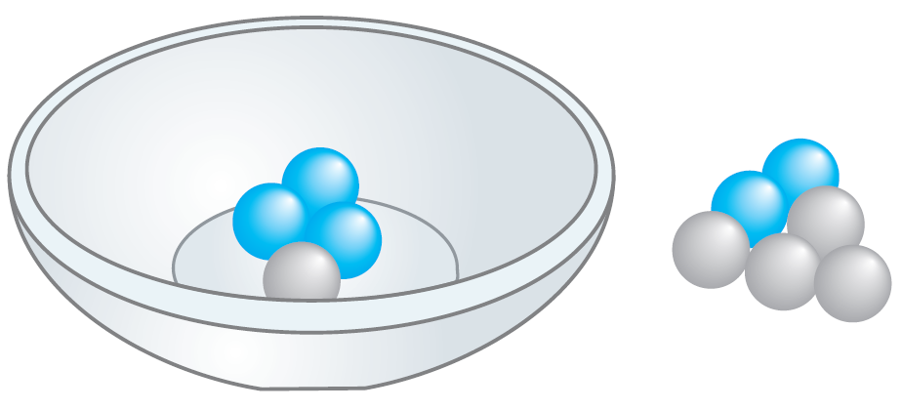
Vacuous Truth of Universal Statements
The statement “All the balls in the bowl are blue” would be false (since one of the balls in the bowl is gray).

Slide 68
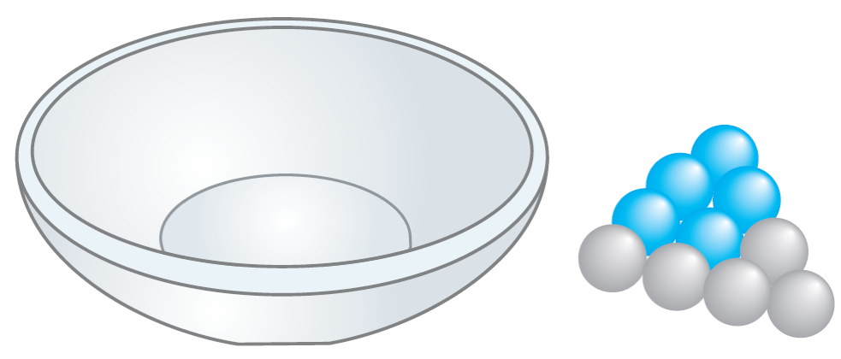
Vacuous Truth of Universal Statements
Consider the statement
All the balls in the bowl are blue.
Figure 3.2.1(b)

Slide 69
Vacuous Truth of Universal Statements
Is this statement true or false?
All the balls in the bowl are blue.
The statement is false if, and only if, its negation is true.
Its negation is:
There exists a ball in the bowl that is not blue.
But the only way this negation can be true is for there actually to be a nonblue ball in the bowl.
And there is not! Hence the negation is false, and so the statement is true “by default.”

Slide 70
Vacuous Truth of Universal Statements
In general, a statement of the form
is called vacuously true or true by default if, and only if, P(x) is false for every x in D.

Slide 71
Variants of Universal Conditional Statements

Slide 72
Variants of Universal Conditional Statements
A conditional statement has a contrapositive, a converse, and an inverse.
The definitions of these terms can be extended to universal conditional statements.

Slide 73
Example 5 – Contrapositive, Converse, and Inverse of a Universal Conditional Statement
Write a formal and an informal contrapositive, converse, and inverse for the following statement:
If a real number is greater than 2, then its square is greater than 4.
Solution: The formal version of this statement is
∀x ∈ R, if x > 2 then x² > 4.

Slide 74
Example 5 – Solution
cont’d
Contrapositive: ∀x ∈ R, if x² ≤ 4 then x ≤ 2.
Or: If the square of a real number is less than or equal to 4, then the number is less than or equal to 2.
Converse: ∀x ∈ R, if x² > 4 then x > 2. Or: If the square of a real number is greater than 4, then the number is greater than 2.
Inverse: ∀x ∈ R, if x ≤ 2 then x² ≤ 4. Or: If a real number is less than or equal to 2, then the square of the number is less than or equal to 4.

Slide 75
Variants of Universal Conditional Statements
Let P(x) and Q(x) be any predicates, let D be the domain of x, and consider
and its contrapositive
Any particular x in D that makes “if P(x) then Q(x)” true also makes “if ~Q(x) then ~P(x)” true (by the logical equivalence between p → q and ~q → ~p).

Slide 76
Variants of Universal Conditional Statements
It follows that the sentence “If P(x) then Q(x)” is true for all x in D if, and only if, the sentence “If ~Q(x) then ~P(x)” is true for all x in D.

Slide 77
Variants of Universal Conditional Statements
In Example 3.2.5 we noted that the statement
∀x ∈ R, if x > 2 then x² > 4
has the converse
∀x ∈ R, if x² > 4 then x > 2.
Observe that the statement is true whereas its converse is false (since, for instance, (−3)² = 9 > 4 but −3 2).

Slide 78
Variants of Universal Conditional Statements
This shows that a universal conditional statement may have a different truth value from its converse.
This is written in symbols as follows:

Slide 79
Necessary and Sufficient Conditions, Only If

Slide 80
Necessary and Sufficient Conditions, Only If
The definitions of necessary, sufficient, and only if can also be extended to apply to universal conditional statements.

Slide 81
Example 6 – Necessary and Sufficient Conditions
Rewrite the following statements as quantified conditional statements.
a. Squareness is a sufficient condition for rectangularity.
b. Being at least 35 years old is a necessary condition for being President of the United States.
Solution: a. A formal version of the statement is
∀x, if x is a square, then x is a rectangle.

Slide 82
Example 6 – Solution
cont’d
Or, in informal language:
If a figure is a square, then it is a rectangle.
b. Using formal language, you could write the answer as
∀ people x, if x is younger than 35, then x
cannot be President of the United States.
Or, by the equivalence between a statement and its contrapositive:
∀ people x, if x is President of the United States,
then x is at least 35 years old.

Slide 83
SECTION 3.3
Statements with Multiple Quantifiers
Copyright © Cengage Learning. All rights reserved.

Slide 84
Statements with Multiple Quantifiers
When a statement contains more than one quantifier, we imagine the actions suggested by the quantifiers as being performed in the order in which the quantifiers occur.
∀x in set D, ∃y in set E such that x and y satisfy property P(x, y).
To show this is true, you must be able to meet the following challenge:
Imagine that someone is allowed to choose any element whatsoever from D, and imagine that the person gives you that element. Call it x.
The challenge for you is to find an element y in E so that the person’s x and your y, taken together, satisfy property P(x, y).

Slide 85
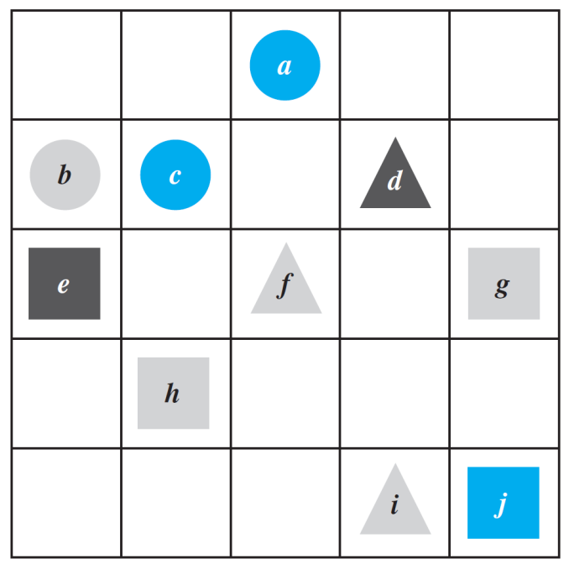
Example 1 – Truth of a ∀∃ Statement in a Tarski World
Consider the Tarski world shown in Figure 3.3.1.
For all triangles x, there is a square y such that x and y have the same color.

Slide 86
Statements with Multiple Quantifiers
Now consider a statement containing both ∀ and ∃, where the ∃ comes before the ∀:
∃ an x in D such that ∀y in E, x and y satisfy property P(x, y).
To show that a statement of this form is true: You must find one single element (call it x) in D with the following property:
After you have found your x, someone is allowed to choose any element whatsoever from E. The person challenges you by giving you that element. Call it y.
Your job is to show that your x together with the person’s y satisfy property P(x, y).

Slide 87
Interpreting Statements with Two Different Quantifiers
To establish the truth of a statement of the form
∀x in D, ∃y in E such that P(x, y)
your challenge is to allow someone else to pick whatever element x in D they wish and then you must find an element y in E that “works” for that particular x.

Slide 88
Statements with Multiple Quantifiers
If you want to establish the truth of a statement of the form
∃x in D such that ∀y in E, P(x, y)
your job is to find one particular x in D that will “work” no matter what y in E anyone might choose to challenge you with.

Slide 89
Example 3 – Interpreting Multiply-Quantified Statements
A college cafeteria line has four stations: salads, main courses, desserts, and beverages.
The salad station offers a choice of green salad or fruit salad; the main course station offers spaghetti or fish; the dessert station offers pie or cake; and the beverage station offers milk, soda, or coffee. Three students, Uta, Tim, and Yuen, go through the line and make the following choices:
Uta: green salad, spaghetti, pie, milk
Tim: fruit salad, fish, pie, cake, milk, coffee
Yuen: spaghetti, fish, pie, soda

Slide 90
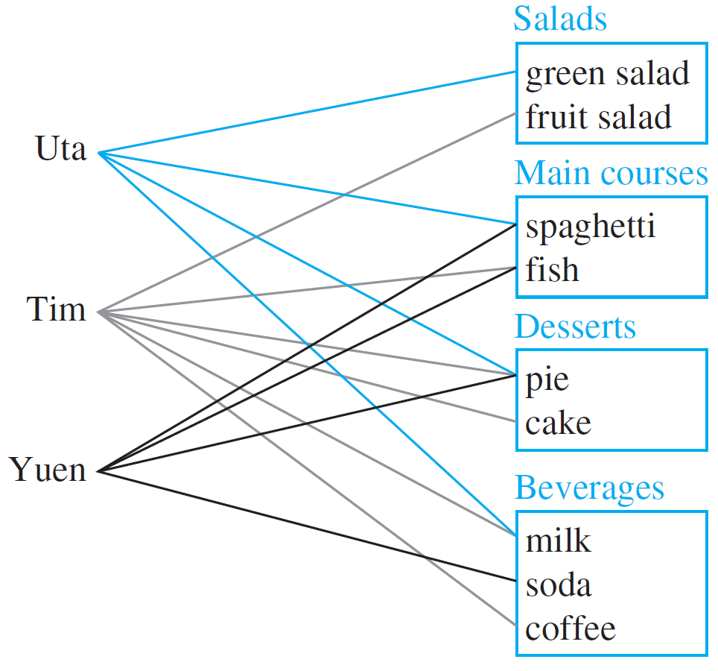
Example 3 – Interpreting Multiply-Quantified Statements
cont’d
These choices are illustrated in Figure 3.3.2.
Figure 3.3.2

Slide 91
Example 3 – Interpreting Multiply-Quantified Statements
cont’d
Write each of following statements informally and find its truth value.
a. ∃ an item I such that ∀ students S, S chose I.
b. ∃ a student S such that ∀ items I, S chose I.
c. ∃ a student S such that ∀ stations Z, ∃ an item I in Z such that S chose I.
d. ∀ students S and ∀ stations Z, ∃ an item I in Z such that S chose I.

Slide 92
Example 3 – Solution
a. There is an item that was chosen by every student. This is true; every student chose pie.
b. There is a student who chose every available item. This is false; no student chose all nine items.
c. There is a student who chose at least one item from every station. This is true; both Uta and Tim chose at least one item from every station.
d. Every student chose at least one item from every station. This is false; Yuen did not choose a salad.

Slide 93
Translating from Informal
to Formal Language

Slide 94
Translating from Informal to Formal Language
Most problems are stated in informal language, but solving them often requires translating them into more formal terms.

Slide 95
Example 4 – Translating Multiply-Quantified Statements from Informal to Formal Language
The reciprocal of a real number a is a real number b such that ab = 1. The following two statements are true.
Rewrite them formally using quantifiers and variables:
a. Every nonzero real number has a reciprocal.
b. There is a real number with no reciprocal.
Solution:
a. ∀ nonzero real numbers u, ∃ a real number v such that uv = 1.
b. ∃ a real number c such that ∀ real numbers d, cd ≠ 1.
The number 0 has no reciprocal.

Slide 96
Ambiguous Language

Slide 97
Ambiguous Language
Imagine you are visiting a factory that manufactures computer microchips. The factory guide tells you, There is a person supervising every detail of the production process.
Note that this statement contains informal versions of both the existential quantifier there is and the universal quantifier every.

Slide 98
Ambiguous Language
Which of the following best describes its meaning?
There is one single person who supervises all the details of the production process.
For any particular production detail, there is a person who supervises that detail, but there might be different supervisors for different details.

Slide 99
Ambiguous Language
Once you interpreted the sentence in one way, it may have been hard for you to see that it could be understood in the other way.
Perhaps you had difficulty even though the two possible meanings were explained.
Although statements written informally may be open to multiple interpretations, we cannot determine their truth or falsity without interpreting them one way or another.
Therefore, we have to use context to try to ascertain their meaning as best we can.

Slide 100
Negations of
Multiply-Quantified Statements

Slide 101
Negations of Multiply-Quantified Statements
You can use the same rules to negate multiply-quantified statements that you used to negate simpler quantified statements.
We have known that
∼(∀x in D, P(x)) ≡ ∃x in D such that ∼P(x).
and
∼(∃x in D such that P(x)) ≡ ∀x in D,∼P(x).

Slide 102
Negations of Multiply-Quantified Statements
We apply these laws to find
∼(∀x in D, ∃y in E such that P(x, y))
First version of negation: ∃x in D such that ∼(∃y in E such that P(x, y)).
Final version of negation: ∃x in D such that ∀y in E, ∼P(x, y).

Slide 103
Negations of Multiply-Quantified Statements
Similarly, to find
∼(∃x in D such that ∀y in E, P(x, y)),
we have
First version of negation: ∀x in D,∼(∀y in E, P(x, y)).
Final version of negation: ∀x in D, ∃y in E such that ∼P(x, y).

Slide 104
Negations of Multiply-Quantified Statements
These facts can be summarized as follows:

Slide 105
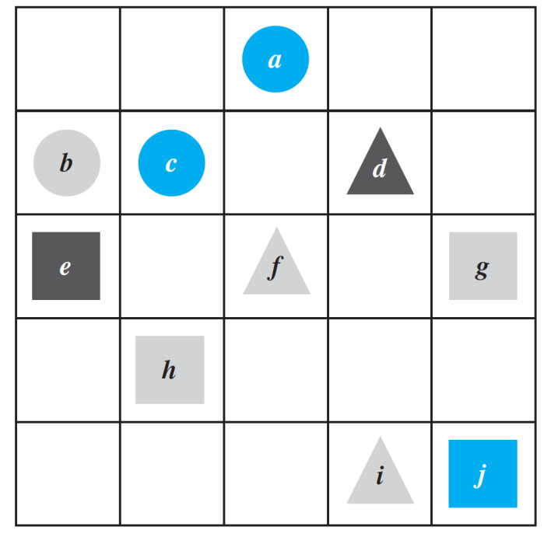
Example 8 – Negating Statements in a Tarski World
Refer to the Tarski world of Figure 3.3.1.
Write a negation for each of the following statements, and determine which is true, the given statement or its negation.
a. For all squares x, there is a circle y such that x and y have the same color.
b. There is a triangle x such that for all squares y, x is to the right of y.
Figure 3.3.1

Slide 106
Example 8(a) – Solution
First version of negation: ∃ a square x such that ∼(∃ a circle y such that x and y have the same color).
Final version of negation: ∃ a square x such that ∀ circles y, x and y do not have the same color.
The negation is true. Square e is black and no circle is black, so there is a square that does not have the same color as any circle.

Slide 107
Example 8(b) – Solution
cont’d
First version of negation: ∀ triangles x,∼ (∀ squares y, x is to the right of y).
Final version of negation: ∀ triangles x, ∃ a square y such that x is not to the right of y.
The negation is true because no matter what triangle is chosen, it is not to the right of square g (or square j ).

Slide 108
Order of Quantifiers

Slide 109
Order of Quantifiers
Consider the following two statements:
∀ people x, ∃ a person y such that x loves y.
∃ a person y such that ∀ people x, x loves y.
Note that except for the order of the quantifiers, these statements are identical.
However, the first means that given any person, it is possible to find someone whom that person loves, whereas the second means that there is one amazing individual who is loved by all people.

Slide 110
Order of Quantifiers
The two sentences illustrate an extremely important property about multiply-quantified statements:
Interestingly, however, if one quantifier immediately follows another quantifier of the same type, then the order of the quantifiers does not affect the meaning.

Slide 111
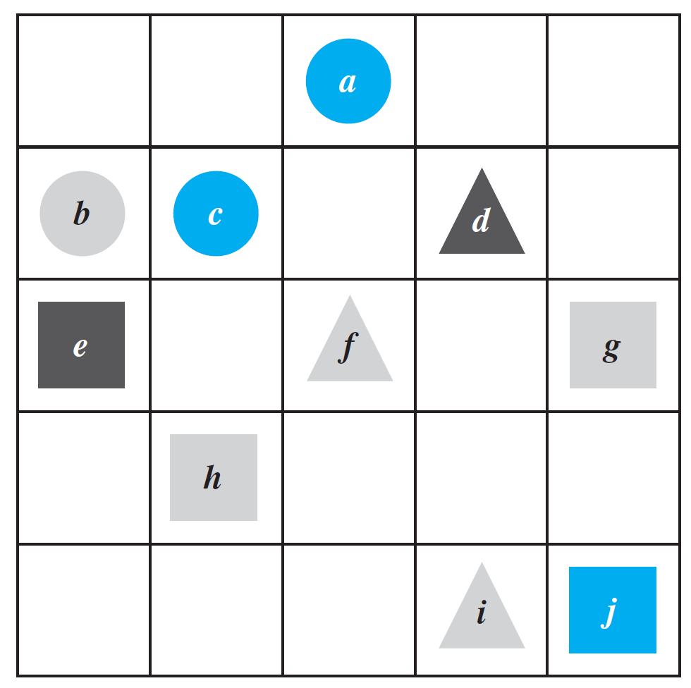
Example 9 – Quantifier Order in a Tarski World
Look again at the Tarski world of Figure 3.3.1. Do the following two statements have the same truth value?
a. For every square x there is a triangle y such that x and y have different colors.
b. There exists a triangle y such that for every square x, x and y have different colors.
Figure 3.3.1

Slide 112
Example 9 – Solution
Statement (a) says that if someone gives you one of the squares from the Tarski world, you can find a triangle that has a different color. This is true.
If someone gives you square g or h (which are gray), you can use triangle d (which is black); if someone gives you square e (which is black), you can use either triangle f or triangle i (which are both gray); and if someone gives you square j (which is blue), you can use triangle d (which is black) or triangle f or i (which are both gray).

Slide 113
Example 9 – Solution
cont’d
Statement (b) says that there is one particular triangle in the Tarski world that has a different color from every one of the squares in the world. This is false.
Two of the triangles are gray, but they cannot be used to show the truth of the statement because the Tarski world contains gray squares.
The only other triangle is black, but it cannot be used either because there is a black square in the Tarski world.
Thus one of the statements is true and the other is false, and so they have opposite truth values.

Slide 114
Formal Logical Notation

Slide 115
Formal Logical Notation
In some areas of computer science, logical statements are expressed in purely symbolic notation.
The notation involves using predicates to describe all properties of variables and omitting the words such that in existential statements.
The formalism also depends on the following facts:
“∀x in D, P(x)” can be written as “∀x(x in D → P(x)),” and
“∃x in D such that P(x)” can be written as “∃x(x in D ∧ P(x)).”
We illustrate the use of these facts in Example 10.

Slide 116
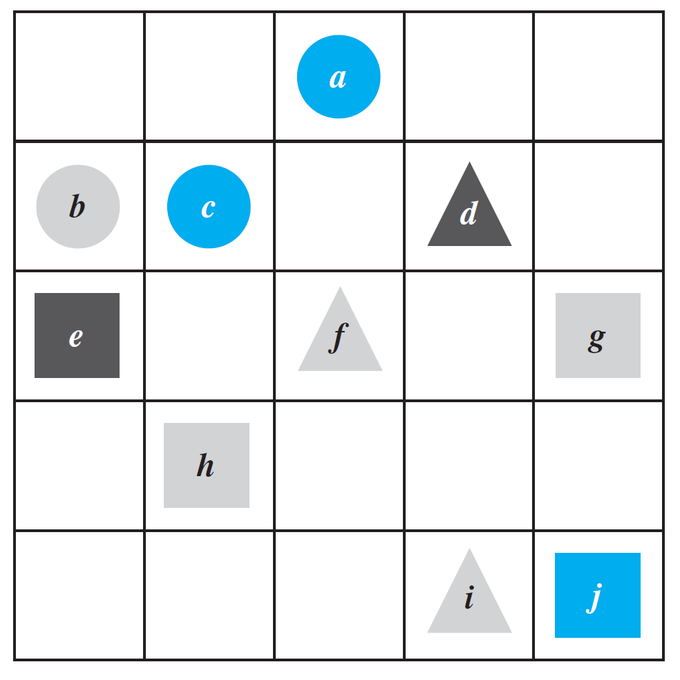
Example 10 – Formalizing Statements in a Tarski World
Consider once more the Tarski world of Figure 3.3.1:
Figure 3.3.1

Slide 117
Example 10 – Formalizing Statements in a Tarski World
cont’d
Let Triangle(x), Circle(x), and Square(x) mean “x is a triangle,” “x is a circle,” and “x is a square”; let Blue(x), Gray(x), and Black(x) mean “x is blue,” “x is gray,” and “x is
black”;
let RightOf(x, y), Above(x, y), and SameColorAs(x, y) mean “x is to the right of y,” “x is above y,” and “x has the same color as y”; and use the notation x = y to denote the predicate “x is equal to y”.
Let the common domain D of all variables be the set of all the objects in the Tarski world.

Slide 118
Example 10 – Formalizing Statements in a Tarski World
cont’d
Use formal, logical notation to write each of the following statements, and write a formal negation for each statement.
a. For all circles x, x is above f.
b. There is a square x such that x is black.
c. For all circles x, there is a square y such that x and y have the same color.
d. There is a square x such that for all triangles y, x is to right of y.

Slide 119
Example 10(a) – Solution
Statement: ∀x(Circle(x) →Above(x, f )).
Negation: ∼(∀x(Circle(x) → Above(x, f ))
≡ ∃x ∼ (Circle(x) → Above(x, f ))
≡ ∃x(Circle(x) ∧ ∼Above(x, f ))
by the law for negating a ∀ statement
by the law of negating an if-then statement

Slide 120
Example 10(b) – Solution
cont’d
Statement: ∃x(Square(x) ∧ Black(x)).
Negation: ∼(∃x(Square(x) ∧ Black(x))
≡ ∀x ∼ (Square(x) ∧ Black(x))
≡ ∀x(∼Square(x) ∨ ∼Black(x))
by the law for negating a ∃ statement
by De Morgan’s law

Slide 121
Example 10(c) – Solution
cont’d
Statement: ∀x(Circle(x) → ∃y(Square(y) ∧ SameColor(x, y))).
Negation: ∼(∀x(Circle(x) → ∃y(Square(y) ∧ SameColor(x, y))))
≡ ∃x ∼ (Circle(x) → ∃y(Square(y) ∧ SameColor(x, y)))
≡ ∃x(Circle(x) ∧ ∼(∃y(Square(y) ∧ SameColor(x, y))))
≡ ∃x(Circle(x) ∧ ∀y(∼(Square(y) ∧ SameColor(x, y))))
≡ ∃x(Circle(x) ∧ ∀y(∼Square(y) ∨ ∼SameColor(x, y)))
by the law for negating a ∀ statement
by the law for negating an if-then statement
by the law for negating a ∃ statement
by De Morgan’s law

Slide 122
Example 10(d) – Solution
cont’d
Statement: ∃x(Square(x) ∧ ∀y(Triangle(y) → RightOf(x, y))).
Negation: ∼(∃x(Square(x) ∧ ∀y(Triangle(y) → RightOf(x, y))))
≡ ∀x ∼ (Square(x) ∧ ∀y(Triangle(x) → RightOf(x, y)))
≡ ∀x(∼Square(x) ∨ ∼(∀y(Triangle(y) → RightOf(x, y))))
≡ ∀x(∼Square(x) ∨ ∃y(∼(Triangle(y) → RightOf(x, y))))
≡ ∀x(∼Square(x) ∨ ∃y(Triangle(y) ∧ ∼RightOf(x, y)))
by the law for negating a ∃ statement
by De Morgan’s law
by the law for negating a ∀ statement
by the law for negating an if-then statement

Slide 123
Formal Logical Notation
The disadvantage of the fully formal notation is that because it is complex and somewhat remote from intuitive understanding, when we use it, we may make errors that go unrecognized.
The advantage, however, is that operations, such as taking negations, can be made completely mechanical and programmed on a computer.
Also, when we become comfortable with formal manipulations, we can use them to check our intuition, and then we can use our intuition to check our formal manipulations.

Slide 124
Formal Logical Notation
Formal logical notation is used in branches of computer science such as artificial intelligence, program verification, and automata theory and formal languages.
Taken together, the symbols for quantifiers, variables, predicates, and logical connectives make up what is known as the language of first-order logic.
Even though this language is simpler in many respects than the language we use every day, learning it requires the same kind of practice needed to acquire any foreign language.

Slide 125
Prolog

Slide 126
Prolog
The programming language Prolog (short for programming in logic) was developed in France in the 1970s by A. Colmerauer and P. Roussel to help programmers working in the field of artificial intelligence.
A simple Prolog program consists of a set of statements describing some situation together with questions about the situation. Built into the language are search and inference techniques needed to answer the questions by deriving the answers from the given statements.
This frees the programmer from the necessity of having to write separate programs to answer each type of question. Example 11 gives a very simple example of a Prolog program.

Slide 127
Example 11 – A Prolog Program
Consider the following picture, which shows colored blocks stacked on a table.
The following are statements in Prolog that describe this picture and ask two questions about it.
isabove(g, b₁) color(g, gray) color(b₃, blue)

Slide 128
Example 11 – A Prolog Program
cont’d
isabove(b₁, w₁) color(b₁, blue) color(w₁, white)
isabove(w₂, b₂) color(b₂, blue) color(w₂, white)
isabove(b₂, b₃) isabove(X, Z ) if isabove(X, Y ) and isabove(Y, Z)
?color(b₁, blue) ?isabove(X, w₁)
The statements “isabove(g, b₁)” and “color(g, gray)” are to be interpreted as “g is above b₁” and “g is colored gray”. The statement “isabove(X, Z ) if isabove(X, Y ) and isabove(Y, Z )” is to be interpreted as “For all X, Y, and Z, if X is above Y and Y is above Z, then X is above Z.”

Slide 129
Example 11 – A Prolog Program
cont’d
The program statement
?color(b₁, blue)
is a question asking whether block b₁ is colored blue. Prolog answers this by writing
Yes.
The statement
?isabove(X, w₁)
is a question asking for which blocks X the predicate “X is above w₁” is true.

Slide 130
Example 11 – A Prolog Program
cont’d
Prolog answers by giving a list of all such blocks. In this case, the answer is
X = b₁, X = g.
Note that Prolog can find the solution X = b₁ by merely searching the original set of given facts. However, Prolog must infer the solution X = g from the following statements:
isabove(g, b₁),
isabove(b₁,w₁),
isabove(X, Z ) if isabove(X, Y ) and isabove(Y, Z ).

Slide 131
Example 11 – A Prolog Program
cont’d
Write the answers Prolog would give if the following questions were added to the program above.
a. ?isabove(b₂, w₁) b. ?color(w₁, X ) c. ?color(X, blue)
Solution:
a. The question means “Is b₂ above w₁?”; so the answer is “No.”
b. The question means “For what colors X is the predicate ‘w₁ is colored X ’ true?”; so the answer is “X = white.”

Slide 132
Example 11 – Solution
cont’d
c. The question means “For what blocks is the predicate ‘X is colored blue’ true?”; so the answer is “X = b₁,” “X = b₂,” and “X = b₃.”

Slide 133
SECTION 3.4
Arguments with Quantified Statements
Copyright © Cengage Learning. All rights reserved.

Slide 134
Arguments with Quantified Statements
The rule of universal instantiation (in-stan-she-AY-shun):
the fundamental tool of deductive reasoning.
Mathematical formulas, definitions, and theorems are like general templates that are used over and over in a wide variety of particular situations.

Slide 135
Arguments with Quantified Statements
A given theorem says that such and such is true for all things of a certain type.
If, in a given situation, you have a particular object of that type, then by universal instantiation, you conclude that such and such is true for that particular object.
You may repeat this process 10, 20, or more times in a single proof or problem solution.

Slide 136
Universal Modus Ponens

Slide 137
Universal Modus Ponens
The rule of universal instantiation can be combined with modus ponens to obtain a valid form of argument called universal modus ponens.

Slide 138
Universal Modus Ponens
Note that the first, or major, premise of universal modus ponens could be written “All things that make P (x) true make Q (x) true,” in which case the conclusion would follow by universal instantiation alone.
However, the if-then form is more natural to use in the majority of mathematical situations.

Slide 139
Example 1 – Recognizing Universal Modus Ponens
Rewrite the following argument using quantifiers, variables, and predicate symbols. Is this argument valid? Why?
If an integer is even, then its square is even.
k is a particular integer that is even.
k² is even.
Solution:
The major premise of this argument can be rewritten as
x, if x is an even integer then x² is even.

Slide 140
Example 1 – Solution
cont’d
Let E (x) be “x is an even integer,” let S (x) be “x² is even,” and let k stand for a particular integer that is even.
Then the argument has the following form:
x, if E (x) then S (x).
E (k), for a particular k.
• S (k).
This argument has the form of universal modus ponens and is therefore valid.

Slide 141
Use of Universal Modus Ponens in a Proof

Slide 142
Use of Universal Modus Ponens in a Proof
Prove that the sum of any two even integers is even.
It makes use of the definition of even integer, namely, that an integer is even if, and only if, it equals twice some integer. (Or, more formally: integers x, x is even if, and only if, ∃ an integer k such that x = 2k.)
Suppose m and n are particular but arbitrarily chosen even integers. Then m = 2r for some integer r,⁽¹⁾ and n = 2s for some integer s.⁽²⁾

Slide 143
Use of Universal Modus Ponens in a Proof
Hence
Now r + s is an integer,⁽⁴⁾ and so 2(r + s) is even.⁽⁵⁾
Thus m + n is even.

Slide 144
Use of Universal Modus Ponens in a Proof
The following expansion of the proof shows how each of the numbered steps is justified by arguments that are valid by universal modus ponens.
(1) If an integer is even, then it equals twice some integer.
m is a particular even integer.
• m equals twice some integer r.
(2) If an integer is even, then it equals twice some integer.
n is a particular even integer.
• n equals twice some integer s.

Slide 145
Use of Universal Modus Ponens in a Proof
(3) If a quantity is an integer, then it is a real number.
r and s are particular integers.
• r and s are real numbers. For all a, b, and c, if a, b, and c are real numbers, then ab + ac = a (b + c).
2, r, and s are particular real numbers.
• 2r + 2s = 2(r + s).
(4) For all u and v, if u and v are integers, then u + v is an integer.
r and s are two particular integers.
• r + s is an integer.

Slide 146
Use of Universal Modus Ponens in a Proof
(5) If a number equals twice some integer, then that number is even.
2(r + s) equals twice the integer r + s.
• 2(r + s) is even.

Slide 147
Universal Modus Tollens

Slide 148
Universal Modus Tollens
Another crucially important rule of inference is universal modus tollens. Its validity results from combining universal instantiation with modus tollens.
Universal modus tollens is the heart of proof of contradiction, which is one of the most important methods of mathematical argument.

Slide 149
Example 3 – Recognizing the Form of Universal Modus Tollens
Rewrite the following argument using quantifiers, variables, and predicate symbols. Write the major premise in conditional form. Is this argument valid? Why?
All human beings are mortal.
Zeus is not mortal.
• Zeus is not human.
Solution:
The major premise can be rewritten as
x, if x is human then x is mortal.

Slide 150
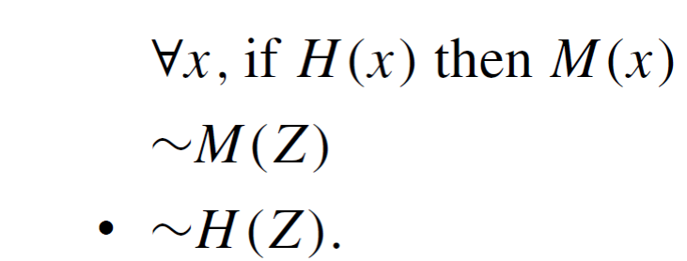
Example 3 – Solution
cont’d
Let H (x) be “x is human,” let M (x) be “x is mortal,” and let Z stand for Zeus.
The argument becomes
This argument has the form of universal modus tollens and is therefore valid.

Slide 151
Proving Validity of Arguments with Quantified Statements

Slide 152
Proving Validity of Arguments with Quantified Statements
The intuitive definition of validity for arguments with quantified statements is the same as for arguments with compound statements.
An argument is valid if, and only if, the truth of its conclusion follows necessarily from the truth of its premises.

Slide 153
Using Diagrams to Test for Validity

Slide 154
Using Diagrams to Test for Validity
Consider the statement
All integers are rational numbers.
Or, formally,
integers n, n is a rational number.
Picture the set of all integers and the set of all rational numbers as disks.

Slide 155
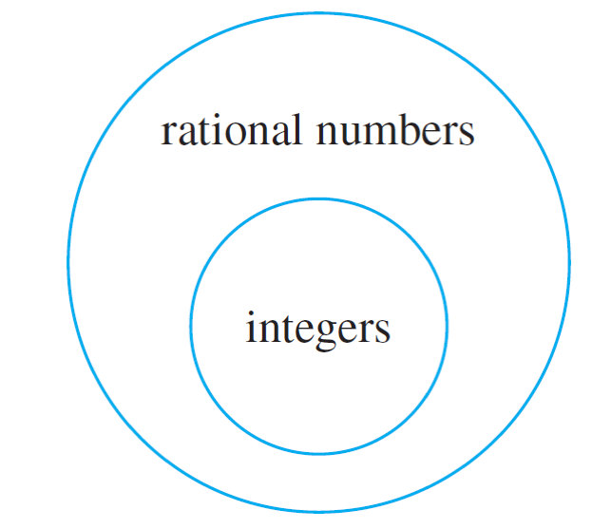
Using Diagrams to Test for Validity
The truth of the given statement is represented by placing the integers disk entirely inside the rationals disk, as shown in Figure 3.4.1.
Because the two statements if x is in D then Q(x)” are logically equivalent, both can be represented by diagrams like the foregoing.
Figure 3.4.1

Slide 156
Using Diagrams to Test for Validity
To test the validity of an argument diagrammatically, represent the truth of both premises with diagrams.
Then analyze the diagrams to see whether they necessarily represent the truth of the conclusion as well.

Slide 157
Example 6 – Using Diagrams to Show Invalidity
Use a diagram to show the invalidity of the following argument:
All human beings are mortal.
Felix is mortal.
• Felix is a human being.

Slide 158
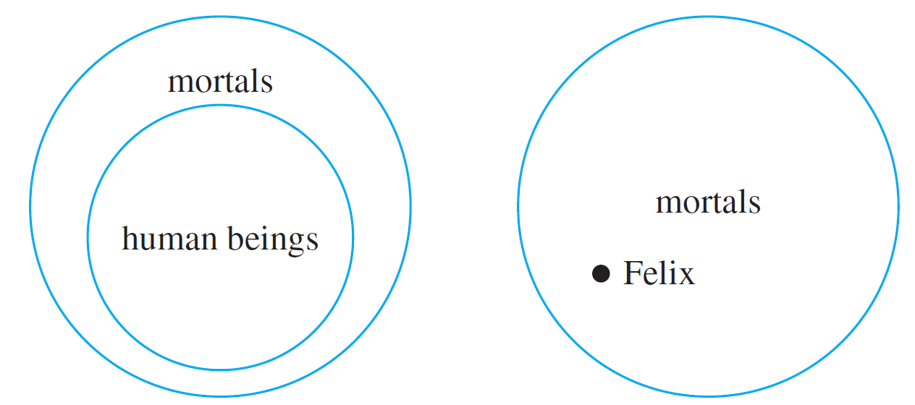
Example 6 – Solution
The major and minor premises are represented diagrammatically in Figure 3.4.4.
Major premise
Minor premise
Figure 3.4.4

Slide 159
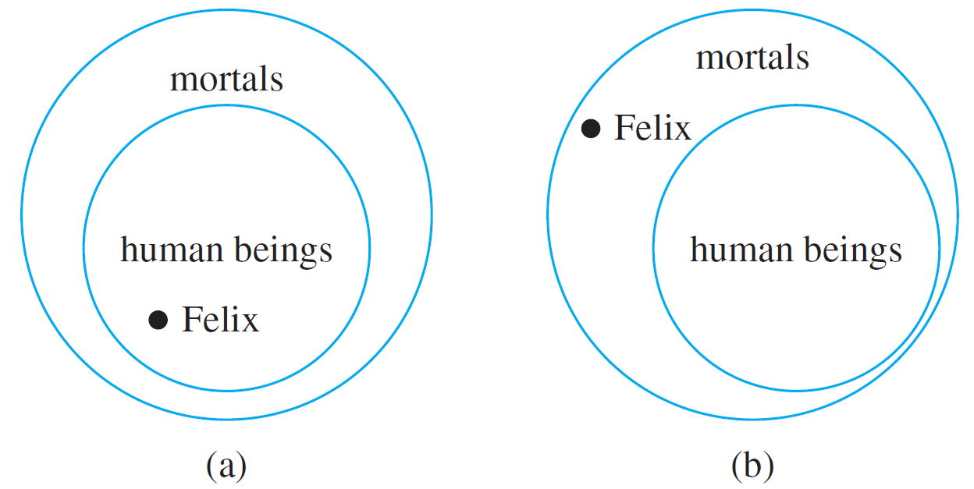
Example 6 – Solution
cont’d
All that is known is that the Felix dot is located somewhere inside the mortals disk. Where it is located with respect to the human beings disk cannot be determined. Either one of the situations shown in Figure 3.4.5 might be the case.
Figure 3.4.5

Slide 160
Example 6 – Solution
cont’d
The conclusion “Felix is a human being” is true in the first case but not in the second (Felix might, for example, be a cat).
Because the conclusion does not necessarily follow from the premises, the argument is invalid.

Slide 161
Using Diagrams to Test for Validity
The argument of Example 6 would be valid if the major premise were replaced by its converse. But since a universal conditional statement is not logically equivalent to its converse, such a replacement cannot, in general, be made.
We say that this argument exhibits the converse error.

Slide 162
Using Diagrams to Test for Validity
The following form of argument would be valid if a conditional statement were logically equivalent to its inverse. But it is not, and the argument form is invalid. We say that it exhibits the inverse error.

Slide 163
Example 7 – An Argument with “No”
Use diagrams to test the following argument for validity:
No polynomial functions have horizontal asymptotes.
This function has a horizontal asymptote.
• This function is not a polynomial function.

Slide 164
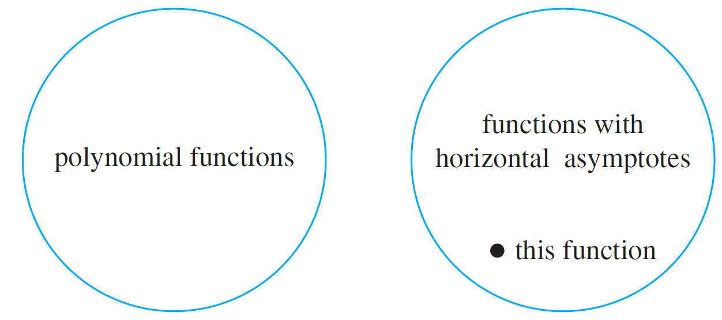
Example 7 – Solution
A good way to represent the major premise diagrammatically is shown in Figure 3.4.6, two disks—a disk for polynomial functions and a disk for functions with horizontal asymptotes—that do not overlap at all.
Figure 3.4.6

Slide 165
Example 7 – Solution
cont’d
The minor premise is represented by placing a dot labeled “this function” inside the disk for functions with horizontal asymptotes.
The diagram shows that “this function” must lie outside the polynomial functions disk, and so the truth of the conclusion necessarily follows from the truth of the premises.
Hence the argument is valid.

Slide 166
Using Diagrams to Test for Validity
An alternative approach to this example is to transform the statement “No polynomial functions have horizontal asymptotes” into the equivalent form “ x, if x is a polynomial function, then x does not have a horizontal asymptote.”

Slide 167
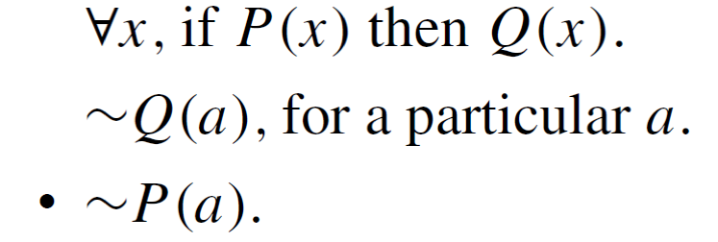
Using Diagrams to Test for Validity
If this is done, the argument can be seen to have the form
where P (x) is “x is a polynomial function” and Q (x) is “x does not have a horizontal asymptote.”
This is valid by universal modus tollens.

Slide 168
Creating Additional Forms of Argument

Slide 169
Creating Additional Forms of Argument
Universal modus ponens and modus tollens were obtained by combining universal instantiation with modus ponens and modus tollens.
In the same way, additional forms of arguments involving universally quantified statements can be obtained by combining universal instantiation with other of the valid argument forms discussed earlier.

Slide 170
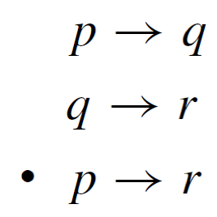
Creating Additional Forms of Argument
Consider the following argument:
This argument form can be combined with universal instantiation to obtain the following valid argument form.

Slide 171
Example 8 – Evaluating an Argument for Tarski’s World
Consider the Tarski world shown in Figure 3.3.1.
Figure 3.3.1

Slide 172
Example 8 – Evaluating an Argument for Tarski’s World
cont’d
Reorder and rewrite the premises to show that the conclusion follows as a valid consequence from the premises.
1. All the triangles are blue.
2. If an object is to the right of all the squares, then it is above all the circles.
3. If an object is not to the right of all the squares, then it is not blue.
• All the triangles are above all the circles.

Slide 173
Example 8 – Solution
It is helpful to begin by rewriting the premises and the conclusion in if-then form:
1. x, if x is a triangle, then x is blue.
2. x, if x is to the right of all the squares, then x is above all the circles.
3. x, if x is not to the right of all the squares, then x is not blue.
• x, if x is a triangle, then x is above all the circles.

Slide 174
Example 8 – Solution
cont’d
The goal is to reorder the premises so that the conclusion of each is the same as the hypothesis of the next.
Also, the hypothesis of the argument’s conclusion should be the same as the hypothesis of the first premise, and the conclusion of the argument’s conclusion should be the same as the conclusion of the last premise.
To achieve this goal, it may be necessary to rewrite some of the statements in contrapositive form.

Slide 175
Example 8 – Solution
cont’d
In this example you can see that the first premise should remain where it is, but the second and third premises should be interchanged.
Then the hypothesis of the argument is the same as the hypothesis of the first premise, and the conclusion of the argument’s conclusion is the same as the conclusion of the third premise.
But the hypotheses and conclusions of the premises do not quite line up. This is remedied by rewriting the third premise in contrapositive form.

Slide 176
Example 8 – Solution
cont’d
Thus the premises and conclusion of the argument can be rewritten as follows:
1. x, if x is a triangle, then x is blue.
3. x, if x is blue, then x is to the right of all the squares.
2. x, if x is to the right of all the squares, then x is above all the circles.
• x, if x is a triangle, then x is above all the circles.

Slide 177
Example 8 – Solution
cont’d
The validity of this argument follows easily from the validity of universal transitivity.
Putting 1 and 3 together and using universal transitivity gives that
4. x, if x is a triangle, then x is to the right of all the squares.
And putting 4 together with 2 and using universal transitivity gives that
x, if x is a triangle, then x is above all the circles,
which is the conclusion of the argument.

Slide 178
Remark on the Converse and Inverse Errors

Slide 179
Remark on the Converse and Inverse Errors
A variation of the converse error is a very useful reasoning tool, provided that it is used with caution.
It is the type of reasoning that is used by doctors to make medical diagnoses and by auto mechanics to repair cars.

Slide 180
Remark on the Converse and Inverse Errors
It is the type of reasoning used to generate explanations for phenomena. It goes like this: If a statement of the form
For all x, if P (x) then Q (x)
is true, and if
Q (a) is true, for a particular a,
then check out the statement P (a); it just might be true.

Slide 181
Remark on the Converse and Inverse Errors
For instance, suppose a doctor knows that
For all x, if x has pneumonia, then x has a fever and chills, coughs deeply, and feels exceptionally tired and miserable.
And suppose the doctor also knows that
John has a fever and chills, coughs deeply,
and feels exceptionally tired and miserable.
On the basis of these data, the doctor concludes that a diagnosis of pneumonia is a strong possibility, though not a certainty.

Slide 182
Remark on the Converse and Inverse Errors
The doctor will probably attempt to gain further support for this diagnosis through laboratory testing that is specifically designed to detect pneumonia.
Note that the closer a set of symptoms comes to being a necessary and sufficient condition for an illness, the more nearly certain the doctor can be of his or her diagnosis.
This form of reasoning has been named abduction by researchers working in artificial intelligence. It is used in certain computer programs, called expert systems, that attempt to duplicate the functioning of an expert in some field of knowledge.

