Slide 1
Divide and Conquer CISC5835, Algorithms for Big Data
CIS, Fordham Univ.
Instructor: X. Zhang

Slide 2
Acknowledgement
The set of slides have use materials from the following resources
Slides for textbook by Dr. Y. Chen from Shanghai Jiaotong Univ.
Slides from Dr. M. Nicolescu from UNR
Slides sets by Dr. K. Wayne from Princeton
which in turn have borrowed materials from other resources
Other online resources

Slide 3
Outline
Sorting problems and algorithms
Divide-and-conquer paradigm
Merge sort algorithm
Master Theorem
recursion tree
Median and Selection Problem
randomized algorithms
Quicksort algorithm
Lower bound of comparison based sorting

Slide 4
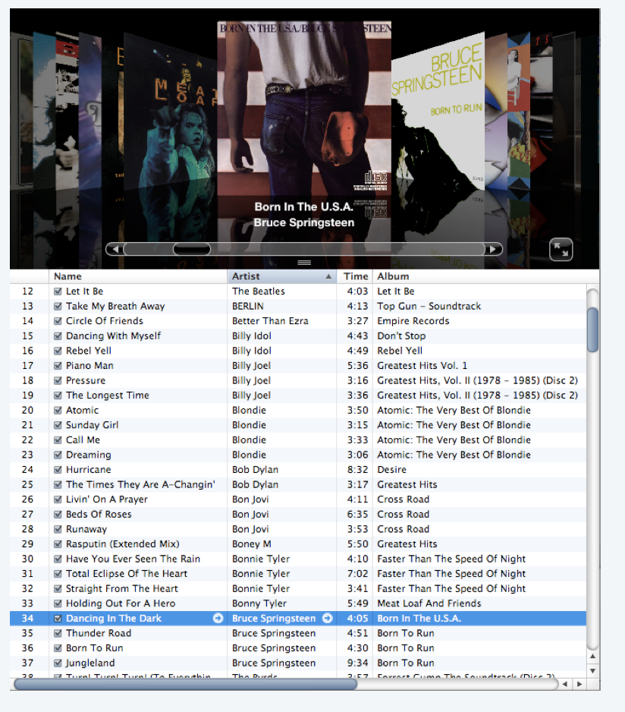
Sorting Problem
Problem: Given a list of n elements from a totally-ordered universe, rearrange them in ascending order.
CS 477/677 - Lecture 1

Slide 5
Sorting applications
Straightforward applications:
organize an MP3 library
Display Google PageRank results
List RSS news items in reverse chronological order
Some problems become easier once elements are sorted
identify statistical outlier
binary search
remove duplicates
Less-obvious applications
convex hull
closest pair of points
interval scheduling/partitioning
minimum spanning tree algorithms
…

Slide 6
Classification of Sorting Algorithms
Use what operations?
Comparison based sorting: bubble sort, Selection sort, Insertion sort, Mergesort, Quicksort, Heapsort, …
Non-comparison based sort: counting sort, radix sort, bucket sort
Memory (space) requirement:
in place: require O(1), O(log n) memory
out of place: more memory required, e.g., O(n)
Stability:
stable sorting: elements with equal key values keep their original order
unstable sorting: otherwise

Slide 7
Stable vs Unstable sorting
therefore, not stable!

Slide 8
Bubble Sort High-level Idea
Questions:
How many passes are needed?
No need to scan/process whole array on second pass, third pass…

Slide 9
Algorithm Analysis: bubble sort
Algorithm/Function.: bubblesort (a[1…n])
input: an array of numbers a[1…n]
output: a sorted version of this array
for e=n-1 to 2:
swapCnt=0;
for j=1 to e: //no need to scan whole list every time
if a[j] > a[j+1]: swap (a[j], a[j+1]); swapCnt++;
if (!swapCnt==0) //if no swap, then already sorted
break;
return
Memory requirement: memory used (note that input/output does not count)
Is it stable?
worst case: always swap
assume the if … swap … takes c time/steps

Slide 10
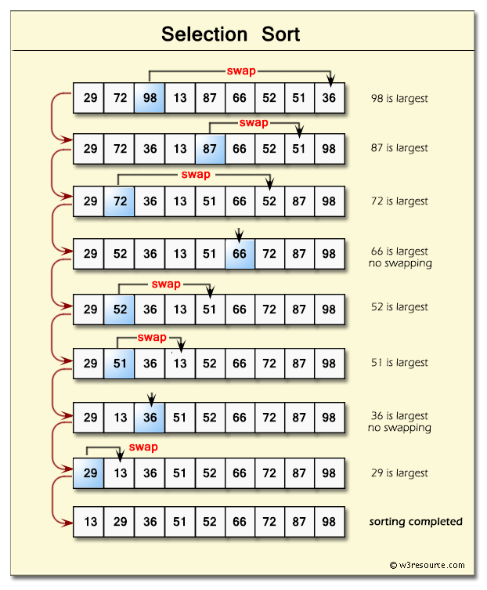
Selection Sort: Idea
Running time analysis:

Slide 11
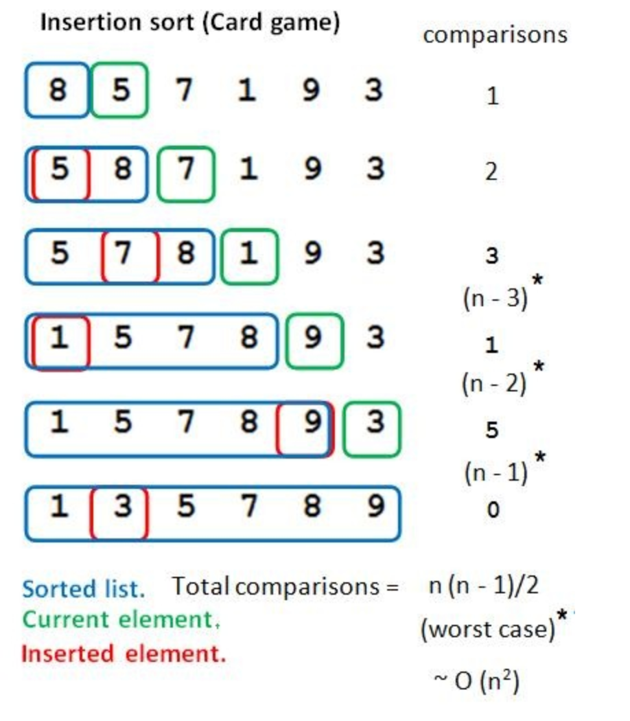
Insertion Sort
data movements
Idea
array: sorted part, unsorted part
insert element from unsorted part into sorted part
Example:
<=2
<=3
<=4
<=5
<=6
<=7

Slide 12
O(n²) Sorting Algorithms
Bubble sort: O(n²)
stable, in-place
Selection sort: O(n²)
Idea: find the smallest, exchange it with first element; find second smallest, exchange it with second, …
stable, in-place
Insertion Sort: O(n²)
idea: expand “sorted” sublist, by insert next element into sorted sublist
stable (if inserted after elements of same key), in-place
asymptotically same performance
selection sort is better: less data movement (at most n)

Slide 13
From quadric sorting algorithms to nlogn sorting algorithms
—- using divide and conquer

Slide 14
What are Algorithms?

Slide 15
MergeSort: think recursively!
recursively sort left half
recursively sort right half
merge two sorted halves to make sorted whole
“Recursively” means “following the same algorithm, passing smaller input”

Slide 16
Pseudocode for mergesort
mergesort (a[left … right])
if (left>=right) return; //base case, nothing to do
m = (left+right)/2;
mergeSort (a[left … m])
mergeSort (a[m+1 … right])
merge (a, left, m, right)
// given a[left…m], a[m+1 … right] are sorted:
// 1) first merge them one sorted array c[left…right]
// 2) copy c back to a

Slide 17
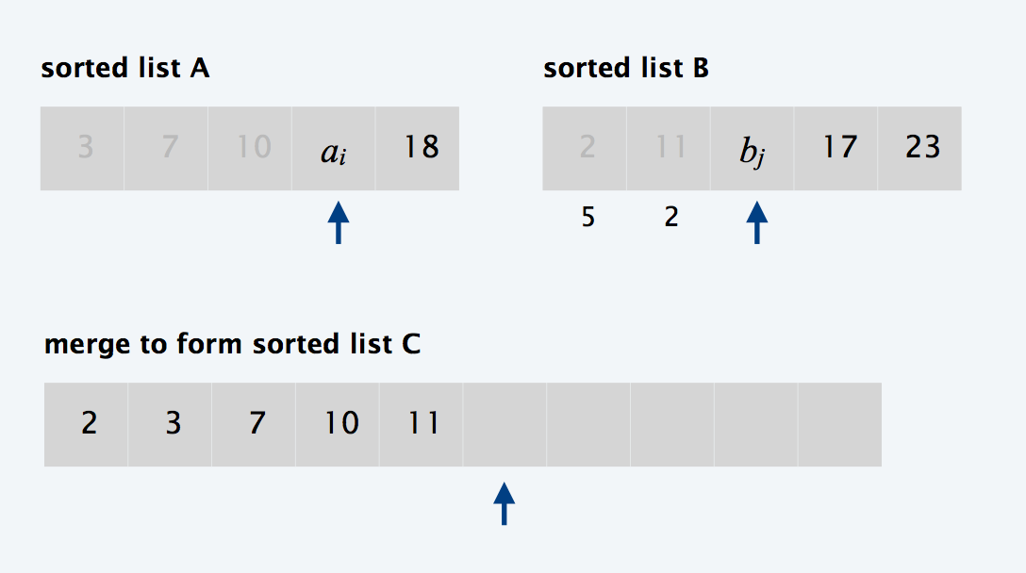
merge (A, left, m, right)
Goal: Given A[left…m] and A[m+1…right] are each sorted, make A[left…right] sorted
Step 1: rearrange elements into a staging area (C)
Step 2: copy elements from C back to A
T(n)=c*n //let n=right-left+1
Note that each element is copied twice, at most n comparisons
A
left
m
m+1
right

Slide 18
Running time of MergeSort
T(n): running time for MergeSort when sorting an array of size n
Input size n: the size of the array
Base case: the array is one element long
T(1) = C1
Recursive case: when array is more than one element long
T(n)=T(n/2)+T(n/2)+O(n)
O(n): running time of merging two sorted subarrays
What is T(n)?

Slide 19
Master Theorem
If for some constants a>0, b>1, and , then
for analyzing divide-and-conquer algorithms
solve a problem of size n by solving a subproblems of size n/b, and using O(n^{d}) to construct solution to original problem
binary search: a=1, b=2, d=0 (case 2), T(n)=log n
mergesort: a=2,b=2, d=1, (case 2), T(n)=O(nlogn)

Slide 20
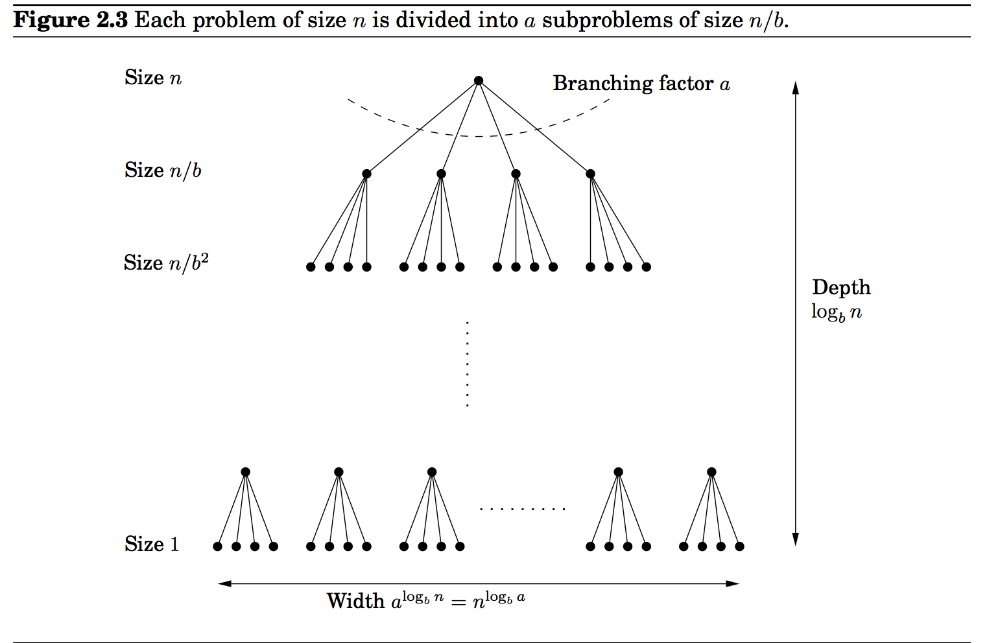
Proof of Master Theorem
Assume that n is a power of b.

Slide 21
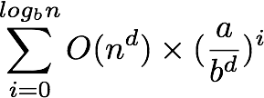
Proof
Assume n is a power of b, i.e., n=b^{k}
size of subproblems decreases by a factor of b at each level of recursion, so it takes k=logbn levels to reach base case
branching factor of the recursion tree is a, so the i-th level has a^{i} subproblems of size n/b^{i}
total work done at i-th level is:
Total work done:

Slide 22
Proof (2)
Total work done:
It’s the sum of a geometric series with ratio
if ratio is less than 1, the series is decreasing, and the sum is dominated by first term: O(n^{d})
if ratio is greater than 1 (increasing series), the sum is dominated by last term in series,
if ratio is 1, the sum is O(n^{d} logbn)
Note: see hw2 question for details

Slide 23
Iterative MergeSort
Recursive MergeSort
pros: conceptually simple and elegant (language’s support for recursive function calls helps to maintain status)
cons: overhead for function calls (allocate/deallocate call stack frame, pass parameters and return value), hard to parallelize
Iterative MergeSort
cons: coding is more complicated
pros: efficiency, and possible to take advantage of parallelism

Slide 24
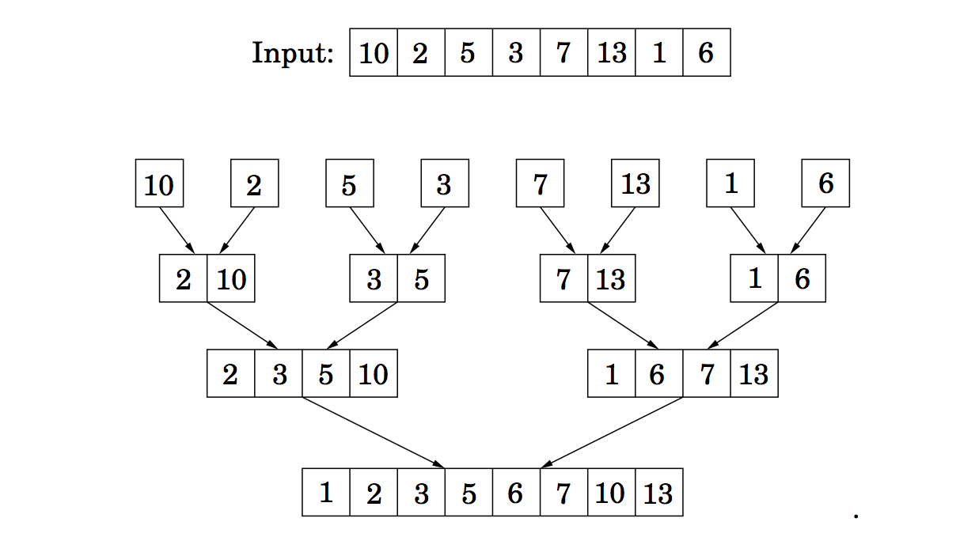
Iterative MergeSort (bottom up)
For sublistSize=1 to ceiling(n/2)
merge sublist of size 1
into sublist of size 2
merge sublist of size 2
into sublist of size 4
merge sublist of size 4
into sublist of size 8
Question: what if there are 9 elements? 10 elements?
pros: O(n) memory requirement; cons: harder to code (keep track starting/ending index
of sublists)

Slide 25
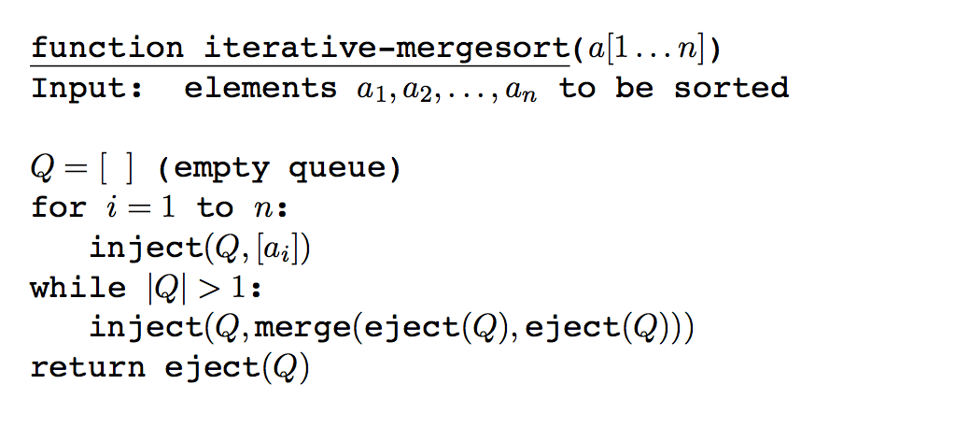
MergeSort: high-level idea
//Q stores the sublists to be merged
//create sublists of size 1, add to Q
eject(Q): remove the front element from Q
inject(a): insert a to the end of Q
Pros: could be parallelized!
e.g., a pool of threads, each thread obtains two lists from Q to merge…
Cons: memory usage O(nlogn)

Slide 26
Outline
Sorting problems and algorithms
Divide-and-conquer paradigm
Merge sort algorithm
Master Theorem
recursion tree
Median and Selection Problem
randomized algorithms
Quicksort algorithm
Lower bound of comparison based sorting

Slide 27
Find Median & Selection Problem
median of a list of numbers: bigger than half of the numbers, and smaller than half of the numbers
A better summary than average value (which can be skewed by outliers)
A straightforward way to find median
sort it first O(nlogn), and return elements in middle index
if list has even # of elements, then return average of the two in the middle
Can we do better?
we did more than needed by sorting…

Slide 28
Selection Problem
More generally, Selection Problem: find K-th smallest element from a list S
Idea:
randomly choose an element p in S
partition S into three parts:
SL (those less than p) Sp (those equal to p) SR (those greater than p)
|<—- |SL| ——>| Sp |<— |SR| —>|
Recursively select from SL or SR as below

Slide 29
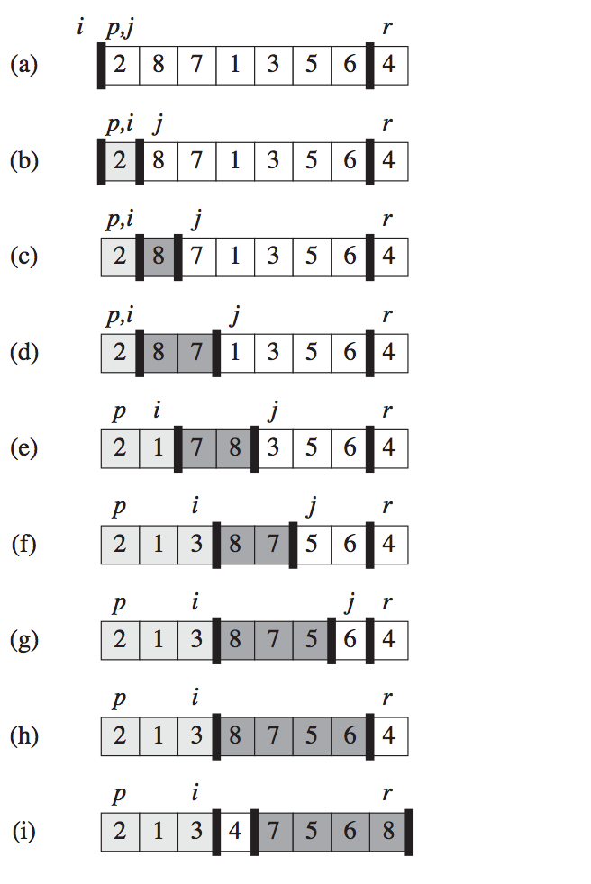
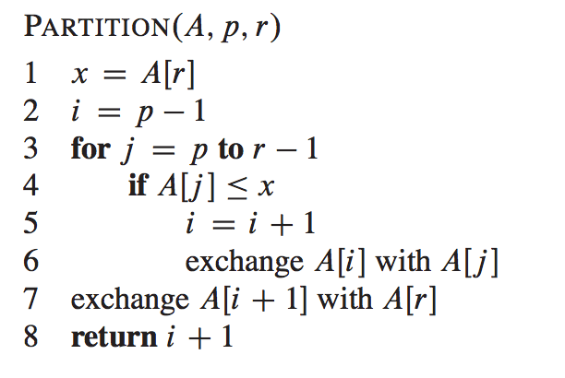
Partition Array
//i: wall
A[p…r]: i represents the wall
subarray p… i: less than x
subarray i+1…j-1: greater than x
subarray j…r: not yet processed
——
i+1 —-

Slide 30
Selection Problem: Running Time
T(n)=T(?)+O(n) //// linear time to partition
How big is subproblem?
Depending on choice of p, and value of k
Worst case: p is largest value, k is 1; or p is smallest value, k is k…,
T(n)=T(n-1)+O(n) => T(n)=n²
As k is unknown, best case is to cut size by half
T(n)=T(n/2)+O(n)
By Master Theorem, T(n)=?

Slide 31
Selection Algorithm
Observation: with deterministic way to choose pivot value, there will be some input that deterministically yield worst performance
if choose last element as pivot, input where elements in sorted order will yield worst performance
if choose first element as pivot, same
If choose 3rd element as pivot, what if the largest element is always in 3rd position
…

Slide 32
Randomized Selection Algorithm
How to achieve good “average” performance in face of all inputs? (Answer: Randomization!)
Choose pivot element uniformly randomly (i.e., choose each element with equal prob)
Given any input, we might still choose “bad” pivot, but we are equally likely to choose “good” pivot
with prob. 1/2 the pivot chosen lies within 25% - 75% percentile of data, shrinking prob. size to 3/4 (which is good enough!)
in average, it takes 2 partition to shrink to 3/4
By Master Theorem, T(n)=O(n)
By Master Theorem: T(n)=O(n)

Slide 33
Randomized Selection Problem
randomly choose an element v in S:
int index=random() % inputArraySize;
v = S[index];
partition S into three parts: SL (those less than v), Sv (those equal to v), SR (those greater than v)
Recursively select from SL or SR as below

Slide 34
Partitioning array
p… i: less than x
i…j: greater than x
j…r: not yet processed

Slide 35
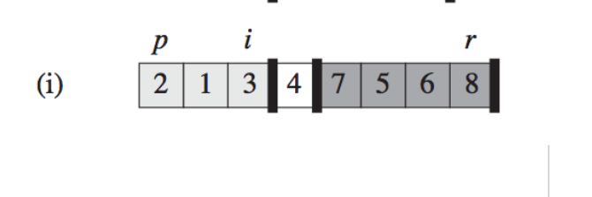
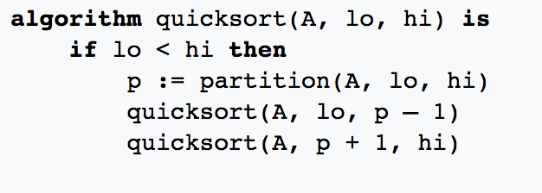
quicksort
Observation: after partition, pivot
is in the correct sorted position
We now just need to sort left and
right partition!
That’s quicksort!

Slide 36
quicksort: running time
T(n)=O(n)+T(?) + T(?)
The size of subproblems depend on choice of pivot
If pivot is smallest (or largest) element:
T(n)=T(n-1)+T(1)+O(n) => T(n)=O(n²)
If pivot is median element:
T(n)=2T(n/2)+O(n) => T(n)=O(n logn)
Similar to selection problem, choose pivot randomly

Slide 37
Outline
Sorting problems and algorithms
Divide-and-conquer paradigm
Merge sort algorithm
Master Theorem
recursion tree
Median and Selection Problem
randomized algorithms
Quicksort algorithm
Lower bound of comparison based sorting

Slide 38
sorting: can we do better?
MergeSort and quicksort both have average performance of O(n log n)
quicksort performs better than merge sort
perform less copying of data
Can we do better than this?
no, if sorting based on comparison operation (i.e., merge sort and quick sort are asymptotically optimal sorting algorithm)
if (a[i]>a[i+1]) in bubblesort
if (a[i]>max) in selection sort …

Slide 39
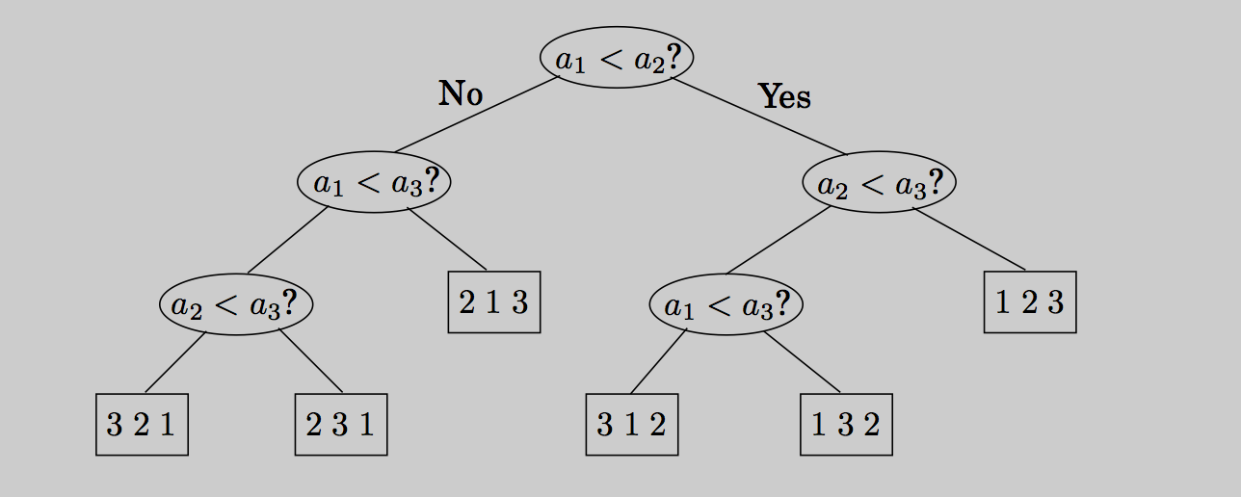
Lower bound on sorting
Comparison based sorting algorithm as a decision tree:
leaves: sorting outcome (true order of array elements)
nodes: comparison operations
binary tree: two outcomes for comparison
Ex: Consider sorting an array of three elements a1, a2, a3
number of possible true orders? (P(3,3)= 3! )
if input is 4,1,3, which path is taken? how about 2, 1, 5?
This means sorted order should be a1, a3, a2

Slide 40
lower bound on sorting
When sorting an array of n elements: a1, a2, …, an
Total possible true orders is: n!
Decision tree is a binary tree with n! leaf nodes
Height of tree: worst case performance
Recall: a tree of height n has at most 2^{n} leaf nodes
So a tree with n! leaf nodes has height of at least log2(n!)=O(nlog2n)
Any sorting algorithm must make in the worst case (nlog2n) comparison.

Slide 41
Comment
Such lower bound analysis applies to the problem itself, not to particular algorithms
reveal fundamental lower bound on running time, i.e., you cannot do better than this
Can you apply same idea to show a lower bound on searching an sorted array for a given element, assuming that you can only use comparison operation?

Slide 42
Outline
Sorting problems and algorithms
Divide-and-conquer paradigm
Merge sort algorithm
Master Theorem
recursion tree
Median and Selection Problem
randomized algorithms
Quicksort algorithm
Lower bound of comparison based sorting

Slide 43
Non-Comparison based sorting
Example: sort 100 kids by their ages (taken value between 1-9)
comparison based sorting: at least nlogn
Counting sort:
count how many kids are of each age
and then output each kid based upon how many kids are of younger than him/her
Running time: a linear time sorting algorithm that sort in O(n+k) time when elements are in range from 1 to k.

Slide 44
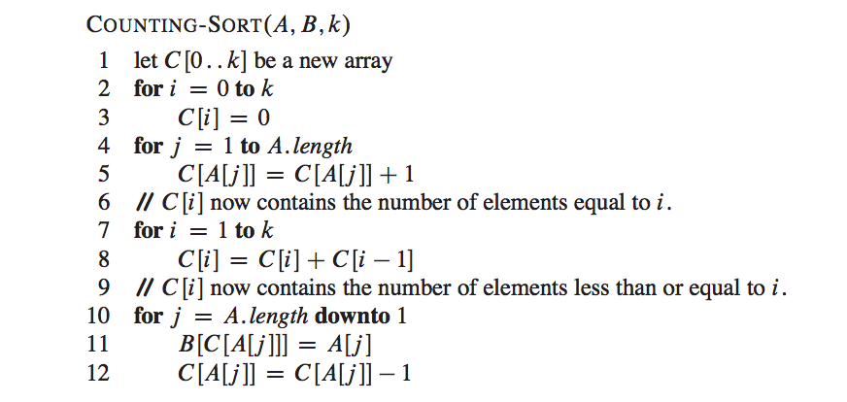
Counting Sort

Slide 45
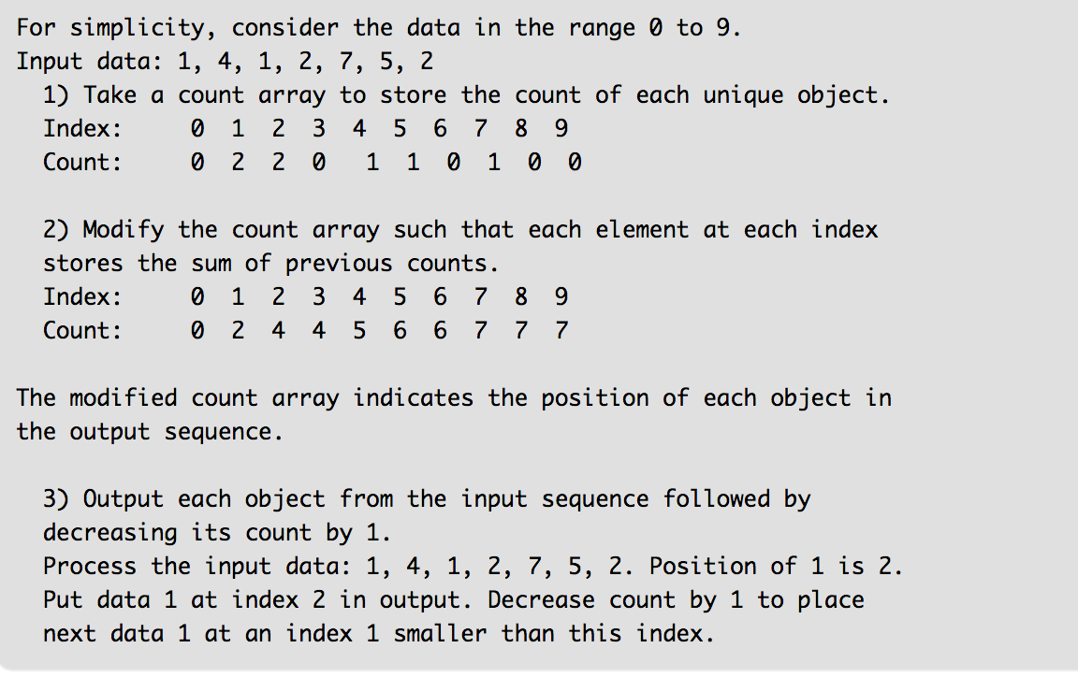
Counting Sorting

Slide 46
Recall: stable vs unstable sorting
therefore, not stable!

Slide 47
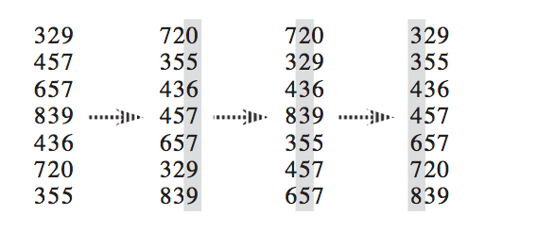
Radix Sorting
What if range of value, k, is large?
Radix Sort: sort digit by digit
starting from least significant digit to most significant digit, uses counting sort (or other stable sorting algorithm) to sort by each digit
What if unstable soring is used?

Slide 48
Readings
Chapter 2

