Slide 1
Dynamic Programming
CISC5835, Algorithms for Big Data
CIS, Fordham Univ.
Instructor: X. Zhang

Slide 2
Rod Cutting Problem
A company buys long steel rods (of length n), and cuts them into shorter one to sell
integral length only
cutting is free
rods of diff lengths sold for diff. price, e.g.,
Best way to cut the rods?
n=4: no cutting: $9, 1 and 3: 1+8=$9, 2 and 2: 5+5=$10
n=5: ?

Slide 3
Rod Cutting Problem Formulation
Input:
a rod of length n
a table of prices p[1…n] where p[i] is price for rod of length i
Output
determine maximum revenue rn obtained by cutting up the rod and selling all pieces
Analysis solution space (how many possibilities?)
how many ways to write n as sum of positive integers?
4=4, 4=1+3, 4=2+2
# of ways to cut n:

Slide 4
Rod Cutting Problem Formulation
// return r_n: max. revenue
int Cut_Rod (int p[1…n], int n)
Divide-and-conquer?
how to divide it into smaller one?
we don’t know we want to cut in half…

Slide 5
Rod Cutting Problem
// return rn: max. revenue for rod of length n
int Cut_Rod (int n, int p[1…n])
Start from small
n=1, r1=1 //no possible cutting
n=2, r2=5 // no cutting (if cut, revenue is 2)
n=3, r3=8 //no cutting
r4=9 (max. of p[4], p[1]+r3, p[2]+r3, p[3]+r1)
r5 = max (p[5], p[1]+r4, p[2]+r2, p[3]+r2, p[4]+r1)
…

Slide 6
Rod Cutting Problem
// return rn: max. revenue for rod size n
int Cut_Rod (int n, int p[1…n])
Given a rod of length n, consider first rod to cut out
if we don’t cut it at all, max. revenue is p[n]
if first rod to cut is1: max. revenue is p[1]+rn-1
if first rod to cut out is 2: max. revenue is p[2]+rn-2, …
max. revenue is given by maximum among all the above options
rn = max (p[n], p[1]+rn-1, p[2]+rn-2, …, p[n-1]+r1)

Slide 7
Optimal substructure
// return rn: max. revenue for rod size n
int Cut_Rod (int n, int p[1…n])
rn = max (p[n], p[1]+rn-1, p[2]+rn-2, …, p[n-1]+r1)
Optimal substructure: Optimal solution to a problem of size n incorporates optimal solutions to problems of smaller size (1, 2, 3, … n-1).

Slide 8
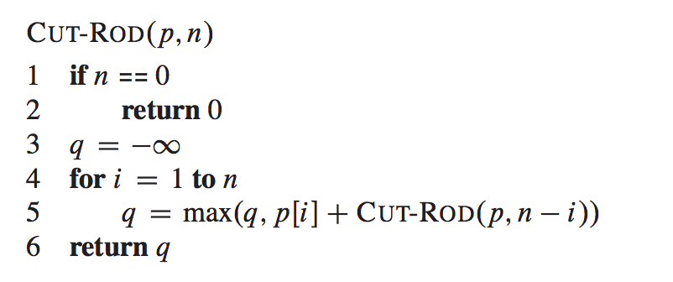
Rod Cutting Problem
// return r_n: max. revenue for rod size n
int Cut_Rod (int p[1…n], int n)
rn = max (p[n], p[1]+rn-1, p[2]+rn-2, …, p[n-1]+r1)

Slide 9
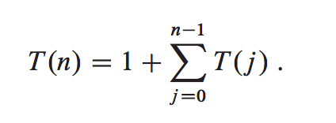
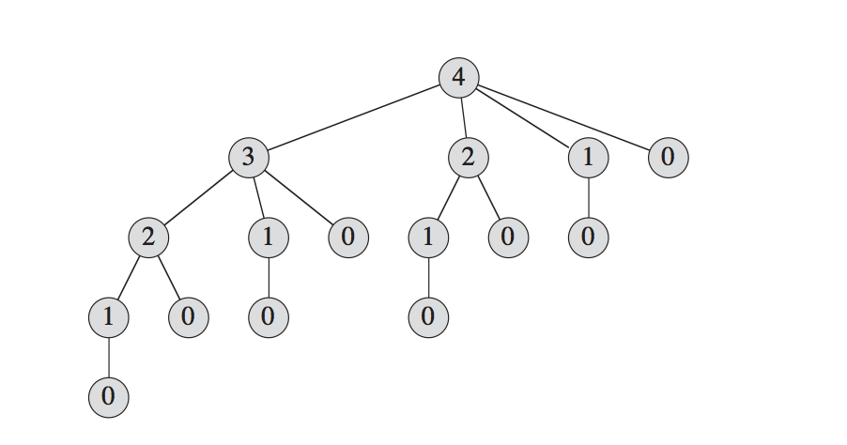
Recursive Rod Cutting
// return r_n: max. revenue for rod size n
int Cut_Rod (int p[1…n], int n)
Running time T(n)
Closed formula: T(n)=2^{n}
Recursive calling tree: n=4

Slide 10
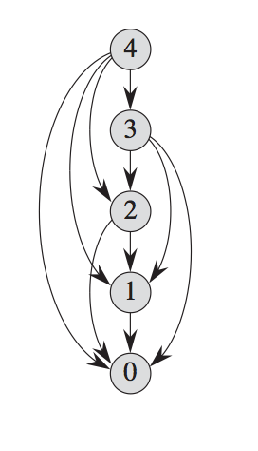
Subproblems Graph
Avoid recomputing subproblems again and again by storing subproblems solutions in memory/table (hence “programming”)
trade-off between space and time
Overlapping of subproblems

Slide 11
Dynamic Programming
Avoid recomputing subproblems again and again by storing subproblems solutions in memory/table (hence “programming”)
trade-off between space and time
Two-way to organize
top-down with memoization
Before recursive function call, check if subproblem has been solved before
After recursive function call, store result in table
bottom-up method
Iteratively solve smaller problems first, move the way up to larger problems

Slide 12
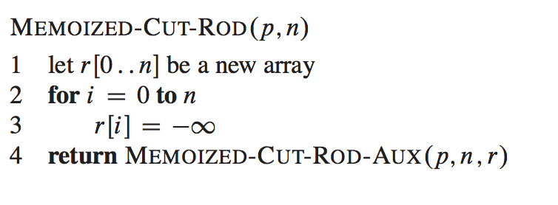
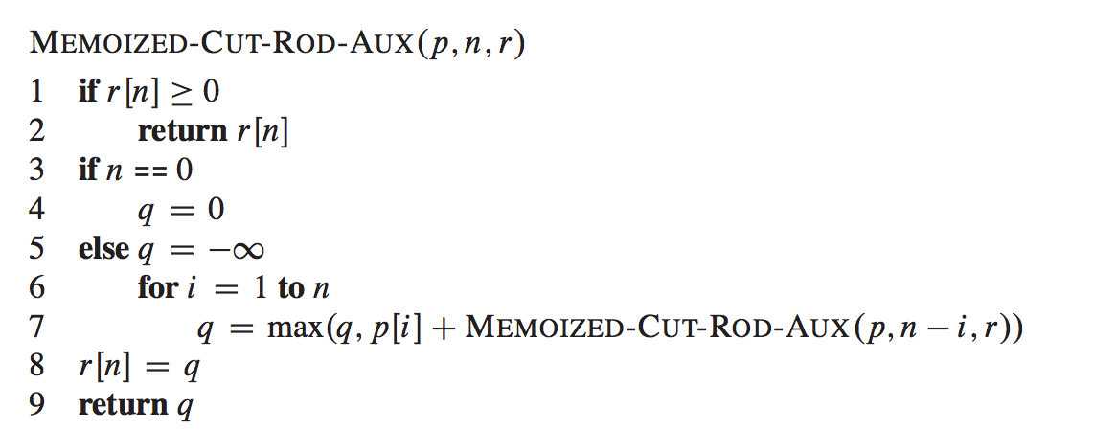
Memoized Cut-Rod
// stores solutions to all problems
// initialize to an impossible negative value
// A recursive function
// If problem of given size (n) has been
solved before, just return the stored result
// same as before…

Slide 13
Memoized Cut-Rod: running time
// stores solutions to all problems
// initialize to an impossible negative value
// A recursive function
// If problem of given size (n) has been
solved before, just return the stored result
// same as before…

Slide 14
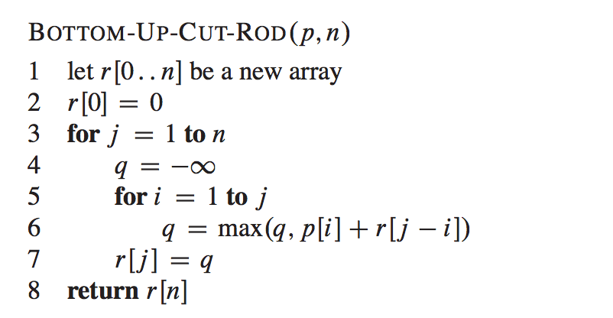
Bottom-up Cut-Rod
// stores solutions to all problems
// Solve subproblem j, using
solution to smaller subproblems
Running time: 1+2+3+..+n-1=O(n²)

Slide 15
Bottom-up Cut-Rod (2)
// stores solutions to all problems
What if we want to know who to achieve r[n]?
i.e., how to cut?
i.e., n=n_1+n_2+…n_k, such that p[n_1]+p[n_2]+…+p[n_k]=rn

Slide 16
Recap
We analyze rod cutting problem
Optimal way to cut a rod of size n is found by
1) comparing optimal revenues achievable after cutting out the first rod of varying len,
This relates solution to larger problem to solutions to subproblems
2) choose the one yield largest revenue

Slide 17
maximum (contiguous) subarray
Problem: find the contiguous subarray within an array (containing at least one number) which has largest sum (midterm lab)
If given the array [-2,1,-3,4,-1,2,1,-5,4],
contiguous subarray [4,-1,2,1] has largest sum = 6
Solution to midterm lab
brute-force: n² or n³
Divide-and-conquer: T(n)=2 T(n/2)+O(n), T(n)=nlogn
Dynamic programming?

Slide 18
Analyze optimal solution
Problem: find contiguous subarray with largest sum
Sample Input: [-2,1,-3,4,-1,2,1,-5,4] (array of size n=9)
How does solution to this problem relates to smaller subproblem?
If we divide-up array (as in midterm)
[-2,1,-3,4,-1,2,1,-5,4] //find MaxSub in this array
[-2,1,-3,4,-1] [2,1,-5,4]
still need to consider subarray that spans both halves
This does not lead to a dynamic programming sol.
Need a different way to define smaller subproblems!

Slide 19
Analyze optimal solution
Problem: find contiguous subarray with largest sum
A
Index
MSE(k), max. subarray ending at pos k, among all subarray ending at k (A[i…k] where i<=k), the one with largest sum
MSE(1), max. subarray ending at pos 1, is A[1..1], sum is -2
MSE(2), max. subarray ending at pos 2, is A[2..2], sum is 1
MSE(3) is A[2..3], sum is -2
MSE(4)?

Slide 20
Analyze optimal solution
A
Index
MSE(k) and optimal substructure
MSE(3): A[2..3], sum is -2 (red box)
MSE(4): two options to choose
(1) either grow MSE(3) to include pos 4
subarray is then A[2..4], sum is MSE(3)+A[4]=-2+A[4]=2
(2) or start afresh from pos 4
subarray is then A[4…4], sum is A[4]=4 (better)
Choose the one with larger sum, i.e.,
MSE(4) = max (A[4], MSE(3)+A[4])
How a problem’s optimal solution can be derived from optimal solution to smaller
problem

Slide 21
Analyze optimal solution
A
Index
MSE(k) and optimal substructure
Max. subarray ending at k is the larger between A[k…k] and Max. subarray ending at k-1 extended to include A[k]
MSE(k) = max (A[k], MSE(k-1)+A[k])
MSE(5)= , subarray is
MSE(6)
MSE(7)
MSE(8)
MSE(9)
MSE(4)=4, array is A[4…4]

Slide 22
Analyze optimal solution
A
Index
Once we calculate MSE(1) … MSE(9)
MSE(1)=-2, the subarray is A[1..1]
MSE(2)=1, the subarray is A[2..2]
MSE(3)=-2, the subarray is A[2..3]
MSE(4)=4, the subarray is A[4…4]
… MSE(7)=6, the subarray is A[4…7]
MSE(9)=4, the subarray is A[9…9]
What’s the maximum subarray of A?
well, it either ends at 1, or ends at 2, …, or ends at 9
Whichever yields the largest sum!

Slide 23
Idea to Pseudocode
A
Index
Calculate MSE(1) … MSE(n)
MSE(1)= A[1]
MSE(i) = max (A[i], A[i]+MSE(i-1));
Return maximum among all MSE(i),
for i=1, 2, …n
(int, start,end) MaxSubArray (int A[1…n])
{
// Use array MSE to store the MSE(i)
MSE[1]=A[1];
max_MSE = MSE[1];
for (int i=2;i<=n;i++)
{
MSE[i] = ??
if (MSE[i] > max_MSE) {
max_MSE = MSE[i];
end = i;
}
}
return (max_MSE, start, end)
}
Practice:
1) fill in ??
2) How to find out the starting index of
the max. subarray, i.e., the start parameter?

Slide 24
Running time Analysis
int MaxSubArray (int A[1…n], int & start,
int & end)
{
// Use array MSE to store the MSE(i)
MSE[1]=A[1];
max_MSE = MSE[1];
for (int i=2;i<=n;i++)
{
MSE[i] = ??
if (MSE[i] > max_MSE) {
max_MSE = MSE[i];
end = i;
}
}
return max_MSE;
}
It’s easy to see that running time is O(n)
a loop that iterates for n-1 times
Recall other solutions:
brute-force: n² or n³
Divide-and-conquer: nlogn
Dynamic programming wins!

Slide 25
What is DP? When to use?
We have seen several optimization problems
brute force solution
divide and conquer
dynamic programming
To what kinds of problem is DP applicable?
Optimal substructure: Optimal solution to a problem of size n incorporates optimal solution to problem of smaller size (1, 2, 3, … n-1).
Overlapping subproblems: small subproblem space and common subproblems

Slide 26
Optimal substructure
Optimal substructure: Optimal solution to a problem of size n incorporates optimal solution to problem of smaller size (1, 2, 3, … n-1).
Rod cutting: find rn (max. revenue for rod of len n)
rn = max (p[1]+rn-1, p[2]+rn-2, p[3]+rn-3,…, p[n-1]+r1, p[n])
A recurrence relation (recursive formula)
=> Dynamic Programming: Build an optimal solution to the problem from solutions to subproblems
We solve a range of sub-problems as needed
Sol to problem
instance of size n
Sol to problem
instance of size n-1, n-2, … 1

Slide 27
Optimal substructure in Max. Subarray Problem
Optimal substructure: Optimal solution to a problem of size n incorporates optimal solution to problem of smaller size (1, 2, 3, … n-1).
Max. Subarray Problem:
MSE(i) = max (A[i], MSE(i-1)+A[i])
Max Subarray = max (MSE(1), MSE(2), …MSE(n))
Max. Subarray Ending at position i
is the either the max. subarray ending at pos i-1
extended to pos i; or just made up of A[i]

Slide 28
Overlapping Subproblems
space of subproblems must be “small”
total number of distinct subproblems is a polynomial in input size (n)
a recursive algorithm revisits same problem repeatedly, i.e., optimization problem has overlapping subproblems.
DP algorithms take advantage of this property
solve each subproblem once, store solutions in a table
Look up table for sol. to repeated subproblem using constant time per lookup.
In contrast: divide-and-conquer solves new subproblems at each step of recursion.

Slide 29
Longest Increasing Subsequence
Input: a sequence of numbers given by an array a
Output: a longest subsequence (a subset of the numbers taken in order) that is increasing (ascending order)
Example, given a sequence
5, 2, 8, 6, 3, 6, 9, 7
There are many increasing subsequence: 5, 8, 9; or 2, 9; or 8
The longest increasing subsequence is:
2, 3, 6, 9 (length is 4)

Slide 30
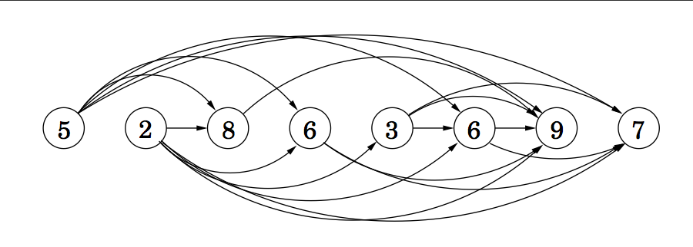
LIS as a DAG
Find longest increasing subsequence of a sequence of numbers given by an array a
5, 2, 8, 6, 3, 6, 9, 7
Observation:
If we add directed edge from smaller number to larger one, we get a DAG.
A path (such as 2,6,7) connects nodes in increasing order
LIS corresponds to longest path in the graph.

Slide 31
Graph Traversal for LIS
Find longest increasing subsequence of a sequence of numbers given by an array a
5, 2, 8, 6, 3, 6, 9, 7
Observation:
LIS corresponds to longest path in the graph.
Can we use graph traversal algorithms here?
BFS or DFS?
Running time

Slide 32
Dynamic Programming Sol: LIS
Find Longest Increasing Subsequence of a sequence of numbers given by an array a
Let L(n) be the length of LIS ending at n-th number
L(1) = 1, LIS ending at pos 1 is 5
L(2) = 1, LIS ending at pos 2 is 2
L(7)= // how to relate to L(1), …L(6)?
Consider LIS ending at a[7] (i.e., 9). What’s the number before 9?
.… ? ,9
1 2 3 4 5 6 7 8

Slide 33
Dynamic Programming Sol: LIS
Given a sequence of numbers given by an array a
Let L(n) be length of LIS ending at n-th number
Consider all increasing subsequence ending at a[7] (i.e., 9).
What’s the number before 9?
It can be either NULL, or 6, or 3, or 6, 8, 2, 5 (all those numbers pointing to 9)
If the number before 9 is 3 (a[5]), what’s max. length of this seq? L(5)+1 where the seq is …. 3, 9
1 2 3 4 5 6 7 8
LIS ending at pos 5

Slide 34
Dynamic Programming Sol: LIS
Given a sequence of numbers given by an array a
Let L(n) be length of LIS ending at n-th number
Consider all increasing subsequence ending at a[7] (i.e., 9).
It can be either NULL, or 6, or 3, or 6, 8, 2, 5 (all those numbers pointing to 9)
L(7)=max(1, L(6)+1, L(5)+1, L(4)+1, L(3)+1, L(2)+1, L(1)+1)
L(8)=?
Pos: 1 2 3 4 5 6 7 8

Slide 35
Dynamic Programming Sol: LIS
Given a sequence of numbers given by an array a
Let L(n) be length of LIS ending at n-th number.
Recurrence relation:
Note that the i’s in RHS is always smaller than the j
How to implement? Running time?
LIS of sequence = Max (L(i), 1<=i<=n) // the longest among all
Pos: 1 2 3 4 5 6 7 8

Slide 36
Next, two-dimensional subproblem space
i.e., expect to use two-dimensional table

Slide 37
Longest Common Subseq.
Given two sequences
X = 〈x₁, x₂, …, x_{m}〉
Y = 〈y₁, y₂, …, y_{n}〉
find a maximum length common subsequence (LCS) of X and Y
E.g.:
X = 〈A, B, C, B, D, A, B〉
Subsequence of X:
A subset of elements in the sequence taken in order but not necessarily consecutive
〈A, B, D〉, 〈B, C, D, B〉, etc

Slide 38
Example
X = 〈A, B, C, B, D, A, B〉 X = 〈A, B, C, B, D, A, B〉
Y = 〈B, D, C, A, B, A〉 Y = 〈B, D, C, A, B, A〉
〈B, C, B, A〉 and 〈B, D, A, B〉 are longest common subsequences of X and Y (length = 4)
BCBA = LCS(X,Y): functional notation, but is it not a function
〈B, C, A〉, however is not a LCS of X and Y

Slide 39
Brute-Force Solution
Check every subsequence of X[1 . . m] to see if it is also a subsequence of Y[1 .. n].
There are 2^{m} subsequences of X to check
Each subsequence takes O(n) time to check
scan Y for first letter, from there scan for second, and so on
Worst-case running time: O(n2^{m})
Exponential time too slow

Slide 40
Towards a better algorithm
Simplification:
Look at length of a longest-common subsequence
Extend algorithm to find the LCS itself later
Notation:
Denote length of a sequence s by |s|
Given a sequence X = 〈x₁, x₂, …, x_{m}〉 we define the i-th prefix of X as (for i = 0, 1, 2, …, m)
X_{i} = 〈x₁, x₂, …, x_{i}〉
Define:
c[i, j] = | LCS (Xi, Yj) = |LCS(X[1..i], Y[1..j])|:
the length of a LCS of sequences X_{i} = 〈x₁, x₂, …, x_{i}〉 and Y_{j} = 〈y₁, y₂, …, y_{j}〉
|LCS(X,Y)| = c[m,n] //this is the problem we want to solve

Slide 41
Find Optimal Substructure
Given a sequence X = 〈x₁, x₂, …, x_{m}〉, Y = 〈y₁, y₂, …, y_{n}〉
To find LCS (X,Y) is to find c[m,n]
c[i, j] = | LCS (Xi, Yj) |
//length LCS of i-th prefix of X and j-th prefix of Y
// X[1..i], Y[1..j]
How to solve c[i,j] using sol. to smaller problems?
what’s the smallest (base) case that we can answer right away?
How does c[i,j] relate to c[i-1,j-1], c[i,j-1] or c[i-1,j]?

Slide 42
Recursive Formulation
Base case: c[i, j] = 0 if i = 0 or j = 0
LCS of an empty sequence, and any sequence is empty
General case:
c[i-1, j-1] + 1 if X[i]= Y[j]
c[i, j] =
max(c[i, j-1], c[i-1, j]) otherwise (i.e., if X[i] ≠ Y[j])
X: 1 2 i m
…
Y: 1 2 j n
compare X[i], Y[j]
…

Slide 43
Recursive Solution. Case 1
Case 1: X[i] ==Y[j]
e.g.: X₄ = 〈A, B, D, E〉
Y₃ = 〈Z, B, E〉
Choice: include one element into common sequence (E) and solve resulting subproblem
LCS of X3 = 〈A, B, D〉 ανδ Y2 = 〈Z, B〉
Append X[i] = Y[j] to the LCS of X_{i-1} and Y_{j-1}
Must find a LCS of X_{i-1} and Y_{j-1}
c[4, 3] =
c[4 - 1, 3 - 1] + 1

Slide 44
Recursive Solution. Case 2
Case 2: X[i] ≠ Y[j]
e.g.: X₄ = 〈A, B, D, G〉
Y₃ = 〈Z, B, D〉
Must solve two problems
find a LCS of X_{i-1} and Y_{j}: X_{i-1} = 〈A, B, D〉 and Y_{j} = 〈Z, B, D〉
find a LCS of X_{i} and Y_{j-1} : X_{i} = 〈A, B, D, G〉 and Y_{j-1} = 〈Z, B〉
Either the G or the D
is not in the LCS
(they cannot be both in LCS)
c[i, j] =
max { c[i - 1, j], c[i, j-1] }
If we ignore last element in Xi
If we ignore last element in Yj

Slide 45
Recursive algorithm for LCS
// X, Y are sequences, i, j integers
//return length of LCS of X[1…i], Y[1…j]
LCS(X, Y, i, j)
if i==0 or j ==0
return 0;
if X[i] == Y[ j] // if last element match
then
c[i, j] ←LCS(X, Y, i–1, j–1) + 1
else
c[i, j] ←max{LCS(X, Y, i–1, j),
LCS(X, Y, i, j–1)}

Slide 46
Optimal substructure &
Overlapping Subproblems
A recursive solution contains a “small” number of distinct subproblems repeated many times.
e.g., C[5,5] depends on C[4,4], C[4,5], C[5,4]
Exercise: Draw there subproblem dependence graph
each node is a subproblem
directed edge represents “calling”, “uses solution of” relation
Small number of distinct subproblems:
total number of distinct LCS subproblems for two strings of lengths m and n is mn.

Slide 47
Memoization algorithm
Memoization: After computing a solution to a subproblem, store it in a table. Subsequent calls check the table to avoid redoing work.
LCS(X, Y, i, j)
if c[i, j] = NIL // LCS(i,j) has not been solved yet
then if x[i] = y[j]
then c[i, j] ←LCS(x, y, i–1, j–1) + 1
else c[i, j] ←max{LCS(x, y, i–1, j),
LCS(x, y, i, j–1)}
Same as before

Slide 48
Bottom-Up
0 1 2 3 4 5 6 7
Y A B C B D A B
Initialization: base case c[i,j] = 0 if i=0, or j=0
//Fill table row by row
// from left to right
for (int i=1; i<=m;i++)
for (int j=1;j<=n;j++)
update c[i,j]
return c[m, n]
Running time = Θ(mn)
0
1
2
3
4
5
6
X
B
D
C
A
B
A
 |  |  | C[2,3] | C[2,4]
 |  |  | C[3,3] | C[3,4]
C[3,4]= length of LCS (X3, Y4)
= Length of LCS (BDC, ABCB)
i-th row, 4-th column element

Slide 49
Dynamic-Programming Algorithm
Reconstruct LCS tracing backward:
how do we get value of C[i,j] from? (either C[i-1,j-1]+1, C[i-1,j], C[i, j-1)
as red arrow indicates…
A B C B D A B
0
0
0
0
0
0
0
0
B
D
C
A
B
A
0
0
1
1
1
1
1
1
0
0
1
1
1
2
2
2
0
0
1
2
2
2
2
2
0
1
1
2
2
2
3
3
0
1
2
2
3
3
3
4
0
1
2
2
3
3
4
4
Output
B
Output
C
Output
B
Output
A

Slide 50
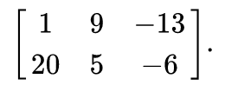
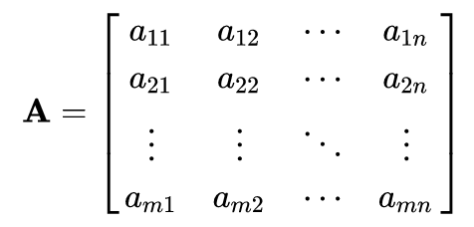
Matrix
Matrix: a 2D (rectangular) array of numbers, symbols, or expressions, arranged in rows and columns.
e.g., a 2 × 3 matrix (there are two rows and three columns)
Each element of a matrix is denoted by a variable with two subscripts, a2,1 element at second row and first column of a matrix A.
an m × n matrix A:

Slide 51
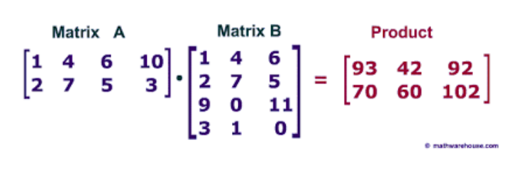
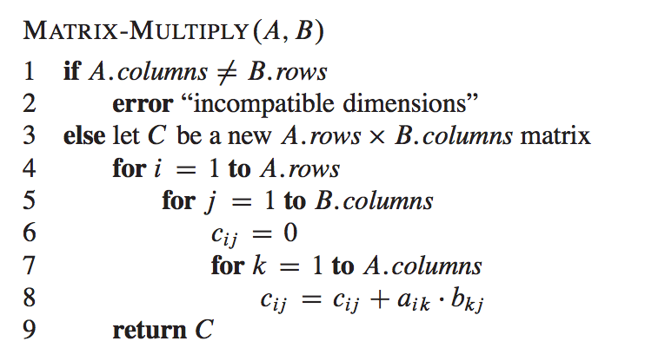
Matrix Multiplication
Dimension of A, B, and A x B?
Matrix Multiplication:
Total (scalar) multiplication: 4x2x3=24
Total (scalar) multiplication: n2xn1xn3

Slide 52
Multiplying a chain of Matrix Multiplication
Given a sequence/chain of matrices, e.g., A₁, A₂, A_{3,} there are different ways to calculate A₁A₂A₃
1. (A1A2)A3)
2. (A1(A2A3))
Dimension of A1: 10 x 100
A2: 100 x 5
A3: 5 x 50
all yield the same result
But not same efficiency

Slide 53
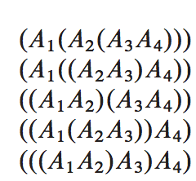
Matrix Chain Multiplication
Given a chain <A_{1,} A₂, … A_{n>} of matrices, where matrix A_{i} has dimension p_{i-1x} p_{i}, find optimal fully parenthesize product A₁A₂…A_{n} that minimizes number of scalar multiplications.
Chain of matrices <A₁, A₂, A₃, A₄>: five distinct ways
A1: p1 x p2 A2: p2 x p3 A3: p3 x p4 A4: p4 x p5
# of multiplication: p3p4p5+ p2p3p5+ p1p2p5
Find the one with minimal multiplications?

Slide 54
Matrix Chain Multiplication
Given a chain <A_{1,} A₂, … A_{n>} of matrices, where matrix A_{i} has dimension p_{i-1x} p_{i}, find optimal fully parenthesize product A₁A₂…A_{n} that minimizes number of scalar multiplications.
Let m[i, j] be the minimal # of scalar multiplications needed to calculate AiAi+1…Aj (m[1…n]) is what we want to calculate)
Recurrence relation: how does m[i…j] relate to smaller problem
First decision: pick k (can be i, i+1, …j-1) where to divide AiAi+1…Aj into two groups: (Ai…Ak)(Ak+1…Aj)
(Ai…Ak) dimension is pi-1 x pk, (Ak+1…Aj) dimension is pk x pj

Slide 55
Summary
Keys to DP
Optimal Substructure
overlapping subproblems
Define the subproblem: r(n), MSE(i), LCS(i,j) LCS of prefixes …
Write recurrence relation for subproblem: i.e., how to calculate solution to a problem using sol. to smaller subproblems
Implementation:
memoization (table+recursion)
bottom-up table based (smaller problems first)
Insights and understanding comes from practice!

