Slide 1
Theory of Computation
Last updated 1/12/20

Slide 2
What is this course about?
This course is about the fundamental capabilities and limitations of computers/computation
This course covers 3 areas, which make up the theory of computation:
  Automata and Languages
  Computability Theory
  Complexity Theory

Slide 3
Automata and Languages
Introduces models of computation
  We will study finite automata and context free grammars
  Each model determines what can be expressed, as we will see in Part I of this course
  Will allow us to become familiar with simple models before we move on to more complex models like a Turing machine
  Given a model, we can examine computability and complexity

Slide 4
Computability Theory
A major mathematical discovery in 1930s
  Certain problems cannot be solved by computers
    That is, they have no algorithmic solution
We can ask what a model can and can’t do
  As it turns out, a simple model of a computer, A Turing machine, can do everything that a computer can do
  So we can use a Turing machine to determine what a computer can and can’t do (i.e., compute)

Slide 5
Complexity Theory
How hard is a problem?
You already should know a lot about this
  You should know how to determine the time complexity of most simple algorithms
    You should know the Big O notation. We can say that a problem is O(n²) and that is harder than an O(n) problem
We take one step forward and study NP-completeness
  A first course in theory of computation generally stops there and hence we will not cover Chapters 8, 9, or 10 of the text

Slide 6
About this Course
Theory of Computation traditionally considered challenging
  I expect (and hope) that you will find this to be true!
A very different kind of course
  In many ways, a pure theory course
    But very grounded (the models of computation are not abstract at all)
  Proofs are an integral part of the course, although I and the text both rely on informal proofs
    But the reasoning must still be clear
The only way to learn this material is by doing problems
  You should expect to spend several hours per week on homework
  You should expect to read parts of the text 2-4 times
  You should not give up after 5 minutes if you are stumped by a problem
  The best way to prepare for the exams is to put significant effort into the homework

Slide 7
Mathematical Preliminaries
Chapter 0
A review of discrete math with some new material

Slide 8
Mathematical Preliminaries
We will now very quickly review discrete math
  You should know most of this from 1100/1400
  Reading Chapter 0 of the text should help you review
    Ask me for help if you have trouble with some of this
  Mathematical Notation
    Sets
    Sequences and Tuples
    Functions and Relations
    Graphs
    Strings and Languages (not covered previously)
    Boolean Logic
  Proofs and Types of Proofs

Slide 9
Sets
A set is a group of objects, order doesn’t matter
  The objects are called elements or members
  Examples:
    {1, 3, 5}, {1, 3, 5, …}, or {x|x∈Z and x mod 2 ≠ 0}
  You should know these operators/concepts
    Subset (A ⊂ B or A ⊆ B)
    Cardinality: Number elements in set (|A| or n(A))
    Intersection (∩) and Union (∪), Complement
      What do we need to know to determine complement of set A?
    Venn Diagrams: can be used to visualize sets

Slide 10
Sets II
Power Set: All possible subsets of a set
  If A = {0, 1} then what is P(A)?
  In general, what is the cardinality of P(B)?

Slide 11
Sequences and Tuples
A sequence is a list of objects, order matters
  Example: (1, 3, 5) or (5, 3, 1)
In this course we will use term tuple instead
  (1, 3, 5) is a 3-tuple and a k-tuple has k elements

Slide 12
Sequences and Tuples II
Cartesian product (x) is an operation on sets but yields a set of tuples
  Example: if A = {1, 2} and B = {x, y, z}
    A x B = {(1,x), (1,y), (1,z), (2,x), (2,y), (2,z)}
  If we have k sets A₁, A₂, …, A_{k}, we can take the Cartesian product A₁ x A₂ … x A_{k} which is the set of all k-tuples (a₁, a₂, …, a_{k}) where a_{i} ∈A_{i}
  We can take Cartesian product of a set with itself
    A^{k} represents A x A x A … x A where there are k A’s.
  The set Z² represents Z x Z all pairs of integers, which can be written as {(a,b)|a∈Z and b∈Z}

Slide 13
Functions and Relations
A function maps an input to a (single) output
  f(a) = b, f maps a to b
The set of possible inputs is the domain and the set of possible outputs is the range
  f: D → R
  Example 1: for the abs function, if D = Z, what is R?
  Example 2: sum function
    Can say Z x Z → Z
Functions can be described using tables
  Example: Describe f(x) = 2x for D={1,2,3,4}

Slide 14
Relations
A predicate is a function with range {True, False}
  Example: even(4) = True
A (k-ary) relation is a predicate whose domain is a set of k-tuples A x A x A … x A
  If k =2 then binary relation (e.g., =, <, ...)
  Can just list what is true (even(4))
  The text represents the beats relation in Example 0.10 (page 9) using a table and a set
Relations have 3 key properties:
  reflexive, symmetric, transitive
  A binary relation is an equivalence relation if it has all 3
  Try =, <, friend

Slide 15
Graphs
A graph is a set of vertices V and edges E
  G= (V,E) and can use this to describe a graph
A
B
D
C
  V = {A, B, C, D}
  E = {(A,B), (A,C), (C,D), (A,D), (B,C)}

Slide 16
Graphs II
Definitions:
  The degree of a vertex is the number of edges touching it
  A path is a sequence of nodes connected by edges
  A simple path does not repeat nodes
  A path is a cycle if it starts and ends at same node
  A simple cycle repeats only first and last node
  A graph is a tree if it is connected and has no simple cycles

Slide 17
Strings and Languages
This is heavily used in this course
An alphabet is any non-empty finite set
  Members of the alphabet are alphabet symbols
  ∑₁ = {0,1}
  ∑₂ = {a,b,c,d,e,f,g,h,i,j,k,l,m,n,o,p,q,r,s,t,u,v,w,x,y,z}
  ∑₃ = {0,1,a,b,c}
A string over an alphabet is a finite sequence of symbols from the alphabet
  0100 is a string from ∑₁ and cat is a string from ∑₂

Slide 18
Strings and Languages II
The length of a string w, |w| is its number of symbols
The empty string, ε, has length 0
If w has length n then it can be written as w₁w₂… w_{n}, where w_{i} ∈ ∑
Strings can be concatenated
  ab is string a concatenated with string b
  a string x can be concatenated with itself k times
    This is written as x^{k}
A language is a set of strings

Slide 19
Boolean Logic
Boolean logic is a mathematical system built around True and False or 0 and 1
Below are the boolean operators, which can be defined by a truth table
  ∧ (and/conjunction) 1 ∧ 1 = 1; else 0
  ∨ (or/disjunctions) 0 ∨ 0 = 1; else 1
  ¬ (not) ¬1 = 0 and ¬0 = 1
  → (implication) 1 → 0 = 0; else 1
  ↔ (equality) 1 ↔ 1 = 1; 0 ↔ 0 =1
Can prove equality using truth tables
  DeMorgan’s law and Distributive law

Slide 20
Proofs
Proofs are a big part of this class
  A proof is a convincing logical argument
    Proofs in this class need to be clear, but not very formal
      The books proofs are often informal, using English, so it isn’t just that we are being lazy
  Types of Proofs
    A ⇔ B means A if and only if B
      Prove A ⇒ B and prove B ⇒ A
    Proof by counterexample (prove false via an example)
    Proof by construction (main proof technique we will use)
    Proof by contradiction
    Proof by induction

Slide 21
Proofs: Example 1
Prove for every graph G sum of degrees of all nodes is even
  Take a minute to prove it or at least convince yourself it is true
  The book does not really say it, but this is a proof by induction
    Their informal reasoning: every edge you add touches two vertices and increases the degree of both of these by 1 (i.e., you keep adding 2)
    See Example 0.19 p18 and Theorem 0.21 p20
  A proof by induction means showing 1) it is true for some base case and then 2) if true for any n then it is true for n+1
    So spend a minute formulating the proof by induction
    Base case: 0 edges in G means sum-degrees=0, is even
    Induction step: if sum-degrees even with n edges then show even with n+1 edges
      When you add an edge, it is by definition between two vertices (but can be the same). Each vertex then has its degree increase by 1, or 2 overall
      even number + 2 = even (we will accept that for now)

Slide 22
Proofs: Example 2
For any two sets A and B, (A ∪ B)′ = A′ ∩ B′ (Theorem 0.20, p 20)
  Where X′ means the complement of X
  We prove sets are equal by showing that they have the same elements
  What proof technique to use? Any ideas?
  Prove in each direction:
    First prove forward direction then backward directions
      Show if element x is in one of the sets then it is in the other
    We will do in words, but not as informal as it sounds since we are really using formal definitions of each operator

Slide 23
Proof: Example 2
(A ∪ B)′ = A′ ∩ B′
Forward direction (LHS → RHS):
  Assume x ∈ (A ∪ B)′
  Then x is not in (A ∪ B) [defn. of complement]
  Then x is not in A and x is not in B [defn. of union]
  So x is in A′ and x is in B′ and hence is in RHS
Backward direction (RHS → LHS)
  Assume x ∈ A′ ∩ B′
  So x ∈ A′ and x ∈ B′ [defn. of intersection]
  So x ∉ A and x ∉ B [defn. of complement]
  So x not in union (A ∪ B) [application of union]
  So x must be its complement [defn. of complement]
So we are done!

Slide 24
Proofs: Example 3
For every even number n > 2, there is a 3-regular graph with n nodes (Theorem 0.22, p 21)
  A graph is k-regular if every node has degree k
We will use a proof by construction
  Many theorems say that a specific type of object exists. One way to prove it exists is by constructing it.
  May sound weird, but this is by far the most common proof technique we will use in this course
    We may be asked to show that some property is true. We may need to construct a model which makes it clear that this property is true

Slide 25
Proof: Example 3 continued
Can you construct such a graph for n=4, 6, 8?
  Try now.
  If you see a pattern, then generalize it and that is the proof.
  Hint: place the nodes into a circle
Solution:
  Place the nodes in a circle and then connect each node to the ones next to it, which gives us a 2-regular graph.
  Then connect each node to the one opposite it and you are done. This is guaranteed to work because if the number of nodes is even, the opposite node will always get hit exactly once.
    The text describes it more formally.
    Note that if it was odd, this would not work.

Slide 26
Proof: Example 4
Jack sees Jill, who has come in from outside. Since Jill is not wet he concludes it is not raining (Ex 0.23, p 22)
  This is a proof by contradiction.
    To prove a theorem true by contradiction, assume it is false and show that leads to a contradiction
    In this case, that translates to assume it is raining and look for contradiction
  If we know that if it were raining then Jill would be wet, we have a contradiction because Jill is not wet.
  That is the process, although not a very good example (what if she left the umbrella at the door!)
  This case is perhaps a bit confusing. Lets go to a more mathematical example …

Slide 27
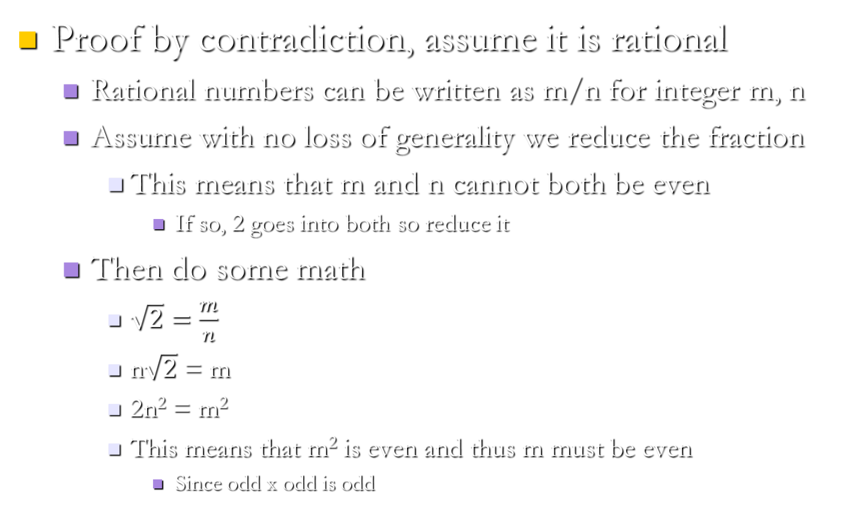
Prove Square Root of 2 Irrational
Proof by contradiction, assume it is rational
  Rational numbers can be written as m/n for integer m, n
  Assume with no loss of generality we reduce the fraction
    This means that m and n cannot both be even
      If so, 2 goes into both so reduce it
  Then do some math
    $\sqrt{2}=\frac{m}{n}$
    n$\sqrt{2}$ = m
    2n² = m²
    This means that m² is even and thus m must be even
      Since odd x odd is odd

Slide 28
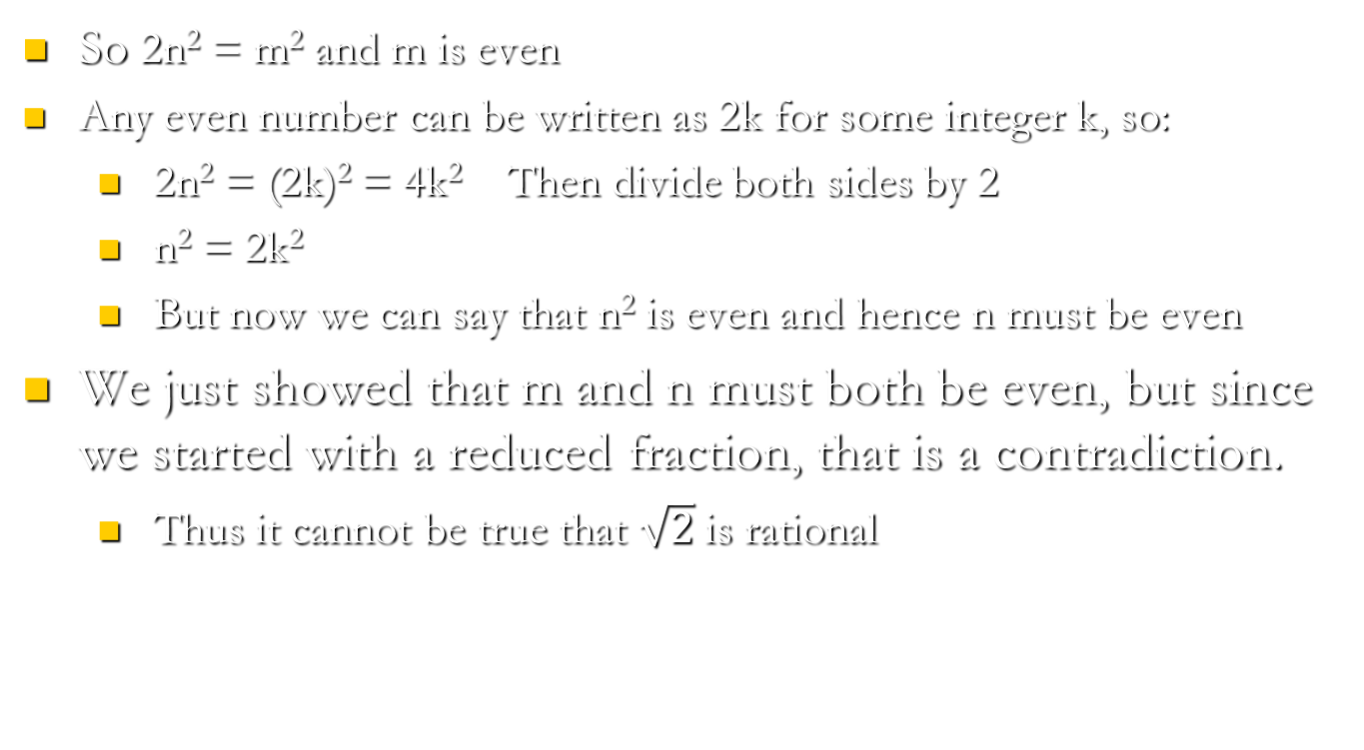
Prove Square Root of 2 Irrational
    So 2n² = m² and m is even
    Any even number can be written as 2k for some integer k, so:
      2n² = (2k)² = 4k² Then divide both sides by 2
      n² = 2k²
      But now we can say that n² is even and hence n must be even
    We just showed that m and n must both be even, but since we started with a reduced fraction, that is a contradiction.
      Thus it cannot be true that $\sqrt{2}$ is rational

Slide 29
More on Proof by Induction
Worth going over one more example since some of you may not have used this technique before
Please ignore Theorem 0.25, p 24 in text which is how the book explains proof by induction
  complicated induction proof which is not very illustrative
You have a proof by induction for HW1, so the next example should help

Slide 30
Another Proof by Induction Example
Prove that n² ≥ 2n for all n 2, 3, …
Base case (n=2): 2² ≥ 2x2? Yes.
Assume true for n=m and then show it must also be true for n=m+1
  So we start with m² ≥ 2m and assume it is true
  we must show that this requires (m+1)² ≥ 2(m+1)
    Rewriting we get: m²+2m+1 ≥ 2m+2
    Simplifying a bit we get: m² ≥ 1.
    So, we need to show that m² ≥ 1 given that m² ≥ 2m
      If 2m ≥ 1, then we are done. Is it?
      Yes, since m itself ≥ 2

