Slide 1
What can we Learn from Student Course-Grade Data?
Gary M. Weiss
Educational Data Mining (EDM) Lab
Department of Computer and Information Science
Fordham University, NY, USA
gaweiss@fordham.edu

Slide 2
General Motivation & Goals
Data science being applied to many domains, but the education domain seems to receive less attention
Course-grade enrollment data tracked by every university
  Each record describes one student course enrollment and final grade
What can we learn from the course enrollment grade data?

Slide 3
What Questions can we Answer using only Course Enrollment Data?
Grading:
  Q1: What are the grading patterns (policies) at the department, course, and instructor levels? Do they vary substantially?
Course Sequencing:
  Q2: What are the most common sequences of courses that students take?
  Q3: How does number semesters between courses impact performance?
  Q4: How does the order of taking courses impact performance?
Q5: Instructors: How effective is an instructor (based on future student performance)?
Q6: Student Majors: What major will a student perform well in? Choose?
Course relationships:
  Q7: How can we group courses based on similar student performance (i.e., grades)?
  Q8: What can we learn about courses based on co-enrollment patterns?

Slide 4
What Questions can we Answer using only Course Enrollment Data?
Grading:
  Q1: What are the grading patterns (policies)?
    At department, course, and instructor levels. Do patterns vary substantially?
Course Sequencing:
  Q2: What are the most common sequences of courses that students take?
  Q3: How does number semesters between courses impact performance?
  Q4: How does the order of taking courses impact performance?
Q5: Instructors: How effective is an instructor (based on future grades)?
Q6: Student Majors: What major will a student perform well in?* Choose?
Course relationships:
  Q7: How can we group courses based on similar student performance (i.e., grades)?
  Q8: What can we learn about courses based on co-enrollment patterns?
Description*
(Unsupervised
Learning)
Less focused and not easy to assess utility of the results
* Identifying which major a student will perform well in is the one exception and is a prediction task

Slide 5
The Data
Eight years Fordham University undergraduate course data
  ~10,000 undergraduate students per year
Each record represents one student in one class
  Course: name, dept. code, course #, section #, semester, year
  Instructor: Instructor id (anonymized)
  Student: Student id (anonymized)
  Final grade
What we don’t have due to privacy/legal concerns:
  Student info. (race, gender, parent income, SAT scores, etc.)
  Instructor info. (rank, race, gender, years of experience, surveys)
Type | Count
Records | 446,508
Students | 24,691
Unique Courses | 2,663
Course Sections | 22,608
Student Majors | 83
Departments | 78

Slide 6
Q1: What Grading Patterns Exist?
Motivation:
  Undergraduate grades are important:
    Provide feedback/motivation to student
    Used for “admission” to majors, graduate programs, jobs
  Conflict of interest: grades impact student assessment of instructors
  We want accurate and fair grades
    Major deviations in grading may be considered unfair
Goals:
  Identify patterns at the department, course, and instructor level.
  Analyze the patterns– are there big differences? (Answer: yes)
  Provide an open-source software tool for general use and research
    https://www.cis.fordham.edu/edmlab/software/grade-analysis-tool
Gary M. Weiss, Luisa A. L. Rosa, Hyun Jeong and Daniel D. Leeds (2023). An Analysis of Grading Patterns in Undergraduate University Courses. Proceedings of the 2023 IEEE 467h Annual Computers, Software, and Applications Conference (COMPSAC), IEEE, Torino, Italy.

Slide 7
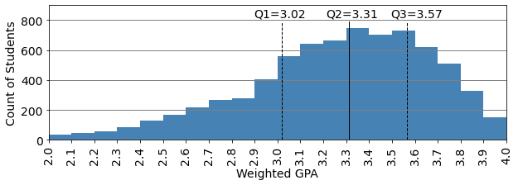
General Grading Trends
Average Grade by Student Year and Course Level
 | Course Level
Student Year | 1000 | 2000 | 3000 | 4000 | Average
Freshman | 3.109 | 3.276 | 3.037 | 3.235 | 3.122
Sophomore | 3.190 | 3.284 | 3.217 | 3.257 | 3.224
Junior | 3.169 | 3.313 | 3.281 | 3.322 | 3.264
Senior | 3.182 | 3.348 | 3.333 | 3.411 | 3.331
Average | 3.137 | 3.305 | 3.275 | 3.389
Student Grade Distribution (μ=3.25)

Slide 8

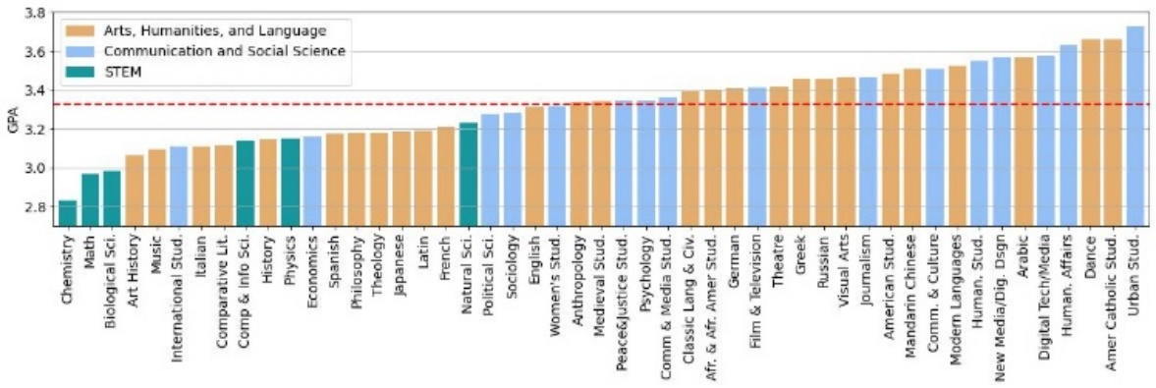
GPA by Department
Large variation by department
STEM departments have lowest grades (consistent with research)
Research: instructors teaching in multiple department adhere to department grading pattern

Slide 9
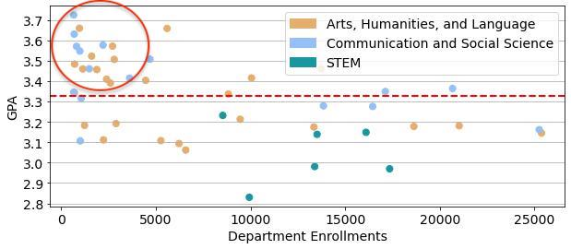
Department GPA vs. Enrollment
Hypothesis: inverse relationship between dept. enrollment and GPA
Conclusion: GPA impacted mainly when enrollments are small
  No big difference between medium and large departments
  Of 21 highest GPA departments, 19 have enrollments under 5000
  No department with enrollment over 5000 has GPA > 3.5
  High GPA → Low Enrollment
    Low GPA not related to enrollment
Low enrollment/High GPA

Slide 10

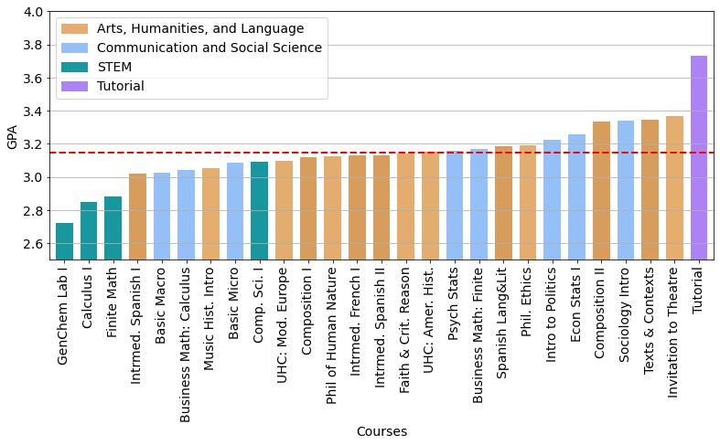
GPA by Course
Large variation at course level
GPA pattern follows department
  Most are lower than department
  Popular courses have lower grades
Tutorial courses
  Insufficient students for course
  Small sections with high grades
  Why?
    Too few to establish distribution
    Familiarity with students
    Maybe more effective teaching?
GPA by Course for 27 Courses with at least 70 Sections

Slide 11
Course Grade Distribution Patterns
Average Course Grade Distribution by Cluster (k-means k=4)
 | Letter Grade (%)
Cluster | A | A- | B+ | B | B- | C | D | F | GPA | Count
0 | 27.7 | 14.6 | 13.2 | 14.2 | 8.8 | 16.1 | 3.1 | 2.3 | 3.11 | 58
1 | 40.6 | 23.0 | 13.6 | 10.4 | 5.0 | 5.6 | 0.7 | 1.0 | 3.49 | 47
2 | 20.6 | 22.9 | 20.0 | 16.0 | 8.6 | 9.6 | 1.2 | 1.2 | 3.25 | 71
3 | 12.9 | 12.9 | 15.6 | 18.3 | 13.3 | 22.6 | 2.7 | 1.6 | 2.91 | 45
Course Cluster Distribution by Department
 | Cluster
Department | 0 | 1 | 2 | 3 | Total
Biological Sciences | 1 | 1 | 5 | 7 | 14
Chemistry | 0 | 0 | 2 | 8 | 10
Communications | 2 | 8 | 12 | 1 | 23
Computer Science | 7 | 1 | 2 | 3 | 13
Economics | 8 | 1 | 2 | 3 | 14
English | 0 | 0 | 5 | 0 | 5
History | 1 | 1 | 6 | 2 | 10
Mathematics | 13 | 0 | 0 | 0 | 13
Natural Science | 4 | 6 | 2 | 4 | 16
Philosophy | 0 | 0 | 3 | 0 | 3
Physics | 1 | 2 | 0 | 6 | 9
Psychology | 6 | 8 | 1 | 0 | 15
Spanish | 1 | 0 | 4 | 1 | 6
Theology | 0 | 0 | 12 | 2 | 14
221 courses with total enrollments over 300
  Grade distribution vectors formed for each
  K-means clustering with k=4 run
  Cluster 3 only bell-shaped distribution
    Only traditional sciences (Bio/Chem/Physics)
  Cluster 0 and 2 similar GPA, different A/A- behavior
    Math has all high enrollment courses in cluster 0

Slide 12
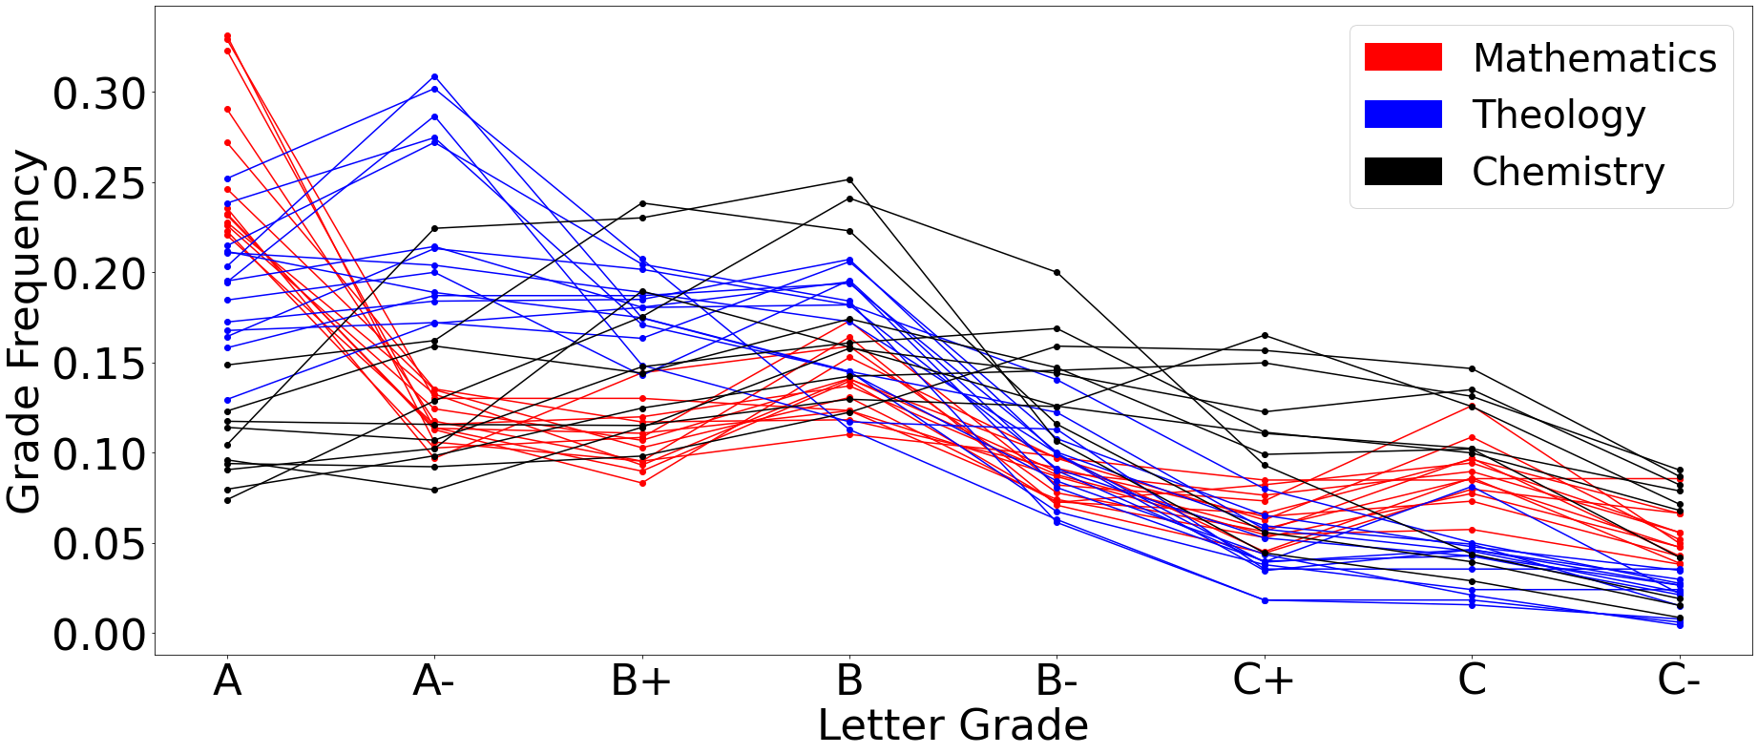
Individual Course Grade Distributions
Grade Distributions shown for each popular course in three departments
Each line represents one course (parallel coordinates)
Substantial amount of consistency (not just different averages)
Look at the distribution of A versus A- in math courses!

Slide 13
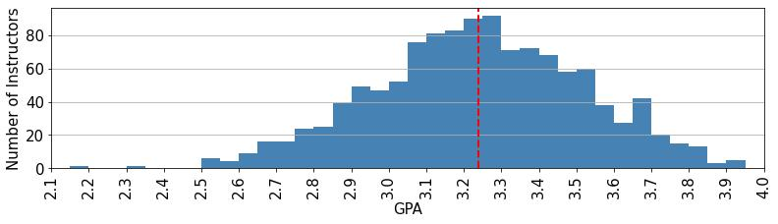
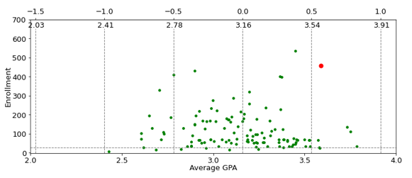
Instructor Grading Patterns
Instructor GPA Distribution (minimum 6 sections)
Substantial spread in instructor grading
The lower figure shows the distribution of individual instructors for a single course
  Y-axis shows total enrollment per instructor (can ignore those with few students)
  One instructor more than 0.5 standard deviations above mean; many below
Not shown is table of extreme graders
  One has 2.08 GPA over 248 students
  One has 3.85 GPA over 195 students
Instructor GPA Distribution (Faith and Critical Reasoning)

Slide 14
Course Sequencing Questions
Q2: What are the most common sequences of courses that students take?
  Better understand curricula and how students take courses
  Inform course scheduling and advising
Q3: How does number semesters between courses impact performance?
  Magnitude of impact may inform us about relationship between courses
  Improved advising
Q4: How does the order of taking courses impact performance?
  Identifying optimal ordering can inform advising
  Could suggest prerequisites
  May suggest relationships between courses thought to be unconnected

Slide 15
Q2: What are Most Common Course Sequences?
Variation of association analysis
  Finds frequent sequences rather than frequent itemsets (i.e., order matters).
  Uses Generalized Sequential Pattern (GSP) mining algorithm, an extension to Apriori algorithm that considers order.
  Raw data transformed so each entry ordered list of courses for one student
We have a Python-based open source tool that will run GSP on course enrollment data to find frequent sequences
  https://www.cis.fordham.edu/edmlab/software
Daniel Leeds, Cody Chen, Yijun Zhao, Fiza Metla, James Guest, and Gary Weiss. Generalized Sequential Pattern Mining of Undergraduate Courses. Proc. of 15th Int. Conference on Educational Data Mining (EDM22), Durham, UK, July 24-27, 2022.

Slide 16
Computer Science Frequent 5-Sequences
(minimum support = 50)
Index | Computer Science Frequent 5-Sequence | Support | Index | Computer Science Frequent 5-Sequence | Support
1 | Discrete Struct, CS1, CS2, Data Struct, Theory of Comp | 50 | 13 | CS1, CS2, Data Struct, Theory of Comp, Data Mining | 63
2 | CS1, CS2, Data Struct, Databases, Operating Sys | 67 | 14 | CS1, CS2, Data Struct, Data Comm and Net, Theory of Comp | 55
3 | CS1, CS2, Data Struct, Databases, Comp Alg | 60 | 15 | CS1, CS2, Databases, Operating Sys, Theory of Comp | 80
4 | CS1, CS2, Data Struct, Databases, Theory of Comp | 73 | 16 | CS1, CS2, Databases, Comp Alg, Theory of Comp | 58
5 | CS1, CS2, Data Struct, Comp Org, Operating Sys | 52 | 17 | CS1, CS2, Comp Org, Data Struct, Operating Sys | 54
6 | CS1, CS2, Data Struct, Comp Org, Comp Alg | 60 | 18 | CS1, CS2, Comp Org, Data Struct, Theory of Comp | 52
7 | CS1, CS2, Data Struct, Comp Org, Theory of Comp | 52 | 19 | CS1, CS2, Comp Org, Operating Sys, Theory of Comp | 73
8 | CS1CS1, CS2, Data Struct, Operating Sys, Comp Alg | 70 | 20 | CS1, CS2, Comp Org, Comp Alg, Theory of Comp | 59
9 | CS1, CS2, Data Struct, Operating Sys, Theory of Comp | 110 | 21 | CS1, CS2, Operating Sys, Theory of Comp, Data Mining | 50
10 | CS1, CS2, Data Struct, Operating Sys, Data Mining | 61 | 22 | CS1, Data Struct, Databases, Operating Sys, Theory of Comp | 56
11 | CS1, CS2, Data Struct, Comp Alg, Theory of Comp | 84 | 23 | CS2, Data Struct, Databases, Operating Sys, Theory of Comp | 56
12 | CS1, CS2, Data Struct, Comp Alg, Data Comm and Net | 55

Slide 17
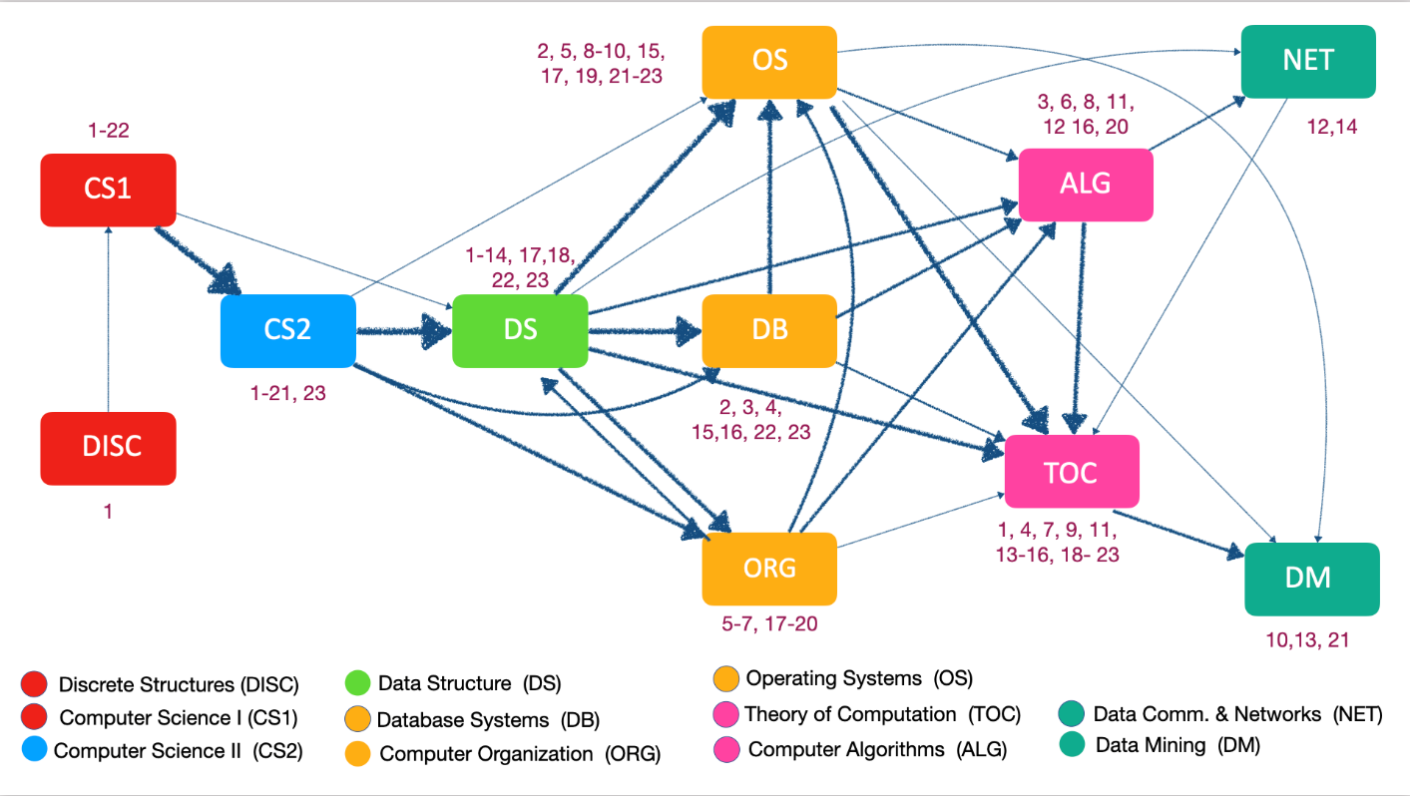
Computer Science Course Sequence Flow
(covers all 5-sequences)
Identifies CS1→CS2 →DS programming sequence
Mostly identifies different course levels (CS1 intro, Algorithms advanced)
Shows Data Mining often taken very late even though no prereqs and could be taken early
Algorithms usually taken before TOC even though similar levels and no prereq relationship. Artifact of scheduling or job prep.

Slide 18
Summary Department Level Results
 |  | Number of k-sequences (k from 2 to 9)
Department | minsup | 2 | 3 | 4 | 5 | 6 | 7 | 8 | 9
CompSci | 50* | 56 | 111 | 97 | 21 | 1
 | 100* | 61 | 61 | 18 | 1
Chemistry | 50* | 9 | 44 | 178 | 152 | 40 | 4
 | 100* | 12 | 4 | 1
Physics | 50* | 17 | 14 | 12 | 10 | 5 | 1
 | 100* | 10 | 2
Biology | 50* | 22 | 61 | 59 | 23 | 1
 | 100* | 14 | 24 | 16 | 5
Math | 50* | 40 | 98 | 68 | 6
 | 100* | 35 | 32 | 1
Psychology | 50* | 110 | 193 | 48
 | 100* | 72 | 41 | 8
Bio+Chem | 50* | 38 | 179 | 512 | 592 | 395 | 170 | 38
 | 100* | 48 | 115 | 202 | 248 | 174 | 64 | 3
All | 500* | 322 | 819 | 902 | 599 | 328 | 141 | 40
 | 1000* | 105 | 238 | 148 | 6
Minsup has large impact
Highly constrained majors have larger sequences
Adding courses makes large difference
  See “Bio+Chem”
  See “All” (high minsup to avoid exponential growth in sequences)

Slide 19
Q3: How does Gap between Courses Impact Performance?
Methodology
  We compute, for every pair of courses (A,B), the performance of students taking B after A based on semester gaps between A and B
  To remove impact of different instructor grading policies we z-normalize grades at section level (Level 1 normalization- L1)
  To remove impact of differing student abilities in the different partitions, we then z-normalize by student overall GPA (Level 2 normalization- L2)
Gary Weiss, Joseph Denham, and Daniel Leeds. The Impact of Semester Gaps on Student Grades. Proc. of The 15th Int. Conference on Educational Data Mining (EDM22), Durham, UK, July 24-27, 2022.

Slide 20
Computer Science Course Gap Table
CS1→CS2 →Data Struct is key course sequence
We focus on L2 normalization
L2 Diff is difference between performance of gap 1 and 2. Positive: larger gap worse.
Gap 1 means consecutive semesters and gap 2 means extra semester in between
Key result:
An intervening semester between CS1 & CS2 or CS2 & Data Struct leads to worse grades
 |  | L1 | L2 |  |  | L1 gap |  | L2 gap
Course 1 | Course 2 | Diff | Diff | Corr. | Stdnts | 1 | 2 | 1 | 2
CS1 | CS2 | .250 | .808 | .568 | 582 | .052 | -.198 | .078 | -.730
CS2 | DataStruct | .301 | .357 | .549 | 351 | .072 | -.229 | .063 | -.293
Databases | DataComm | .044 | .346 | .526 | 170 | .000 | -.044 | .452 | .107
Databases | OS | -.017 | .069 | .520 | 187 | .146 | .163 | .188 | .118
CS1 | Databases | .116 | .024 | .443 | 274 | -.193 | -.309 | -.087 | -.111
CS2 | Databases | -.029 | -.009 | .469 | 238 | .069 | .098 | .304 | .313
DiscMath | CS1 | -.196 | -.137 | .382 | 300 | -.320 | -.125 | -.160 | -.024
DataStruct | Algrthms | -.163 | -.346 | .526 | 232 | .011 | .174 | -.131 | .215
DataStruct | OS | -.168 | -.353 | .550 | 226 | -.114 | .054 | -.284 | .069
DataStruct | TOC | -.143 | -.412 | .460 | 251 | -.149 | -.006 | -.402 | .010

Slide 21
Spanish Course Gap Table
Spanish 1 → Spanish 2 → Lang & Lit form initial course sequence
Results show that an extra semester between these key courses leads to worse performance.
 |  | L1 | L2 |  |  | L1 gap |  | L2 gap
Course 1 | Course 2 | Diff | Diff | Corr. | Stdnts | 1 | 2 | 1 | 2
Spanish1 | Spanish2 | .686 | .420 | .663 | 2348 | .001 | -.685 | -.036 | -.456
Spanish2 | Lang&Lit | .471 | .232 | .640 | 2472 | -.023 | -.494 | -.236 | -.468
ApprToLit | LatinAmerica | -.111 | .151 | .592 | 166 | -.092 | .019 | -.451 | -.602
Spanish1 | Lang&Lit | -.317 | -.246 | .583 | 2020 | -.395 | -.078 | -.580 | -.334
Lang&Lit | ApprToLit | -.113 | -.397 | .390 | 496 | .009 | .122 | -.747 | -.350

Slide 22

Q4: How Does Order of Courses Impact Performance?
This study considers, for pairs of courses A and B, whether it is better to take A → B or B → A
  Examine all course pairs where enough common students take the courses in both orderings
  Normalize grades at section level to account for different instructor grading policies (e.g., easy graders)
  Order Benefit (defined below) measures the difference in one order over the reverse order
New metrics
  DNG = Difference in normalized grades
    ${DNG}_{A:B}=μ_{A}\left(B→A\right)−μ_{A}\left(A→B\right)$ // Advantage of taking Course A second
    ${DNG}_{B:A}=μ_{B}\left(A→B\right)−μ_{B}\left(B→A\right)$ // Advantage of taking Course B second
    Both DNGs often positive since usually do best if a course taken second
  OB = Order Benefit (positive OB preferred order)
    ${OB}_{A→B} ={DNG}_{B:A} − {DNG}_{A:B}$ (Note: ${OB}_{A→B}$ = -${OB}_{B→A}$)
    Order Benefit measures relative performance of taking B versus A second
    If ${OB}_{A→B}$> 0 then best to take A → B (if < 0 then take B → A
Tess Gutenbrunner, Daniel Leeds, Spencer Ross, Michael Riad-Zaky, and Gary Weiss, Measuring the Academic Impact of Course Sequencing using Student Grade Data. Proc. of 14th Int. Conference on Educational Data Mining (EDM21), Paris France, June 29-July 2, 2021, 799-803.

Slide 23
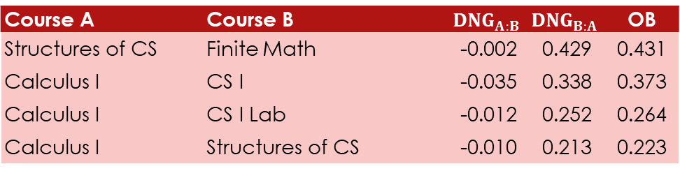
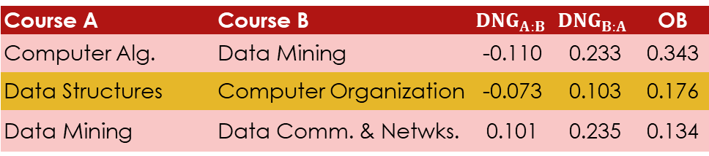
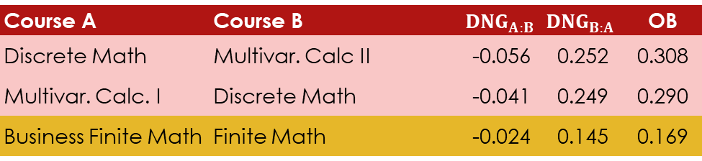
CompSci Courses with highest OB
Course A | Course B | $${DNG}_{A:B}$$ | $${DNG}_{B:A}$$ | OB
Computer Alg. | Data Mining | -0.110 | 0.233 | 0.343
Data Structures | Computer Organization | -0.073 | 0.103 | 0.176
Data Mining | Data Comm. & Netwks. | 0.101 | 0.235 | 0.134
Some of these results are easily justified
We advise students to take “Data Structures” before “Computer Org,” so supports this advice.
“Business Finite Math” and “Finite Math” cover similar material
  Assume business version simpler, so we expect best outcome if simpler taken first.
Nice to see that taking calculus before CS1 programming course is beneficial.
  Supports decision to require calculus, although hard to explain these results.
  Calculus not that important to programming especially compared to discrete math.
Math Courses with highest OB
Course A | Course B | $${DNG}_{A:B}$$ | $${DNG}_{B:A}$$ | OB
Discrete Math | Multivar. Calc II | -0.056 | 0.252 | 0.308
Multivar. Calc. I | Discrete Math | -0.041 | 0.249 | 0.290
Business Finite Math | Finite Math | -0.024 | 0.145 | 0.169
CompSci/Math Courses with highest OB
Course A | Course B | $${DNG}_{A:B}$$ | $${DNG}_{B:A}$$ | OB
Structures of CS | Finite Math | -0.002 | 0.429 | 0.431
Calculus I | CS I | -0.035 | 0.338 | 0.373
Calculus I | CS I Lab | -0.012 | 0.252 | 0.264
Calculus I | Structures of CS | -0.010 | 0.213 | 0.223

Slide 24
Q5: How Effective is an Instructor?
Motivation
  Critical for tenure and promotion decisions, deciding who should teach what courses, and who needs more training.
  Current methods rely on student surveys and peer evaluations, both of which are highly subjective and may suffer from gender and racial bias
  Our goal is to assess effectiveness only based on future performance
  Have observed that at least one “CS 2” instructor said that student grades were largely dependent on the prior instructor for “CS 1”
Gary Weiss, Erik Brown, Michael Riad-Zaky, Ruby Iannone, and Daniel Leeds. Assessing Instructor Effectiveness Based on Future Student Performance. Proc. of 15th International Conference on Educational Data Mining (EDM22), Durham, UK, July 24-27, 2022.

Slide 25
Methodology
Instructor effectiveness measured between pairs of courses (although can be subsequently aggregated)
For first course use all sections taught by instructor being evaluated and consider all sections of second course
  For example, if I teach CS1, then measure performance of my CS1 students when they take CS2 (with any instructor)
Normalize grades to account for instructor grading (Level 1) and student ability as measured by GPA (Level 2)
Compute mean instructor benefit between course pairs

Slide 26
Instructor Effectiveness for CS2
(based on Grades in Data Structures)
Data Structures follows CS2 in programming sequence
Results from Table:
  Effective instructors: F177 & F653
  Less effective: F212 & F589
  T-test between F177 and F212
    p-value of 0.0003
Other Results:
  4 of top-10 instructors from STEM
  8 of bottom-10 from STEM
Instructor | Sections | Total # Students |  | Instructor Benefit
ID | Taught | CS2 | DataStruct | Level 1 | Level 2
F212 | 12 | 293 | 158 | -0.226 | -0.189
F177 | 4 | 92 | 62 | 0.151 | 0.396
F589 | 3 | 56 | 36 | -0.177 | -0.228
F653 | 3 | 35 | 33 | -0.042 | 0.400
All | 32 | 697 | 410 | -0.145 | -0.054

Slide 27
Q6: What Major will a Student Perform Well In? Choose?
Motivation
  Selection of academic major extremely important yet often done with little guidance
  Poor choice can lead to academic failure or delay in graduation (major change)
Our approach
  View this as a recommendation problem and use collaborative filtering
  Measure similarity based on grades in core courses over first two years
  We use “average grade in major” in place of product or movie rating
    Recommend majors student will perform well in (but may not be best for them)
    Also evaluate how likely the major they choose is in the top-5 recommendations
Samuel Stein, Gary Weiss, Yiwen Chen, and Daniel Leeds. A College Major Recommendation System. Proc. of the Fourteenth ACM Conference on Recommender Systems (RECSYS 20), 640-644, September 2020.

Slide 28
Methodology
Use nearest neighbor algorithm to find similar students
  Use cosine distance as similarity metric
  Compute similarity based on grades in core courses over first two years
    Must recommend majors early on so that is why limit time
    Only use core courses since if students decide on major early, could take courses from major and that would make recommending easy
Evaluation Metric Components
  Recommended: % of cases where actual major in the top-5 of recommended majors
  nGPA > 0: If satisfied then student outperforms average major GPA
    Accounts for fact that grades vary heavily by department and major

Slide 29
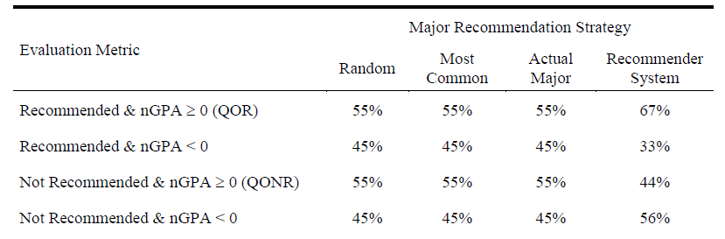
Recommendation Results
4 Recommendation Strategies
  Randomly pick major
  Pick most common major
  Pick student’s actual major
  Use recommender system
Care most about what is recommended
  QOR: recommender system does best
  Outperforms actual major!
    Only possible if students perform better in recommended versus actual major
When major is not recommended by system, students perform worse, which is encouraging

Slide 30
Majors often Recommended with Neuroscience

Slide 31
Q7: How Can we Group Courses Based on Similar Student Performance?
Measuring similarity
  Two courses are considered similar if the correlation of grades of students taking both courses is high (above threshold)
  There may be a causal link (doing well in the one impacts the other) or no causal link (the courses may require similar skills)
  This is a relatively unusual/innovative way of measuring course similarity
Related useful questions:
  Are courses within a major more similar than courses in different majors?
  Can pairwise similarities be used to form meaningful course clusters?
  Are there high-level patterns that exist/differ between course groupings?
Daniel Leeds, Tianyi Zhang and Gary Weiss, Mining Course Groupings using Academic Performance. Proc. of 14th Int. Conference on Educational Data Mining (EDM21), Paris France, June 29-July 2, 2021, 804-808.

Slide 32
Methodology
Normalize grade at section level to account for different instructor grading policies (easy vs. hard).
Generate course pair dataset (e.g., CS1, CS2), with grades of common students in same position.
Compute correlation between grade vectors pairs
Form graph with courses as node
  Edge between courses if grade correlation above threshold.
Analyze graph

Slide 33
Distribution of Course-Pair Correlations
Graph has edge if correlation ≥ 0.5
  covers 20% of courses
Strong (weak) students may perform similarly in different classes
  but still much variation

Slide 34
Course Pairs with High Correlations
Course 1 | Course 2 | Correlation
Comp Sci 2 | Comp Sci 2 Lab | 0.95
Gen Phys 1 | Computational Neuro. | 0.81
Intro Bio 1 | Intro Bio 1 Lab | 0.79
Web Programming | Bioinformatics | 0.79
Learning | Health Psychology | 0.78
Gen Chem 2 Lab | Computer Algorithms | 0.78
Philos. of Human Nature | Infant & Child Develop. | 0.78
Law & Psychology | Cllinical Child Psych. | 0.77
Lectures and their labs heavily correlated
  This is expected
Connection between General Physics and Comp. Neuro. interesting
Chem Lab & Algorithms correlated
  Both involve following ”recipe”?

Slide 35
Network/Graph Analysis & Metrics
Modularity:
  Groups of nodes are densely connected to each other
    High modularity score means more edges than expected by chance
Betweenness Centrality:
  How often node appears on shortest paths between random pair of nodes
Next three figures automatically generated by Gephi (www.gephi.org)
  Color indicates modularity class
  Size represents betweenness centrality

Slide 36
Course Network for Computer Science
Purple: Mainly Programming Courses
  Data Mining (4631)
  Web Programming (2350)
  Informatics (2500)
  CS I with Lab (1600, 1610)
  CS II with lab (2000, 2010)
  Scientific Computing (4750)
Green: Advanced CS Courses
Data Structures (2200)
Algorithms (4080)
Theory of Computation(4090)
Operating Systems (3593)
UNIX programming (3130)
Blue: Info Science& Miscellaneous
Computer Data Analysis )2850)
Database Systems (3500)
Advanced Database Systems (4515)
Robots and Film (3001)
  Color indicates modularity class
  Size represents betweenness centrality

Slide 37
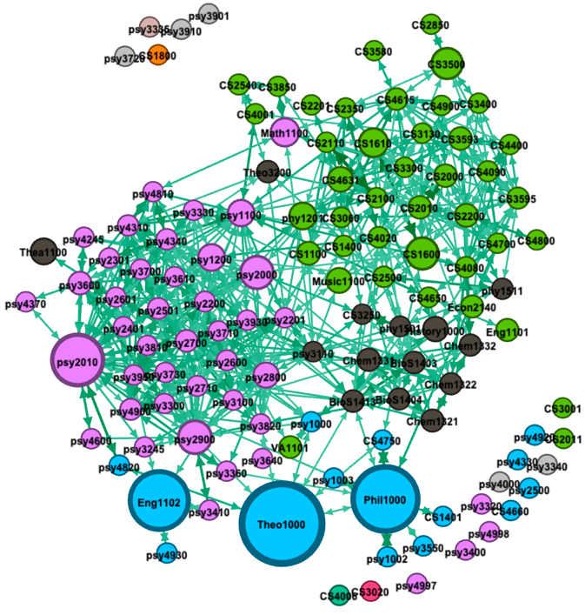
Course Network for 3 Departments + Core Curriculum Courses
Modularity classes:
  Green (right): Computer Science
  Purple (left): Psychology
  Dark grey (under green): Pre-health courses
Courses within departments better connected than between departments
First-year core curriculum courses large and hence have high betweenness-centrality
  English 1102
  Theology 1000
  Philosophy 1000
  Color indicates modularity class
  Size represents betweenness centrality

Slide 38
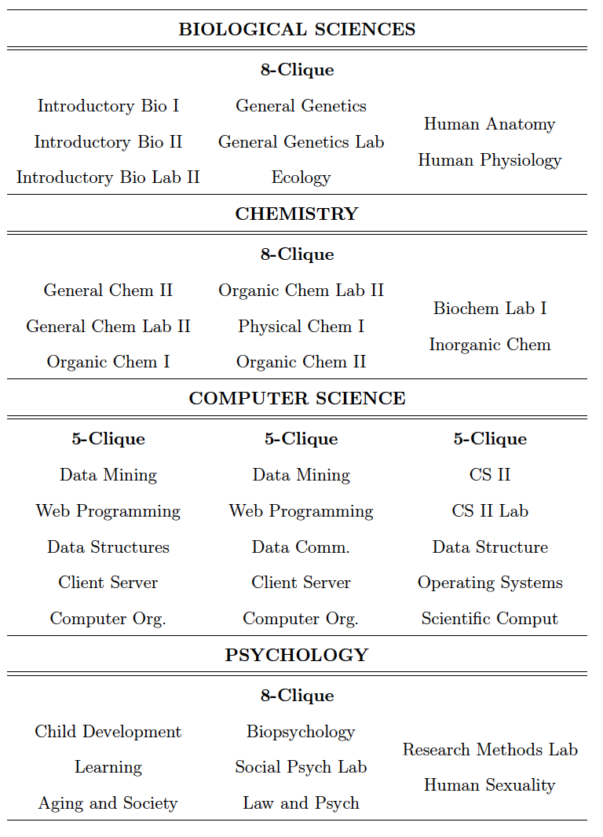
Courses Comprising the Largest Cliques
Clique:
  Fully connected set of nodes (edge between all nodes)
  N-clique: clique with n nodes
Courses within a clique usually follow a common theme

Slide 39
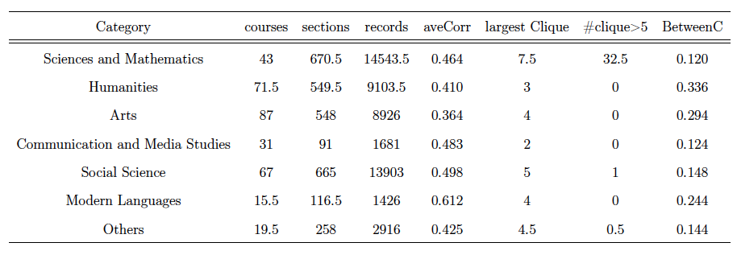
Category Level Summary Clique Info
Science & Math have the most large cliques and lowest betweenness centrality
  Makes sense if most courses are highly related/connected
Modern Languages has the highest average correlation
  Courses highly connected/related, as expected (fewer courses limits cliques)

Slide 40
Q8: What Can we Learn from Course Co-enrollment Patterns?
Use graph theory to learn about courses frequently taken together
  Differs from last Q7 since that focused on grade similarity
  Identify hub courses that are well connected to other courses
  Compute network metrics to provide insight into course groupings/subnetworks
    A traditional task often applied to social networks
Acquired knowledge can aid in:
  course planning
  understanding course structure in different academic departments
  as-yet-unknown benefits
Gary Weiss, Nam Nguyen, Karla Dominguez and Daniel Leeds. Identifying Hubs in Undergraduate Course Networks Based on Scaled Co-Enrollments. Proc. of The 14th Int. Conference on Educational Data Mining (EDM21), Paris France, June 29-July 2, 2021, 809-813.

Slide 41
Formation of Network Graph
Network graph again formed from the course-pair data
  Nodes represent courses and edges connect nodes if number common students above threshold
Two types of thresholds
  Static: edge included if at least 20 common students
  Dynamic: edge included if co-enrollment proportion exceeds threshold and at least 20 common students
  Dynamic threshold removes many edges associated with popular core curriculum courses.

Slide 42
Network Analysis Metrics
Metric | Summary Description | Range
Density | Fraction of possible edges present | 0 - 1
Diameter | Maximum distance between any pair of nodes in network | Z⁺
Ave. Clustering Coefficient (ACC) | Fraction of pairs of neighbor nodes connected to each other | 0 - 1
Degree Centrality | Number of edges to node (degree) | Z⁺
Eigenvector centrality | Based on centrality of node’s neighbors | ≥ 0
Betweenness centrality | Measure all shortest paths passing through a node | ≥ 0
Network or Subnetwork Level
Node Level Centrality Metrics

Slide 43
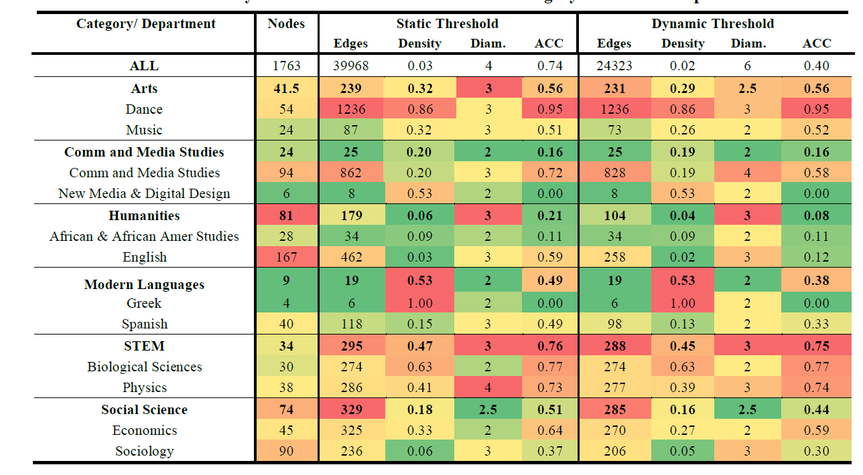
Course Network Results
Two departments displayed per category
Network covering “All” courses has much lower density
Dynamic threshold vs. Static
  decreases edges, density, and cluster coefficient (AC)
STEM departments have very high density and ACC
  Most likely because the knowledge in courses is dependent on other courses
    Lots of prerequisites

Slide 44
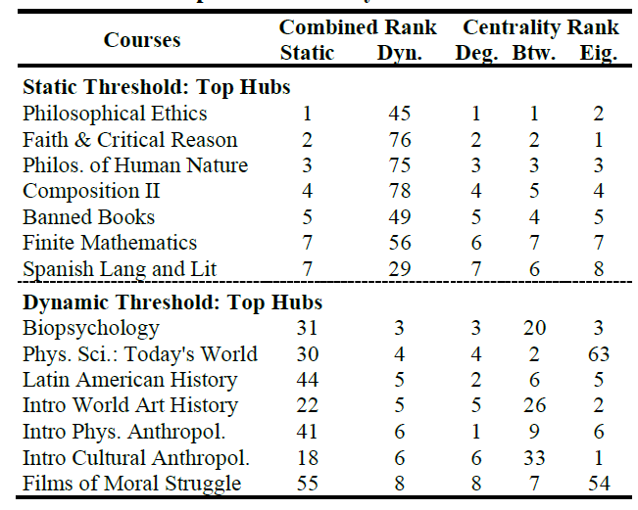
Hub Analysis
Top static and dynamic hubs based on combined rank that is median of 3 centrality metrics
  Similar values for static but not dynamic threshold
Core courses dominate static hubs
  Not surprising that popular courses taken by most students are always hubs
  Lower ranked static hubs that are not core courses may be more interesting
Dynamic hubs may be interesting
  Biopsychology frequently taken with many other courses
    Makes sense since it is of interest to several communities

Slide 45


Slide 46
Limitations and Future Work
Limitations
  Little validation, but difficult for descriptive data analysis/data mining
    Could replicate statistics across subsets of data (like train and test sets)
  Maybe link to other info sources
    E.g., validate instructor effectiveness via student surveys
  We often find that our dataset is not as large as we would like
    Especially at the department, instructor (small class size), course level
Future Work
  Replicate grading study on other universities’ data (we have the data)
  Working to make our grading and sequence analysis tools easy to use
    Code shareable now and packaged with documentation/tutorials within few weeks
    https://www.cis.fordham.edu/edmlab/software/

Slide 47
Other Educational Research
Working with Dr. Yijun Zhao on studying MS in Computer Science and MS in Data Science admission application data
  Predicting admissions decisions using predictive modeling including textual data (letters of recommendation and resumes)
  Analyzing letters of recommendation for gender bias and cultural bias based on country of origin
  If interested, we expect most of this work to be published within the next few weeks

Slide 48
Fordham EDM Lab References
References numbered by the questions covered in this talk (listed on slide 3)
  https://www.cis.fordham.edu/edmlab/publications
Gary M. Weiss, Luisa A. L. Rosa, Hyun Jeong and Daniel D. Leeds (2023). An Analysis of Grading Patterns in Undergraduate University Courses. Proceedings of the 2023 IEEE 467h Annual Computers, Software, and Applications Conference (COMPSAC), IEEE, Torino, Italy.
Daniel Leeds, Cody Chen, Yijun Zhao, Fiza Metla, James Guest, and Gary Weiss. Generalized Sequential Pattern Mining of Undergraduate Courses. Proc. of 15th Int. Conference on Educational Data Mining (EDM22), Durham, UK, July 24-27, 2022.
Gary Weiss, Joseph Denham, and Daniel Leeds. The Impact of Semester Gaps on Student Grades. Proc. of The 15th Int. Conference on Educational Data Mining (EDM22), Durham, UK, July 24-27, 2022.
Tess Gutenbrunner, Daniel Leeds, Spencer Ross, Michael Riad-Zaky, and Gary Weiss, Measuring the Academic Impact of Course Sequencing using Student Grade Data. Proc. of 14th Int. Conference on Educational Data Mining (EDM21), Paris France, June 29-July 2, 2021, 799-803.
Gary Weiss, Erik Brown, Michael Riad-Zaky, Ruby Iannone, and Daniel Leeds. Assessing Instructor Effectiveness Based on Future Student Performance. Proc. of 15th International Conference on Educational Data Mining (EDM22), Durham, UK, July 24-27, 2022.
Samuel Stein, Gary Weiss, Yiwen Chen, and Daniel Leeds. A College Major Recommendation System. Proc. of the Fourteenth ACM Conference on Recommender Systems (RECSYS 20), 640-644, September 2020.
Daniel Leeds, Tianyi Zhang and Gary Weiss, Mining Course Groupings using Academic Performance. Proc. of 14th Int. Conference on Educational Data Mining (EDM21), Paris France, June 29-July 2, 2021, 804-808.
Gary Weiss, Nam Nguyen, Karla Dominguez and Daniel Leeds. Identifying Hubs in Undergraduate Course Networks Based on Scaled Co-Enrollments. Proc. of The 14th Int. Conference on Educational Data Mining (EDM21), Paris France, June 29-July 2, 2021, 809-813.

Slide 49
Acknowledgements
All of this research was done collaboratively with Dr. Daniel Leeds and some with Dr. Yijun Zhao
Many graduate and undergraduate students were involved in this research. The following appear as co-authors on the papers:
  Erik Brown, Cody Chen, Yiwen Chen, Joseph Denham, Karla Dominguez,
  James Guest, Ruby Iannone, Hyun Jeong, Fiza Metla, Nam Nguyen, Michael Riad-Zaky, Luisa Rosa, Spencer Ross, Samuel Stein , Tianyi Zhang

Slide 50
Questions?
For more information:
You can contact me at: gaweiss@fordham.edu
My webpage: https://storm.cis.fordham.edu/~gweiss/
EDM Lab page: https://www.cis.fordham.edu/edmlab/
These Slides: https://storm.cis.fordham.edu/~gweiss/presentations/Weiss-ICDATA23-invited-talk.pptx (or .pdf)

