Slide 1
CISC 4090 Theory of Computation
Final slides
Relating CFGs and PDAs
Identifying non-CFG languages
Context-Free Languages and
Push Down Automata
Professor Daniel Leeds
dleeds@fordham.edu
JMH 332

Slide 2
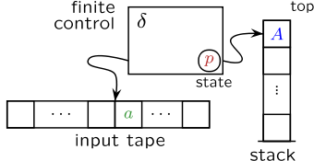
Push down automata
$$1,0 →ε$$
q₂
q₃
FSA augmented with memory
Equivalent to CFG if use non-determinism
Finite control: transition function
Tape: holds input string
Stack: Can write to stack/read from stack
Input is Last In First Out (“LIFO”)

Slide 3
PDA to accept 0^{n}1^{n}
$$0,ε→0$$
$$1,0→ε$$
$$ε,ε→\$$$
$$1,0 →ε$$
$$ε,\$ →ε$$
q₁
q₂
q₃
q₄
Input: 0011
0
0
0
0
$
$
$
$
$

Slide 4
PDA to accept {ww^{R}}
Equivalent CFG:
S -> 0S0 | 1S1 | 0 | 1 | $ε$
Power of non-determinism:
At start, don’t know where string w ends
$$0,ε→0$$
$$1,ε→1$$
$$0,0→ε$$
$$1,1→ε$$
$$ε,ε→\$$$
$$ε,ε→ε$$
$$ε,\$ →ε$$
q₁
q₂
q₃
q₄

Slide 5
PDA to accept a^{i}b^{j}c^{k}, i=j or j=k

Slide 6
PDA to accept a^{i}b^{j}c^{k}, i=j or j=k
Power of non-determinism:
At start, don’t know if i=j or j=k
$$a,ε→a$$
$$b,a→ε$$
$$c,ε→ε$$
$$0,ε→0$$
$$1,ε→1$$
$$b,a →ε$$
$$ε,\$ →ε$$
$$a,ε→a$$
q₃
q₃
q₄
$$ε,ε→\$$$
q₁
q₂
$$a,ε→ε$$
$$b,ε→b$$
$$c,b→ε$$
$$ε,ε→ε$$
$$c,b →ε$$
$$ε,\$ →ε$$
q₅
q₃
q₃
q₄
$$b,ε→b$$

Slide 7
Theorem: A language is context free if and only if some PDA recognizes it
Let’s prove: If a language L is CFL, some PDA recognizes it
Idea: Show how CFG can define a PDA
Stack has set of terminals/variables to compare with input
Place proper terminal/variable pattern onto stack based on rules
Non-determinism: Clone your machine, following different branches of rules

Slide 8
CFG -> PDA
If top of stack is variable, sub one right-hand rule for the variable
If top of stack is terminal, keep going iff terminal matches input
If top of stack is $, accept!

Slide 9
Example 2.25 in textbook
S -> aTb | b
T -> Ta | $ε$
q₁
$$ε,ε→\$$$
$$ε,S→b$$
$$ε,ε→T$$
$$ε,ε→a$$
$$ε,T→a$$
$$ε,ε→T$$
$$ε,ε→S$$
loop
$$ε,S →b$$
$$ε,T →ε$$
$$a,a →ε$$
$$b,b →ε$$
$$ε,\$→ε$$
fin

Slide 10
Theorem: A language is context free if and only if some PDA recognizes it
Let’s prove: If a language L is CFL, some PDA recognizes it
Idea: Show how CFG can define a PDA
Stack has set of terminals/variables to compare with input
Place proper terminal/variable pattern onto stack based on rules
Non-determinism: Clone your machine, following different branches of rules

Slide 11
Regular languages vs. CFLs
CFGs define CFLs
PDAs recognize CFLs and Regular languages
FSAs recognize Regular languages, but not CFLs
CFLs and Regular languages not equivalent

Slide 12
Non Context Free Languages
Languages recognized by PDAs
L={ww^{R}}
L={a^{n}b^{n} | n$≥$0}
Languages not recognized by PDAs
L={ww}
L={a^{n}b^{n}c^{n} | n$≥$0}

Slide 13
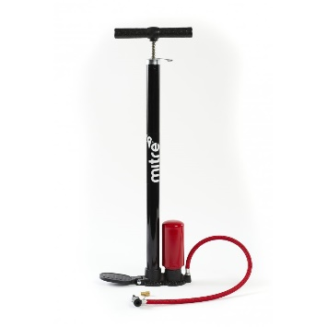
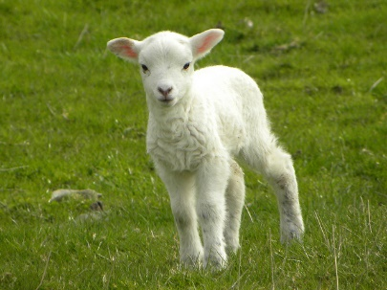
Proving non context free – NEW pumping lemma!
Every string in CFL A with length greater than or equal to the pumping length p can be “pumped”
Every string $w∈A$ (|w|$≥$p) can be written as uvxyz where
For each $i≥0$, $uv^{i}xy^{i}z∈A$
|vy| > 0
$\left|vxy\right|≤p$

Slide 14
Regular language PUMPING: Proof idea
If $\left|s\right|<p$, trivially true
If |s| $≥$p, consider the states the FSA goes through
Since there are only p states, |s|>p, one state must be repeated
Pigeonhole principle: There must be a cycle

Slide 15
CFL pumping: Proof idea
T
Pigeonhole idea: Given a long enough string, some variable will need to be repeated
Example Grammar: S -> uRz
R -> x | vRy
R
R
u v x y z

Slide 16
Prove F={ww | w=${\left(0∪1\right)}^{∗}$} not CFL
Try a sample string s={0^{p}10^{p}1} |s|>p
Can we define uvxyz=s so uv^{i}xy^{i}z$∈$F ?
Yes: u=0^{p-1} , v=0, x=1, y=0, z=0^{p-1}1
Try another sample string s={0^{p}1^{p}0^{p}1^{p}}
Can we define uvxyz=s so uv^{i}xy^{i}z$∈$F ?
No:
If vxy is in first w, pumping will make increase 1’s and/or 0’s in first w but not in second
If vxy straddles the middle, vxy will either increase 1’s for first w and 0’s for second w, or will break the 0^{n}1^{n} pattern

Slide 17
Prove B={a^{n}b^{n}c^{n} | n$≥$0} not CFL

