Slide 1
CISC 4090 Theory of Computation
Turing machines
Professor Daniel Leeds
dleeds@fordham.edu
JMH 332

Slide 2
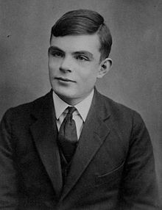
Alan Turing (1912-1954)
Father of Theoretical Computer Science
Key figure in Artificial Intelligence
Codebreaker for Britain in World War I

Slide 3
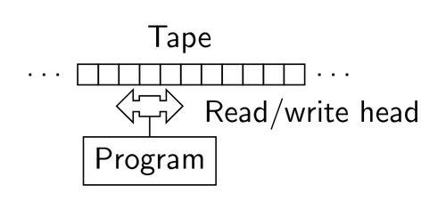
Turing machine
Simple theoretical machine
Can do anything a real computer can do!

Slide 4
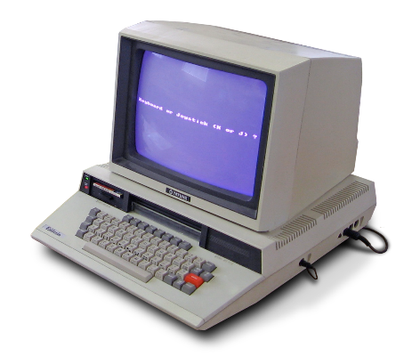
Detour: “Turing test”
A computer is “intelligent” if human investigator can’t tell if she’s talking to a human or a computer

Slide 5
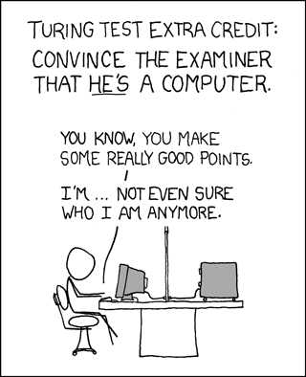
http://xkcd.com/329/

Slide 6
Turing machine
Simple theoretical machine
Can do anything a real computer can do!

Slide 7
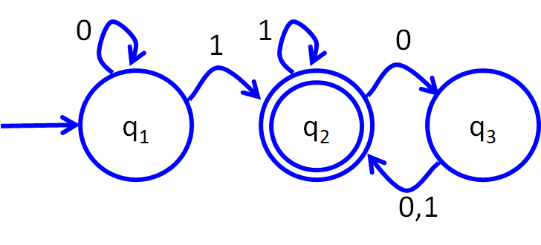
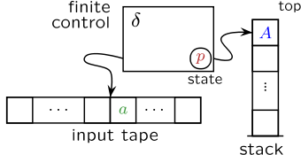
Review of machines
Finite state automaton (Regular languages)
Push down automaton (Context free languages)
Turing machine (beyond CFLs)

Slide 8
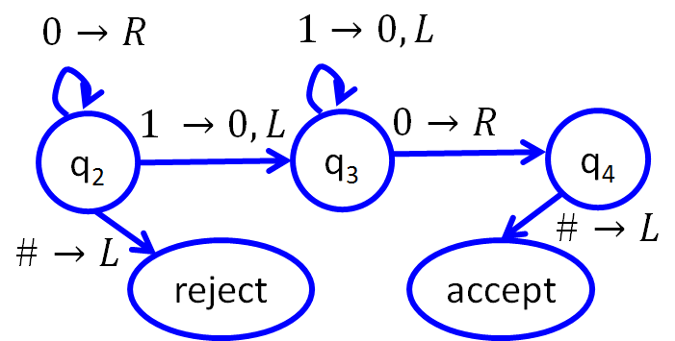
Turing machine structure
Infinite tape
At each step
Must move left/right on tape
Can change state
Can change tape content
When reaches accept or reject state, terminates and outputs “accept” or “reject”
Can loop forever
Control
State Machine
Read/write head
0 1 0 0 1 2 1 0 0
Tape

Slide 9
accept
reject
$$1→0,R$$
$$0→0,R$$
$$1→0,L$$
$$0→0,R$$
$$1 →0,R$$
$$0→1,R$$
q₂
q₃
q₄
$$\#→\#,L$$
$$\#→\#,L$$
reject
accept

Slide 10
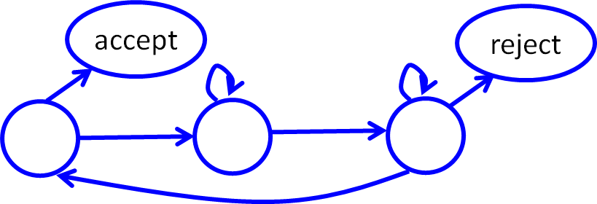
A Turing Machine for B={w#w|$w∈{\left\{0,1\right\}}^{∗}$}
Assume the string is written on the tape and you start at the beginning of the string. What can we do?
Control
State Machine
~ 0 1 0 0 1 # 0 1 0 0 1 ~
Tape

Slide 11
Strategy:
Find left-most 0-or-1 character in first word
If match left-most character in second word, X out both chars
Else reject
If no characters left, accept
~ ~ ~ 0 1 1 0 0 0 # 0 1 1 0 0 0 ~ ~ ~
~ ~ ~ X 1 1 0 0 0 # X 1 1 0 0 0 ~ ~ ~
~ ~ ~ X X 1 0 0 0 # X X 1 0 0 0 ~ ~ ~
How do we move this with single actions: move-by-one and write?

Slide 12
Strategy, in more detail:
Read left-most character, X it out
Move right until find #, then move right until find 0-or-1-or-~
If current character is ~ or mismatches with character before #: reject
Else, X it out
Move left until pass #, keep moving until find first X
Move one to right
If #, check right hand string,
If no extra chars, accept
If not #, go to top
~ ~ ~ 0 1 1 0 0 0 # 0 1 1 0 0 0 ~ ~ ~
~ ~ ~ X 1 1 0 0 0 # 0 1 1 0 0 0 ~ ~ ~
~ ~ ~ X 1 1 0 0 0 # 0 1 1 0 0 0 ~ ~ ~
…
~ ~ ~ X 1 1 0 0 0 # 0 1 1 0 0 0 ~ ~ ~
~ ~ ~ X 1 1 0 0 0 # X 1 1 0 0 0 ~ ~ ~
Problem keeps shrinking
Will accept or reject each input

Slide 13
Turing machine: the formal definition
7 tuple: $\left(Q,Σ,Γ,δ,q_{0},q_{accept},q_{reject}\right)$
Q is set of states
$Σ$ is input alphabet
$Γ$ is the tape alphabet; blank$∈Γ$ and $Σ∈Γ$
$δ:Q×Γ→Q×Γ×\left\{L,R\right\}$ transition function
Start, accept, and reject state: q₀, q_{accept}, q_{reject}

Slide 14
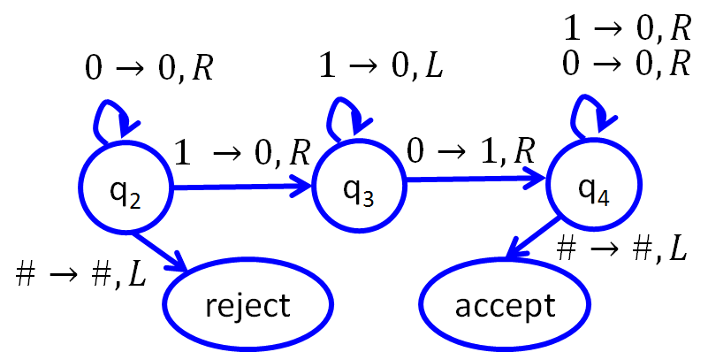
The transition function
$δ:Q×Γ→Q×Γ×\left\{L,R\right\}$
Given state q and symbol a at present location on tape,
change to state r, change symbol on tape to b, move Left or Right
Change in: (state, tape content, head location) – called “configuration”

Slide 15
The transition function
Example:
Start at q₂. Current position underlined.
Step 0: q₂ ~ 0 0 1 1 # ~ ~ 0 0 1 1 # ~
Step 1: q₃ ~ 0 0 0 1 # ~ ~ 0 0 0 1 # ~
Step 2: q? Tape: ? ? ?
Step 3: q? Tape: ? ? ?

Slide 16
The transition function
Example:
Start at q₂. Current position underlined.
Step 0: q₂ ~ 0 0 1 1 # ~ ~ 0 0 1 1 # ~
Step 1: q₃ ~ 0 0 0 1 # ~ ~ 0 0 0 1 # ~
Step 2: q₄ ~ 0 1 0 1 # ~
Step 3: q₄ ~ 0 1 0 1 # ~

Slide 17
The transition function
Example:
Start at q₂. Current position underlined.
Step 0: q₂ ~ 0 0 # 1 # ~ ~ 0 0 # 1 # ~
Step 1: q₃ ~ 0 0 # 1 # ~ ~ 0 0 # 1 # ~
Step 2: q? Tape: ? ? ?
Step 3: q? Tape: ? ? ?

Slide 18
The transition function
Example:
Start at q₂. Current position underlined.
Step 0: q₂ ~ 0 0 # 1 # ~ ~ 0 0 # 1 # ~
Step 1: q₃ ~ 0 0 # 1 # ~ ~ 0 0 # 1 # ~
Step 2: q₄ ~ 0 1 # 1 # ~
Step 3: accept ~ 0 1 # 1 # ~

Slide 19
Strategy: B={w#w|$w∈{\left\{0,1\right\}}^{∗}$}
Find left-most 0-or-1 character in first word
If match left-most character in second word, X out both chars
Else reject
If no characters left, accept
~ ~ ~ 0 1 1 0 0 0 # 0 1 1 0 0 0 ~ ~ ~
~ ~ ~ X 1 1 0 0 0 # X 1 1 0 0 0 ~ ~ ~
~ ~ ~ X X 1 0 0 0 # X X 1 0 0 0 ~ ~ ~

Slide 20
Strategy: B={w#w|$w∈{\left\{0,1\right\}}^{∗}$}
Define TM state sequence for each big-picture algorithmic step
Given character s in left word
Move to right word
Check if first available symbol in right word == s
If match, keep going; else reject
~ ~ ~ 0 1 1 0 0 0 # 0 1 1 0 0 0 ~ ~ ~
~ ~ ~ X 1 1 0 0 0 # X 1 1 0 0 0 ~ ~ ~
~ ~ ~ X X 1 0 0 0 # X X 1 0 0 0 ~ ~ ~

Slide 21
Strategy: B={w#w|$w∈{\left\{0,1\right\}}^{∗}$}
$$0→X,R$$
$$1→X,R$$
Move to right word
$$0→0,R$$
$$1→1,R$$
$$0→0,R$$
$$1→1,R$$
$$\#→\#,R$$
$$\#→\#,R$$
Pass right of #
Given character s in left word
Move to right word
Check if first available symbol in right word == s
If match, keep going; else reject
Check if first free symbol is 0
Check if first free symbol is 1

Slide 22
Strategy: B={w#w|$w∈{\left\{0,1\right\}}^{∗}$}
$$0→X,R$$
$$1→X,R$$
Move to right word
$$0→0,R$$
$$1→1,R$$
$$0→0,R$$
$$1→1,R$$
$$\#→\#,R$$
$$\#→\#,R$$
Pass right of #
$$X→X,R$$
$$X→X,R$$
$$1→1,L$$
$$0→X,L$$
$$0→0,L$$
reject
$$1→1,L$$
reject
Go back to left word

Slide 23
Strategy: B={w#w|$w∈{\left\{0,1\right\}}^{∗}$}
Typical big-picture solution
Find left-most 0-or-1 character in first word
If match left-most character in second word, X out both chars
Else reject
If no characters left, accept
~ ~ ~ 0 1 1 0 0 0 # 0 1 1 0 0 0 ~ ~ ~
~ ~ ~ X 1 1 0 0 0 # X 1 1 0 0 0 ~ ~ ~
~ ~ ~ X X 1 0 0 0 # X X 1 0 0 0 ~ ~ ~

Slide 24
Strategy: B={w#w|$w∈{\left\{0,1\right\}}^{∗}$}
Find left-most 0-or-1 character in first word
If match left-most character in second word, X out both chars
Else reject
If no characters left, accept
Analysis: We will always get an answer (accept or reject), because problem gets smaller after each step
~ ~ ~ 0 1 1 0 0 0 # 0 1 1 0 0 0 ~ ~ ~
~ ~ ~ X 1 1 0 0 0 # X 1 1 0 0 0 ~ ~ ~
~ ~ ~ X X 1 0 0 0 # X X 1 0 0 0 ~ ~ ~

Slide 25
Some TM details for B={w#w|$w∈{\left\{0,1\right\}}^{∗}$}
After X out the 0 at the far left, move right looking for the first digit after # to be 0. Use state q_{MoveTo#->(Then0)}
$δ$(q_{MoveTo#->(Then0)},0) -> (q_{MoveTo#->(Then0)},0,R)
$δ$(q_{MoveTo#->(Then0)},0) -> (q_{MoveTo#->(Then0)},0,R)
$δ$(q_{MoveTo#->(Then0)},#) -> (q_{Find0},0,R)
Once we’ve passed #, search for matching digit for 0: q_{Find0}
$δ$(q_{Find0},X) -> (q_{Find0},X,R)
$δ$(q_{Find0},0) -> (q_{MoveTo#<-},X,L)
$δ$(q_{Find0},1) -> (q_{reject},?,?)
$δ$(q_{Find0},~) -> (q_{reject},?,?)
~ 0 1 1 0 0 0 # 0 1 1 0 0 0 ~ ~
~ X 1 1 0 0 0 # 0 1 1 0 0 0 ~ ~

Slide 26
“Turing recognizable” vs. “Decidable”
L(M) – “language recognized by M” is set of strings M accepts
Language is Turing recognizable if some Turing machine recognizes it
Also called “recursively enumerable”
Machine that halts on all inputs is a decider. A decider that recognizes language L is said to decide language L
Language is Turing decidable, or just decidable, if some Turing machine decides it

