Slide 1
Machine Learning
CISC 5800
Dr Daniel Leeds

Slide 2
What is machine learning
Finding patterns in data
Adapting program behavior
Advertise a customer’s favorite products
Search the web to find pictures of dogs
Change radio channel when user says “change channel”

Slide 3
Advertise a customer’s favorite products
This summer, I had two meetings, one in Portland and one in Baltimore
Today I get an e-mail from Priceline:

Slide 4
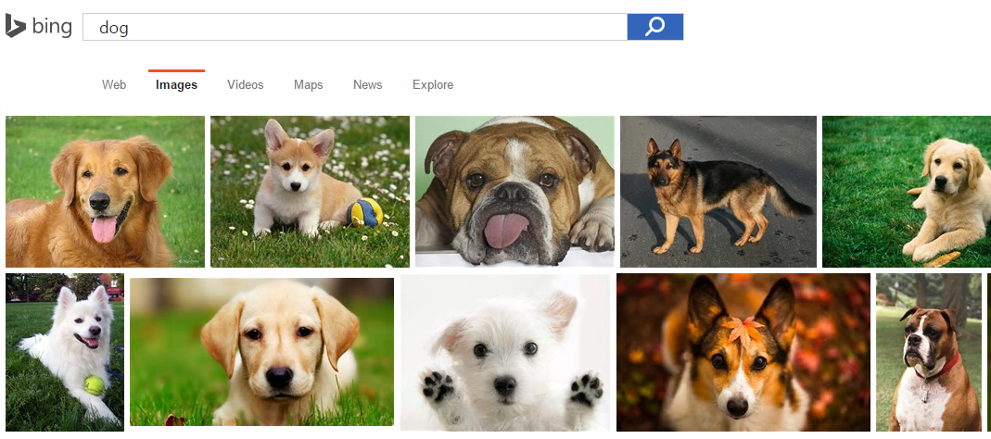
Search the web to find pictures of dogs
Filenames:
- Dog.jpg
- Puppy.bmp
Caption text
Pixel patterns

Slide 5
Change radio channel when user says “change channel”
Distinguish user’s voice from music
Understand what user has said

Slide 6
What’s covered in this class
Theory: describing patterns in data
Probability
Linear algebra
Calculus/optimization
Implementation: programming to find and react to patterns in data
Matlab
Data sets of text, speech, pictures, user actions, neural data…

Slide 7
Outline of topics
Groundwork: probability, slopes, and programming
Classification overview: Training, testing, and overfitting
Discriminative and generative methods: Regression vs Naïve Bayes
Classifier theory: Separability, information criteria
Support vector machines: Slack variables and kernels
Expectation-Maximization: Gaussian mixture models
Dimensionality reduction: Principle Component Analysis
Graphical models: Bayes nets, Hidden Markov model

Slide 8
What you need to do in this class
Class attendance
Assignments: homeworks (4) and final project
Exams: midterm and final

Slide 9
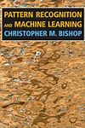
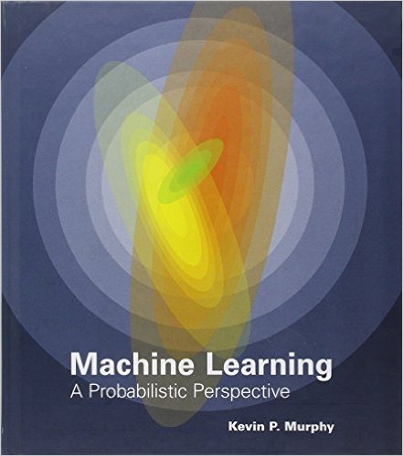
Resources
Office hours: Wednesday 3-4pm and by appointment
Course web site: http://storm.cis.fordham.edu/leeds/cisc5800
Fellow students
Textbooks/online notes
Matlab

Slide 10
Outline of topics
Groundwork: probability, slopes, and programming
Classification overview: Training, testing, and overfitting
Discriminative and generative methods: Regression vs Naïve Bayes
Classifier theory: Separability, information criteria
Support vector machines: Slack variables and kernels
Expectation-Maximization: Gaussian mixture models
Dimensionality reduction: Principle Component Analysis
Graphical models: Bayes nets, Hidden Markov model

Slide 11
Probability
What is the probability that a child likes chocolate?
The “frequentist” approach:
Ask 100 children
Count who likes chocolate
Divide by number of children asked
P(“child likes chocolate”) = $\frac{85}{100}=0.85$
In short: P(C)=0.85 C=“child likes chocolate”
Name | Chocolate?
Sarah | Yes
Melissa | Yes
Darren | No
Stacy | Yes
Brian | No

Slide 12
General probability properties
P(A) means “Probability that statement A is true”
0≤Prob(A) ≤1
Prob(True)=1
Prob(False)=0

Slide 13
Random variables
A variable can take on a value from a given set of values:
{True, False}
{Cat, Dog, Horse, Cow}
{0,1,2,3,4,5,6,7}
A random variable holds each value with a given probability
To start, let us consider a binary variable
P(LikesChocolate) = P(LikesChocolate=True) = 0.85

Slide 14
Complements
C=“child likes chocolate”
P(“child likes chocolate”) = $\frac{85}{100}=0.85$
What is the probability that a child DOES NOT like chocolate?
Complement: C’ = “child doesn’t like chocolate”
P(C’) =
In general: P(A’) =
All children (the full “sample space”)
C’
C

Slide 15
Addition rule
Name | Chocolate? | Ice cream?
Sarah | Yes | No
Melissa | Yes | Yes
Darren | No | No
Stacy | Yes | Yes
Brian | No | Yes
Prob(A or B) = ???
C=“child likes chocolate”
I=“child likes ice cream”
All children
C
I

Slide 16
Joint and marginal probabilities
Across 100 children:
55 like chocolate AND ice cream
30 like chocolate but not ice cream
5 like ice cream but not chocolate
10 don’t like chocolate nor ice cream
Corrected slide
Prob(I) =
Prob(C) =
Prob(I,C)

Slide 17
Conditional probability
Corrected slide
Also, Multiplication Rule:
P(A,B) = P(A|B) P(B)
P(A,B):Probability A and B
are both true
Across 100 children:
55 like chocolate AND ice cream P(C,I)
30 like chocolate but not ice cream P(C,I’)
5 like ice cream but not chocolate P(C’,I)
10 don’t like chocolate nor ice cream P(C’,I’)
Prob(C|I) : Probability child likes chocolate given s/he likes ice cream
P(C|I) = $\frac{P(C,I)}{P(I)}=\frac{P(C,I)}{P\left(C,I\right)+P(C^{′},I)}$

Slide 18
Independence
If the truth value of B does not affect the truth value of A:
P(A|B) = P(A)
Equivalently
P(A,B) = P(A) P(B)

Slide 19
Multi-valued random variables
A random variable can hold more than two values, each with a given probability
P(Animal=Cat)=0.5
P(Animal=Dog)=0.3
P(Animal=Horse)=0.1
P(Animal=Cow)=0.1

Slide 20
Probability rules: multi-valued variables
For a given variable A:
P($A=a_{i}$ and $A=a_{j}$) = 0 if $i≠j$
$\sum_{i}{P\left(A=a_{i}\right)=1}$
$P\left(A=a_{i}\right)=\sum_{j}{P(A=a_{i},B=b_{j})}$
animal
cat
dog
horse
cow

Slide 21
Bayes rule
$$P(A|B)=\frac{P\left(B | A\right)P(A)}{P(B)}$$
Terminology:
P(A|B) is the “posterior probability”
P(B|A) is the “likelihood”
P(A) is the “prior probability”
We will spend (much) more time with Bayes rule in following lectures
Notes:
Two multi-valued variables. Examples of bayes and marginal and conditional

Slide 22
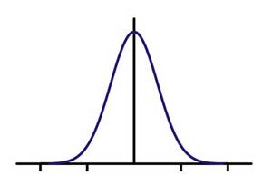
Continuous random variables
A random variable can take on a continuous range of values
From 0 to 1
From 0 to $∞$
From $−∞$ to $∞$
Probability expressed through a “probability density function” f(x)
$P\left(Aε\left[a,b\right]\right)=\int_{a}^{b}{f\left(x\right)dx}$
“Probability A has value between i and j is area under the curve of f between i and j
f(x)
x
-2 -1 0 1 2

Slide 23
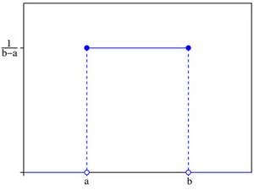
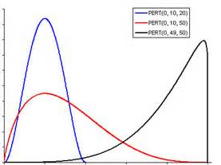
Common probability distributions
Uniform: $f_{uniform}\left(x\right)=\left\{\begin{aligned}\frac{1}{b−a} if a≤x≤b \\ 0 otherwise\end{aligned}\right.$
Gaussian: $f_{gauss}\left(x\right)=\frac{1}{σ\sqrt{2π}}e^{−\frac{{(x−μ)}^{2}}{2σ^{2}}}$
Beta: $f_{beta}\left(x\right)=\frac{x^{α−1}{(1−x)}^{β−1}}{B(α,β)}$
f(x)
x
0.1
0.08
0.06
0.04
0.02
0
-2 -1 0 1 2
0 0.2 0.4 0.6 0.8 1

Slide 24
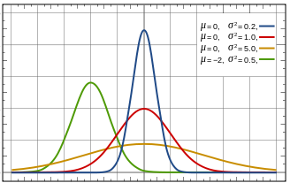
The Gaussian function
1
0.8
0.6
0.4
0.2
0
$$μ=0, σ^{2}=1.0$$
$f_{gauss}\left(x\right)=\frac{1}{σ\sqrt{2π}}e^{−\frac{{(x−μ)}^{2}}{2σ^{2}}}$
Mean $μ$ – center of distribution
Standard deviation $σ$ – width of distribution
Which color is $μ$=-2, $σ^{2}$=0.5? Which color is $μ$=0, $σ^{2}$=0.2?
$N\left(μ_{1},σ_{1}^{2}\right)+N\left(μ_{2},σ_{2}^{2}\right)=N\left(μ_{1}+μ_{2},σ_{1}^{2}+σ_{2}^{2}\right)$
-5 -4 -3 -2 -1 0 1 2 3 4 5

Slide 25
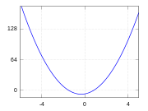
Calculus: finding the slope of a function
What is the minimum value of: f(x)=x²-5x+6
Find value of x where slope is 0
General rules: slope of f(x): $\frac{d}{dx}f\left(x\right)=f^{′}(x)$
$\frac{d}{dx}x^{a}=ax^{a−1}$
$\frac{d}{dx}kf(x)=kf^{′}(x)$
$\frac{d}{dx}\left[f\left(x\right)+g\left(x\right)\right]=f^{′}\left(x\right)+g^{′}\left(x\right)$

Slide 26
Calculus: finding the slope of a function
What is the minimum value of: f(x)=x²-5x+6
f'(x)=
What is the slope at x=5?
What is the slope at x=-5?
What value of x gives slope of 0?

Slide 27
More on derivatives: $\frac{d}{dx}f\left(x\right)= f^{′}(x)$
$\frac{d}{dx}f\left(w\right)=0$ -- w is not related to x, so derivative is 0
$\frac{d}{dx}\left(f\left(g(x)\right)\right)$=$g^{′}(x) ∙f^{′}(g\left(x\right))$
$\frac{d}{dx}\log{x}=\frac{1}{x}$
$\frac{d}{dx}e^{x}=e^{x}$

Slide 28
Programming in Matlab: Data types
Numbers: -8.5, 0, 94
Characters: 'j', '#', 'K' - always surrounded by single quotes
Groups of numbers/characters – placed in between [ ]
[5 10 12; 3 -4 12; -6 0 0] - spaces/commas separate columns, semi-colons separate rows
'hi robot', ['h' 'i' ' ' 'robot'] - a collection of characters can be grouped inside a set of single quotes

Slide 29
Matrix indexing
Start counting at 1
matrix1=[4 8 12; 6 3 0; -2 -7 -12];
matrix1(2,3) -> 0
Last row/column can also be designated by keyword “end”
matrix1(1,end) -> 12
Colon indicates counting up by increment
[2:10] -> [2 3 4 5 6 7 8 9 10]
[3:4:19] -> [3 7 11 15 19]
matrix1(2,1:3) -> [6 3 0]

Slide 30
Vector/matrix functions
vec1=[9, 3, 5, 7]; matrix2=[4.5 -3.2; 2.2 0; -4.4 -3];
mean mean(vec1) -> 6
min min(vec1) -> 3
max max(vec1) -> ?
std std(vec1) -> 2.58
length length(vec1) -> ?
size size(matrix2) -> [3 2];

Slide 31
Extra syntax notes
Semicolons suppress output of computations:
> a=4+5
a =
9
> b=6+7;
>
% starts a comment for the line (like // in C++)
.* , ./ , .^ performs element-wise arithmetic
>c=[2 3 4]./[2 1 2]
>c =
[1 3 1]
>

Slide 32
Variables
who, whos – list variables in environment
Comparisons:
Like C++: ==, <, >, <=, >=
Not like C++: not ~, and &, or |
Conditions:
if(...), end;
Loops:
while(...), end;
for x=a:b, end;

Slide 33
Data: .mat files
save filename variableNames
load filename
Confirm correct directories:
pwd – show directory (print working directory)
cd – change directory
ls – list files in directory

Slide 34
Define new functions: .m files
Begin file with function header:
function output = function_name(input)
statement1;
statement2;
$⋮$
Can allow multiple inputs/outputs
function [output1, output2] = function_name(input1, input2, input3)

Slide 35
Linear algebra: data features
Document 1
Document 2
Document 3
Vector – list of numbers: each number describes a data feature
Matrix – list of lists of numbers: features for each data point
Wolf | 12
Lion | 16
Monkey | 14
Broker | 0
Analyst | 1
Dividend | 1
⁞ d | ⁞
8
10
11
1
0
1
⁞
0
2
1
14
10
12
⁞
# of word occurrences

Slide 36
Feature space
Each data feature defines a dimension in space
Document1
Document2
Document3
Wolf | 12
Lion | 16
Monkey | 14
Broker | 0
Analyst | 1
Dividend | 1
⁞ d | ⁞
8
10
11
1
0
1
⁞
0
2
1
14
10
12
⁞
20
10
0
doc1
lion
doc2
doc3
0 10 20
wolf

Slide 37
The dot product
The dot product compares two vectors:
$a=\left[\begin{matrix}a_{1} \\ ⋮ \\ a_{n}\end{matrix}\right]$ , $b=\left[\begin{matrix}b_{1} \\ ⋮ \\ b_{n}\end{matrix}\right]$ $a∙b=\sum_{i=1}^{n}{a_{i}b_{i}} =a^{T}b$
$$\left[\begin{matrix}5 \\ 10\end{matrix}\right]∙\left[\begin{matrix}10 \\ 10\end{matrix}\right]=5×10+10×10$$
$=50+100=150$
20
10
0
0 10 20

Slide 38
The dot product, continued
$$a∙b=\sum_{i=1}^{n}{a_{i}b_{i}}$$
Magnitude of a vector is the sum of the squares of the elements
$\left|a\right|=\sqrt{\sum_{i}{a_{i}^{2}}}$
If $a$ has unit magnitude, $a∙b$ is the “projection” of $b$ onto $a$
$$\left[\begin{matrix}0.71 \\ 0.71\end{matrix}\right]∙\left[\begin{matrix}1.5 \\ 1\end{matrix}\right]=.71×1.5+.71×1$$
$≈1.07+.71=1.78$
2
1
0
$$\left[\begin{matrix}0.71 \\ 0.71\end{matrix}\right]∙\left[\begin{matrix}0 \\ 0.5\end{matrix}\right]=.71×0+.71×0.5$$
$≈0+.35=0.35$
0 1 2

Slide 39
Multiplication
“scalar” means single numeric value (not a multi-element matrix)
Scalar $×$ matrix: Multiply each element of the matrix by the scalar value
$$c\left[\begin{matrix}\begin{matrix}a_{11} & ⋯ & a_{1m}\end{matrix} \\ \begin{matrix}⋮ & ⋱ & ⋮\end{matrix} \\ \begin{matrix}a_{n1} & ⋯ & a_{nm}\end{matrix}\end{matrix}\right]=\left[\begin{matrix}\begin{matrix}{c a}_{11} & ⋯ & {c a}_{1m}\end{matrix} \\ \begin{matrix}⋮ & ⋱ & ⋮\end{matrix} \\ \begin{matrix}{c a}_{n1} & ⋯ & {c a}_{nm}\end{matrix}\end{matrix}\right]$$
Matrix $×$ column vector: dot product of each row with vector
$$\left[\begin{matrix}\begin{matrix}a_{11} & ⋯ & a_{1m}\end{matrix} \\ \begin{matrix}⋮ & ⋱ & ⋮\end{matrix} \\ \begin{matrix}a_{n1} & ⋯ & a_{nm}\end{matrix}\end{matrix}\right]\left[\begin{matrix}b_{1} \\ ⋮ \\ b_{m}\end{matrix}\right]=\left[\begin{matrix}a_{1}∙b \\ ⋮ \\ a_{n}∙b\end{matrix}\right]$$
$$\left[\begin{matrix}−a_{1}− \\ ⋮ \\ −a_{n}−\end{matrix}\right]$$
$$b$$

Slide 40
Multiplication
Matrix $×$ matrix: Compute dot product of each left row and right column
$$\left[\begin{matrix}−a_{1}− \\ ⋮ \\ −a_{n}−\end{matrix}\right]\left[\begin{matrix}| & & | \\ b_{1} & ⋯ & b_{m} \\ | & & |\end{matrix}\right]=\left[\begin{matrix}\begin{matrix}a_{1}∙b_{1} & ⋯ & a_{1}∙b_{m}\end{matrix} \\ \begin{matrix}⋮ & ⋱ & ⋮\end{matrix} \\ \begin{matrix}a_{n}∙b_{1} & ⋯ & a_{n}∙b_{m}\end{matrix}\end{matrix}\right]$$
NB: Matrix dimensions need to be compatible for valid multiplication – number of rows of left matrix (A) = number of columns of right matrix (B)

