Slide 1
Hidden Markov Models
CISC 5800
Professor Daniel Leeds

Slide 2
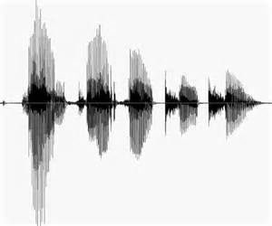
Representing sequence data
Spoken language
DNA sequences
Daily stock values
Example: spoken language
F?r plu? fi?e is nine
Between F and r expect a vowel: “aw”, “ee”, “ah”; NOT “oh”, “uh”
At end of “plu” expect consonant: “g”, “m”, “s”; NOT “d”, “p”

Slide 3
Markov Models
Start with:
n states: s₁, …, s_{n}
Probability of initial start states: $Π_{1}$,…, $Π_{n}$
Probability of transition between states: A_{i,j} = P(q_{t}=s_{i}|q_{t-1}=s_{j})
.5
.2
1
.8
2
.2
.3
3
.1
.9

Slide 4
A dice-y example
$$Π_{A}=0.3,Π_{B}=0.7$$
Two colored die
What is the probability we start at s_{A}?
What is the probability we have the sequence of die choices:
s_{A}, s_{A}?
What is the probability we have the sequence of die choices:
s_{B}, s_{A}, s_{B}, s_{A}?

Slide 5
A dice-y example
What is the probability we have the sequence of die choices:
s_{B}, s_{A}, s_{B}, s_{A}?
Dynamic programming: find answer for q_{t} , then compute q_{t+1}
$$Π_{A}=0.3,Π_{B}=0.7$$
State\Time | t₁ | t₂ | t₃
s_{A} | 0.3
s_{B} | 0.7
$$p_{t}\left(i\right)=\sum_{j}{{p\left(q_{t}=s_{i}|q_{t−1}=s_{j}\right)p}_{t−1}(j)}$$

Slide 6
Hidden Markov Models
Actual state q “hidden”
State produces visible data o: $φ_{i,j}=P(o_{t}=x_{i}|q_{t}=s_{j})$
Compute $P\left(O,Q|θ\right)=p(q_{1}|π)\prod_{t=2}^{T}{p(q_{t}|q_{t−1},A)}\prod_{t=1}^{T}{p(o_{t}|q_{t},φ)}$
A
A
A
Q
$$φ$$
O

Slide 7
Deducing die based on observed “emissions”
o | P(o|s_{A}) | P(o|s_{B})
1 | .3 | .1
2 | .2 | .1
3 | .2 | .1
4 | .1 | .2
5 | .1 | .2
6 | .1 | .3
Each color is biased
A (red) B (blue)
We see: 5 What is probability of o=5 | B (blue)
We see: 5, 3 What is probability of o=5,3 | B, B? What is probability of o=5,3 and s=B,B What is MOST probable s | o=5,3?

Slide 8
Goal: calculate most likely states given observable data
Define and use $δ_{t}(i)$
Find the most likely path from q₁ to q_{t} that
q_{t}=s_{i}
Outputs are o₁, …, o_{t}

Slide 9
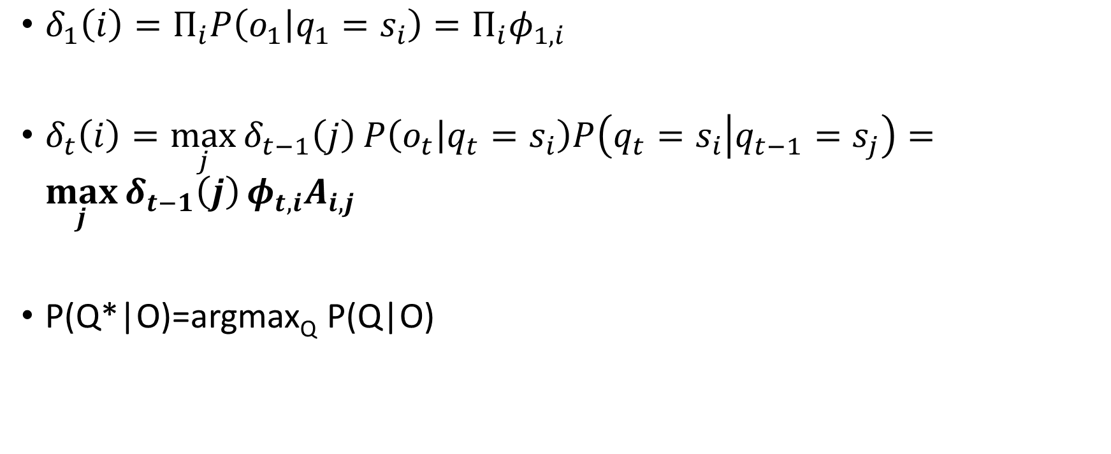
Viterbi algorithm: $δ_{t}(i)$
$δ_{1}\left(i\right)=Π_{i}P\left(o_{1} | q_{1}=s_{i}\right)=Π_{i}φ_{1,i}$
$δ_{t}\left(i\right)=\max_{j}{δ_{t−1}\left(j\right)}P\left(o_{t} | q_{t}=s_{i}\right)P\left(q_{t}=s_{i} | q_{t−1}=s_{j}\right)=\max_{j}{δ_{t−1}\left(j\right)}φ_{t,i}A_{i,j}$
P(Q*|O)=argmax_{Q} P(Q|O)

Slide 10
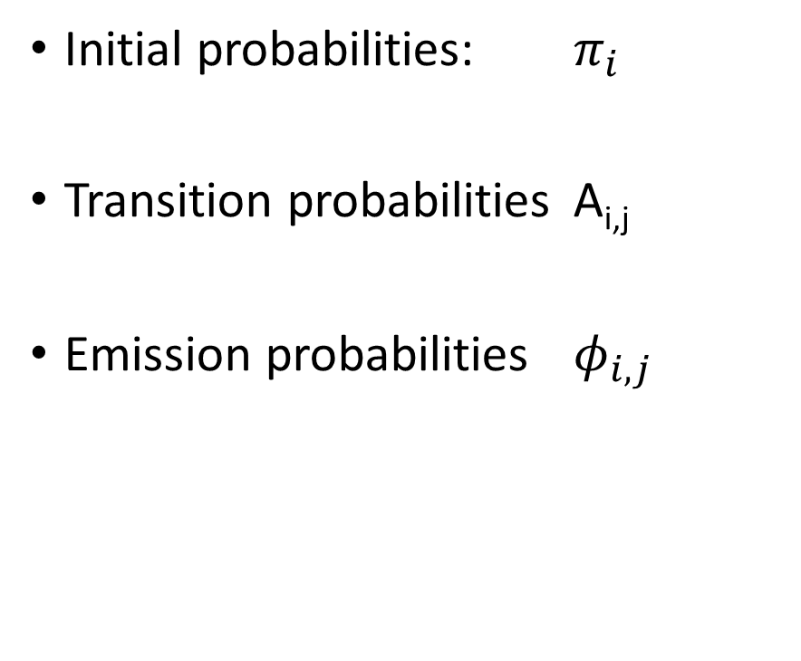
Parameters in HMM
Initial probabilities: $π_{i}$
Transition probabilities A_{i,j}
Emission probabilities $φ_{i,j}$
How do we learn these values?

Slide 11

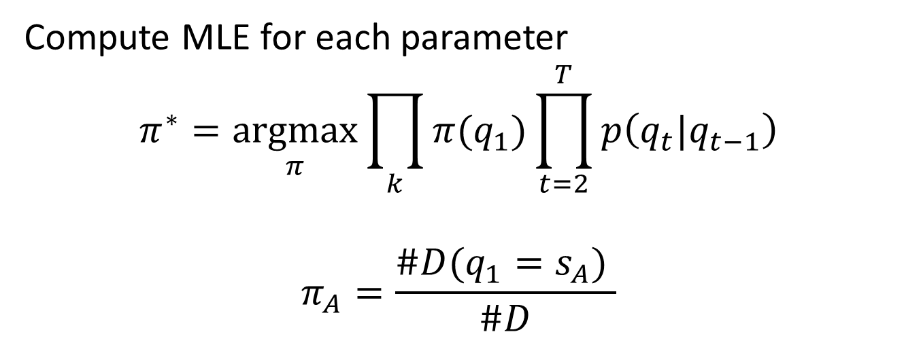
Learning HMM parameters: $π_{i}$
First, assume we know the states
x¹: A,B,A,A,B
x²: B,B,B,A,A
x³: A,A,B,A,B
$⋮$
Compute MLE for each parameter
$$π^{∗}=\underset{π}{argmax}{\prod_{k}{π(q_{1})}\prod_{t=2}^{T}{p\left(q_{t}|q_{t−1}\right)}}$$
$$π_{A}=\frac{\#D(q_{1}=s_{A}) }{\#D}$$

Slide 12
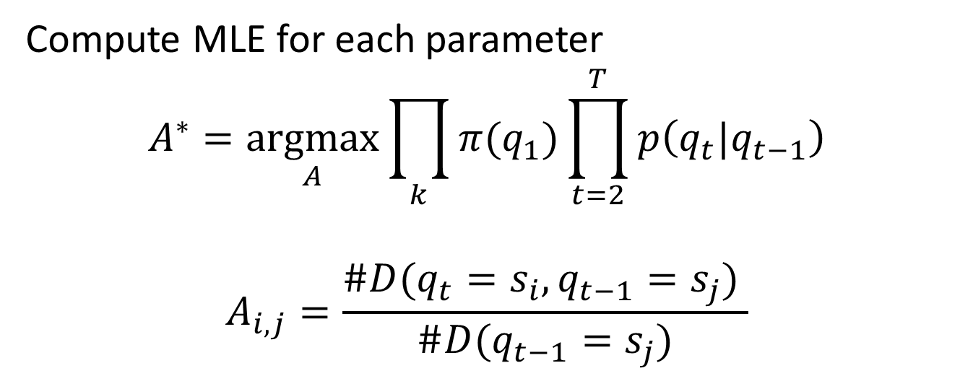
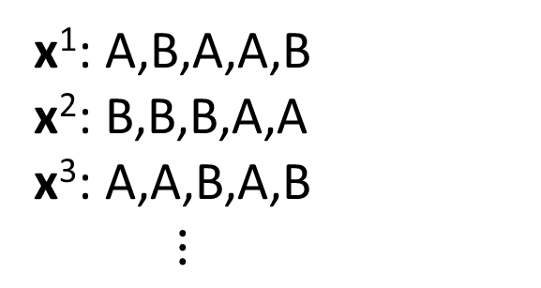
Learning HMM parameters: A_{i,j}
First, assume we know the states
x¹: A,B,A,A,B
x²: B,B,B,A,A
x³: A,A,B,A,B
$⋮$
Compute MLE for each parameter
$$A^{∗}=\underset{A}{argmax}{\prod_{k}{π(q_{1})}\prod_{t=2}^{T}{p\left(q_{t}|q_{t−1}\right)}}$$
$$A_{i,j}=\frac{\#D(q_{t}=s_{i},q_{t−1}=s_{j}) }{\#D(q_{t−1}=s_{j})}$$

Slide 13
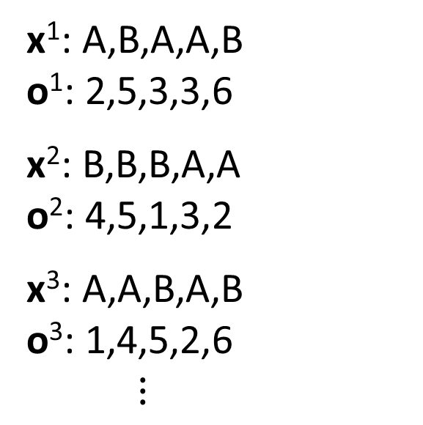
Learning HMM parameters: $φ_{i,j}$
First, assume we know the states
x¹: A,B,A,A,B
o¹: 2,5,3,3,6
x²: B,B,B,A,A
o²: 4,5,1,3,2
x³: A,A,B,A,B
o³: 1,4,5,2,6
$⋮$
Compute MLE for each parameter
$$φ_{i,j}=\frac{\#D(o_{t}=i,q_{t}=s_{j}) }{\#D(q_{t}=s_{j})}$$

Slide 14
Challenges in HMM learning
Learning parameters ($π,A,φ$) with known states is not too hard
BUT usually states are unknown
If we had the parameters and the observations, we could figure out the states: Viterbi P(Q*|O)=argmax_{Q} P(Q|O)

Slide 15
Expectation-Maximization, or “EM”
Problem: Uncertain of y^{i} (class), uncertain of $θ^{i}$ (parameters)
Solution: Guess y^{i}, deduce $θ^{i}$, re-compute y^{i}, re-compute $θ^{i}$ … etc. OR: Guess $θ^{i}$, deduce y^{i}, re-compute $θ^{i}$, re-compute y^{i}
Will converge to a solution
E step: Fill in expected values for missing variables
M step: Regular MLE given known and filled-in variables
Also useful when there are holes in your data

Slide 16
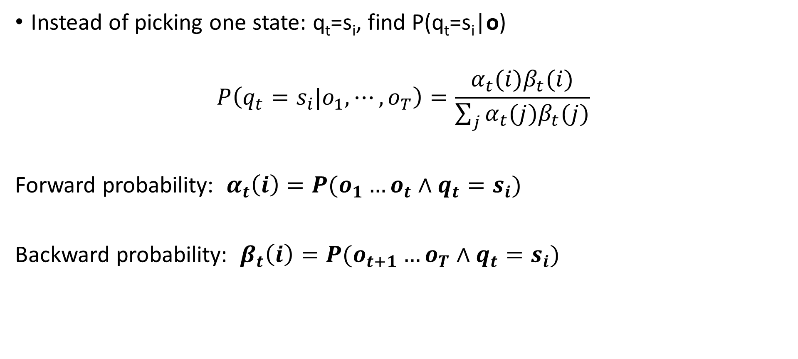
Computing states q_{t}
Instead of picking one state: q_{t}=s_{i}, find P(q_{t}=s_{i}|o)
$$P\left(q_{t}=s_{i}|o_{1},⋯,o_{T}\right)=\frac{α_{t}(i)β_{t}(i)}{\sum_{j}{α_{t}(j)β_{t}(j)}}$$
Forward probability: $α_{t}\left(i\right)=P(o_{1}…o_{t}∧q_{t}=s_{i})$
Backward probability: $β_{t}\left(i\right)=P(o_{t+1}…o_{T}∧q_{t}=s_{i})$

Slide 17

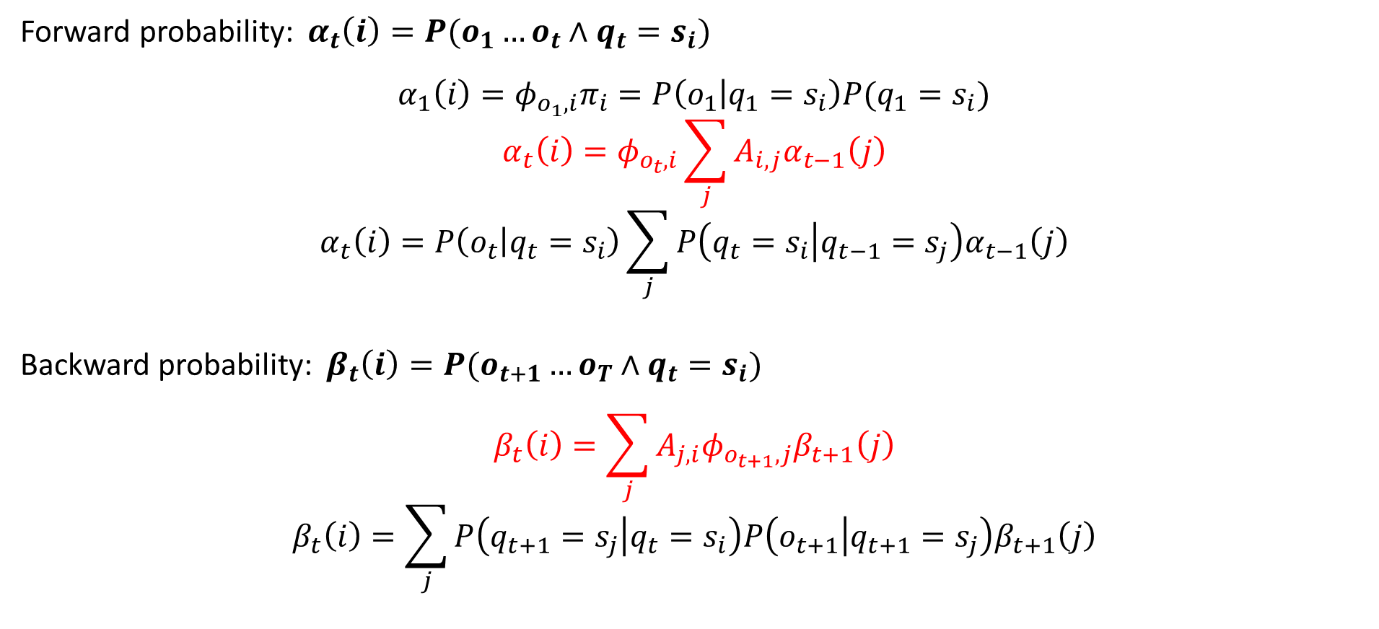
Details of forward and backward probabilities
Forward probability: $α_{t}\left(i\right)=P(o_{1}…o_{t}∧q_{t}=s_{i})$
$$α_{1}\left(i\right)=φ_{o_{1},i}π_{i}=P\left(o_{1} | q_{1}=s_{i}\right)P(q_{1}=s_{i})$$
$$α_{t}\left(i\right)=φ_{o_{t},i}\sum_{j}{A_{i,j}α_{t−1}\left(j\right)}$$
$$α_{t}\left(i\right)=P\left(o_{t} | q_{t}=s_{i}\right)\sum_{j}{P\left(q_{t}=s_{i} | q_{t−1}=s_{j}\right)α_{t−1}\left(j\right)}$$
Backward probability: $β_{t}\left(i\right)=P(o_{t+1}…o_{T}∧q_{t}=s_{i})$
$$β_{t}\left(i\right)=\sum_{j}{A_{j,i}φ_{o_{t+1},j}β_{t+1}\left(j\right)}$$
$$β_{t}\left(i\right)=\sum_{j}{P\left(q_{t+1}=s_{j} | q_{t}=s_{i}\right)P\left(o_{t+1} | q_{t+1}=s_{j}\right)β_{t+1}\left(j\right)}$$
Final $β$: $β_{T−1}(i)$
$$β_{T−1}(i)=\sum_{j}{A_{j,i}φ_{o_{T−1},j}}=P\left(q_{T}=s_{j} | q_{T−1}=s_{i}\right)P(o_{T}|q_{T}=s_{j})$$

Slide 18
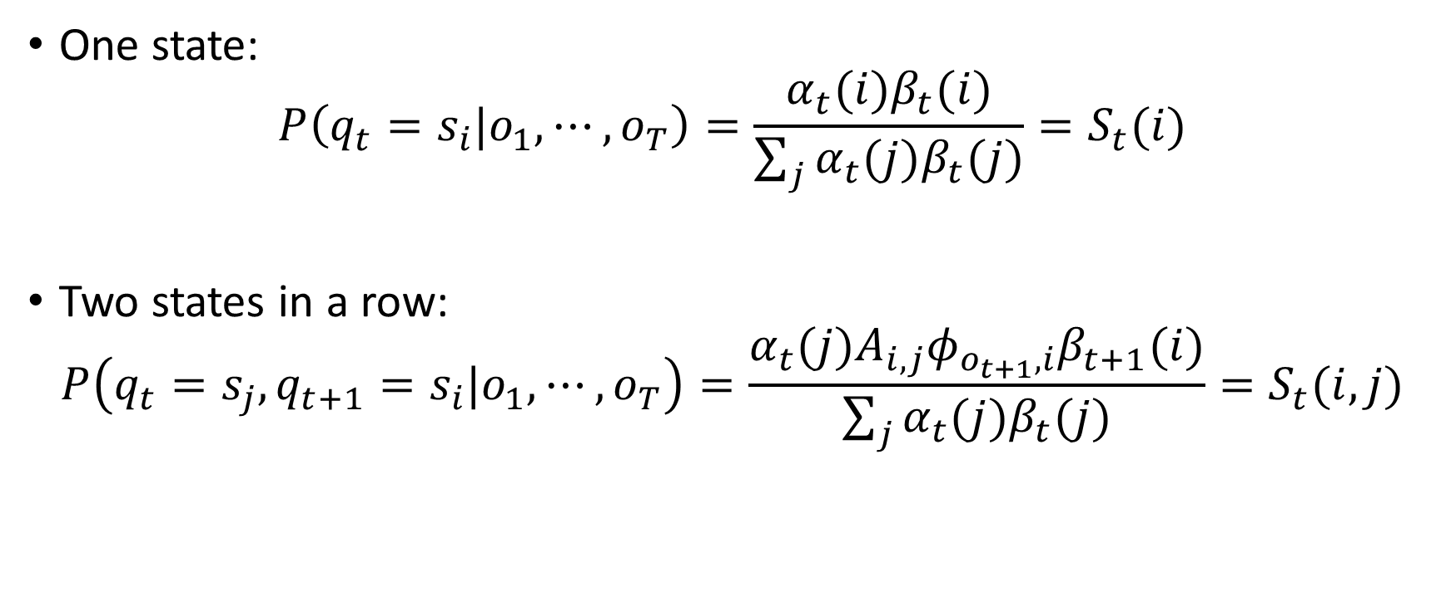
E-step: State probabilities
One state:
$$P\left(q_{t}=s_{i}|o_{1},⋯,o_{T}\right)=\frac{α_{t}(i)β_{t}(i)}{\sum_{j}{α_{t}(j)β_{t}(j)}}=S_{t}(i)$$
Two states in a row:
$$P\left(q_{t}=s_{j},q_{t+1}=s_{i}|o_{1},⋯,o_{T}\right)=\frac{α_{t}(j)A_{i,j}φ_{o_{t+1},i}β_{t+1}(i)}{\sum_{j}{α_{t}(j)β_{t}(j)}}=S_{t}(i,j)$$

Slide 19

Recall: when states known
$π_{A}=\frac{\#D(q_{1}=s_{A}) }{\#D}$
$A_{i,j}=\frac{\#D(q_{t}=s_{i},q_{t−1}=s_{j}) }{\#D(q_{t−1}=s_{j})}$
$φ_{i,j}=\frac{\#D(o_{t}=i) }{\#D(q_{t}=s_{j})}$

Slide 20

M-step
$A_{i,j}=\frac{\sum_{t}{S_{t}}(i,j)}{\sum_{k}{\sum_{t}{S_{t}}(k,j)}}$
$φ_{obs,i}=\frac{\sum_{t|o_{t}=obs}{S_{t}(i)}}{\sum_{j}{\sum_{t|o_{t}=j}{S_{t}(i)}}}$
$π_{i}=\frac{\sum_{seq}{S_{1}(i)}}{\sum_{j}{\sum_{seq}{S_{1}(j)}}}$
Known states:
$π_{A}=\frac{\#D(q_{1}=s_{A}) }{\#D}$
$A_{i,j}=\frac{\#D(q_{t}=s_{i},q_{t−1}=s_{j}) }{\#D(q_{t−1}=s_{j})}$
$φ_{i,j}=\frac{\#D(o_{t}=i) }{\#D(q_{t}=s_{j})}$

Slide 21
Review of HMMs in action
For classification, find highest probability class given features
Features for one sound:
[q₁, o₁, q₂, o₂, …, q_{T}, o_{T}]
Conclude word:
Generates states:
Q
O
sound1
sound2
sound3

