Slide 1
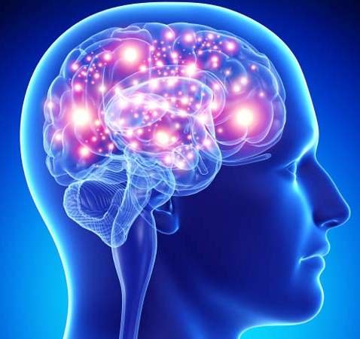
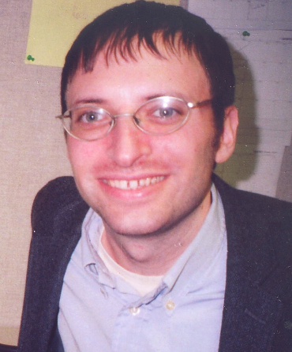
Machine Learning
CISC 5800
Dr Daniel Leeds

Slide 2
What is machine learning
Finding patterns in data
Adapting program behavior

Slide 3
Dog photos and the internet
Model of dog appearance
Search for “dog” from web images:

Slide 4
Advertise a customer’s favorite products
This summer, I had two meetings, one in Portland and one in Baltimore
Today I get an e-mail from Priceline:

Slide 5
What’s covered in this class: Theory & Implementation
Theory: math for describing patterns in data
Probability
Linear algebra
Calculus/optimization
Implementation: programming to find and react to patterns in data
Popular and successful algorithms
Matlab
Data sets of text, speech, pictures, user actions, neural data…

Slide 6
Outline of topics
Groundwork: probability and slopes
Classification overview: Training, testing, and overfitting
Basic classifiers: Naïve Bayes and Logistic Regression
Advanced classifiers: Neural networks and support vector machines
Deep learning Kernel methods
Dimensionality reduction: Feature selection, information criteria
Graphical models: Bayes Nets and Hidden Markov Model
Expectation-Maximization

Slide 7
What you need to do in this class
Class attendance
Assignments: homeworks (4-5) and final project
Exams: midterm and final
Don’t cheat
You may discuss homeworks with other students, but your submitted work must be your own. Copying is not allowed.

Slide 8
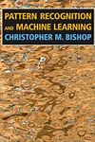
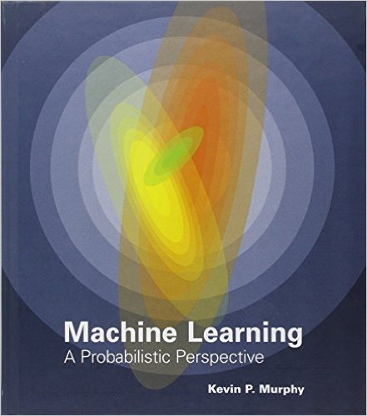
Resources
Office hours: Monday 4-5pm and by appointment
Course web site: http://storm.cis.fordham.edu/leeds/cisc5800
Fellow students
Textbooks/online notes
Matlab
Andrew Ng’s Stanford course notes

