Slide 1
Marginal and conditional probabilities
A | B | P(A?,B?)
True | True | 0.3
True | False | 0.3
False | True | 0.25
False | False | 0.15
For two binary random variables A and B
P(A) = P(A,B)+P(A,B’) = P(A=True, B=True) + P(A=True, B=False)
P(B) = P(A,B)+P(A’,B)
For marginal probability P(X), “marginalize” over all possible values of the other random variables
Prob(C|I) : Probability child likes chocolate given s/he likes ice cream
P(C|I) = $\frac{P(C,I)}{P(I)}=\frac{P(C,I)}{P\left(C,I\right)+P(C^{′},I)}$

Slide 2
Marginal and conditional probabilities
For two binary random variables A and B
P(A) = P(A,B)+P(A,B’) = P(A=True, B=True) + P(A=True, B=False)
P(B) = P(A,B)+P(A’,B)
For marginal probability P(X), “marginalize” over all possible values of the other random variables
Prob(C|I) : Probability child likes chocolate given s/he likes ice cream
P(C|I) = $\frac{P(C,I)}{P(I)}=\frac{P(C,I)}{P\left(C,I\right)+P(C^{′},I)}$

Slide 3
Independence
If the truth value of B does not affect the truth value of A, we say A and B are independent.
P(A|B) = P(A)
P(A,B) = P(A) P(B)

Slide 4
Multi-valued random variables
A random variable can hold more than two values, each with a given probability
P(Animal=Cat)=0.5
P(Animal=Dog)=0.3
P(Animal=Horse)=0.1
P(Animal=Cow)=0.1

Slide 5
Probability rules: multi-valued variables
For given random variable A:
P($A=a_{i}$ and $A=a_{j}$) = 0 if $i≠j$
$\sum_{i}{P\left(A=a_{i}\right)=1}$
$P\left(A=a_{i}\right)=\sum_{j}{P(A=a_{i},B=b_{j})}$
animal
cat
dog
horse
cow
$a$ is a value assignment for variable A

Slide 6
Probability table
Grade | Honor-Student | P(G,H)
A | False | 0.05
B | False | 0.05
C | False | 0.05
D | False | 0.1
A | True | 0.3
B | True | 0.2
C | True | 0.15
D | True | 0.1
P(G=C,H=True)
P(H=True)
P(G=C|H=True)
P(H=True|G=C)

Slide 7
Probability table
Grade | Honor-Student | P(G,H)
A | False | 0.05
B | False | 0.05
C | False | 0.05
D | False | 0.1
A | True | 0.3
B | True | 0.2
C | True | 0.15
D | True | 0.1
P(G=C,H=True)=0.15
P(H=True) =0.75
P(G=C|H=True) =$\frac{.15}{.75}$=0.2
P(H=True|G=C) =$\frac{.15}{.2}$=0.75

Slide 8
Bayes rule
$$P(A|B)=\frac{P\left(B | A\right)P(A)}{P(B)}$$
Terminology:
P(A|B) is the “posterior probability”
P(B|A) is the “likelihood”
P(A) is the “prior probability”
We will spend (much) more time with Bayes rule in following lectures
Notes:
Two multi-valued variables. Examples of bayes and marginal and conditional

Slide 9
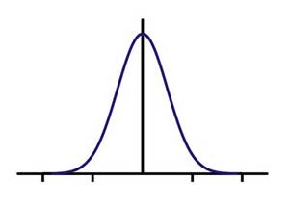
Continuous random variables
A random variable can take on a continuous range of values
From 0 to 1
From 0 to $∞$
From $−∞$ to $∞$
Probability expressed through a “probability density function” f(x)
f(x)
x
-2 -1 0 1 2

Slide 10
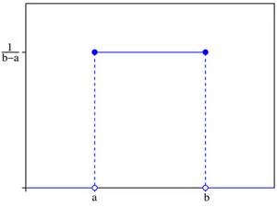
Common probability distributions
Uniform: $f_{uniform}\left(x\right)=\left\{\begin{aligned}\frac{1}{b−a} if a≤x≤b \\ 0 otherwise\end{aligned}\right.$
Gaussian: $f_{gauss}\left(x\right)=\frac{1}{σ\sqrt{2π}}e^{−\frac{{(x−μ)}^{2}}{2σ^{2}}}$
f(x)
x
-2 -1 0 1 2

Slide 11
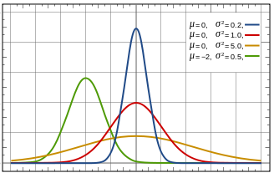
The Gaussian function
1
0.8
0.6
0.4
0.2
0
$$μ=0, σ^{2}=1.0$$
$f_{gauss}\left(x\right)=\frac{1}{σ\sqrt{2π}}e^{−\frac{{(x−μ)}^{2}}{2σ^{2}}}$
Mean $μ$ – center of distribution
Standard deviation $σ$ – width of distribution
Which color is $μ$=-2, $σ^{2}$=0.5?
Which color is $μ$=0, $σ^{2}$=0.2?
$N\left(μ_{1},σ_{1}^{2}\right)+N\left(μ_{2},σ_{2}^{2}\right)=N\left(μ_{1}+μ_{2},σ_{1}^{2}+σ_{2}^{2}\right)$
-5 -4 -3 -2 -1 0 1 2 3 4 5

Slide 12
The Gaussian function
1
0.8
0.6
0.4
0.2
0
$$μ=0, σ^{2}=1.0$$
$f_{gauss}\left(x\right)=\frac{1}{σ\sqrt{2π}}e^{−\frac{{(x−μ)}^{2}}{2σ^{2}}}$
Mean $μ$ – center of distribution
Standard deviation $σ$ – width of distribution
Which color is $μ$=-2, $σ^{2}$=0.5? Which color is $μ$=0, $σ^{2}$=0.2?
$N\left(μ_{1},σ_{1}^{2}\right)+N\left(μ_{2},σ_{2}^{2}\right)=N\left(μ_{1}+μ_{2},σ_{1}^{2}+σ_{2}^{2}\right)$
-5 -4 -3 -2 -1 0 1 2 3 4 5

Slide 13
Probability and basic calculus

Slide 14
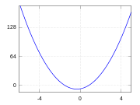
Calculus: finding the slope of a function
What is the minimum value of: f(x)=x²-5x+6
Find value of x where slope is 0
General rules: slope of f(x): $\frac{d}{dx}f\left(x\right)=f^{′}(x)$
$\frac{d}{dx}x^{a}=ax^{a−1}$
$\frac{d}{dx}kf(x)=kf^{′}(x)$
$\frac{d}{dx}\left[f\left(x\right)+g\left(x\right)\right]=f^{′}\left(x\right)+g^{′}\left(x\right)$

Slide 15
Calculus: finding the slope of a function
What is the minimum value of: f(x)=x²-5x+6
f'(x)=
What is the slope at x=5?
What is the slope at x=-3?
What value of x gives slope of 0?

Slide 16
Calculus: finding the slope of a function
What is the minimum value of: f(x)=x²-5x+6
f'(x)=2x-5
What is the slope at x=5? f’(5)=5
What is the slope at x=-3? f’(-3)=-11
What value of x gives slope of 0? x=2.5

Slide 17
More on derivatives: $\frac{d}{dx}f\left(x\right)= f^{′}(x)$
$\frac{d}{dx}f\left(w\right)=0$ -- w is not related to x, so derivative is 0
$\frac{d}{dx}\left(f\left(g(x)\right)\right)$=$g^{′}(x) ∙f^{′}(g\left(x\right))$
$\frac{d}{dx}\log{x}=\frac{1}{x}$
$\frac{d}{dx}e^{x}=e^{x}$

