Slide 1
Introduction to classifiers

Slide 2
The goal of a classifier
Learn function C to maximize correct labels (Y) based on features (X)
C(x)=y
lion: 16
wolf: 12
monkey: 14
broker: 0
analyst: 1
dividend: 1
lion: 0
wolf: 2
monkey: 1
broker: 14
analyst: 10
dividend: 12
C
C
jungle
wallStreet

Slide 3
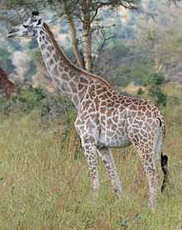
Giraffe detector
Label x : height
Class y : True or False (“is giraffe” or “is not giraffe”)
Learn optimal classification parameter(s)
Parameter: x^{thresh}
Example function:
$$C\left(x\right)=\left\{\begin{matrix}True if x>x^{thresh} \\ False otherwise \end{matrix}\right.$$

Slide 4
Learning our classifier parameter(s)
X Y
1.5 True
2.2 True
1.8 True
1.2 False
0.9 False
Adjust parameter(s) based on observed data
Training set: contains features and corresponding labels
v
v
0 0.5 1.0 1.5 2.0 2.5

Slide 5
The testing set
Testing set must be distinct from training set!
Does classifier correctly label new data?
Train
v
v
0 0.5 1.0 1.5 2.0 2.5
Example “good” performance:
90% correct labels
baby giraffe
cat
lion
Trex
giraffe
?
?
?
?
?
?
?
?
Test
0 0.5 1.0 1.5 2.0 2.5

Slide 6
Be careful with your training set
What if we train with only baby giraffes and ants?
What if we train with only T rexes and adult giraffes?

Slide 7
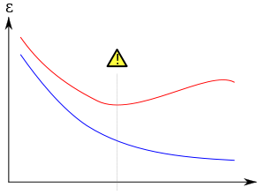
Training vs. testing
Training: learn parameters from set of data in each class
Testing: measure how often classifier correctly identifies new data
More training reduces classifier error $ε$
Too much training data causes worse testing error – overfitting
Test error
error
Train error
time spent training

